Slide 1
Mitosis and Meiosis
What’s the difference?
And why does it matter?

Slide 2
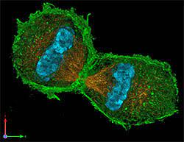
Why do we teach cell division?
Why do cells divide?
What are the types of cell division?

Slide 3
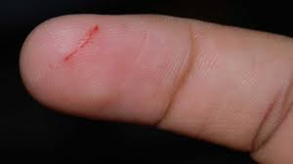
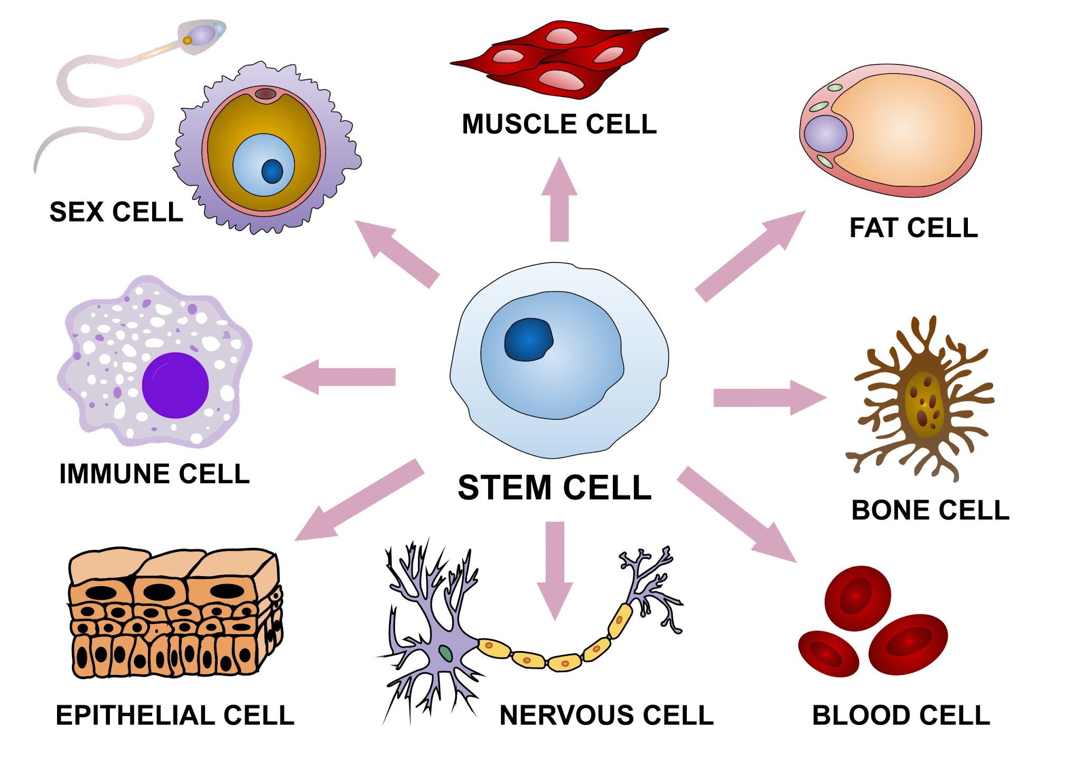
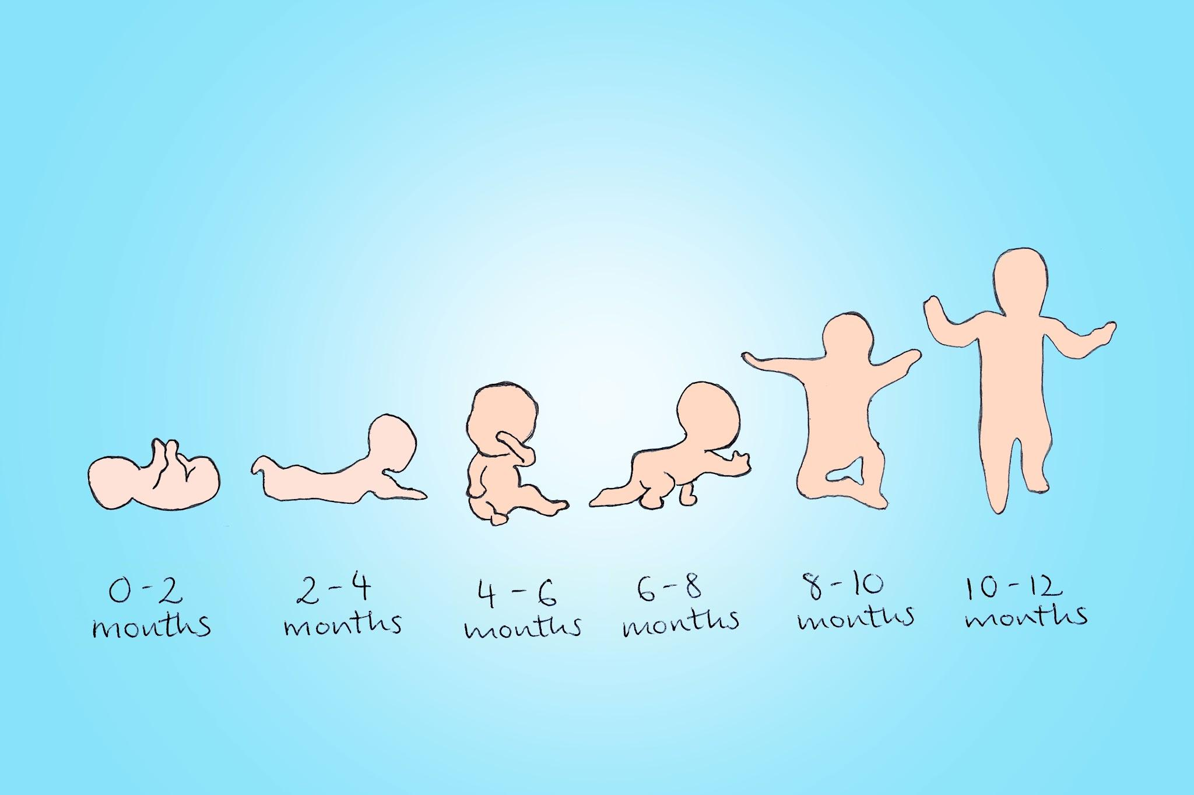
Why do cells divide?
Cellular repair
Differentiation
Growth

Slide 4
Mitosis is NOT cell division.
It is nuclear division
Misconception Alert!

Slide 5
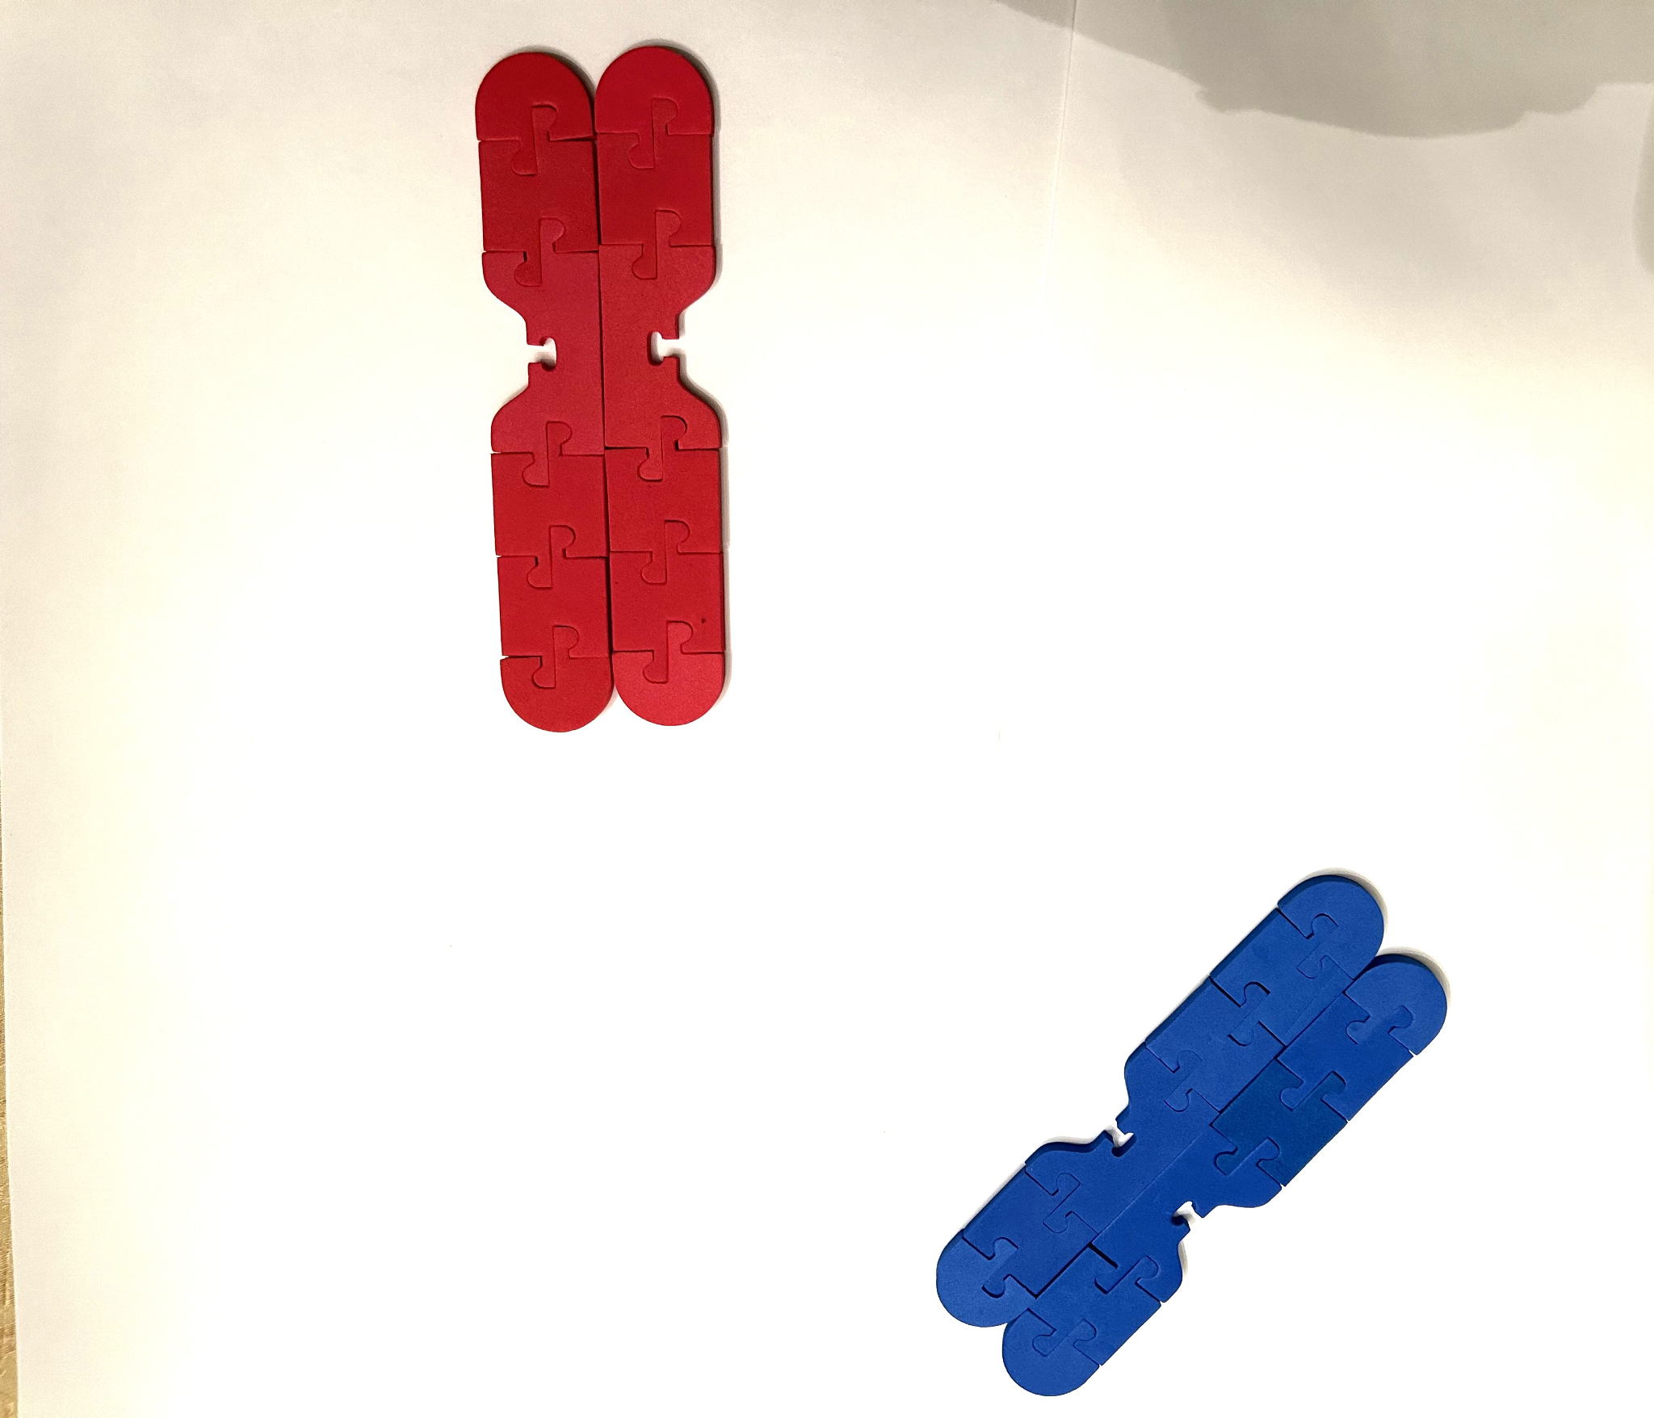
Let’s Model Mitosis
Prophase
Chromosomes condense
The nuclear membrane breaks down
The mitotic spindle forms

Slide 6
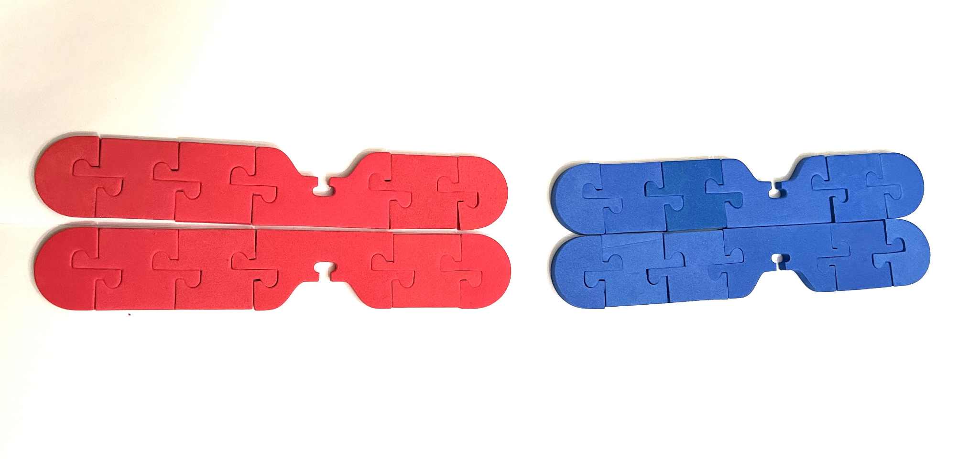
Let’s Model Mitosis
Metaphase
Chromosomes attach to the spindle fibers down the middle of the cell.

Slide 7
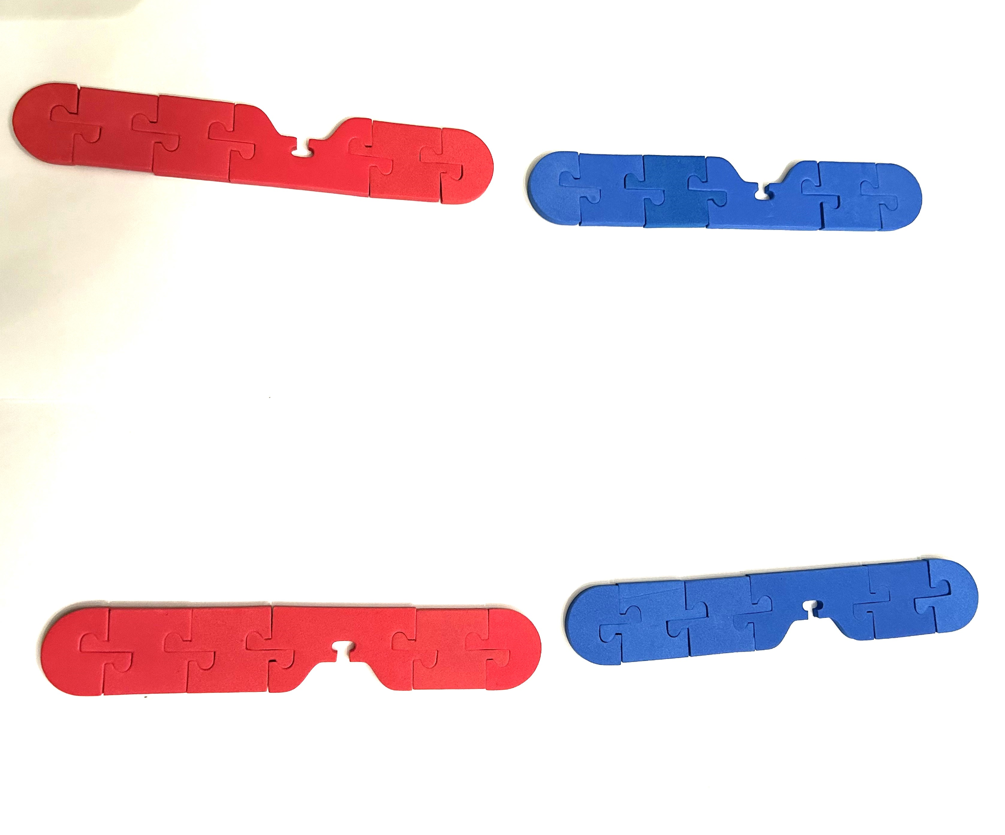
Let’s Model Mitosis
Anaphase
Sister chromatids break apart and migrate towards opposite poles of the cell.

Slide 8
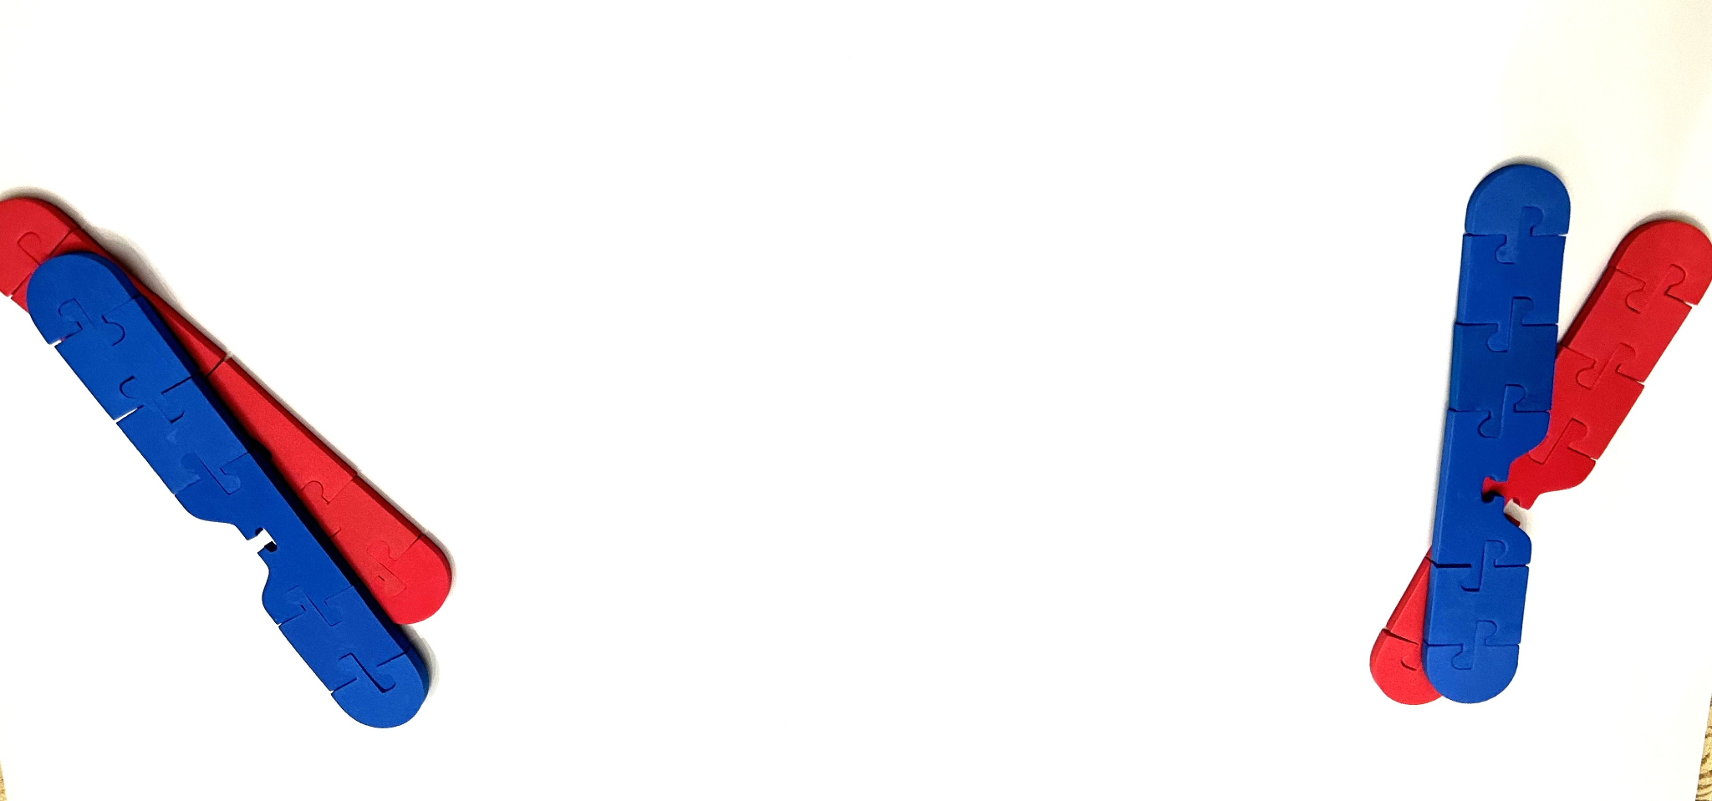
Let’s Model Mitosis
Telophase and cytokinesis
Nuclear membranes form around chromosomes at each pole.
Chromosomes relax.
Cell division occurs between the two new nuclei.

Slide 9
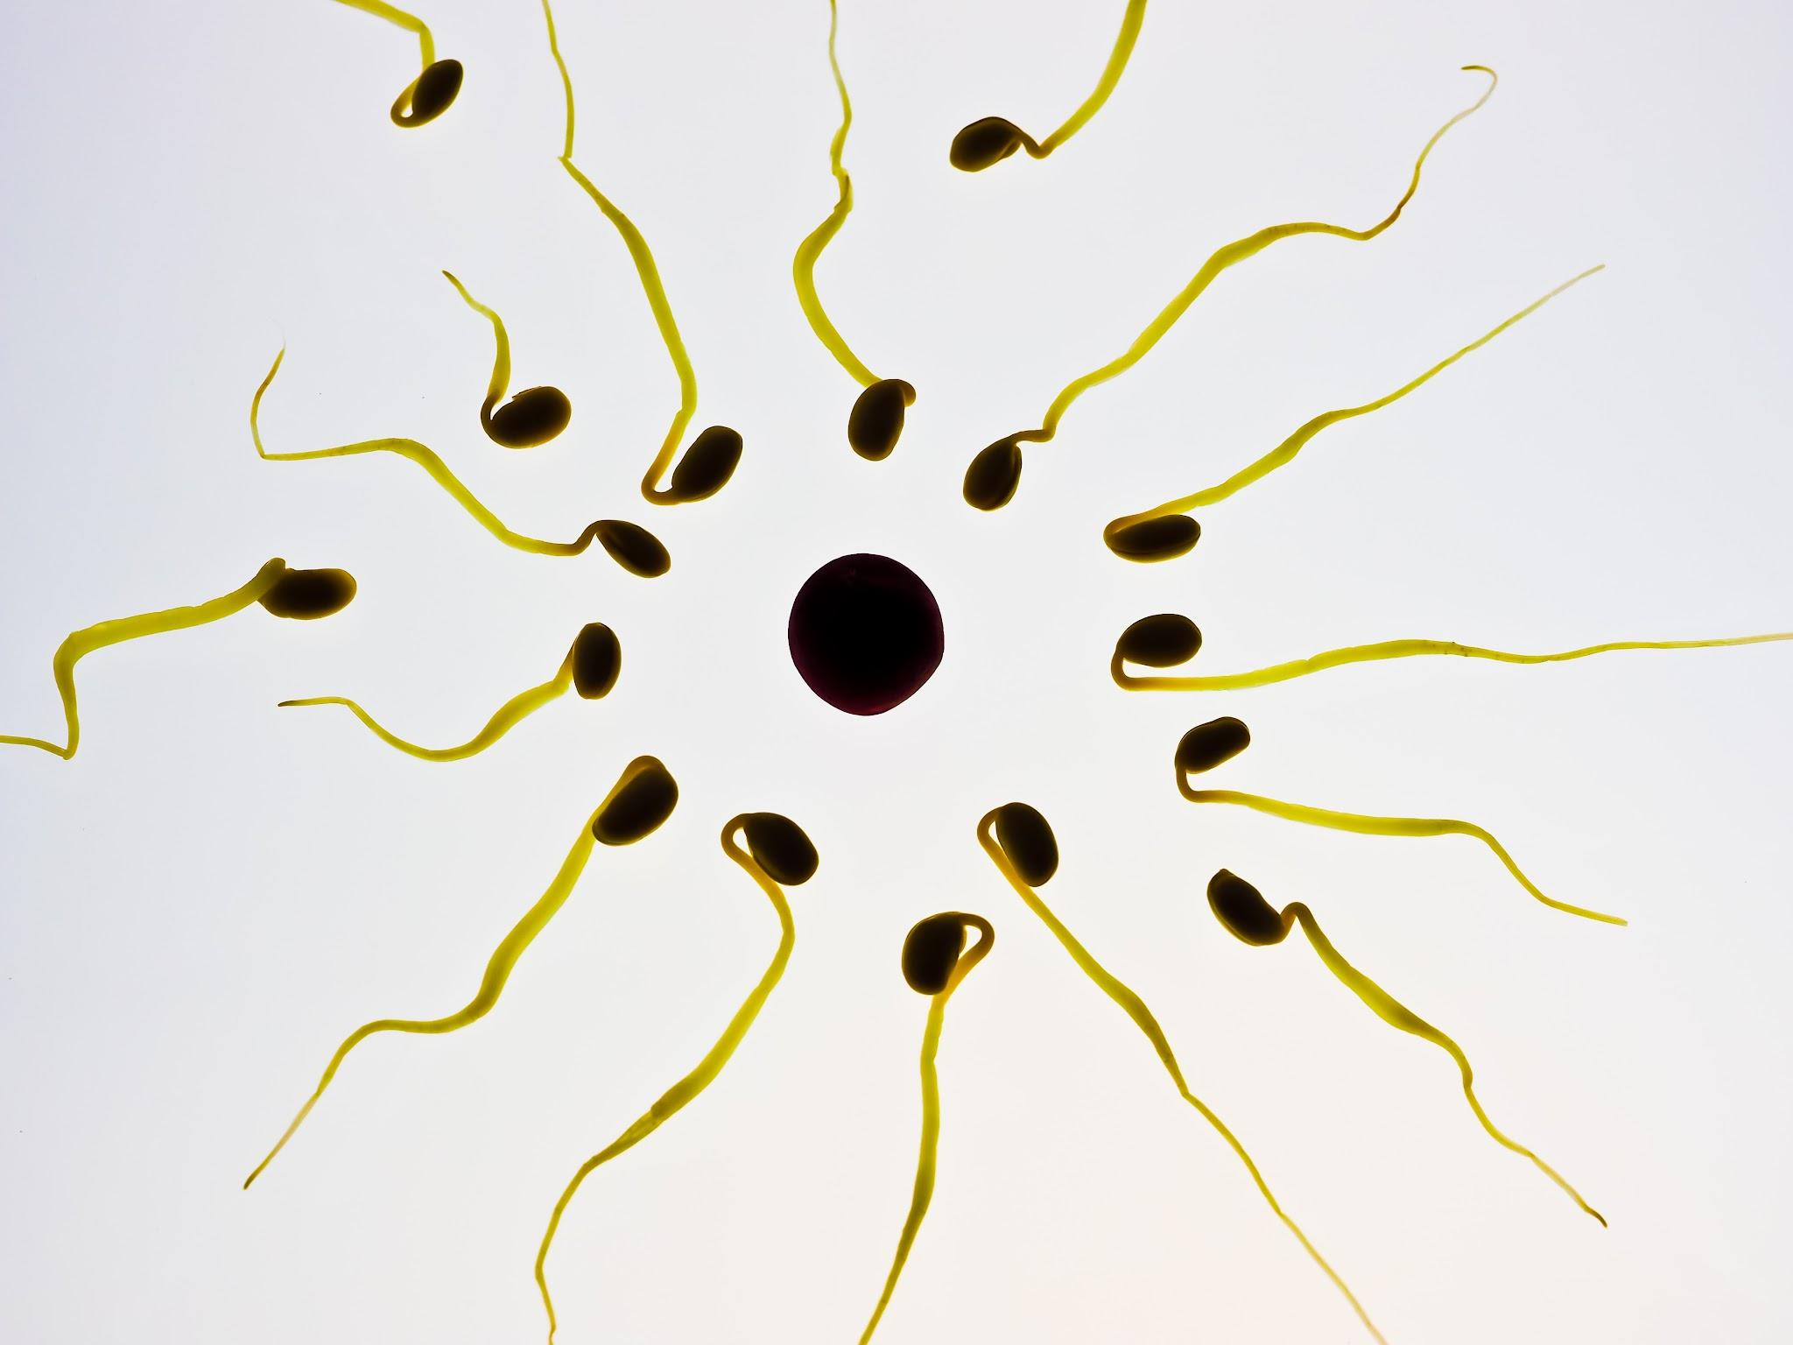
If we have mitosis, then, why do we have meiosis?

Slide 10
Meiosis not just mitosis twice.
It is a reduction division.
Misconception Alert!

Slide 11
Meiosis 1 - all of the big events happen here.
Homologous replication
Diploid to haploid

Slide 12
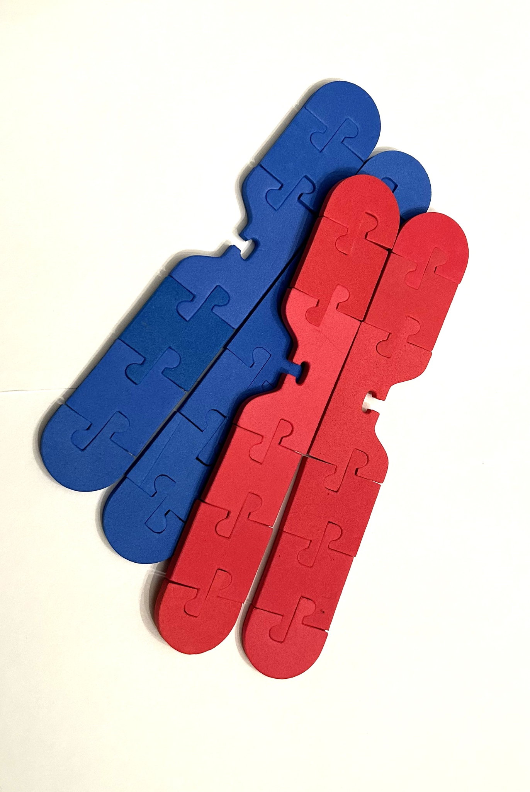
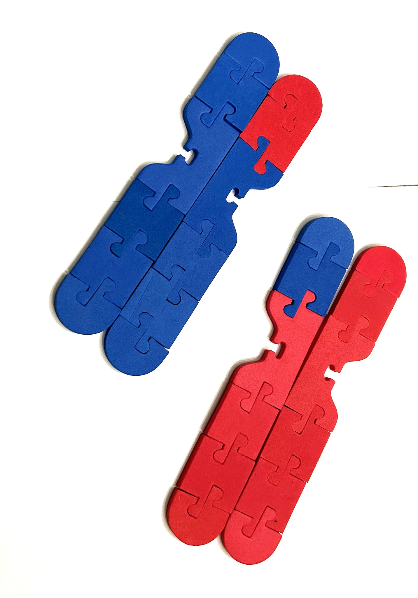
Meiosis 1 -
Prophase 1:
Chromosomes condense
Homologous chromosomes form tetrads
Homologous recombination occurs producing genetically distinct chromosomes.
Spindle fibers form

Slide 13
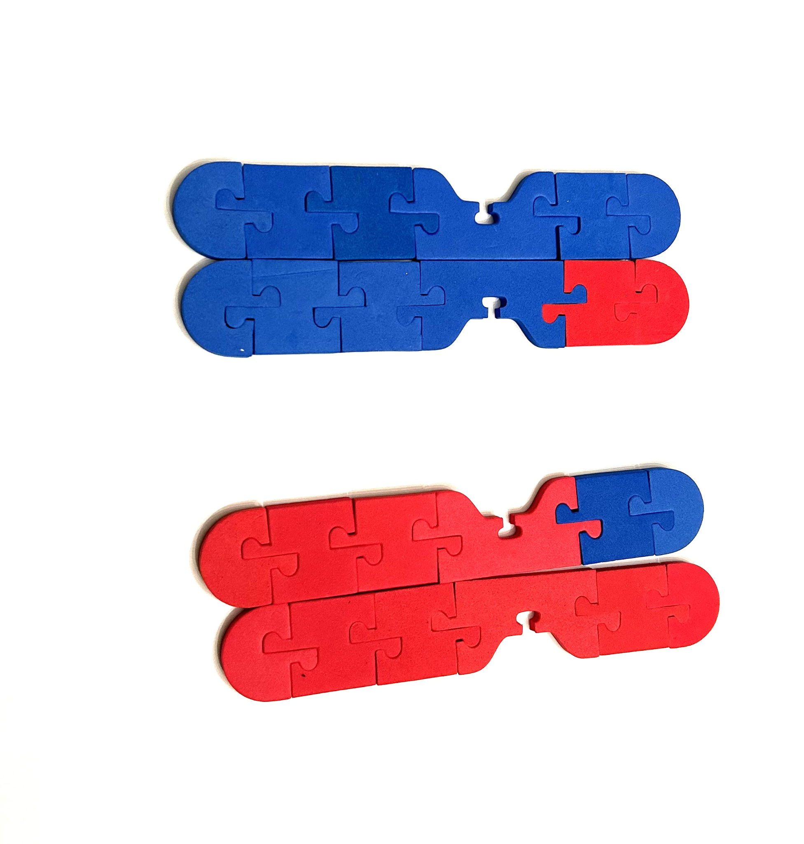
Meiosis 1 -
Metaphase 1:
Chromosomes attach in pairs in the middle of the cell.

Slide 14
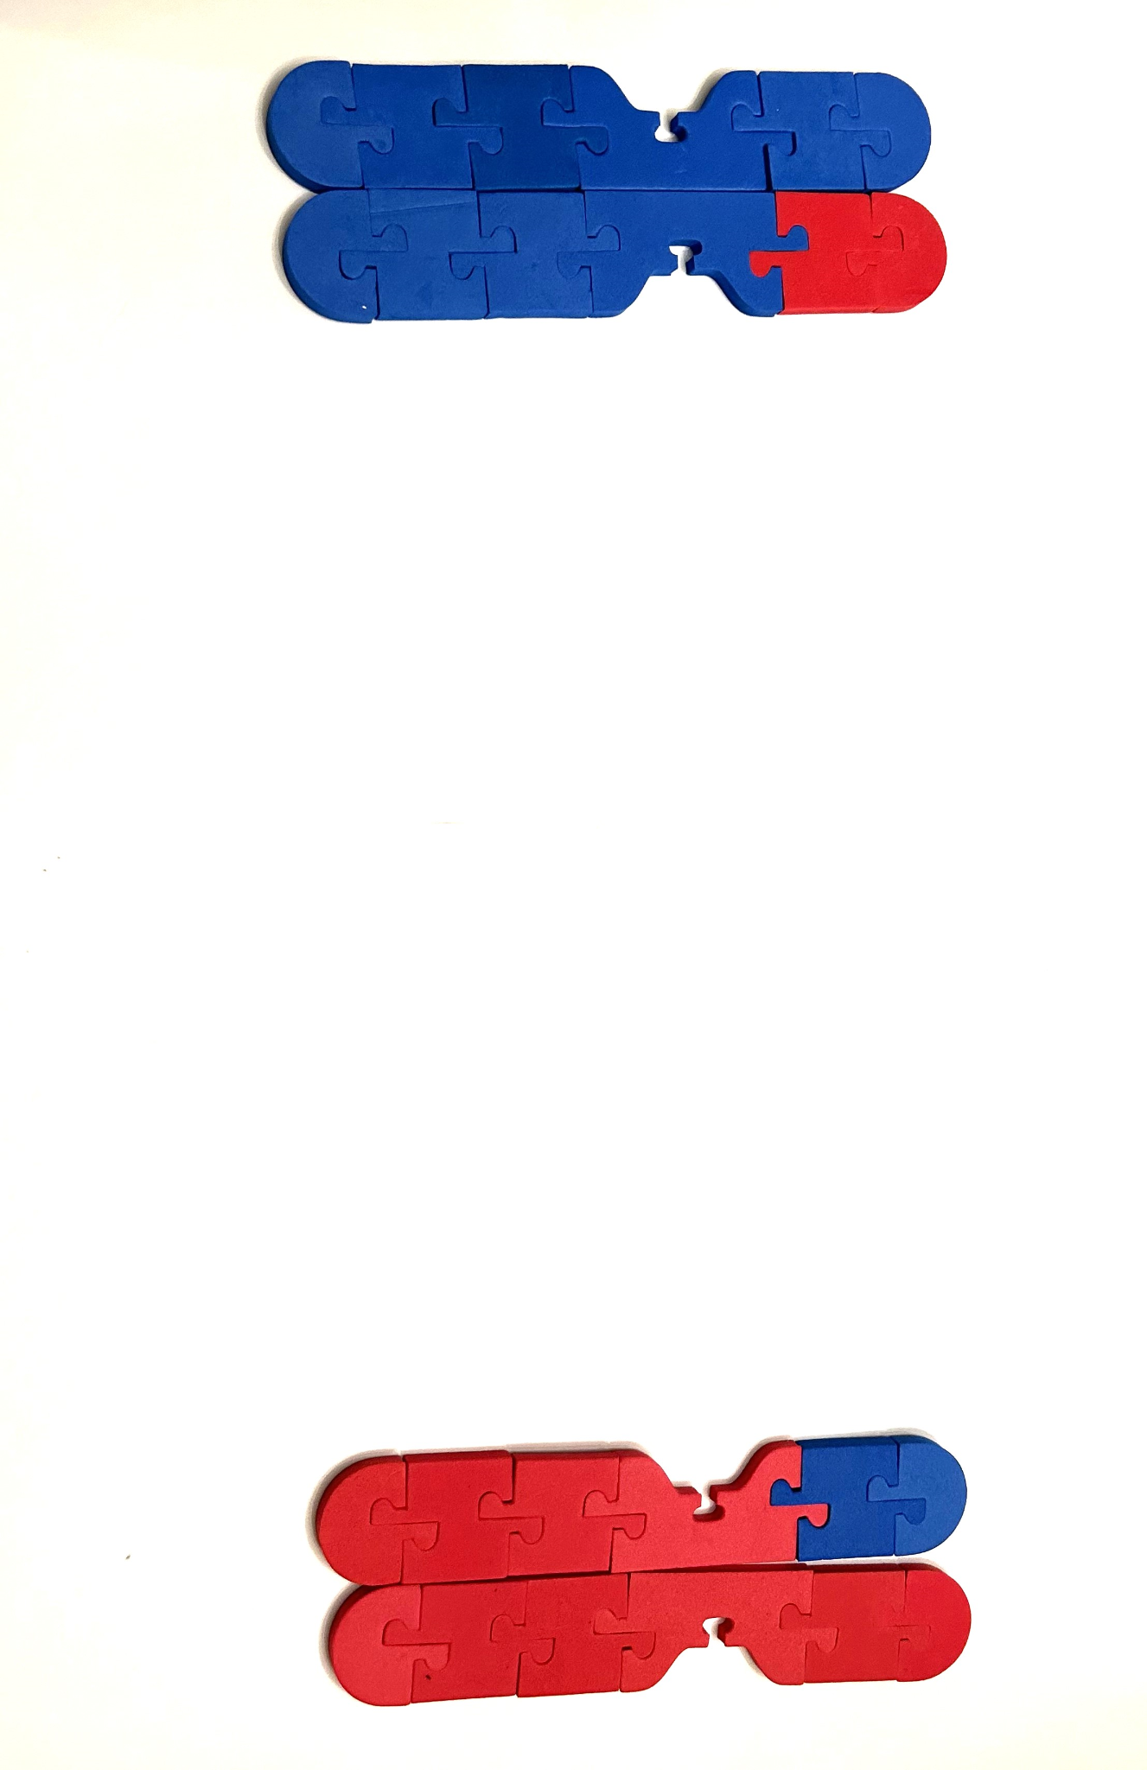
Meiosis 1 -
Anaphase 1:
Chromosomes separate and migrate towards opposite poles.

Slide 15
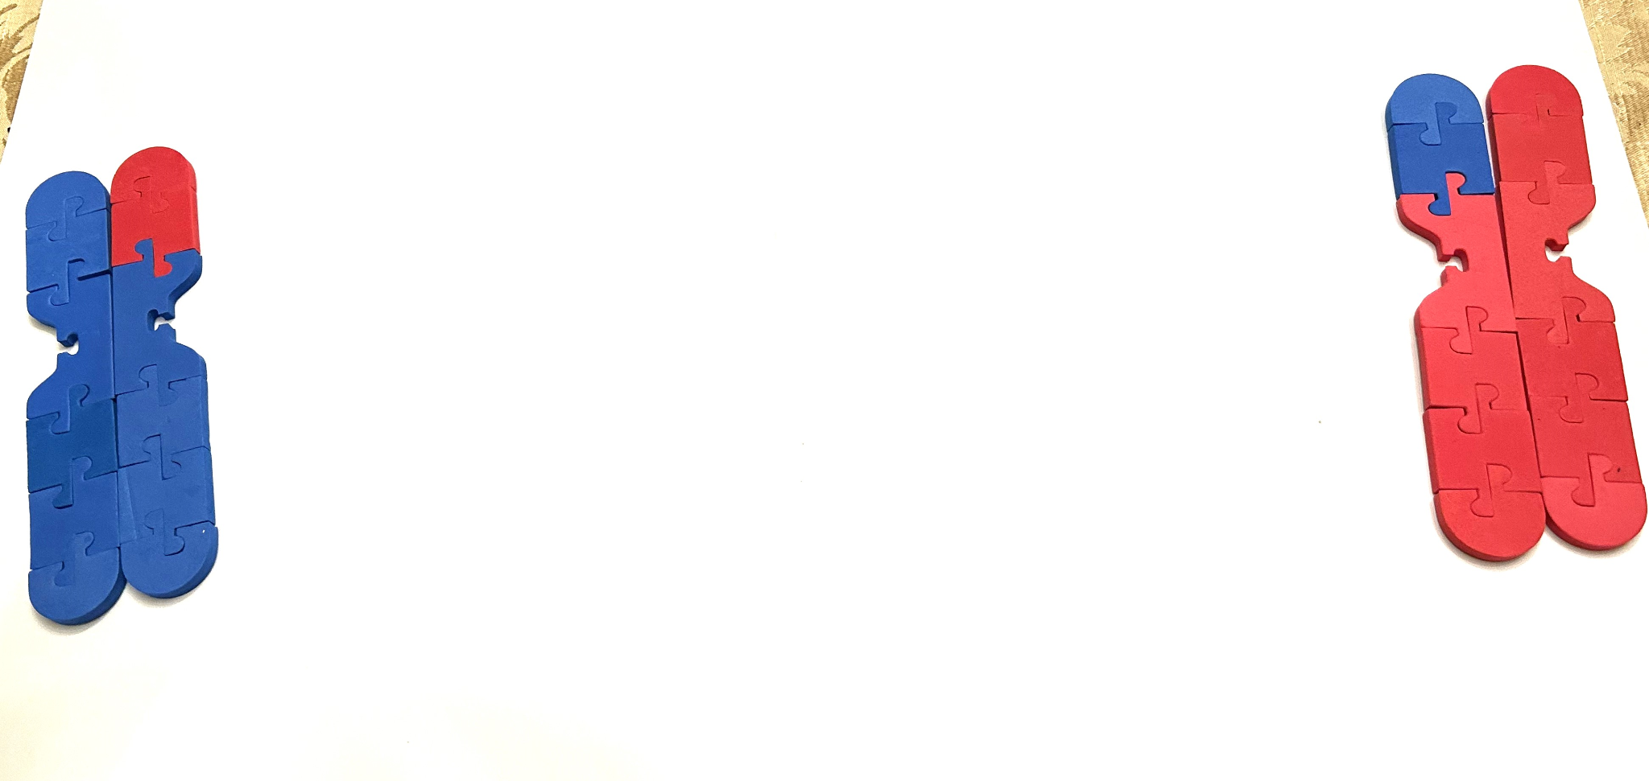
Meiosis 1 -
Telophase 1 and Cytokinesis:
Nuclear membranes form around the nuclei at opposite poles. Each nuclei will be haploid.
The cell will divide in the center.

Slide 16
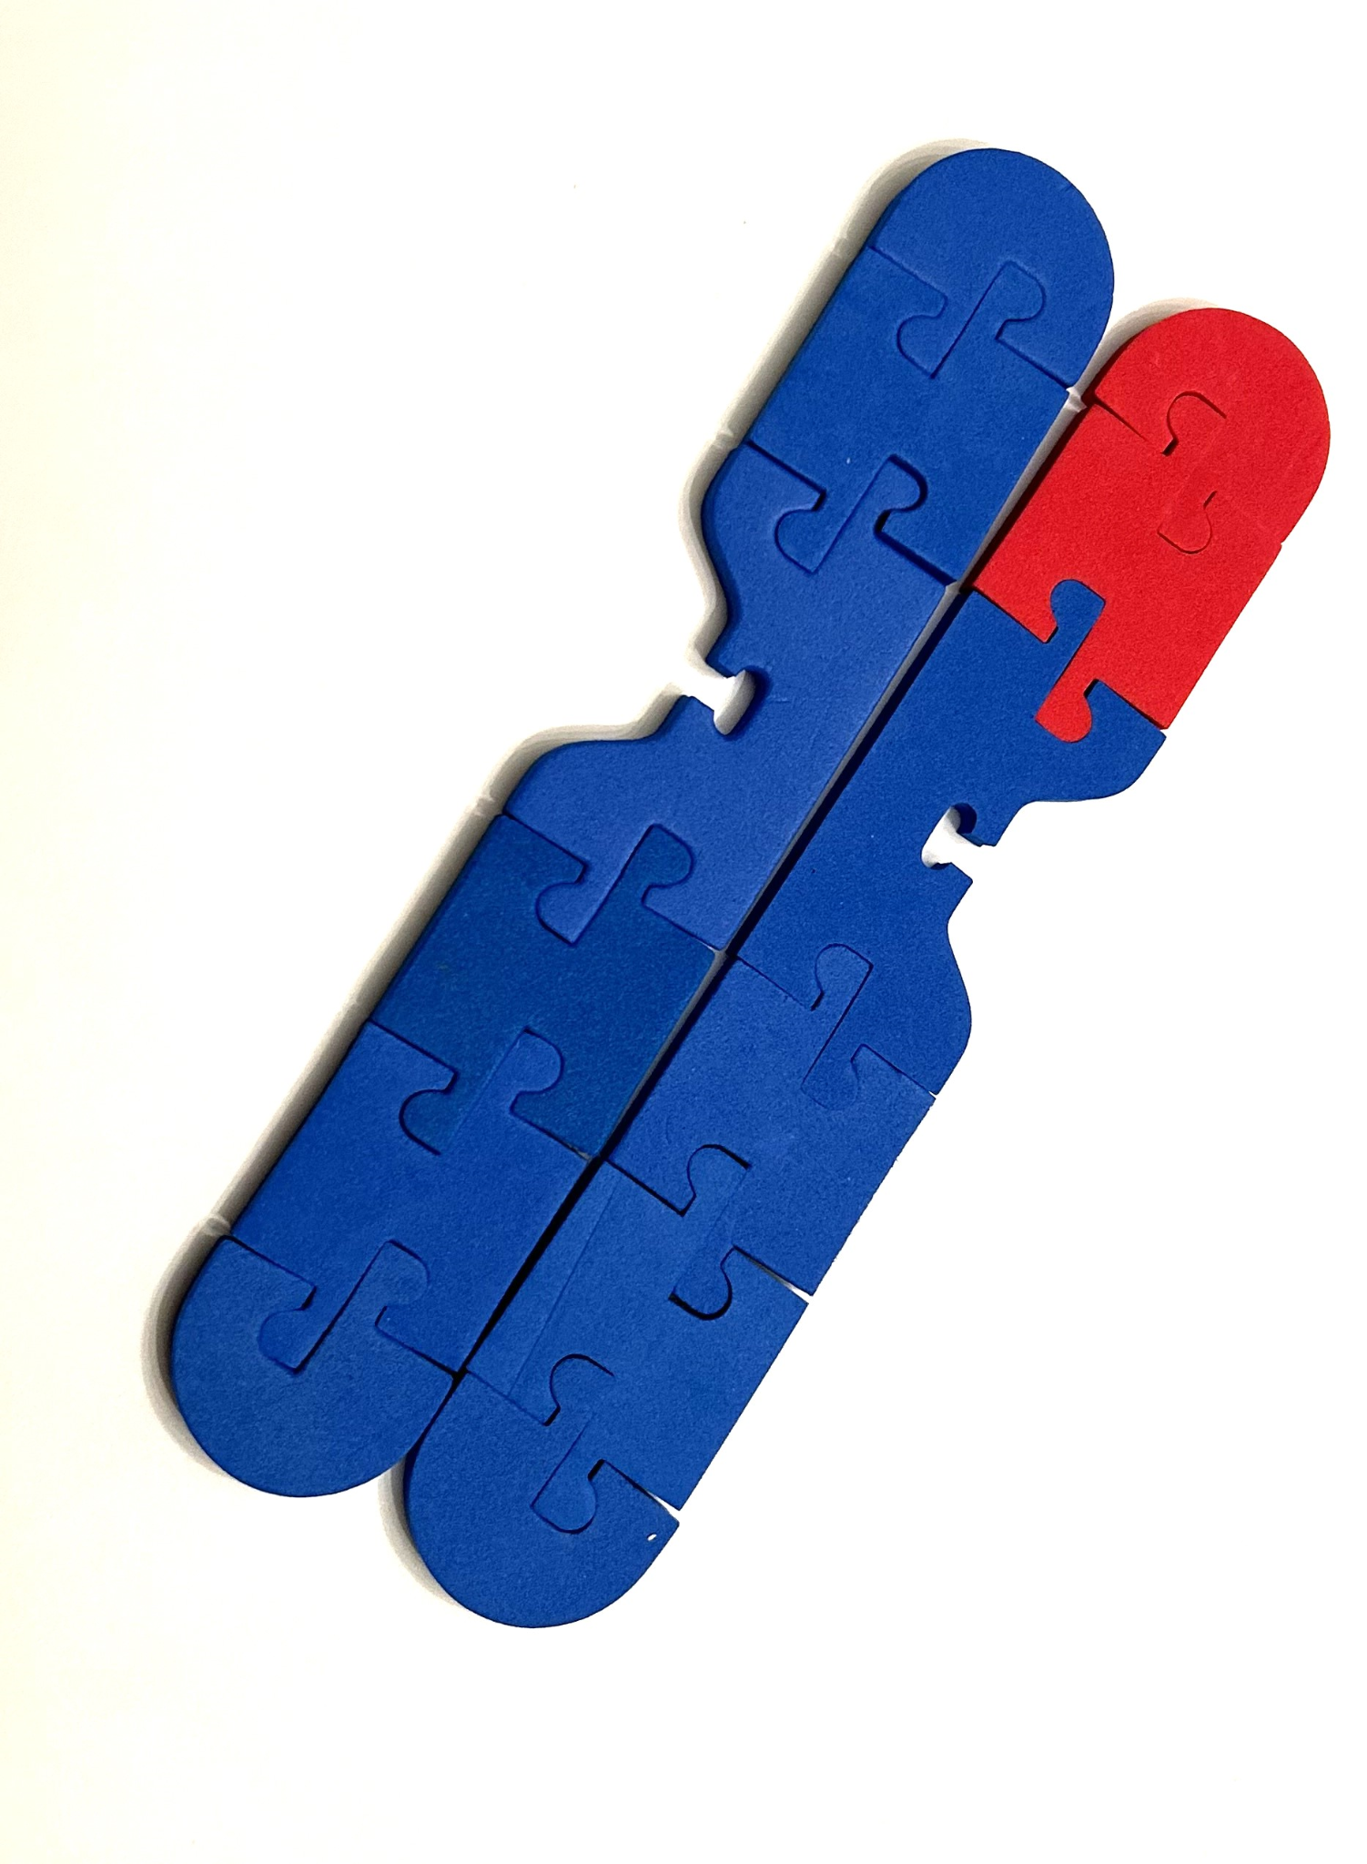
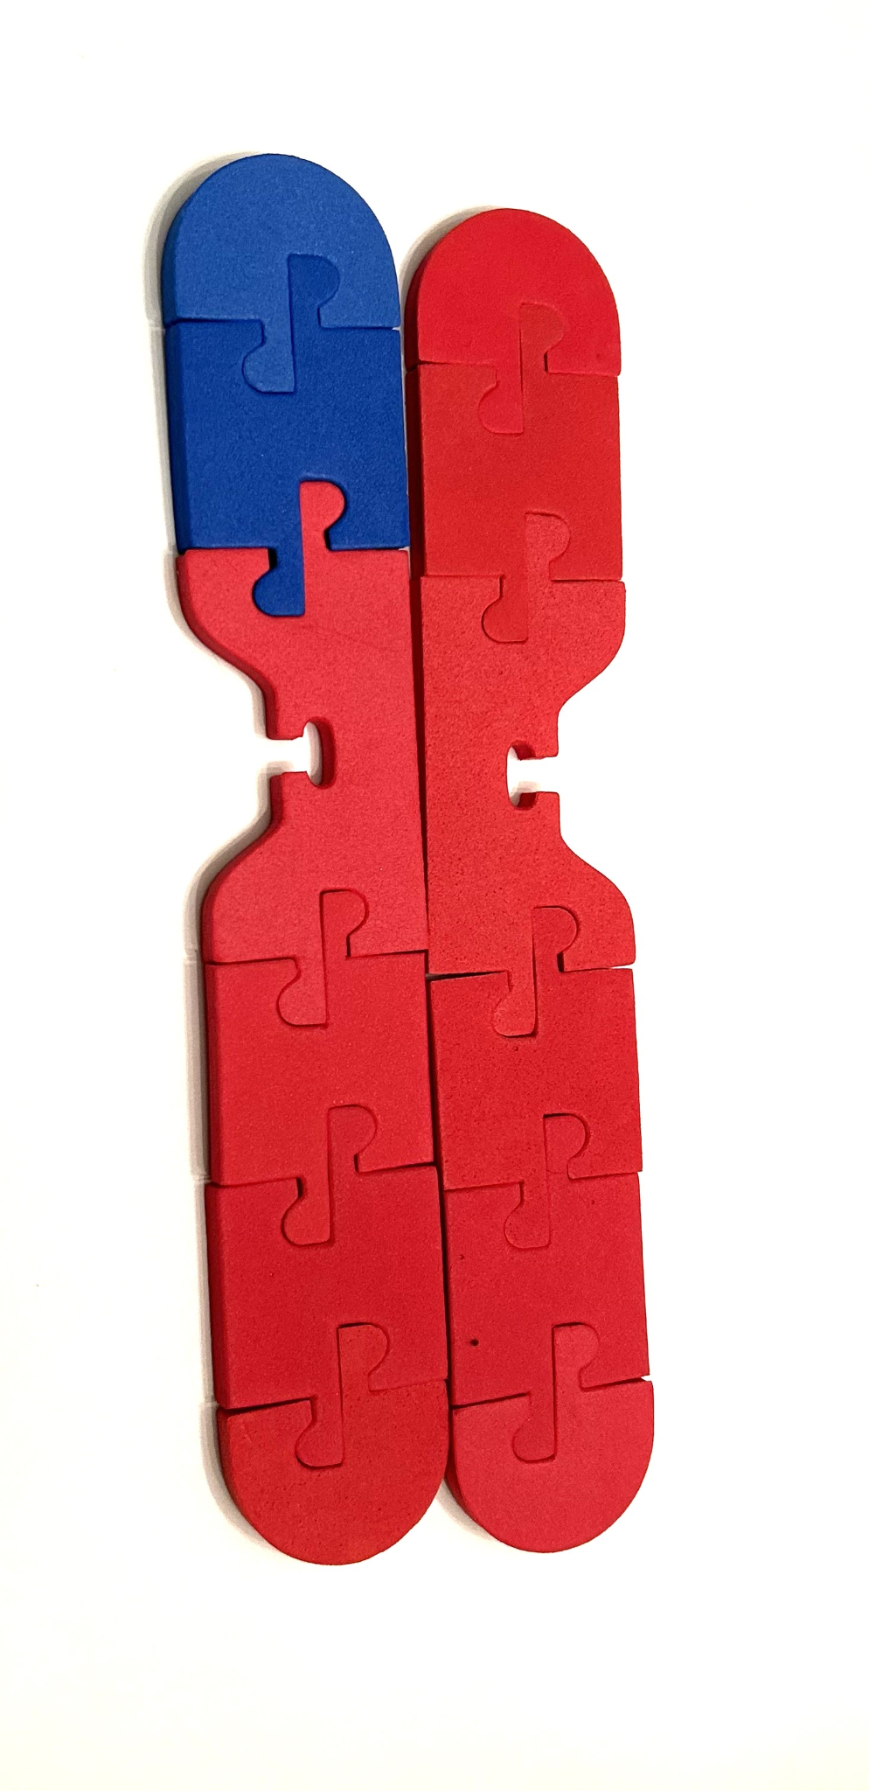
Meiosis 2 -
Prophase 2:
If chromosomes have relaxed, they will condense again.
The nuclear membrane dissolves.
Spindle fibers form.

Slide 17
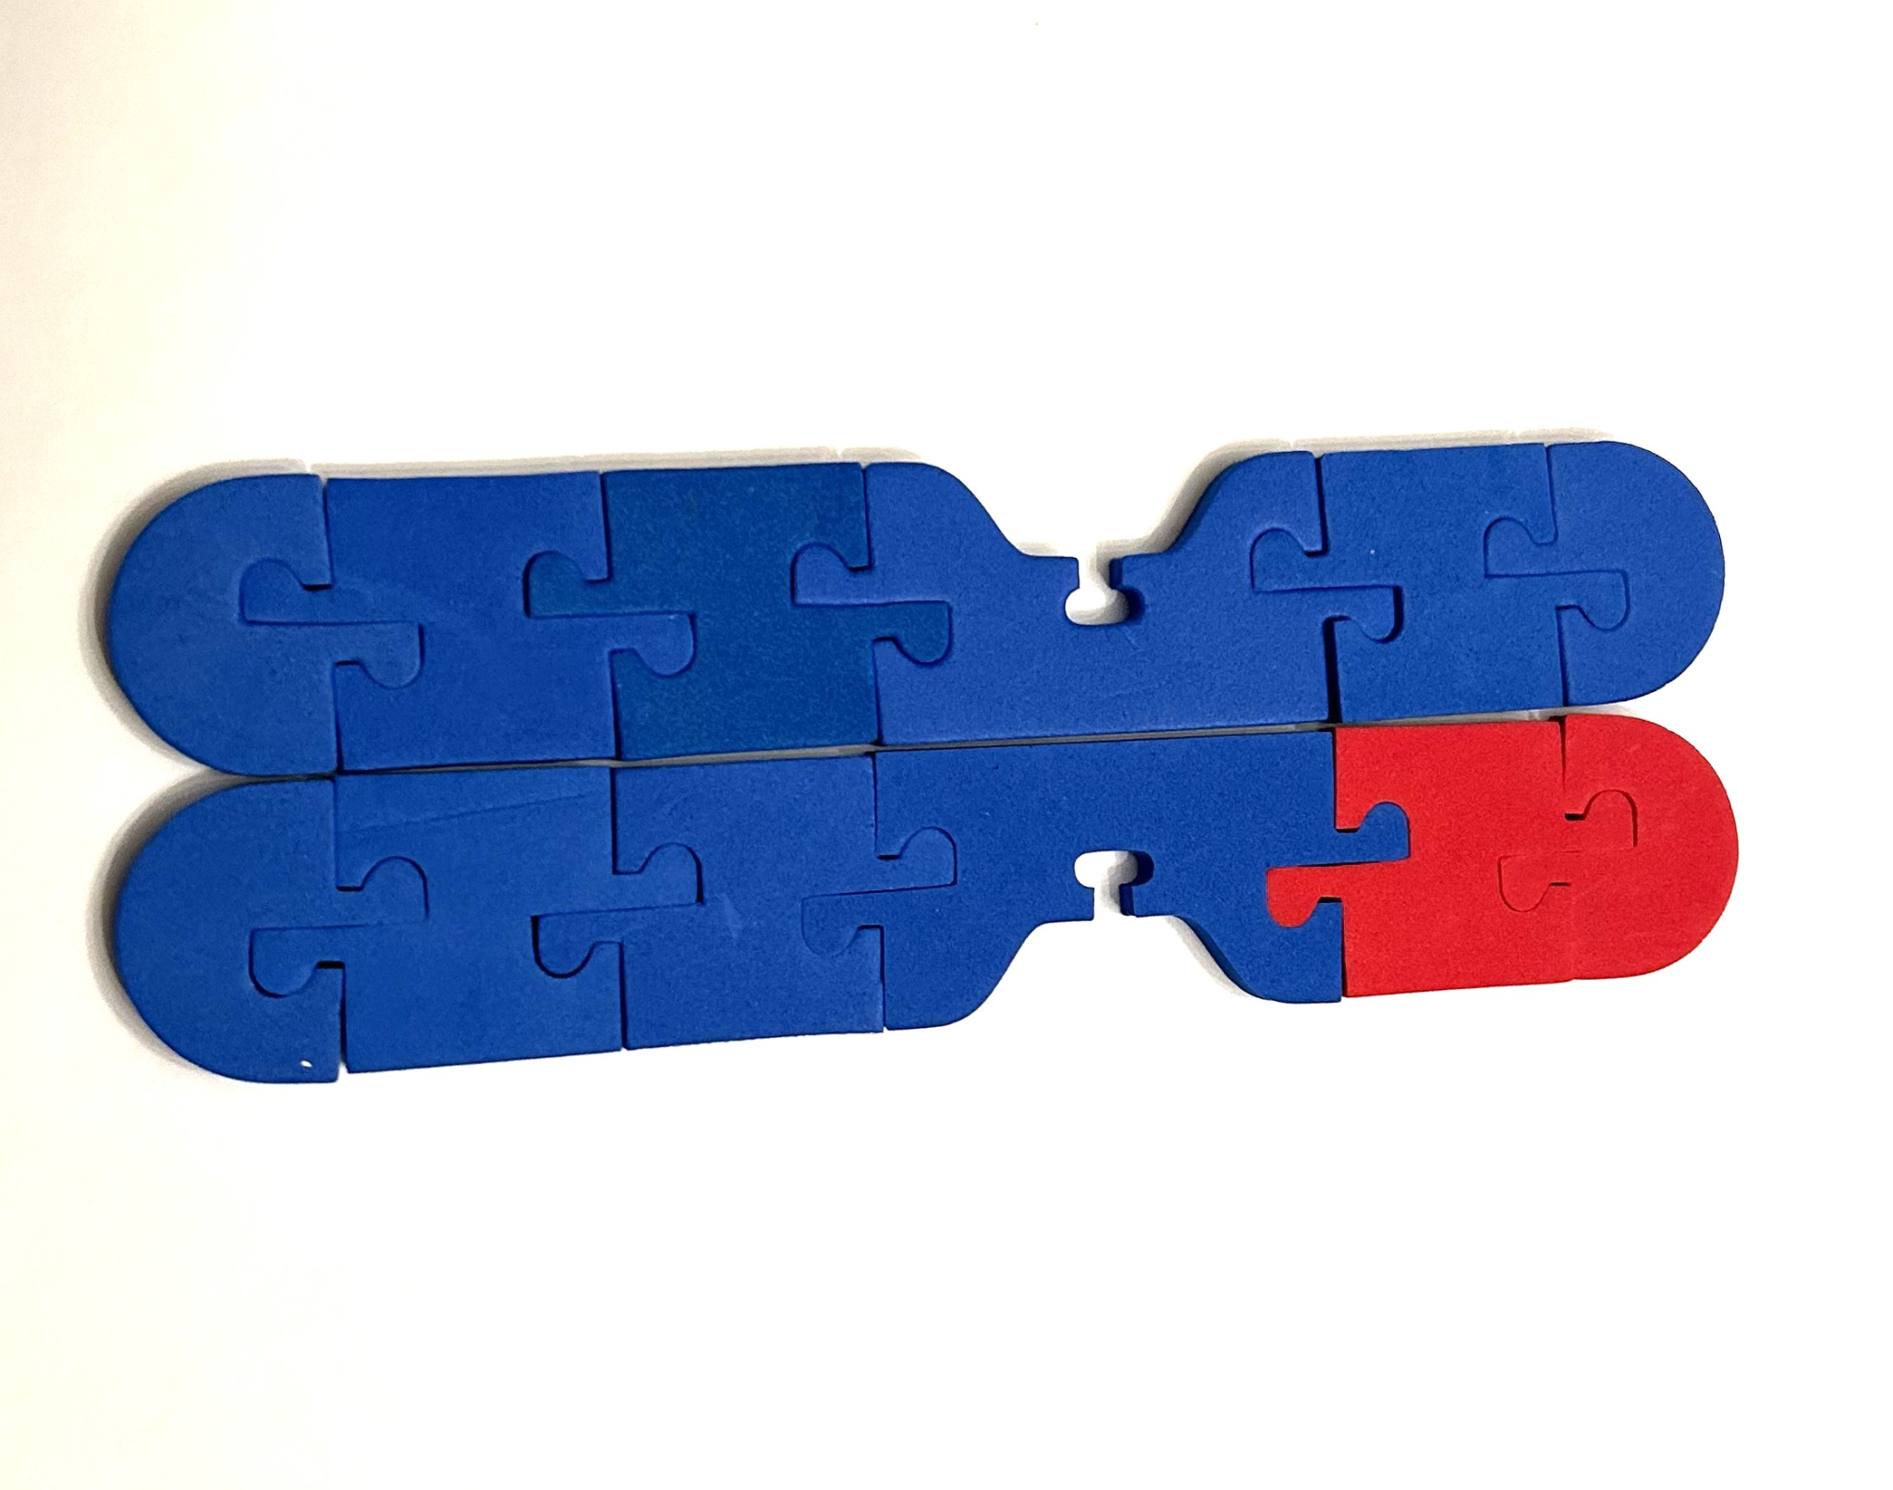
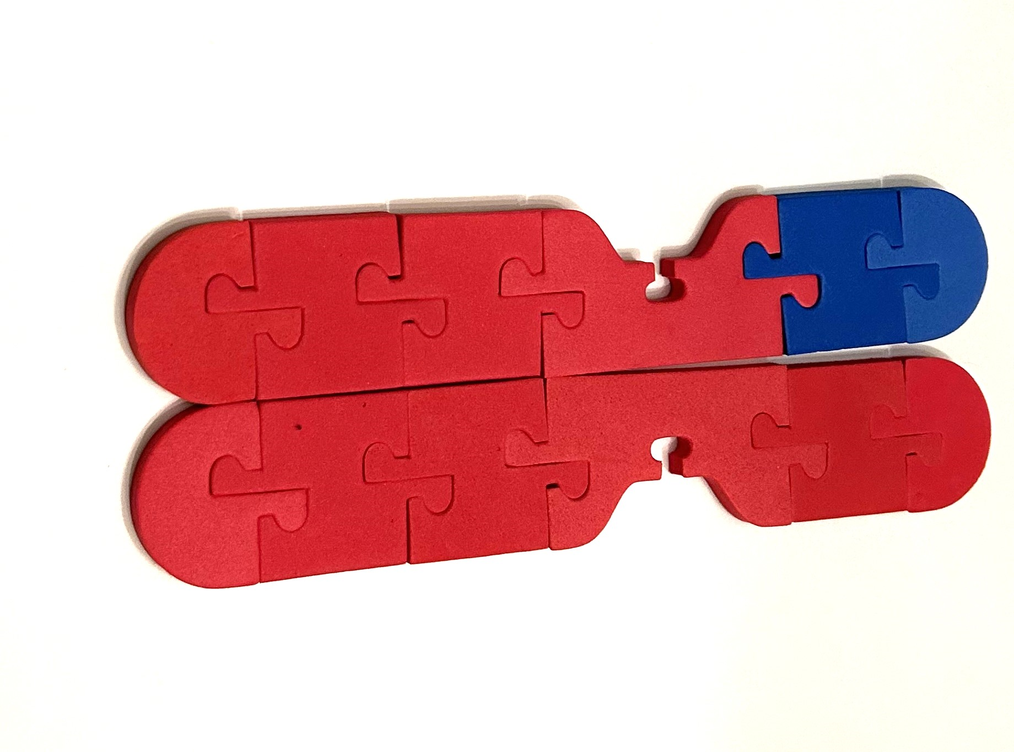
Meiosis 2 - much more like mitosis!
Metaphase 2:
Chromosomes attach to the spindle fibers in the middle of the cell.

Slide 18
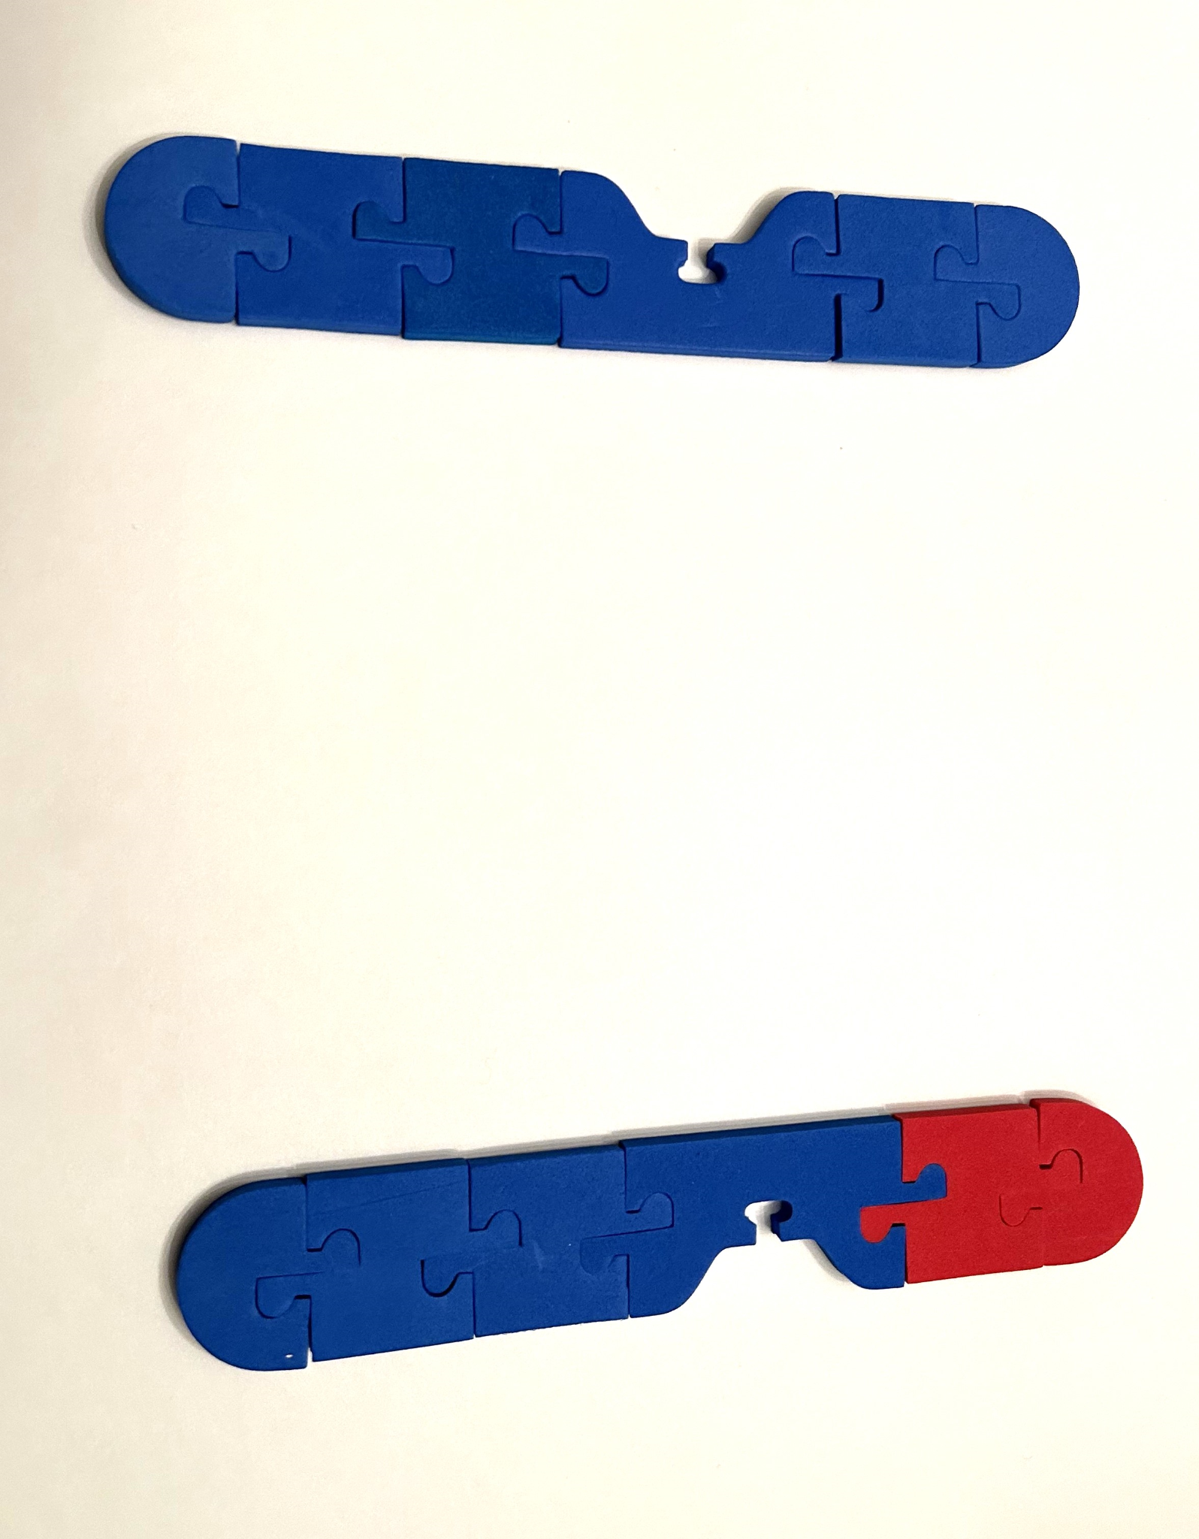
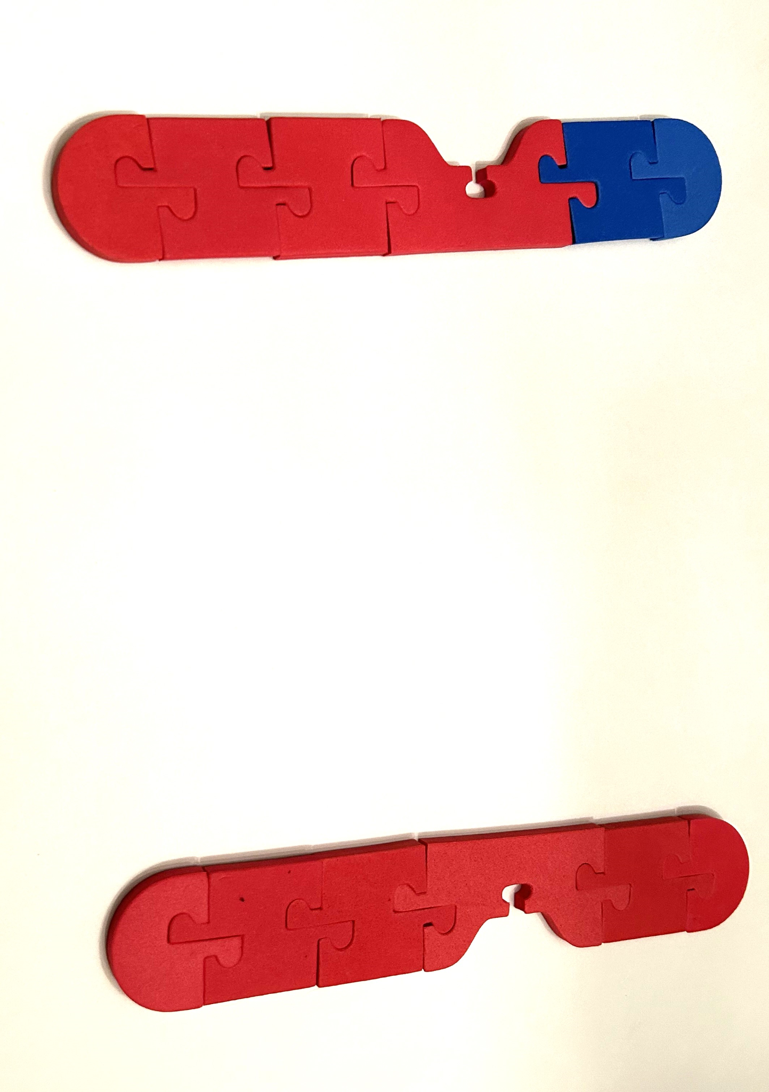
Meiosis 2 - much more like mitosis!
Anaphase 2:
Sister chromatids are pulled towards opposite poles.

Slide 19
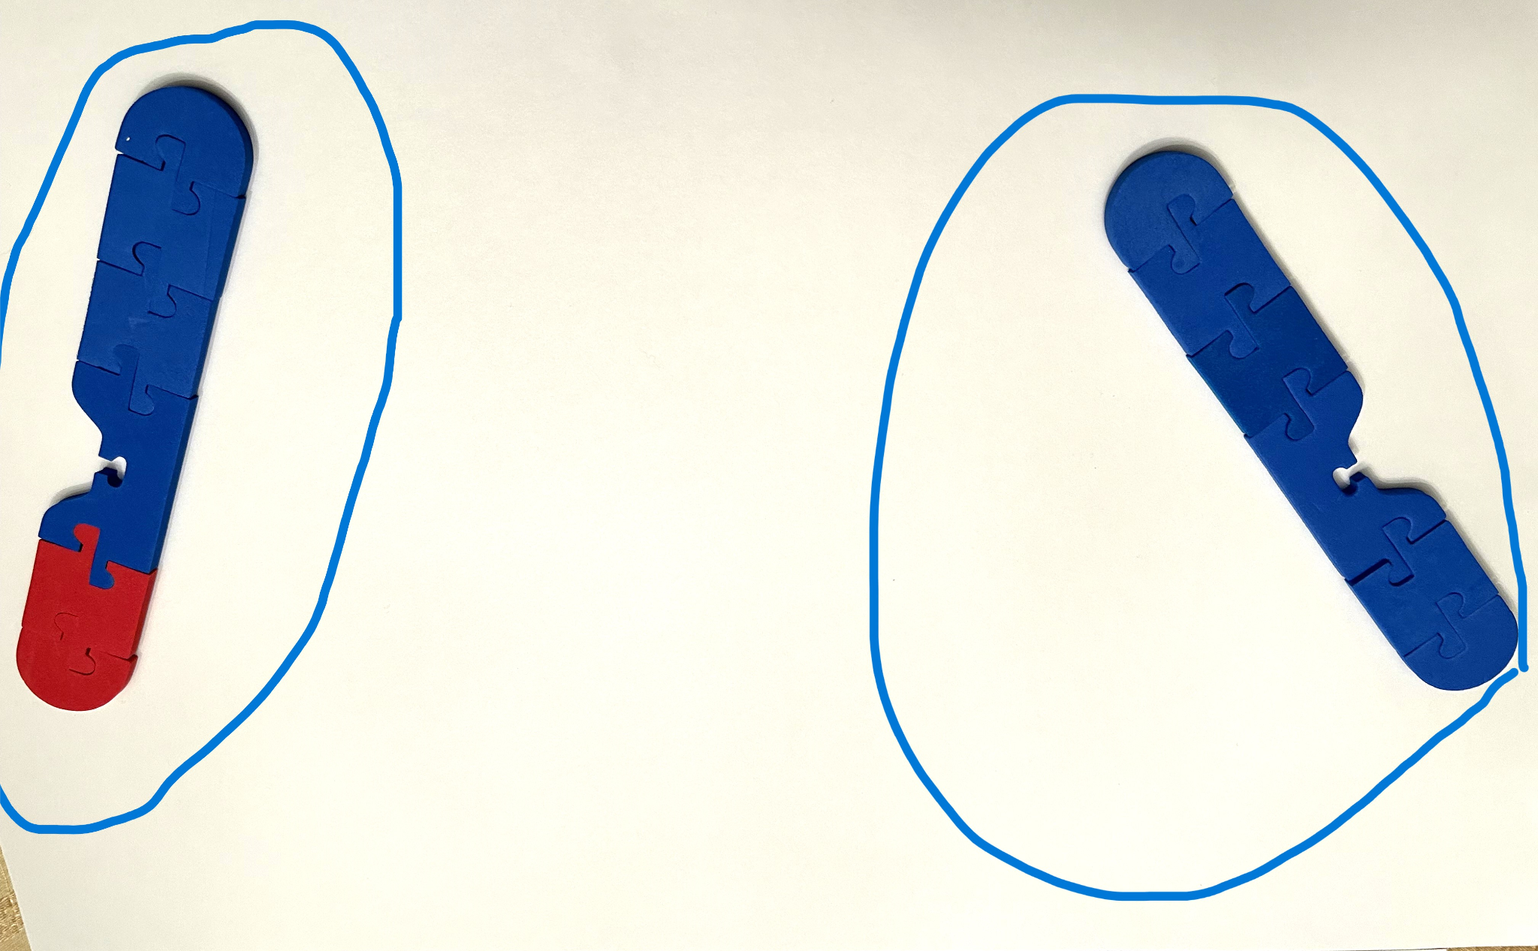
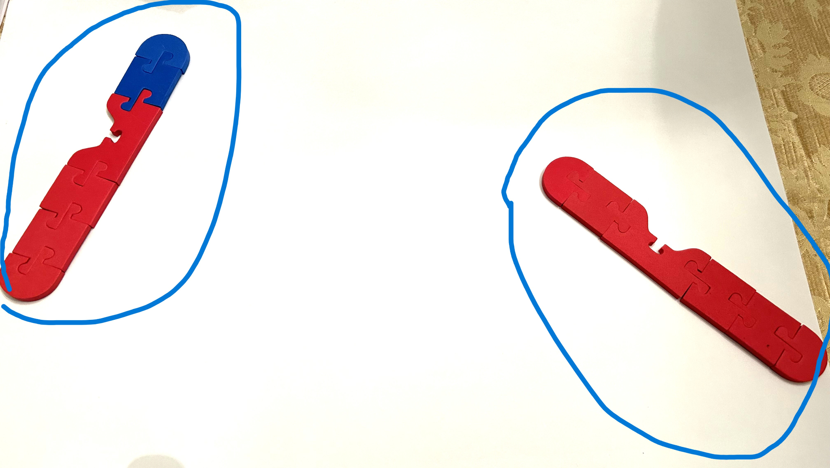
Meiosis 2 - much more like mitosis!
Telophase and Cytokinesis 2:
New nuclear membranes form.
Chromosomes relax.
Cells divide down the middle.
4 haploid cells now exist from the original cell.

Slide 20
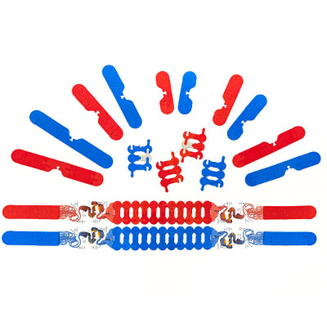
3D Molecular Designs Chromosome Connections

Slide 21


Summer Course 2024– Modeling the Molecular World
Join us in Milwaukee for hands-on discovery and professional development
July 29 – Aug 2 OR Aug 5 – 9
Scan to register!
Bring an empty suitcase!
You'll take home all these classroom resources!

Slide 22


