Slide 1
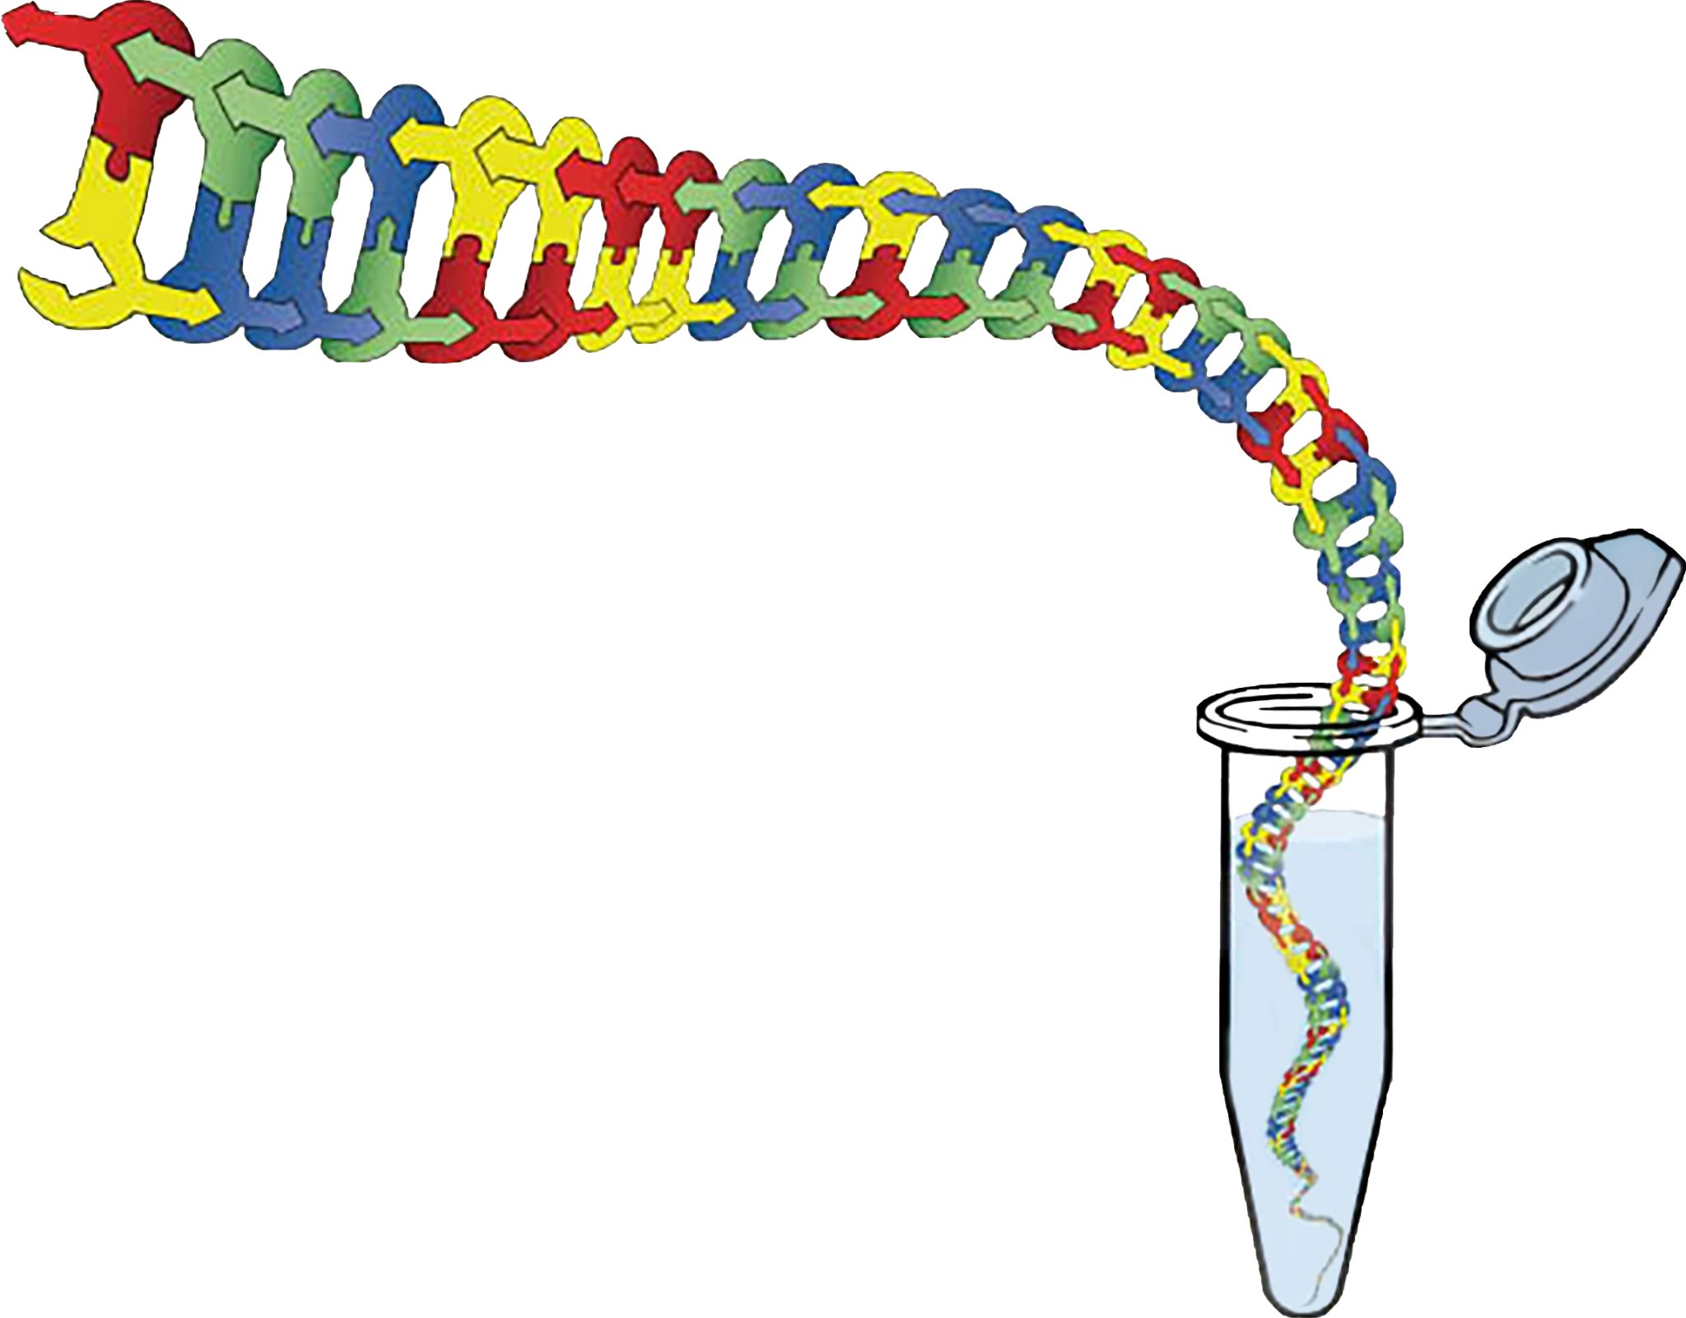
In the Tube Where it Happens: Using Models to Support Understanding in Biotechnology
Keri Shingleton, Ph.D.
Holland Hall School
Tulsa, Oklahoma

Slide 2
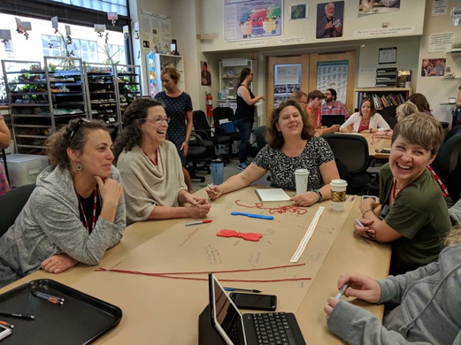



Who am I?
Who am I?

Slide 3
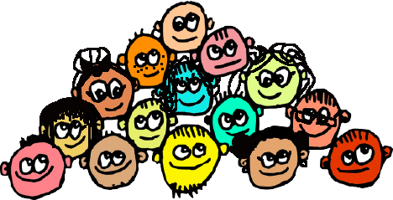
Who are you?

Slide 4
Today we will…
Experience the authentic learning we (and our students) will encounter while modeling the processes of:
PCR (Polymerase Chain Reaction)
Restriction digestion
Electrophoresis
Identify pedagogies that can be used with modeling to help
Increase deep engagement
Make student thinking visible
Formative assessments

Slide 5
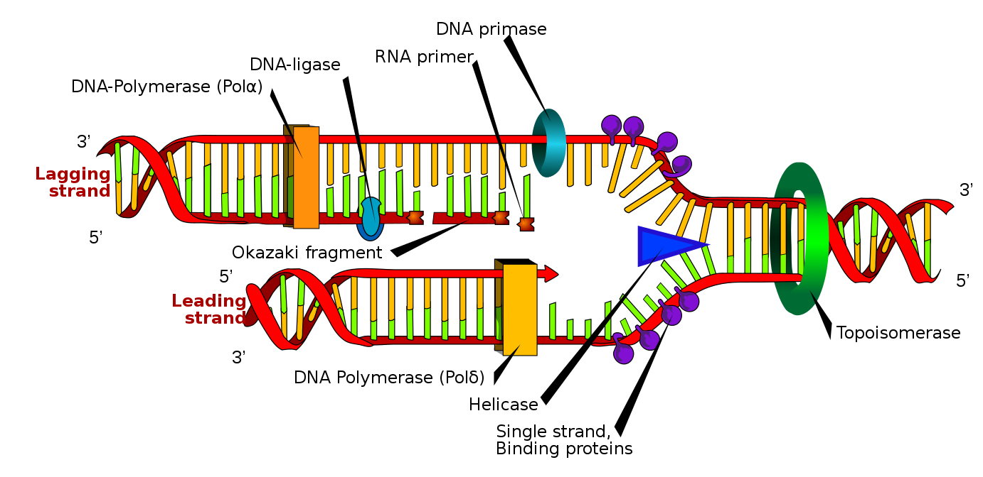
“Enzymes” in DNA replication… ENZYMES ARE EXPENSIVE!
https://commons.wikimedia.org/wiki/File:DNA_replication_en.svg

Slide 6

What is biotechnology/ bioengineering?

Slide 7
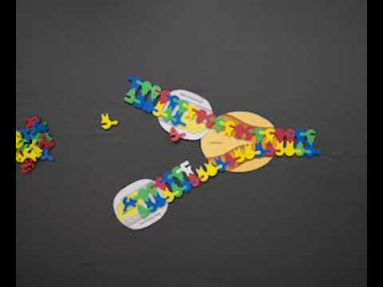
Let’s learn about DNA replication!

Slide 8
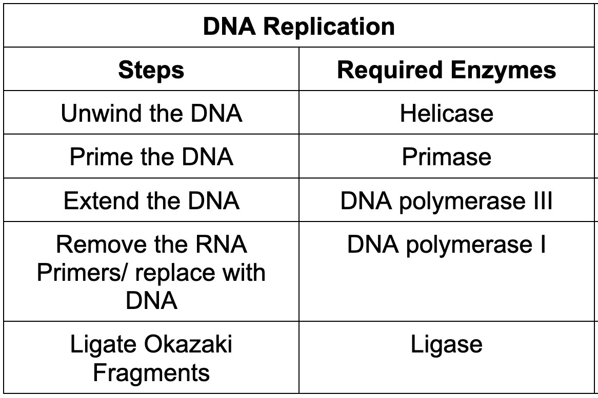
Steps in DNA Replication in your cells…

Slide 9
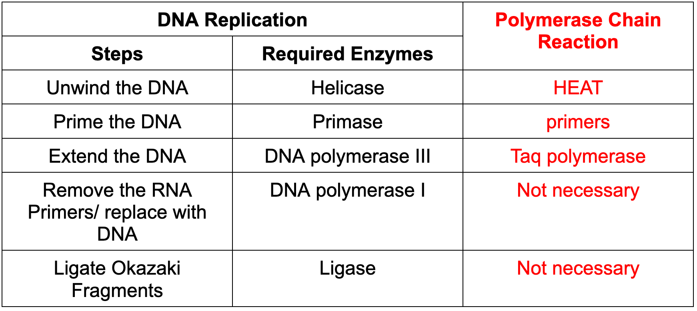

Slide 10


Slide 11
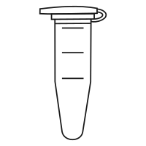
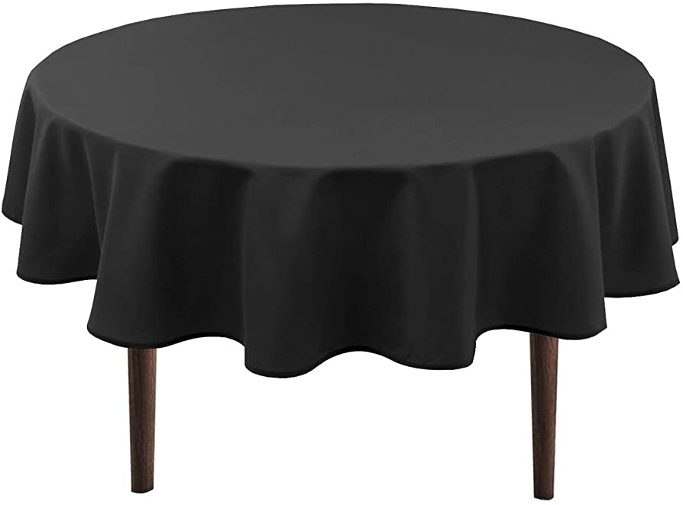

Your table is now a…

Slide 12
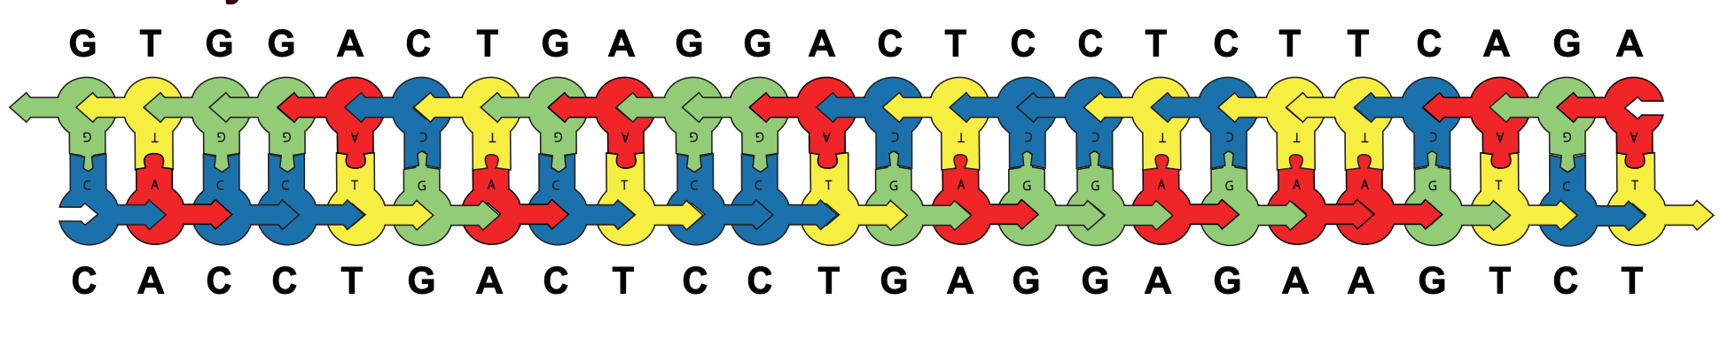

Slide 13
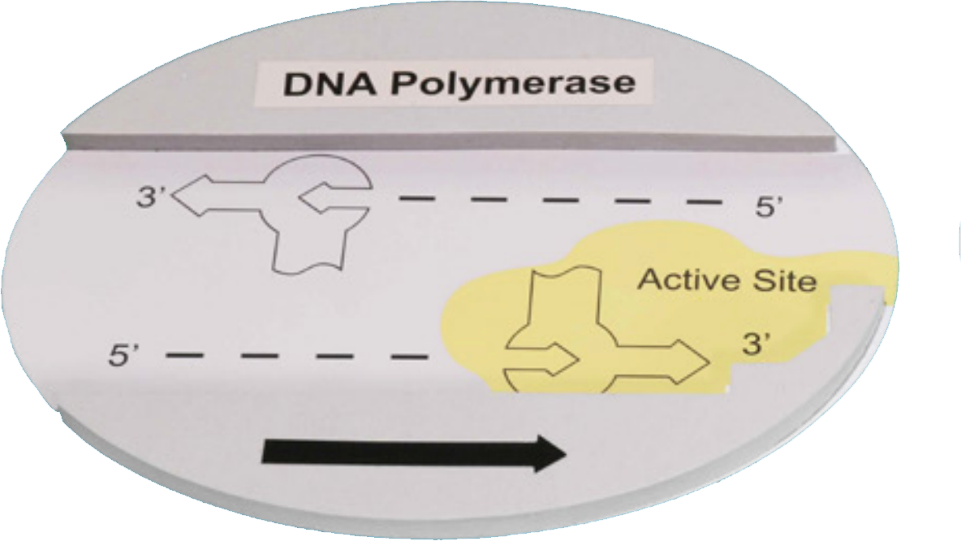

Slide 14


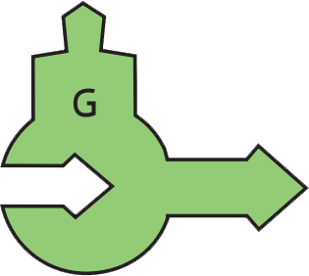
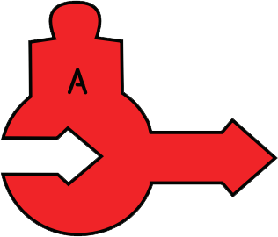

Slide 15
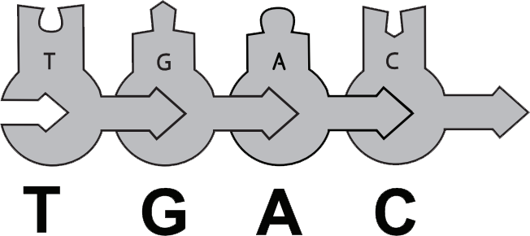


Slide 16
Remember these ingredients are all in a tube…
Not on a table.

Slide 17
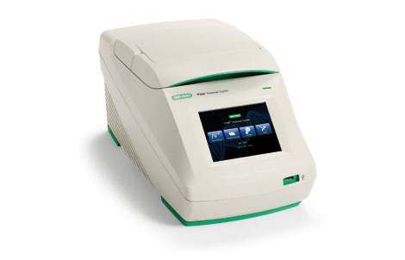

Slide 18
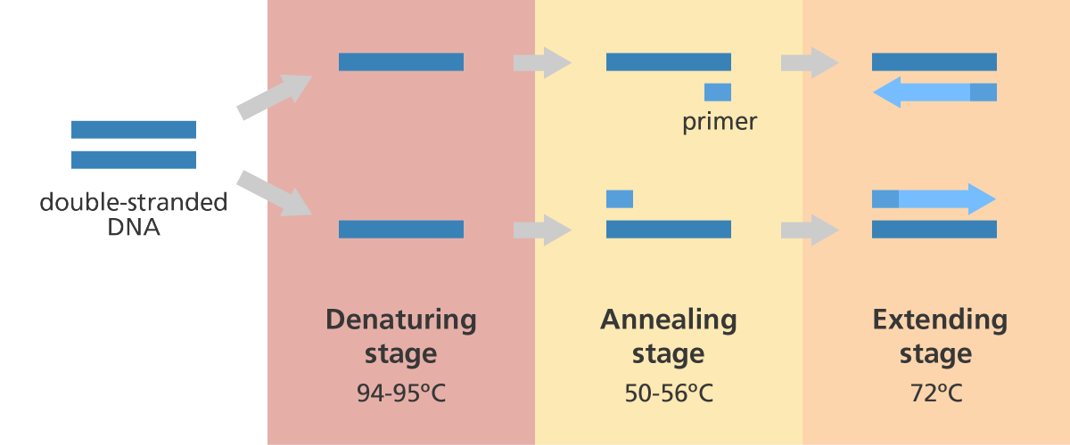

Slide 19
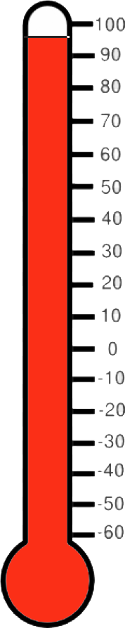
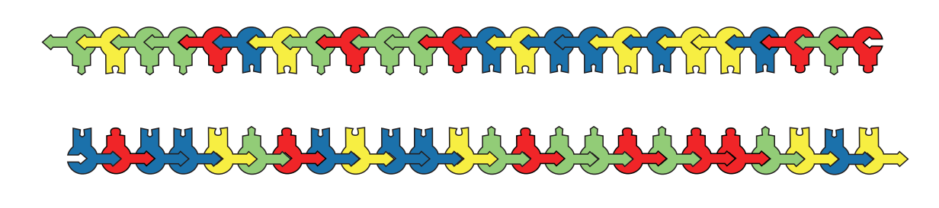

First step....
Denature for 11 minutes at 95°C
1

Slide 20
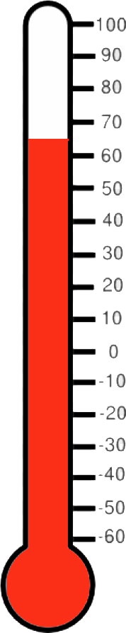
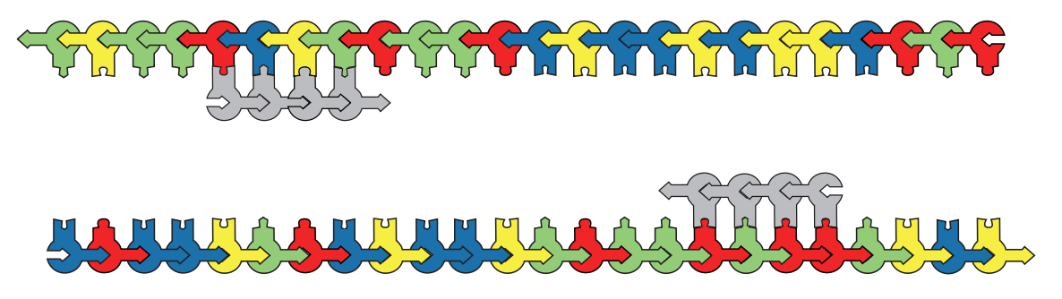
Anneal
1

Slide 21
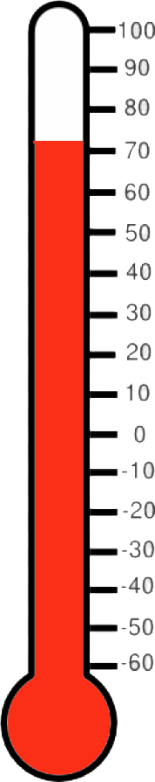
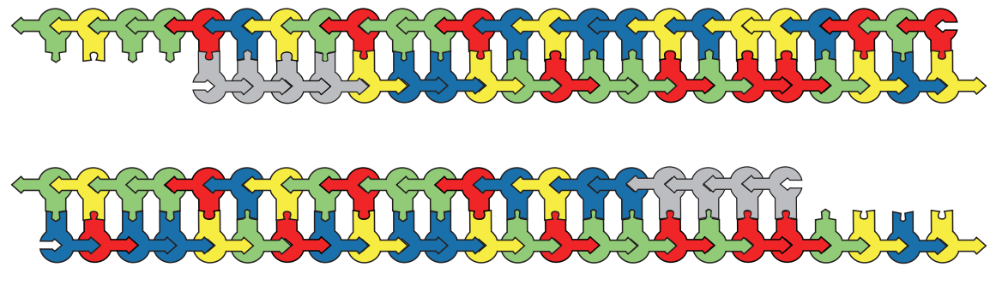
Extend
1

Slide 22
Cycle 2

Slide 23
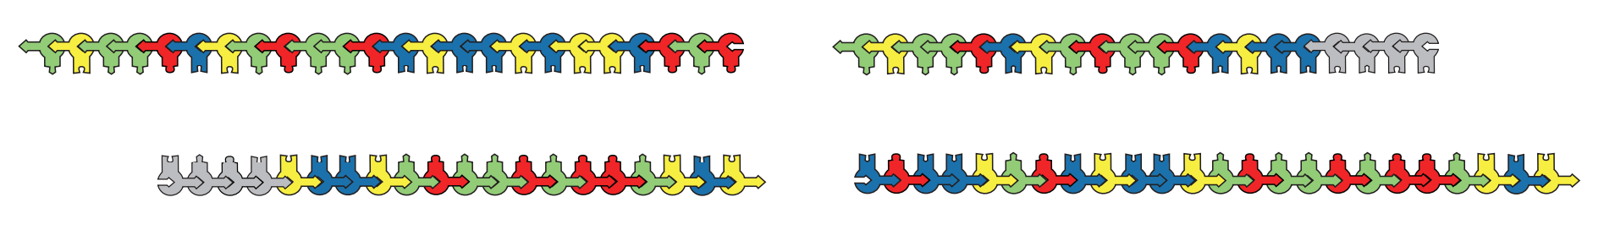
1 minute at 95°C. Why shorter this time?
2

Slide 24
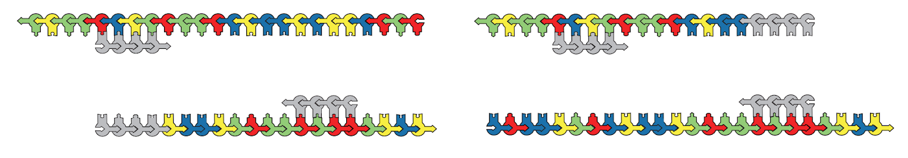
Extend
2

Slide 25
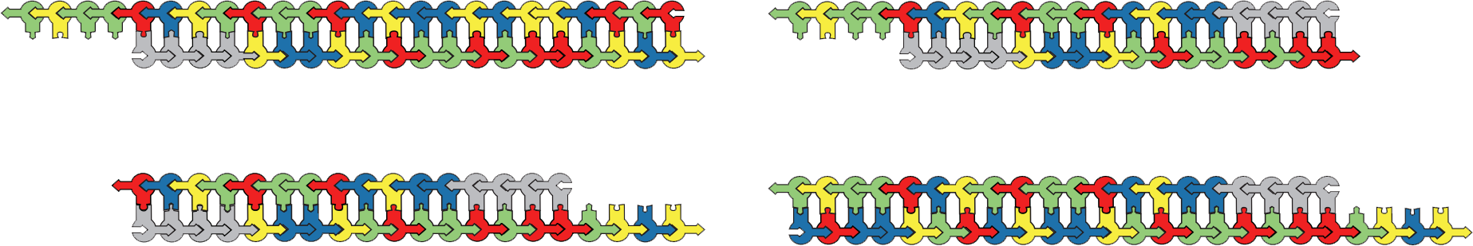
Extend
2

Slide 26
Cycle 3

Slide 27
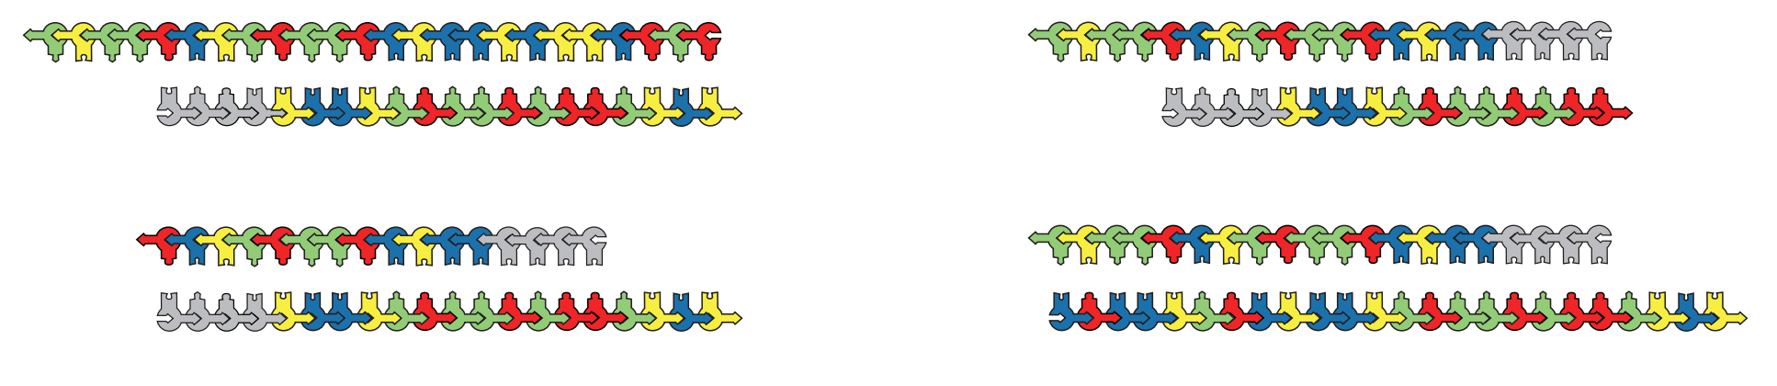
Denature: 95°C.
3

Slide 28
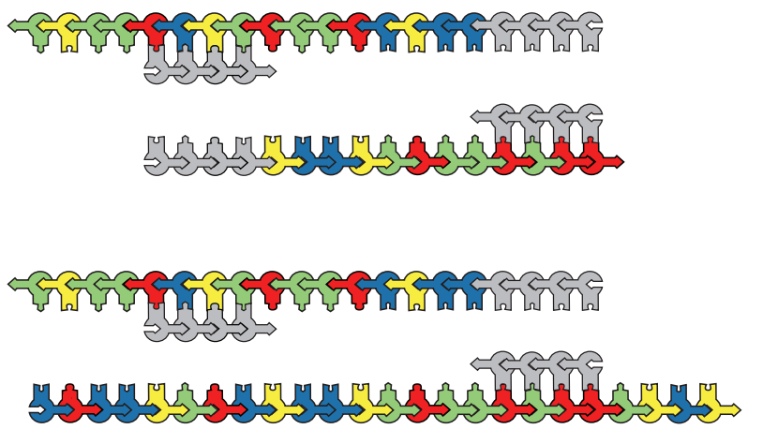
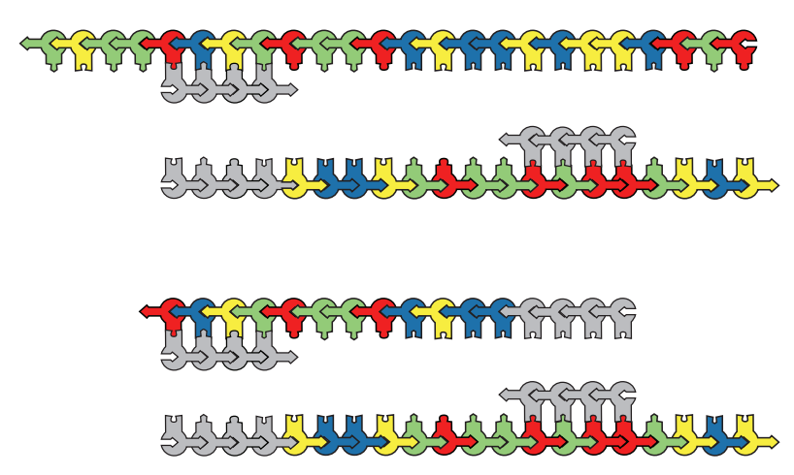
Anneal
3

Slide 29
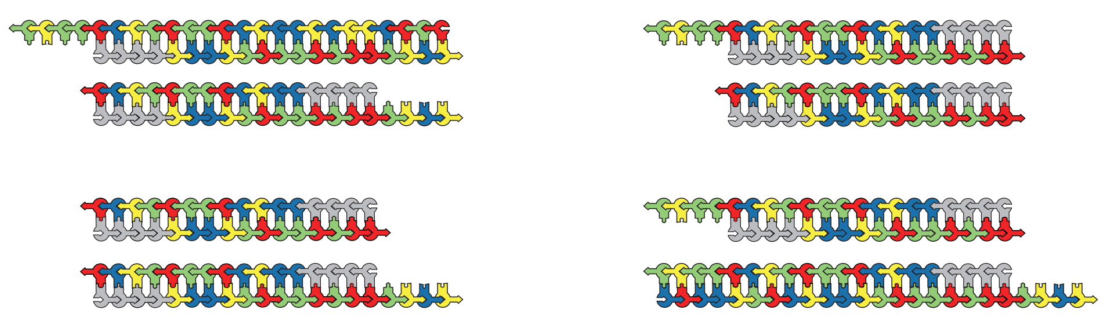
Extend
3

Slide 30
Extend
3

Slide 31
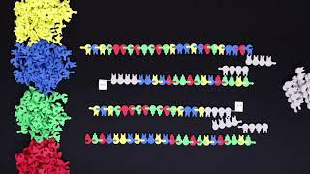

Slide 32
35 cycles, done!

Slide 33

Remember, your table is a PCR tube…

Slide 34

Context? Let’s zoom out!

Slide 35
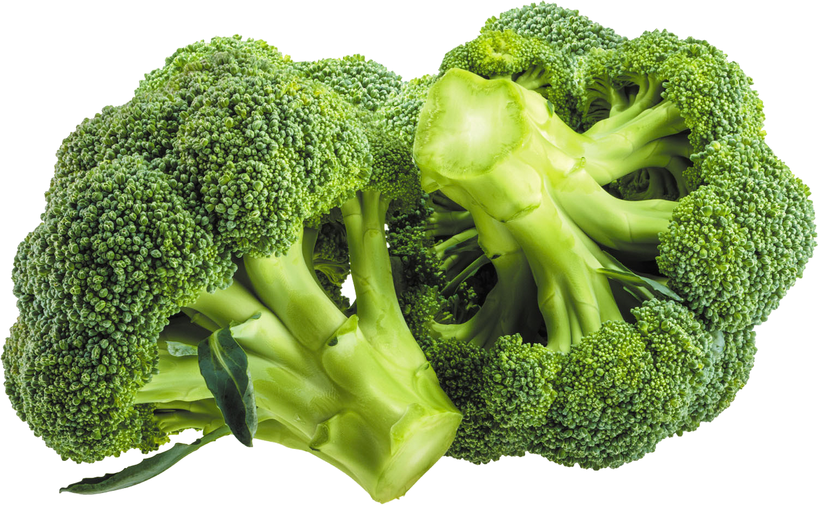
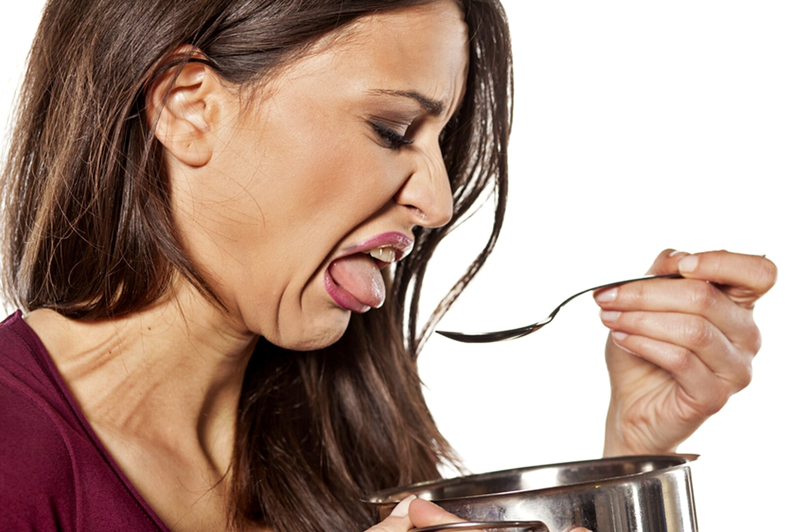
The Science of Bitter Taste
https://www.womensalphabet.com/bitter-taste-in-your-mouth-how-do-i-get-rid-of-it/

Slide 36
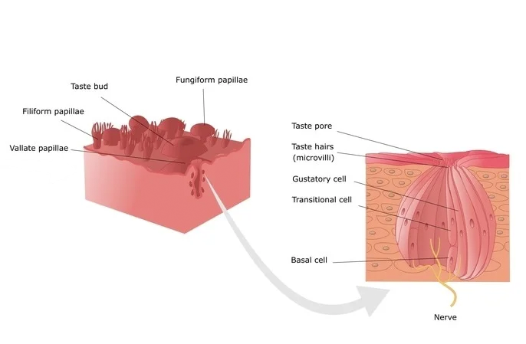
Taste Bud? Or Taste Pore?
https://www.news-medical.net/health/Genetics-of-Taste.aspx

Slide 37
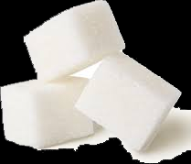
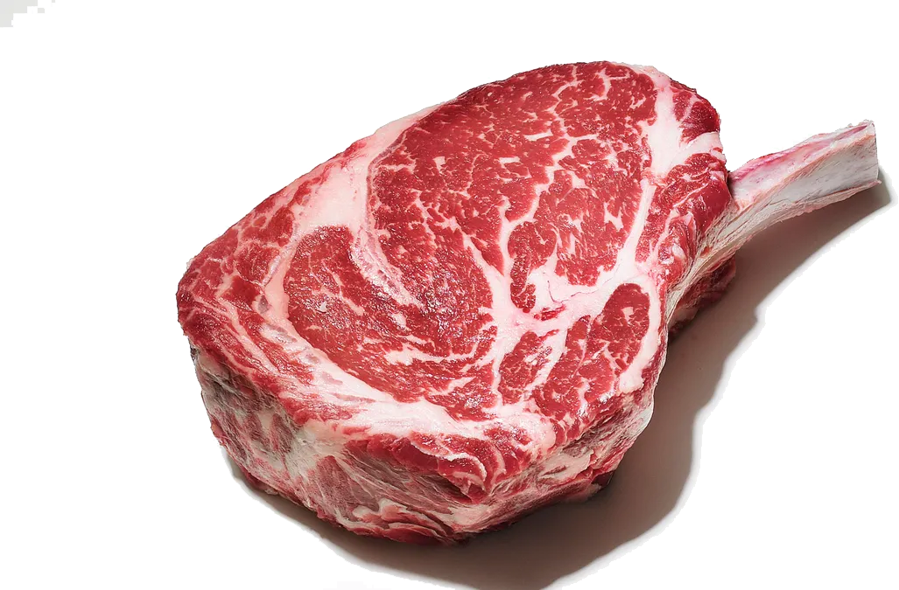
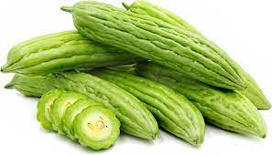
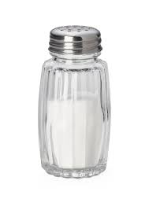
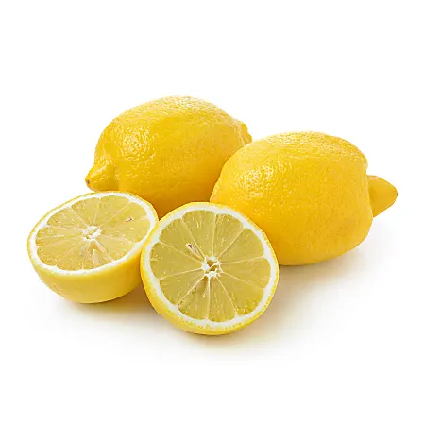
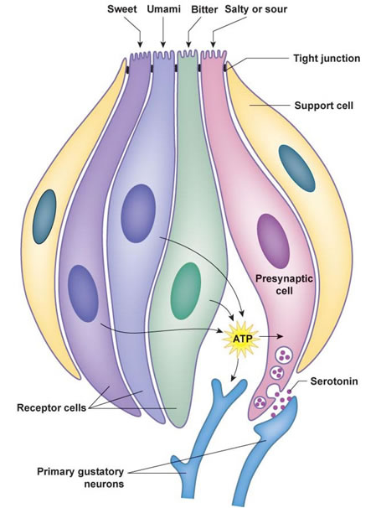
https://www.d.umn.edu/~jfitzake/Lectures/DMED/SensoryPhysiology/Chemosensation/Gustation/TasteBuds.html

Slide 38
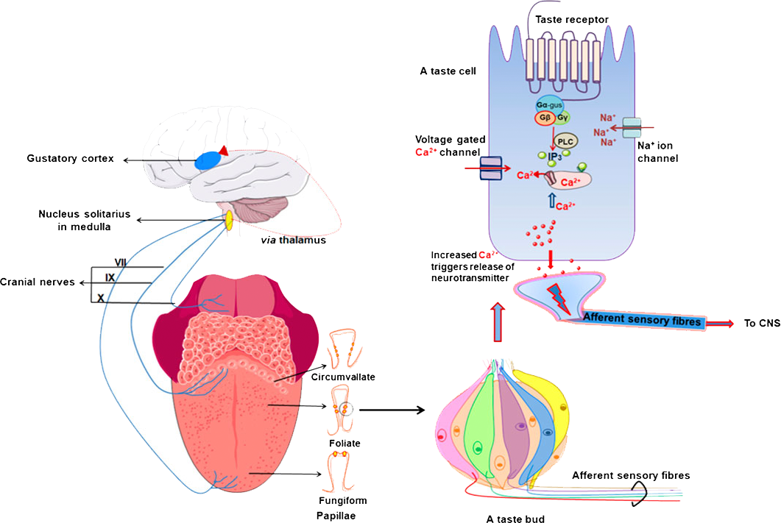
https://www.frontiersin.org/files/Articles/587664/fphar-11-587664-HTML/image_m/fphar-11-587664-g001.jpg

Slide 39
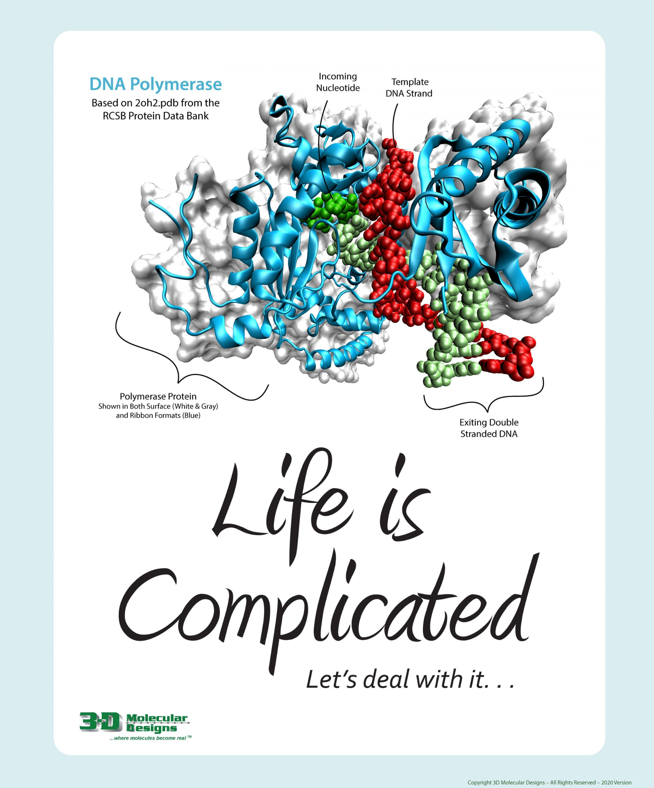
But how?

Slide 40
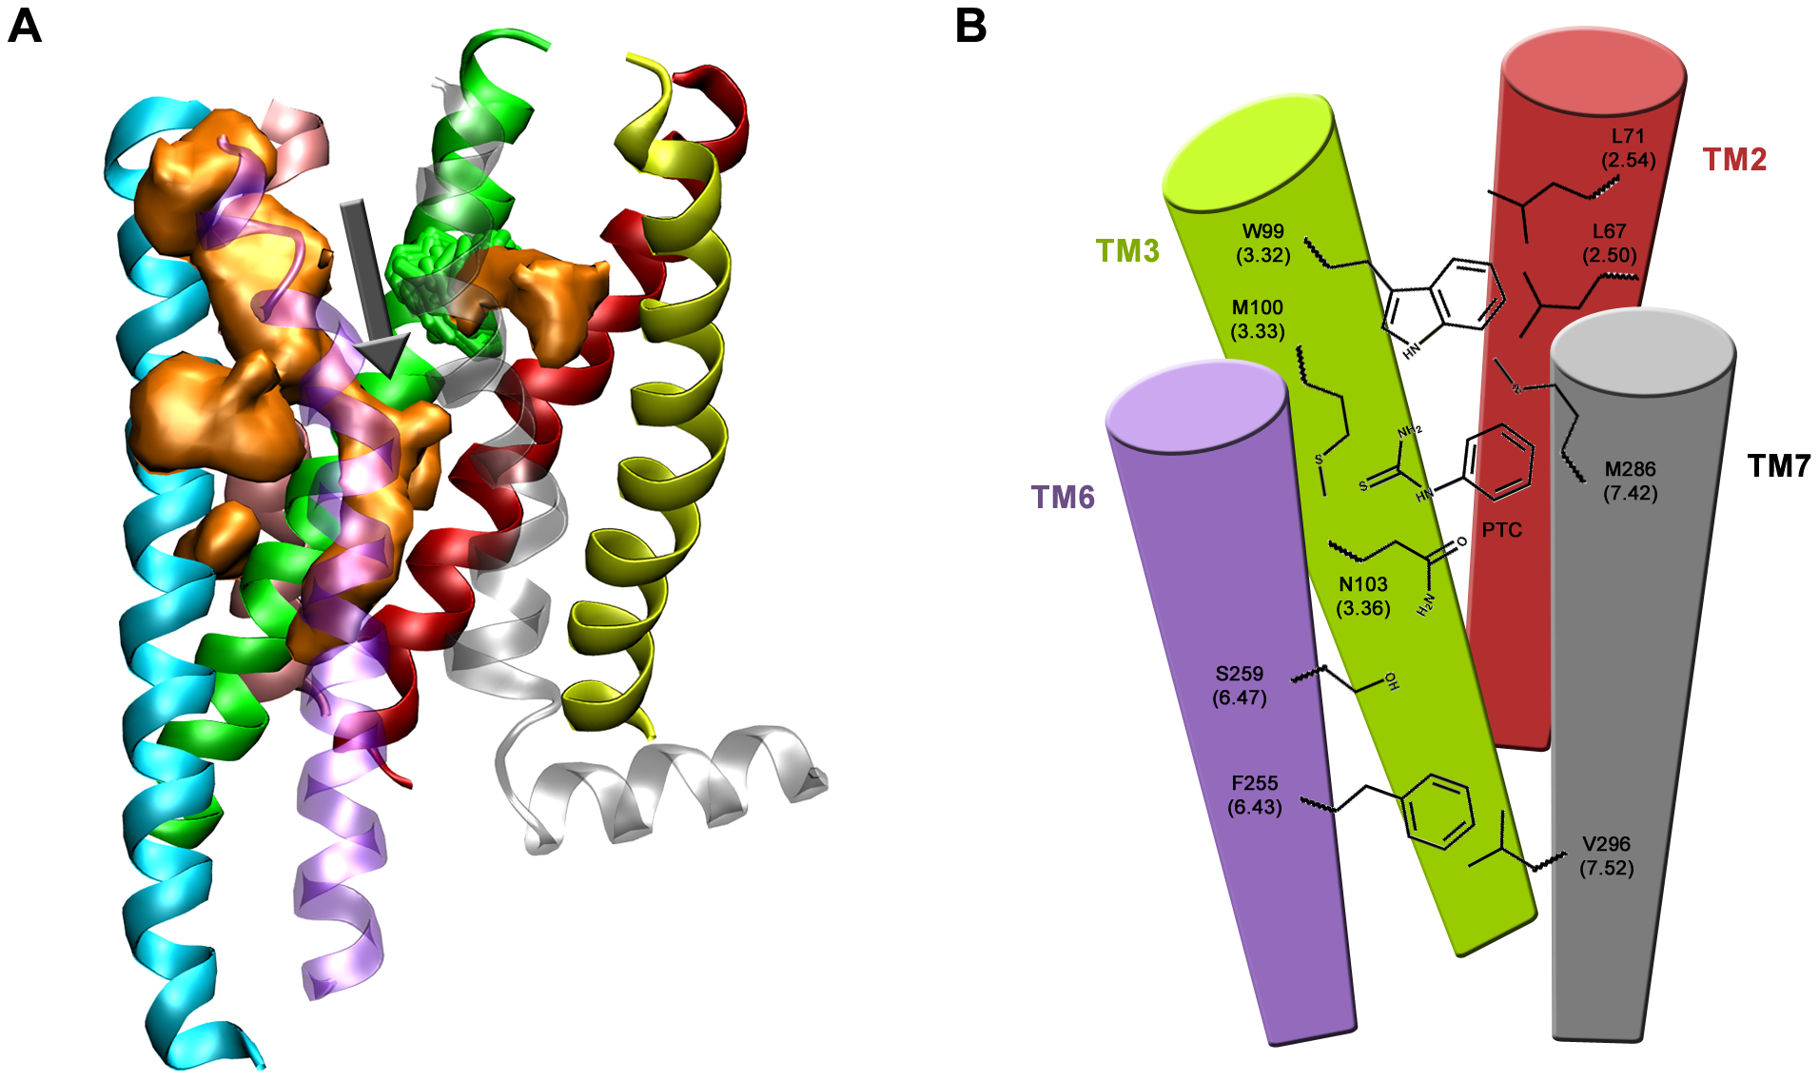
TAS2R38 bitter taste receptor protein
https://journals.plos.org/plosone/article?id=10.1371/journal.pone.0012394

Slide 41
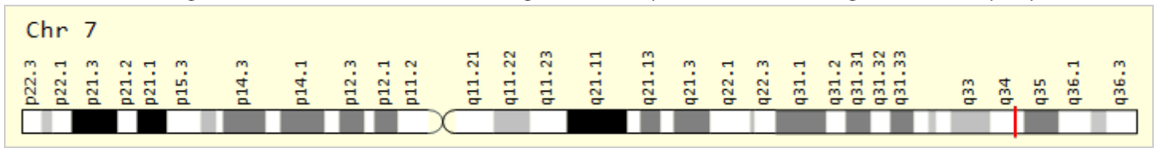
https://www.genecards.org/cgi-bin/carddisp.pl?gene=TAS2R38

Slide 42

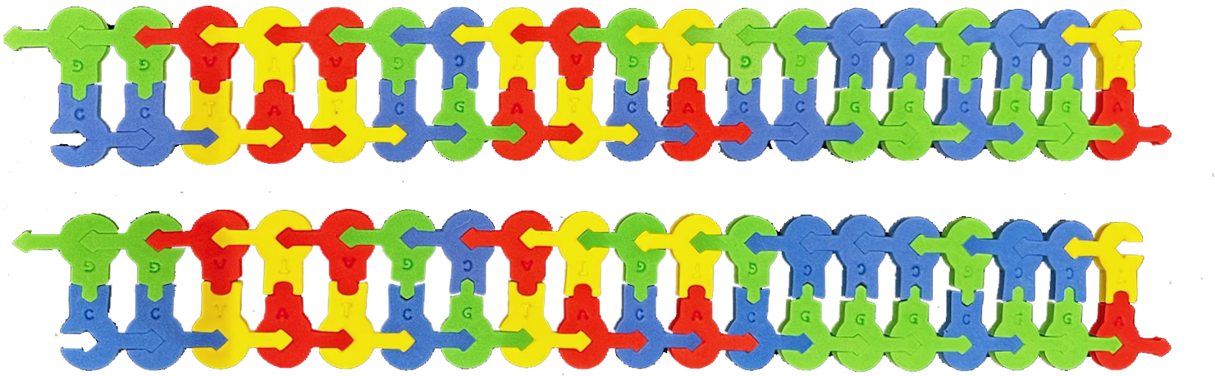
TAS2R38 bitter taste receptor gene…
Can you find the SNP?

Slide 43
TAS2R38 bitter taste receptor gene…

Slide 44
TAS2R38 bitter taste receptor gene…
HAE Cut site: GGCC
CCGG

Slide 45
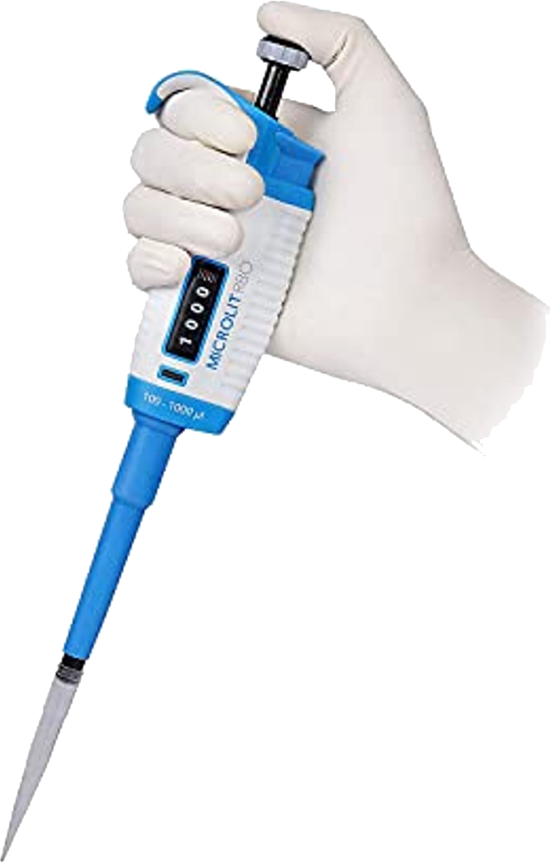
TAS2R38 bitter taste receptor gene…
HAE Cut site: GGCC
CCGG

Slide 46


Slide 47
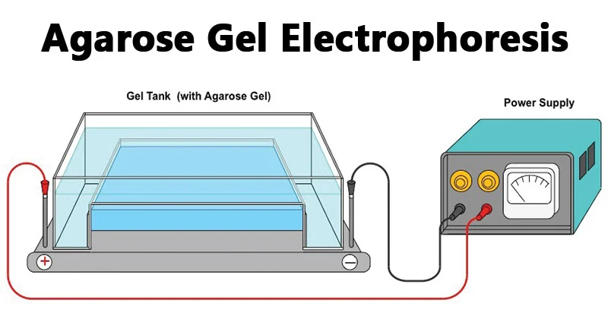
Electrophoresis!
https://microbenotes.com/agarose-gel-electrophoresis/

Slide 48
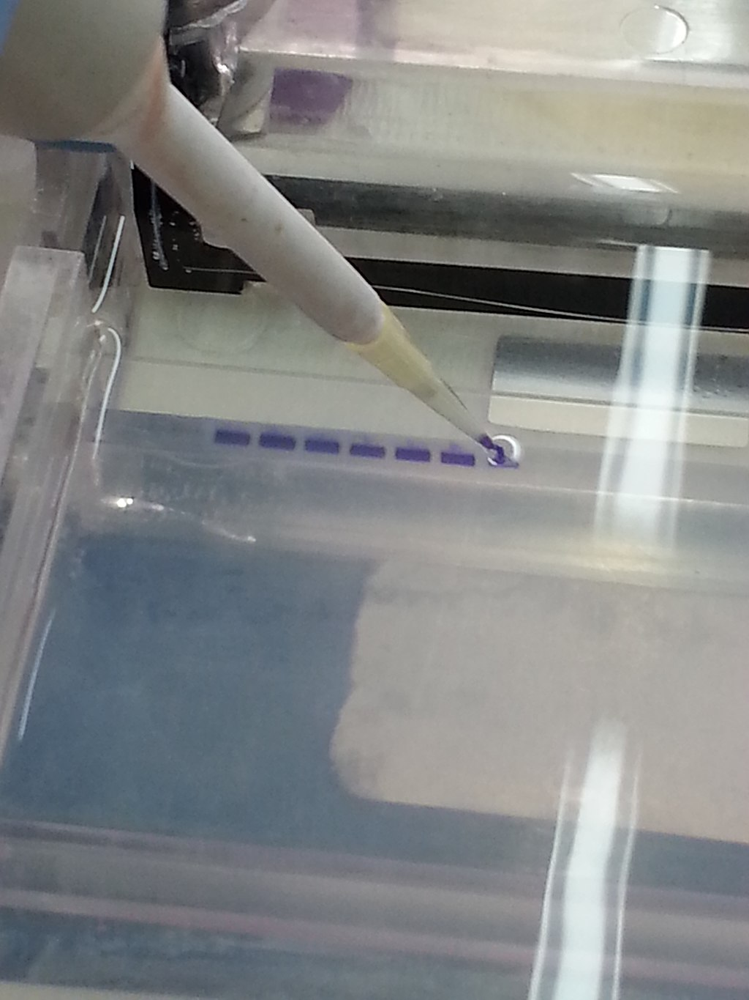
Remember, your table is an electrophoresis apparatus!
https://commons.wikimedia.org/wiki/File:Loading_DNA_sample_into_to_agarose_gel_electrophoresis.jpg

Slide 49
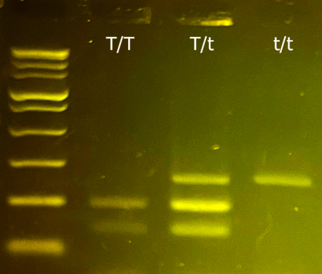
https://www.minipcr.com/product/minipcr-genotype-to-phenotype-ptc-taster-lab/

Slide 50
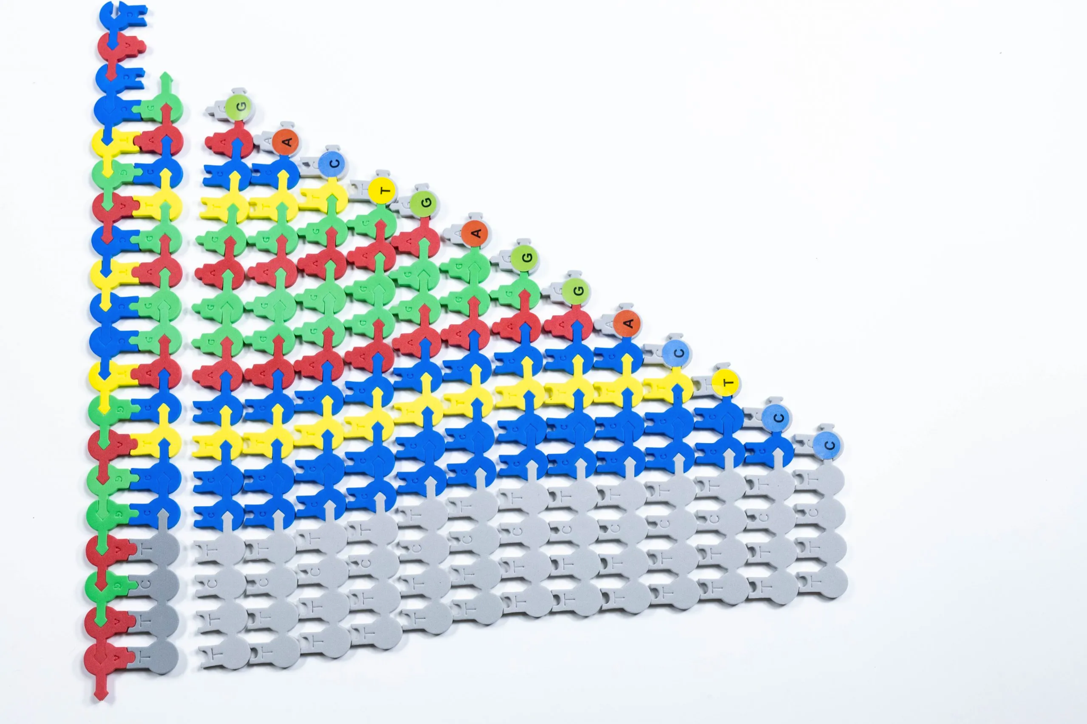
Sanger Sequencing

Slide 51
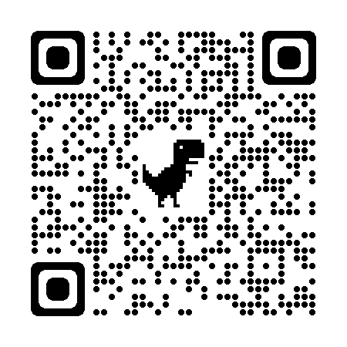
Summer Courses!

Slide 52

THANK YOU!!
Remember the conference discount code: SC23
Keri Shingleton
kerishingleton@gmail.com

Slide 53

Scan this code for a chance to win a $250 gift certificate to 3D Molecular Designs!

