Slide 1
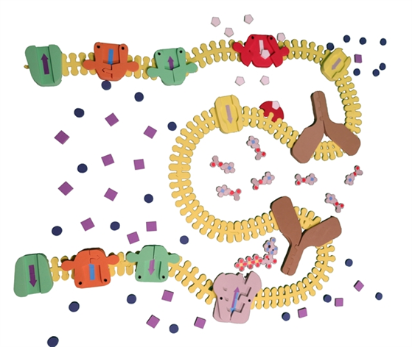
When Cells Talk
Things Happen
The Synapse Construction Kit

Slide 2
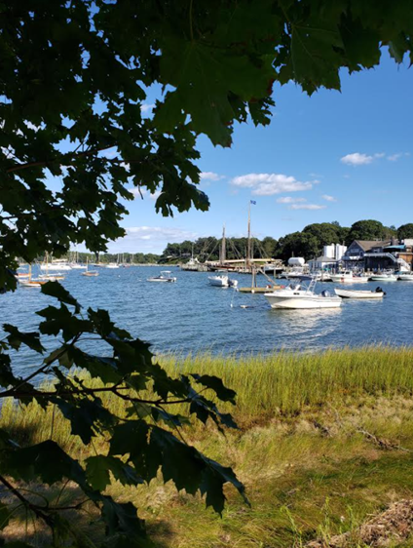





Dan Williams
BS, MA Biology
High School Teacher
NYS Master Teacher
Biology SAR - STANYS Suffolk
Dan.Williams@shelterisland.k12.ny.us
@Willida25

Slide 3
Workshop Learning Goals
1. What makes a good model?
2. What can we learn from the synapse model?
3. What do you find difficult when you are teaching about cell interactions?
4. Where do multidimensional models help with this topic?
5. How can you show cell communication, synapses, disruptions of communication between cells and signal transduction using this model?

Slide 4
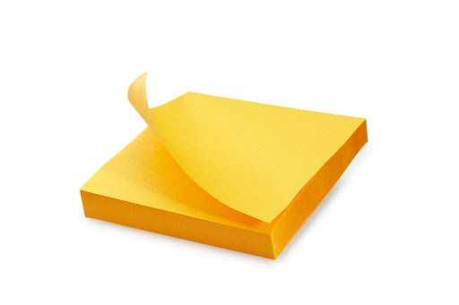
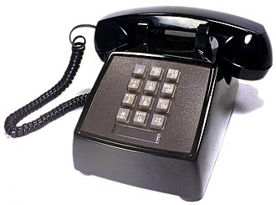
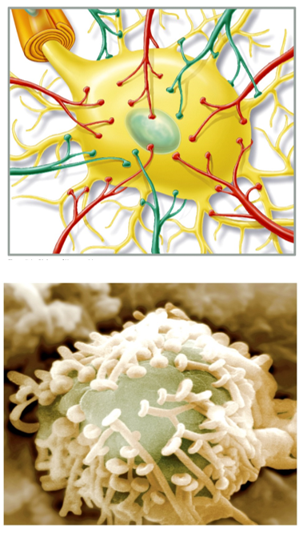
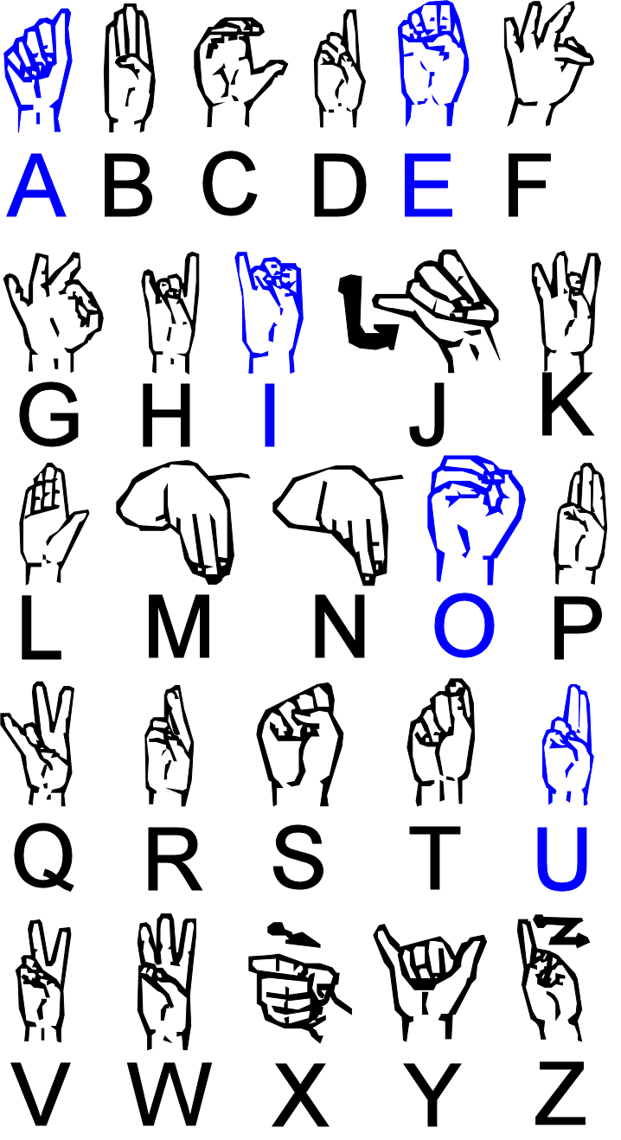


Slide 5
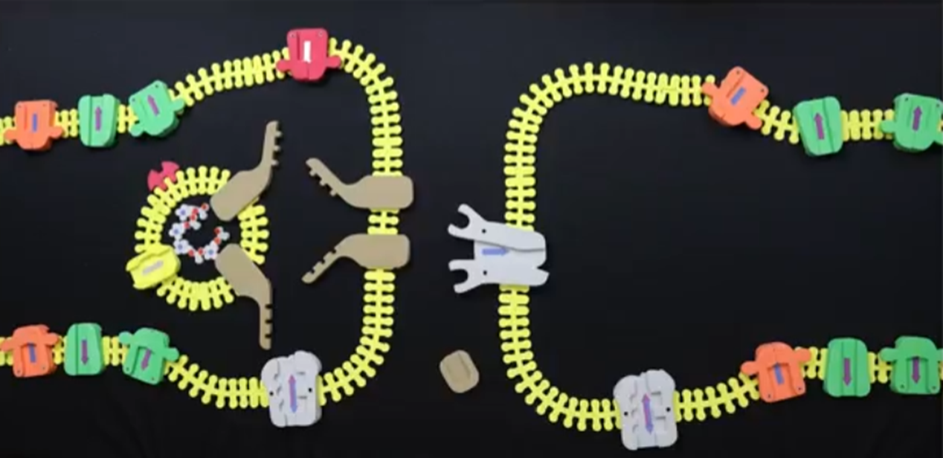
Synapse Kit -Overview

Slide 6
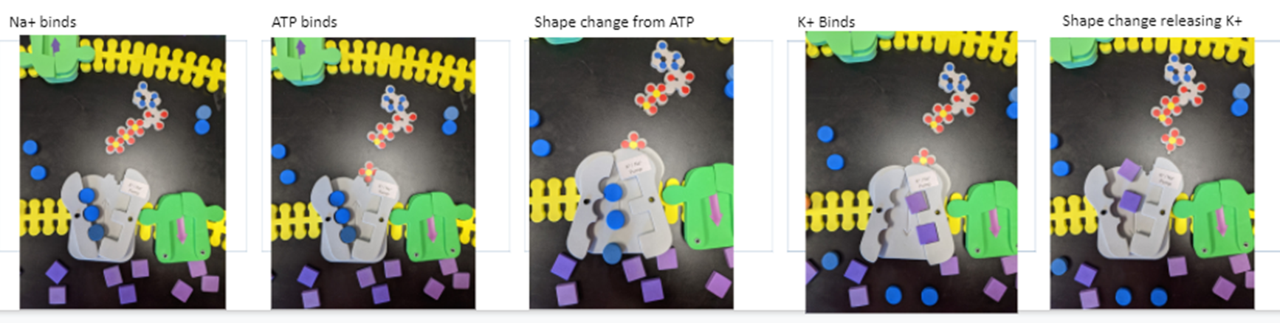
Na⁺/K⁺ Pump –the best ATP Mediated shape change model example!

Slide 7
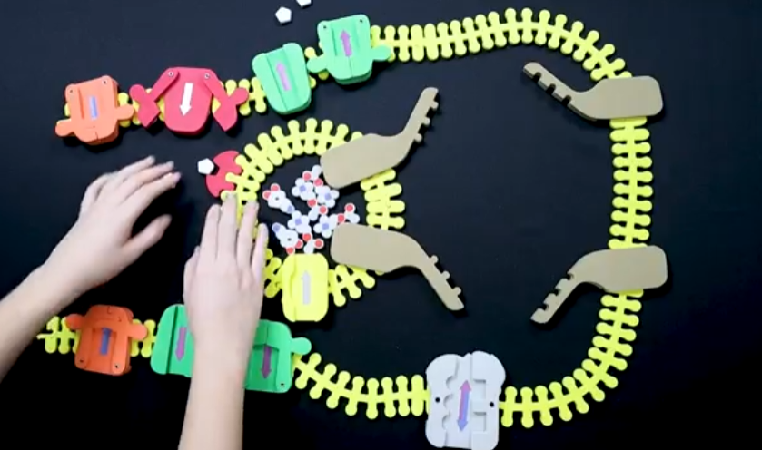
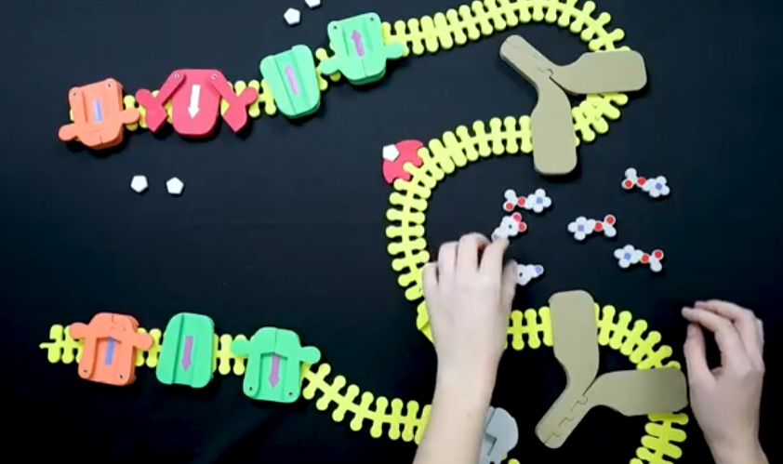
Cell to Cell Communication –Pre Synapse

Slide 8
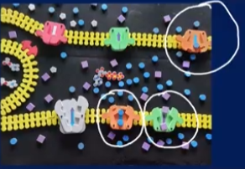
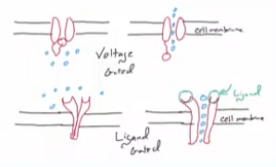
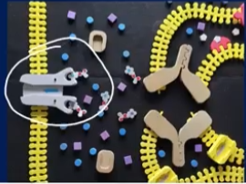
Voltage vs. Ligand Gated –Post Synapse

Slide 9
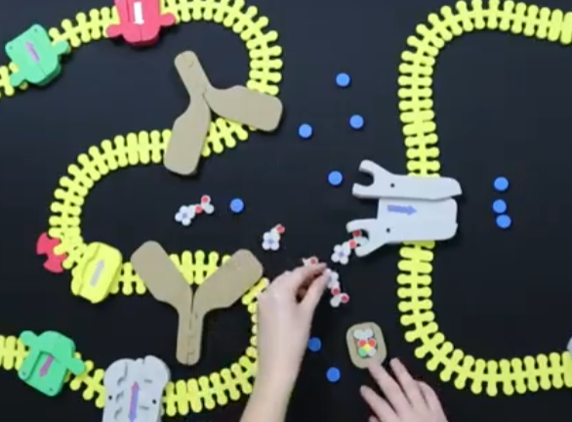
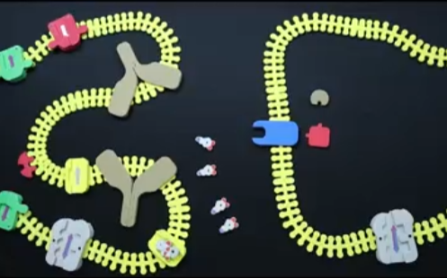
Messing up the Synapse

Slide 10
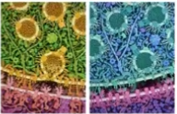

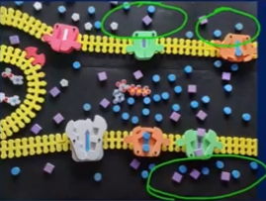
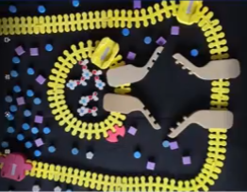
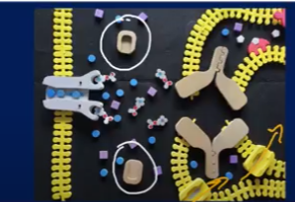
Student Questions

Slide 11
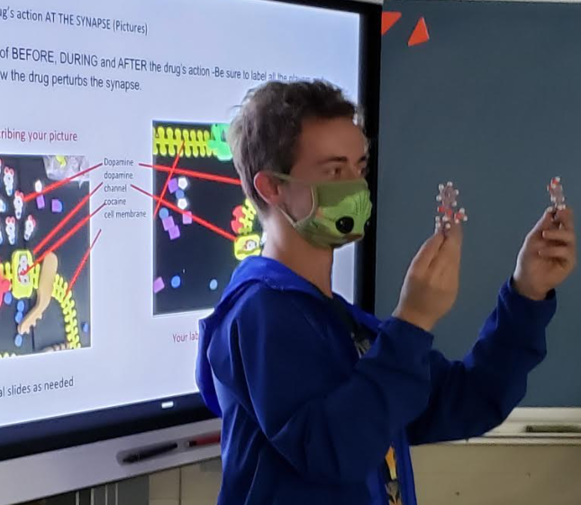
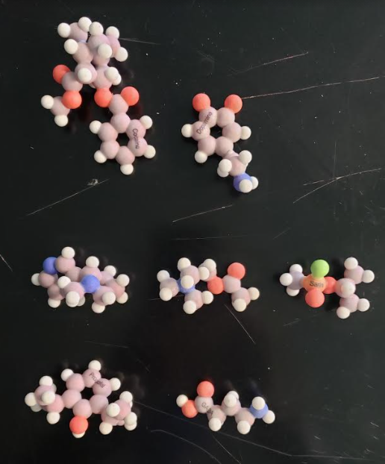
Making Claims

Slide 12
Workshop NGSS Connections
(and/or other applicable standards)
SEPs | CCCs | DCIs
Asking Questions and Defining Problems | Patterns | LS1.A: Structure and Function
Developing and Using Models | Cause and Effect: Mechanism and Explanation
Constructing Explanations and Designing Solutions | Scale, Proportion, and Quantity
Engaging in Argument from Evidence | Structure and Function
Analyzing and Interpreting Data | Stability and Change

Slide 13
Thank you!
Visit us at booth 1600
Dan.Williams@shelterisland.k12.ny.us
@Willida25

Slide 14
