Slide 1
Unwinding the Complexities of the Central Dogma
The Flow of Genetic Information

Slide 2
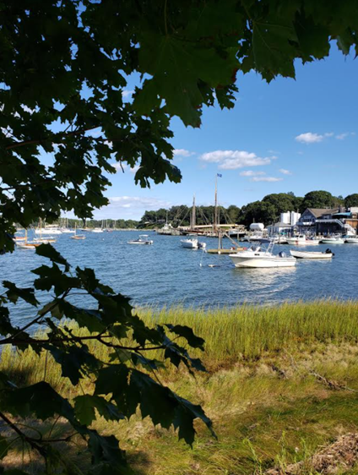





Dan Williams
BS, MA Biology
High School Teacher
NYS Master Teacher
Biology SAR - STANYS Suffolk
Dan.Williams@shelterisland.k12.ny.us
@Willida25

Slide 3
Workshop Learning Goals
1. What makes a good model?
2. What can we learn from the Flow of Genetic Information Kit?
3. What do you find difficult when you are teaching about ‘the central dogma’?
4. Where do multidimensional models help with this topic?
5. How can you show DNA Synthesis, Transcription and Translation?

Slide 4
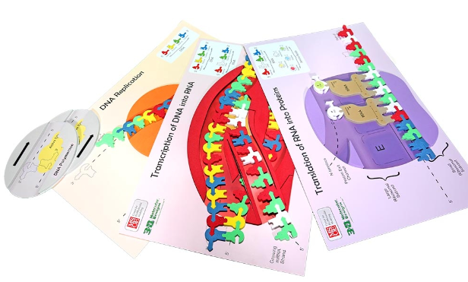
The Central Dogma

Slide 5
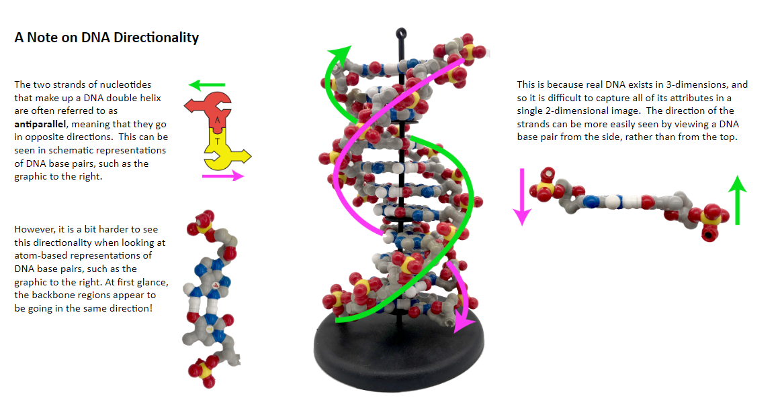

Slide 6
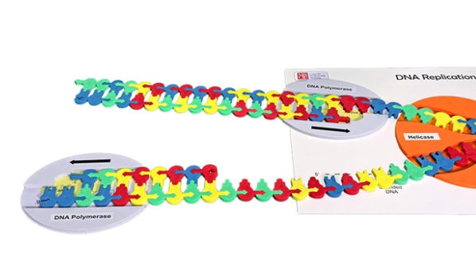
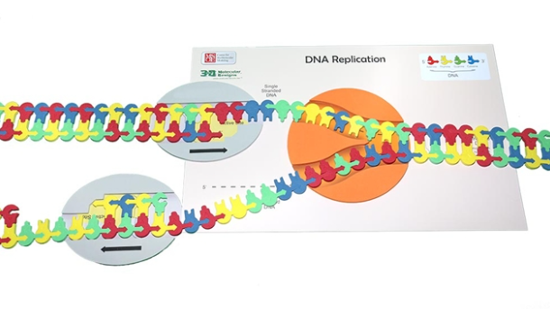
DNA Replication

Slide 7
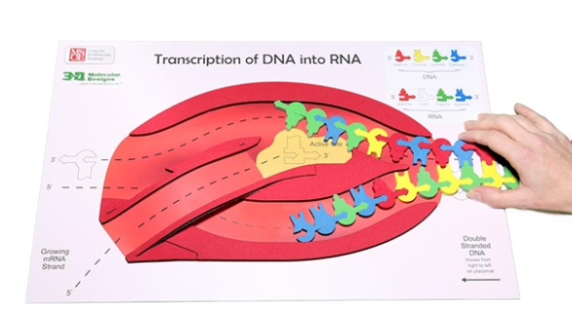
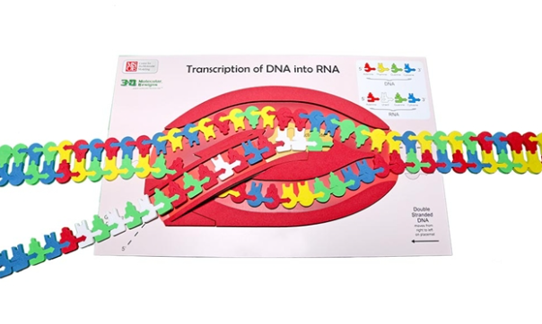
Transcription

Slide 8
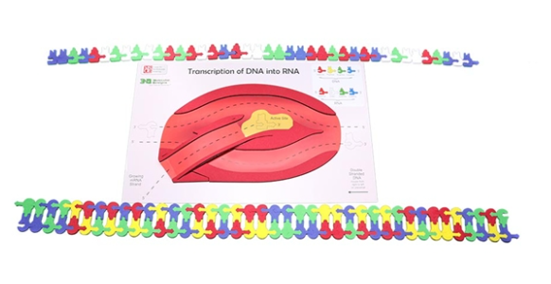
Model Enhancements?

Slide 9
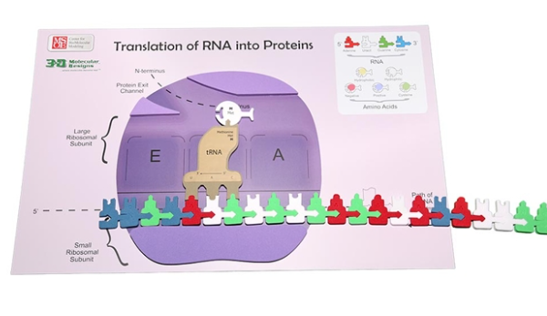
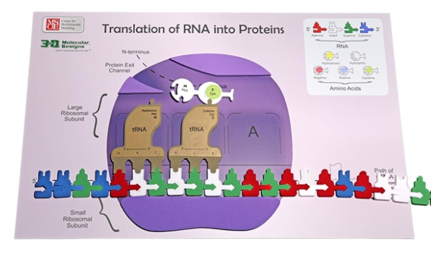
Translation

Slide 10
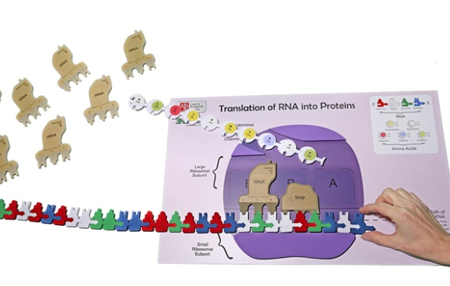

Slide 11
Workshop NGSS Connections
(and/or other applicable standards)
SEPs | CCCs | DCIs
Asking Questions and Defining Problems | Patterns | LS1.A: Structure and Function
Developing and Using Models | Cause and Effect: Mechanism and Explanation
Constructing Explanations and Designing Solutions | Scale, Proportion, and Quantity
Engaging in Argument from Evidence | Structure and Function
Analyzing and Interpreting Data | Stability and Change

Slide 12
Thank you!
Visit us at booth 1600
Dan.Williams@shelterisland.k12.ny.us
@Willida25

Slide 13


