Slide 1
Folding and Molding
Hands-on Protein Structure

Slide 2
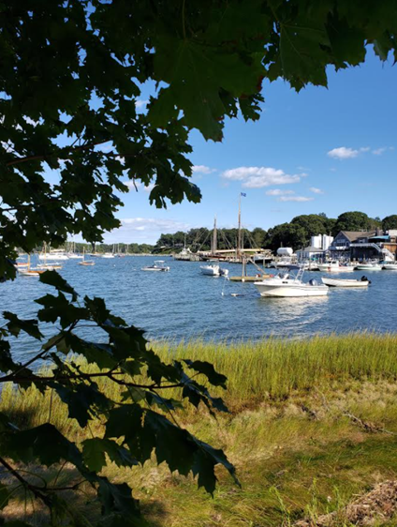





Dan Williams
BS, MA Biology
High School Teacher
NYS Master Teacher
Biology SAR - STANYS Suffolk
Dan.Williams@shelterisland.k12.ny.us
@Willida25

Slide 3
Workshop Learning Goals
1. What makes a good model?
2. What can we learn from the Amino Acid Starter Kit?
3. What do you find difficult when you are teaching about protein structure/function?
4. Where do multidimensional models help with this topic?
5. How can you show protein chemistry, how shape influences function and how mutations change function with this model?

Slide 4
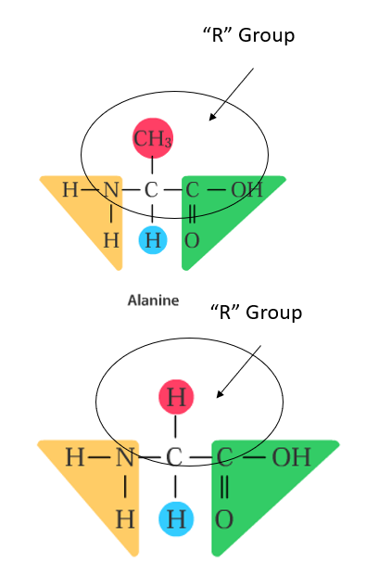
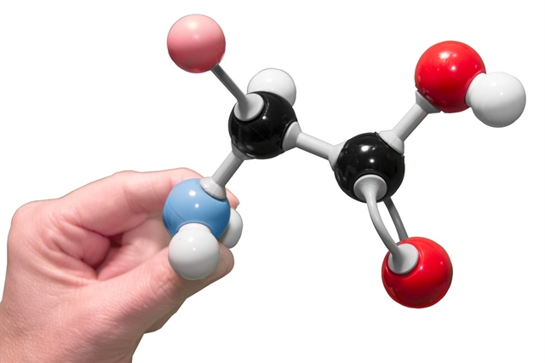
Amino Acids
Each amino Acid has a different “R” Group.
Different elements at the “R” group provide Amino Acids with different shapes.
There are 20 different Amino Acids. –Like an alphabet of 20 letters, these amino acids make the protein “words”

Slide 5
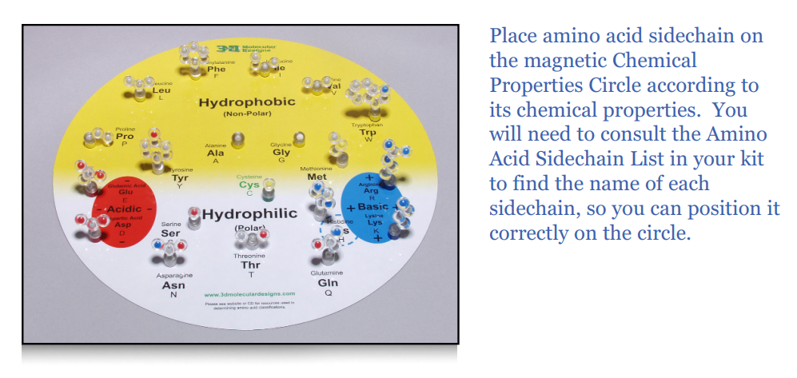

Slide 6
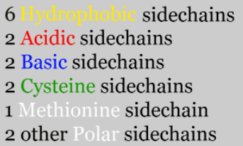
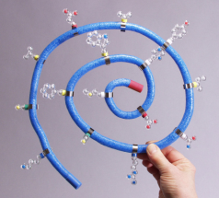
Build your own protein

Slide 7
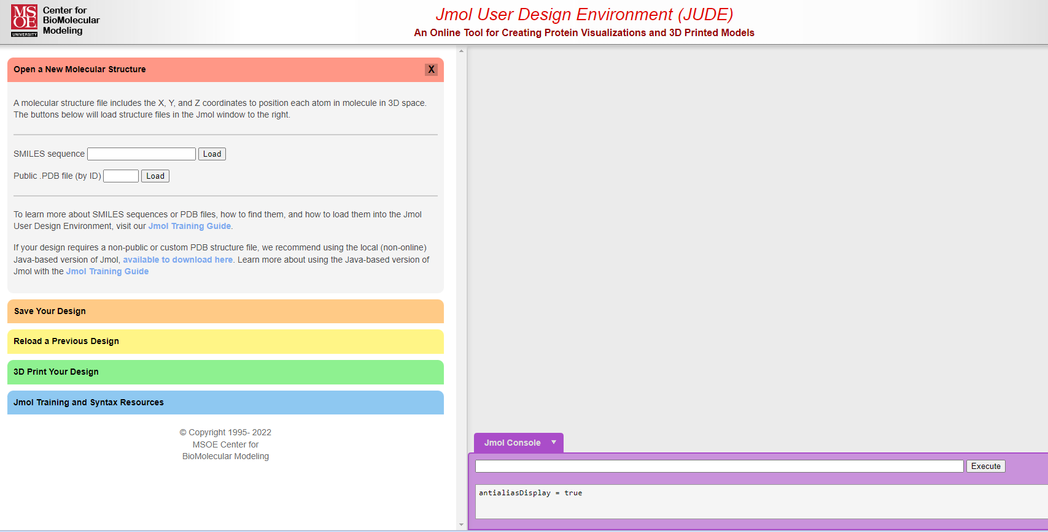
Explore ANY Structure!

Slide 8
Workshop NGSS Connections
(and/or other applicable standards)
SEPs | CCCs | DCIs
Asking Questions and Defining Problems | Patterns | LS1.A: Structure and Function
Developing and Using Models | Cause and Effect: Mechanism and Explanation
Constructing Explanations and Designing Solutions | Scale, Proportion, and Quantity
Engaging in Argument from Evidence | Structure and Function
Analyzing and Interpreting Data | Stability and Change

Slide 9
Thank you!
Visit us at booth 1600
Dan.Williams@shelterisland.k12.ny.us
@Willida25

Slide 10


