Slide 1
DNA with a Twist: Use of Multiple Models in the Classroom
Keri Shingleton, Ph.D.
Notes:
Saturday 10:30 AM

Slide 2
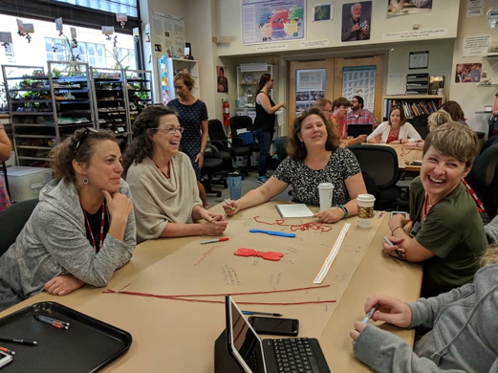



Who am I?
Who am I?

Slide 3
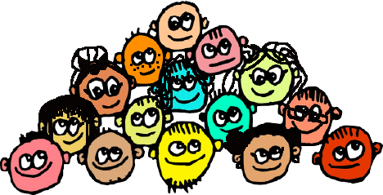
Who are you?

Slide 4
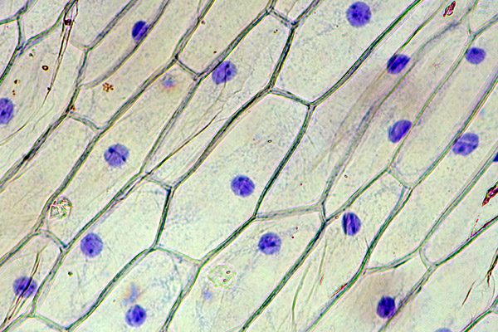
DNA UNDER A MICROSCOPE
http://www.microbehunter.com/wp/wp-content/uploads/2009/onion1.jpg
Notes:
This image is perhaps the best we can expect our students to see on a slide they prepared with the limitations of light microscopy… it’s a big leap to go from this image of DNA to the molecular structure of DNA. For our students, this immensely abstract. So how to we always teach about the structure of DNA We use…..
This might be a big leap for our students… but let’s start with the molecular structure of DNA.

Slide 5
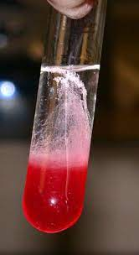
DNA UNDER A MICROSCOPE
OR IN A TEST TUBE
http://www.microbehunter.com/wp/wp-content/uploads/2009/onion1.jpg
https://www.instructables.com/Extracting-DNA-from-Strawberries/
Notes:
This image is perhaps the best we can expect our students to see on a slide they prepared with the limitations of light microscopy… it’s a big leap to go from this image of DNA to the molecular structure of DNA. For our students, this immensely abstract. So how to we always teach about the structure of DNA We use…..
This might be a big leap for our students… but let’s start with the molecular structure of DNA.

Slide 6
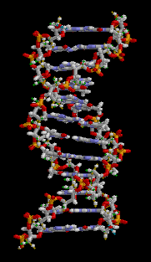
DOESN’T LOOK
LIKE THIS!
DNA UNDER A MICROSCOPE
OR IN A TEST TUBE
http://www.microbehunter.com/wp/wp-content/uploads/2009/onion1.jpg
https://www.instructables.com/Extracting-DNA-from-Strawberries/
Notes:
This image is perhaps the best we can expect our students to see on a slide they prepared with the limitations of light microscopy… it’s a big leap to go from this image of DNA to the molecular structure of DNA. For our students, this immensely abstract. So how to we always teach about the structure of DNA We use…..
This might be a big leap for our students… but let’s start with the molecular structure of DNA.

Slide 7
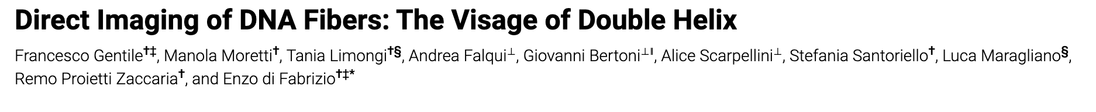
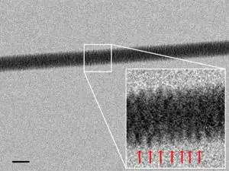
https://pubs.acs.org/doi/10.1021/nl3039162
https://www.newscientist.com/article/dn22545-dna-imaged-with-electron-microscope-for-the-first-time/

Slide 8
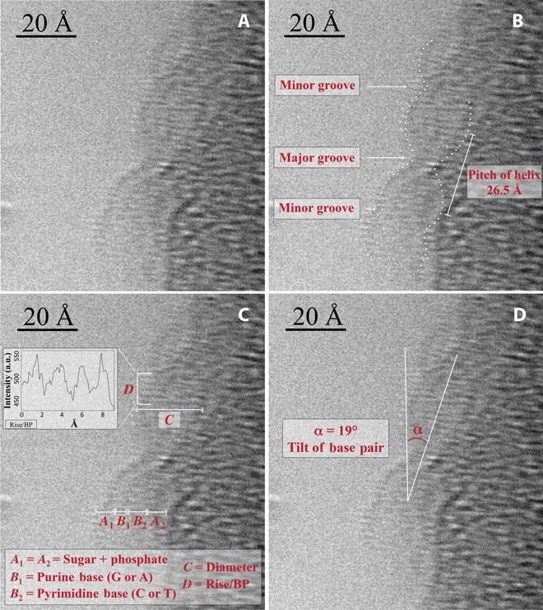
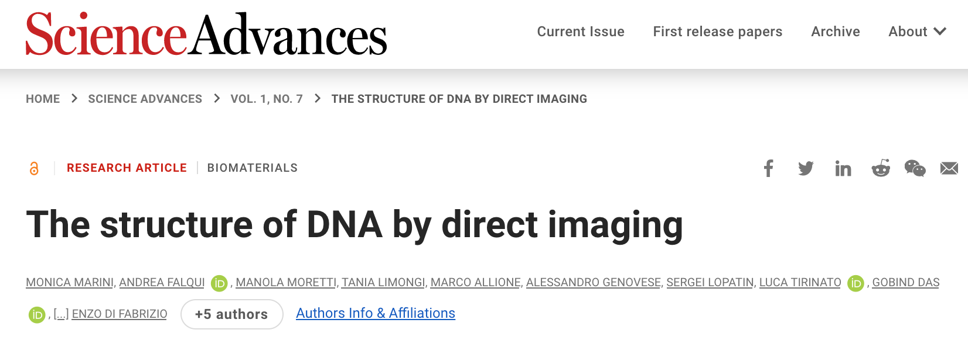
The best we’ve seen… 2015
Notes:
So whether we realize it or not, we are all teaching using models… Why not do it intentionally.

Slide 9
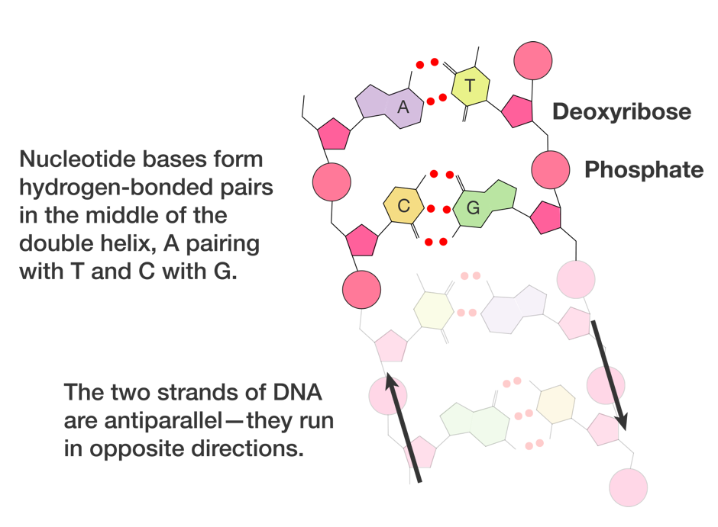
So, whether or not we realize it, we all learned about DNA from models…
From E.O. Wilson, Life on Earth
Notes:
Whether you use your favorite google image or textbook image, draw on your whiteboard, or have a physical model to show your students, as teachers we always use models to teach details of molecules and living systems
All models are designed to tell a story – when we draw images on our boards, we decide what details to include; this is also true for textbook images and any model produced by any company.

Slide 10
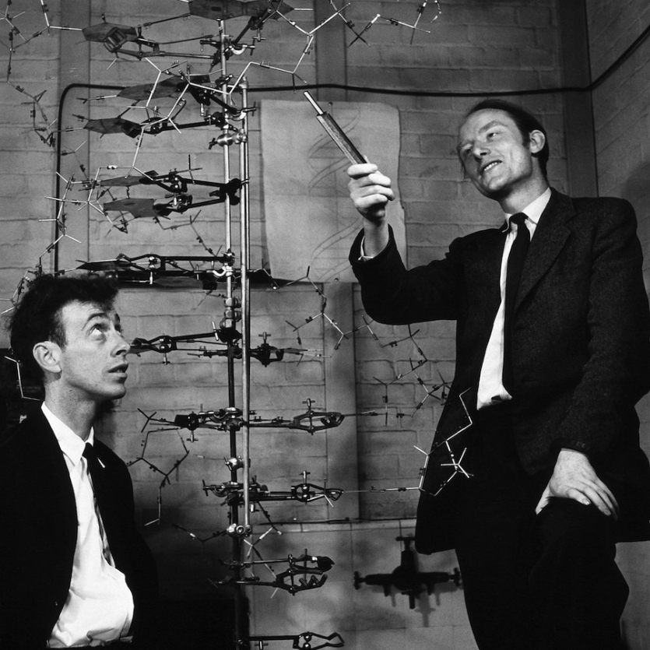
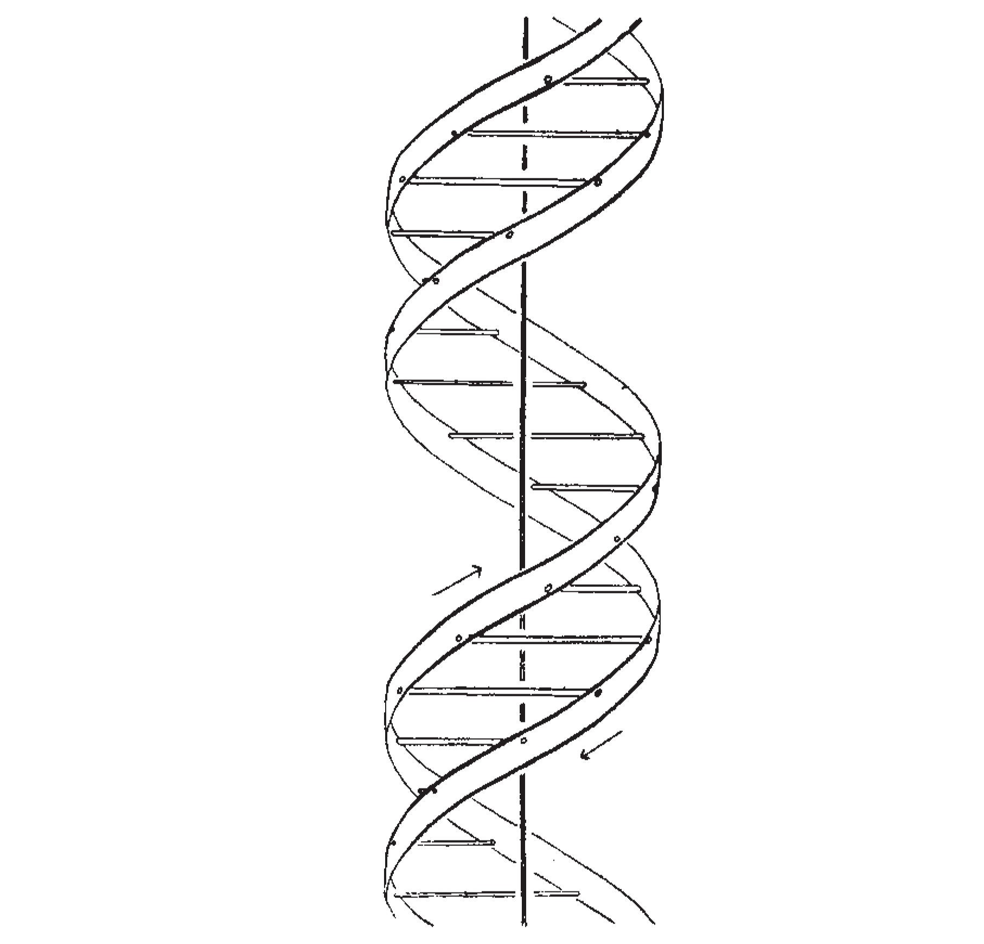
Even Watson and Crick “discovered” the structure of DNA by building a model
https://www.sciencehistory.org/historical-profile/james-watson-francis-crick-maurice-wilkins-and-rosalind-franklin
https://www.nature.com/articles/171737a0

Slide 11
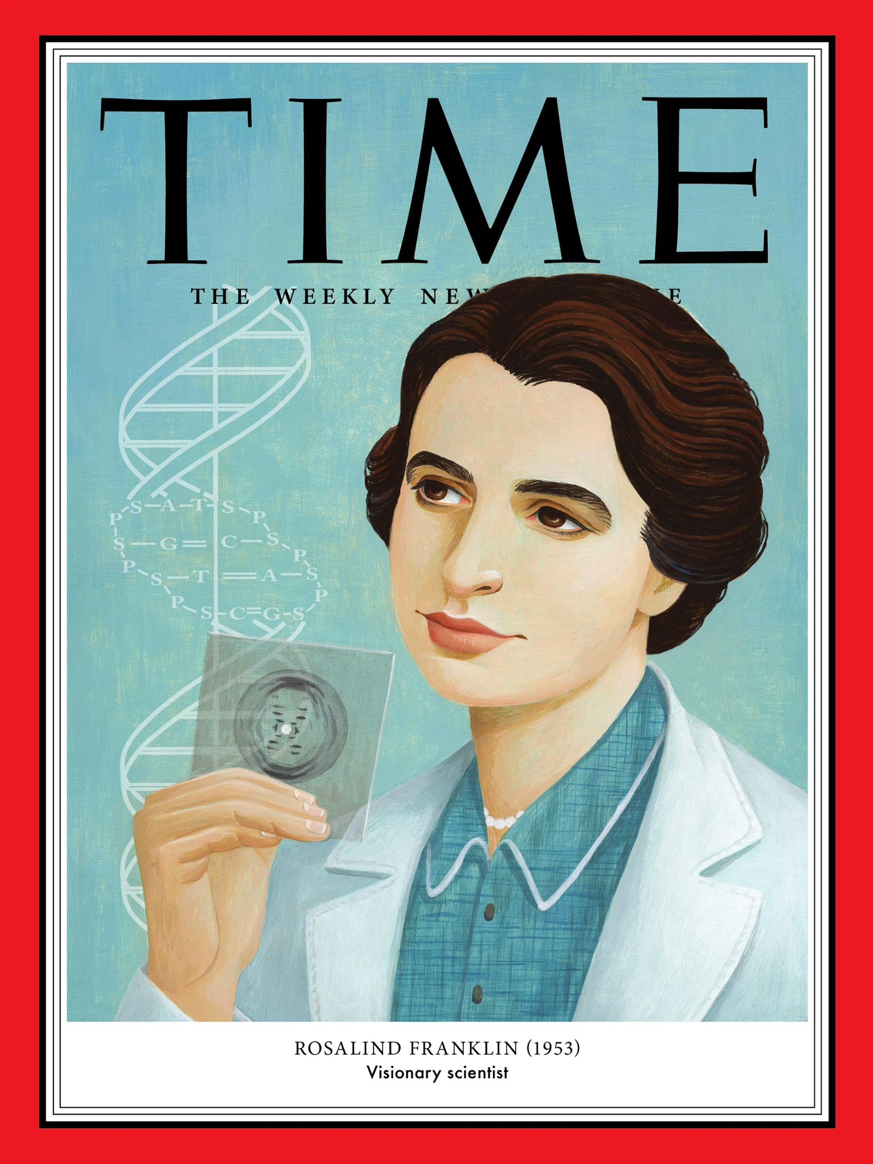
…with a little help from a “friend”
https://time.com/5793551/rosalind-franklin-100-women-of-the-year/

Slide 12
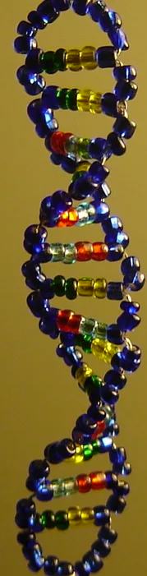
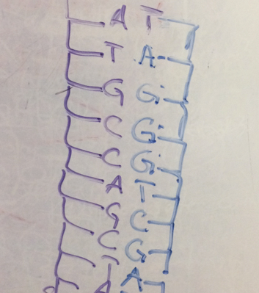
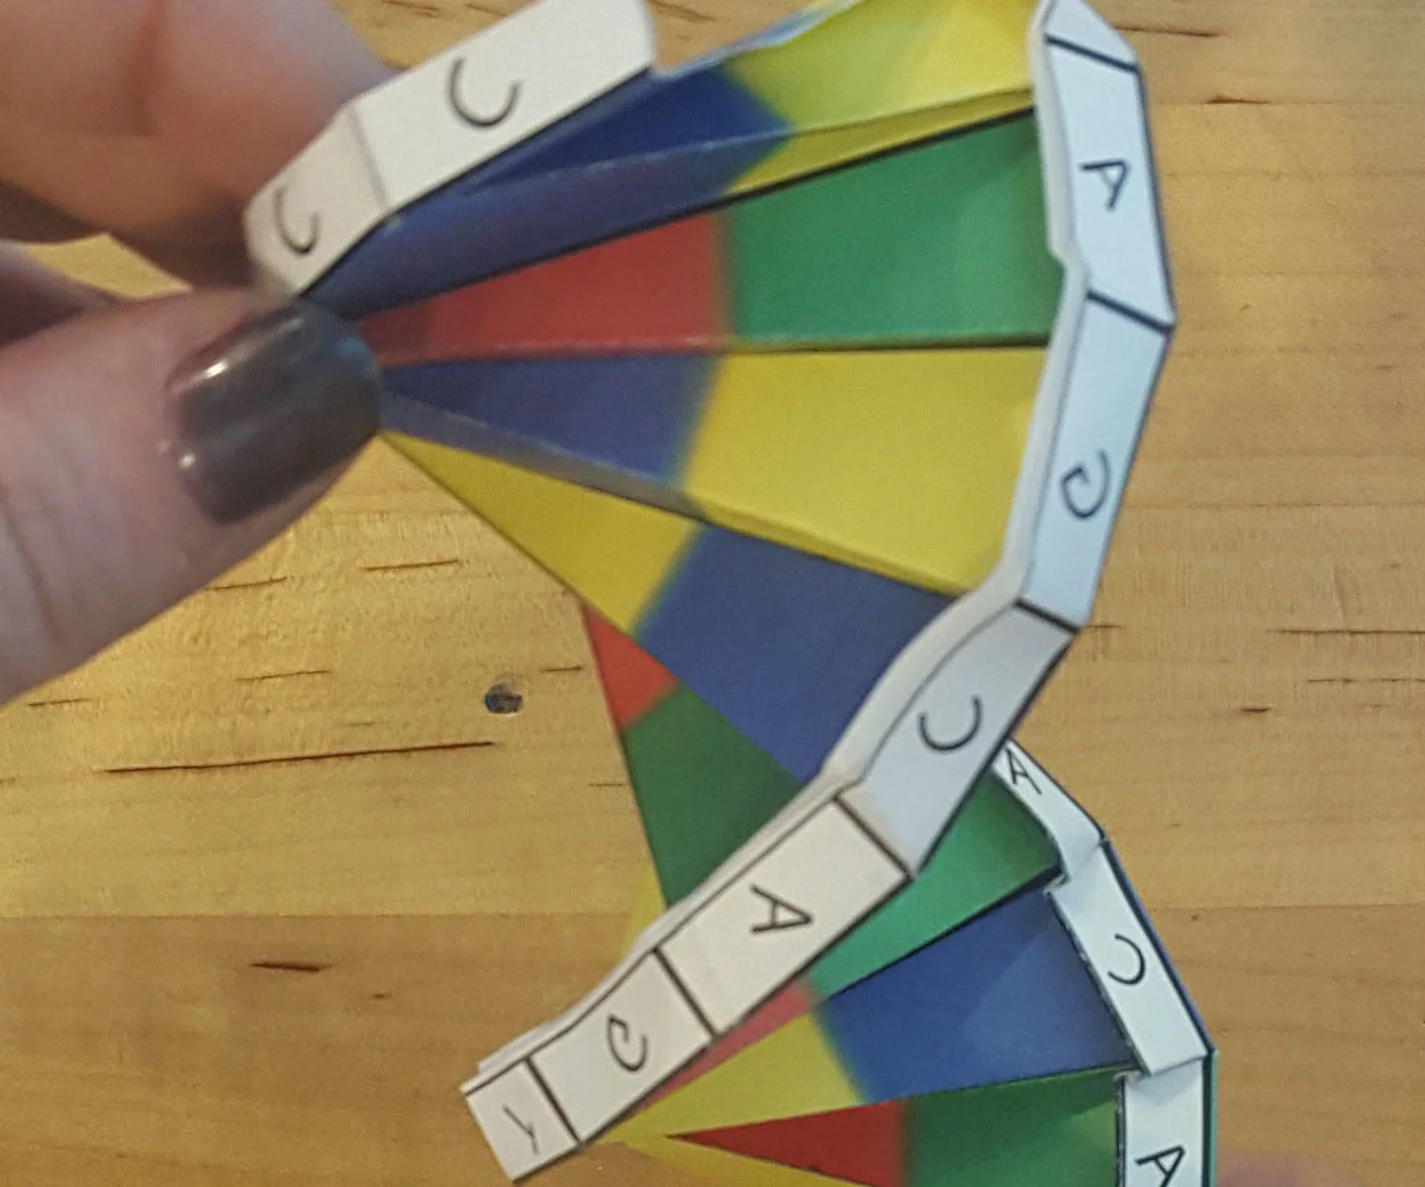
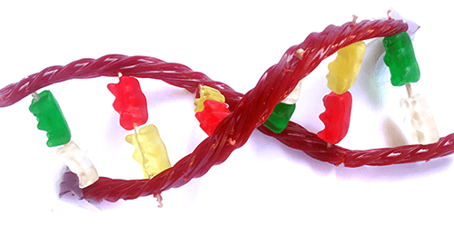
… and we teach with models
https://www.instructables.com/The-Double-Helix-Glass-Bead-DNA-model-V20/
https://www.instructables.com/DNA-Origami/
https://www.sciencebuddies.org/stem-activities/candy-DNA-model
Notes:
Whether you use your favorite google image or textbook image, draw on your whiteboard, or have a physical model to show your students, as teachers we always use models to teach details of molecules and living systems
All models are designed to tell a story – when we draw images on our boards, we decide what details to include; this is also true for textbook images and any model produced by any company.

Slide 13
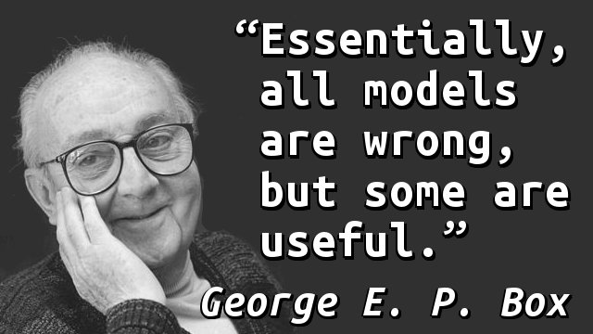
We must be aware of the limitations of the models…
And this conceptions they create…
And the essential information that they include… or exclude…
https://yahooeysblog.wordpress.com/2013/10/18/quote-of-the-day-1062/george-e-p-box-models/

Slide 14
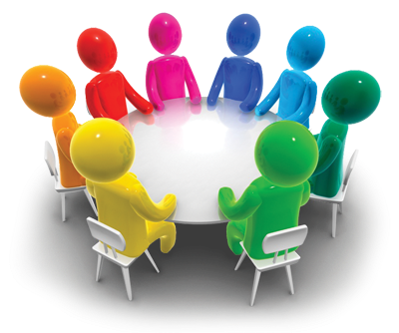
What do our students NEED to know about the structure of DNA, and why?

Slide 15
ATTENDEE RESPONSES:
Notes:
Beta Thalassemia- DNA in the nucleus, gene, premarriage gene test, allows student so know how to manage their lives.
GCAT
MRNA vaccines- effect on DNA?

Slide 16
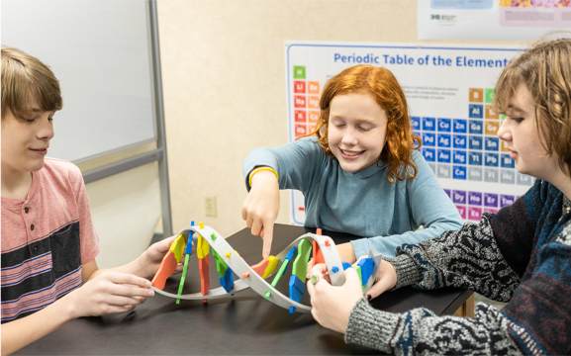
Let’s get our hands busy!
“Based on this model, I see that DNA…”

Slide 17
Let’s get our hands busy!
“Based on this model, I wonder…”

Slide 18
What learning targets have we hit when students interact with just this model?

Slide 19
What are some limitations of this model
(and why do they matter?)

Slide 20
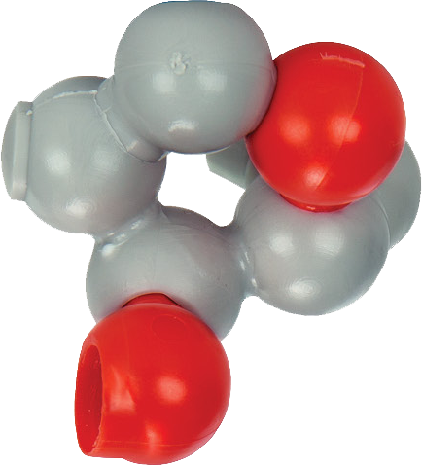
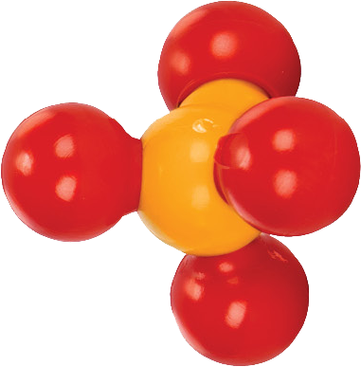
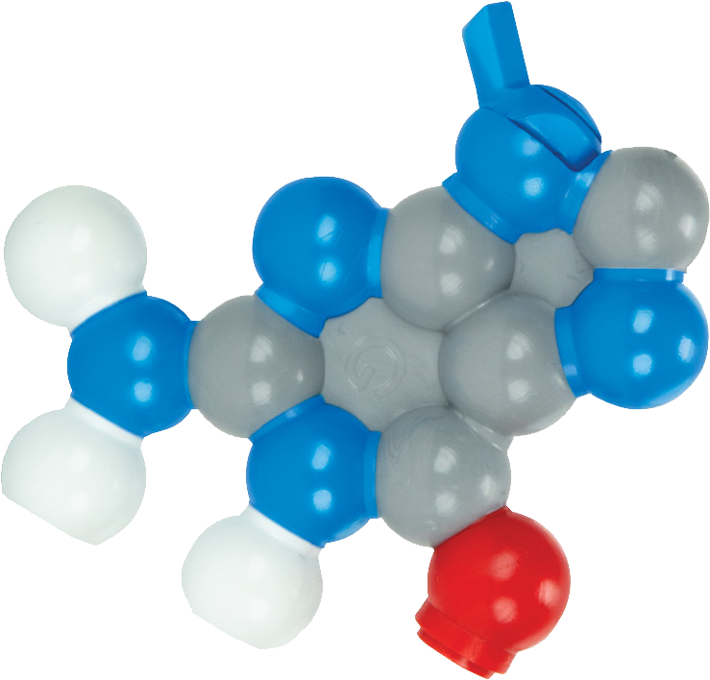

Let’s BUILD some DNA!

Slide 21
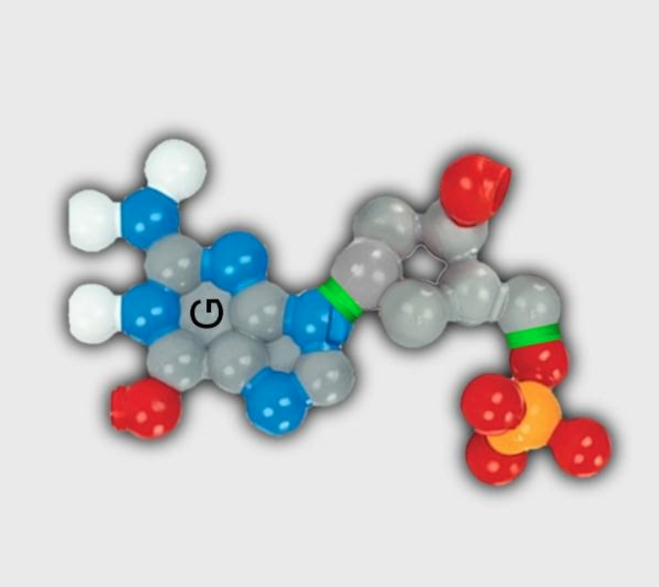
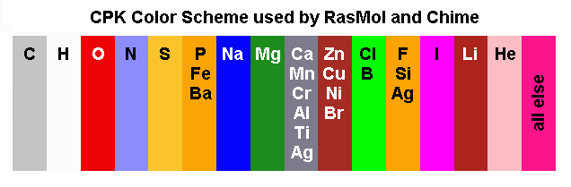
What you have now is a… nucleotide!
https://www.umass.edu/microbio/chime/pe_beta/pe/shared/cpk-rgb.htm

Slide 22

What you have now is a… nucleotide!
Is yours the same as your neighbors?

Slide 23
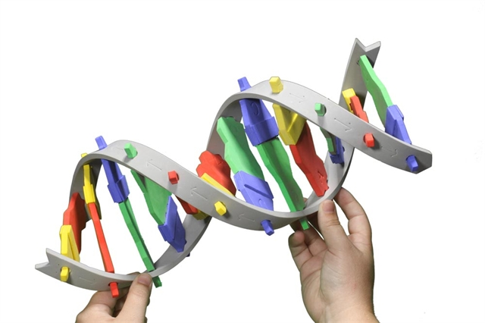
Remember A pairs with T and G pairs with C?

Slide 24
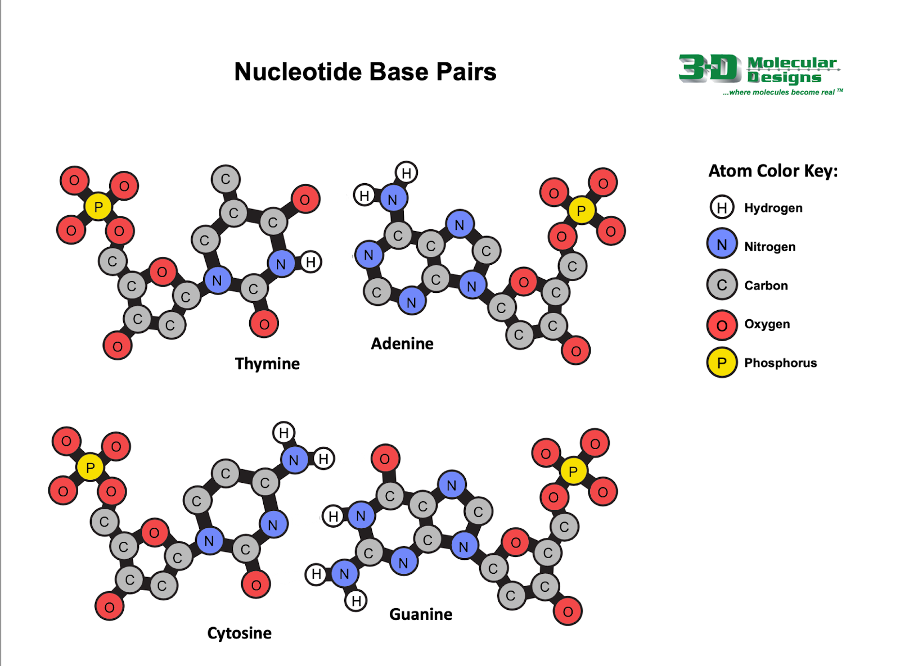

Find your partner / pair!
And this time… use your magnets!

Slide 25
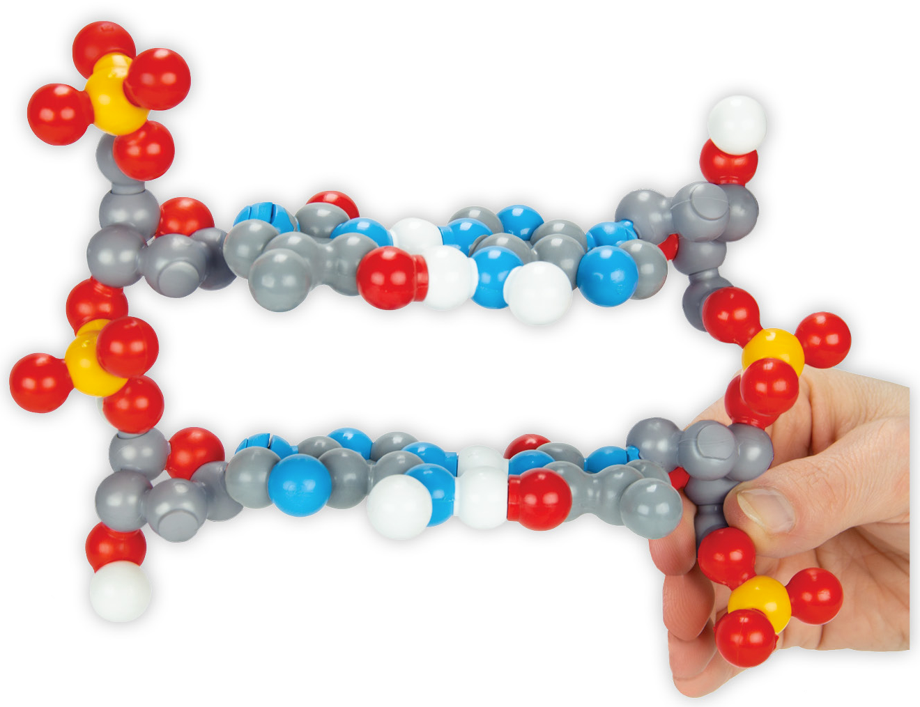
Find another pair… and put yours together!

Slide 26
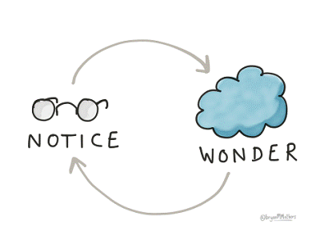
https://atlasabe.org/news/what-do-you-notice-what-do-you-wonder-getting-students-thinking-and-talking-about-math/

Slide 27
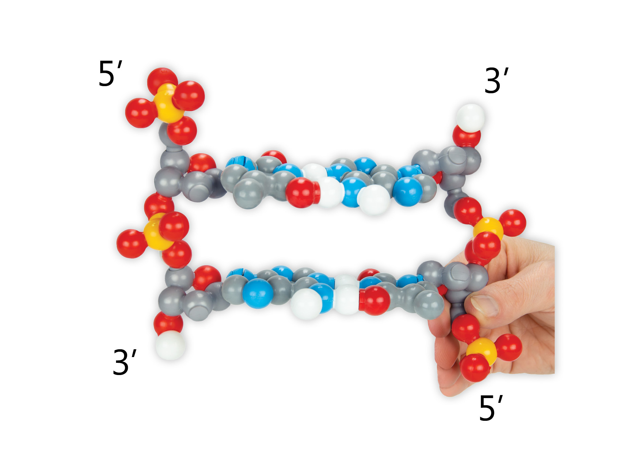
DNA is Antiparallel
1’
5’
2’
3’
4’

Slide 28
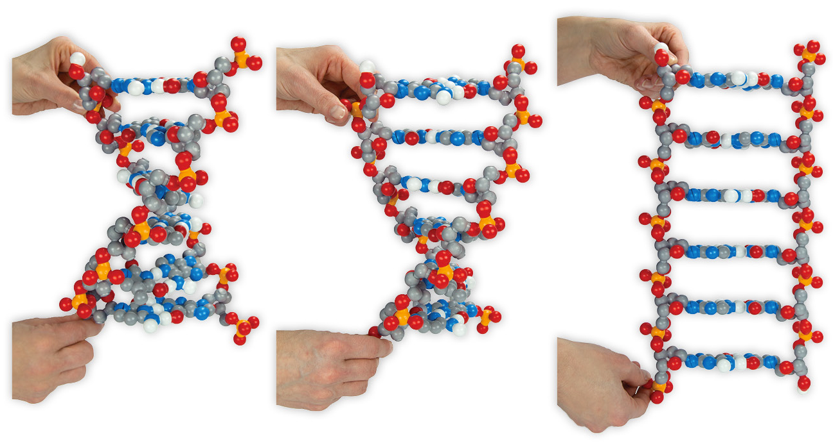
DNA is Flexible

Slide 29
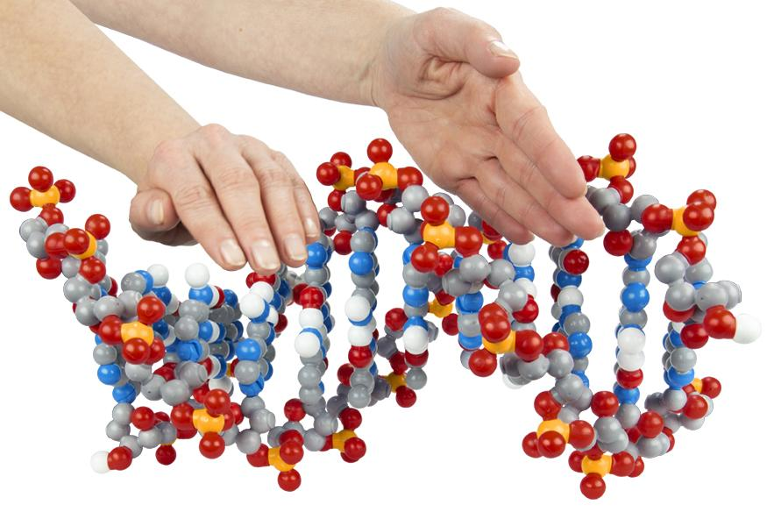
DNA has a major groove… and a minor groove

Slide 30
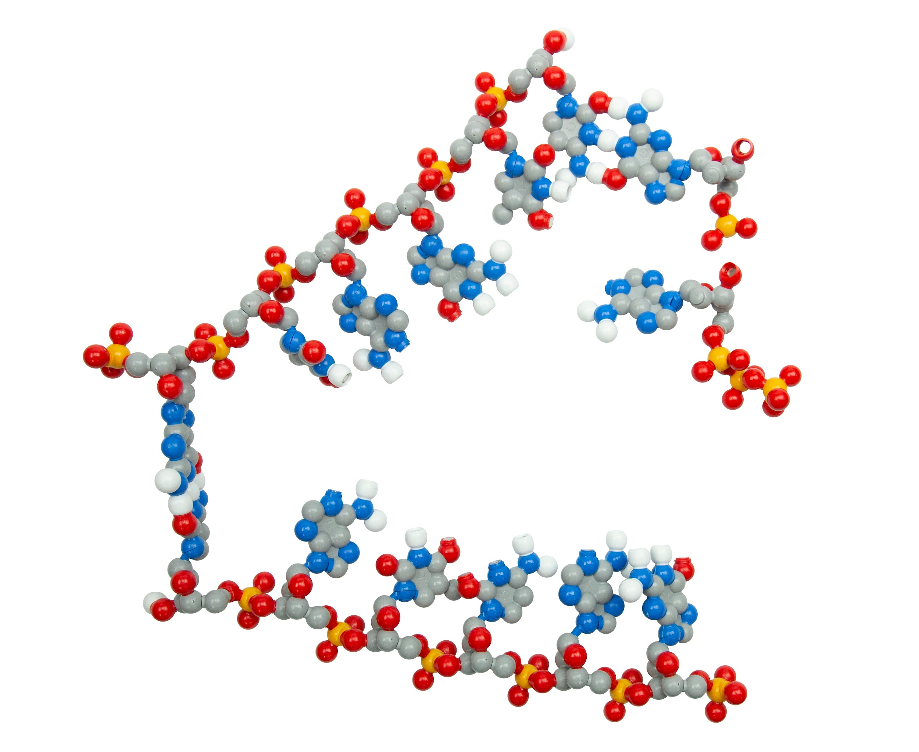
DNA can be replicated!

Slide 31
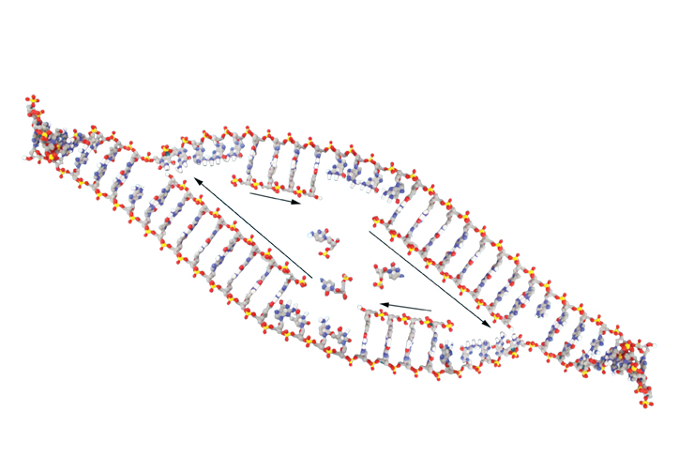
DNA can be replicated!

Slide 32

Wait, this isn’t just DNA!
How does DNA differ from RNA?

Slide 33
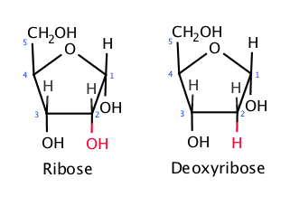
Wait, this isn’t just DNA!
How does DNA differ from RNA?
https://commons.wikimedia.org/wiki/File:The_difference_between_ribose_and_deoxyribose.png

Slide 34
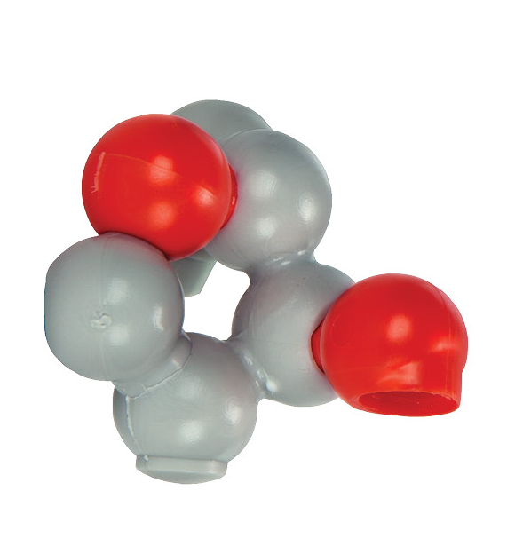
Wait, this isn’t just DNA!
How does DNA differ from RNA?

Slide 35
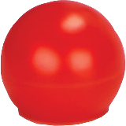
Wait, this isn’t just DNA!
How does DNA differ from RNA?

Slide 36
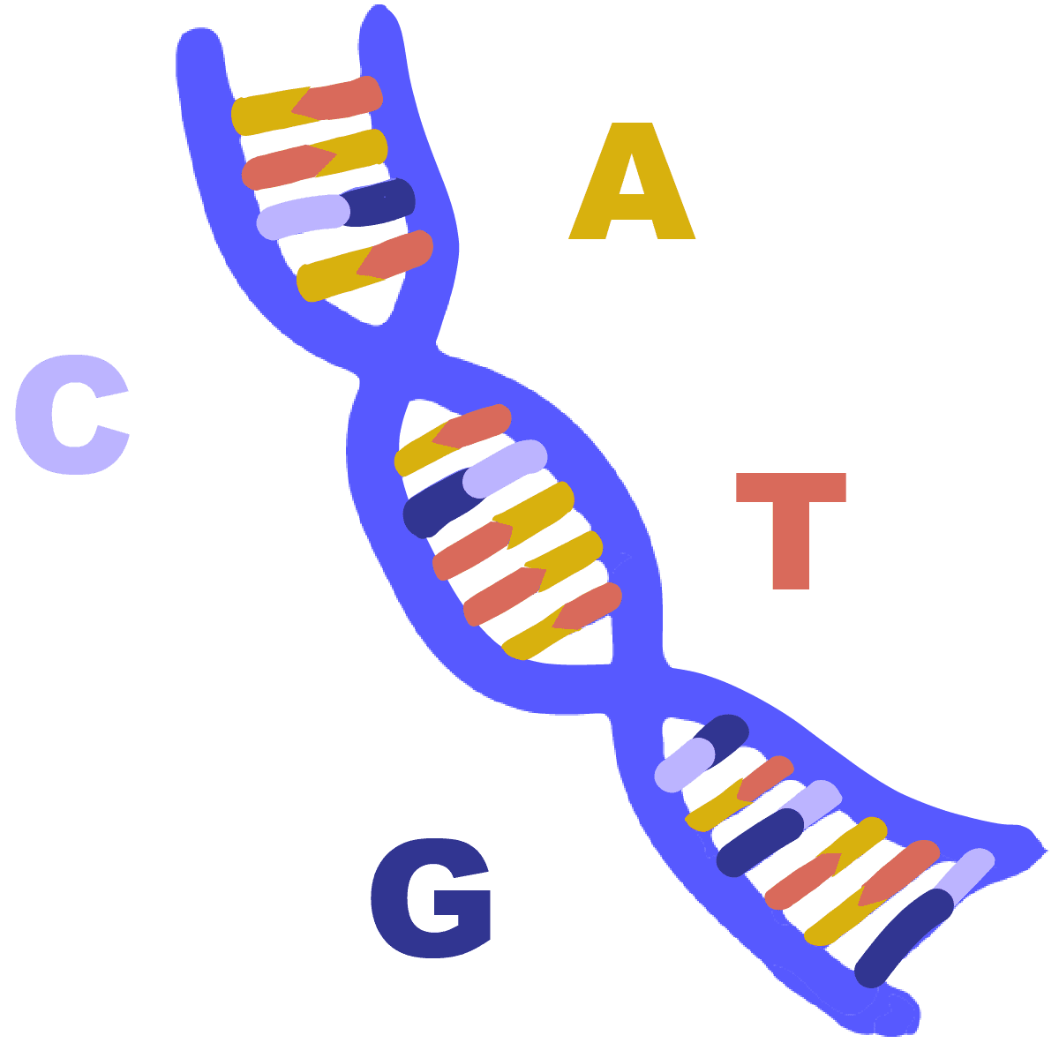
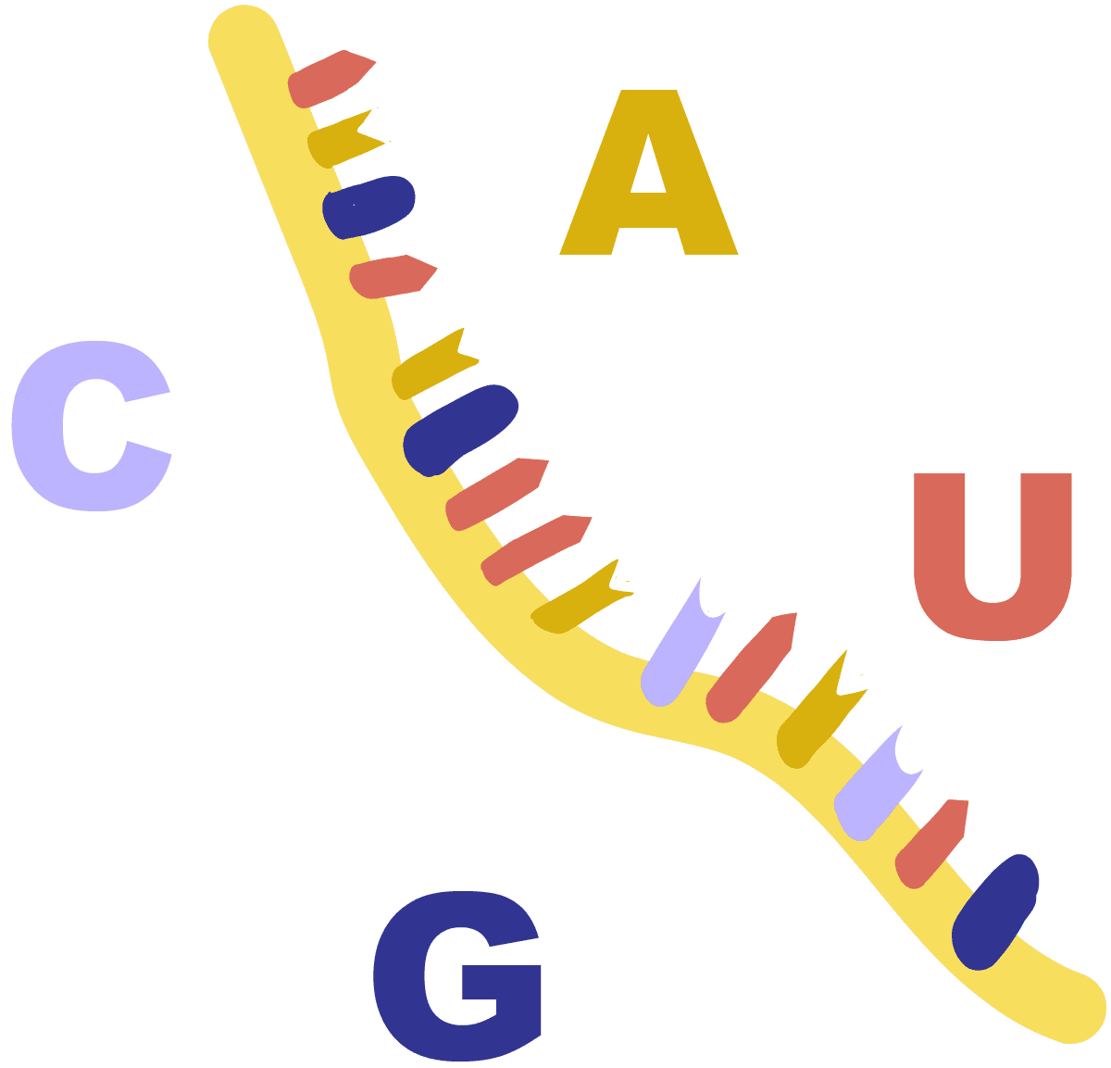
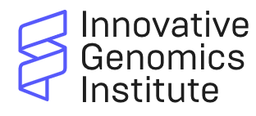
But why U?
https://innovativegenomics.org/glossary/rna/

Slide 37
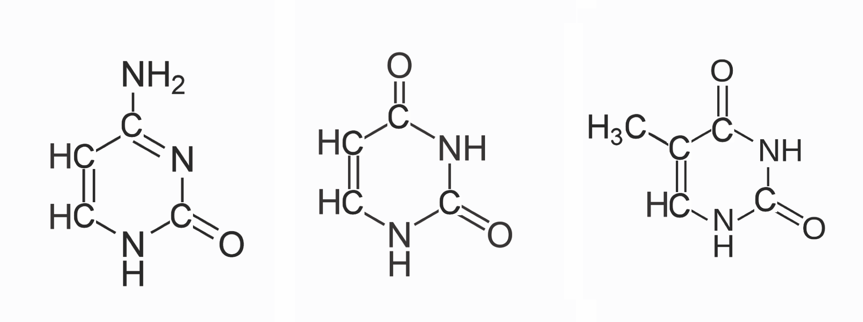
But why U?
The Pyrimidines: cytosine, uracil, and thymine
Cytosine Uracil Thymine

Slide 38
But why U?
Adenine
Adenine
3
3
3
U
T
C
1
1
1

Slide 39
But why U?
Adenine
Adenine
Guanine
3
3
3
U
T
C
1
1
1

Slide 40
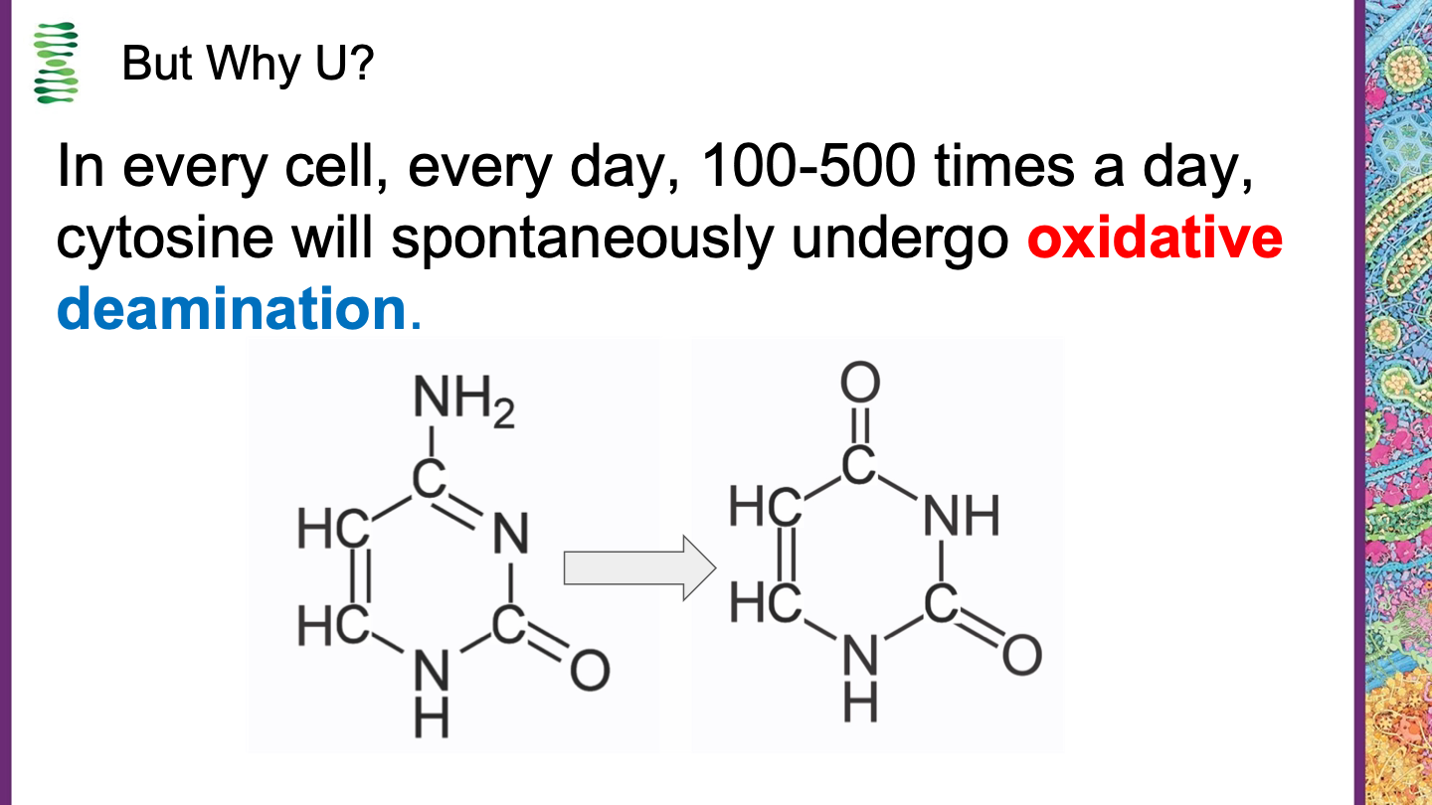
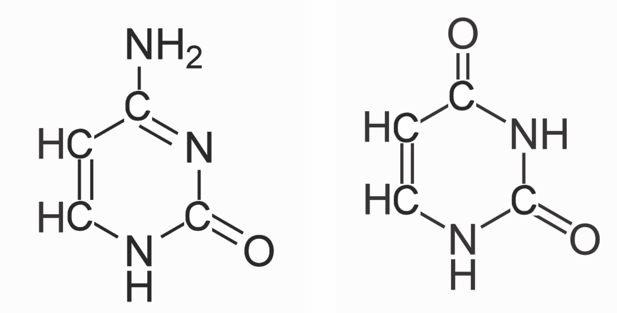
But Why U?
In every cell, every day, 100-500 times a day, cytosine will spontaneously undergo oxidative deamination.

Slide 41
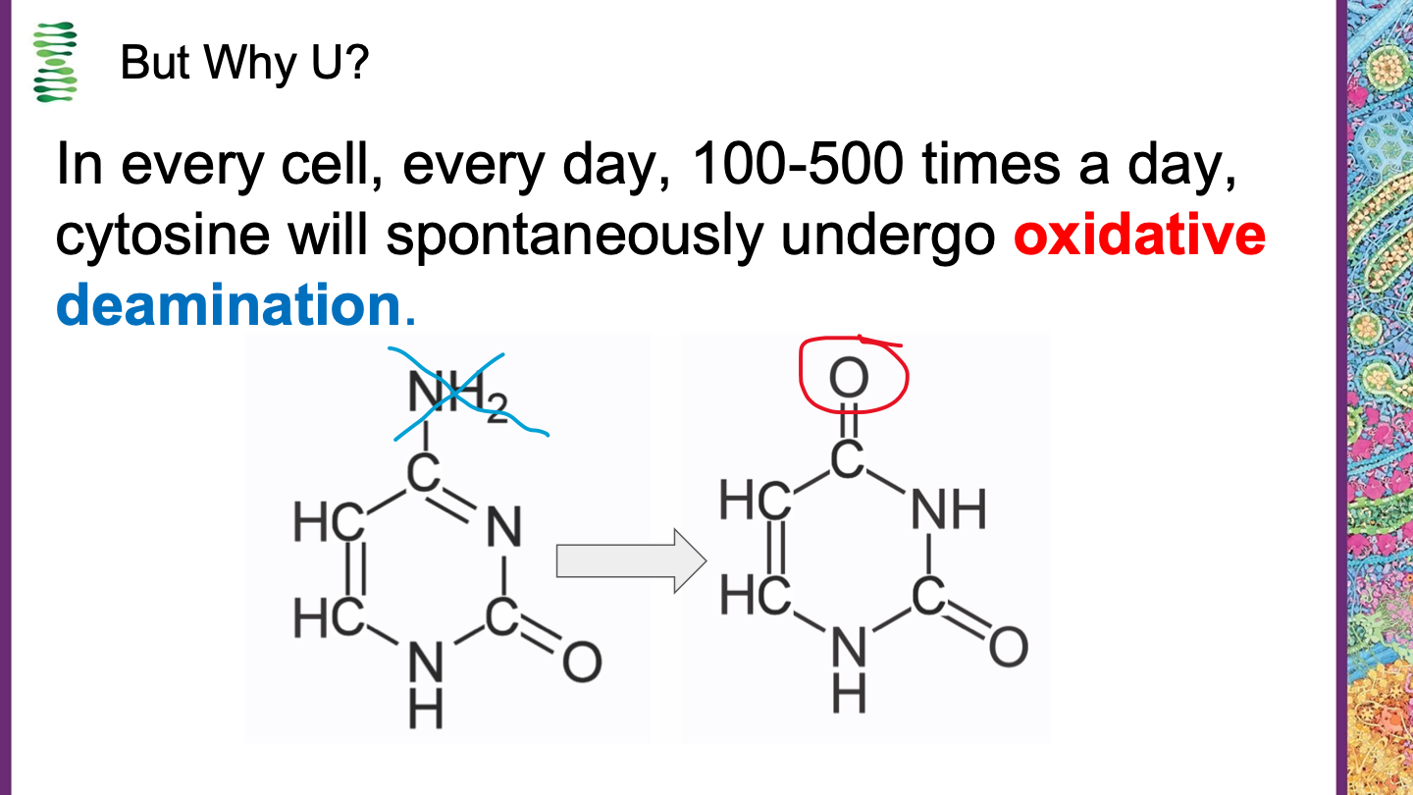
But Why U?
In every cell, every day, 100-500 times a day, cytosine will spontaneously undergo oxidative deamination.
Yikes!
This is uracil!!!

Slide 42
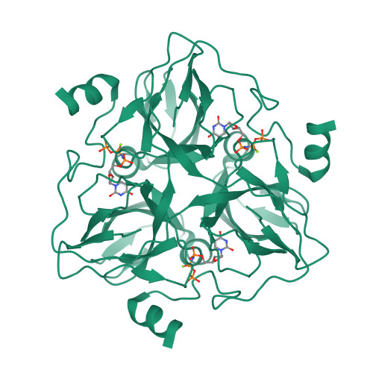
But Why U?
dUTPase to the rescue!
Cytosine
Uracil

Slide 43
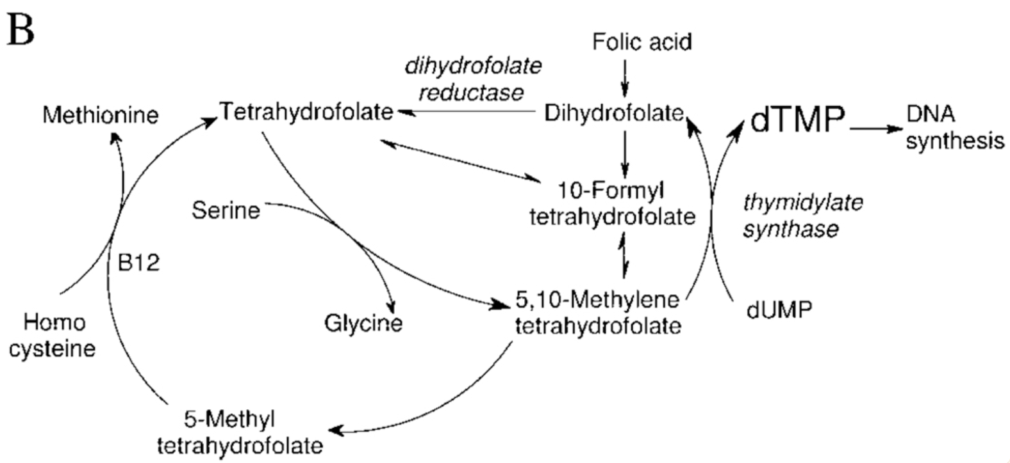
Thymine biosynthesis starts with U and is converted to T!

Slide 44
So the real question is…
Why Thymine?

Slide 45
Back to our model…

Slide 46
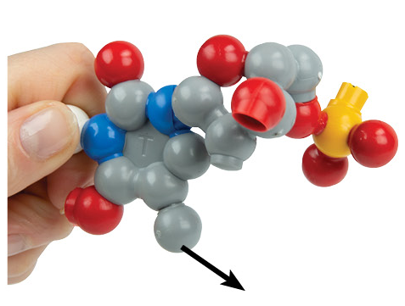
What about U?

Slide 47
What about U?
Remove a methyl from T!!!

Slide 48

What about U?
Remove a methyl from T!!!

Slide 49
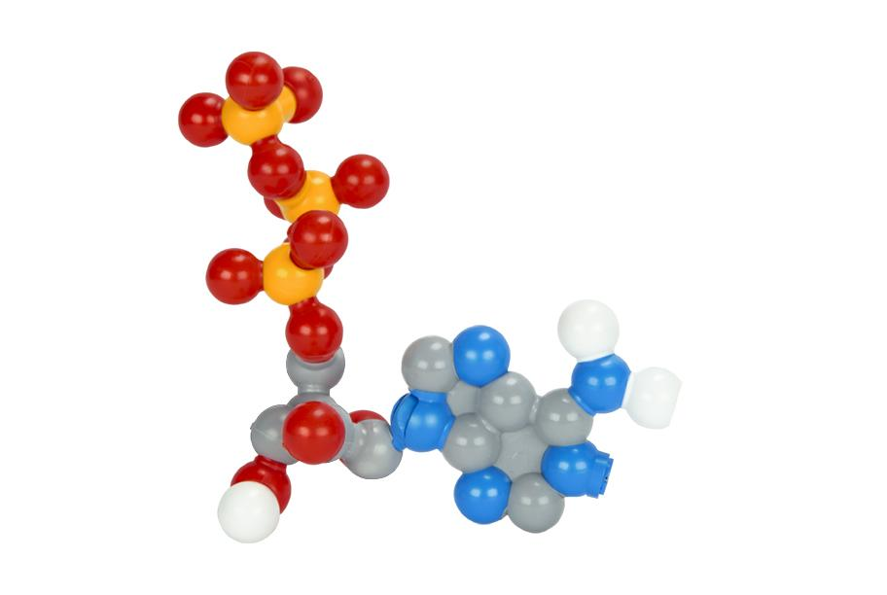
ONE MORE THING!! WHAT IS THIS?

Slide 50
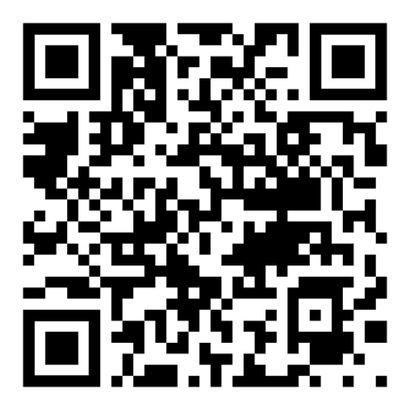
Summer Courses!

Slide 51
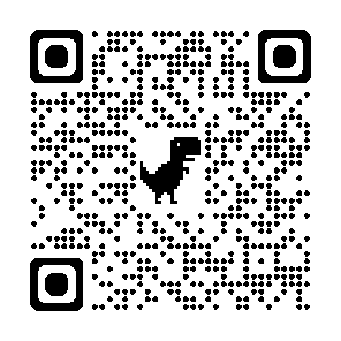
THANK YOU!!
Remember the conference discount code: SC23
Keri Shingleton
kerishingleton@gmail.com

Slide 52

Scan this code for a chance to win a $250 gift certificate to 3D Molecular Designs!

