Slide 1
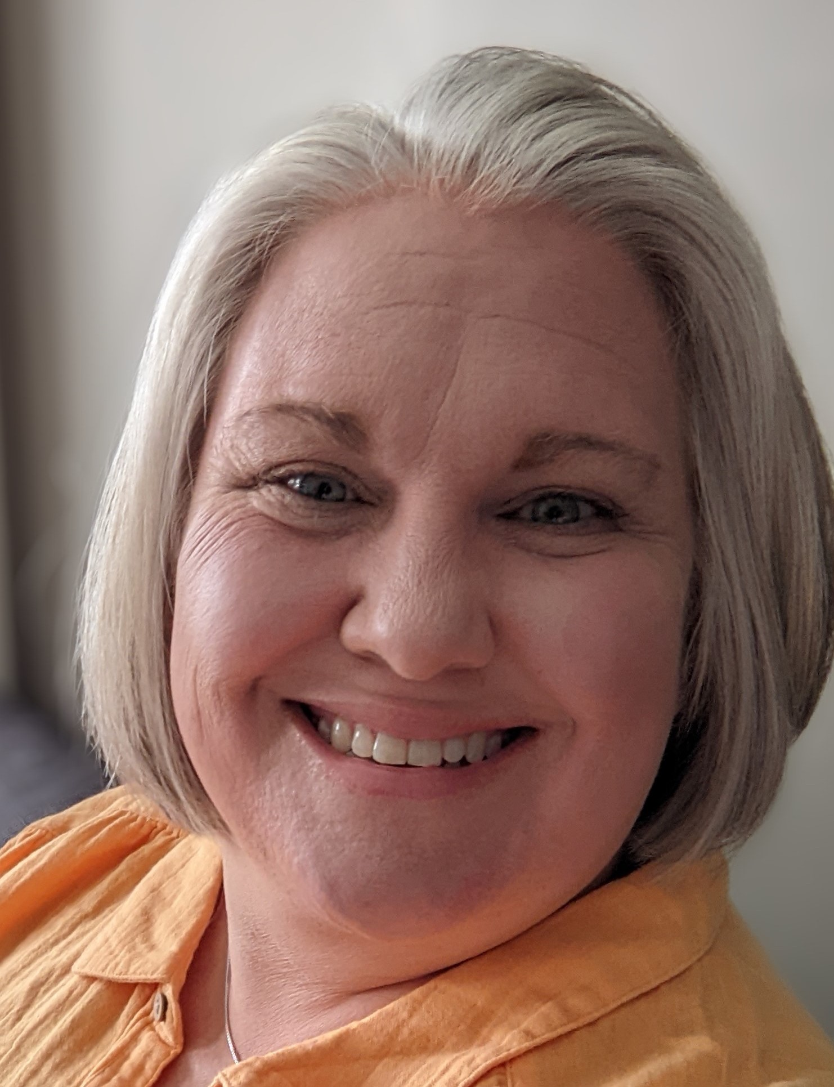
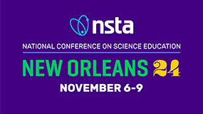
From Code to Construction:
Modeling
DNA Replication Essentials
Ruth Hutson, MSSE

Slide 2
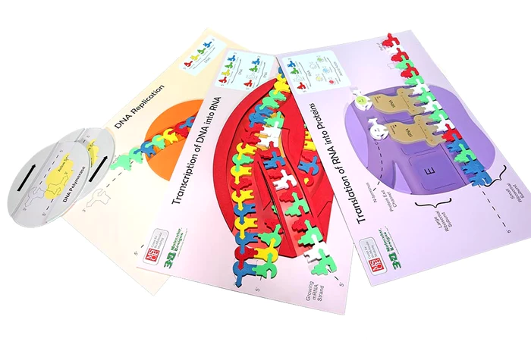
Notes:
In this 60-minute session, we will use the Flow of Genetic Information Kit and several David Goodsell landscapes.

Slide 3
Workshop Outcomes
Model how our DNA genome replicates -- the first stage of the flow of genetic information and preserves genome integrity.
Construct an explanation based on evidence for how the structure of DNA determines the structure of proteins, which carry out the essential functions of life through systems of specialized cells by explaining the purpose and process of replication using models of DNA.
Have fun!

Slide 4
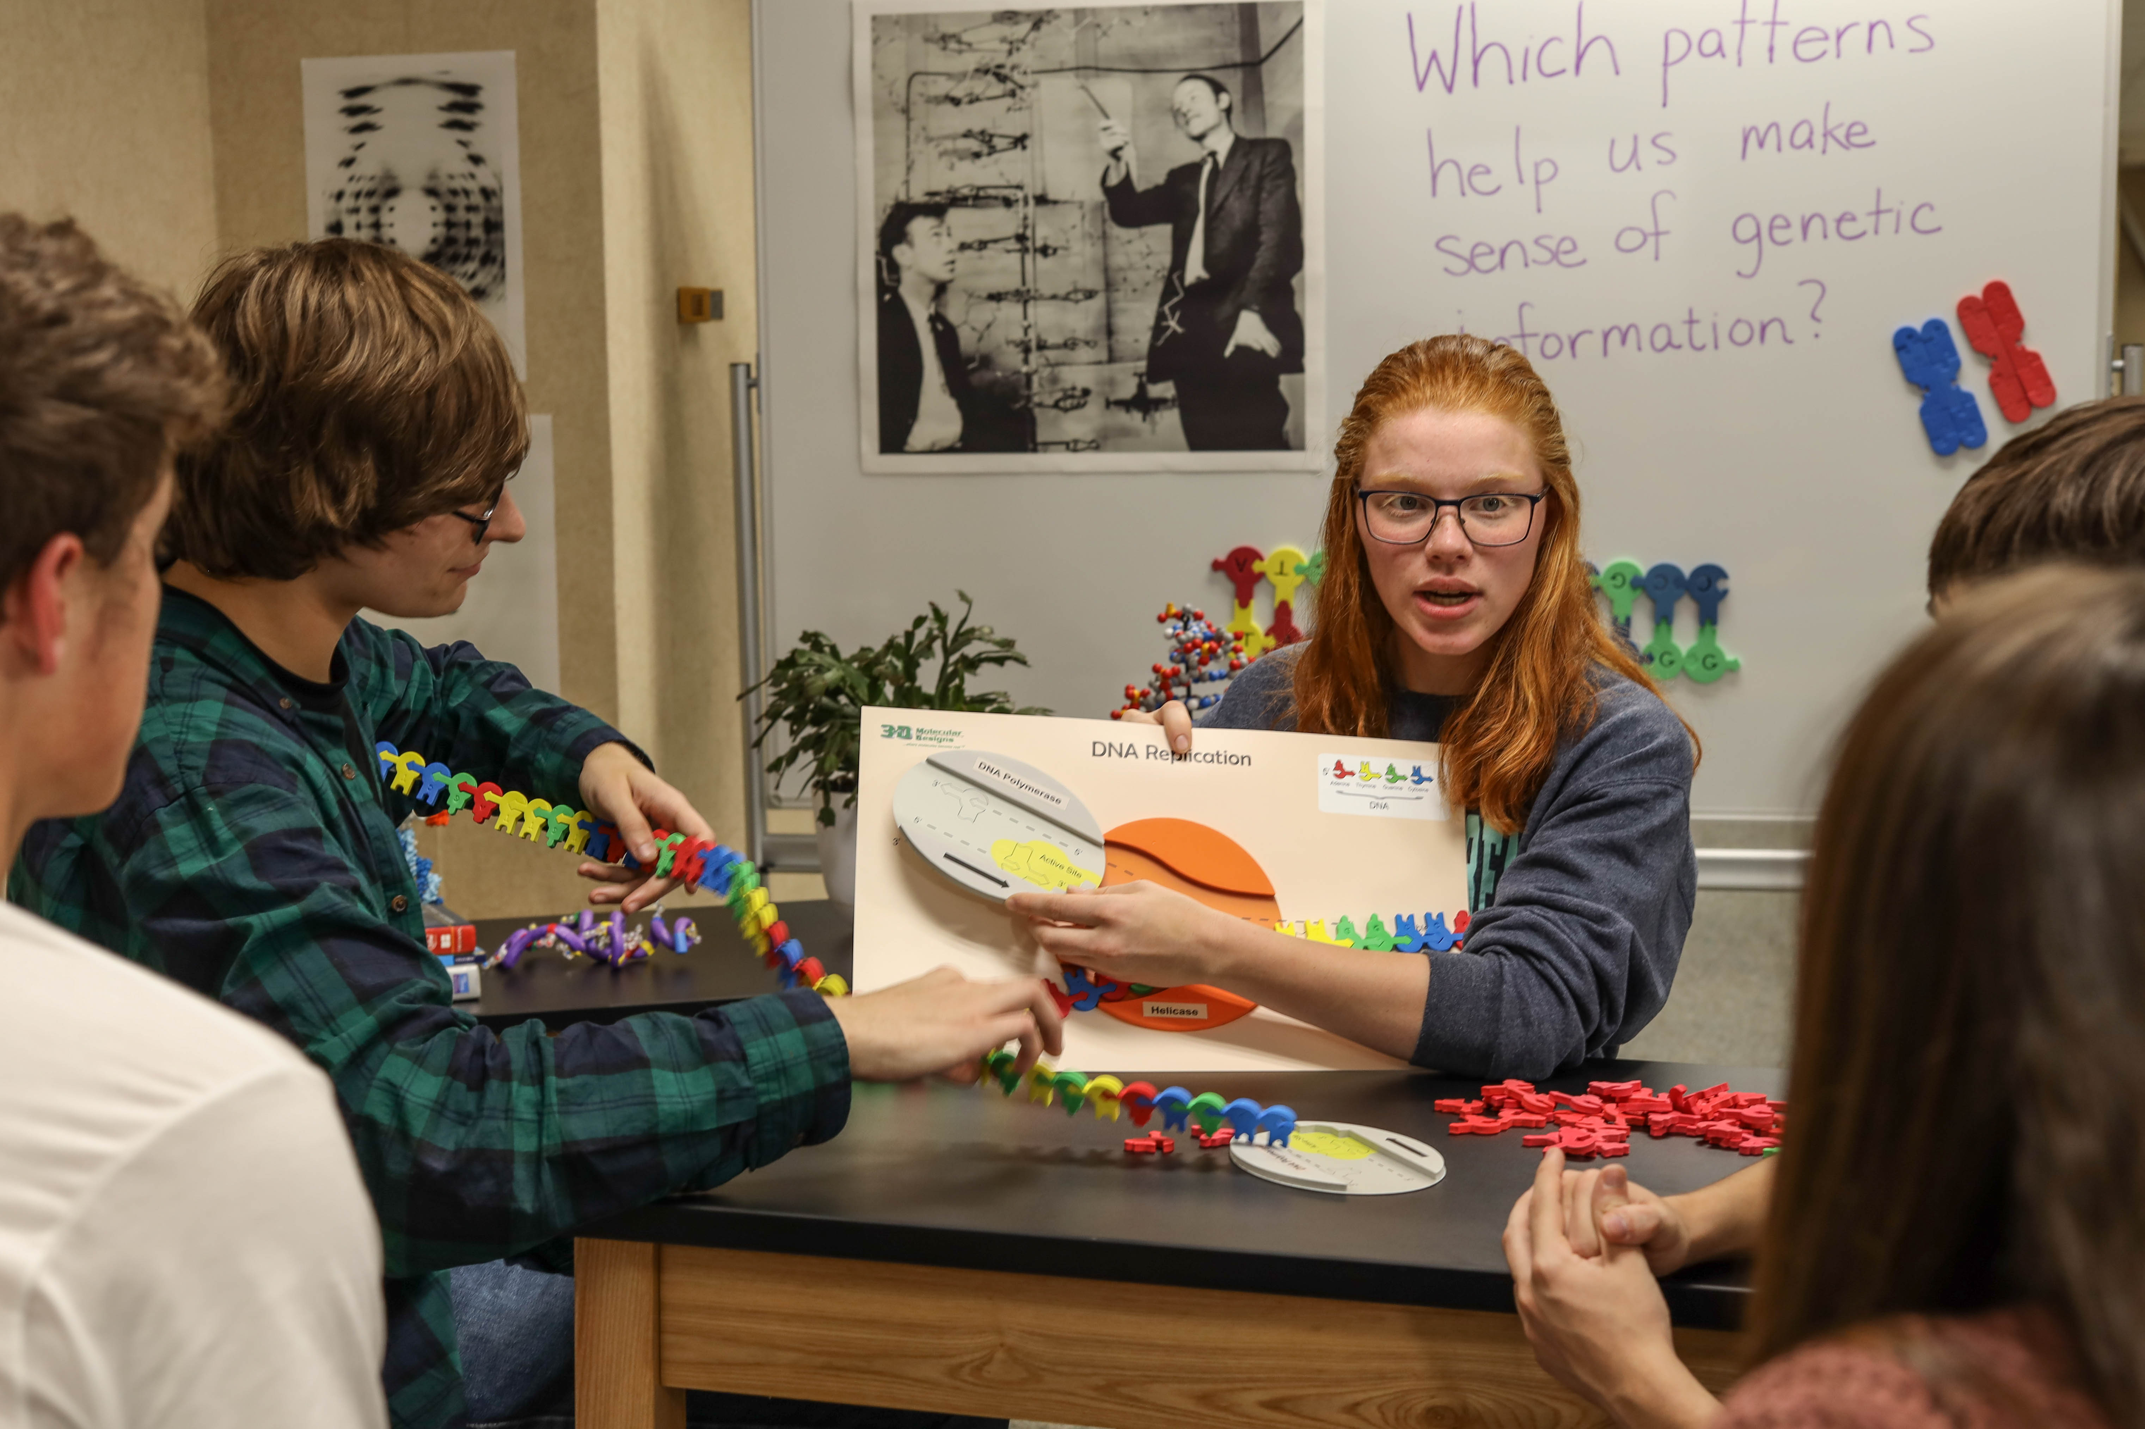
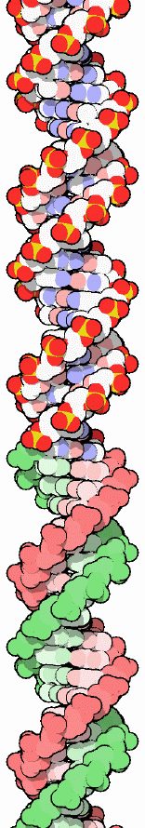
Which patterns help us make sense of genetic information?
Notes:
Preserving the integrity of our ​DNA genome is important as this information guide the construction of everything in your body. I use driving questions like the one above or how my students come up with questions of their own. What questions do your students have about DNA and how the information in it is kept the same when cells divide?
PDB-101: Molecule of the Month: DNA (rcsb.org)

Slide 5
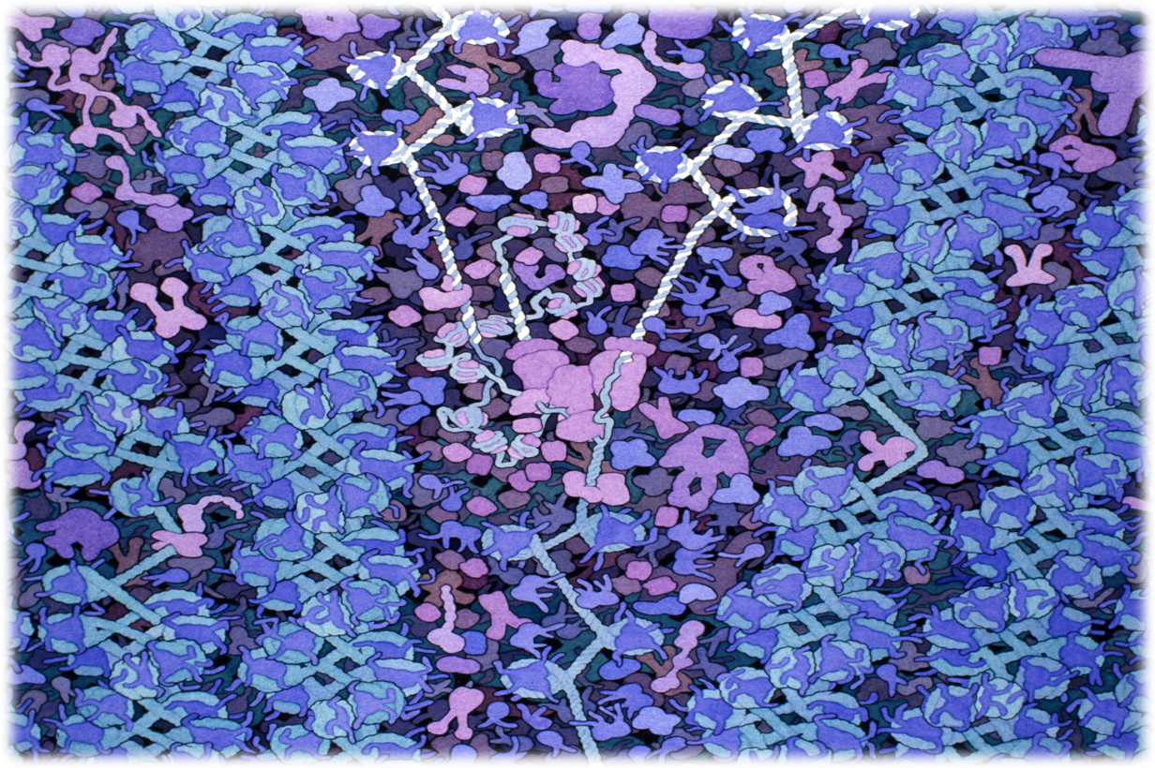
Replication​ in the Eukaryotic Nucleus
Notes:
​
Acknowledgment: Illustration by David S. Goodsell. doi: 10.2210/rcsb_pdb/goodsell-gallery-004​
​
This painting shows DNA being replicated in the nucleus. DNA polymerase is shown at the center in purple, with a DNA strand entering from the bottom and exiting as two strands towards the top. The new strands are shown in white. Chromatin fibers are shown at either site of the replication fork, with DNA wrapped into nucleosomes. This painting was created for the biotech company Biosites.​
​
Things to notice on this landscape: DNA-Histone Complex

Slide 6
Replication​ in the Eukaryotic Nucleus
Notes:
​
Acknowledgment: Illustration by David S. Goodsell. doi: 10.2210/rcsb_pdb/goodsell-gallery-004​
​
This painting shows DNA being replicated in the nucleus. DNA polymerase is shown at the center in purple, with a DNA strand entering from the bottom and exiting as two strands towards the top. The new strands are shown in white. Chromatin fibers are shown at either site of the replication fork, with DNA wrapped into nucleosomes. This painting was created for the biotech company Biosites.​
​Things to notice on this landscape: DNA polymerase complex

Slide 7
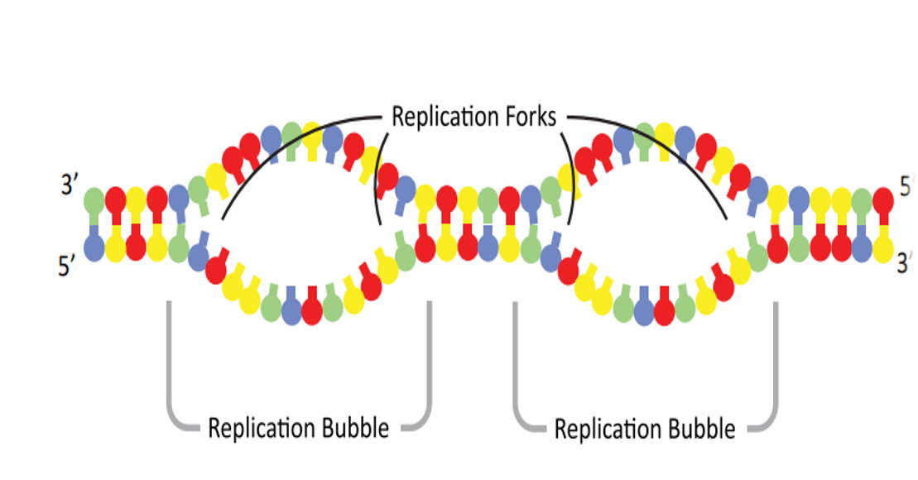
Replication​ Forks
Notes:
Set the scene: The nucleus of the eukaryotic cell has multiple replication bubbles. For simplification, we will only model one of them. ​
​
Thought experiment about to consider why we need many replication bubbles. ​
Nucleotides are added at an approximate rate of 50 nucleotides per second in eukaryotic cells. The human genome contains 6.4 billion nucleotides (3.2 billion base pairs), which must be copied. Calculate the length of time in days that it would take to copy the human genome. Show all calculations including units.

Slide 8
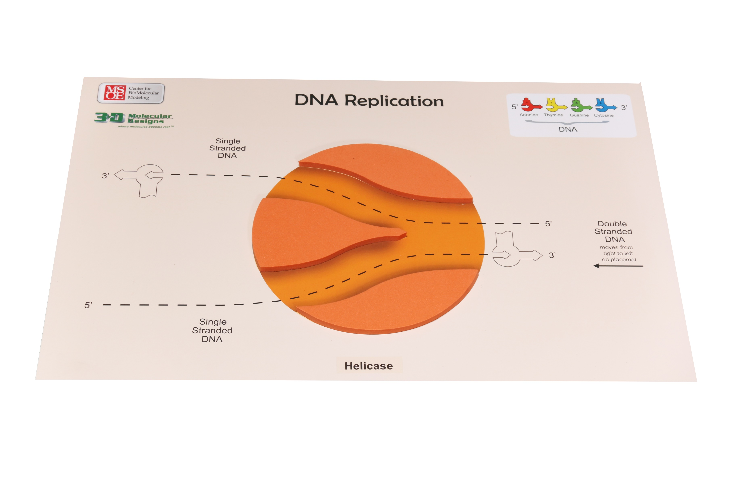
DNA Helicase
Notes:
Set the scene: DNA helicase is responsible for breaking hydrogen bonds between the double-stranded DNA.
Questions to consider: Why is it important to separate the DNA strand down the middle? Why would ATP be needed to drive this chemical reaction?
Helpful hints: Review the information on the placemat before the students start the activity. It is there to give hints about replication.
What the model shows: Look closely at the placemat and notice some of the information given: DNA nucleotides, the directionality of the double-stranded DNA, and the location where the hydrogen bonds of the DNA base pairs are broken. Helicase will move into the replication fork.
​
What the model doesn’t show: DNA helicase is driven by the breakdown of ATP. The image to the right is painted by David Goodsell and shows It also needs an initiator protein that guides the helicase in finding a section of DNA that is rich in adenine and thymine. The initiator protein leaves and a second protein, a helicase loader, chaperones the DNA helicase to a single strand of DNA. DNA helicase then begins to separate the DNA between nitrogenous base pairs. Helicase is coupled with a ATPase to drive the breaking of hydrogen bonds between nitrogenous bases.

Slide 9
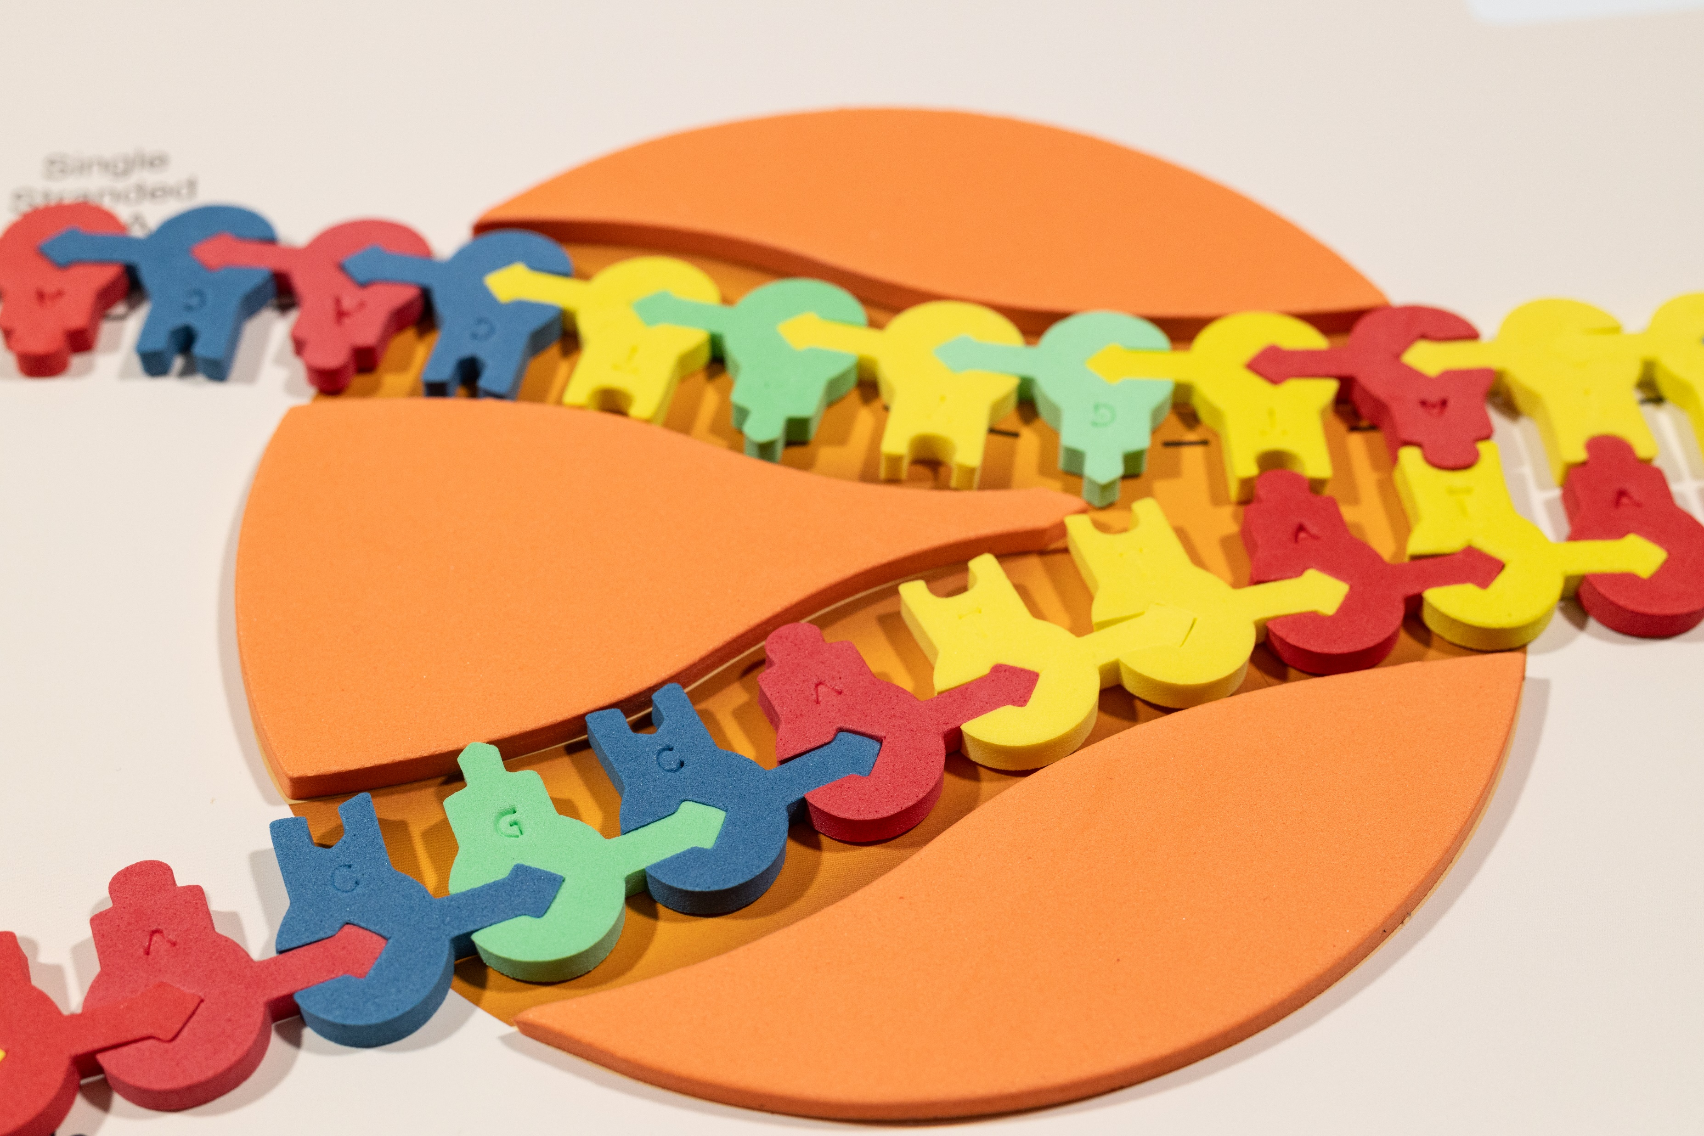
DNA Helicase
Notes:
Set the scene: DNA helicase is responsible for breaking hydrogen bonds between the double-stranded DNA. For this process to start, ATP is needed. We don’t show that portion, but it is worth noting to students. It is also worth noting that these are cross-sections of 3d structures. We have stylized them so students can learn the process without being hung up on the complexity.
The image to the right is painted by David Goodsell and shows a DNA helicase (in blue and purple) pulling a single strand of DNA (orange) through the center.
PDB-101: Molecule of the Month: DNA Helicase (rcsb.org)

Slide 10
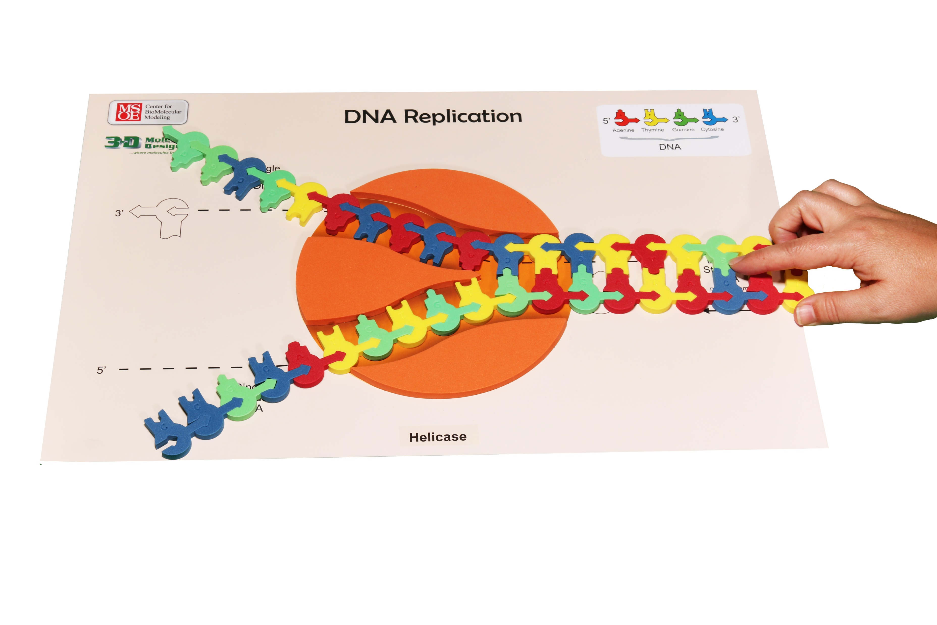
Replication​
Notes:
Set the scene: The nucleus of the eukaryotic cell at an origin of replication on the double-stranded DNA. Enter DNA helicase. In the wings: DNA polymerase​
​
Questions to consider: What does the helicase appear to be doing? What type of bond is being broken? Why is the helicase able to break these bonds? ​
​
Helpful hints: For large classes, pre-make the DNA sequence. The kit has some labeled Sequence I and Sequence II. We are going to be working with Sequence I. ​
You can also use double-stick tape to hold those sequences together so students don’t take them apart. Arrows on the models guide students in showing the direction of replication. ​
​
What the model shows: The directionality (5’ to 3’) of the DNA molecule. Only one replication bubble (origin of replication) is shown. This is what the mat represents. Replication of both lagging and leading strands is shown. Hydrogen bonding between the base pairs and the base pairing rules are highlighted in this model. ​
​
What the model doesn’t show: The 3-D structure of DNA and the sugar-phosphate backbone are not shown. The role of initiator proteins that form the replication bubbles is not shown. We arrive on the scene with all of that in place. This kit also doesn’t focus on the role of gyrase and ligase. That complexity can be brought in later, if you wish with other modeling. ​ Having students modify the model and design parts of their own really helps them master the concept of replication.
​

Slide 11
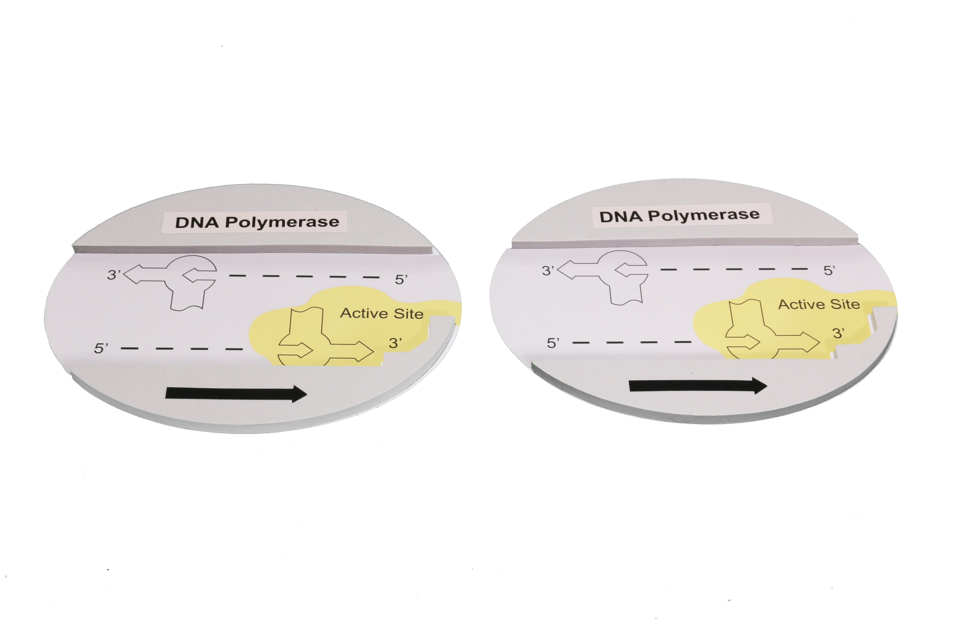
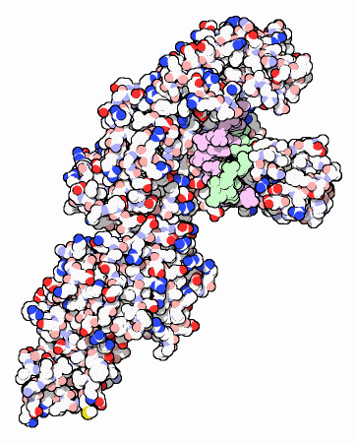
Replication​
Notes:
Set the scene: Enter DNA polymerase​. Two DNA polymerases are necessary to make an accurate copy of the cell’s genome. One to copy the leading or continuous strand and the other to copy the lagging (discontinuous) strand.
​
Questions to consider: What is the active site of this enzyme? What type of bond is being made? Why is the polymerase able to break these bonds? ​
​
Helpful hints: Before starting the next part of the activity, have students ​notice the active site and the black arrow that shows directionality.
The image to the right is painted by David Goodsell and shows Taq DNA polymerase, which is used by Thermus aquaticus, a species of bacteria that is found in hot springs. DNA is shown in magenta and green.
PDB-101: Molecule of the Month: DNA Polymerase (rcsb.org)
​

Slide 12
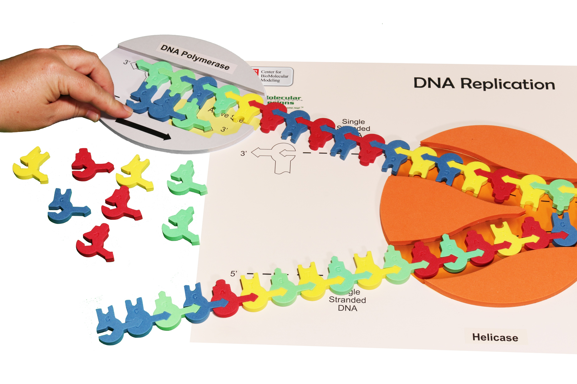
Continuous Replication​
Notes:
Set the scene: Enter DNA polymerase. The DNA polymerase enzyme catalyzes the synthesis of new DNA by adding nucleotides to a preexisting chain. New DNA can elongate only in the 5’ 3’ direction. The DNA strand that is made continuously is referred to as the leading strand. ​
​
Questions to consider: As the new nucleotide is added to the growing DNA strand, which part of the new nucleotide forms a bond with the 3’OH group? Why won’t you be able to synthesize the other strand of DNA in a continuous manner when using the model? ​
​
Helpful hints: Arrows on the models guide students in showing the direction of replication. The top strand is the strand that continuously replicates. ​
​
What the model shows: The directionality (5’ to 3’) of the DNA molecule. Only one replication bubble (origin of replication) is shown. This is what the mat represents. Replication of both lagging and leading strands are shown. Hydrogen bonding between the base pairs and the base pairing rules are highlighted in this model. ​
​
What the model doesn’t show: 3-D structure of DNA and the sugar-phosphate backbone are not shown. The role of initiator proteins that form the replication bubbles is not shown. We arrive on the scene with all of that in place. This kit also doesn’t focus on the role of gyrase and ligase. That complexity can be brought in later, if you wish with other modeling.

Slide 13
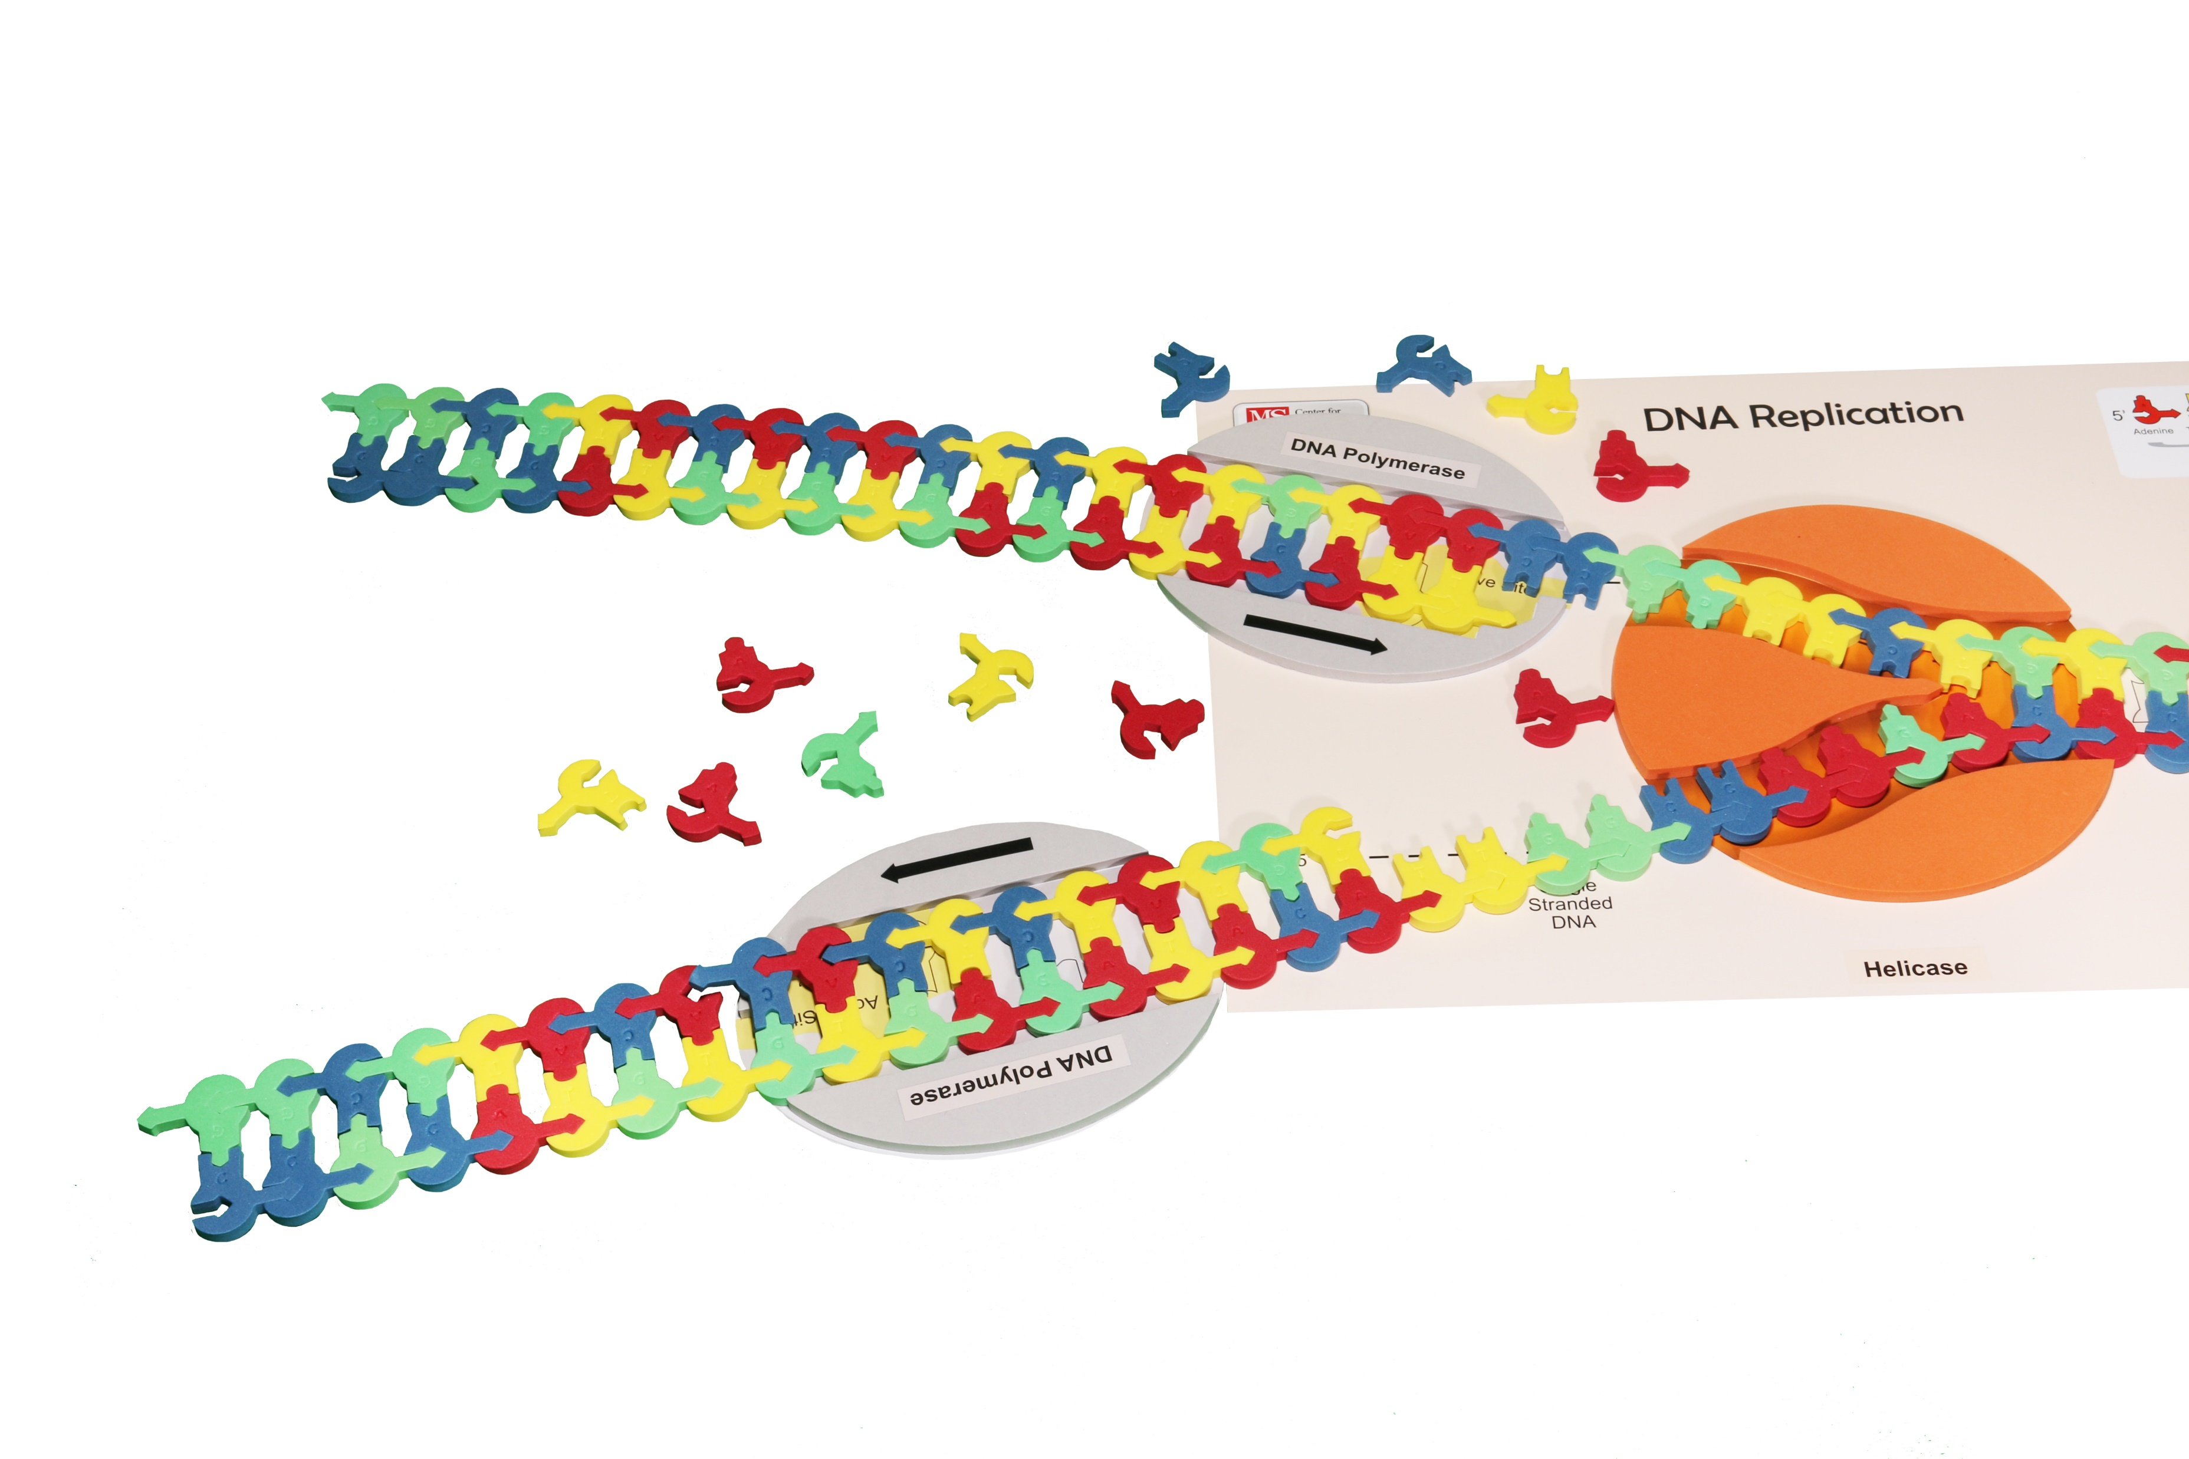
Discontinuous Replication​
Notes:
Set the scene: Enter DNA polymerase on the lagging strand. The DNA polymerase enzyme catalyzes the synthesis of new DNA by adding nucleotides to a preexisting chain. New DNA can elongate only in the 5’ 3’ direction. The DNA strand that is made discontinuously is referred to as the lagging strand. Notice that the DNA polymerase must move away from the fork instead of toward the fork, as it did in the leading strand. In order to accommodate the 5’ 3’ synthesis of DNA, short fragments are made on the second strand. ​
​
Questions to consider: As the new nucleotide is added to the growing DNA strand, which part of the new nucleotide forms a bond with the 3’OH group? Why won’t you be able to synthesize the other strand of DNA in a continuous manner when using the model? ​
​
Helpful hints: Arrows on the models guide students in showing the direction of replication. The top strand is the strand that continuously replicates. ​
​
What the model shows: The directionality (5’ to 3’) of the DNA molecule. Only one replication bubble (origin of replication) is shown. This is what the mat represents. Replication of both lagging and leading strands are shown. Hydrogen bonding between the base pairs and the base pairing rules are highlighted in this model. ​
​
What the model doesn’t show: 3-D structure of DNA and the sugar-phosphate backbone are not shown. The role of initiator proteins that form the replication bubbles is not shown. We arrive on the scene with all of that in place. This kit also doesn’t focus on the role of gyrase and ligase. That complexity can be brought in later, if you wish with other modeling. ​

Slide 14
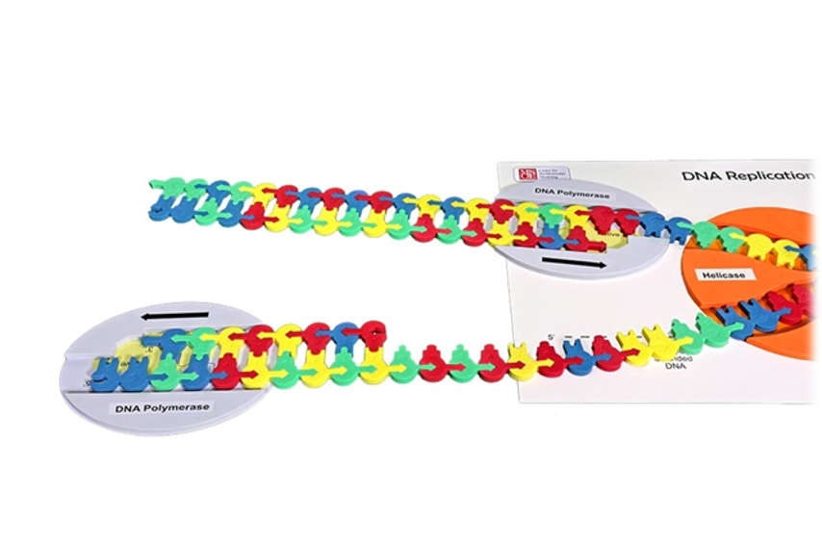
Comparing Leading and Lagging Strands​
Notes:
The lagging strand requires you to move the DNA polymerase! Place the DNA polymerase back at the fork junction to create the next fragment. Move the DNA polymerase so that the bases may be added from the 5’ 3’ direction. You have now created a second fragment of DNA on the lagging strand. These fragments are referred to as Okazaki fragments and are usually 100-200 nucleotides long in eukaryotic cells.​
​
Although there are multiple enzymes involved in DNA replication, the kit only focuses on DNA Polymerase and DNA helicase. You can look at the student handout for this activity at FGIKReplicationStudentHandout6-19-15.compressed.pdf (3dmoleculardesigns.com).

Slide 15
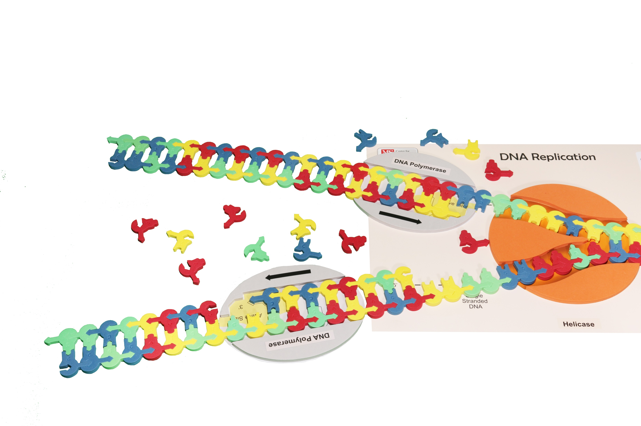
Comparing Leading and Lagging Strands​
Notes:
The lagging strand requires you to move the DNA polymerase! Place the DNA polymerase back at the fork junction to create the next fragment. Move the DNA polymerase so that the bases may be added from the 5’ 3’ direction. You have now created a second fragment of DNA on the lagging strand. These fragments are referred to as Okazaki fragments and are usually 100-200 nucleotides long in eukaryotic cells.​
​
Although there are multiple enzymes involved in DNA replication, the kit only focuses on DNA Polymerase and DNA helicase. You can look at the student handout for this activity at FGIKReplicationStudentHandout6-19-15.compressed.pdf (3dmoleculardesigns.com).

Slide 16
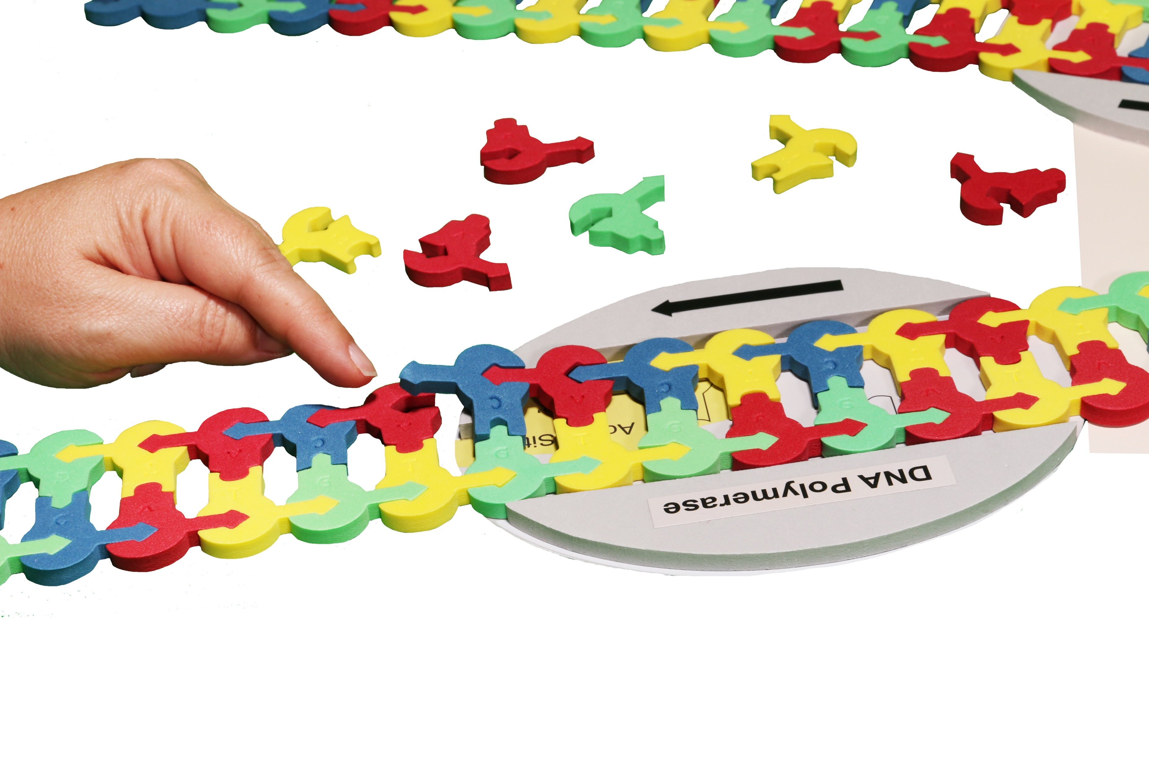
Comparing Leading and Lagging Strands​
Notes:
The lagging strand requires you to move the DNA polymerase! Place the DNA polymerase back at the fork junction to create the next fragment. Move the DNA polymerase so that the bases may be added from the 5’ 3’ direction. You have now created a second fragment of DNA on the lagging strand. These fragments are referred to as Okazaki fragments and are usually 100-200 nucleotides long in eukaryotic cells.​
​
Although there are multiple enzymes involved in DNA replication, the kit only focuses on DNA Polymerase and DNA helicase. You can look at the student handout for this activity at FGIKReplicationStudentHandout6-19-15.compressed.pdf (3dmoleculardesigns.com).

Slide 17
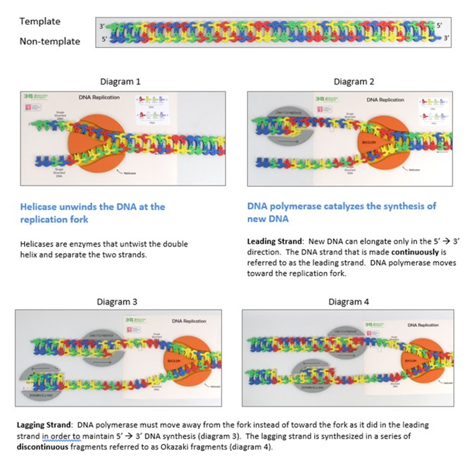
Notes:
A quick review of what we discovered.

Slide 18
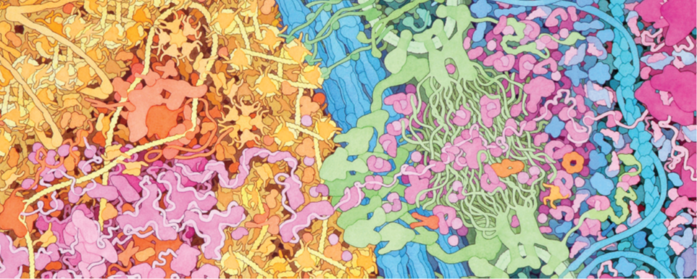
A Brief Tour Through the Cell​
This image is an excerpt from Tour of a Human Cell by David Goodsell, as shown in 3D Molecular​
Designs’ Tour of a Human Cell© poster and David Goodsell’s book, The Machinery of Life
Notes:
This is one of the many molecular landscapes by Dr. David Goodsell who is affiliated with the Protein Data Bank. You can more of these at PDB-101: Goodsell Gallery (rcsb.org). I love using them in conjunction with the kit because they demonstrate to students that we are only touching on a fraction of the cell’s complexity.

Slide 19
Nucleus
Nuclear Membrane
Cytoplasm
This image is an excerpt from Tour of a Human Cell by David Goodsell, as shown in 3D Molecular
Designs’ Tour of a Human Cell© poster and David Goodsell’s book, The Machinery of Life.
Notes:
Let’s note where we have been and where we are going.

Slide 20
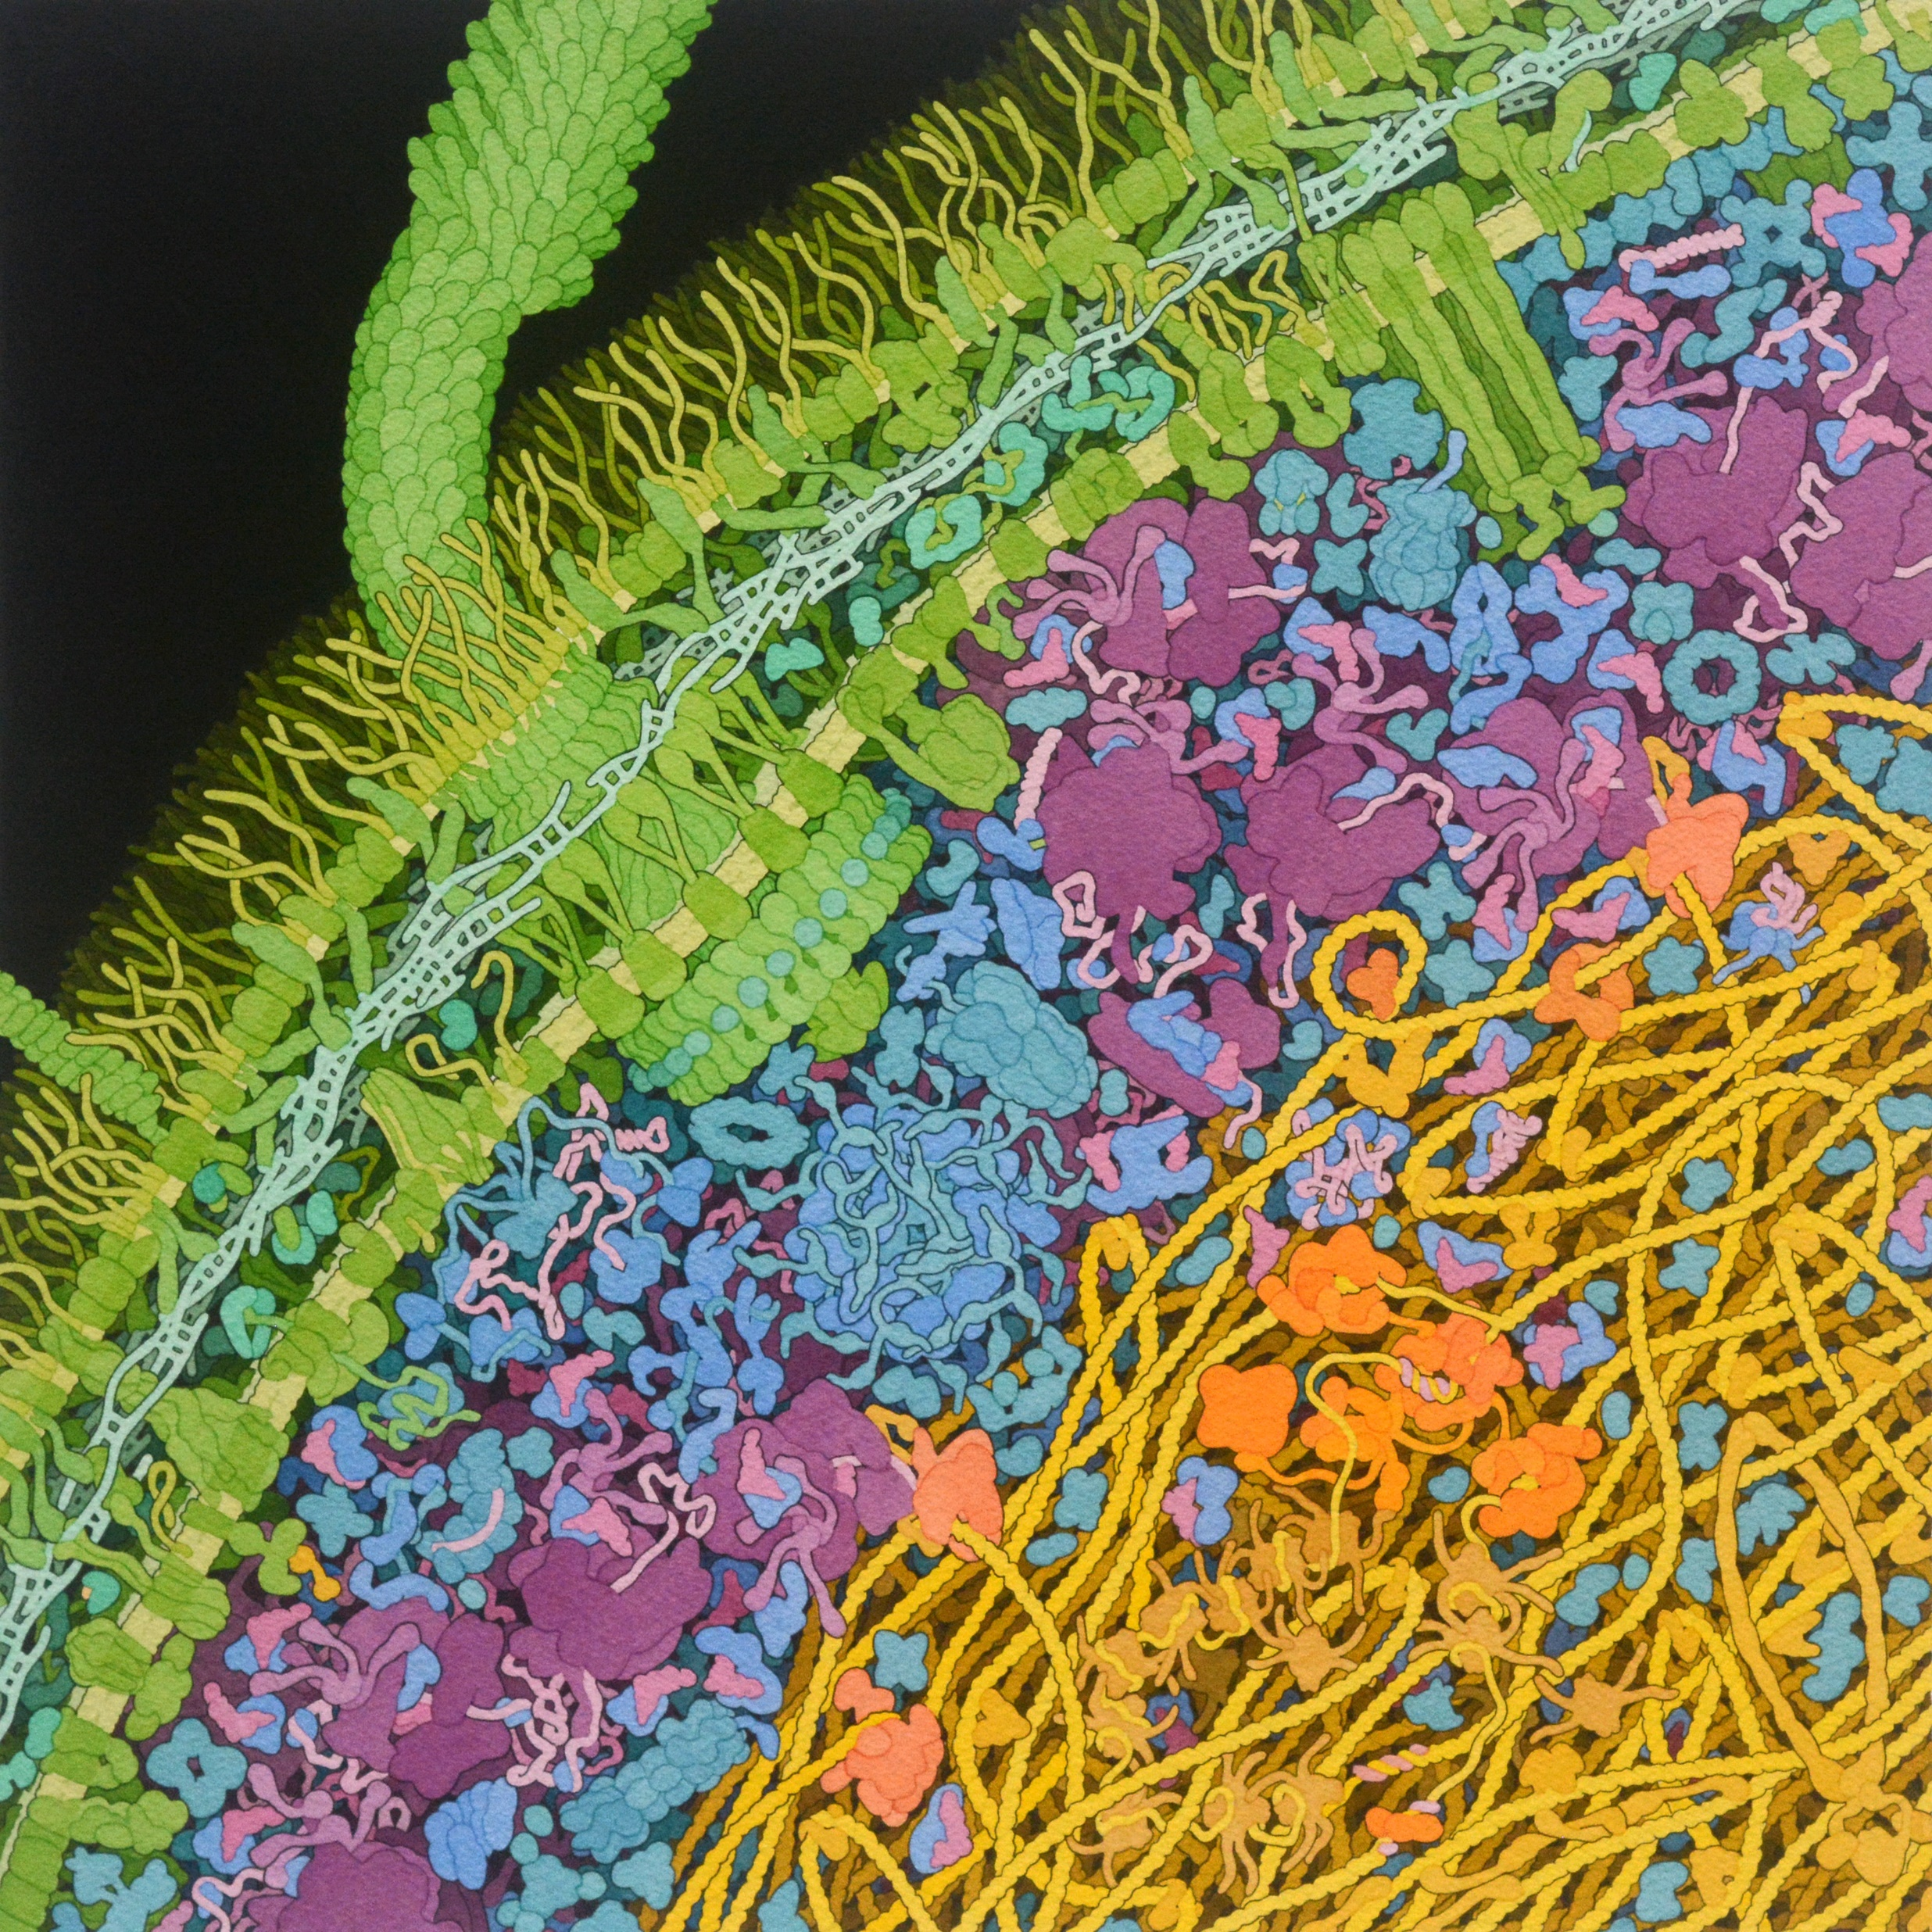
Escherichia coli Bacterium, 2021​
Acknowledgment: Illustration by David S. Goodsell, RCSB Protein Data Bank. doi: 10.2210/rcsb_pdb/goodsell-gallery-028
Notes:
This painting shows a cross-section through an Escherichia coli cell. The characteristic two-membrane cell wall of gram-negative bacteria is shown in green, with many lipopolysaccharide chains extending from the surface and a network of cross-linked peptidoglycan strands between the membranes. The genome of the cell forms a loosely-defined "nucleoid", shown here in yellow, and interacts with many DNA-binding proteins, shown in tan and orange. Large soluble molecules, such as ribosomes (colored in reddish purple), mostly occupy the space around the nucleoid.
Find out more by going to PDB-101: Goodsell Gallery: Escherichia coli Bacterium (rcsb.org).

Slide 21
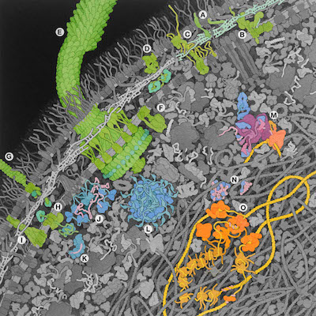
Escherichia coli Bacterium, 2021​
Acknowledgment: Illustration by David S. Goodsell, RCSB Protein Data Bank. doi: 10.2210/rcsb_pdb/goodsell-gallery-028
Notes:
This painting is an update of an earlier E. coli painting from 1999, incorporating abundant new data that has been gathered since then, including proteomics information and many amazing new structures. For the purposes of this presentation, notice letter O. which shows the replisome including several DNA polymerases and single-strand DNA-binding proteins protecting the single-stranded intermediates formed during the process of DNA replication.
Find out more by going to PDB-101: Goodsell Gallery: Escherichia coli Bacterium (rcsb.org).

Slide 22
Helpful Resources
Tracking the Resolution of Student Misconceptions about the Central Dogma of Molecular Biology - PubMed (nih.gov)​
What's in a cell? — young people's understanding of the genetic relationship between cells, within an individual: Journal of Biological Education: Vol 34, No 3 (tandfonline.com)​
Eukaryotic cell panorama - Goodsell - 2011 - Biochemistry and Molecular Biology Education - Wiley Online Library
2022_EcoliPainting (rcsb.org)

Slide 23
Workshop NGSS Connections
SEPs | CCCs | DCIs
Asking Questions | Scale, Proportion, and Quantity | HS-LS1-1
Developing and Using Models | Patterns | MS-LS1-2
Constructing Explanations and Designing Solutions | Structure and Function
Notes:
Here are the NGSS Connections for this workshop.

Slide 24
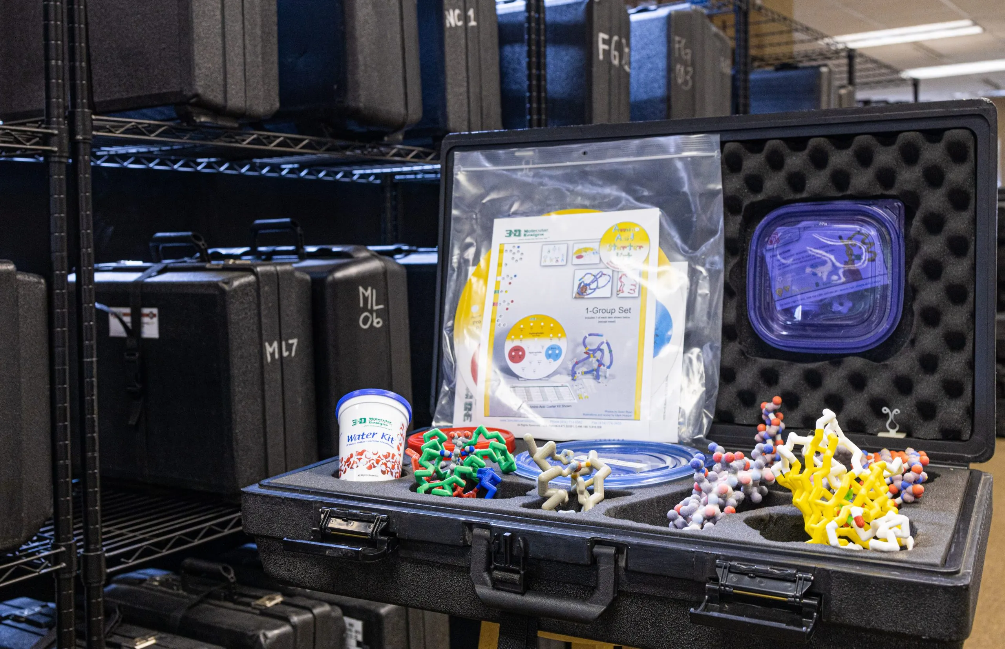
Want to try things out first?
Visit our Lending Library at
3DMD Lending Library – 3D Molecular Designs.
Notes:
Check out a class pack. You pay for shipping to and from your school.

Slide 25
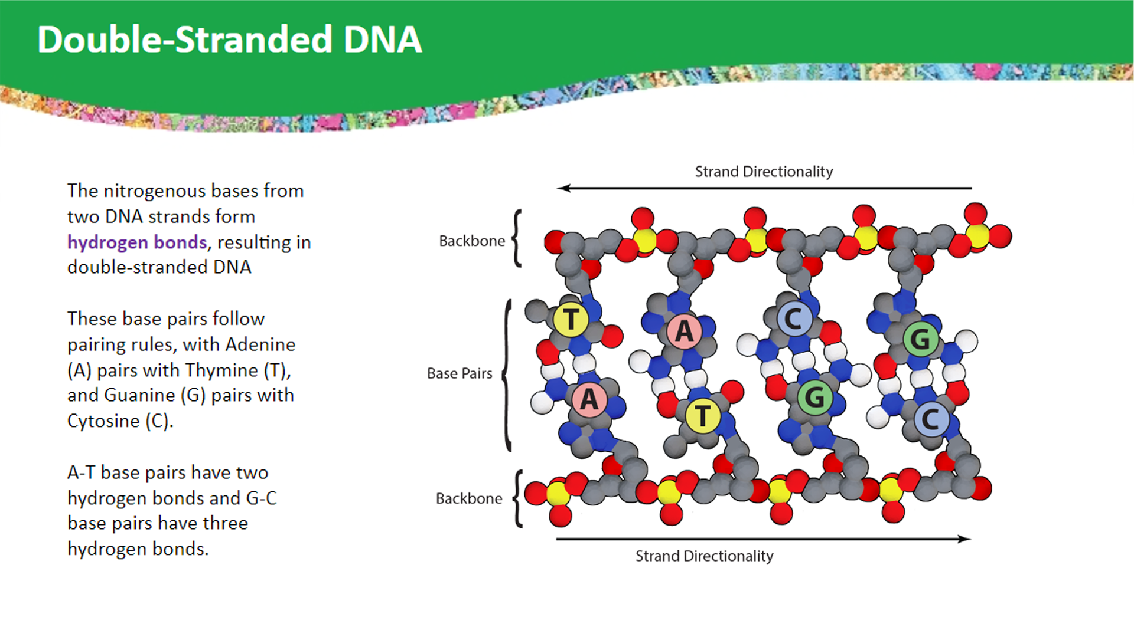
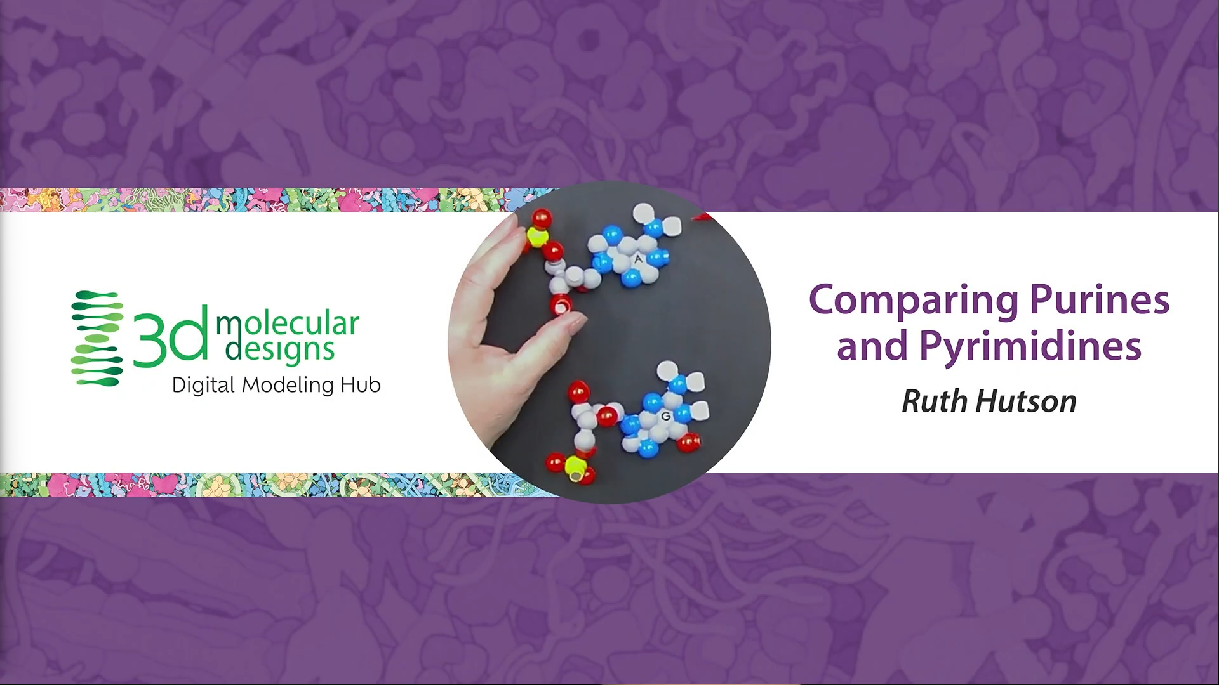
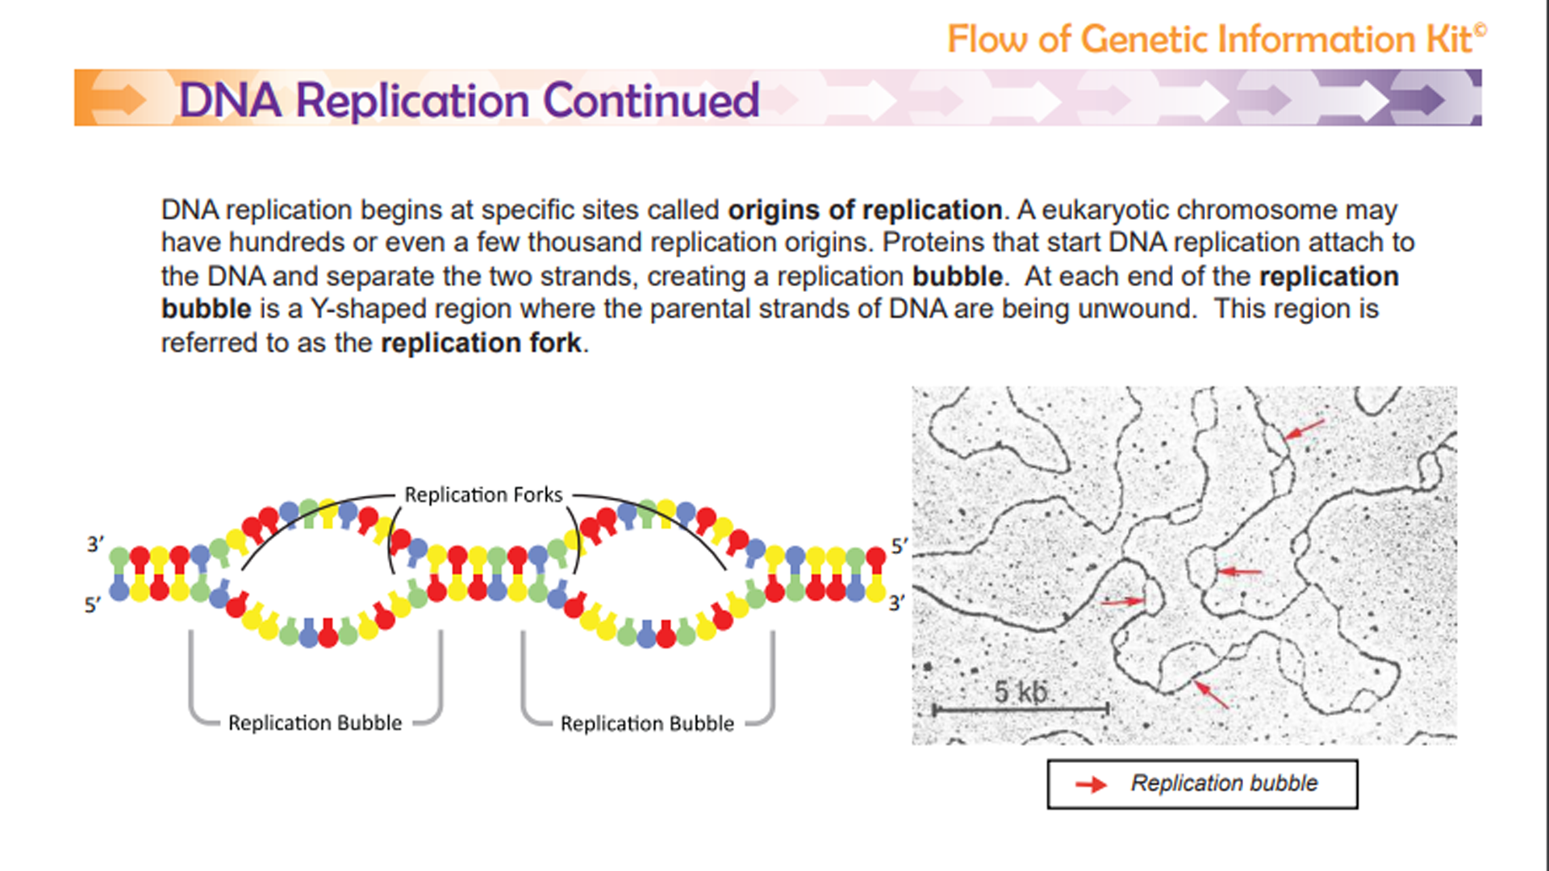
Digital Modeling Hub
We're enhancing our kits and models to inspire more hands-on learning with our classic content, Interactables, short content videos, and much more!! Check it out!
Look at our new
Digital Modeling Hub for additional resources to use with the Flow of Genetic Information Kit.
Get your access code by responding to our survey!

Slide 26
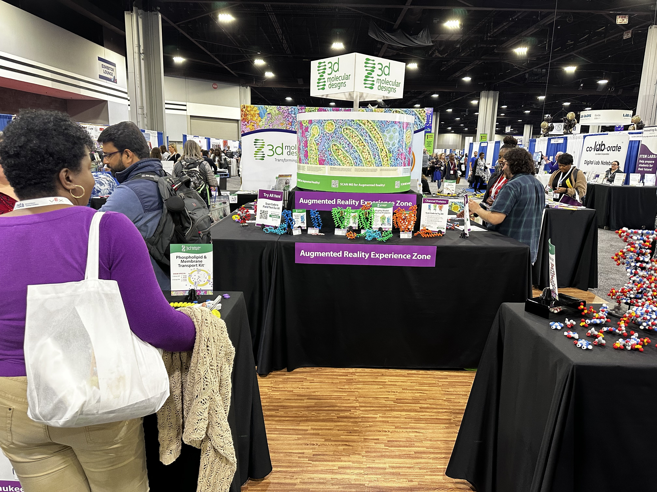
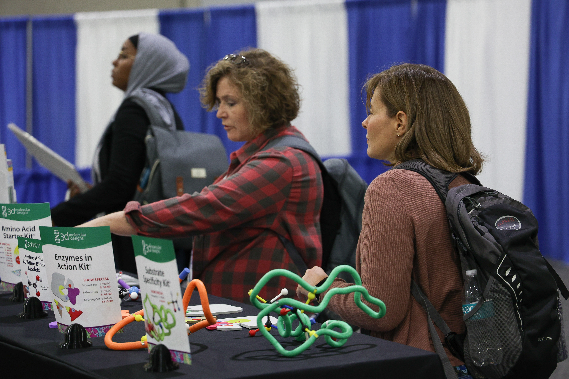
Visit Our Booth!
Continue your exploration of our dynamic kits and models at Booth 609

Slide 27
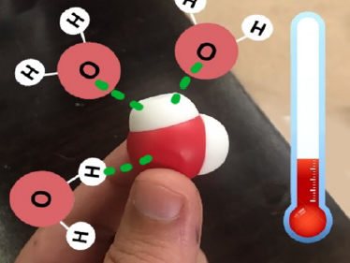
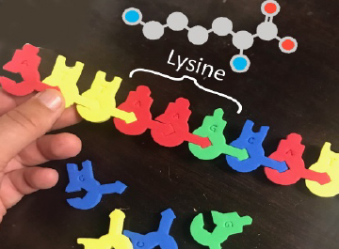
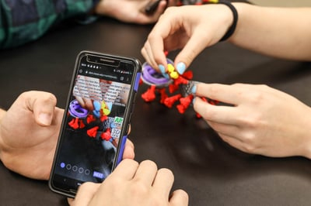
AR Enhancements
We're enhancing our kits and models to inspire more hands-on learning with new augmented reality features!
Stop by Booth 609 to
check out our new
Augmented Reality Enhancements!

Slide 28

Summer Course 2025 – Modeling the Molecular World
Join us in Milwaukee for hands-on discovery and professional development on July 7 – 11.
Registration begins in October. Check out 3D Molecular Designs website for more information.
Bring an empty suitcase!
You'll take home all these classroom resources!
Notes:
Scholarships are available. If you have questions, you can contact Ruth Hutson at ruth.hutson@3dmoleculardesigns.com.

Slide 29

We value your opinion!
Let us know what you think.
Scan the QR Code and complete this short survey.

