Slide 1
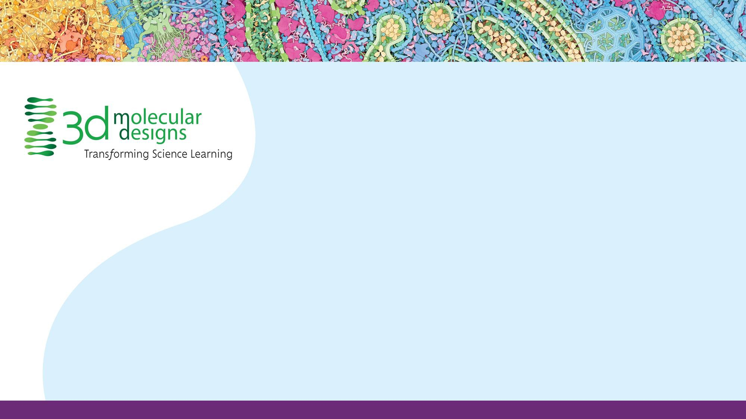
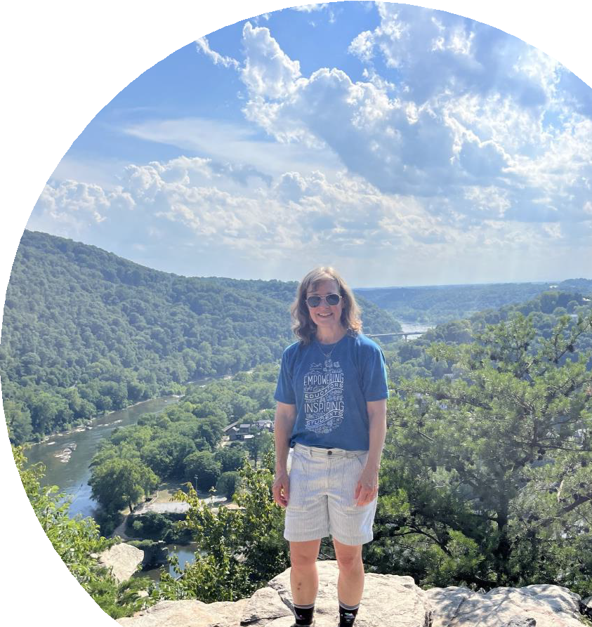
Activating Student Thinking with a Twist on DNA Modeling
Karen Avery, EdD Pennsylvania College of Technology

Slide 2

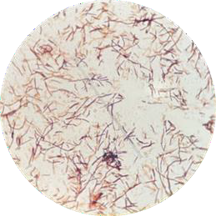
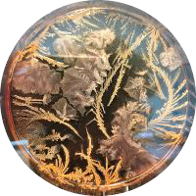

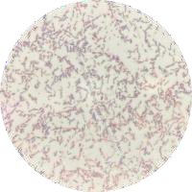
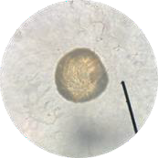
Introductions: Karen Avery

Slide 3
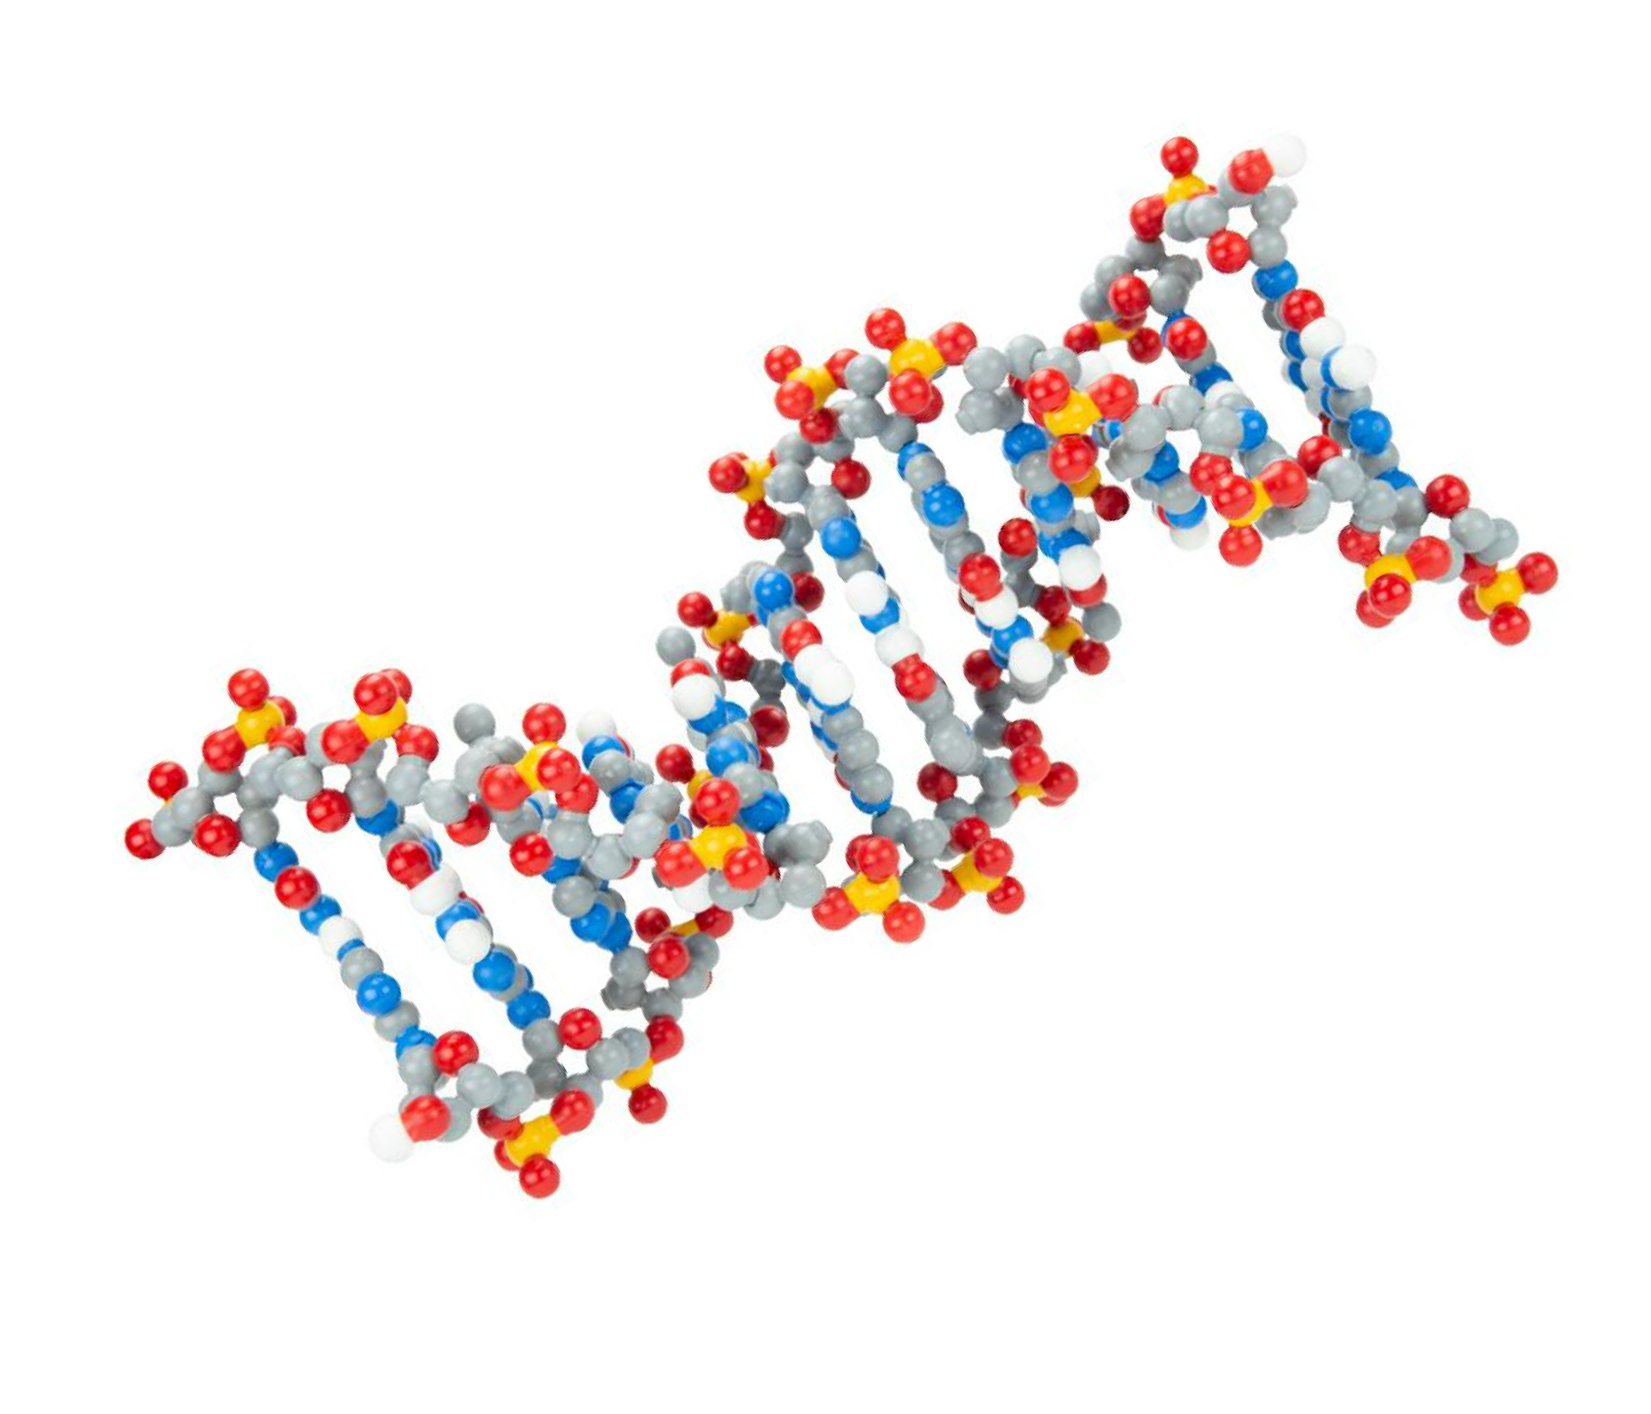
Activating Student Thinking with a Twist on DNA Modeling
Karen Avery, EdD Pennsylvania College of Technology

Slide 4
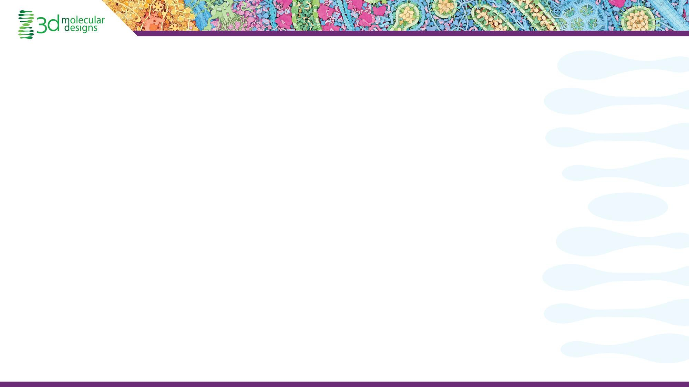

Who’s in the Room?
What age group are you teaching?
What are you teaching?

Slide 5
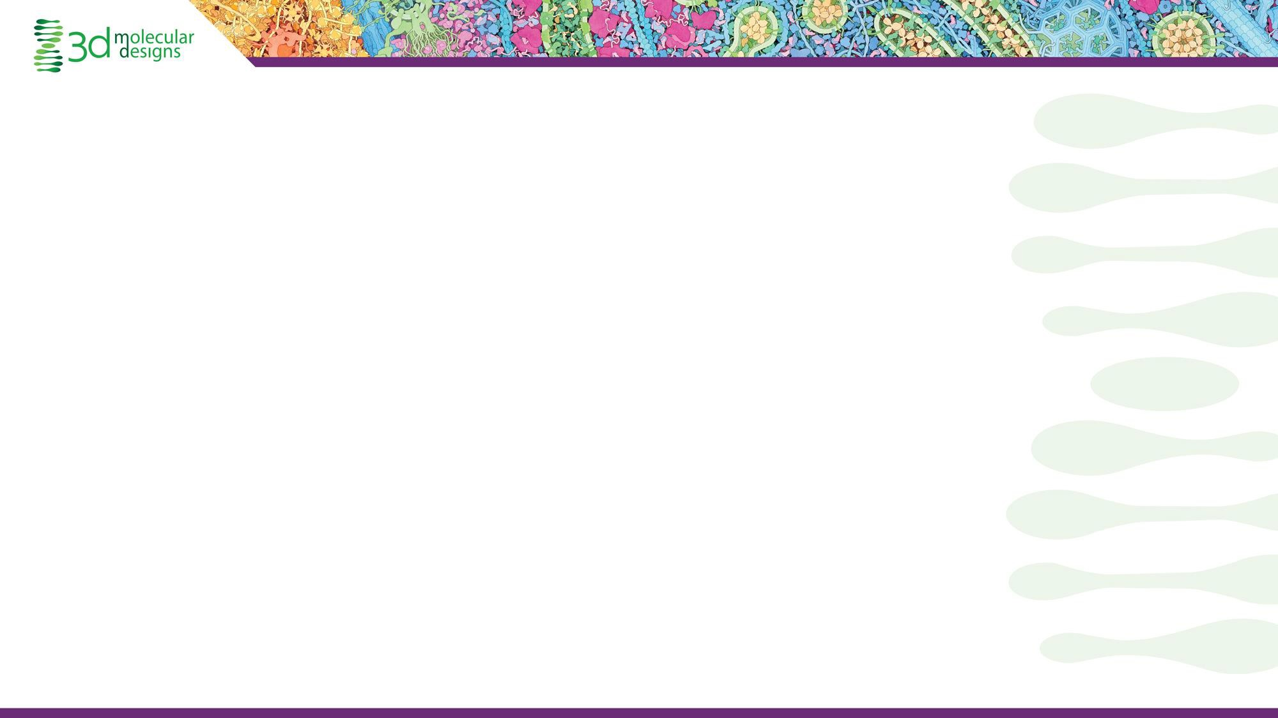
Workshop Goals:
Identifying effective ways to model DNA
Teaching DNA structure and Function with Dynamic DNA
What else can students learn using Dynamic DNA?

Slide 6
As you get to know each other…
Think, then share…
What was your favorite toy growing up?

Slide 7
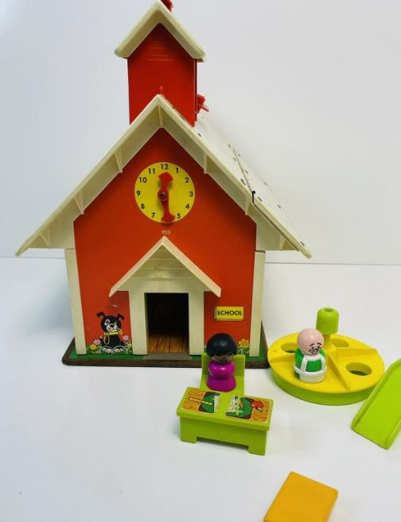
Time for Sharing!
What was your favorite toy growing up?
What is the difference between a toy and a model?
Maybe they are not so different?

Slide 8
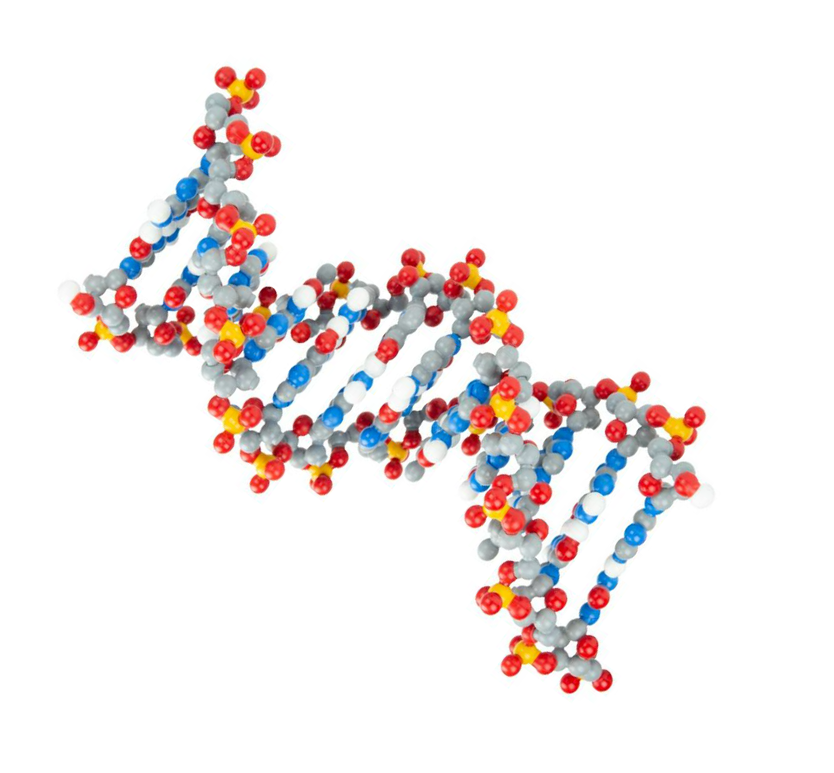
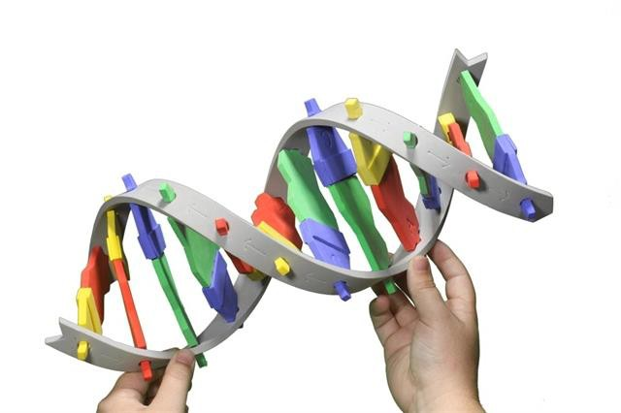
So are these models? Or toys?

Slide 9
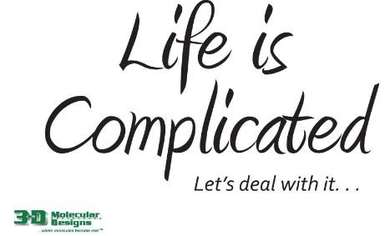
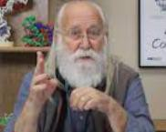
Teaching and Learning about DNA Structure and Function can be fun….
…..and complicated!

Slide 10

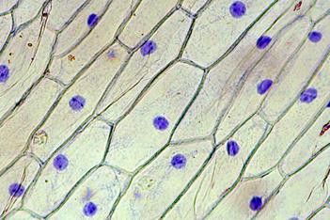
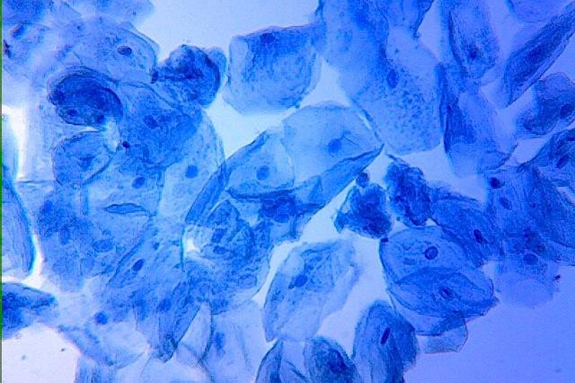
How do your students first “see” DNA?
UNDER A MICROSCOPE?
https://upload.wikimedia.org/wikipedia/ commons/2/23/Human_Cheek_Cells.jpg
http://www.microbehunter.com/wp/wp-content/uploads/2009/onion1.jpg

Slide 11
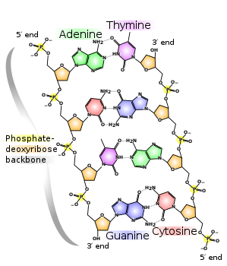
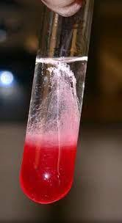
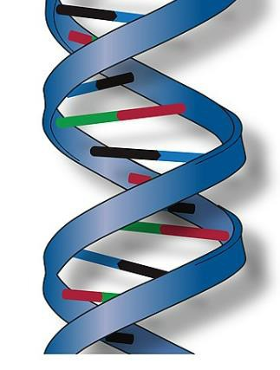
The BIG LEAP
OR IN A TEST TUBE?
https://www.instructables.com/Extracting-DNA-
from-Strawberries/

Slide 12
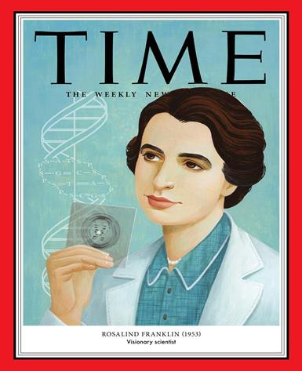
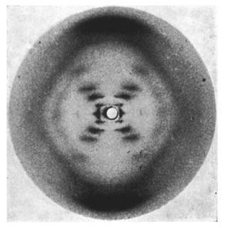
Would it help to see DNA?
Wikimedia commons

Slide 13
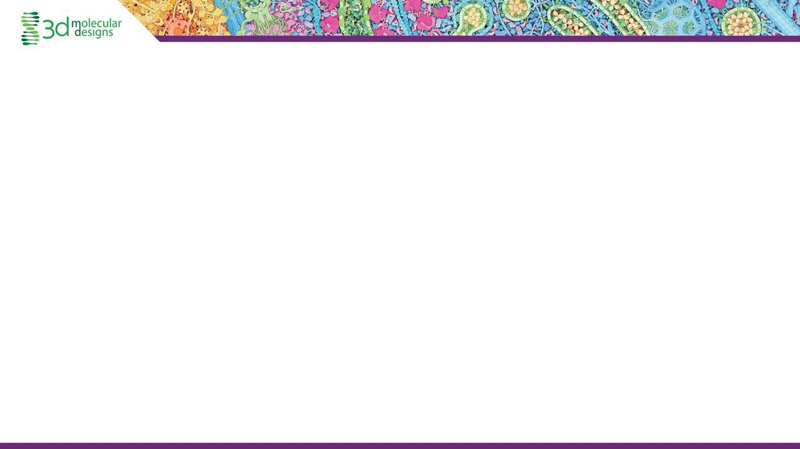
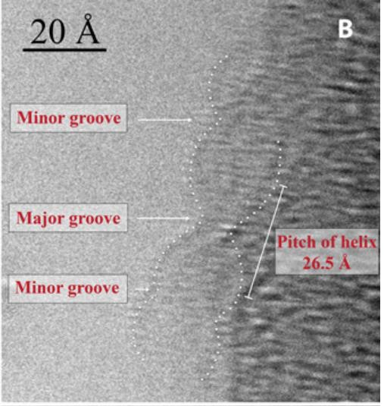
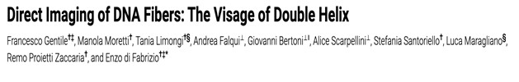
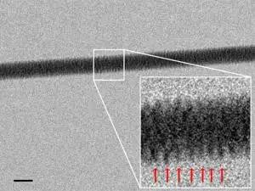
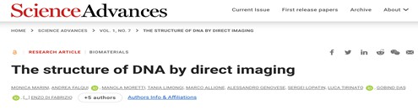
Would it help to see DNA?
https://www.newscientist.com/article/dn22545-dna-imaged-with-electron-
microscope-for-the-first-time/

Slide 14
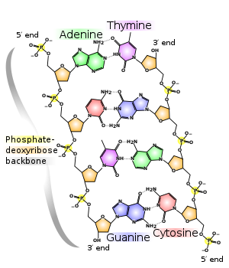
The BIG LEAP

Slide 15
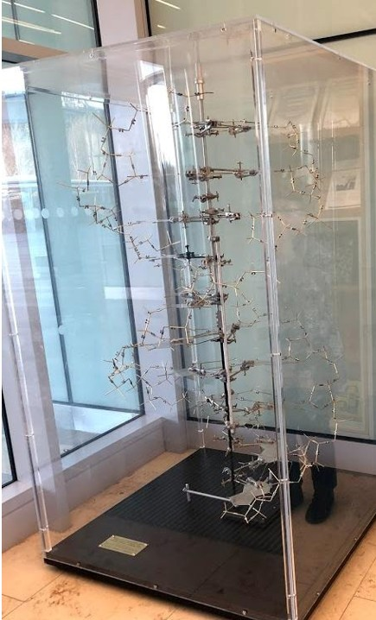
This was one of many proposed models of DNA!

Slide 16

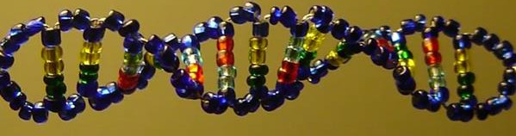
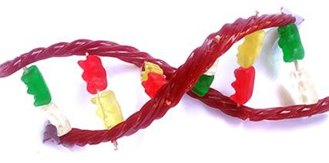
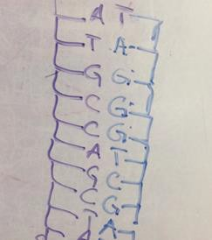
Could the answer be...
So What Makes a Good Model for Exploring DNA Structure and Function?
https://www.instructables.com/The-Double-Helix-Glass-Bead-DNA-model-V20/
It depends?
https://www.sciencebuddies.org/stem-activities/candy-DNA-model

Slide 17
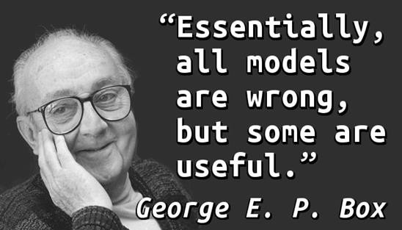
Models can bridge the gap between research and understanding for our students

Slide 18

Let’s Play!
Thinking as one of your students…. Use this model to…
Make 5 observations and
Generate 3 questions
Share out one observation and one question on your sticky note!

Slide 19
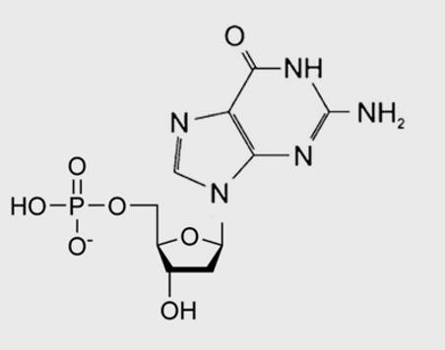
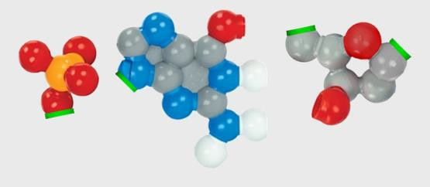

Zooming In!
Let’s assemble a nucleotide!

Slide 20

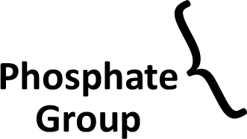
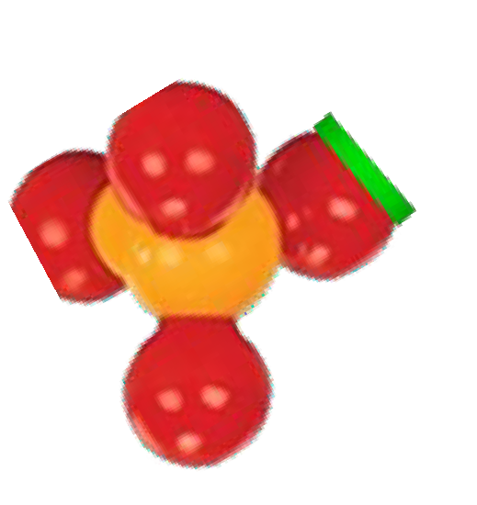
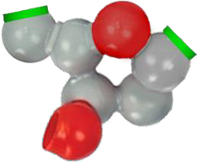
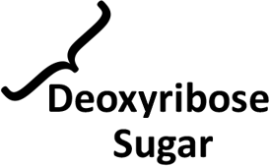
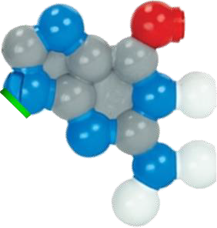
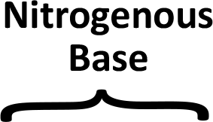
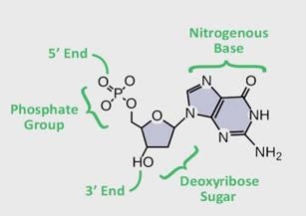
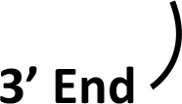
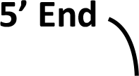
3DMD Digital Resource!
Building a DNA Nucleotide
Double stranded DNA is made up of individual DNA units called nucleotides. Each nucleotide contains a phosphate group and a deoxyribose sugar that make up the backbone, and a nitrogenous base.
Study the chemical structure below.
Drag and connect the nucleotide components on the right to build your own single DNA nucleotide.
Label the parts of the nucleotide.
Answer the question below and move to the next slide.
How many different nucleotides are there in DNA and what are they named?

Slide 21
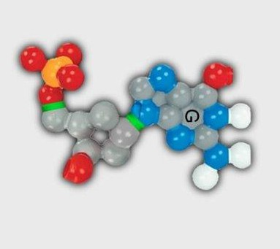
How does it compare to our flat model?

Slide 22
Models can help us predict molecular behavior
Compare your nucleotide to that of ONE other person
Predict how your nucleotides might interact based on your observations
Test it out!
What did you find?

Slide 23

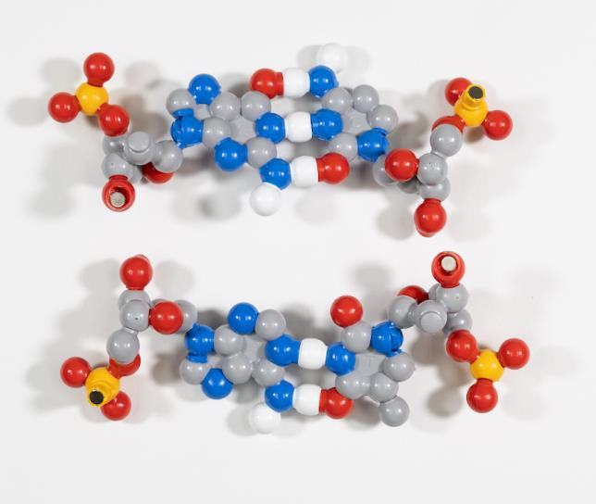
You’ve made some base pairs!
What do you notice?
What predictions can you make and test?

Slide 24
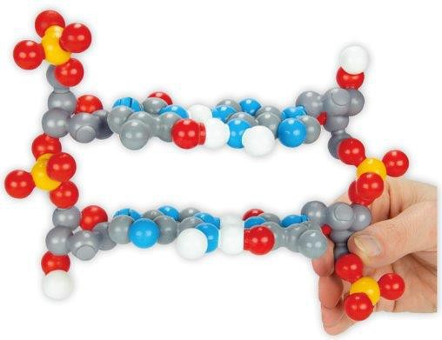
Assemble your base pair with another!
What new questions are emerging at this point?

Slide 25

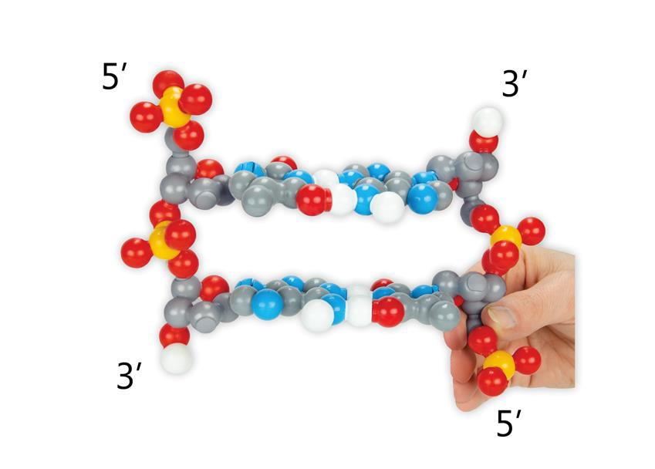
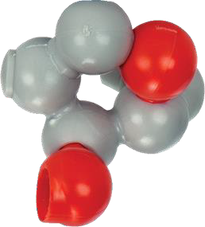
DNA is Antiparallel
1
5
2
3
4

Slide 26

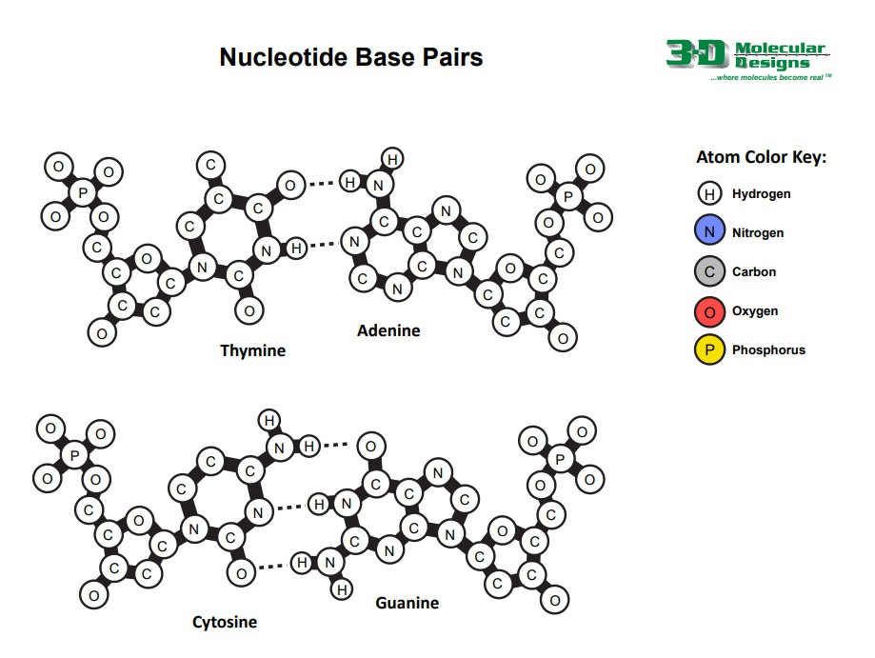
Let’s look for patterns
3D Molecular Designs Resource!

Slide 27

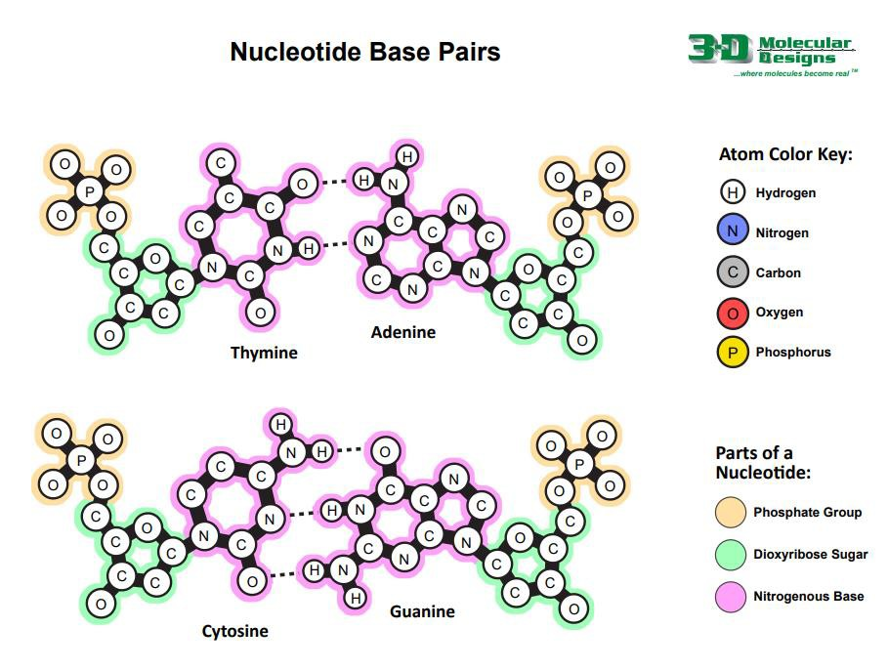
Let’s look for patterns

Slide 28

In Biology Shape Matters!

Slide 29

With 12 base pairs, we can see more!
Minor groove
Major groove

Slide 30

Look here it is!

Slide 31

DNA is Antiparallel

Slide 32

Zooming Out for Function-DNA Replication

Slide 33

Zooming Out for Function: Transcription
But we have a problem!

Slide 35


Zooming Back IN! RNA Nucleotides
5
4
1
3
2

Slide 36
Convert your DNA nucleotide into an RNA nucleotide!
Let’s make RNA nucleotides!
U ➔ T

Slide 37




Zooming Back IN! RNA Nucleotides
Why is this important?
Stability and change!
Now we can make RNA nucleotides!

Slide 38

Converting Uracil to Thymine…
Remove a methyl group!

Slide 39






Many Representations of DNA
There are a variety of ways to represent DNA nucleotides. Despite being very different, the four illustrations shown to the right all show the DNA backbone, the nitrogenous base and the 5’ to 3’ directionality ends of the backbone.
Grab and position the labels below to name the parts of each nucleotide illustration on the right.
Answer the question below and then move to the next slide.
3DMD Resource!

Slide 40
Now that we have RNA nucleotides, what else can we do?
Transcription
Also…look closely!
Energy Transfer!

Slide 41

ATP!
dNTPS – Which is our favorite?
Let’s make
some!

Slide 42


Which parts of DNA remain constant and which change?

Slide 43

What can we see in this model?

Slide 44

What are the strengths and limitations of each model?
Model Analysis-
Teacher Perspective
Student Perspective

Slide 45

What are some stories we can explore with DNA?
More traditional…
Insulin
Cystic fibrosis
Sickle cell
Dog breeding
Corn genetics
Inheritance of sickle cell allele
Huntingdon's disease:
  Outside Resource: Robbie McNab's Story

Slide 46
Other Interesting Stories!
EPAS1 – differences in hemoglobin concentration
FAAH gene – a deletion prevents feelings of pain and anxiety
CCR5-delta 32 – reduces HIV binding to T cells
Stories waiting to be found:
Outside resource: www.omim.org

Slide 47


Dynamic DNA

Slide 48

Double Helix Student Modeling Kit

Slide 49

Other Models to Explore: Flow of Genetic Information

Slide 50

Grades 6-8

Slide 51


Slide 52

Lending Library
Dynamic DNA and DNA starter kits are both available via the Lending Library
https://3dmoleculardesigns.com/lending_library/

Slide 53


Summer Classes
Join us in Milwaukee for Modeling the Molecular World this summer!
July 29 – Aug. 2 OR Aug. 5 – 9

Slide 54

Feedback for 3DMolecular Designs-THANKS!
For a chance to win a $50 Gift Certificate to spend on 3DMolecular Design Kits and Models!
Use FC23
20% Off Orders through 12/31/23
And oh hey! There’s a prize!

Slide 55

PSTA Reflections & Feedback (Thank you!)
Session Evaluation Link: https://bit.ly/psta2023eval

Slide 56



molecular
designs
Transforming Science Learning

Slide 57




�
� �t;
Transforming � � \Q �
p...
·----�
Science Learning �

