Slide 1
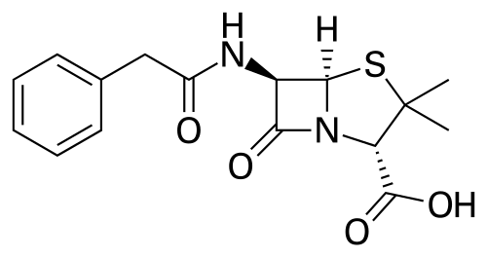
Benzylpenicillin (Penicillin – G)

Slide 2
Benzylpenicillin (Penicillin – G)

Slide 3
Benzylpenicillin (Penicillin – G)

Slide 4
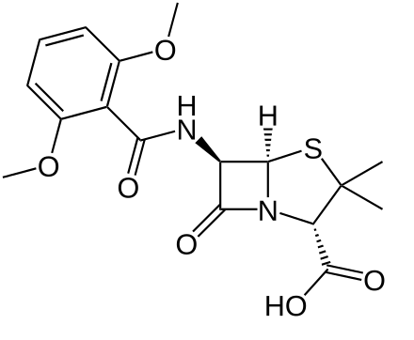
Benzylpenicillin -> Methicillin
Carbon

Slide 5
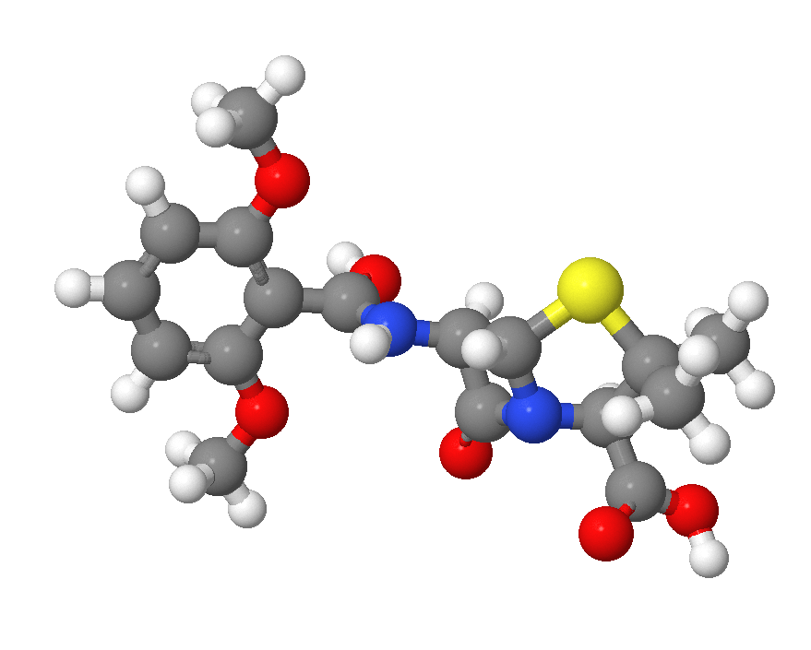
Methicillin

Slide 6
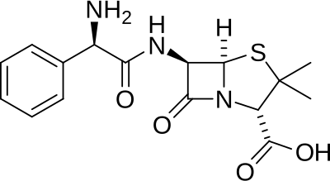
Benzylpenicillin -> Ampicillin

Slide 7
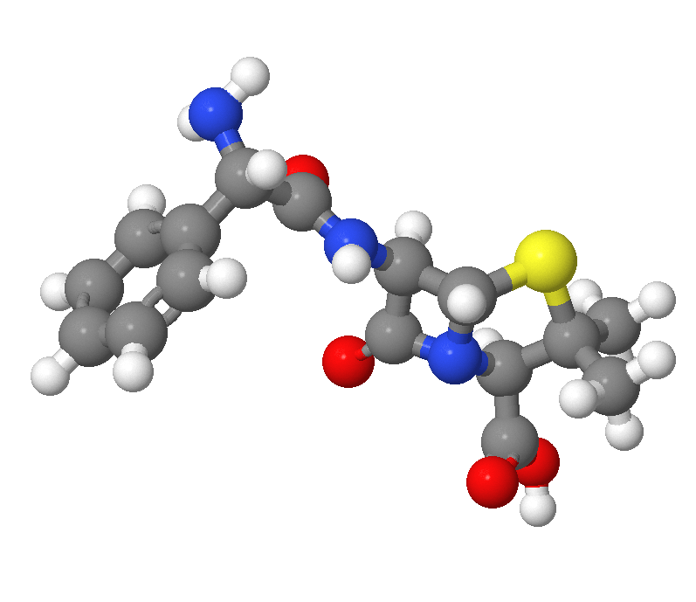
Ampicillin

Slide 8
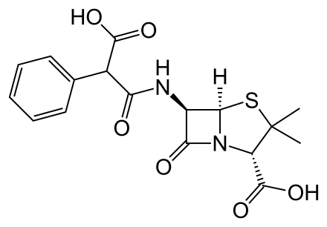
Benzylpenicillin -> Carbenicillin

Slide 9
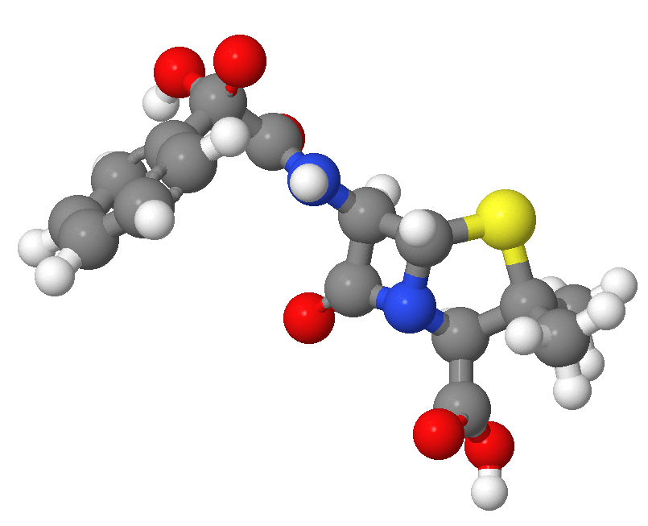
Carbenicillin

Slide 10
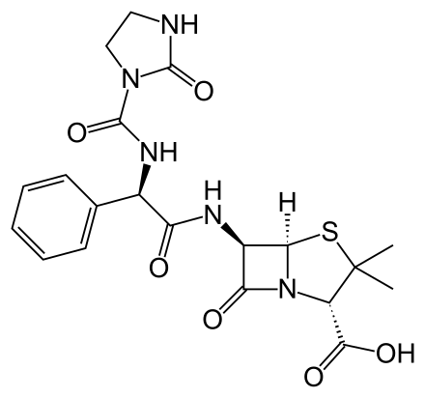
Benzylpenicillin -> Alzocillin

Slide 11
Azlocillin

