Slide 1
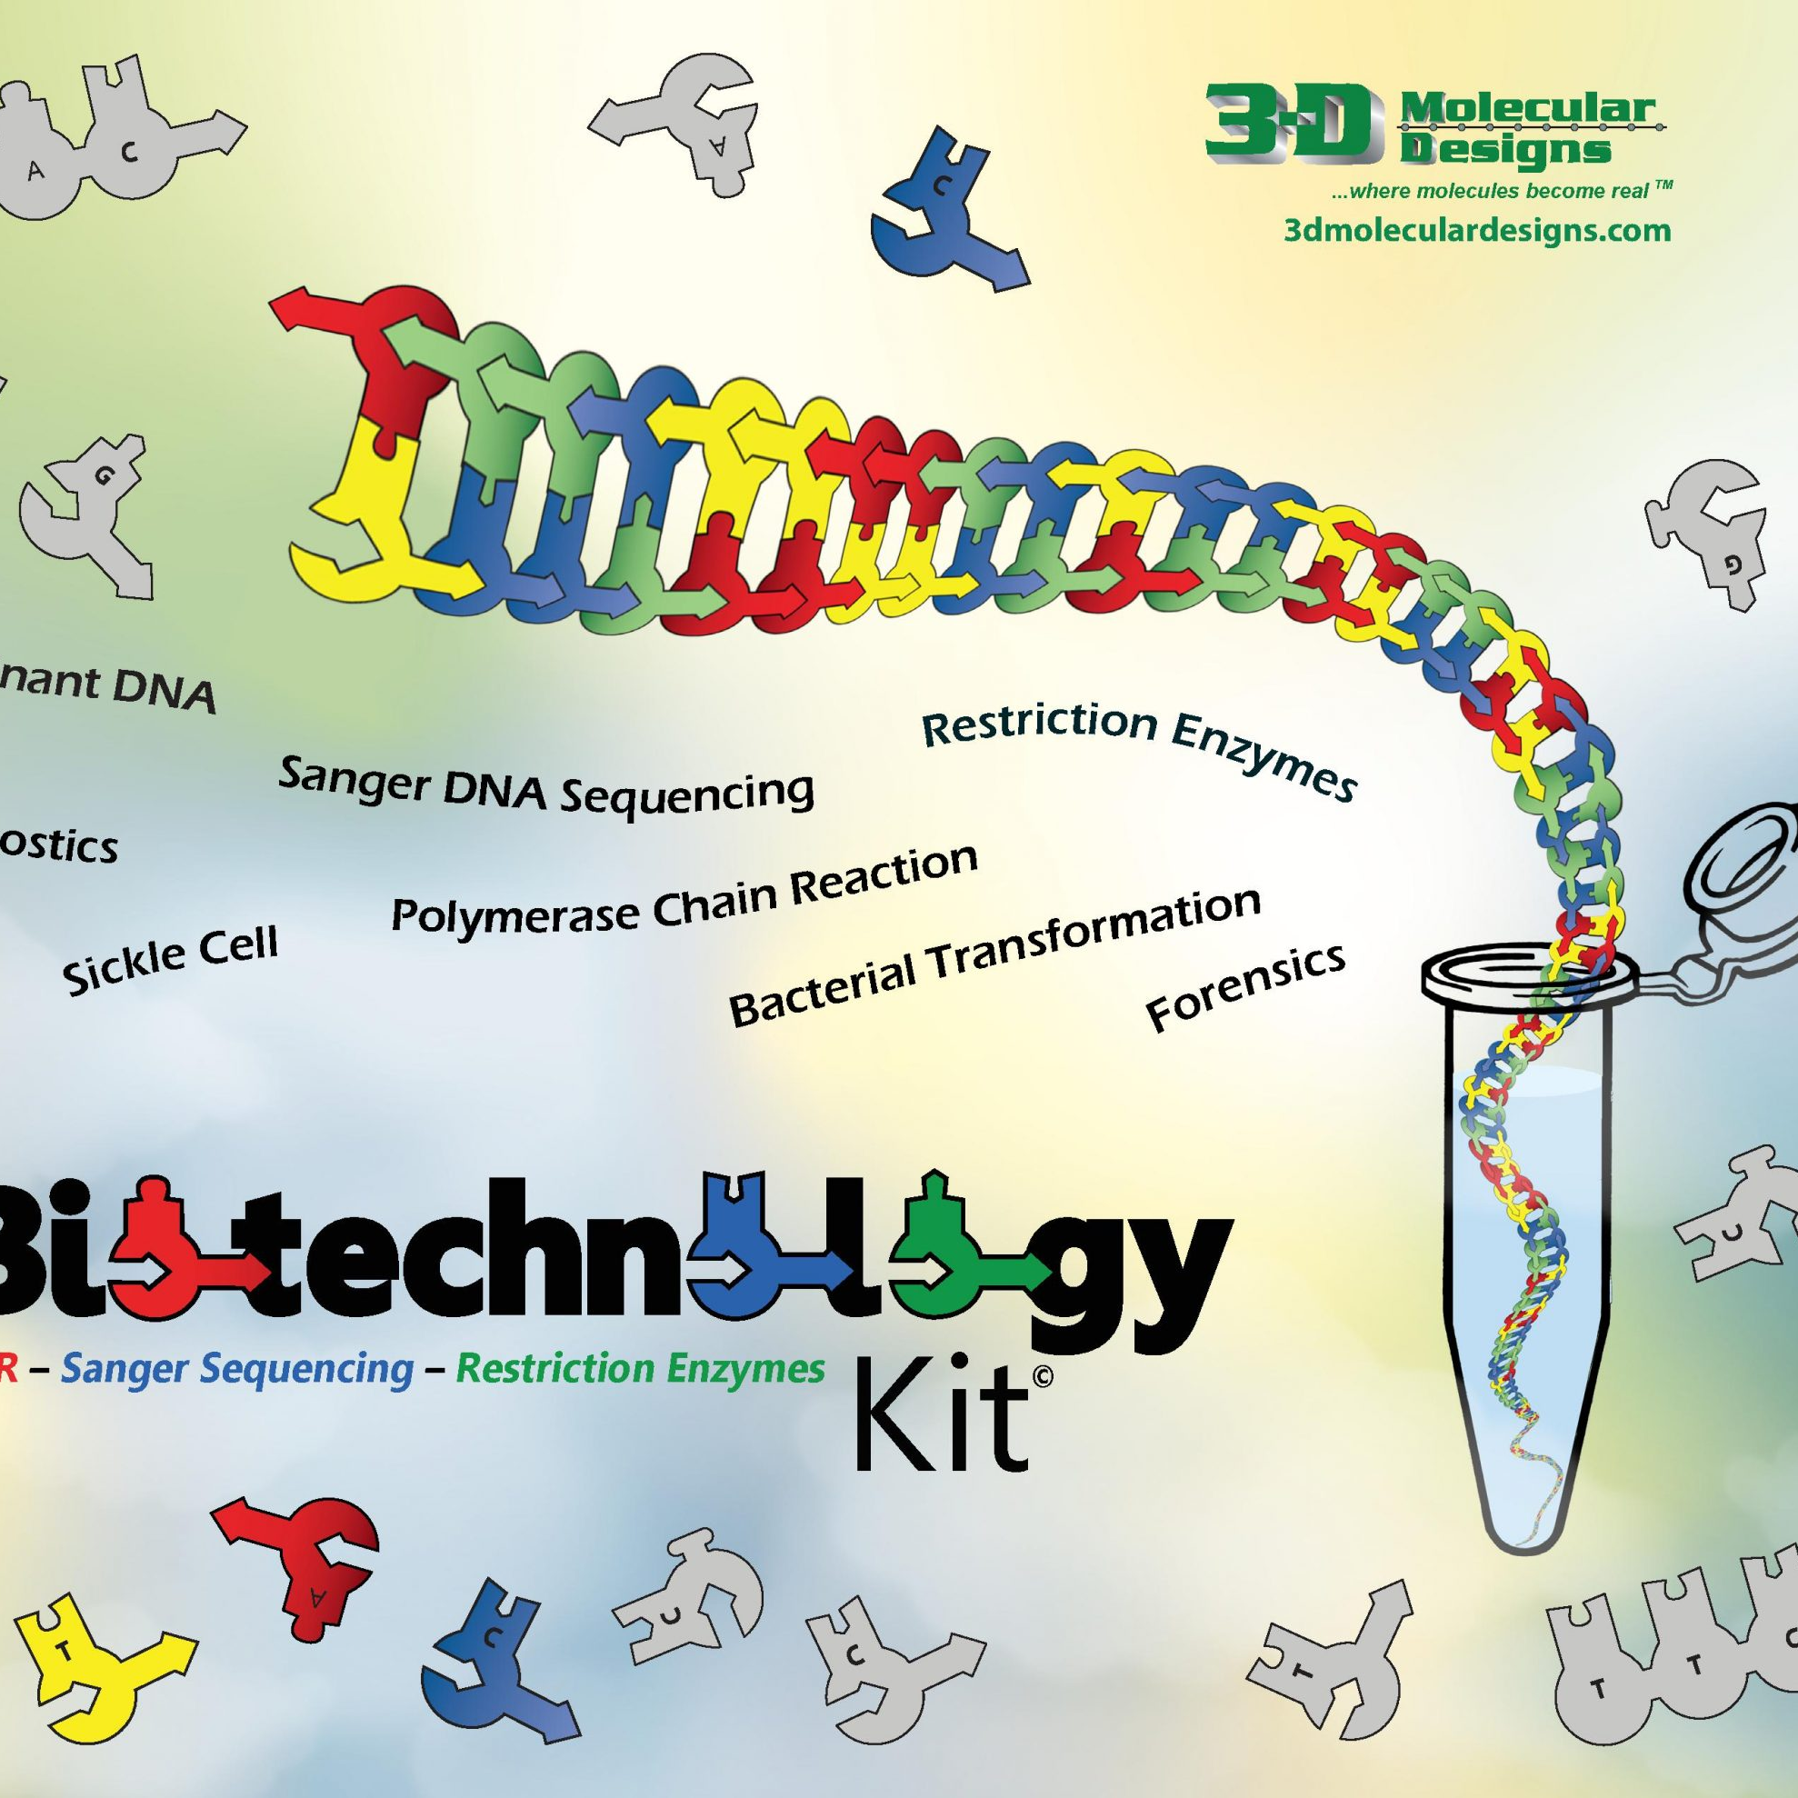

Hurry up and wait…
Plasmid
Ligations
Mark “Arnie” Arnholt
3D Molecular Designs

Slide 2
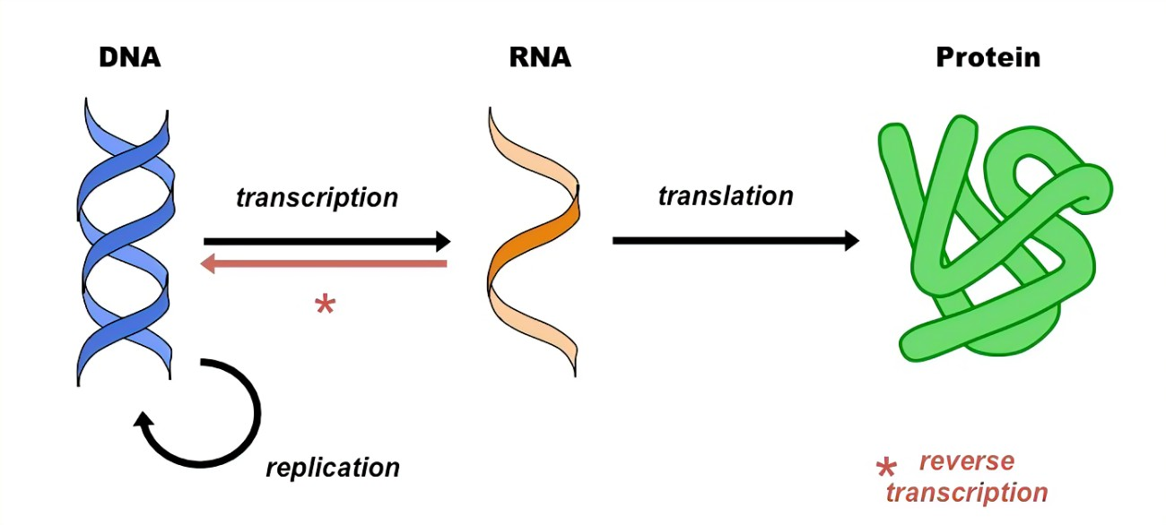
The Central Dogma of Biology

Slide 3
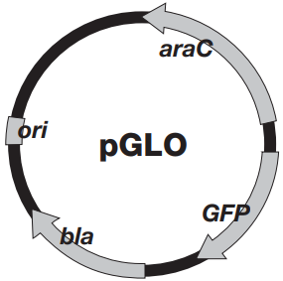
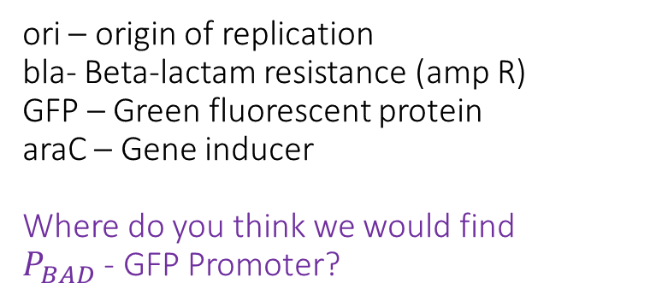
ori – origin of replication bla- Beta-lactam resistance (amp R)
GFP – Green fluorescent protein araC – Gene inducer
Where do you think we would find
$P_{BAD}$ - GFP Promoter?
Our simplified plasmid map:

Slide 4
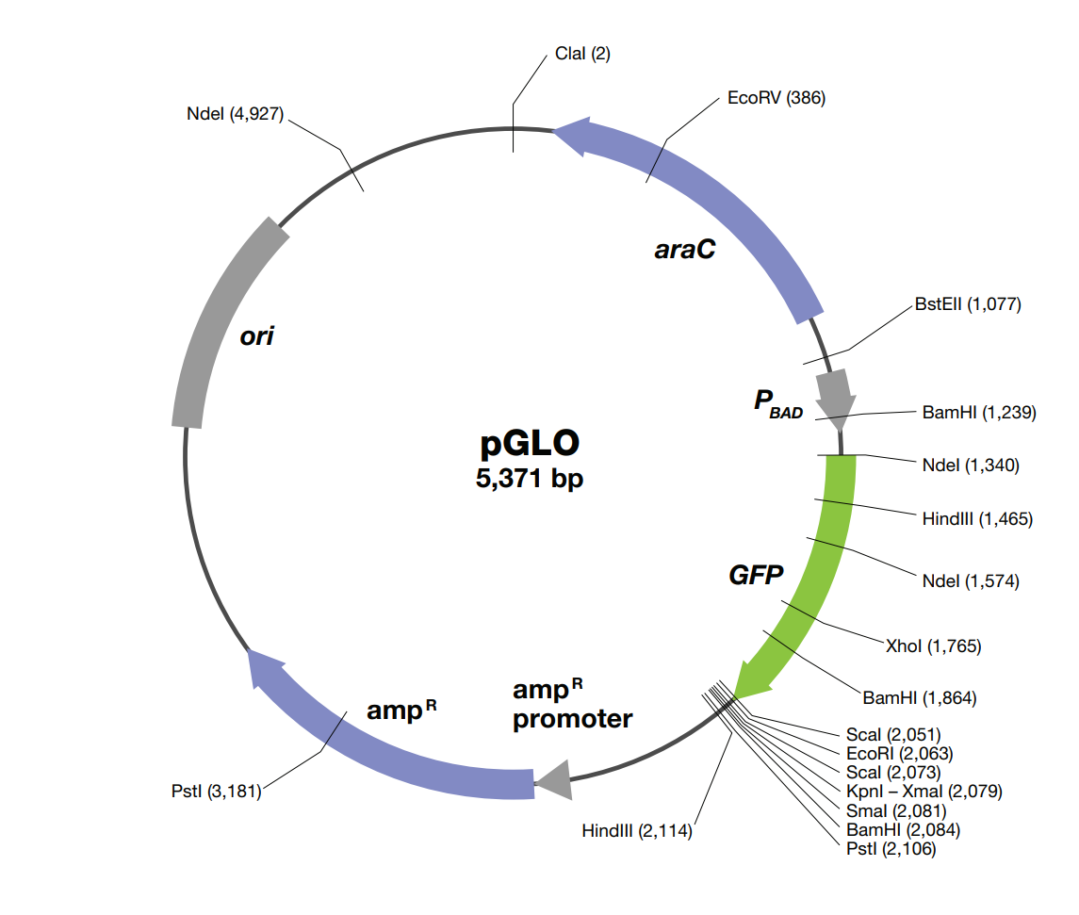
pGLO is a 5,371 bp plasmid
Promoters and restriction sites are identified
See handout-
A little more detailed

Slide 5
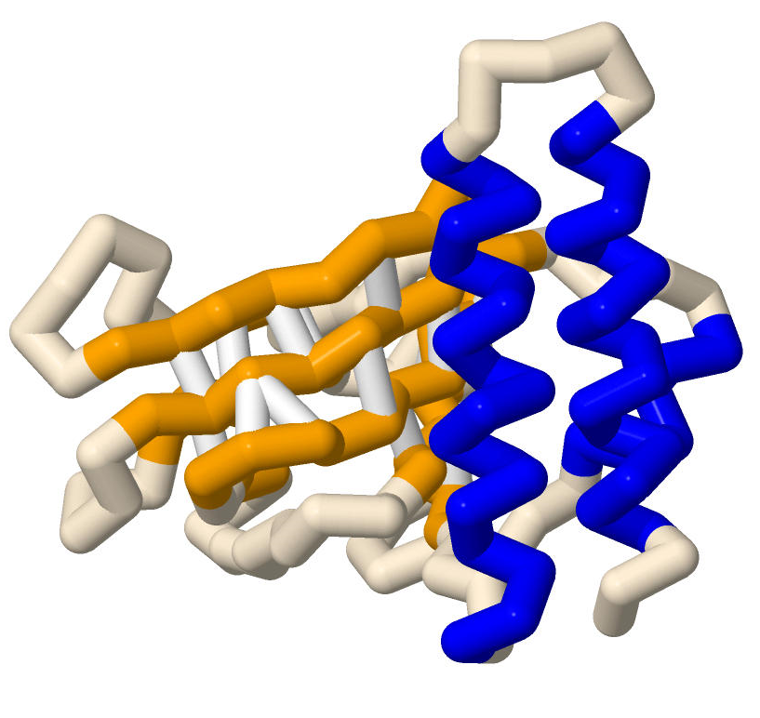
How does araC regulate the GFP transcription?
araC gene regulation

Slide 6
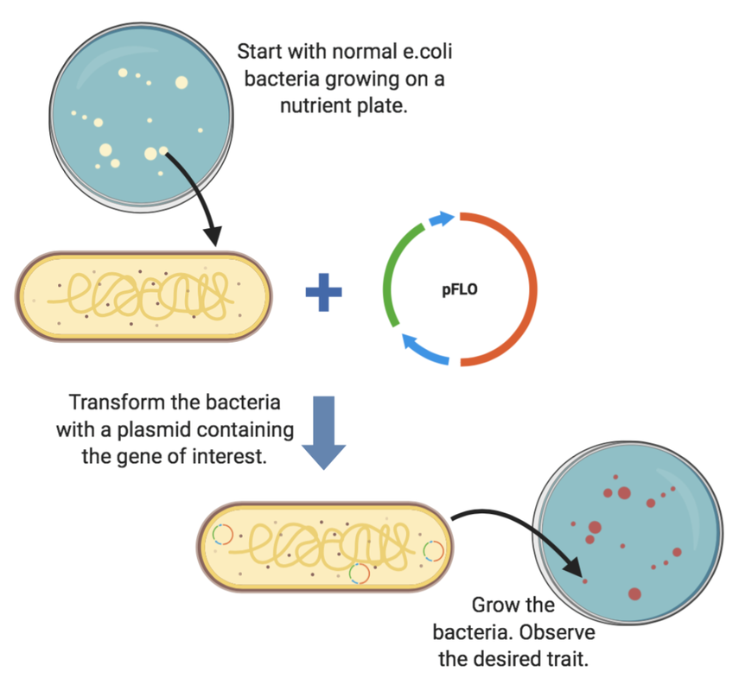
Harnessing the power of microbes
How do I transform a bacterial cell?

Slide 7
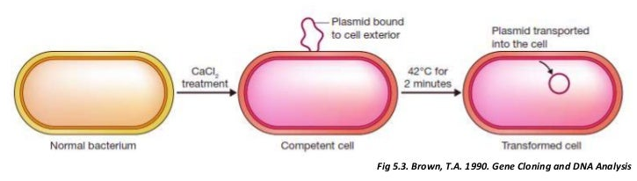
Bacterial Transformation

Slide 8
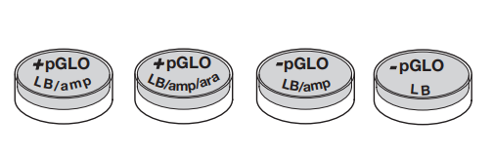
Predict our outcomes on these plates.
-pGLO have not been transformed
+ pGLO have our plasmid
Predicted growth / glow
Screening our products:
Plate I Plate II Plate III Plate IV
I | II | III | IV
Notes:
LB is Lysogeny broth (or Luria Broth) agar.

Slide 9
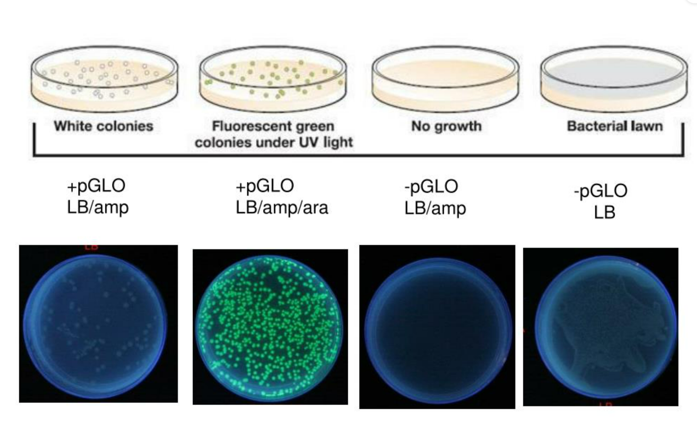
Predicted results
I | II | III | IV
A few grow no glow | A few grow and glow | No growth | Lawn (TMTC)

Slide 10
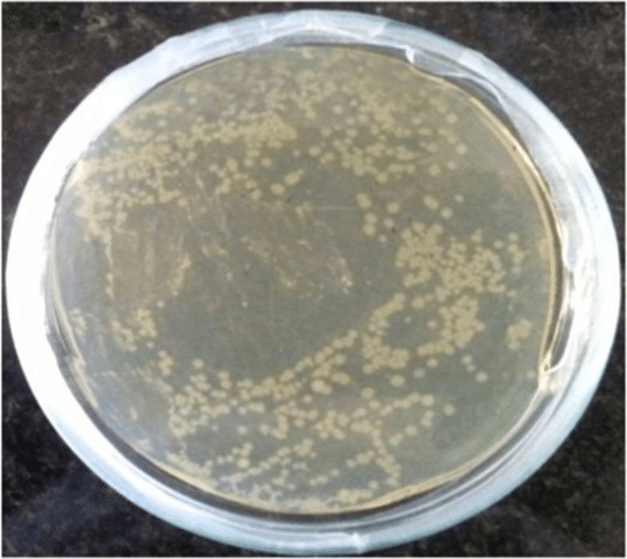
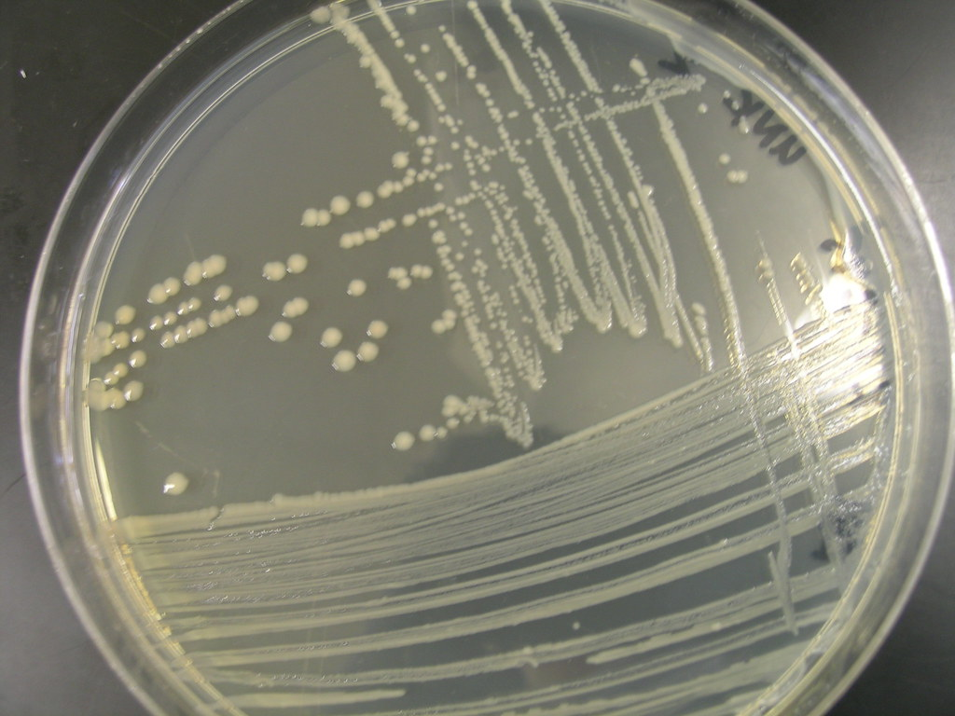
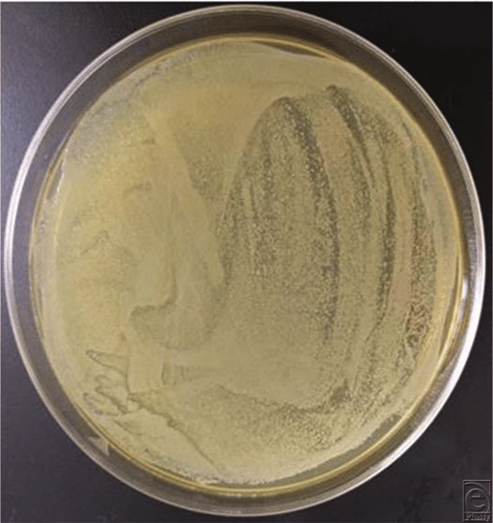
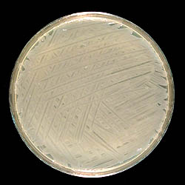
Our Actual plates:
I | II | III | IV
Lawn | Lawn | Lawn | Lawn

Slide 11
What happened?
I | II | III | IV
Lawn | Lawn | Lawn | Lawn
How can we troubleshoot this?

Slide 12
How do I get a gene of interest into a plasmid?
1) Identify the target gene
2) PCR
3) Restriction enzyme digest
4) Ligate plasmid
5) Bacterial transformation and screening

Slide 13
Let’s look at our antibiotics…
Ampicillin – inhibitor of transpeptidase – prevents cell wall formation
Kanamycin – targets 30s subunit of a ribosome -> leads to incorrect amino acids being added to a peptide during translation
We will try and insert a kanamycin resistance gene into our plasmid and screen our bacteria. We can induce the gene with arabinose.

Slide 14
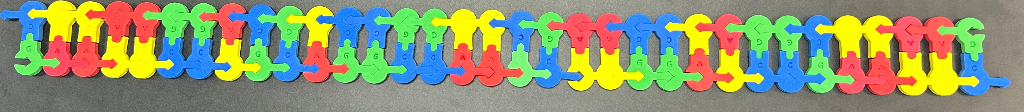
Let’s look at out target gene…
Our target gene has been truncated as the actual gene would be hundreds of BP’s long.
It also has lots of restriction sites in it-

Slide 15
Restriction enzymes – Molecular scissors
Endonucleases that cleave DNA into fragments at specific recognition sites.
Defense mechanism for bacteria and archaea to defend themselves against viruses
Make incisions through the sugar-phosphate backbone of DNA

Slide 16
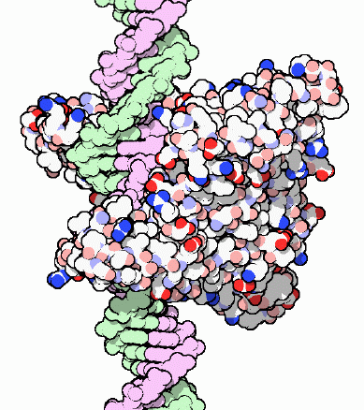
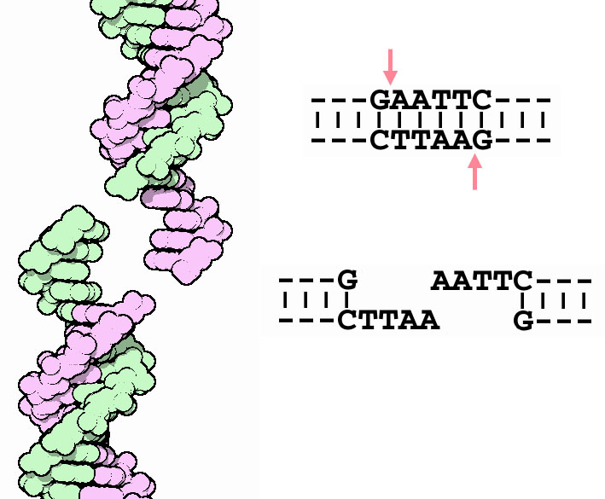
EcoRI

Slide 17
We will need to digest our target DNA
Restriction enzymes at hand include:
Eco RI
Bam HI
PstI
HIND III
Hae III

Slide 18
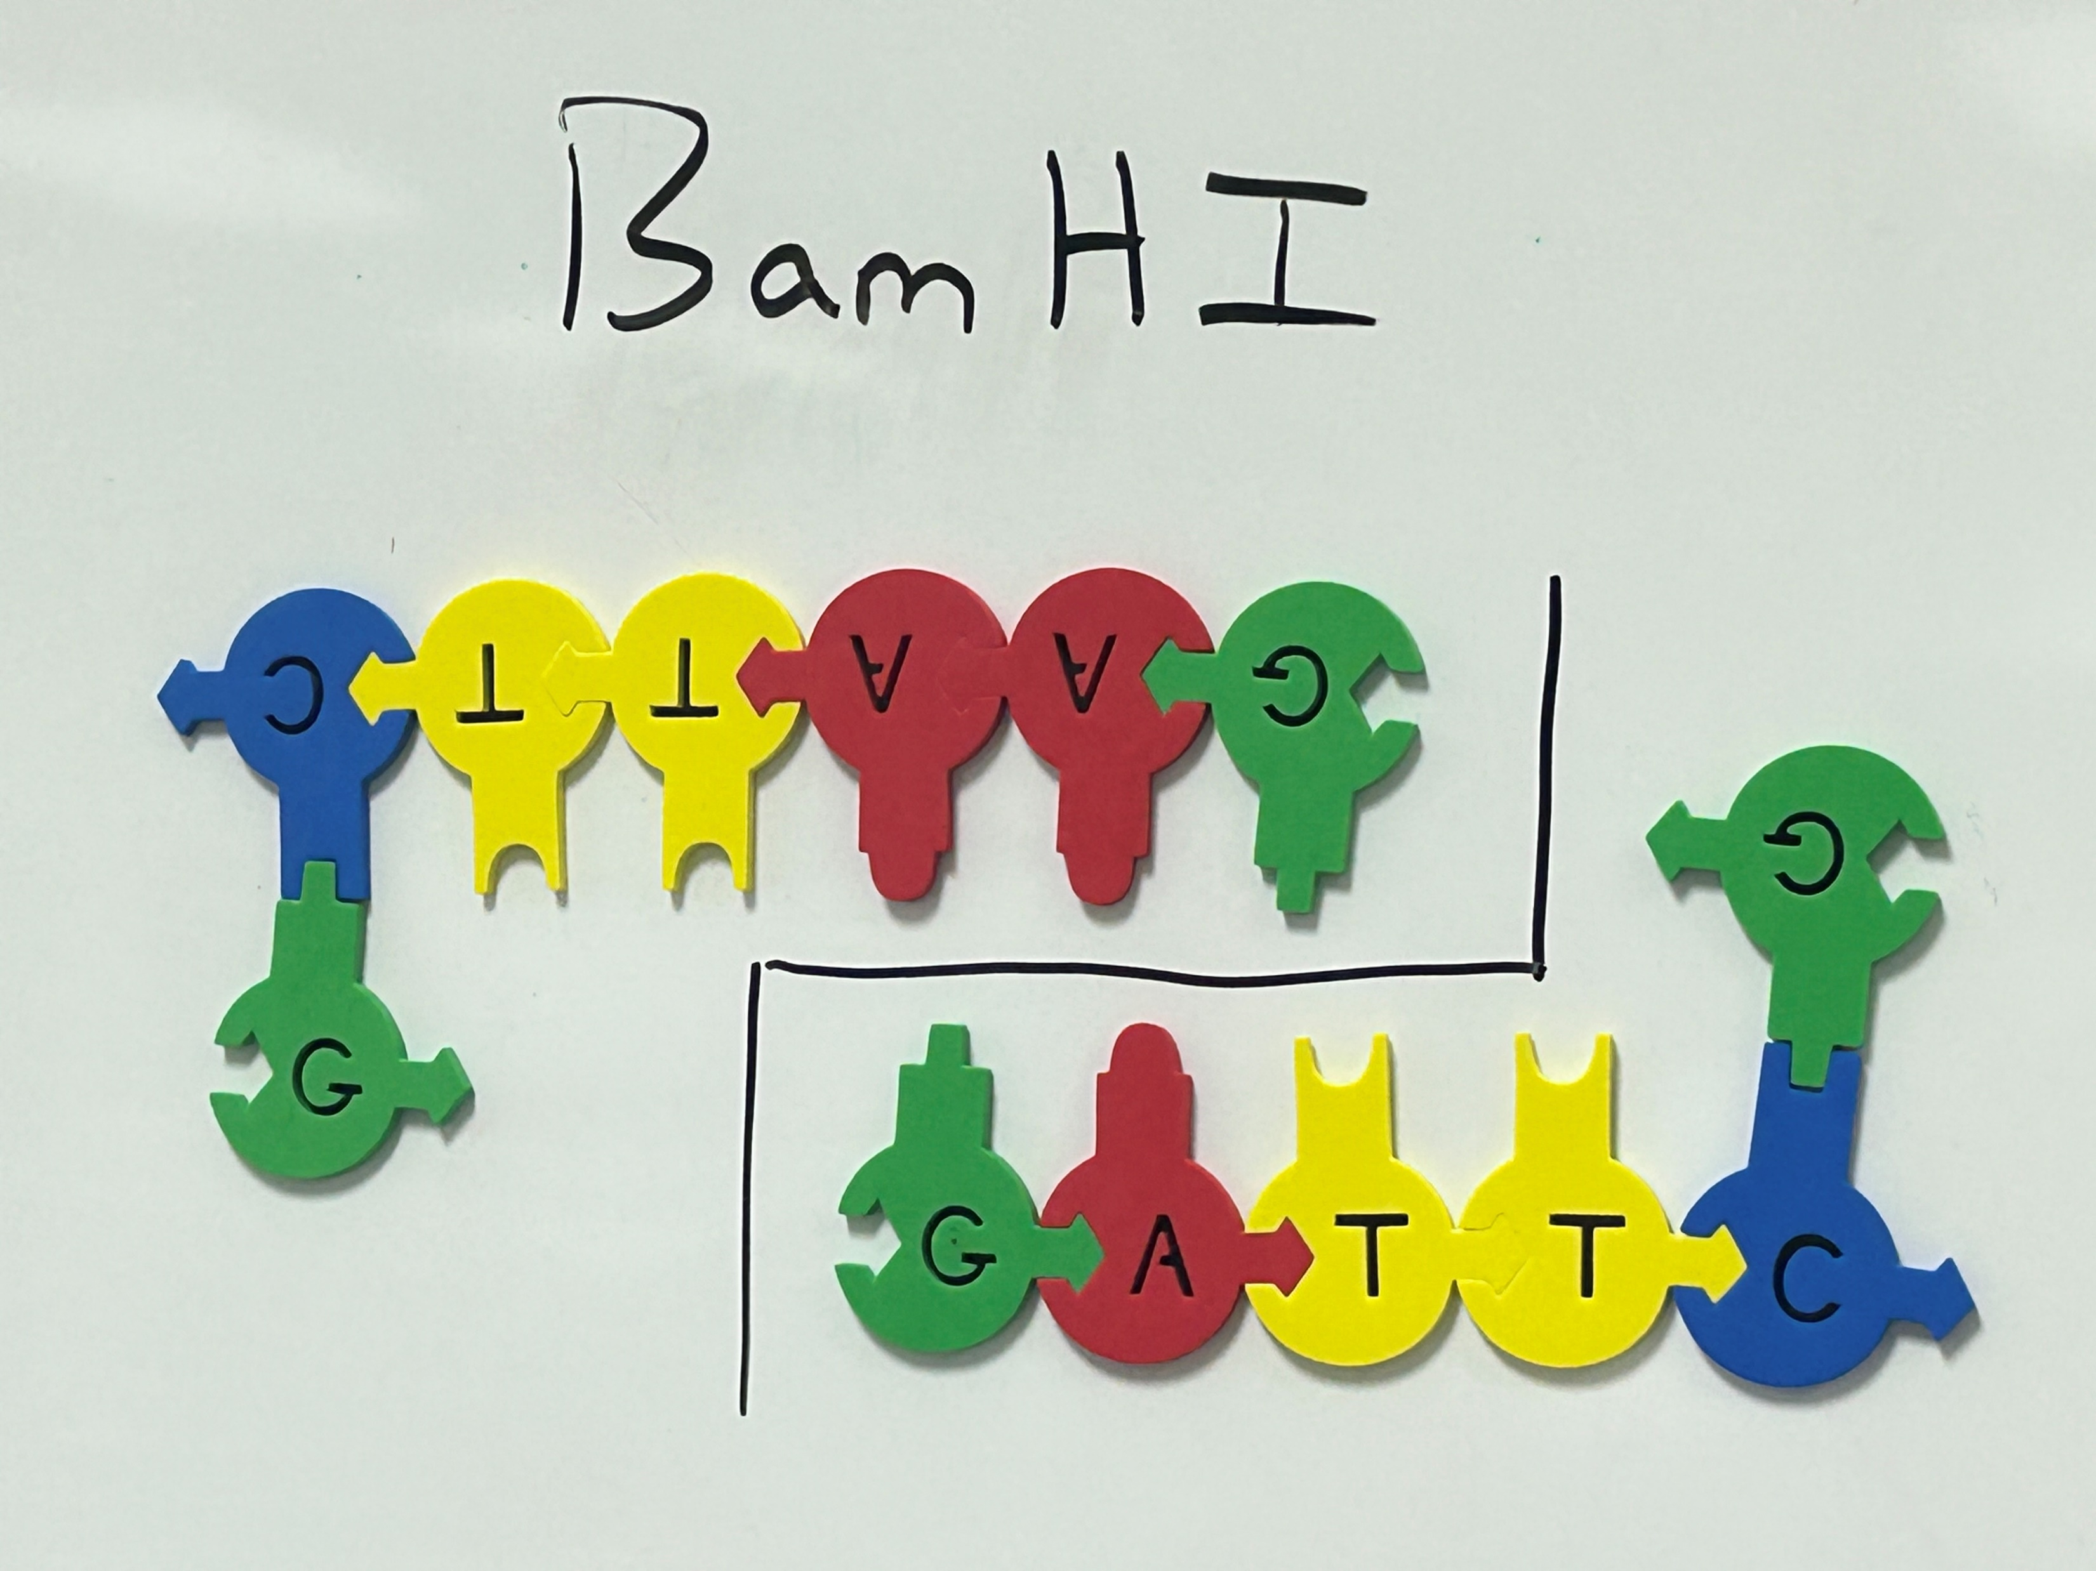
BamHI

Slide 19
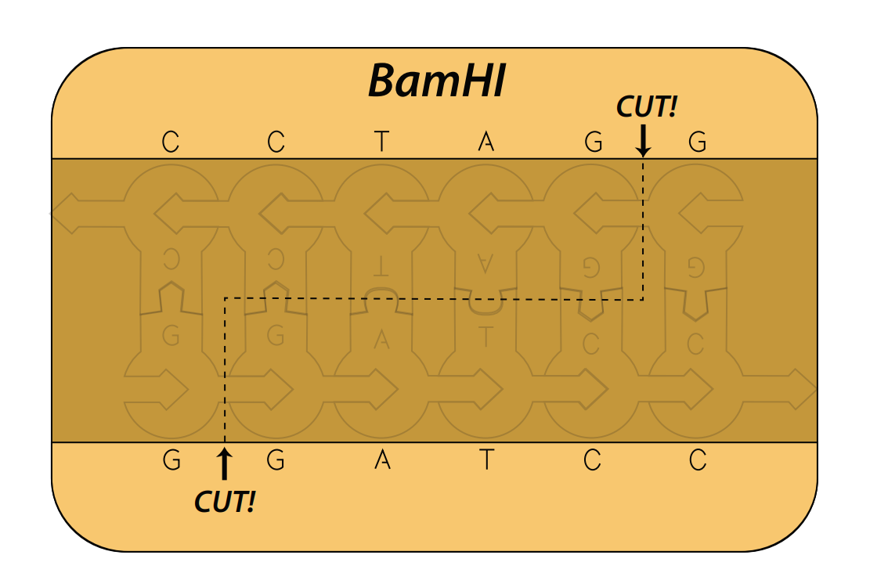
BamHI

Slide 20
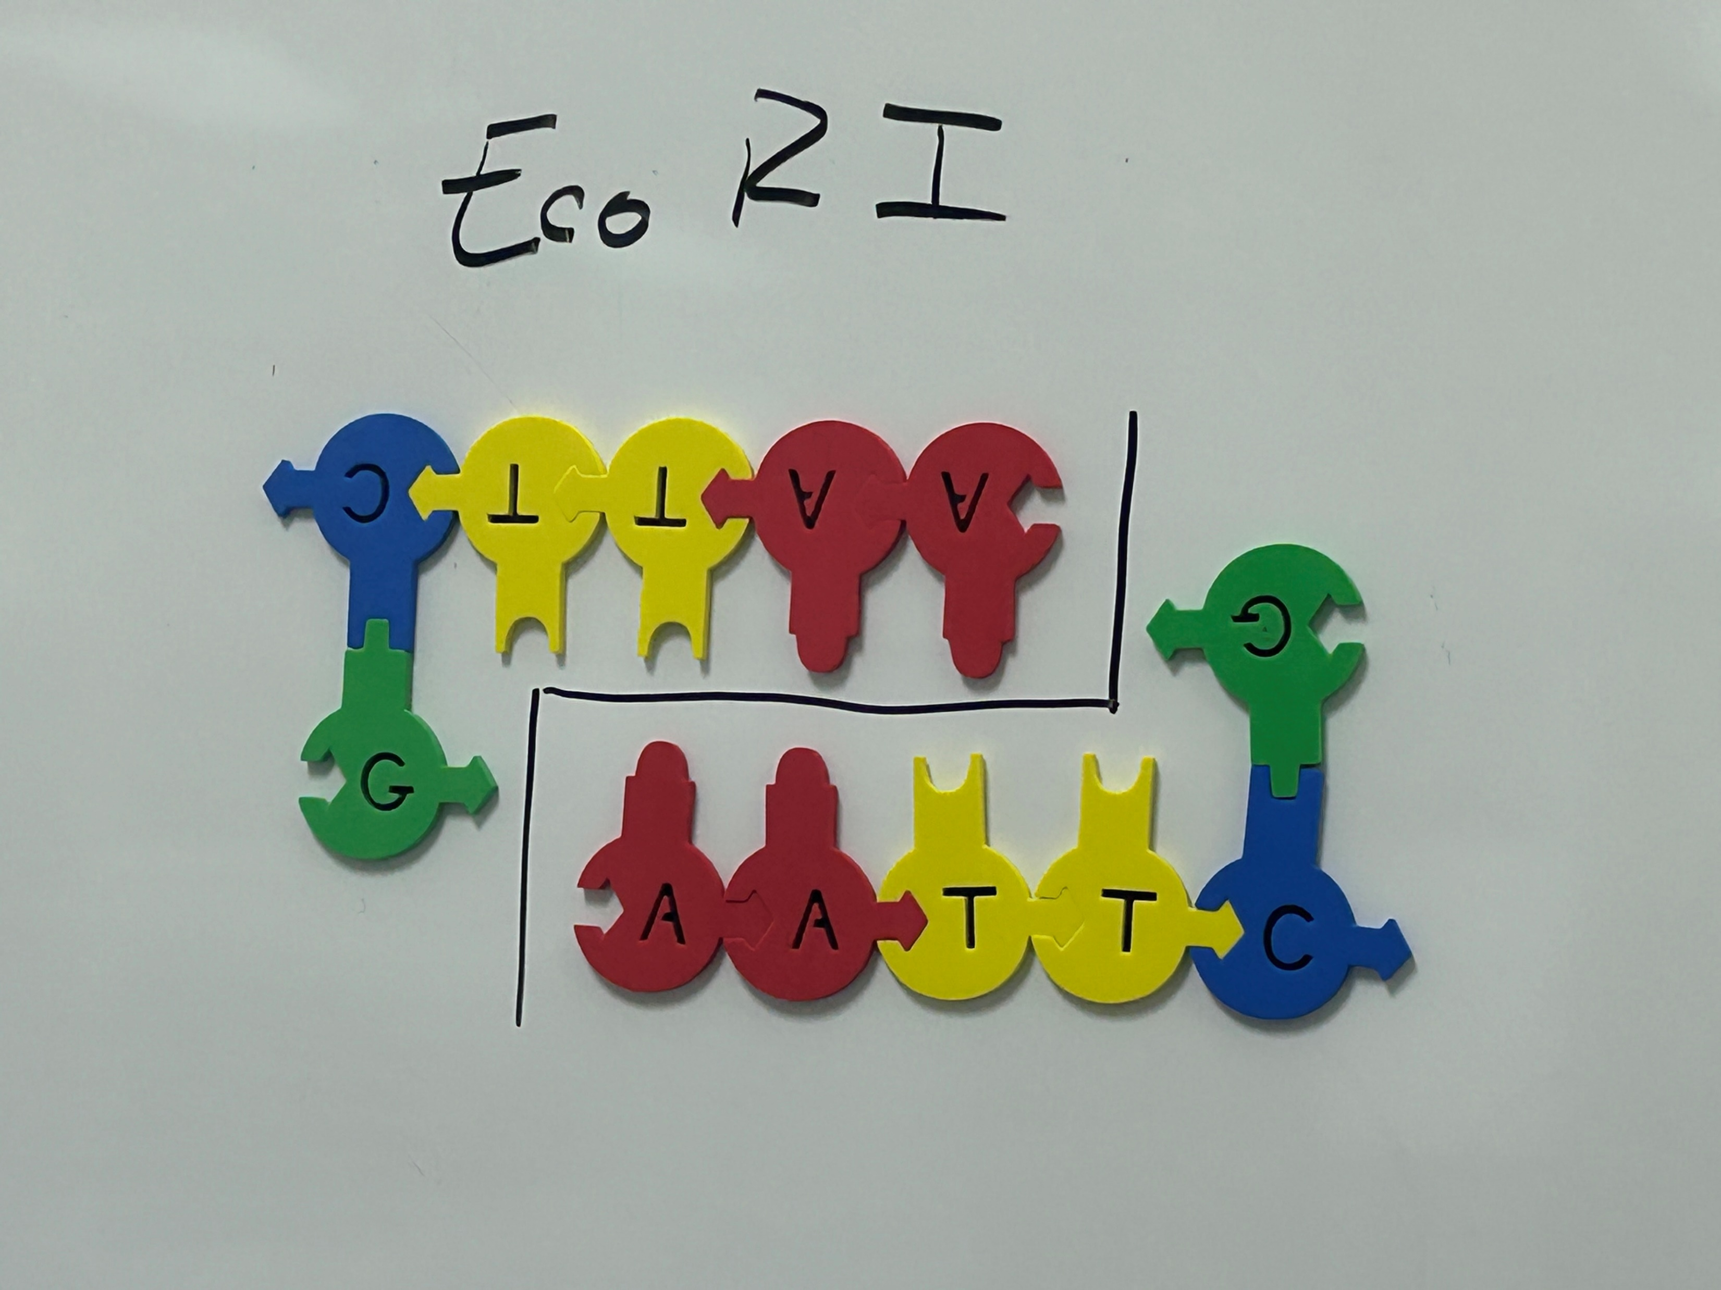
EcoRI

Slide 21
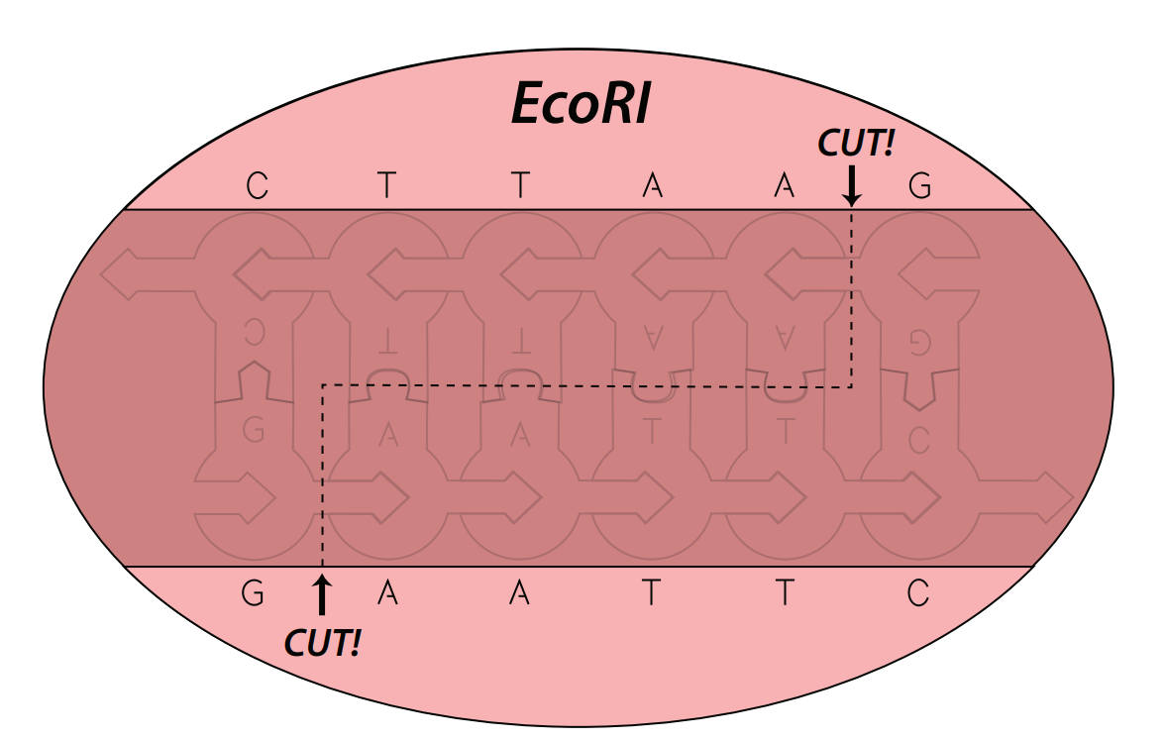
EcoRI

Slide 22
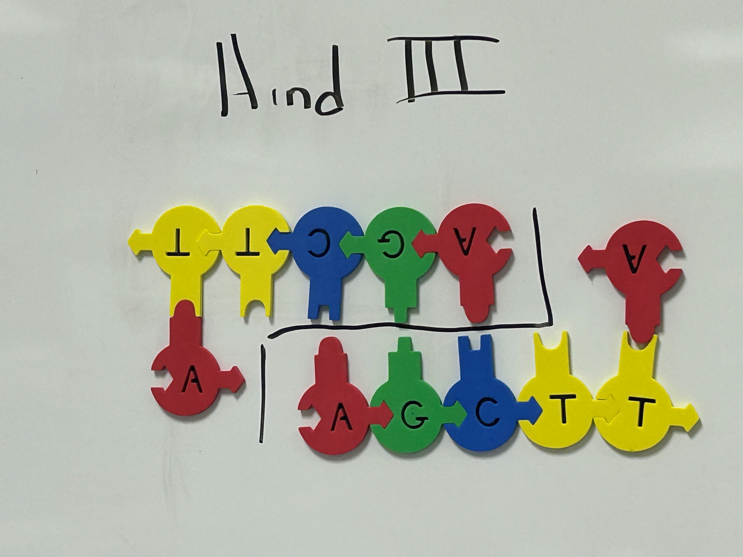
Hind III

Slide 23
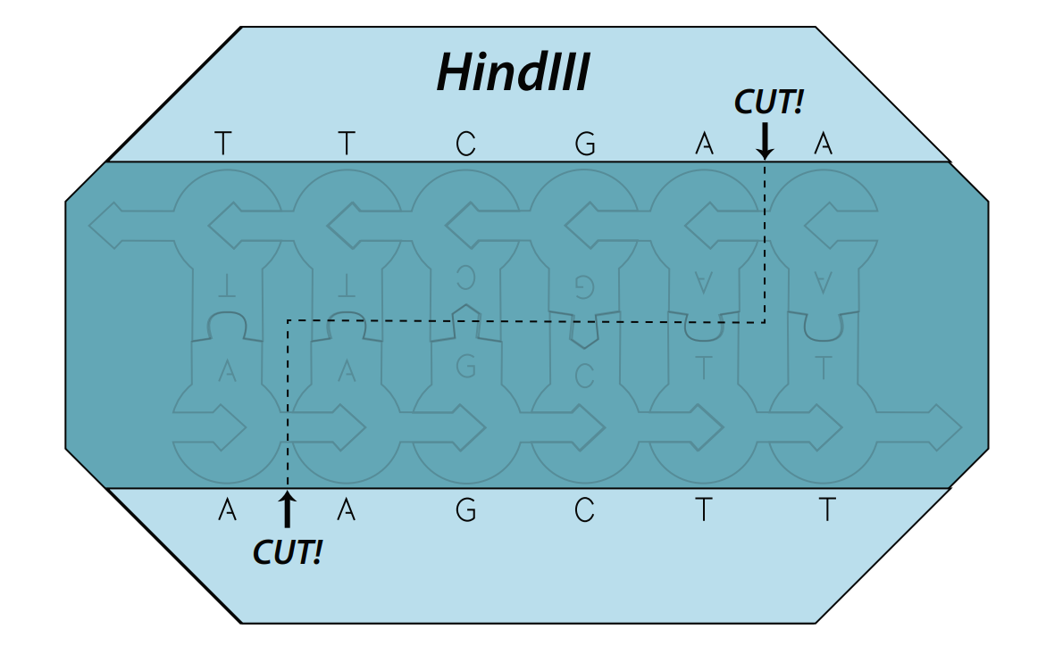
Hind III

Slide 24
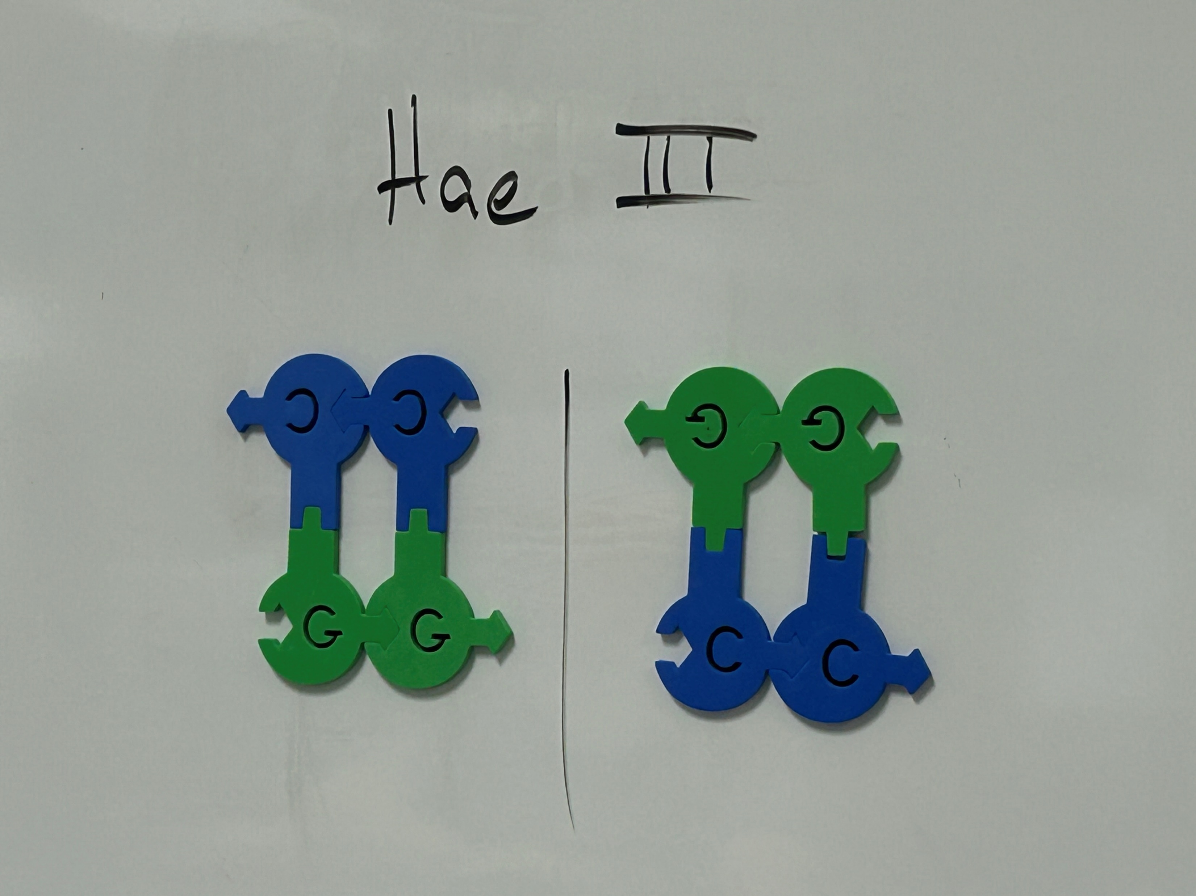
Hae III

Slide 25
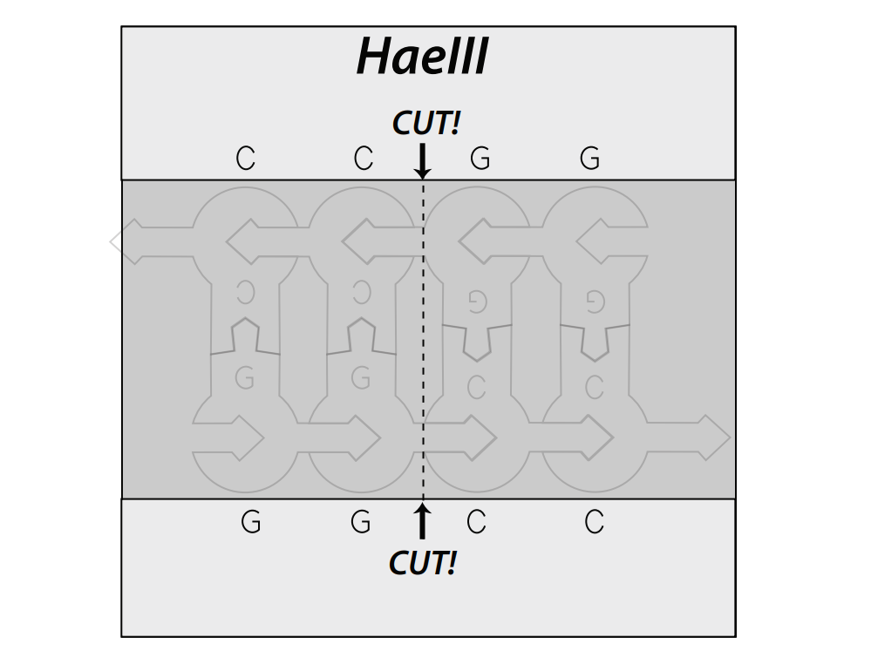
Hae III

Slide 26
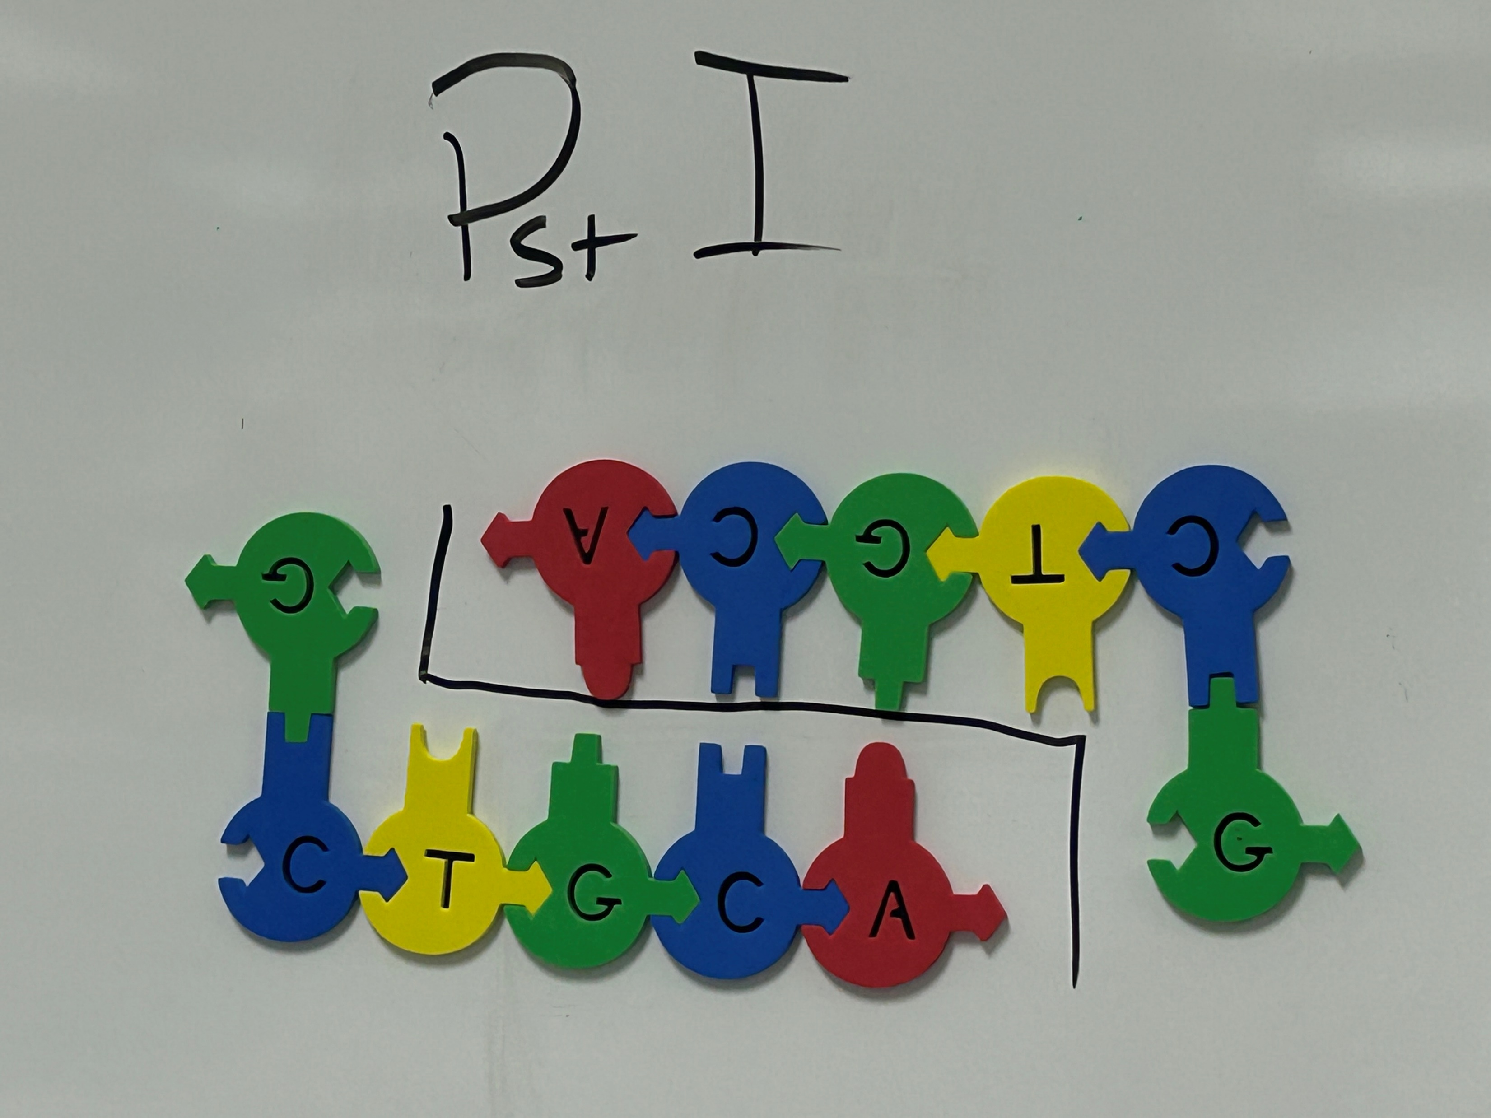
PstI

Slide 27
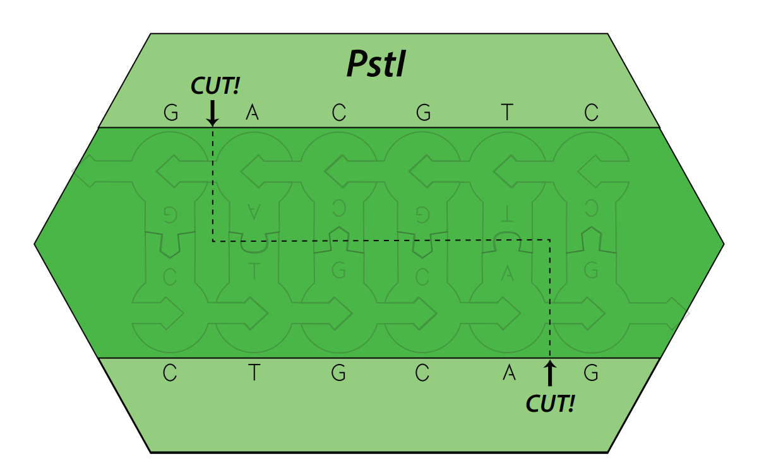
PstI

Slide 28
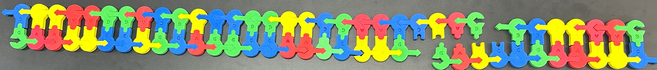
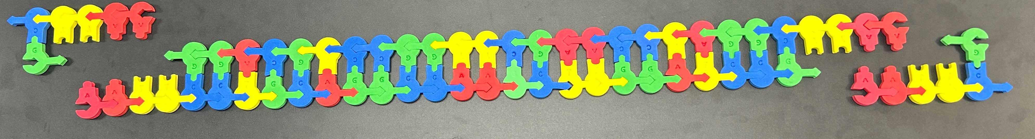
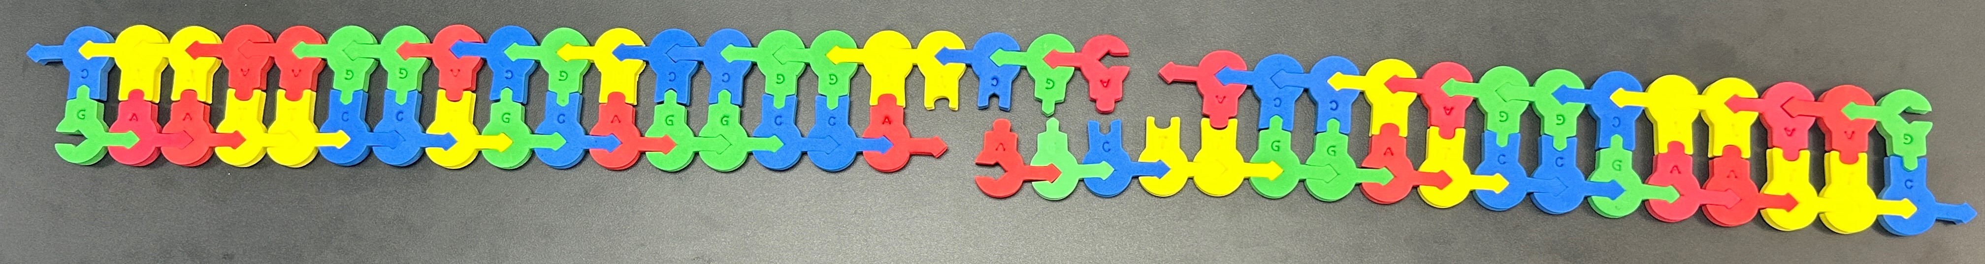
Our digests…

Slide 29
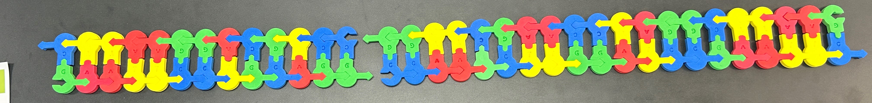
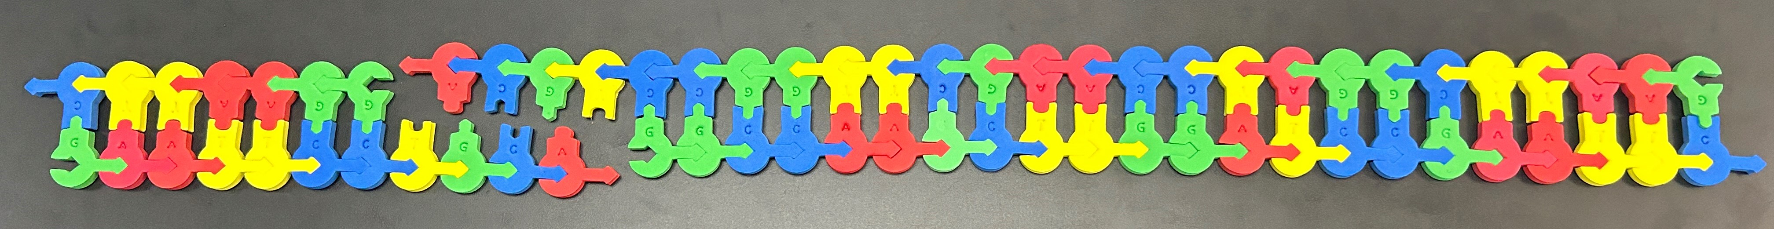
Our digests…

Slide 30
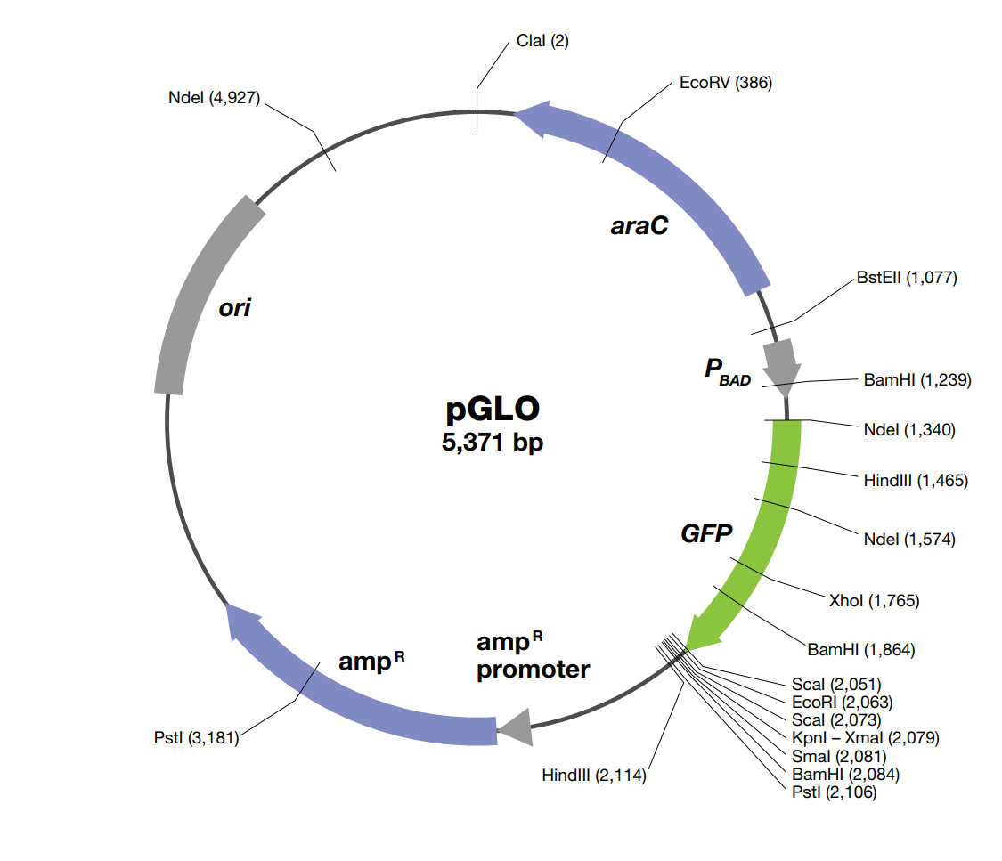
Our actual map:
All of our potential restriction sites have been identified:
See handout-

Slide 31
We need to use the same enzyme
The target DNA and the plasmid need to be digested with the same restriction enzyme.
Which one should we use?

Slide 32
EcoRI !

Slide 33
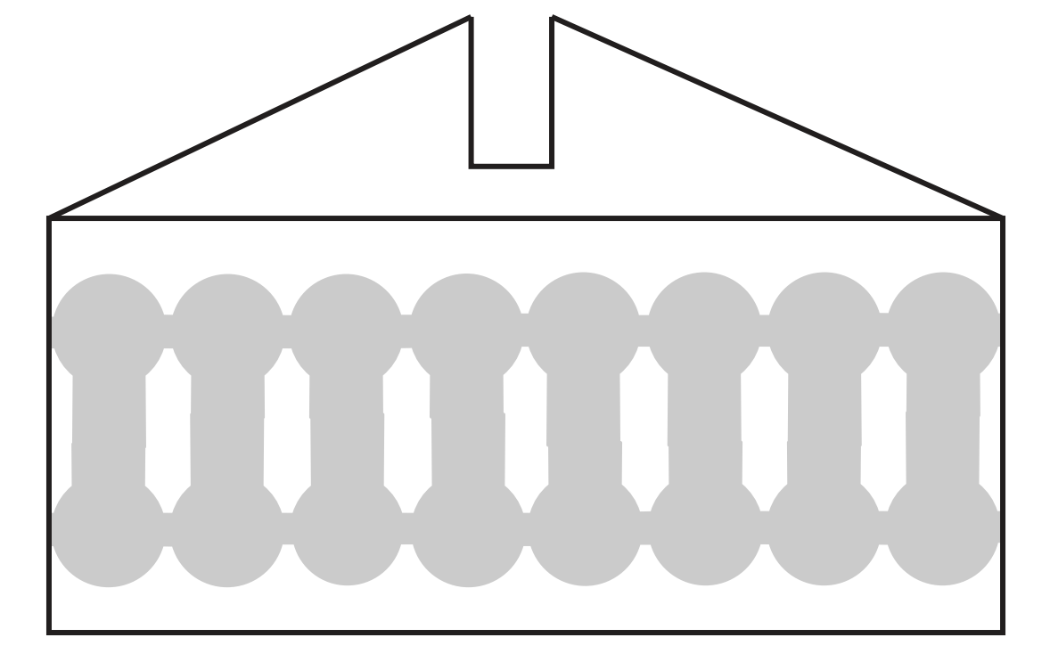
Build the EcoRI Sequence in gray -
G A A T T C
G A A T T C

Slide 34
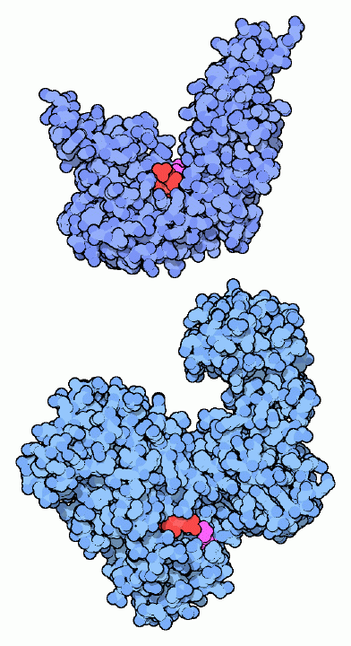
DNA Ligase – Molecular tape

Slide 35
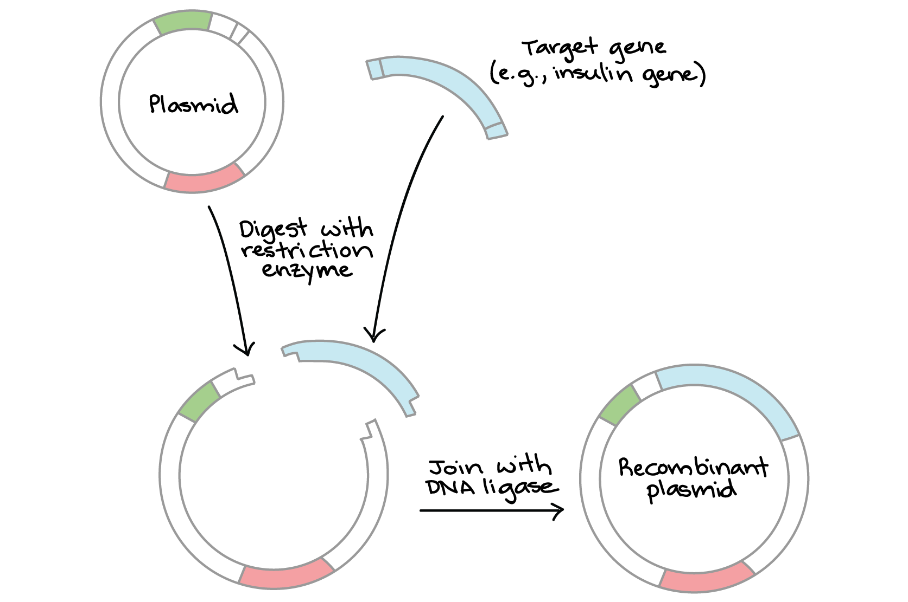
Digest and Ligate

Slide 36
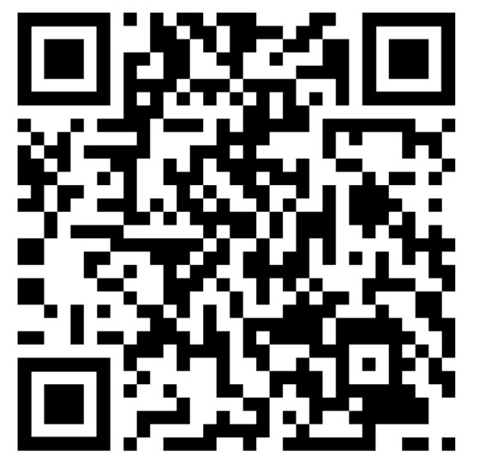
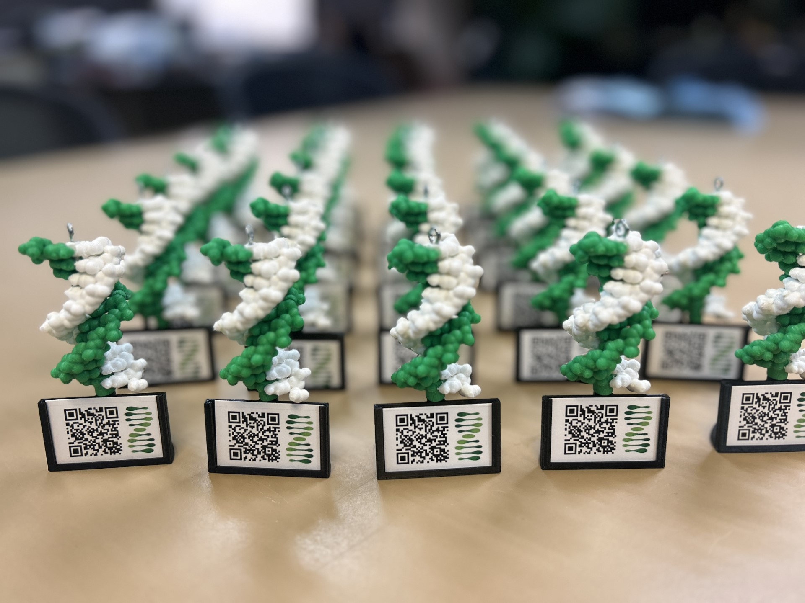
Scan this QR code and fill out our survey!
Show me your DNA molecule image and I’ll give you a model with AR enhancement as a thank-you gift!

Slide 37
TEKS
(6) The student explores the emerging field of biotechnology. The student is expected to:
define biotechnology and provide examples of biotechnology products such as recombinant proteins, fermented foods, biopharmaceuticals, and genetically modified foods;
(i) Define biotechnology
(ii) Provide examples of biotechnology products

