Slide 1
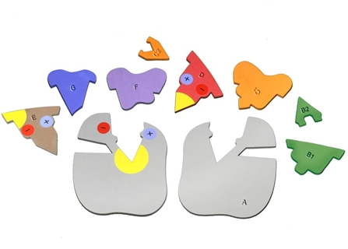
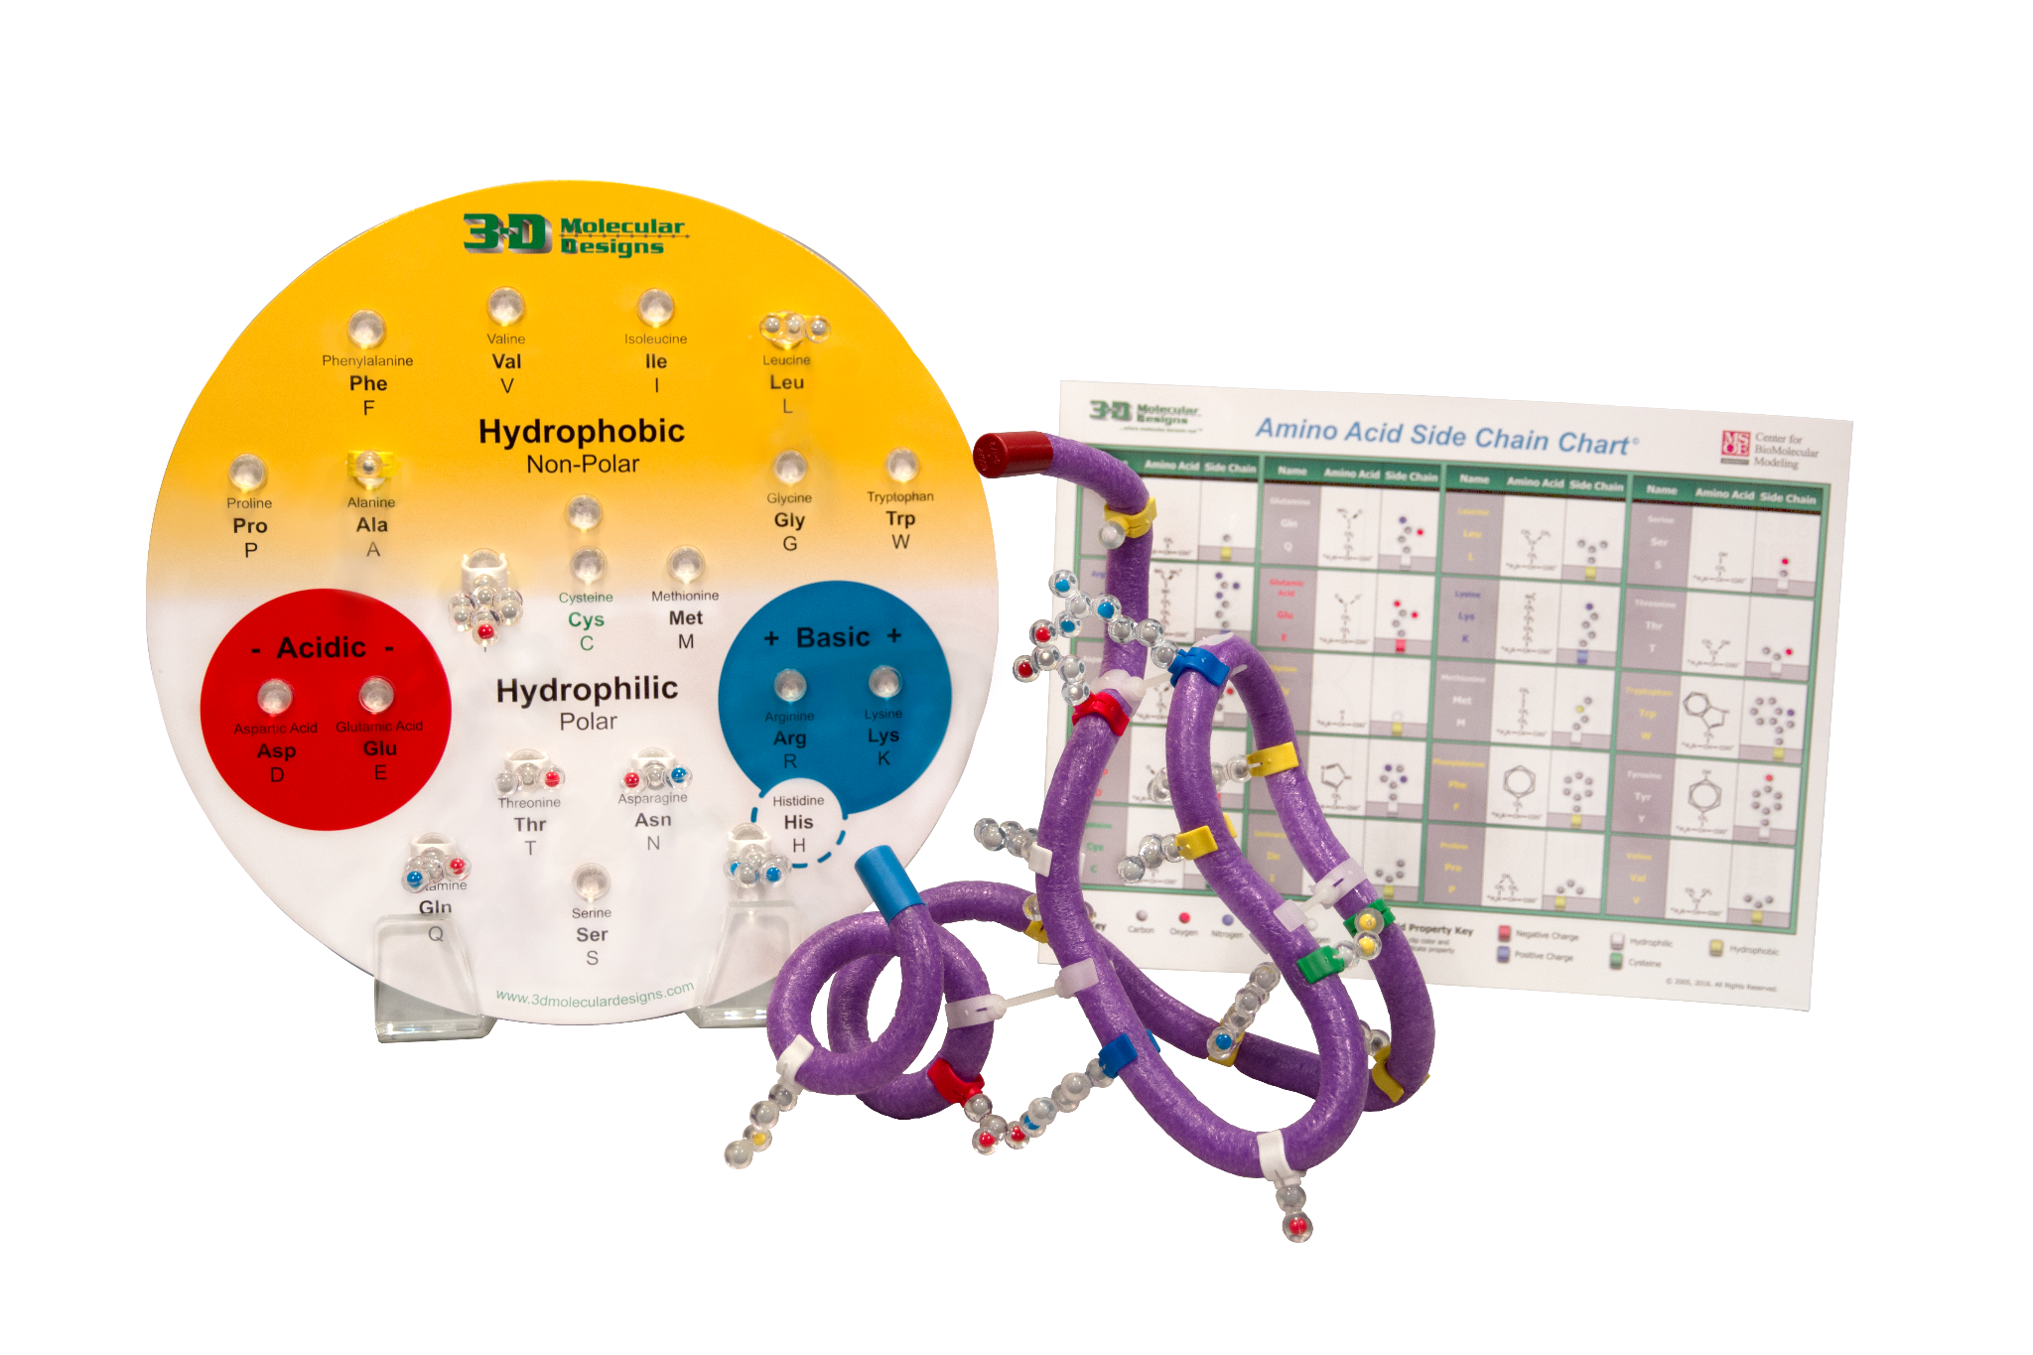
Demystifying Protein
Dimensionality
& Exploring Enzymes
Notes:
Welcome, we are so glad you are here. We will primarily be using two kits today: the Enzymes in Action Kit and the Amino Acid Starter Kit.

Slide 2

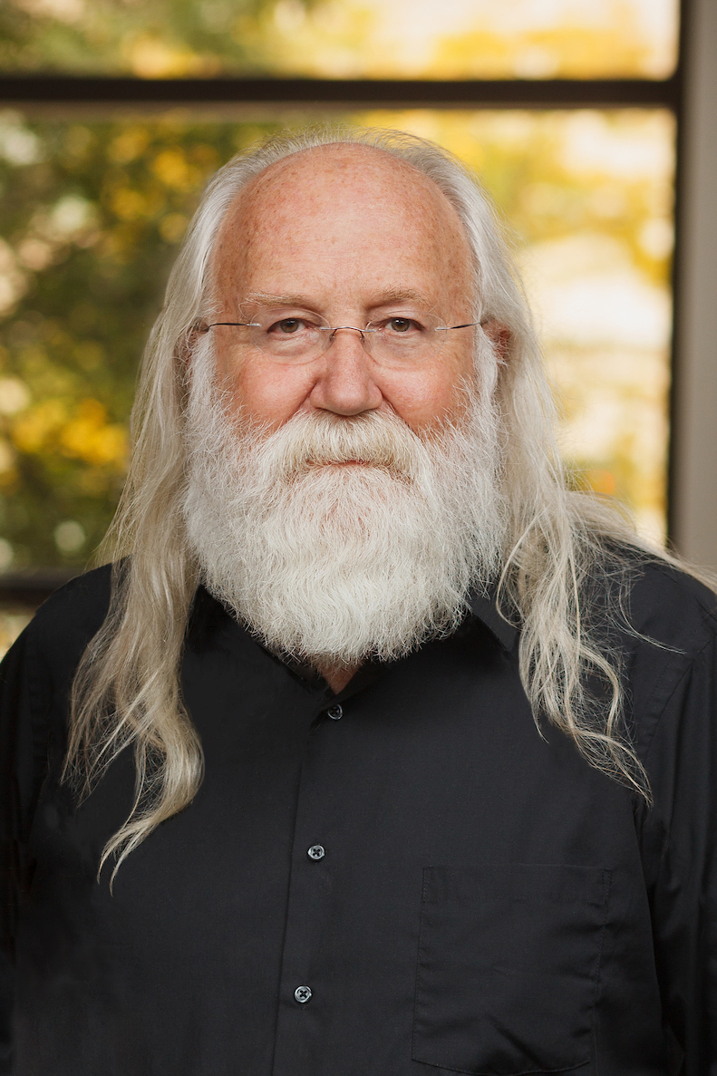
Presenters:
RUTH HUTSON, MSSE
3D Molecular Designs Science Educator
TIM HERMAN, PH.D.
3D Molecular Designs Chief Science Officer
Notes:
I’m Ruth Hutson, a 3D Molecular Designs Science Educator. I’ve been teaching for 25 years. Before coming to 3DMD, I was the science department at a small rural high school in Northeast Kansas and taught Concurrent College Biology, biology, chemistry, physics, and Earth Science. I discovered the 3DMD products in 2015 and loved using them with all of my classes. Today I liked to talk to you about how I use these kits in my Concurrent College Biology course and with my high school biology students.

Slide 3
Workshop Learning Goals
Demonstrate how the unique properties of the 20 amino acids determine the final shape of the protein
Demonstrate how modifications to the enzyme active site affect its reactivity
Apply knowledge of enzymes to explain the results of the catalase lab
Notes:
Ruth says: At the end of this session you should be able to…(read goals from slide).
So let’s get started with some modeling. [Advance slide]

Slide 4
Notes:
Ruth says: The first kit that I want to outline is the amino acid starter kit. We use this kit at several times throughout the year, but today I want to focus on my students first introduction to the kit. You have this kit on the tables for your use during this session. Please work together with the people at your table as we begin to do some modeling. [Advance slide]

Slide 5
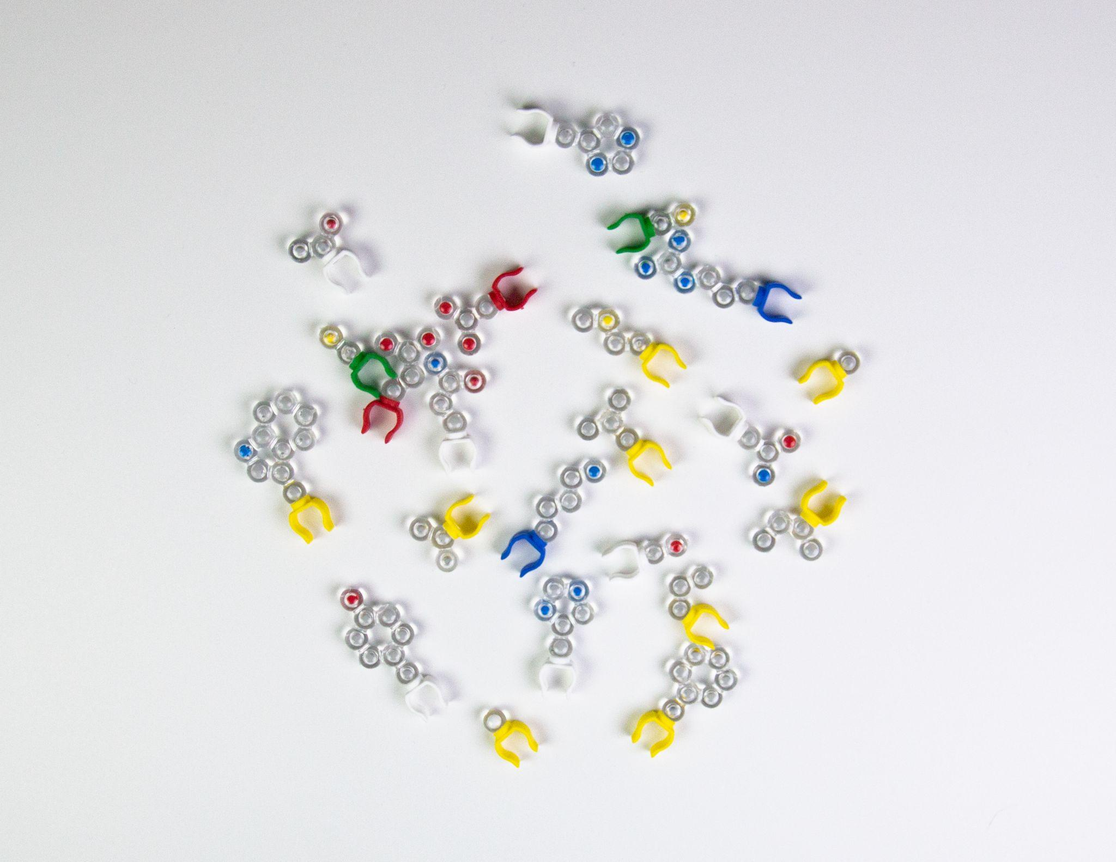
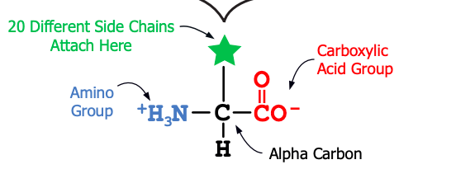
Notes:
Ruth says: Please get out the amino acid side chains from your kit. Each of my students or student groups (depending on class size) get a bag of the 20 amino acid side chains. I first ask my students to sort these side chains into a meaningful pattern. Would you do this for me with the amino acids that you have in your kit? [Give about 2 minutes to sort amino acids; walk around the room and give feedback to participants.] Hopefully, I’ve given you enough time to sort your amino acids. [Advance slide]

Slide 6
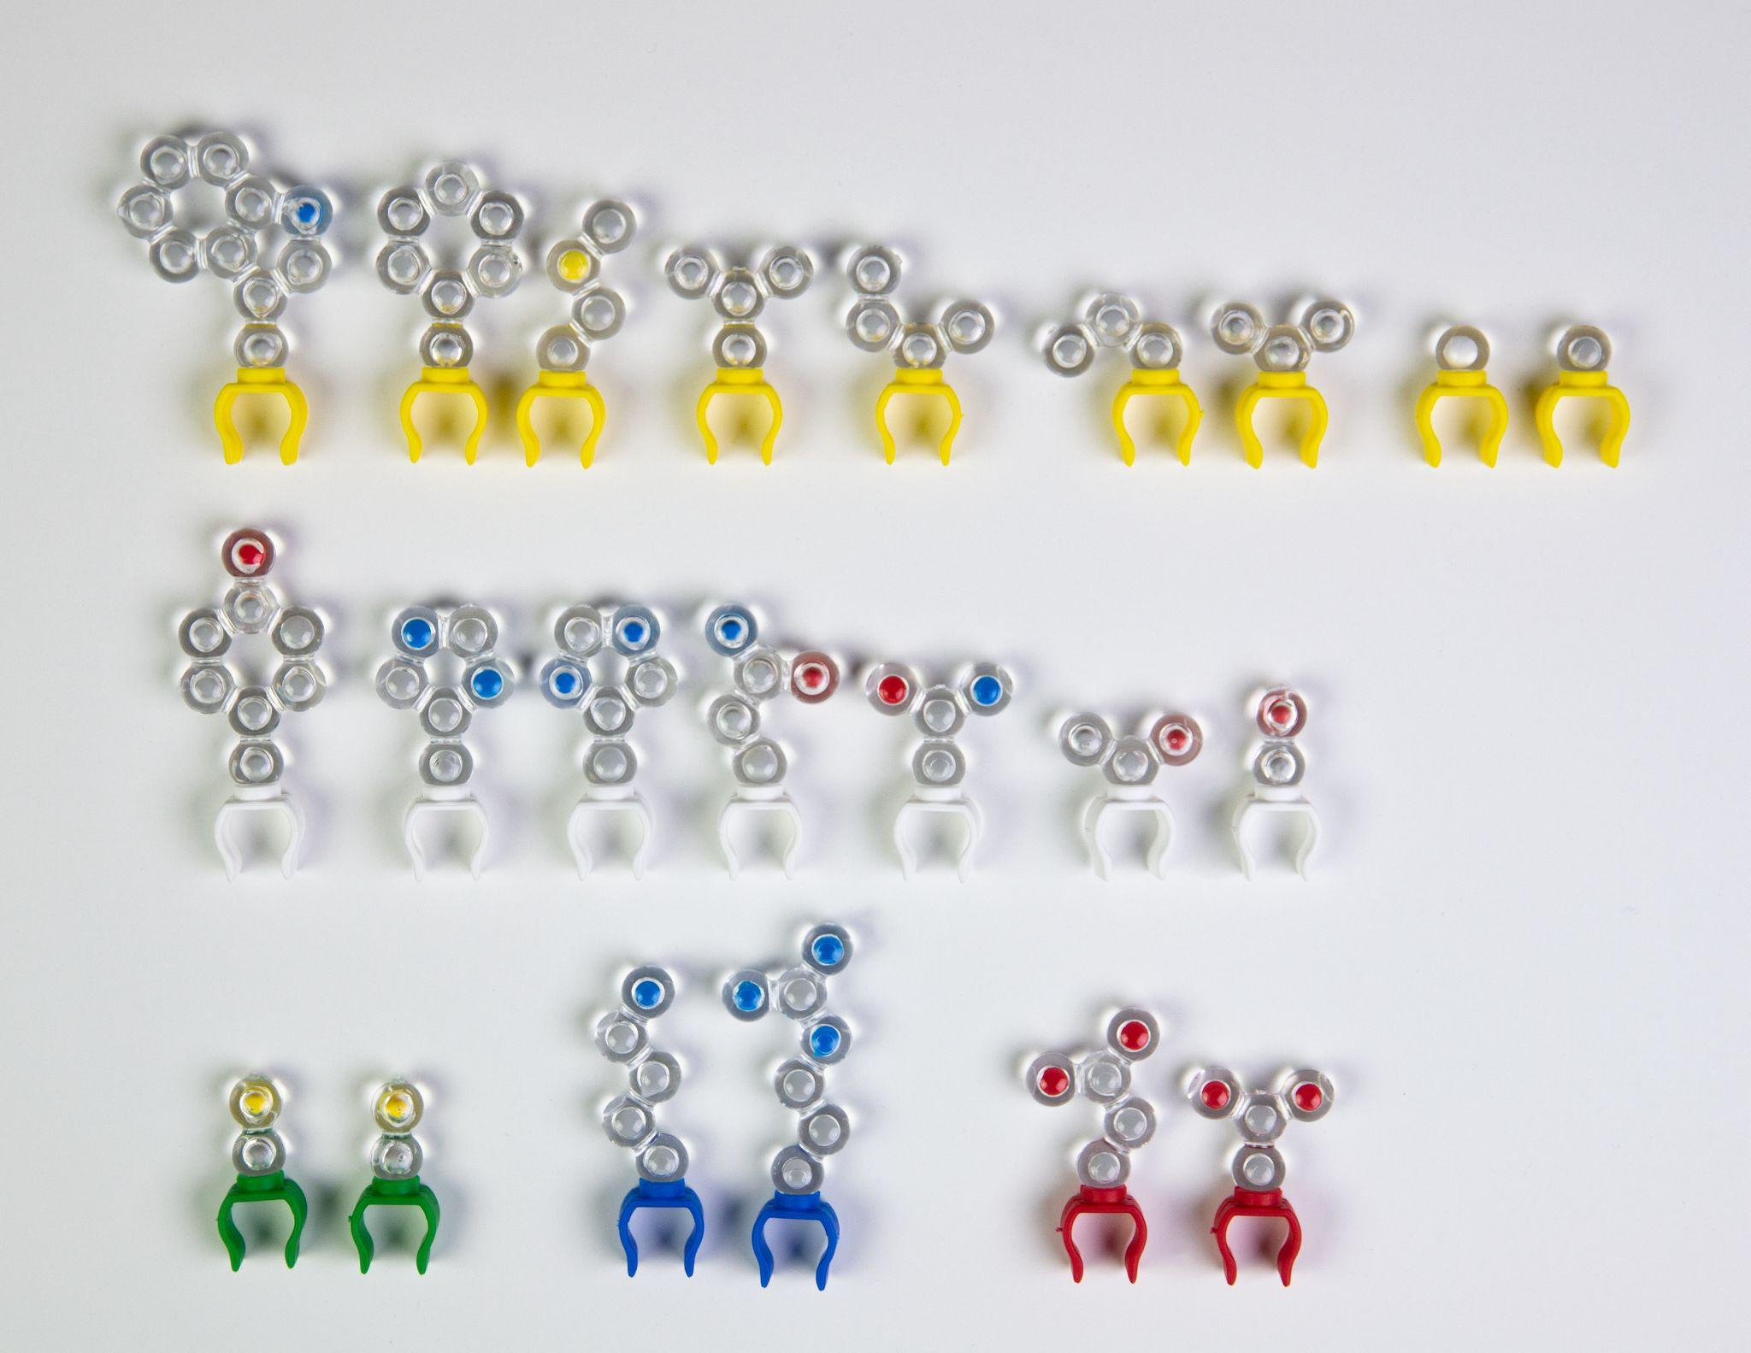
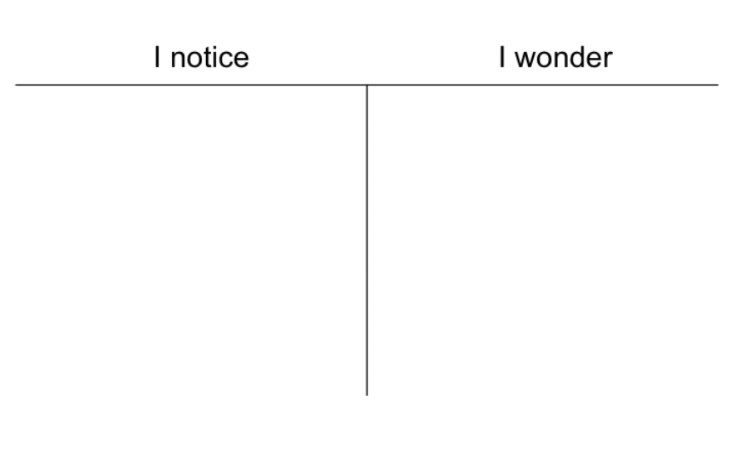
Notes:
Ruth says: Next I have my students make a Notice|Wonder t-chart so that they can record their ideas and questions in their lab notebook. Please do this a sheet of paper that you have handy. [Advance slide]

Slide 7
WHAT PATTERNS DO YOU SEE AMONG THE SIDE CHAINS?
WHAT QUESTIONS DO YOU HAVE?
Notes:
Ruth says: Look closely at the side chains and consider the two questions on the screen.
[I will read the questions. Next I will explain why it is important to give students time to look at these chemical structures before we give out the entire kit. [Advance slide.]

Slide 8
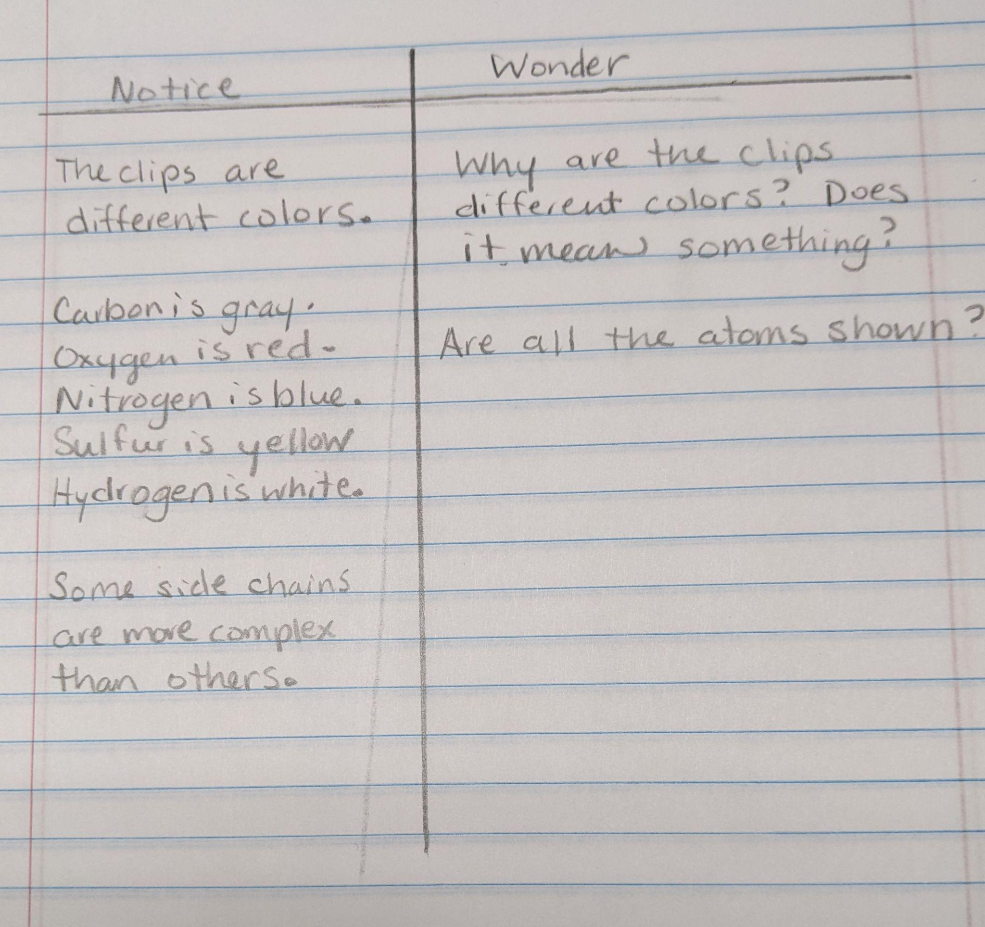
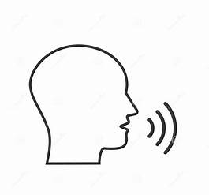
Notes:
Ruth says: [I will read the participants responses in the chat and also read the responses on my student’s work.] Now that students are familiar with the side chains and what each of the representations of the models mean, I ask them to get of their Amino acid side chain chart. [Advance slide]

Slide 9
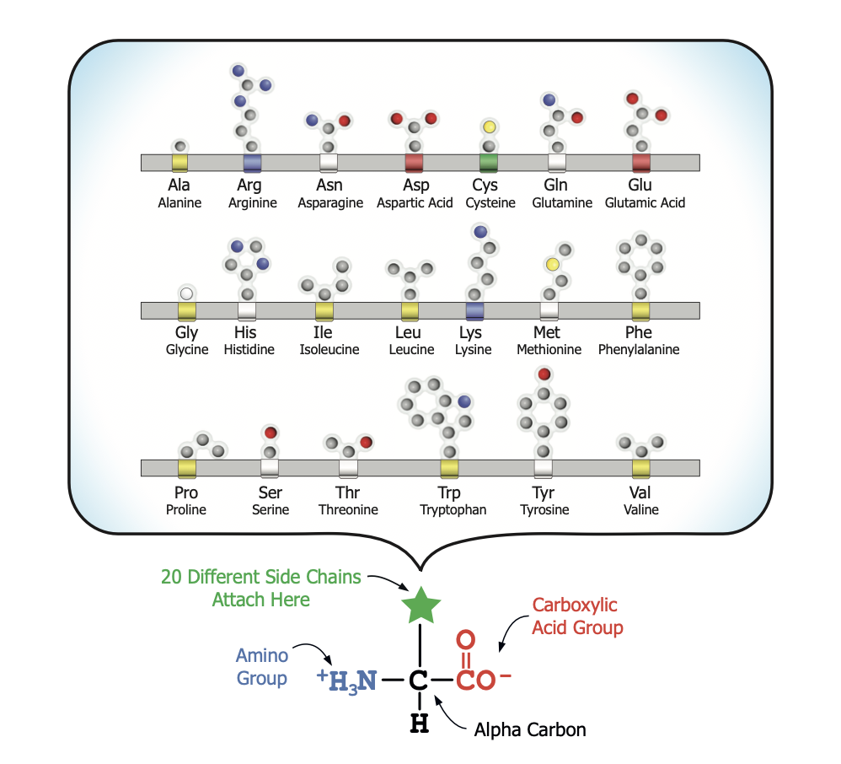
Notes:
Ruth says: You should have been given a copy of this in your student modeling pack. This side shows all twenty amino acids in alphabetical order as they appear in model form. The opposite side has both the structural formulas and an image of the models so that you can compared them. [Answer student question about the structural formula.] I have my students use the amino acid side chain chart, identify and place the side chains in their proper location on the amino acid organizer. [Advance slide.]

Slide 10
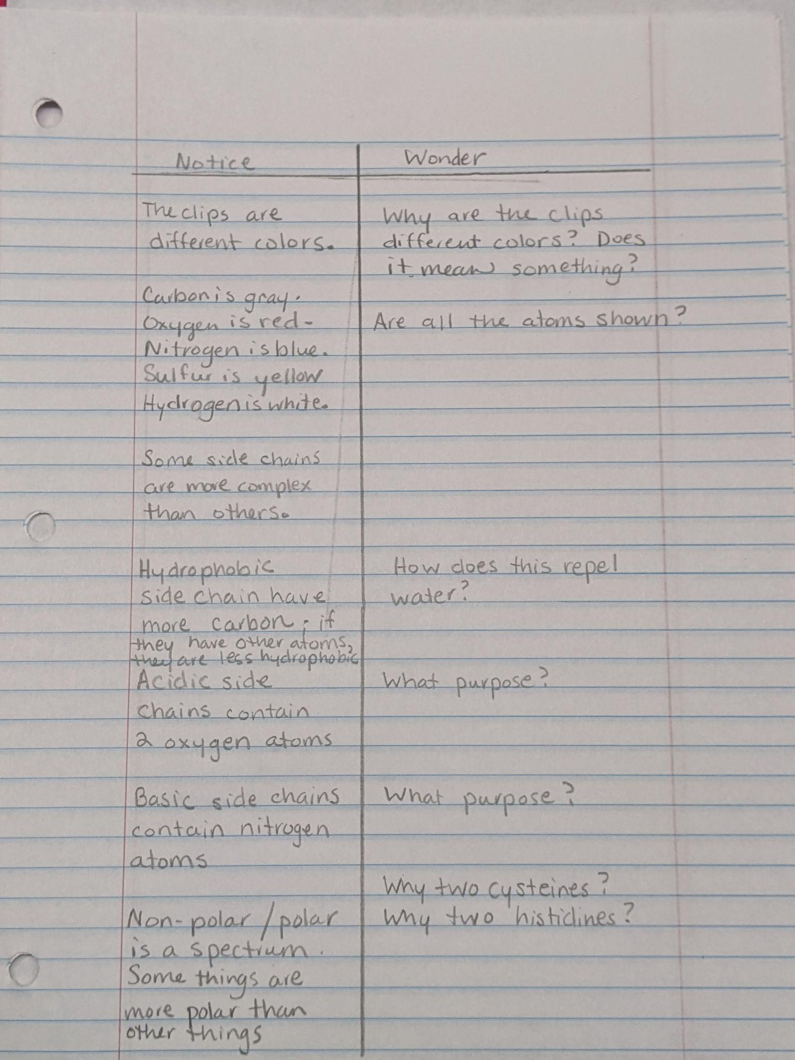
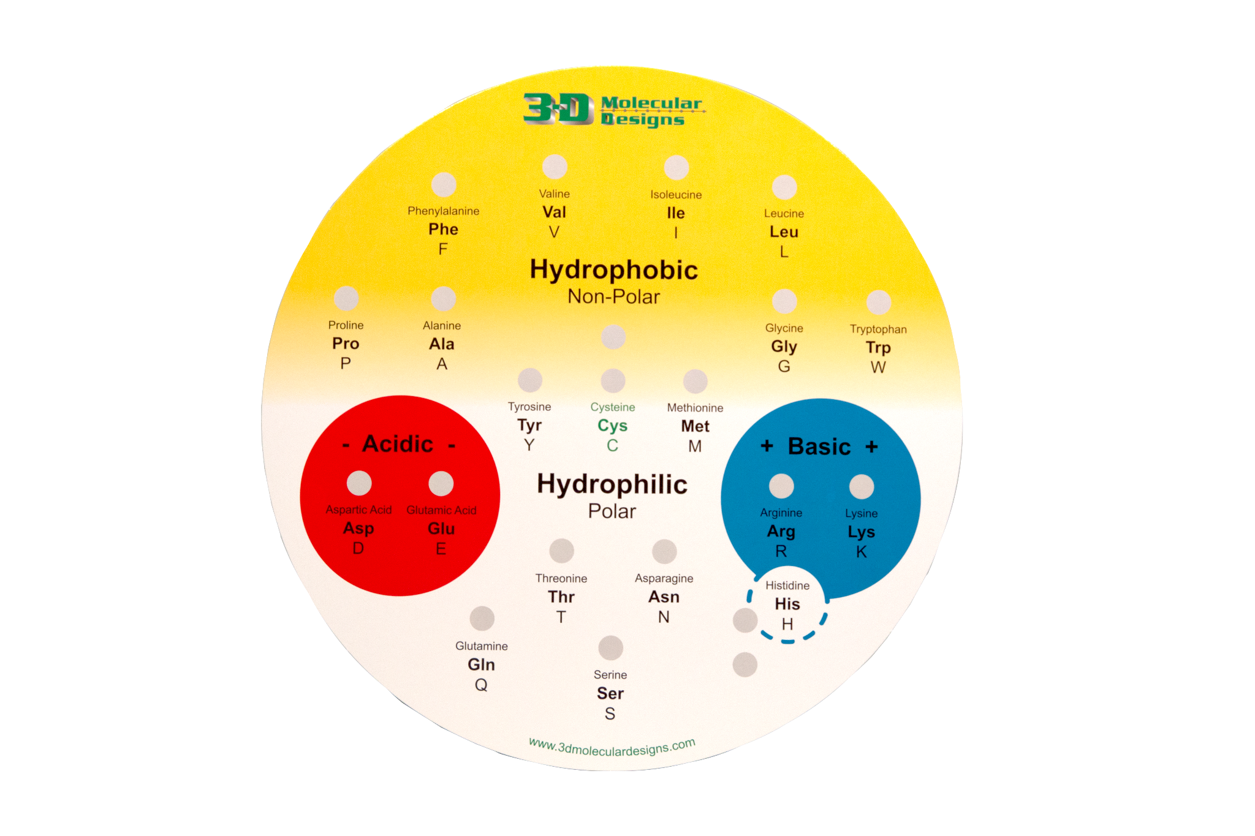
WHAT ARE THE DIFFERENCES BETWEEN THE HYDROPHOBIC AMINO ACIDS AND THE HYDROPHILIC AMINO ACIDS?
Notes:
Ruth says: Then I have them consider the following two questions. [Read questions from the slide] Once they have placed the side chains in the correct locations on the amino acid organizer I then ask them to add to their notice|wonder chart. Please have a look at this organizer on the screen and craft an answer that you can share in the chat about the differences between hydrophobic amino acids and hydrophilic amino acids. Notice that my students continue to add to their chart throughout the activity. As a question gets answered, they can add that answer into their chart or they can place it elsewhere in their lab notebooks. Typically, this ends day one for us. [Explain how materials are managed for a single class or for multiple sections.] As an exit ticket, I ask my students to answer the following question.[Advance slide]

Slide 11
WHAT CAUSES PROTEINS TO FOLD INTO THEIR 3-D SHAPES? MAKE A PREDICTION
Notes:
Ruth says: [Read the question aloud.] Consider this question and answer how you think your students would answer. In general my students would not have a good understanding of the guidelines used when proteins form their 3-D shapes. Sometimes I give a hint that it has something to do with its affinity to water. [Advance slide]

Slide 12
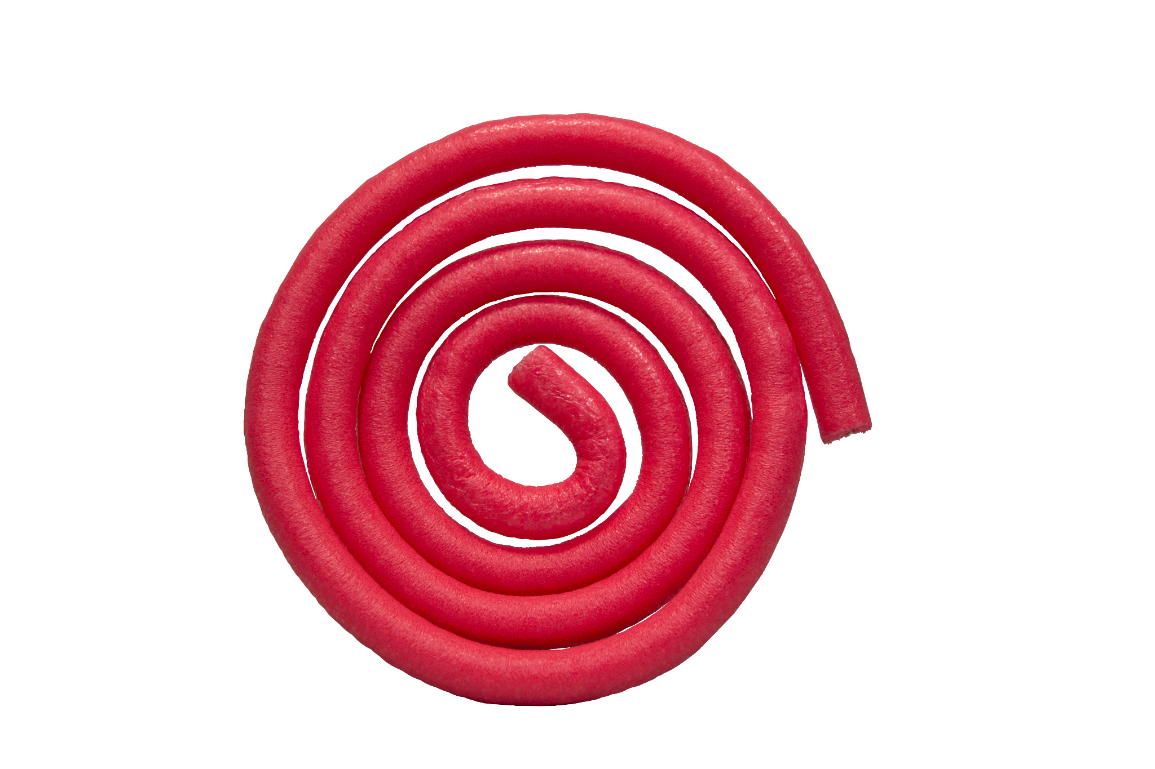
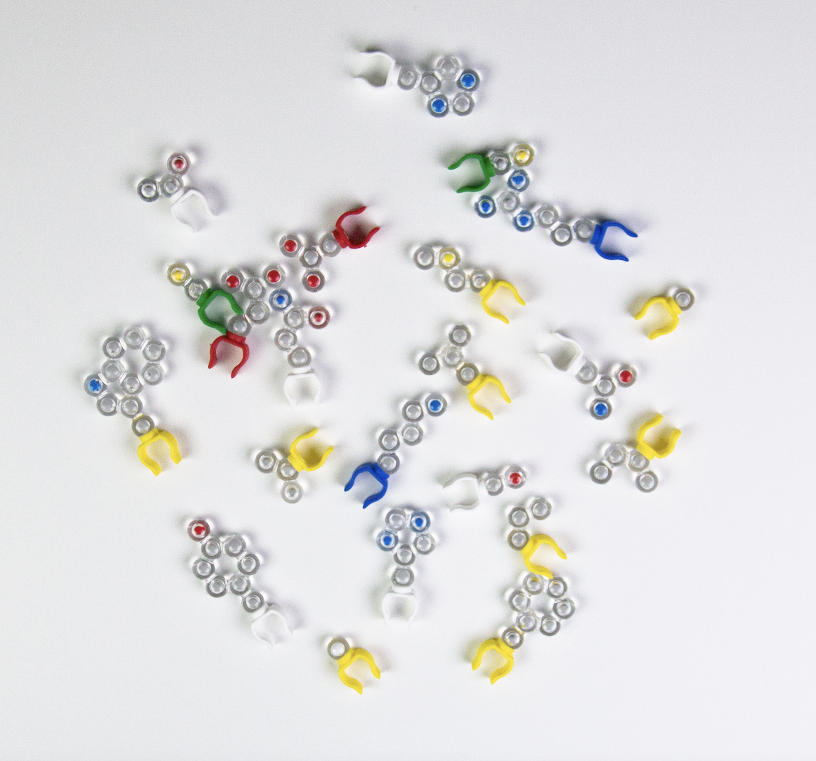
Notes:
Ruth says: Now let’s do some more modeling, for this exercise you will next the mini-toober and 10 amino acid side chains in your modeling pack. [Explain the difference between the size of toobers in the student kit and the larger kit.]
Let’s remind ourselves what we learn in yesterday’s lesson. [Advance slide.]

Slide 13
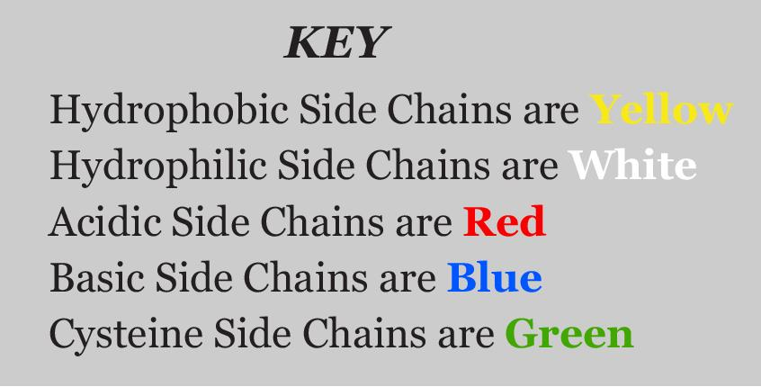
Notes:
Ruth says: [Explain the key for the colors on the side chains models.] You will use all ten of the amino acids in your kit, but remember there are 20 amino acids. [Advance slide.]

Slide 14
SIX HYDROPHOBIC
THREE HYDROPHILIC
TWO ACIDIC
TWO BASIC
TWO CYSTEINE
A TOTAL OF FIFTEEN SIDE CHAINS
Notes:
Ruth says: Since I have my students use the larger kits, we use a total of 15 amino acid side chains. [Read the guidelines for this exercise from the box.] Once students have chosen their amino acids, I ask them to unroll their toober. [Advance slide.]

Slide 15
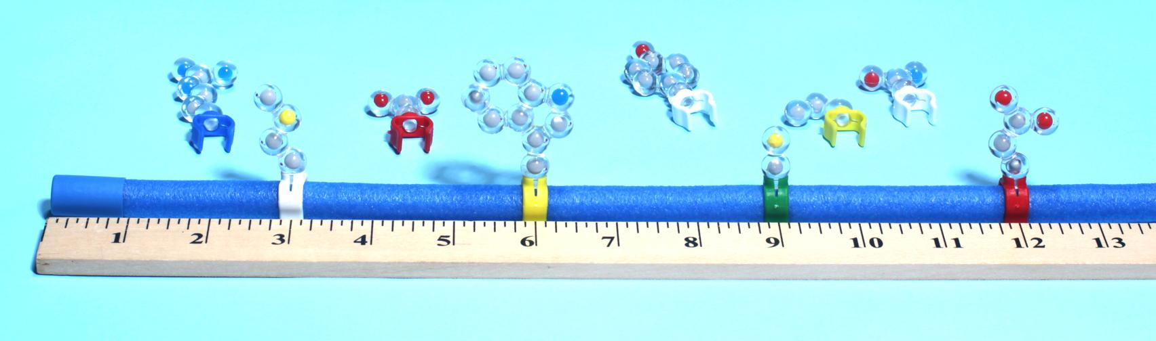
IN ANY ORDER ARRANGE YOUR AMINO ACIDS EQUIDISTANT FROM EACH OTHER.
YOU HAVE MADE A POLYPEPTIDE.
Notes:
Ruth says: [Explain how my students conduct the exercise.] Place your 10 amino acids in any order just make sure they are equidistant for each other. You have now made a polypeptide which is the primary structure of a protein. [Advance slide.]

Slide 16
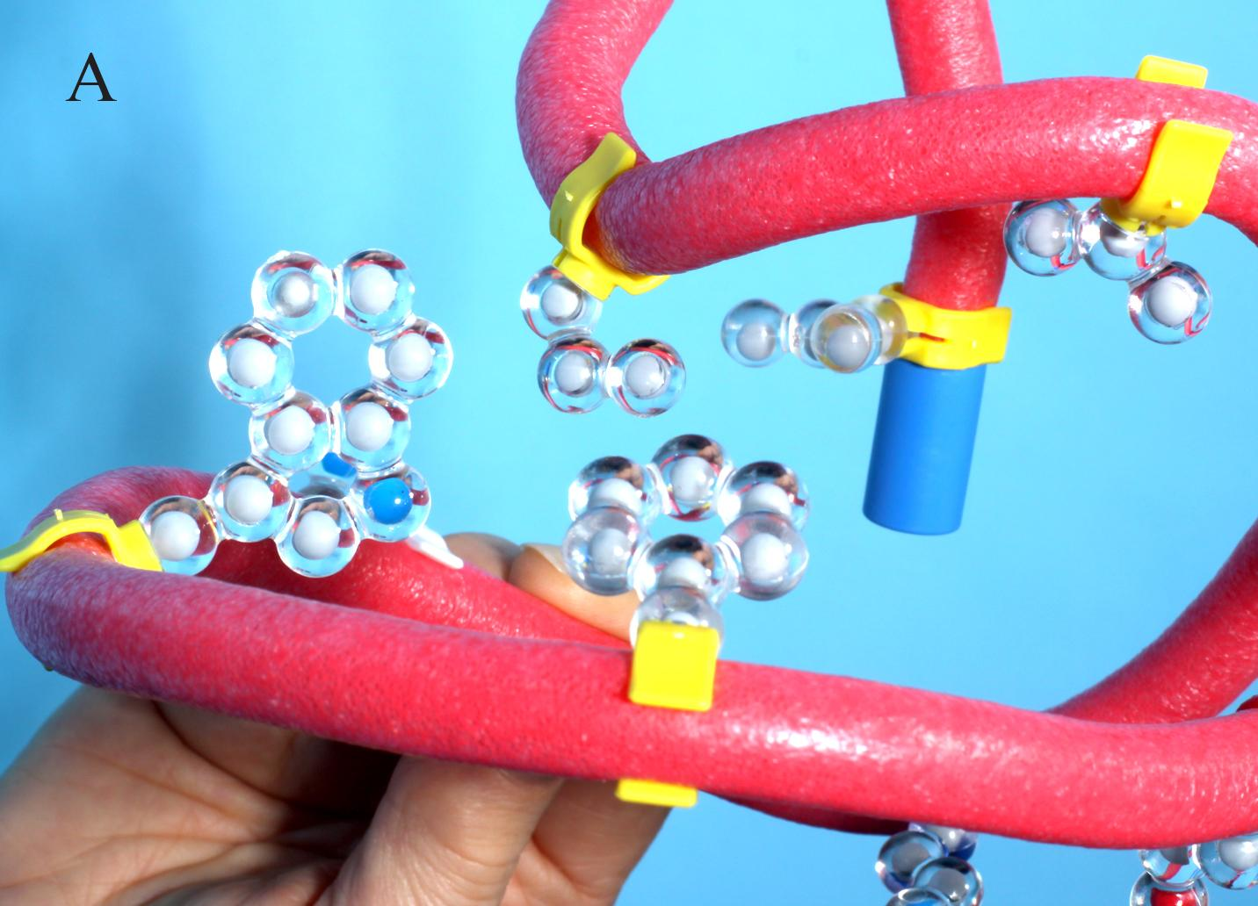
LET’S “FOLD” IT INTO A PROTEIN
ROTATE THE HYDROPHOBIC AMINO ACIDS TO THE INSIDE
Notes:
Ruth says: Now let’s fold our polypeptide into a protein. [Explain what we mean by “fold.”] Why do the hydrophobic amino acids rotate to the inside? Exactly, they are trying to get away from the water. They are non-polar and water is a slightly polar molecule. Next we will focus on the acidic and basic side chains. [Advance slide.]

Slide 17
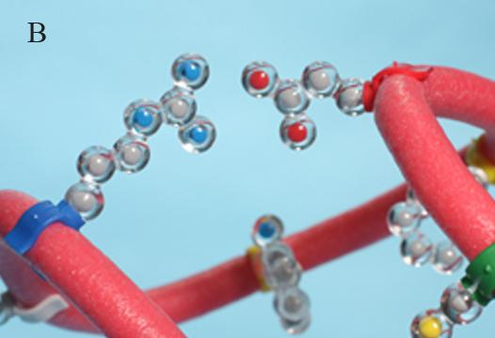
CONTINUE “FOLDING”
BRING THE ACIDIC AND BASIC SIDE CHAINS TOGETHER UNTIL THEY ARE TWO CM FROM EACH OTHER
Notes:
Ruth says: Continue to fold by bringing the acidic and basic side chains together until they are about two centimeters from each other. [Explain the interaction between the acidic and basic side chains.] I should bring up there is one caveat to this folding exercise. [Advance slide.]

Slide 18
MAKE SURE THAT YOU ALSO ROTATE ANY HYDROPHOBIC SIDE CHAINS THAT MOVE OUT OF PLACE.
THROUGHOUT THIS WHOLE EXERCISE FIND A SHAPE IN WHICH ALL THE PROPERTIES APPLY.
Notes:
Ruth says: At the same time you are folding the acidic and basic side chains, you need to make sure that you also rotate any hydrophobic side chains that may have moved out of place. In fact, throughout this entire exercise, you must find a shape in which all the properties we are highlighting occur simultaneously. This makes sure that the protein is in the lowest energy state. [Advance slide.]

Slide 19
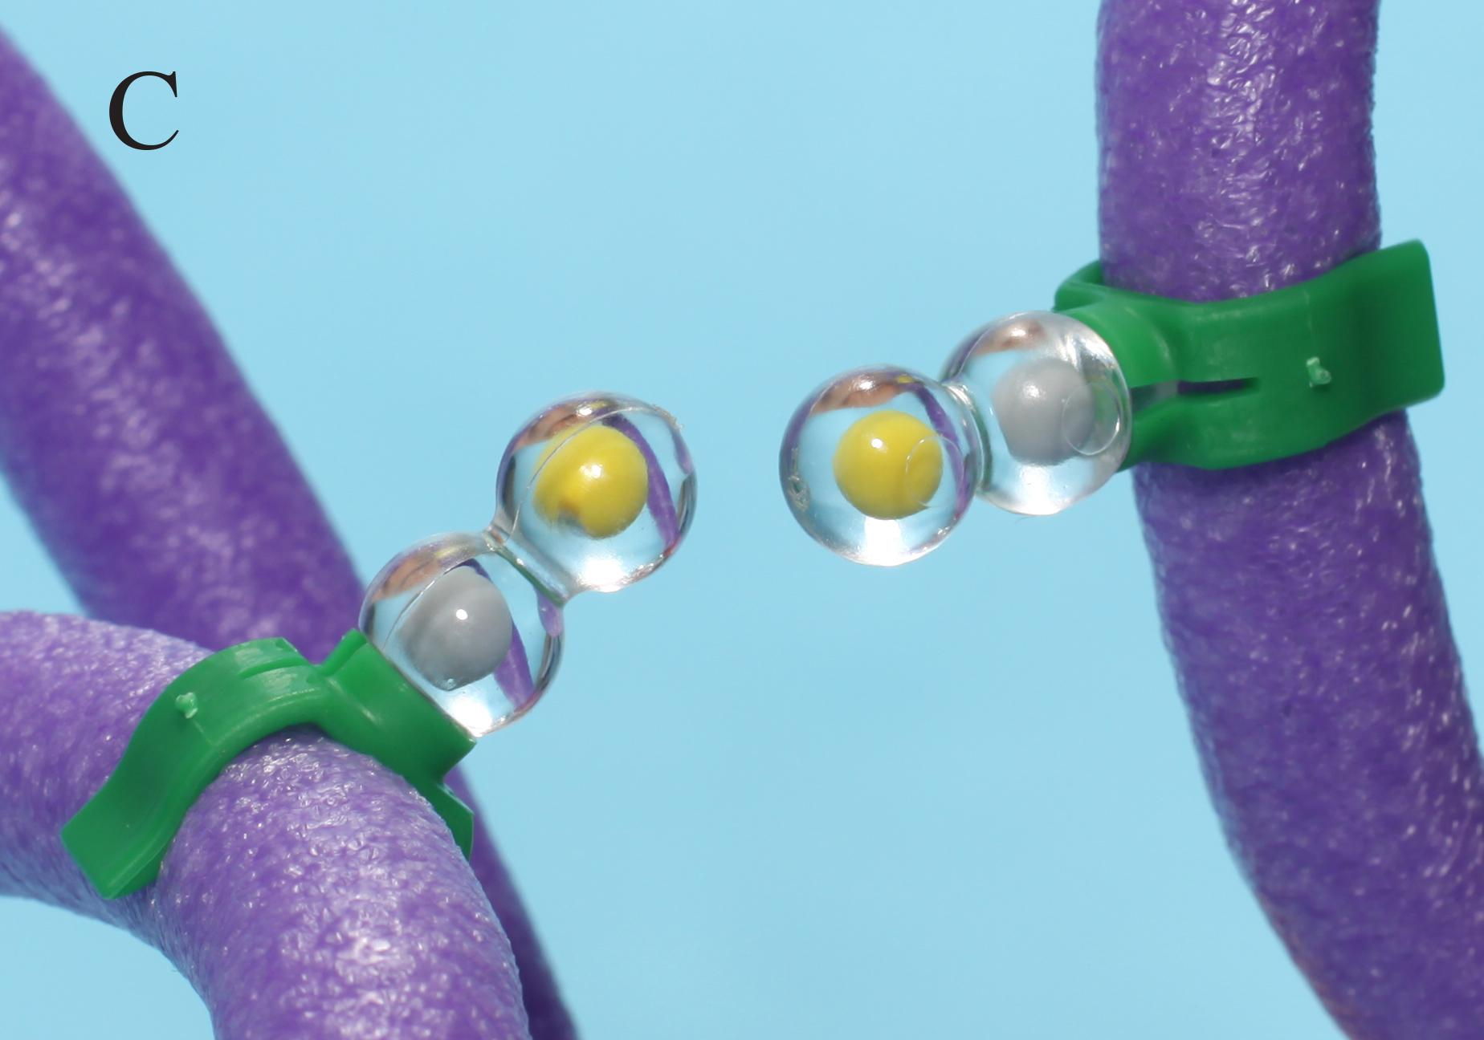
CONTINUE “FOLDING”
POSITION THE CYSTEINES SO THEY ARE OPPOSITE EACH OTHER.
Notes:
Ruth says: Now we focus on the cysteine side chains which bond together to form a disulfide bond. Position them so they are opposite each other. [Advance slide.]

Slide 20
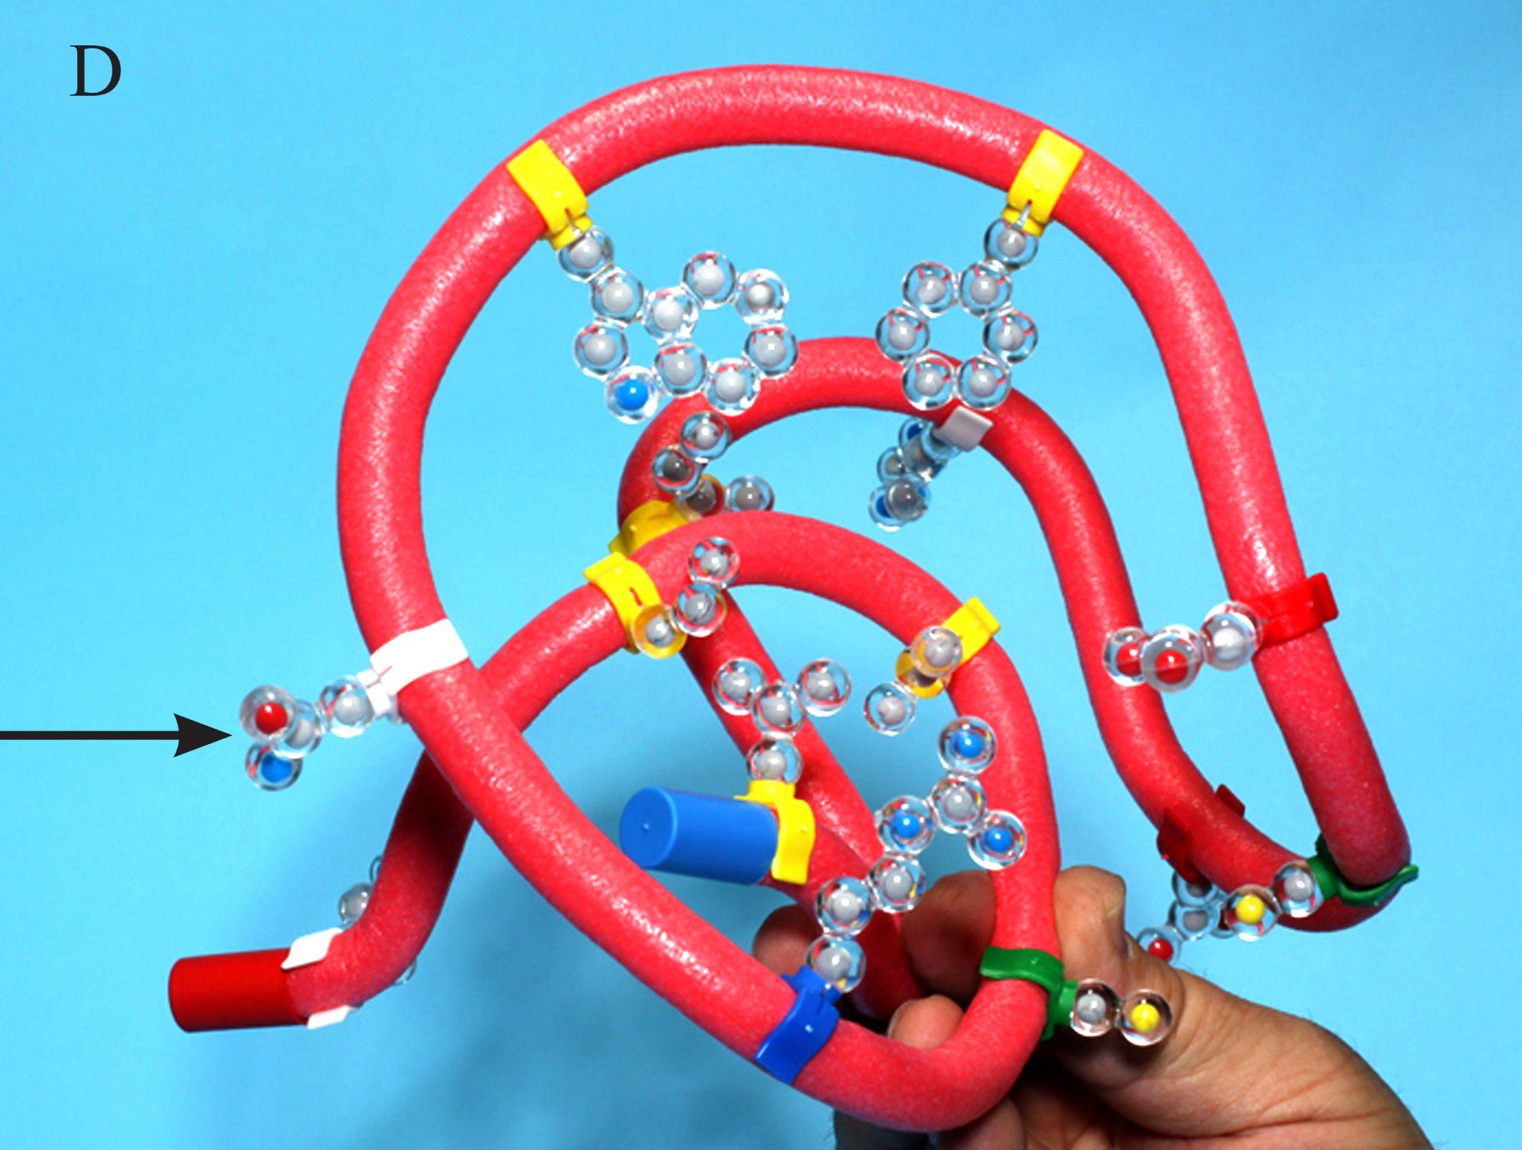
CONTINUE “FOLDING”
FINALLY ROTATE THE HYDROPHILIC SIDE CHAINS SO THEY ARE ON THE OUTER SURFACE
Notes:
Ruth says: Lastly, we rotate the hydrophilic side chain about the toober so they are on the outer surface. Take a moment to notice the shape of your protein. [Advance slide.]

Slide 21
THE FINAL SHAPE OF THE PROTEIN IS CALLED THE
TERTIARY STRUCTURE
Notes:
Ruth says: This final shape is known as a tertiary structure. [Explain primary, secondary, and tertiary structures and talk about the stability of the globular protein made.] It is important before we show students secondary structure that they master the folding guidelines. Otherwise, they do not gain as deep an understanding of why proteins naturally arrange themselves in the shapes they do. [Advance slide.]

Slide 22
WHY DIDN’T YOUR PROTEINS ALL LOOK THE SAME?
Notes:
Ruth says: This would end day two in my class. [Talk about managing materials for a single class or multiple sections.] I would ask my students to answer the following questions as an exit ticket. Take some time to reflect on this question and type your answer in the chat when the chat waterfall icon appears. [Advance slide.]

Slide 23
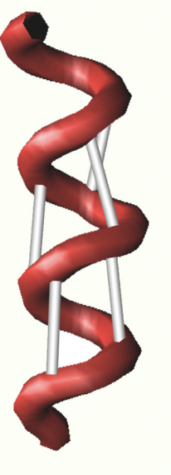
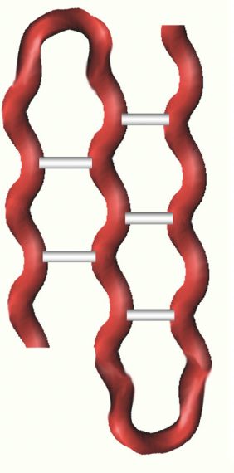
THE IMPORTANCE OF SECONDARY STRUCTURE
ALPHA HELIX
BETA SHEET
HOW DO SECONDARY STRUCTURES STABILIZE A PROTEIN?
Notes:
Ruth says: Consider this question. [Reads question from slide.] Craft an answer and place it in the chat when you see the chat waterfall icon. [Advance slide.]

Slide 24
WHAT ABOUT QUATERNARY STRUCTURE?
Notes:
Ruth says: My students and I explore quaternary structure using a case study/wet lab using the enzyme catalase. [Advance slide]

Slide 25
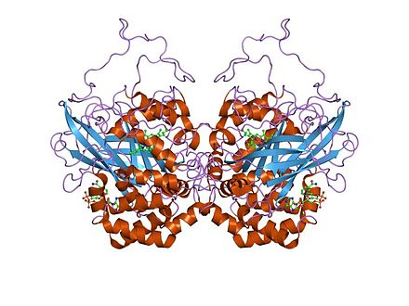
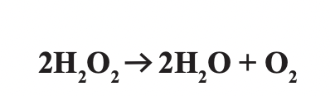
Catalase Lab
Case study and a multi-day wet lab that allows students to explore and manipulate enzyme actions
Notes:
Ruth says:[Briefly explain what catalase’s purpose is for the cell. ] We like to use catalase because it is found in many different organisms. I typically use bovine catalase because we can it from beef liver. If that is unacceptable for you, you can order purified bovine catalase solution from a biological supply house like Carolina Biological or you can make a slurry of potato catalase. [Briefly explain the location and structure of the active site, what the enzyme breaks down, and the premise of the wet lab.] I discovered that some of my students were very confused when it came to interpreting what they saw macroscopic level with what was happening nanoscopic level. They could not envision it. It was too abstract for them. [Advance slide.]

Slide 26
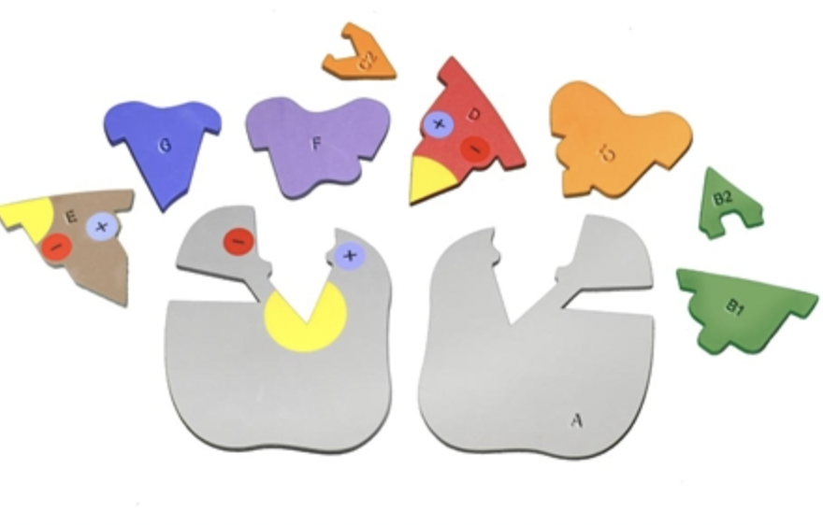
Catabolism
Anabolism
Enzyme
Specificity
Lock and Key Model
Induced Fit Model
Notes:
Ruth says: Before we complete the lab I use a worksheet from 3DMD to introduce students to the different components of the model and how those can be used to explain the general functions of enzymes. We look at the relationship between catabolism and anabolism and also the lock and key model and induced fit model.
That worksheet can be found on our website. Now let’s delve into the specifics of the lab more deeply. Let’s look at some specific parts of the lab and how students used the kit to explain what was happening at the nanoscopic level. Please use parts included in your student modeling kit as we explore enzyme specificity. [Advance slide.]

Slide 27
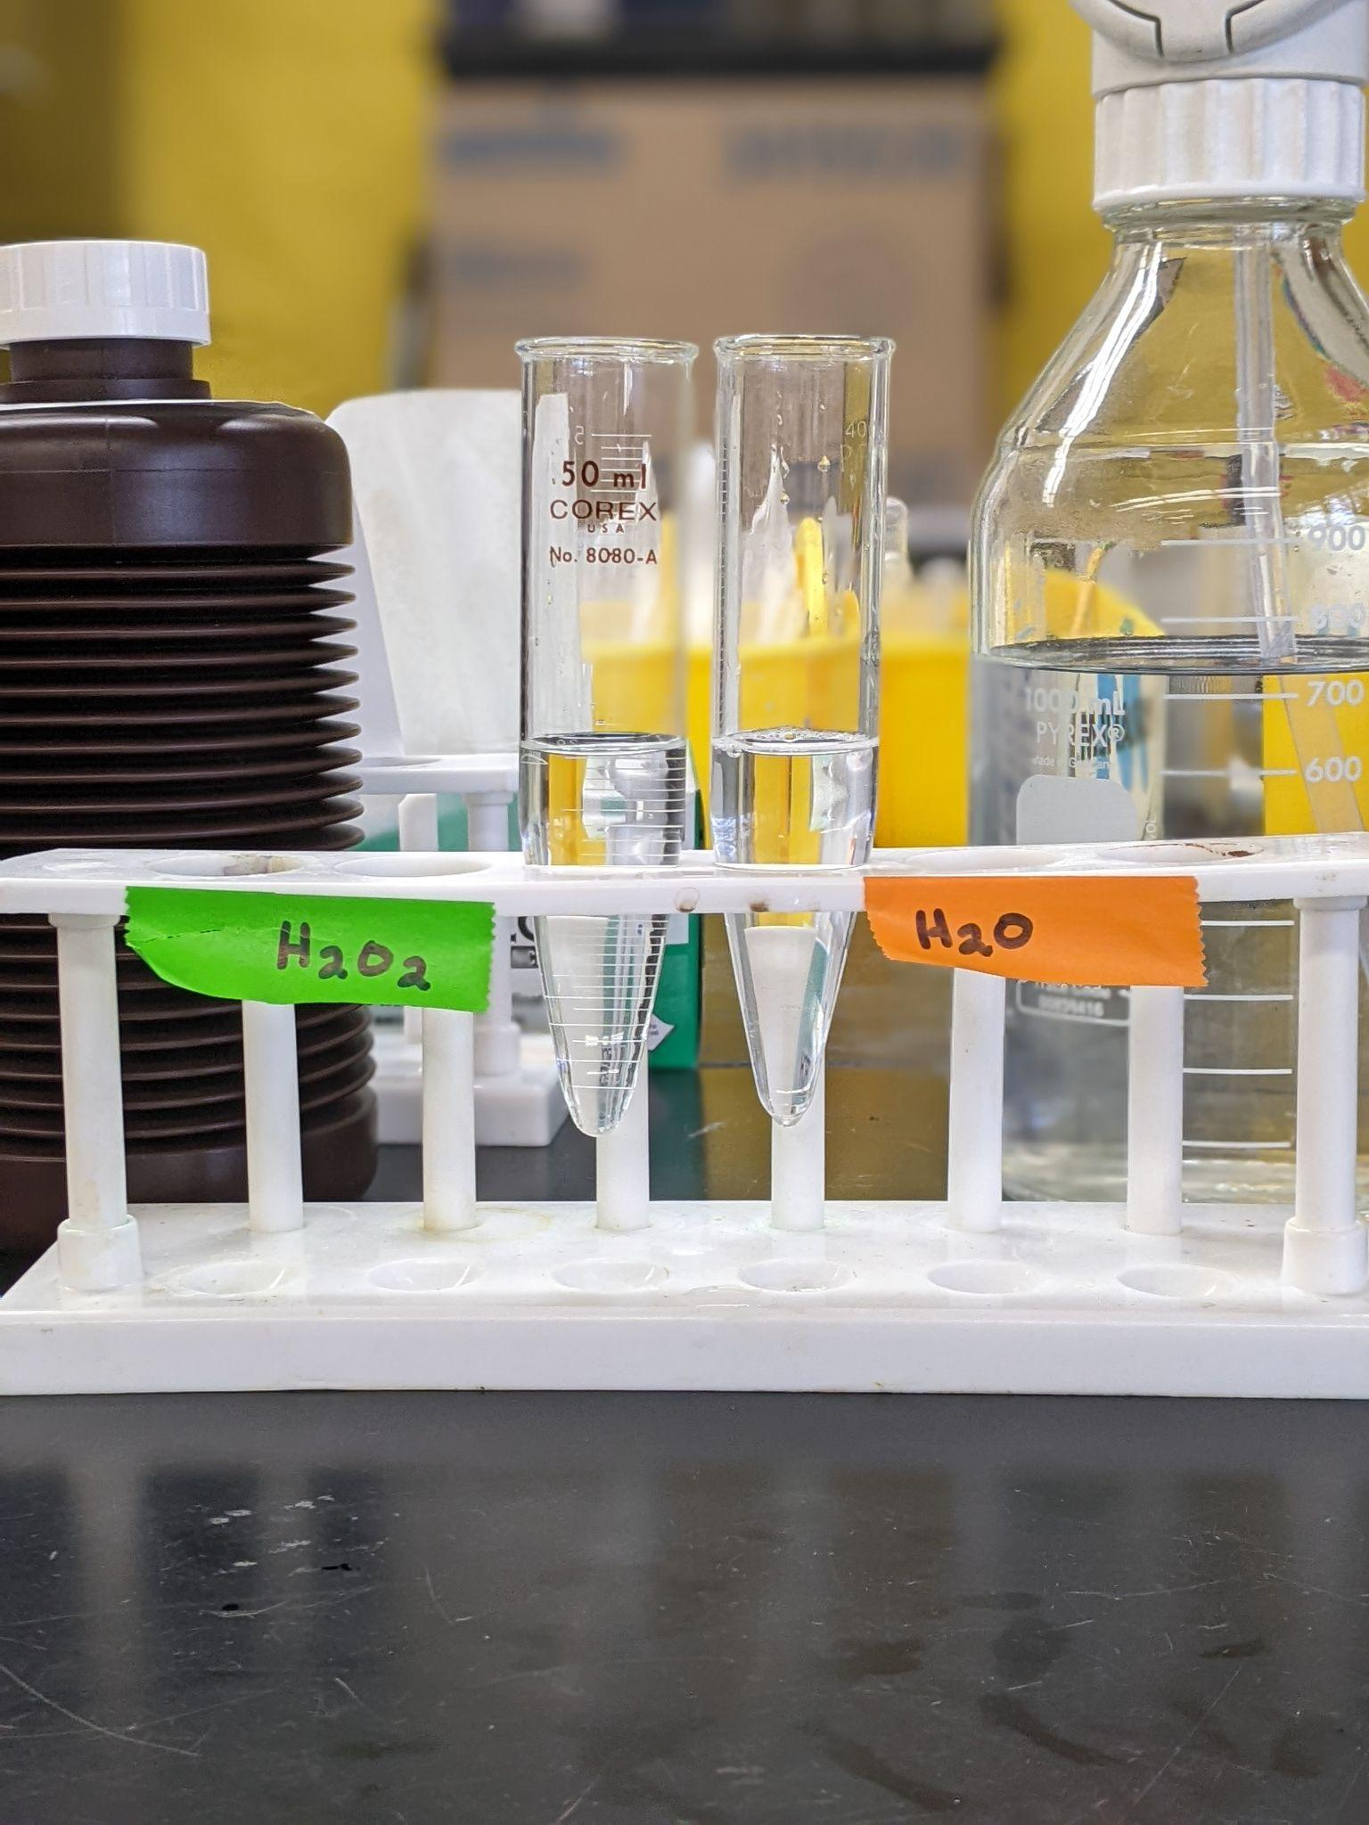
HYDROGEN PEROXIDE
WATER
Notes:
Ruth says: We first look at enzyme specificity by reacting water and hydrogen peroxide with a liver slurry (that contain catalase). [Explain why you used liver.] Throughout this part of the presentation I will show the before image first, followed by the after image, then I will ask you to do some modeling with your enzymes in action pieces. For these modeling exercises, please retrieve the following parts from your student modeling kit: A, B1, B2, D, F, and G. All of the images that shown are either from my students’ lab results or the Enzymes in Action kit. Let’s do some modeling.
[Advance slide]

Slide 28
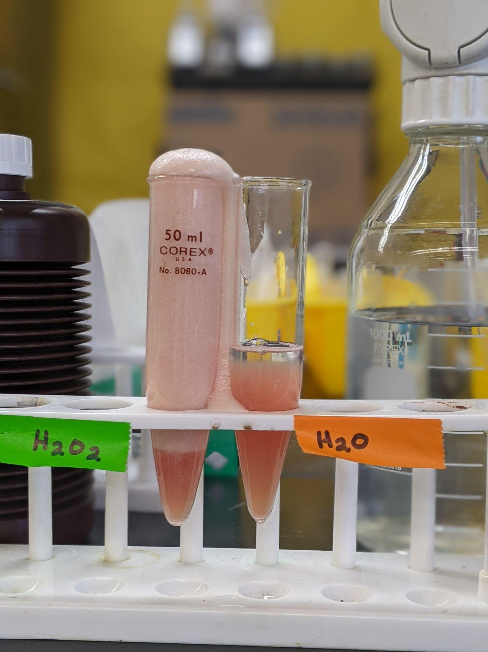
HYDROGEN PEROXIDE
WATER
Notes:
Ruth says: When catalase comes in contact with hydrogen peroxide, it causes the activation energy to be lower and hydrogen peroxide decomposes into oxygen and water.
Notice that water does not decompose in the presence of catalase.
How can we use the Enzyme in Action kit to model what is going on at the nanoscopic level?
[Advance slide]

Slide 29
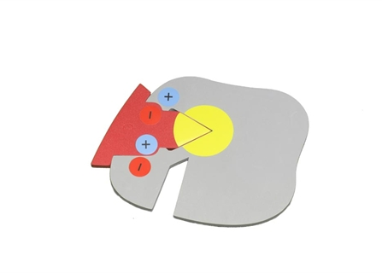
HYDROGEN PEROXIDE
WATER
Notes:
Ruth says: [Explain what is happening in the model.]
What happens with water on the nanoscopic level?
[Advance slide]

Slide 30
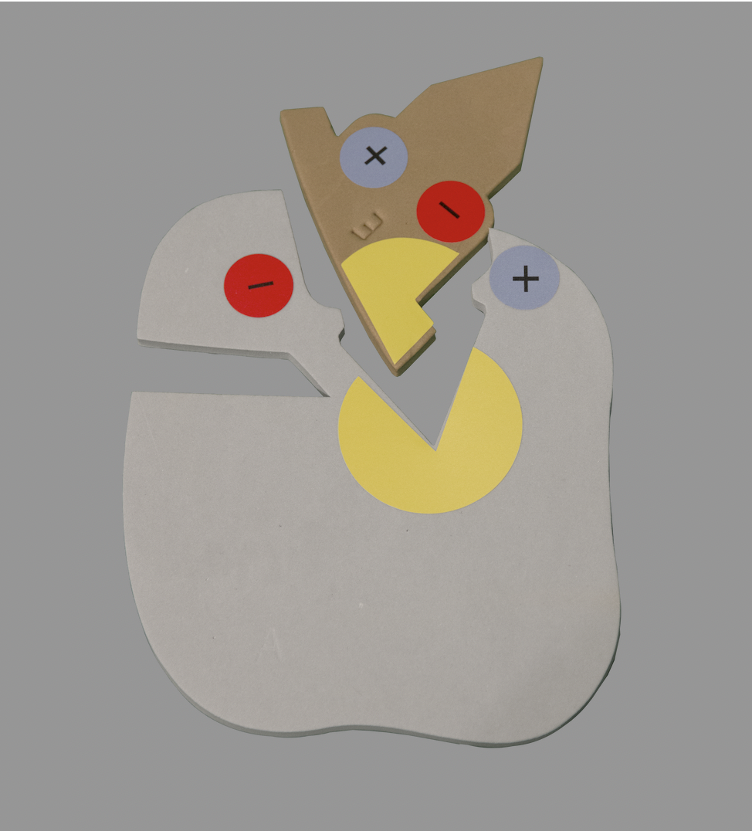
HYDROGEN PEROXIDE
WATER
Notes:
Ruth says: [Briefly Describe what you see in the models]. Now let’s look at competitive inhibition.
[Advance slide]

Slide 31
Notes:
Ruth says: We use the amino acid starter kit to further understand what happens to the enzyme active site when it is exposed to fluctuations in temperature or exposed to chemicals like acids and bases. Please get out your mini-toober to model along with me.
[Advance slide]

Slide 32
Modeling Catalase‘s Active Site
Notes:
Ruth says: [Explain the limitations of the toober model and how actually need four toober held side by side to create the tunnel.] We are only going to use one toober today. However, I feel that we can still gain a limited understanding of what is happening at the actual active site.
[Advance slide]

Slide 33
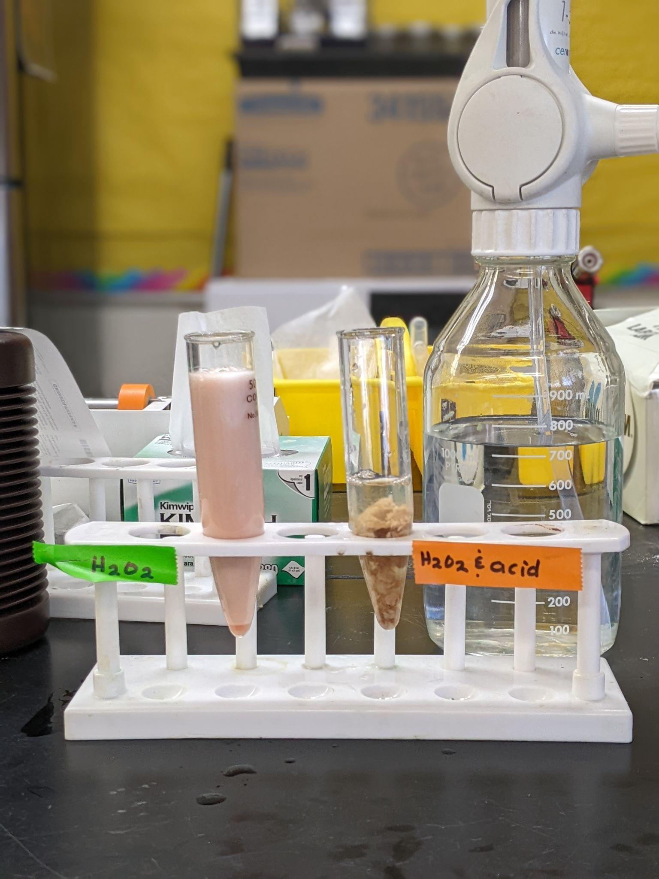
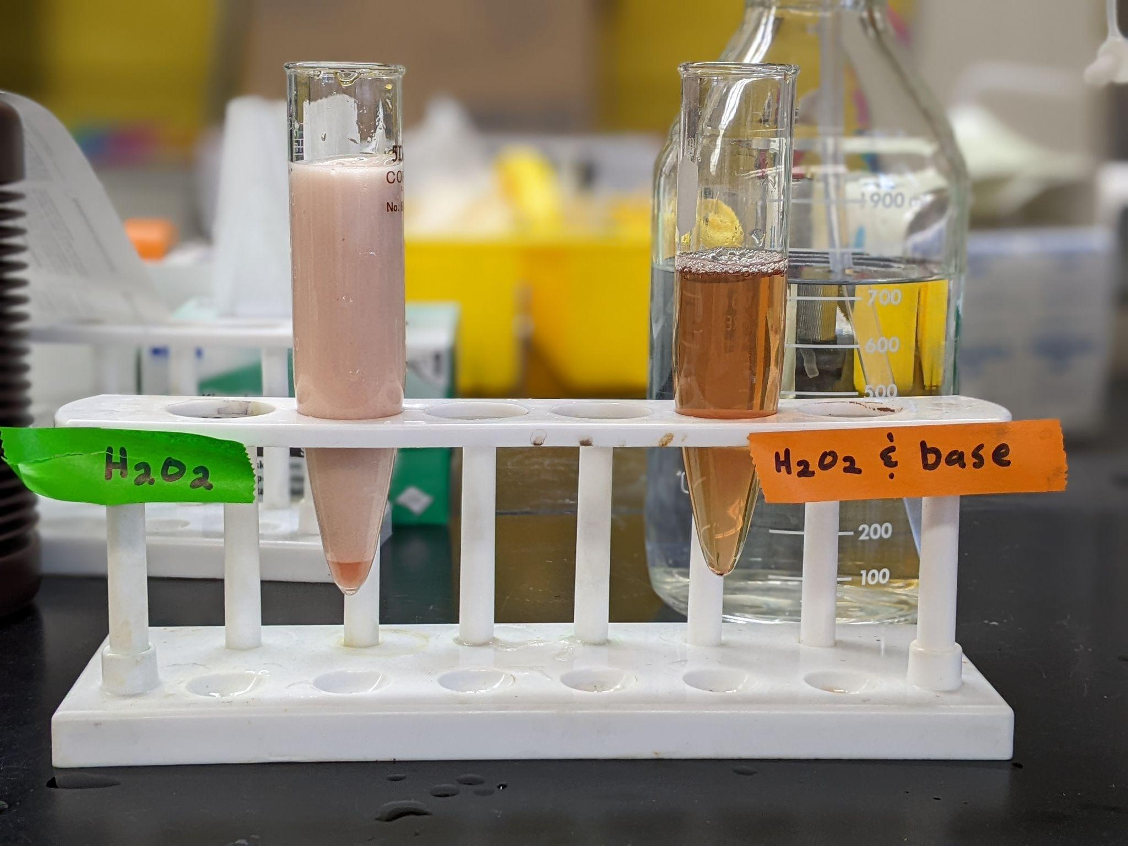
COMPARING ACIDS AND BASES
Notes:
Ruth says: [Discuss after images of wet lab and the damaged active site.]
So what is going on at the molecular level?
[Advance slide]

Slide 34
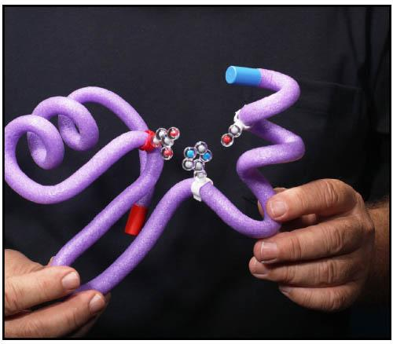
COMPARING ACIDS AND BASES
Notes:
Ruth says: [Discuss after images of wet lab and the damaged active site.]
Let’s build a simple active site. Just reminder that this is highly simplified, but later I’ll share a link to a resource that discusses catalase’s actual active site.
[Advance slide]

Slide 35
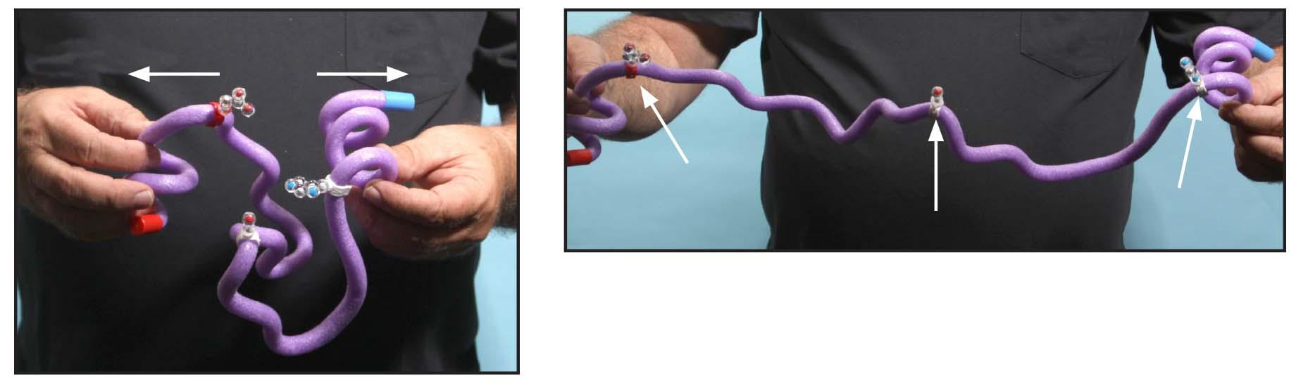
COMPARING ACIDS AND BASES
Notes:
Ruth says: [Discuss after images of wet lab and the damaged active site.]
Both the acid and the base cause the protein to denature.
[Advance slide]

Slide 36
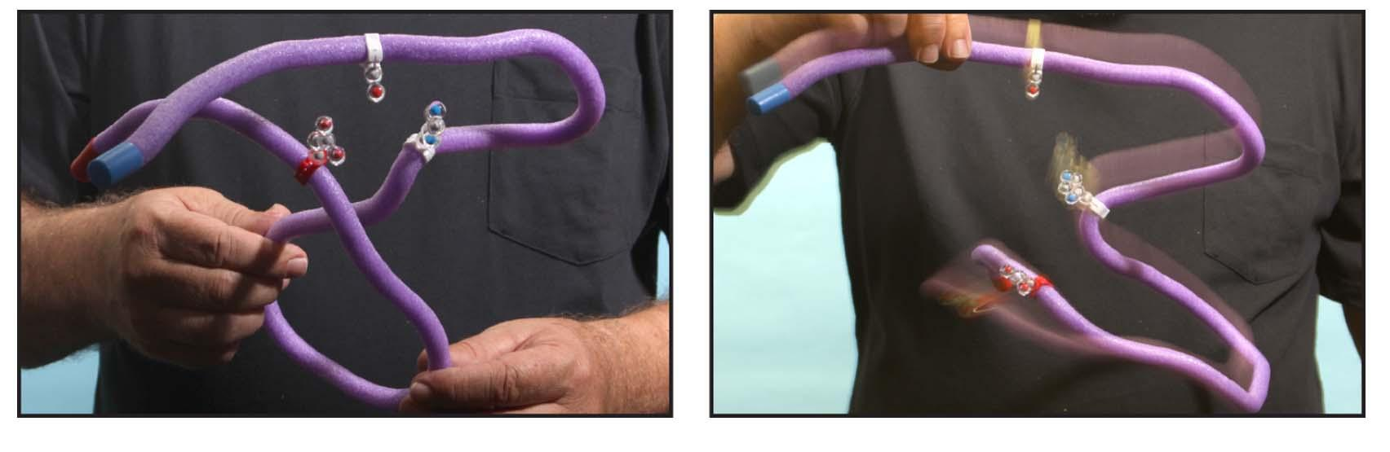
COMPARING ACIDS AND BASES
Notes:
Ruth says: [Discuss after images of wet lab and the damaged active site.]
What do you see as the end result? Please type your noticings in the chat. [Read some of the respondents. If no one responds, then describe what you see on the slide.]
We also look at the effects of temperature on the enzyme.
[Advance slide]

Slide 37
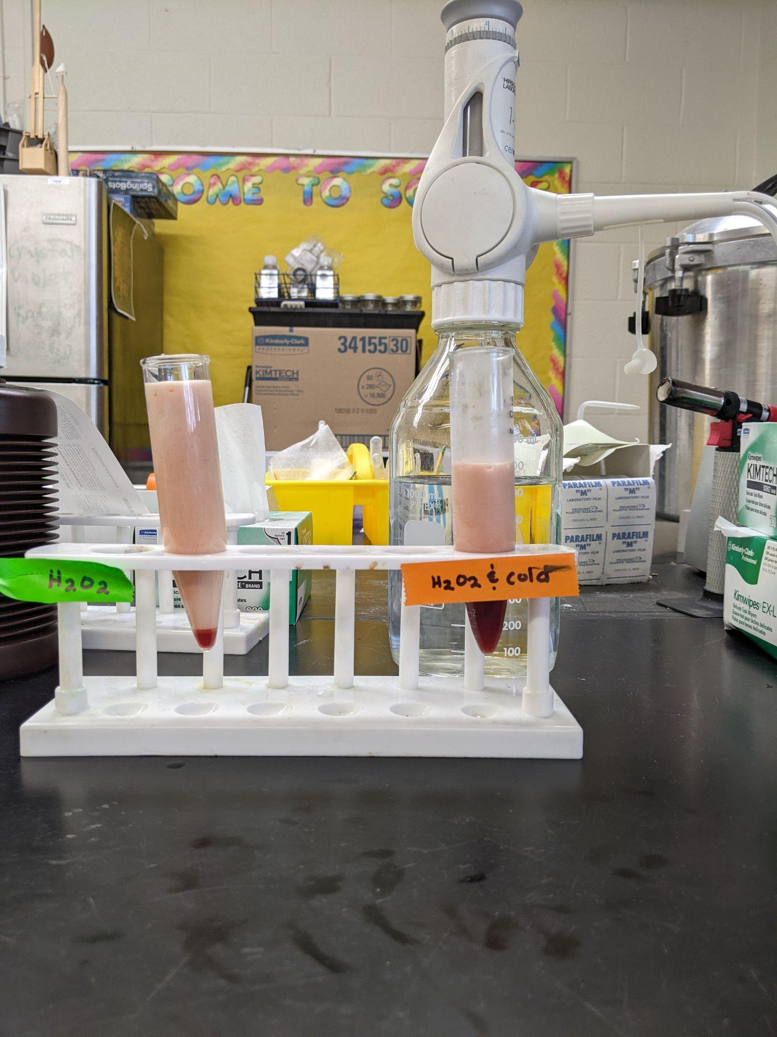
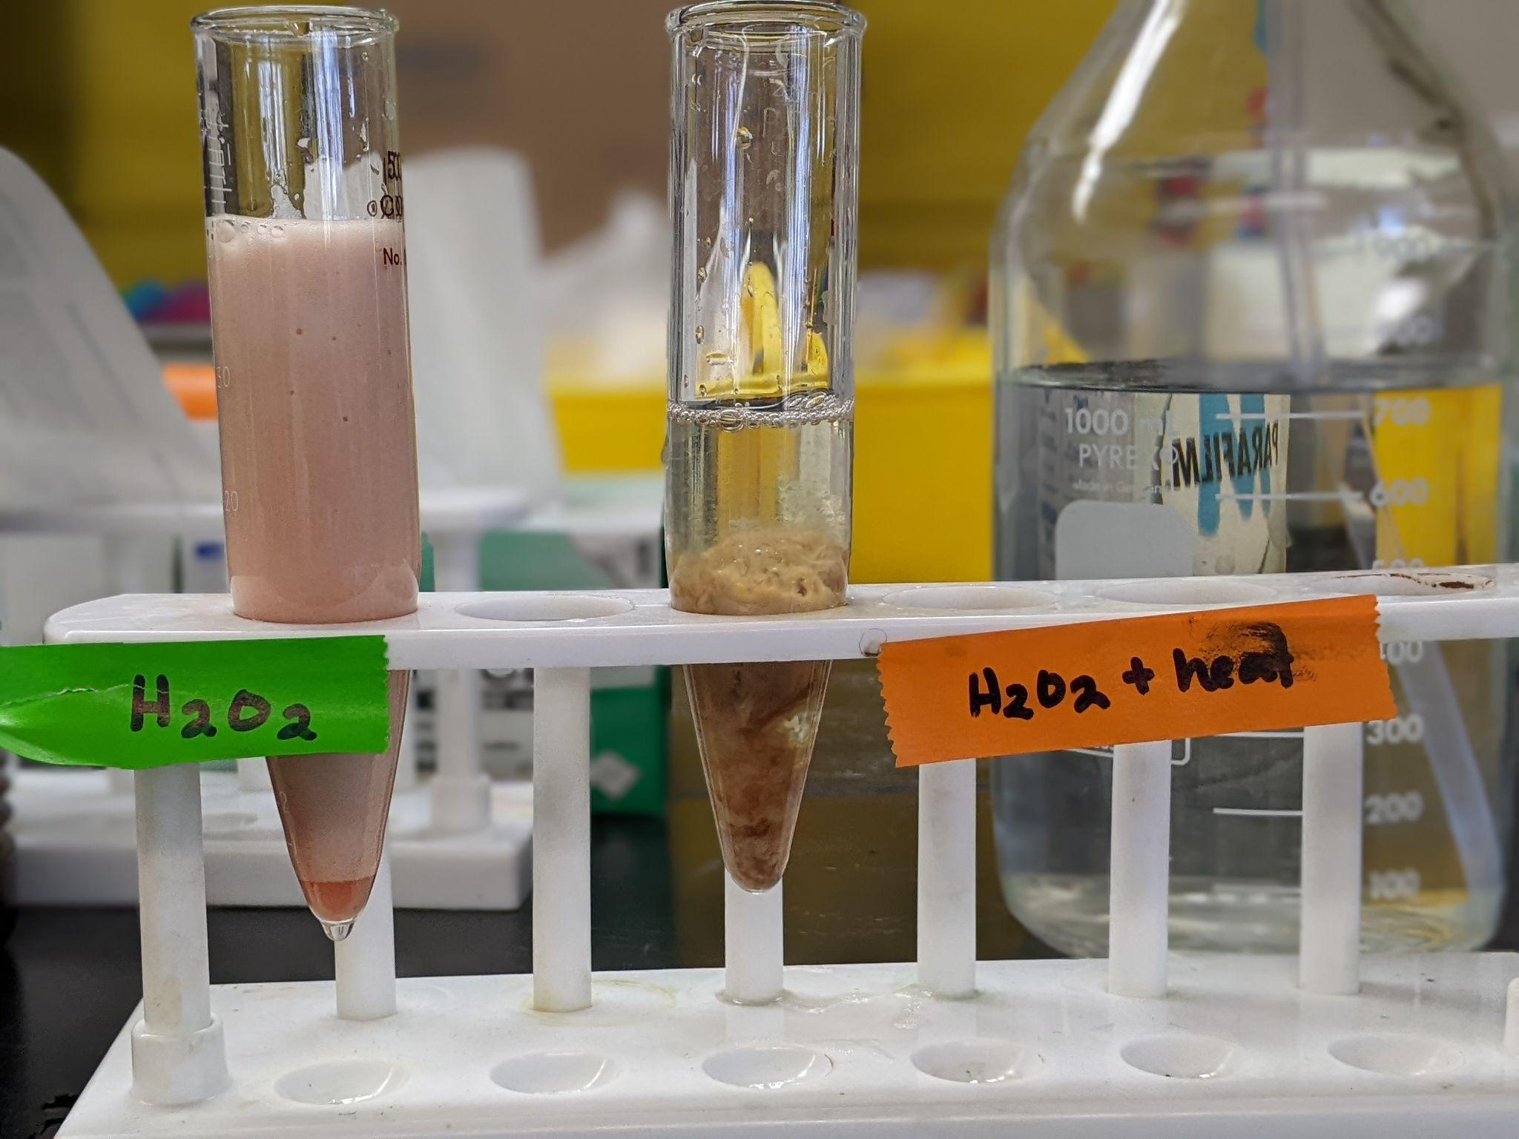
COMPARING COLD AND HEAT
Notes:
Ruth says: [Discuss after images of wet lab and the damaged active site.]
Let’s model both of these at the nanoscopic level starting with what happens with heat.
[Advance slide]

Slide 38
COMPARING COLD AND HEAT
Notes:
Ruth says: [Discuss after images of wet lab and the damaged active site.]
First let’s look at the effects of heat. We model a normal active site. Ask participant to look at the results again and model what happened in the test that was heated.
[Advance slide]

Slide 39
COMPARING COLD AND HEAT
Notes:
Ruth says: [Discuss after images of wet lab and the damaged active site.]
The cold still have a little activity. How could we explain this? [Put your ideas in the chat.]
Let’s model this at the nanoscopic level and I will show you one theory my students had. Ask participants to model what has happens. Ask Tim to expound on what might be going on In the test tube.
[Advance slide]

Slide 40
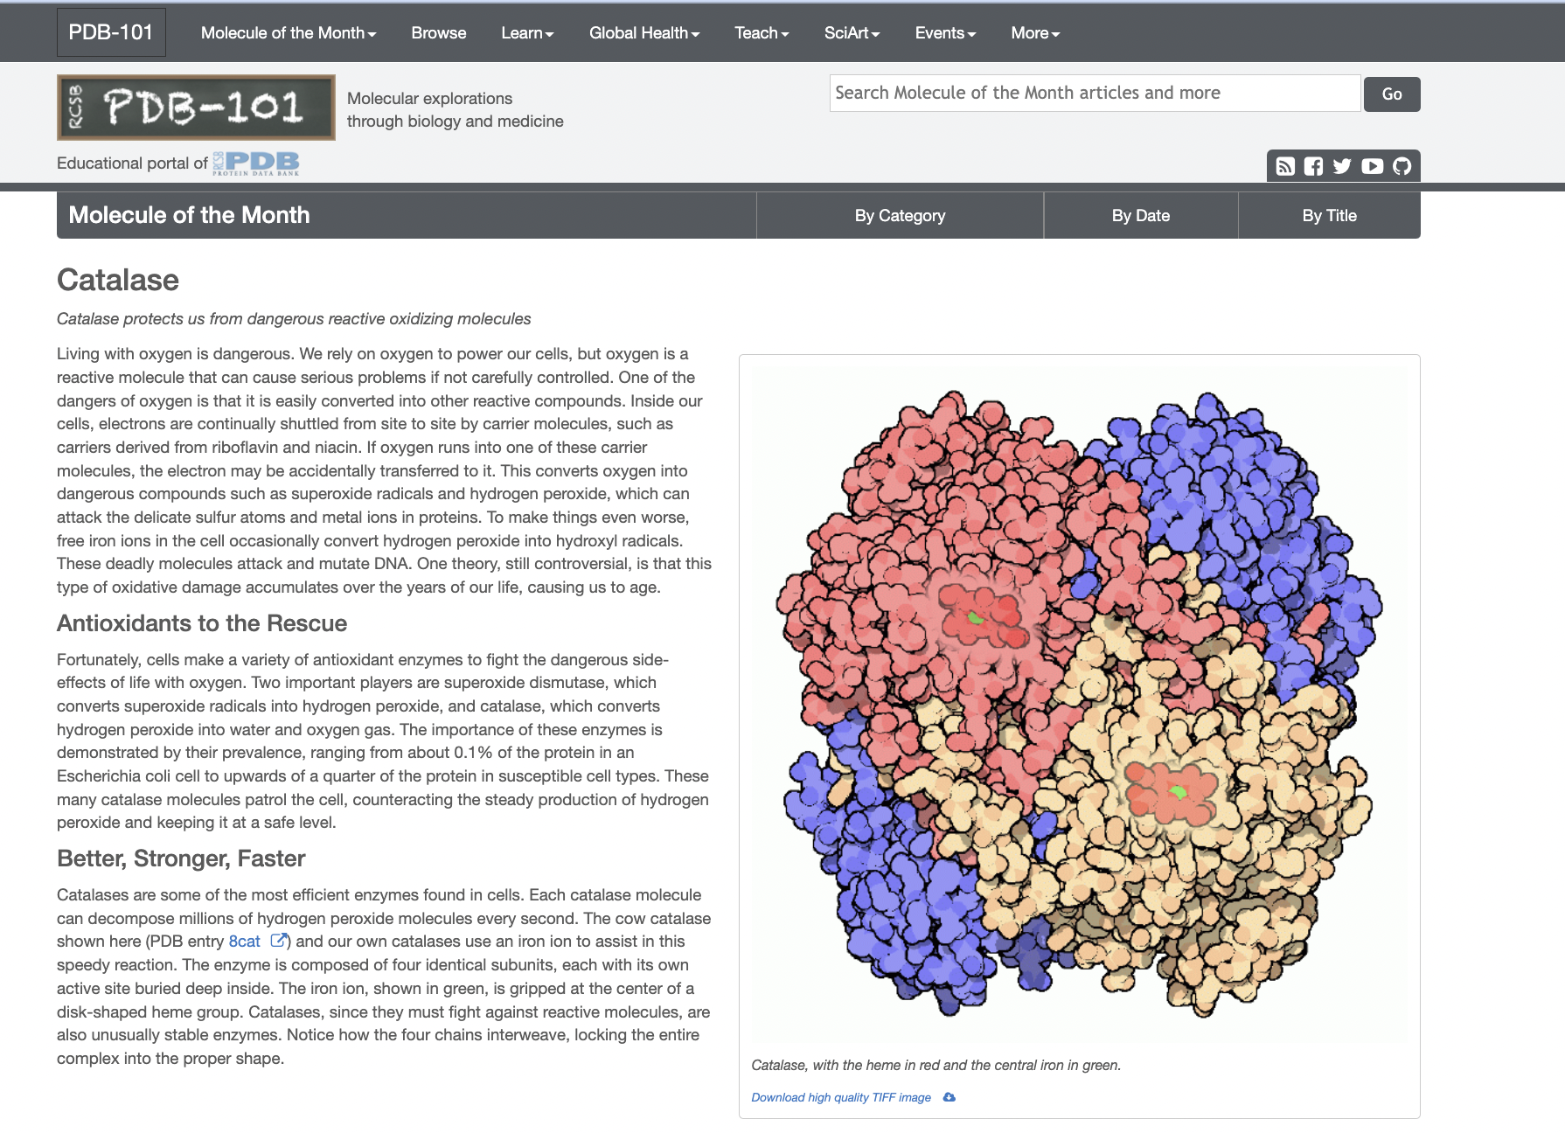
Notes:
Ruth says: Many of my students are really intrigued by this model and want to know more. They have questions or want further information so I post additional resources on my online Planbook. This is a great way to steer students to realize that there is more to understand and that our models don’t provide the entire answer.
The link to the resource is https://pdb101.rcsb.org/motm/57.
[Advance slide]

Slide 41
Assessment Time
Notes:
Ruth says: [Explain how students can use the manipulatives to help them on the assessment: writing an essay, drawing a storyboard, or discussing it with me using the manipulatives to help them explain what has happened at each certain points in the lab.] I hope that my sharing how we use both the amino acid starter kit and the enzymes in action kit has gotten you thinking of scenarios in which you can further use these kits in your classrooms. Students also start planning an investigation that limits one variable and we explore the effects of concentration or determine the temperature range of the enzyme catalase.
As students begin to design an experiment to determine the pH range or optimum temperature for catalase, it is important to understand how denaturation of the protein affects the enzyme's activity so they can better interpret their lab results.
I'm going to turn the presentation over to Tim to explain this using
[Advance slide]

Slide 42
This is a placeholder for the image of the Catalase Jmol exploration.
CBM - Catalase (msoe.edu)
Notes:
Tim takes over from here. The next two slides can be removed or additional ones can be added.
Using Jmol (a free and open-source viewer of molecular structures), participants will analyze protein structures more deeply. Tim will guide participants through an extensive tour of the enzyme catalase using a Jmol exploration. [10 minutes]
CBM - Catalase (msoe.edu)

Slide 43
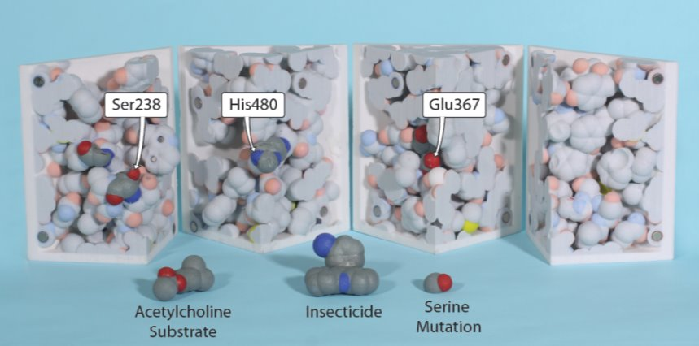
Notes:
Acetylcholinesterase Active Site Case Study: Participants will explore a physical model of the acetylcholinesterase active site to determine the structure-function relationship of a single protein. [15 minutes]

Slide 44
Workshop NGSS Connections
SEPs | CCCs | DCIs
Asking Questions | Patterns | HS-LS1-1
Developing and Using Models | Cause and Effect | HS-LS1-2
Constructing Explanations | Structure and Function | LS-1A
 | Stability and Change | LS-1C
 | Scale, Proportion, and Quantity | LS-1D
Notes:
Ruth says: These kits are aligned with many of the Next Generation Science Standards including the following Science and Engineering Practices, Cross Cutting Concepts, and Disciplinary Core Ideas. [Outline some of the connections by reading from the graphic organizers.]
We still have a couple of minutes left in the presentation. Does anyone have any comments or questions they would like to make?
Thank you so much for your time. I’m going to turn the program back to Heather.
[Move to break.]

