Slide 1



The Future is CRISPR
Using models to teach Genetic Engineering and CRISPR Technology

Slide 2
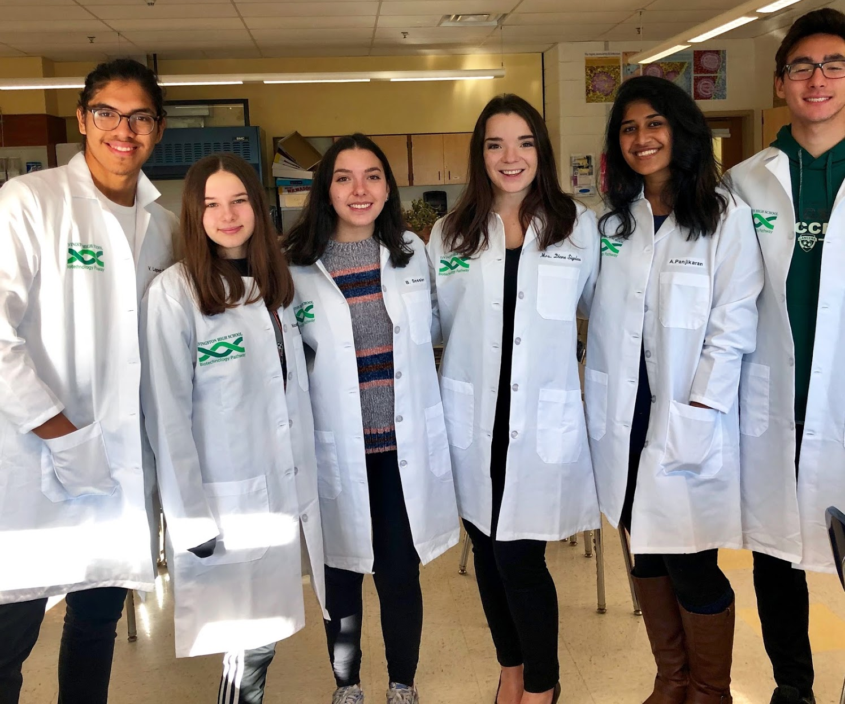
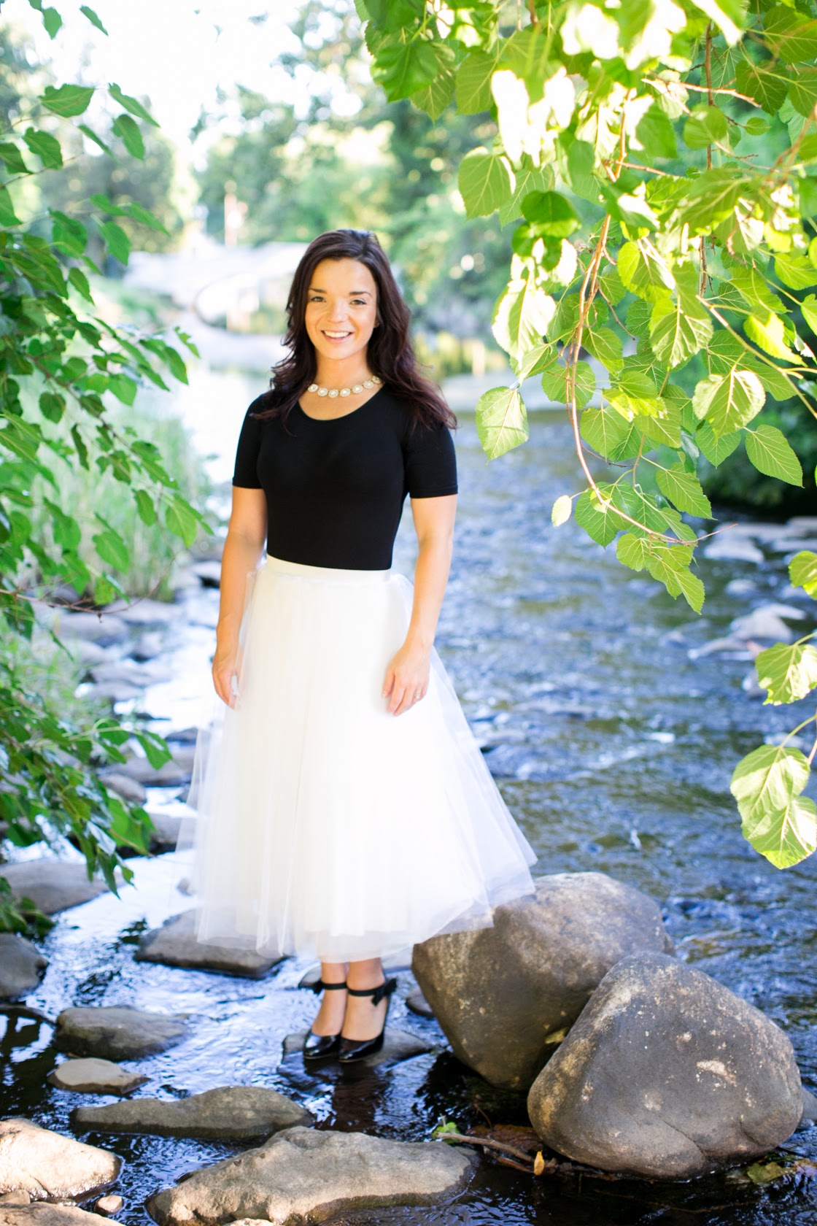
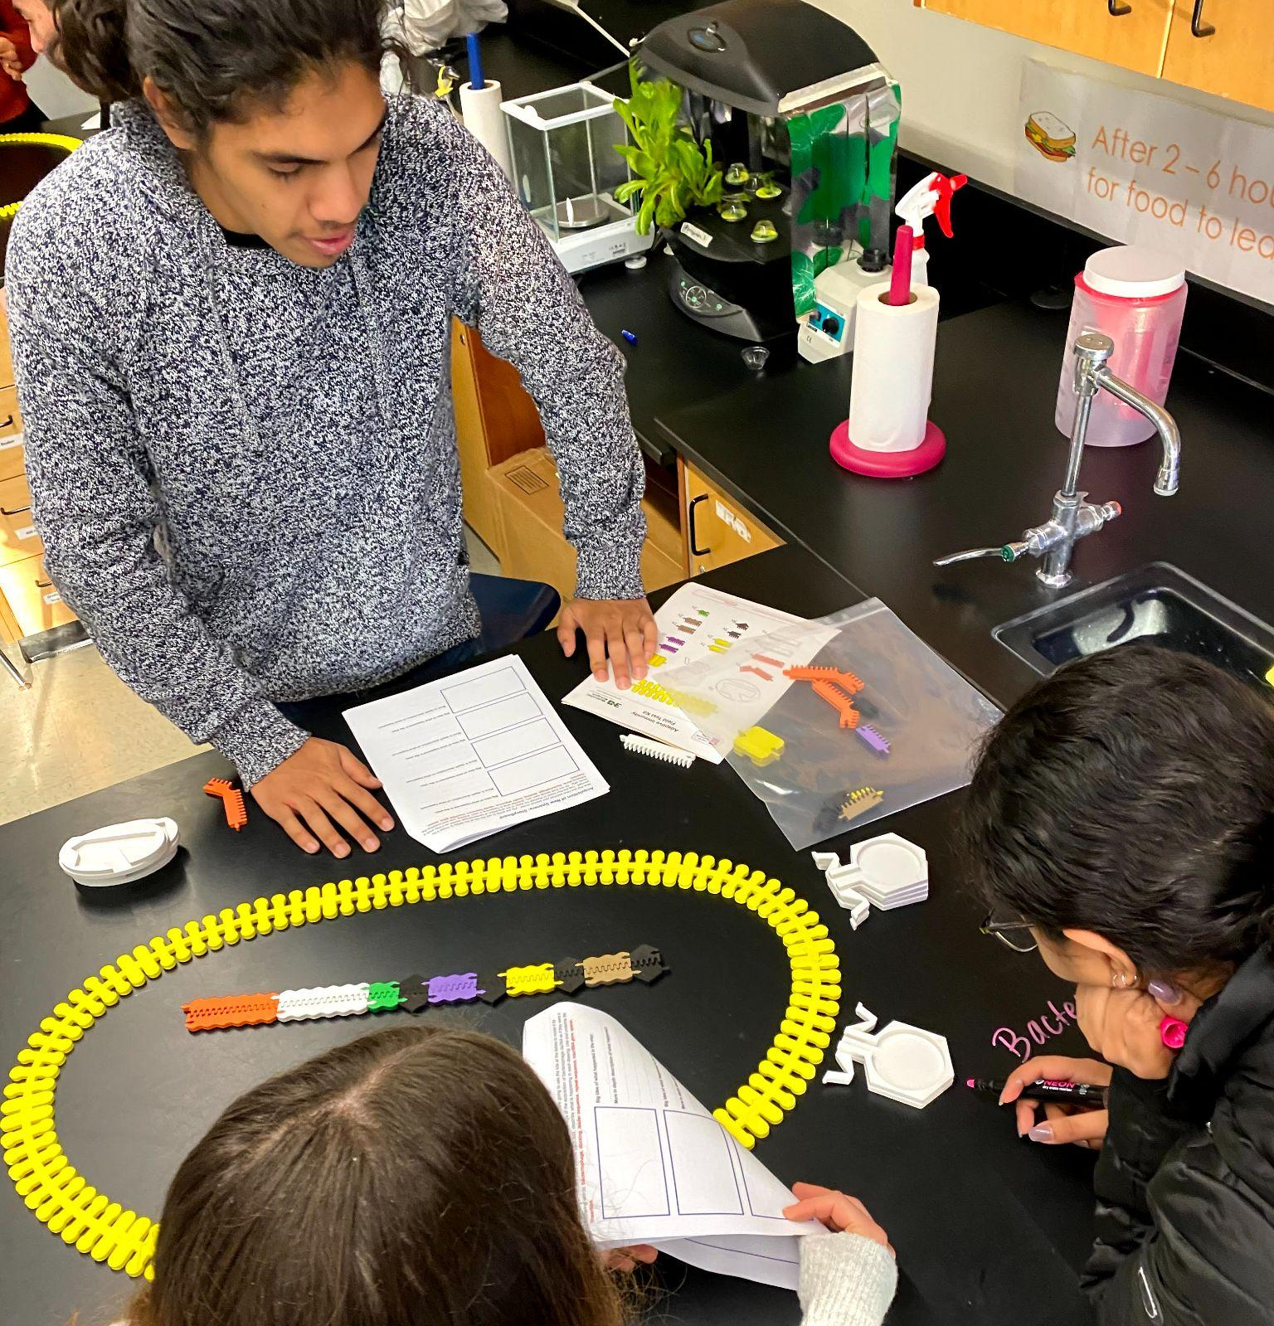
Why Me?
Diane Sigalas
Biotechnology Teacher at Livingston High School - Livingston, NJ
Curriculum Developer
M.Ed: Educational Leadership
Cohort 2- Science and Ethics of Genome Engineering with MSOE
Model Teacher with 3D Molecular Designs

Slide 3

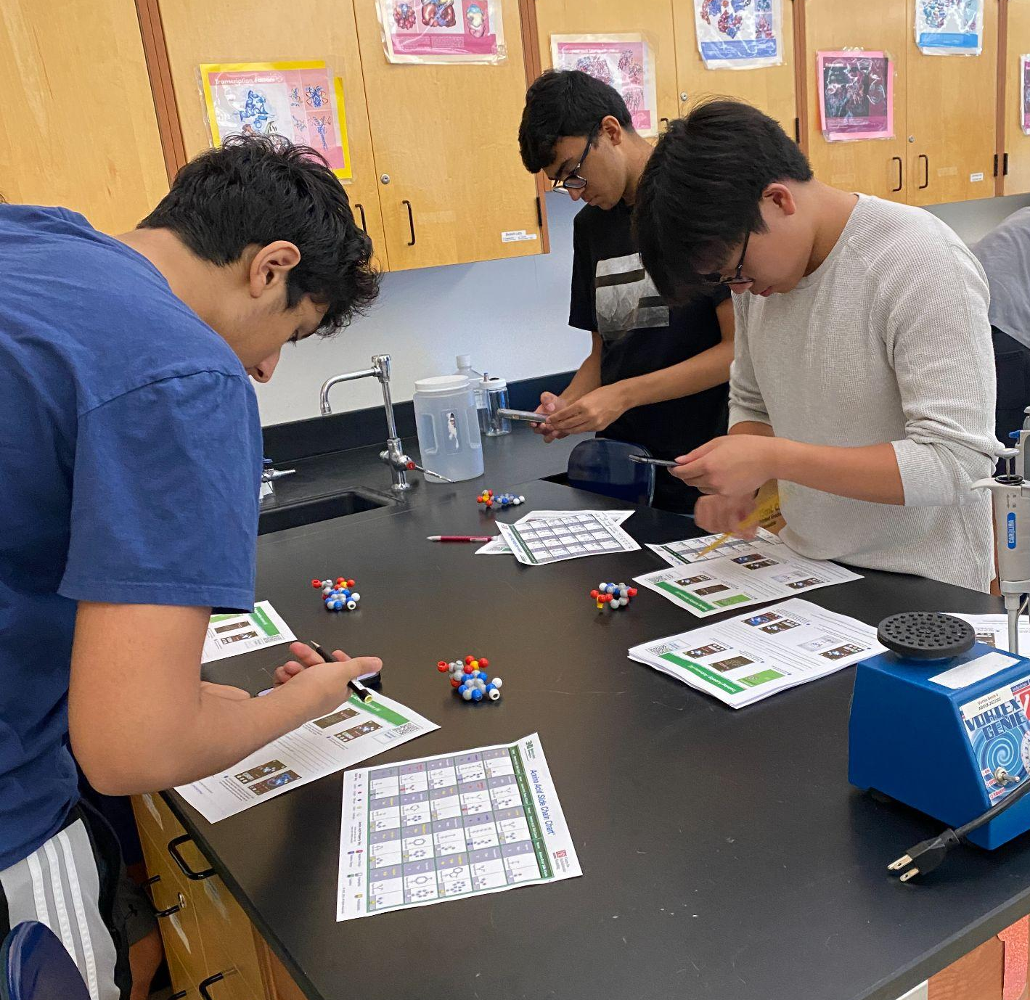
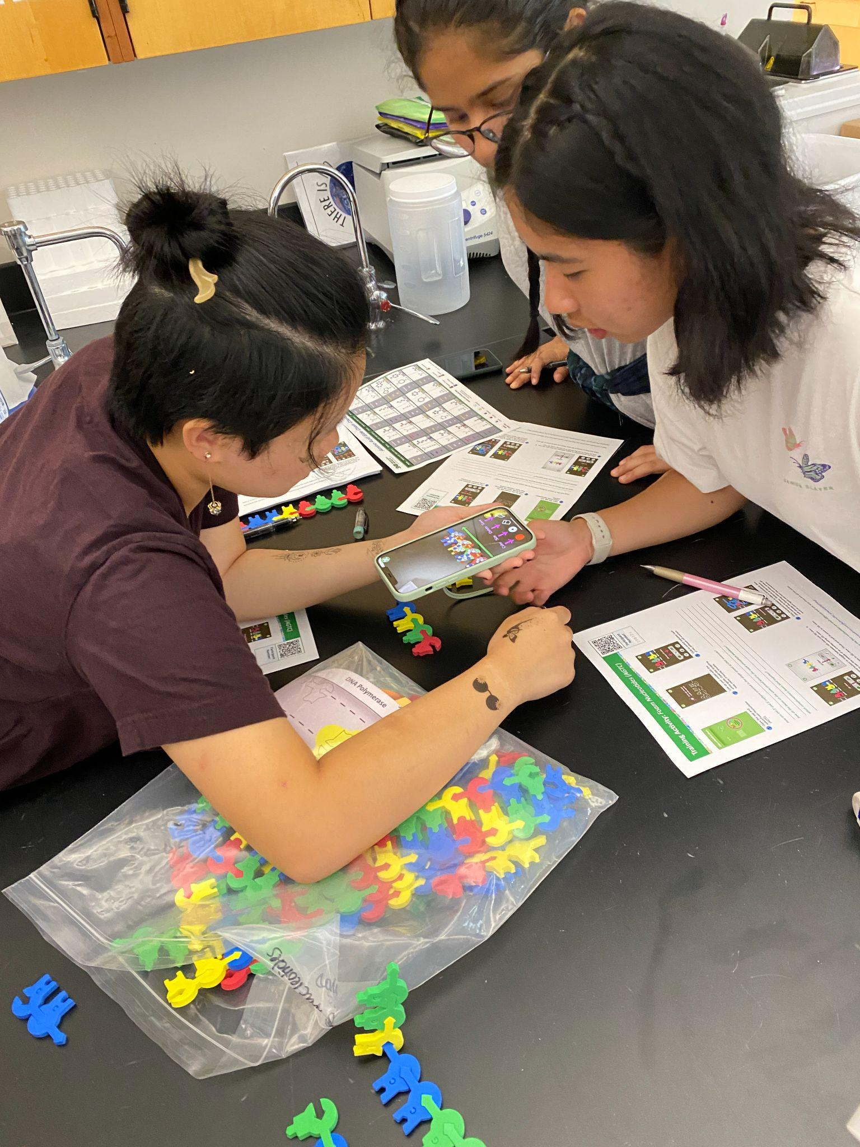
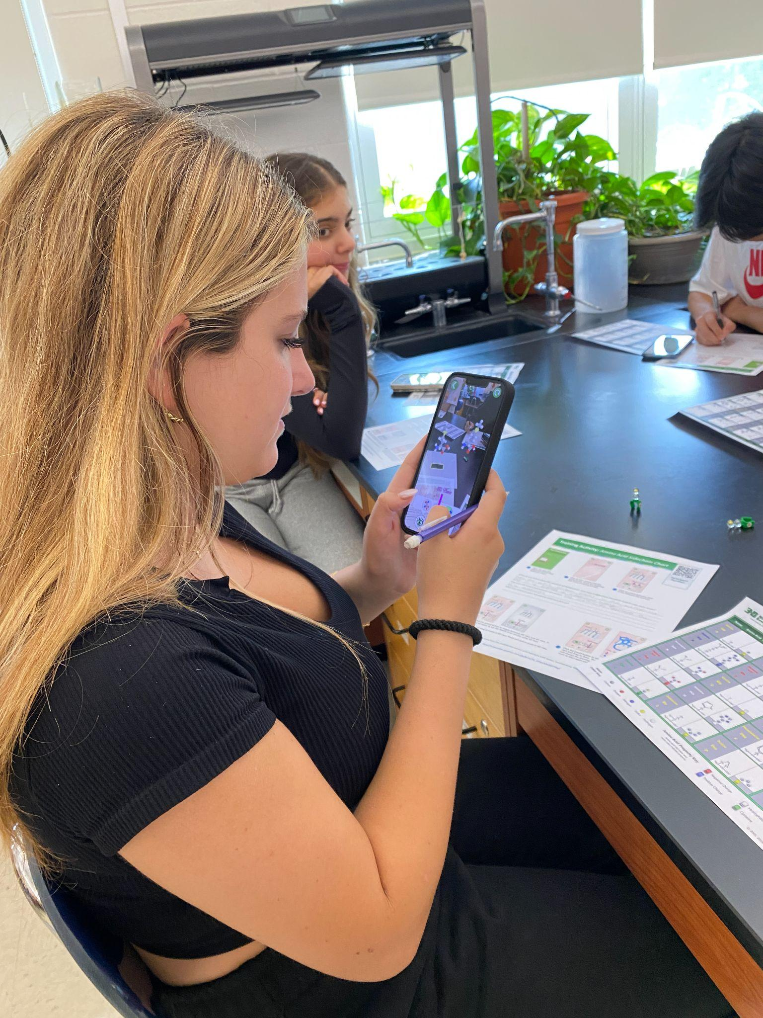
The AR Future!
Come visit us today at Booth 6 & 7 to grab an AR DNA model!
Be a part of this amazing new venture to bring AR technology into the classroom - and engage your students like you never imagined!

Slide 4

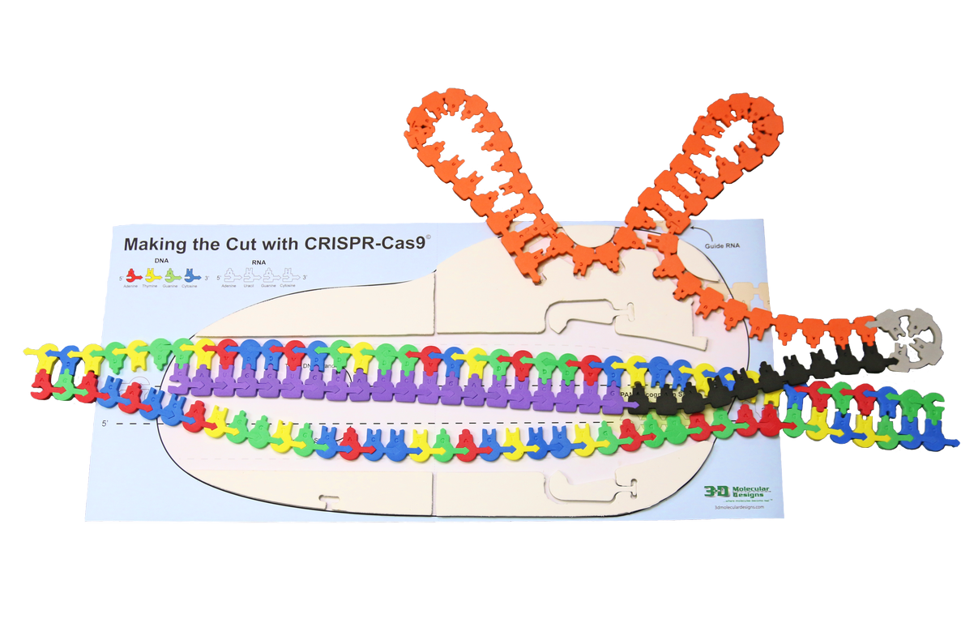
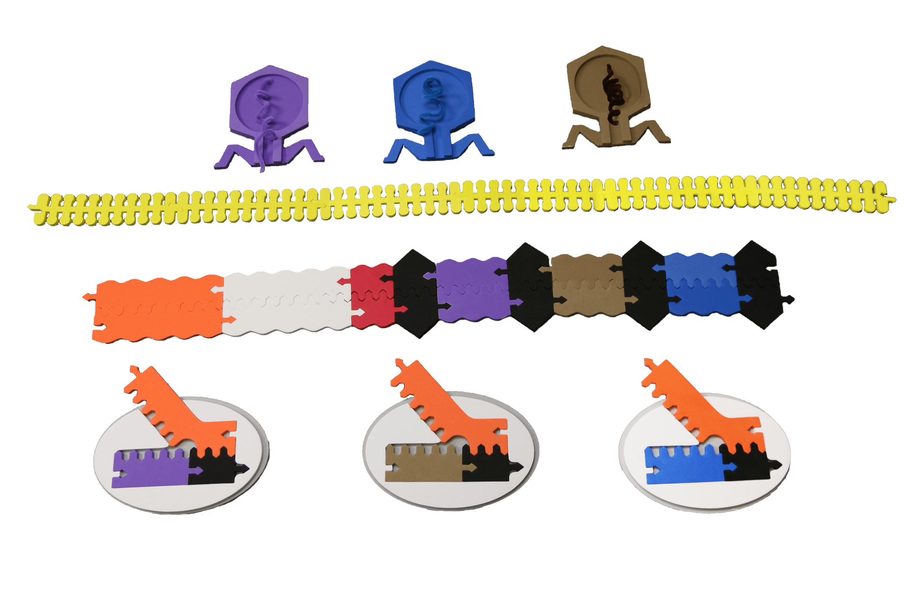
The Dynamic Duo
Making the Cut with CRISPR-Cas 9
MCC
Adaptive Immunity Kit
(AIK)

Slide 5
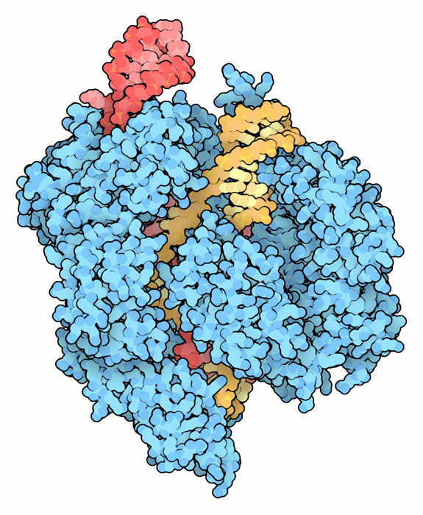
Workshop Learning Goals
Get excited about the benefits of modeling.
Practice how to use the kit
Realize how incredibly amazing (and understandable!) CRISPR research is!
Identify places where you could incorporate CRISPR based science into your curriculum.

Slide 6


NGSS Connections
SEPs | CCCs | DCIs
Asking Questions and Defining Problems | Patterns | LS3: Heredity: Inheritance and Variation of Traits - LS3.A / LS3.B
Developing and Using Models | Cause and Effect: Mechanism and Explanation | LS1: From Molecules to Organisms: Structures and Processes - LS1.A
Analyze & Interpret Data | Structure and Function
Construct Explanations | System and System Models
Engage in Arguments from Evidence | Scale, Proportion, and Quantity
It is one gigantic festival of NGSS-ness! They all honestly fit. It just depends what route you choose to go with your kids.

Slide 7
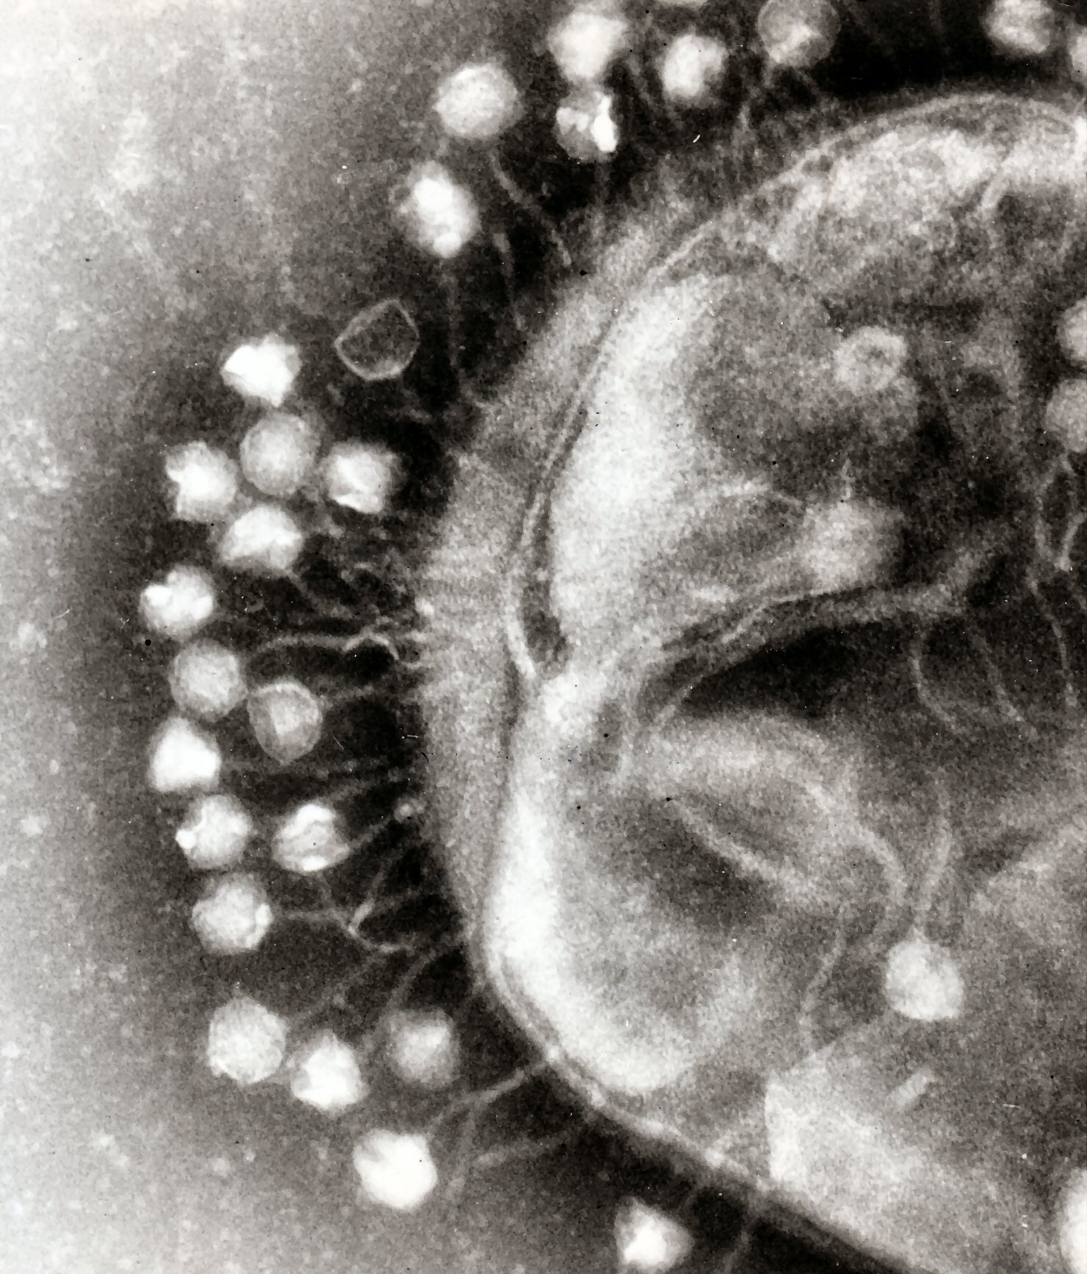
Attack of the Phages
From the dawn of time, viruses have evolved along side of their host. As one entity develops a new offensive tactic, the other responds with a new defensive maneuver.
Pictured to the right is a bacterial cell with a halo of attacking phages eagerly ready to infect it. It is from these seemingly simplistic organisms that a new frontier of science is evolving before our very eyes.

Slide 8
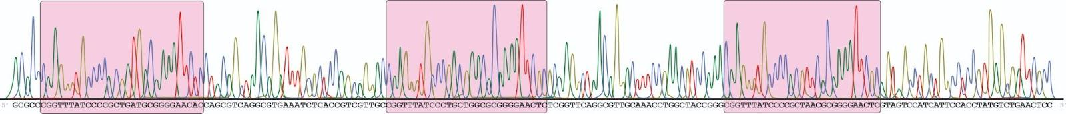

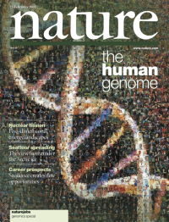
Acronyms on acronyms
Teacher Hat...
How will your students react to grounding scientific events in historical context?
cas genes
Bacterial/archeal
chromosome

Slide 9
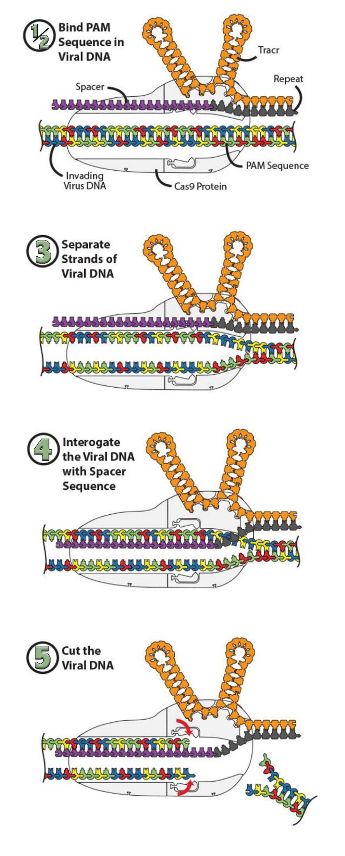
Let’s wonder a little… shall we?
Before we even begin, what interactions do you see?
Who is touching who?
What do you notice?

Slide 10
Just who are these pieces?
Let’s go over just who these pieces are and what they do in this system pictured to the right:
tracrRNA
Spacer
Repeat
cas9 Protein
Viral DNA
PAM Sequence
Let’s pause.
Turn to your neighbor… discuss, re-explain, find a question you want to ask.

Slide 11
Time for a little wonder again
Now that you know who is who and what they do…
Who is touching who?
Why do you think those parts are touching?
Let’s pause.
Now look at the 3D model at your table. How do you see these schematic foam pieces interacting in the 3-dimensional version? Does this change your answer?

Slide 12
Step One: Bind PAM
Let’s explore how the system works! First, the DNA will bind to the cas9 protein at a PAM sequence, 5’-NGG-3’.
Think of this like the AUG start codon with transcription!

Slide 13
Step Two: Keep em’ Separated!
Then, there are positive amino acid residues along where the DNA interacts with the cas9 protein.
+
+
+
+
+
+
+
+
+
+
+
+
Remember, DNA is negatively charged due to the phosphates. So, positive… negative…
Opposites attract! Open Sesame!
+
+
+
+
+
+
+
+
+
+
+
+

Slide 14
Step Four: Interrogation Time
Then, the bacterial CRISPR/cas9 system will use the spacer sequence from a previous phage attack to interrogate the suspicious DNA. Does it match?
Does this remind you of anything in our own bodies? Remember… this is originally the bacterial immune system…

Slide 15
Step Five: Break it Up!
Finally, if the spacer sequence matches the invading DNA strand - time to cut it! Two endonucleases will create a double strand break in the DNA. Think about how this will affect the DNA…?
Next question…
How could we use this model to help explain how CRISPR works to our students?

Slide 16

What could this look like
Levels?
Integration into lessons?
How much do you want to open the floodgates?

Slide 17
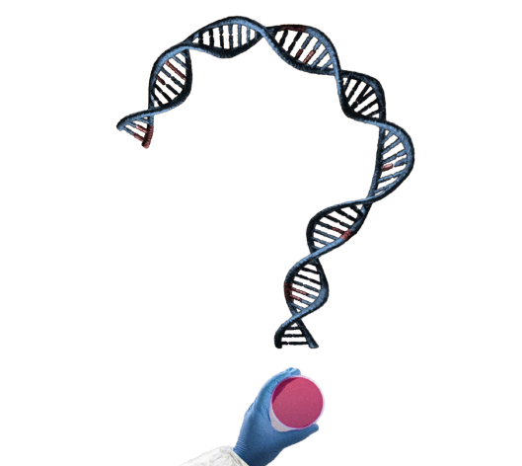
But floodgates are so much fun
Stopping at this point has it purpose… but leaves out on all of those questions the students have…
What do you wonder about with the future of CRISPR?
What do your students wonder about? What are their big questions?

Slide 18

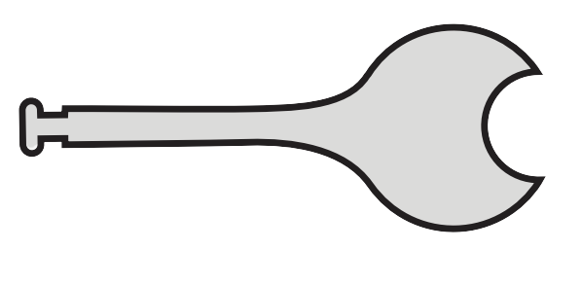
A tiny little add-on
We can attach a little protein called a cytidine deaminase.
Human Genome
Is this the only thing you can add on to a cas protein?
Nope!
Cytidine Deaminase

Slide 19
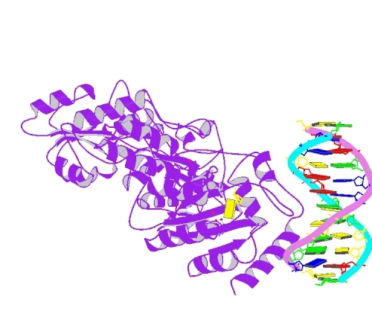
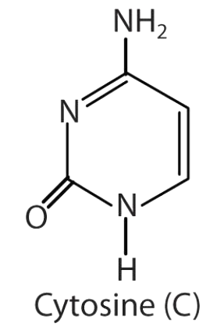
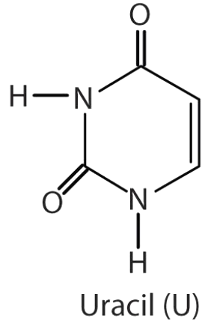
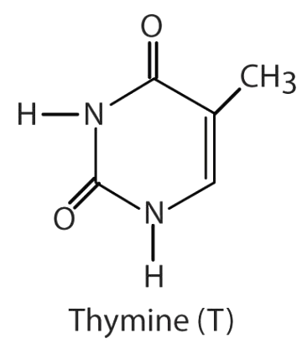
Cytidine Deamin…what?
Cytidine deaminases are one of the proteins responsible for all of the diversity in our antibodies.
Cytidine Deaminase
DNA Replication

Slide 20
So let’s go back…
Looking again at our sequence, is there a C in reach of our cytidine deaminase that we can change to a U?
Awesome, now if that U changes to a T… how would DNA polymerase 1 respond?
Human Genome
Cytidine Deaminase

Slide 21
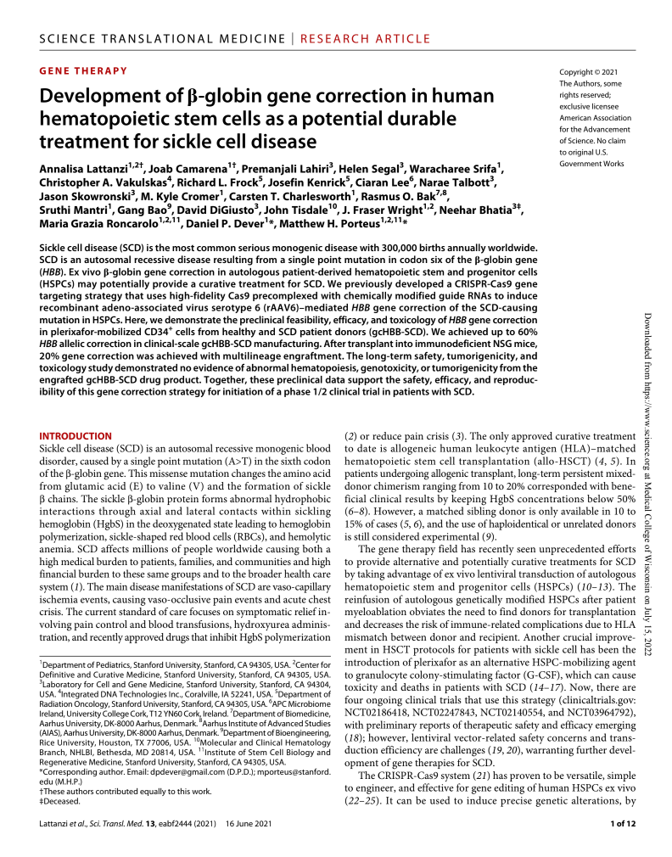
What did you just do?
That is the much simplified description of what Matthew Porteus is doing to cure sickle cell anemia!
Human Genome
Cytidine Deaminase

Slide 22

Sequencing Ideas
Depends on what your course sequence.
Biotechnology I - Bioethics Unit
    Adaptive Immunity & Basics of Structure
Biotechnology II - Modifications that can be made to the system
    System modifications (protein & genomic)
    Use as a testing modality

Slide 23
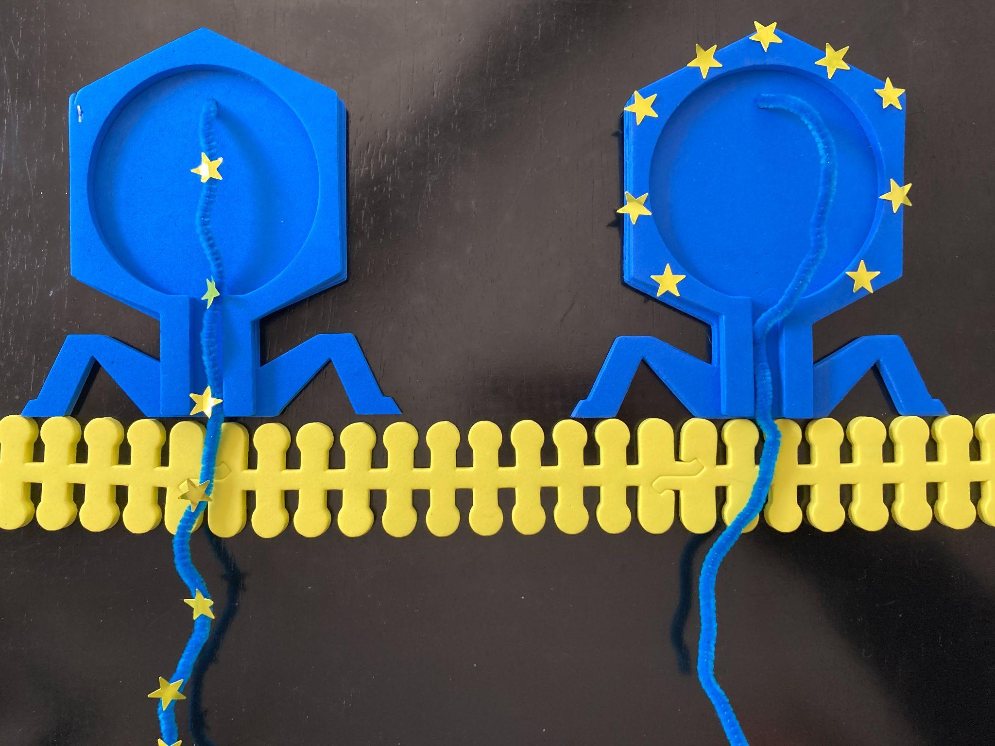
The Buffet of Options:
Middle School | High School CP | High School Honors | High School Elective | AP Bio | Collegiate Level
Teacher demo model the Adaptive Immunity Kit as a way to illustrate protein formations. | Student model the Adaptive Immunity Kit. Teacher demo model the Making the Cut Kit Can also be used for teacher demo Hershey/Chase experiment! | Student model the Adaptive Immunity Kit Connect to diversification of Ig molecules. Student model the Making the Cut Kit. Can also be used for student discovery/modeling of the Hershey/Chase experiment. | Student model of the Adaptive Immunity Kit. Student model the Making the Cut Kit. Base editor design project. Teacher demo the the MCC kit for base editing. Connections back to Sickle Cell and various other diseases are possible! | Student model of the Adaptive Immunity Kit. Student model the Making the Cut Kit. Student developed extensions/parallels to VDJ recombination with Ig development. | Student model of the Adaptive Immunity Kit. Student model the Making the Cut Kit. Base editor design project. Teacher demo the the MCC kit for base editing or PRIME editing. With lit review extension to ways it is being used in current research.

Slide 24
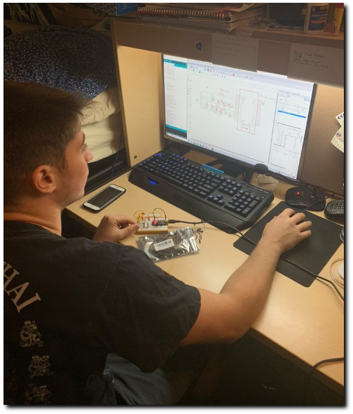
Student Thoughts
Brian took Biotech 1, and is now a sophomore at Drew University
I just want to let you know that I was talking with my bio professor the other day about CRISPR and genomic modifications. I not only understood what they were saying but could add in.
Meet Brian!

Slide 25
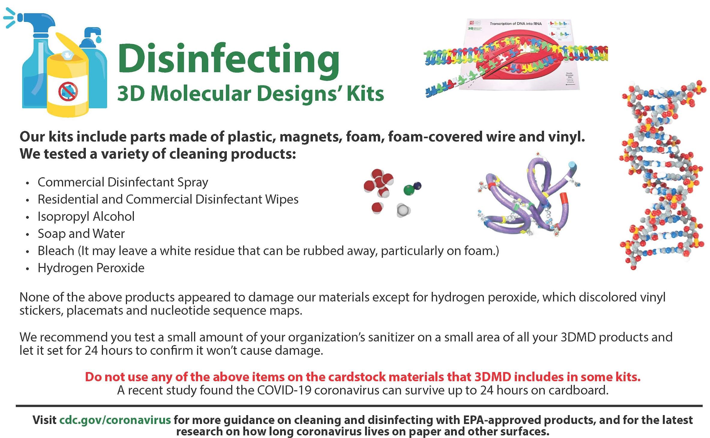
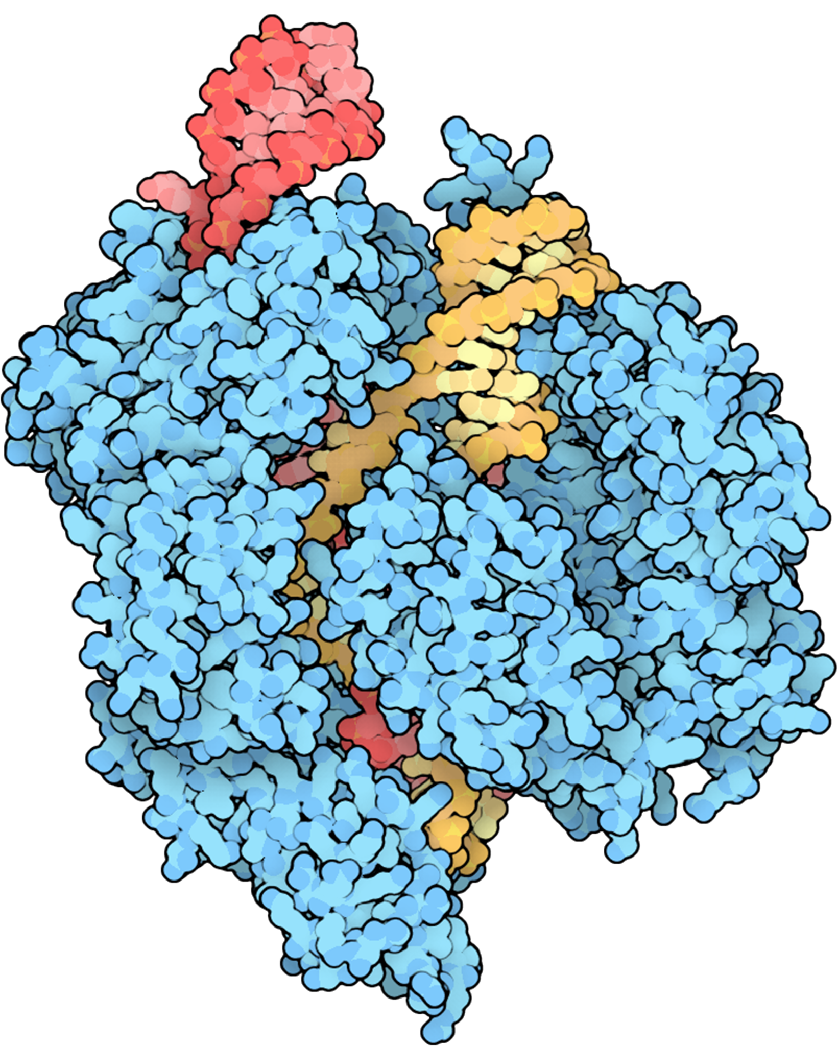

Slide 26
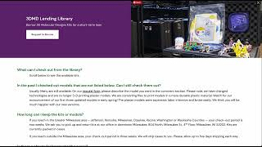
So… Now What?
3DMD website for resources
Lending Library
3dmoleculardesigns.com

Slide 27
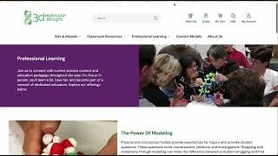
Ready for a life altering experience?

Slide 28

Wrapping Things Up
Thank you for attending!
Question!
Question!

Slide 29





Thank You
Diane Sigalas
dsigalas@livingston.org
https://www.linkedin.com/in/diane-sigalas/
@LancerBiotech

