Slide 1


Uncooking the Egg
Modeling protein folding and denaturation
Mark Arnholt
Science Educator
SMART Team Coordinator
3D Molecular Designs
Milwaukee, WI

Slide 2
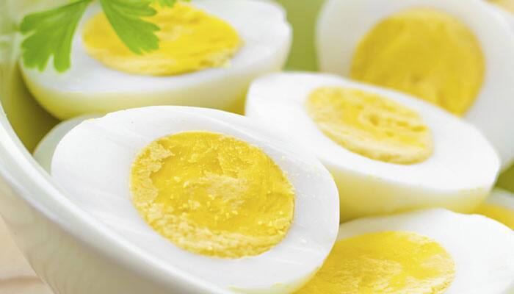
Uncooking the Egg
Protein folding and denaturation

Slide 3
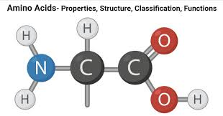
Notes:
Teacher: Be sure to point out the NCC backbone of an Amino Acid. This sequence repeats itself inside the protein, creating an N terminus and a C terminus in all protein sequences.

Slide 4
α carbon
Amine group
Carboxyl group
R group
Notes:
Teacher: Be sure to point out the NCC backbone of an Amino Acid. This sequence repeats itself inside the protein, creating an N terminus and a C terminus in all protein sequences.

Slide 5
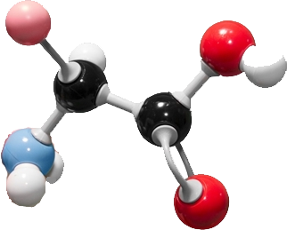
Moly Mods – Amino Acid

Slide 6
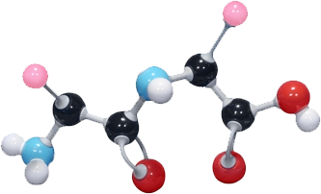
How do amino acids form proteins? (or in this case, a dipeptide?)
+

Slide 7
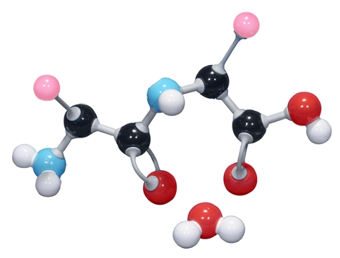
Dehydration Synthesis!

Slide 8
What is this?

Slide 9
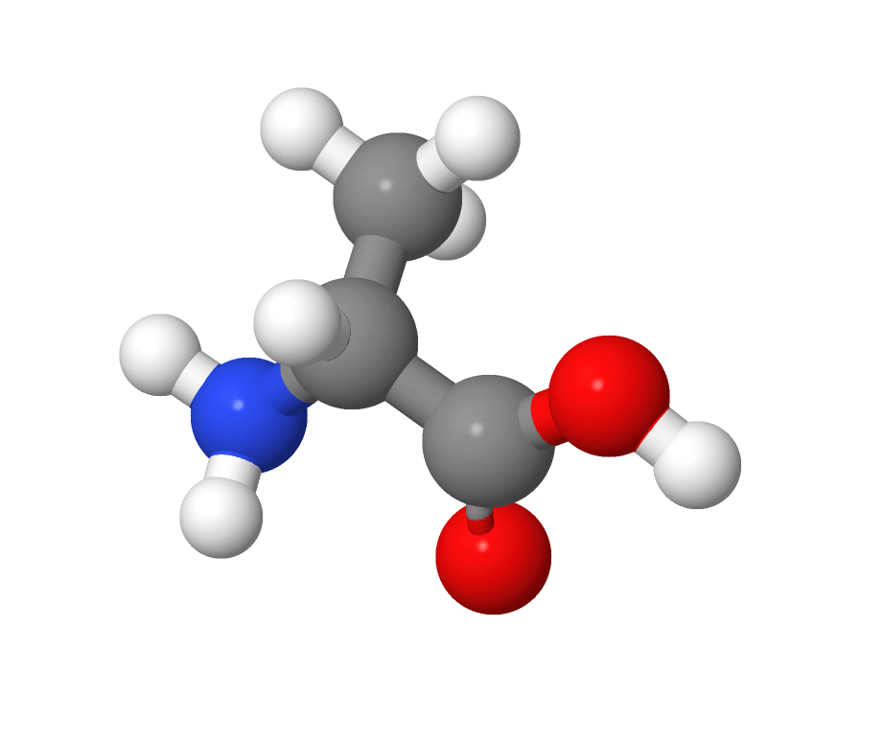
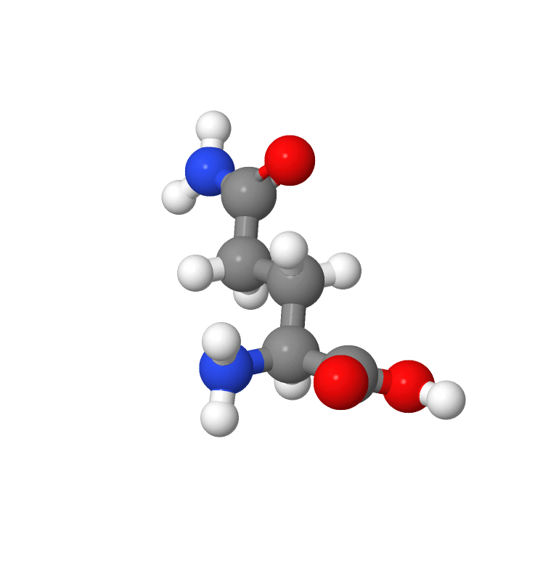
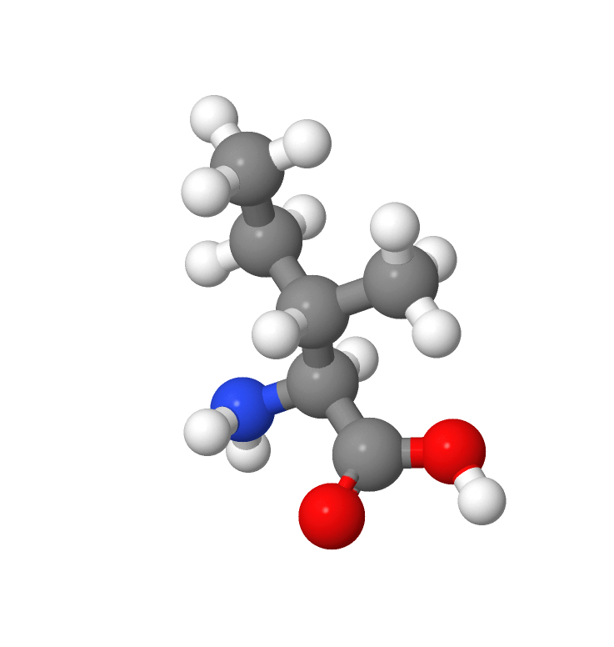
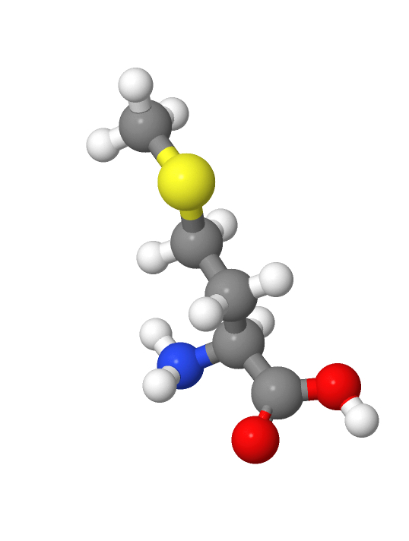
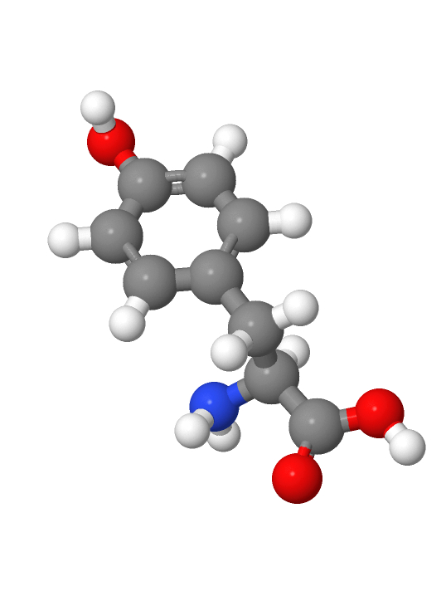
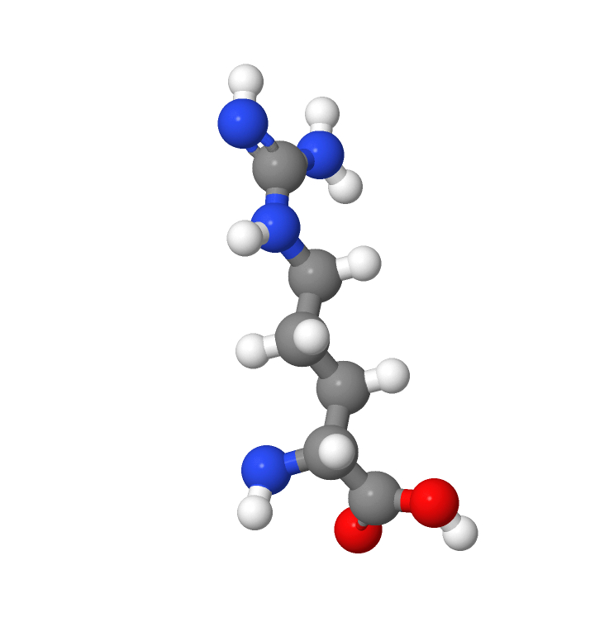
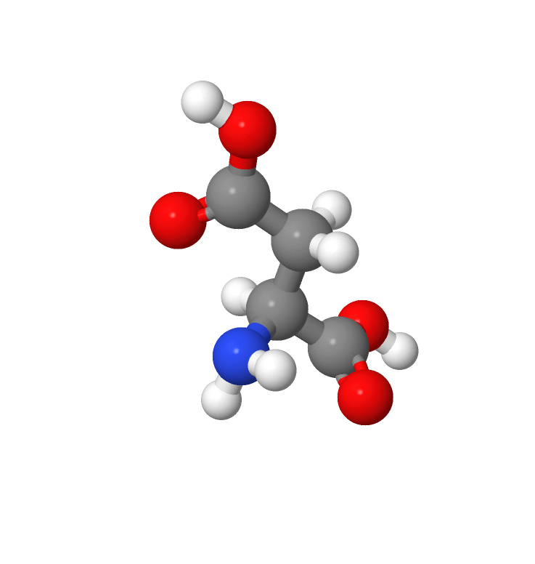
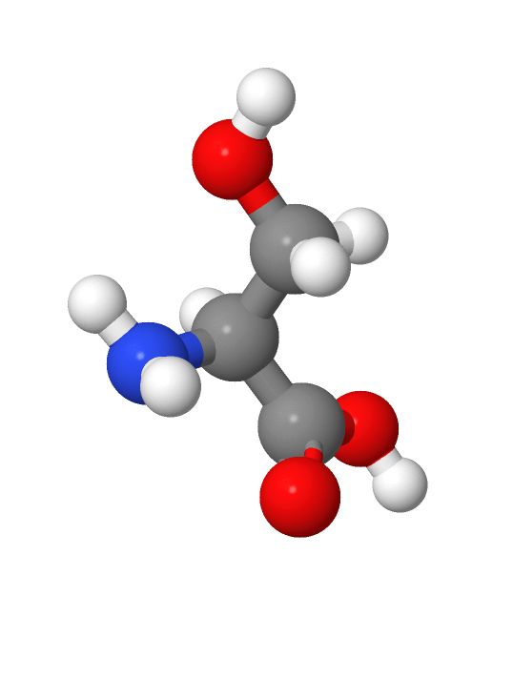
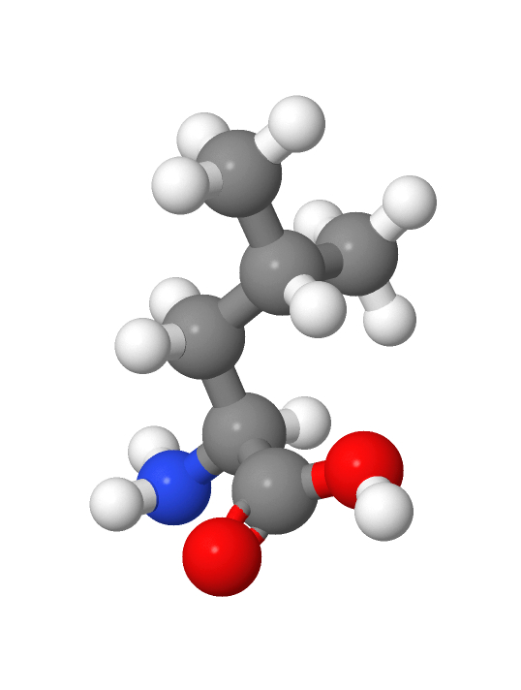
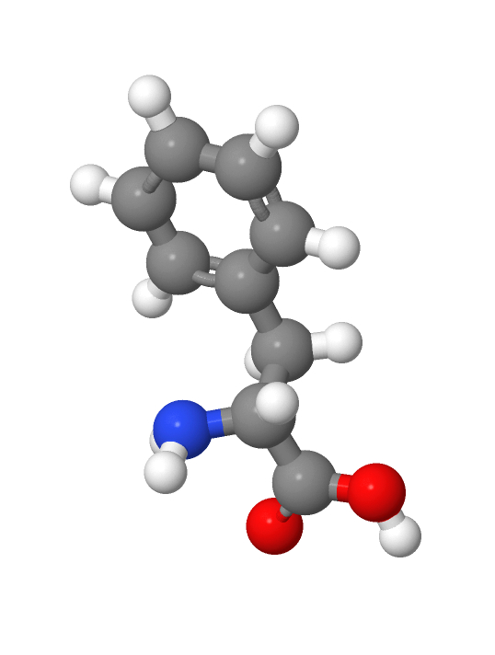
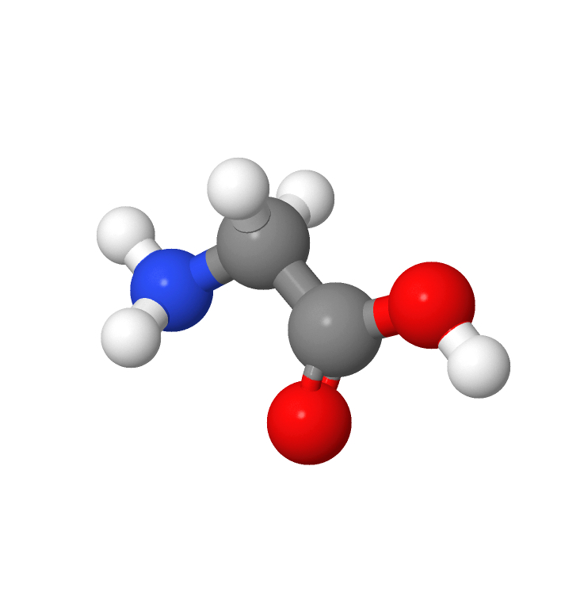
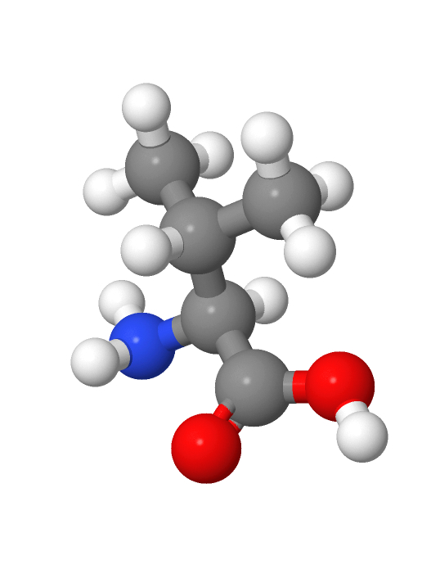
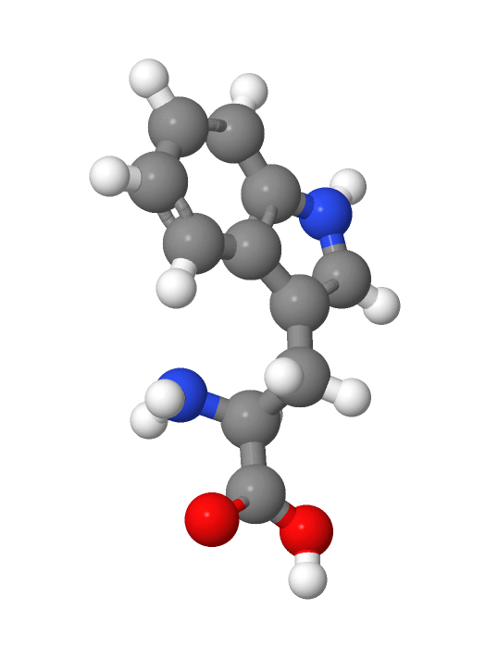
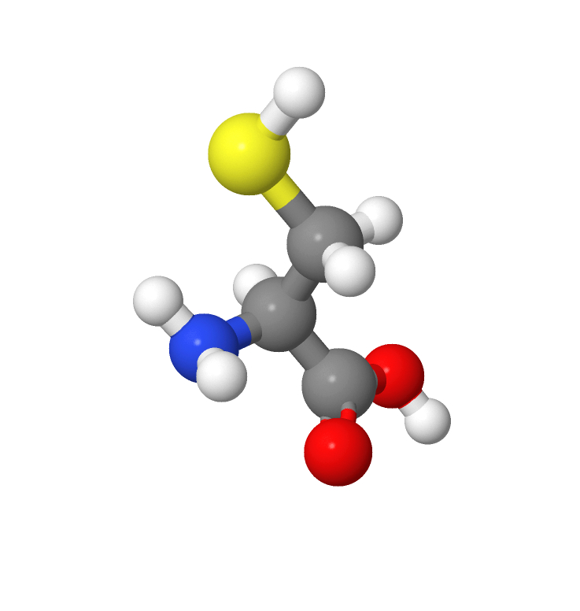
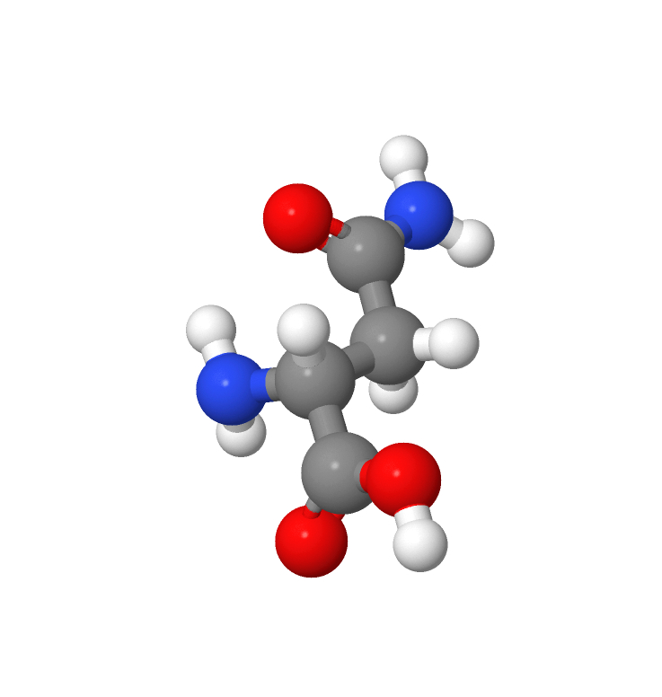
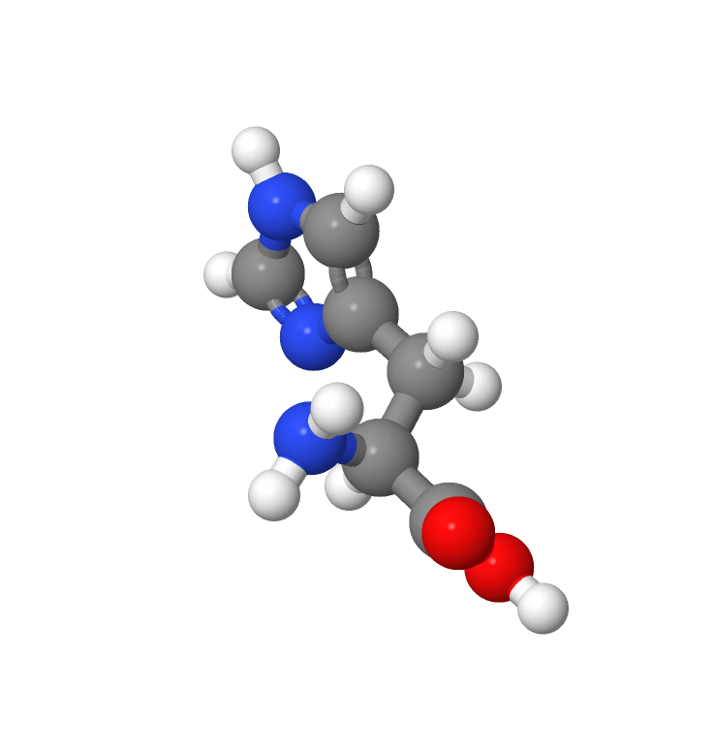
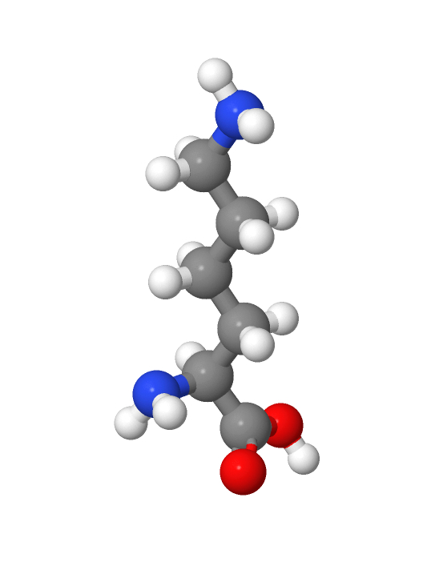
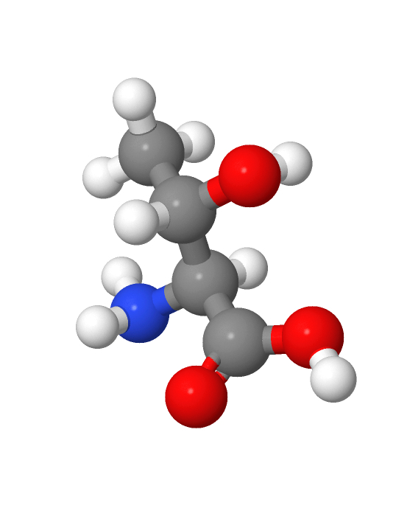
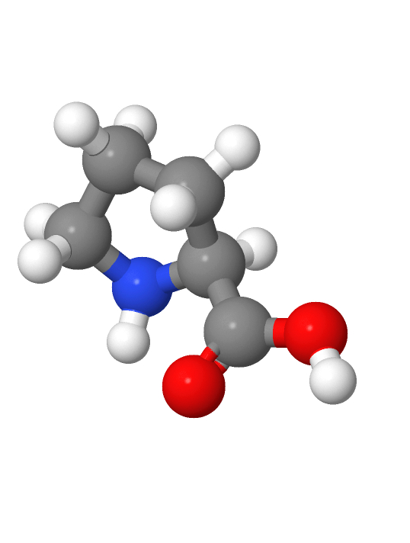
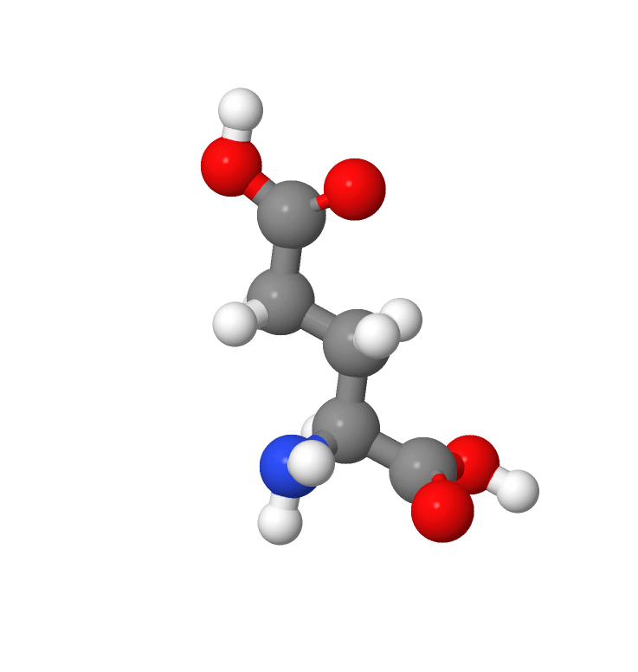
Here are all 20 common Amino Acids with their unique R-groups
Notes:
Teacher Note: The images here still contain the NCC backbone. The kits your students have only contain the R groups.
R groups in the kits do not have hydrogen molecules attached, with the exception of Glycine (r group is a Hydrogen)
Facilitate discussion in each group, but don’t give them too much guidance. This is designed for them to begin to identify patterns.
Students: Explore -> Justify (potential CER (Claim, Evidence, Reasoning Paragraph) opportunity – formative assessment)

Slide 10

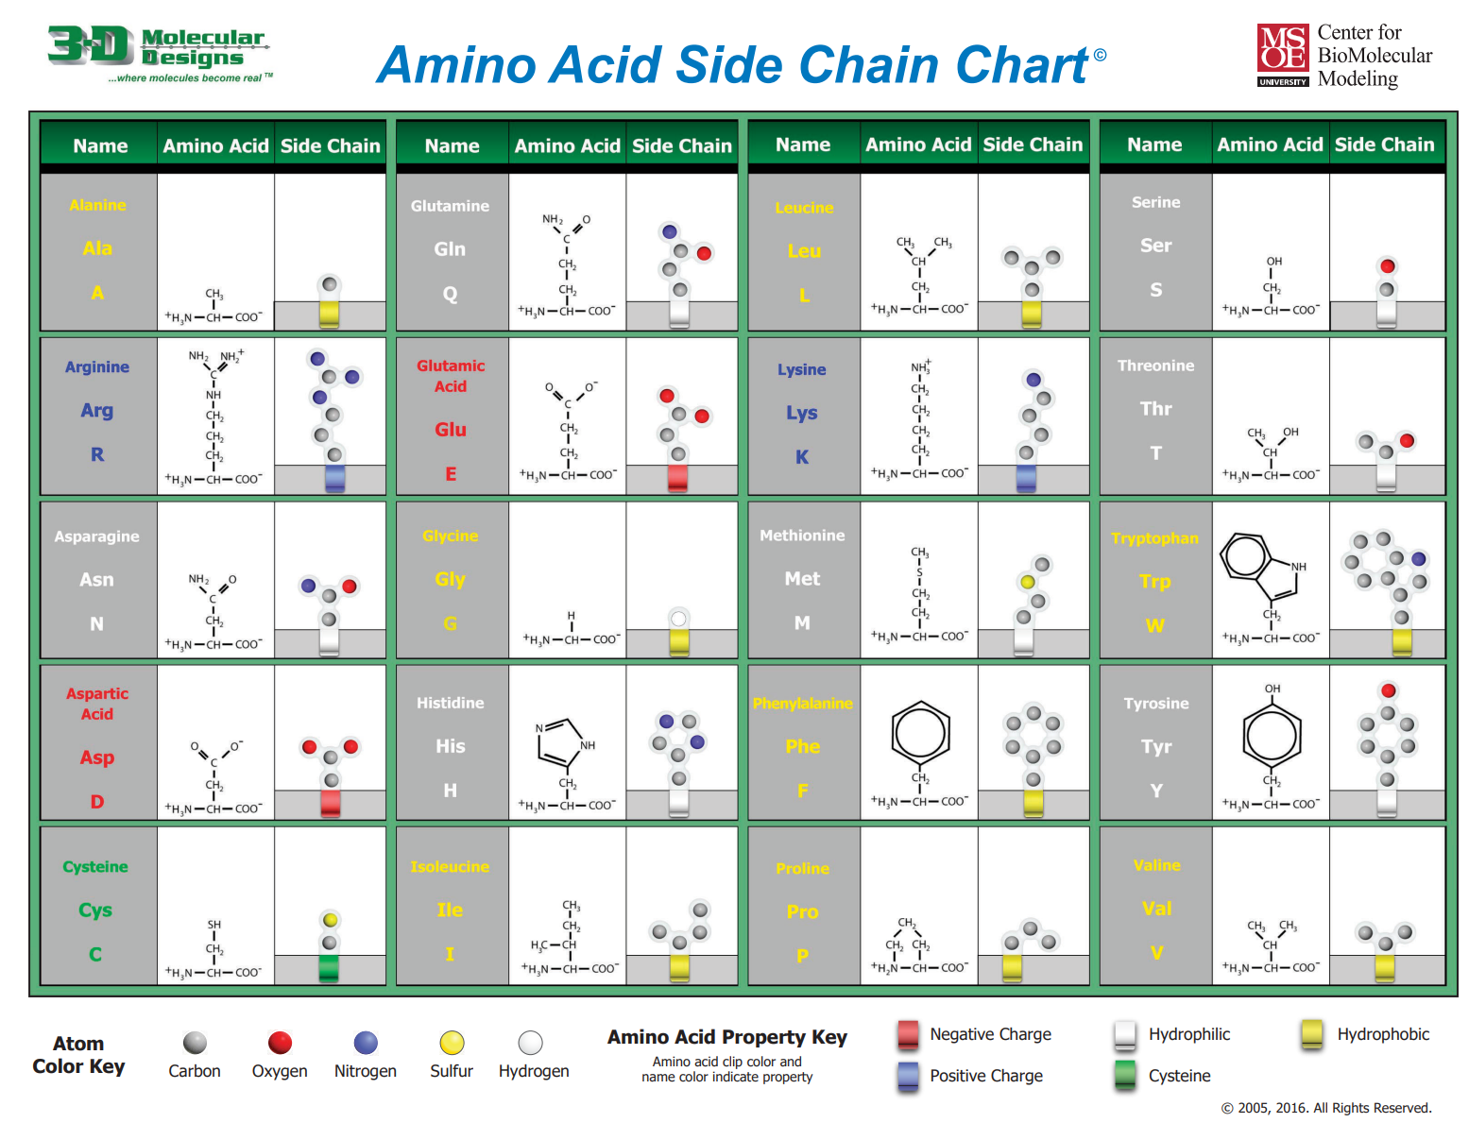
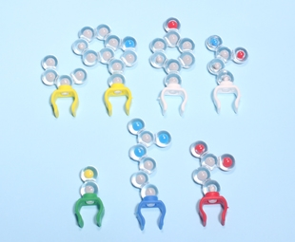
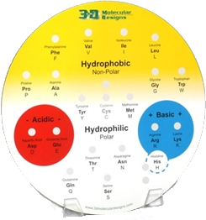
Open your bag and sort your amino acids on the property circle

Slide 11
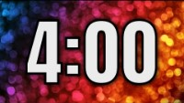
Notes:
Give them time, but stay firm in your timeframes. Students should be actively sorting and discussing the sidechains.

Slide 12
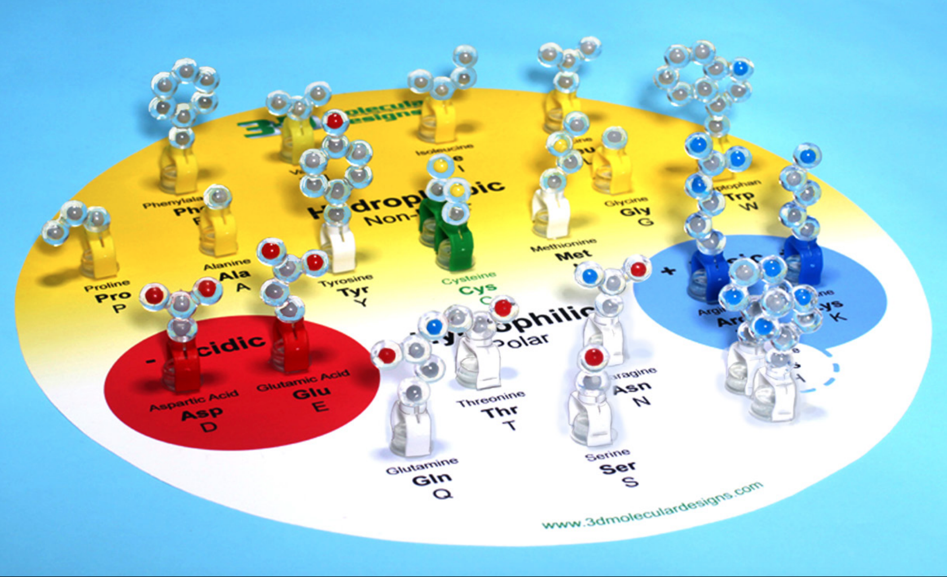

Slide 13
Let’s build a random protein!
Begin by choosing your favorite Amino Acids
6 Hydrophobic sidechains
2 Acidic sidechains
2 Basic sidechains
2 Cysteine sidechains
3 Polar sidechains (white)

Slide 14
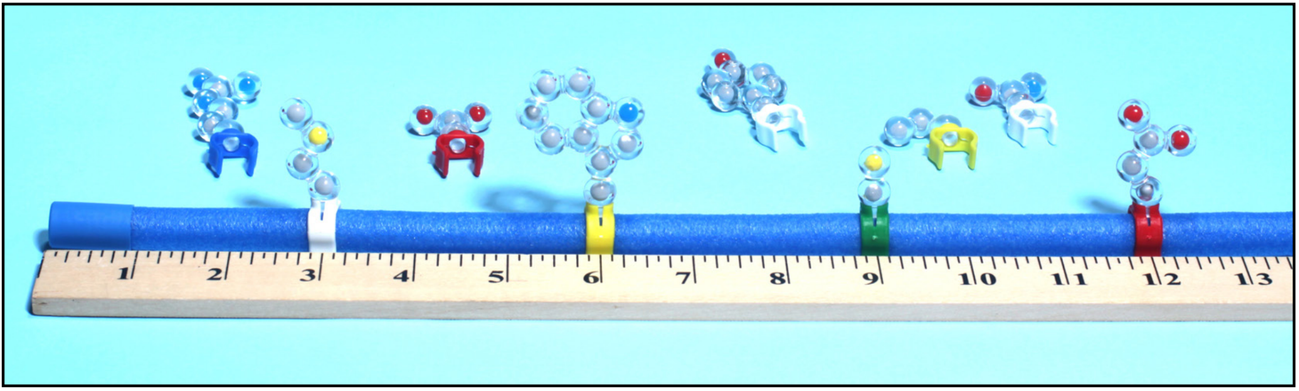
Step 2: Starting at the blue end of your tuber, use the clips to add your selected amino acids to get your primary structure.

Slide 15
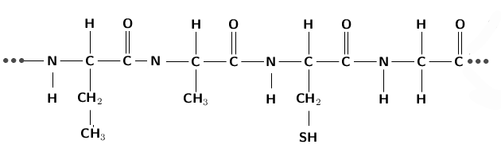
Why did we start at the blue end? What pattern do you notice?

Slide 16
N-C-C-N-C-C-N-C-C-N-C-C … This is our protein backbone- and the PRIMARY structure of a protein

Slide 17
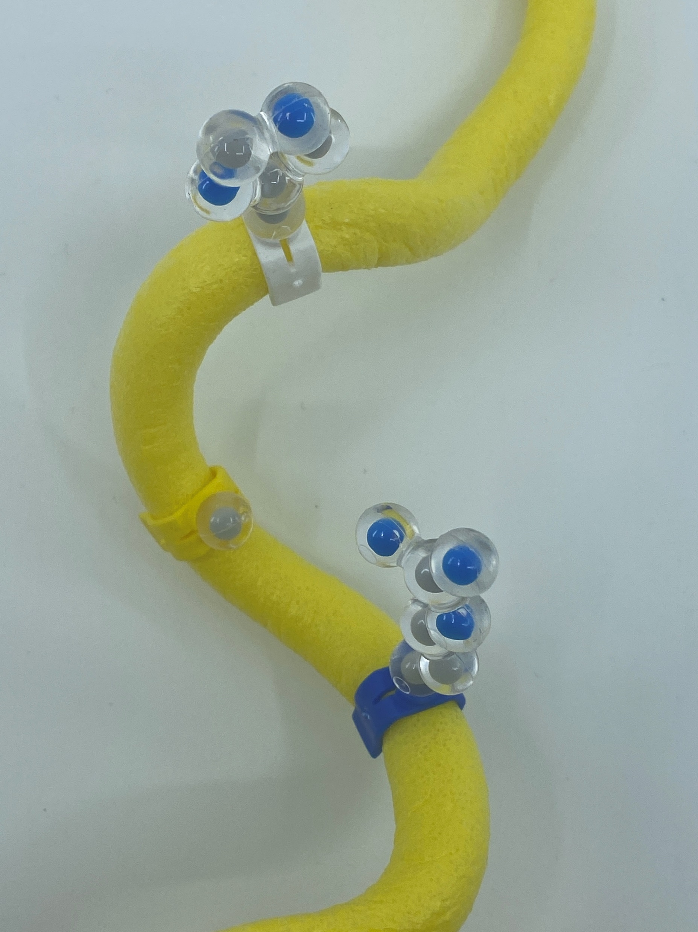
Secondary Structures –
Alpha Helixes form because of hydrogen bonding between components of the protein backbone. The helix is usually right-handed.
*Add a helix to your toober
3.6 Amino Acids
per turn

Slide 18
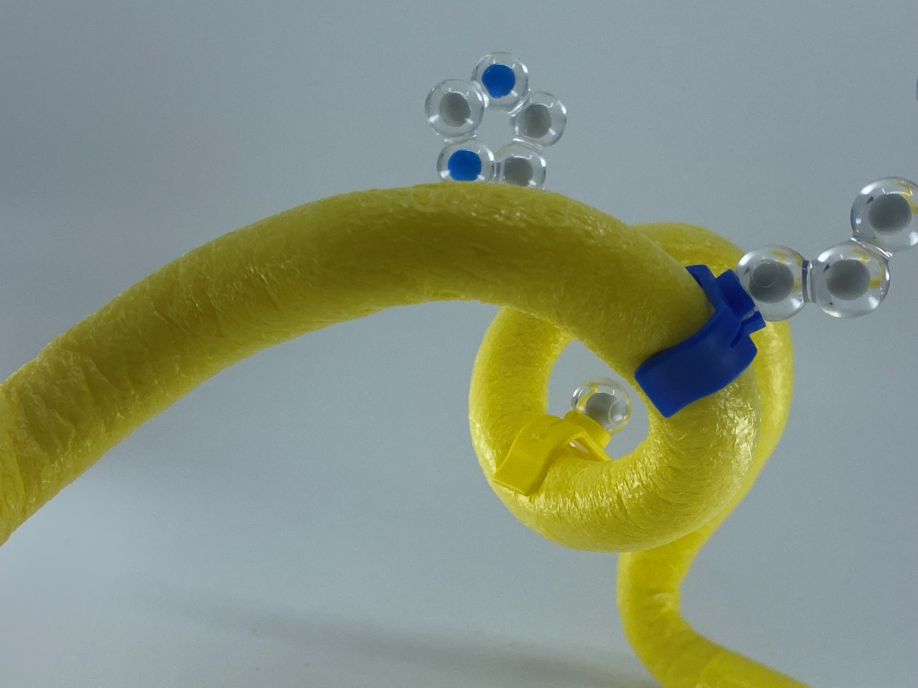
Secondary Structures –
Alpha Helixes form as a result of hydrogen bonding between components of the protein backbone. The helix is usually right-handed.
*Add a helix to your toober
3.6 Amino Acids
per turn

Slide 19
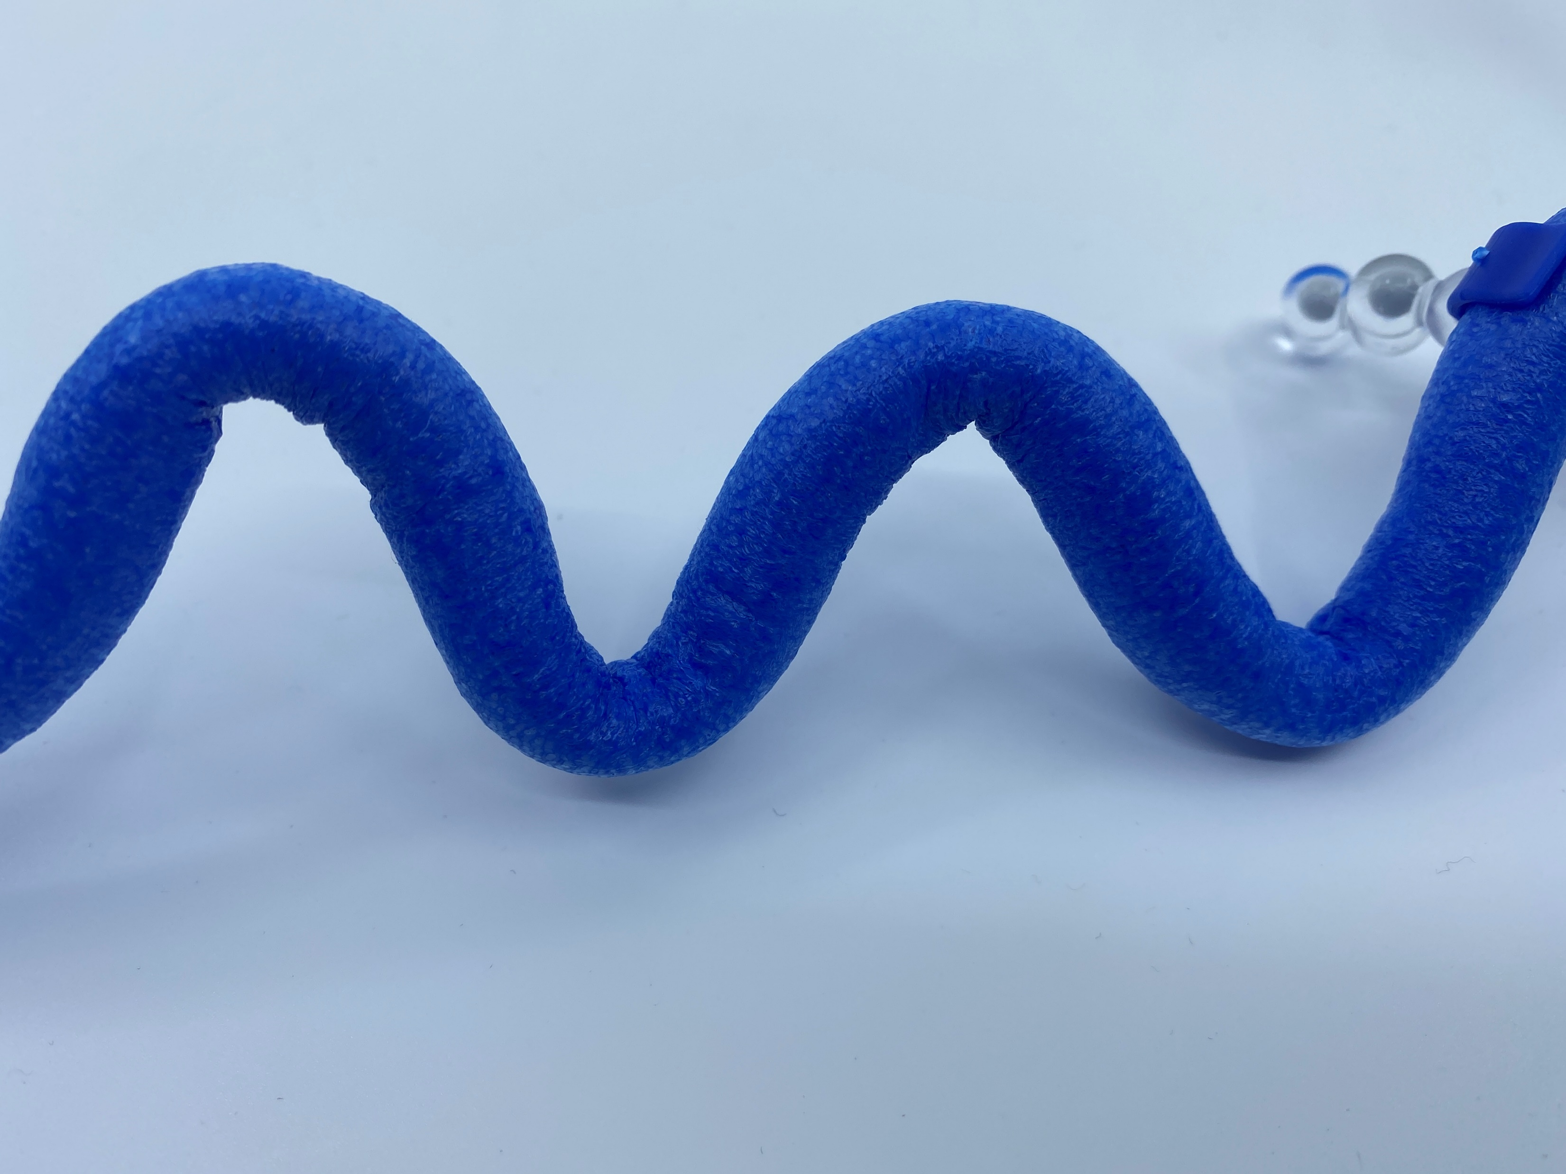
Secondary Structure
2) Beta Sheets are also formed as a result of hydrogen bonding in the backbone of a protein
* Add 1 sheet to your toober

Slide 20
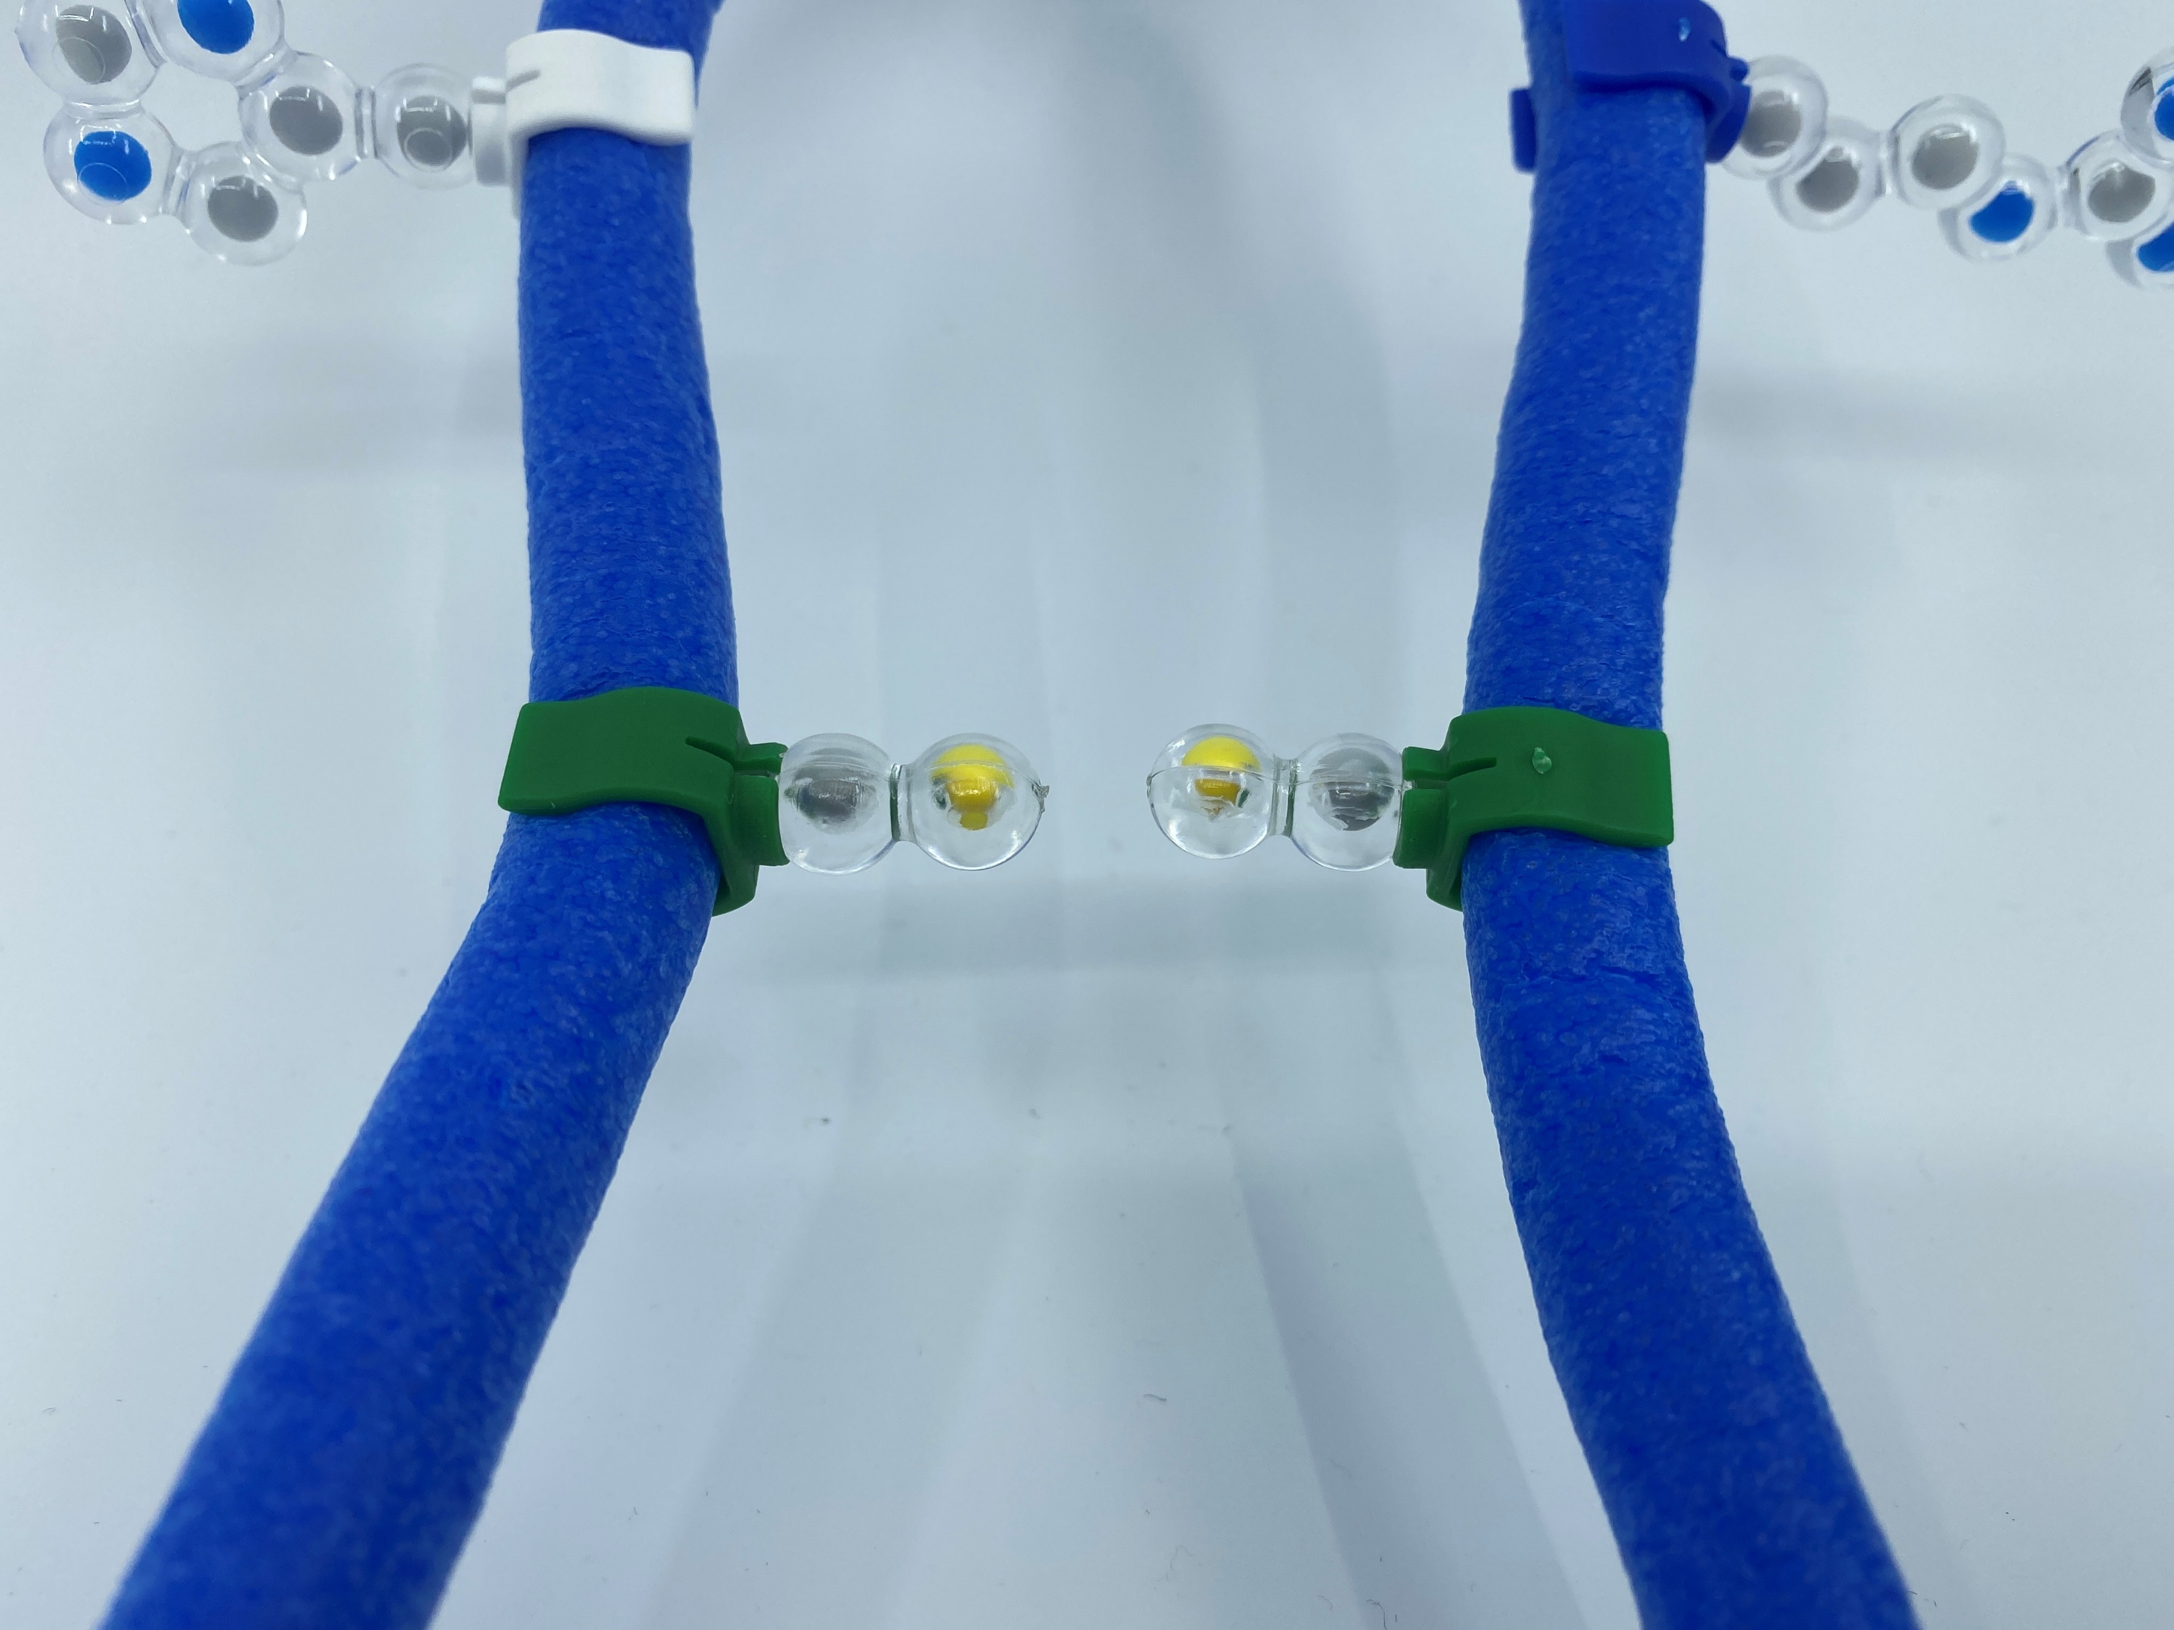
Tertiary structure
Cystines will form a disulfide bond, adding stability to the protein structure-
*Fold your toober so that the Cys – Cys can interact.
Note* - The more disulfide bonds a protein has, the more stable it becomes

Slide 21
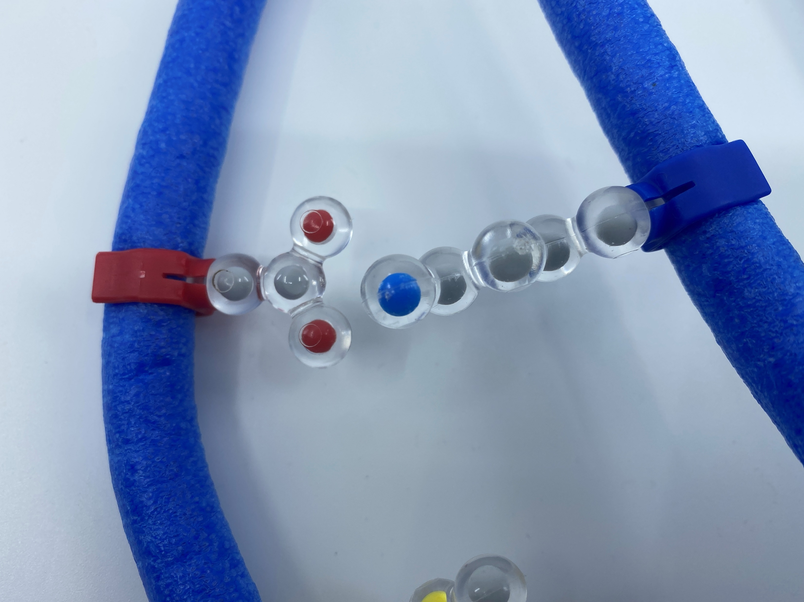
Tertiary Structure
2) Acids and bases will form a salt bridge between them
* Fold your toober to create 2 salt bridges

Slide 22
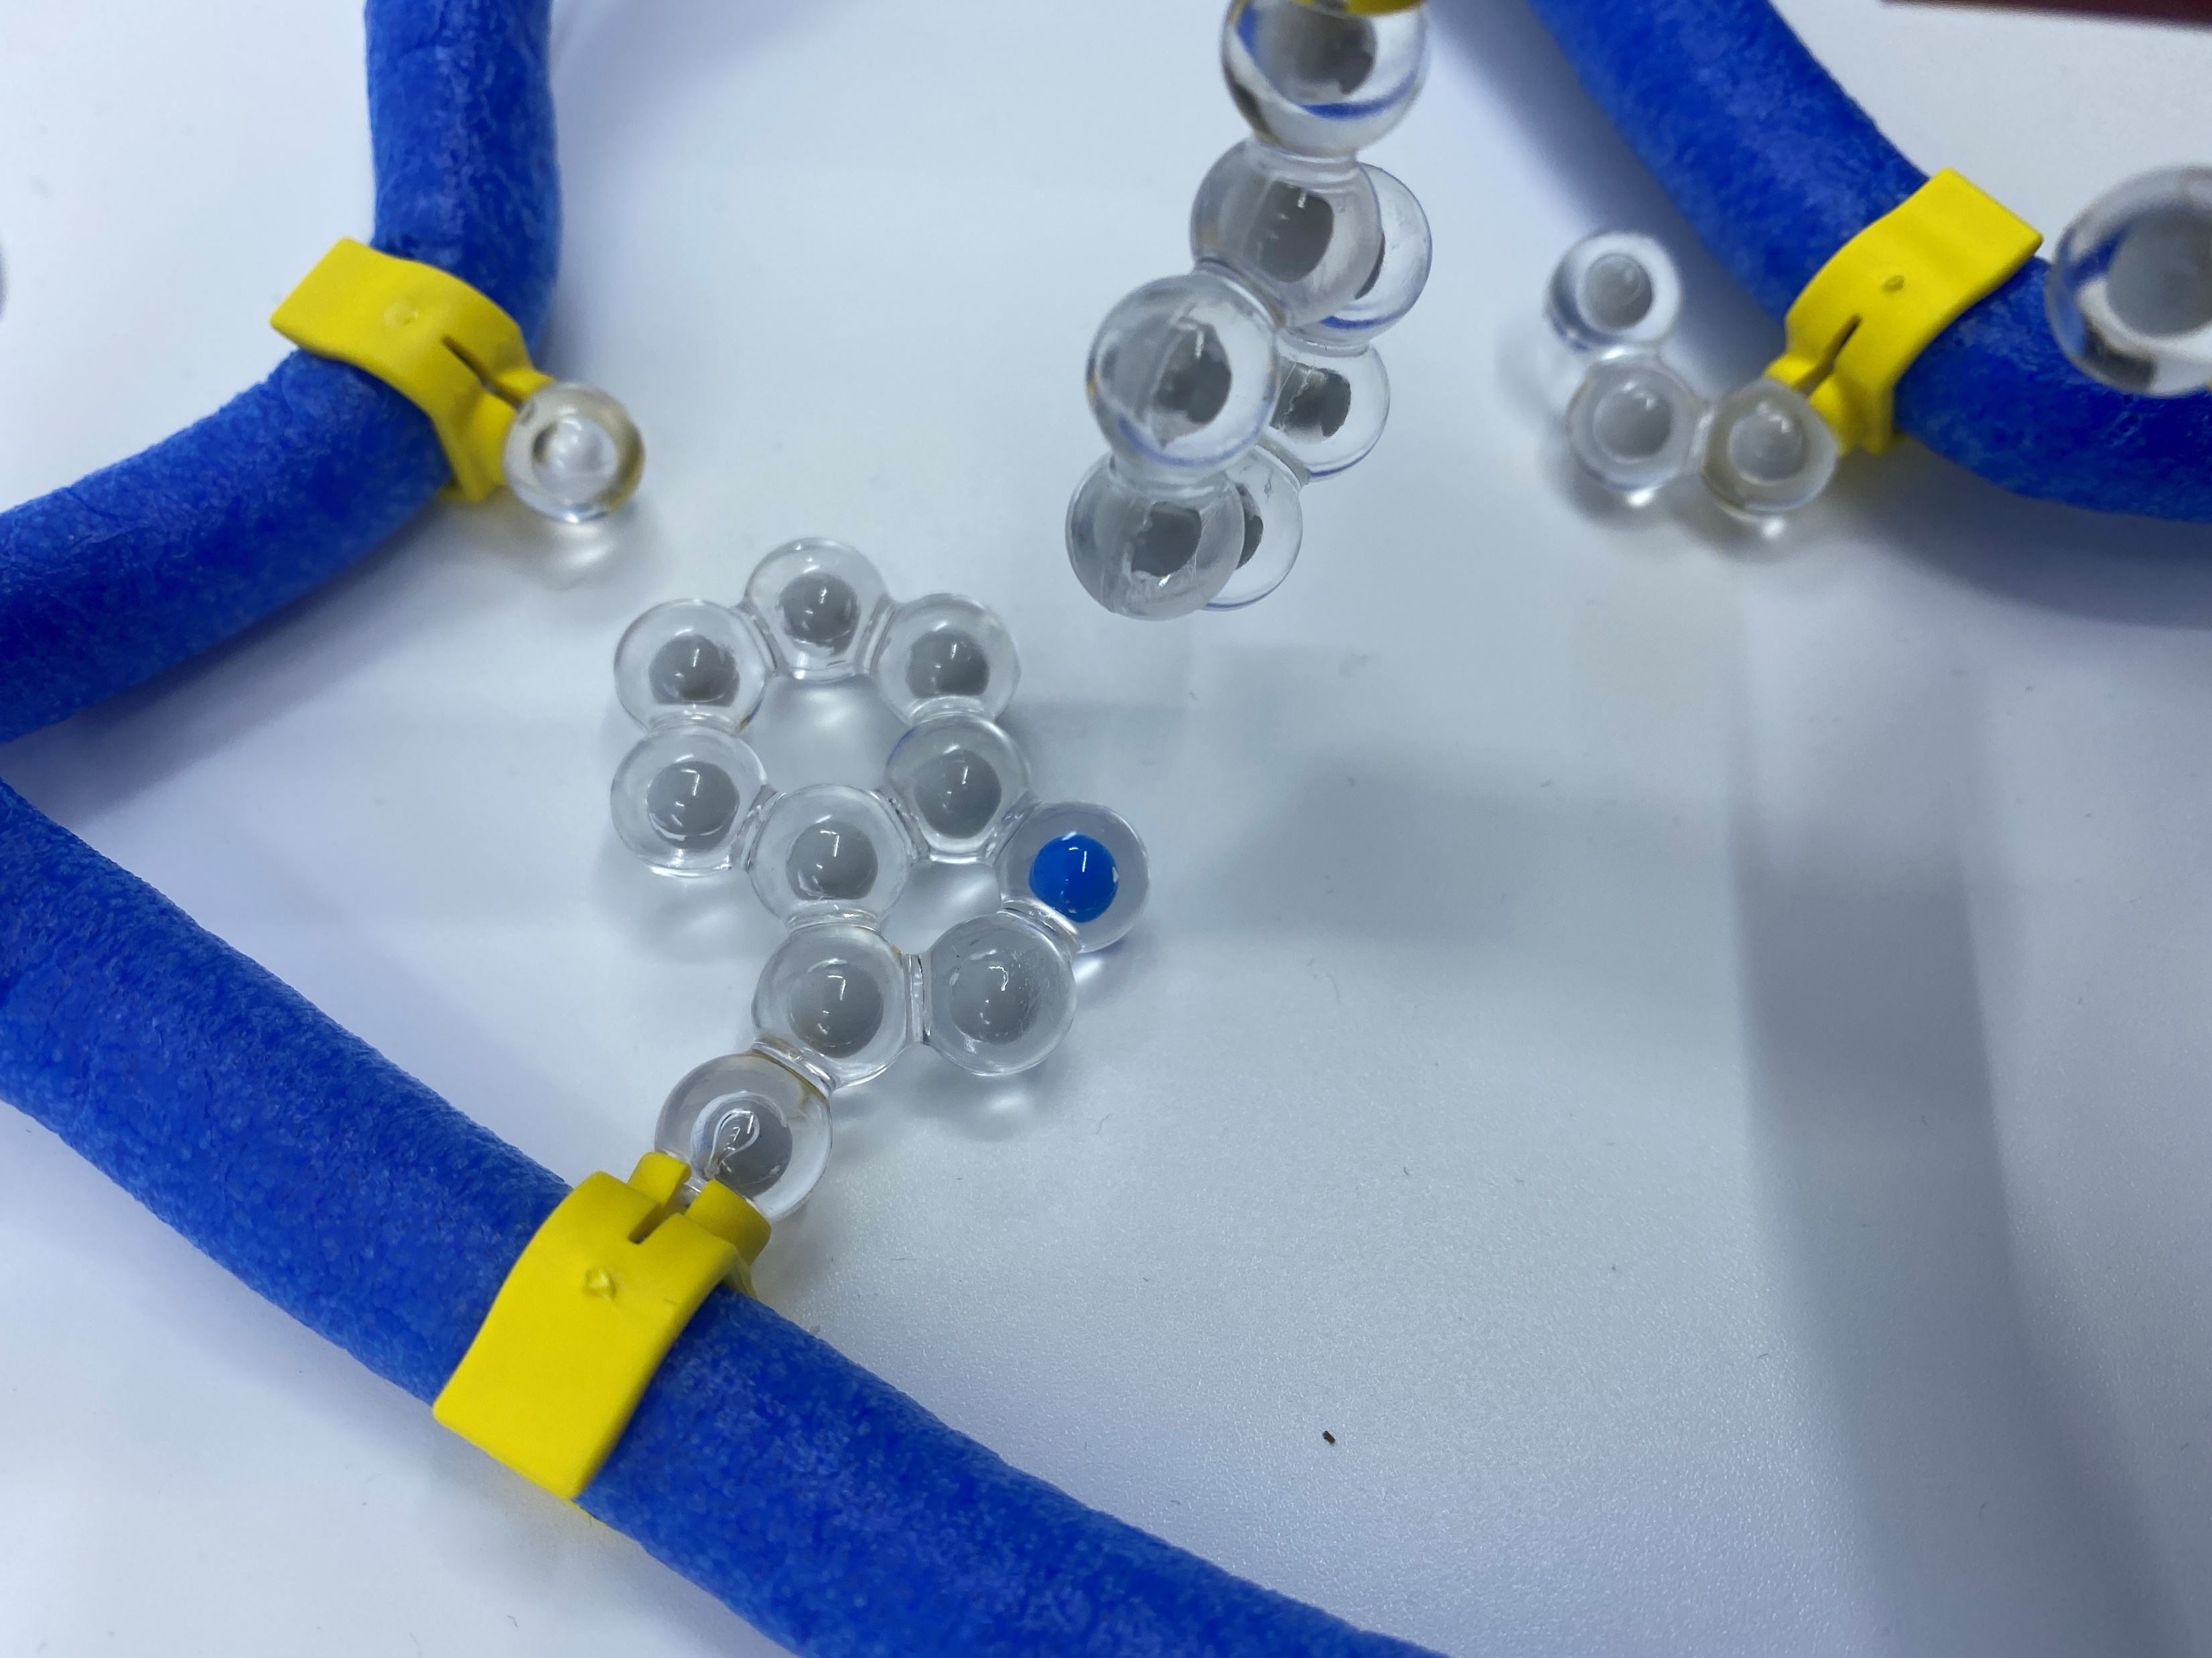
Tertiary Structure
3) Since most of your cells are made of water, the hydrophobic Amino Acids will try to “dive” to the center
* Fold your toober so that the hydrophobic amino acids can interact with each other in the “middle”

Slide 23
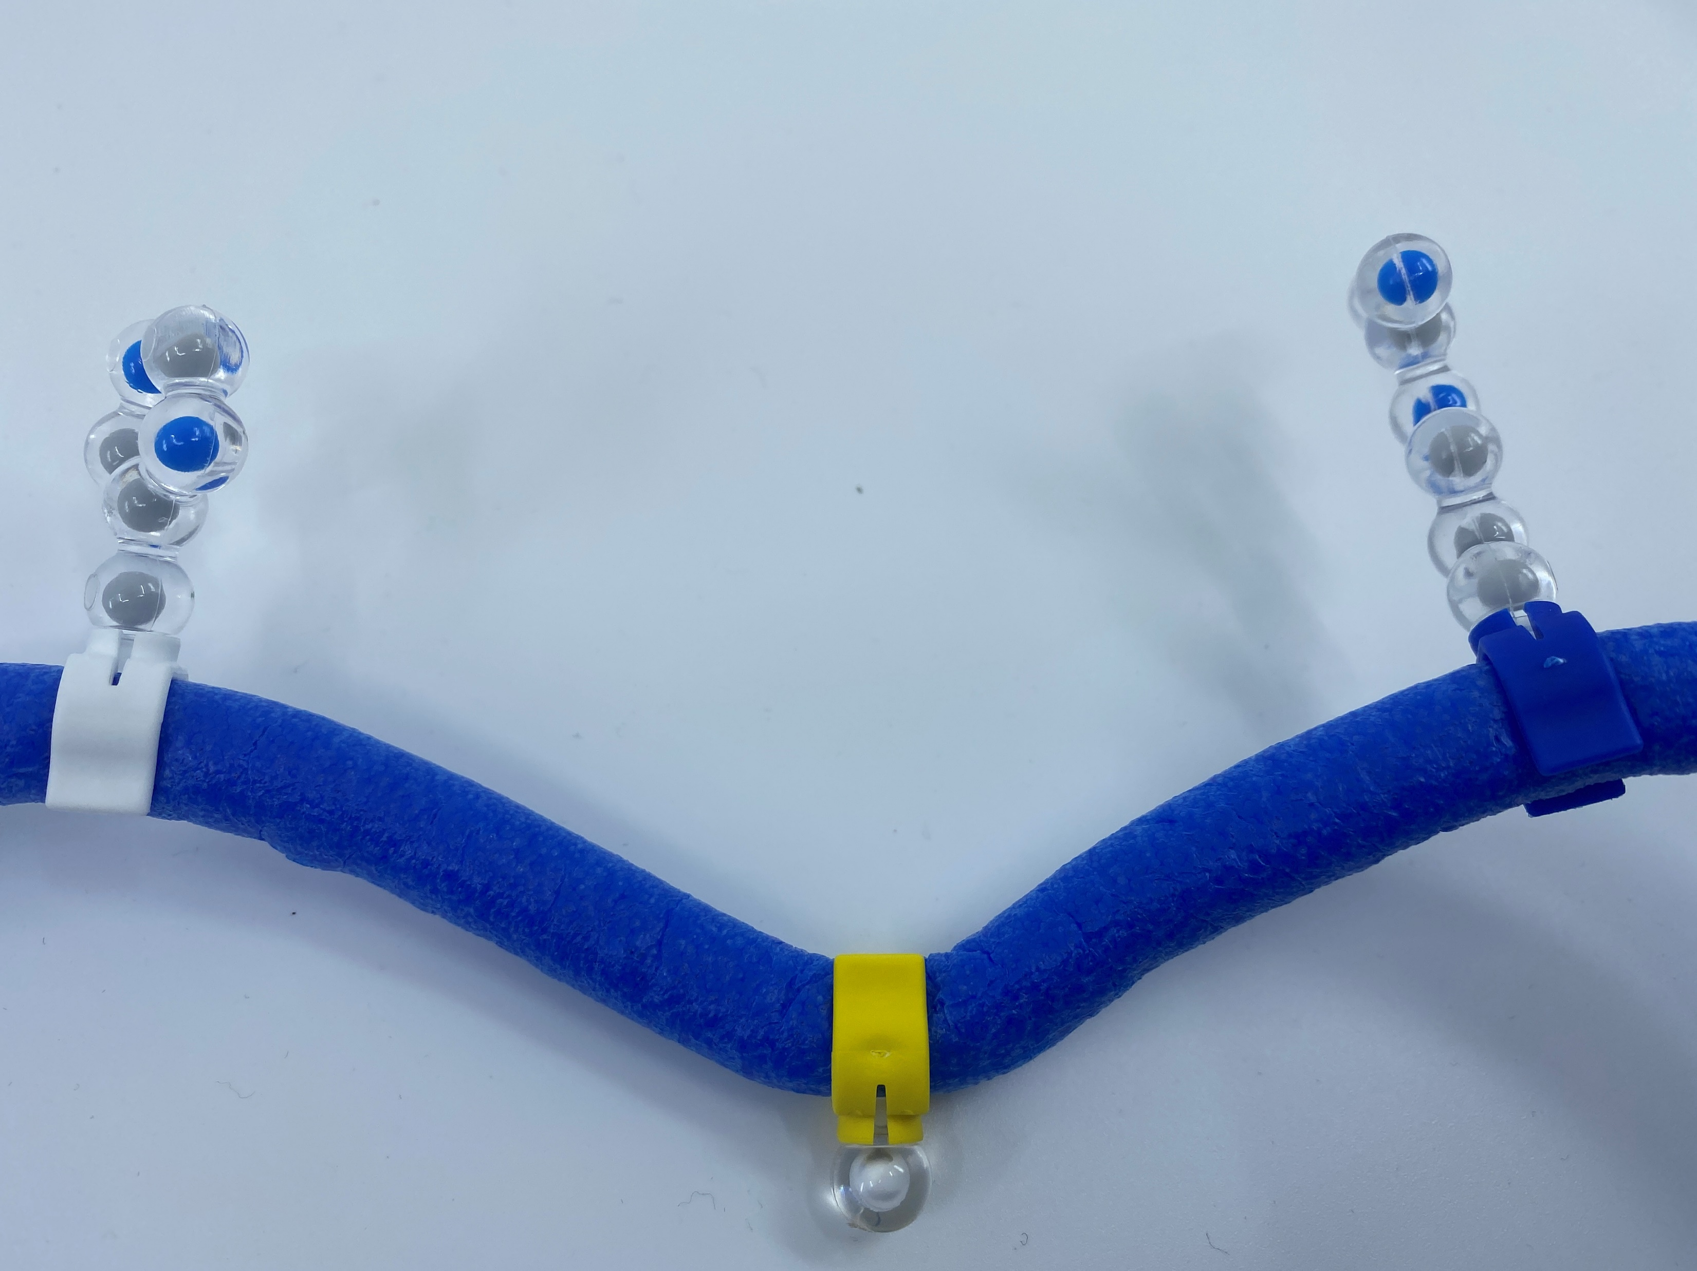
Tertiary Structure
4) Hydrophilic Amino Acids will want to interact with the water inside the cell.
* Spin the hydrophilic amino acids toward the “outside” of your protein so that it can interact with the environment around it.

Slide 24
Hold up your protein!
Why is it different from the other groups?

Slide 25
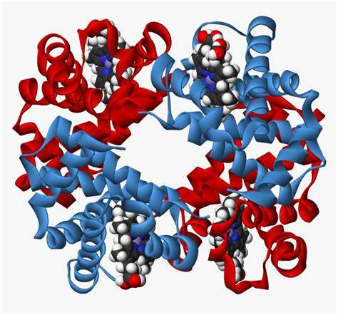
Quaternary Structure
Different proteins interact with each other. Ex. Hemoglobin is comprised of 4 chains of amino acids

Slide 26
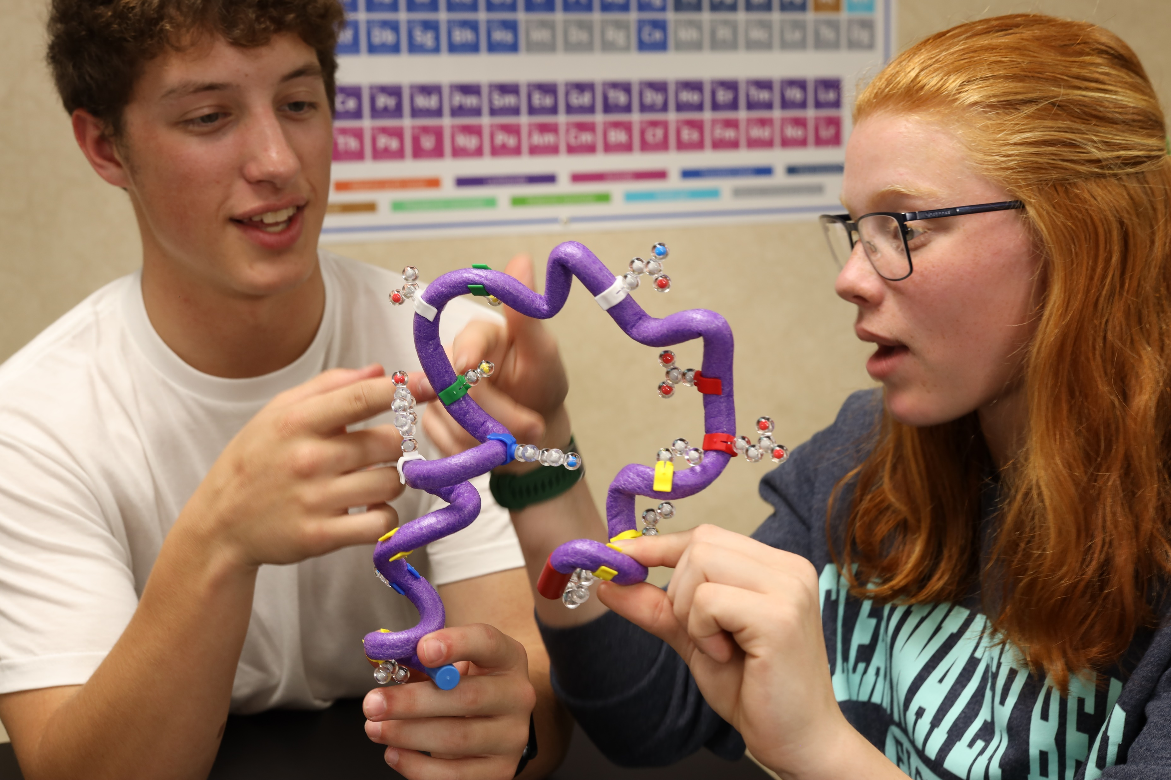
How could you model this with students?

Slide 27
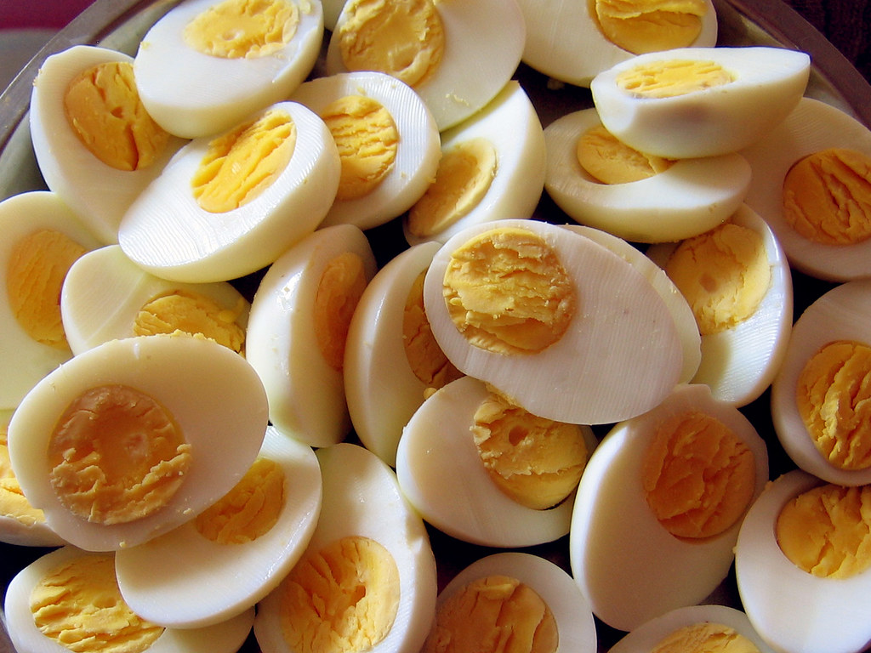
Back to the Egg…
This Photo by Unknown Author is licensed under CC BY

Slide 28
What’s actually happening?
Boiling the egg | Urea – 8M | Centrifuge and dilution
Proteins denature, random movement causes primary structure entanglement, new tertiary bonds form | Newly formed tertiary structures denatured, “Lubricates” protein strands | Centrifuge causes sheer forces that separate the strands, Dilution causes spontaneous refolding into natural shapes

Slide 29
The Principle of Microscopic Reversibility…
“Corresponding to every individual process there is a reverse process, and in a state of equilibrium the average rate of every process is equal to the average rate of its reverse process.”
Lewis, G. N. (1925-03-01). "A New Principle of Equilibrium"

Slide 30
Workshop NGSS Connections
SEPs | CCCs | DCIs
Developing and using models | Structure and Function | HS-LS 1-3: Structure and function
Constructing Explanations and Designing Solutions | Patterns
 | Stability and change
 | Systems and models
 | Cause and Effect

Slide 31
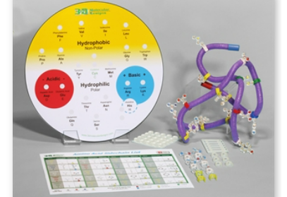
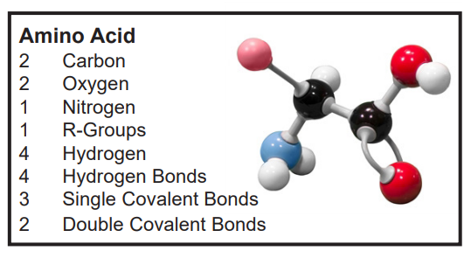
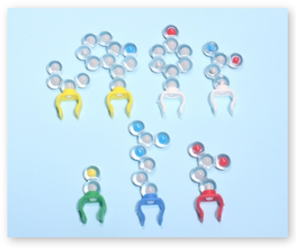
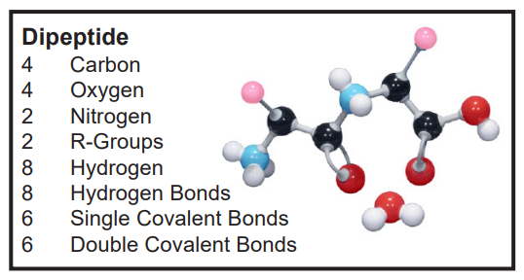
Kit used in this presentation:
Amino Acid Starter Kit
Amino Acid Building Block Models
Complete this short survey to receive a 20% off coupon for your order!
3dmoleculardesigns.com

