Slide 1


Modeling Membrane Explorations: Real-World Connections with Wet Labs
Ruth Hutson, MSSE

Slide 2
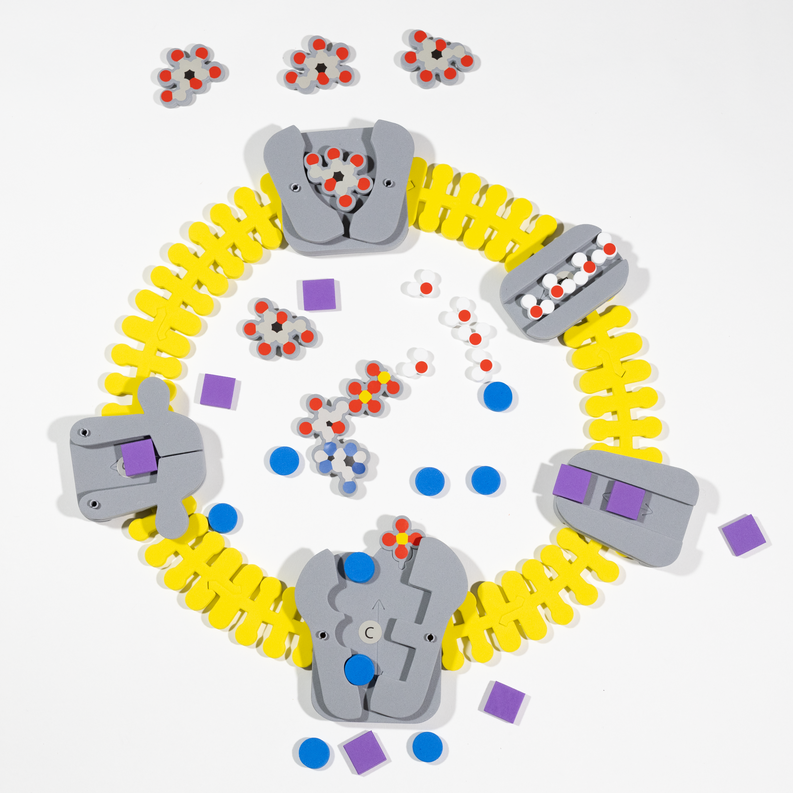
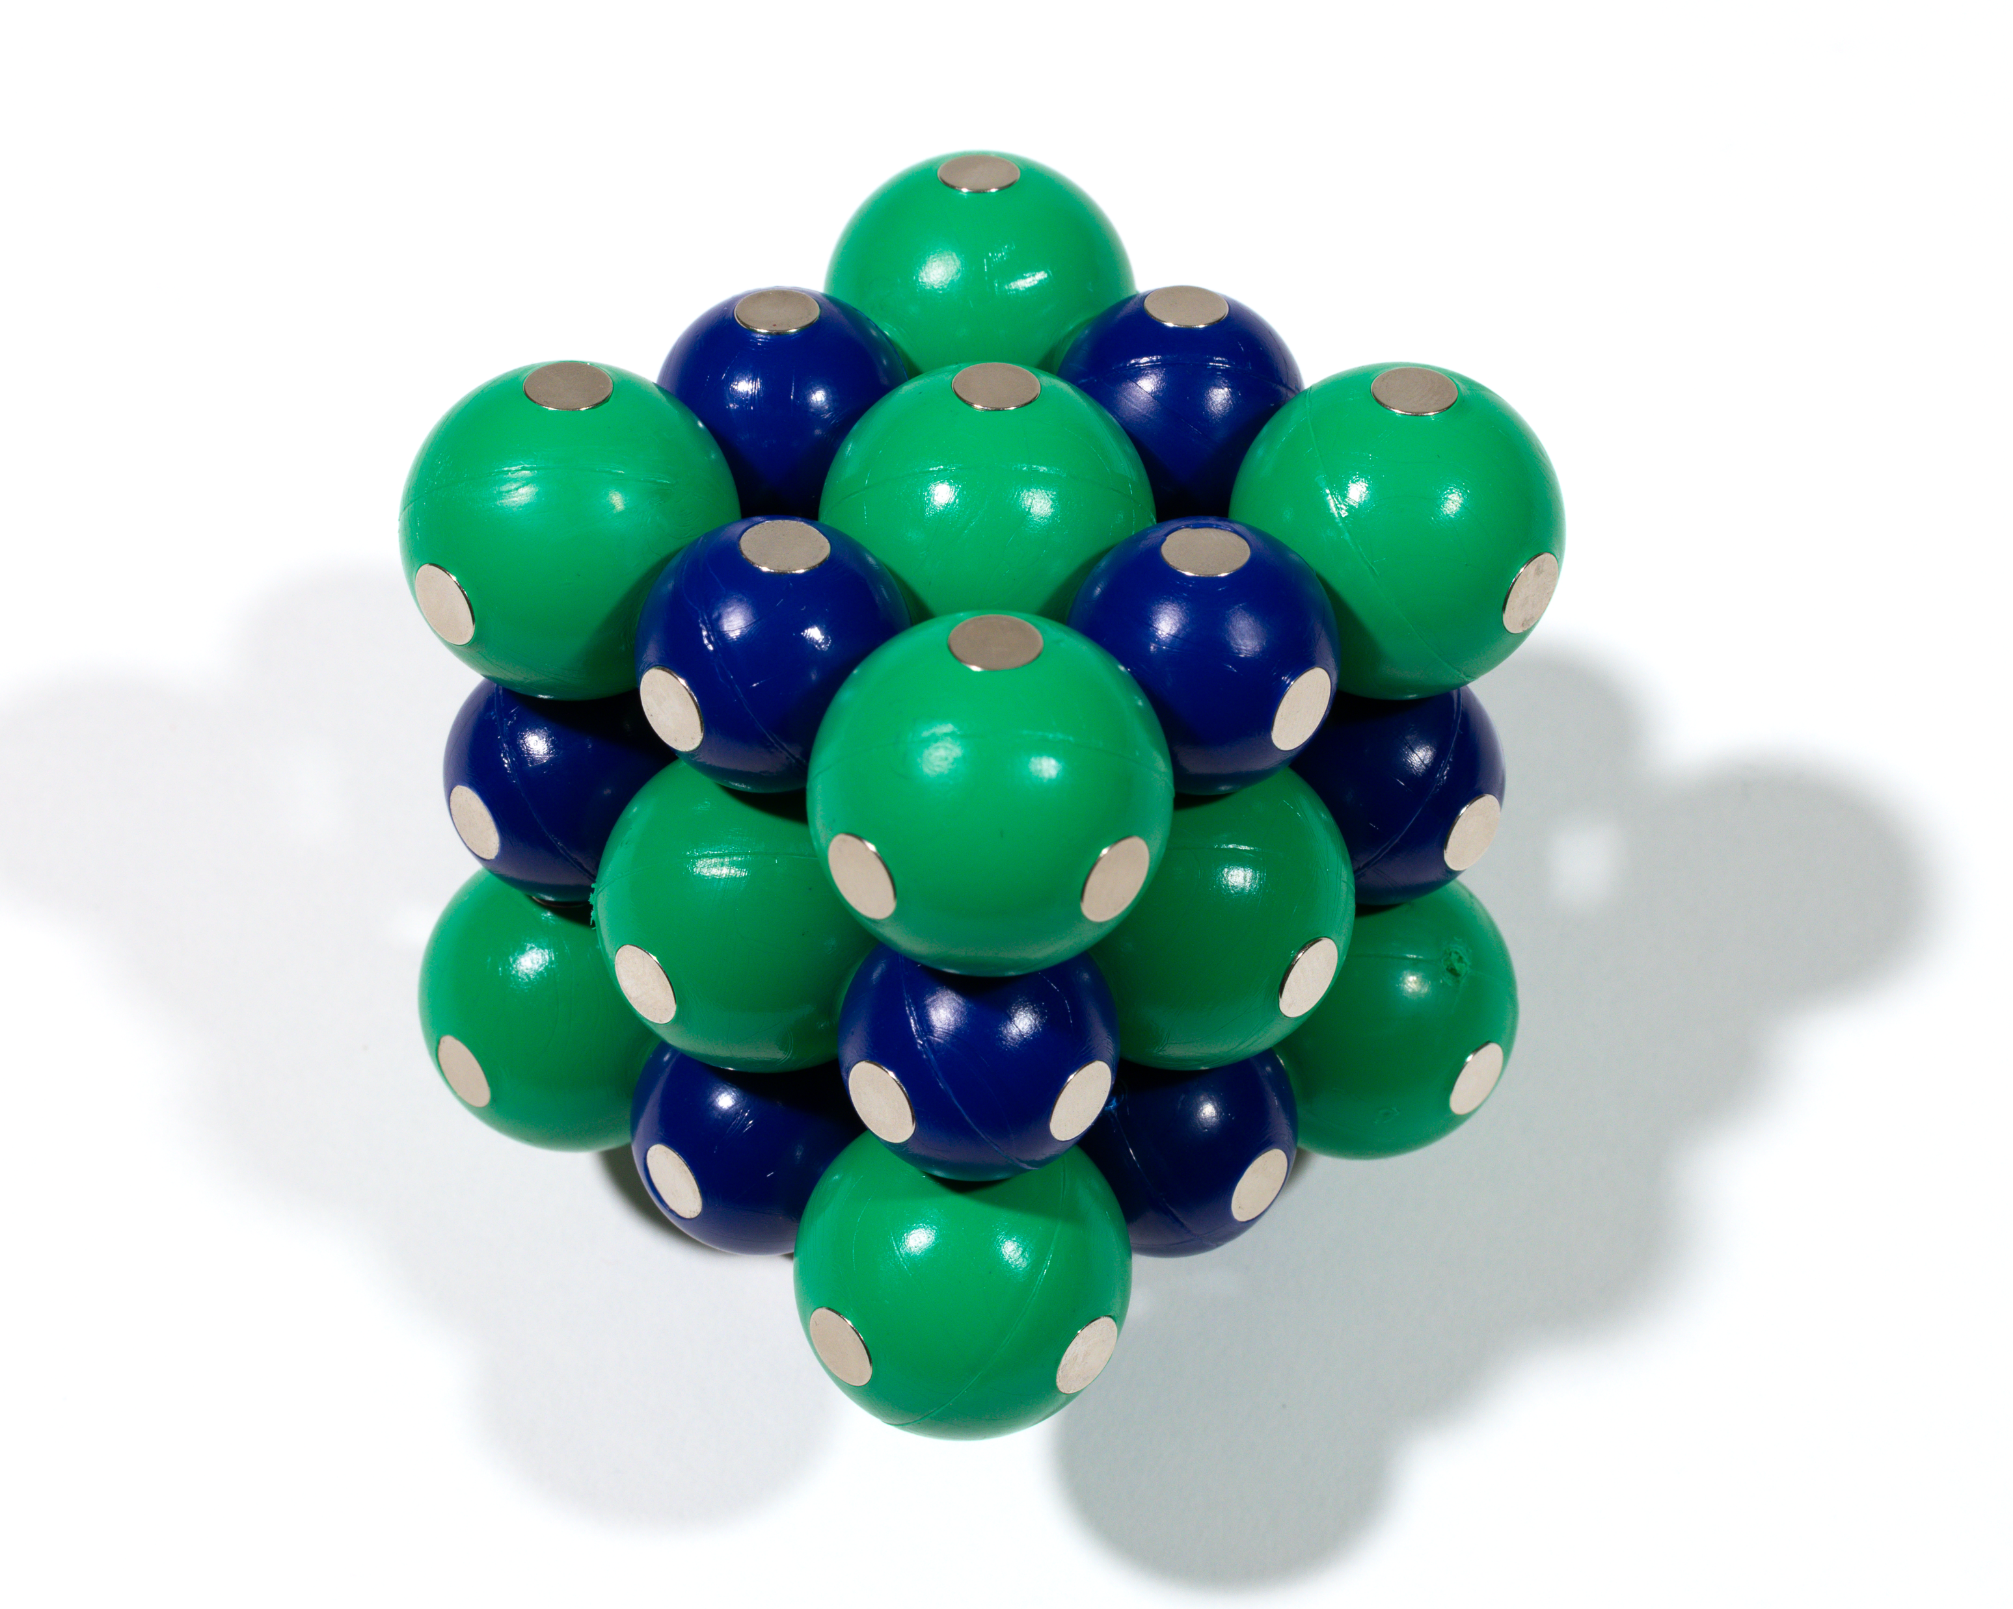
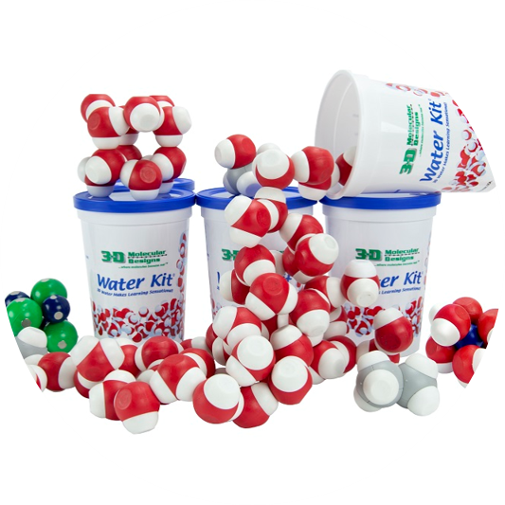
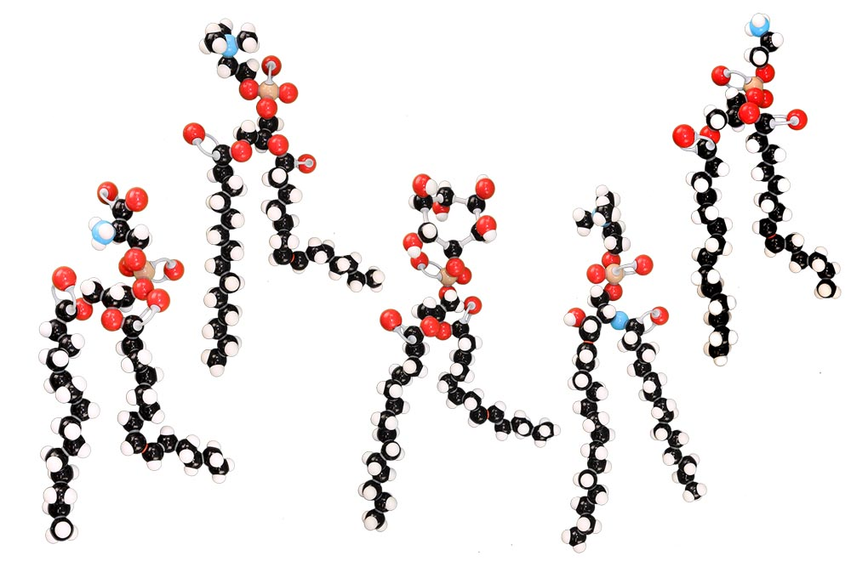
Notes:
For this 75-minute presentation, we will be using the Phospholipid and Membrane Transport Kit to make sense of real-student data from the “Eggperiment”.

Slide 3
Workshop Outcomes
Construct models to show the movement of ions and nutrients across membranes.
Connect theory with the results from popular homeostasis labs.
Make and defend a claim based on evidence that homeostasis results from a variety of factors.
Have fun!

Slide 4
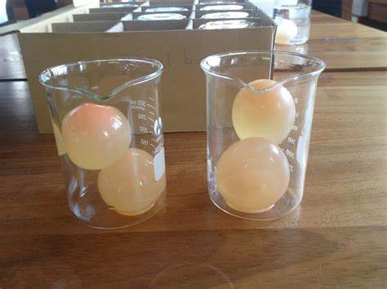
Notes:
What labs do you use to teach about homeostasis and transport across a membrane?

Slide 5
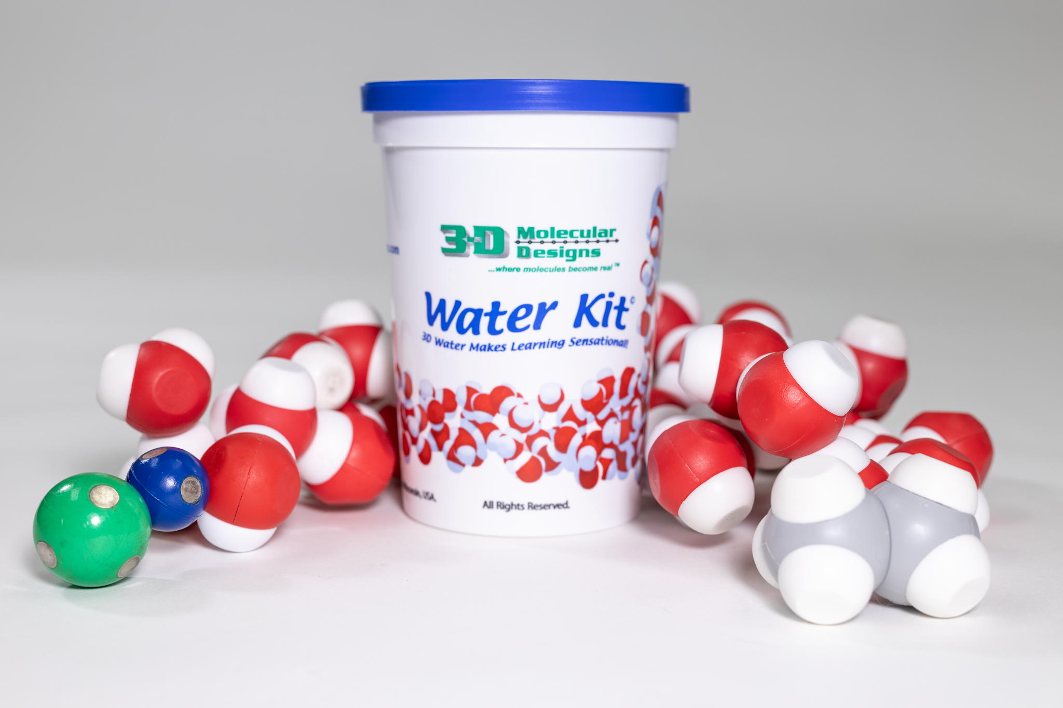
Notes:
The Water Kit helps you review the properties of water with your students.

Slide 6
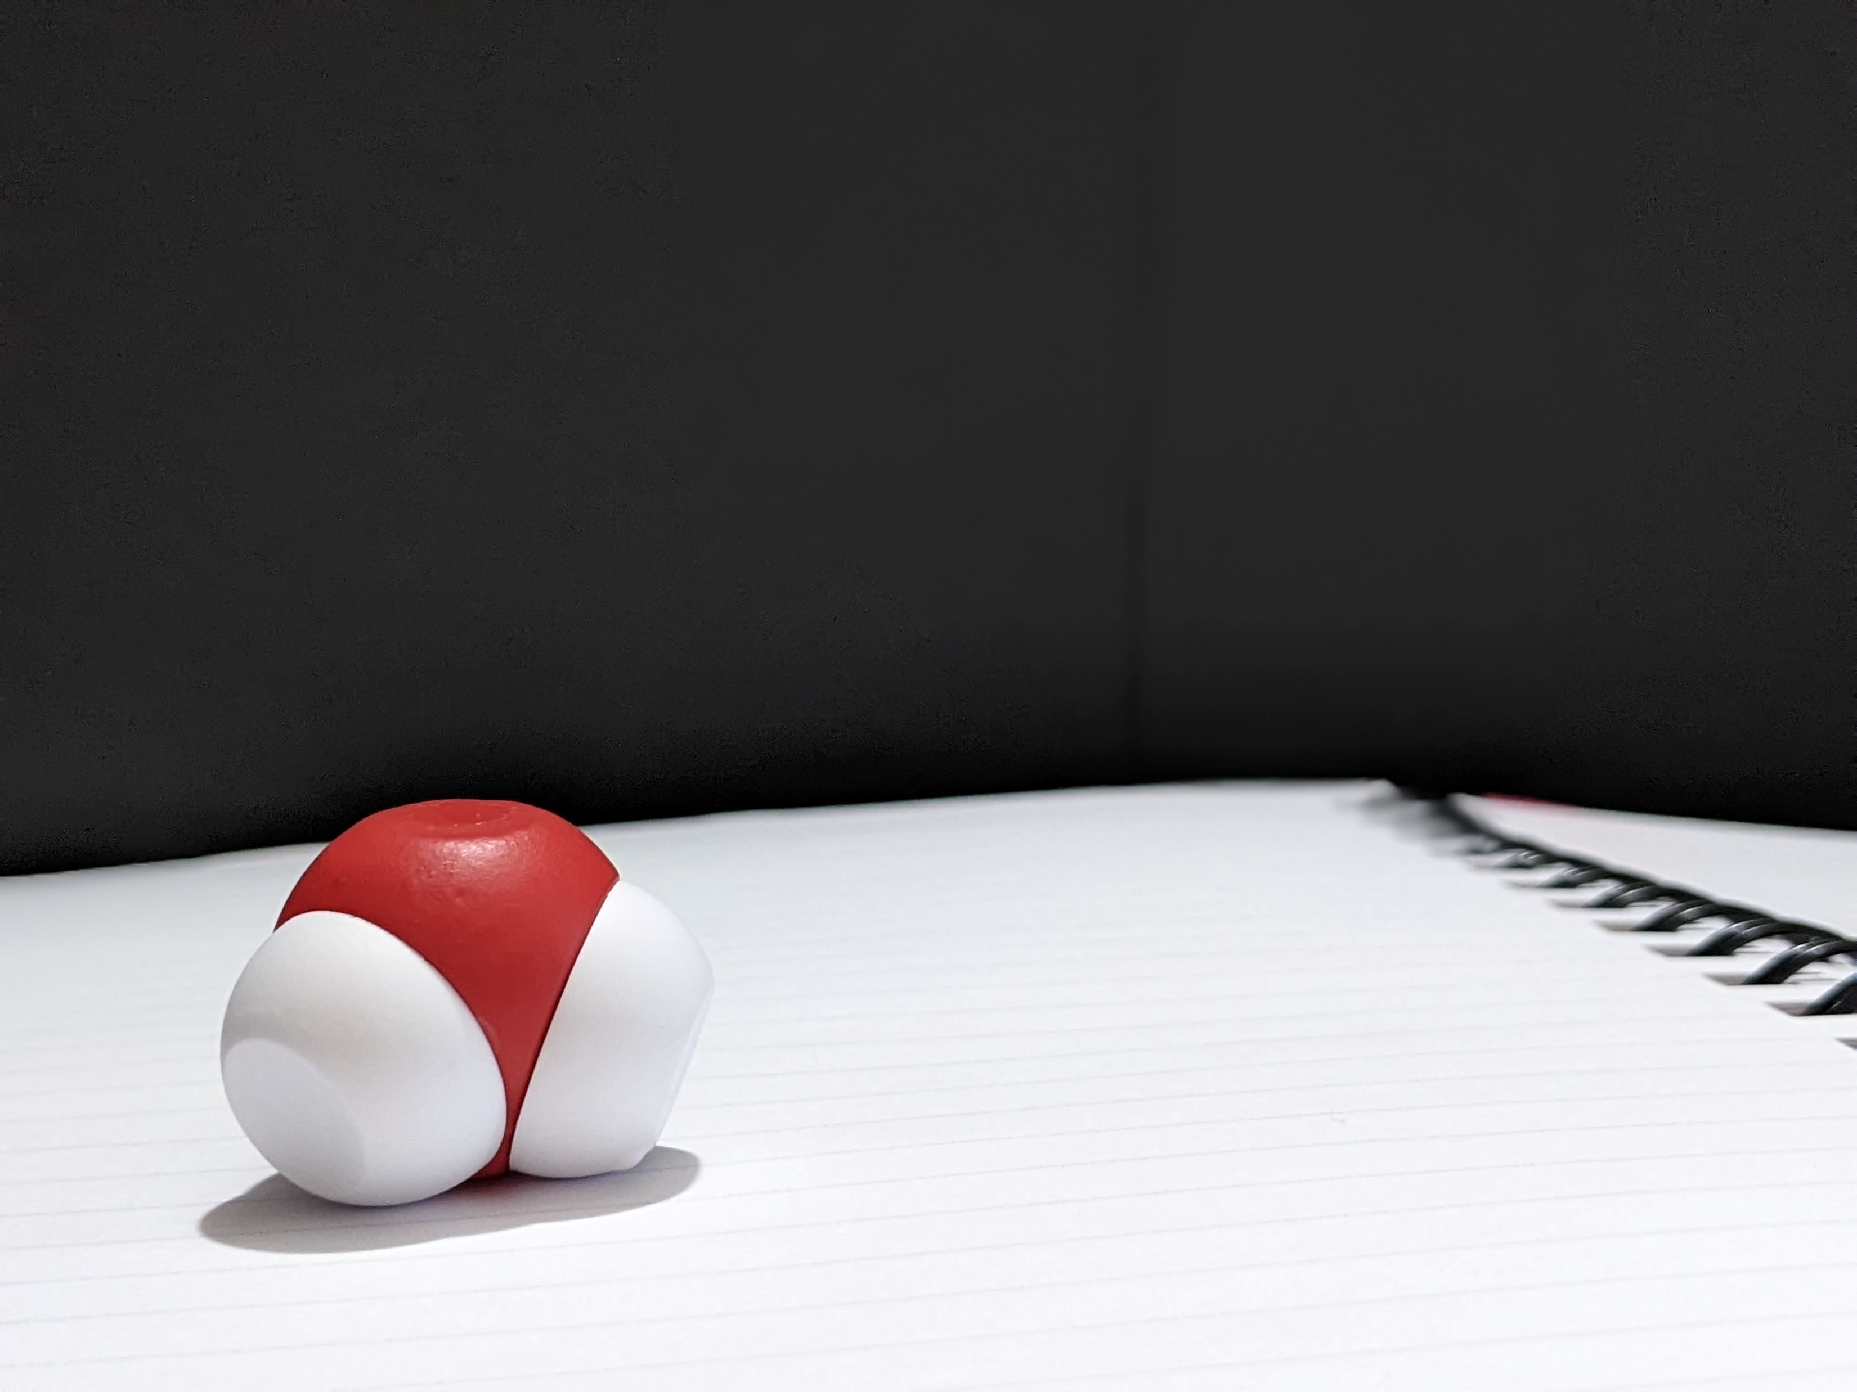
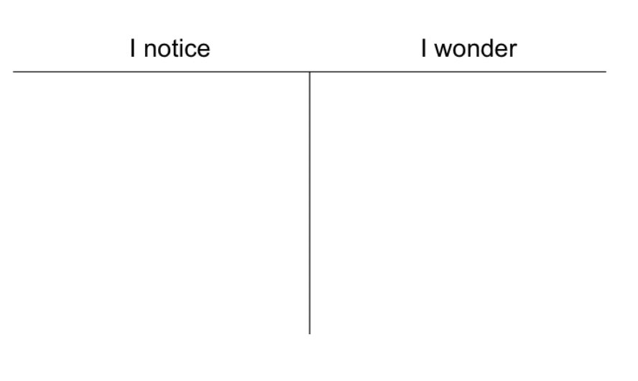
Turn to your shoulder partner.
Tell them one thing you notice and one thing you wonder.
Notes:
Materials management is a must for my classes. I start by having students look at one molecule of water. Please open your cup of water and retrieve one water molecule from it. Each of my students or student group (depending on class size) have a cup of water to work with. I first ask my students to observe a single water molecule and then they get out a second molecule. Would you put your student hat on and observe how you think your students would play with the kit?

Slide 7
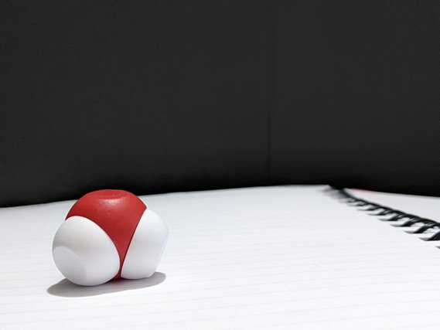
Let's take a closer look at the water molecule. Very carefully separate a hydrogen from an oxygen. ​
What do you see? ​
Do both hydrogens connect to the oxygen in a similar fashion?​
Compare the difficulty in separating a hydrogen from an oxygen within a water molecule to separating two water molecules from each other.

Slide 8
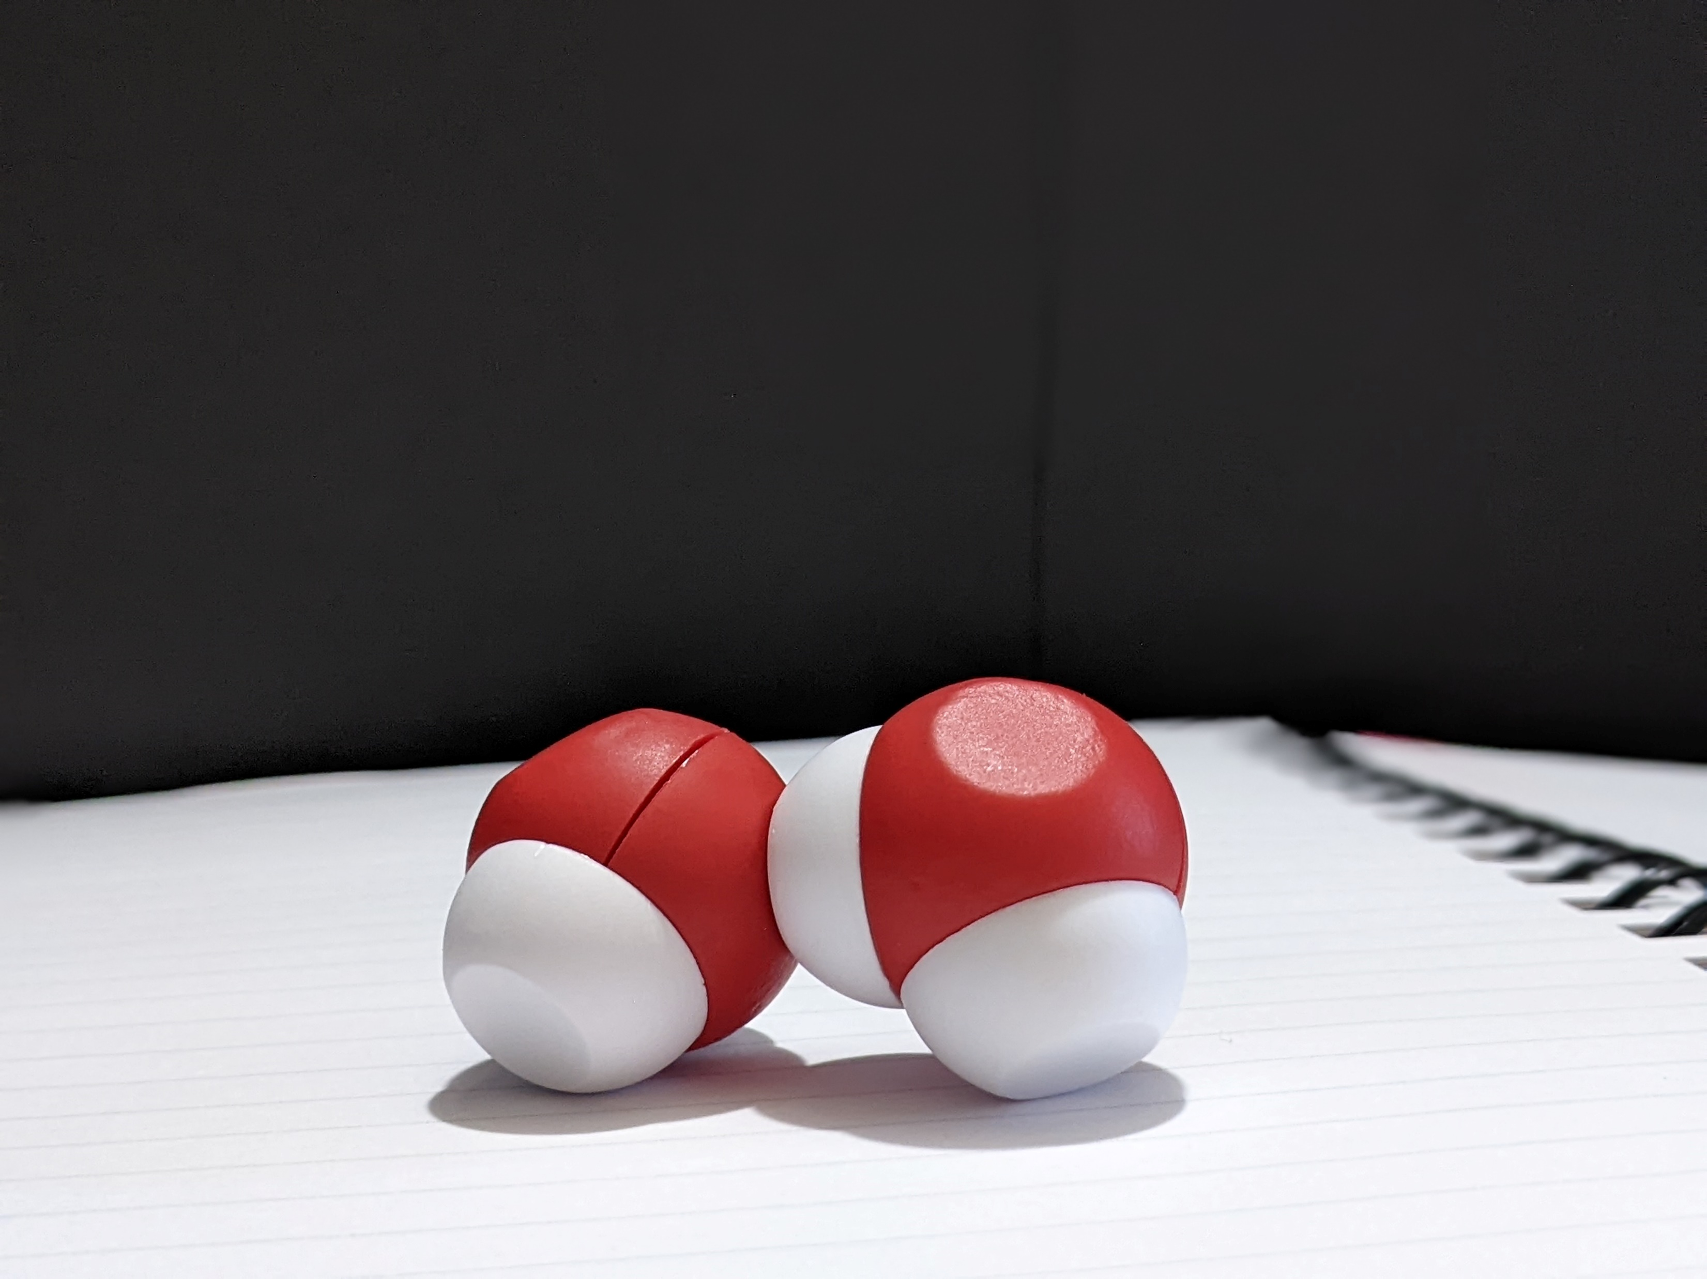
Remove four molecules of water from your Water Kit.
Observe how they interact with each other. ​
​​
​
What occurs as you add more molecules of water until you have added all twelve molecules?
Notes:
[Give 1 minute to see how the two molecules interact and walk around the room giving feedback to participants.] After students’ initial observations, I ask them to complete a notice|wonder chart. Because this is one of the first modeling experiences they would have at the beginning of the year, use a notice|wonder chart as it is low risk and it encourages students to write what they observe without attaching any scientific vocabulary to it.

Slide 9
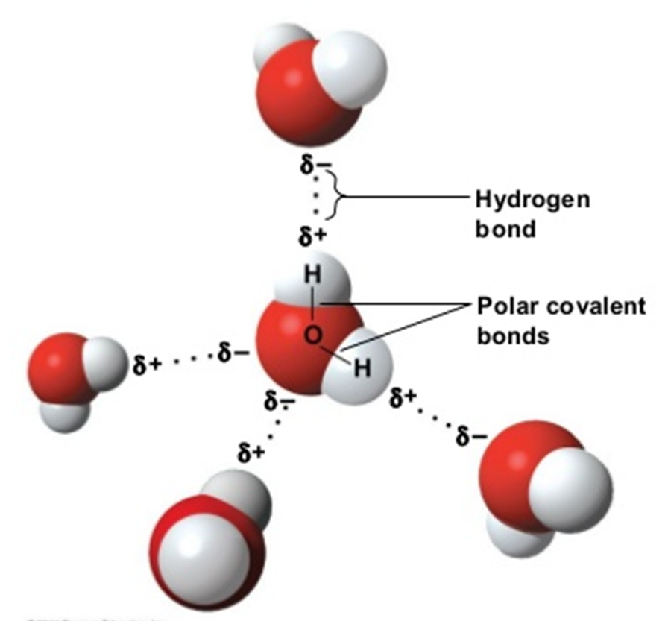
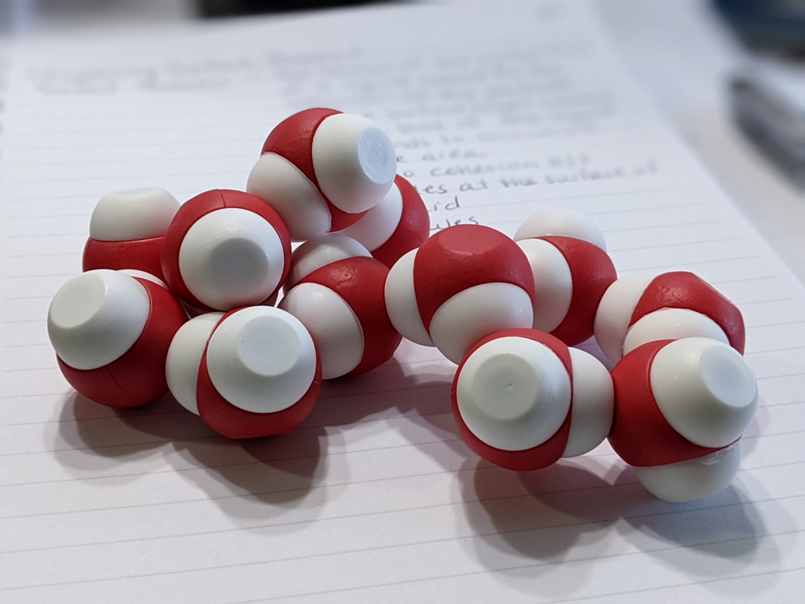
Notes:
Water has an uneven charge making it a polar molecule (dipole). In a molecule of water, there are two polar covalent bonds. Each bond is between the central oxygen and one of the hydrogen atoms. The oxygen atom has a partially-negative charge, while the two hydrogen atoms have partially-positive charges. Because the central oxygen atom bonds with two other atoms and contains two lone pairs of electrons, the structure of water is bent and has a bond angle of 104.5°.
With AP students you might want to compare the electronegativity of oxygen and hydrogen.

Slide 10
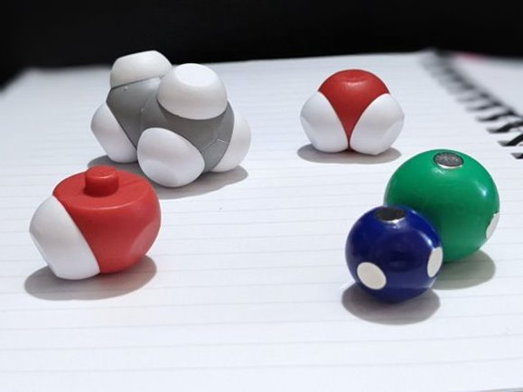
Look at the other contents of the Water Kit.
What other substances contain posts that would represent covalent bonding? ​
​
How many separate covalent bonds can you find?

Slide 11
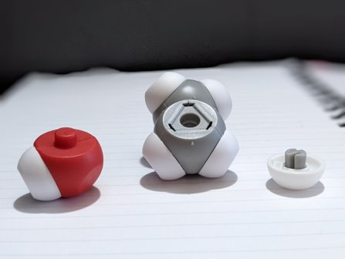
Modify the ethane molecule to make an ethanol molecule.
What is the chemical formula of ethanol? ​
​
How does ethanol interact with water?​
How does that compare to how ethane interacts with water?

Slide 12
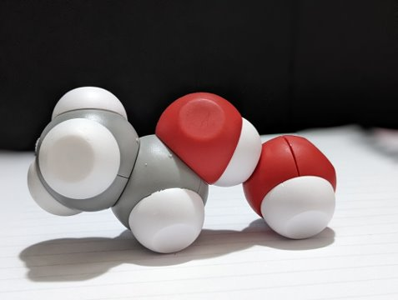
Identify the location of the covalent bonds in the ethanol molecule. ​
Where do you find hydrogen bonding?

Slide 13
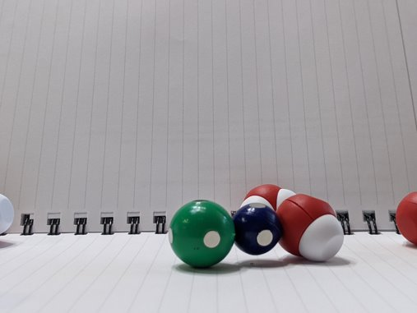
How does sodium chloride interact with water? ​
How do the sodium ion and the chloride ion interact with each other? ​
​
Compare the three types of chemical bonds about which you have learned. Rank them in order of strength of the bond.​

Slide 14

Let’s start by modeling sodium chloride’s interaction with water​
Describe what occurs when water interacts with sodium chloride. ​
Which ion interacts with oxygen? Why?​
Which ion interacts with hydrogen?
Why?

Slide 15
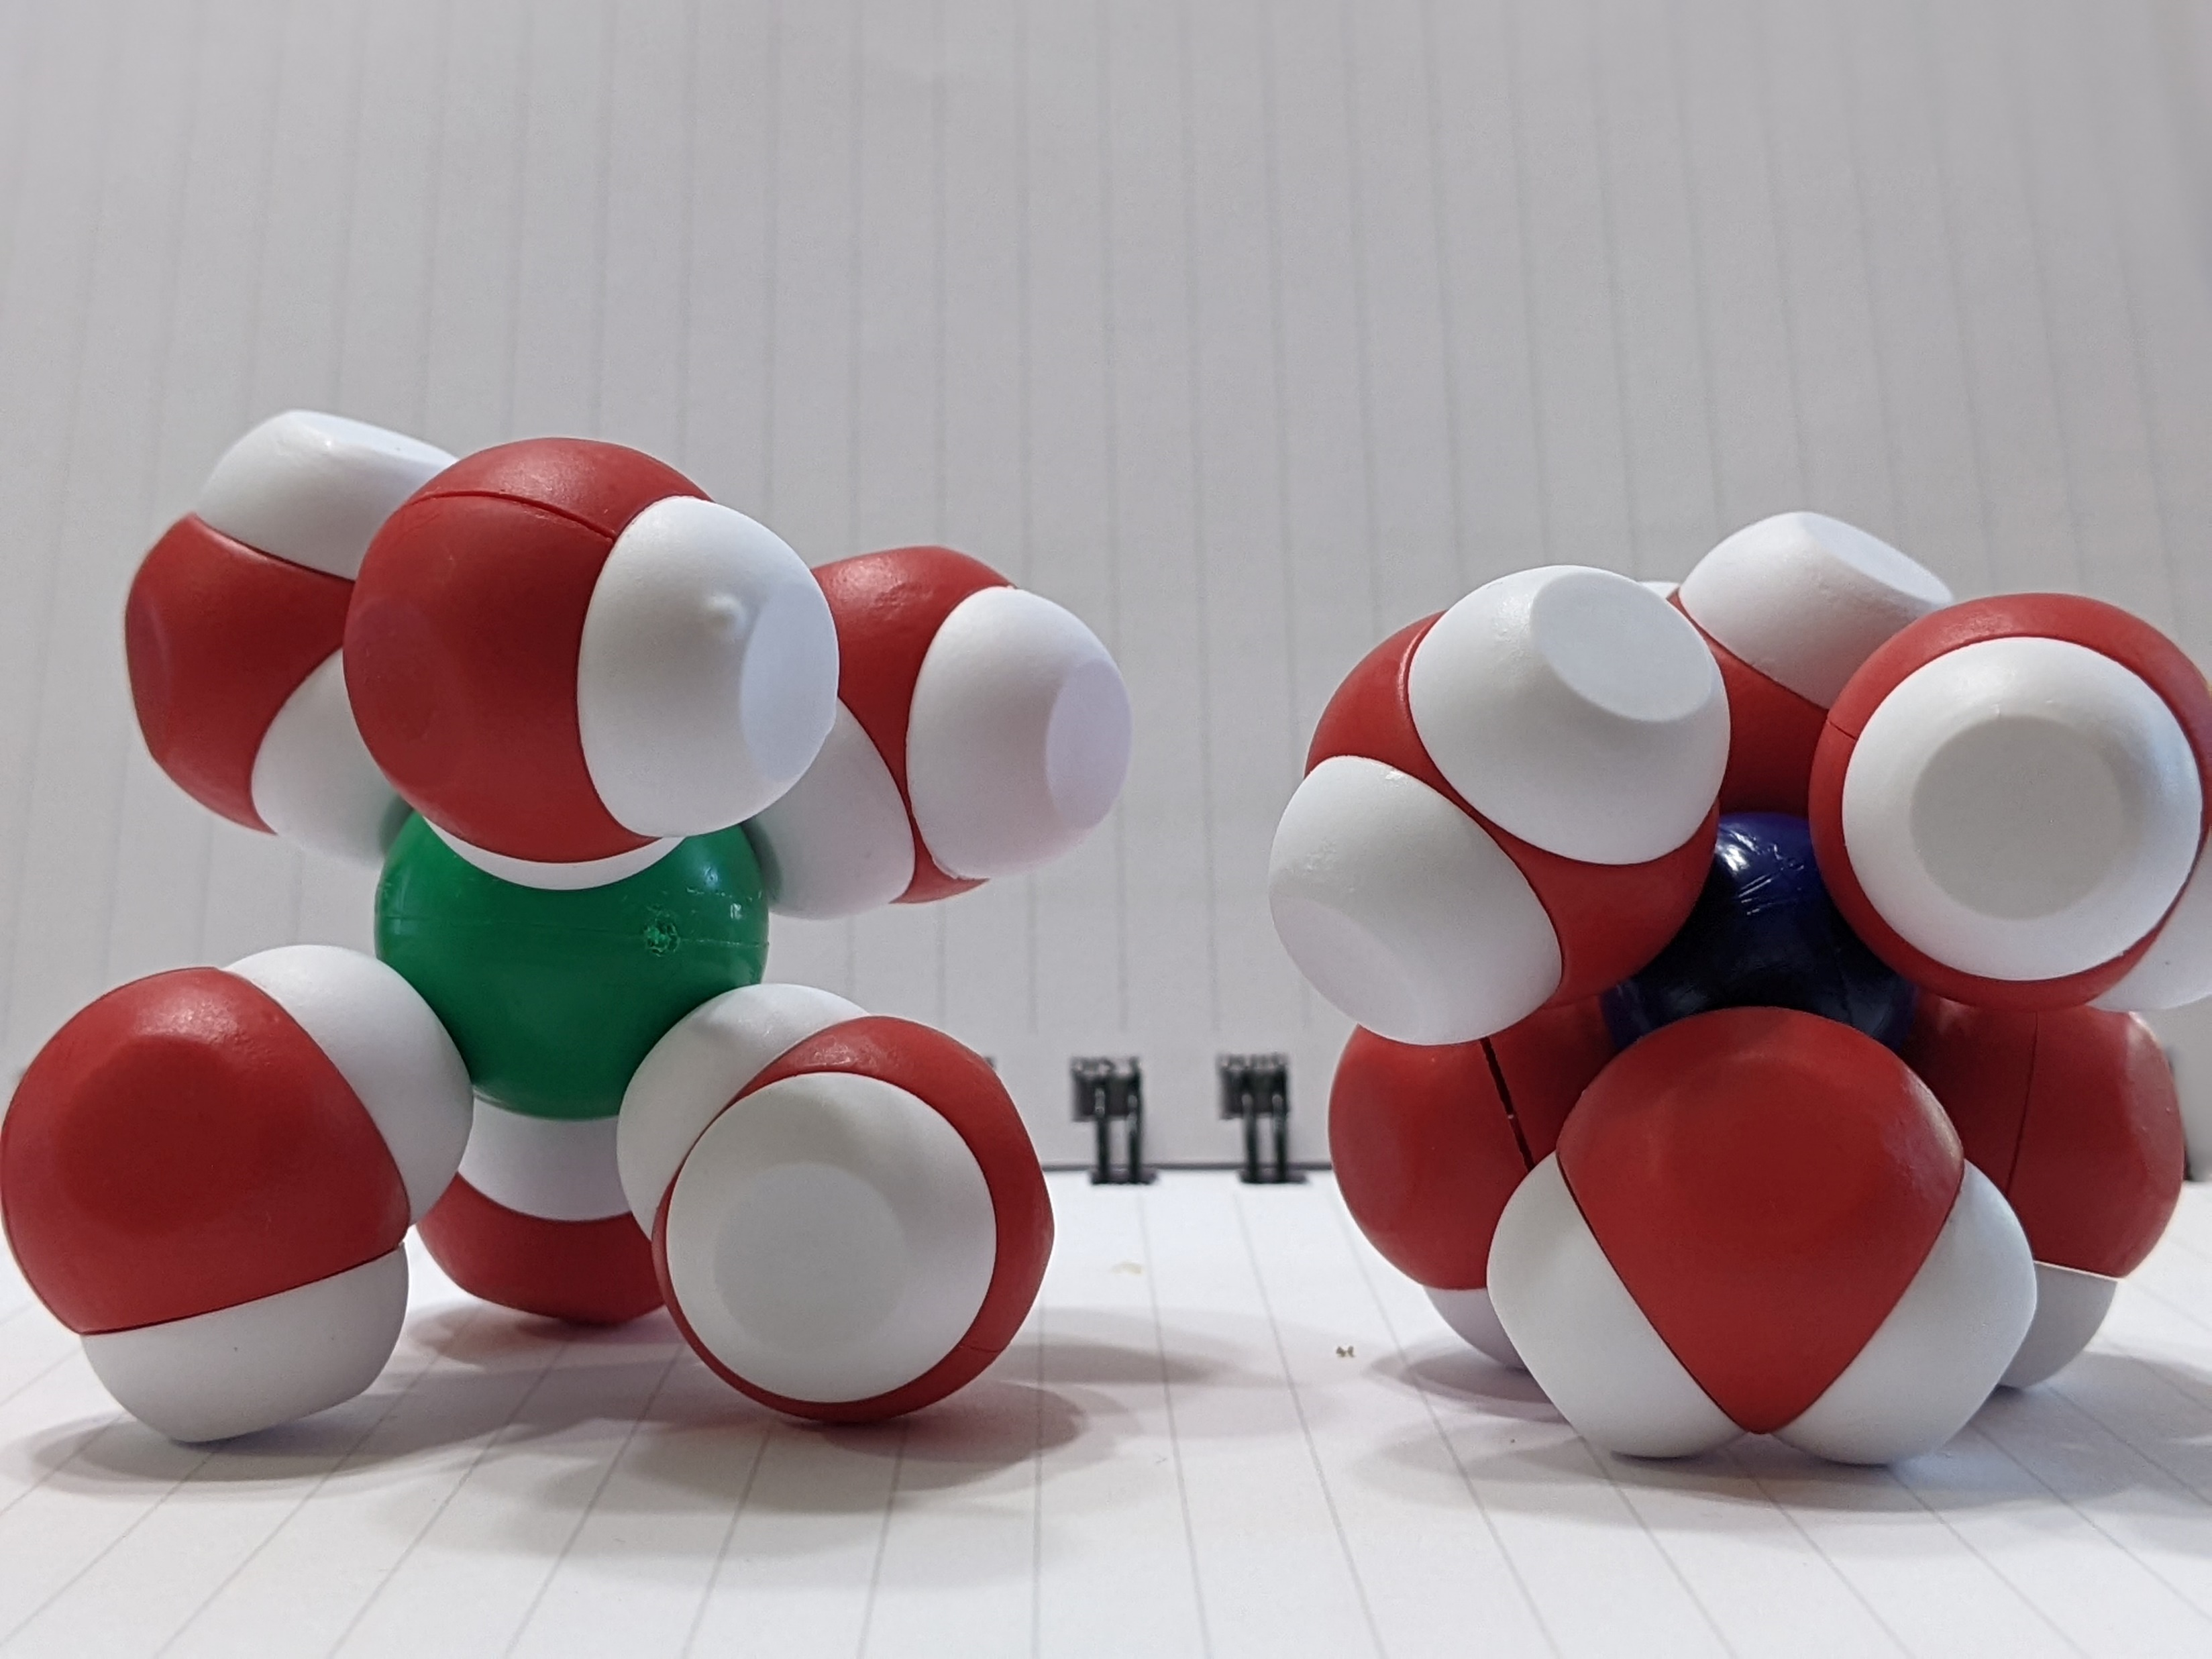
Let’s start by modeling sodium chloride’s interaction with water​
Describe what occurs when water interacts with sodium chloride. ​
Which ion interacts with oxygen? Why?​
Which ion interacts with hydrogen?
Why?
Notes:
Explain to students what a solvation shell is. In the case of water, it is known as a hydration shell.

Slide 16
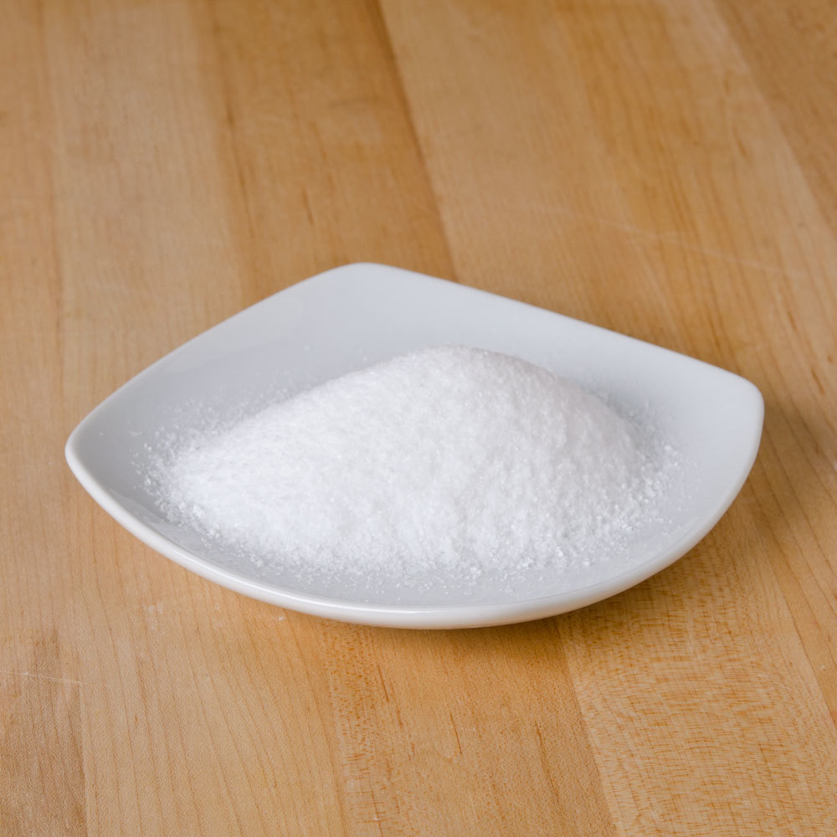
Misconception Alert
Sodium chloride does not appear as a single molecule.
Sodium chloride presents itself as crystals in nature.

Slide 17
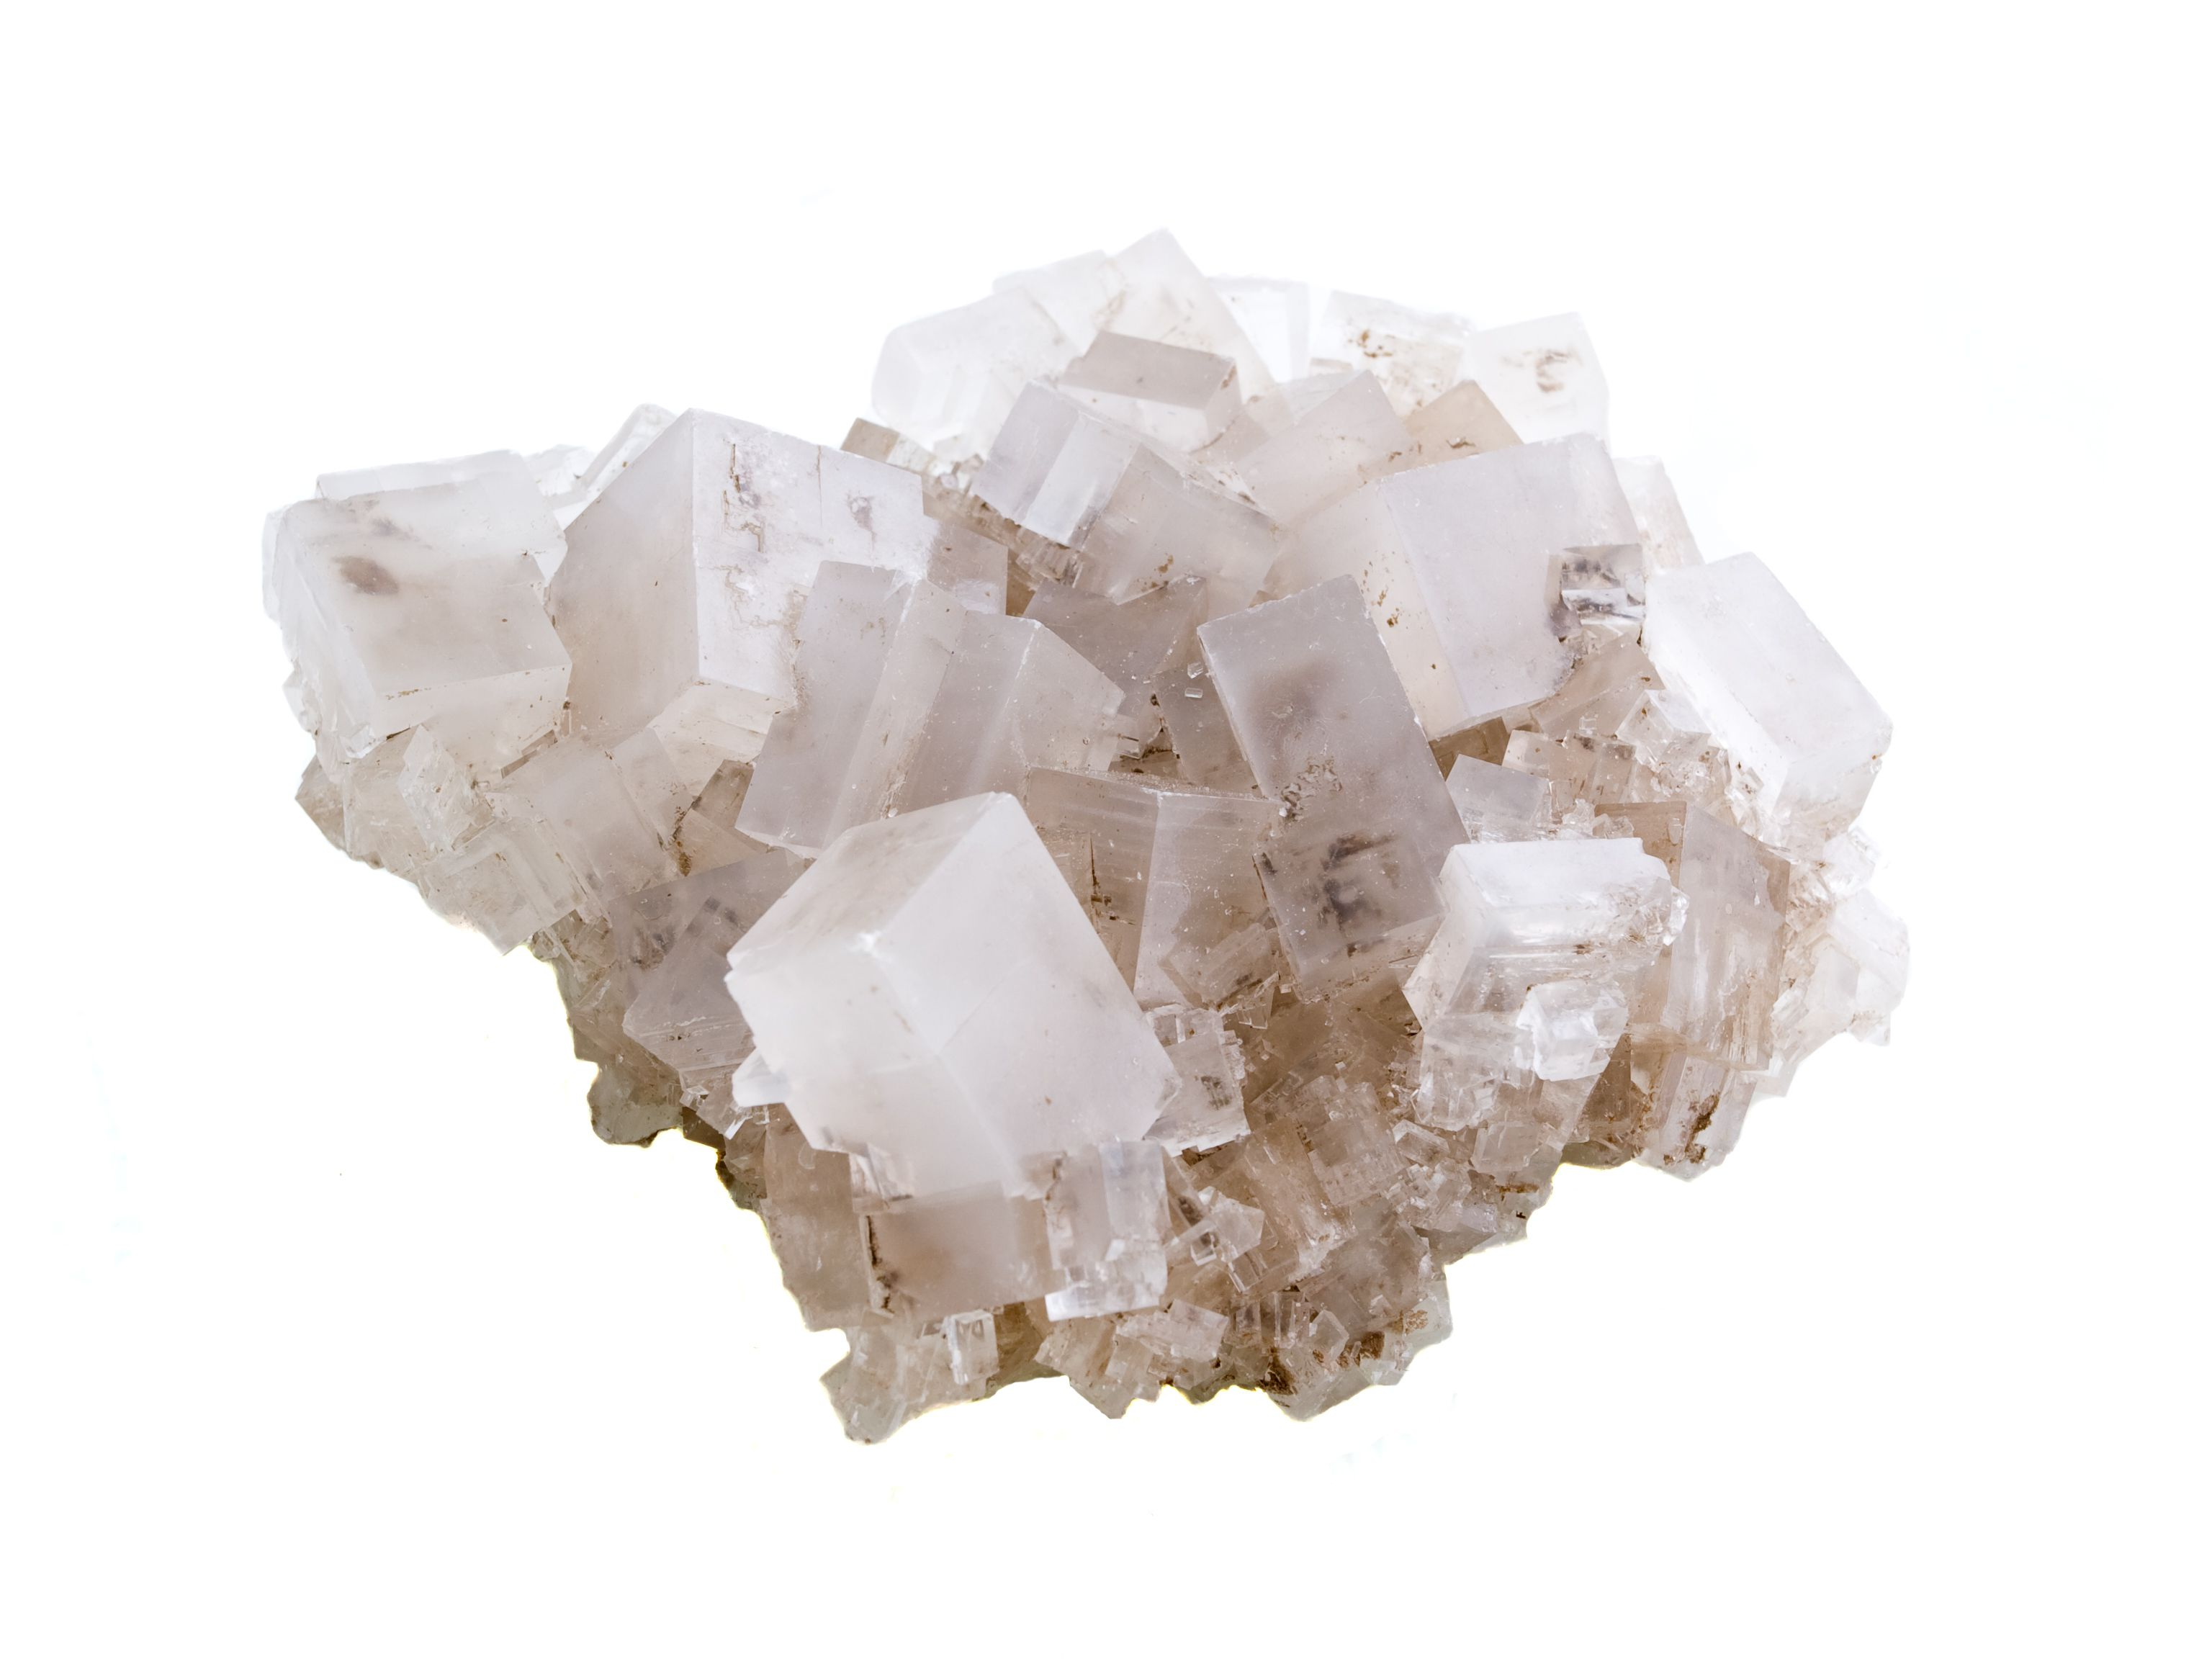
Notes:
After looking at the rock salt, students should model what they see with the NaCl lattice to determine how it might appear at the molecular level.

Slide 18
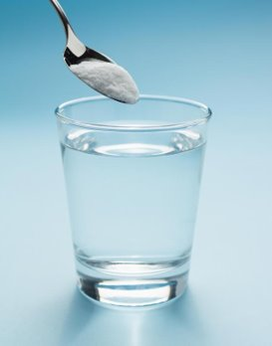
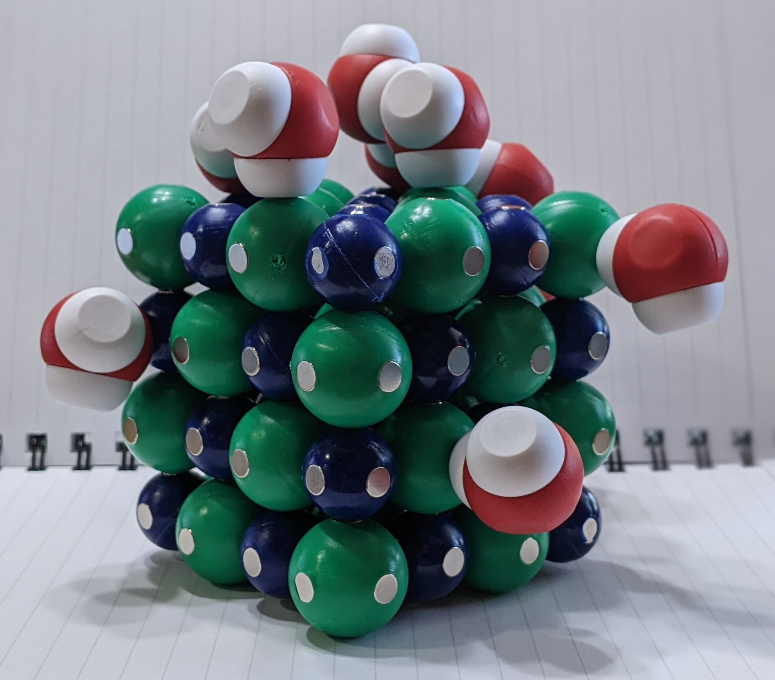
Let’s model a sodium chloride lattice dissolving in water
Notes:
Assess students’ understanding by asking them to model another scenario. Make a saturated solution together. After discussing the characteristics of an unsaturated solution and supersaturated solution, allow students create those models.

Slide 19
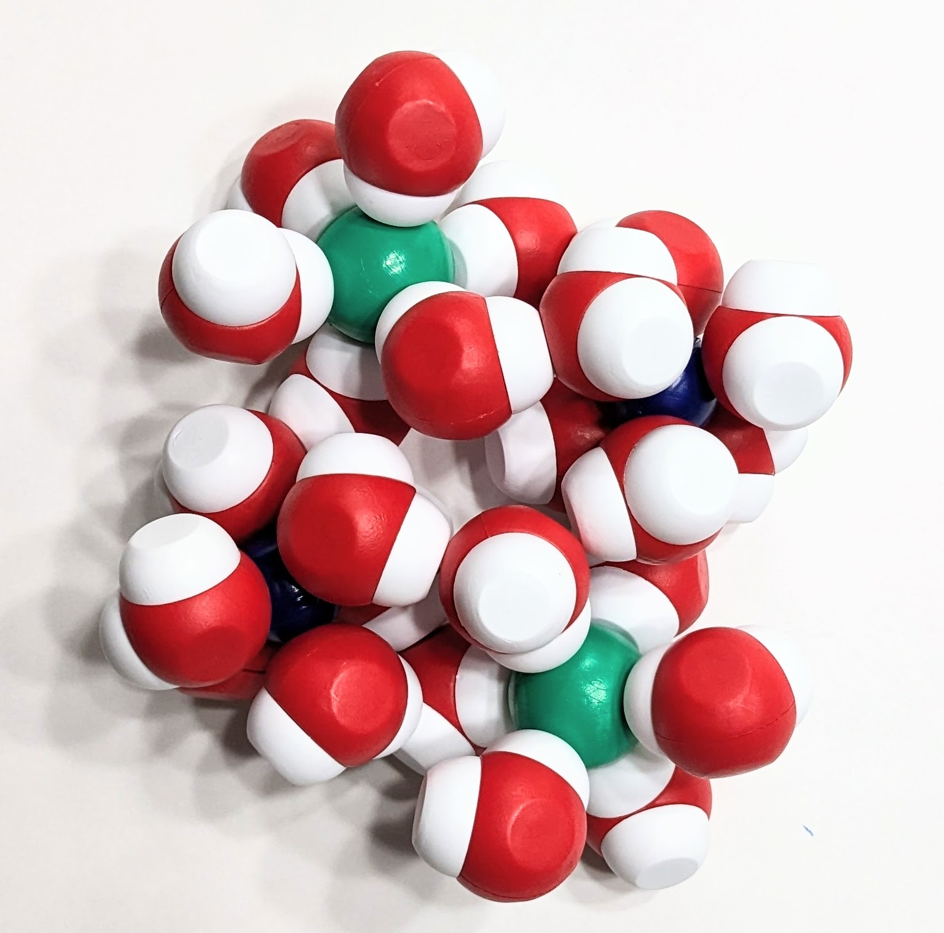
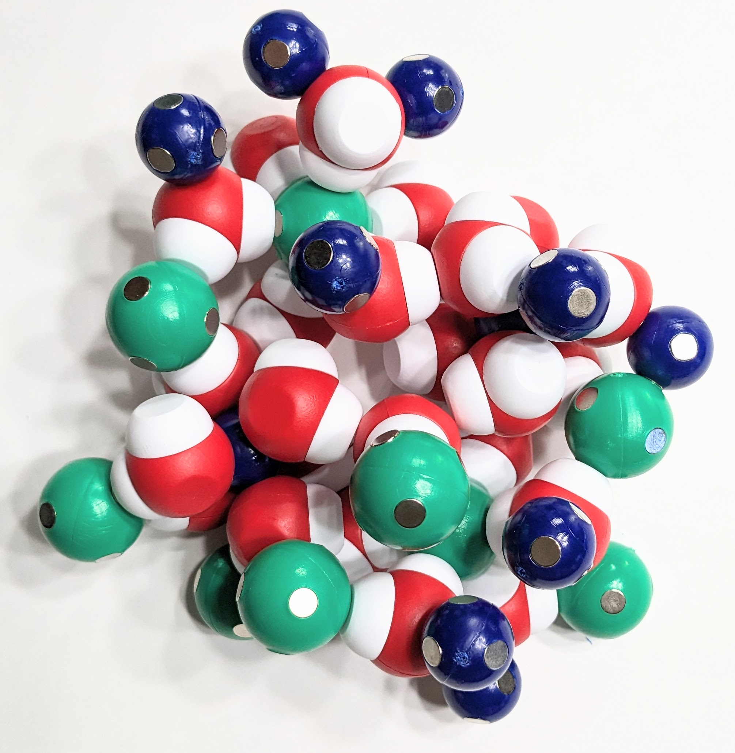
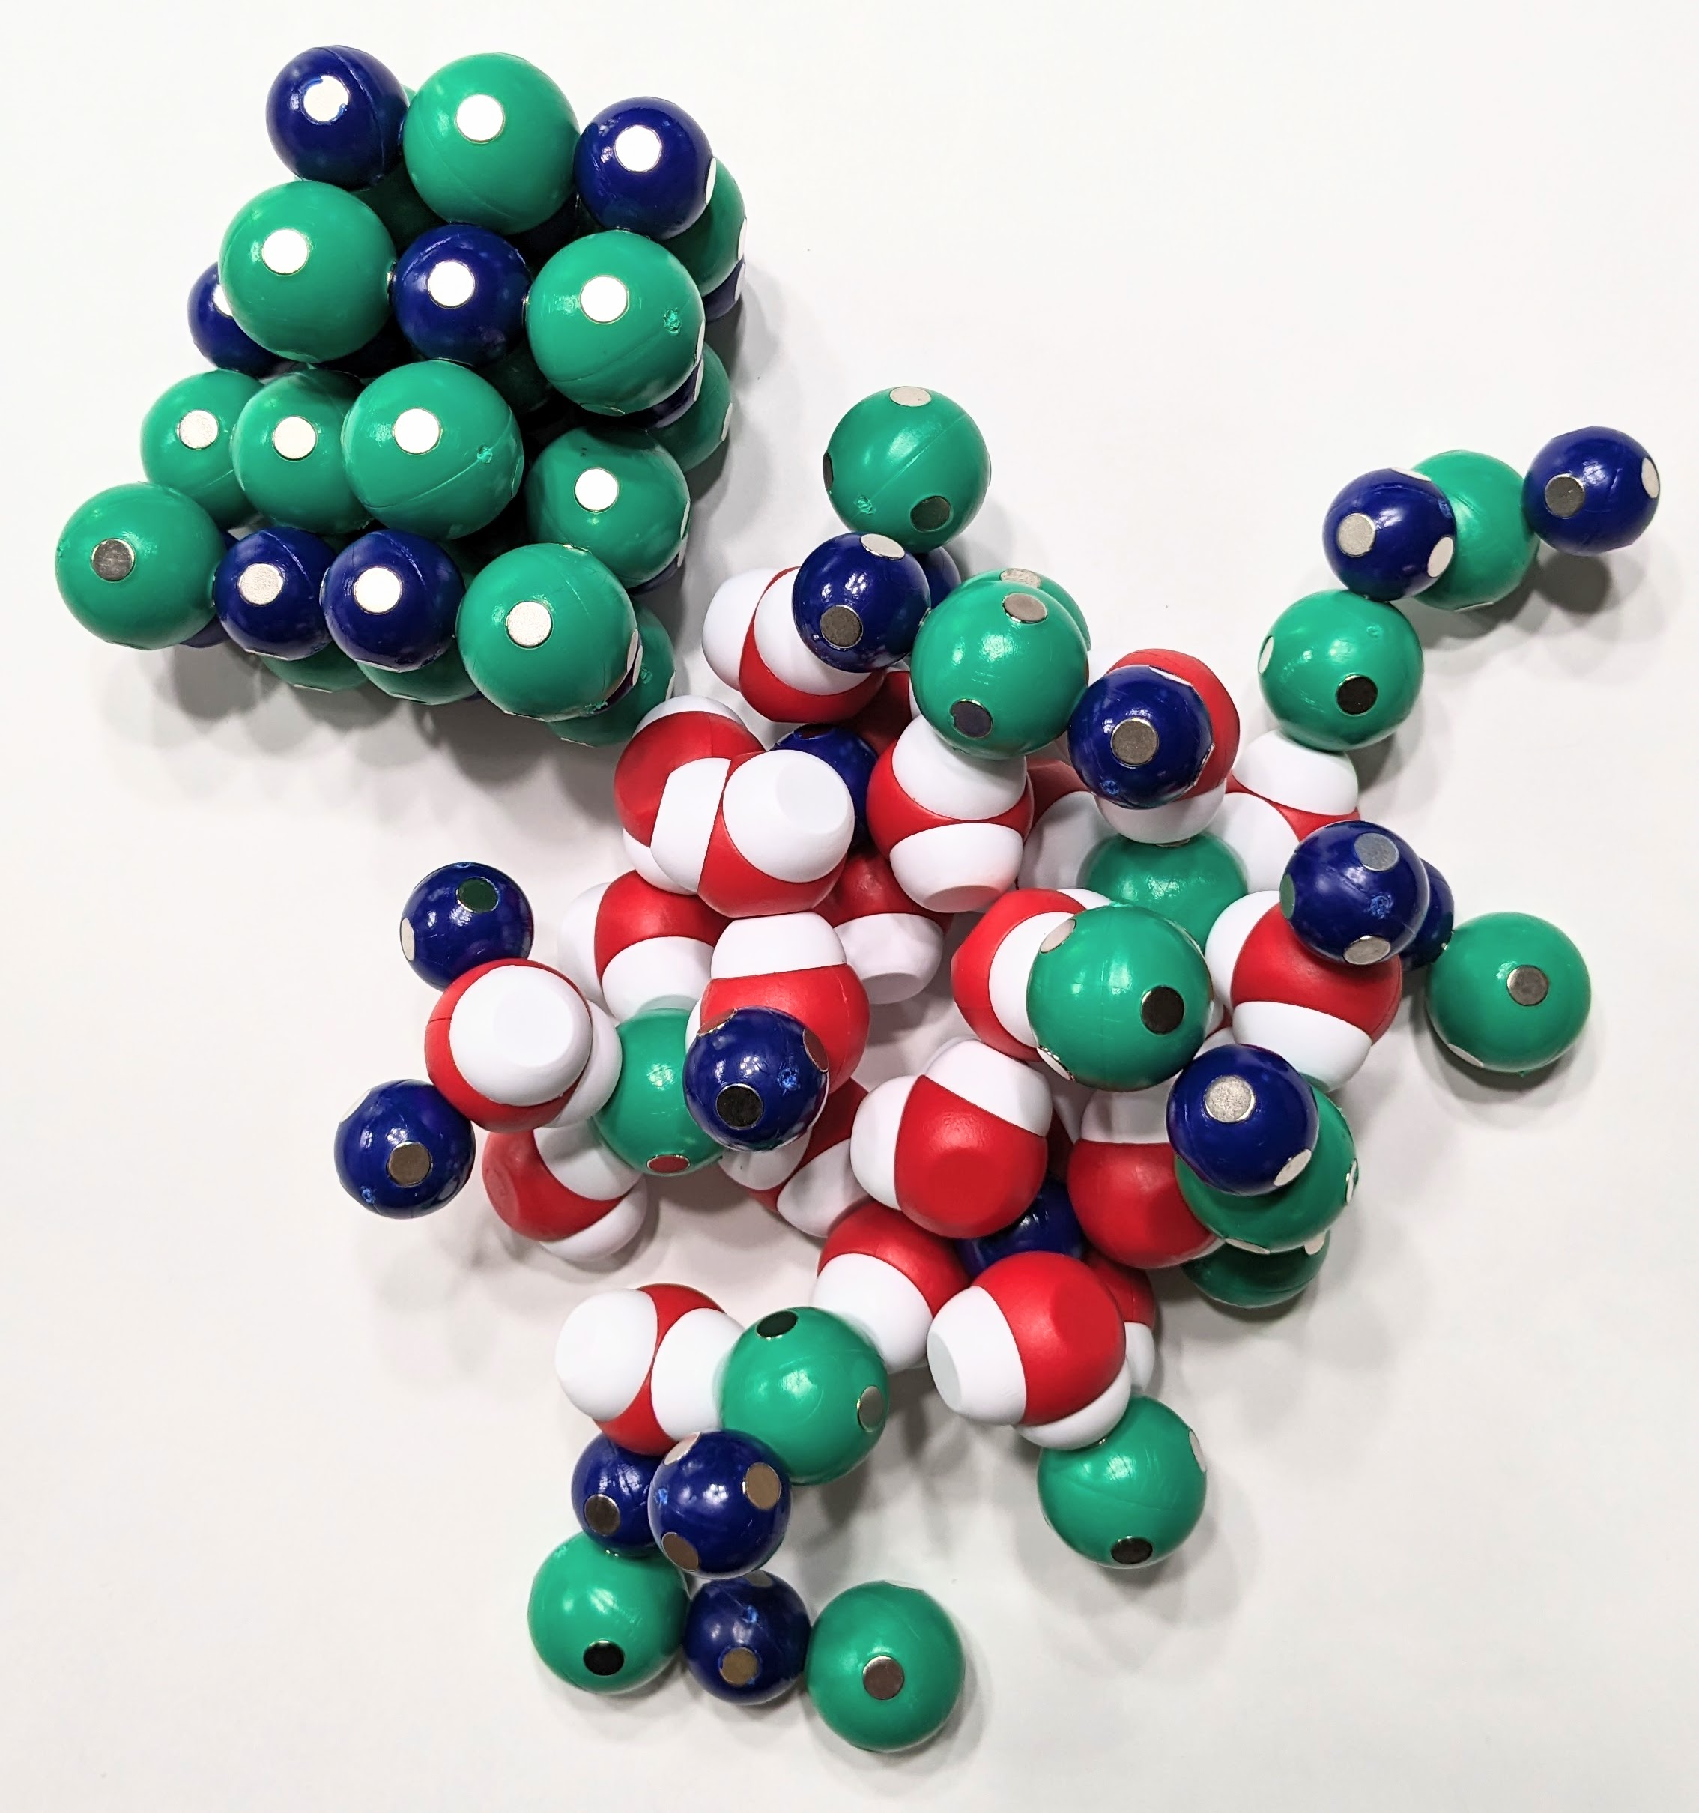
Modeling Solutions
Unsaturated | Saturated | Supersaturated
A solution that contains less than the maximum amount of solute that is capable of being dissolved. | A solution that contains the maximum amount of solute that is capable of dissolving. | A solution that contains more than the maximum amount of solute that is capable of being dissolved at a given temperature. By adding a seed crystal, the solution recrystallizes.

Slide 20
Notes:
There are five phospholipid models: phosphatidylcholine, phosphatidylserine, phosphatidylinositol, phosphatidylethanolamine, and sphingomyelin
Each table has a different phospholipid.

Slide 21
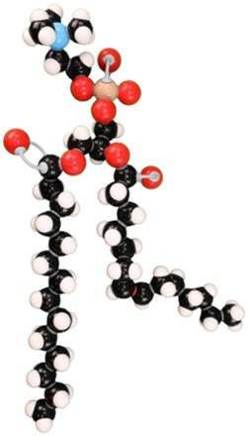
Getting Through the Cell Membrane
Examine the phospholipid at your table.
Describe the overall structure of your model
What atoms are present? What colors represent these atoms?
What are two questions you have about your model?

Slide 22
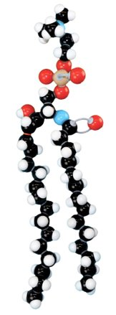
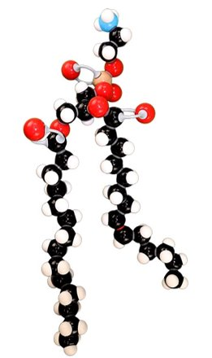
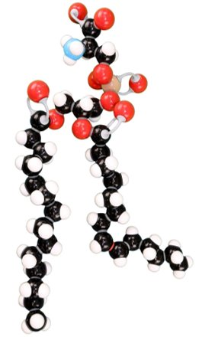
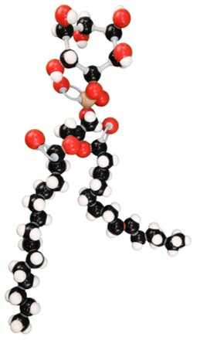
Focus on Phospholipid Heads
.
Phosphatidylserine
Phosphatidylinositol
Sphingomyelin
Phosphatidylethanolamine
Phosphatidylcholine

Slide 23
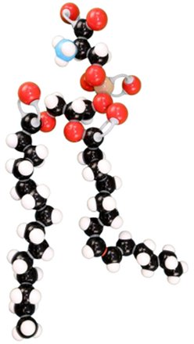
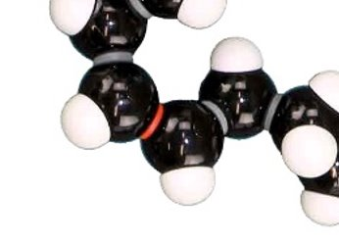
Focus on Phospholipid Tails
Hydrogen in the cis configuration
Produces a larger “kink” in the tail

Slide 24
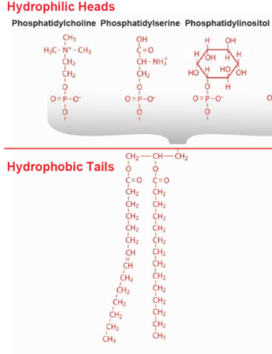
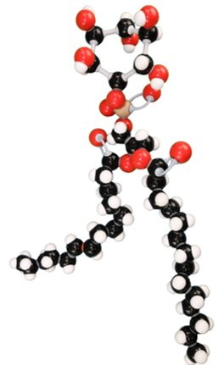
Modeling the Membrane: Phospholipids
Using multiple models help explain nuance in the phenomena we are trying to explain.

Slide 25
Notes:
For the rest of the presentation, we are going to focus on the Phospholipid and Membrane Transport Kit.

Slide 26
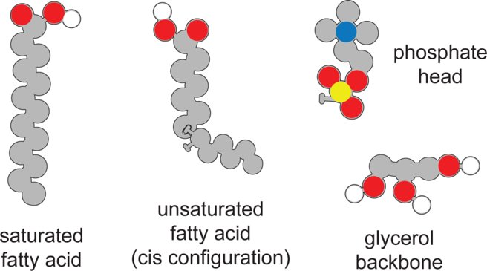
Constructing A Phospholipid
Notes:
Using your Molymod phospholipid as a model, determine how a phospholipid is constructed from its monomers.
Just a note: We have oversimplified this reaction.
The structures of polar lipids are based a condensation reaction of fatty acids with glycerol which only involves two of the -OH groups on the glycerol. If you wanted to model it more accurately with students, begin with a phosphatidic acid and convert into a glycerophospholipid by esterifying a polar phosphate head group. (choline, ethanolamine, inositol, or serine). Esterification involved the process of combining an organic acid with an alcohol (-OH) to form an ester and water. You could do this using the Molymod model.

Slide 27
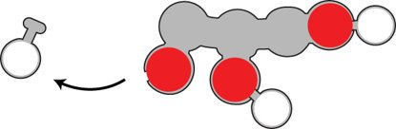
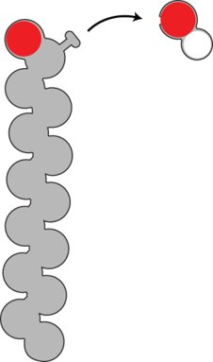
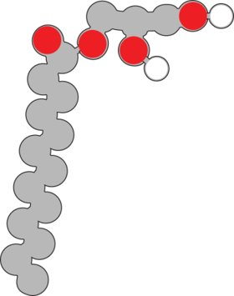
Constructing A Phospholipid
Remove a hydroxyl
From the saturated
fatty acid.
Join the glycerol and
saturated fatty acid
Together.
Remove a hydrogen from the glycerol backbone.

Slide 28

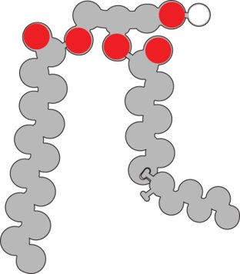
Constructing A Phospholipid
Join the hydrogen and the hydroxyl group to make water.
Remove a
hydrogen from
the glycerol
backbone
Attach the unsaturated
fatty acid to the glycerol
backbone

Slide 29
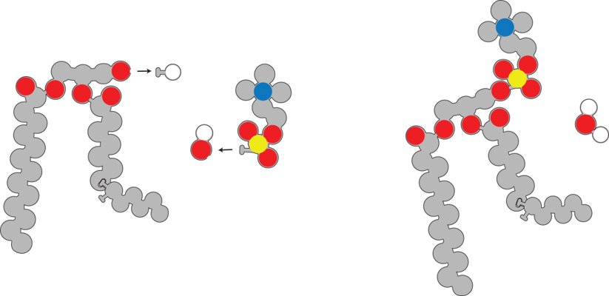
Constructing A Phospholipid
Remove a hydrogen from the glycerol backbone and attach
the phosphate head.
Join the hydrogen with a hydroxyl group to make water.

Slide 30
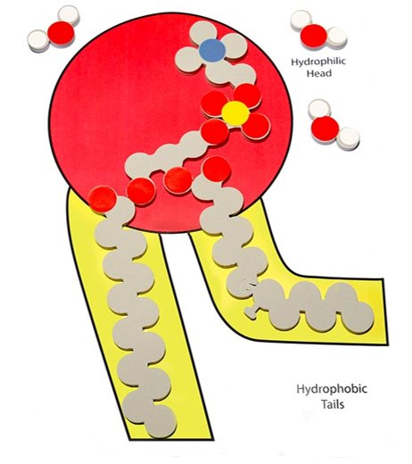
Constructing A Phospholipid
What do all three models have in common?
How are the models different?
Why is it important to use multiple models
to represent the same structure?

Slide 31
Building a Cell Membrane
How would ten phospholipids arrange to form a film on water?
How would ten phospholipids arrange to be submerged in a beaker of water?
How would phospholipids be arranged to be both submerged and contain water.
Notes:
Remember to work in 3D space, if possible.
In the first thought experiment, the phospholipids heads would be pointing down and the phospholipids tails would be pointing away from the water. A monofilm would be formed.
In the second thought experiment, the phospholipid heads would be pointing outwards and the phospholipid tails would be pointing inside. A micelle would be formed.
In the final thought experiment, there would be two layers of phospholipids, the heads would be nearest the water on the inside and outside. The tails would be touching forming a liposome.

Slide 32
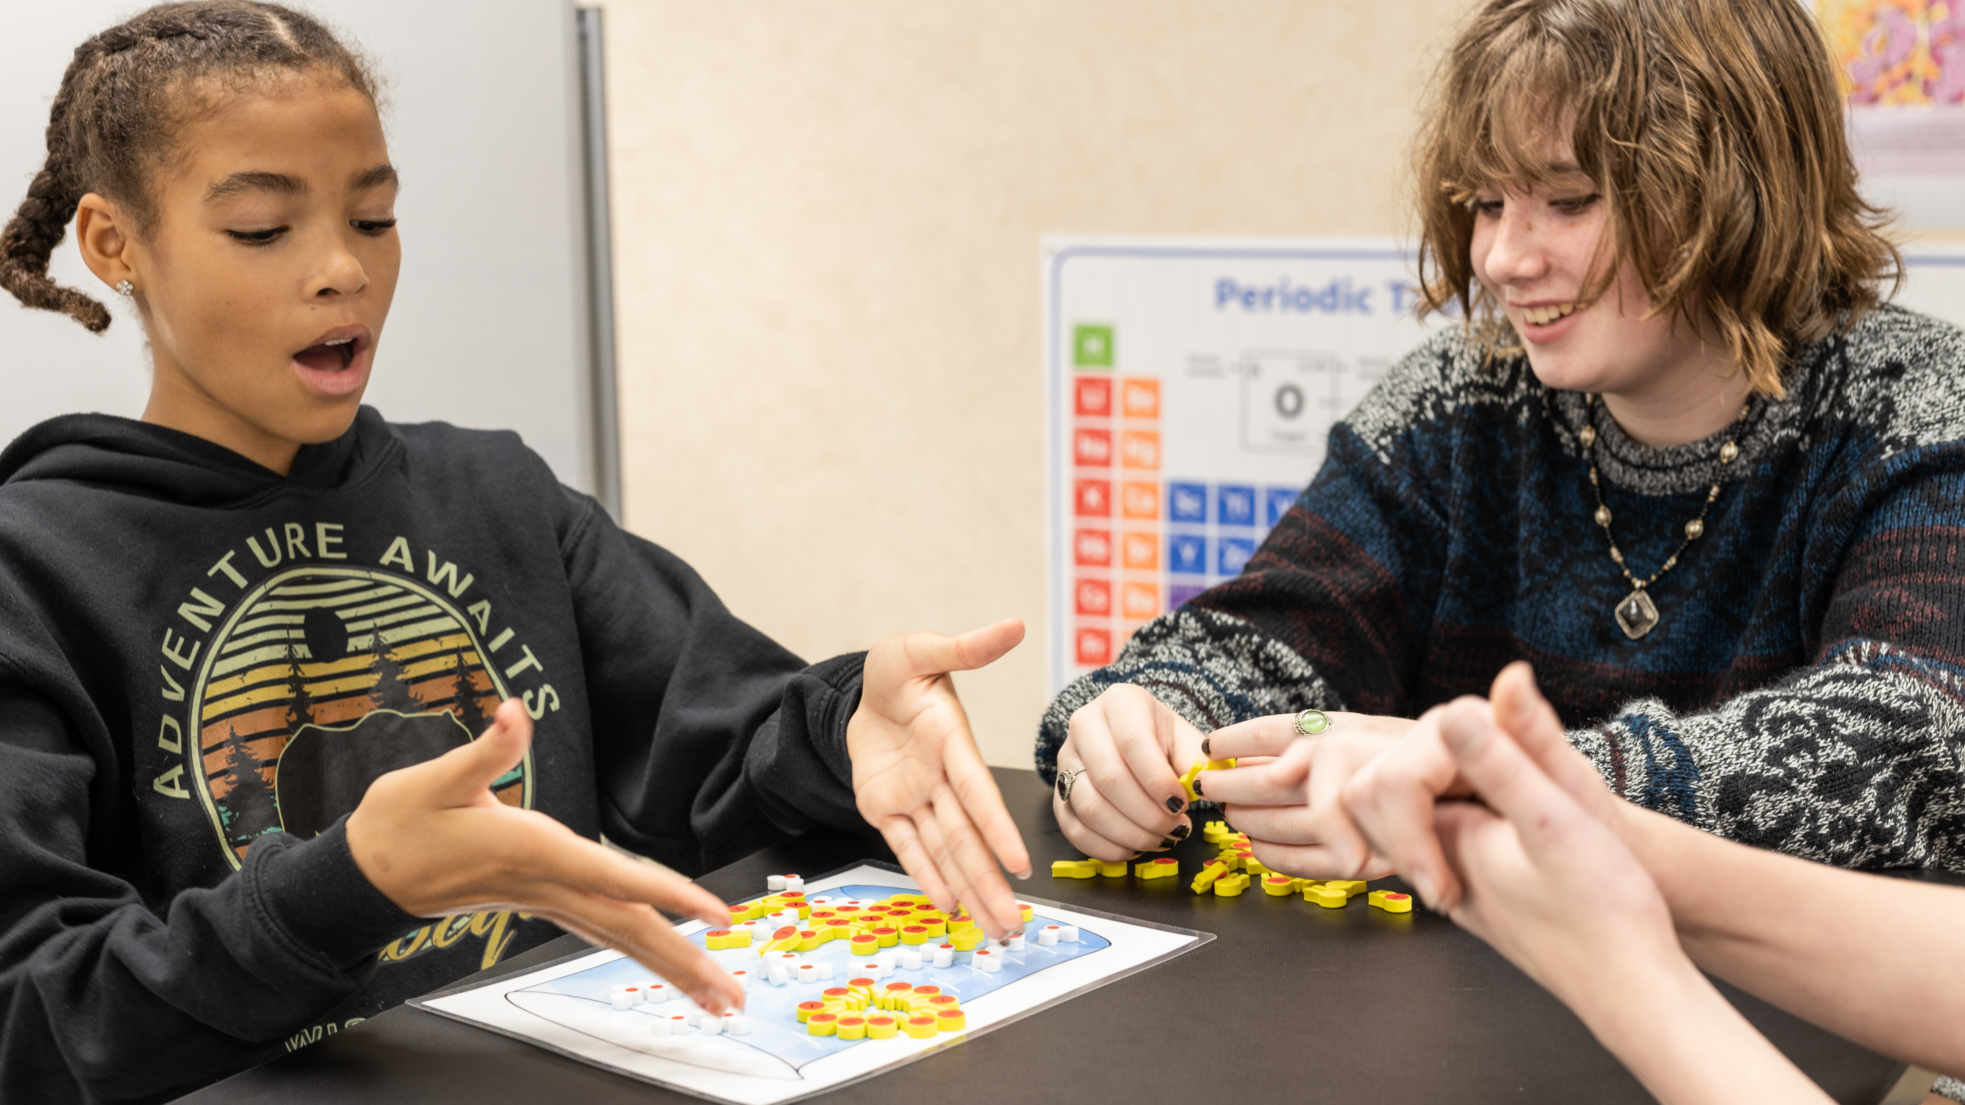
Let’s compare models
Monolayer
Micelle
Lipid Bilayer

Slide 33
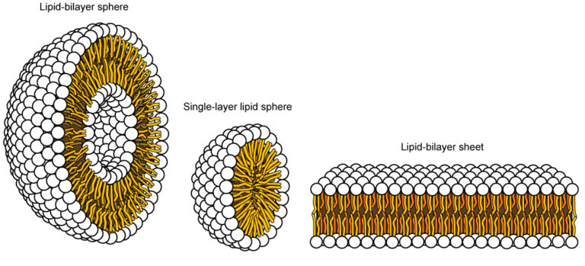
Let’s compare models
Monolayer
Micelle
Lipid Bilayer

Slide 34
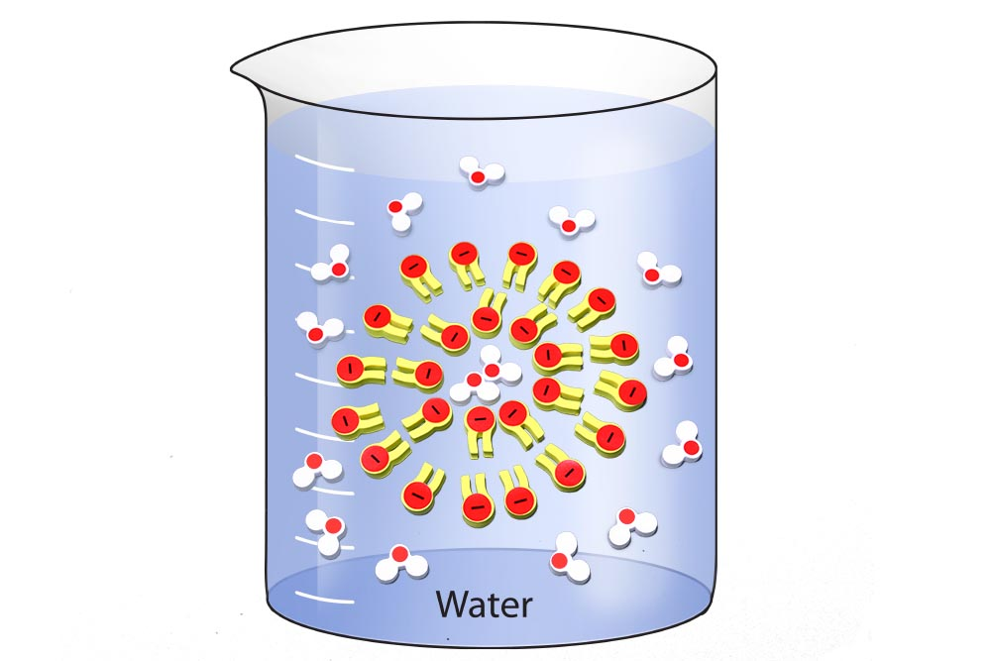
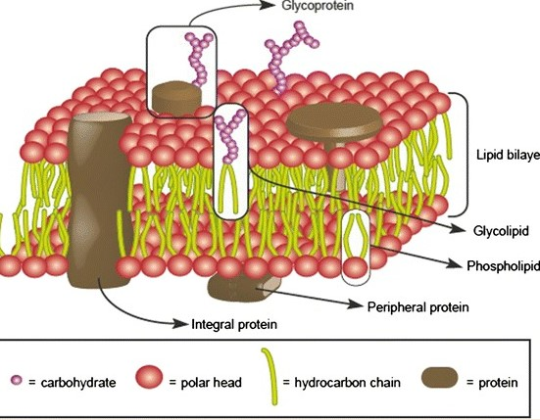
Lipid Bilayer

Slide 35
The Fluid Mosaic Model
Notes:
In 1971 and 1972, Singer and Nicolson presented their fluid mosaic model of cell membrane structure. The basics of the model have remained the same ever since: the membrane is a lipid bilayer with hydrophilic parts on the sides and hydrophobic parts in the interior; proteins can interact with the surface through transient polar contacts, but a lot of proteins are partially or totally embedded in the lipid bilayer where their hydrophobic parts also interact with the hydrophobic parts of lipids.

Slide 36
Raw Egg Components
What is in your cell?
Take five minutes with your group and determine what components are in your egg.
Determine the approximate mass of the egg in grams.
Determine the approximate mass of the individual components.
How might you test for these substances to verify they are present or absent from your egg?
Notes:
To prepare for the lab, let’s do some backwards design.

Slide 37
Raw Egg Components
50 g water
6 g protein
5 g fat
0.2 g glucose
0.147 choline
0.124 g sodium
0.07 g potassium
0.3097 g other micronutrients (like vitamins and cholesterol)
Approximate Total Mass: 61.7 g
Data from:
USDA

Slide 38
Raw Egg Components
50 g water
6 g protein
5 g fat
0.2 g glucose
0.147 choline
0.124 g sodium
0.07 g potassium
0.3097 other micronutrients (like vitamins and cholesterol)
Approximate Total Mass: 61.7 g
Determine the percentage of the total mass.
Notes:
First, research the major components of a raw egg.

Slide 39
Raw Egg Components
50 g water (81%)
6 g protein (9.7%)
5 g fat (8.1%)
0.2 g glucose (0.32%)
0.147 choline (0.23%)
0.124 g sodium 0.2%)
0.07 g potassium (0.11%)
0.3097 other micronutrients (like vitamins and cholesterol) (0.5%)
Approximate Total Mass: 61.7 g (100.16%)
Notes:
Then determine the percentage of components compared to the egg’s total components.

Slide 40
What If?
Weigh the shell-less egg.
Cover the egg in a clear liquid of your choice
Let it set for three days.
While waiting determine the percentage of water and solutes in solution.
Weight the egg and determine the change in mass.
Notes:
Nutrition information for
Distilled water
Lemon-lime soda: Sprite Nutrition Facts - Eat This Much
Clear sports drink: Gatorade Nutrition Facts - Eat This Much
Apple juice: Apple juice Nutrition Facts - Eat This Much
Corn syrup: Corn syrups Nutrition Facts - Eat This Much

Slide 41
What If?
Determine the percentage of water and solutes in solution.
  Distilled water (100%)
  Clear sports drink (93%)
  Lemon-lime soda (90%)
  Apple juice (88%)
  Corn syrup (23%)
Solutes we focused on:
  Glucose (sugar)
  Sodium
  Potassium
Notes:
Nutrition information for
Distilled water
Lemon-lime soda: Sprite Nutrition Facts - Eat This Much
Clear sports drink: Gatorade Nutrition Facts - Eat This Much
Apple juice: Apple juice Nutrition Facts - Eat This Much
Corn syrup: Corn syrups Nutrition Facts - Eat This Much
Percentage of water was determined by dividing the grams of water by the total grams of beverage and multiplying by 100%
The same method can be used to determine the percentage of solutes (sugar, sodium, and potassium).

Slide 42
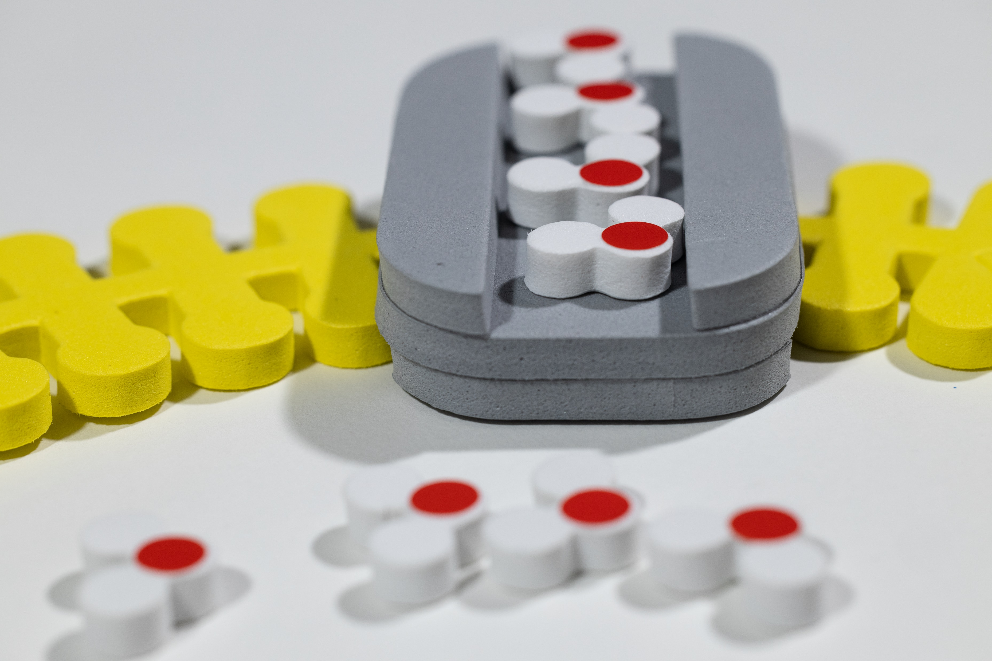
Predict What Would Happen to the Egg in Distilled Water
Notes:
Over the next three days, students would determine the percentage of water, sugar, sodium, and potassium in their clear liquid. They would construct a model to best explain what they think will happen to the overall mass of their egg.
Because the kit didn’t have 100 water molecules, we normalized our data. In this case, the ratio of the molecules of water and solutes was equal but based on using a total of 10 molecules. For example, 100% would equal 10 water molecules, while 81% would equal 8 water molecules.

Slide 43
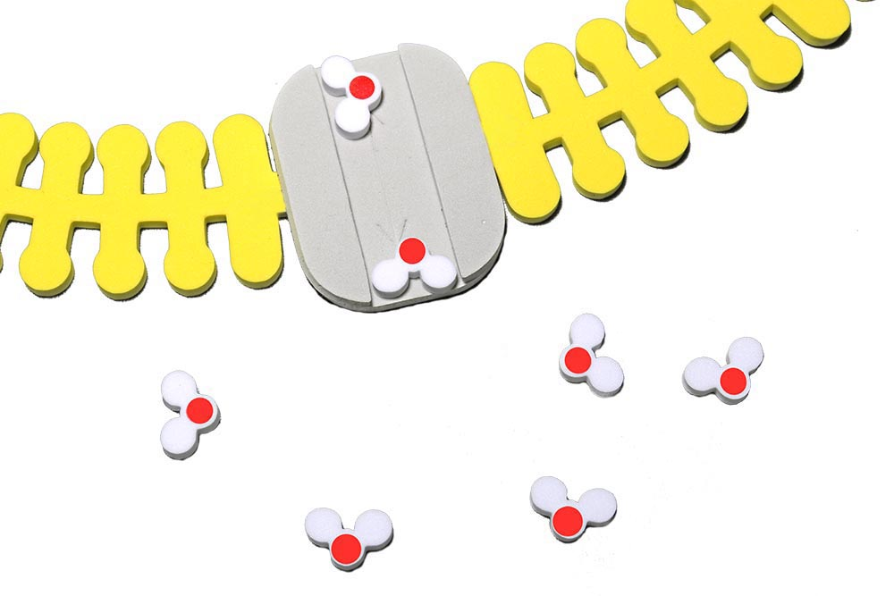
Share Our Predictions
Notes:
Students would then share their predictions with the class. We also build a class consensus model with our predictions.

Slide 44
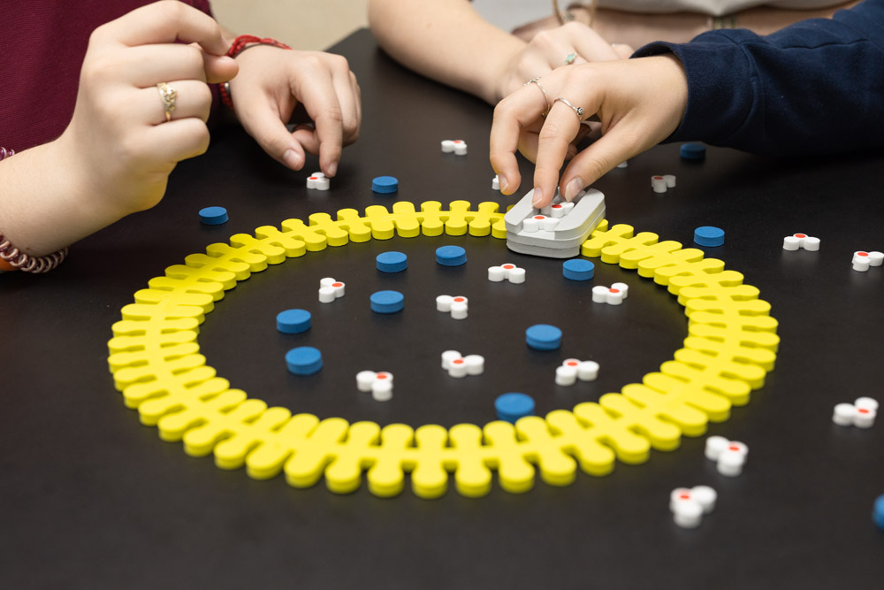
What is the Role of Aquaporin?

Slide 45
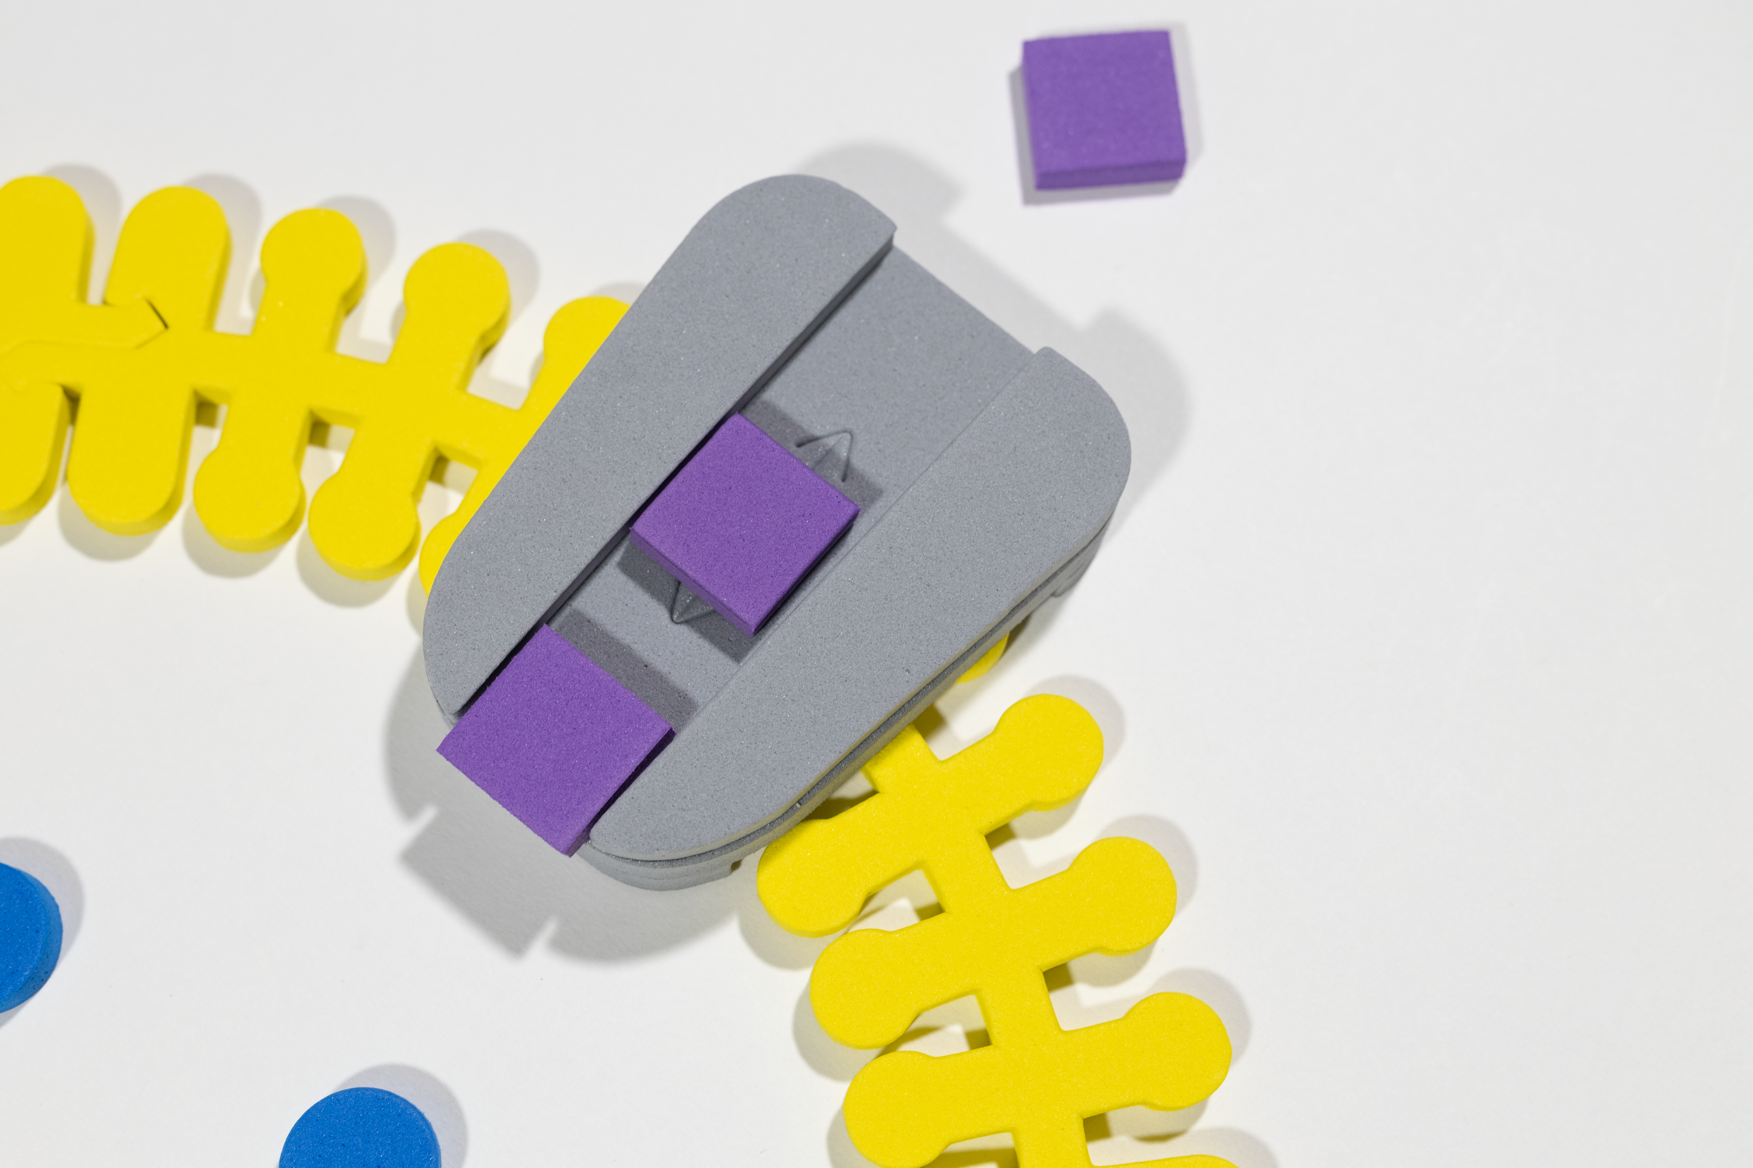
What about the Movement of Solutes?
What are the solutes in the egg?
How might they move passively across the membrane?
Leak channels allow for free movement in and out of the membrane based on concentration gradient.

Slide 46
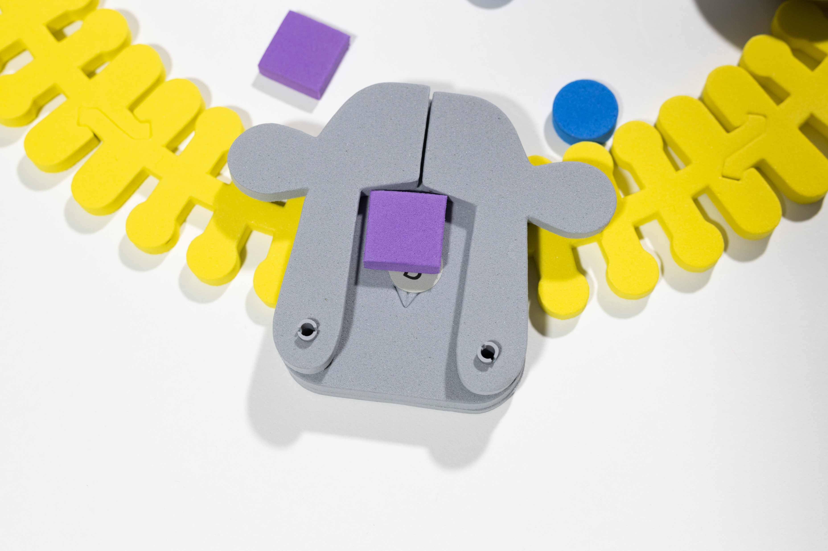
Gated Ion Channels Move Potassium or Sodium across the Membrane
How might they move passively across the membrane?
Gated channels
    voltage-sensitive
    ligand-gated
    mechanically-gated
Notes:
How could students modify the models to reflect the different types of gated channels?

Slide 47
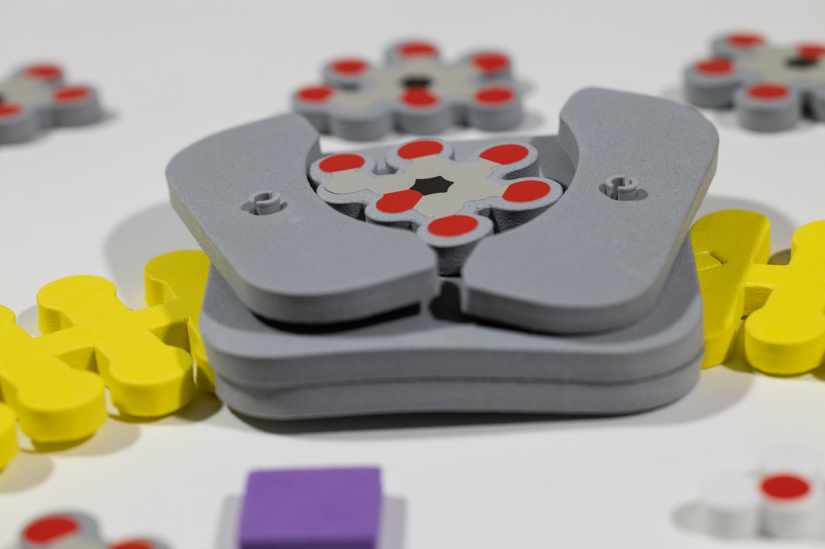
How Is Glucose Transported Using GLUT1?
Notes:
Many biochemical studies have suggested that GLUT1 functions by alternately exposing a binding site for glucose, first on one side of the membrane and then on the other side of the membrane.
New insights into GluT1 mechanics during glucose transfer | Scientific Reports (nature.com)

Slide 48

Modeling passive glucose transport
Notes:
This uses a carrier protein.

Slide 49
Let’s Look Some Student Results
Distilled water
  91.36g – 83.23g = 8.13 g increase in mass
Clear sports drink
  83.25g – 78.78g = 4.47g increase in mass
Apple juice
  82.57g – 65.34g = 17.23g increase in mass
Corn syrup
  42.08g – 82.96g = 40.88 decrease in mass
Notes:
The formula used for calculations:
Ending mass – beginning mass = change in mass

Slide 50
Let’s Look Some Student Results
Distilled water
  91.36g – 83.23g = 8.13 g increase in mass
Clear sports drink
  83.25g – 78.78g = 4.47g increase in mass
Apple juice
  82.57g – 65.34g = 17.23g increase in mass
Corn syrup
  42.08g – 82.96g = 40.88 decrease in mass
Make a model of
your assigned solution
and its results on the egg after 3 days
Notes:
The formula used for calculations:
Ending mass – beginning mass = change in mass

Slide 51
Gallery Walk
Let’s show off our results.

Slide 52

Active Transport
Sodium-Potassium Pump
Notes:
Although not used in this lab, it is important to note that in certain cells in the body, active transport is important to bring the levels of sodium and potassium ions back into balance.

Slide 53

ATP plays an important role in active transport
Notes:
ATP is needed

Slide 54

Phosphorylation causes a conformational change

Slide 55



1. Sodium binds on intracellular side.
2. The pump is phosphorylated by ATP.
3. The pump shape changes, exposing the sodium to the extracellular space.

Slide 56

Removal of phosphate returns it to its original shape

Slide 57



4. Binding affinity changes to release Na+, and take in K+.
5. Phosphate detaches.
6. Original shape is restored, releasing K+ into the cell.

Slide 58

Students should notice the cell works as a unit
Notes:
By the end of the lab, students should realize that the membrane and the transport proteins work together to maintain homeostasis.

Slide 59
Moving Forward
What other questions do you have about cellular transport?
What else would you like to know?

Slide 60
Moving Forward
What other questions do you have about cellular transport?
What else would you like to know?
Why are there so many types of phospholipids?
How do phospholipids play a role in cellular signaling?
How does a vesicle “know” where to go (within a cell or the body)?

Slide 61
Additional Resources
Once upon a time the cell membranes: 175 years of cell boundary research - PMC (nih.gov)
Osmosis and Naked Eggs: The Environment Matters (from Even More Brain-Powered Science NSTA Press )

Slide 62

Additional Resources
Special Thanks to Michele Palmgren and the Blue Valley-Randolph High School Honors Biology Class for sharing their data.

Slide 63
Workshop NGSS Connections
SEPs | CCCs | DCIs
Asking Questions and Defining Problems | Systems and System Models | HS-LS1-4
Developing and Using Models | Cause and Effect | HS-LS3-2
 | Scale, Proportion, and Quantity
Notes:
Ruth says: Here are the NGSS Connections for this workshop.

Slide 64


Want to try things out first?
Visit our Lending Library at
3DMD Lending Library – 3D Molecular Designs.

Slide 65



Digital Modeling Hub
We're enhancing our kits and models to inspire more hands-on learning with our classic content, Interactables, short content videos, and much more!! Check it out!
Look at our new
Digital Modeling Hub for additional resources to use with the Water Kit and Phospholipid and Membrane Transport Kit.
Get your access code by responding to our survey!

Slide 66



AR Enhancements
We're enhancing our kits and models to inspire more hands-on learning with new augmented reality features!
Look at our table to
check out our new
Augmented Reality Enhancements!

Slide 67

Summer Course 2025 – Modeling the Molecular World
Join us in Milwaukee for hands-on discovery and professional development on July 7 – 11.
Registration begins in October. Check out 3D Molecular Designs website for more information.
Bring an empty suitcase!
You'll take home all these classroom resources!
Notes:
Scholarships are available. If you have questions, you can contact Ruth Hutson at ruth.hutson@3dmoleculardesigns.com.

Slide 68

We value your opinion!
Let us know what you think.
Scan the QR Code and complete this short survey.

