Slide 1
Unraveling Chromosomes through Modeling
Alice Scheele
Biology Teacher
Patrick Henry High School
Ashland, VA

Slide 2
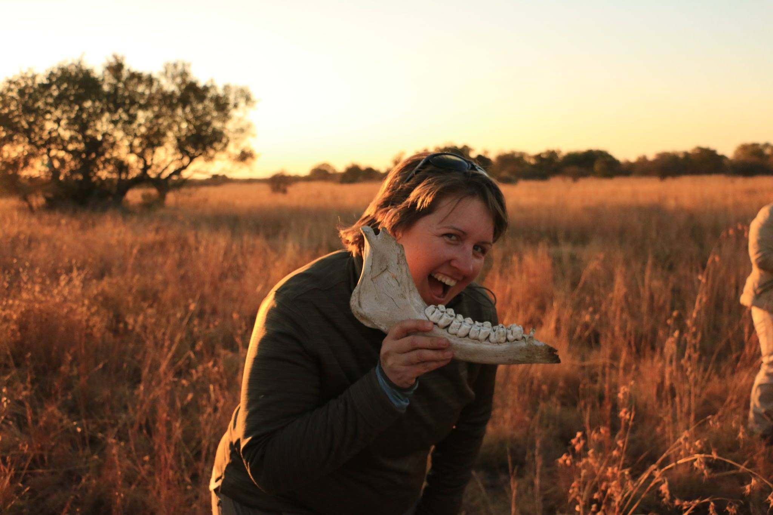
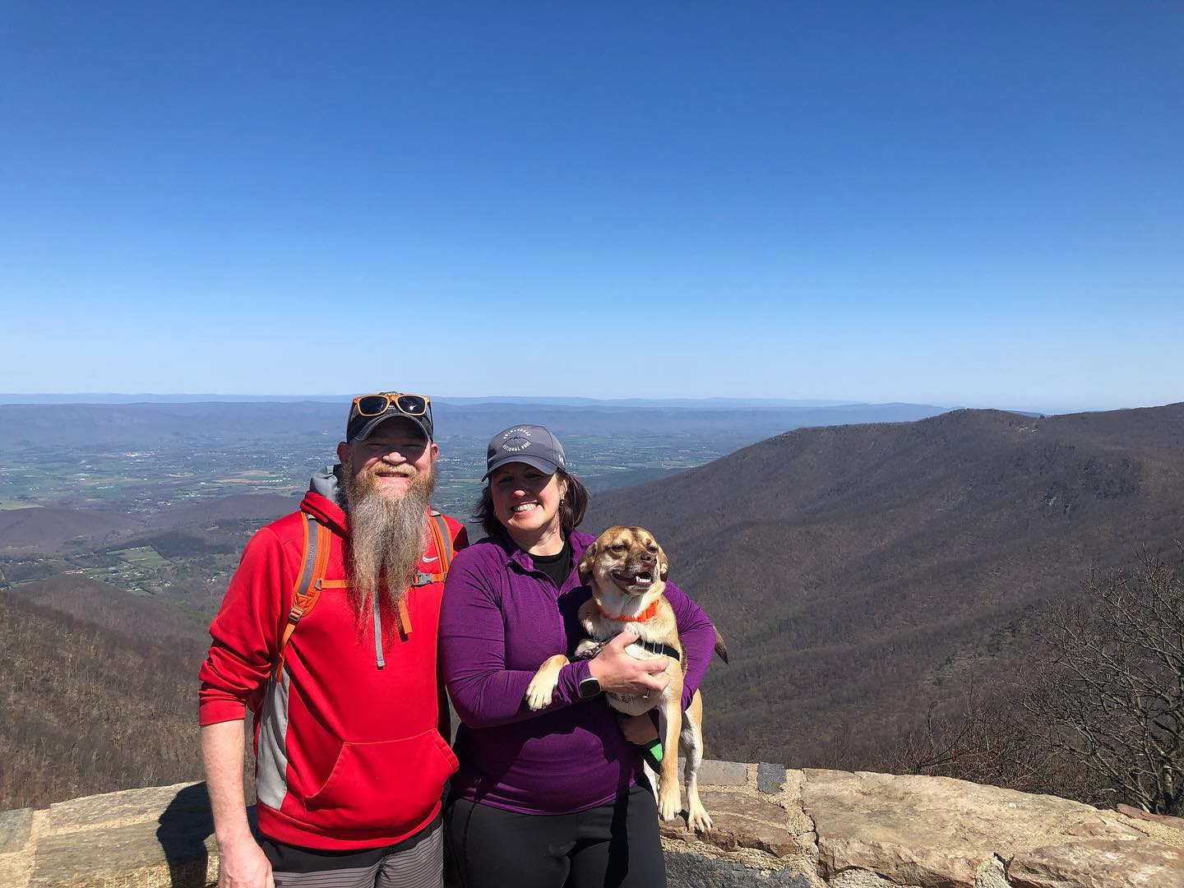
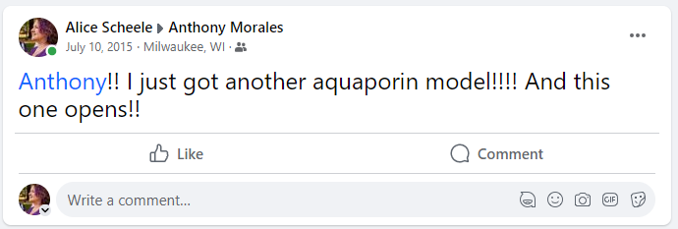
Who am I?
Biology teacher in Hanover County
3DMD Model teacher
AP Reader & consultant

Slide 3

Teaching with models

Slide 4
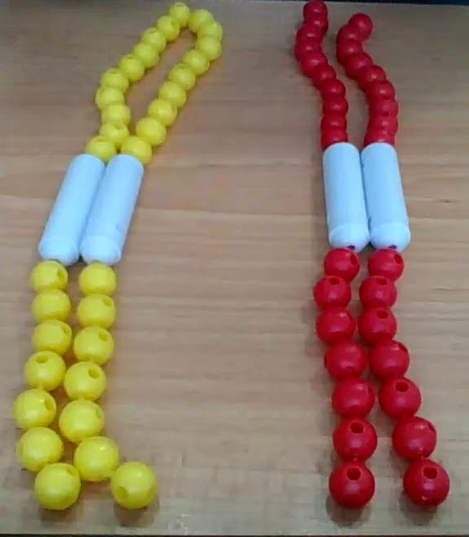
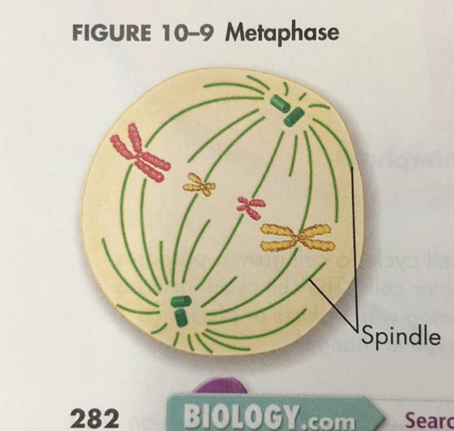
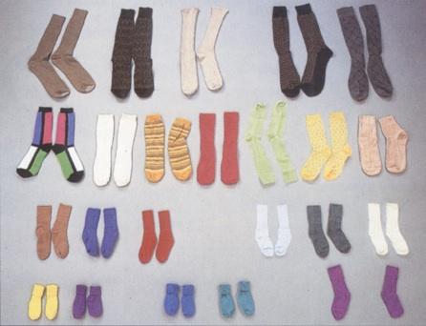
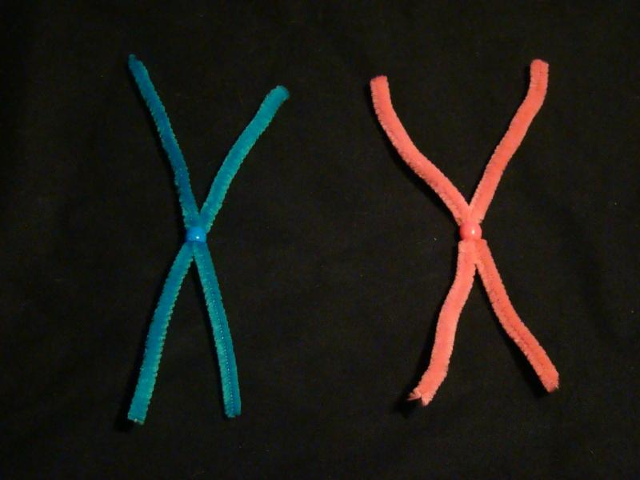
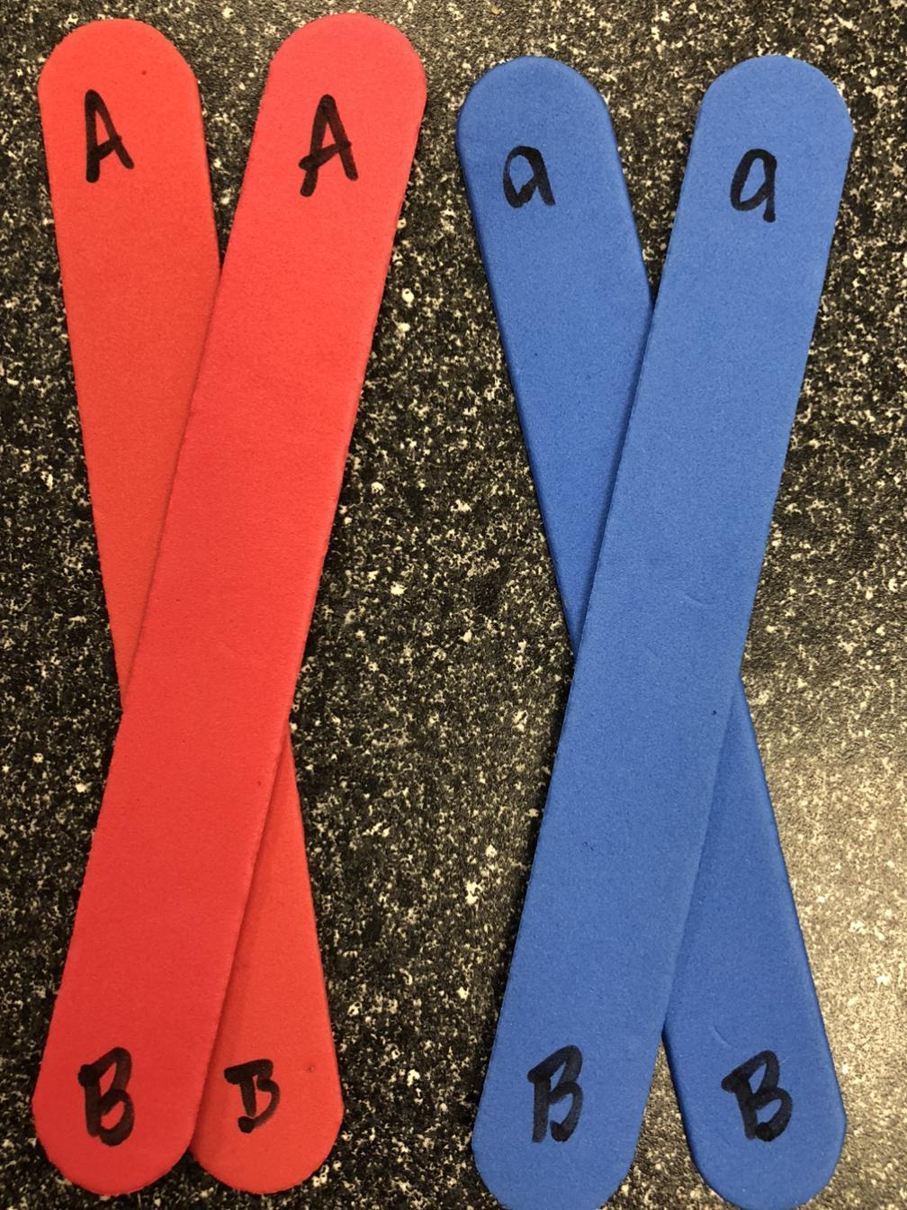
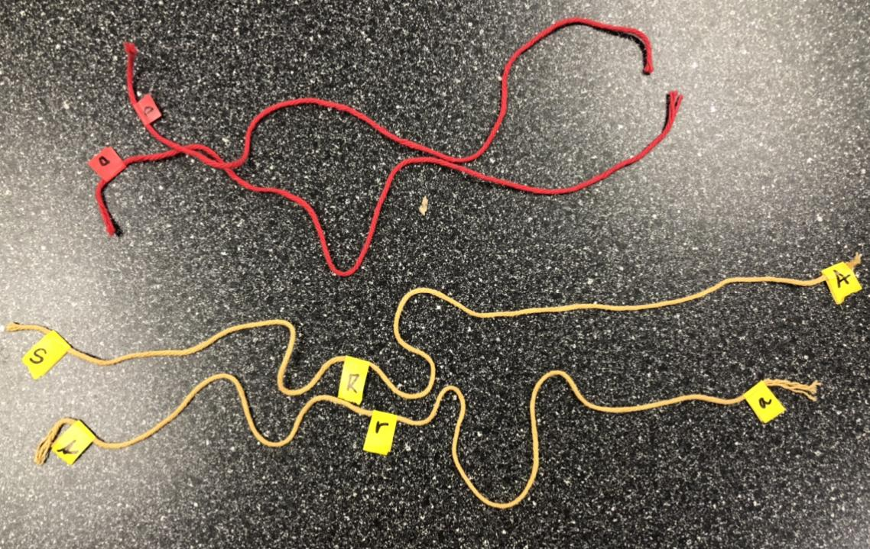
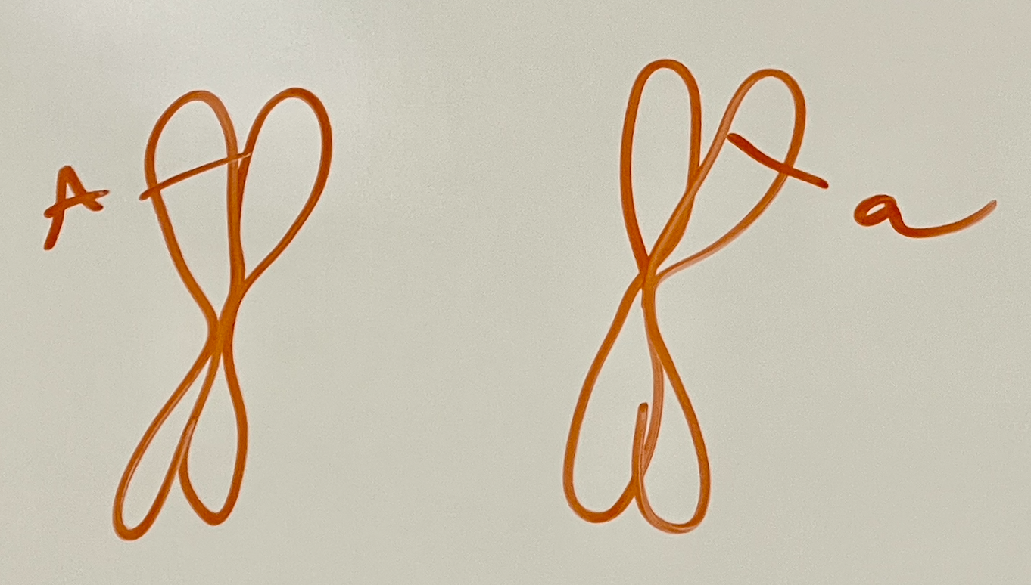
What chromosome models do you use?

Slide 5






But what IS a chromosome? Build one!
Notes:
Hand teachers the chromosome kit and invite them to build a chromosome.

Slide 6
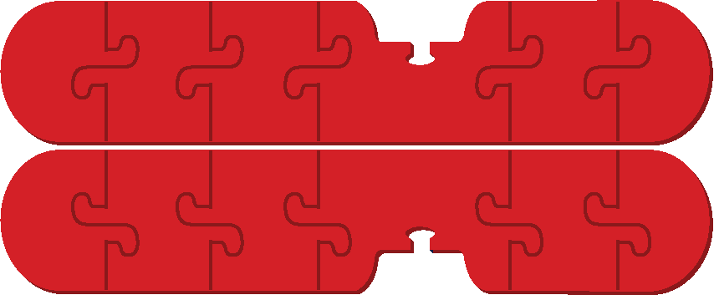

Is this a chromosome? Or this?

Slide 7
Is this a chromosome? Or this?
Or both?

Slide 8
Now build a homologous pair!

Slide 9




Now build a homologous pair!

Slide 10
Could these be homologous pairs?
OR

Slide 11
Could these be homologous pairs?
What more would you need to know?
OR

Slide 12
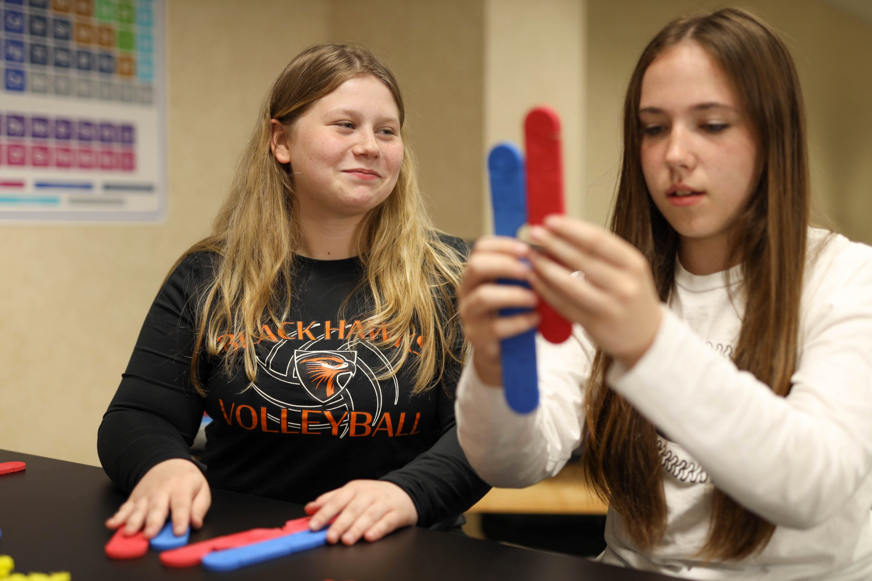
What do our students key into when we model this way?

Slide 13
How can we improve this model so students make these connections?

Slide 14
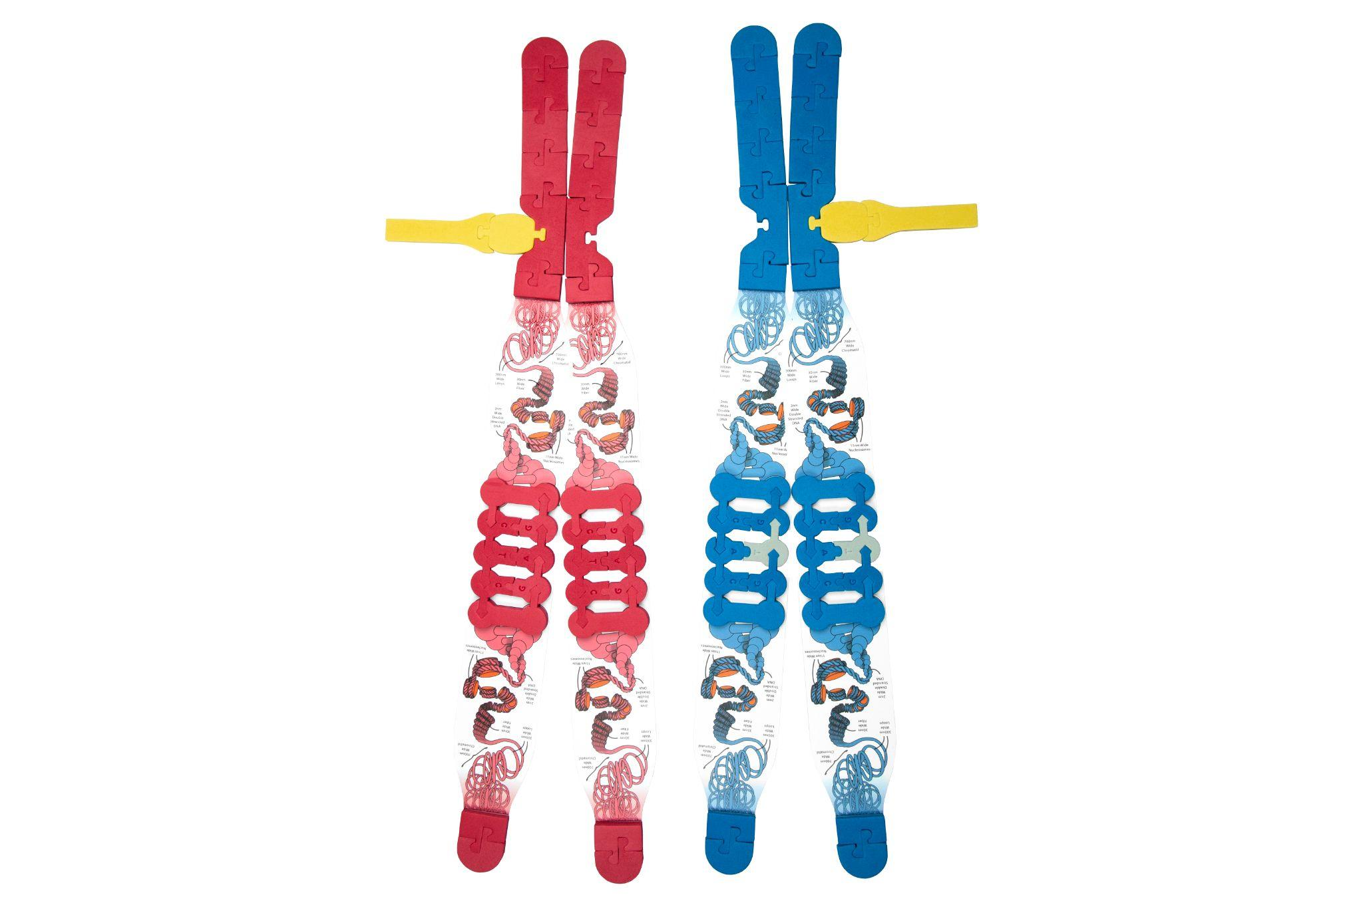
What can we do with a model like this that we could not do before?
A=
=a

Slide 15
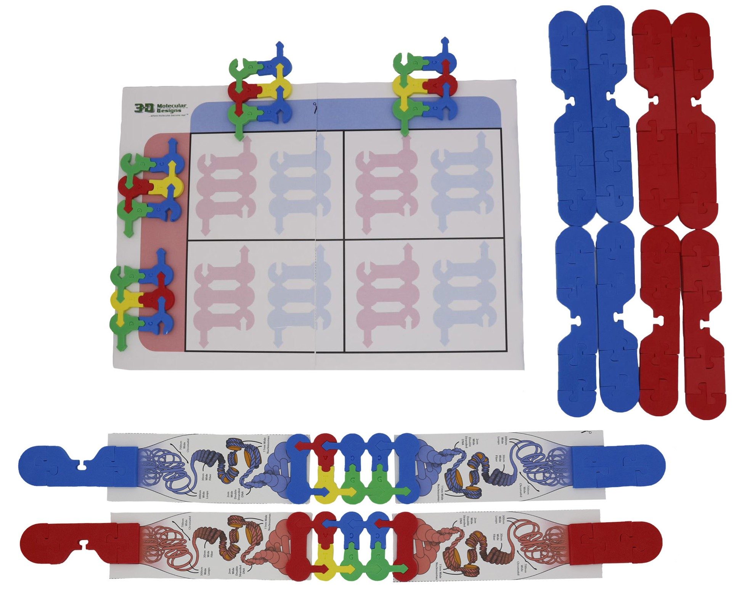
Punnett Squares!
A
a
A
a

Slide 16
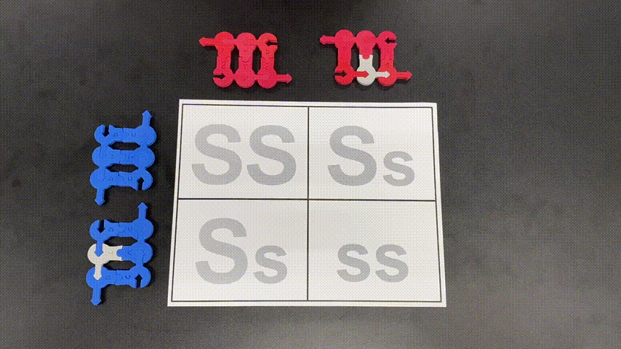
GIF of Punnett Square

Slide 17
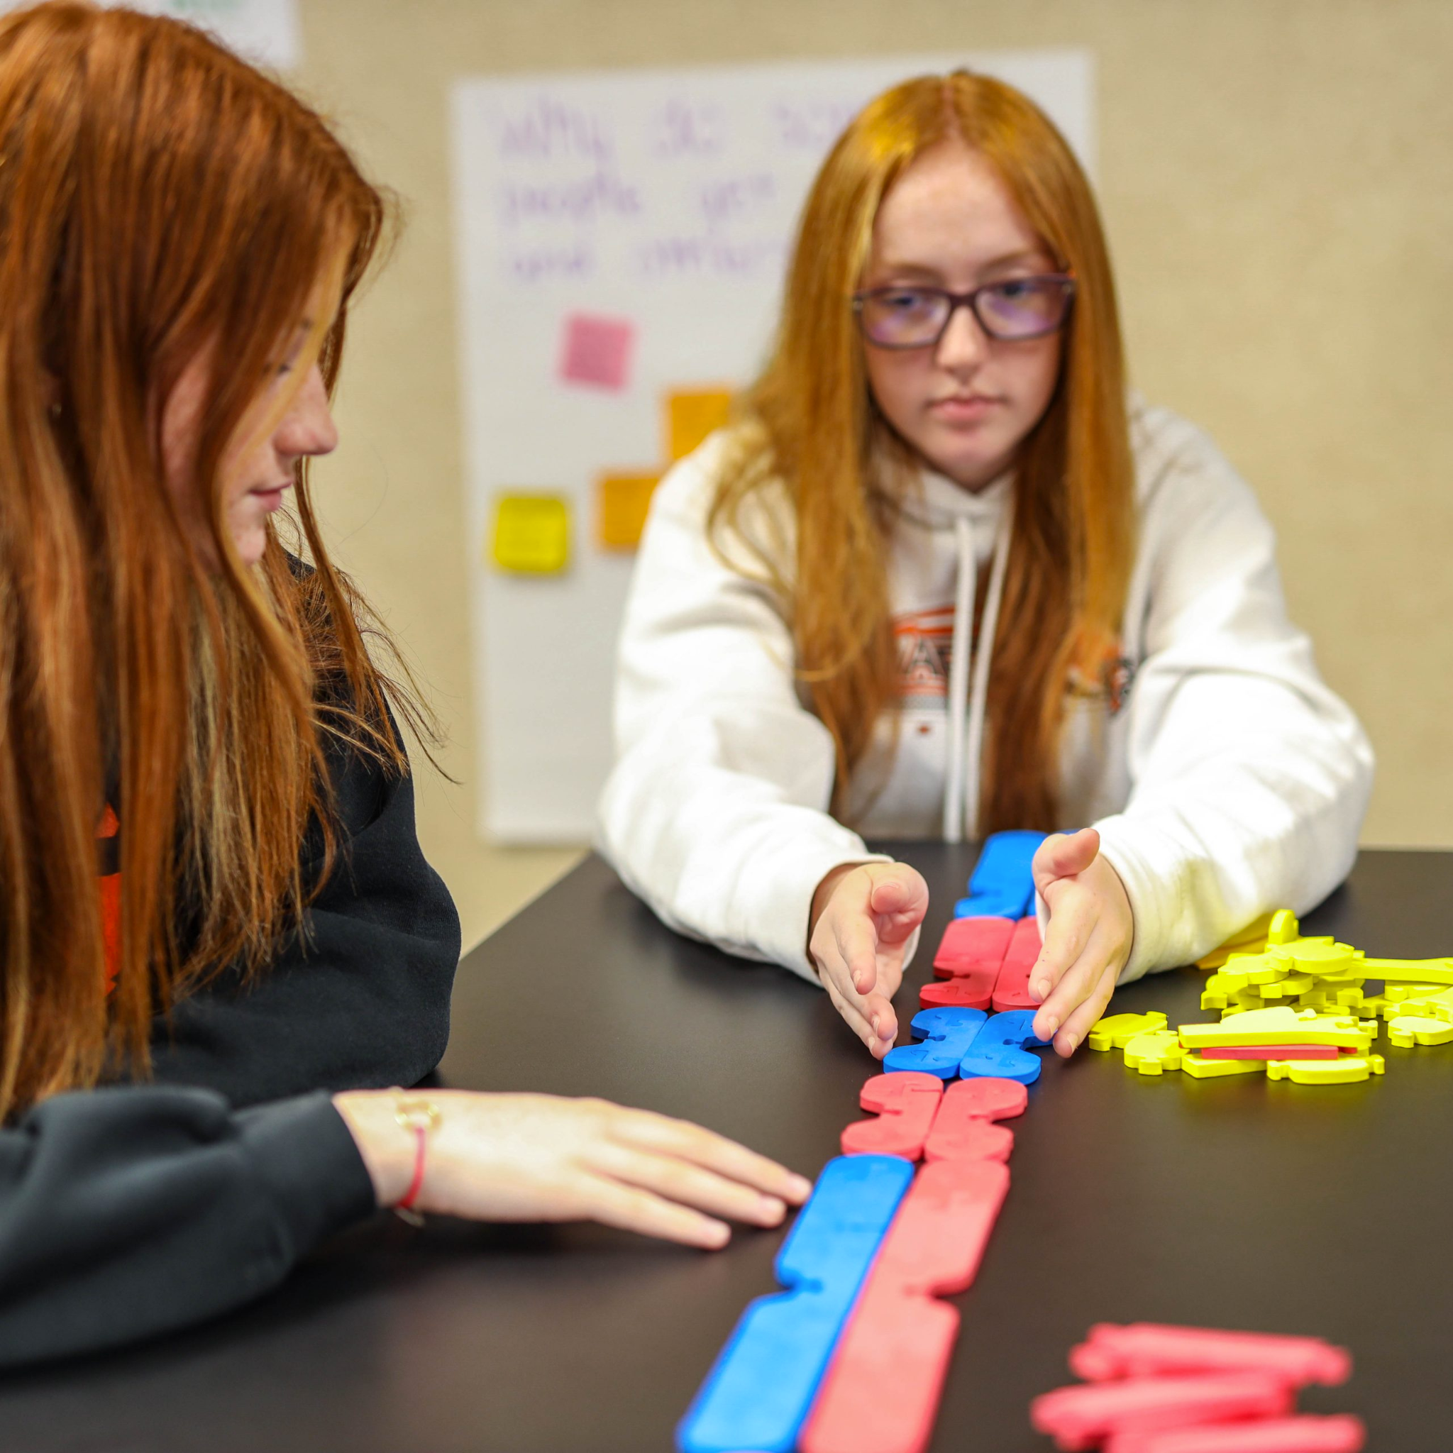
And of course you can still do mitosis and meiosis… But what is different in this picture?

Slide 18
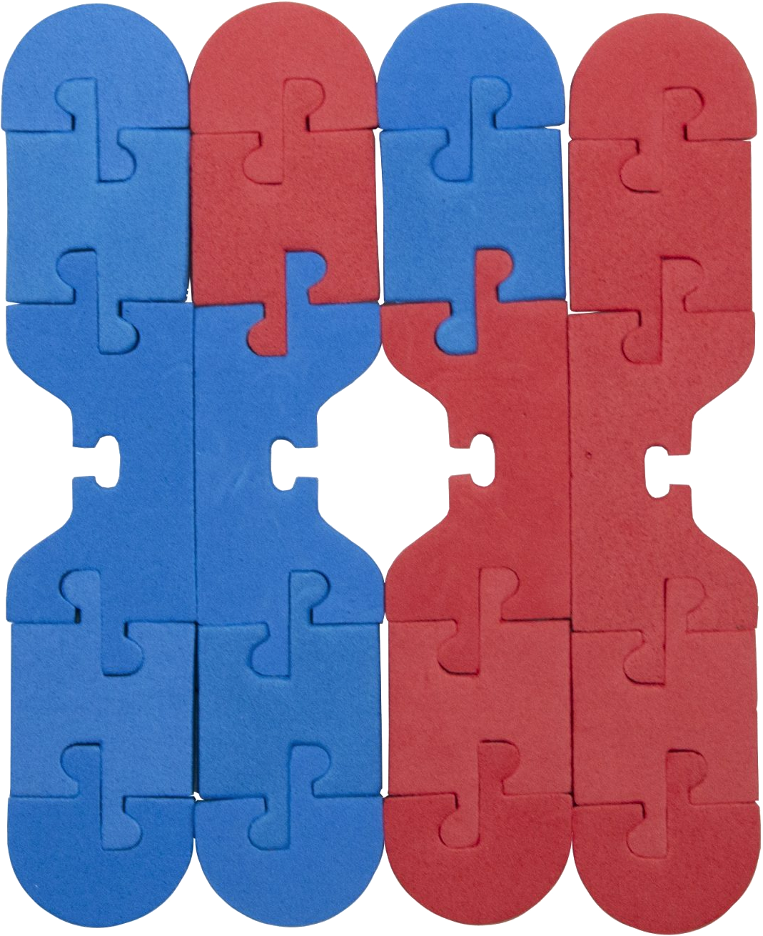
Crossing over… THIS?

Slide 19
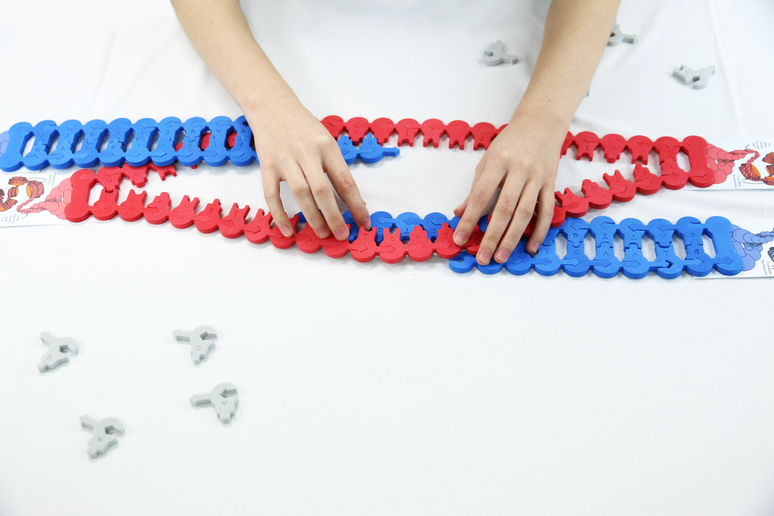
Crossing over… or THIS?

Slide 20
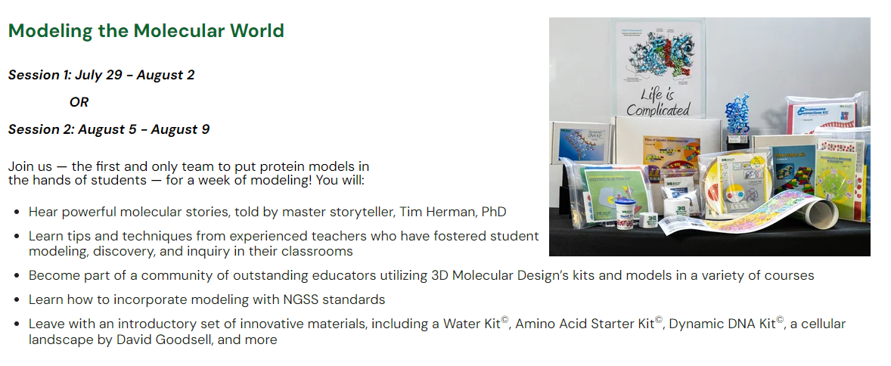

Slide 21

Scan me
Thank you!

