Slide 1
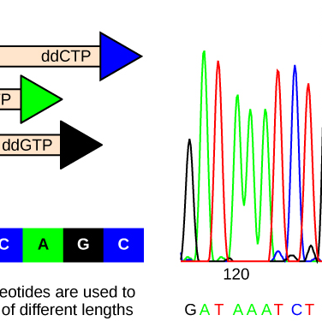
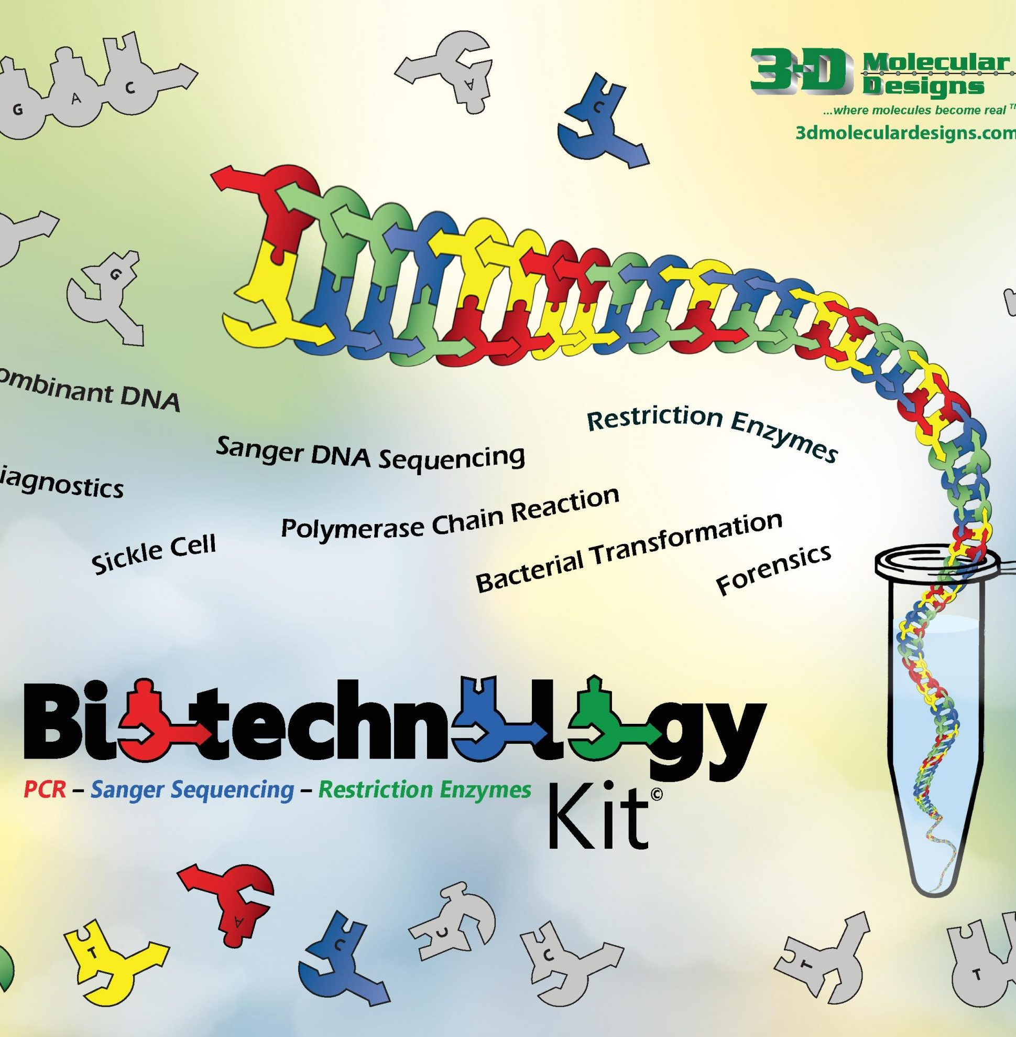
Getting the letters out
Modeling Sanger sequencing
Mark Arnholt
Science Educator
3D Molecular Designs
This Photo by Unknown Author is licensed under CC BY

Slide 2
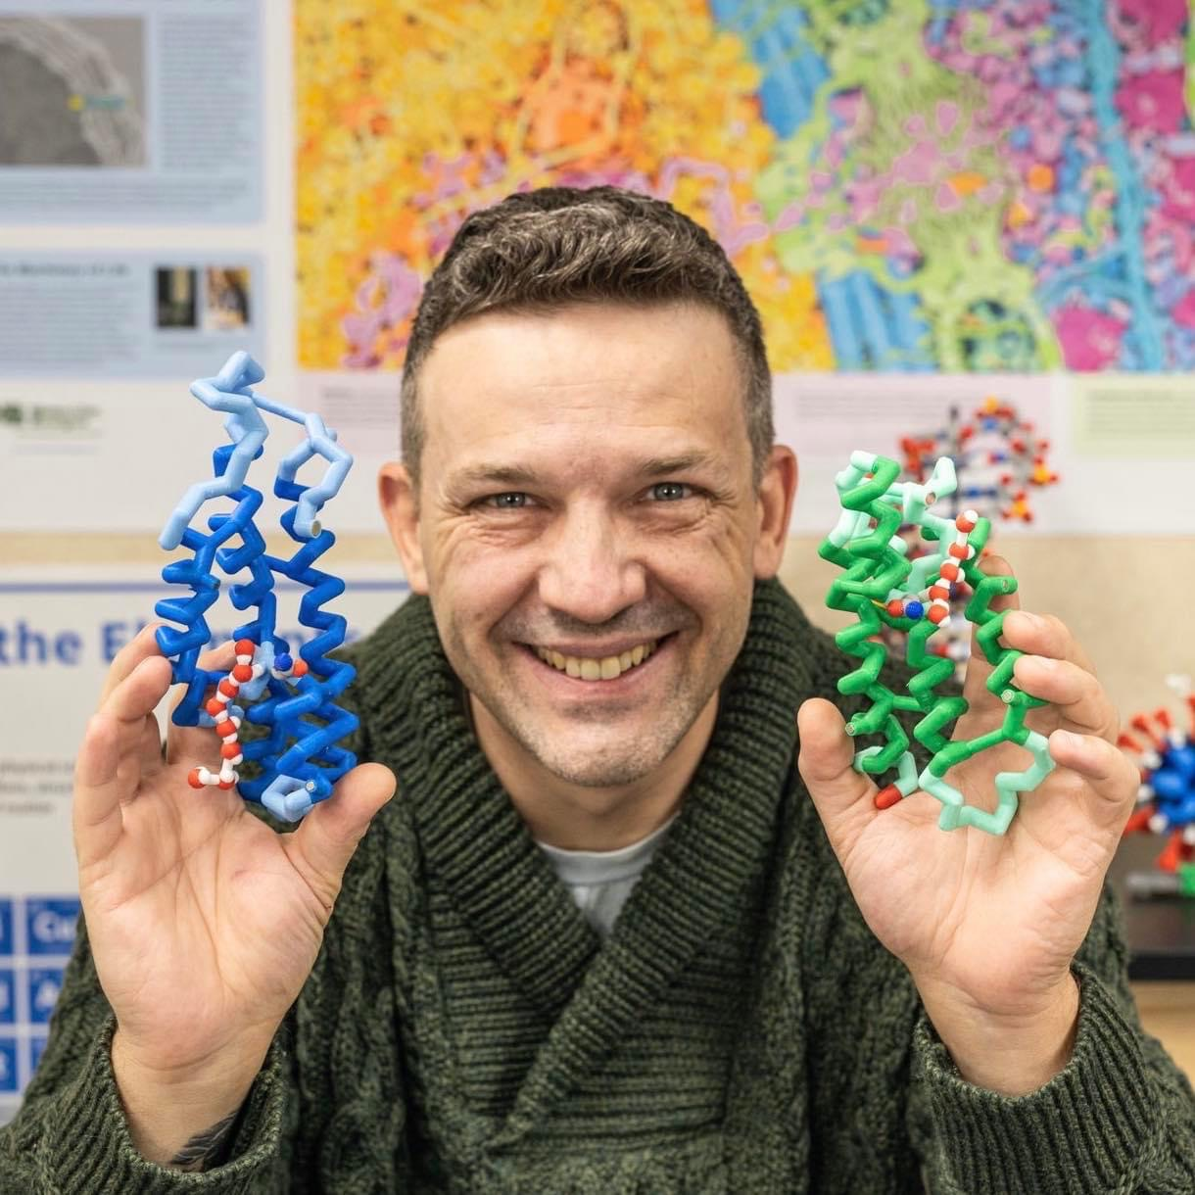

Mark Arnholt
Science Educator
SMART Team Coordinator
3D Molecular Designs
Milwaukee, WI mark.arnholt@3dmoleculardesigns.com
24 years of classroom experience
PLTW BMS Certified (PBS, MI, BI)
Cohort Biology
General Biology (9-10)
Anatomy and Physiology
Biotechnology, Bacteriology, and Genetics
Physical Science(9)
Aviation
After school activities
New Teacher Mentor
SMART team advisor
Wrestling coach
Fishing club advisor
Awards:
Outstanding Science Educator - University of Minnesota – Twin Cities
2014
Educator of the year HUHS
2015
Herb Kohl Fellowship Grant
2016

Slide 3
Workshop Learning Goals
1) Understand how DNA replication is completed in vitro
2) Model the use of ddNTPs in genetic sequencing
3) Show how a sequence can be obtained
4) Understand that science is a process
5) Have fun!

Slide 4
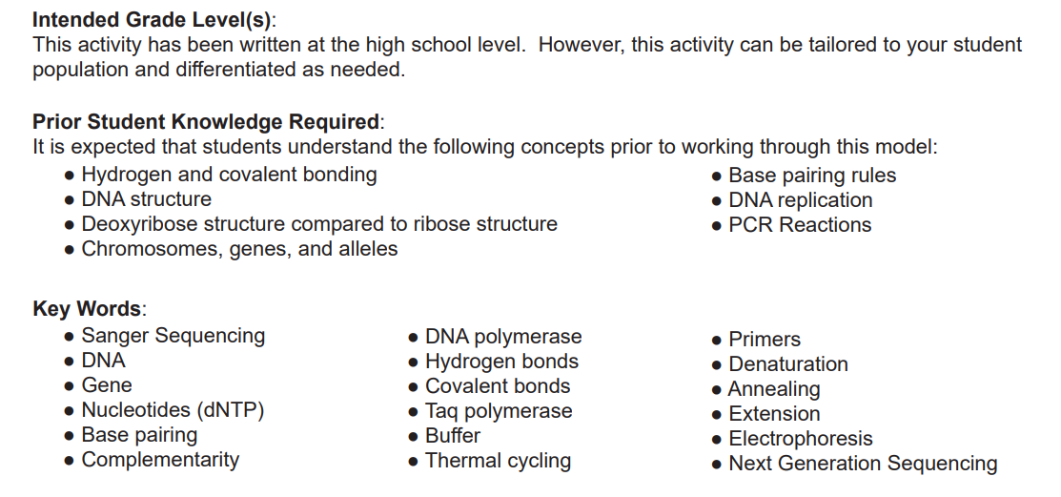

Slide 5
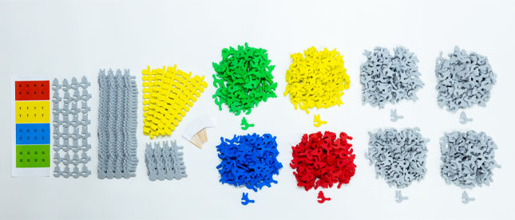
Biotechnology Kit

Slide 6
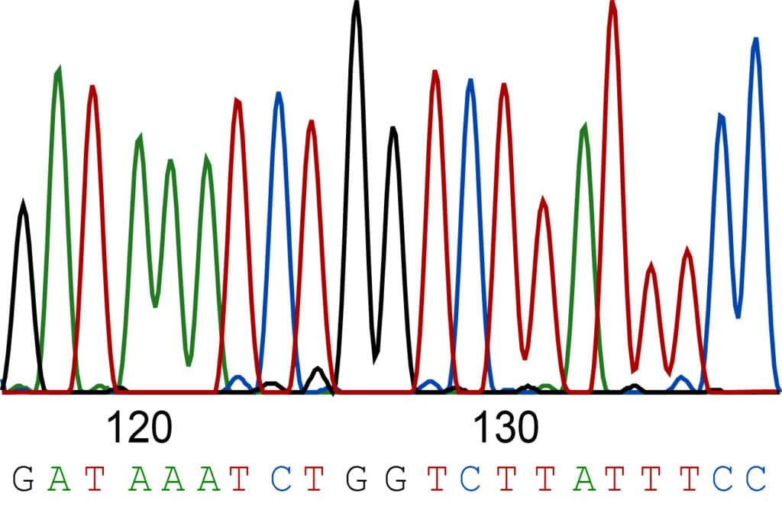
How do we get this data?
Notes:
This is an automated version of Sanger sequencing that uses dyes on ddNTP’s

Slide 7
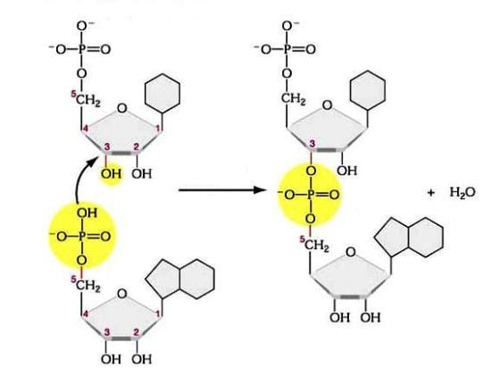
Review of DNA
DNA replication is dependent upon an OH- on the 3’Carbon of Deoxyribose.
Notes:
Phosphodiester bond – Made by adding a dNTP – eliminate a pyrophosphate molecule

Slide 8
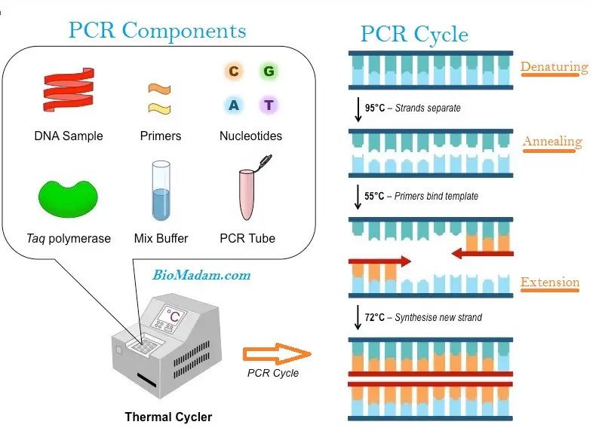
PCR basics
5’
3’
3’ 5’

Slide 9
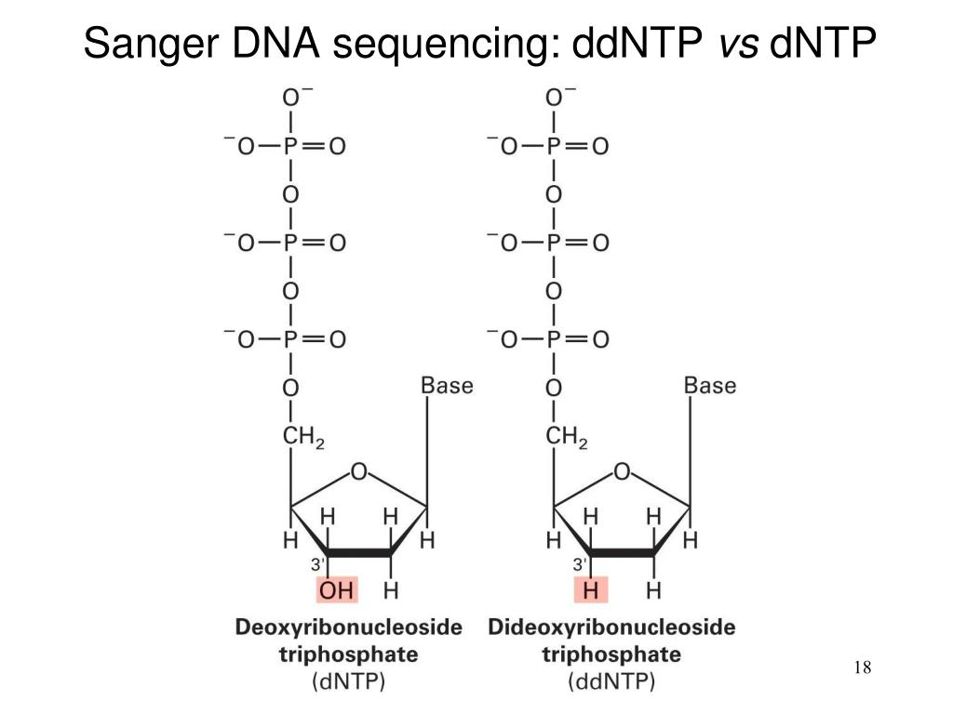
ddNTP’s

Slide 10
Let’s Model!
Grab needed materials
Nucleotide bags
DNA template
Primer Sequences; placed to the side in a stack
2) Using the Unknown Sequence as a guide and following nucleotide base pairing rules:
First add the primer to the 3’ end of the unknown sequence.
Grab one color ddNTP and add it to your nucleotide mix
Then, add free nucleotides to the 5’ end of the primer.
3) When you pull a dideoxynucleotide, ddNTP, where N stands for any one of the nucleotide bases,
then that strand is complete. When you arrive at your ddNTP, look away from your pile and grab
one at random. When your sequence ends with a ddNTP, separate that single strand from
the Unknown Sequence.
4) Repeat this process, starting first with adding a primer to the 3’ end of the Unknown Sequence
and then add nucleotides as you did in step three

Slide 11
Each group is assigned a single ddNTP
The initial protocols for Sanger sequencing required 4 different PCR reactions. All 4 PCR products were run in a gel and the data was pieced together.
We will simulate a gel by taking your individual products and spreading them out on a table. Longest strands at the top, shortest strands at the bottom.
Together, we can determine the genetic sequence for the gene!

Slide 12
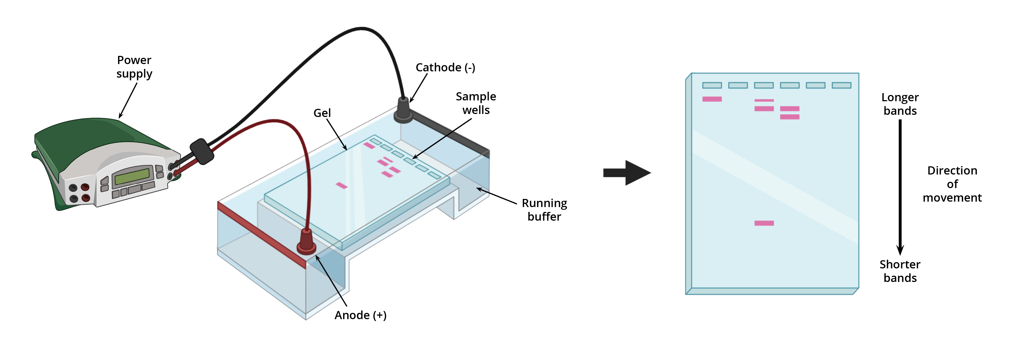
Gel Electrophoresis

Slide 13
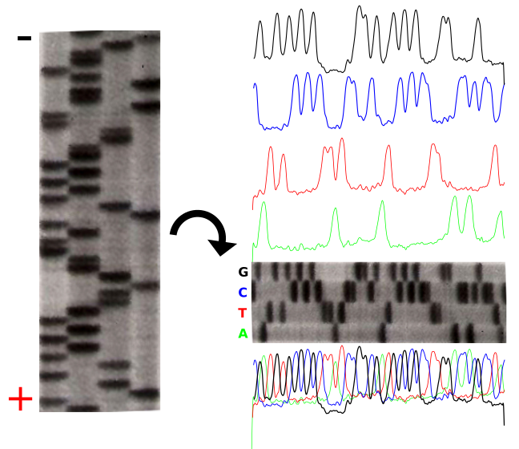
Dyes added to ddNTP’s allow us to visualize

Slide 14
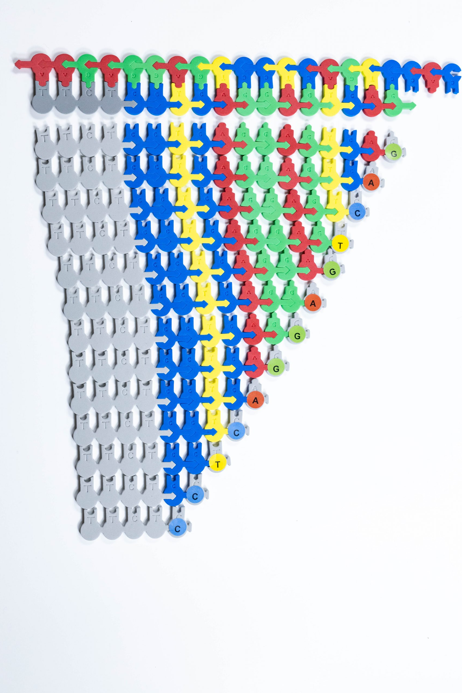
Our end goal…

Slide 15
Workshop NGSS Connections ​
SEPs​ | CCCs​ | DCIs​
Asking Questions​ | Patterns​ | HS-LS1-1​
Developing and Using Models​ | Cause and Effect​ | HS-LS1-2​
Constructing Explanations ​ | ​Scale, Proportion, and Quantity | LS-1A ​
​ | Stability and Change​ | LS-1C ​
​ |  | LS-1D ​

Slide 16
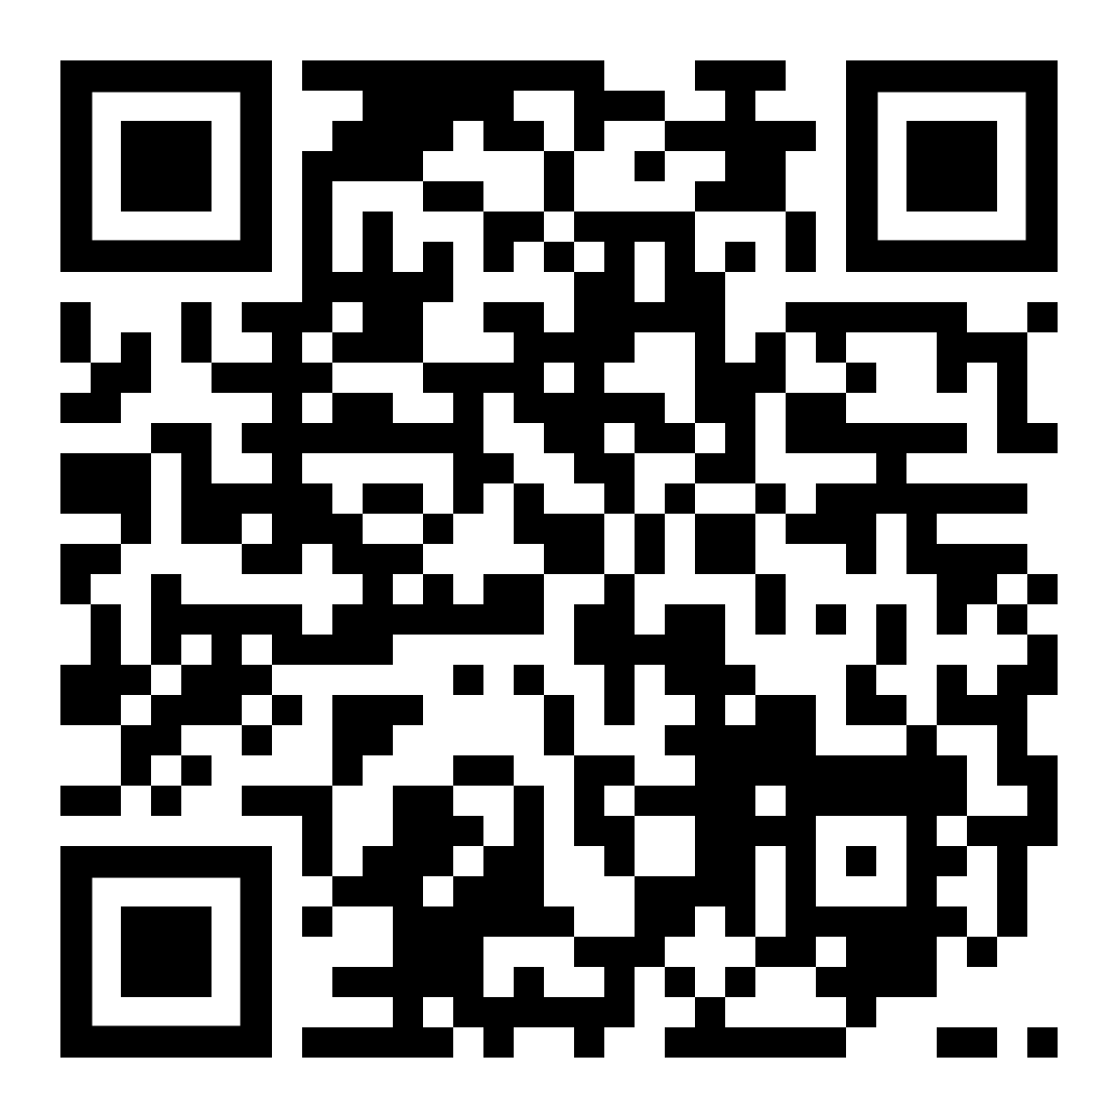
Scan me!

