Slide 1
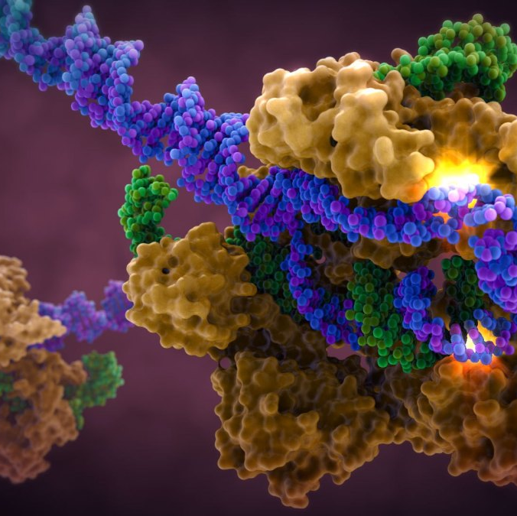
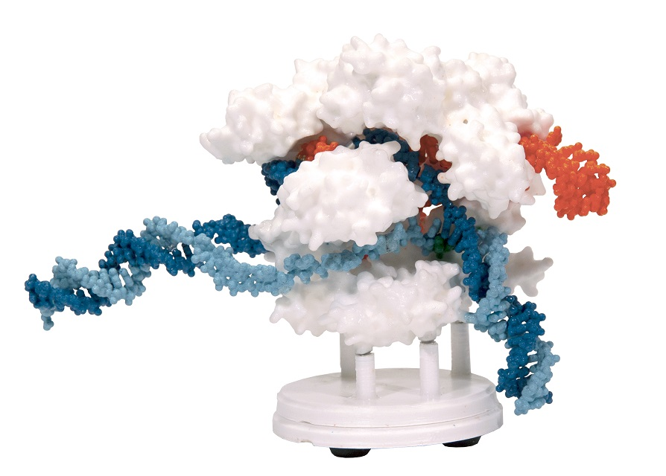
So effective, the viruses stole it!
CRISPR Cas-9 System Structure and function
Mark Arnholt
Science Educator
3D Molecular Designs
This Photo by Unknown Author is licensed under CC BY-NC-ND

Slide 2
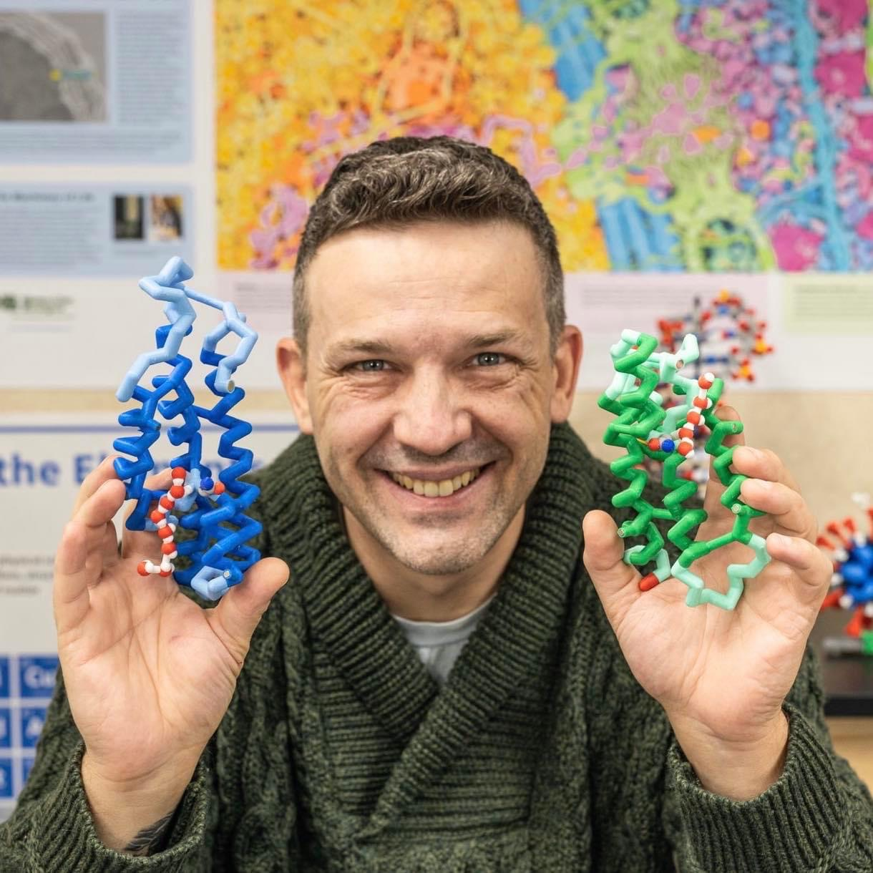

Mark Arnholt
Science Educator
SMART Team Coordinator
3D Molecular Designs
Milwaukee, WI mark.arnholt@3dmoleculardesigns.com
24 years of classroom experience
PLTW BMS Certified (PBS, MI, BI)
Cohort Biology
General Biology (9-10)
Anatomy and Physiology
Physical Science(9)
Aviation
After school activities
New Teacher Mentor
SMART team advisor
Wrestling coach
Fishing club advisor
Awards:
Outstanding Science Educator - University of Minnesota – Twin Cities
2014
Educator of the year HUHS
2015
Herb Kohl Fellowship Grant
2016

Slide 3
Workshop Learning Goals
1) Understand how CRISPR Cas-9 defends a bacterial cell from viral infection
2) Model this acquired immune system in bacteria
3) Determine how it can be used in biotechnology
4) Understand how viruses use CRISPR like systems
5) Have fun!

Slide 4
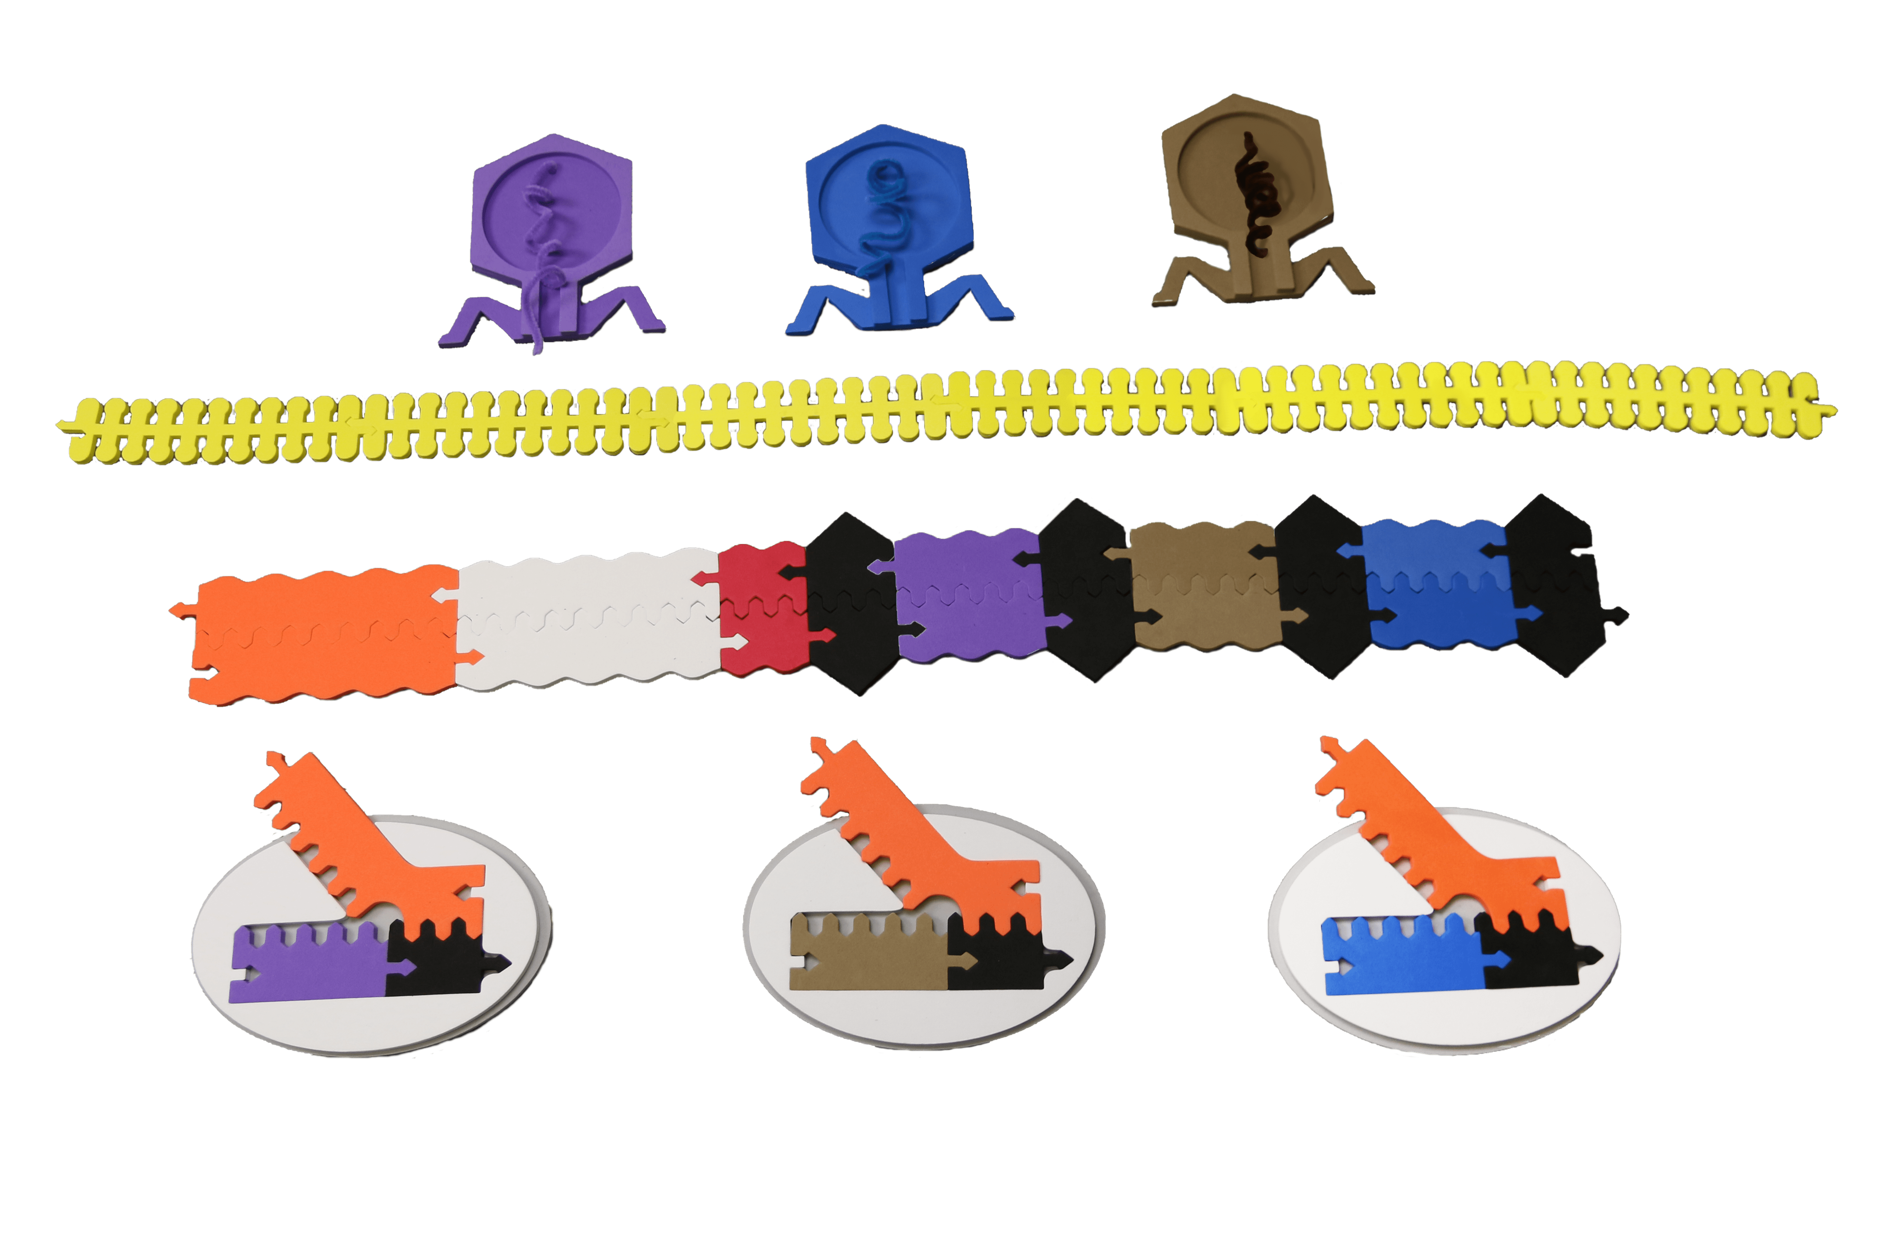
What is CRISPR?
Notes:
Cas-9 surveillance complex protects the cell from viral infection –
Orange – tracrRNA
White – Cas-9 gene – translated in ribosome
Red – Leader
Black – CRISPR
Purple / Tan / Blue – Viral DNA – “Vaccine catalog” -> crRNA

Slide 5
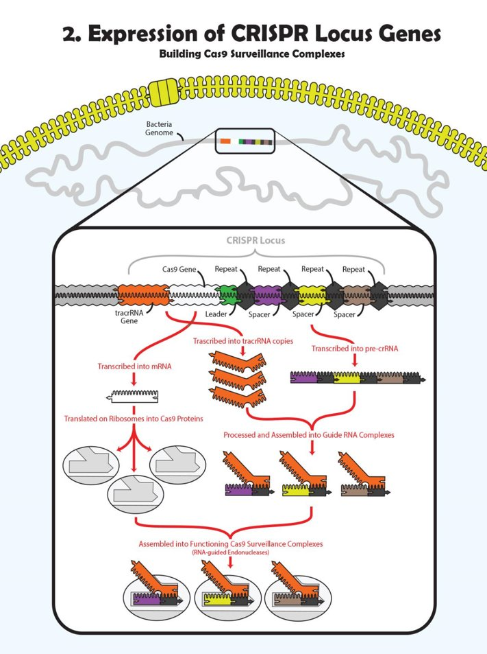

Slide 6
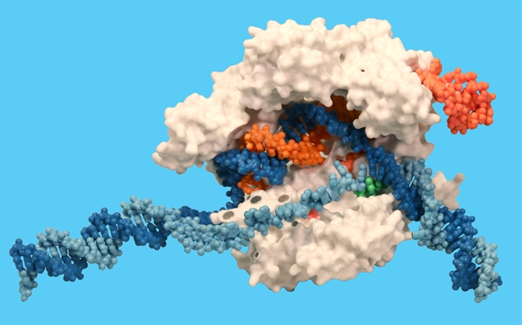
Cas9
tracr RNA
Cas9
Cas9
crRNA
Target DNA strand
Non-Target DNA strand
PAM site

Slide 7
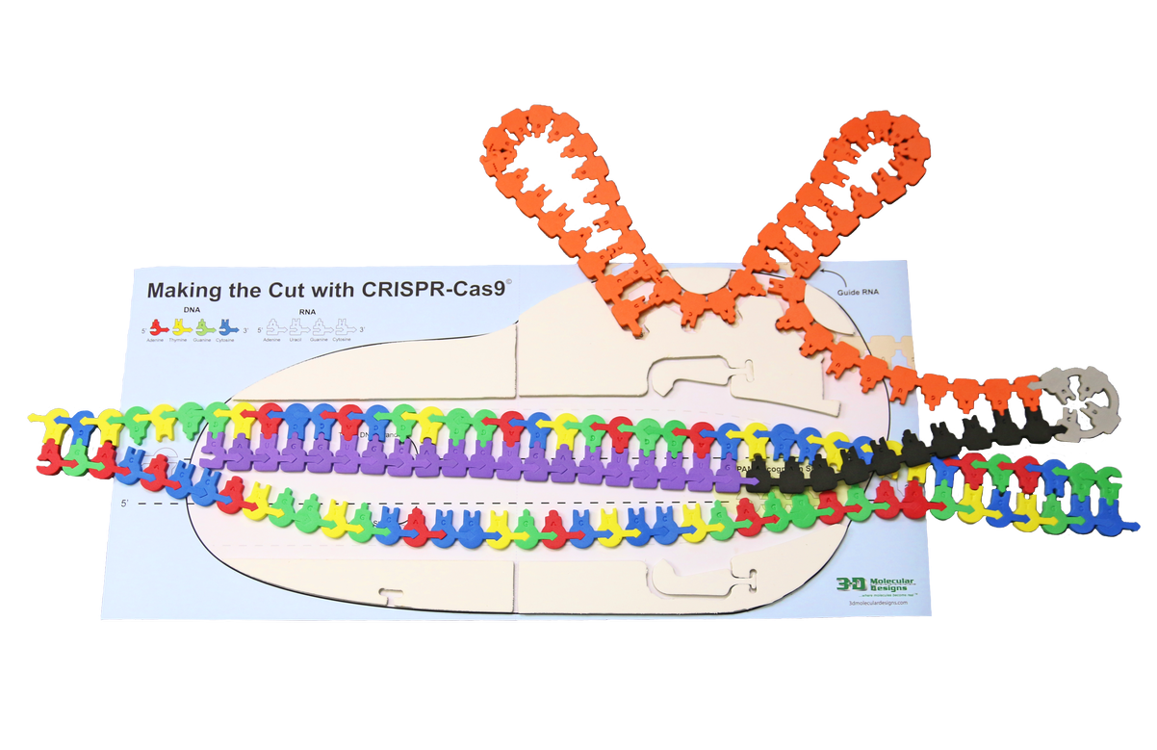
Making the Cut with CRISPR Cas-9

Slide 8
Model transference
tracr RNA
Target DNA strand
crRNA
Non-Target DNA strand
PAM site

Slide 9
Protospacer Adjacent Motif (PAM)
The PAM sequence for Cas-9 is NGG, where N represents any base.
How often would we expect to see this sequence mathematically?
G = ¼
G = ¼
NGG = 1/16
So… statistically, Cas-9 would interrogate DNA every 16 base pairs
Notes:
200,000,000 – Your genome would be a disaster!

Slide 10
Let’s Model!
What happens inside a bacterial cell when it gets infected by a virus-
1) Cas-9 complex finds free floating DNA in the cytoplasm of the cell
2) Cas-9 interrogates DNA after identifying a PAM sequence
3) If DNA matches the crRNA, endonucleases activity makes a double stranded break

Slide 11
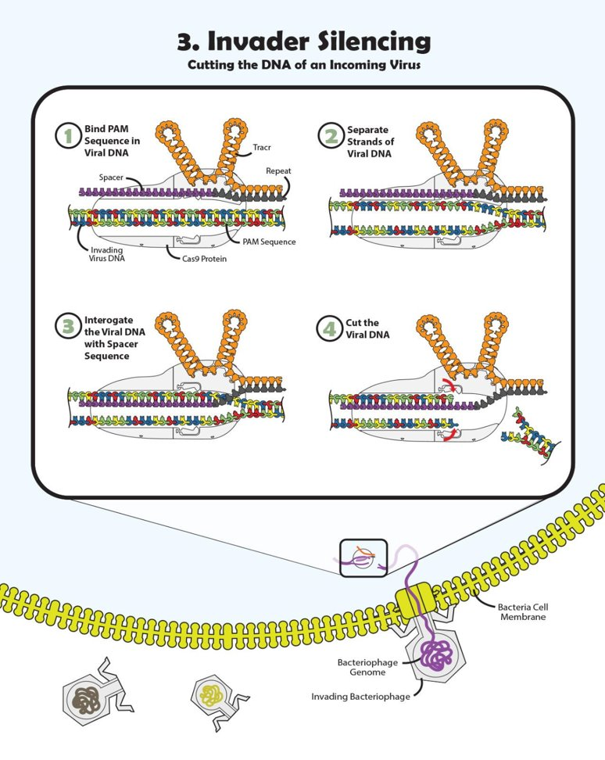

Slide 12
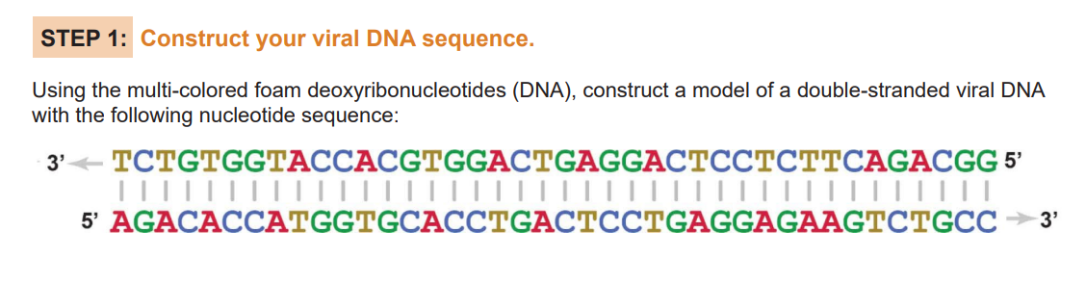

Slide 13
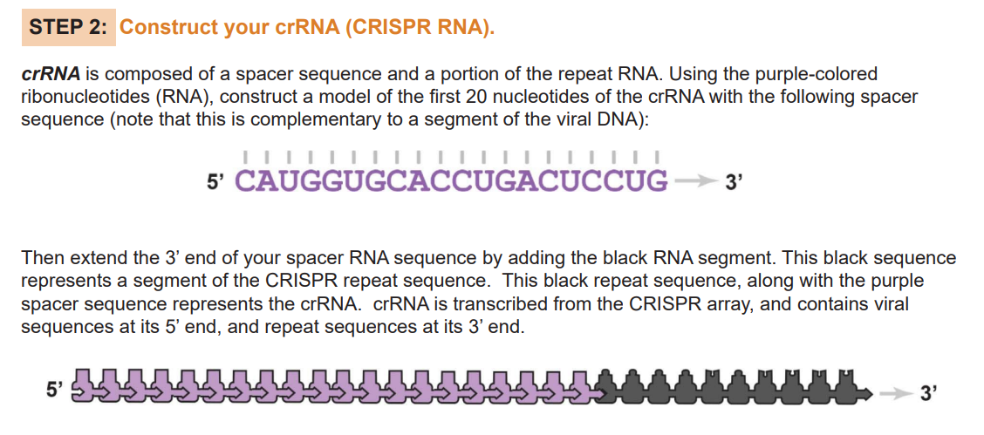

Slide 14
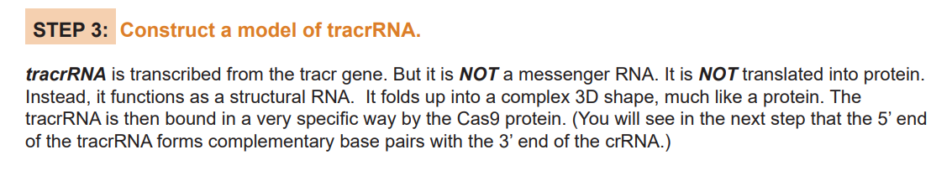
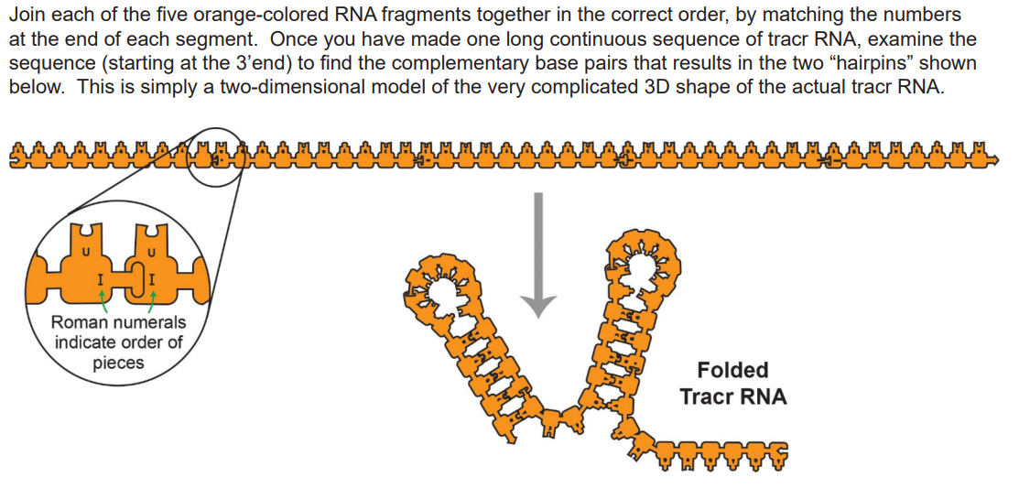

Slide 15
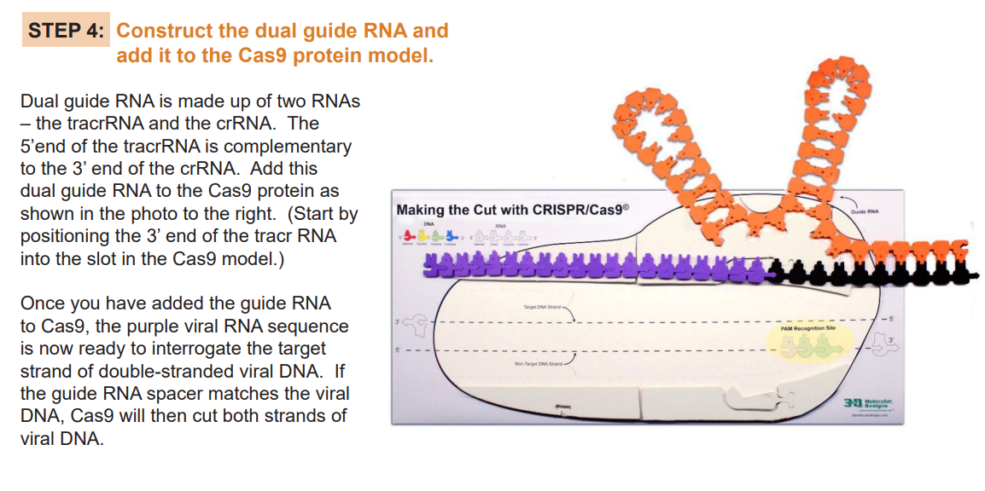

Slide 16
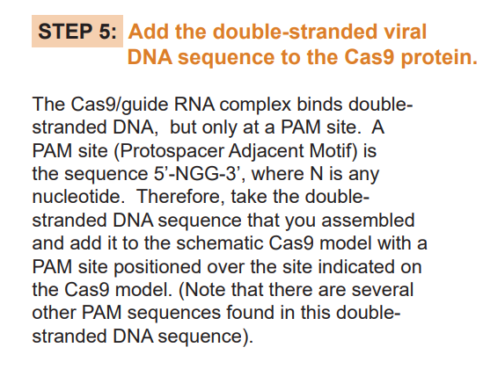
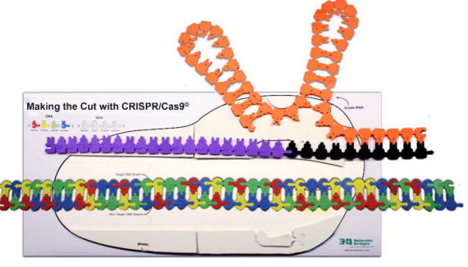

Slide 17
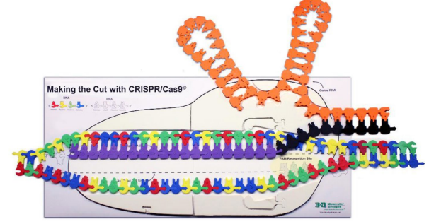
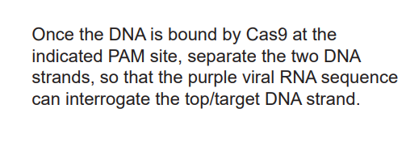

Slide 18
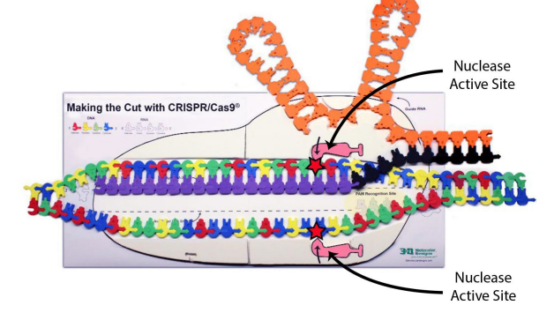
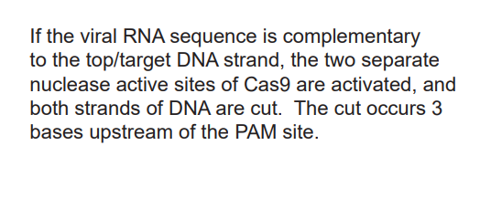

Slide 19
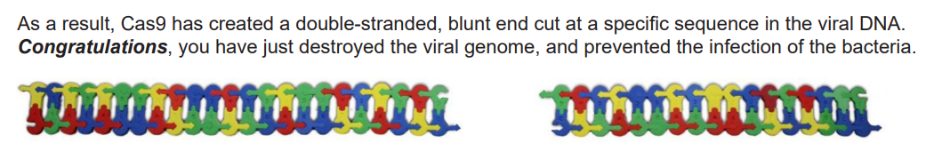
So what?

Slide 20
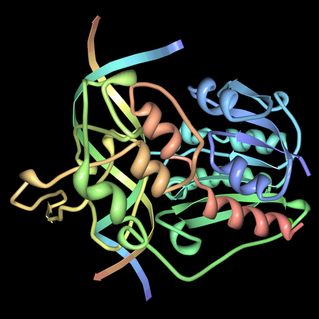
Restriction enzymes
Hae III is an endonuclease that digests DNA at
5’ GG/ CC 3’
3’ CC/ GG 5’
We could use this for a gene knock out – turning a gene off.
… but …
¼ x ¼ x ¼ x ¼ = 1/256
Statistically… 3.2 billion base pairs would be cut into 12.5 million fragments!
This would be ideal if your goal was to turn off ALL OF THE GENES!

Slide 21
Edit the genome?
Cas-9 gives us a highly specific DNA targeting system – All we need to do is write the RNA guide sequence!
What makes this so powerful? I can target a ~20 bp sequence out of 3.2 billion!
For perspective:
One line of genetic code – Times New Roman – 12 font
AATCCCGTGGGGTTTCTTTTTATCTAAATCTTTATTACTTTATTTTCGGGGTATTTATTCTGTTTTAACTTGCACATTTATCTGAATTTGCGGGGGGGATCTTCTAT
2,502 bp on an 8.5” x 11” sheet of paper, one side = 5004 on both sides
The human genome would be a book 639,489 pages long.
500 sheets of high-quality paper is 2.5” (unbound)
(639,489 pages / 500 sheets) * 2.5” = ” / 12” = 266.5 feet thick
In Football Terms…
Our epic genome book on its side would go from our goal line to the opposing teams almost 11-yard line.
(88.8 yards)
This programed machine will find the ATGCTTGGCTAAGTCCACGT sequence on p. 434,473

Slide 22
Guide RNA
CRISPR systems use 17-24 RNA base pairs to interrogate the target strand after identifying the PAM sequence.
How many base pairs would we need to find a statistically unique sequence in the human genome? (3.2 billion base pairs)
That’s ¼ to the 16th power… or 1 / 4,300,000,000
... and it still hits off target…
How is that possible?

Slide 23
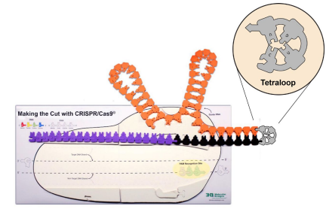
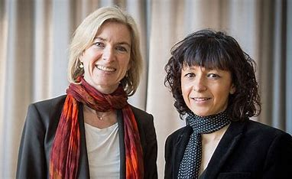
Doudna and Charpentier
The 2020 Nobel Prize in Chemistry was awarded to Jennifer Doudna and Emmanuelle Charpentier for their work on the Tetraloop which allows for a programable Cas-9 protein by making the tracrRNA and crRNA a long single strand

Slide 24
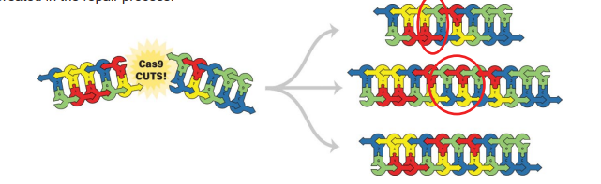
DNA with a double stranded break (DSB)
In your genome, a DSB is … well… bad. Real bad!
Your body has 2 ways to repair a DSB
Non-Homologous End-Joining (NHEJ)
Very error prone – repair the break at all costs, even if it introduces some mistakes
*Knock-out

Slide 25
Homology Directed Repair (HDR)
Broken DNA is repaired using a template-
It’s complicated
The short of it-
Template DNA matches up with broken strand 3’ sticky end - enzymes make a single strand until it matches the other side – Other enzymes ligate and duplicate other strand - *see video

Slide 26
Base editing
Researchers are now using CRISPR in very clever ways
David Liu -> Cas-9 directed base editing
Use Cas-9 to direct base editors to an exact location
C -> T by Cytidine deaminase tethered to Cas-9
Nick the non-edited strand – marked for repair.
“Fix” a single nucleotide polymorphism from C-G base pair to a T-A – accounts for ~14% of SNP pathology

Slide 27
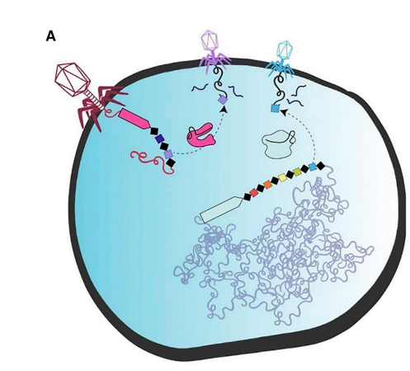
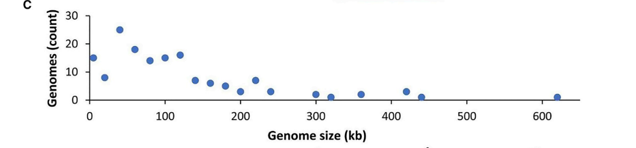
Viruses using CRISPR like proteins?
A study conducted on viral genomes indicate that many viruses have different CRISPR like systems.
These CRISPR like systems are used to gain a monopoly on cellular resources by preventing other viruses from infecting the cell
Researchers are currently investigating these smaller CRISPR like proteins for potentially editing “difficult to edit“ cells

Slide 28
Additional resources
A Programable dual-RNA-guided DNA Endonuclease in adaptive bacterial immunity
Jinek M, Chylinski K, Fonfara I, Hauer M, Doudna JA, Charpentier E. A programmable dual-RNA-guided DNA endonuclease in adaptive bacterial immunity. Science. 2012 Aug 17;337(6096):816-21. doi: 10.1126/science.1225829. Epub 2012 Jun 28. PMID: 22745249; PMCID: PMC6286148.
Diverse virus-encoded CRISPR-Cas systems include streamlined genome editors (cell.com)
Al-Shayeb, B., Skopintsev, P., Soczek, K. M., Stahl, E. C., Li, Z., Groover, E., . . . Doudna, J. A. (2022). Diverse virus-encoded CRISPR-CAS systems include streamlined genome editors. Cell, 185(24). doi:10.1016/j.cell.2022.10.020
HDR – Video
NHEJ video
David Liu – Can we cure genetic diseases by rewriting DNA? (Ted Talk)

Slide 29
Workshop NGSS Connections ​
SEPs​ | CCCs​ | DCIs​
Asking Questions​ | Patterns​ | HS-LS1-1​
Developing and Using Models​ | Cause and Effect​ | HS-LS1-2​
Constructing Explanations ​ | ​Scale, Proportion, and Quantity | LS-1A ​
​ | Stability and Change​ | LS-1C ​
​ |  | LS-1D ​

Slide 30

Scan me!

