Slide 1
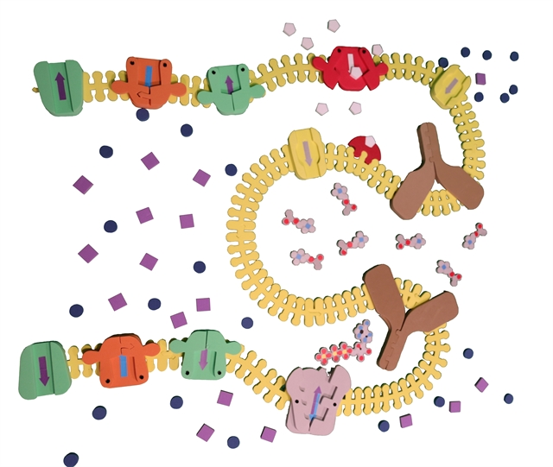
Hands on Modeling
Cell Synapse
Tanya Monet-Bakken

Slide 2
Hands on Modeling
Cell Synapse
Tanya Monet-Bakken

Slide 3
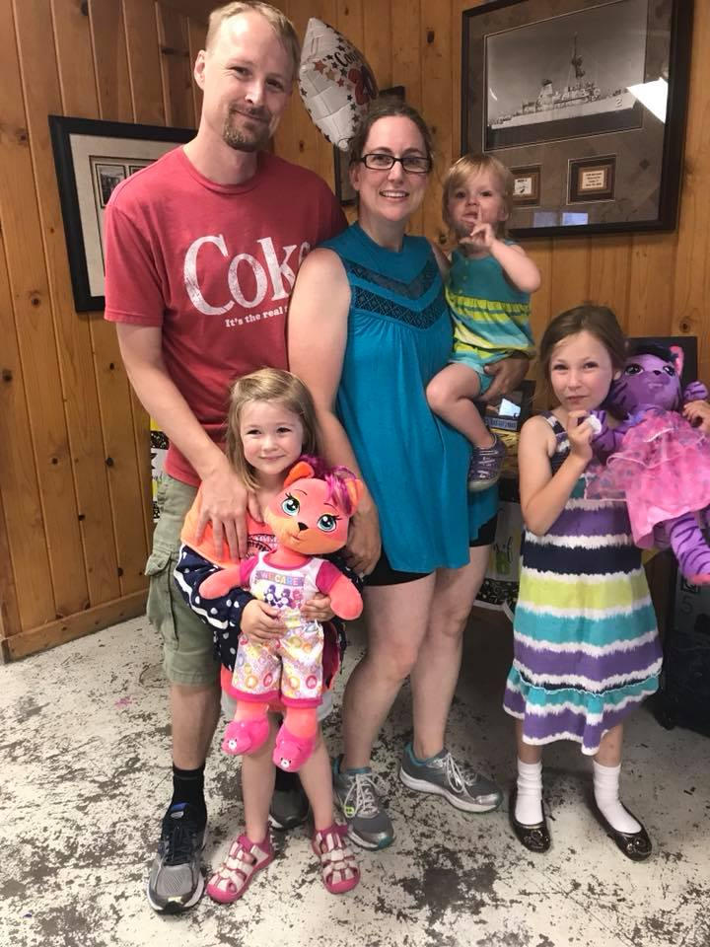
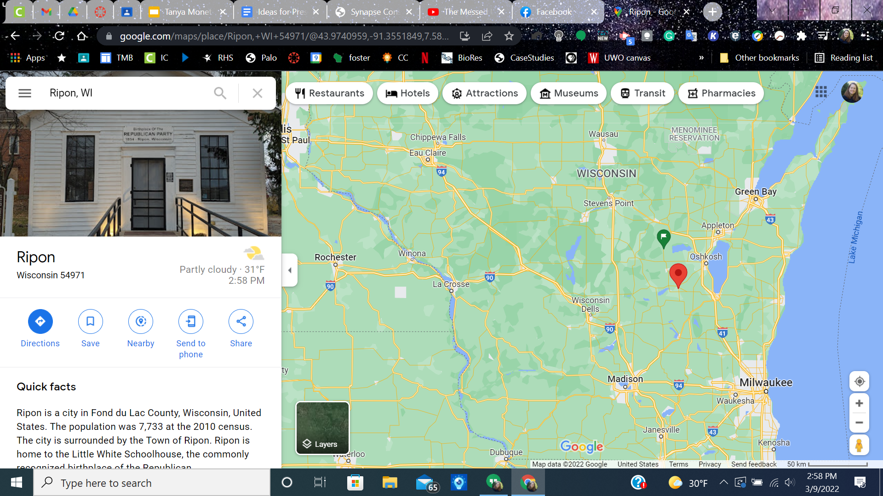
A little about me-Tanya Monet-Bakken
20 years teaching high school life science
Currently at Ripon High School
Sophomore biology
CAPP Bio 105
CAPP Bio 104
Genetics
Anatomy/Physiology

Slide 4
My Background
BS in Biology Education from UW-Eau Claire 2003
Starting teaching with transparencies and textbooks.
MS in Environmental Science in 2007
Moved away from textbook teaching to digital and hands on models (slow transition).
Switched school districts in 2014-no more textbooks, one:one with chromebooks.
Attended Modeling in the Molecular World in 2018-fell in love with products
Grant money to buy lots of models:)
Started the shift to skills based grading in 2020
CRISPR cohort 3 through 3D Molecular Designs
Bought even more models

Slide 5
Workshop Learning Goals
Become familiar with resources at 3D Molecular Designs.
Become familiar with using Cell Synapse kit.
Visualize how the Cell Synapse kit can enhance your curriculum.

Slide 6
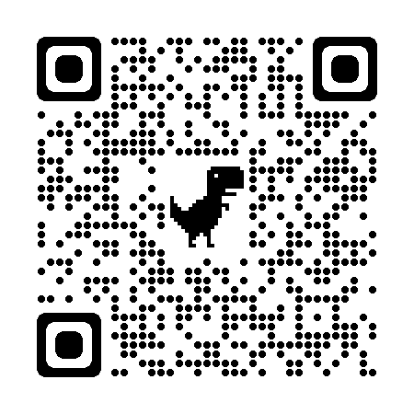
Navigate the site and see how many wonderful resource exist.

Slide 7
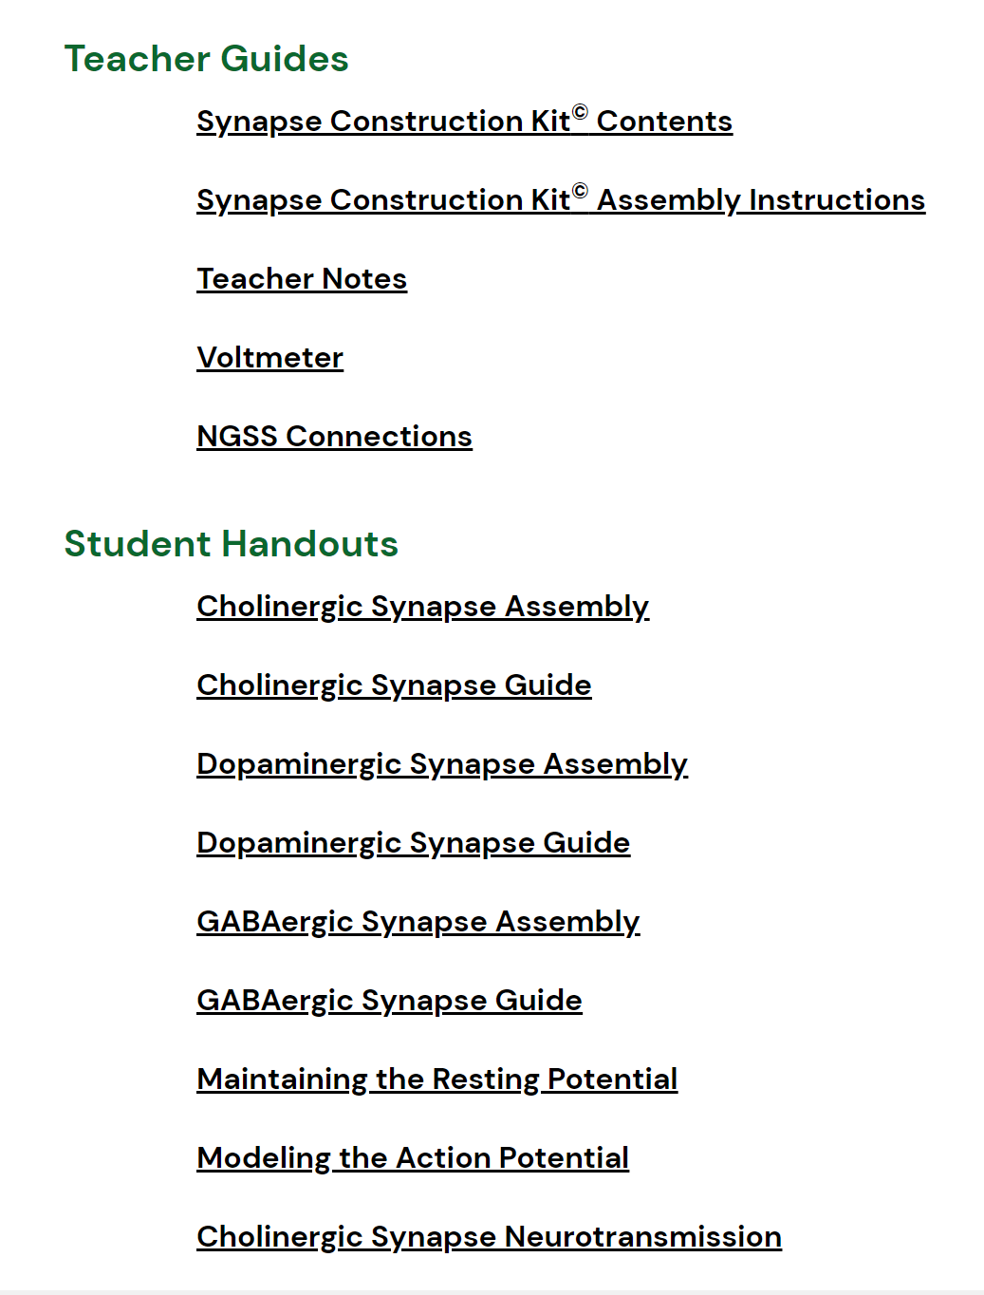
Synapse Construction Kit©

Slide 8
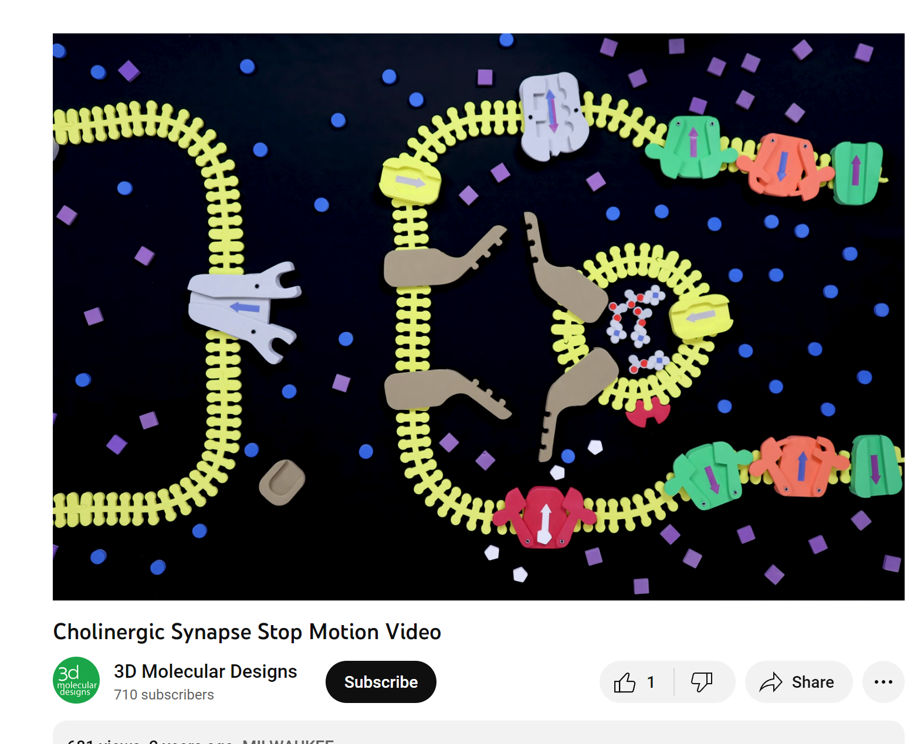
Stop Motion video

Slide 9
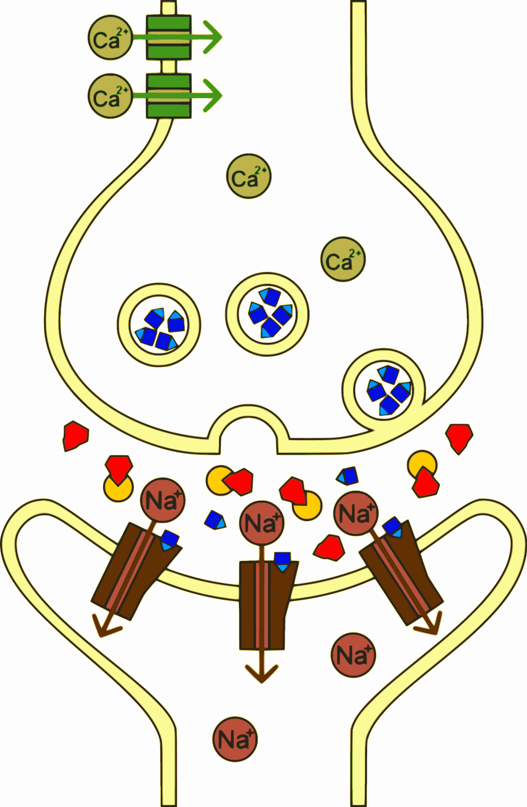
Background on this topic
Before going into the sliding filament theory, we start with neuromuscular junction.
Students should be familiar with:
vesicles, exocytosis, protein channels, receptor proteins, diffusion
https://upload.wikimedia.org/wikipedia/commons/b/b8/Sarin_Biological_effects.svg

Slide 10
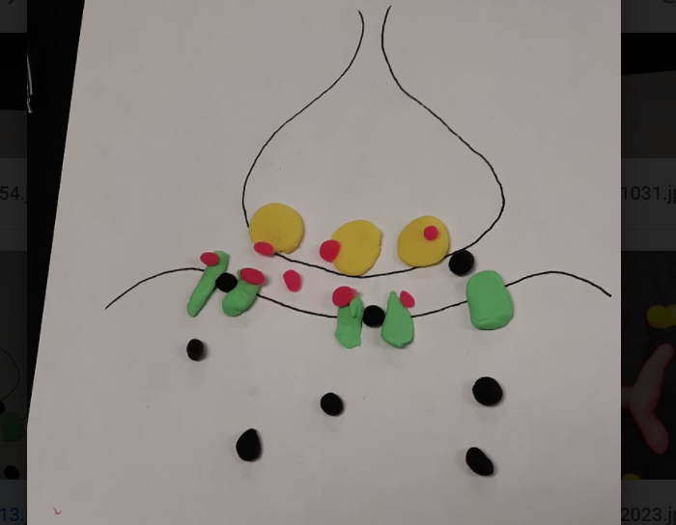
I have my students use playdough to do a “stop animation” of what happens at the neuromuscular junction.

Slide 11
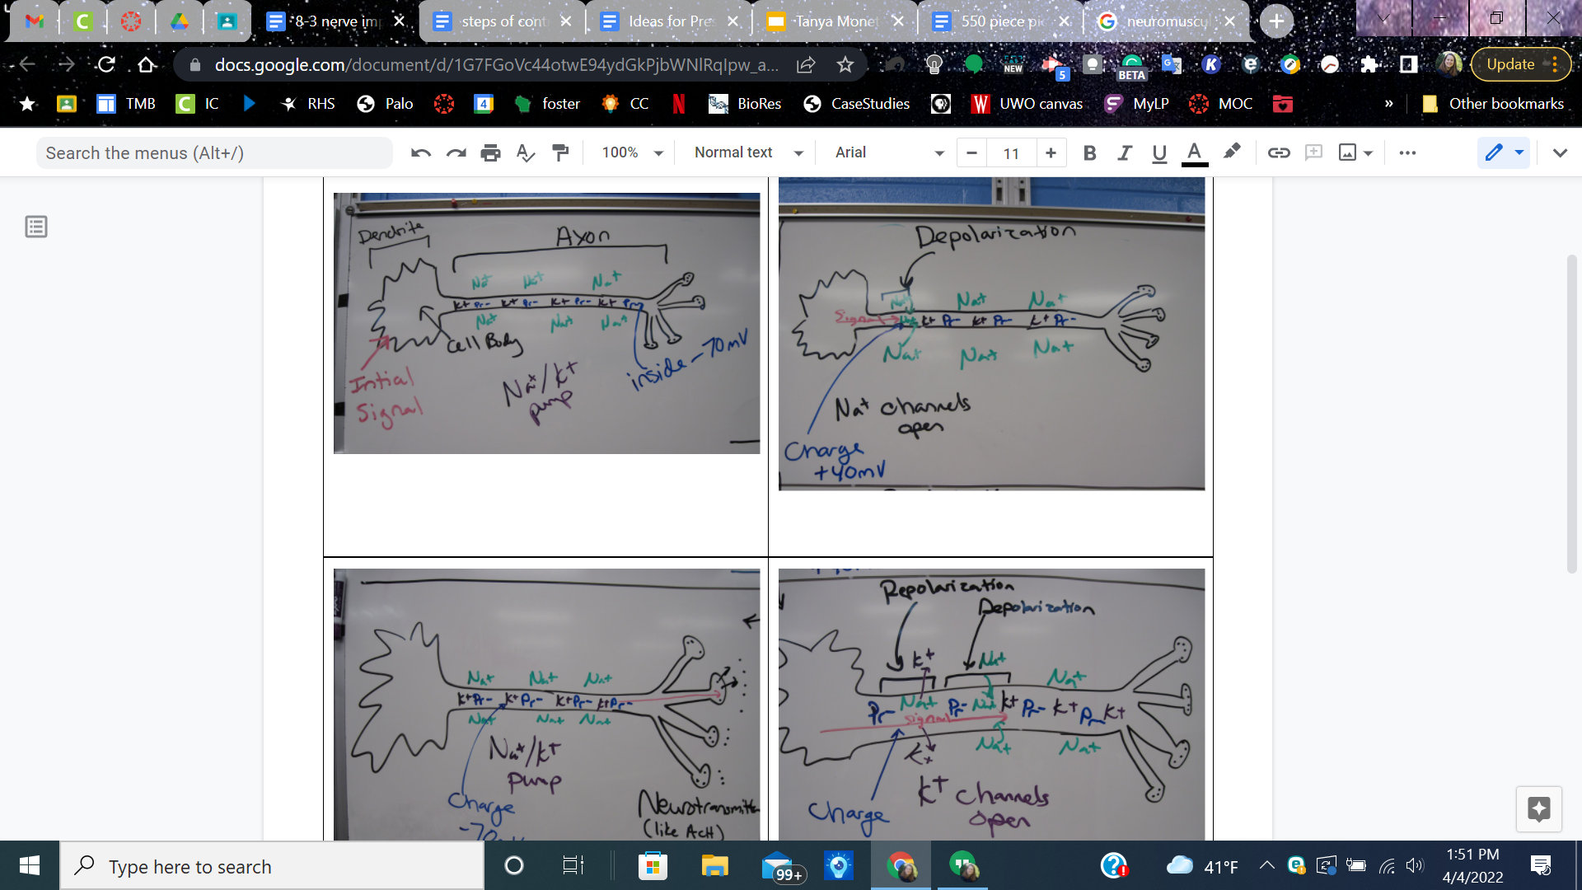
I have my students sketch out (comic book style) nerve propagation.

Slide 12
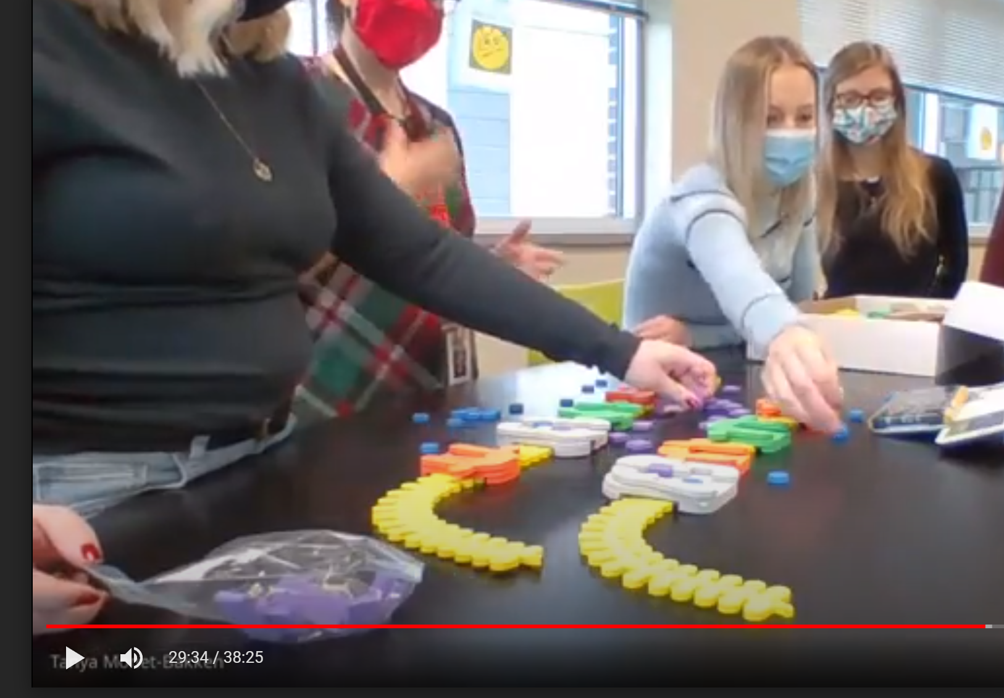
Evidence of use of the kit
Video of kit being used in my room. FF to 29:30
Students are reinforcing their knowledge on how nerve send a signal.

Slide 13
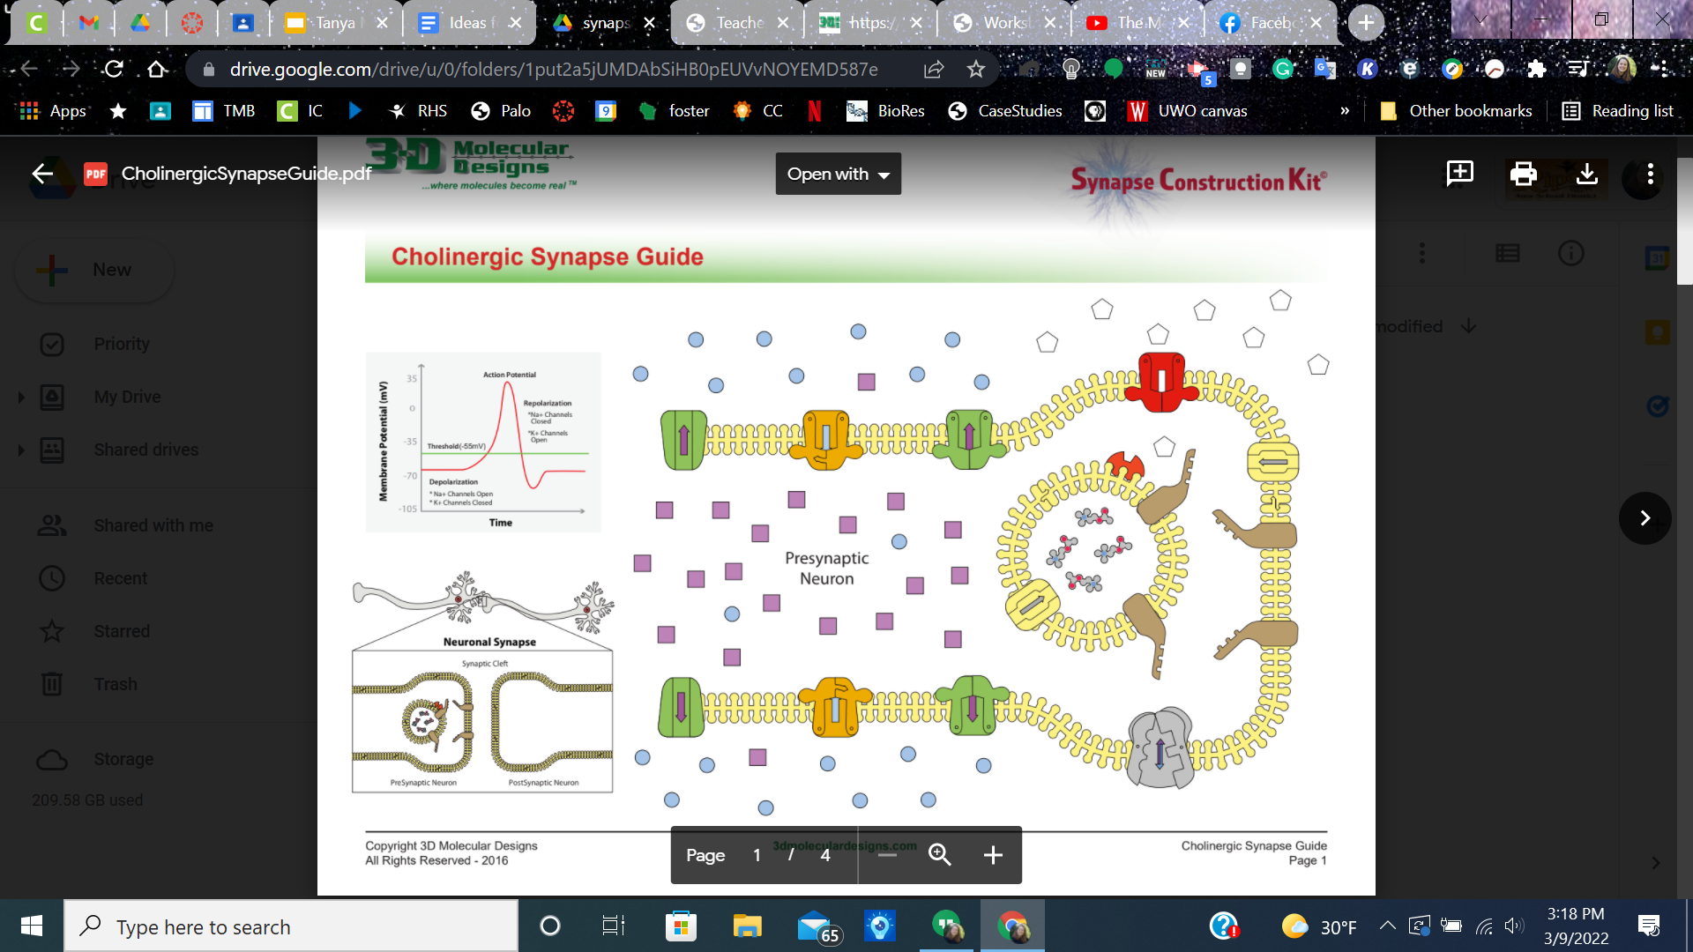
Try the kit out, work in groups to set up the kits and explore:)

Slide 14
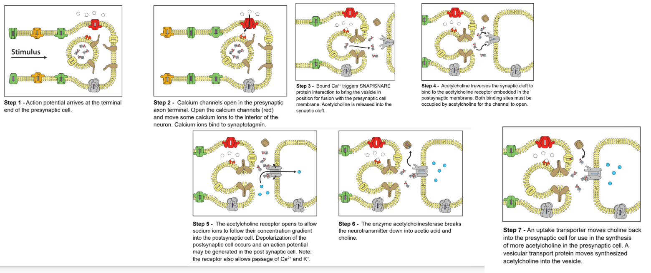
Step by step instructions

Slide 15
Another option, give students the general setup. Have them explain the parts and infer what happens.

Slide 16
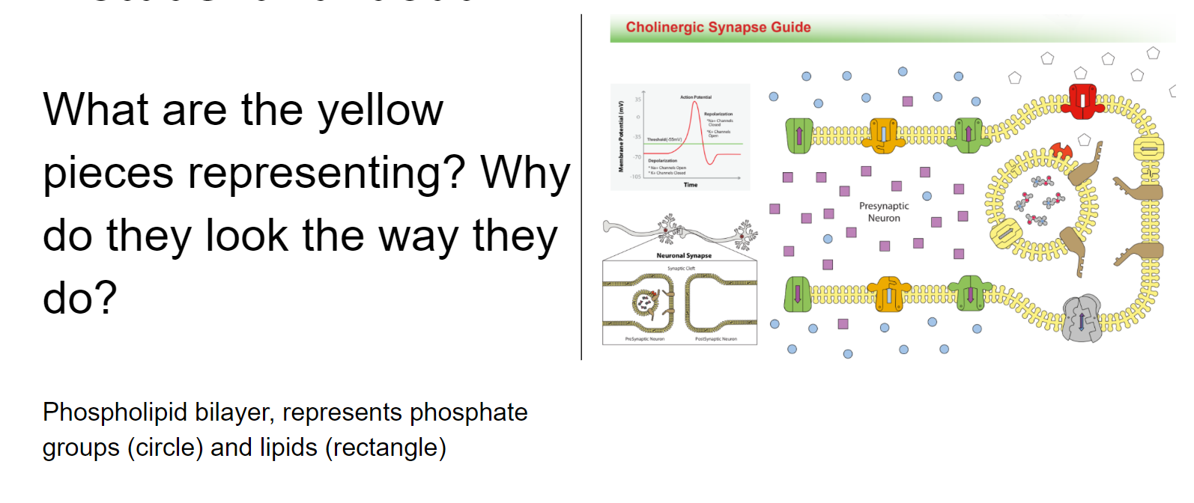
Asking questions

Slide 17
Recall what can go through a phospholipid bilayer?
Small, nonpolar molecules

Slide 18
Why is it important that both cell membranes and the vesicle membrane are made of these same molecules?
So they can blend into each other.

Slide 19
What do the arrows represent on the different colored pieces? (color and direction)
Color for the type of molecule they allow through, direction for direction of movement.
Blue=Sodium
Purple=potassium
White=calcium

Slide 20
Think back to what we learned about nerve transmission, which of the protein channels are always functioning and which need to be triggered?
Sodium/Potassium pump (double arrow) is always working.
Calcium, Sodium channels and potassium channels need to be stimulated.

Slide 21
What is the importance of calcium?
Calcium triggers the vesicle to attach and release AcH

Slide 22
Why are some channel proteins always open?
Leak channels

Slide 23
How is this related to how the AcH gets in (or back in) the vesicle?
There are AcH leak channels in both the cell membrane and vesicle membrane.

Slide 24
How could you see using this kit in your classroom? Chat with your neighbors, then we will share out.
Biology class? Ecology? Anatomy systems? Genetics? Biochemistry?

Slide 25
Table tasks, you will each get an example of how to expand this kit, make it at your table then we will gallery walk:) Feel free to make it your own, the ideas given are just an option of how to use the kit.

Slide 26
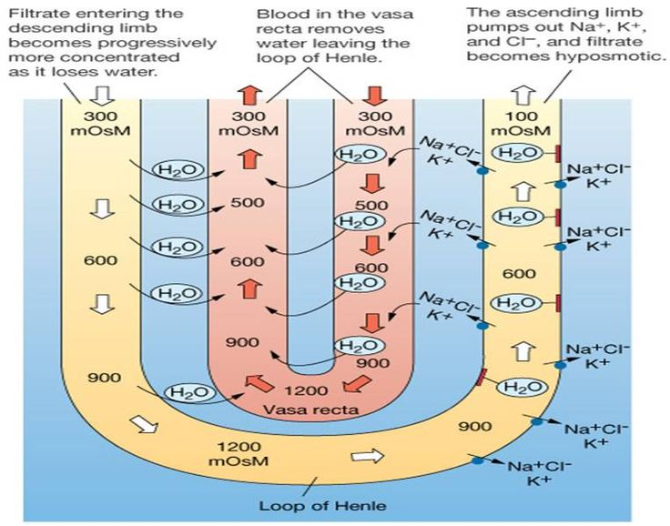
Build a nephron-loop of Henle
You either need to add your own Cl- ions or have kids pretend the Calcium is Cl-

Slide 27
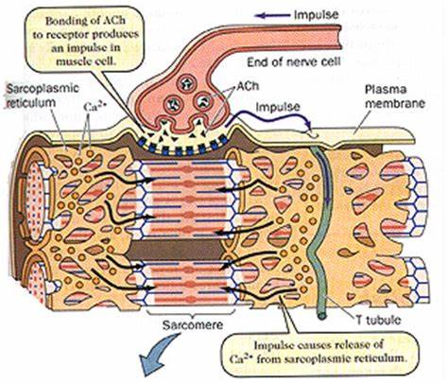
Muscle cell: Have some sort of template printed for the background.
Students can move the Na+ and Cl- around.
Good practice for t-tubule and SR

Slide 28
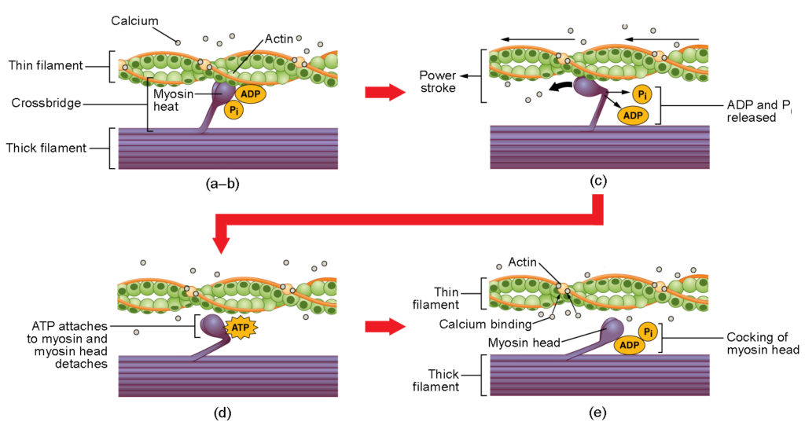
Use pipe cleaners to make actin and myosin, then use the Ca+ to model sliding filament theory.

Slide 29
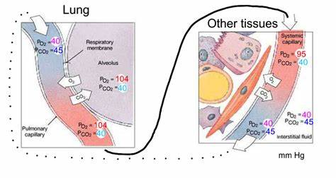
Respiratory System, gas exchange
Set up phospholipid bilayers for blood vessels and alveoli. Make O2 and CO2 molecules (can use hole punch cutouts of different colors).
Have phospholipid bilayer for capillaries and template of other tissues to show movement throughout the body.
.

Slide 30

Any Final Questions or Ideas to share?
Scan the QR code and fill out the survey to get the discount code and be entered to win $250 of product from 3DMD.
Thank you for your time:)

