Slide 1
DNA Discovery Using 3D Molecular Designs Models
Stephanie Ruder
WSST Madison
3/9/2023

Slide 2
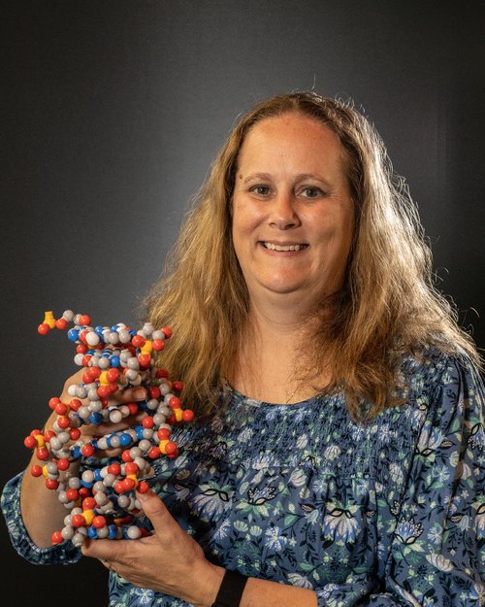
Stephanie Ruder
BS Biology- UW Parkside
MBA- UW Parkside
MEd- National Louis University
National Board Certified Teacher
Case High School Racine, WI
Currently teach PLTW Principles of Biomedical Science and Chemistry.
3DMD/ CBM courses taken: Modeling the Molecular World, Cohort 3 Science and Ethics of Genome Editing

Slide 3
Workshop Learning Goals
Learn how the Dynamic DNA models can be used to explore the structure and function of DNA.
Learn how to connect the Dynamic DNA to other models.

Slide 4
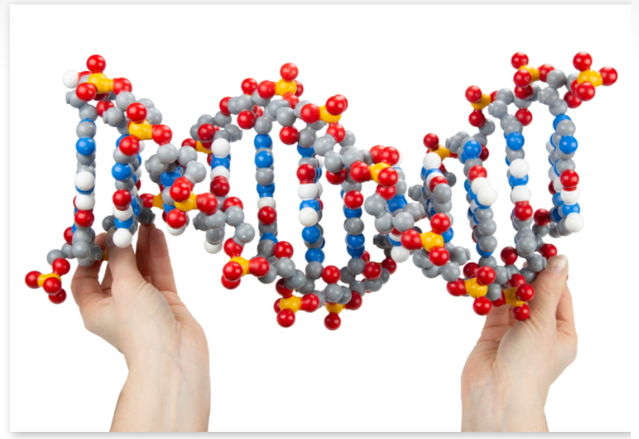
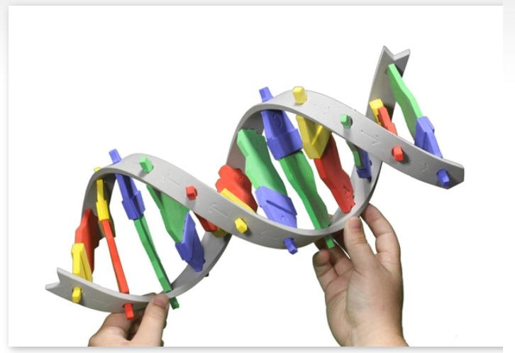
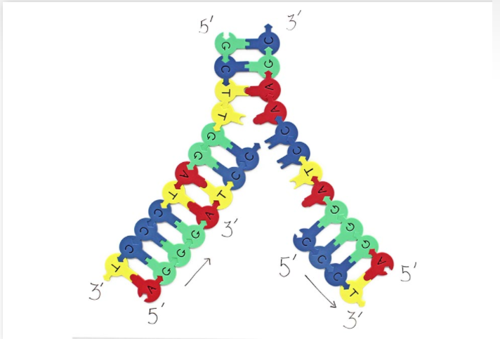
Kits Shown and used today
Dynamic DNA Kit
DNA Starter Kit
Demo DNA Nucleotides

Slide 5
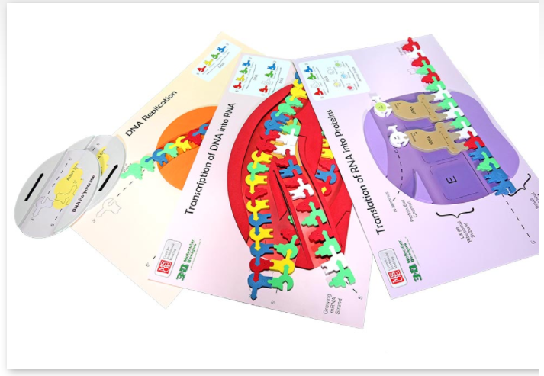
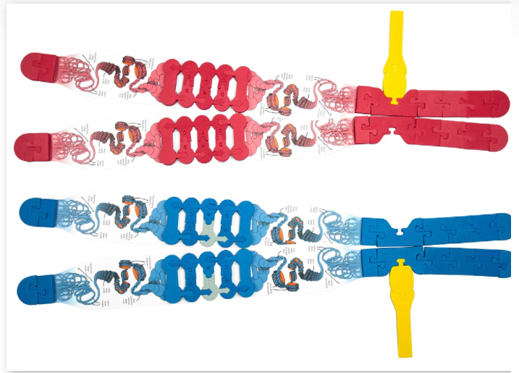
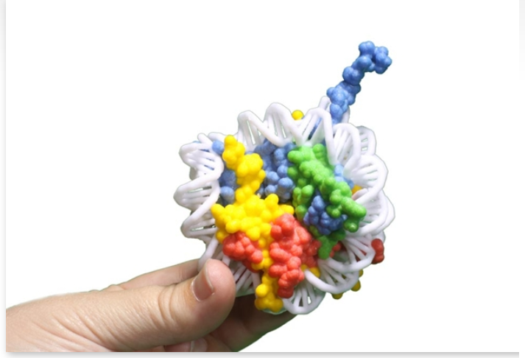
Kits Shown and used today
Flow of Genetic Information Kit
Chromosome Connections Kit
Nucleosome Mini Model

Slide 6
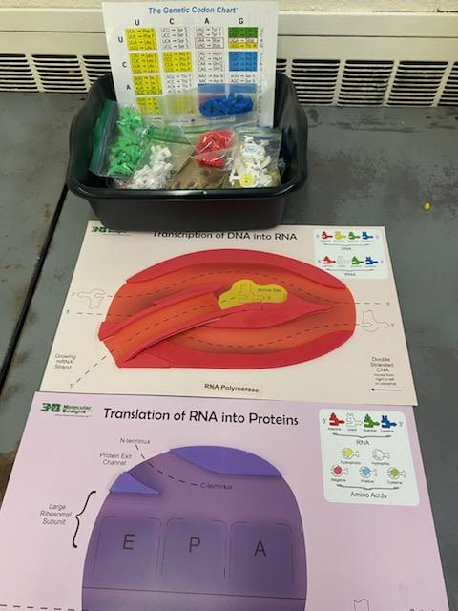
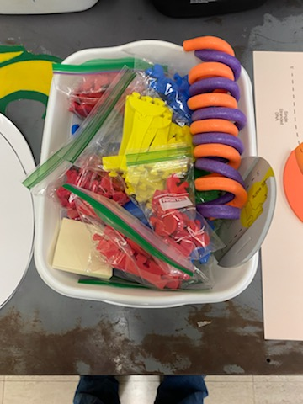
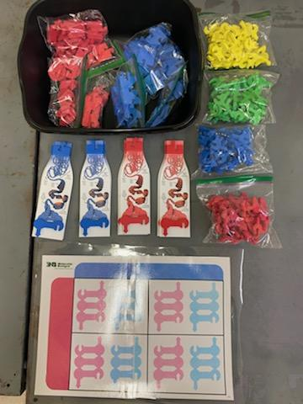
Kit Management-
Use Bins
Only give students what they need at the time

Slide 7
What is a model? List the things you think are a model and Explain your thinking in your notebook. (From MMW 2019)
building a paper airplane
making an analogy (example, the heart is like a pump)
observing a bird’s behavior at a bird feeder
developing a mathematical equation to solve a science problem
making a plant cell out of household materials
analyzing whale migration patterns with a computer program
building and testing a bridge made of toothpicks
drawing an electrical circuit

Slide 8
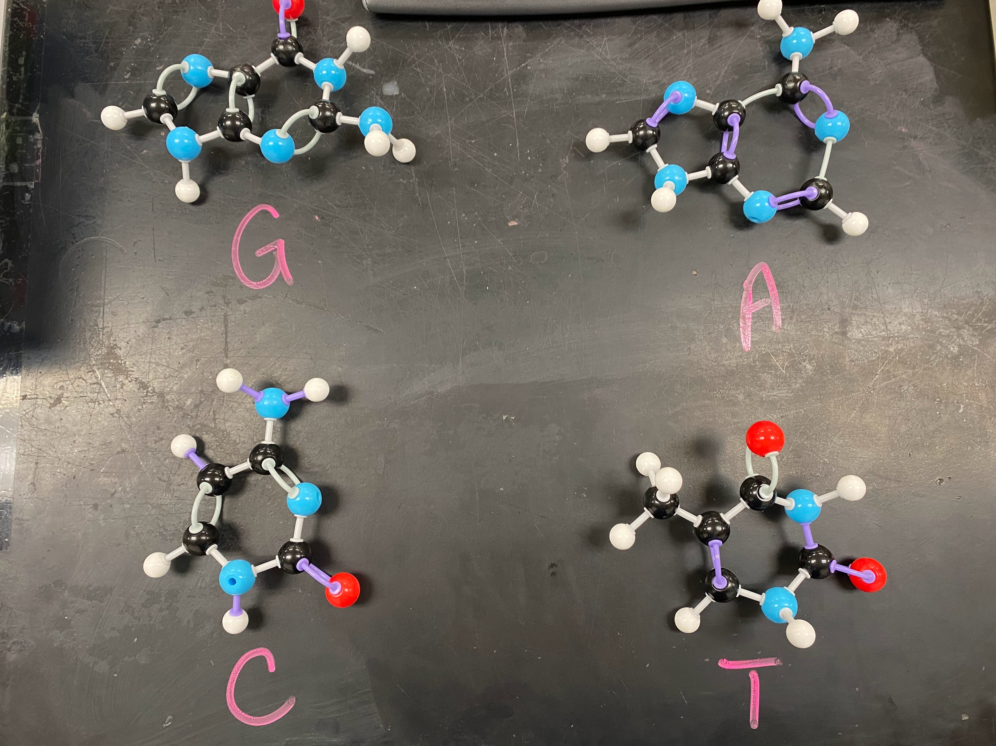
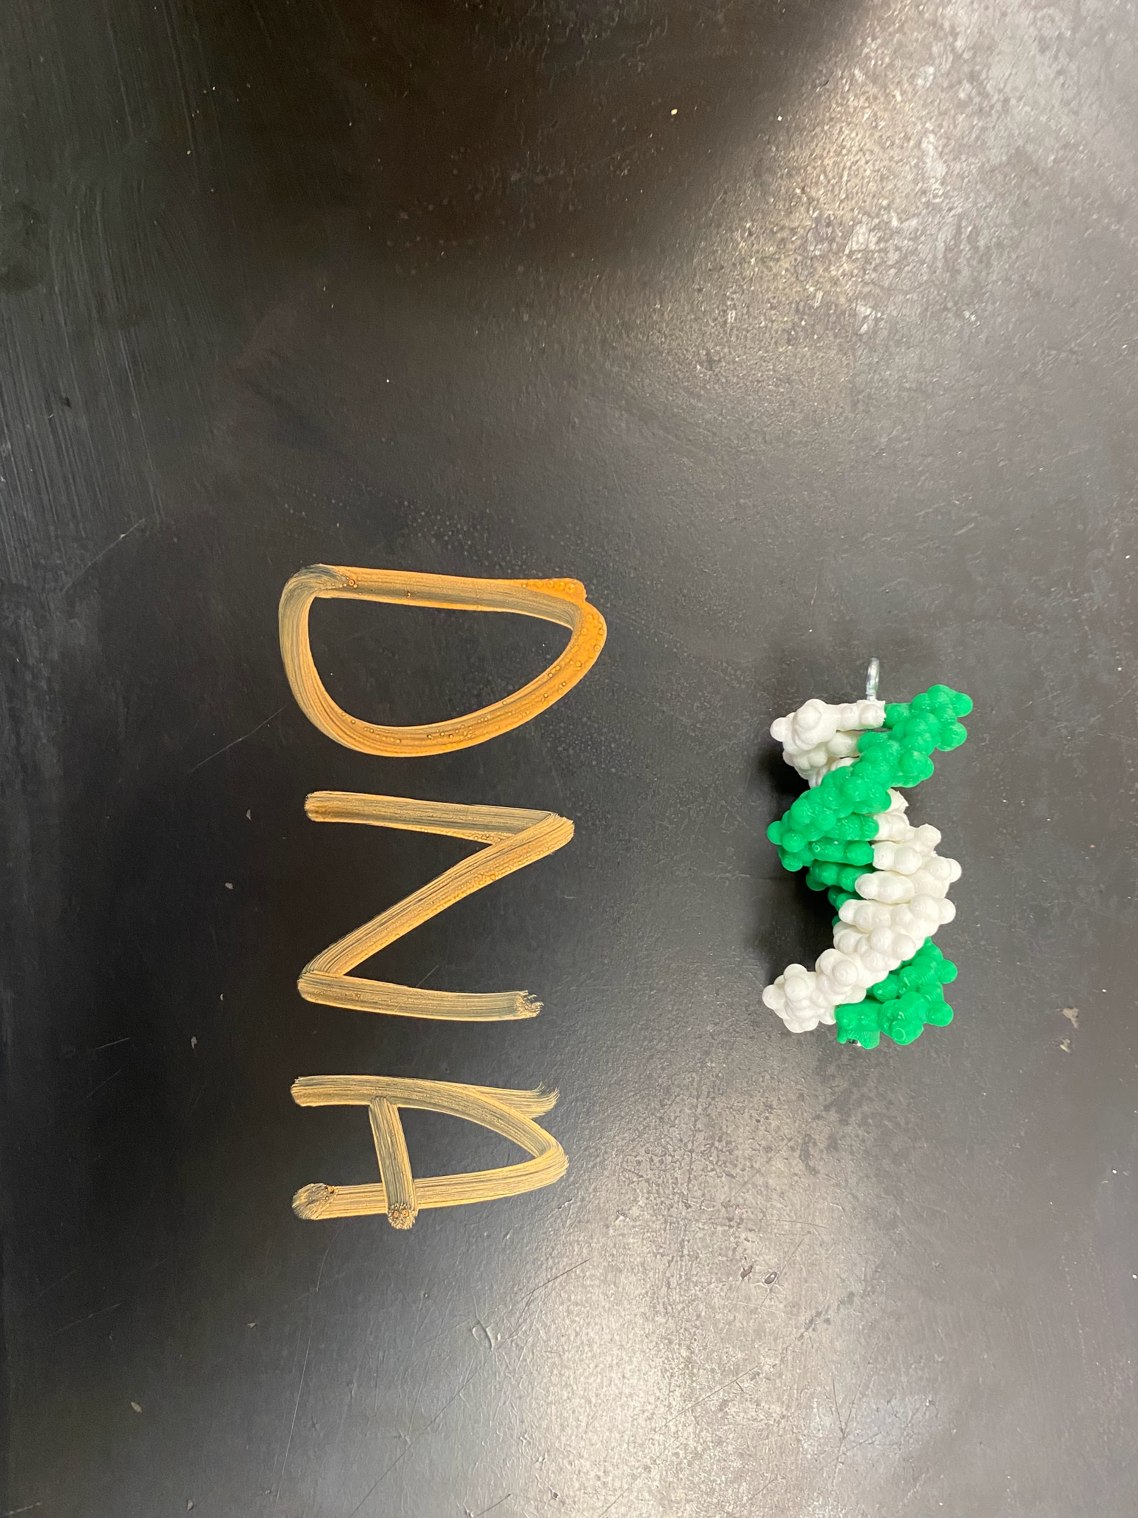
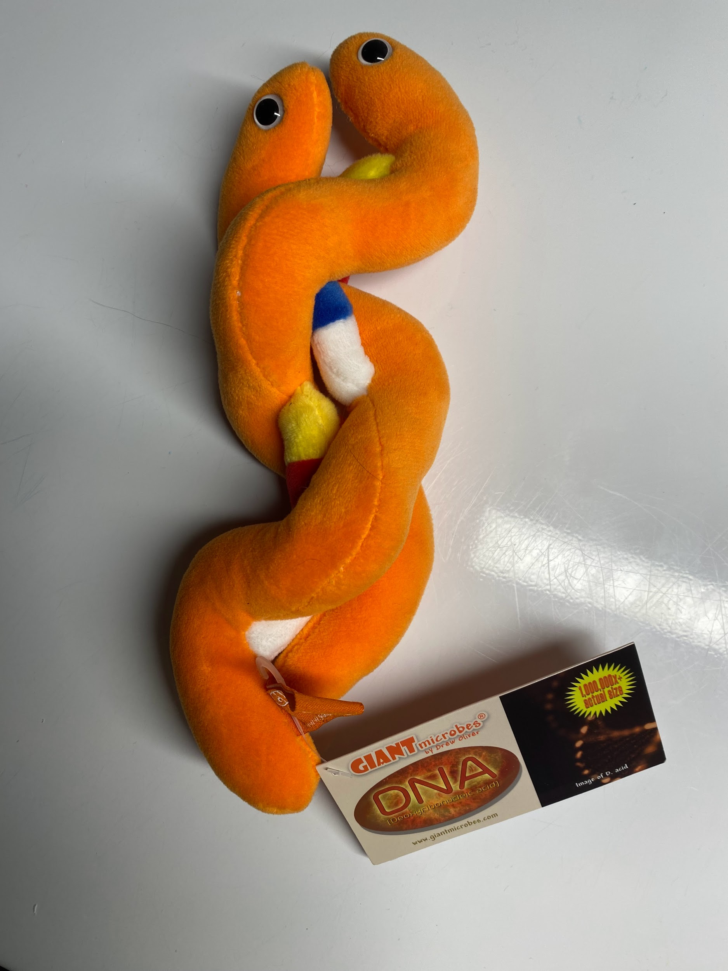
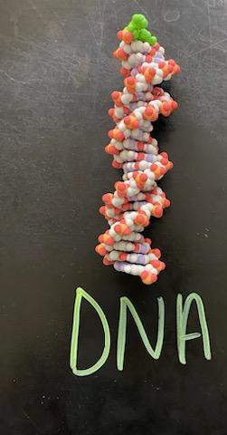
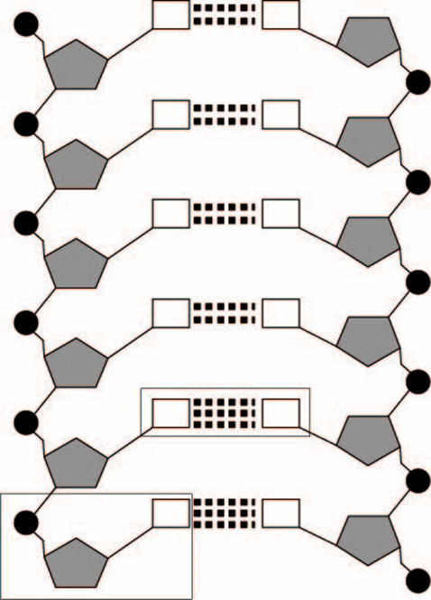
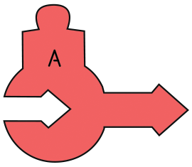

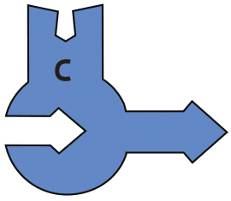
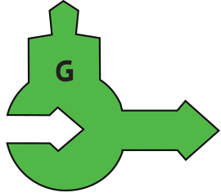
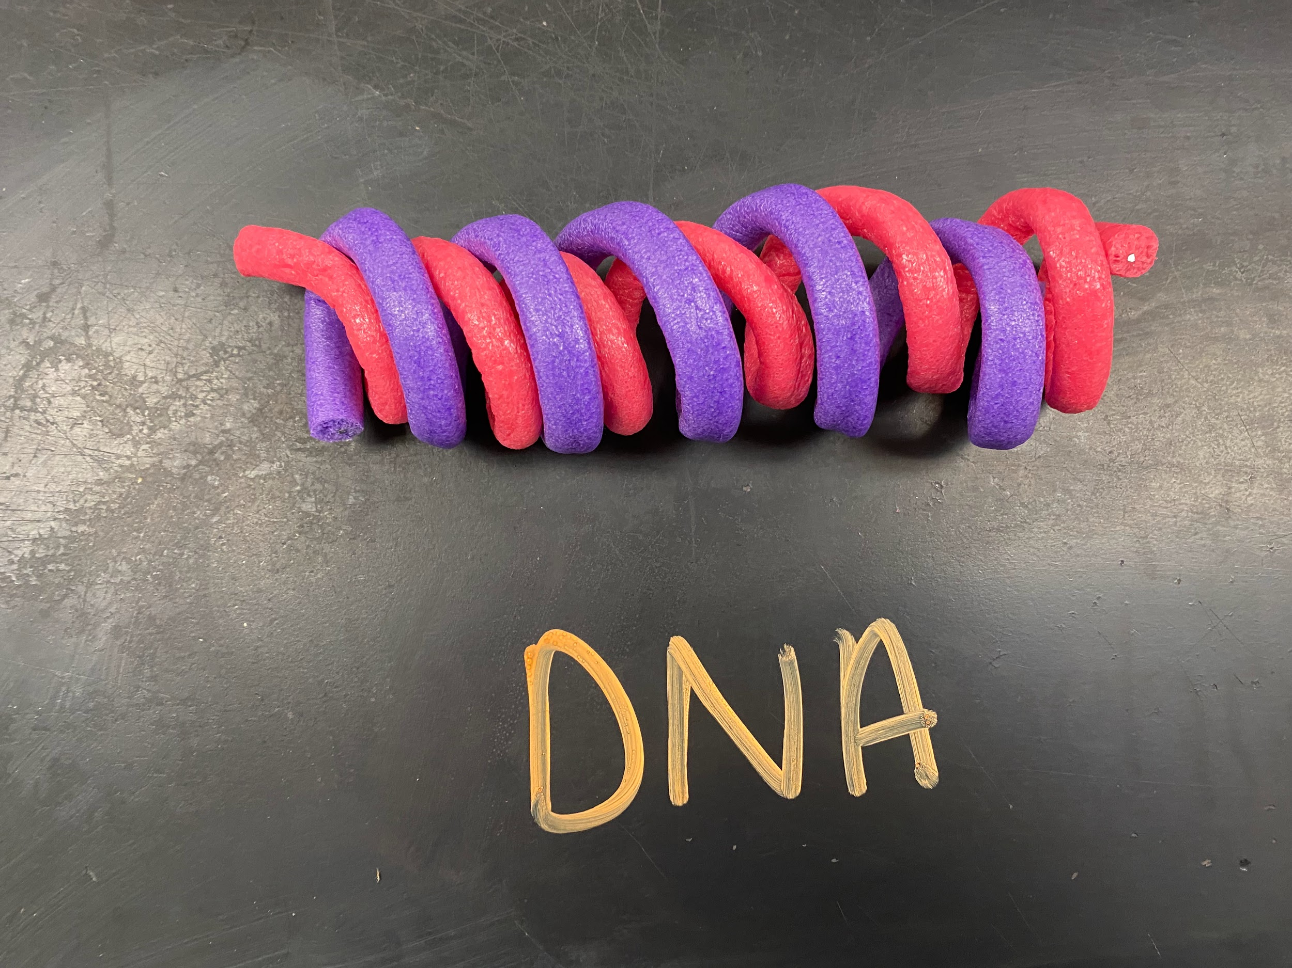
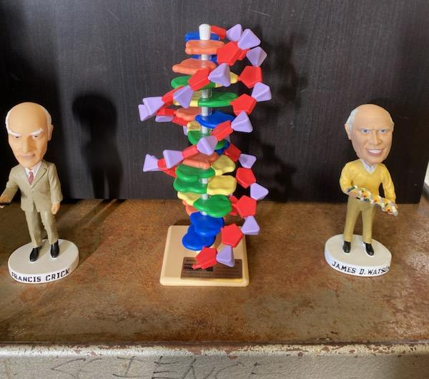
What is DNA? What are similarities and differences in our models?

Slide 9
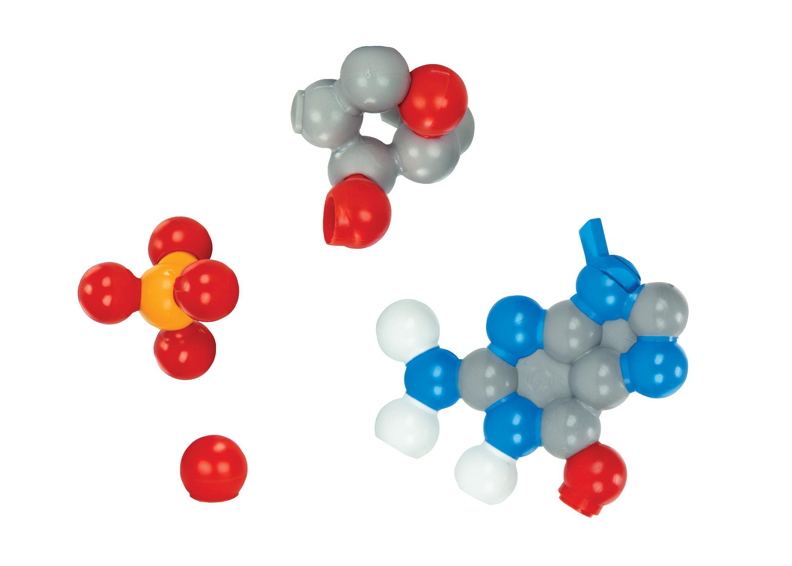
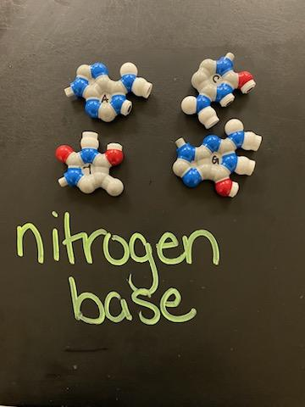
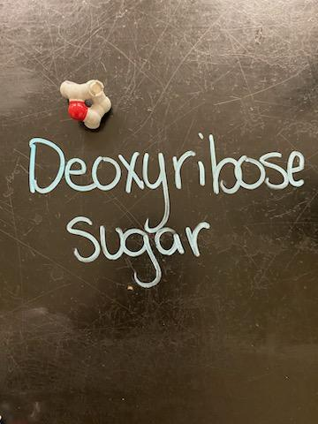
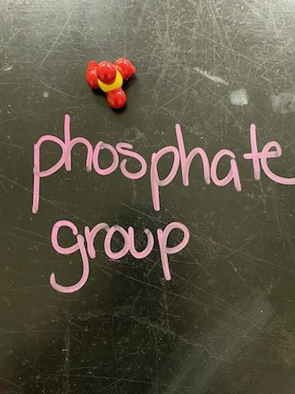
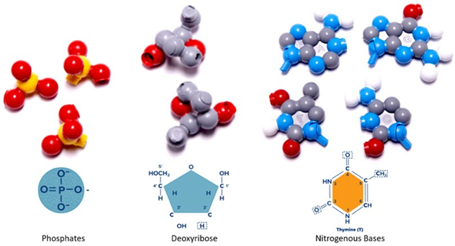
First Activity with Dynamic DNA
Give students materials to make 6 nucleotides
In your notebook sketch the different parts of a nucleotide using color.

Slide 10
Find the nitrogenous bases. In your notebook compare and contrast each of these. Explain to me what is the same for each of them and what is different.
Adenine and Guanine are purines and Thymine and Cytosine are pyrimidines. After looking at each of the different nitrogenous bases what similarities and differences of purine and pyrimidines?
Try to put the different pieces together to make as many nucleotides as possible. Sketch one nucleotide in your notebook.
As you try to put the different pieces together what is representing a hydrogen bond? What represents a covalent bond? Explain.

Slide 11
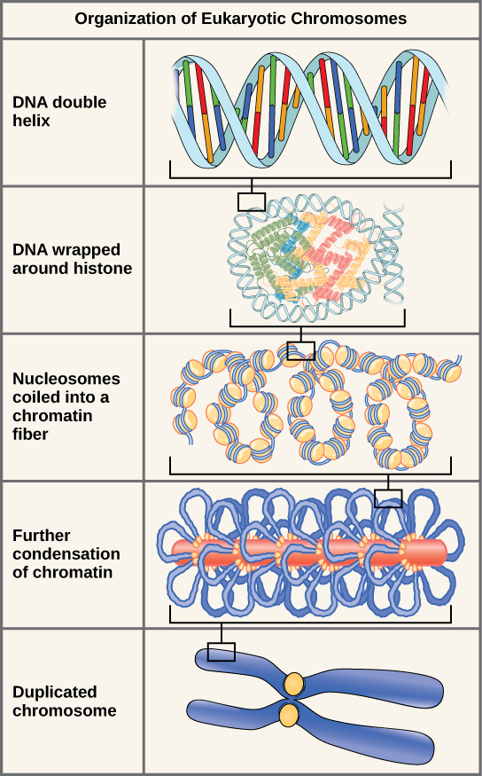
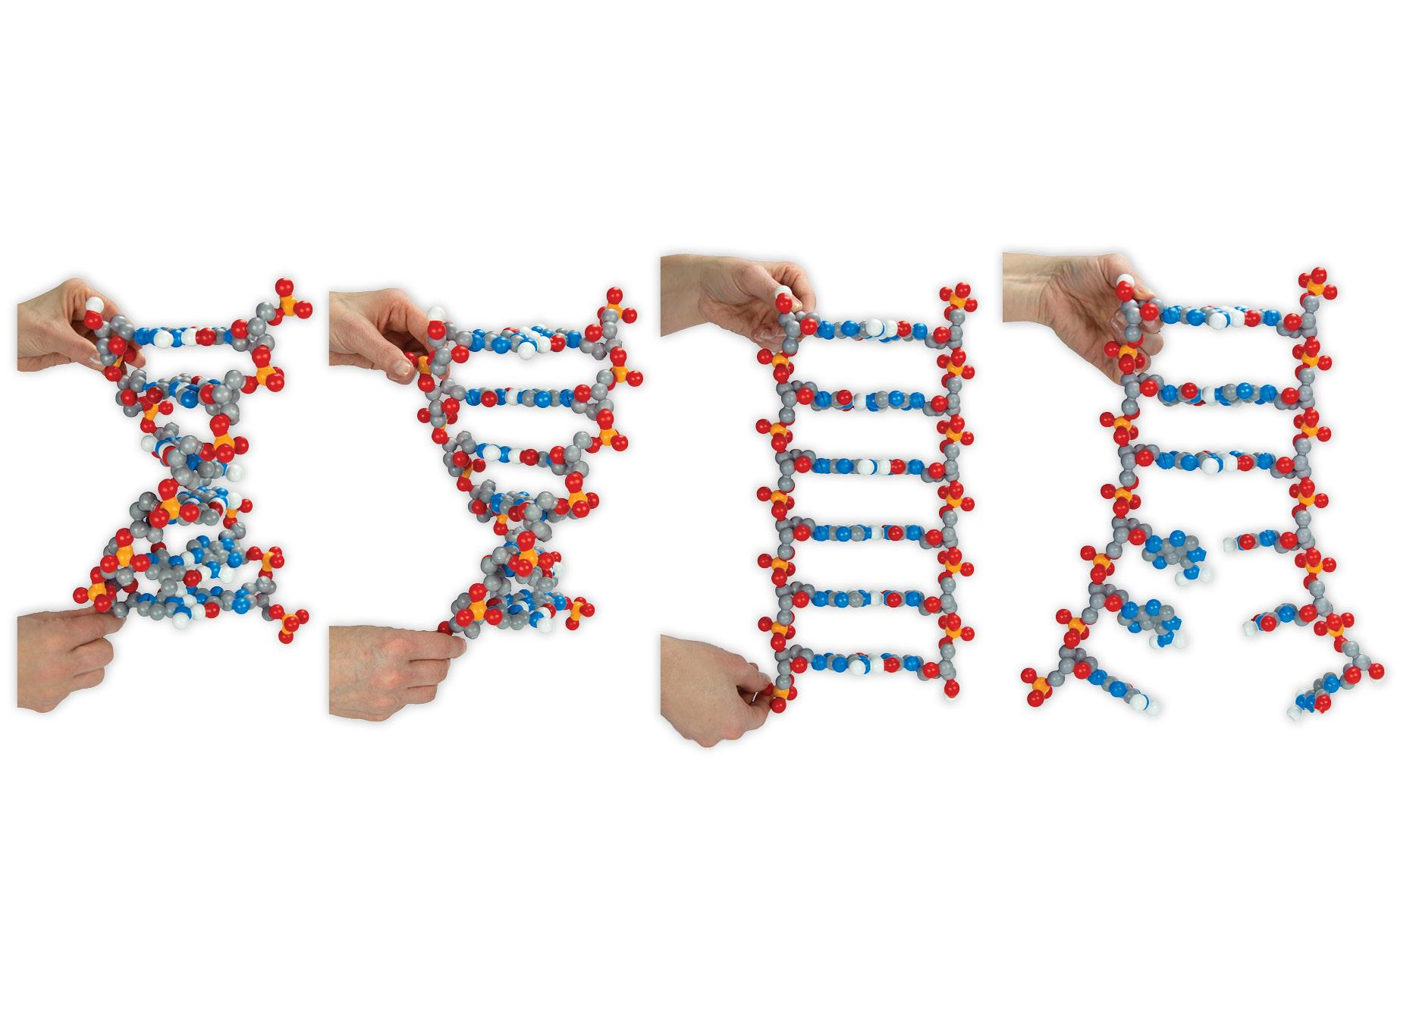
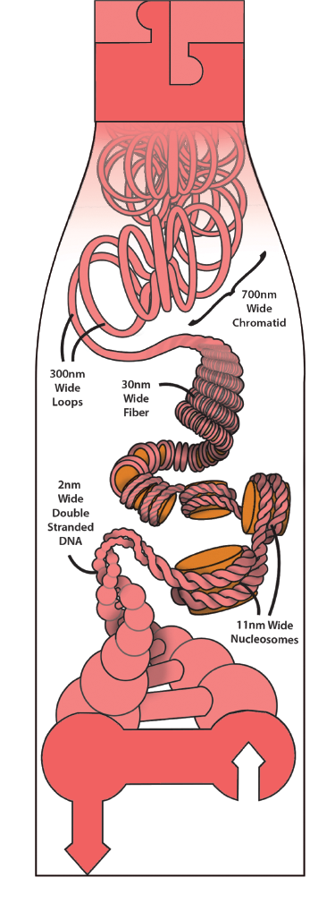
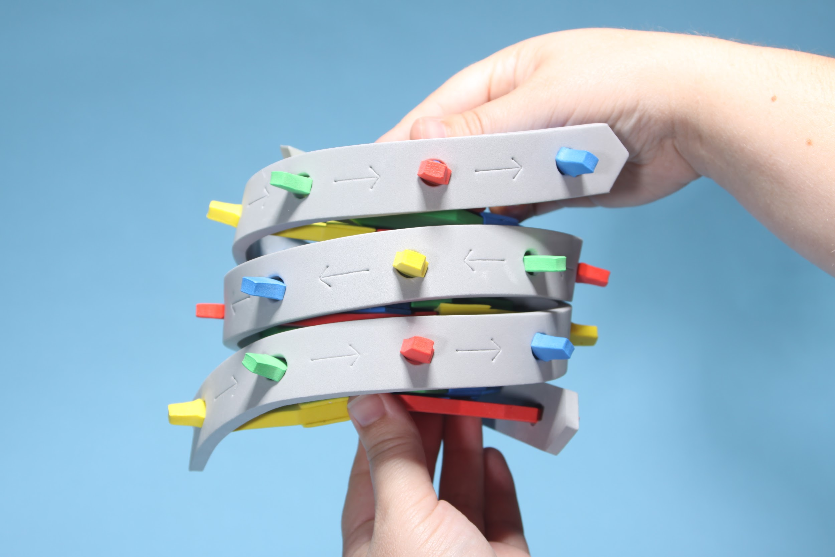
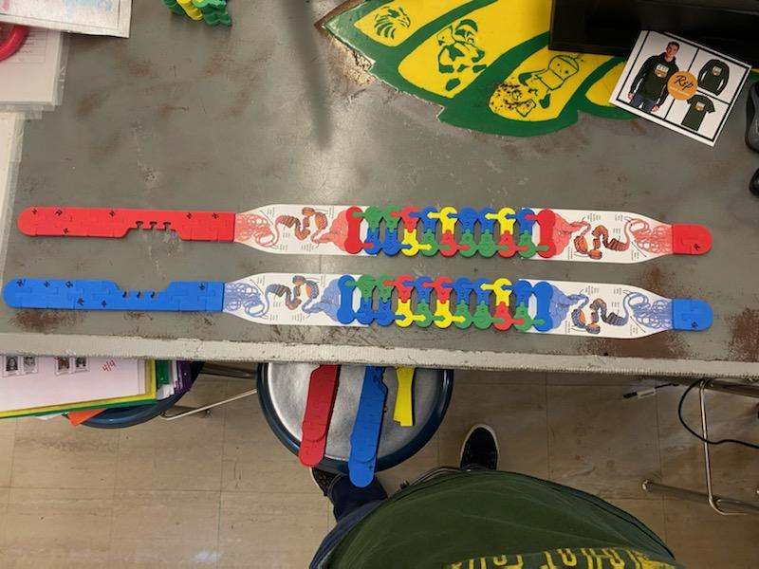
Talk about how chromosome condense

Slide 12
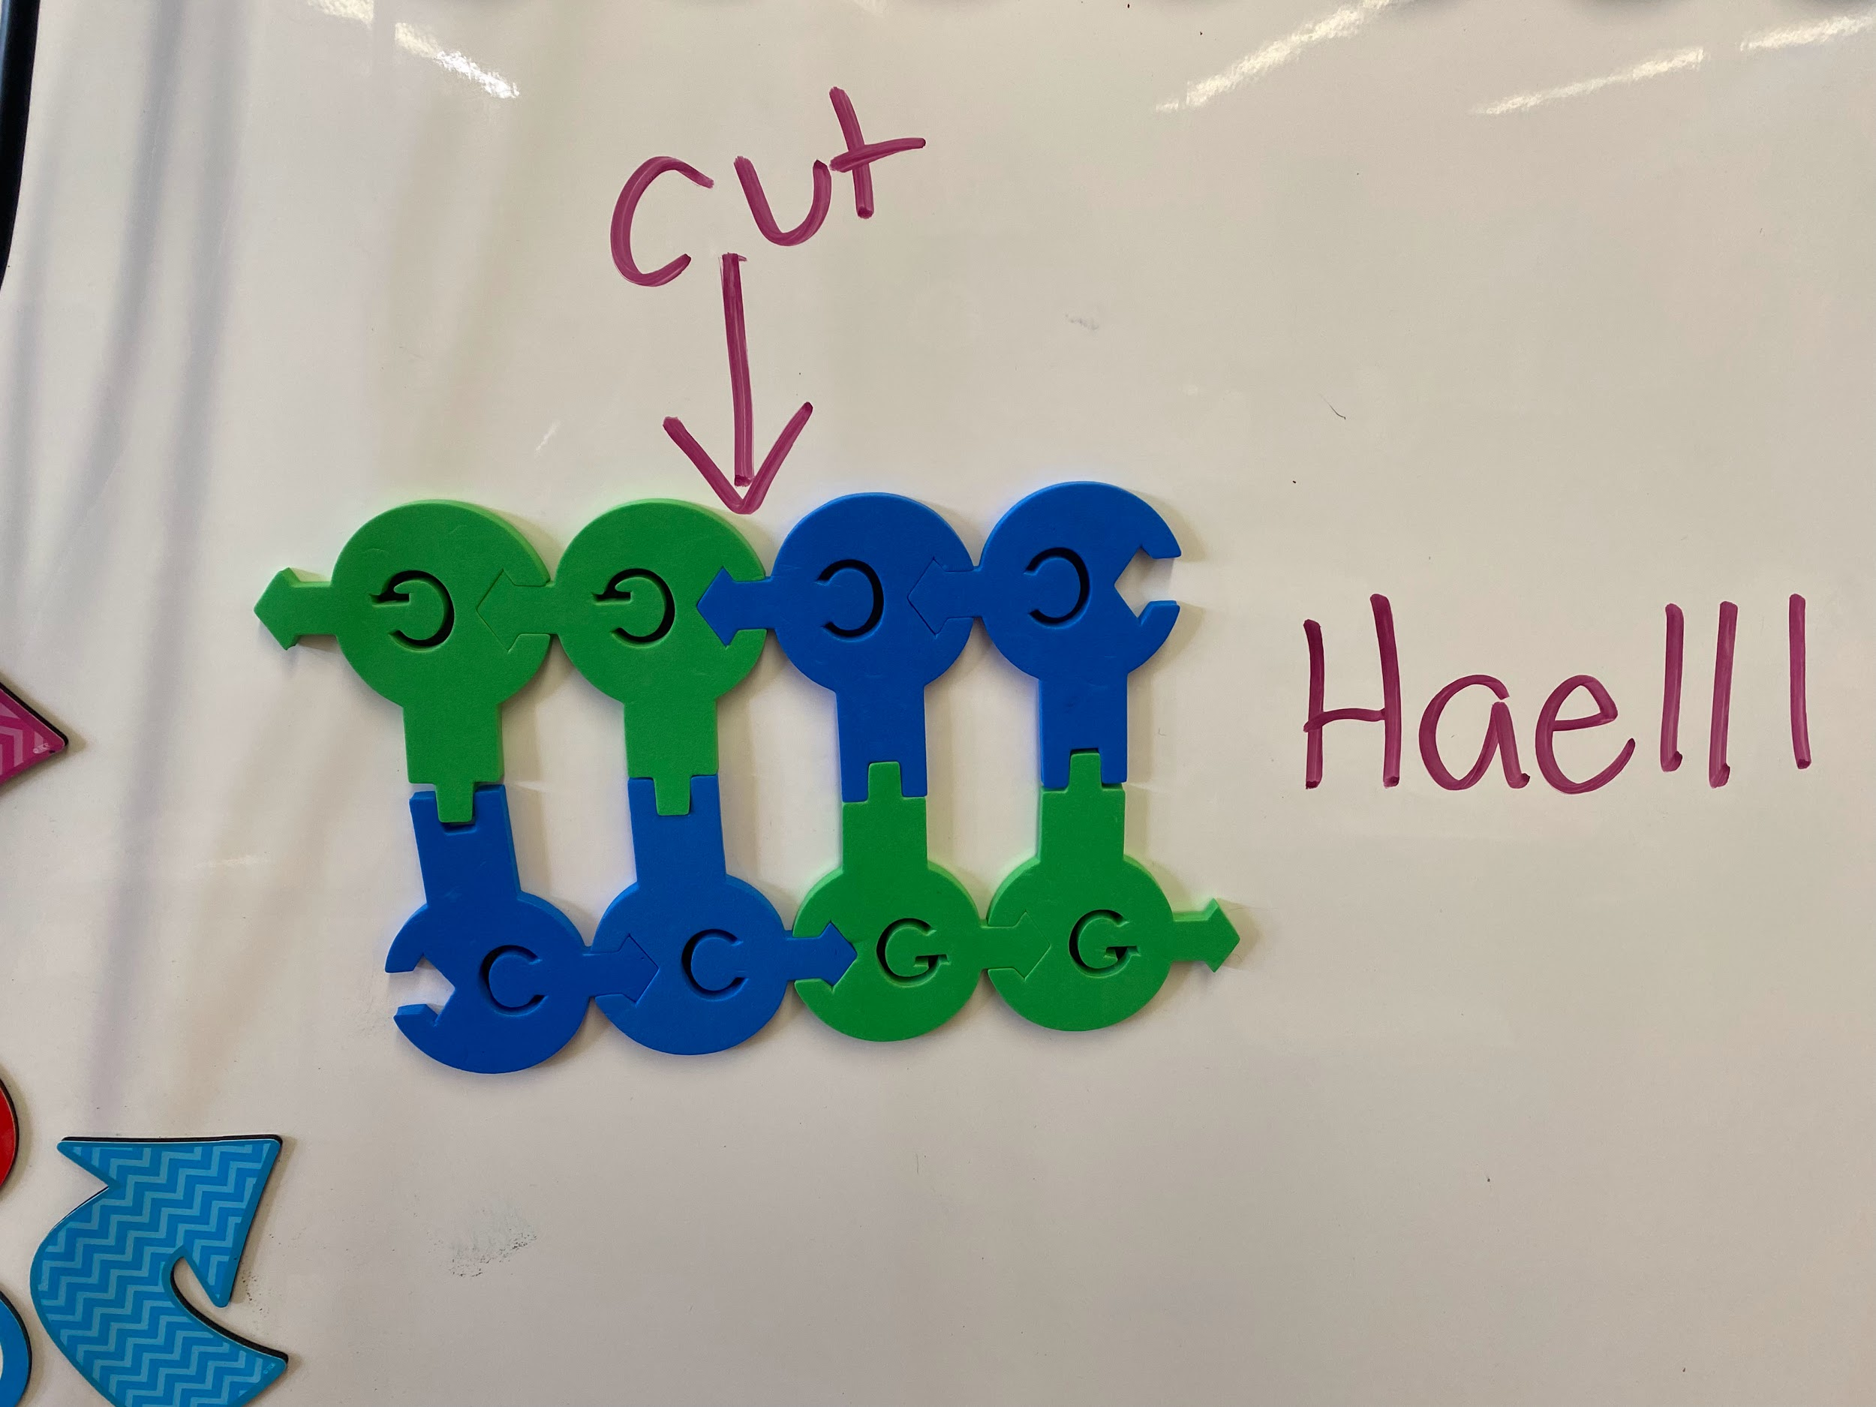
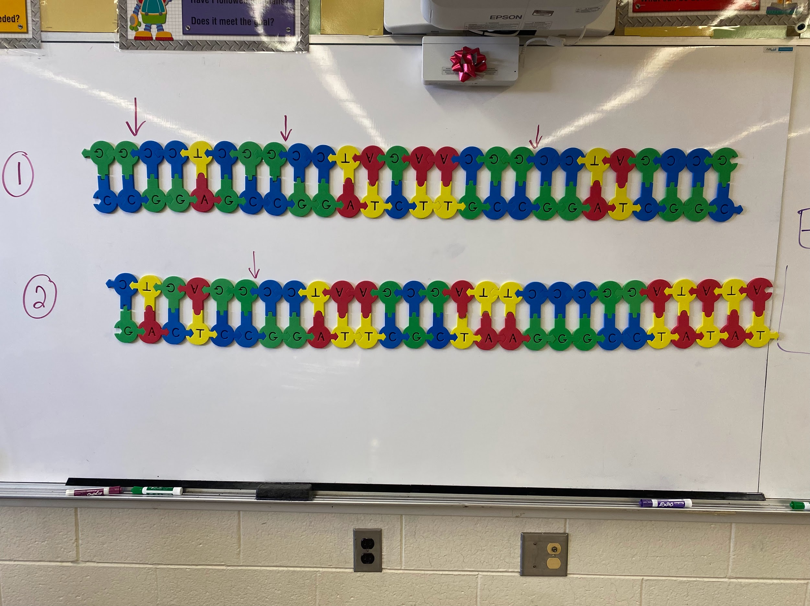
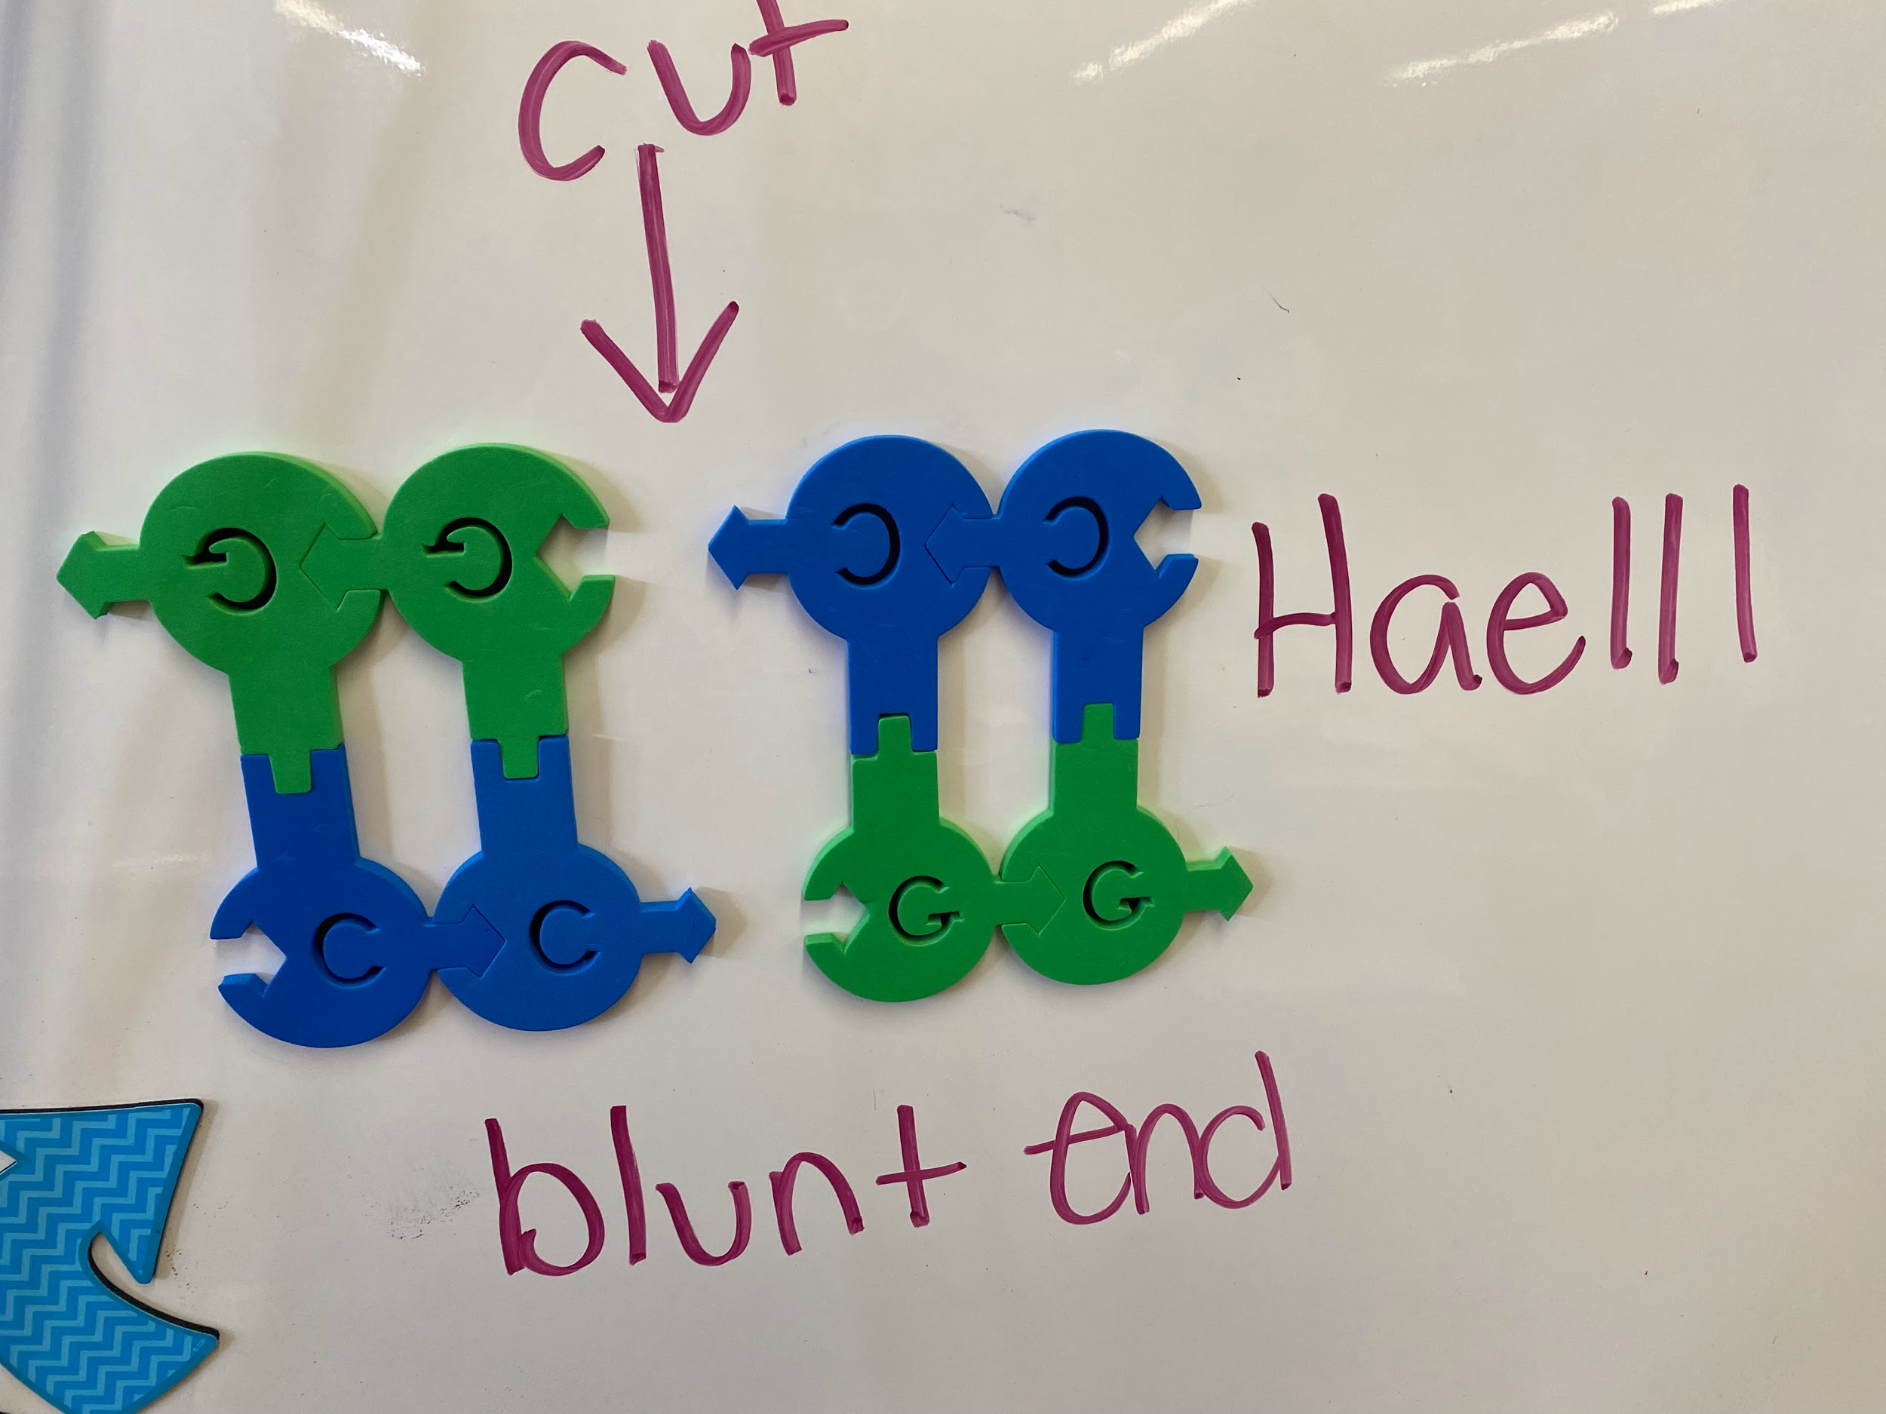
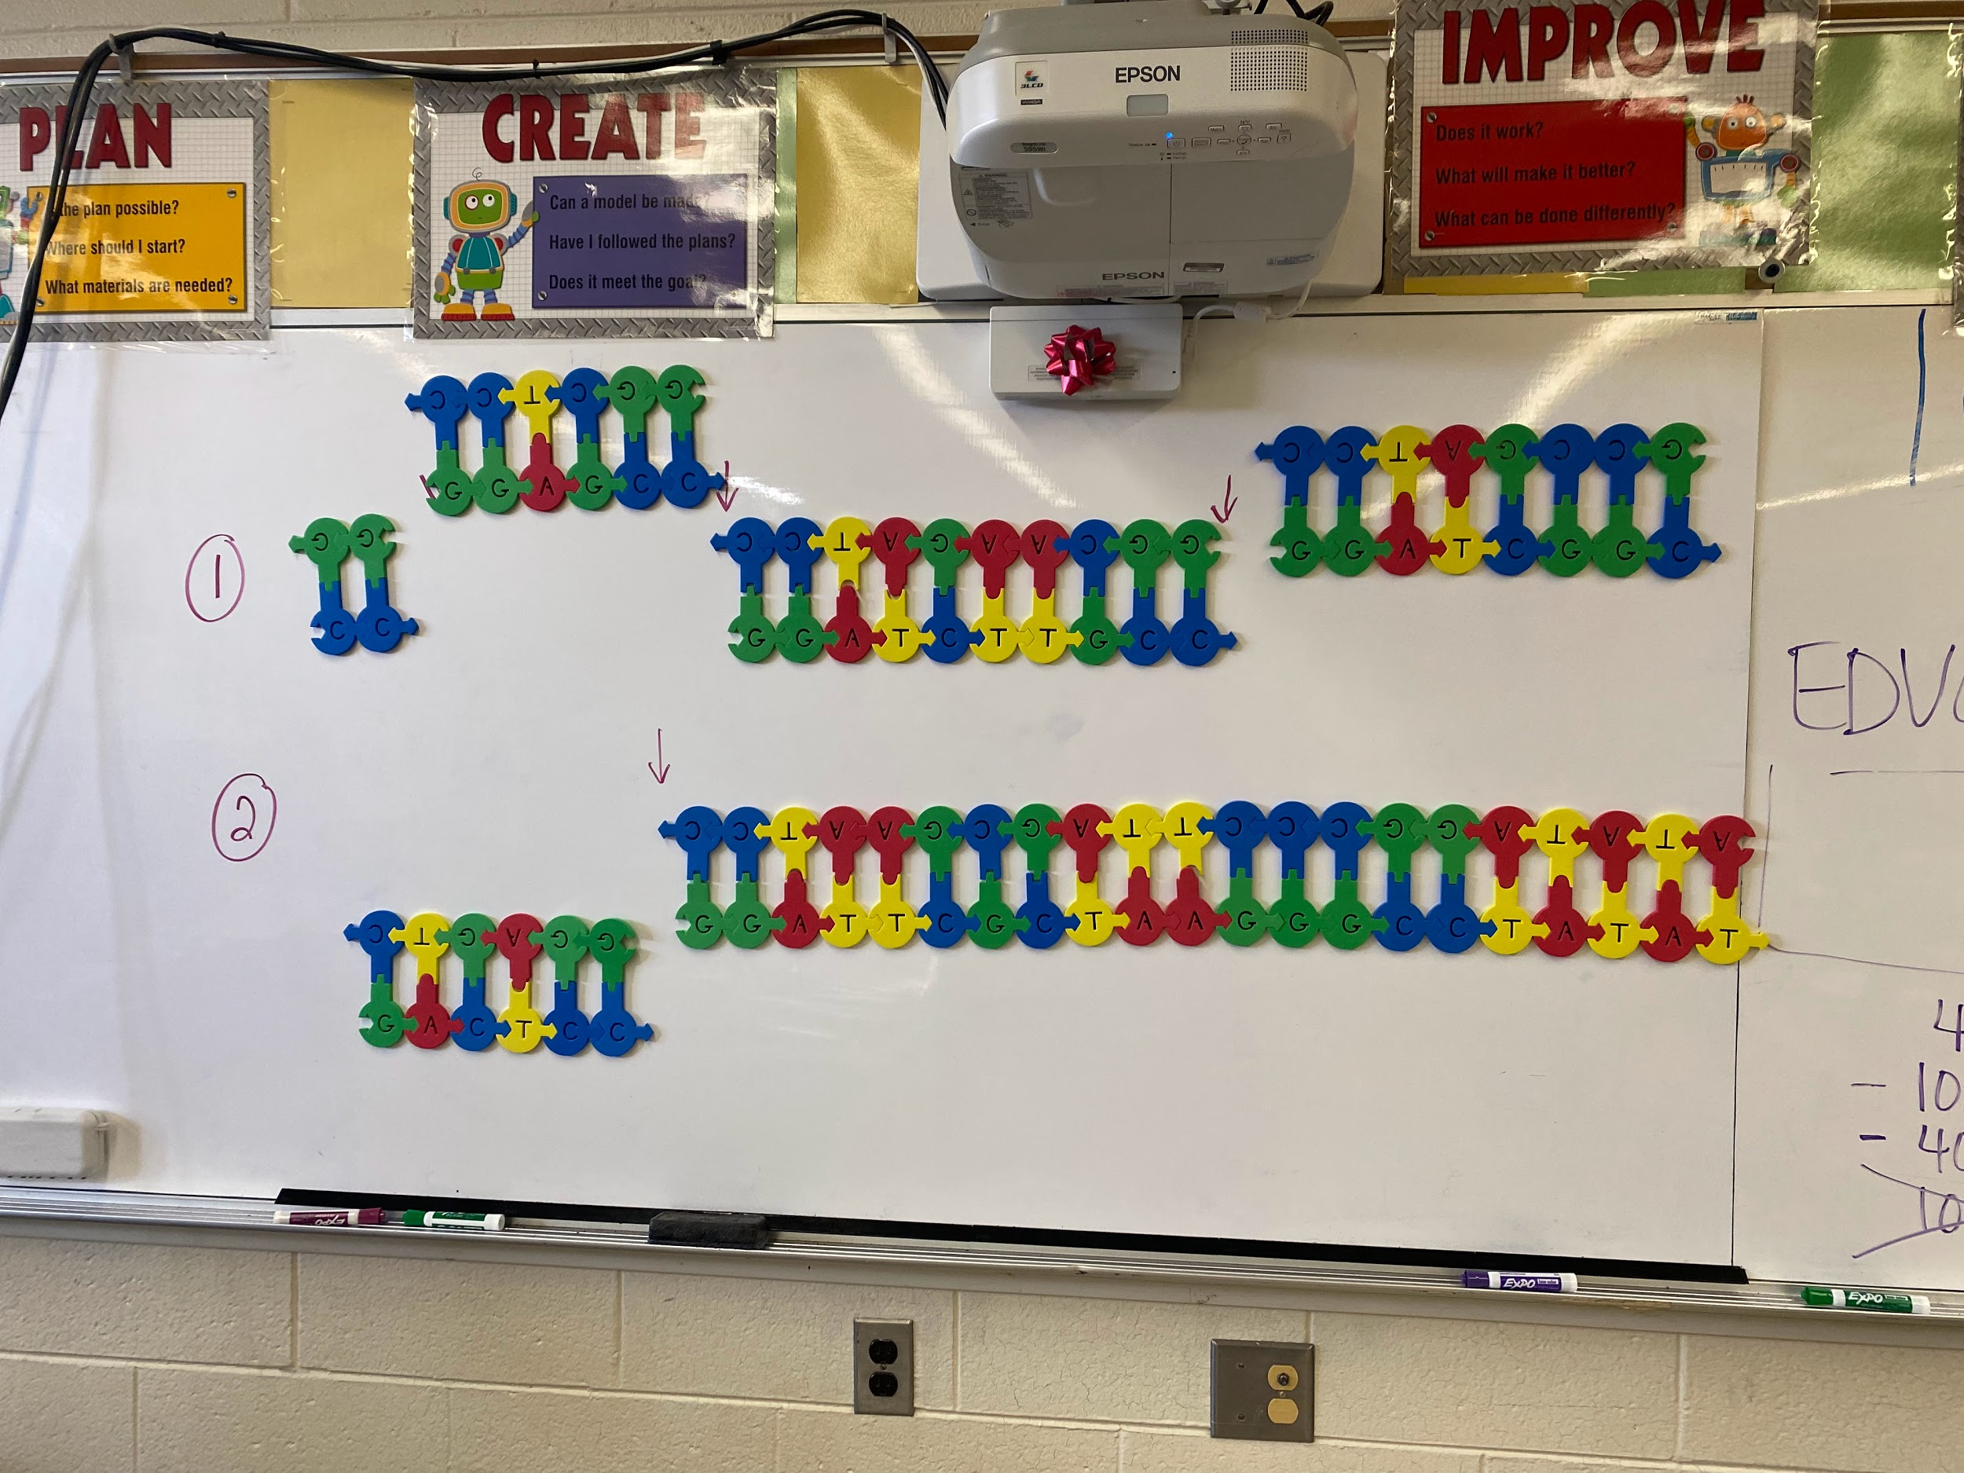
Restriction Enzymes
How can you show restriction enzyme cuts using the Dynamic DNA?

Slide 13
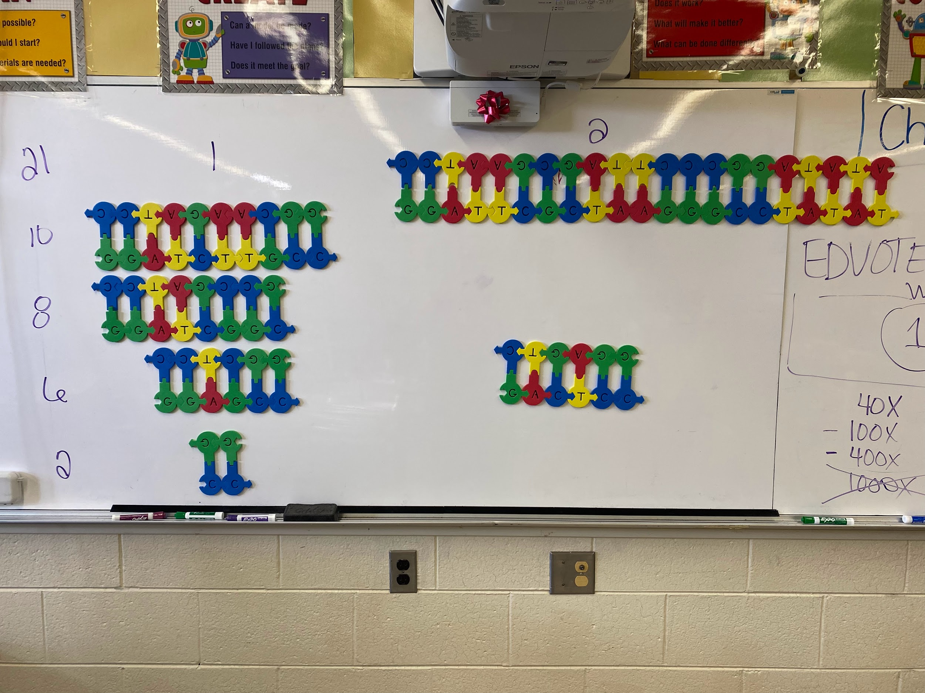
Gel electrophoresis
How can we use Dynamic DNA to show gel electrophoresis?

Slide 14
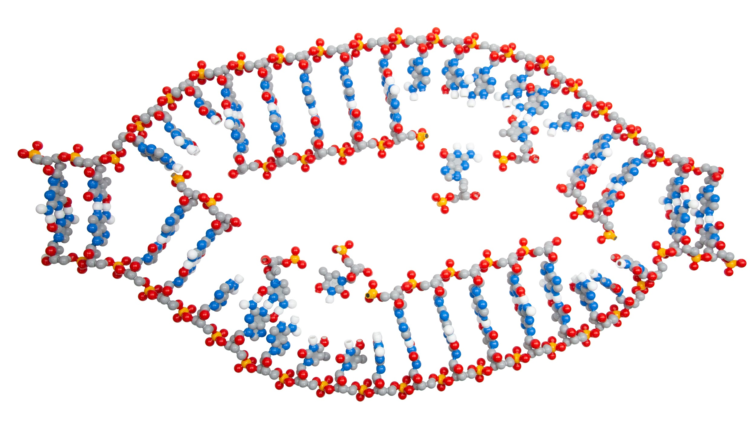
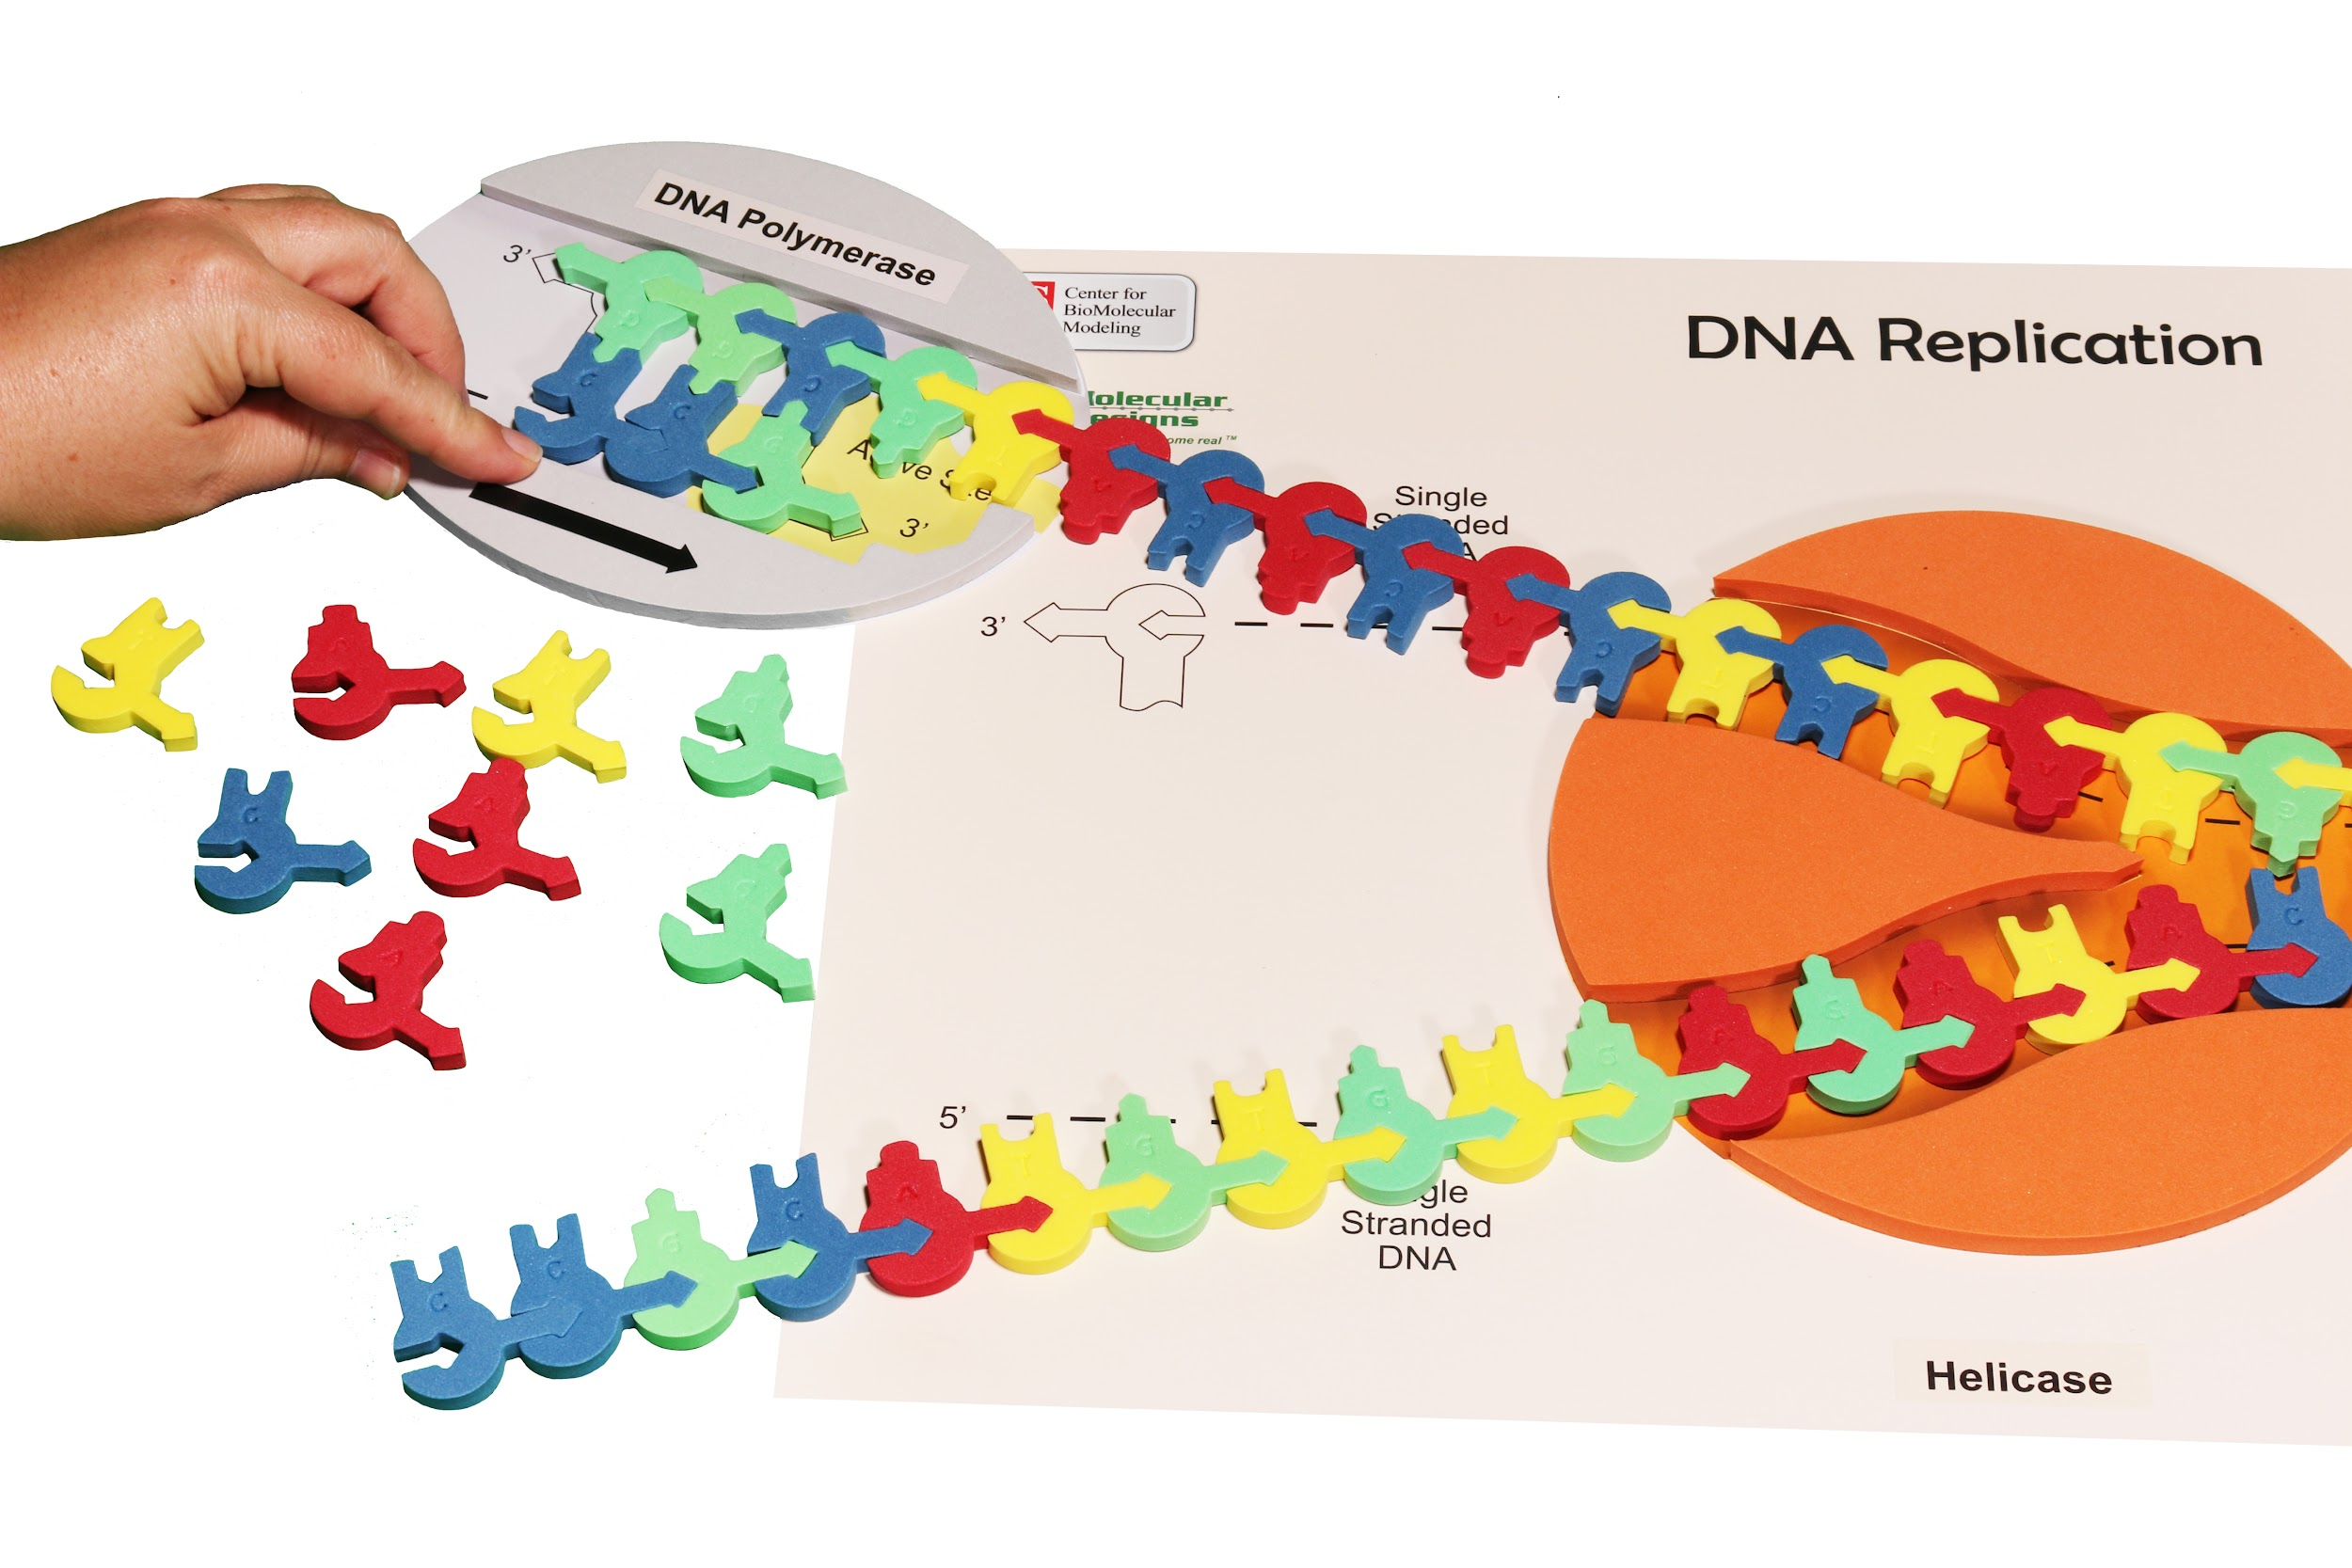
DNA Replication
Get Dynamic DNA kit out again before we do the Flow of Genetic Information kit and talk about how we can show DNA replication using it.

Slide 15
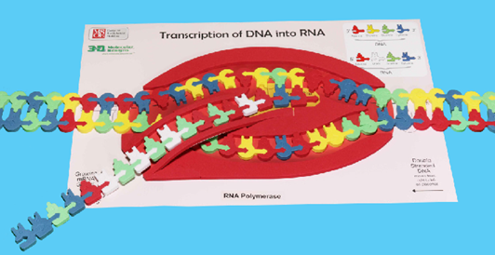
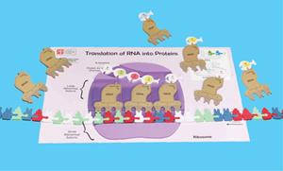
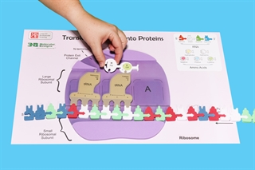
Flow of genetic information Transcription and Translation

Slide 16
Questions?
stephanie.ruder@rusd.org

Slide 17
Workshop NGSS Connections
(and/or other applicable standards)
SEPs | CCCs | DCIs
Asking questions and defining problems | Patterns | HS-LS1-1
Developing and Using Models | Structure and Function | HS-LS1-2
Constructing explanation and designing solutions | Scale, Proportion, and Quantity | HS-LS1-4
Engaging in argument from evidence | Cause and Effect | HS-LS3-1
Analyzing and Interpreting Data | Systems and System models | HS-LS3-2
 |  | HS-LS3-3

Slide 18

Please scan the QR code

