Slide 1
Why does the egg turn white when I cook it?
And Other Stories:
Modeling Protein Structures and Disruptions to their Systems
by Choi Maner
Kohler High School

Slide 2
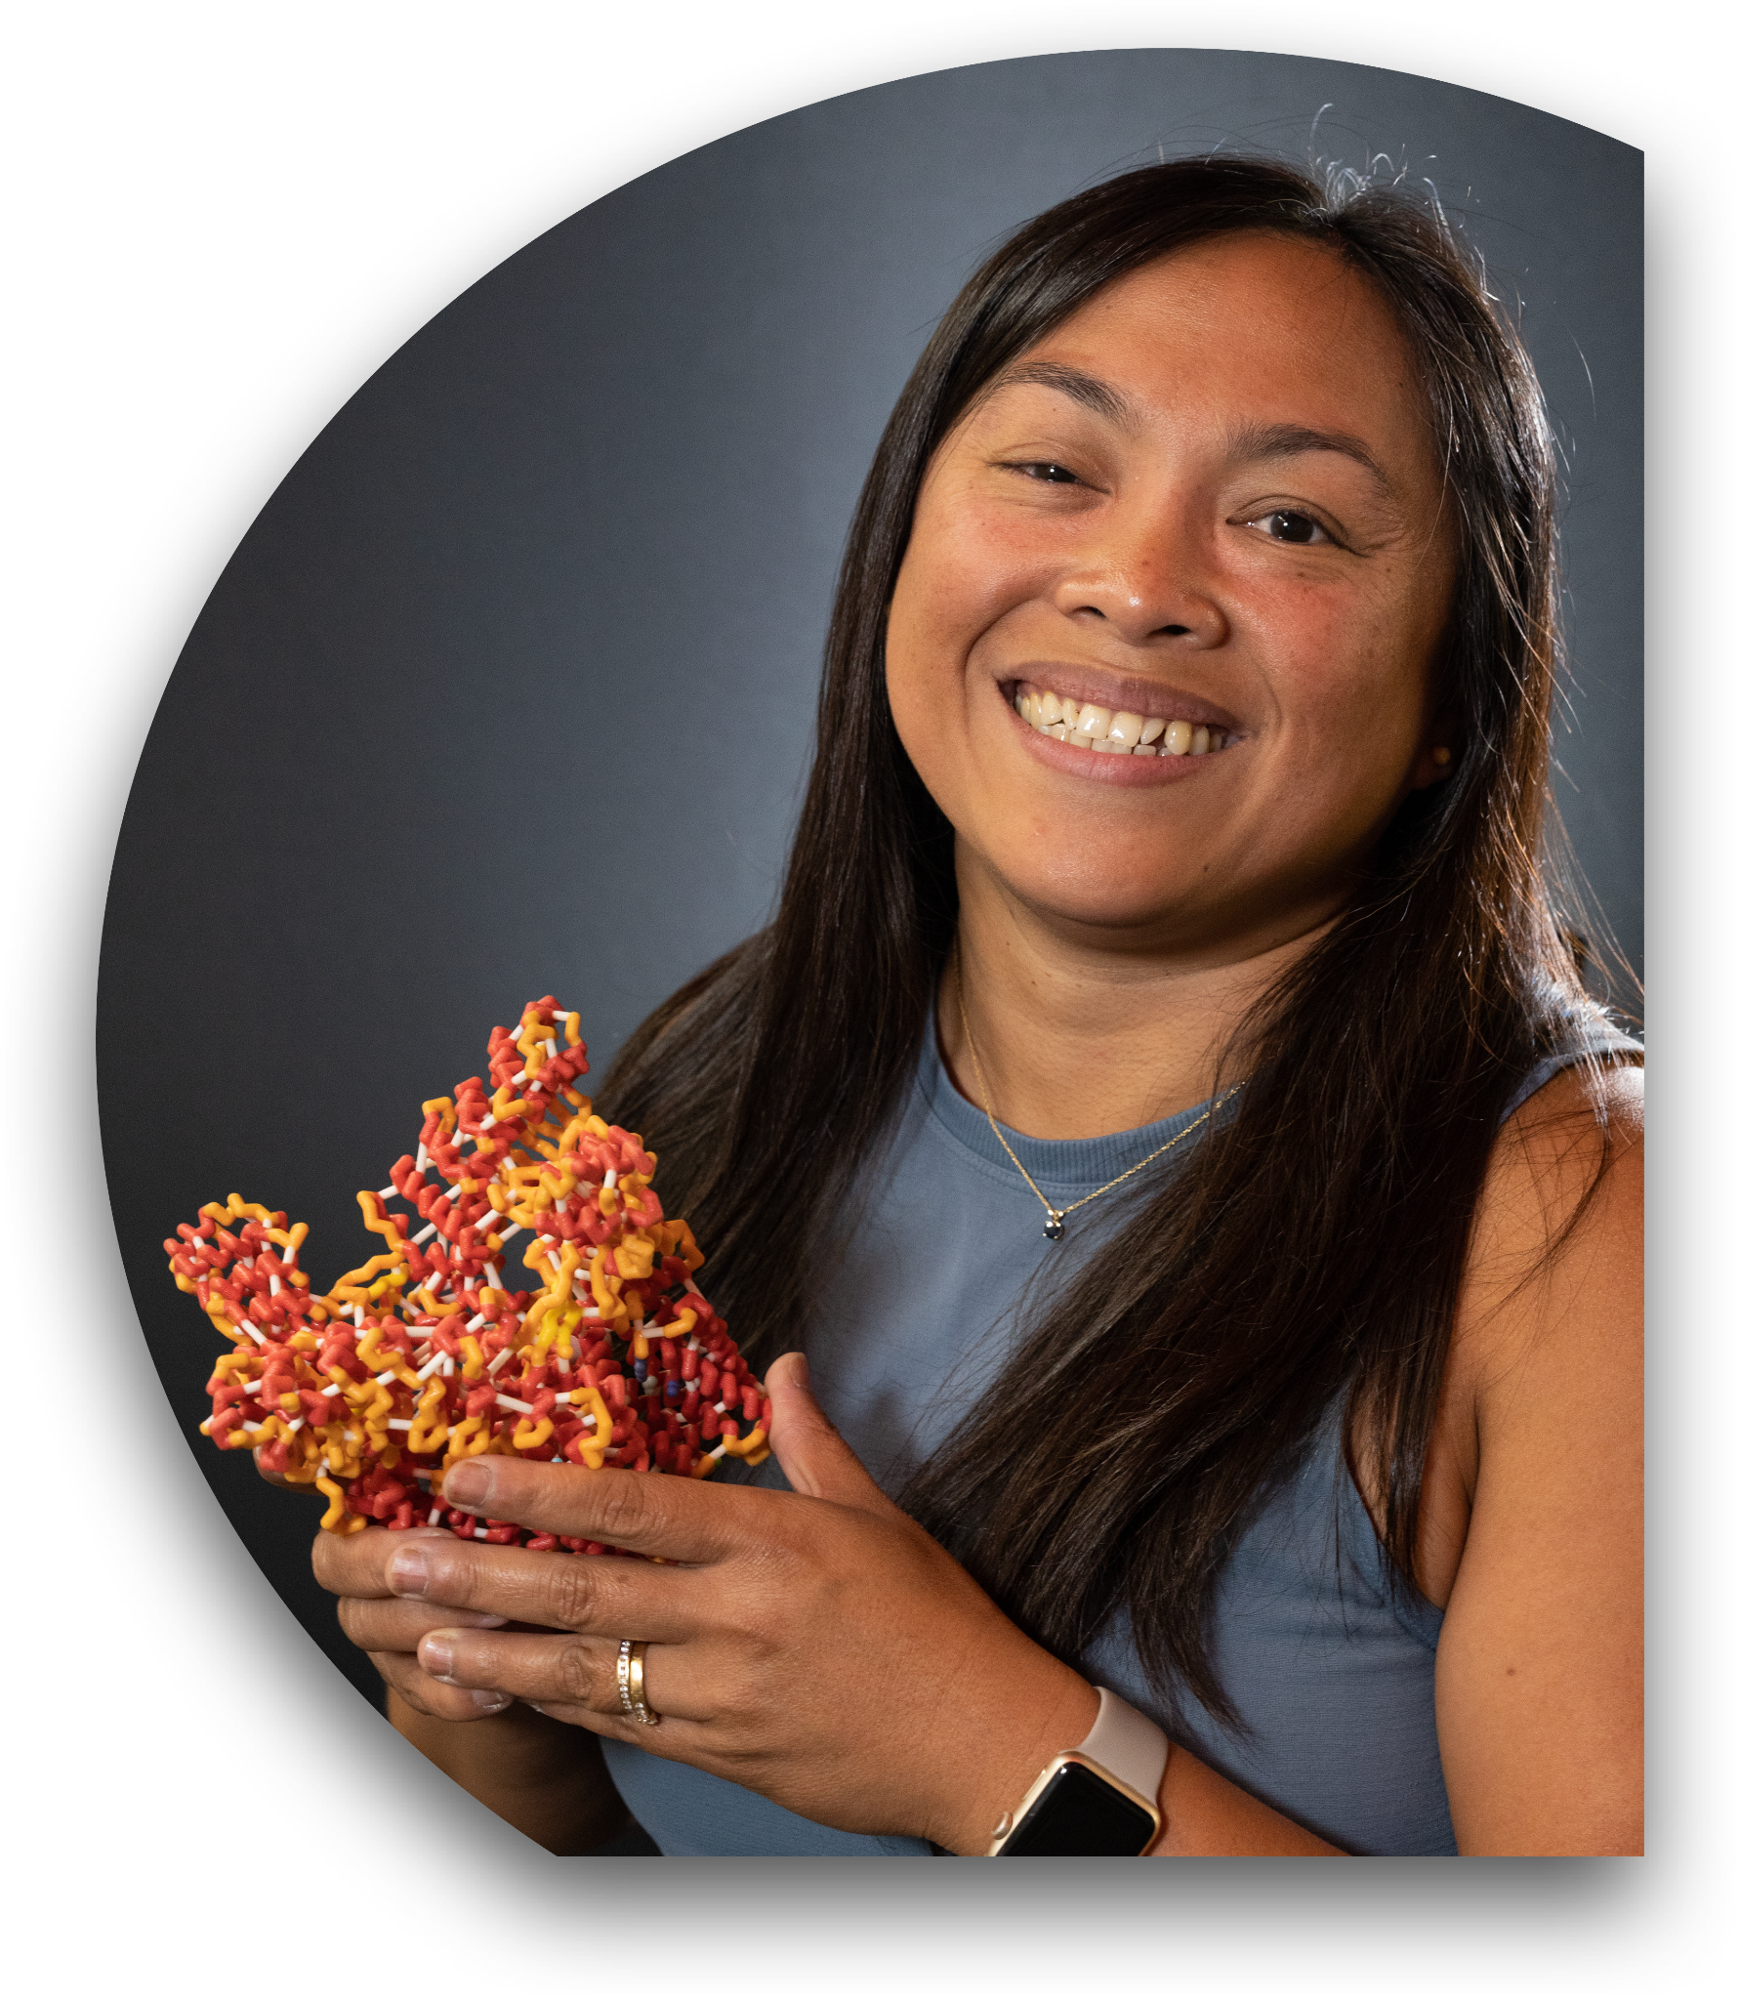
Choi Maner
Kohler High School, Kohler WI
Science educator for 19 years
Educator at KHS for 5 years, teaching Biology (General | Honors | AP); Biotechnology; Medical Terminology; and STEM 8
CBM participant for the following courses:
  Modeling the Molecular World - 2019
  Science & Ethics of Genome Editing (Cohort 3) - 2021, 2022
been using 3Dmol models in the classroom since 2016 (Model teacher since 2021)

Slide 3
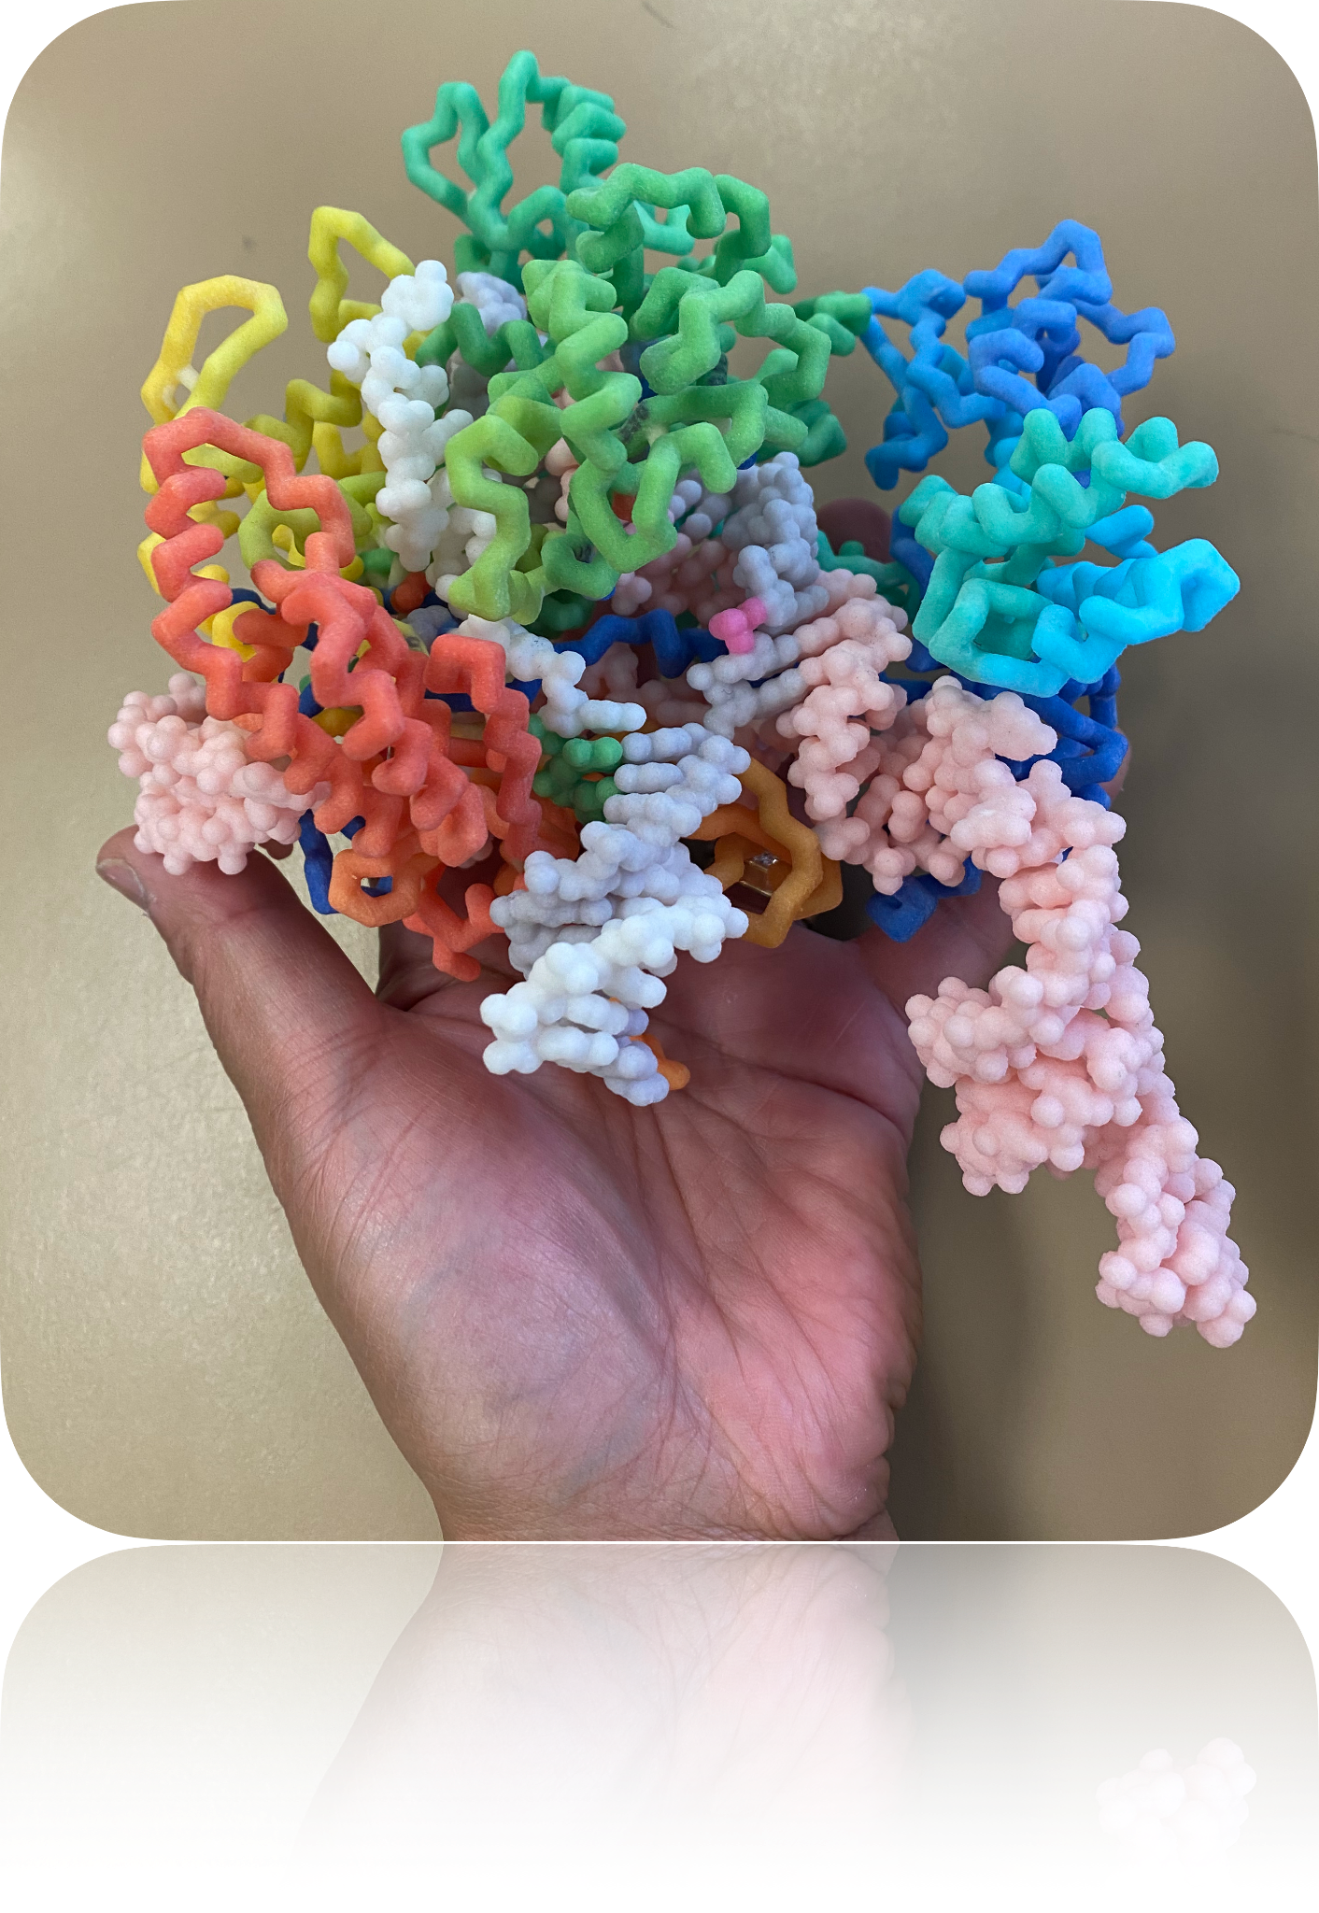

Summer Course Opportunities this Summer!
Modeling the Molecular World
  Session 1: June 26 - June 30
  Session 2: July 17 - July 21
3D Printing for the Biosciences Classroom
  July 1 or July 22
Scan the QR code for
more information.

Slide 4
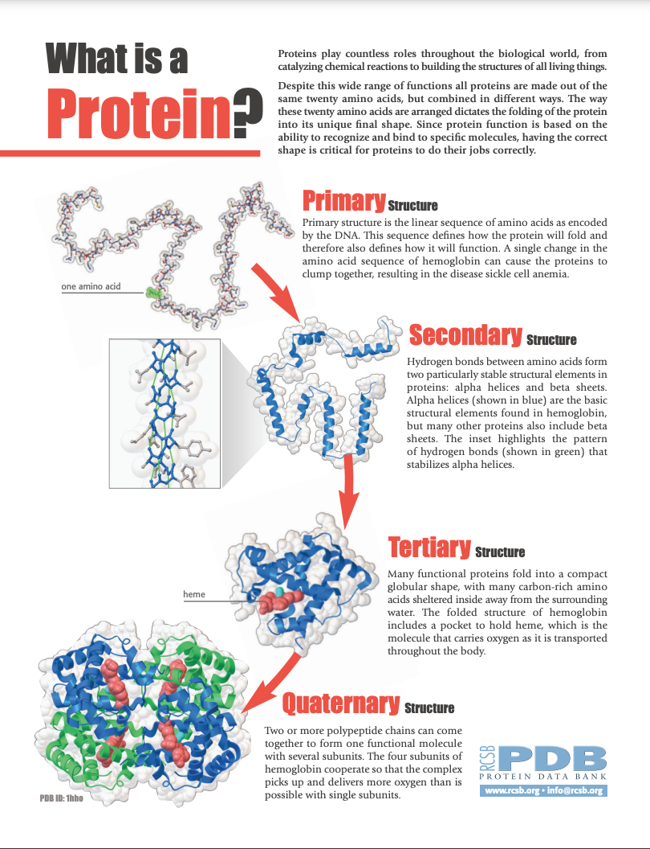
Why model protein structures?
Class Objectives:
Demonstrate how the structure of amino acids dictate their interactions and thus, overall behavior of the protein.
Demonstrate and explain how denaturation can impact the structure and function of proteins.
Explain how mutations can alter the structure and function of proteins.
Image credit: RCSB Protein Data Bank

Slide 5
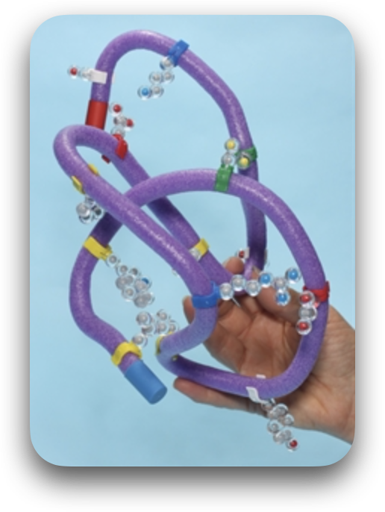
Target WI Science Standards:
Science Practice 2:
Developing and Using Models
Standard SCI.SEP2: Students develop and use models, in conjunction with using crosscutting concepts and disciplinary core ideas, to make sense of phenomena and solve problems.
Cross-cutting Concept 6:
Structure and Function
Standard SCI.CC6: Students use science and engineering practices, disciplinary core ideas, and an understanding of structure and function to make sense of phenomena and solve problems.

Slide 6
Target WI Science Standards:
Cross-cutting Concept 6:
Structure and Function
SCI.CC6.h Students investigate systems by examining the properties of different materials, the structures of different components, and their interconnections to reveal the system’s function and solve a problem. They infer the functions and properties of natural and designed objects and systems from their overall structure, the way their components are shaped and used, and the molecular substructures of their various materials.

Slide 7
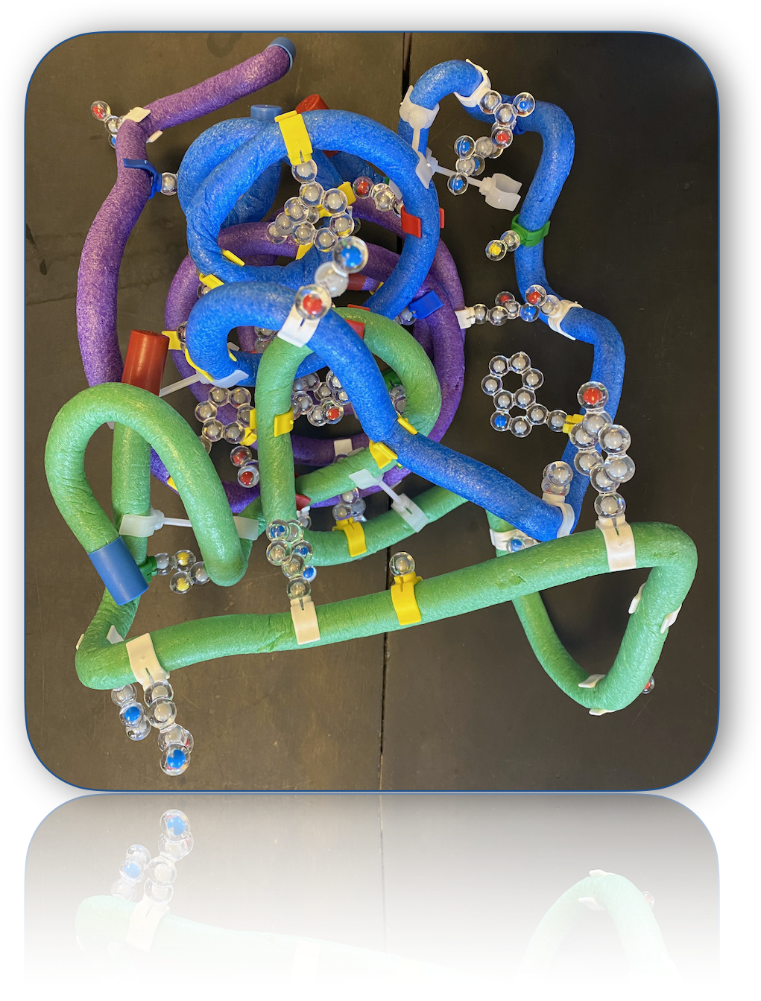
Why model protein structures?
Class Objectives:
Demonstrate how the structure of amino acids dictate their interactions and thus, overall behavior of the protein.
Demonstrate and explain how denaturation can impact the structure and function of proteins.

Slide 8
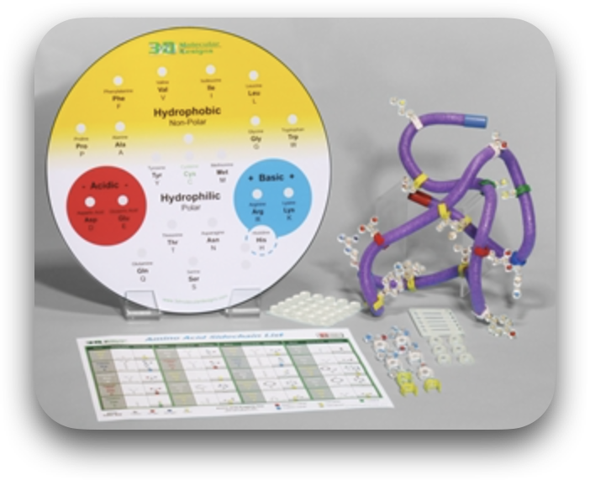
Workshop Outcomes
Educators attending this workshop will:
Model and visualize the formation of primary, secondary and tertiary protein structures, using the Amino Starter Kit.
Also build quaternary structures and manipulate their models further to demonstrate and explain how environmental factors can disrupt the molecular structure and denature proteins.

Slide 9
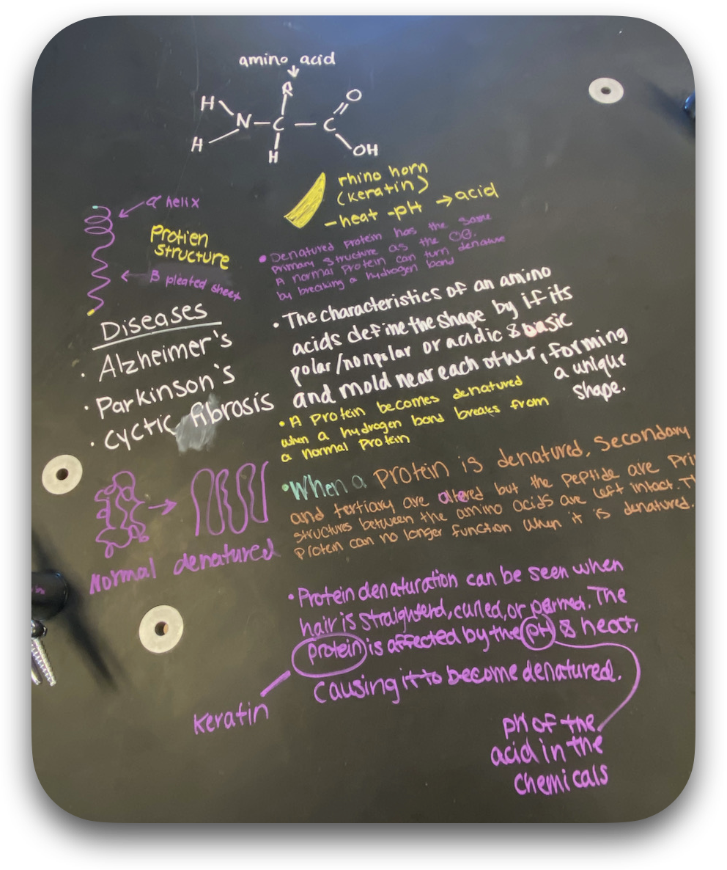
Workshop Outcomes
Educators attending this workshop will:
Also discuss how mutations can impact the structure and function of these biological molecules.
Discuss and share strategies on how this activity can be implemented in different grade and subject levels, including other phenomena that these models can demonstrate and explain.

Slide 10
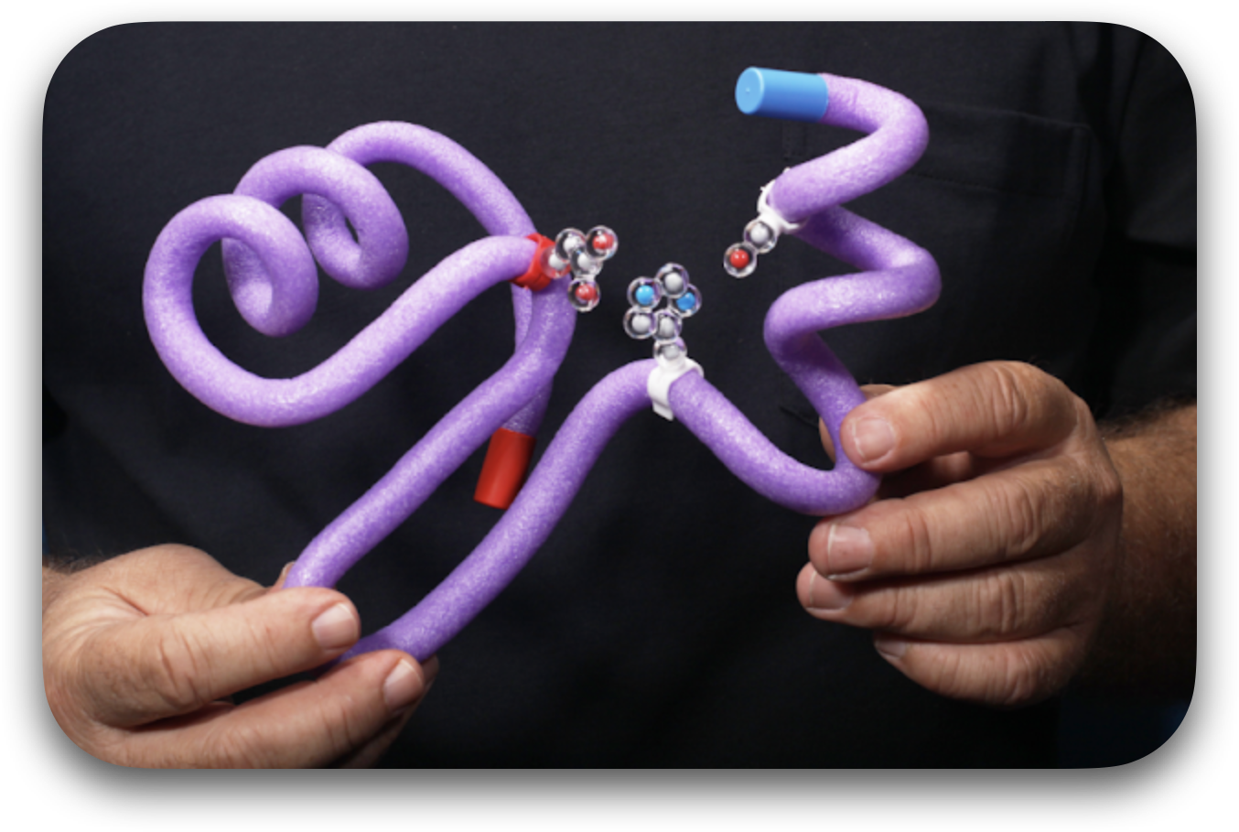
The objective is to bring these ideas to your classroom and help your students have a better appreciation and understanding of biomolecular processes while keeping them engaged and curious about explaining complex biological phenomena.

Slide 11
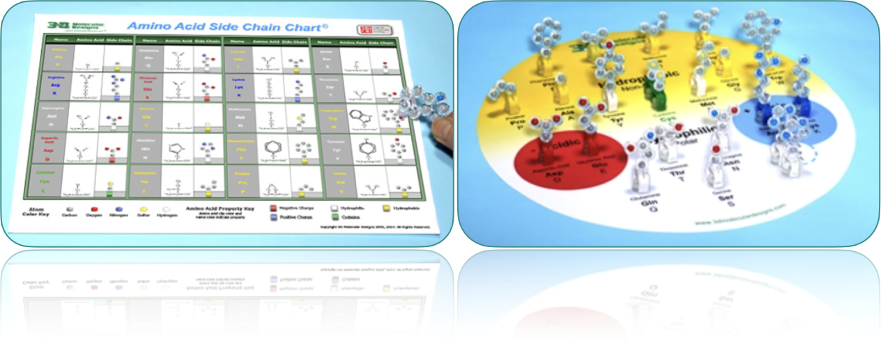
Step 1: Identify and sort the amino acids.

Slide 12
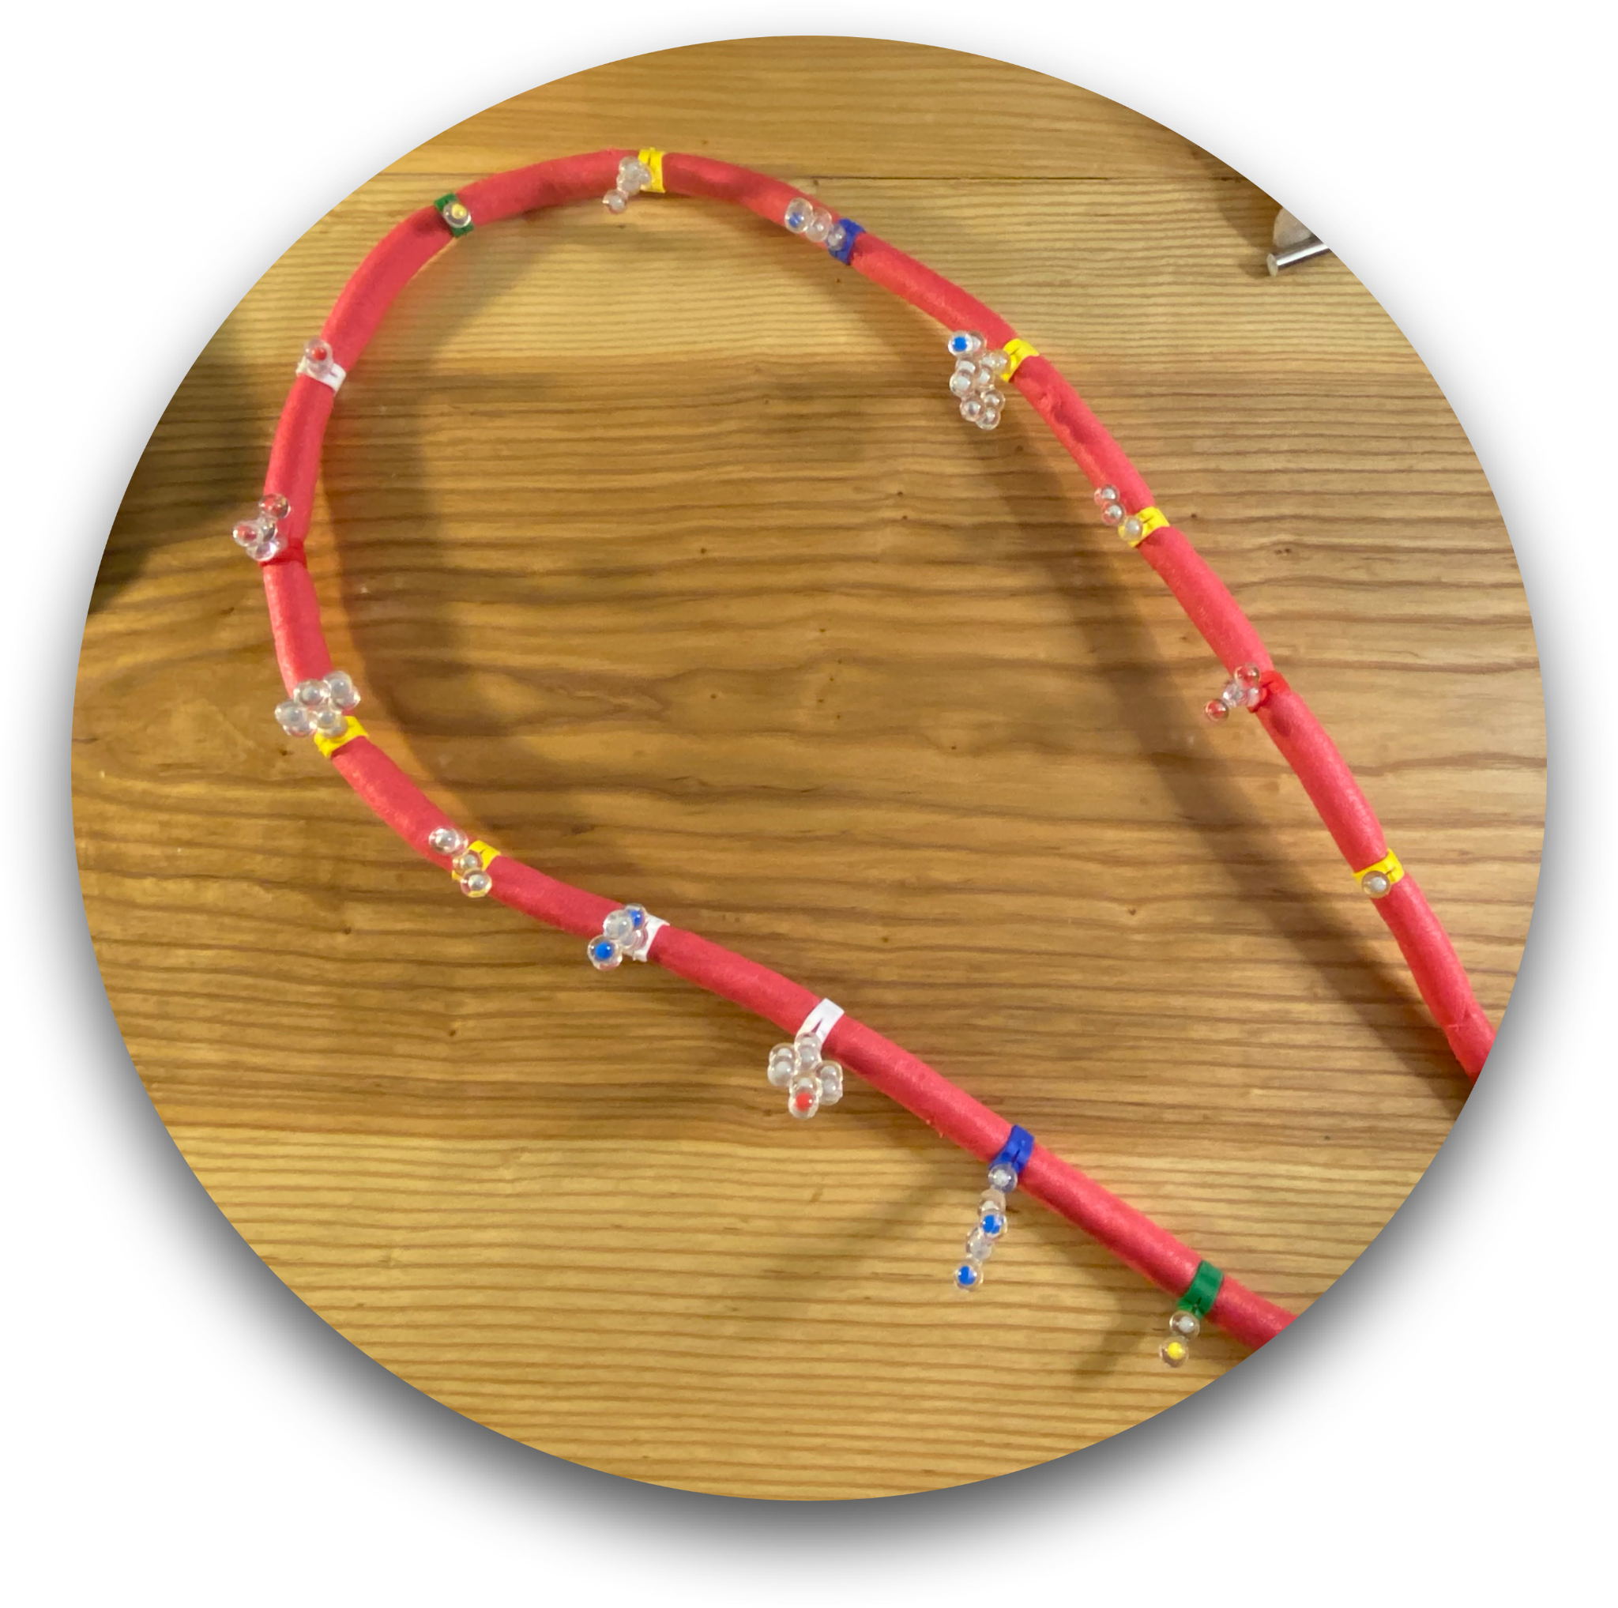
Step 2: Let’s form a primary structure.
Choose 15 amino acids with the following side chains from your kit:
  2 cysteine side chains (green).
  2 acidic side chains (red).
  2 basic side chains (blue).
  Your favorite 3 hydrophilic amino acids (white).
  Your favorite 6 hydrophobic amino acids (yellow).
Randomly distribute them on the TOOBER. (Space them about 6.5 cm apart to get an even distribution).

Slide 13
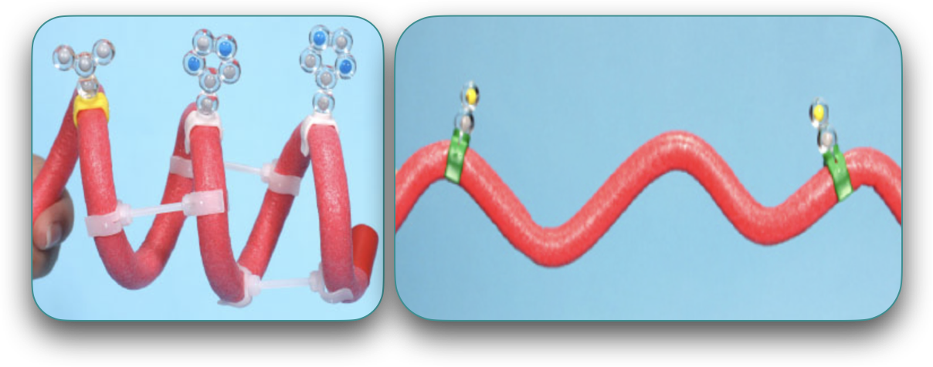
Step 3: Form a secondary structure.
Why are secondary structures important to protein structure and function?

Slide 14
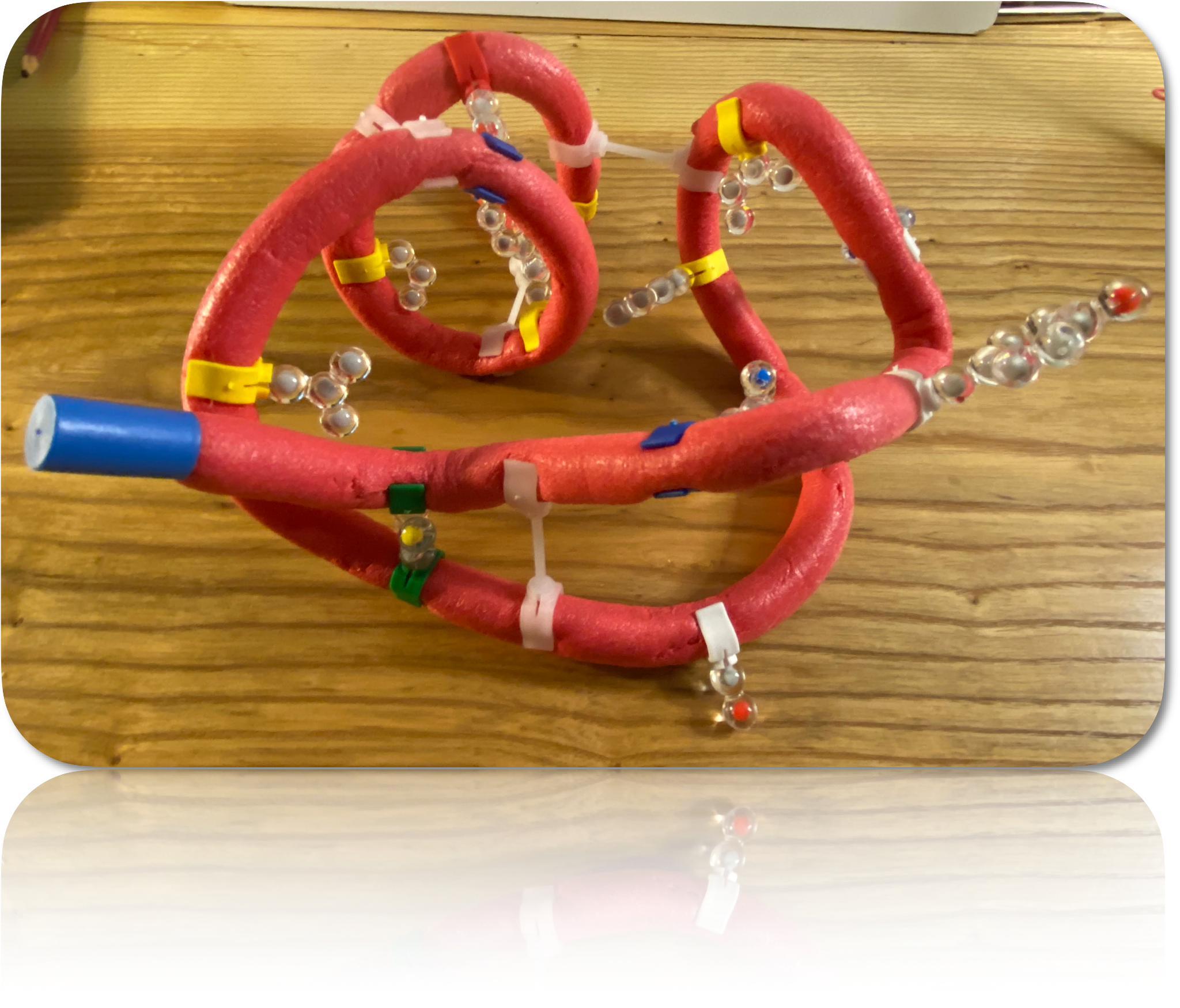
Step 4: Let’s build the tertiary structure.
Fold your protein according to basic principles of chemistry and physics:
In an aqueous environment, where do you expect the hydrophobic side chains to fold? Why?
Likewise, consider where the hydrophilic side chains would fold.
What interaction may occur between acidic and basic amino acids?
What interaction may occur between cysteine amino acids?

Slide 15
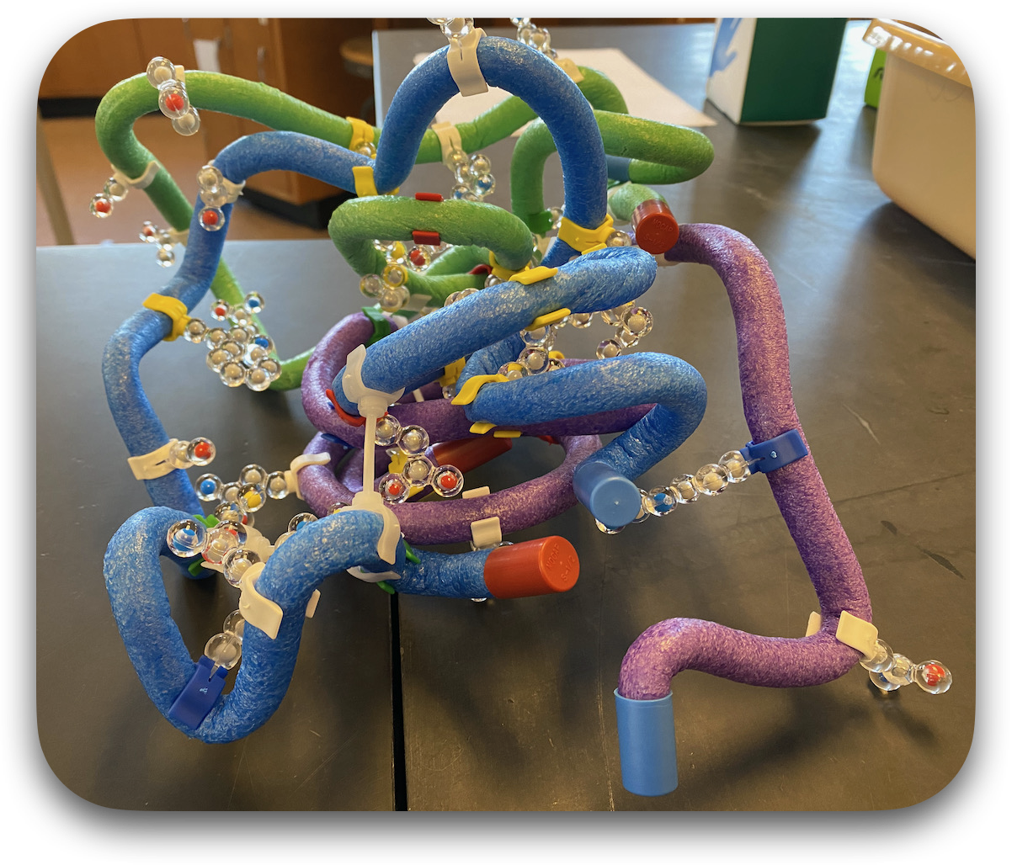
Step 5: Build the quaternary structure.
Using the tertiary structures that your table group built, make a multi-domain protein.
Keep in mind the basic principles of chemistry and physics!

Slide 16
Step 6: Observe and compare the structure of your proteins.
What factors could change the shape (denature) of a protein?
What factors could alter its structure?
What factors could impact its function?

Slide 17
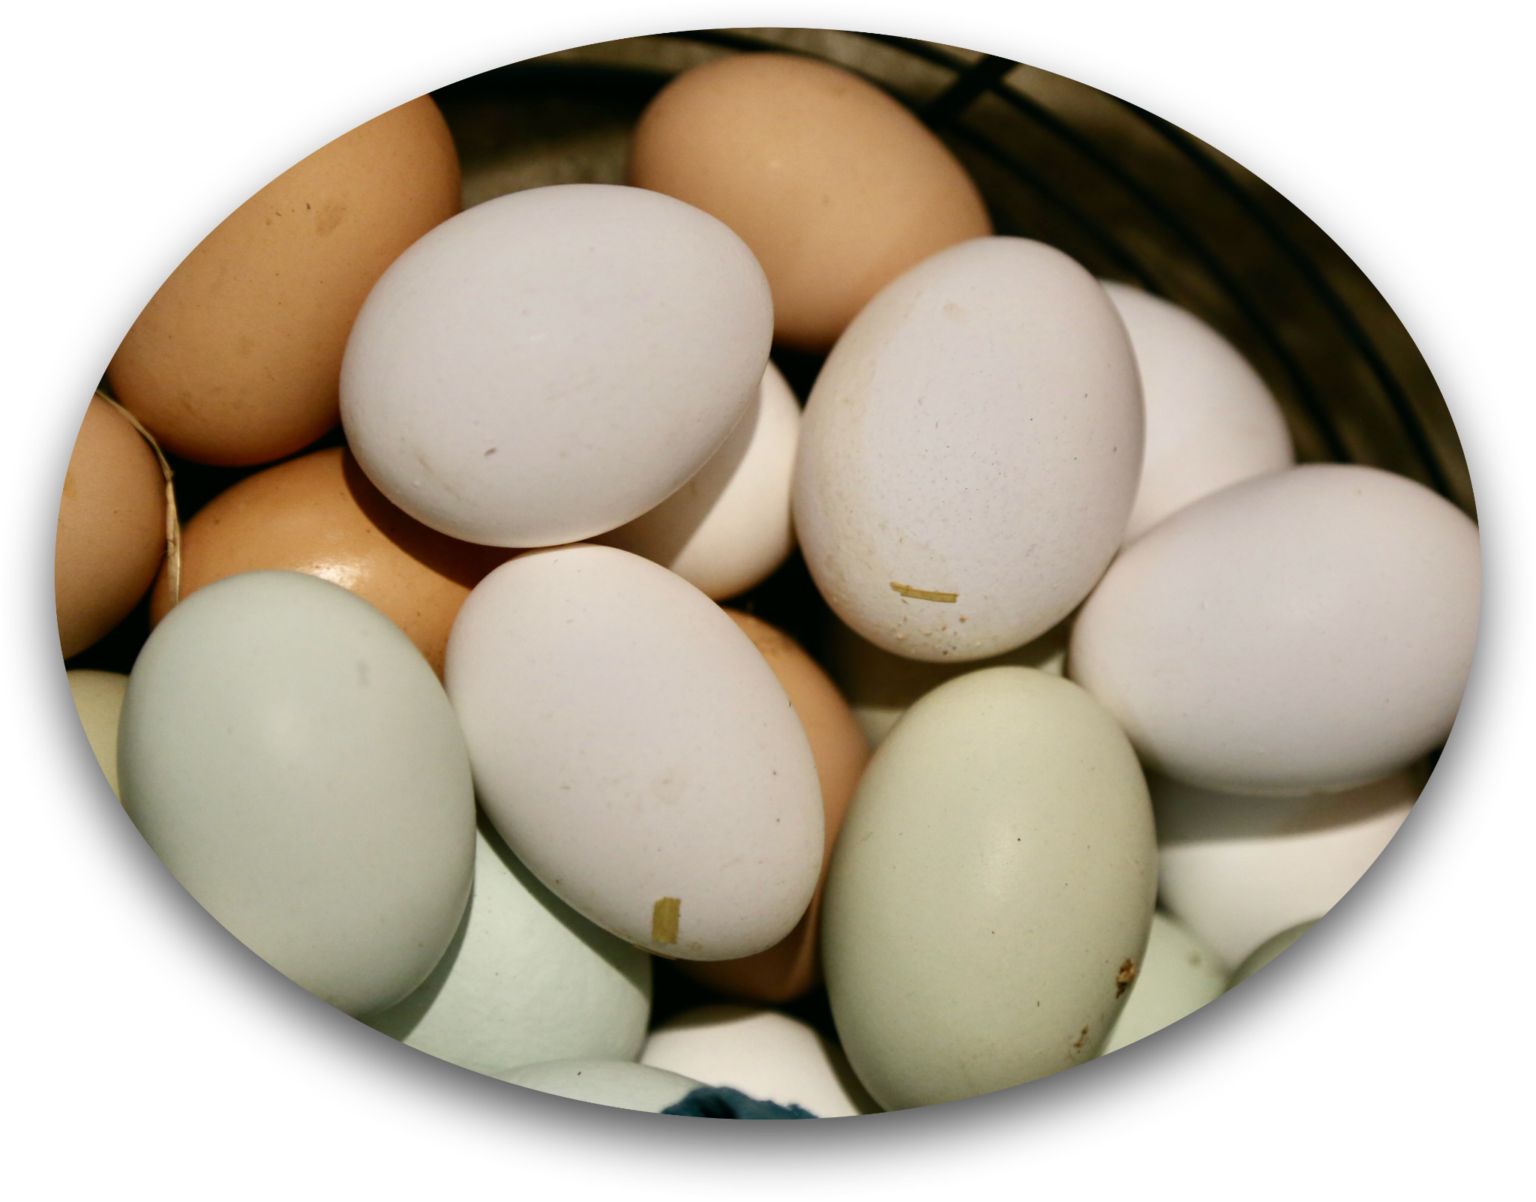
Step 7: Denature your protein.
“Why does the egg turn white when I cook it?”
Simulate denaturation by unraveling the domains.
How does this impact the active site on the protein?
How does this impact the function of the protein?

Slide 18
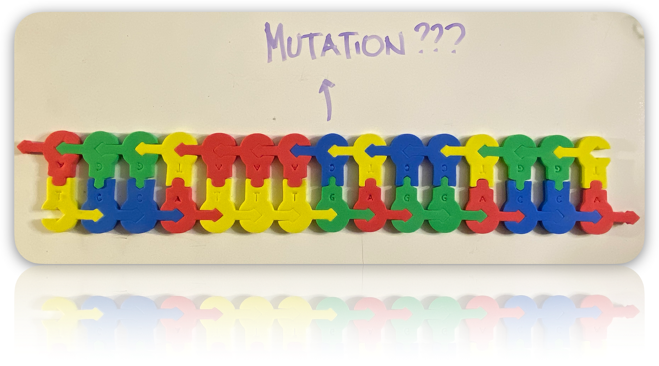
Step 8: What about mutations?
What if there was a mutation that occurred in the DNA?
How would you model:
silent mutation?
missense mutation?
nonsense mutation?
frameshift?
Let’s share ideas!

Slide 19
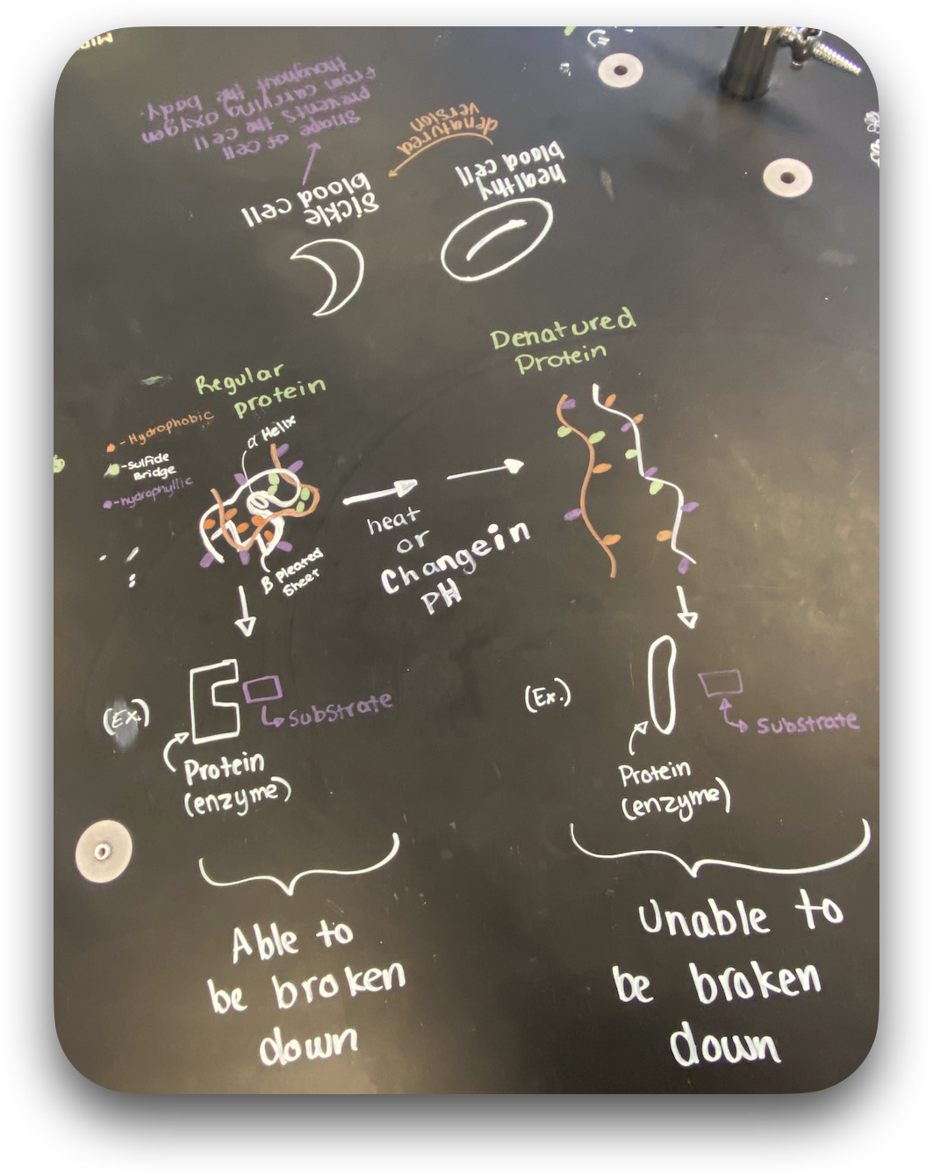
Classroom strategies
Connection to multiple topics, such as
Enzymatic activity
Gene expression
Mutations
Diseases + case studies
How would you use this in your classroom?
Let’s share ideas!

Slide 20
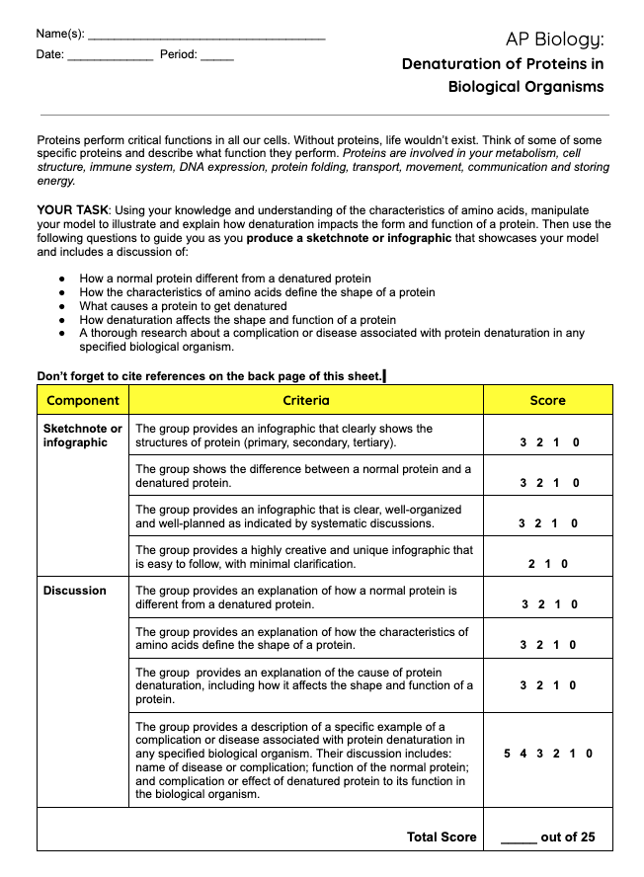

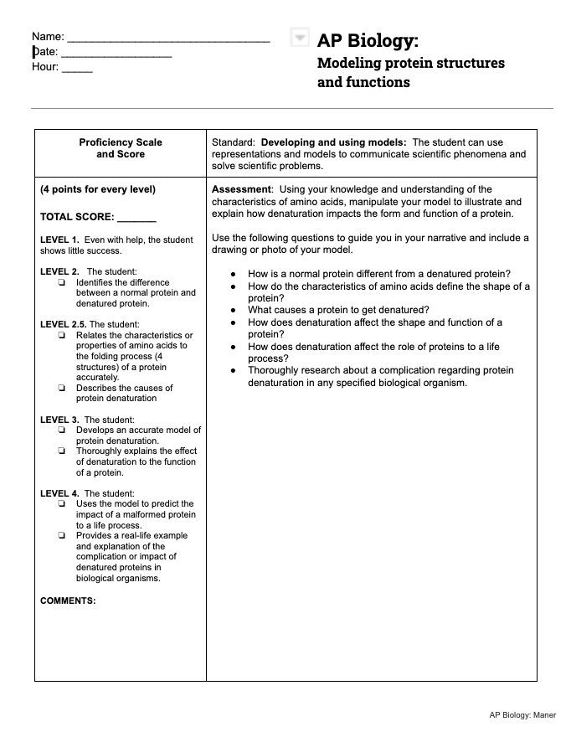

Classroom strategies
Protein Modeling Protocols:
version 1 →
version 2 (SBG) →

Slide 21
Questions?

Slide 22


How do I get these models and materials?
Kits and materials are available for purchase and use at 3dmoleculardesigns.com.
Scan the QR Code below for more details.
You can also borrow them from the lending library!
Scan the QR Code below for more details.

Slide 23
Thank you!

Slide 24


Please scan the QR code
AND
fill out the survey for a chance to win a $250 gift card from 3dmoleculardesigns!

