Slide 1
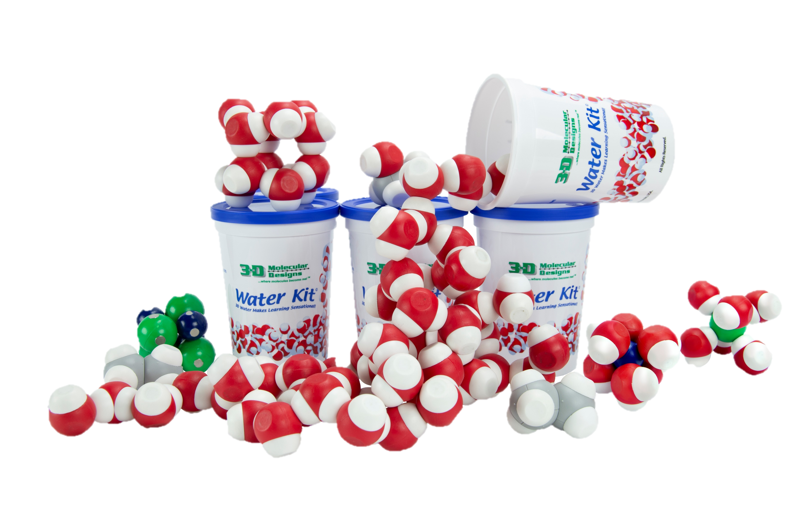
Linking laboratory observations and changes at the molecular level using hand-held models
Anne-Marie Nickel, PhD

Slide 2

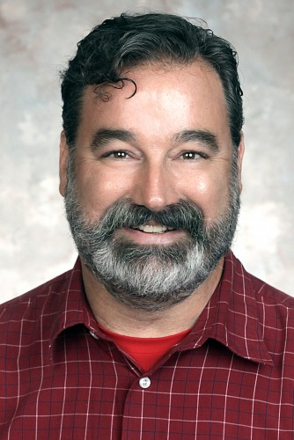
Anne-Marie Nickel, PhD
Professor of Chemistry
Milwaukee School of Engineering
Milwaukee, WI
21st year teaching chemistry at MSOE:
general chemistry
nanotechnology
food chemistry
general, organic and biochemistry for nursing students
PhD in Inorganic Chemistry from the UW-Madison
BA in Chemistry from Lawrence University
nickel@msoe.edu
Anne Alexander, PhD
Professor of Chemistry at MSOE
Michael Navin, PhD
Chemistry Technician and
Adjunct Faculty Member at MSOE

Slide 3
Workshop Learning Goals
Guided-inquiry learning activities to use with students
Discuss extensions of the activity to real-world applications
Evaluate hand-held model representations for their impact on learning
Experience activities first-hand that could be used in a virtual or in-person setting
Discuss connections to NGSS standards such as HS-PS1-3 and MS-PS1-2

Slide 4




Goals for Activity
Link observations of pure substances and mixtures to attractive forces between molecular models
IMF
IMF

Slide 5

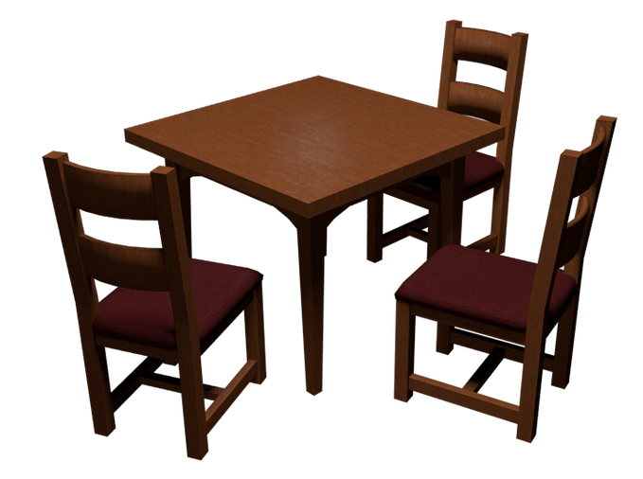
Goals for Activity
Link observations of pure substances and mixtures to attractive forces between molecular models

Slide 6
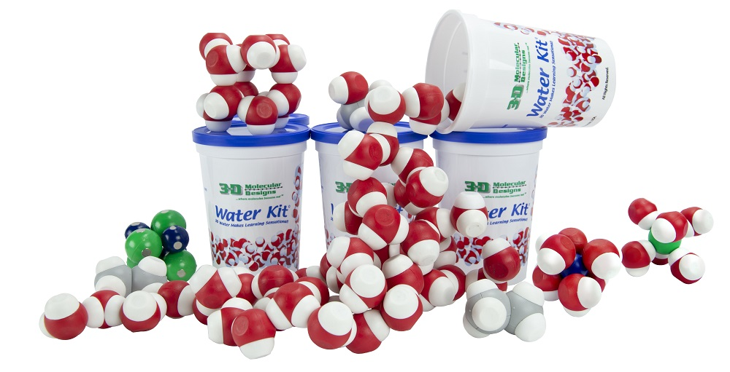
Let’s Play

Slide 7
Students:
engineering, nursing,
business
Duration:
30 - 40 minutes
Current Version
Implementation:
class or lab
Models:
water
ethanol
ethane

Slide 8
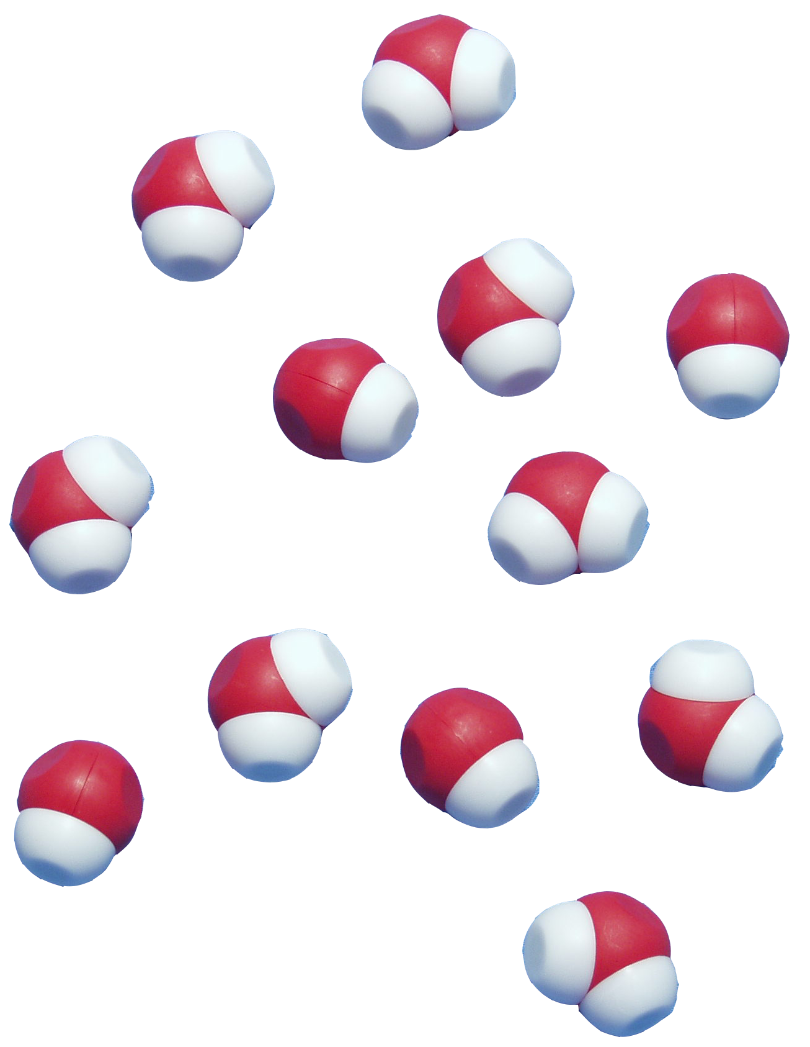
Learning Outcomes (Current Version)

Slide 9
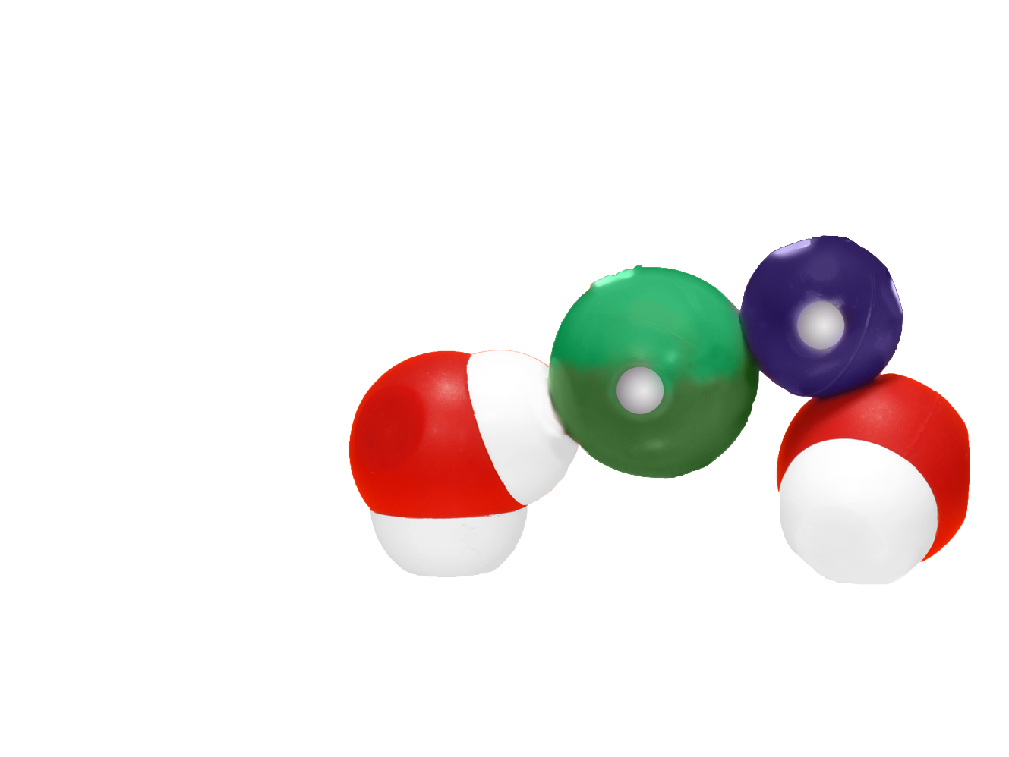
Learning Outcomes (Original Version)
Compare and contrast ionic, polar and non-polar molecules
Compare and contrast effects of hydrogen bonding on evaporation
Compare and contrast intermolecular interactions between ionic, polar and non-polar molecules
Evaluate small mixtures and the relevant intermolecular forces
Identify molecules as polar or non-polar and the appropriate intermolecular forces
Evaluate the relative strengths of ion-dipole, hydrogen bonding and ionic forces
Relate mixtures of different solutes in water to their environmental impacts

Slide 10

Reflection Exercise
40 CFR, Protection of Environment
40 CFR 51.100(s)
Volatile organic compounds (VOC) means any compound of carbon, excluding carbon monoxide, carbon dioxide, carbonic acid, metallic carbides or carbonates, and ammonium carbonate, which participates in atmospheric photochemical reactions.
https://ecfr.federalregister.gov/current/title-40

Slide 11
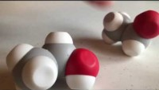
Current Version:
Evaporation: water and ethanol
Pure substances: water, ethanol and ethane (models)
Mixtures: water, ethanol, and oil (models and chemicals)
Original Version:
Evaporation: water and ethanol
Pure substances: water, ethanol, ethane and NaCl (models)
Mixtures: water, ethanol, oil, salt and sugar (models and chemicals)
Original Virtual Version:
Pure substances: water, ethanol and ethane (models)
Mixtures: water, ethanol, oil, salt and sugar (models and chemicals)

Slide 12
Reflection Exercise
Based on what you have learned about intermolecular forces, specifically as they relate to solvents, describe a situation where your choice of a solvent used in a specific application has or had a positive or negative impact on the environment.
This situation can be something from your own experience, or it can be a situation that you may encounter in the future based on your anticipated educational or career path.
Please explain the situation in enough detail to give the reader a clear understanding why you have chosen it as relevant to this activity.
Be sure to describe what the impact on the environment is/was, include what the intermolecular forces are relevant to your example, the physical properties of the solvent and how those properties led or will lead to the environmental impact you described.

Slide 13
Workshop NGSS Connections
SEPs | CCCs | DCIs
Asking questions | Cause and effect | LS1.A: Structure and function
Developing and using models | Structure and function | PS1.A: Structure and properties of matter
Constructing explanations |  | PS1.B: Chemical reactions

Slide 14
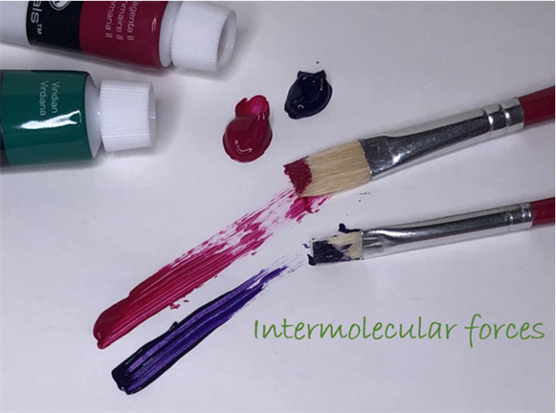

engineeringunleashed.com
Email me with questions:
Anne-Marie Nickel, PhD
nickel@msoe.edu
Introduction to Intermolecular Forces

Slide 15
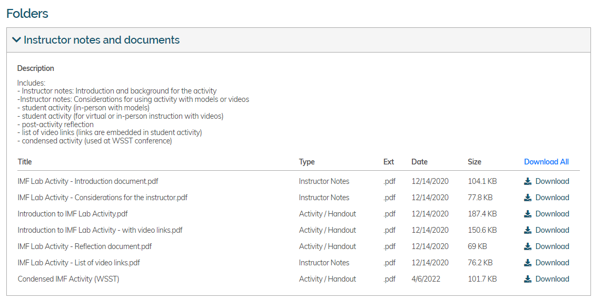
engineeringunleashed.com
Anne-Marie Nickel, PhD
nickel@msoe.edu
https://engineeringunleashed.com/card/2494

Slide 16

Access our 20% discount code by scanning this QR code:

