Slide 1
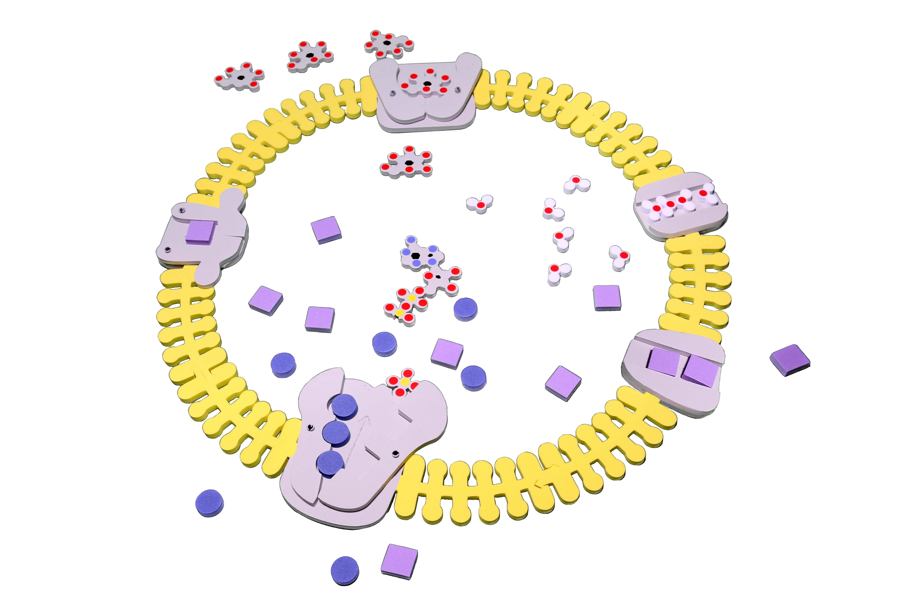
Get a Move On: Modeling Molecular Transport Across Cell Membranes
Susan Auld
Seehome High School

Slide 2

BUILDING THE CELL MEMBRANE
First Thought Experiment:
How would ten phospholipids need to be arranged to form a film at the top of a beaker of water? Think about hydrophobic tails/hydrophilic heads

Slide 3
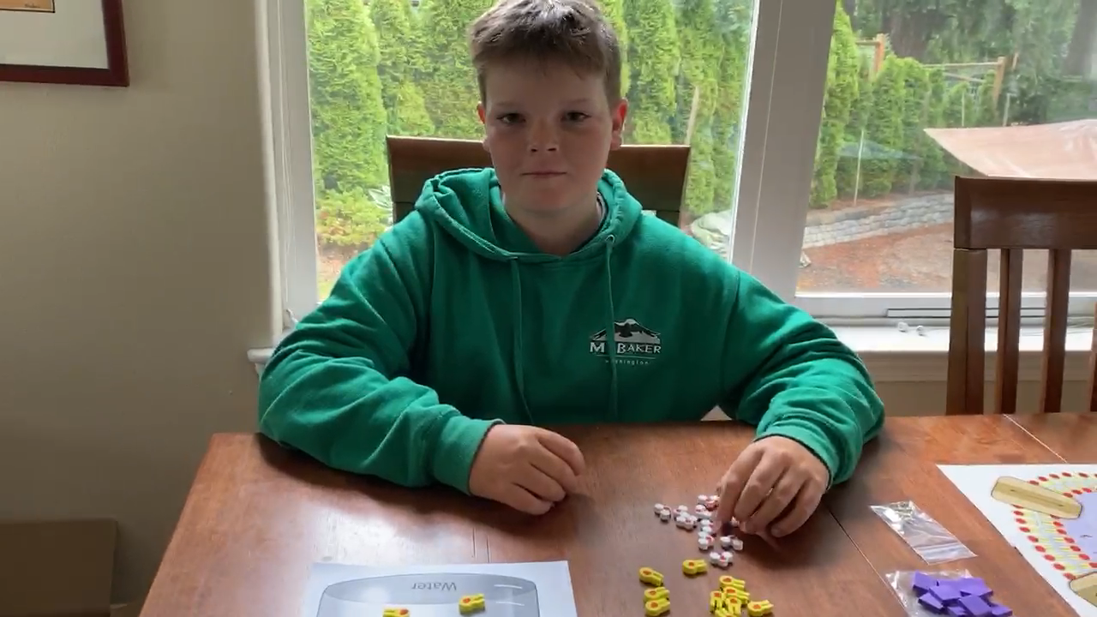
Student Demonstration of a single layer of phospholipids at the surface of a beaker of water.

Slide 4
Discussion questions?

Slide 5
BUILDING THE CELL MEMBRANE
First Thought Experiment:
How would ten phospholipids need to be arranged to form a film at the top of a beaker of water? Think about hydrophobic tails/hydrophilic heads

Slide 6
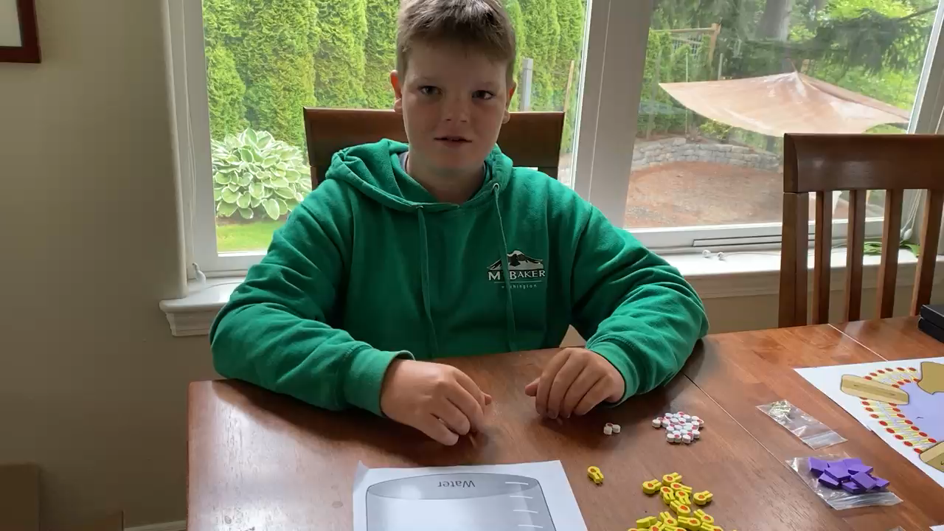
Student demonstration building a single layer of submerged phospholipids.

Slide 7
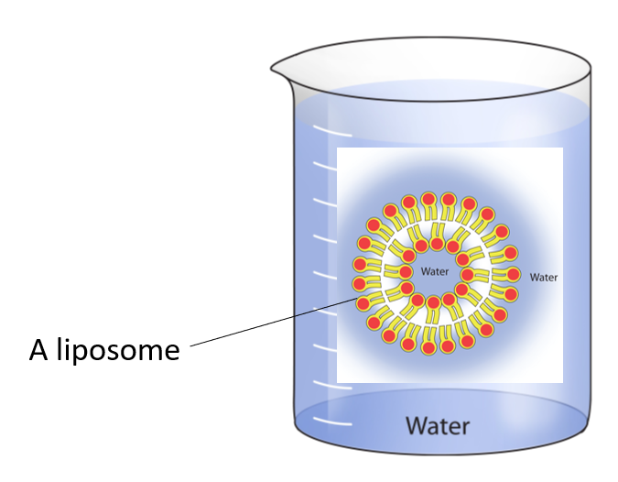
Discussion questions:
1. Are the phospholipid heads near water? Are the fatty acid tails shielded from water?
2. Is there more than one way to arrange these phospholipids to make this work? Kids are very creative during this challenge.
3. Do you think that we are missing part of the membrane? Would this solve the problem of getting necessary materials into the cell and getting rid of waste?

Slide 8
How are membranes involved in cell processes such as respiration?
Into Cell (across membrane)
Food (glucose)
Oxygen
Respiration (Glucose + oxygen --> water + carbon dioxide + ATP)
Out of cell (across membrane)
  Carbon Dioxide
  Water (?)

Slide 9
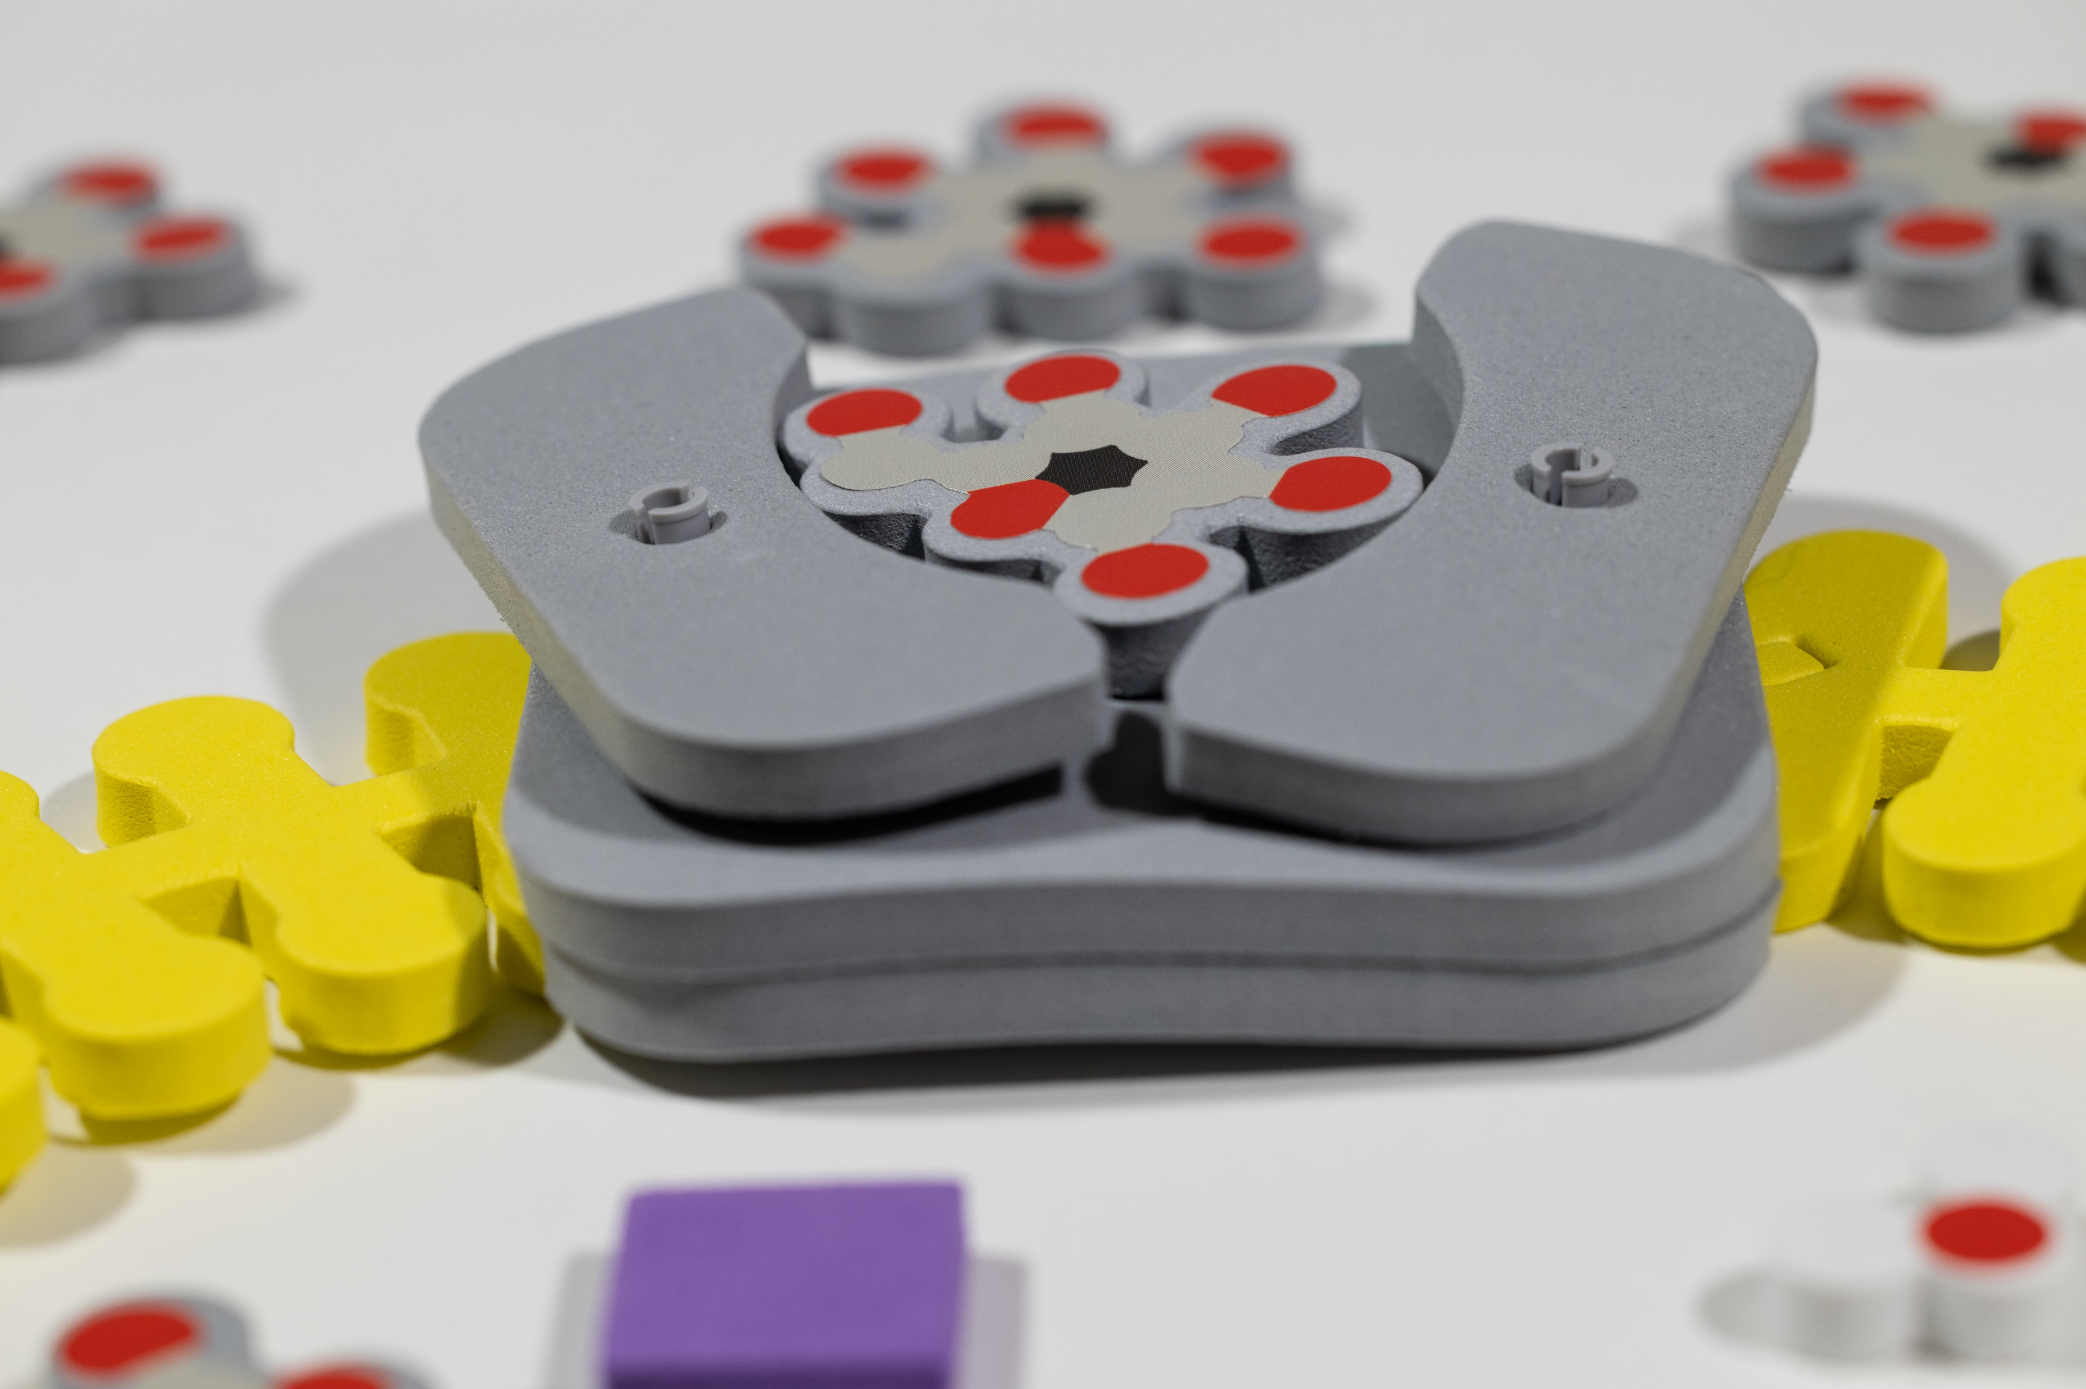
Glut1 is an example of a carrier protein that changes shape when it comes in contact with a particular molecule (glucose)

Slide 10
Looking further at what needs to get in and out of cell during respiration
Out of the cell
Carbon Dioxide
Water
Into the cell
Food (glucose)
Oxygen
Respiration (Glucose + oxygen --> water + carbon dioxide + ATP)

Slide 11
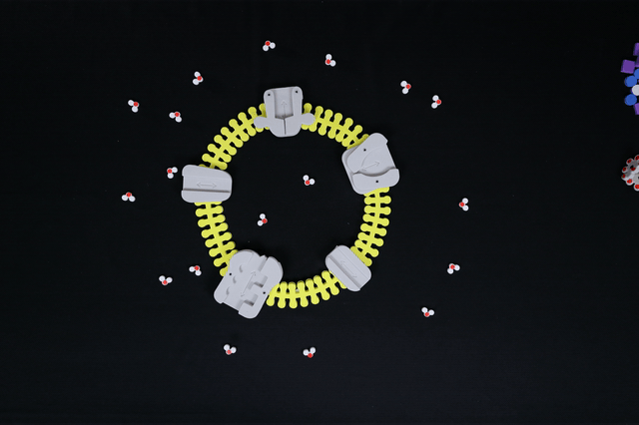
Misconception: Water just goes through the membrane. Hydrophilic water molecules would have a difficult time going through a membrane that contains hydrophilic tails.
Solution to the problem: Add a unique protein (aquaporin) that is a specific shape and has a hydrophilic interior so that water can cross the membrane.

Slide 12
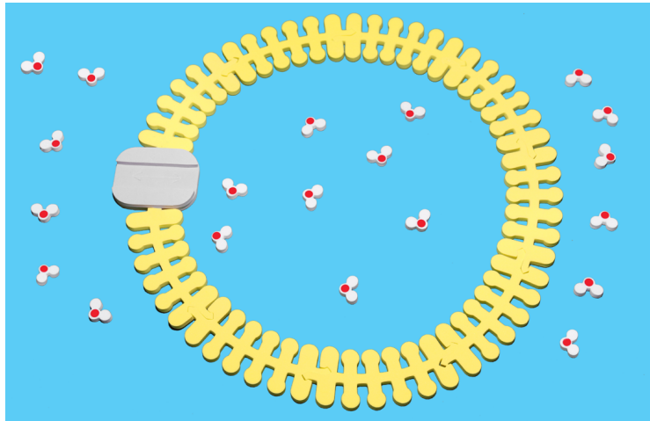
  Set up a system where the water molecules have a higher concentration outside than inside the cell.
  If molecules move randomly, show where the water molecules may be after some time.

Slide 13
Looking further at what needs to get in and out of cell during respiration
Out of the cell
Carbon Dioxide
Water
Into the cell
Food (glucose)
Oxygen
Respiration (Glucose + oxygen --> water + carbon dioxide + ATP)

Slide 14
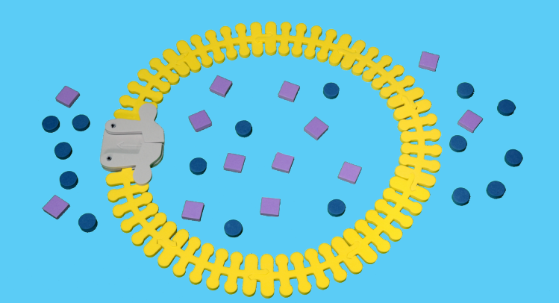
Extensions
Gated Channels: Potassium-gated channels - some channel proteins open in response to a stimulus.
Potassium and Sodium channels are an example of this.

Slide 15
Workshop NGSS Connections
SEPs​ | CCCs​ | DCIs​
Asking questions ​ | Patterns​ | PS1.A: Structure andproperties of matter​
Developing and using models​ | Cause and effect​ | PS1.B: Chemical reactions​
Constructing explanations​ | Scale, proportion, and quantity​ | LS1.A: Structure and function​
​ | Structure and function​ | LS1.C: Organization for matter and energy flow in organisms​

Slide 16


Summer Course 2023 – Modeling the Molecular World
Join us in Milwaukee for hands-on discovery and professional development
July 29 – Aug 2 OR Aug 5 – 9
Scan to register!
Bring an empty suitcase!
You'll take home all these classroom resources!

Slide 17


Slide 18
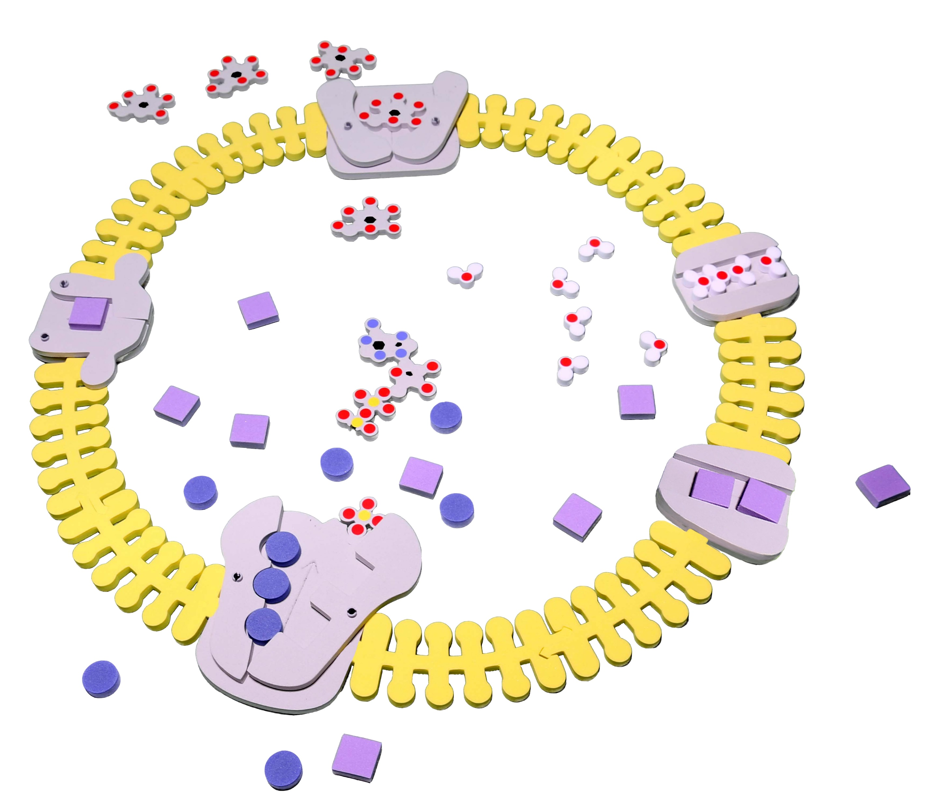
Thank you for attending!
Kits and models used in this session:
Phospholipid & Membrane Transport Kit©
Purchase kits and borrow Kits and Models at 3dmoleculardesigns.com.
Use discount code FC23 to receive 20% off most items in our catalog.

