Slide 1

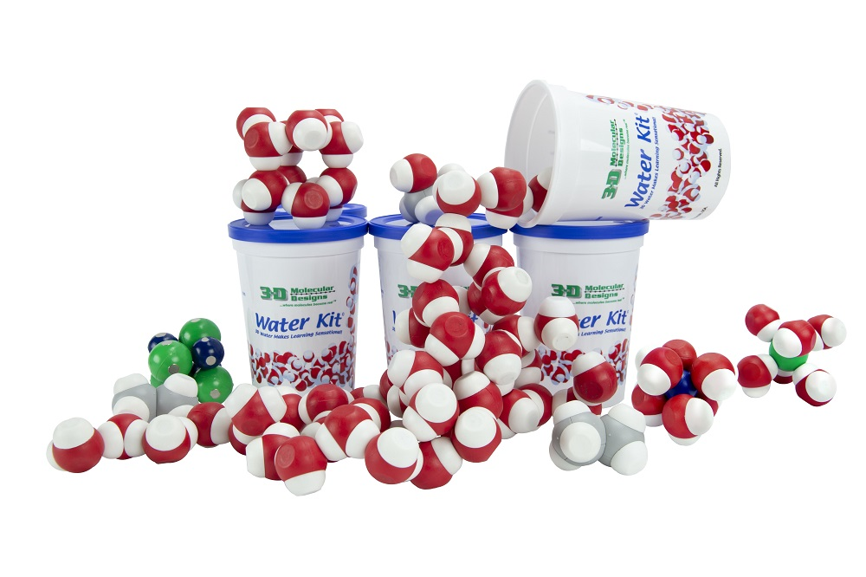
From Particles to Properties: Chemistry Concepts with Water Models
Notes:
For this presentation, we will use the Water Kit, Phospholipids Molymod Models, the Phospholipids and Membrane Kit, and several 3D printed models (aquaporin, potassium voltage-gated channel, and sodium voltage-gated channel).

Slide 2

Presenter:
RUTH HUTSON,MSSE
3D Molecular Designs Science Educator
Notes:
I’m Ruth Hutson, a 3D Molecular Designs Science Educator. I’ve been teaching for 25 years . Before coming to 3DMD, I was the science department at a small rural high school in Northeast Kansas and taught Concurrent College Biology, biology, chemistry, physics, and Earth Science . I discovered the 3DMD products in 2015 and loved using them with all of my classes. Today I'd like to share with you how I use these kits with my chemistry and Earth Science classes.

Slide 3
Workshop Learning Goals
Learn strategies for using hands on models to explain structure-function relationships.
Use models to compare the structure of water at the macroscopic level (the bulk scale) to infer the strength of electrical forces between particles (NGSS HS-PS1-3).
Explore how models can be used to describe the atomic composition of simple molecules and extended structures (NGSS MS-PS1-1).
Measure and graph quantities to provide evidence that regardless of the type of change that occurs when heating, cooling, or mixing substances, the total weight of matter is conserved (NGSS 5-PS1-2)
Have fun!
Notes:
Ruth says We are going to be modeling with the Water Kit and the NaCl Lattice. We use both of these kits throughout the year. At the end of this session, you should be able to… read goals from slide).
So let’s get started with some modeling [Advance slide]

Slide 4
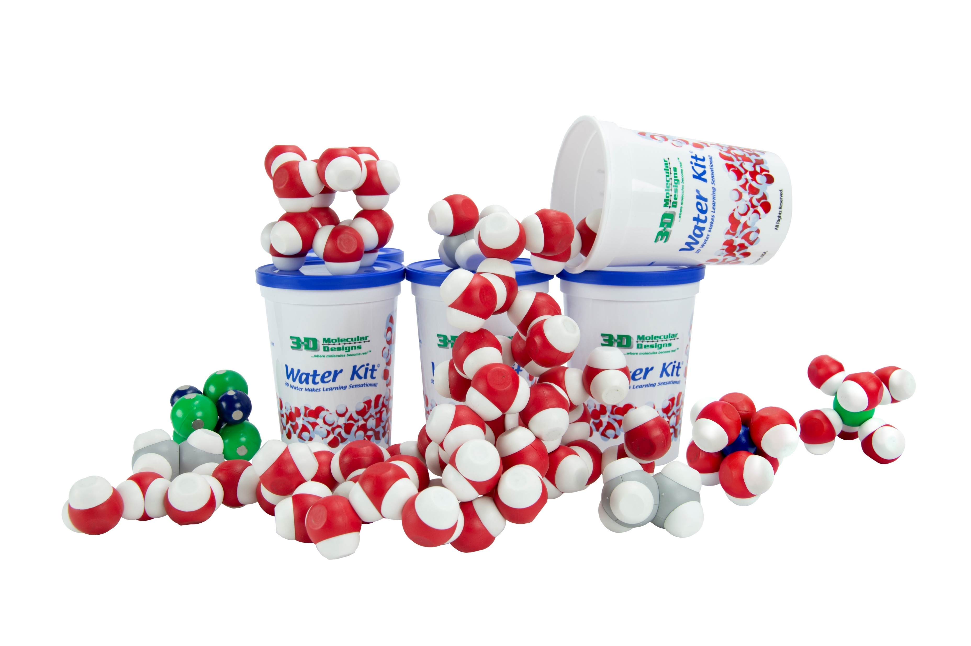
Notes:
Ruth says: The first kit that I want to outline is the water kit. In August when school starts students are firsts introduce to the kit as we are establishing classroom norms and learning how to use models as tools to better help us understand what is happening at the molecular level in many of our laboratory investigations. We continue to use it whenever talk about water. You have this kit on the tables for your use during this session. Please work together with the people at your table as we begin to do some modeling . [Advance slide]

Slide 5
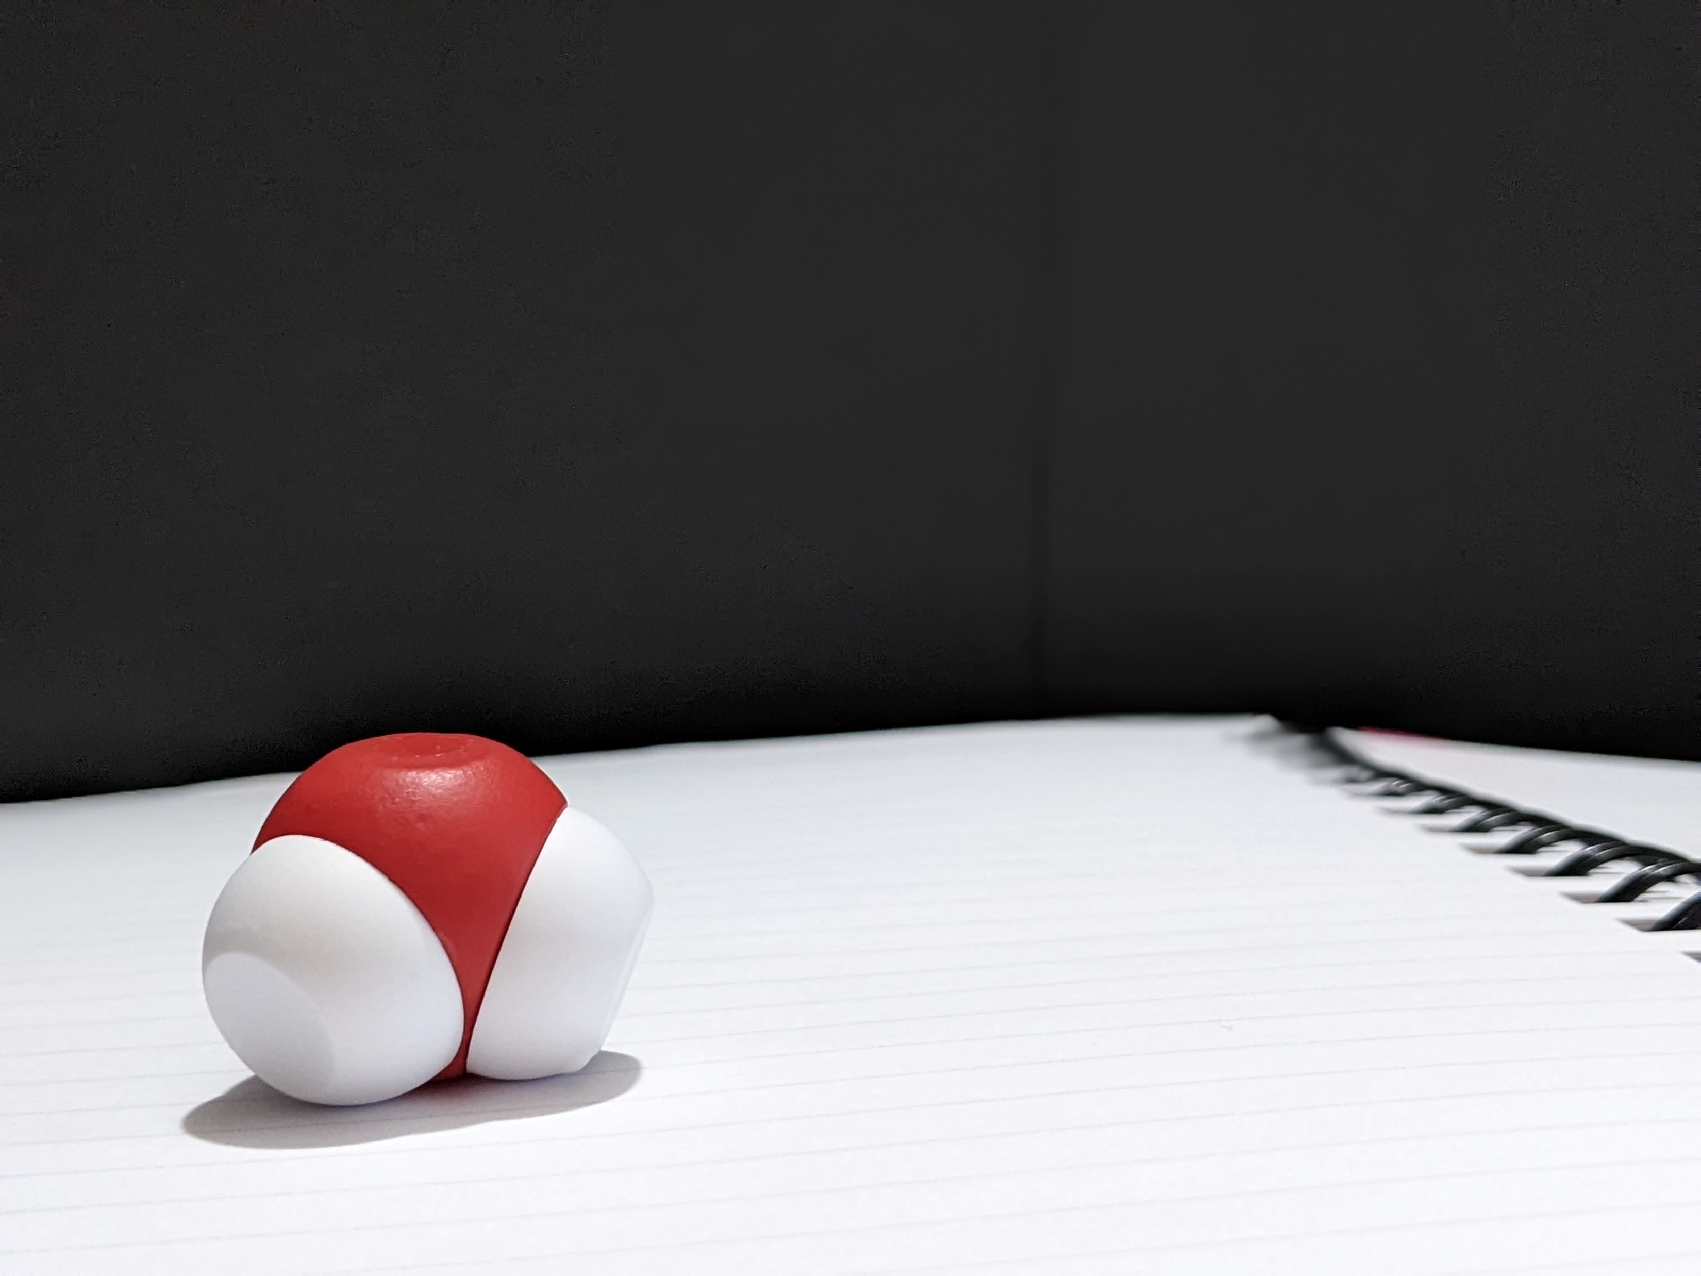
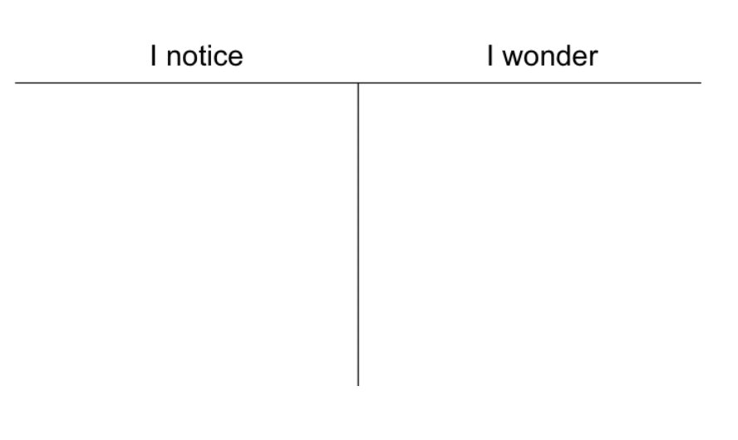
Notes:
Ruth says: Materials management is a must for my classes. I start by having students look at one molecule of water. Please open your cup of water and retrieve one water molecule from it. Each of my students or student group (depending on class size) have a cup of water to work with. I first ask my students to observe a single water molecule and then they get out a second molecule. Would you put your student hat on and observe how you think your students would play with the kit? [Advance slide.]

Slide 6
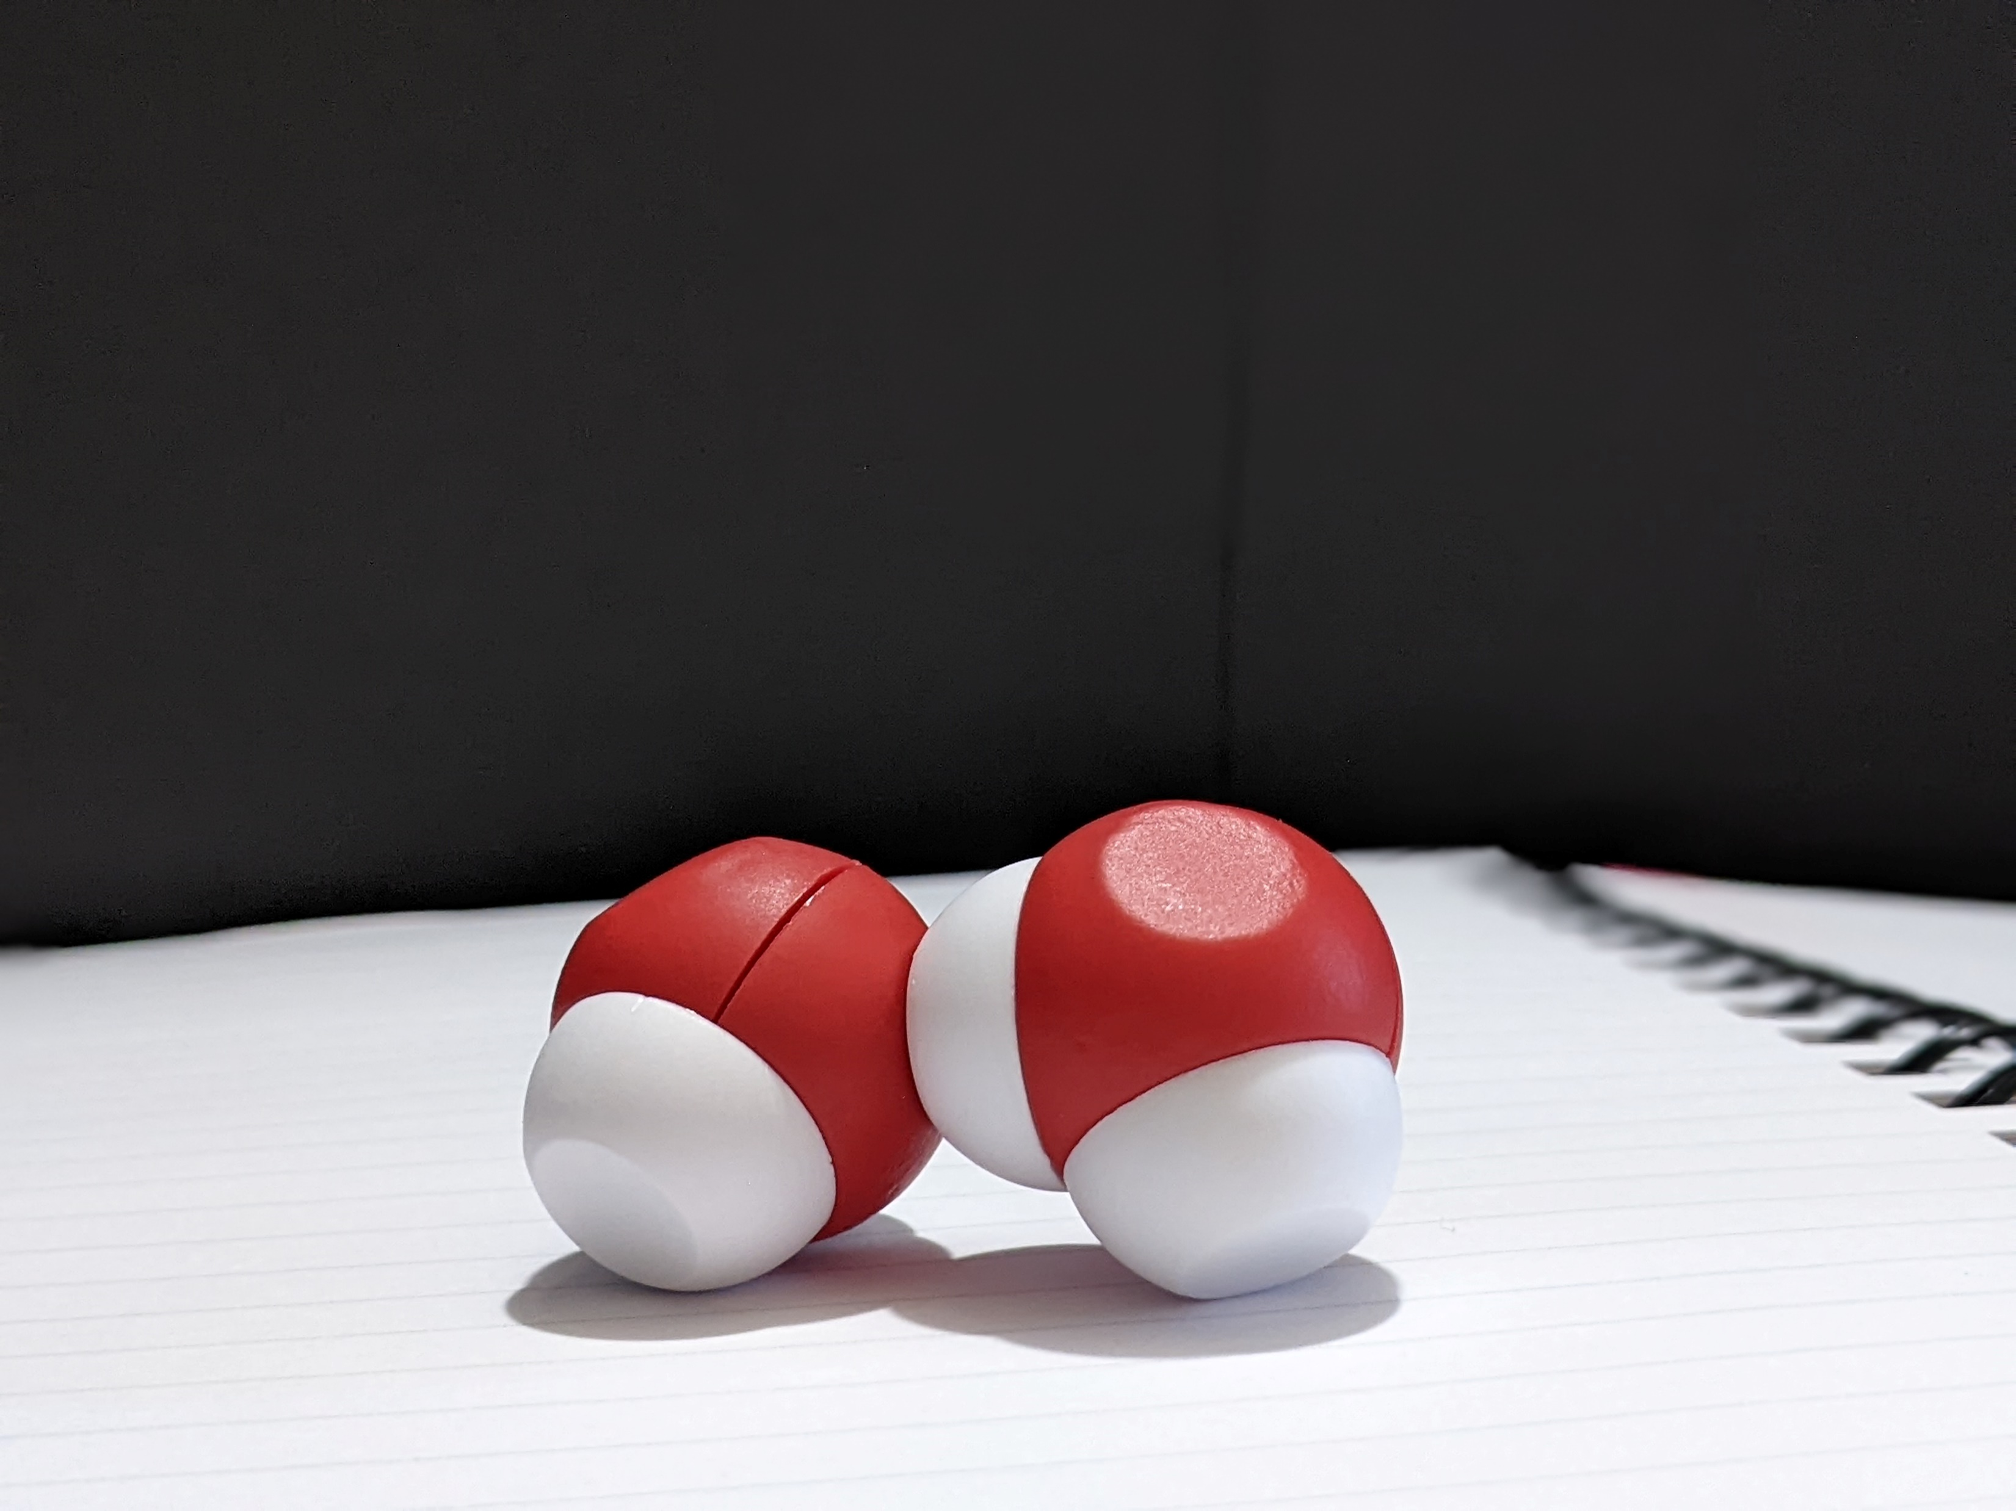
Notes:
[Give 1 minute to see how the two molecules interact and walk around the room giving feedback to participants.] Hopefully, I’ve given you enough time to observe how your water molecules interact. After students initial observations, I ask them to complete a notice|wonder chart. Because this is one of the first modeling experiences they would have at the beginning of the year, we use a notice|wonder chart as it is low risk and it encourages students to write what they observe without attaching any scientific vocabulary to it. [Advance slide.]

Slide 7
What patterns do you see?
What questions do you have?
Notes:
I ask them to follow up their initial observations by answering the questions [Read questions from screen] in their notice wonder chart. [Advance slide.]

Slide 8
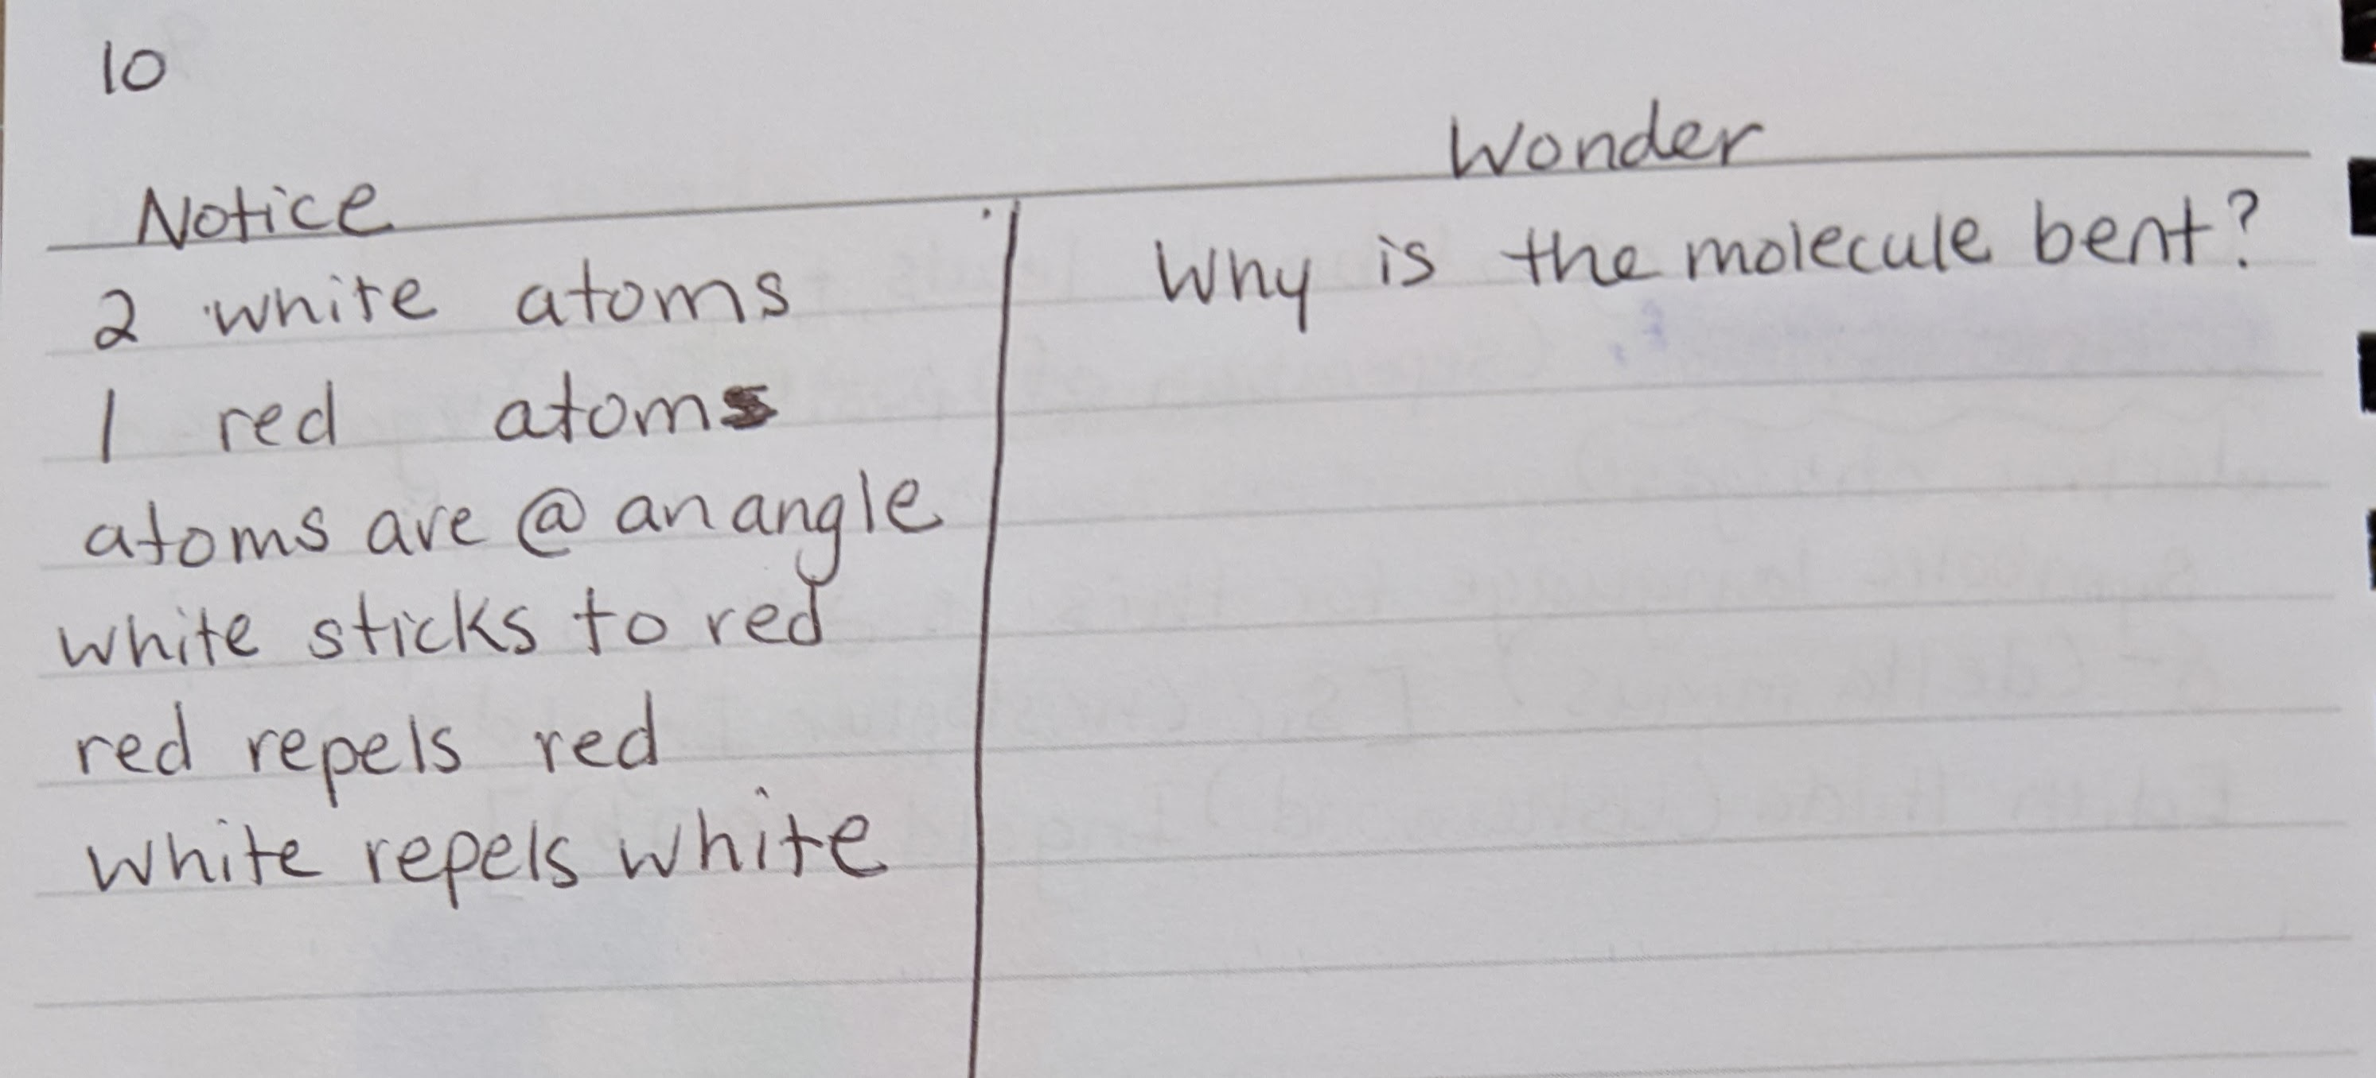
Notes:
Next we share out with our table buddies and then with the class as a whole. Can I have two people share what they notice? What questions did you have as you observed the molecules? [Wait for responses. Then read my student's responses if no one responds.] [Advance slide.]

Slide 9
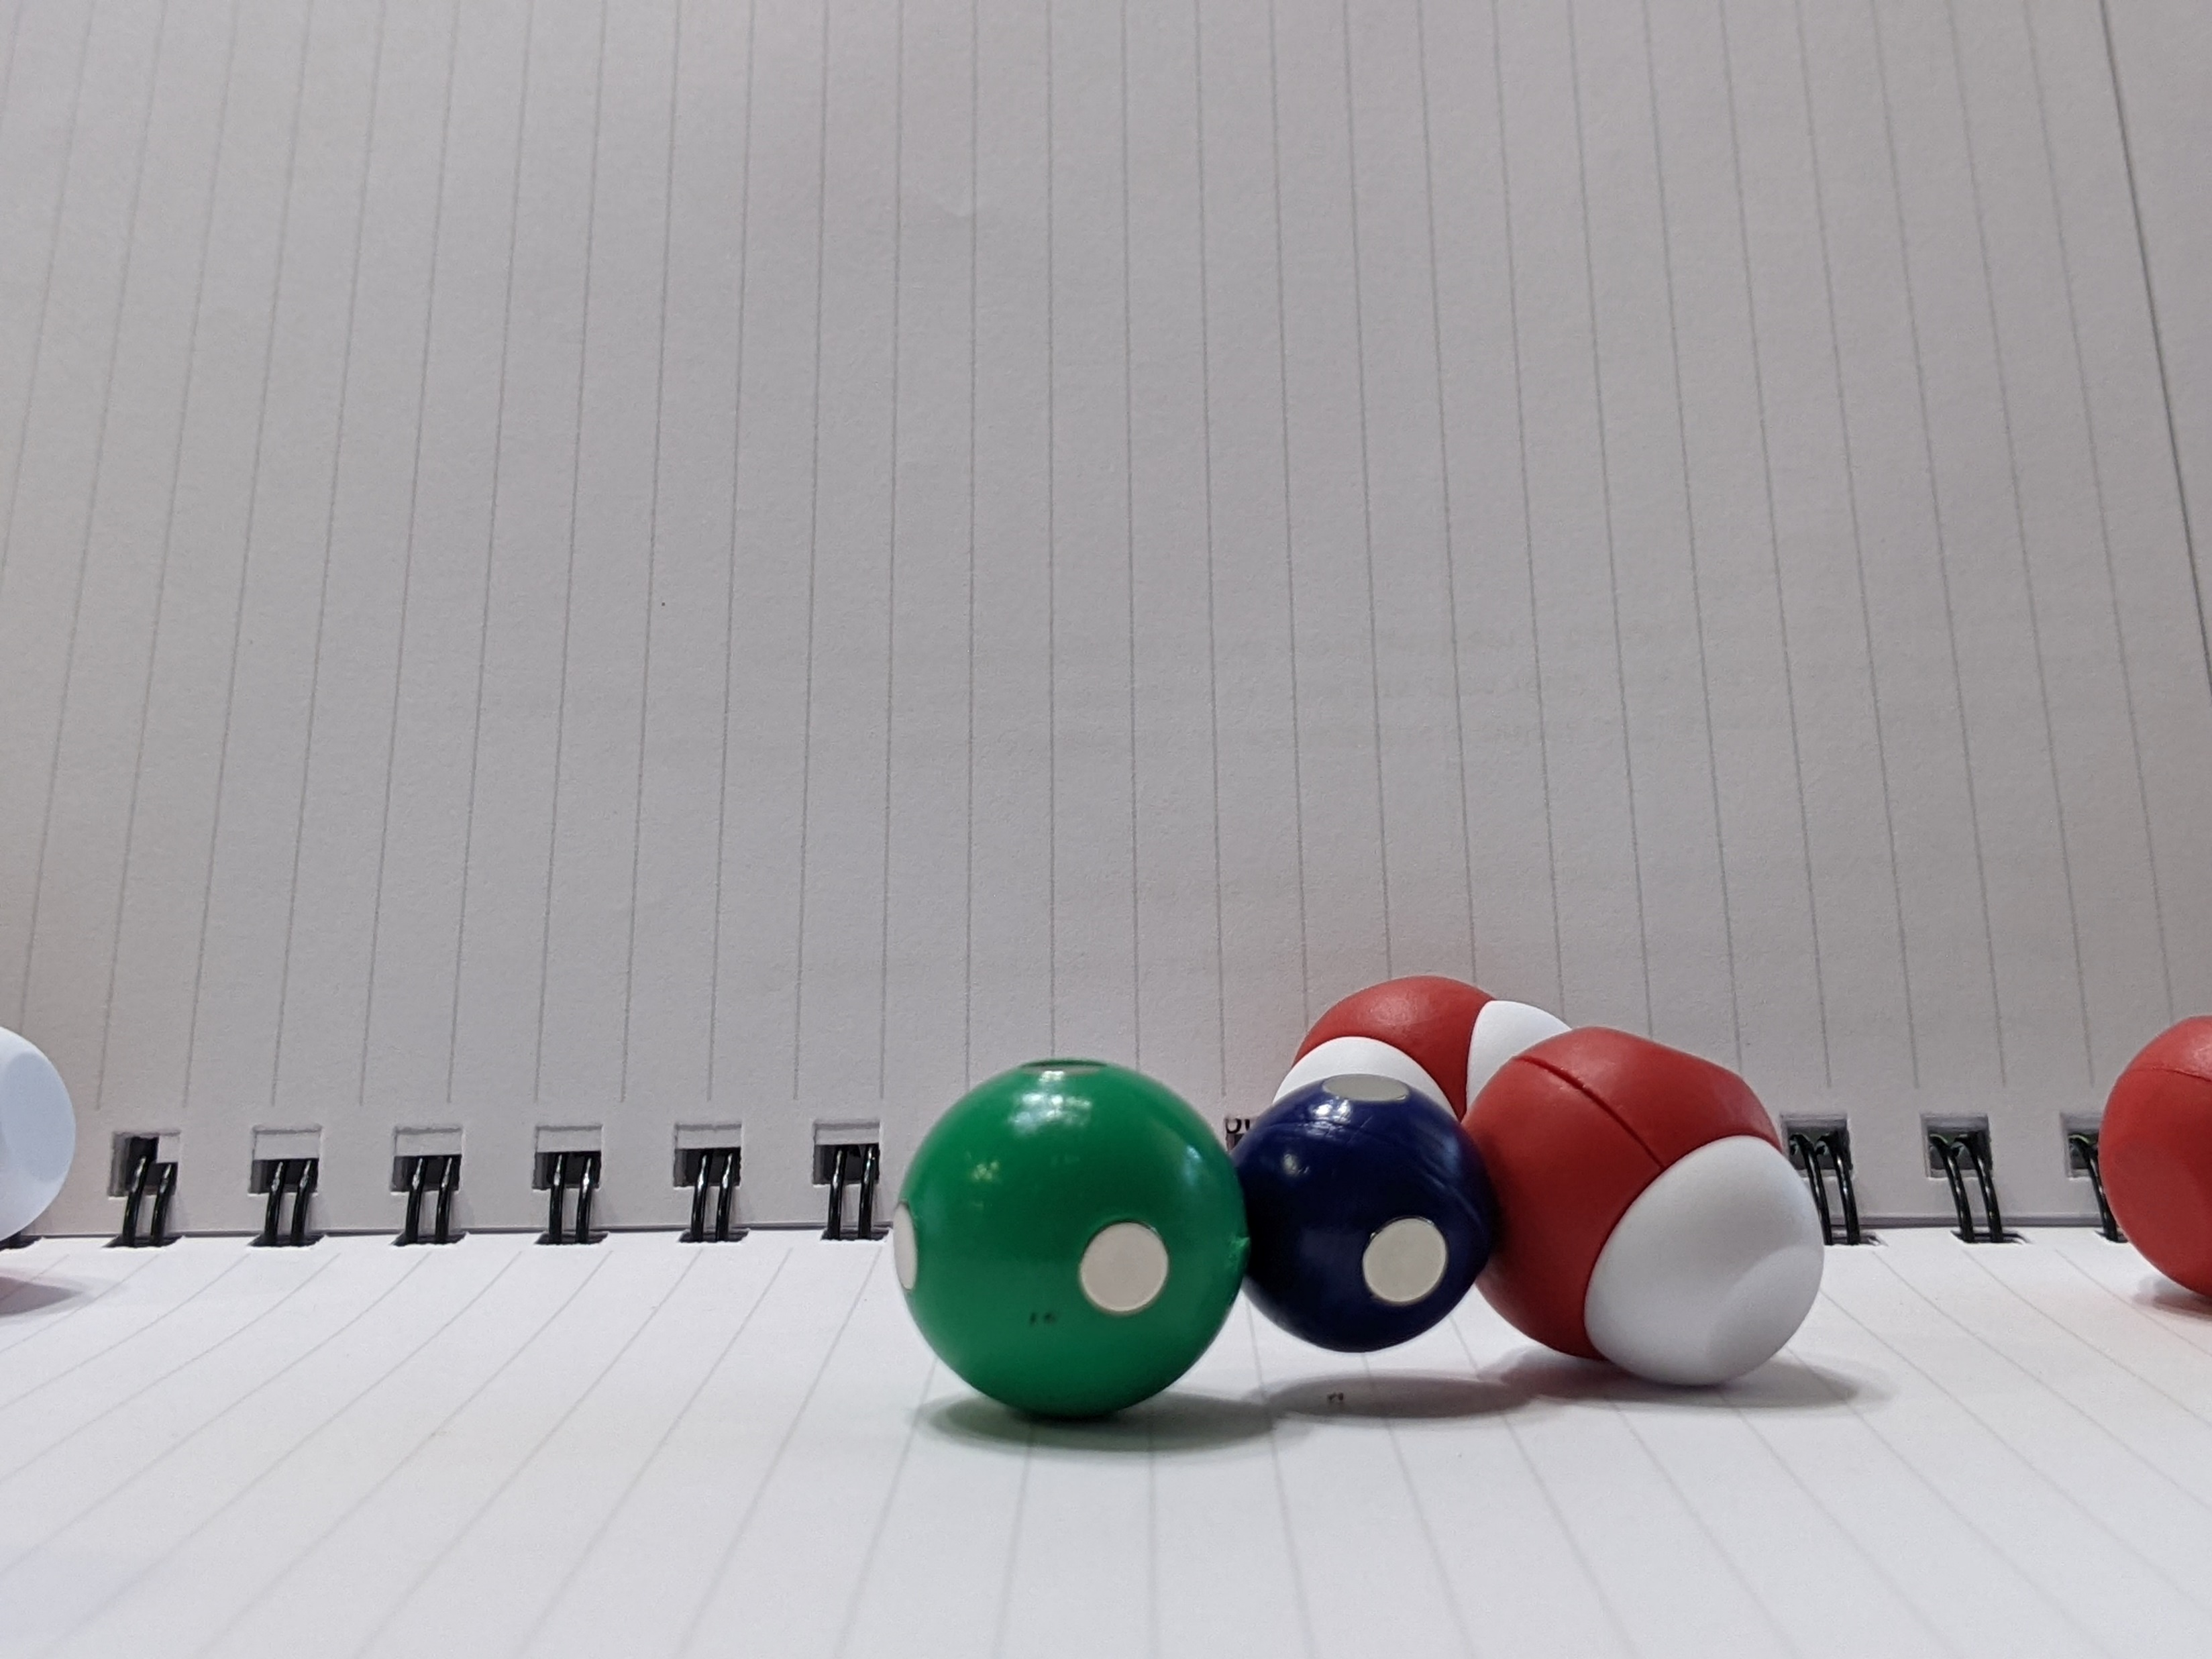
What patterns do you see?
What questions do you have?
Notes:
Now we want to continue the exploration by receiving the green and blue sphere from the cup . Student continue to observe how the molecules interact. They can add more water molecules to the mix and complete their notice|wonder chart. [Advance slide.]

Slide 10
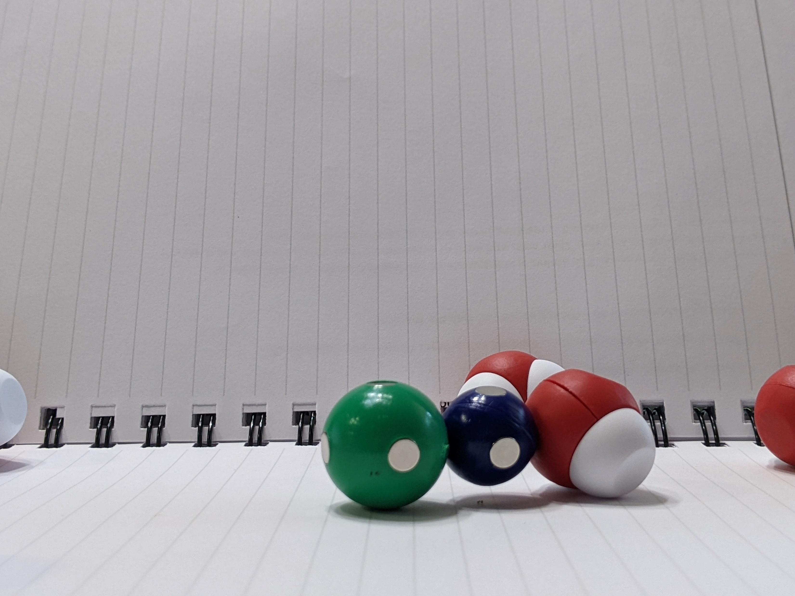
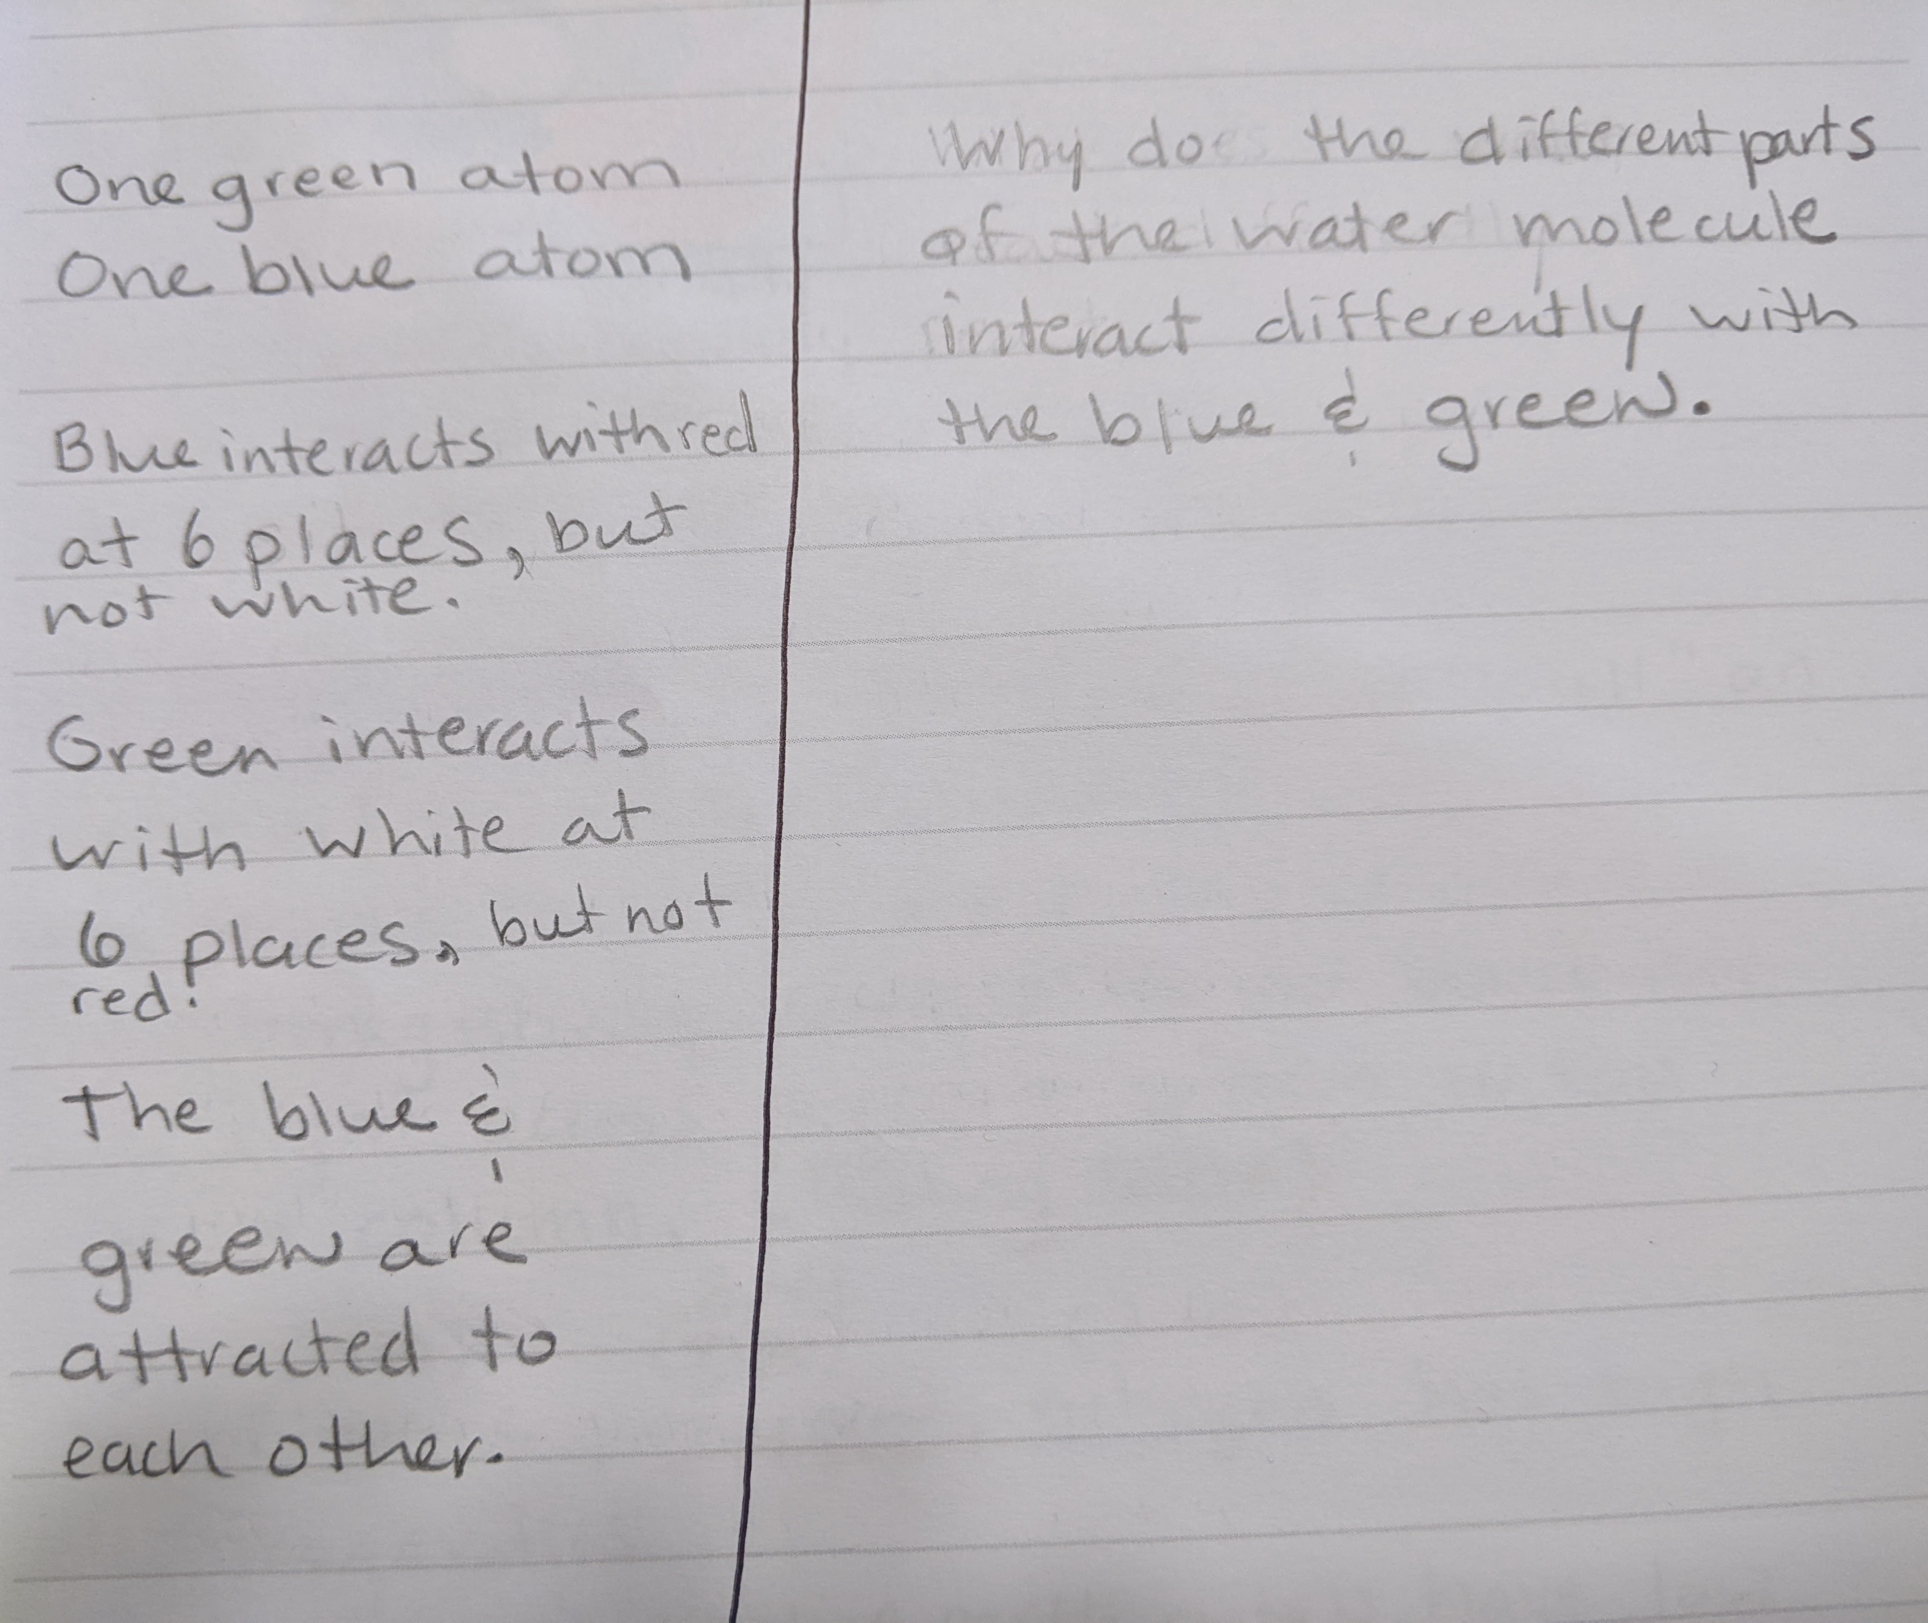
Notes:
What did you notice about how this new molecule interacted? [Wait for responses.] I haven't told my students what these molecules are yet, but they pretty readily notice water especially if they have had a great middle school science teacher. As we play with the model, we start identifying the components of the kit. [Advance slide.]

Slide 11
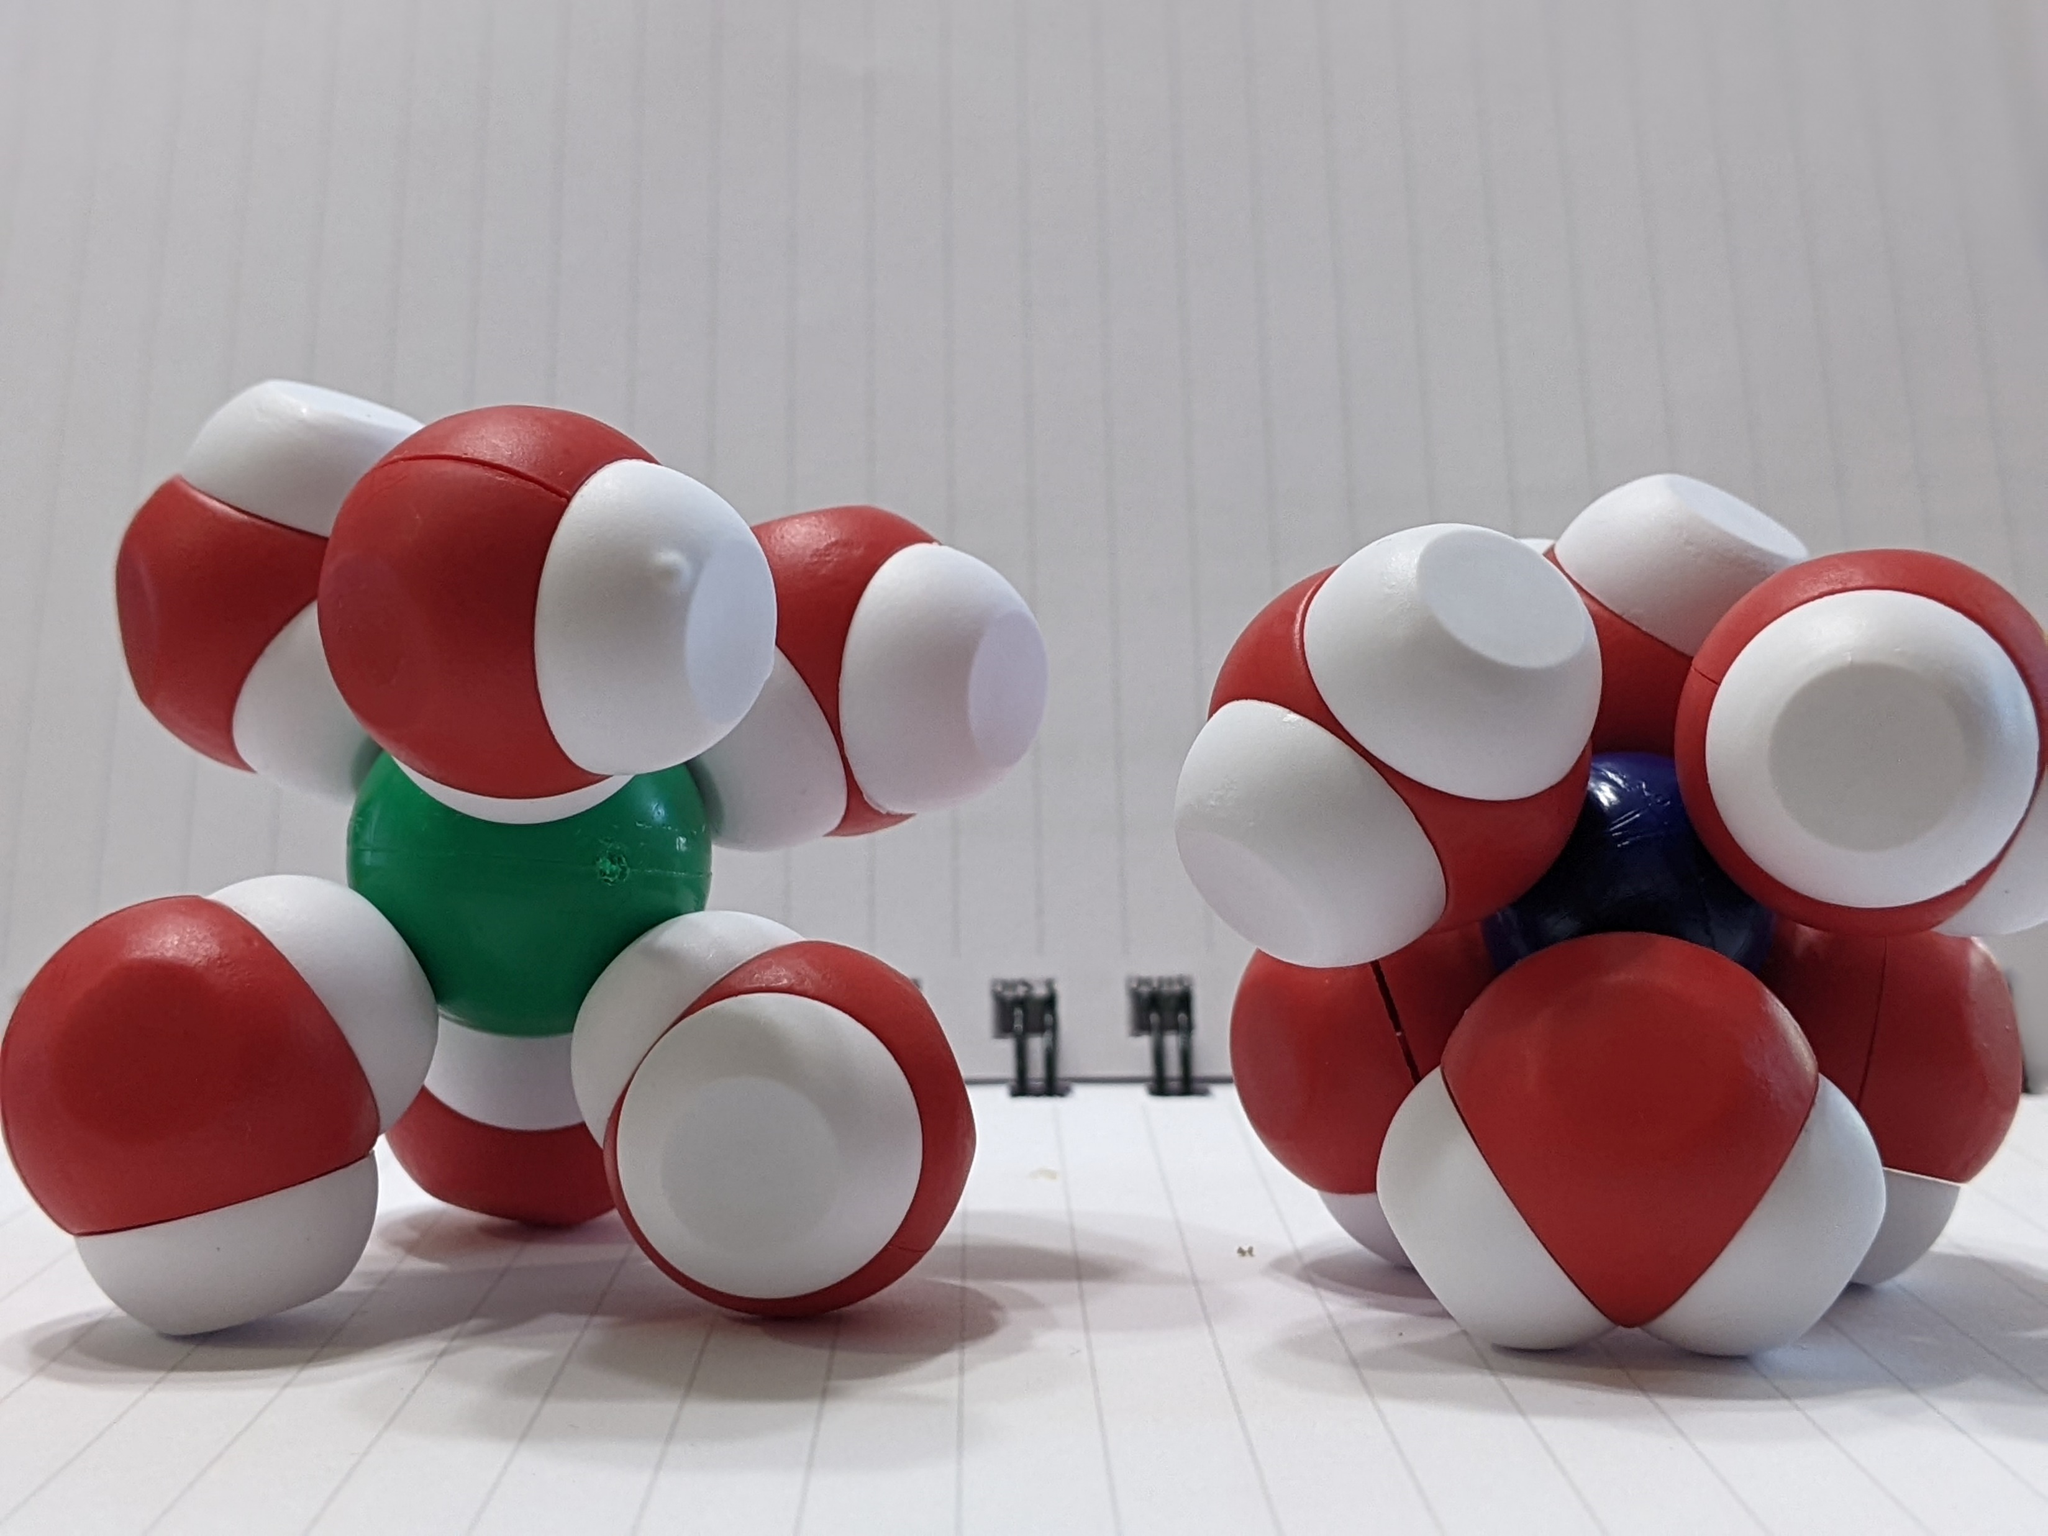
Notes:
What molecule has two atom and could readily dissolve in water? [Wait for responses.] We use CPK coloring for these models. That coloring patterns is used throughout all the models. At this point I would probe my students further and ask them what the chemical formula is for water. Then I would ask them to make an educated guess as to which atom was oxygen (red) and which was hydrogen (white). The green sphere is chlorine and the blue sphere represents sodium. We spend a little time discussing how water dissolves sodium chloride so that they can understand that interaction. [Advance slide.]

Slide 12
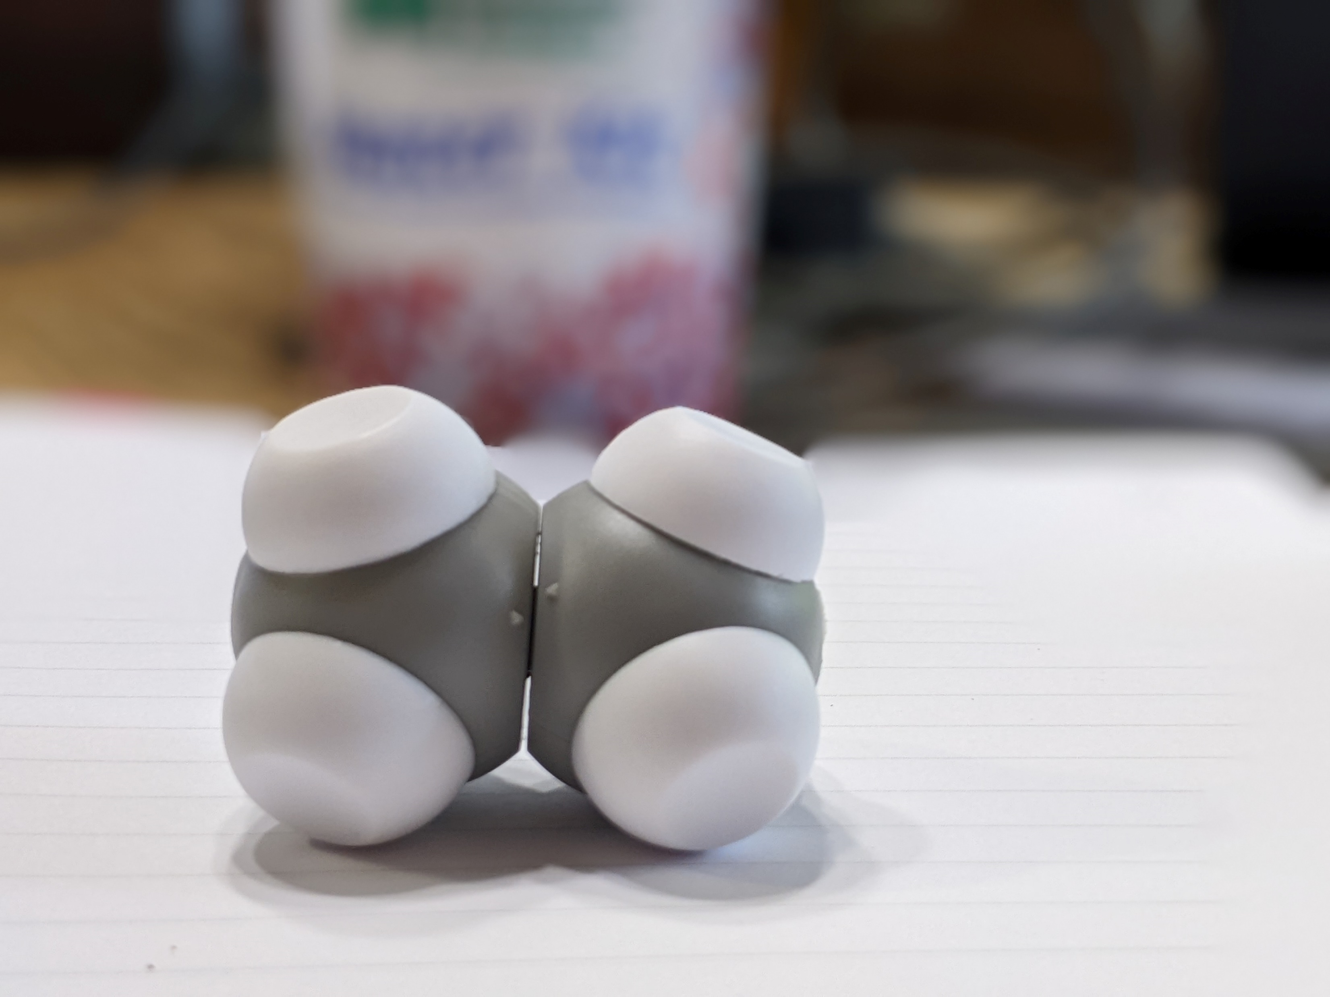
What patterns do you see?
What questions do you have?
Notes:
Next I have them retrieve the grey and white molecule from the cup and interact it with several water molecules. How it this molecule different from how water interacts with itself or with sodium chloride? [Wait for responses.] [Advance slide.]

Slide 13
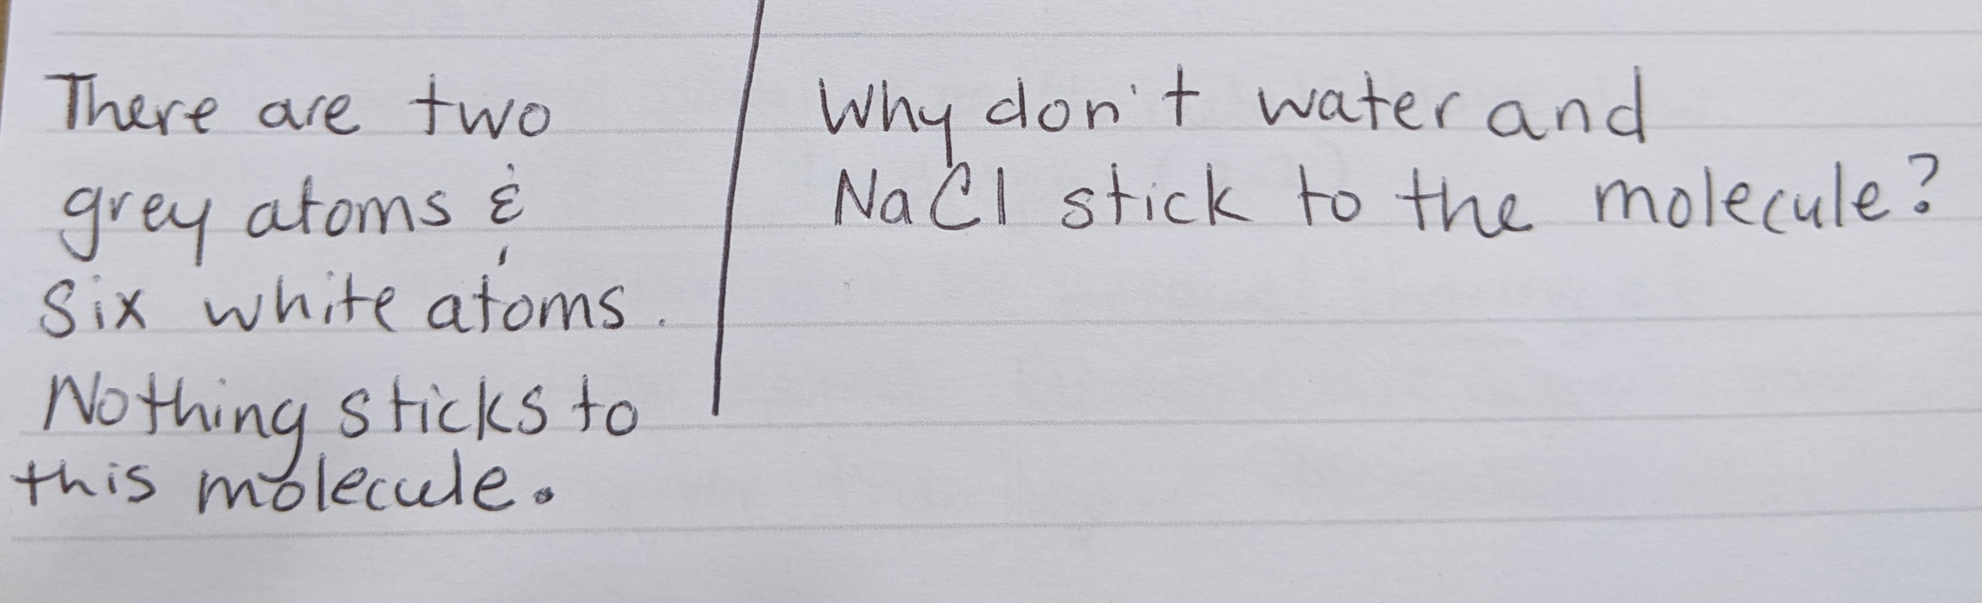
Notes:
[Listen to responses and read my student's responses.] What atoms can you identify from this molecule? (white=hydrogen) What do you think the grey atom represents? (carbon)
Let's look more deeply at all three of these molecules' behaviors. The magnets represent charge and in chemistry we know that how a charge is distributed across a molecule is important. In fact, we have a term for it—polarity. Polarity is a spectrum so molecule can range from very non-polar to very polar or somewhere in between.
At this point, my students and I talk about which molecules have magnets and which ones do not have magnets. We also discuss what the magnets represent.
Water is a polar compound because there is an uneven sharing of electrons. Water forms covalent bonds between the oxygen and hydrogen of a single molecule.
Sodium chloride is a polar compound because there is an uneven distribution of electrons. Sodium gives chlorine an electron to form an ionic bond.
Ethane is a non-polar compound because there is an even sharing of electrons. Ethane forms covalent bonds between the carbon and the hydrogen.
Later in the year we pull this kit back out when we discuss the periodic trend of electronegativity.
[Advance slide]

Slide 14
Comparing Types of Forces | COVALENT BONDING | IONIC BONDING | HYDROGEN BONDING
What is it? | Formed when two atoms share a bond within one molecule, can be partially charged or without charge. | Complete transfer of electrons between two atoms resulting in one that is positively charged, and one negatively charged. | A weak attraction of a hydrogen atom that is covalently bound to a more electronegative “donor” atom or group.
How is it represented by the model? | The plastic post connecting the oxygen and the hydrogen in water | The magnet in the sodium atom connecting to the magnet of chlorine atom | The hydrogen of one water molecule attracted to the oxygen of another water molecule
Type of force | Intramolecular Force | Intramolecular Force | Intermolecular Force
Notes:
This ends the first day of using this kit. We use this graphic to summarize what students should know about the model.
Does anyone have a better way that they use when they summarize using this kit? [Advance slide.]

Slide 15
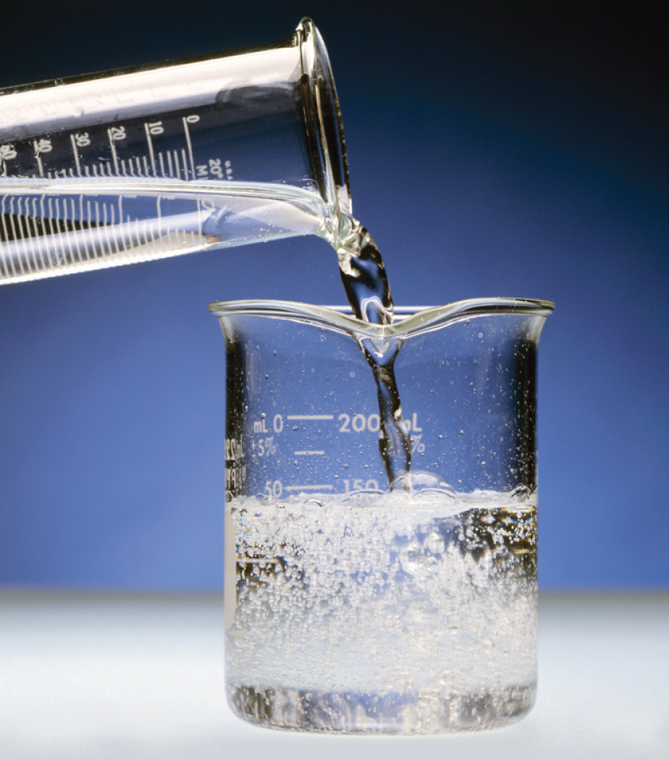
Alcohol | Observations in Lab | Modeling
Methanol
Ethanol
Butanol
Octanol
Notes:
On day 2, students do a simple wet lab where they add equal parts of four different alcohols to equal parts of distilled water. Before moving to the lab, I introduce what an SDS sheet is and we look We do this in the lab in microscale (typically between 5 mL to 10 mL). Students mix the chemicals, record their observations, they clean their glassware and return to their seats in the classroom. [Advance slide.]

Slide 16
What is going on in this beaker at the molecular scale?
Alcohol | Observations in Lab | Modeling
Methanol
Ethanol
Butanol
Octanol
Notes:
Upon returning to their seats, I have them to share out what they saw and ask them if they could model using the water kit what they saw on the macroscopic level. [Advance slide.]

Slide 17
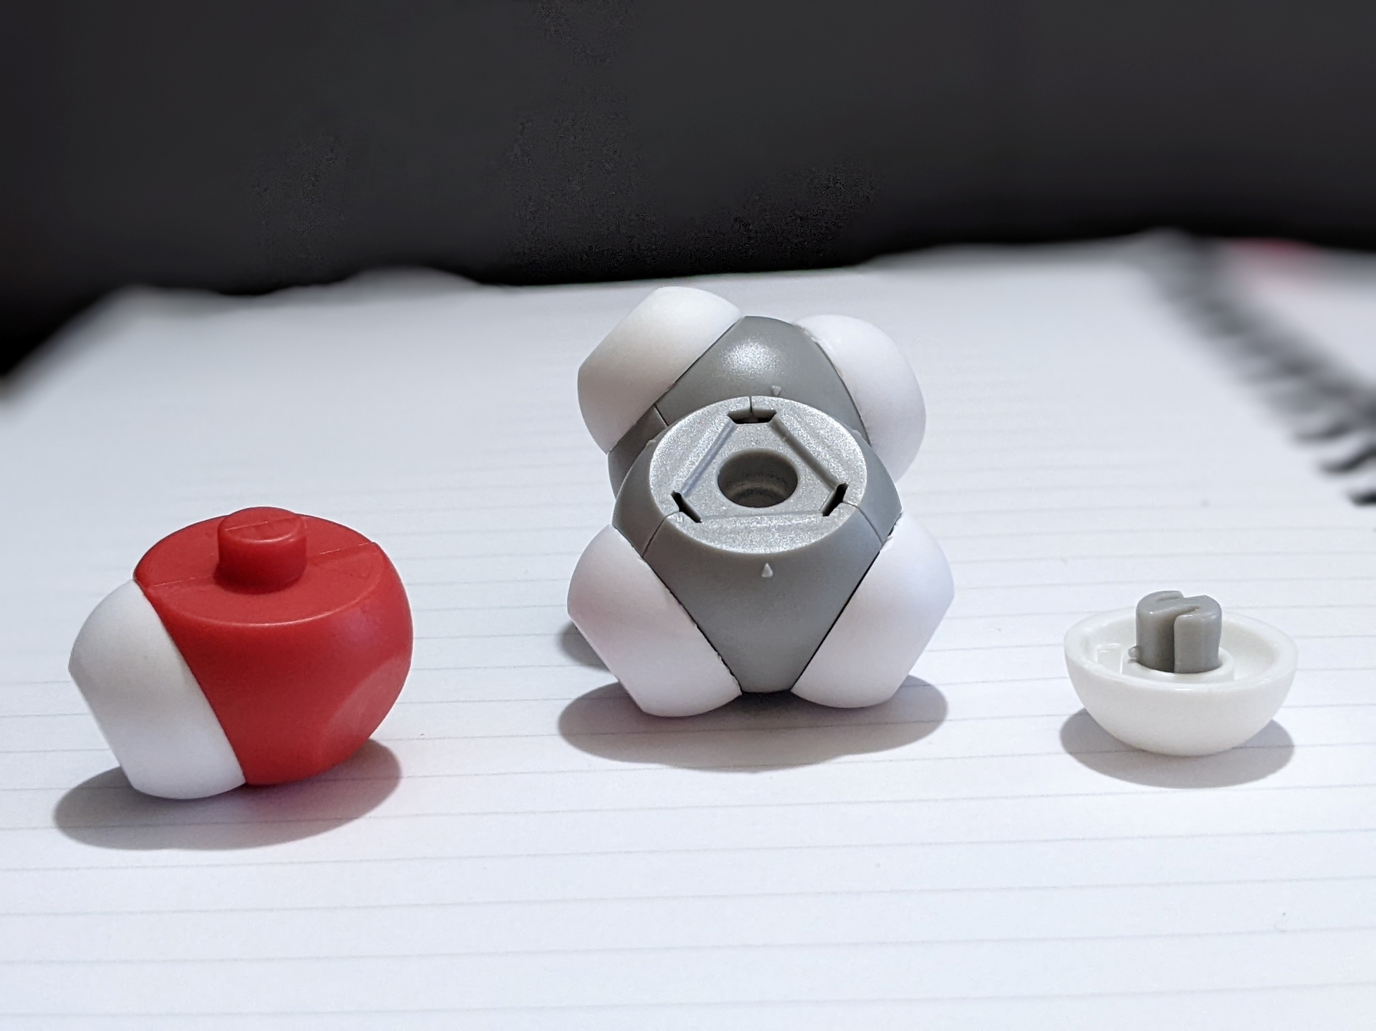
What is going on in this beaker at the molecular scale?
Unknown Solution | Observations in Lab | Modeling
Methanol
Ethanol
Butanol
Octanol
Notes:
To do modeling this at the molecular scale, they first must build a model of alcohol. To do this you, need the 'broken' water part from the kit and the ethane molecule.
We review the parts of the molecules. While my students will make all four molecules, you get to choose whether or not you make methanol or ethanol. Please remove the hydrogen atom that has the S-bond. I've shown it on the screen. It is the hydrogen that has a star beside it. Once you remove that hydrogen and the post, you have a place you the hydroxyl group to covalently bond.
Please make either methanol or ethanol for this next set of modeling. [Advance slide.]

Slide 18
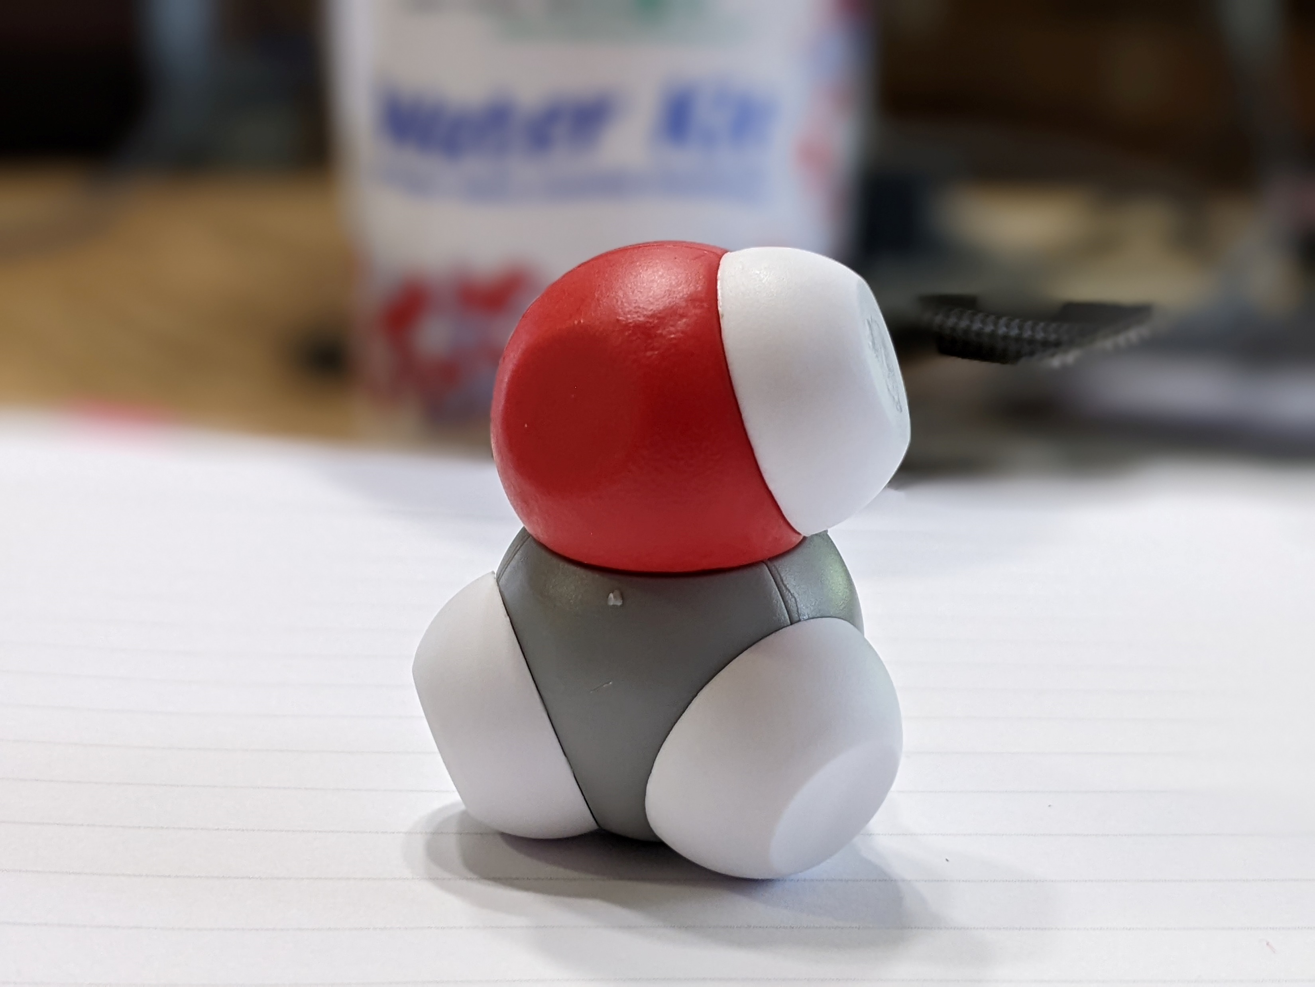
What is going on in this beaker at the molecular scale?
Unknown Solution | Observations in Lab | Modeling
Methanol
Ethanol
Butanol
Octanol
Notes:
Raise your hand if you made methanol? Let's test it's solubility in water by placing the methanol molecule in an empty cup with three or four water molecules. Place your lid on tightly and let's shake to mix. [Shake cup with flourish and pour the contents on the table.] Now pour your contents on the table. [Advance slide.]

Slide 19
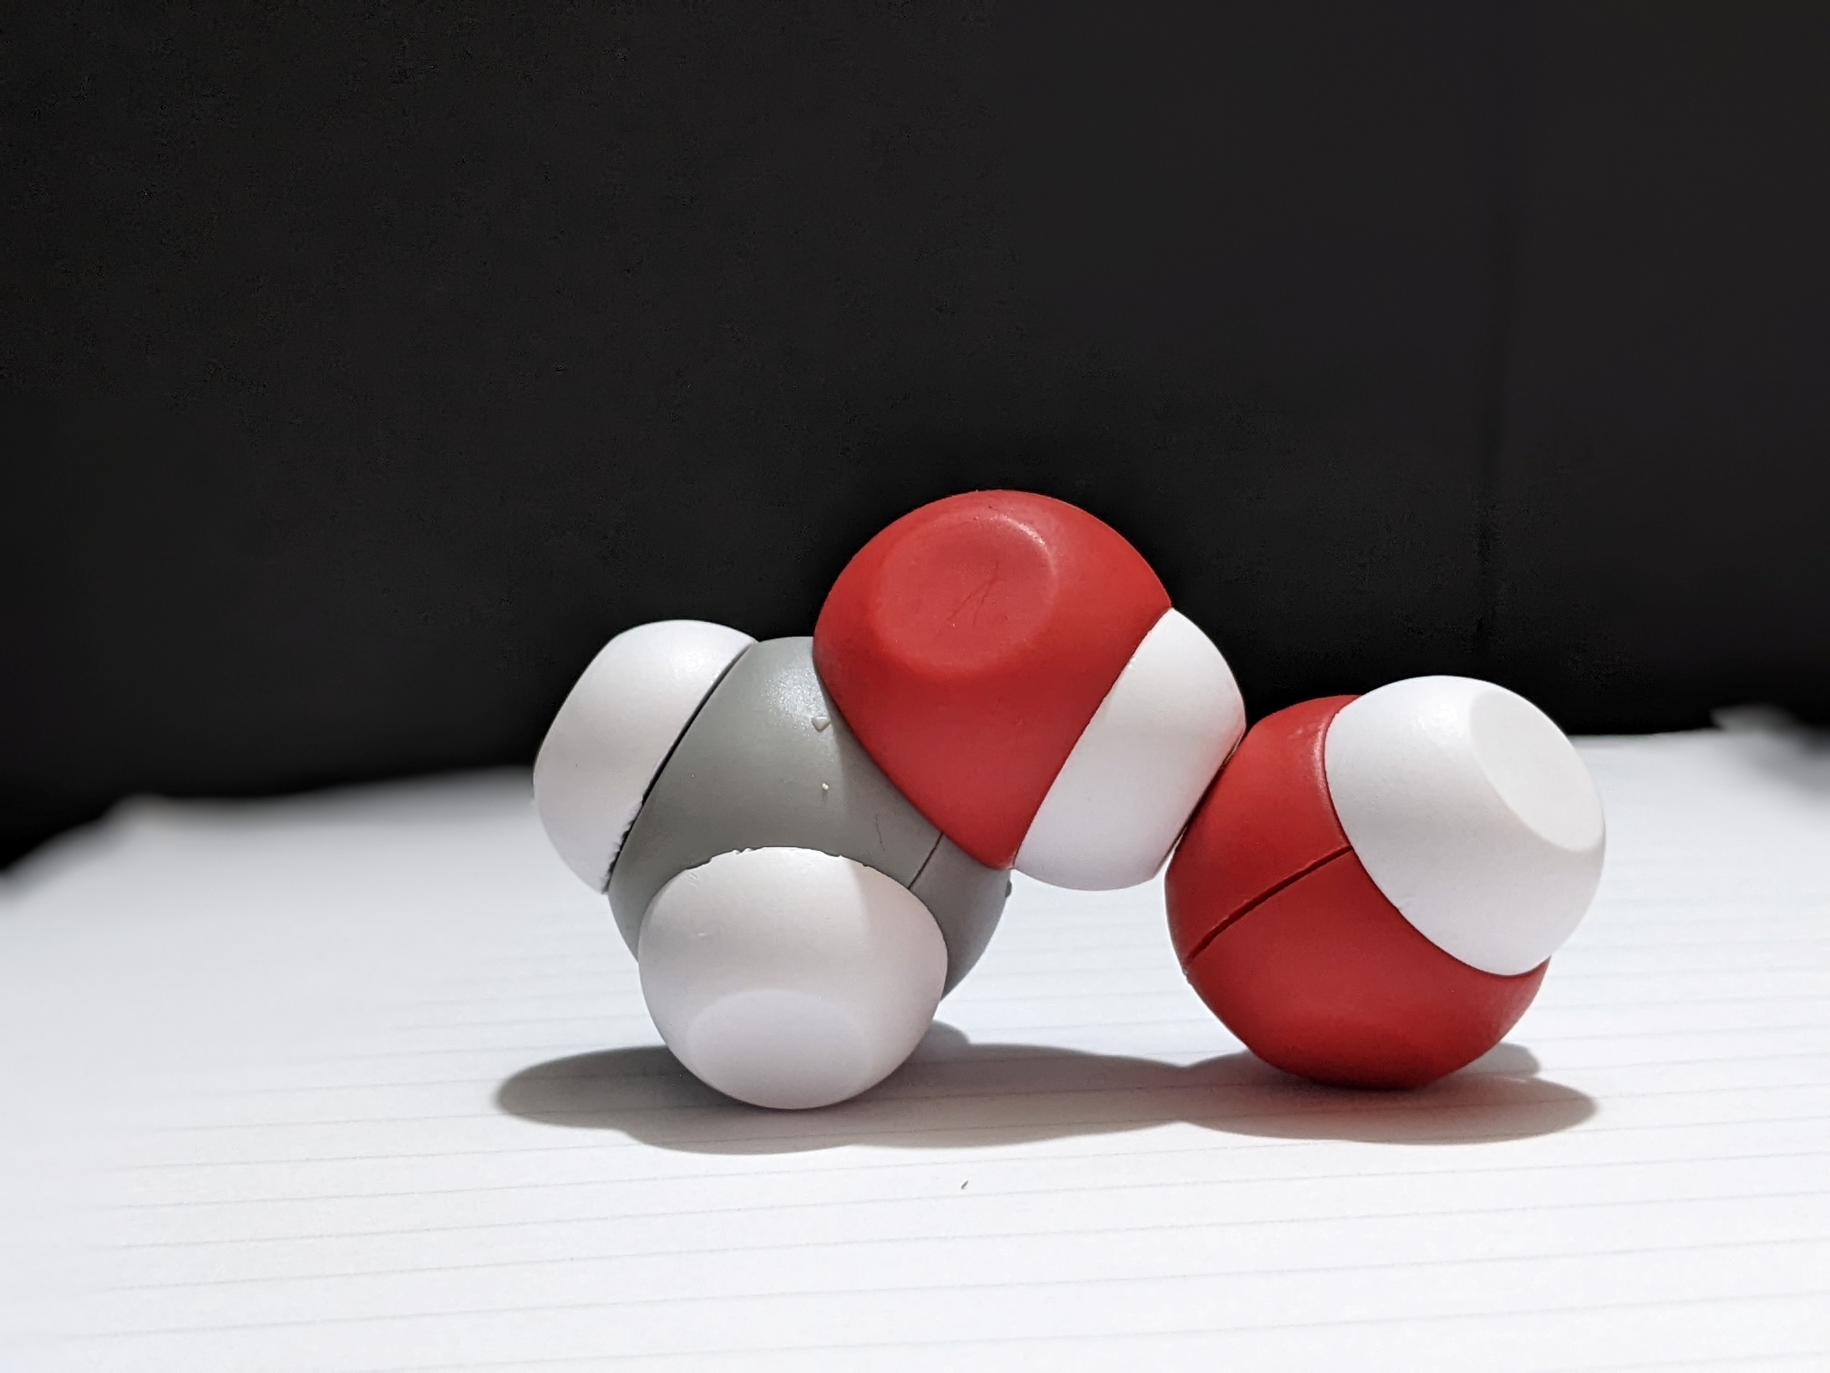
What is going on in this beaker at the molecular scale?
Unknown Solution | Observations in Lab | Modeling
Methanol
Ethanol
Butanol
Octanol
Notes:
What did you find out? [Wait for responses.] [Advance slide.]

Slide 20
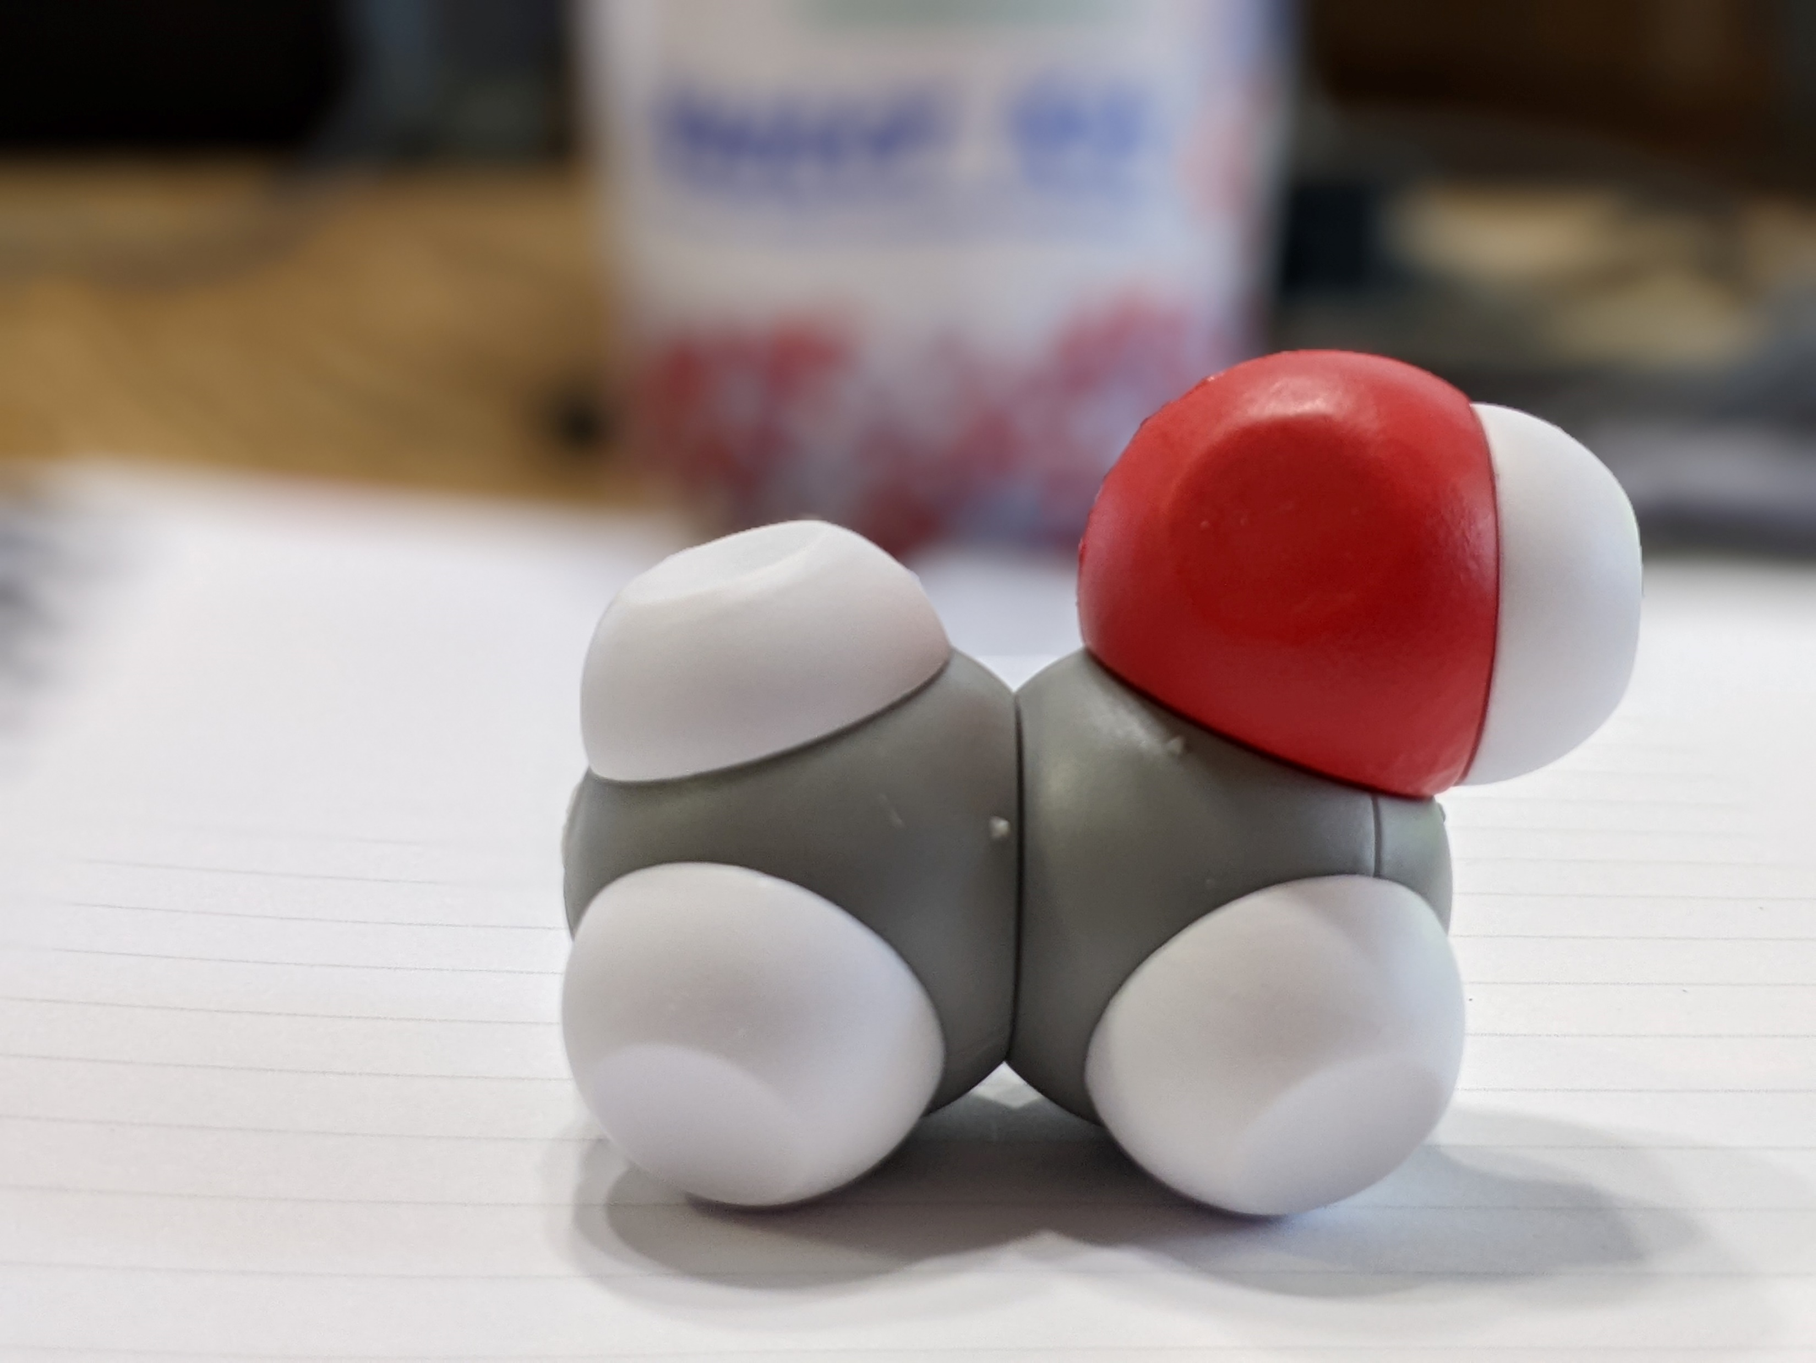
What is going on in this beaker at the molecular scale?
Unknown Solution | Observations in Lab | Modeling
Methanol
Ethanol
Butanol
Octanol
Notes:
Now let's do the same thing for ethanol. [Shake cup with flourish and pour the contents on the table.] Now pour your contents on the table. [Advance slide.]

Slide 21
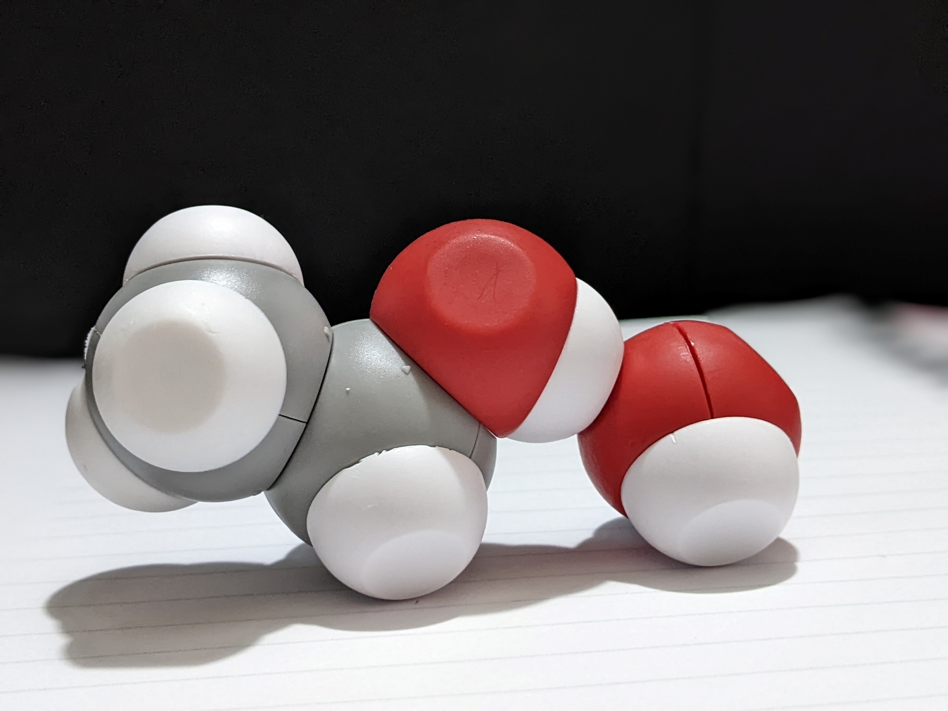
What is going on in this beaker at the molecular scale?
Unknown Solution | Observations in Lab | Modeling
Methanol
Ethanol
Butanol
Octanol
Notes:
What did you find out? [Wait for responses.] [Advance slide.]

Slide 22
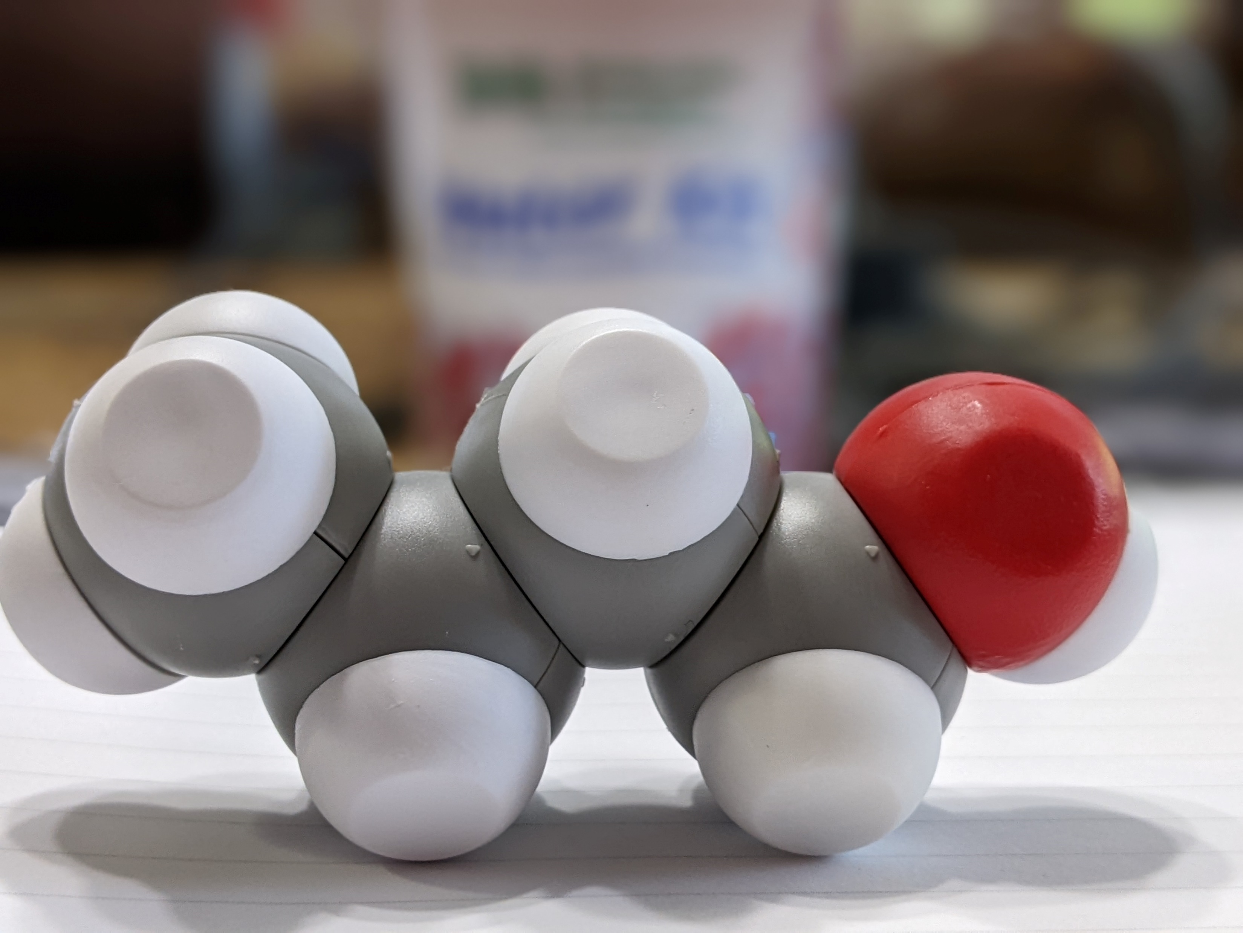
What is going on in this beaker at the molecular scale?
Unknown Solution | Observations in Lab | Modeling
Methanol
Ethanol
Butanol
Octanol
Notes:
To build butanol you have to find a friend or friend. Please move about the room and build butanol. [Wait three minutes.]
Do I have a group that would like to test butanol's solubility. [Add butanol to the container with a handful of water molecules and shake with a flourish.]
What did we find out? Did that match our findings from the lab?
How can we explain what is happening as the carbon and hydrogen chain gets longer?
[Advance slide.]

Slide 23
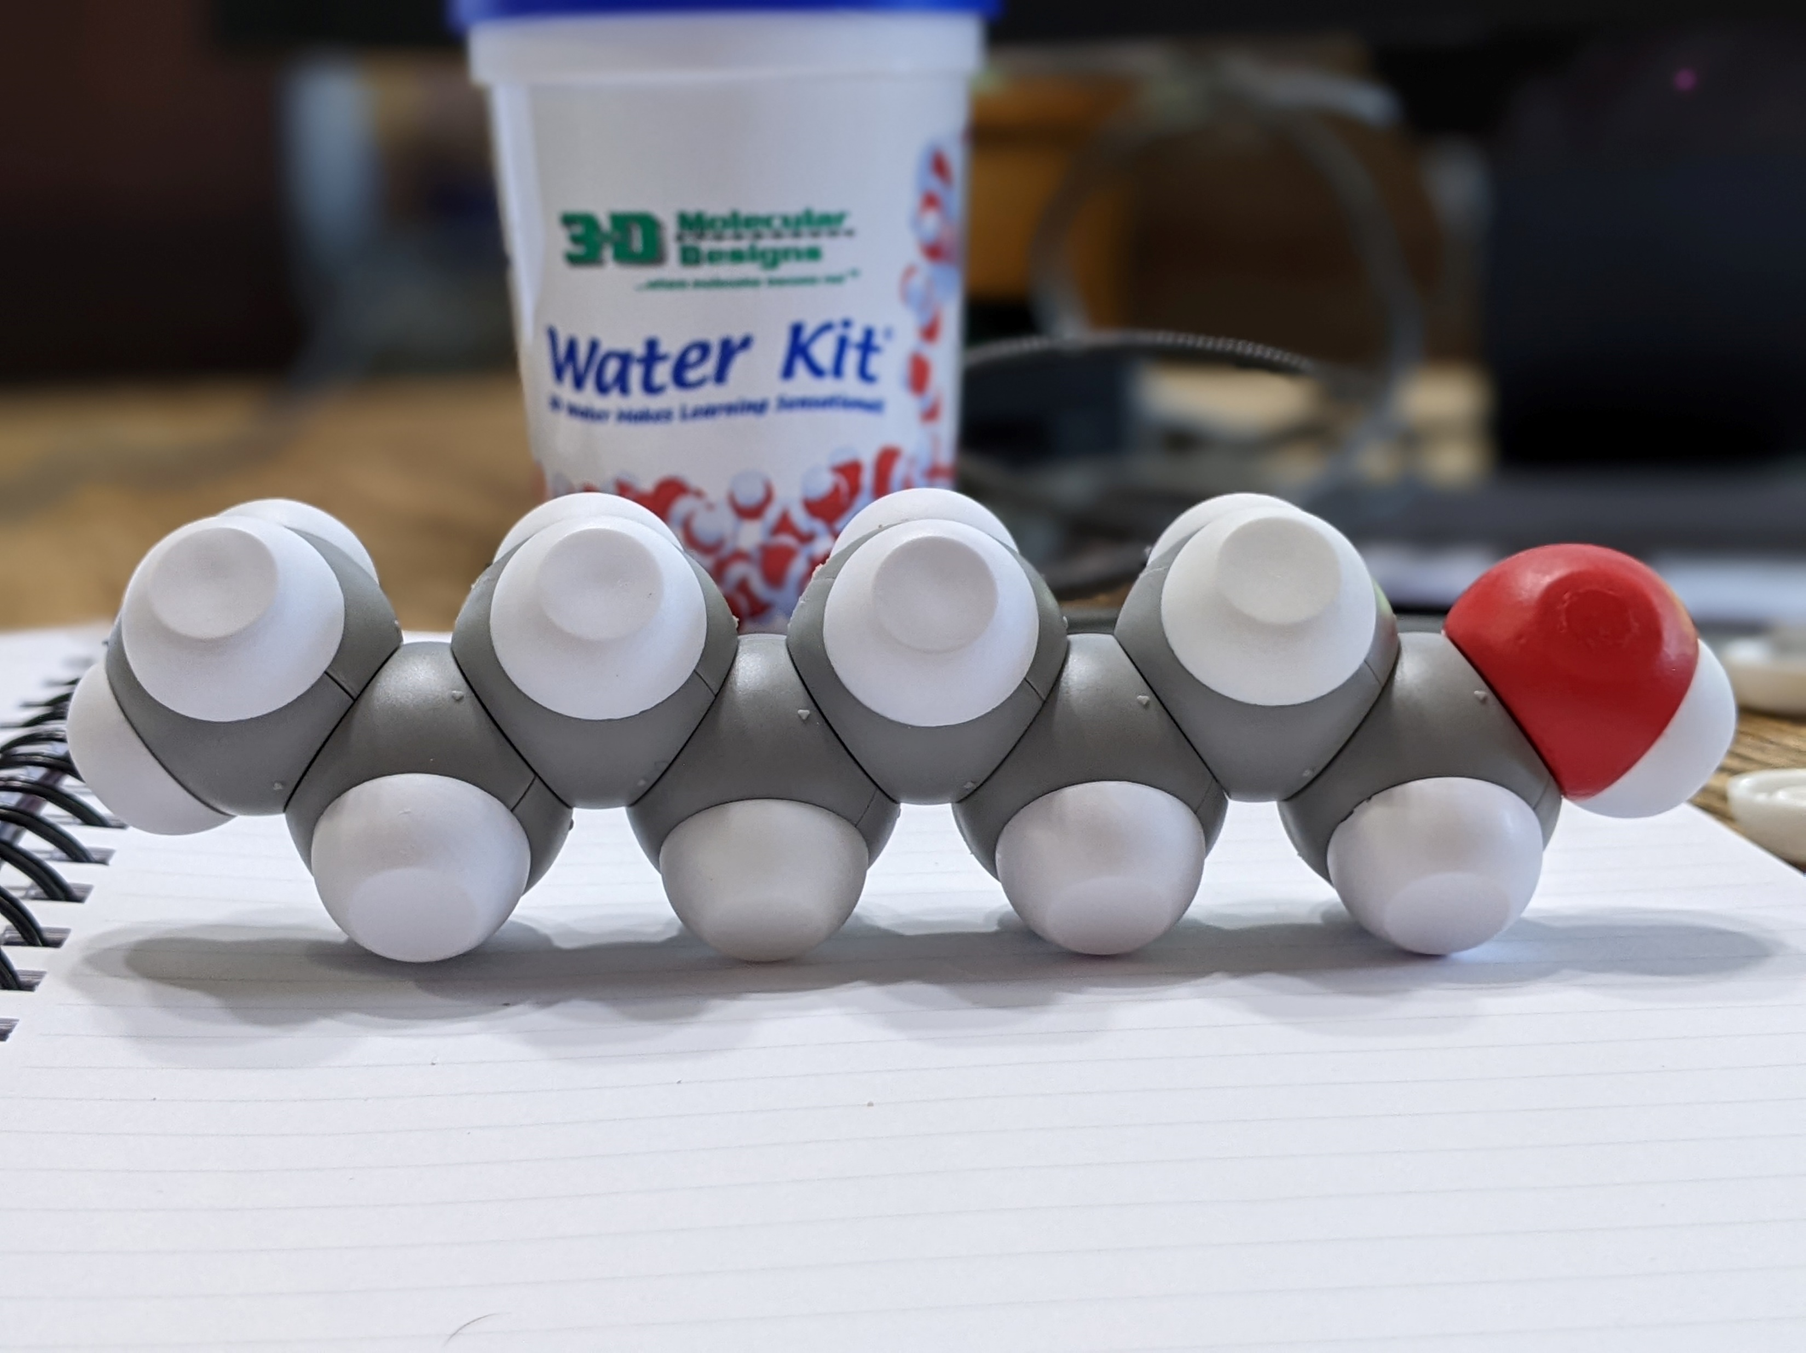
What is going on in this beaker at the molecular scale?
Unknown Solution | Observations in Lab | Modeling
Methanol
Ethanol
Butanol
Octanol
Notes:
Would everyone please take apart their butanol molecule and return to your seats with the parts you used to make it? Would you also please put the ethane back together and return it to the cup? While you are doing that, let's talk about octanol. What is your prediction based on what you already know with methanol, ethanol, and butanol? [Wait for responses.]
Why do you think that is? [Wait for responses.] [Advance slide.]

Slide 24
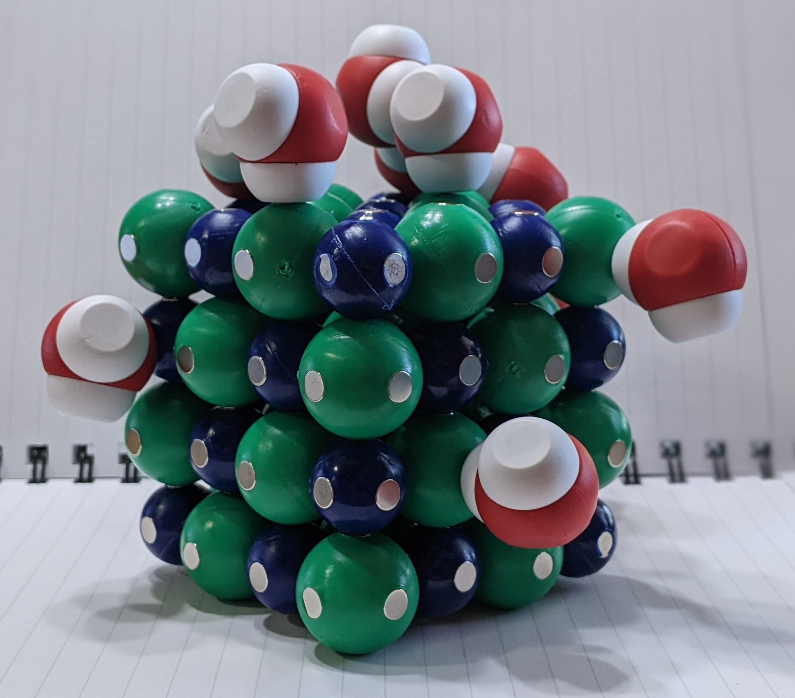
Assessment Time
Salt dissolves readily in water, but not as well in alcohol. Create a model that explains why using either ethanol or methanol. Contrast that model with the model we did in class of salt dissolving in water. Make a sketch in the space provided and write a short narrative for the sketch. Be sure to label all parts of the sketch.
Notes:
I assess my students understanding by asking them to model another scenario. [Talk about the time frame, modifications for those on IEPs, and materials at their disposal. Also, give rationale.

Slide 25
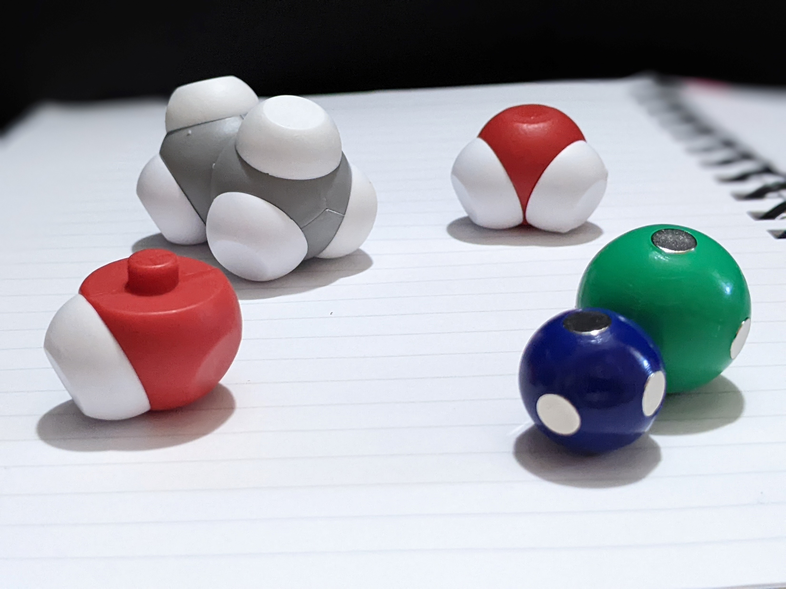
Additional Assessment Ideas
Create an experiment to compare:
Melting points
Boiling points
Vapor pressures
Surface Tension
Evaporation Rates
Then model what is occurring at the molecular level.
Notes:
Discuss some additional assessment ideas.

Slide 26
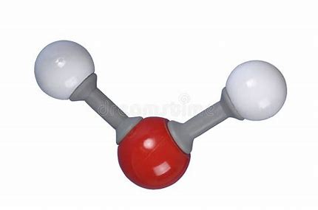
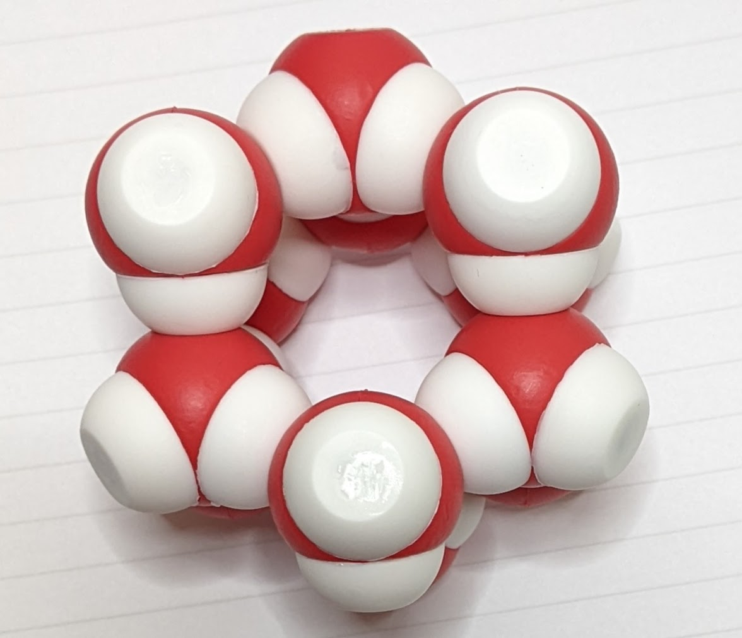
Describe atomic composition of simple molecules and extended structures.
Notes:
Ruth says: I like to have my students compare the water kits with other molecular modeling kits that we have in the room. Please find the molymod water molecule that you see on the screen. How is this similar to the water kit water? How is it different?
[Discuss some common student misconceptions.]
[Advance slide]

Slide 27
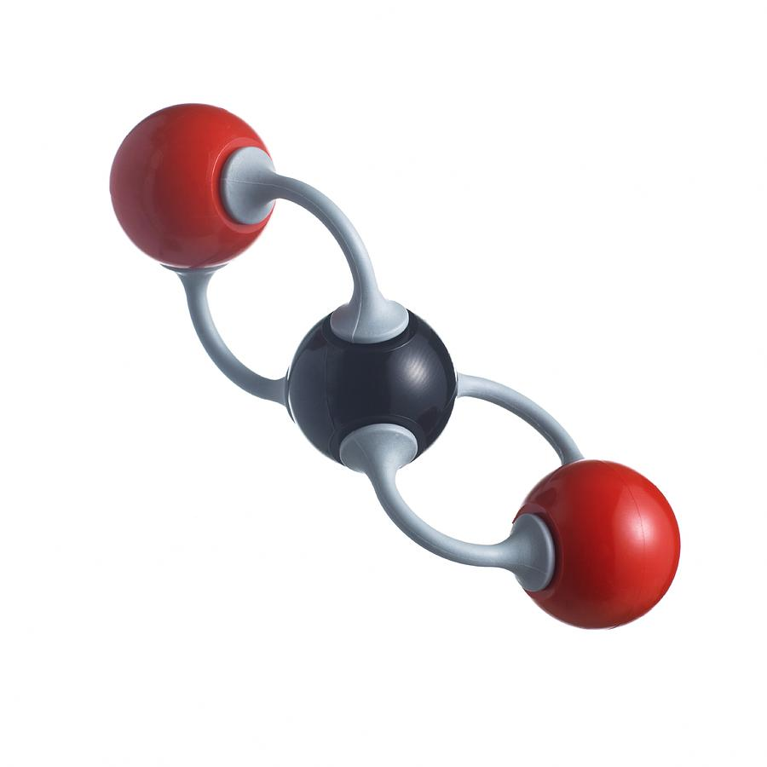
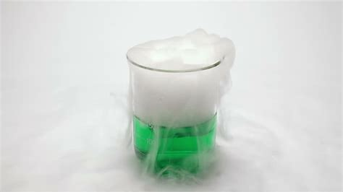
Describe atomic composition of simple molecules and extended structures.
Notes:
Ruth says: Continue to discuss some common student misconceptions and refer to the NSTA article that will be on teacher resource page.
[Advance slide]

Slide 28
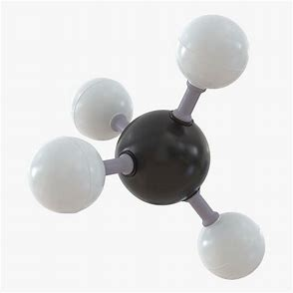
Describe atomic composition of simple molecules and extended structures.
Notes:
Ruth says: [Discuss some common student misconceptions.]
[Advance slide]

Slide 29
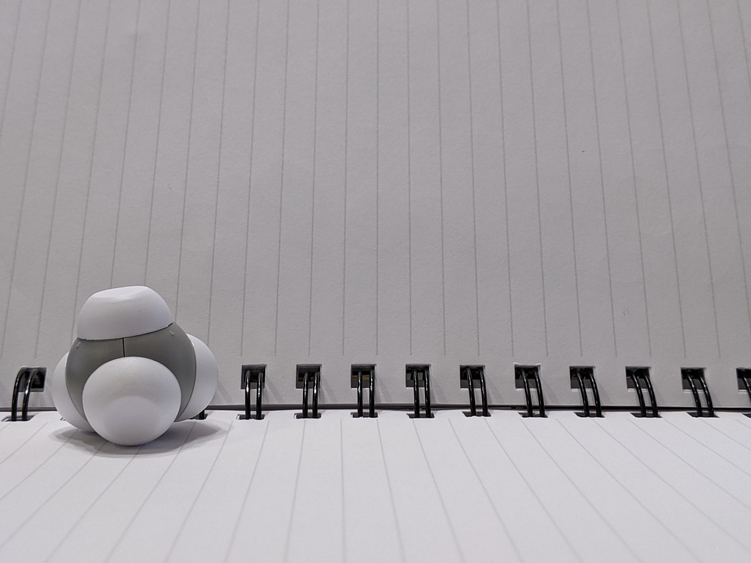
Notes:
Ruth says: The next day, we start with the students having the water kit in front of them. I ask them to make a methane molecule from their ethane. What do they have to take apart? What do they need to add?
[Advance slide]

Slide 30
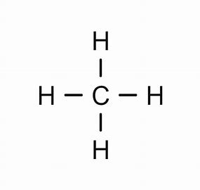
Notes:
Ruth says: Then we talk about the structural formula. For this activity, I am going to have you move about the room as we make ethane, propane, butane, etc. We will end by making octane. With your seat partner, please make ethane. You should already be familiar with the ethane molecule since we just worked with it. What is its structural formula?
[Advance slide]

Slide 31
How can this be made into an extended structure?
Notes:
Ruth says: Then we talk about the structural formula. For this activity, I am going to have you move about the room as we make ethane, propane, butane, etc. We will end by making octane. With your seat partner, please make ethane. You should already be familiar with the ethane molecule since we just worked with it. What is its structural formula?
[Advance slide]

Slide 32
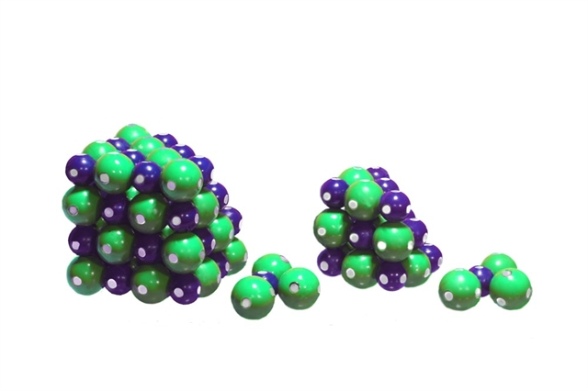
Notes:
Ruth says: We start the year in Earth Science with both the NaCl lattice and the water kit. It gives me a chance to assess what they learned in middle school and determine if we need to review some chemical principles before we dive into our minerals unit.
[Advance slide]

Slide 33
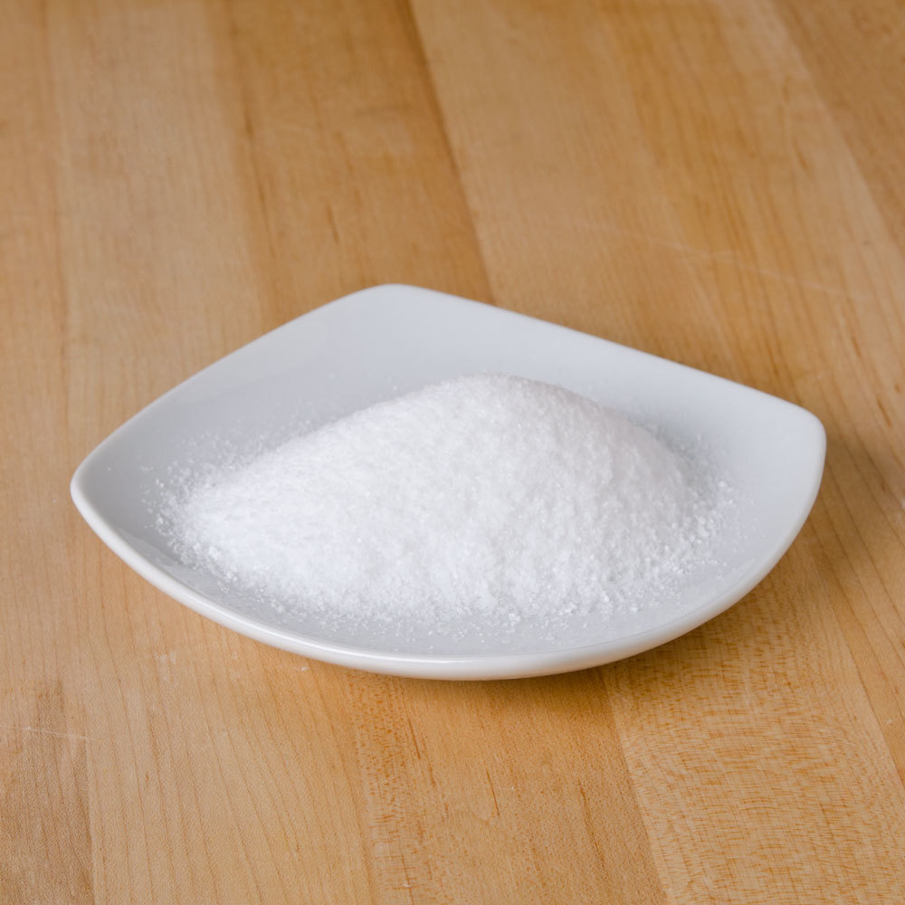
Notes:
Ruth says: I ask them to look at two types of salt: rock salt and Maldon rock (a type of finishing salt).
[Advance slide]

Slide 34
What do you notice?
What pattens do you see?
How are these complex structures similar?
How are they different?
Notes:
Ruth says: I give students a container of table salt or rock salt and have them look at it under a stereoscope. If you don't have access to a stereoscopes, you can use hand-lens.
[Advance slide]

Slide 35
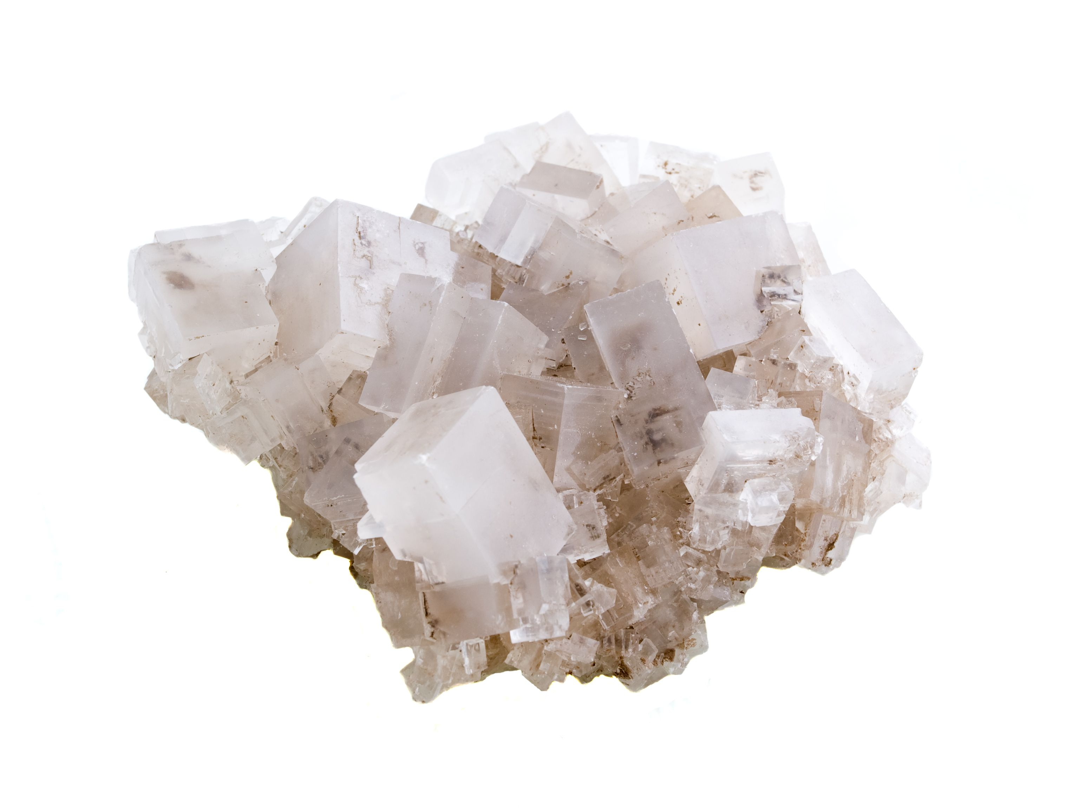
What do you notice?
What pattens do you see?
How are these complex structures similar?
How are they different?
Notes:
Ruth says: After looking at the rock salt, I ask student to model what they see with the NaCl lattice to determine how it might appear at the molecular level.
[Discuss how students move from the lab to the classroom.]
[Advance slide]

Slide 36
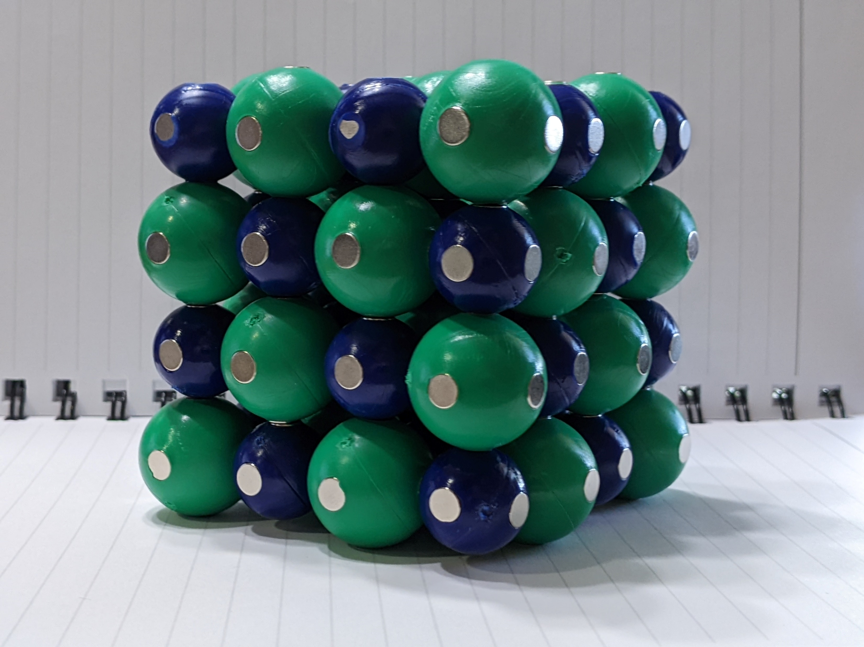
What do you notice?
What pattens do you see?
How are these complex structures similar?
How are they different?
Notes:
Ruth says: Most students don't change the lattice.
[Advance slide]

Slide 37
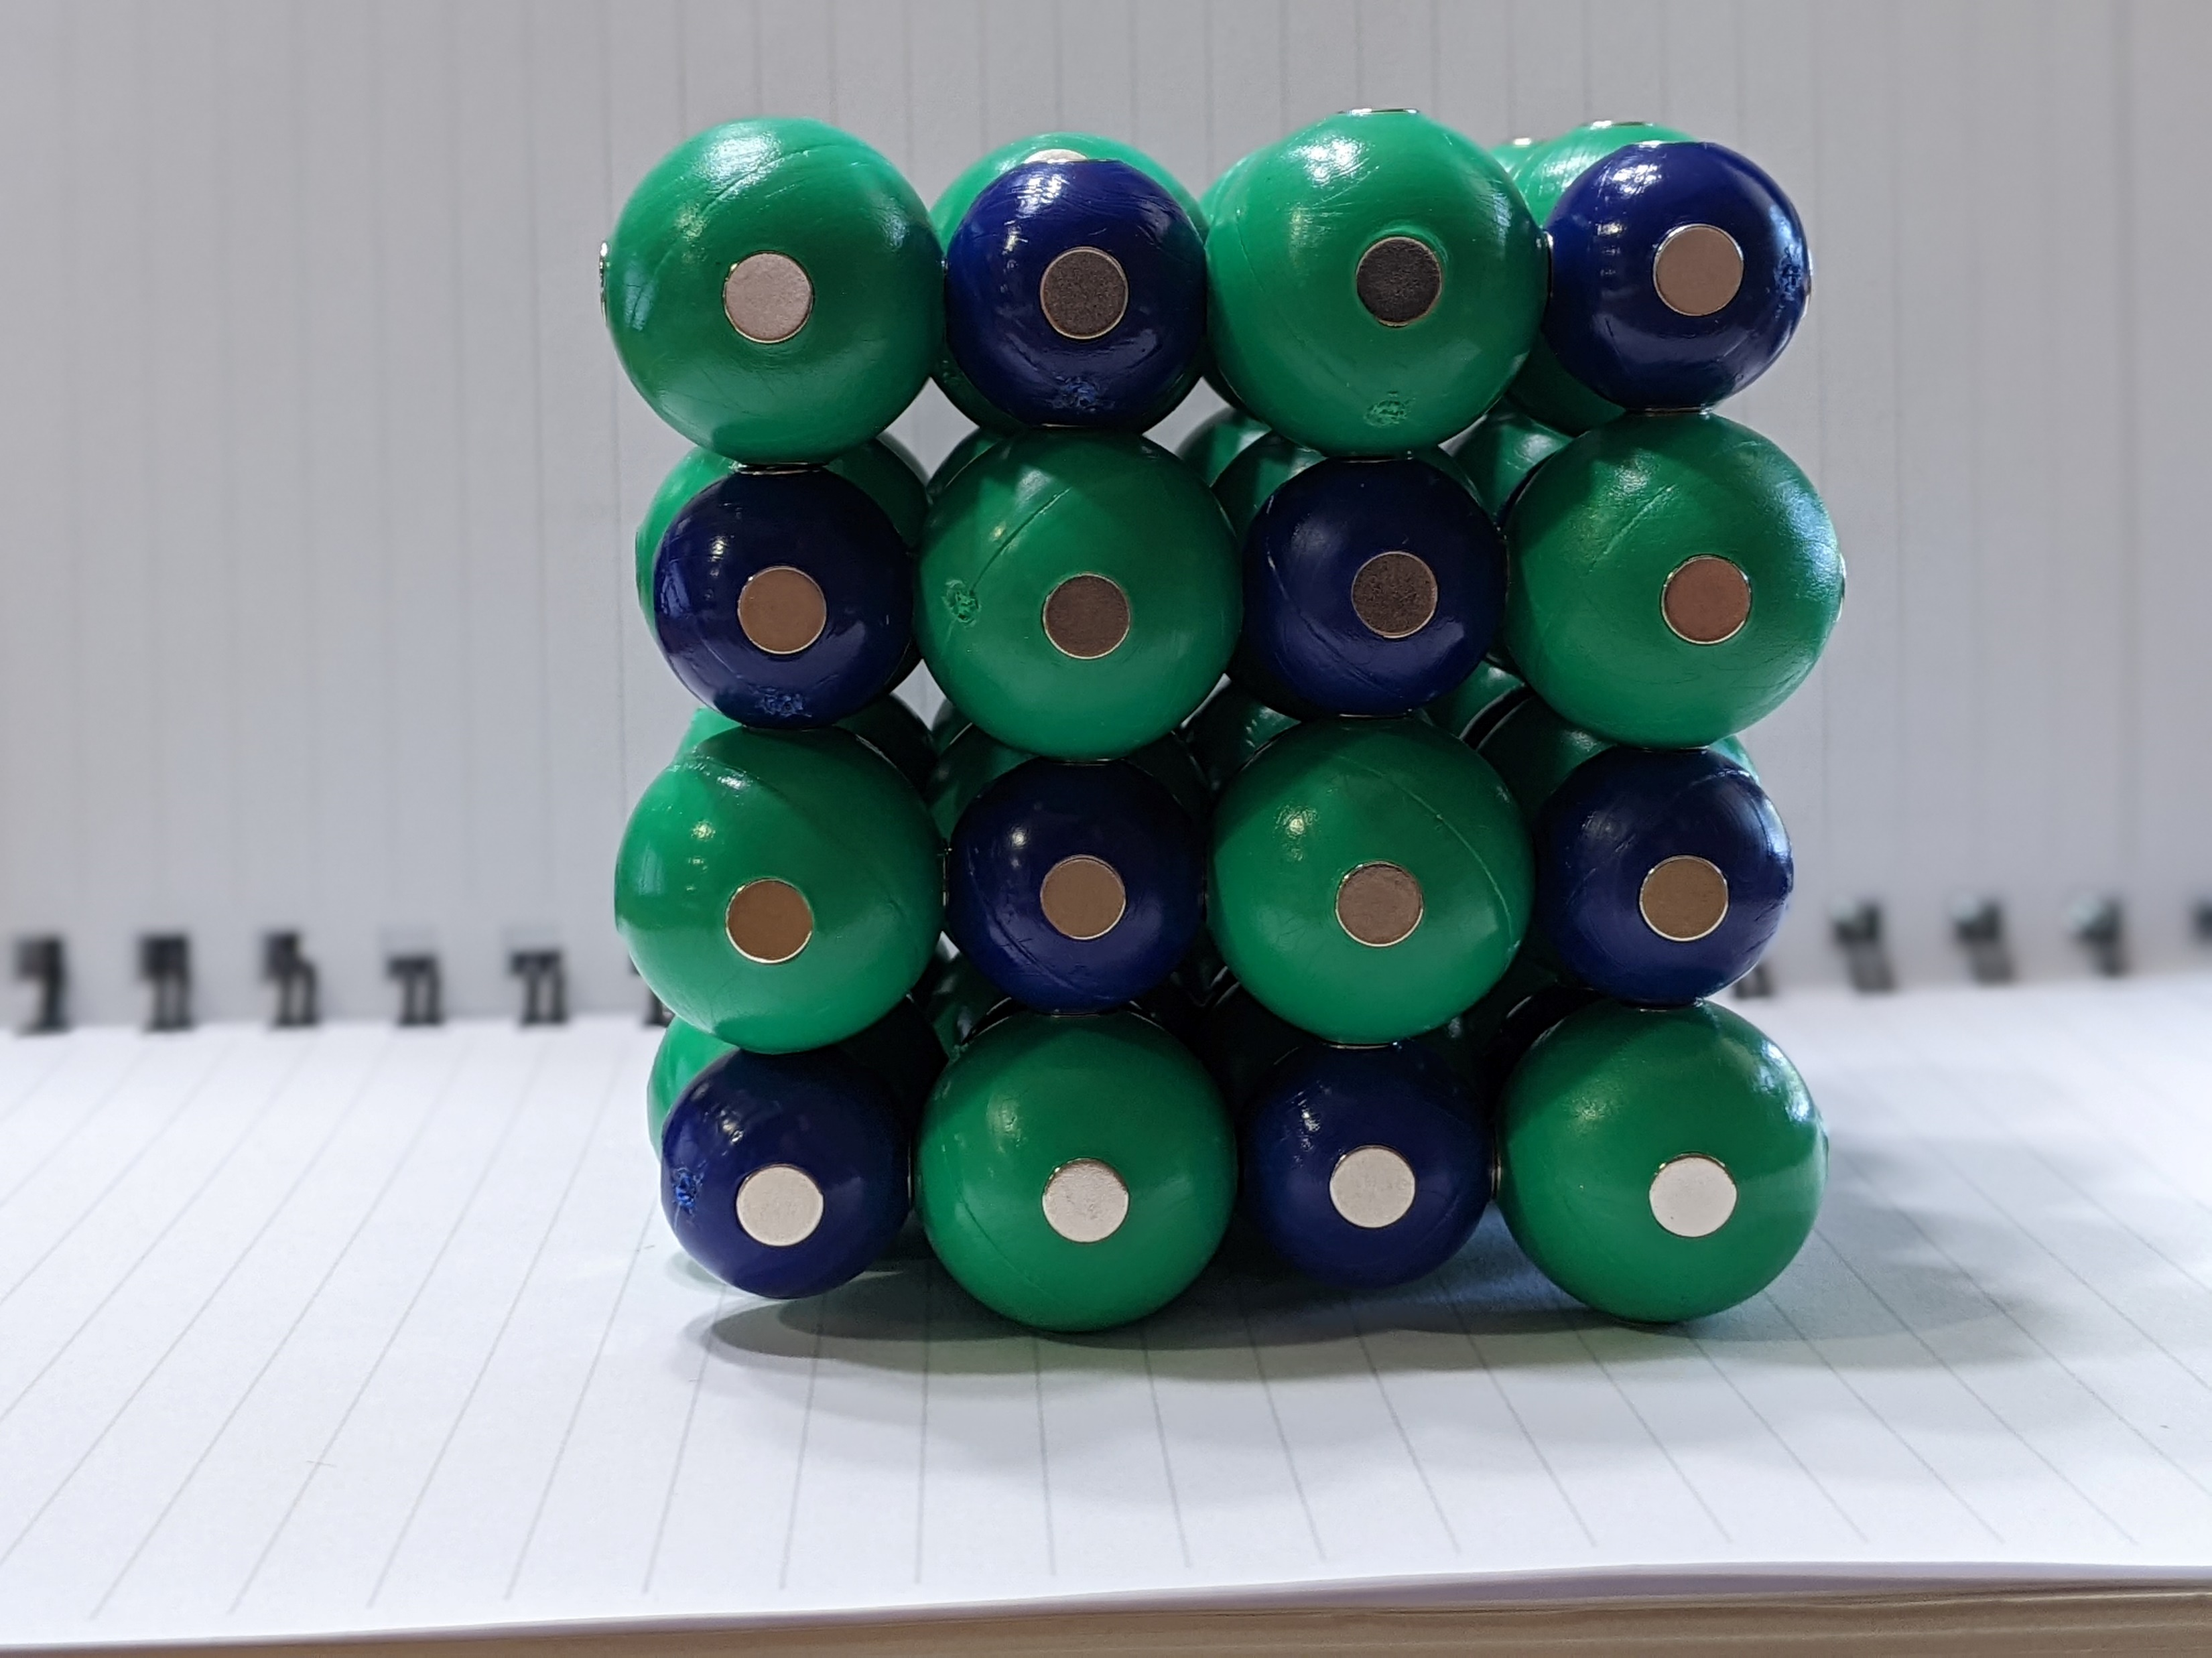
What do you notice?
What pattens do you see?
How are these complex structures similar?
How are they different?
Notes:
Ruth says: I have them write about the patterns they see atomically from the model in their lab notebook.
[Advance slide]

Slide 38
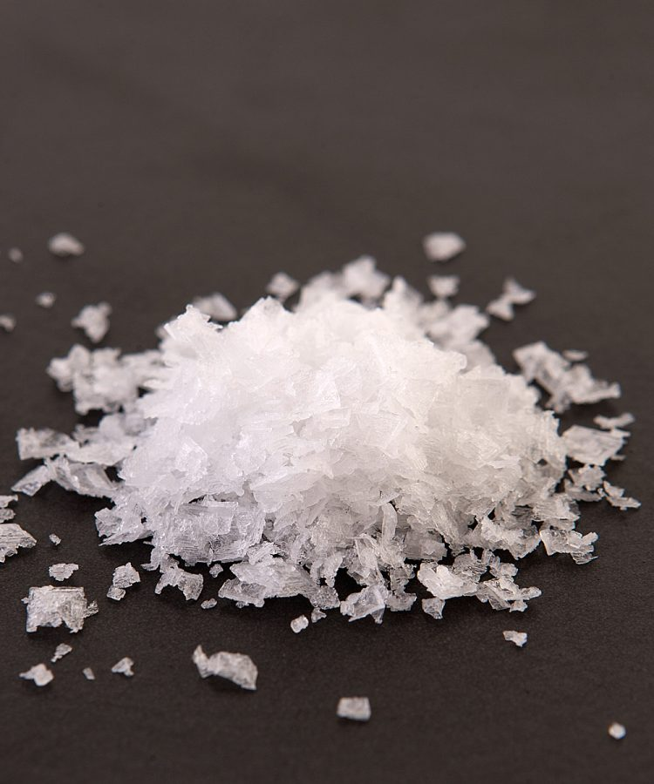
What do you notice?
What pattens do you see?
How are these complex structures similar?
How are they different?
Notes:
Ruth says: Then I give them a small portion of Maldon salt and ask them to look at it under the stereoscope.
[Advance slide]

Slide 39
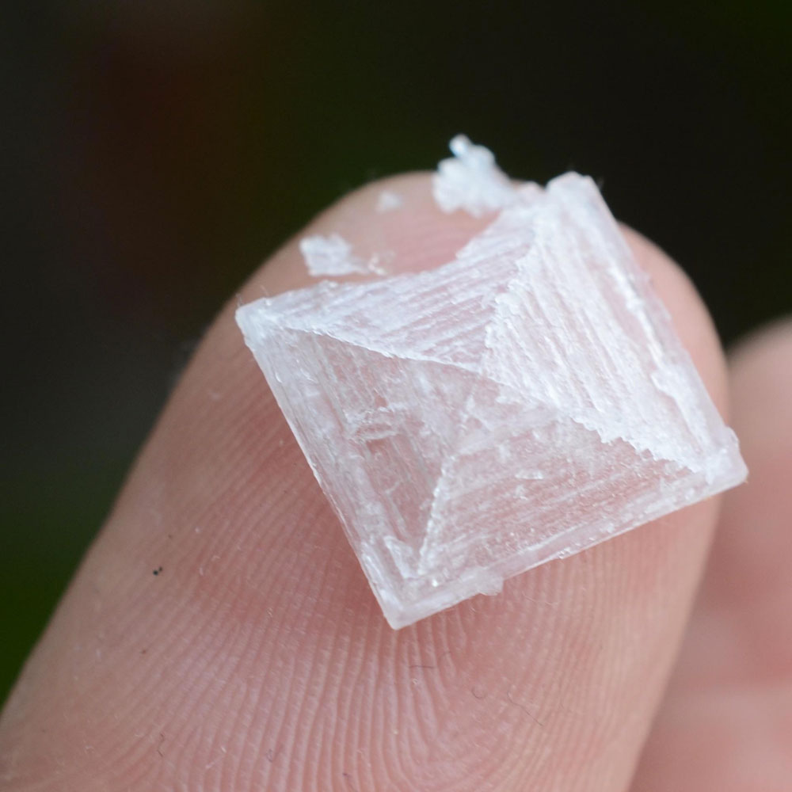
What do you notice?
What pattens do you see?
How are these complex structures similar?
How are they different?
Notes:
Ruth says: When magnified, students noticed that this salt forms pyramids. I ask them to use the salt lattice to model how the structure they see might appear at the molecular level.
[Advance slide]

Slide 40
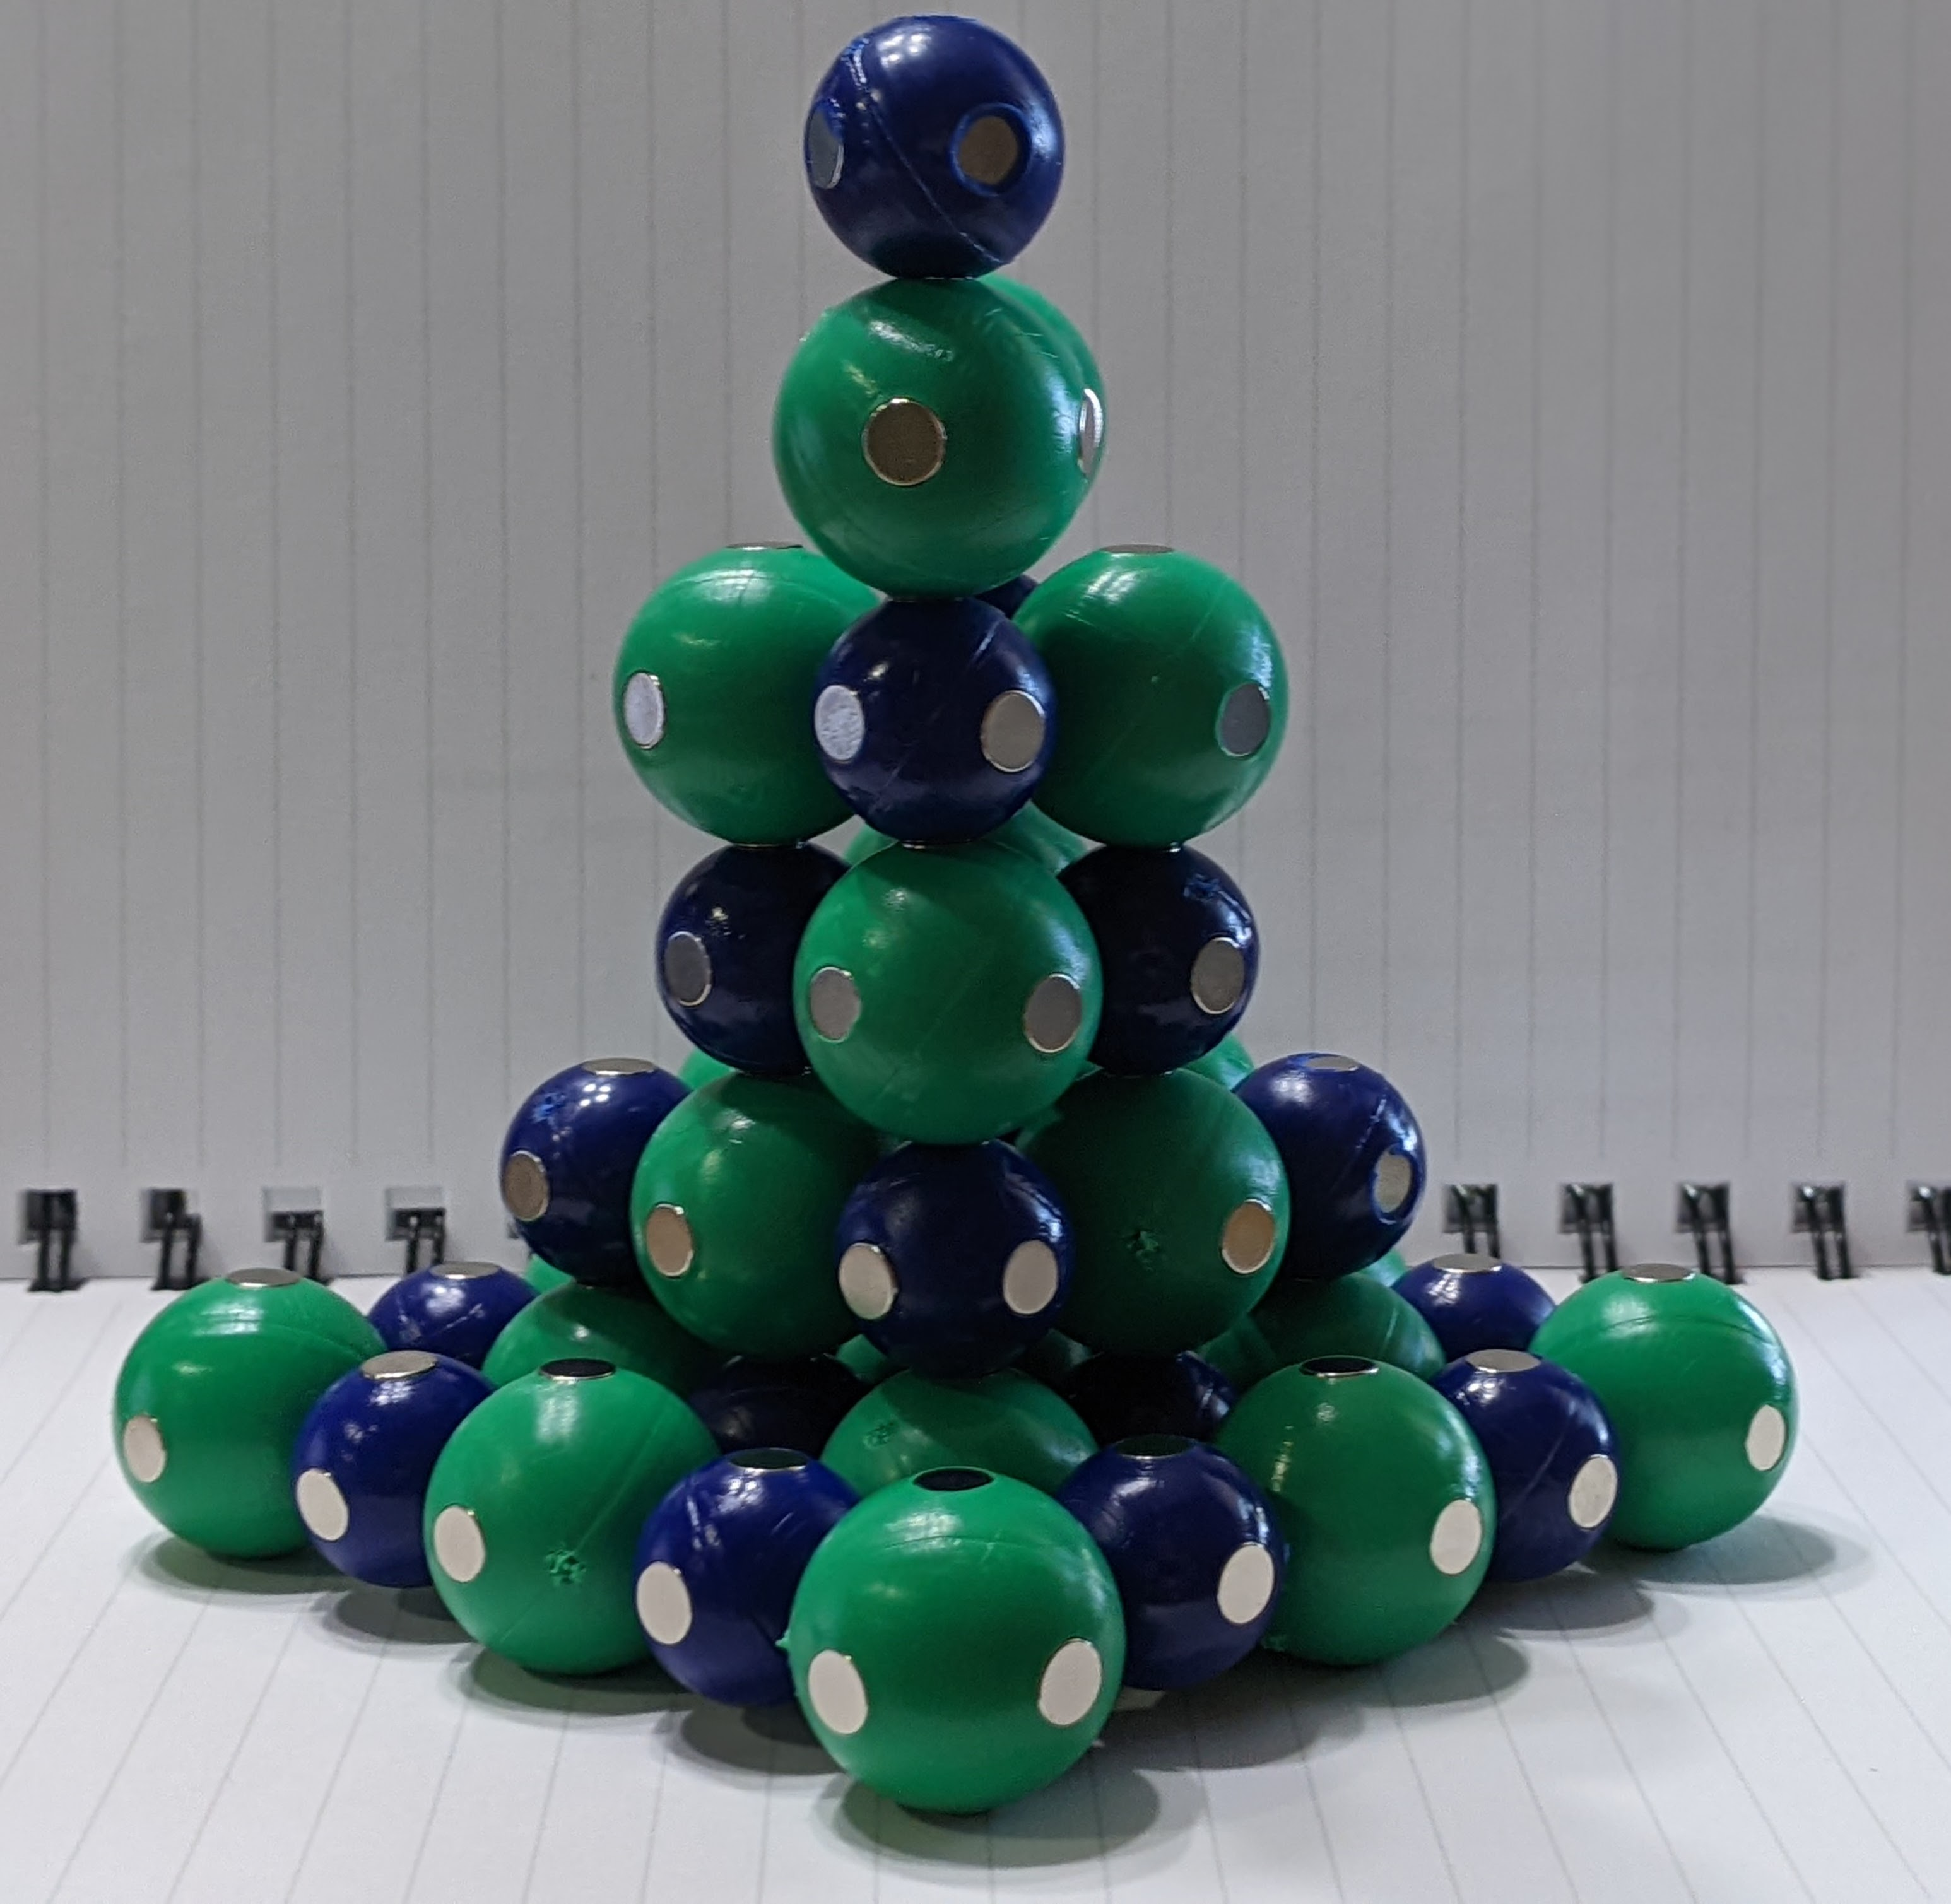
What do you notice?
What pattens do you see?
How are these complex structures similar?
How are they different?
Notes:
Ruth says: Here is a possible option. How does this differ from the rock salt?
This ends day one.
[Advance slide]

Slide 41
Challenge Time
How could you use the NaCl lattice and the Water Kit to support that the total weight of matter doesn't change when sodium chloride is dissolved in water?
Notes:
Ruth says:
[Advance slide]

Slide 42
Workshop NGSS Connections
(and/or other applicable standards)
SEPs | CCCs | DCIs | TEKS
Using Mathematics and Computational Thinking | Scale, Proportion, and Quantity | 5-PS1-2 | Student Expectation- C.10A
Developing and Using Models | Patterns | MS-PS1-1 | Student Expectation- 8.5D
Planning and Carrying Out Investigations |  | HS-PS1-3 | Student Expectation- 5.5C
Notes:
Ruth says: Here are the NGSS Connections for this workshop.

Slide 43
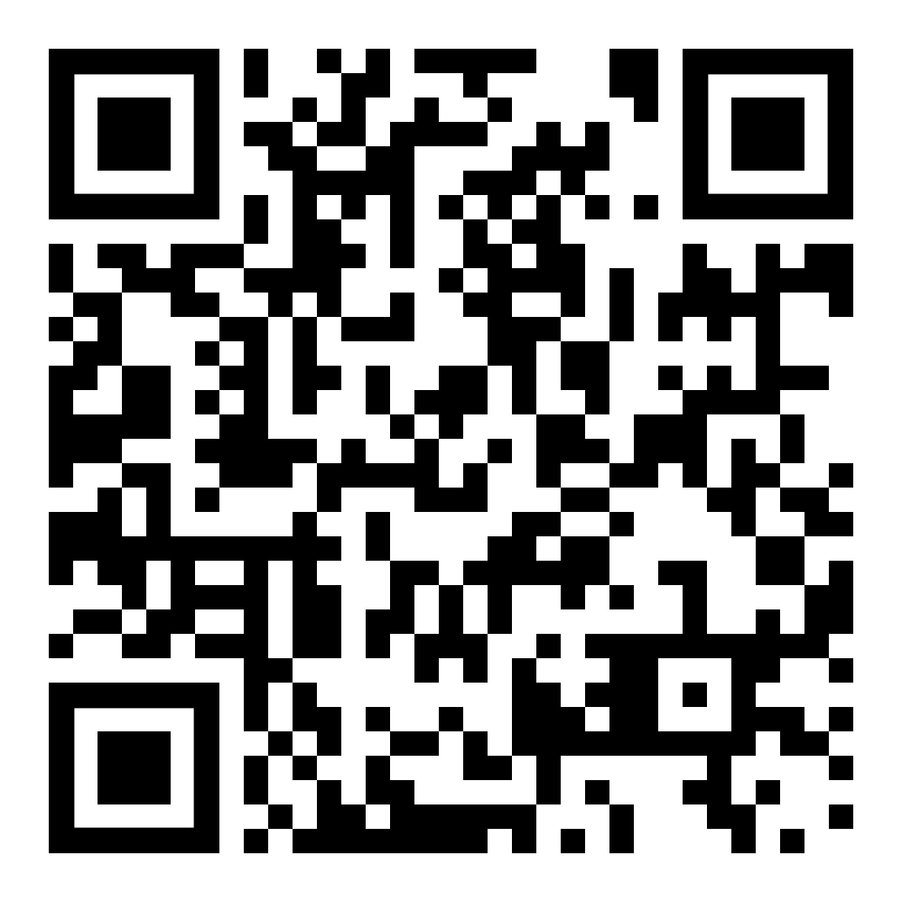
We value your opinion!
Let us know what you think.
Scan the QR Code and complete this short survey.

