Slide 1

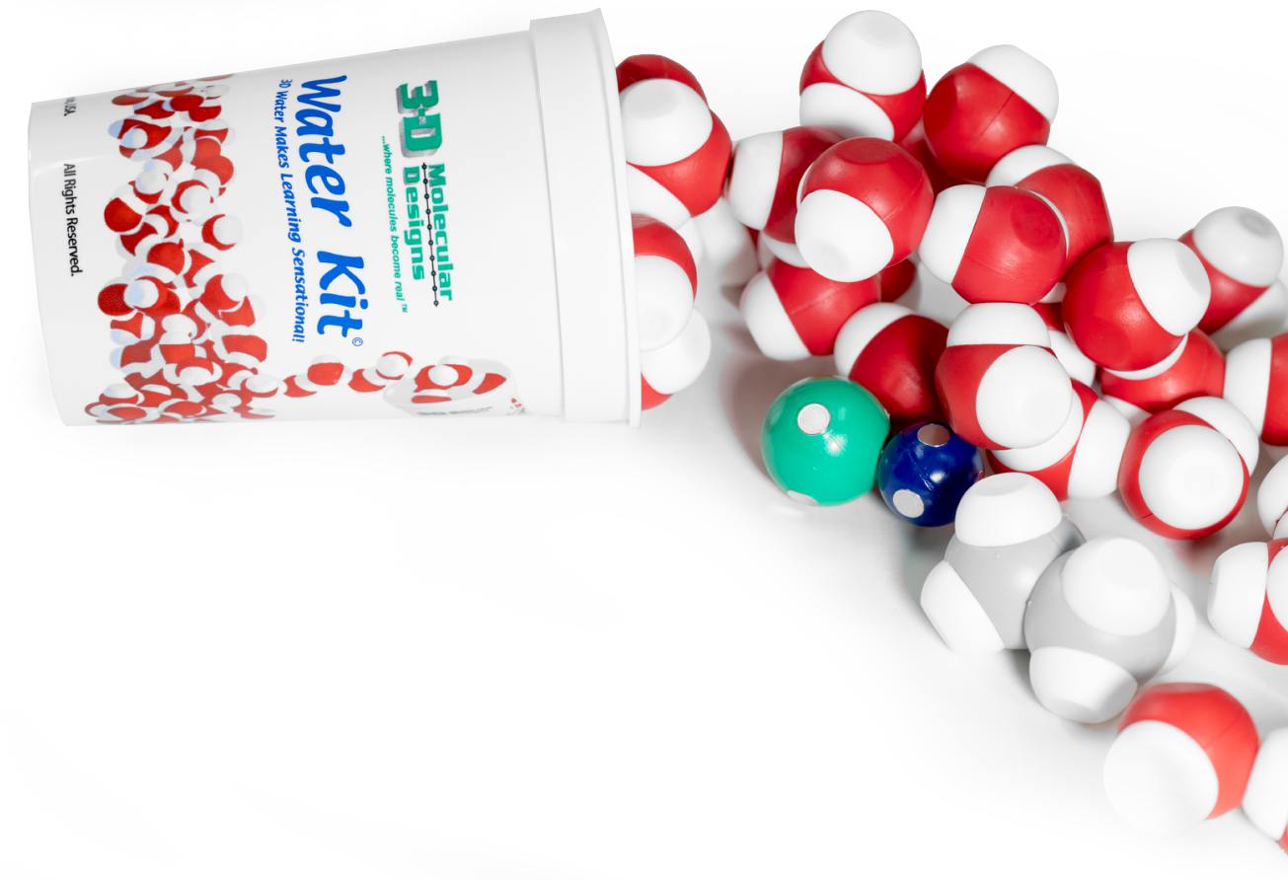
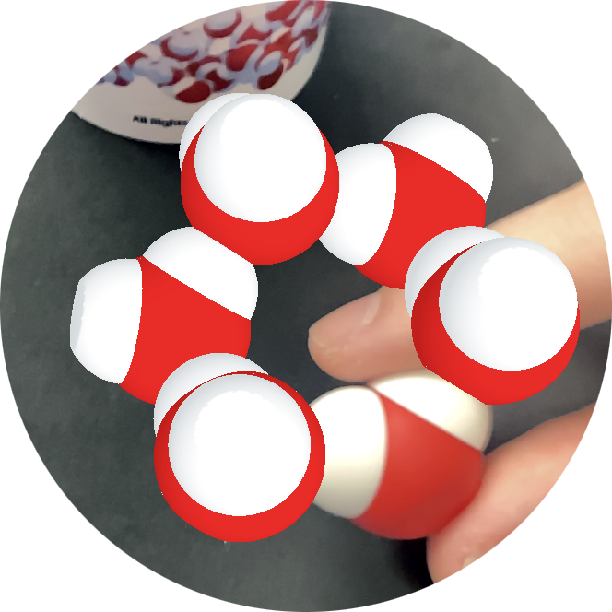

Exploring
States of Matter
“No water, no life. No blue, no green.”
– Sylvia Earle
Activity ID: WK-AR2
Required Models: 1 Water Kit©/ Group
Required Media: 3DMD AR App

Slide 2

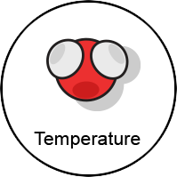

Teacher Guide – Summary
Activity Summary
This AR activity explores how molecular water exists as a solid, liquid, or gas, depending on temperature. When water molecules get cold enough, they form stable hydrogen bonds in an orderly solid lattice. Increasing temperature means increasing the average energy of motion of the water molecules, allowing them to break hydrogen bonds.
This activity requires the 3DMD AR application, available for download from the Google Play and Apple App stores. The activity is split into three AR scenes designed to be explored in order. Each AR scene is represented by a consistent icon in this slide deck and the 3DMD AR app (see icon images below.)
Scene 1: A single water molecule is scanned to reveal additional water molecules. An interactive temperature slider changes the water molecule behavior.
Scene 2: A six molecule ice lattice is scanned to reveal a larger display of water molecules. Volume and mass calculations lead to the density of water as a solid, liquid and gas.

Slide 3
Teacher Guide - Overview
Activity Objectives
  Discover how water behaves at different temperatures and determine at what temperatures it changes state.
  Evaluate the density of different states of water to understand its importance in real-world applications.
  Collect data and use it to calculate density (optional).
  Estimated Class Time:
25 minutes
Required Models:
6x water molecules from the Water Kit©
Required Media:
3DMD AR App + subscription
Other Materials Needed:
None
Grade, Class
9-12 Biology or Chemistry
Topics
States of Matter
Density of Matter
Prerequisite Knowledge
Matter is made of molecules.
Notes:
-Collums are ok

Slide 4






Teacher Guide - Using This Slide Deck
Student and Teacher Slide Deck Pages
  Slides that are meant for student viewing will feature a green top
  banner. Slides that are meant only for teacher viewing will feature a
  purple top banner and will appear hidden when in "slide show" mode.
Prompting Icons
  Each student slide will include a prompting icon in the top right corner of the slide. These icons on each slide queue your students to the type of activity they will be doing.
Turn and talk discussion
Write in your notebook
Quiet thinking time
Digital modeling
Physical modeling
Teacher Moves and Student Moves
Class slides provide notes (teacher notes below the slide) with specific information to assist you in facilitating the activity using effective modeling and education practices.

Slide 5
Teacher Guide - Standards
Next Generation Science Standards
Science and Engineering Practices | Cross Cutting Concepts | Disciplinary Core Ideas
Scientific Investigations Use a Variety of Methods | Patterns | PS1.A
Developing and Using Models
Constructing Explanations and Designing

Slide 6
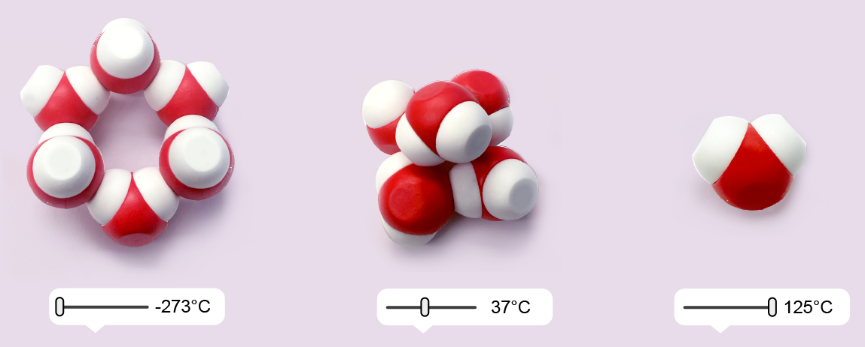
Teacher Guide – Scene 1
Scene 1: Temperature
Students will use a single water molecule from the Water Kit© to explore how water molecules behave as temperature changes. Moving the slider bar at the bottom of the app will change the temperature and the behavior of the water molecules shown in the AR overlay.
Your students will also use physical water molecules to build and evaluate their own representations of the three states of matter. Six water molecules will be used to build solid water (ice). Five water molecules will be used to build liquid water. One water molecule will be used to build gaseous water (vapor).

Slide 7



What properties of water can you observe?
Water is an amazing substance with some interesting properties.
Make some observations about the image to the right.
Do you see any water?
What do you notice?​
What do you wonder?
Notes:
Teacher: Discuss the properties of water with your students.
Student: Brainstorm what water does for life on Earth.

Slide 8

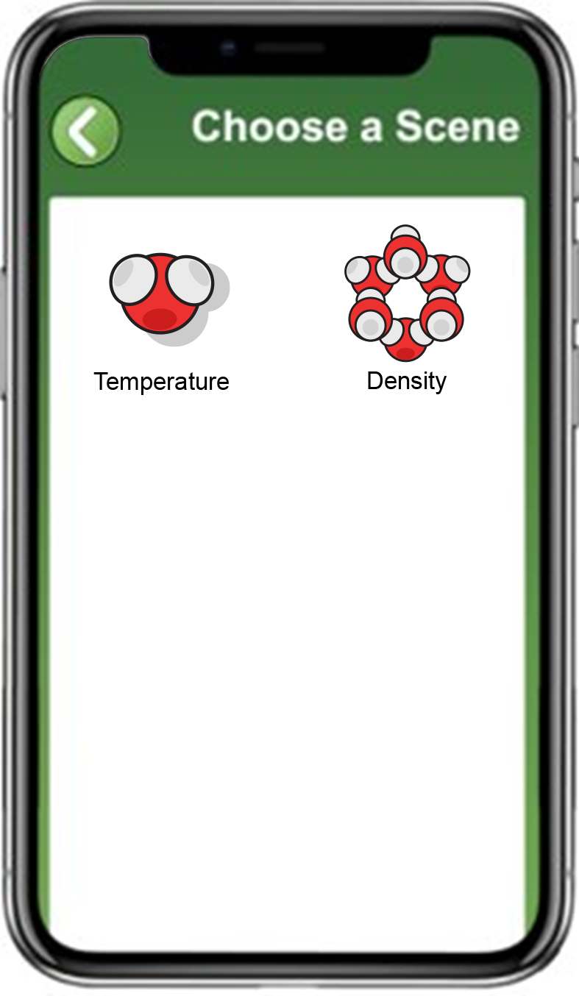
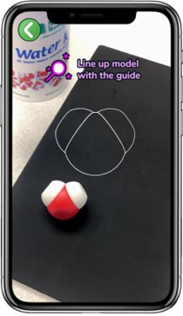
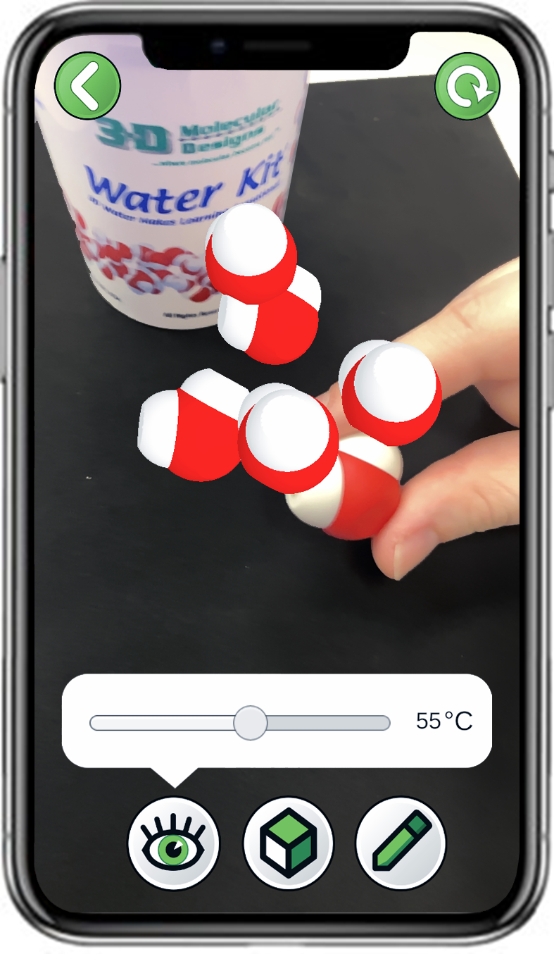
Explore Temperature with the 3DMD AR EDU App
Select
Temperature
Scan a single water molecule
Explore the slider bar
Notes:
Teacher: Give each student a water molecule. Have students open the app and select the appropriate activity and scene. Move around the room and assist students with their technology.
Student: Open the app and select the appropriate activity and scene.

Slide 9

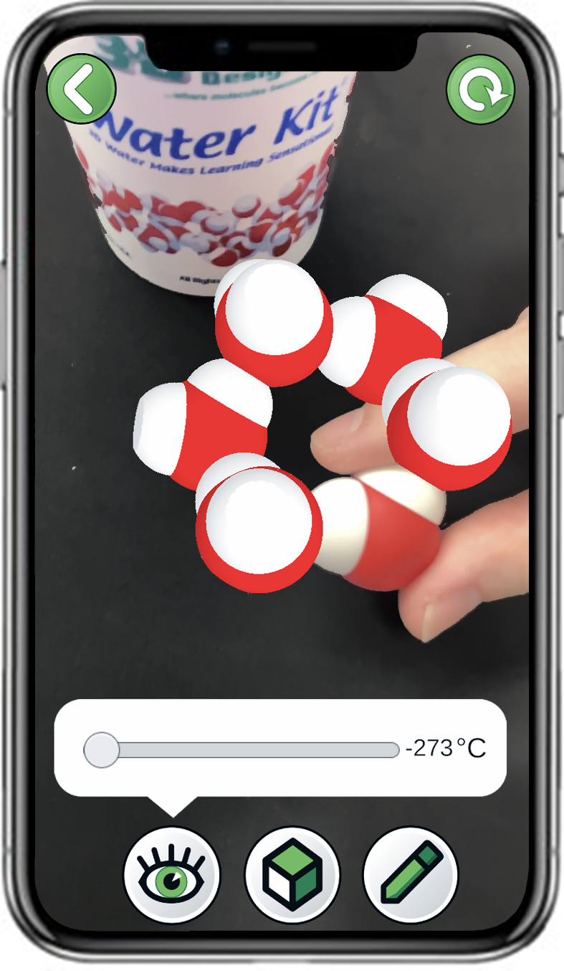
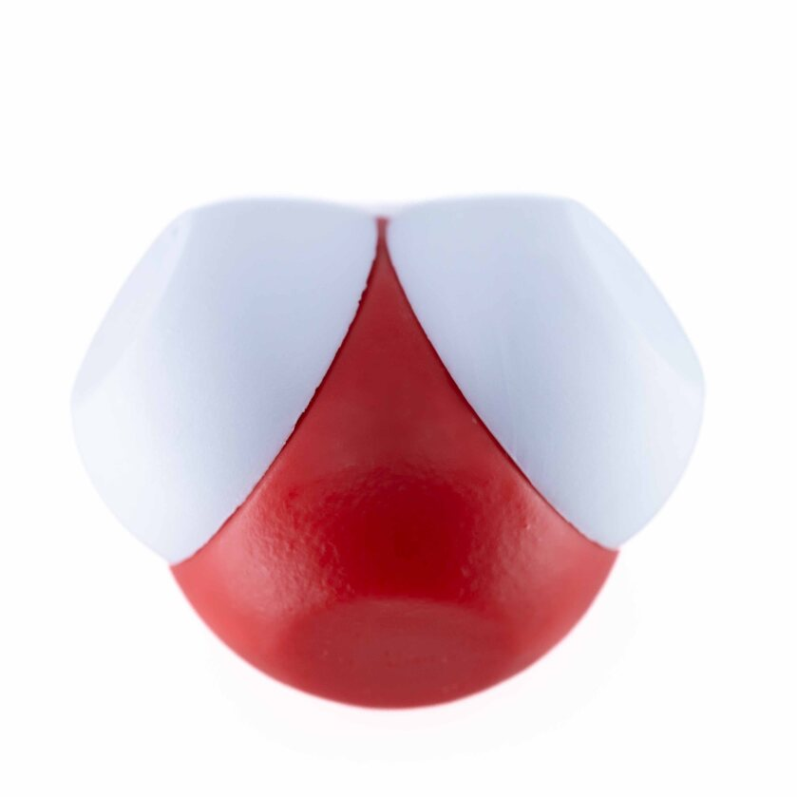
Water at -273ºC
How do water molecules behave at the lowest possible temperature of -273ºC ?
Slide the temperature slider bar all the way to the left and make some observations.
Using 6x water molecules, create a model that matches what you observed in the app at temperatures below zero degrees.
6x
Notes:
Teacher: Move around the room and assist students with their technology. You might recommend that students switch to the 3D display so they can better view the image. Ask students to build one physical model that matches what appears on the screen.
Student: Observe the arrangements of the water molecules that form a crystal lattice. Notice that at absolute zero molecular motion ceases. Set your phone aside and build the physical model of the crystal lattice that appears on the screen.

Slide 10

Record Your Observations at -273ºC
How did the water molecules look?
Do they remain still or move?
What else do you observe?
Discuss these questions with your partner and record your observations in your notebook.
Draw water molecules in your notebook if it helps you describe your observations. Or draw on a screenshot in the app using the pencil in the bottom right corner.
Notes:
Teacher: Ask students to turn and talk before writing their conclusion.
Student: PLAY! In their notebook, describe the scene that they see.

Slide 11
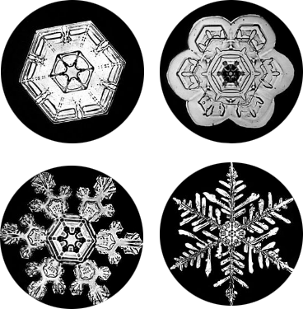
Solid Water Forms a Stable Lattice
Frozen water (ice) forms a stable lattice and is therefore considered a solid.
The water molecules do not move from their fixed positions.
Ice lattices are hexagonal (six-sided). This is why snowflakes are always six-sided!
Notes:
Teacher: Remind students how water molecules interact with each other. Explain that different types of ice form different crystal lattices. Do not go into detail before students are given time to model. Ask them to explain their thought process to you as you check in with individual groups.
Student: Build another ice lattice in a different configuration. Experiment with connecting the two lattices. Be prepared to explain the patterns that they are seeing in the ice lattices.

Slide 12
Record Your Observations at 37ºC
How did the water molecules look?
Do they remain still or move?
What else do you observe?
Discuss these questions with your partner and record your observations in your notebook.
Draw water molecules in your notebook if it helps you describe your observations. Or draw on a screenshot in the app using the pencil in the bottom right corner.
37
Notes:
Teacher: Ask students to turn and talk before writing their conclusion.
Student: PLAY! In their notebook, describe the scene that they see.

Slide 13
Water at 37ºC
How do water molecules behave at a temperature of 37ºC ?
Slide the temperature slider bar to the middle and make some observations.
Using 5x water molecules, create a model that matches what you observed in the app at a temperature of 50ºC.
5x
37
Notes:
Teacher: Move around the room and assist students with their technology. You might recommend that students switch to the 3D display so they can better view the image. Ask students to build one physical model that matches what appears on the screen.
Student: Observe the arrangement of the water molecules that form a crystal lattice. Notice that at average body temperature molecular motion increases. Set your phone aside and build the physical model of water that appears on the screen.

Slide 14
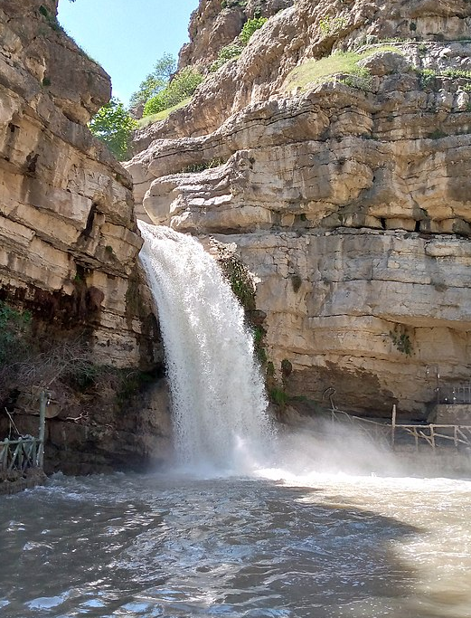
Liquid Water is Constantly Moving
Melted water does not form a stable lattice and is therefore considered a liquid.
The water molecules are constantly moving, bouncing into each other and swirling.
The water molecules are constantly forming and breaking hydrogen bonds.
Notes:
Teacher: Remind students how water molecules interact with each other. Explain the properties of liquid water. There is a limitation to the model because the physical model of liquid will remain stationary.
Student: Students should evaluate their model and identify its limitations.

Slide 15
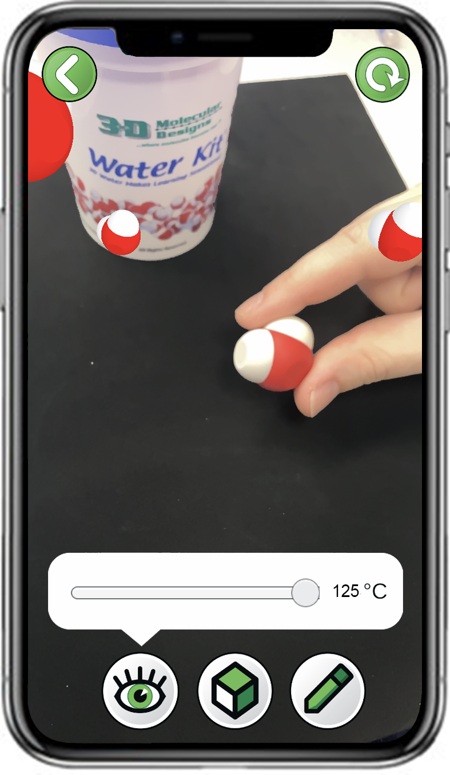
Water at 125ºC
How do water molecules behave at the high temperature of 125ºC ?
Slide the temperature slider bar all the way to the right and make some observations.
Using a single water molecule, create a model that matches what you observed in the app at a temperature of 125ºC.
1x
Notes:
Teacher: Move around the room and assist students with their technology. You might recommend that students switch to the 3D display so they can better view the image. Ask students to build a physical model that matches what appears on the screen.
Student: Observe the arrangements of the water molecules. Notice that the molecular motion is fast. Set your phones aside and build the physical model of that appears on the screen.

Slide 16
Record Your Observations at 125ºC
How did the water molecules look?
Do they remain still or move?
What else do you observe?
Discuss these questions with your partner and record your observations in your notebook.
Draw water molecules in your notebook if it helps you describe your observations. Or draw on a screenshot in the app using the pencil in the bottom right corner.
Notes:
Teacher: Ask students to turn and talk before writing their conclusion.
Student: PLAY! In their notebook, describe the scene that they see.

Slide 17
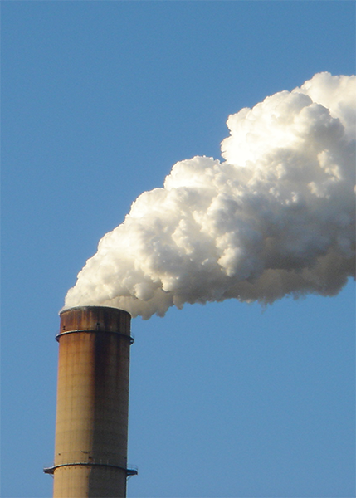
Gas Water Spreads Out
Water vapor does not form a stable lattice or have a fixed shape or volume, and is therefore considered a gas.
The water molecules are so spread out that they rarely interact with each other.
The water molecules form and break hydrogen bonds very quickly.
Notes:
Teacher: Remind students how water molecules interact with each other.
Student: Jot down thoughts and ideas in your notebook.

Slide 18
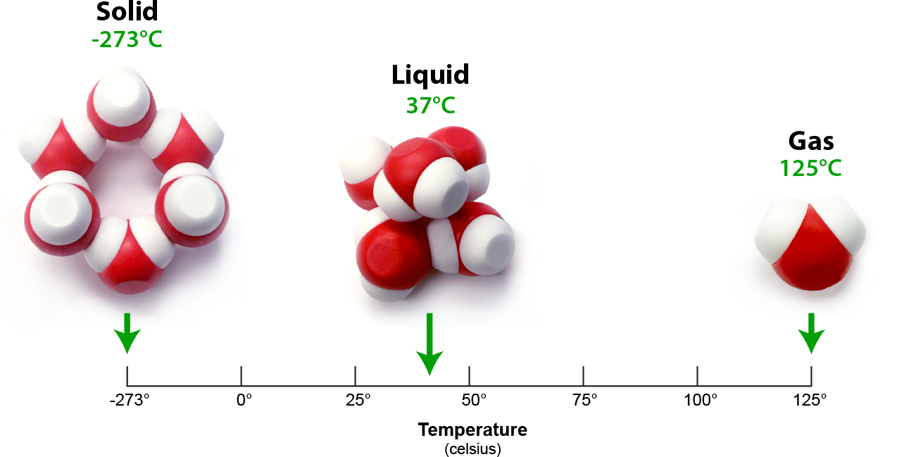
Water Molecules as Solid, Liquid and Gas
Water is a solid at -273ºC.
Water is a liquid at 37ºC.
Water is a gas at 125ºC.
But at what specific temperatures do water change from solid to liquid and from liquid to gas?
Design a procedure that would use the app to determine the range of temperature for solid, liquid, and gas.
Notes:
Teacher: Help students summarize what occurs to water molecules as their molecular motion increases.
Student: Starting with a six molecule ice lattice. Demonstrate how the water molecules changes phase. Be prepared to explain the changes in molecular motion they are seeing.

Slide 19
Collect Data on Temperature Ranges
Use the temperature slider bar in the app to determine the precise minimum and maximum temperature for each of the three states.
Create a data table like the one below in your notebook.
State | Minimum Temperature | Maximum Temperature | Δ Temperature
Solid (Ice)
Liquid (water)
Gas (Steam)
Notes:
Teacher: Move around the room and assist with technology.
Student: Play! Gather and record your data points.

Slide 20
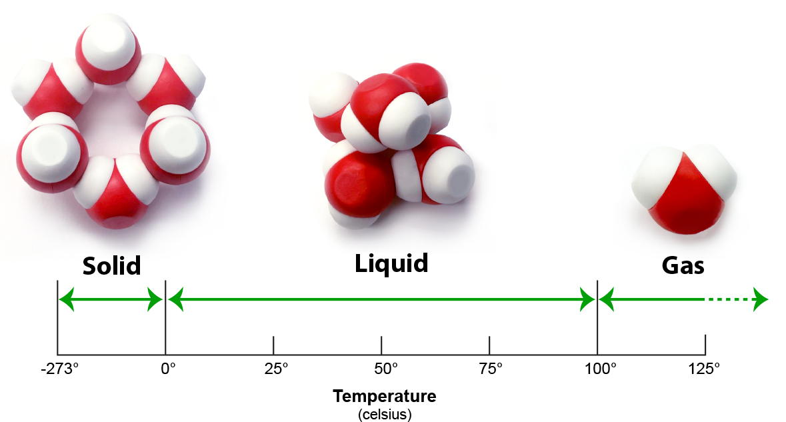
Phases of Water
Water is a solid below 0ºC and forms a stable lattice.
Water is a liquid from 0ºC to 100ºC and is constantly moving.
Water is a gas above 100ºC and spreads out.
Notes:
Teacher: Remind students how water molecules interact with each other.
Student: Jot down thoughts and ideas in your notebook.

Slide 21
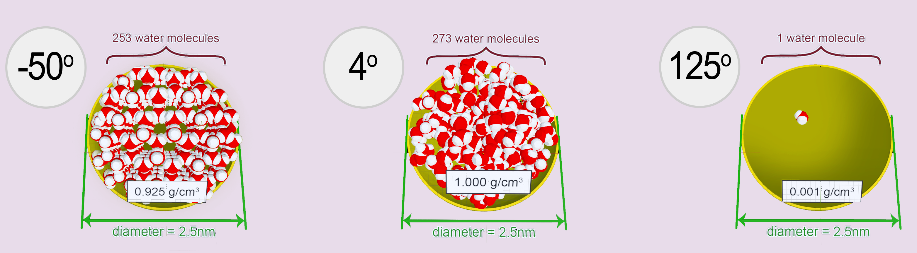
Teacher Guide – Scene 2
Scene 2: Density
Students will use a single water molecule from the Water Kit© to explore three AR overlays that show how water molecules fill a 2.5 nm diameter sphere at three temperatures (-50°C, 4°C, and 125°C). They will explore the property of density and determine why the density of water changes as its state changes. Using this information, they determine how changes in the state of water can affect living organisms.

Slide 22
Temperature and Density of Water
Density is how much matter exists in a given amount of space.
It is defined as dividing the total mass by the volume of the container.
Notes:
Teacher: Summarize for students what density is. The symbol is pronounced "rho".
Student: Jot down thoughts and ideas in your notebook.

Slide 23
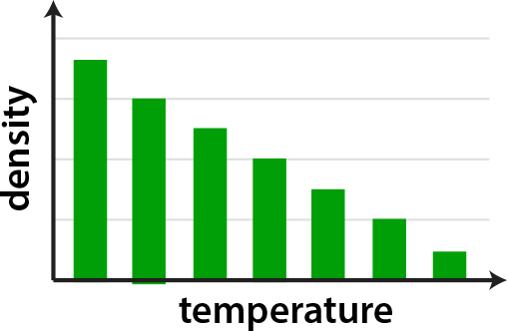
What is Density?
As temperature increases, molecules move faster and spread out.
This usually results in a decrease in density as temperature increases, as shown in the graph to the right.
Do you think this is true for water molecules?
Why or why not?
Notes:
Teacher: Explain to students the relationship between density and temperature. Ask them if this trend would be seen with water molecules.
Student: Turn and talk with your partner(s).

Slide 24
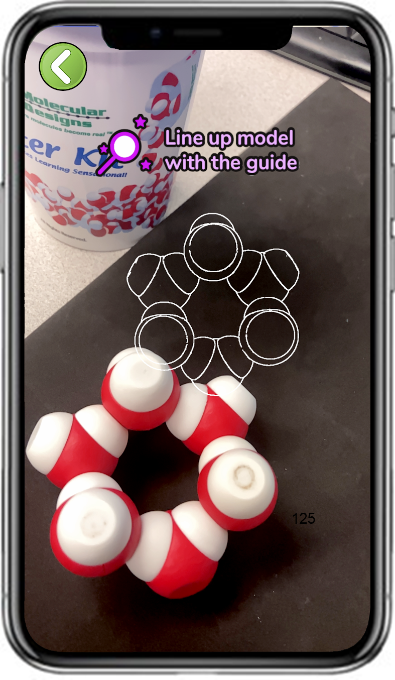
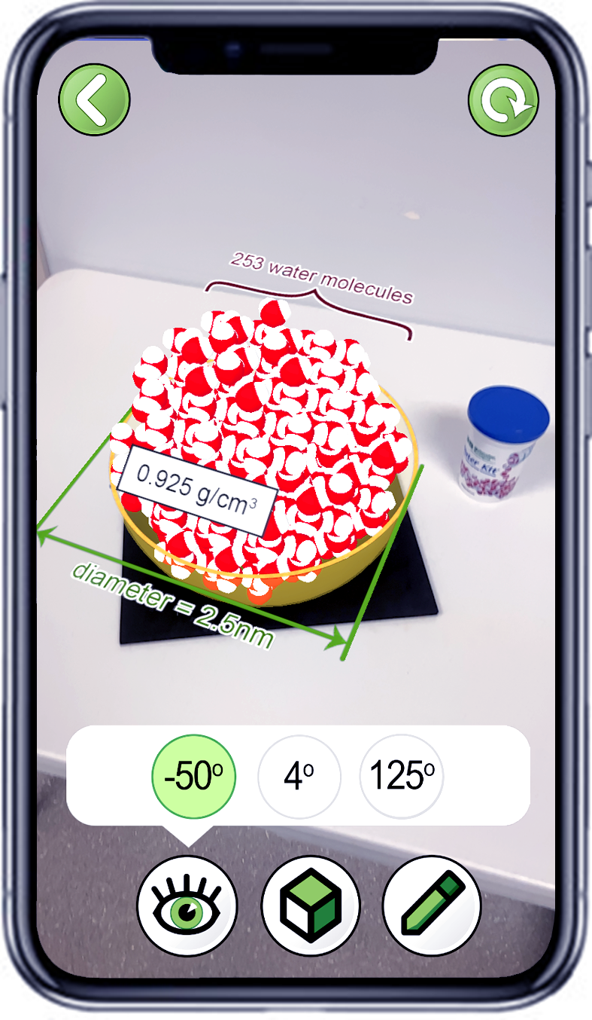
Explore Density with the 3DMD AR EDU App
Select
Density
Scan six water molecules
Explore the three buttons
Note, you may need to stand up and back away from your model to see the full overlay!
Notes:
Teacher: Give each student 6 water molecules. They will need to build a 6 molecule ice lattice. Have students open the app and select the appropriate activity and scene. They can use the scanning target as a template to build their ice lattice. Move around the room and assist students with their technology / build.
Student: Open the app and select the appropriate activity and scene.

Slide 25
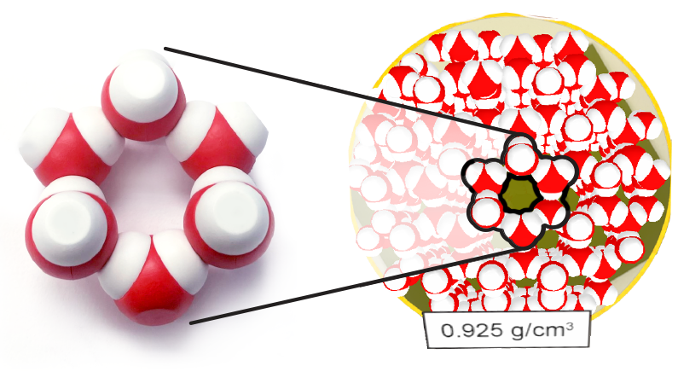
Why is Water Less Dense as a Solid?
Solid water (ice) forms a stable lattice, making it less dense as a solid than as a liquid.
If you look closely, this lattice can be seen when viewing the -50ºC AR overlay from directly above.
Notes:
Teacher: The app will produce a nine inch sphere of water molecules. Your students may need to back away from their seats to get the entire image on screen.
Student: Notice the larger lattice that is made. The image also includes the diameter and the number of water molecules inside. As a result, they could calculate the density and compare it with the density shown.

Slide 26
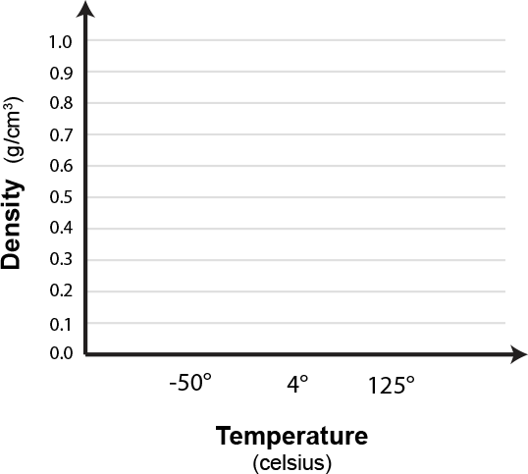
Temperature and Density of Water
The AR overlays represent how many water molecules would fit in a 2.5 nanometer (nm) sphere.
Create a graph in your notebook like the one shown to the right.
Based on your observations in the app, add bars that represent the density of water at each of the three temperatures.
Notes:
Teacher: Ask students to create a graph that shows the change in density at the temperatures shown in the graph.
Student: Use the app to collect your data and place it in the graph. For each temperature highlighted, the image includes the diameter and the number of water molecules inside. As a result, they could calculate the density and compare it with the density shown.

Slide 27
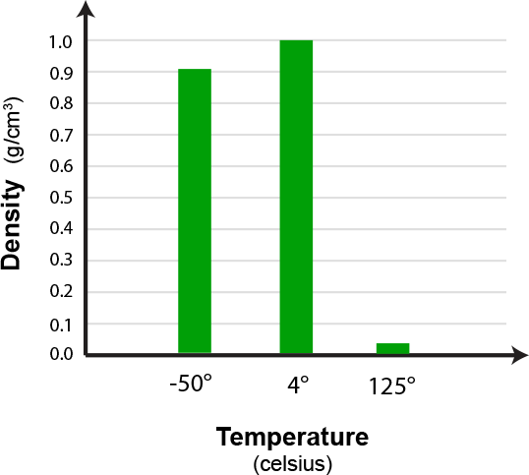
Water Density Does Not Consistently Decrease
Unlike most substances, the density of water does not consistently decrease as temperature increases.
Why might this be?
Use the three models you created earlier to support your answer.
Notes:
Teacher: Ask students to speculate why there is an increase in density. Water is odd because it expands as it gets colder due to hydrogen bonding inside a lattice. Most other substances contract, making them more dense because they have a smaller volume and the same mass.
Student: Check your work and edit accordingly in your notebook.

Slide 28
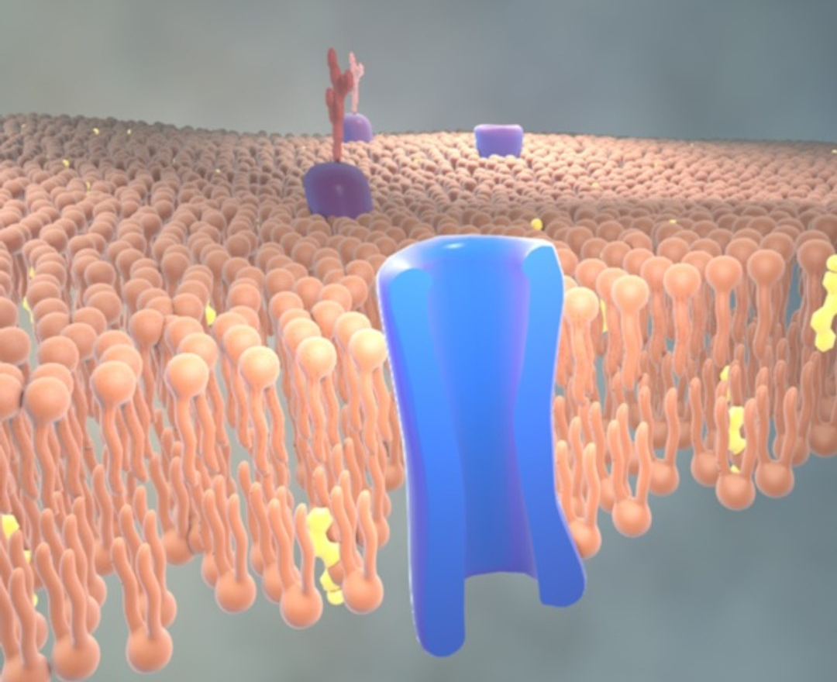
How Might Water Density Impact a Cell?
Why does your science lab have freezers and hot water baths?
What happens to a cell when you freeze it?
What will happen if you put it in boiling water?
Notes:
Teacher: Give students time to think and respond to the prompts. Ask students to apply what they know about the changing density of water as temperature changes and the composition of the cell. Facilitate discussion.
Student: Turn and talk with your partner(s). Be prepared to share your ideas with class.

Slide 29


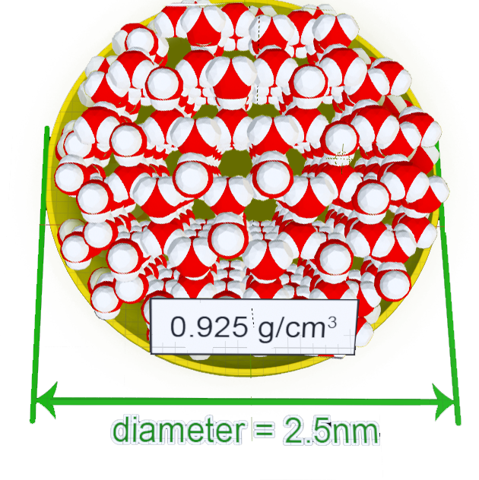
Conclusions
Temperature is an indication of molecular motion.
Molecular motion results in three states of matter: solid, liquid and gas.
Temperature and the resulting state of matter impacts density.
Water as a solid is less dense than water as a liquid.
Notes:
Teacher: Summary slide with learning objectives of this lesson.
Student: Jot your thoughts and ideas in your notebook.

