Slide 1
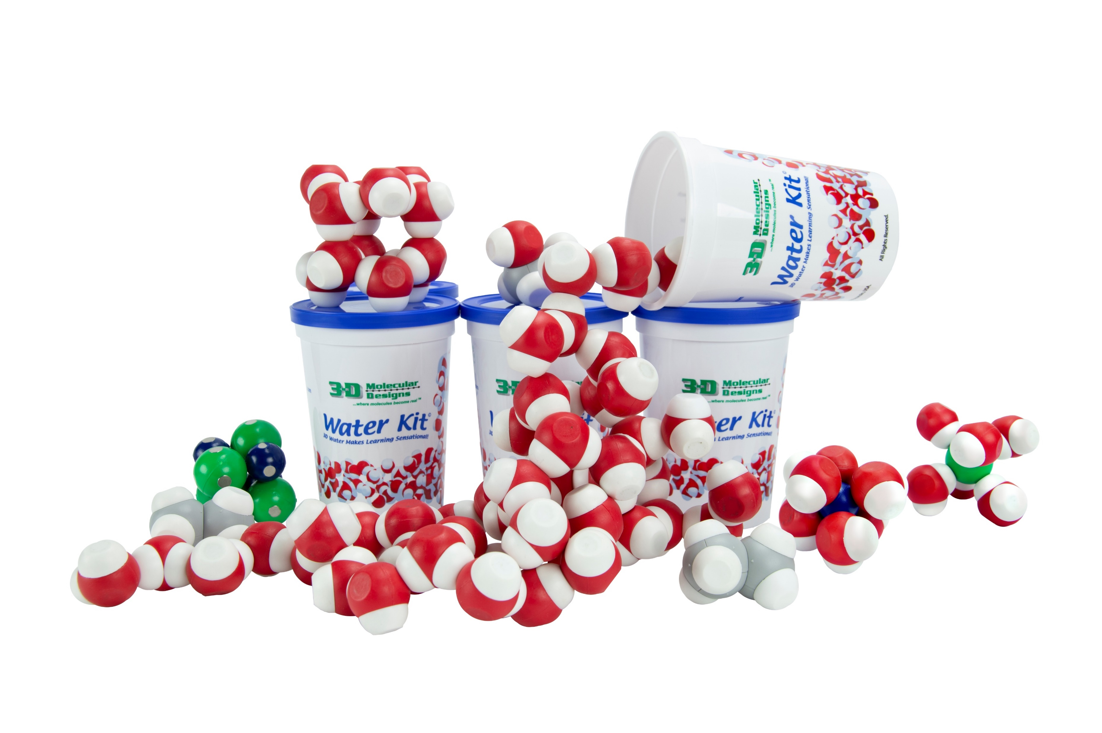
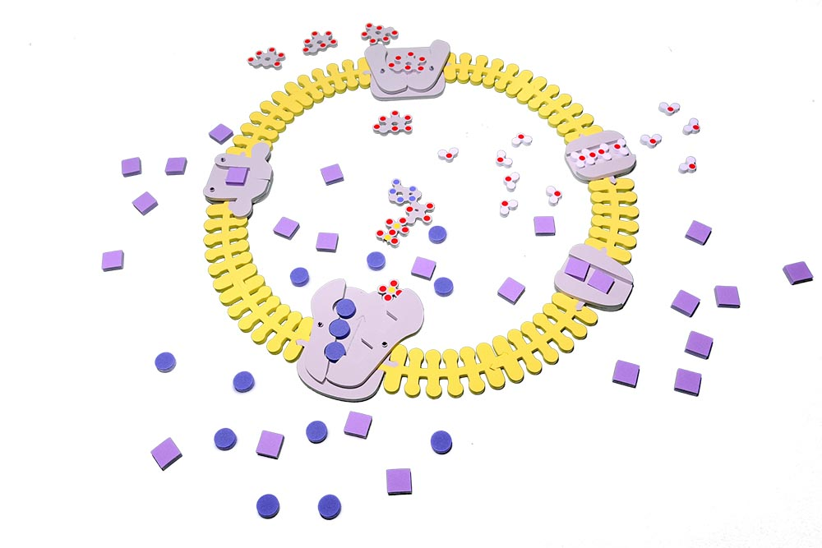

Water water everywhere… but how’d it get in there?
Mark Arnholt
Science Educator
3D Molecular Designs
Milwaukee, WI
Notes:
For this presentation, we will use the Water Kit (optional), Phospholipids Molymod Models (Optional), the Phospholipids and Membrane Kit, and several 3D printed models (aquaporin, potassium voltage-gated channel, and sodium voltage-gated channel).

Slide 2
Find a physical representation of water.
How do you know which model represents a water molecule?
What color represents the oxygen?
Which atoms interact with each other?
Why do water molecules stick to each other?

Slide 3
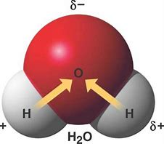
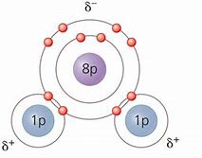
Water exhibits POLAR COVALENT bonds

Slide 4
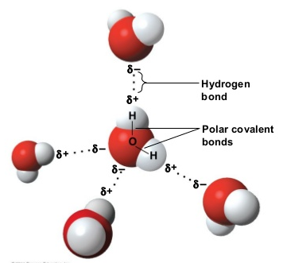
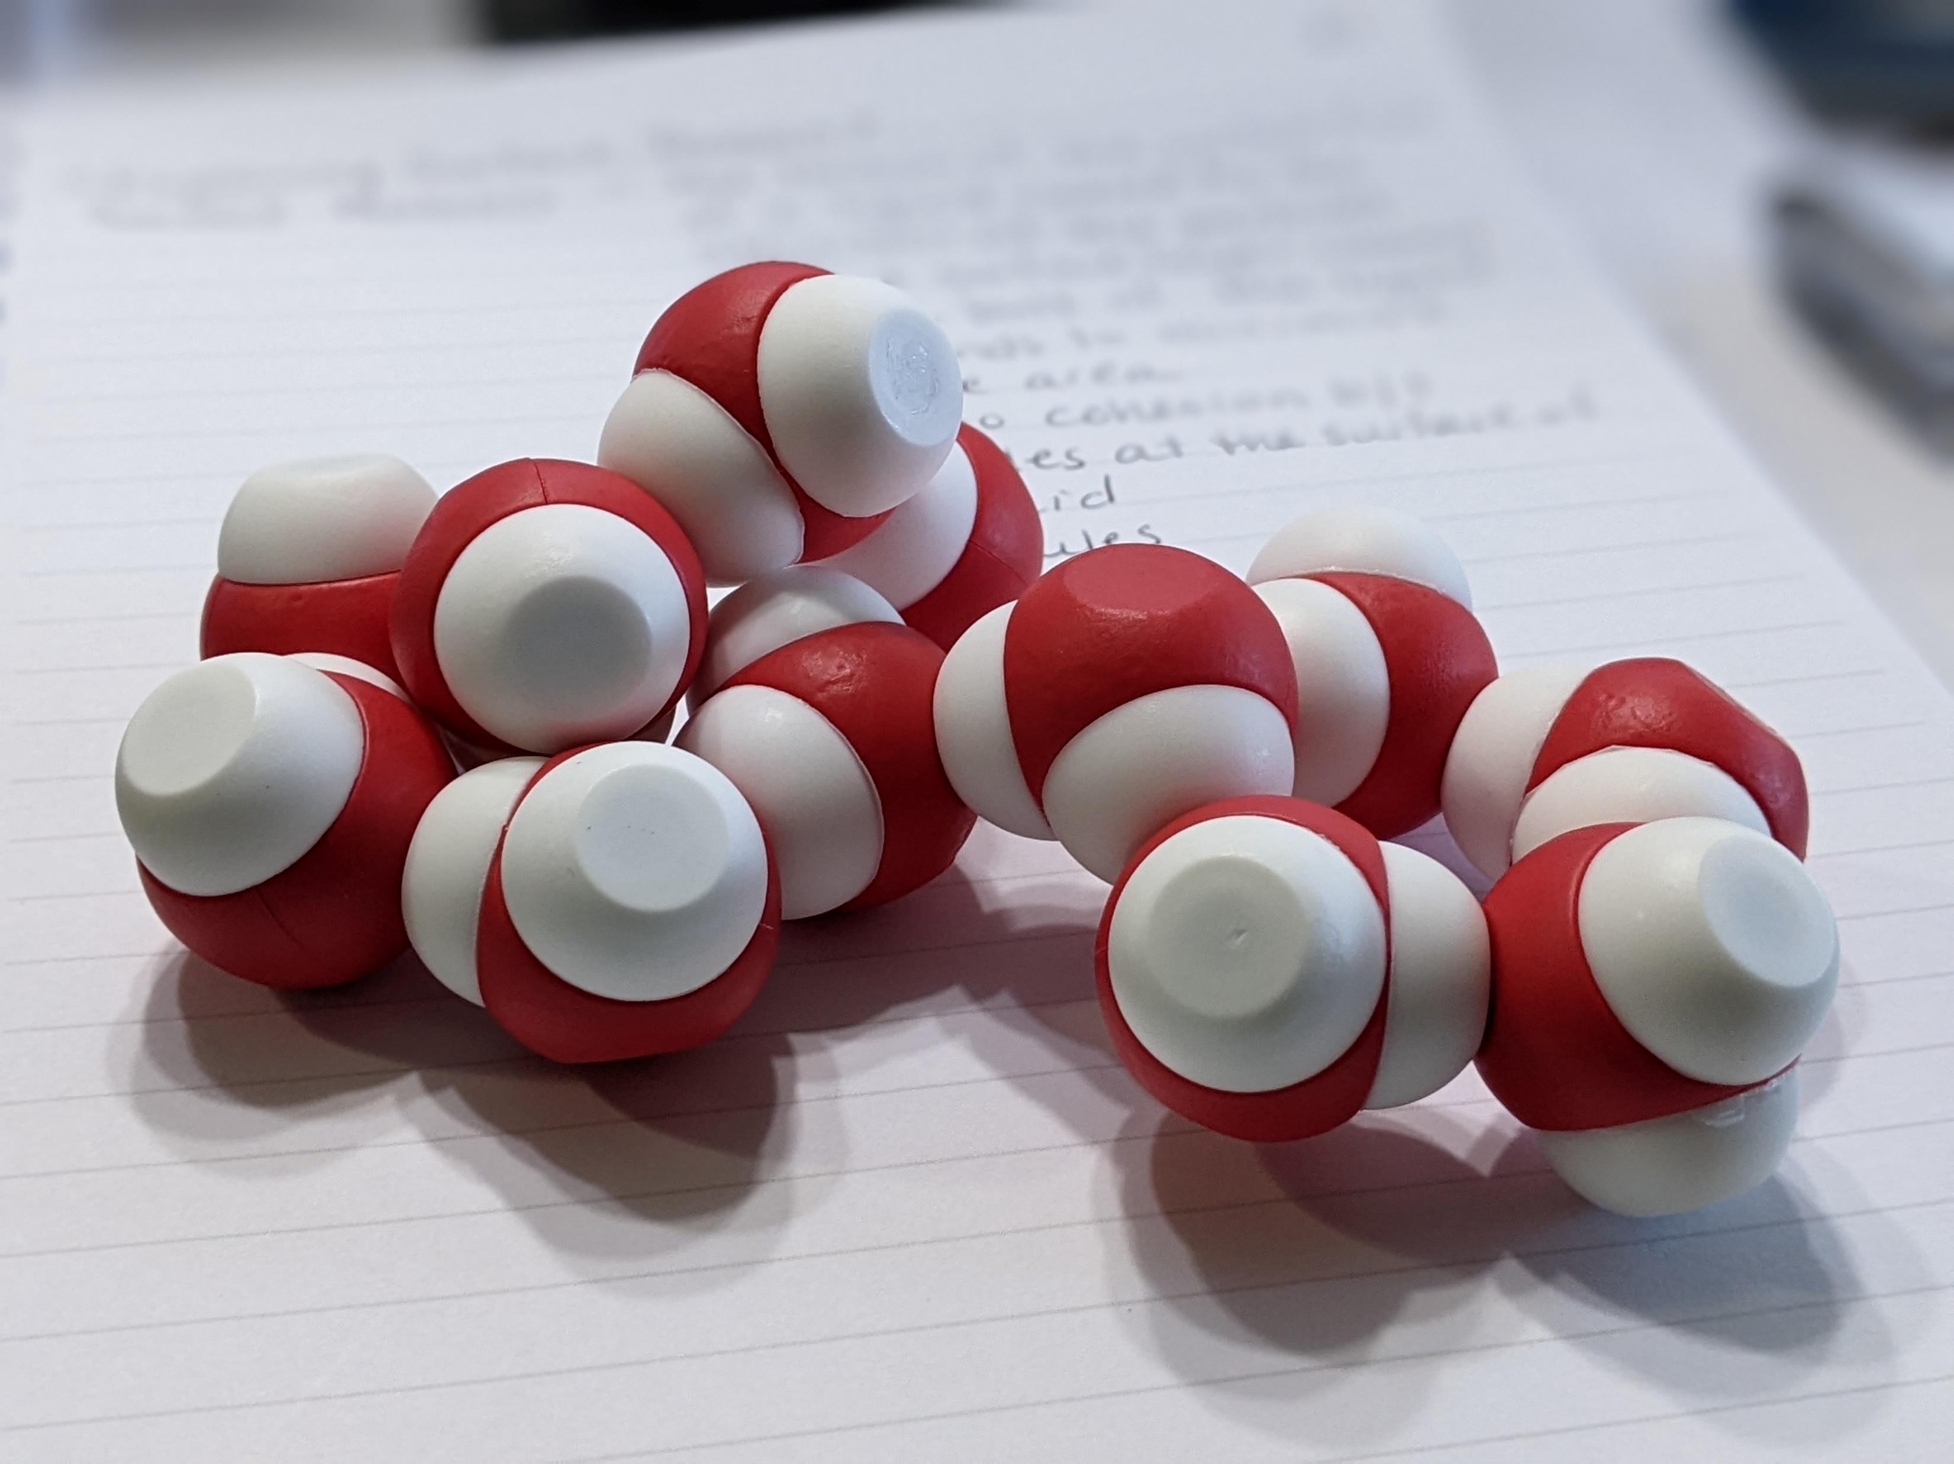
Notes:
You should notice that oxygens are attracted to hydrogens on other water molecules. This is because of hydrogen bonding which leads to many of the important properties of water and how it interacts with other substances.

Slide 5
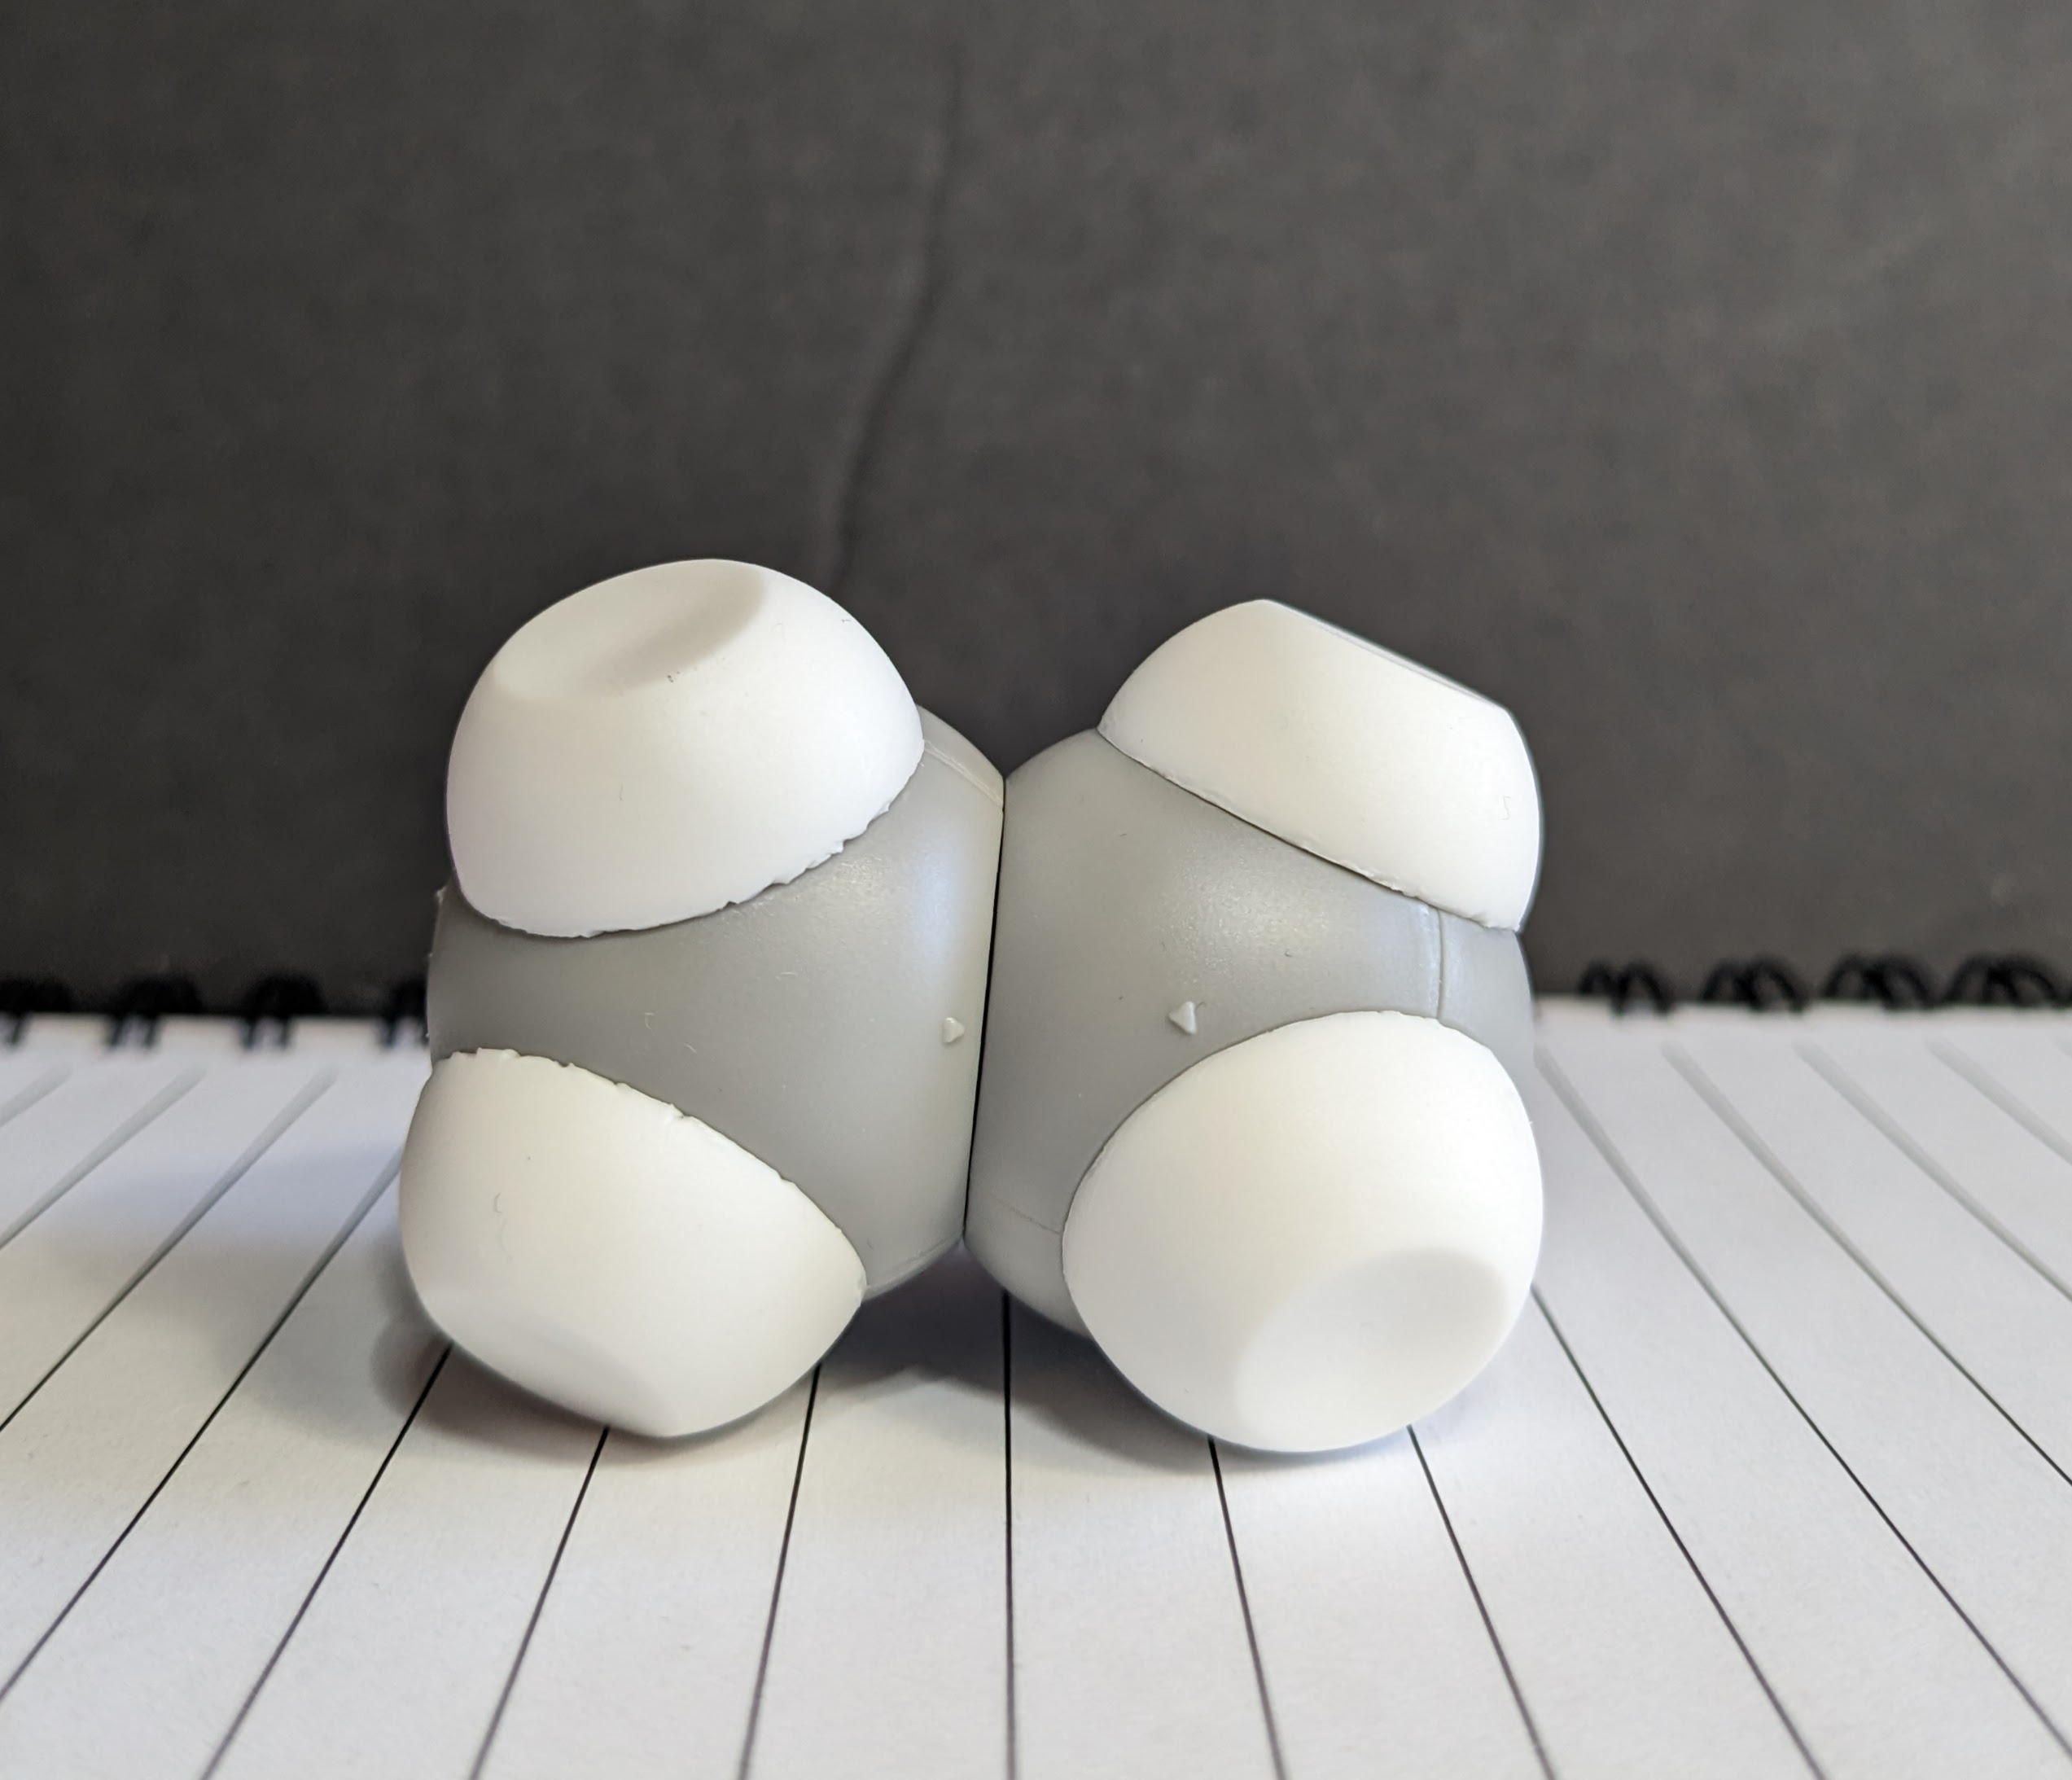
What patterns do you see?
What questions do you have?
Notes:
Now I have them retrieve the grey and white molecule from the cup and interact it with several water molecules. How it this interact with water? Talk about the difference between the thought bubble and text on the screen. [Wait for responses.]
[Advance slide.]

Slide 6
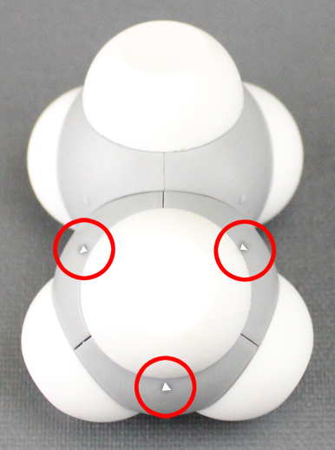
How does this molecule interact with water molecules ?
What patterns do you see?
What questions do you have?
A closer look at solubility
Notes:
Ethane is a non-polar molecule because it has an even charge across the entire molecule. Ethane does not form hydrogen bonds. Since water is polar and has an unequal charge across the molecule, it will not interact with ethane.
[Advance slide.]

Slide 7
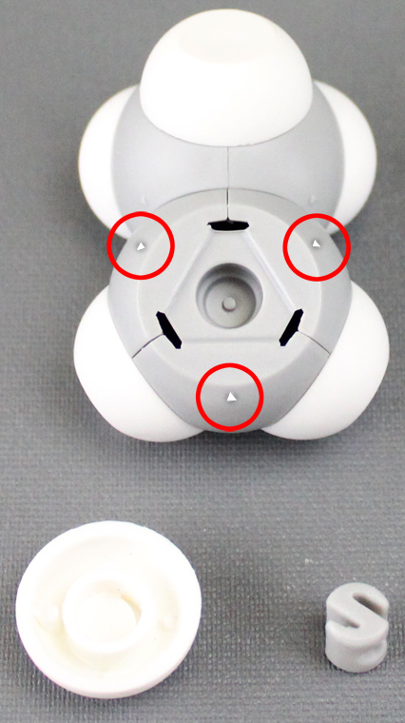
Molecular Manipulation
A closer look at solubility
Remove a hydrogen
Add a hydroxide

Slide 8
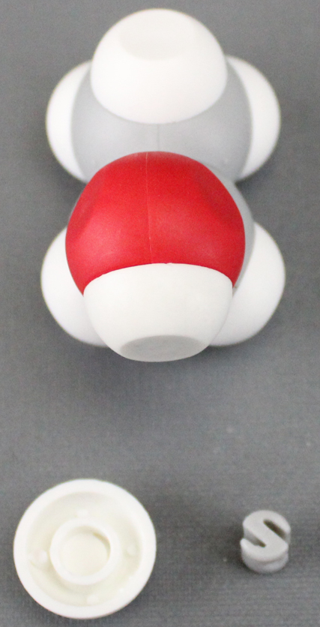
How does this molecule interact with water molecules ?
What patterns do you see?
What questions do you have?
A closer look at solubility

Slide 9
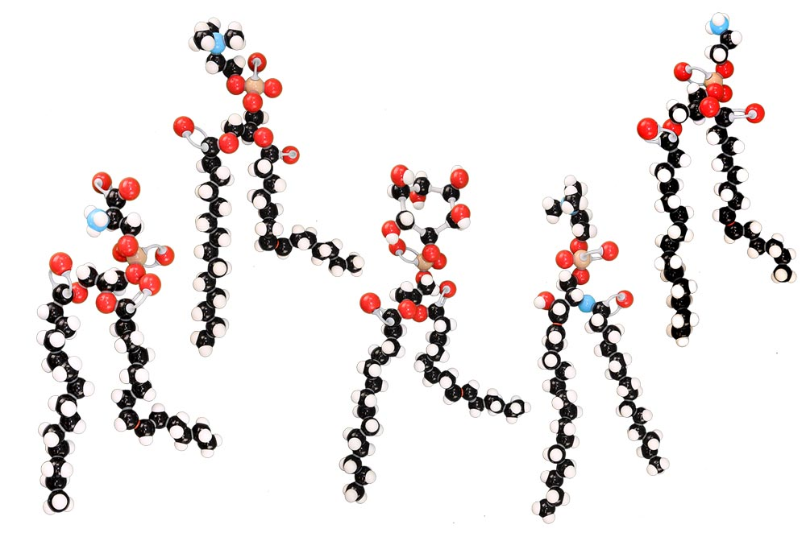
What about a phospholipid?
What do you notice?
Notes:
There are five phospholipid models: phosphatidylcholine, phosphatidylserine, phosphatidylinositol, phosphatidylethanolamine, and sphingomyelin.

Slide 10
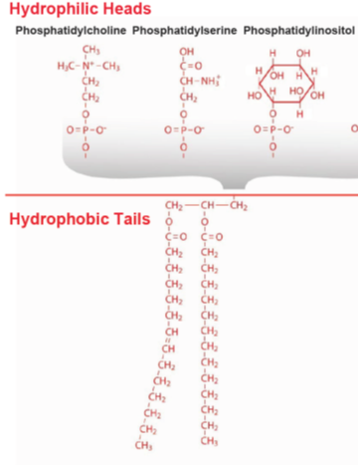
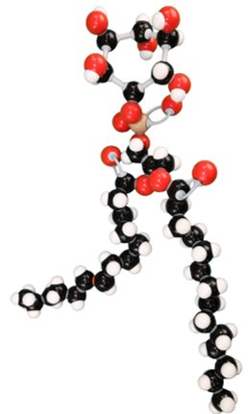
Modeling the Membrane: Phospholipids
Using multiple models help explain nuance in the phenomena we are typing to explain.

Slide 11
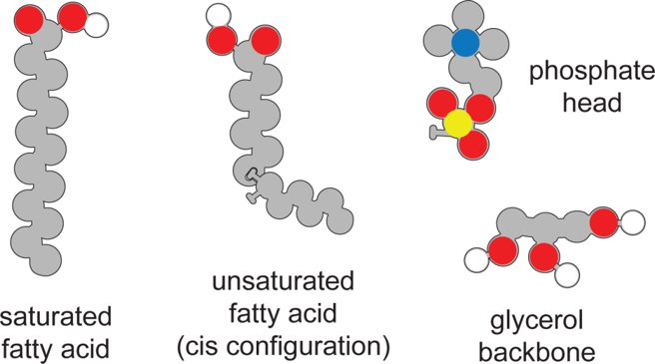
Constructing A Phospholipid

Slide 12
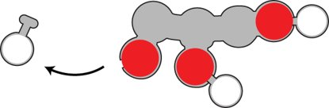
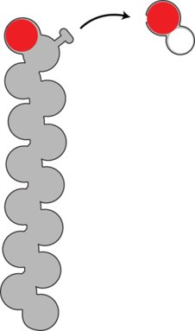
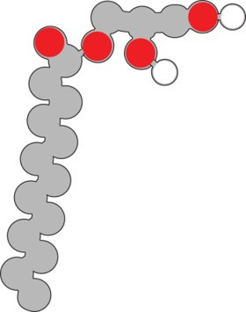
Constructing A Phospholipid
Remove a hydroxyl
From the saturated
fatty acid.
Join the glycerol and
saturated fatty acid
Together.
Remove a hydrogen from the glycerol backbone.

Slide 13

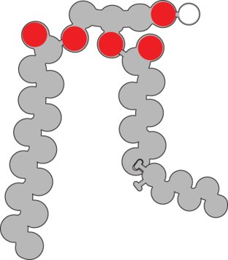
Constructing A Phospholipid
Join the hydrogen and the hydroxyl group to make water.
Remove a
hydrogen from
the glycerol
backbone
Attach the unsaturated
fatty acid to the glycerol
backbone
Notes:
Ruth says: Phospholipid models
[Advance slide]

Slide 14
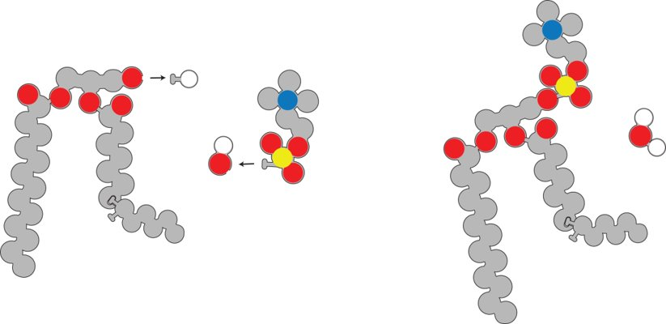
Constructing A Phospholipid
Remove a hydrogen from the glycerol backbone and attach
the phosphate head.
Join the hydrogen with a hydroxyl group to make water.

Slide 15
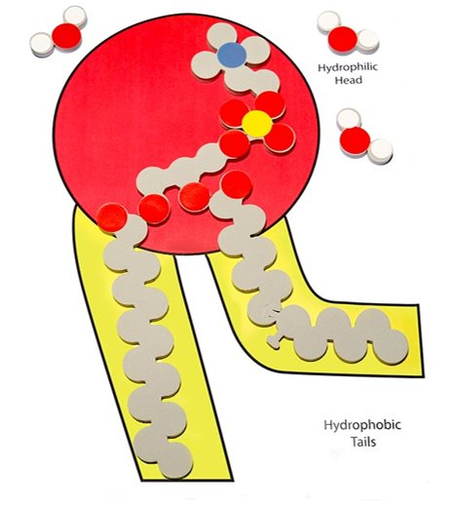
Constructing A Phospholipid
How are the models different?
Why is it important to use multiple models
to represent the same structure?
Notes:
Ruth says: Phospholipid models
[Advance slide]

Slide 16
Building a Cell Membrane
How would ten phospholipids arrange to form a film on water?
How would ten phospholipids arrange to be submerged in a beaker of water?
How would phospholipids be arranged to be both submerged and contain water.
Notes:
In the first thought experiment, the phospholipids heads would be pointing down and the phospholipids tails would be pointing away from the water. A monofilm would be formed.
In the second thought experiment, the phospholipid heads would be pointing outwards and the phospholipid tails would be pointing inside. A micelle would be formed.
In the final thought experiment, there would be two layers of phospholipids, the heads would be nearest the water on the inside and outside. The tails would be touching forming a liposome.

Slide 17
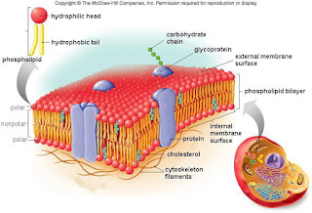
The Cell Membrane

Slide 18
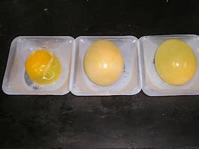
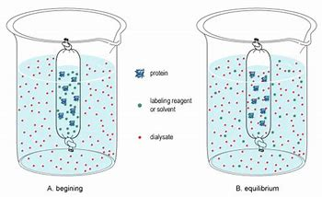
… and then we have our class do a cellular model wet lab

Slide 19

Hold on a second

Slide 20
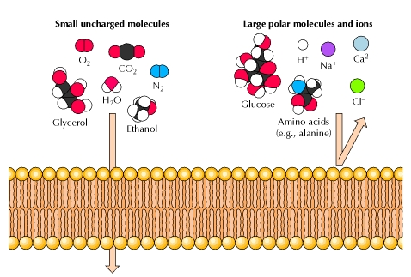
The problem…

Slide 21
There’s a lot going on here, so let’s simplify it!

Slide 22
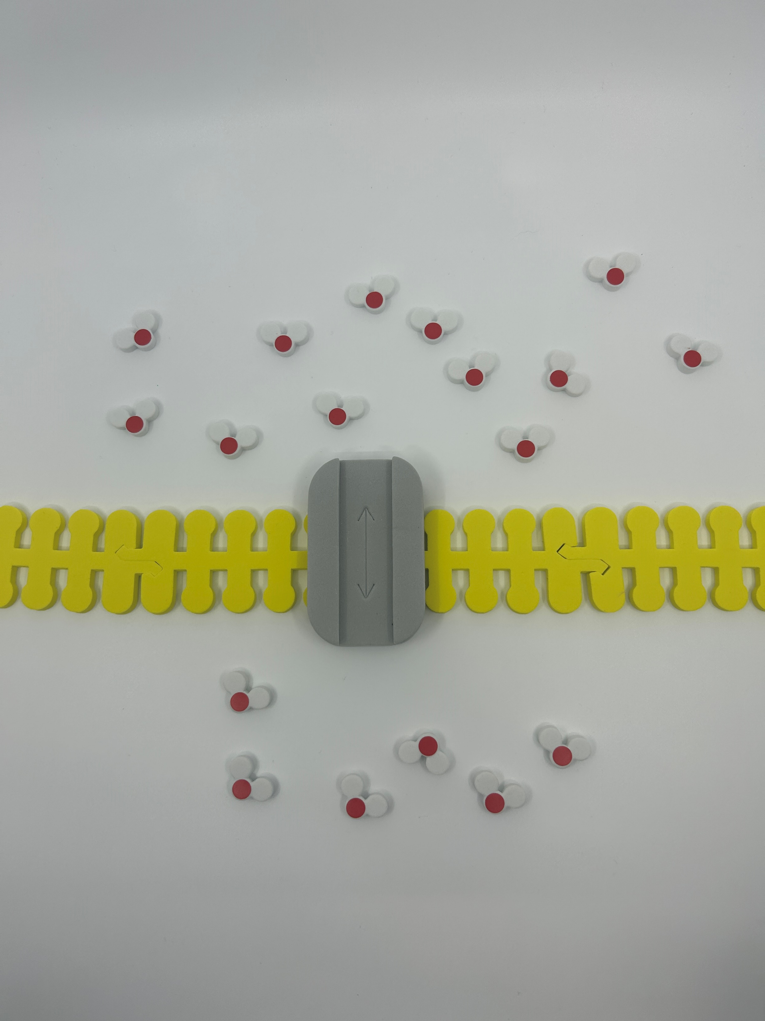
Let’s focus on water first – Add the following
Extracellular – Outside of the cell
12 water molecules
Aquaporin and cell membrane
6 water molecules
Intracellular – Inside of the cell

Slide 23
With an aquaporin in place…
Based on what you know about water potential and osmosis, in which direction would the water molecules move?
How many water molecules should you move?
Notes:
There are 18 water molecules total in this image… equilibrium would be reached on both sides of the membrane if you move 3 from the extracellular side to the intracellular side.

Slide 24
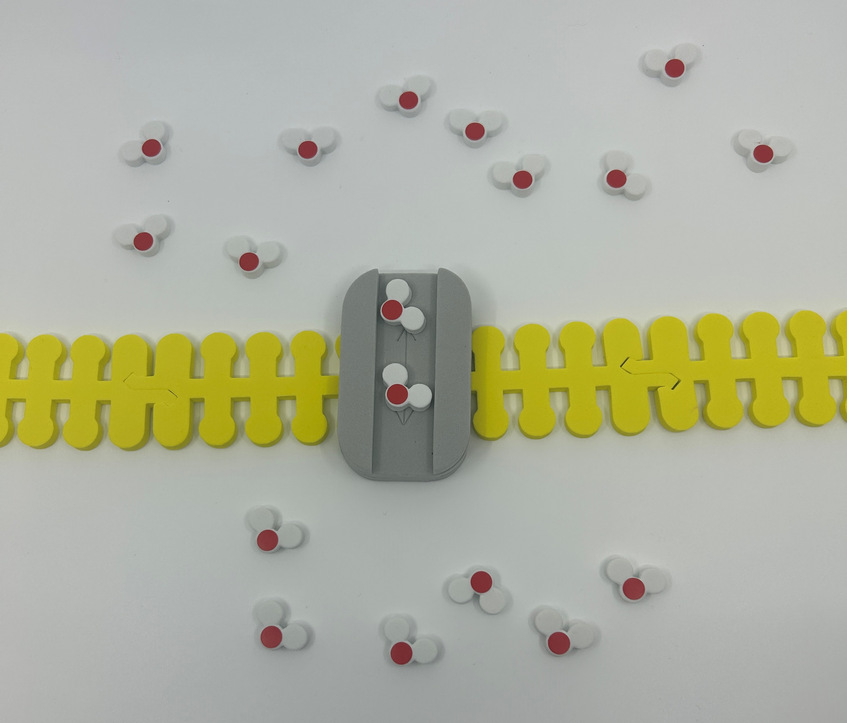
Move 3 water molecules across to reach equilibrium

Slide 25
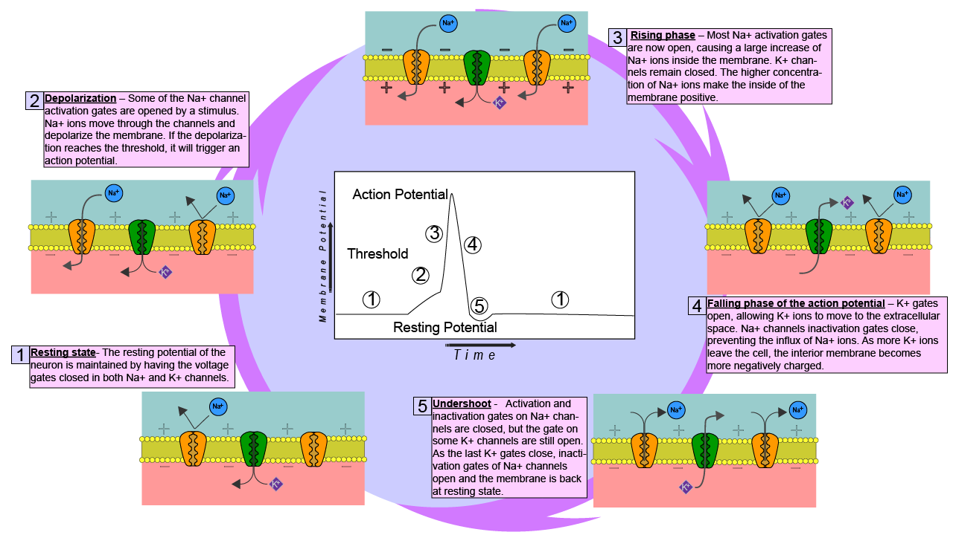
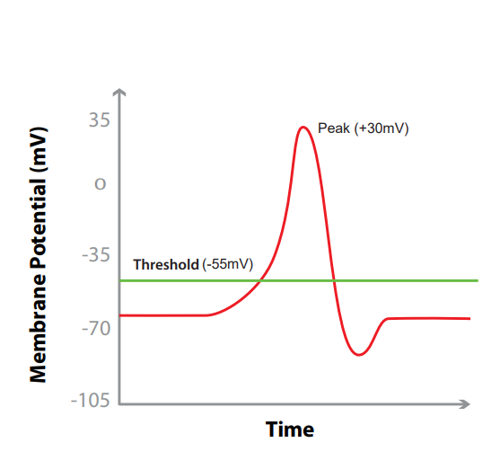
Life is complicated…
Link
Notes:
What the teacher is doing: Point out that action potentials are critical in many multicellular organisms. They signal critical functions such as respiration and muscle movement to escape a predator. Optional activity: Use the Phospholipid and Membrane Transport Kit or Synapse Kit to have students model an action potential.
Encourage students to consider the following question: why would a cell need transport proteins? This may be a time to expand upon the phospholipid bilayer of the cell and explain why they are necessary in living systems.
What the student is doing: Students should model the movement of K+ and Na+ ions in the Phospholipid and Membrane Transport Kit or Synapse Kit. Resources to do this are available by clicking on the link on the slide. Students DO NOT need all the pieces to model this.

Slide 26
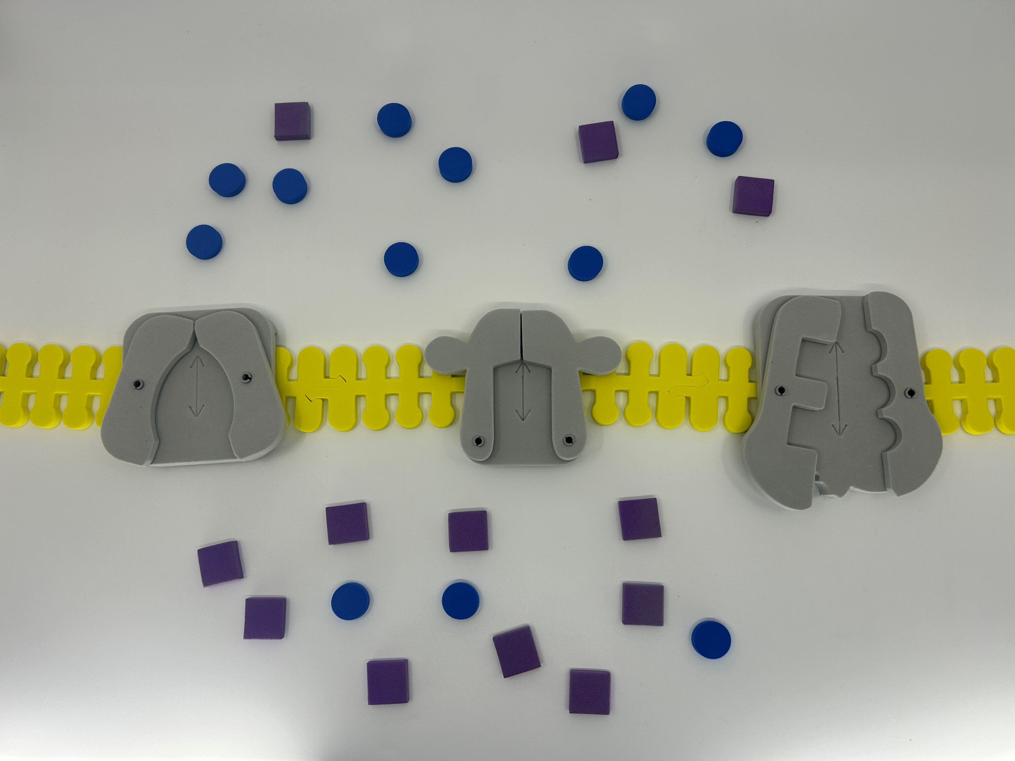
Let’s model an action potential

Slide 27
Let’s identify everything
Na+ (x 12)
K+ (x 12)
Na+ / K+ Channel
Gated Na+ channel (Simulated)
Gated K+ Channel
Notes:
Note – Our “Gated Sodium Channel” is a repurposed GLUT channel for this activity.
*The synapse kit includes Gated K+, leak K+, and gated Na+ channels.

Slide 28
What do you notice?

Slide 29
Life is complicated…
Link
Notes:
What the teacher is doing: Point out that action potentials are critical in many multicellular organisms. They signal critical functions such as respiration and muscle movement to escape a predator. Optional activity: Use the Phospholipid and Membrane Transport Kit or Synapse Kit to have students model an action potential.
Encourage students to consider the following question: why would a cell need transport proteins? This may be a time to expand upon the phospholipid bilayer of the cell and explain why they are necessary in living systems.
What the student is doing: Students should model the movement of K+ and Na+ ions in the Phospholipid and Membrane Transport Kit or Synapse Kit. Resources to do this are available by clicking on the link on the slide. Students DO NOT need all the pieces to model this.

Slide 30
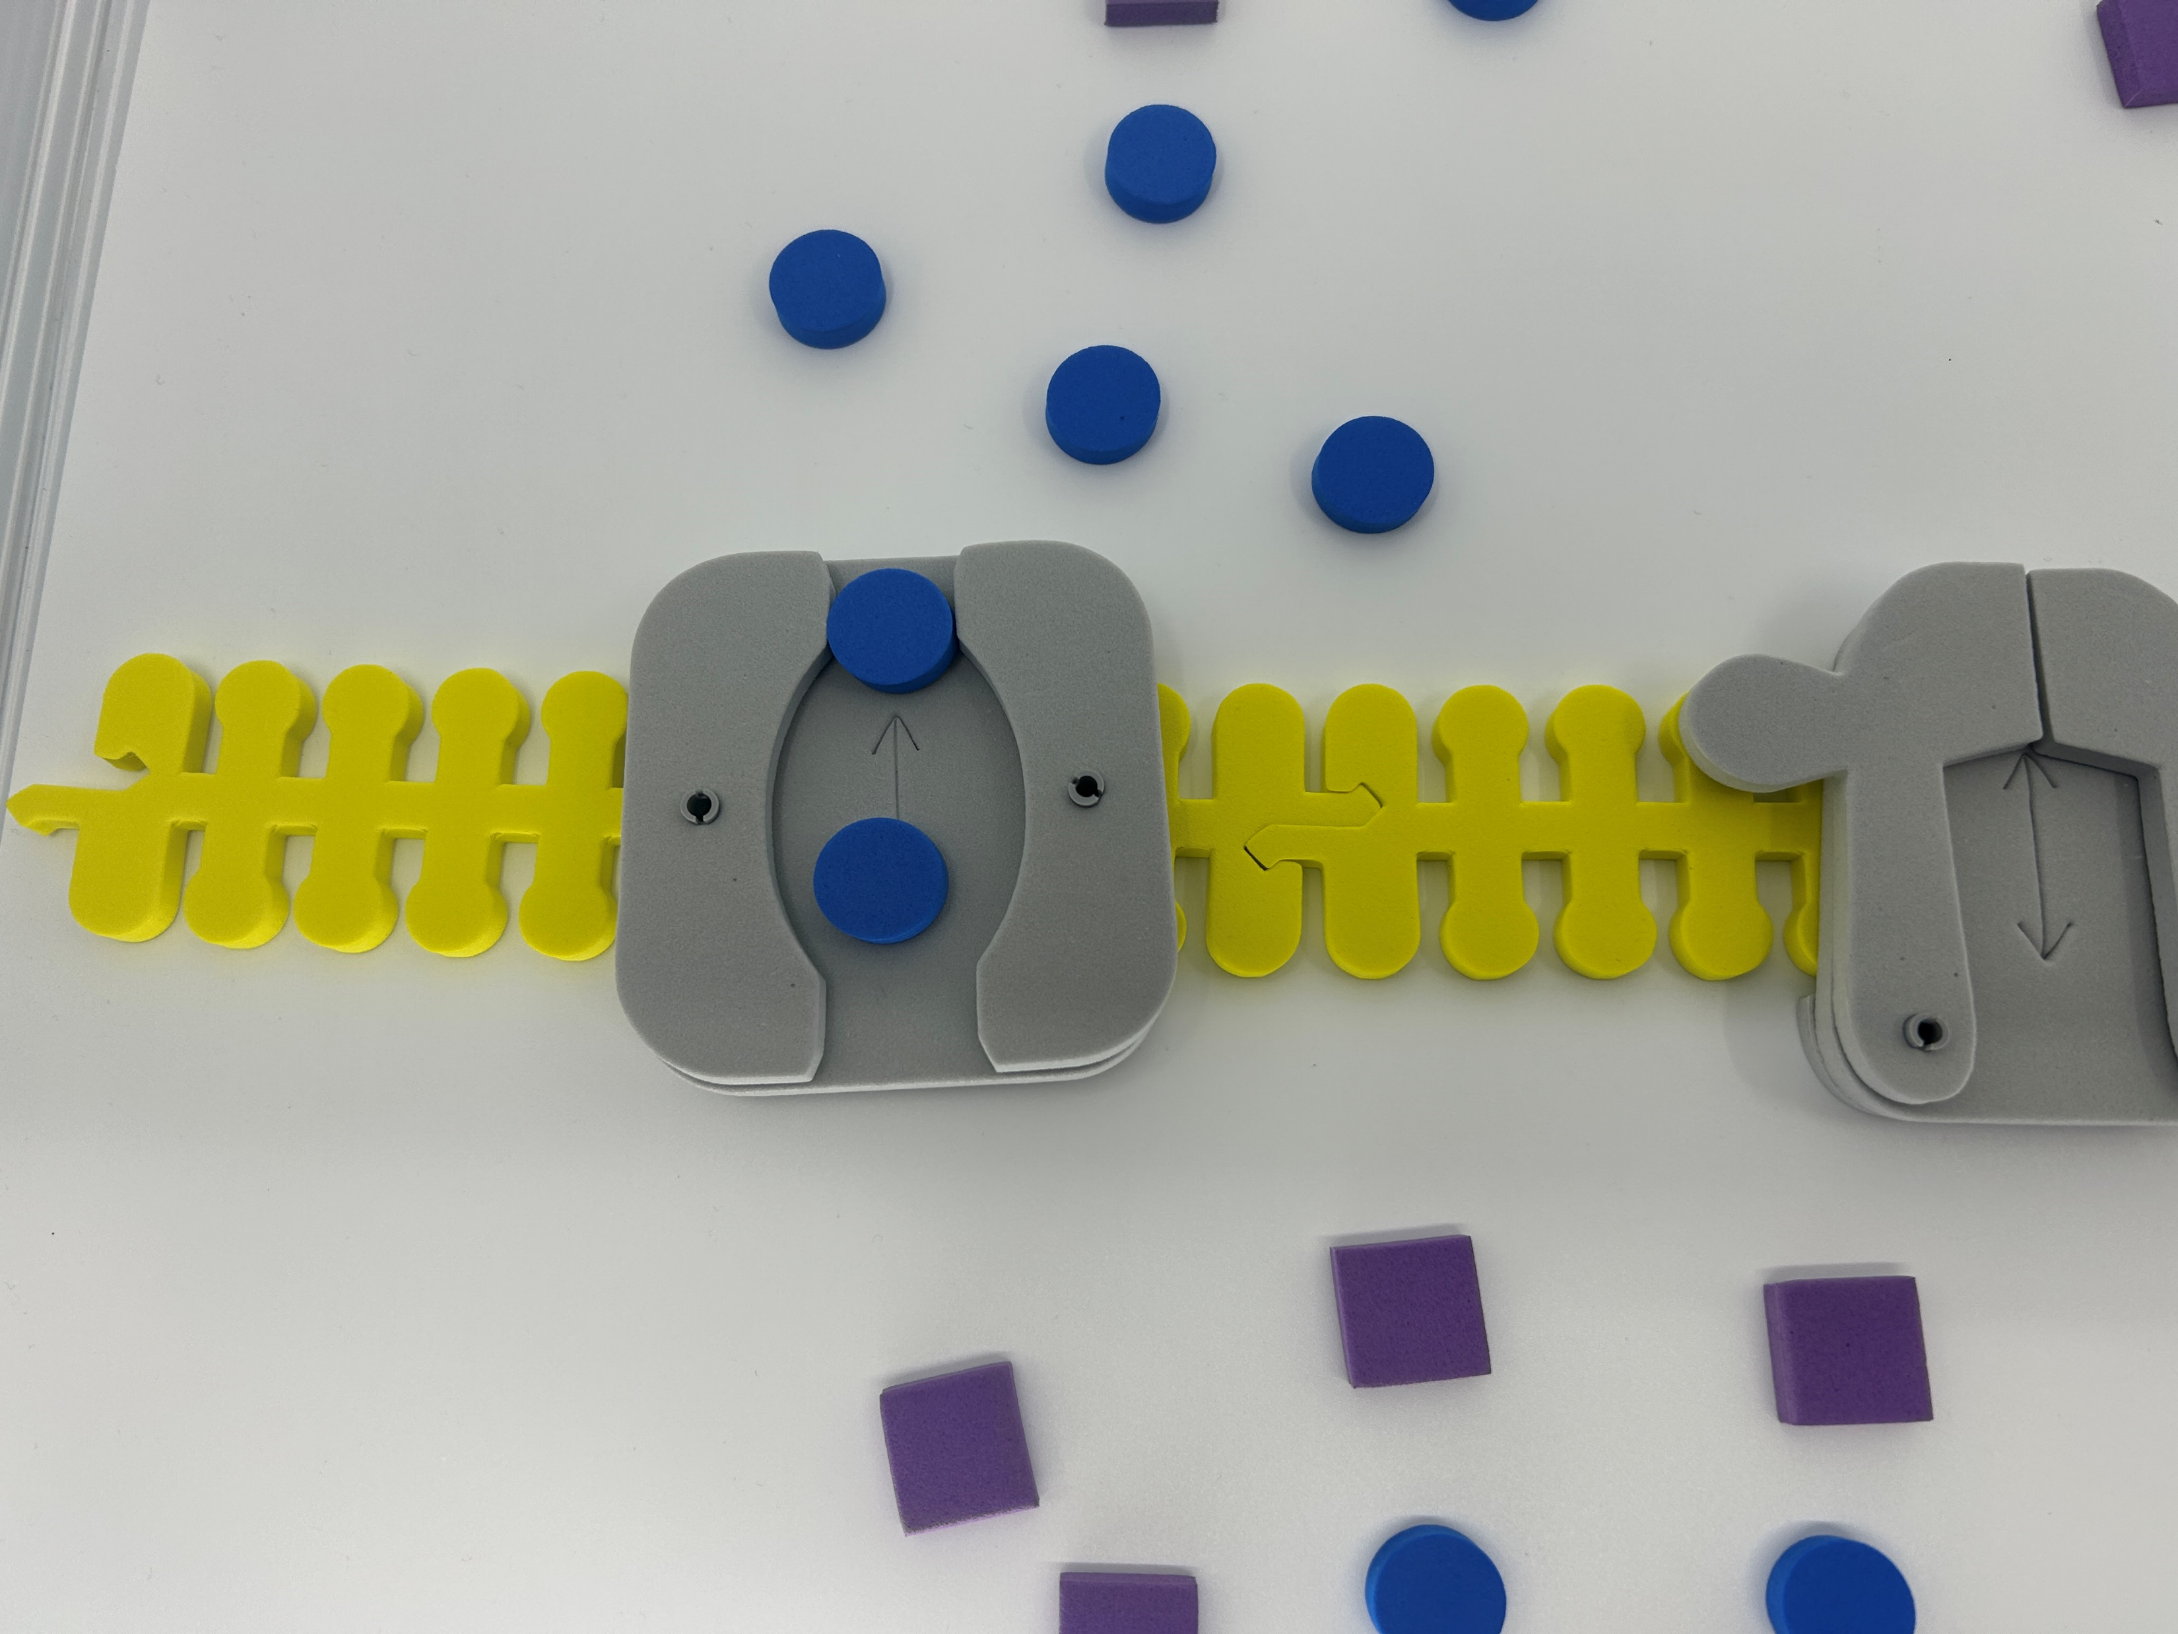
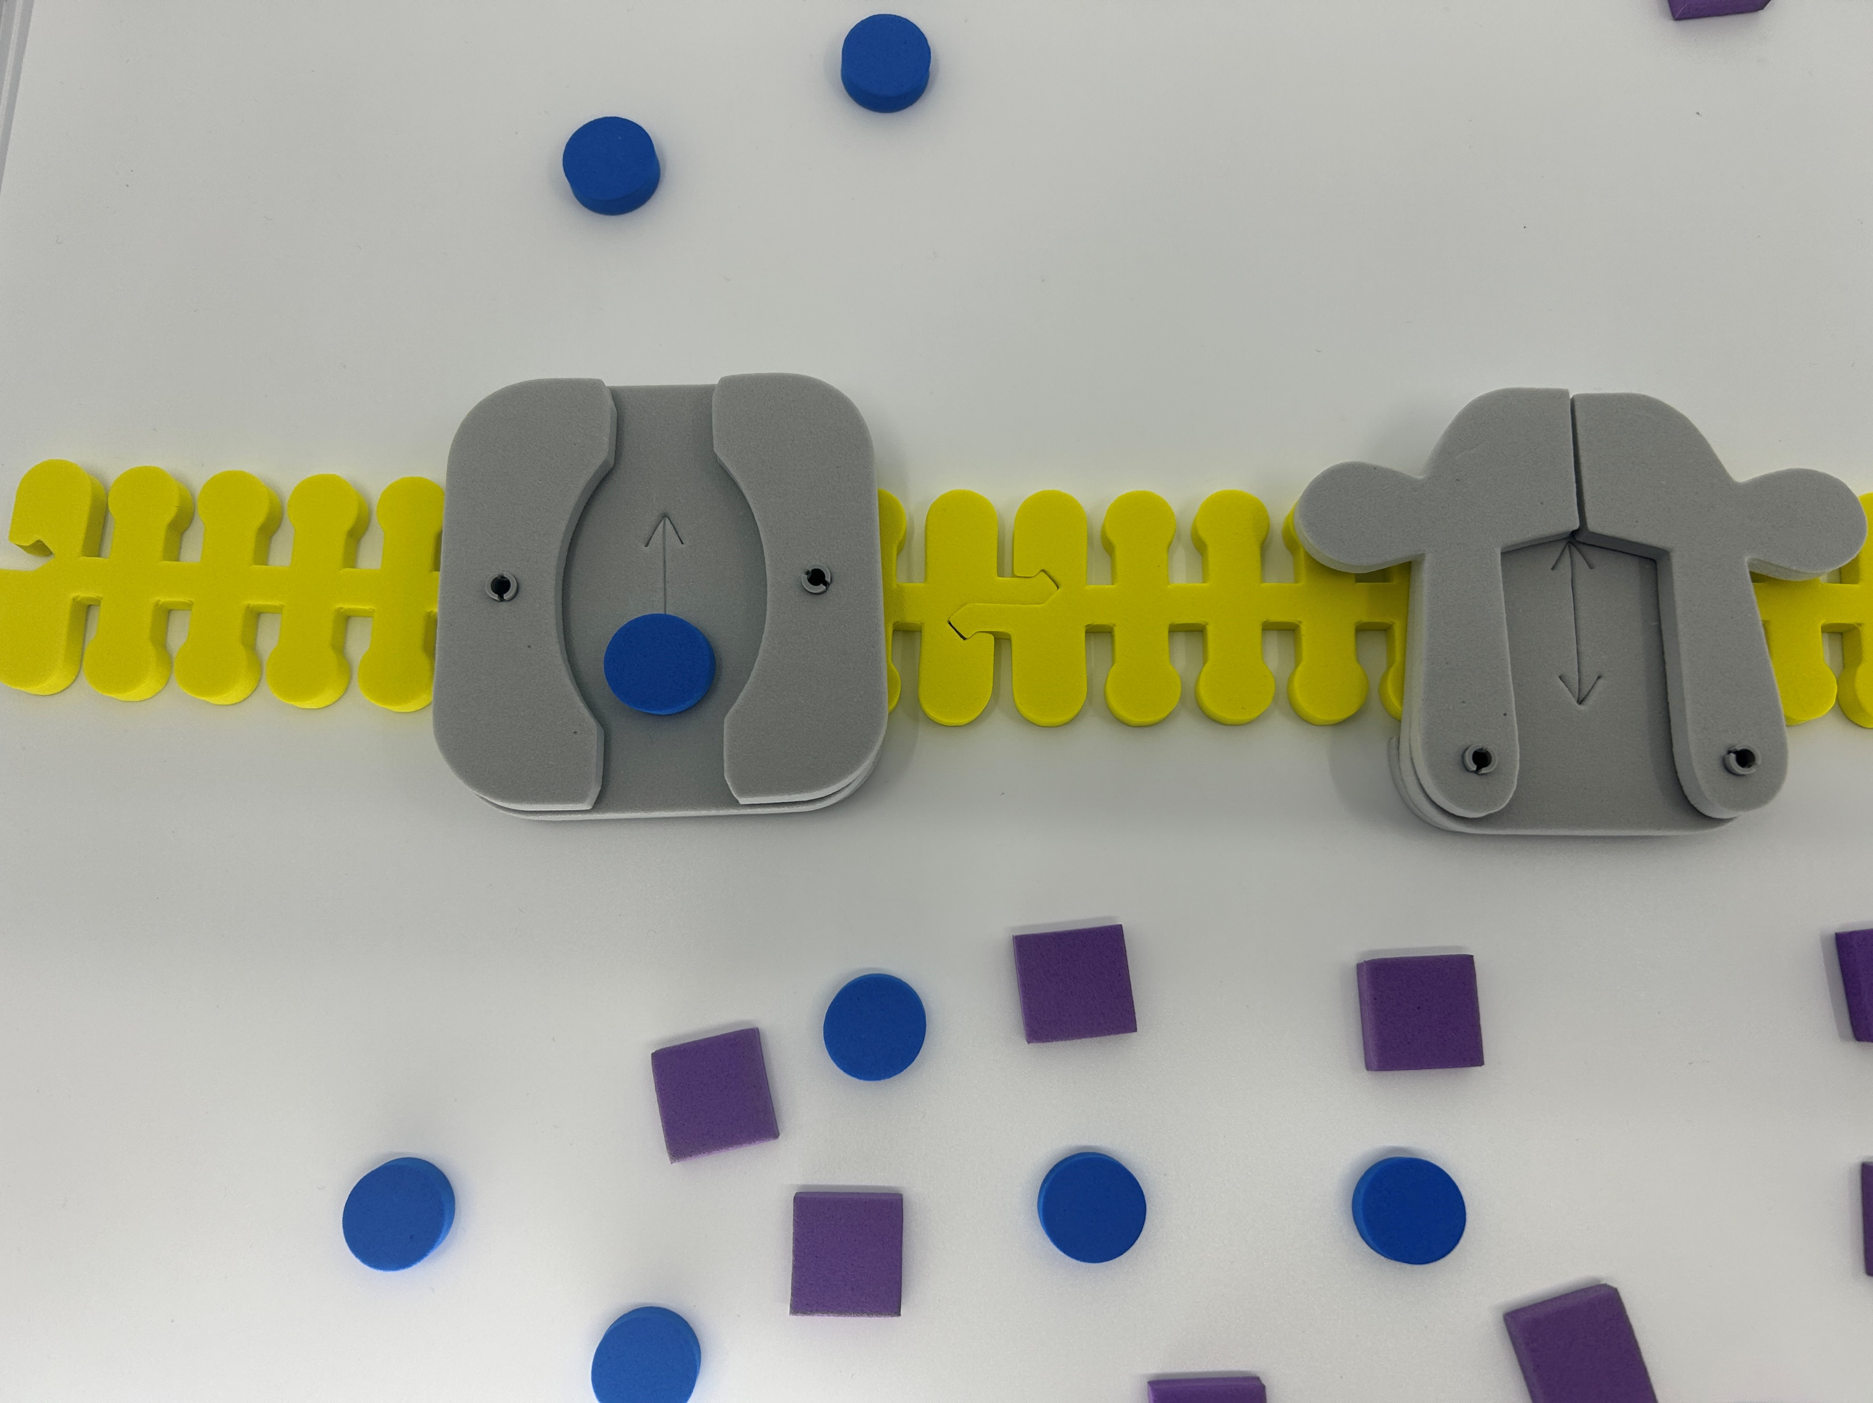
Sodium (Na+ ) first…

Slide 31
What happens to the membrane potential?
Link
Notes:
What the teacher is doing: Point out that action potentials are critical in many multicellular organisms. They signal critical functions such as respiration and muscle movement to escape a predator. Optional activity: Use the Phospholipid and Membrane Transport Kit or Synapse Kit to have students model an action potential.
Encourage students to consider the following question: why would a cell need transport proteins? This may be a time to expand upon the phospholipid bilayer of the cell and explain why they are necessary in living systems.
What the student is doing: Students should model the movement of K+ and Na+ ions in the Phospholipid and Membrane Transport Kit or Synapse Kit. Resources to do this are available by clicking on the link on the slide. Students DO NOT need all the pieces to model this.

Slide 32
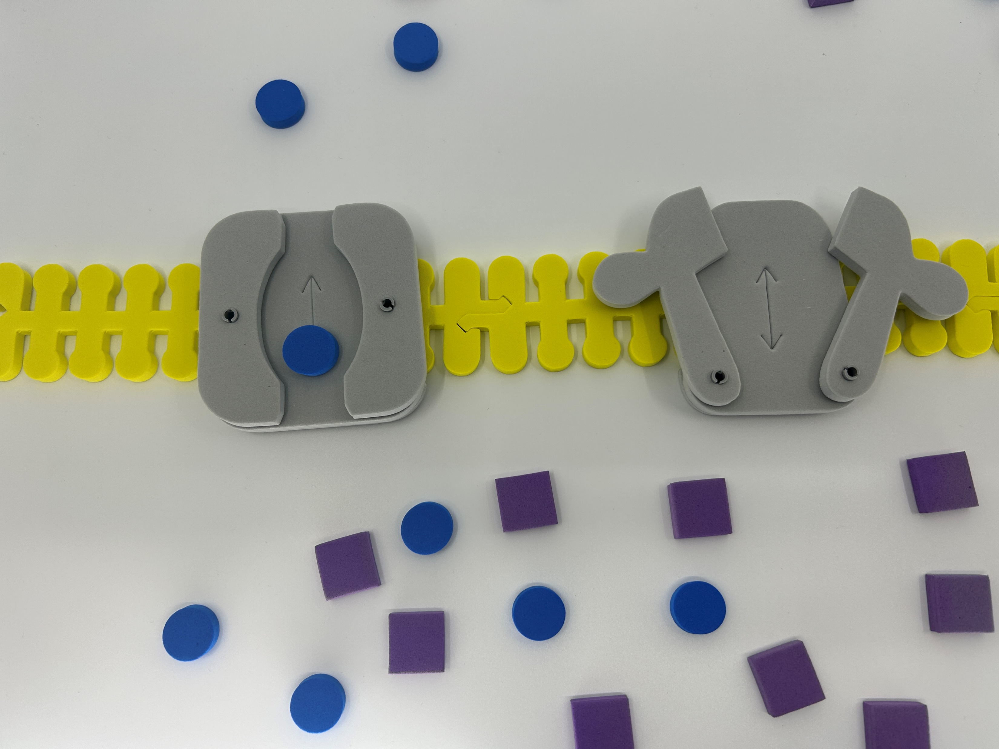
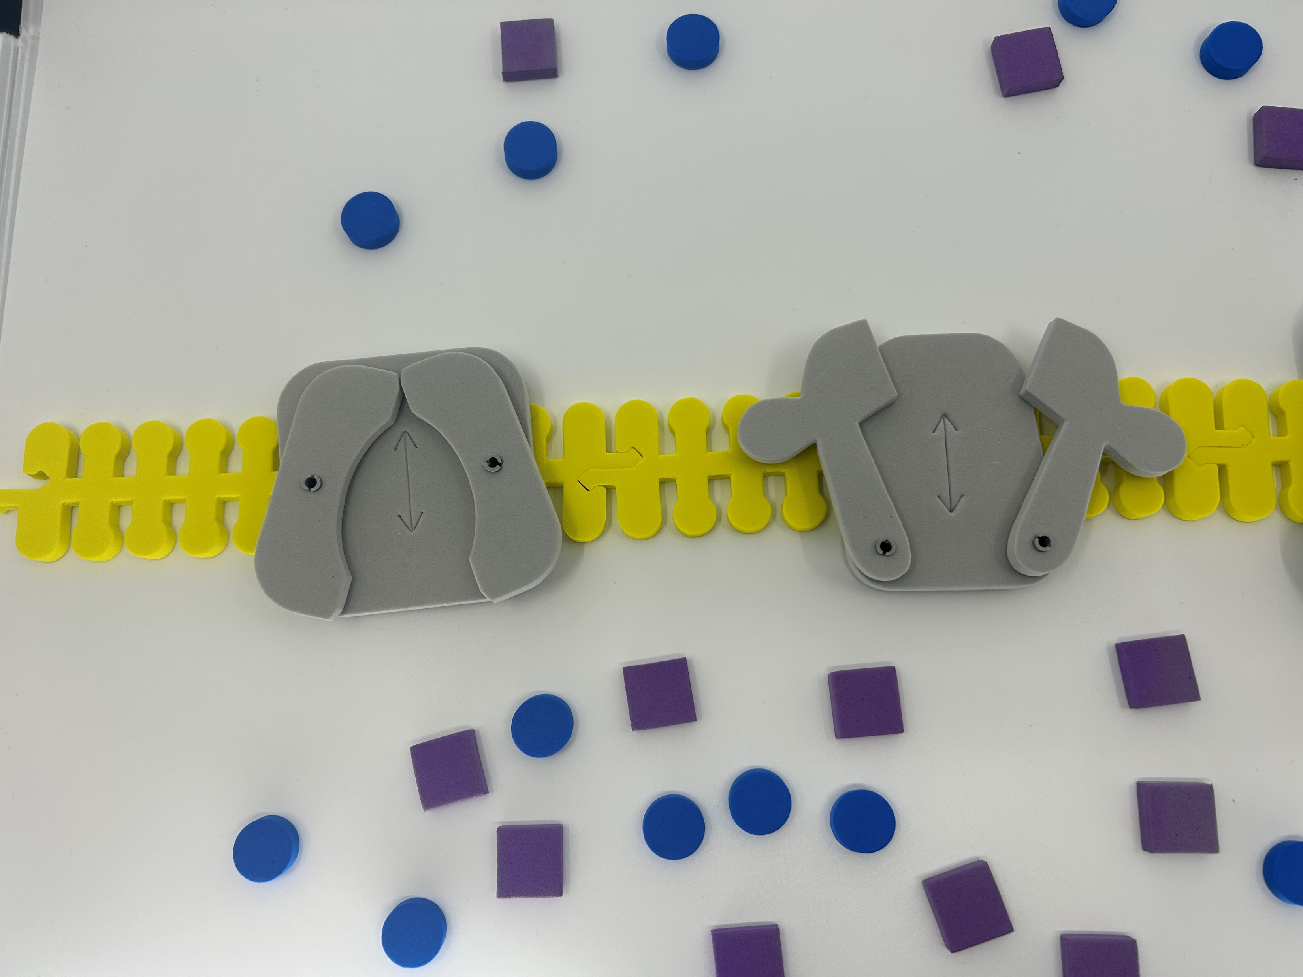
What happened to the charge inside the membrane?

Slide 33
Life is complicated…
Link
Notes:
What the teacher is doing: Point out that action potentials are critical in many multicellular organisms. They signal critical functions such as respiration and muscle movement to escape a predator. Optional activity: Use the Phospholipid and Membrane Transport Kit or Synapse Kit to have students model an action potential.
Encourage students to consider the following question: why would a cell need transport proteins? This may be a time to expand upon the phospholipid bilayer of the cell and explain why they are necessary in living systems.
What the student is doing: Students should model the movement of K+ and Na+ ions in the Phospholipid and Membrane Transport Kit or Synapse Kit. Resources to do this are available by clicking on the link on the slide. Students DO NOT need all the pieces to model this.

Slide 34
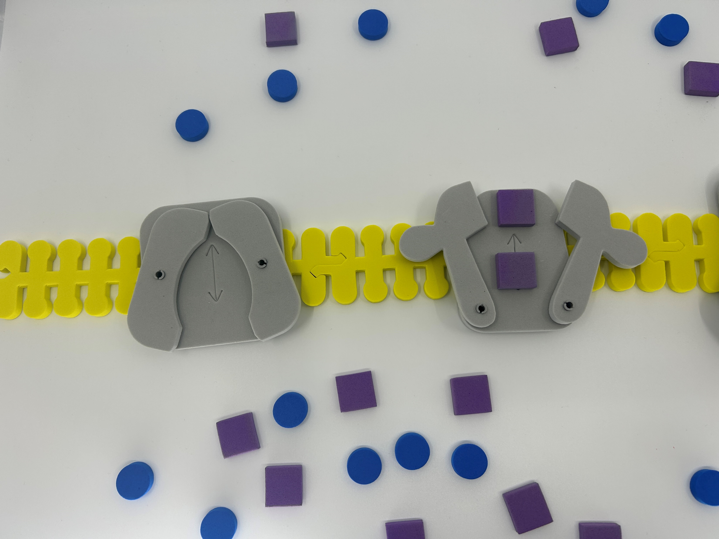
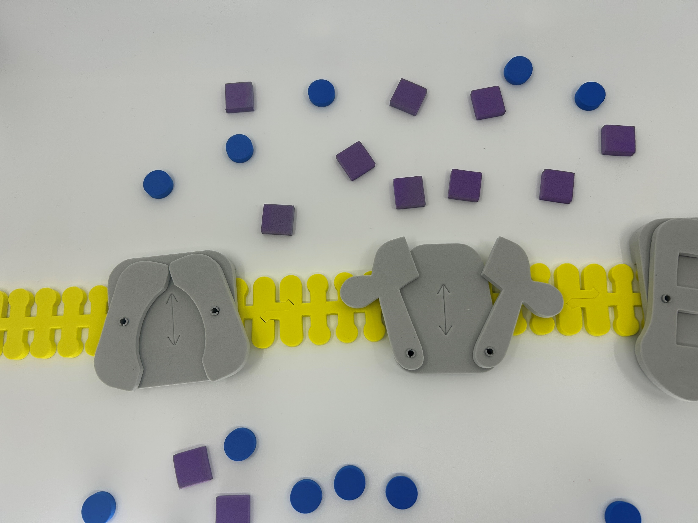
Potassium (K+) moves next

Slide 35
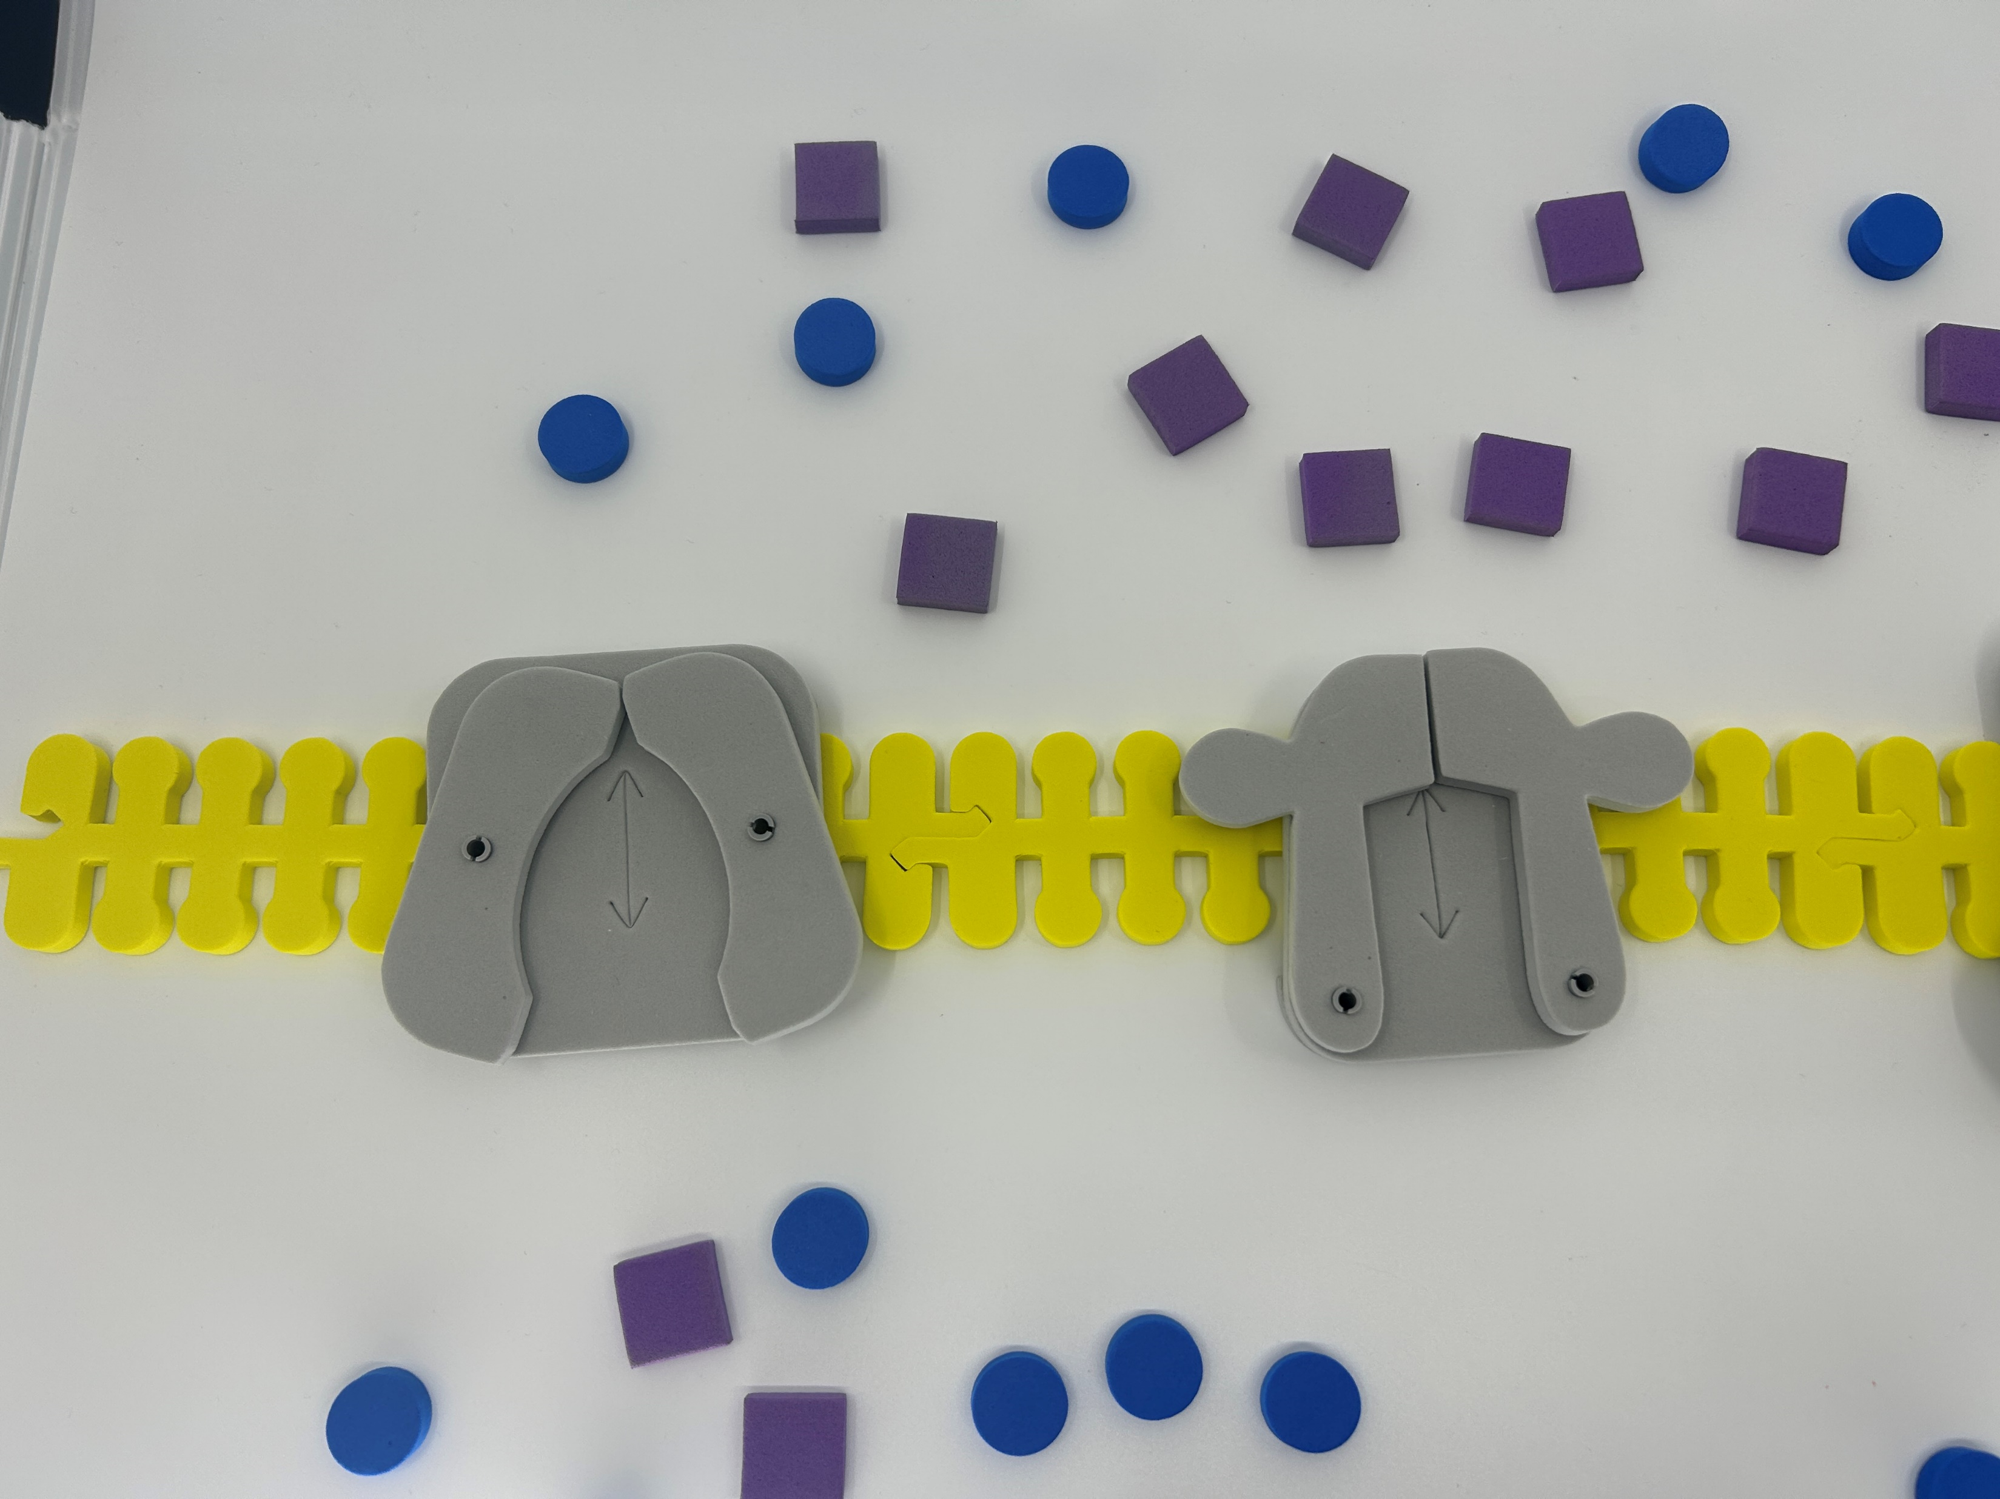
Each channel is “tuned”

Slide 36
What type of cellular transport have we been investigating?
Where could you use this in your class?

Slide 37
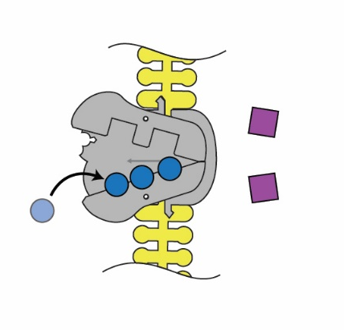
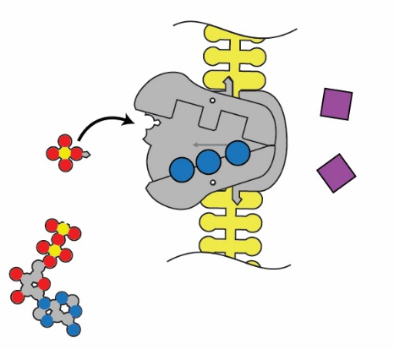
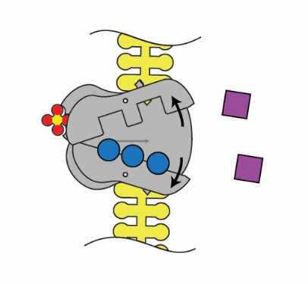
How do we get back to a resting potential?
3. The pump shape changes, exposing the sodium to the extracellular space.
1. Sodium binds on the intracellular side.
2. The pump is phosphorylated by ATP.

Slide 38
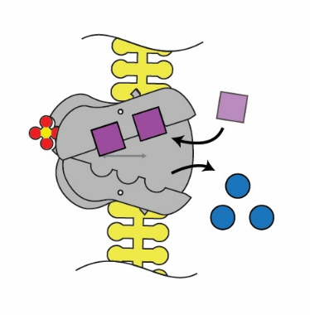
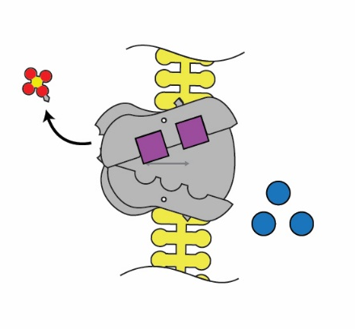
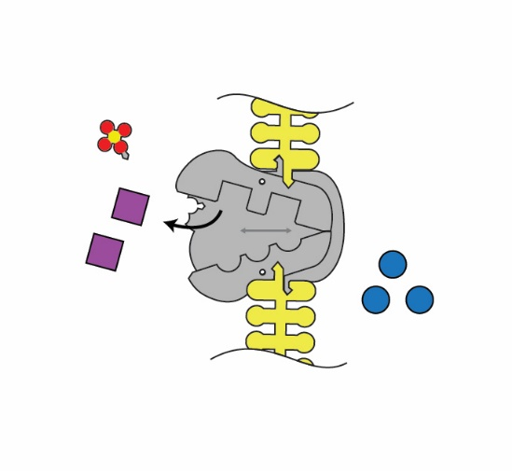
4. Binding affinity changes to release Na+ and take in K+.
5. Phosphate detaches.
6. Original shape is restored, releasing K+ into the cell.

Slide 39
Life is complicated…
Link
Notes:
What the teacher is doing: Point out that action potentials are critical in many multicellular organisms. They signal critical functions such as respiration and muscle movement to escape a predator. Optional activity: Use the Phospholipid and Membrane Transport Kit or Synapse Kit to have students model an action potential.
Encourage students to consider the following question: why would a cell need transport proteins? This may be a time to expand upon the phospholipid bilayer of the cell and explain why they are necessary in living systems.
What the student is doing: Students should model the movement of K+ and Na+ ions in the Phospholipid and Membrane Transport Kit or Synapse Kit. Resources to do this are available by clicking on the link on the slide. Students DO NOT need all the pieces to model this.

Slide 40
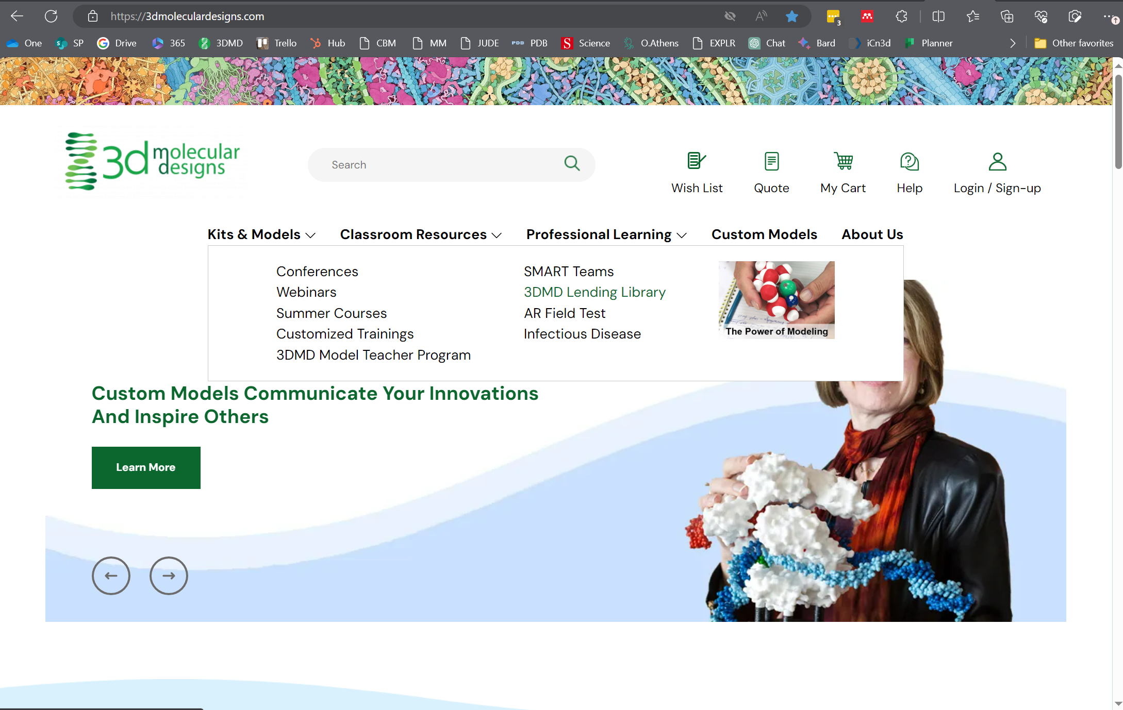
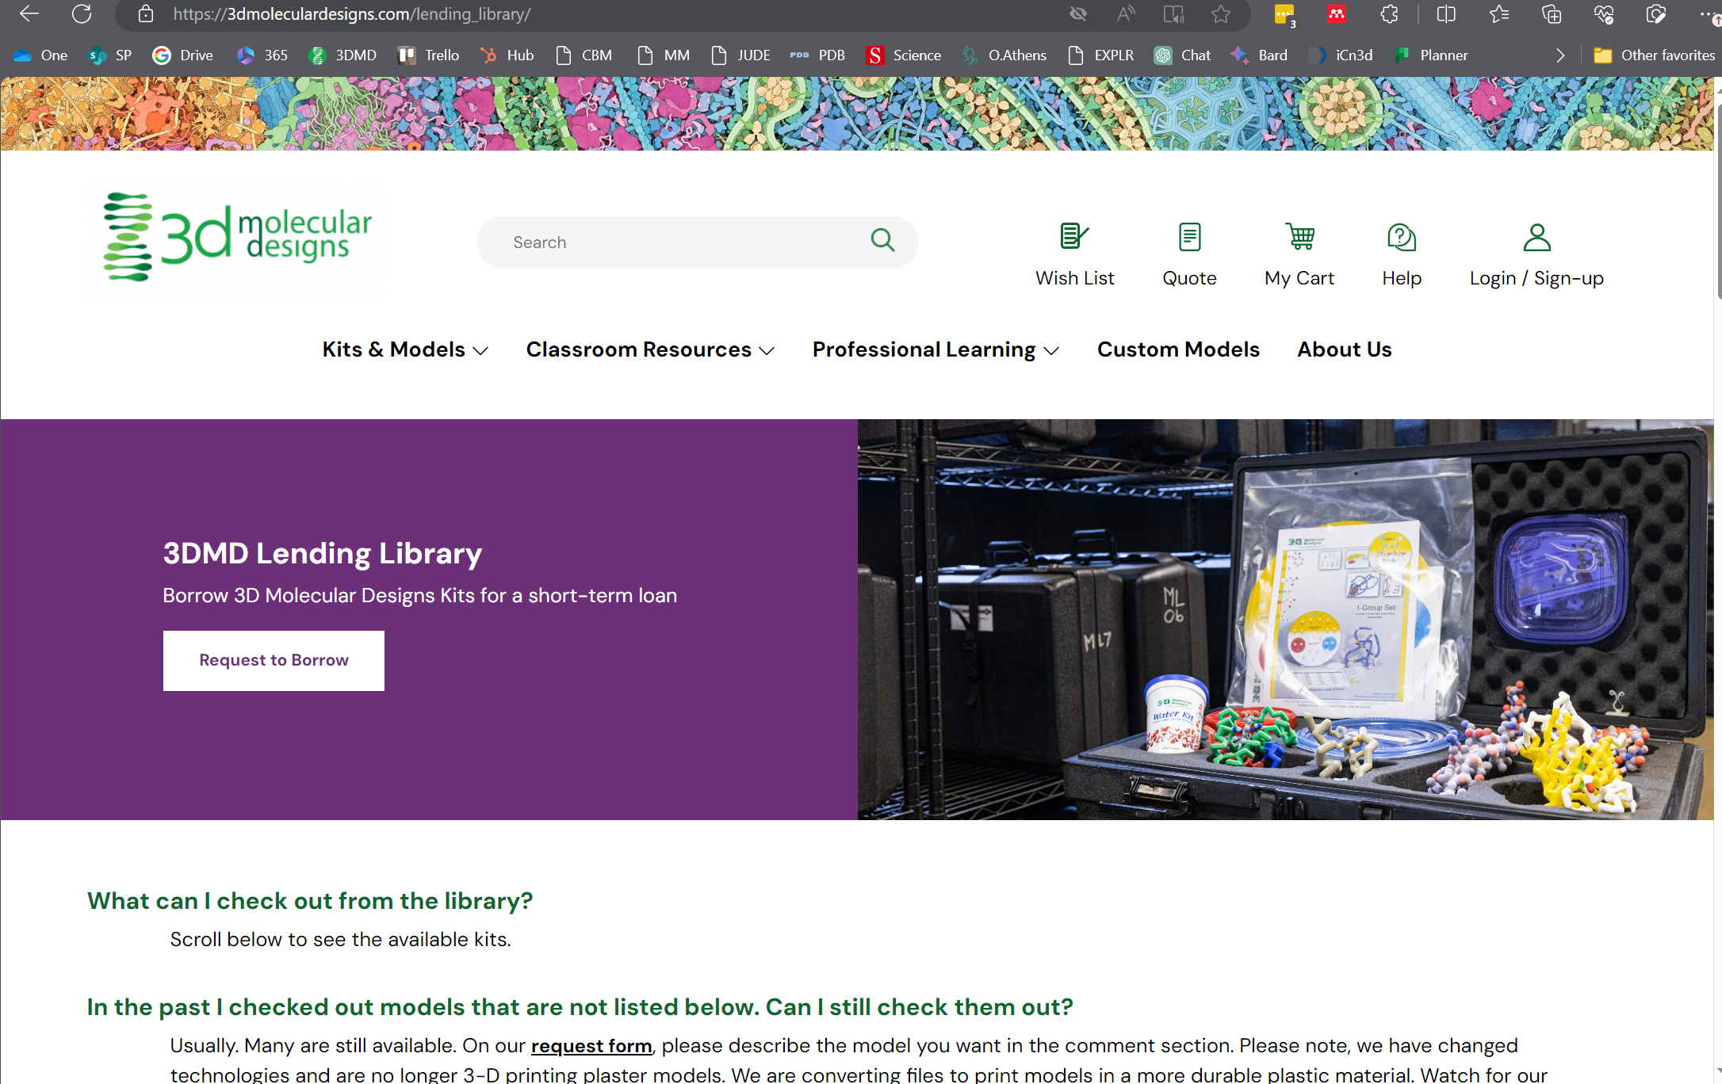
Lending Library

Slide 41

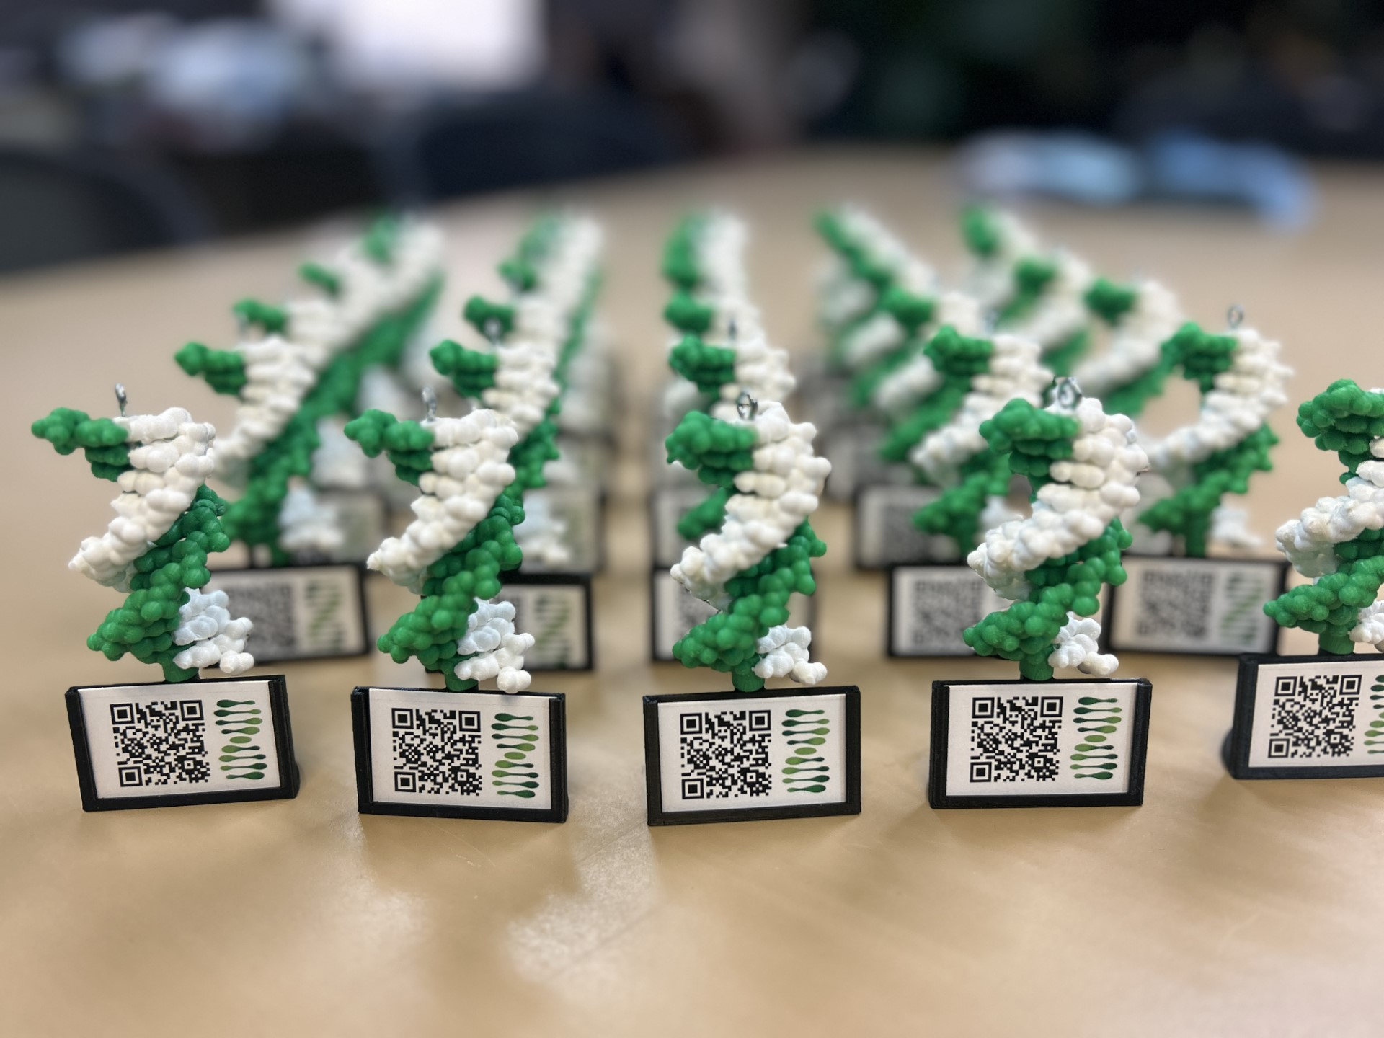
Scan this QR code and fill out our survey!
Show me your DNA molecule image and I’ll give you a model with AR enhancement as a thank-you gift!

Slide 42
TEKS
Biology (9-12):
Biology (9-12):
(4) Science concepts. The student knows the structures and functions of biomolecules. The student is expected to:
(B) explain the role of water in the function of biomolecules.
(C) compare the structures and functions of different types of biomolecules, including carbohydrates, lipids, proteins, and nucleic acids.

