Slide 1

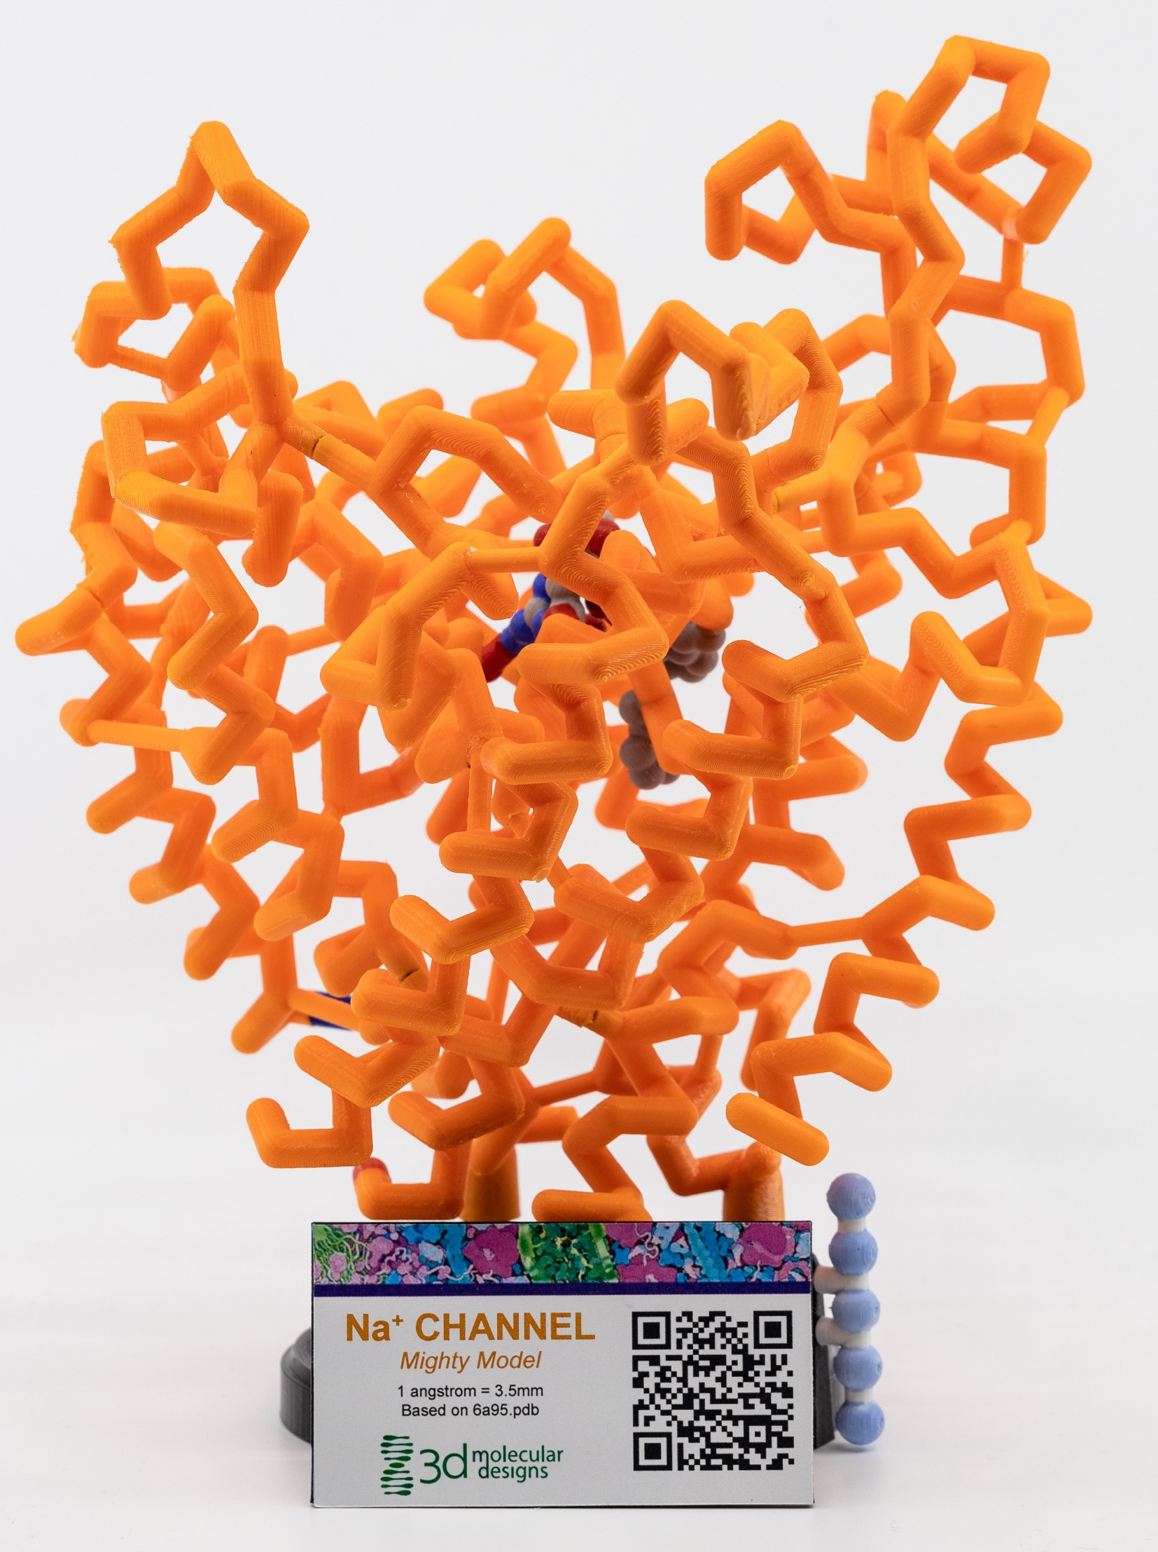
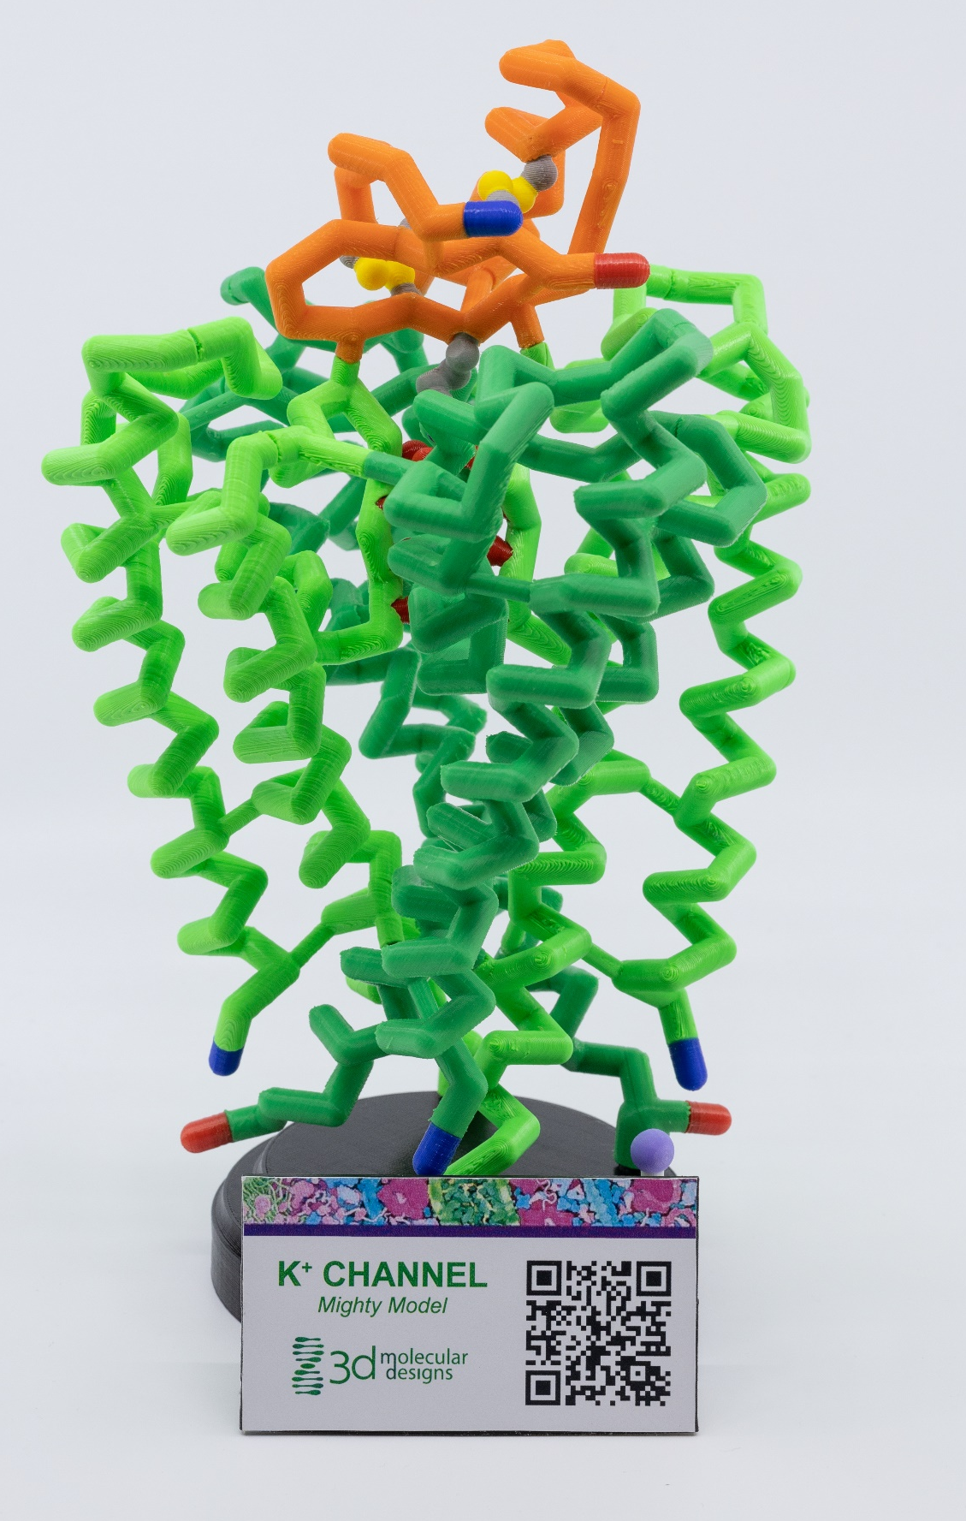
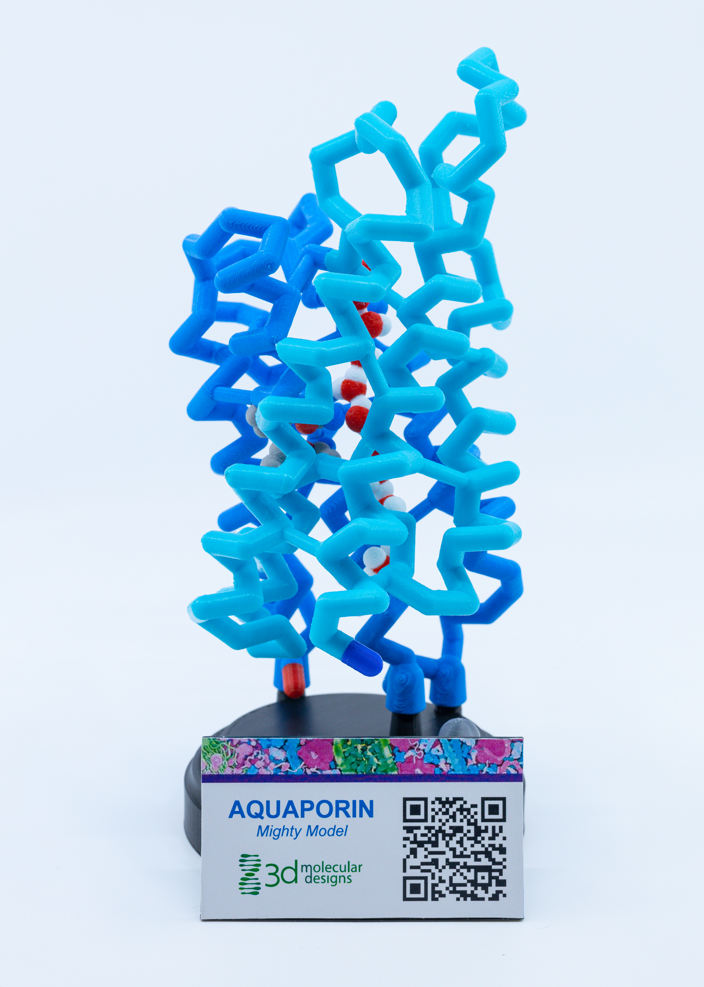
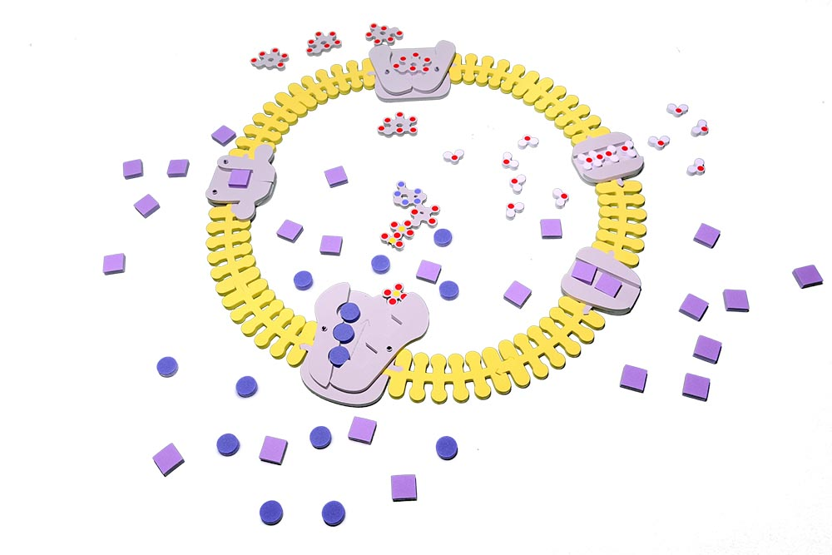
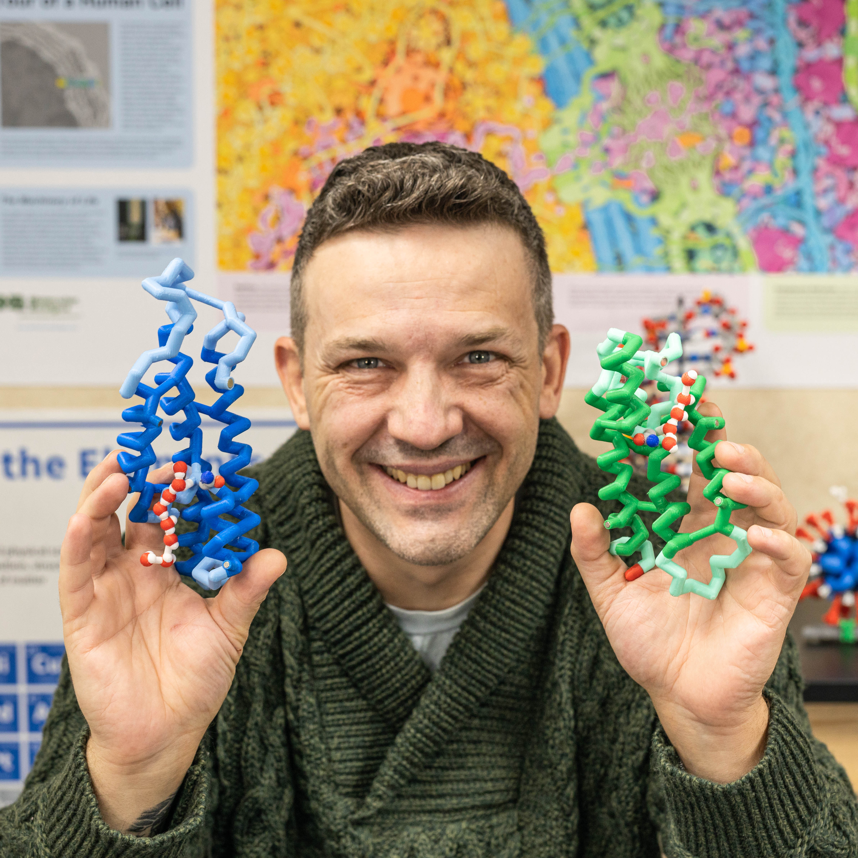
Water water everywhere… but how’d it get in there?
Mark Arnholt
Science Educator
SMART Team Coordinator
3D Molecular Designs
Milwaukee, WI
Notes:
For this presentation, we will use the Water Kit, Phospholipids Molymod Models, the Phospholipids and Membrane Kit, and several 3D printed models (aquaporin, potassium voltage-gated channel, and sodium voltage-gated channel).

Slide 2
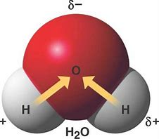
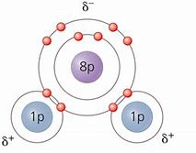
Water exhibits POLAR COVALENT bonds

Slide 3
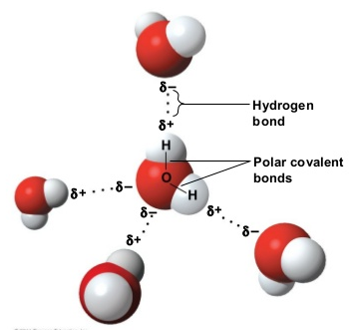
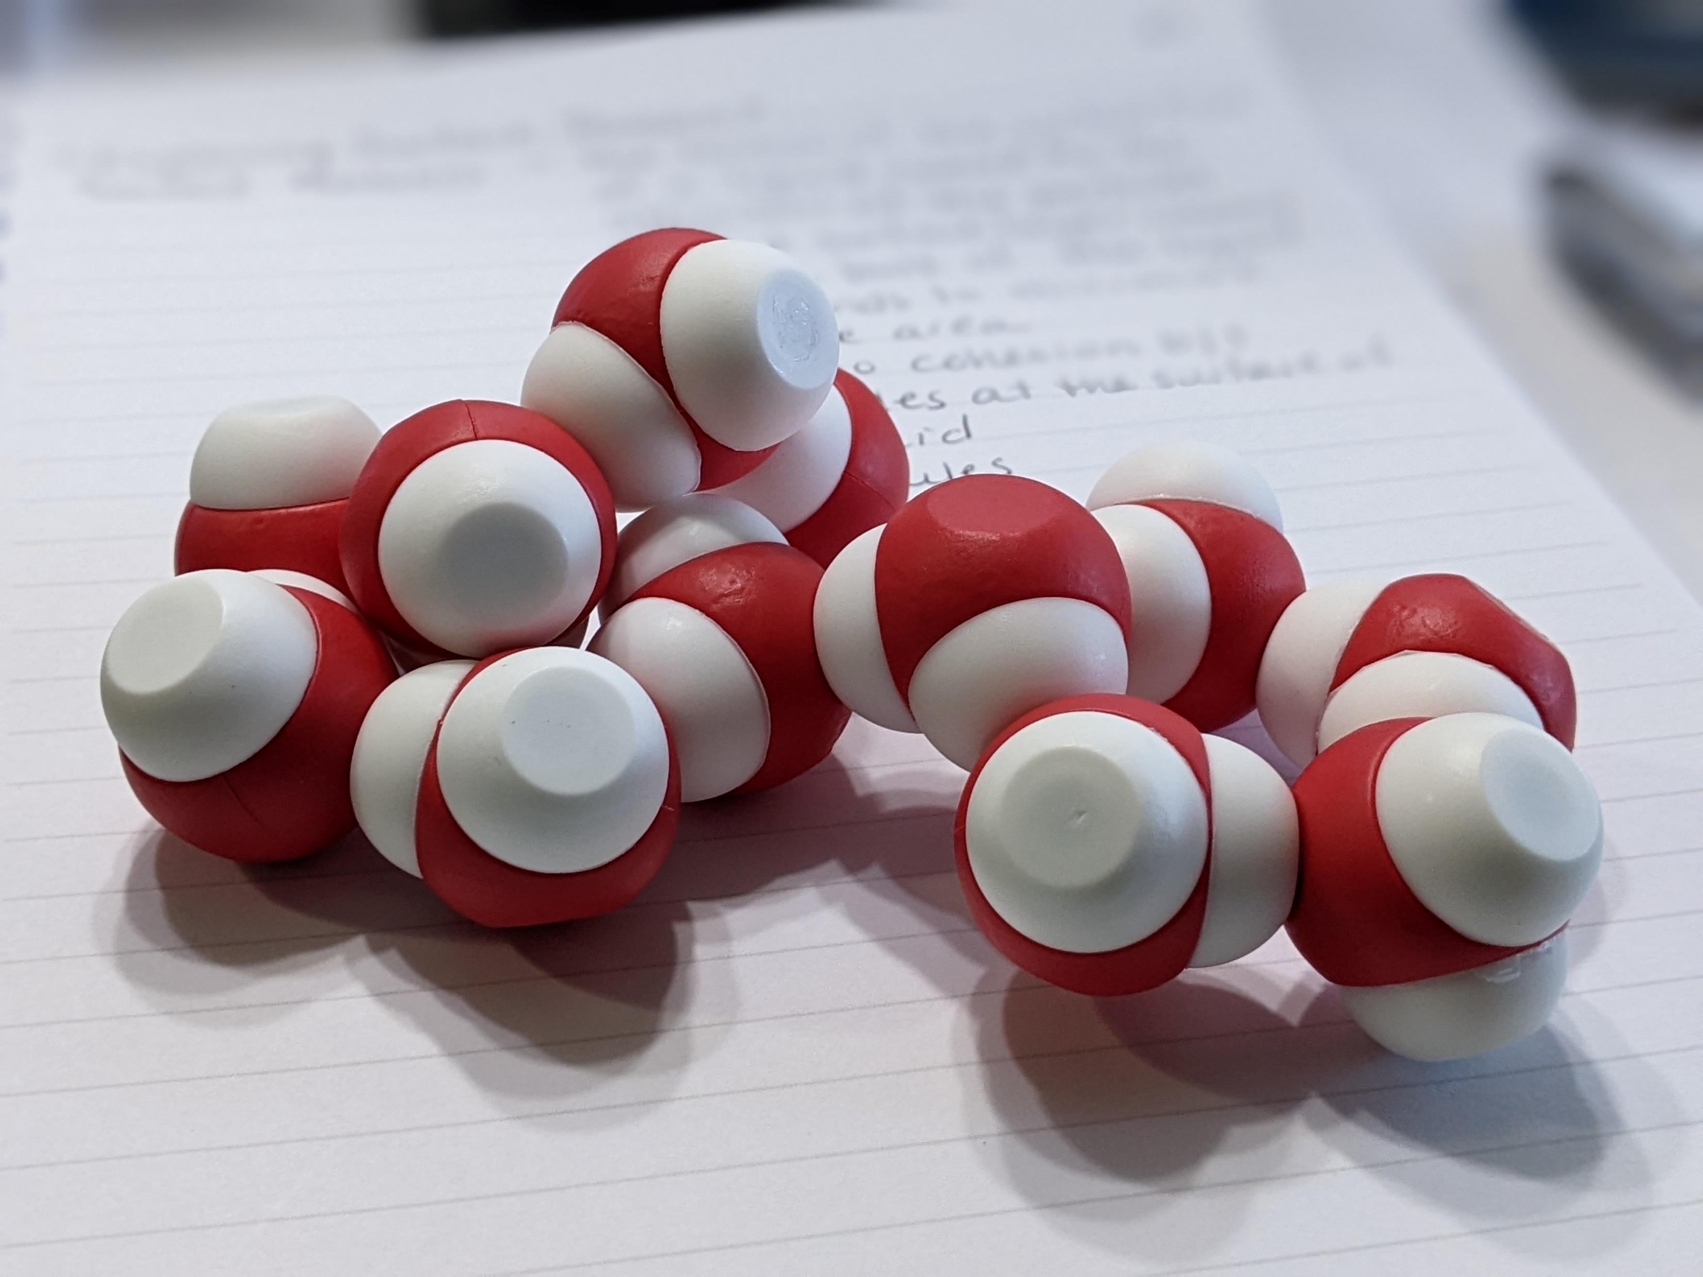
Notes:
You should notice that oxygens are attracted to hydrogens on other water molecules. This is because of hydrogen bonding which leads to many of the important properties of water and how it interacts with other substances.

Slide 4
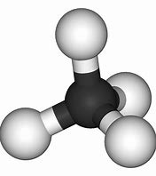
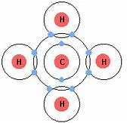
What about Methane?
Notes:
How would this interact with water?

Slide 5
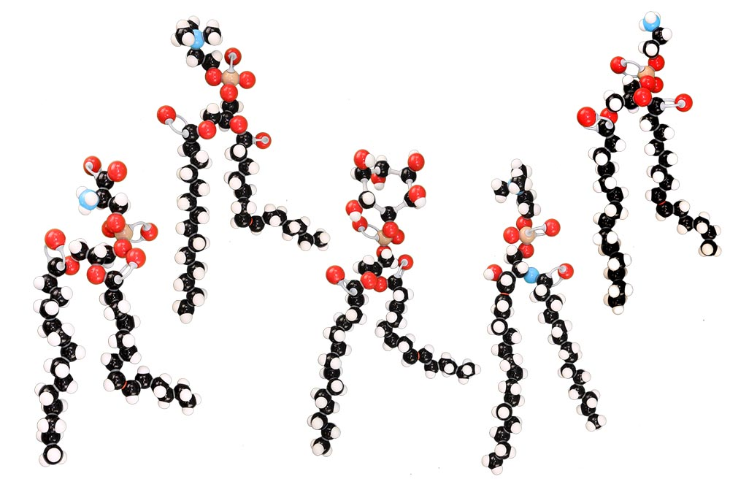
What about a phospholipid?
What do you notice?
Notes:
There are five phospholipid models: phosphatidylcholine, phosphatidylserine, phosphatidylinositol, phosphatidylethanolamine, and sphingomyelin.

Slide 6
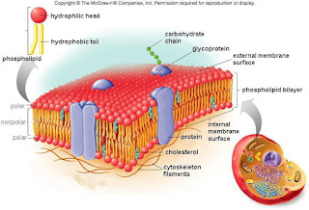
The Cell Membrane

Slide 7
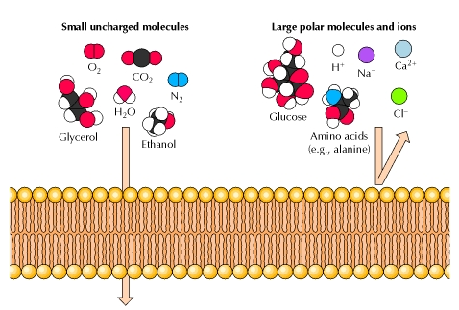
The problem…

Slide 8
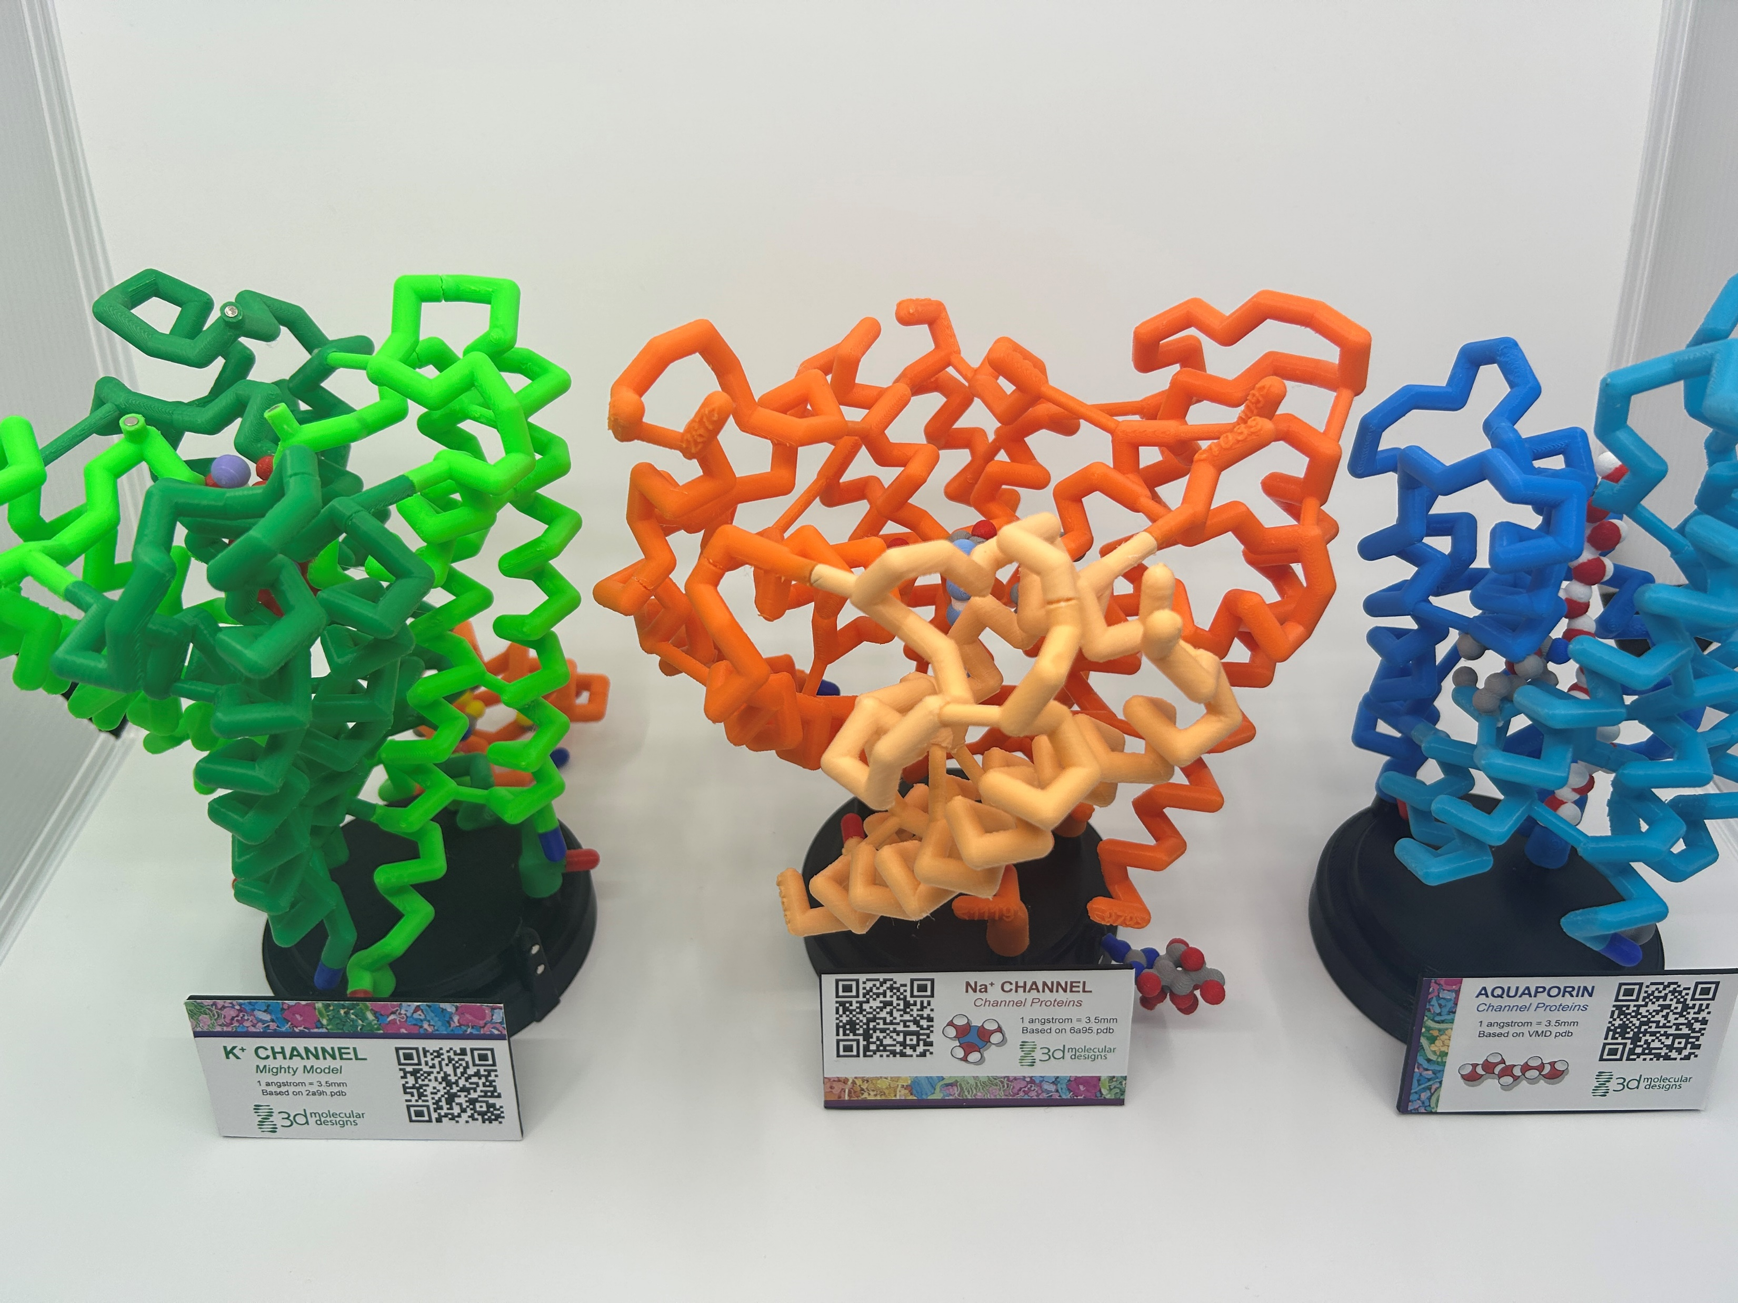
Let’s investigate some channel proteins!

Slide 9
There’s a lot going on here, so let’s simplify it!

Slide 10
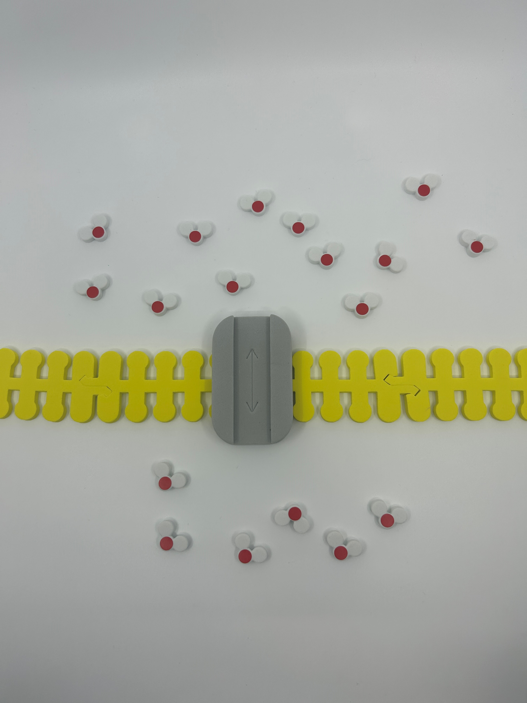
Let’s focus on water first – Add the following
Extracellular – Outside of the cell
12 water molecules
Aquaporin and cell membrane
6 water molecules
Intracellular – Inside of the cell

Slide 11
With an aquaporin in place…
Based on what you know about water potential and osmosis, in which direction would the water molecules move?
How many water molecules should you move?
Notes:
There are 18 water molecules total in this image… equilibrium would be reached on both sides of the membrane if you move 3 from the extracellular side to the intracellular side.

Slide 12
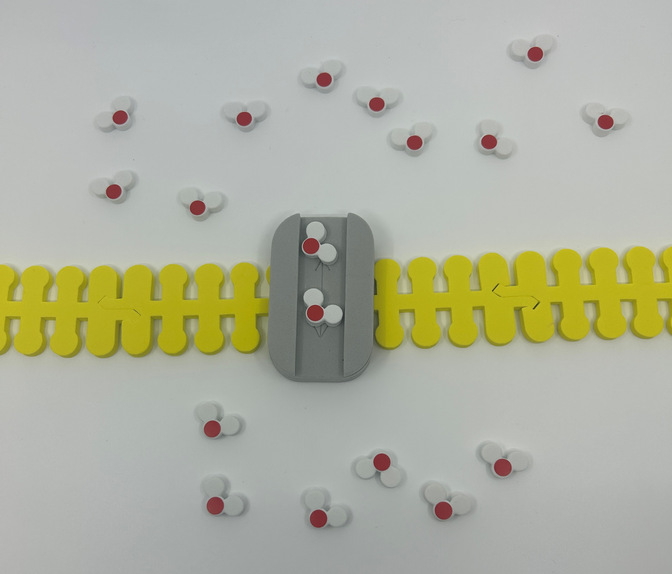
Move 3 water molecules across to reach equilibrium

Slide 13
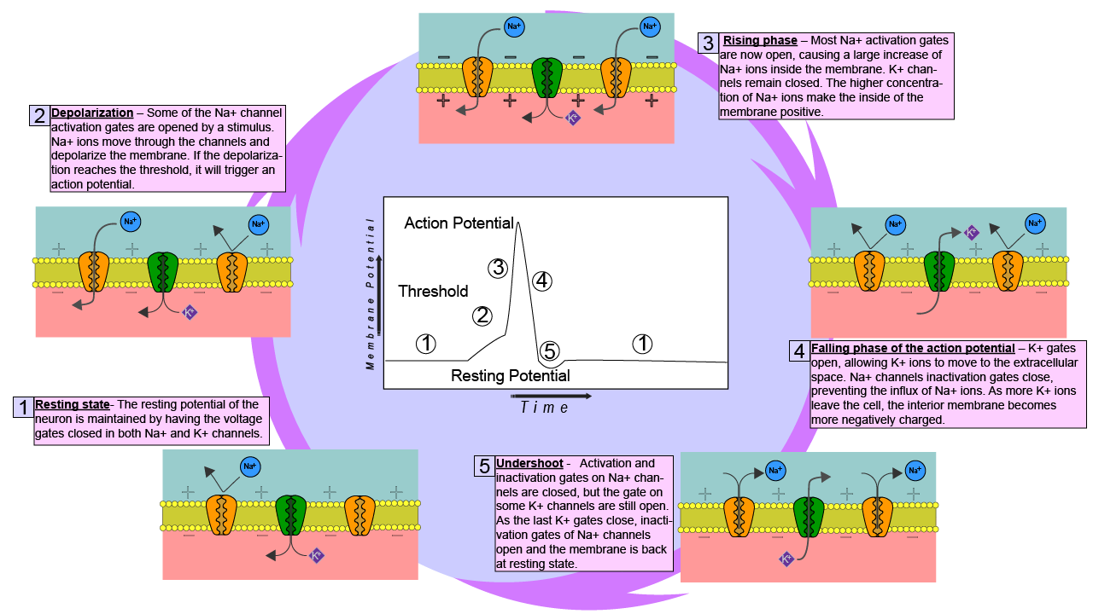
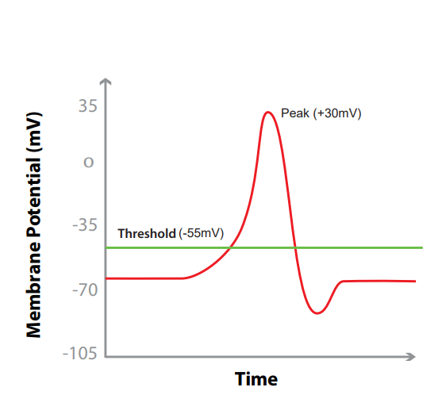
Life is complicated…
Link
Notes:
What the teacher is doing: Point out that action potentials are critical in many multicellular organisms. They signal critical functions such as respiration and muscle movement to escape a predator. Optional activity: Use the Phospholipid and Membrane Transport Kit or Synapse Kit to have students model an action potential.
Encourage students to consider the following question: why would a cell need transport proteins? This may be a time to expand upon the phospholipid bilayer of the cell and explain why they are necessary in living systems.
What the student is doing: Students should model the movement of K+ and Na+ ions in the Phospholipid and Membrane Transport Kit or Synapse Kit. Resources to do this are available by clicking on the link on the slide. Students DO NOT need all the pieces to model this.

Slide 14
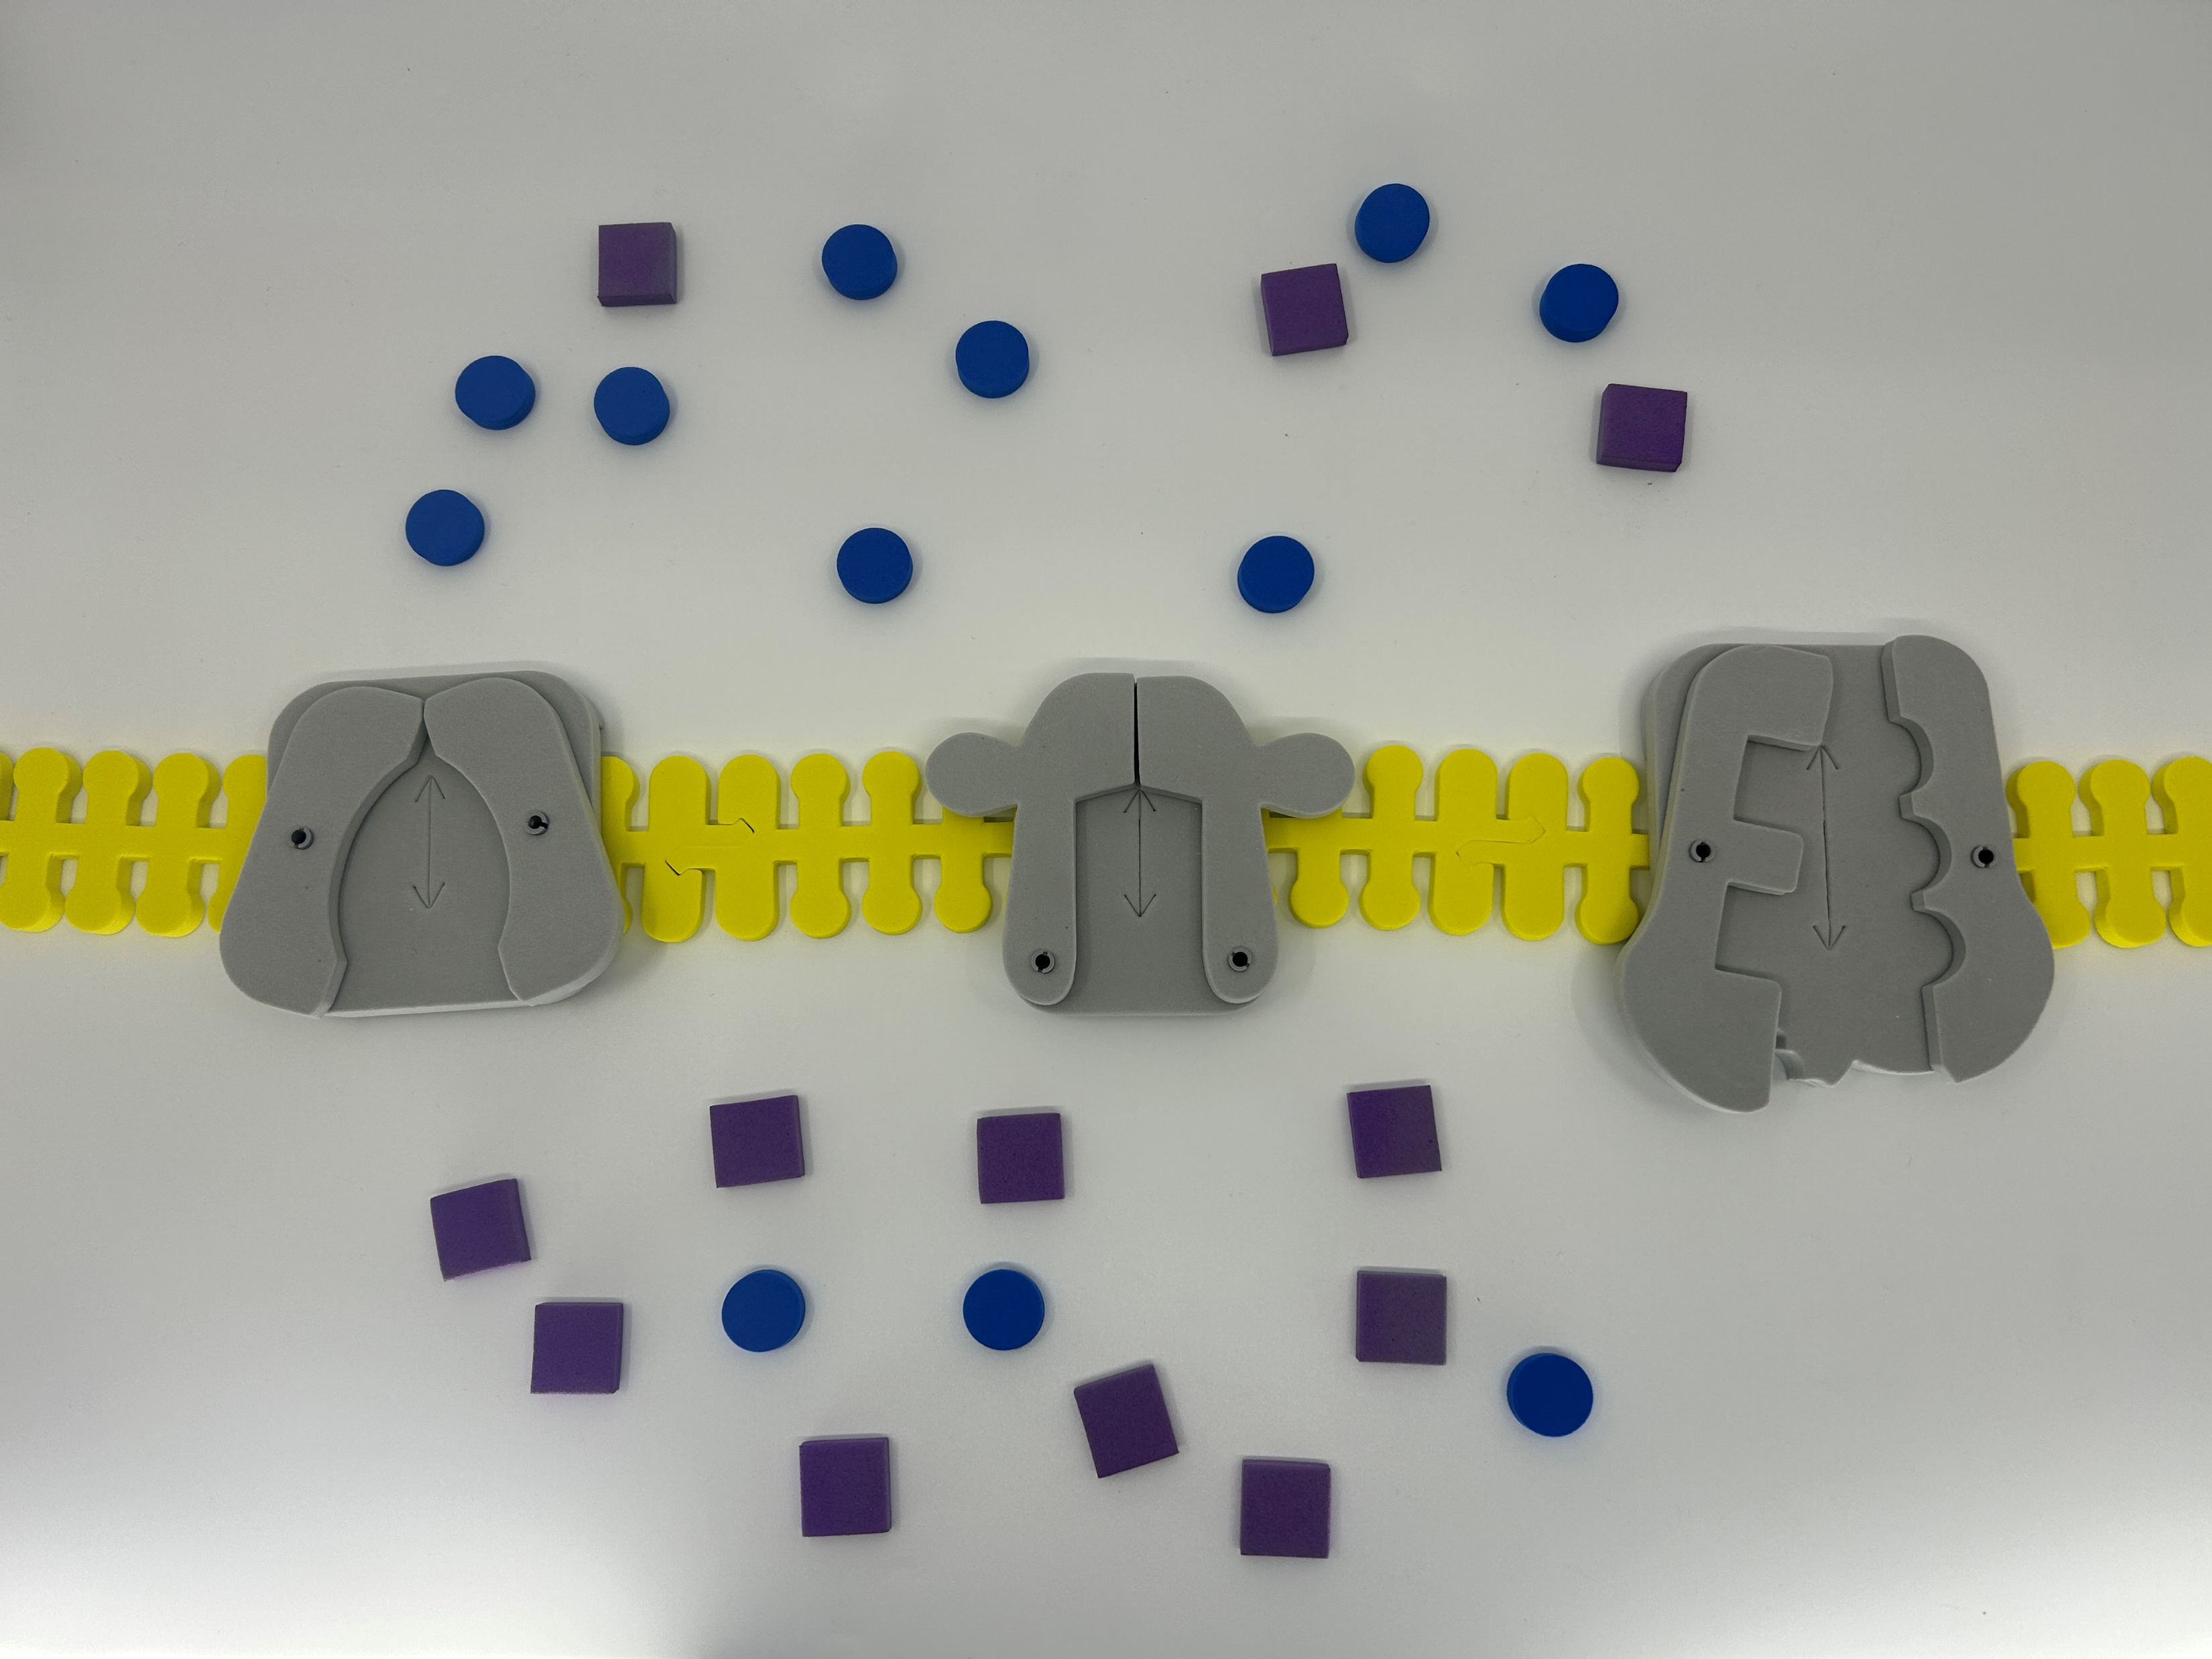
Let’s model an action potential

Slide 15
Let’s identify everything
Na+ (x 12)
K+ (x 12)
Na+ / K+ Channel
Gated Na+ channel (Simulated)
Gated K+ Channel
Notes:
Note – Our “Gated Sodium Channel” is a repurposed GLUT channel for this activity.
*The synapse kit includes Gated K+, leak K+, and gated Na+ channels.

Slide 16
What do you notice?

Slide 17
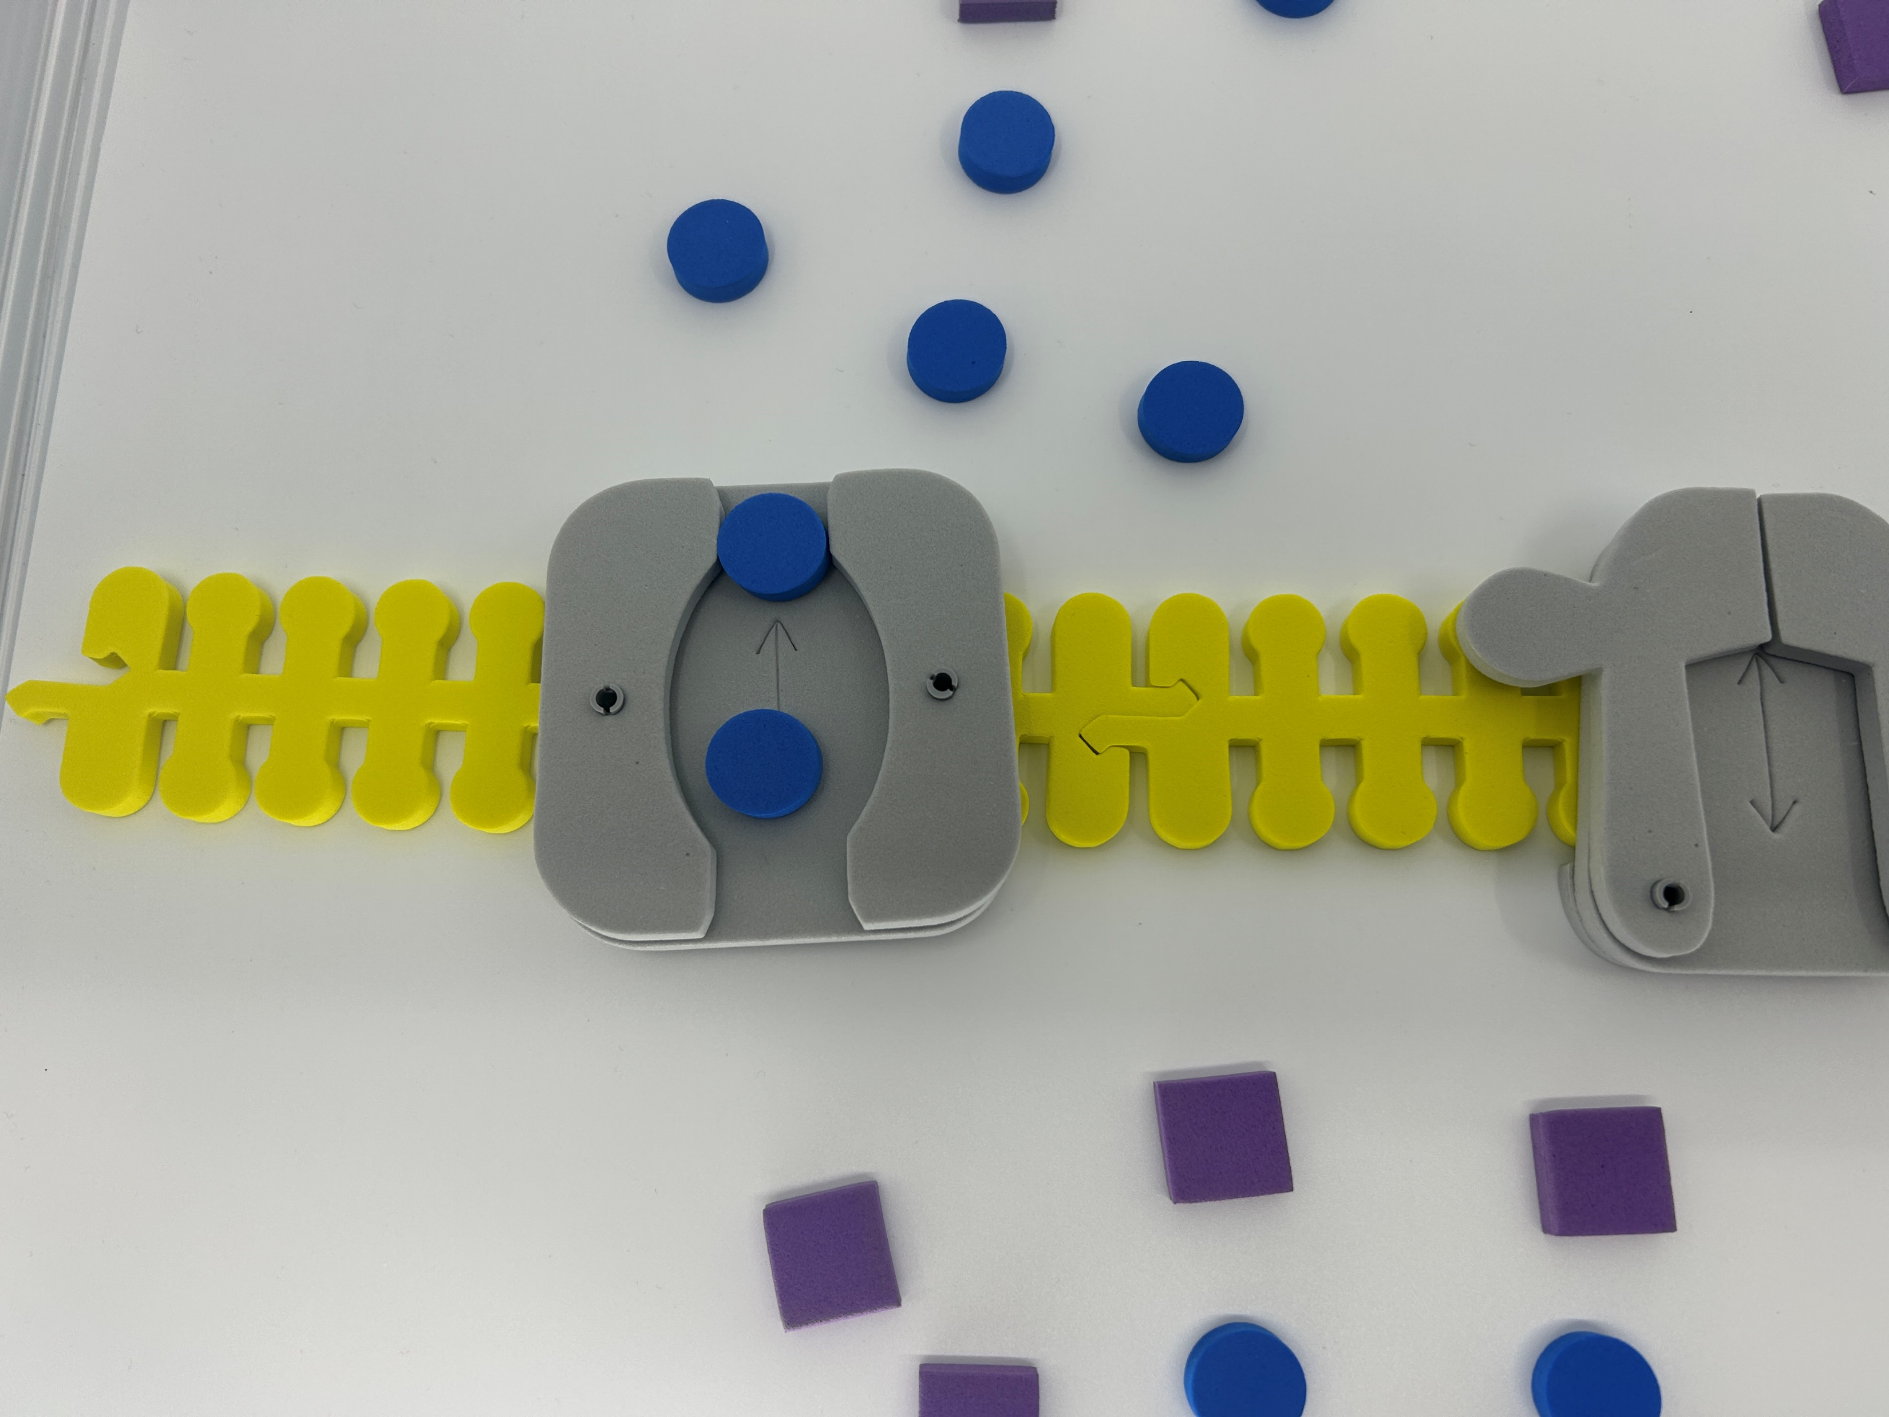
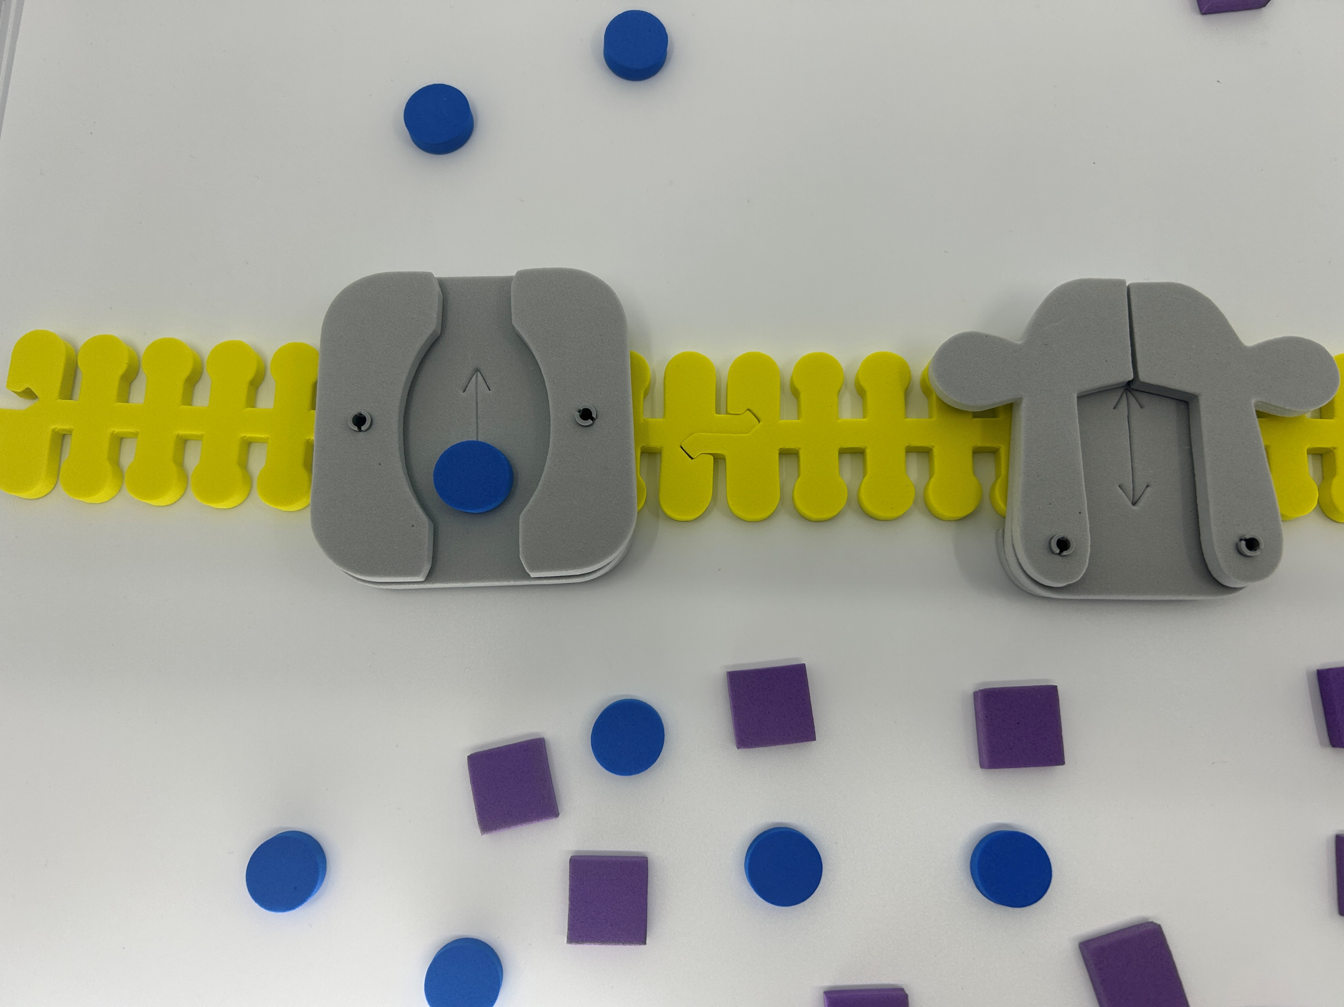
Sodium (Na+ ) first…

Slide 18
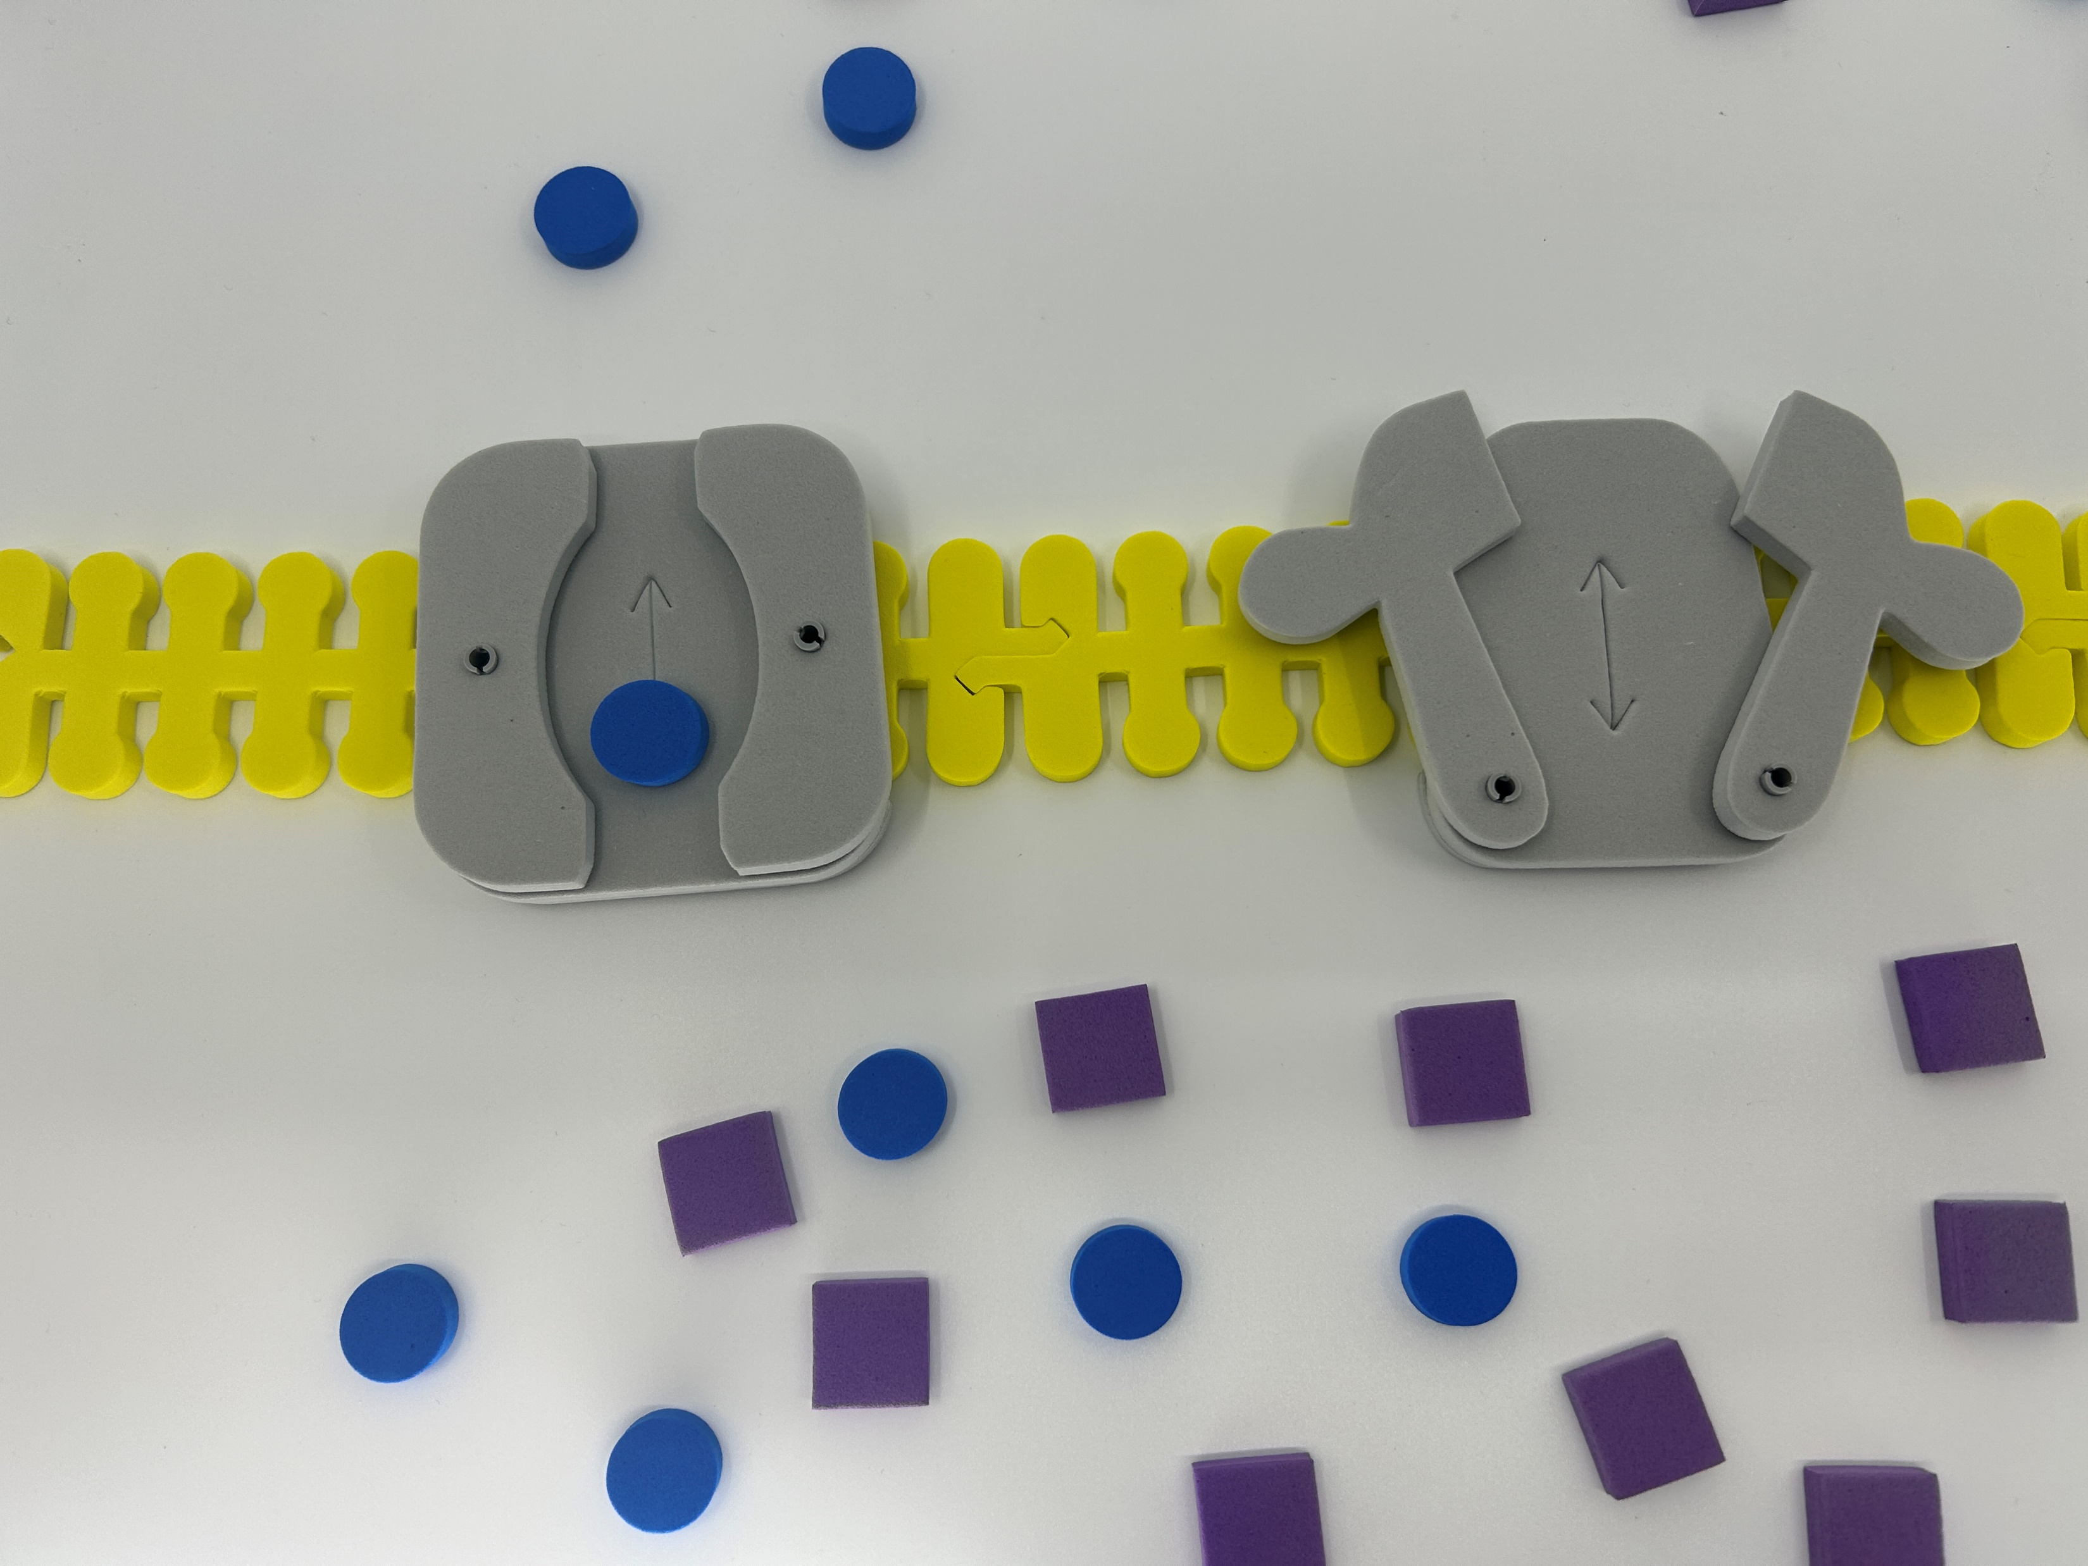
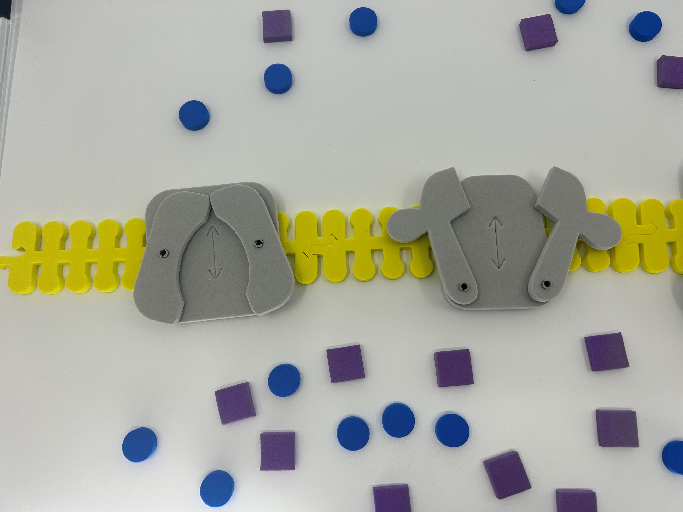
What happened to the charge inside the membrane?

Slide 19
Life is complicated…
Link
Notes:
What the teacher is doing: Point out that action potentials are critical in many multicellular organisms. They signal critical functions such as respiration and muscle movement to escape a predator. Optional activity: Use the Phospholipid and Membrane Transport Kit or Synapse Kit to have students model an action potential.
Encourage students to consider the following question: why would a cell need transport proteins? This may be a time to expand upon the phospholipid bilayer of the cell and explain why they are necessary in living systems.
What the student is doing: Students should model the movement of K+ and Na+ ions in the Phospholipid and Membrane Transport Kit or Synapse Kit. Resources to do this are available by clicking on the link on the slide. Students DO NOT need all the pieces to model this.

Slide 20
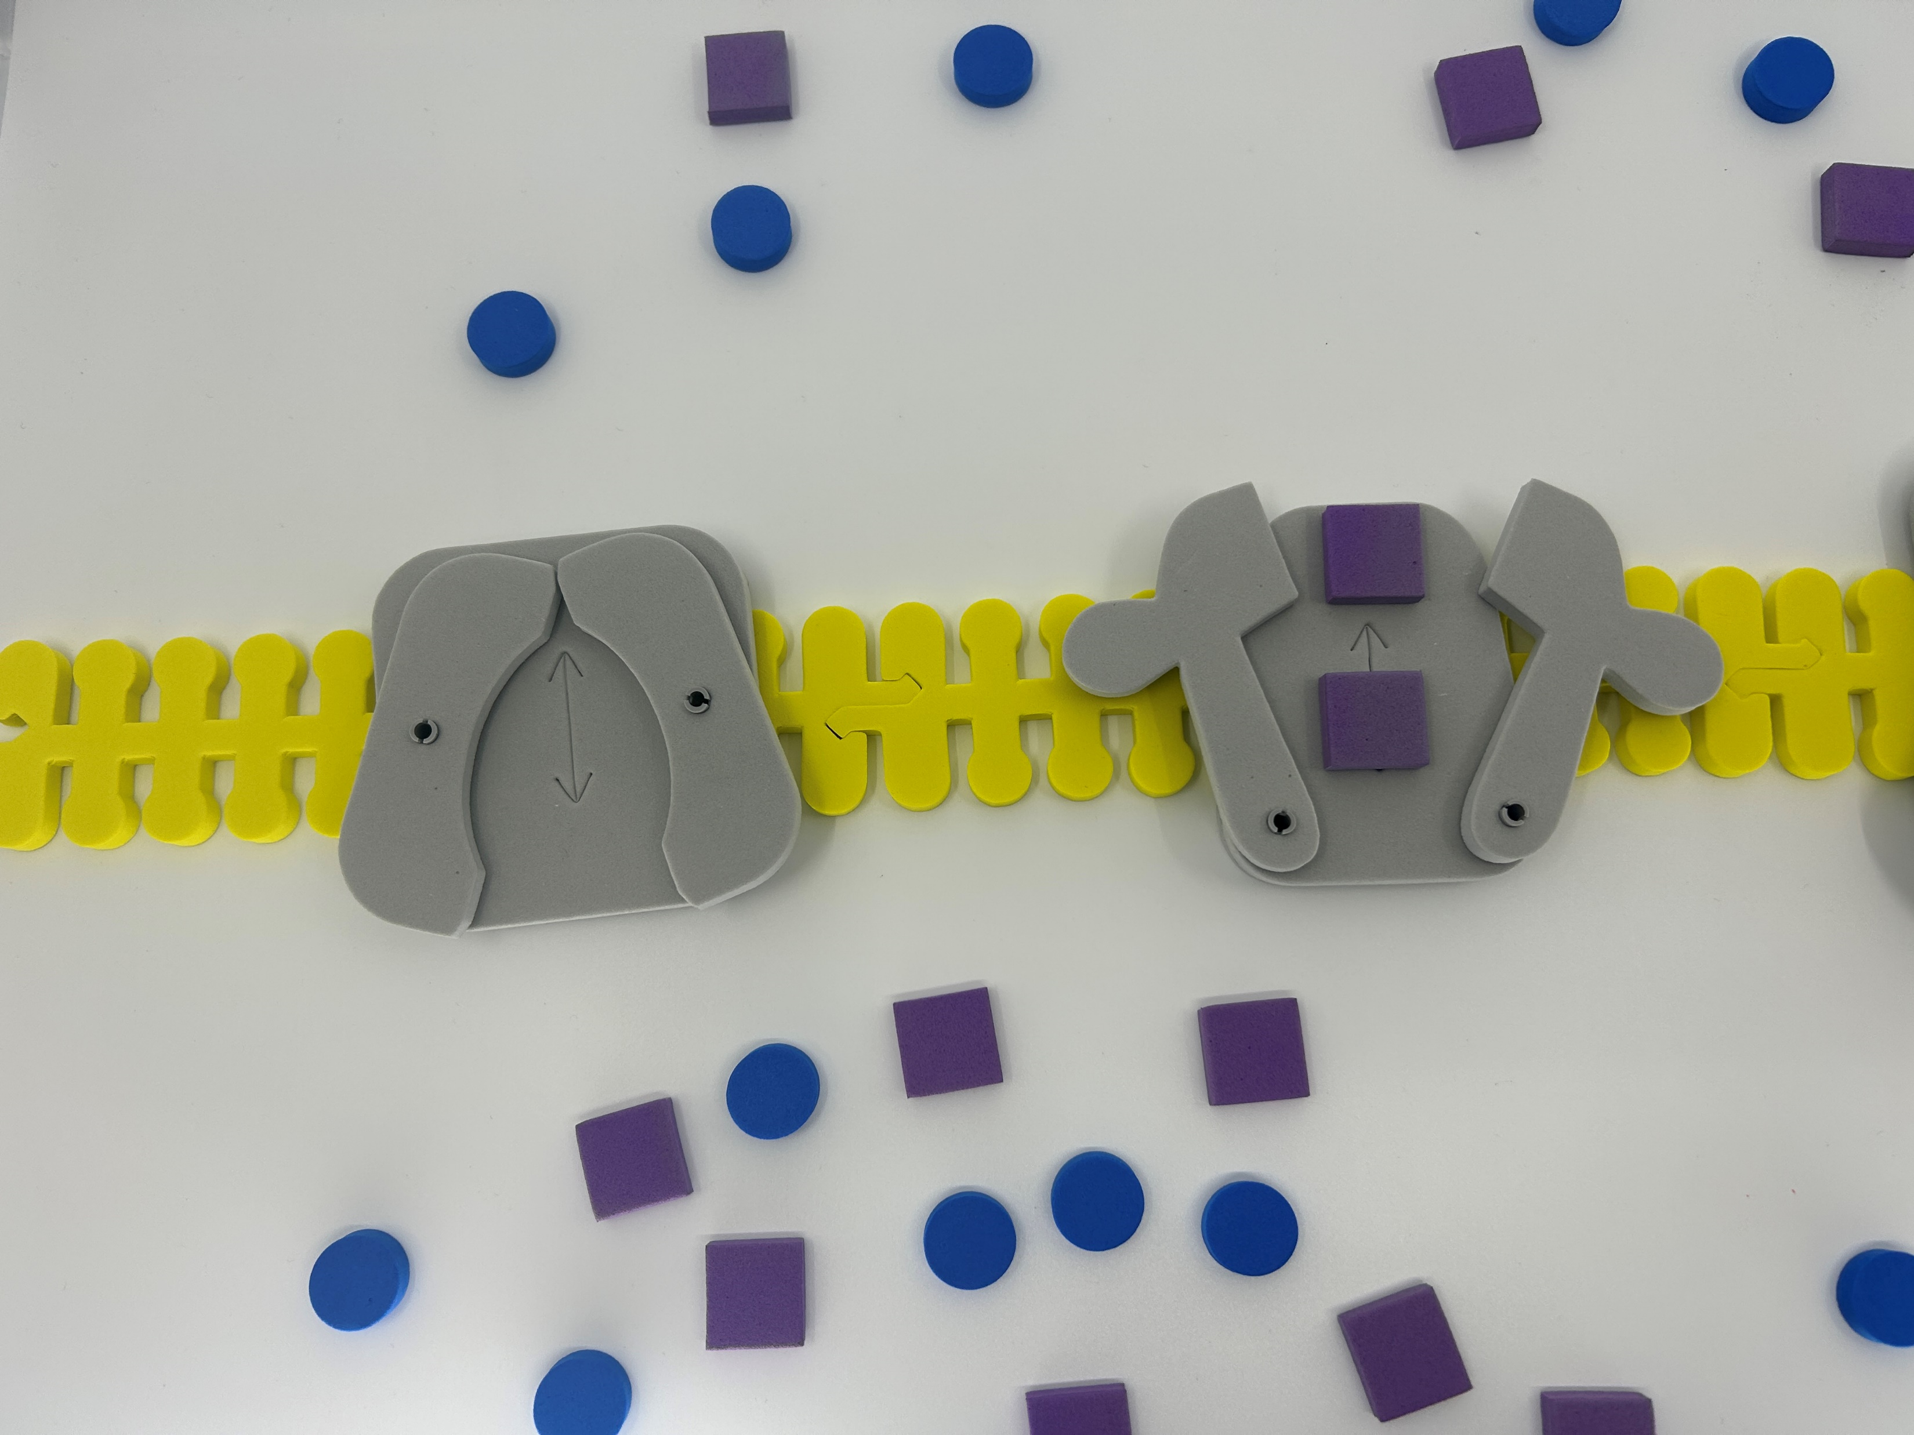
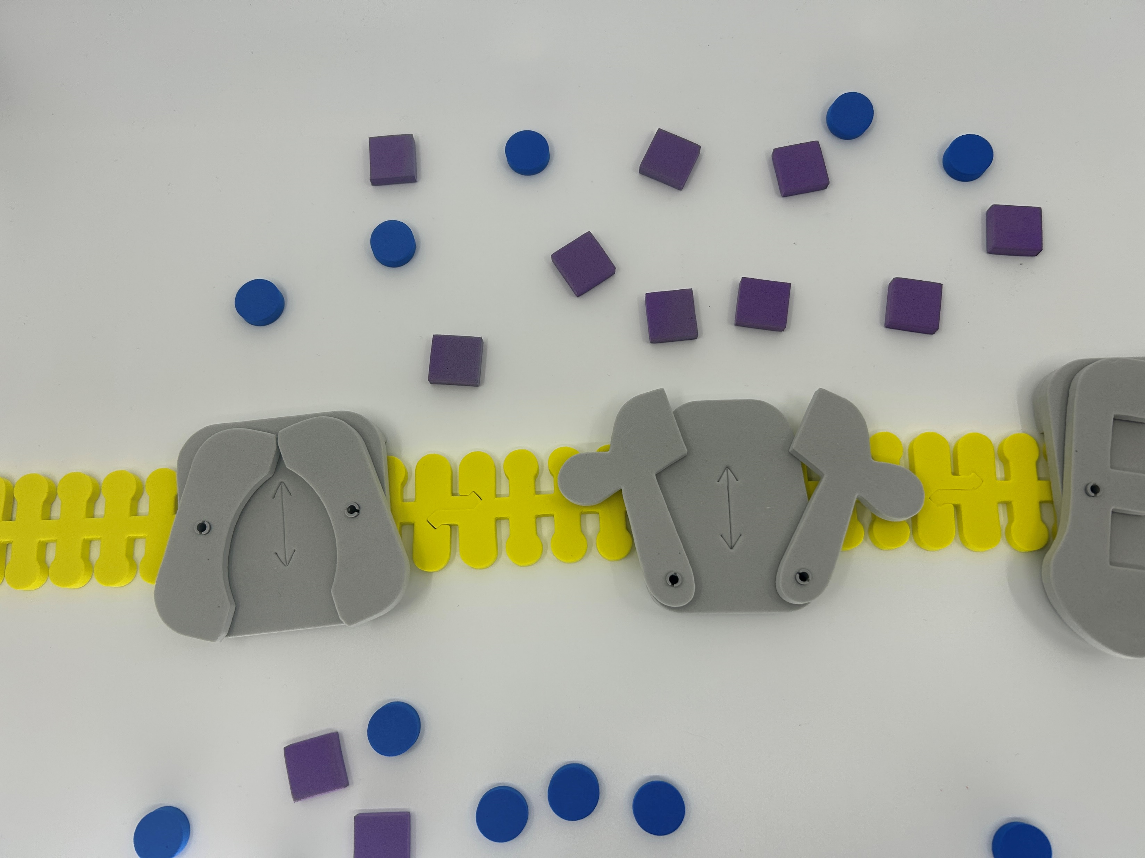
Potassium (K+) moves next

Slide 21
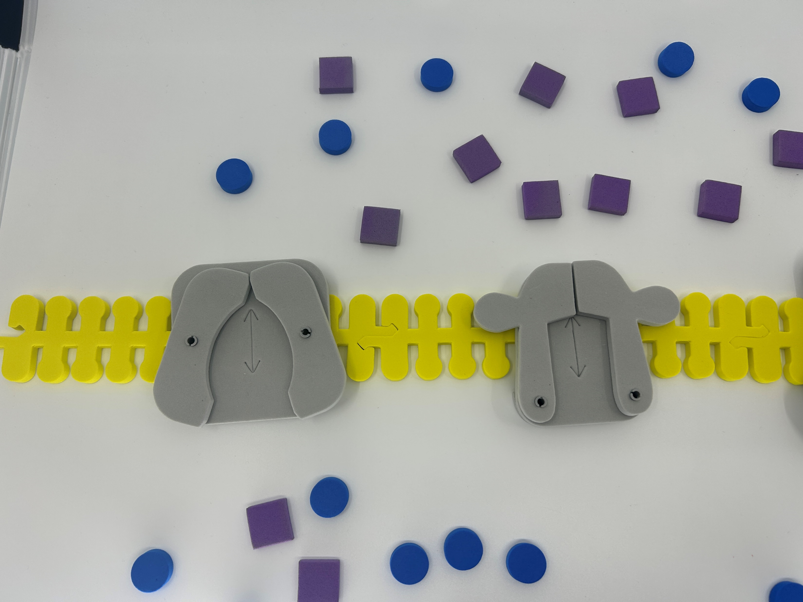
Each channel is “tuned”

Slide 22
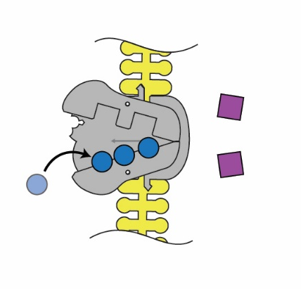
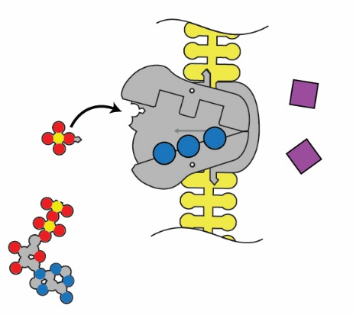
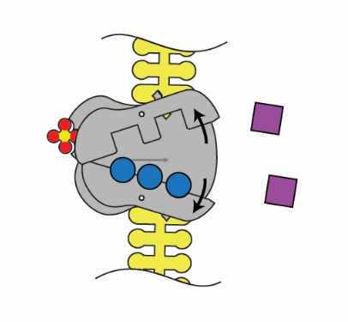
How do we get back to a resting potential?
3. The pump shape changes, exposing the sodium to the extracellular space.
1. Sodium binds on the intracellular side.
2. The pump is phosphorylated by ATP.

Slide 23
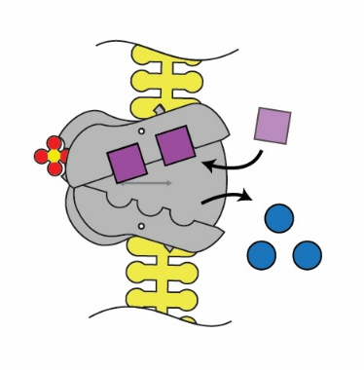
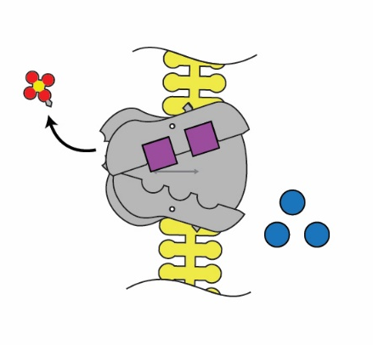
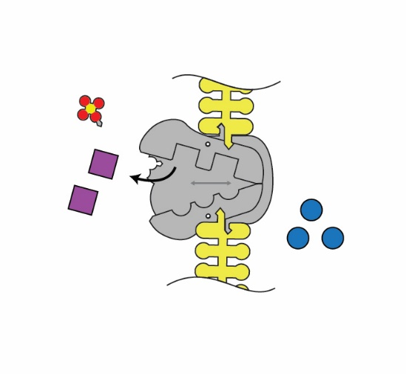
4. Binding affinity changes to release Na+ and take in K+.
5. Phosphate detaches.
6. Original shape is restored, releasing K+ into the cell.

Slide 24
How does a channel “know” which ion to transport?
They don’t…
They follow the basic rules of chemistry!

Slide 25
How does Aquaporin move water?
… and only water?

Slide 26
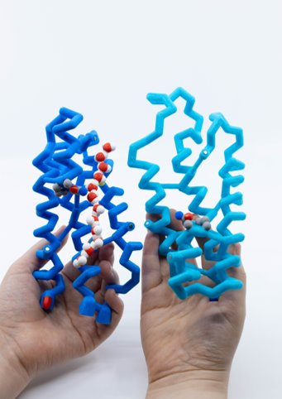
A closer look at water movement
Separate the two portions of the aquaporin monomer.
Remove the chain of water molecules.
What do you notice about the ability of water to enter the channel?

Slide 27
A closer look at water movement
Locate the two asparagine side chains (N78 and N194) inside the channel
Water molecules can move either way through the channel depending on concentration.
Notice the orientation of the oxygen atom and hydrogen atoms in reference to the inside and outside of the cell.
Speculate why there is a change in orientation.
How could you model this?

Slide 28
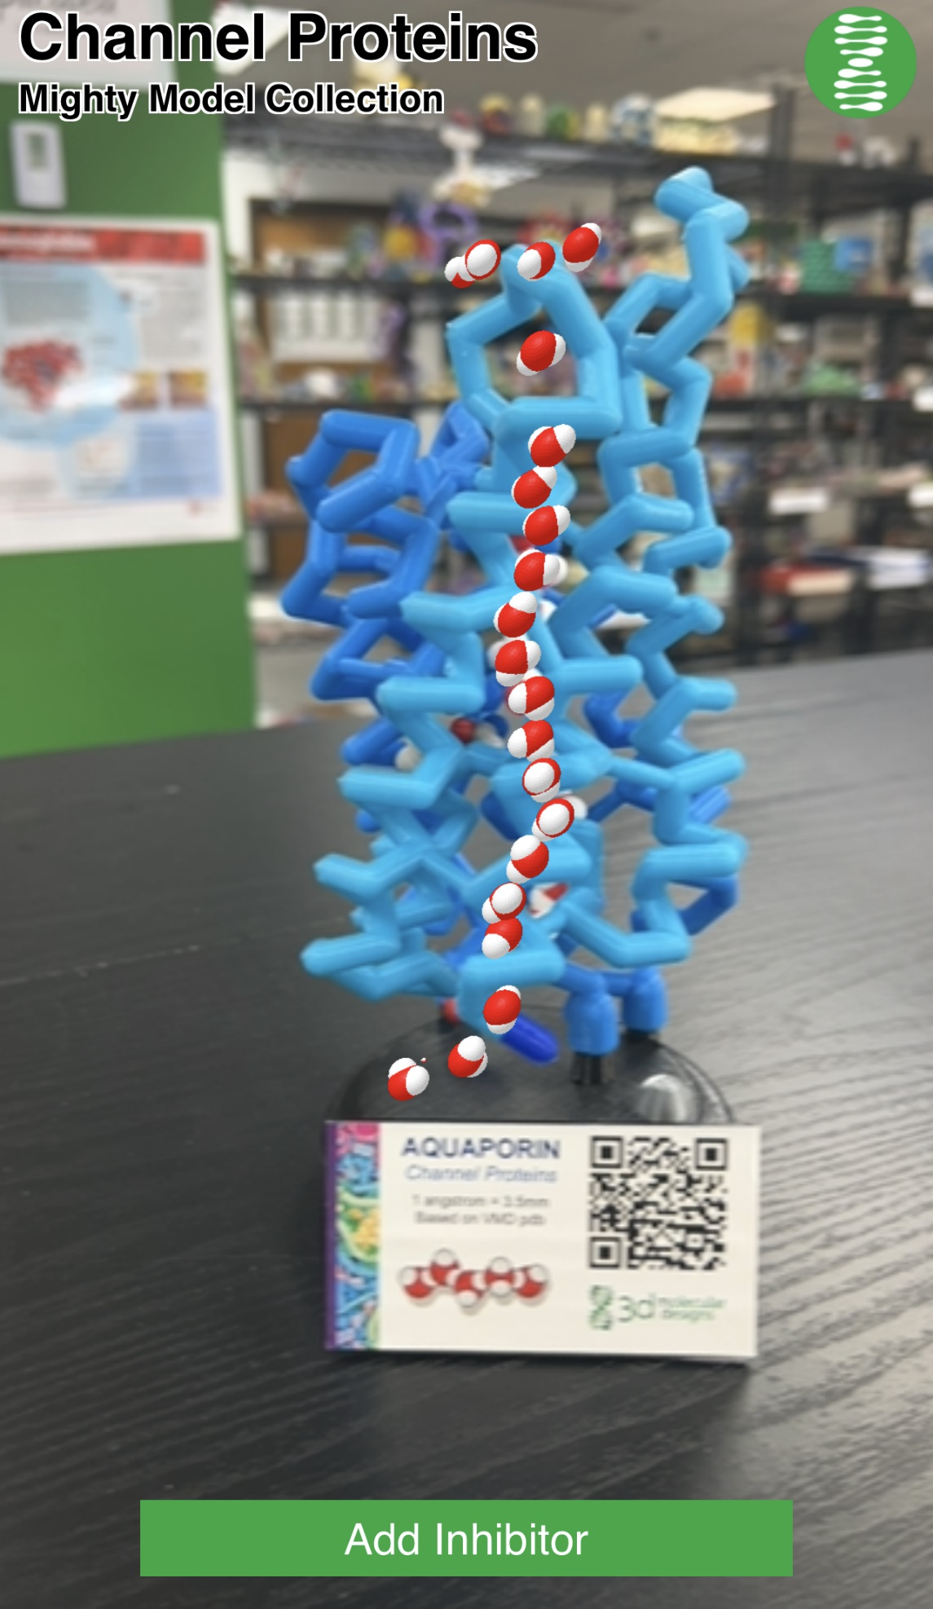
Use the QR code to see it in action-
Note the direction of movement.
What happens when you add the inhibitor? (Hg)

Slide 29

Let’s look at the Sodium (Na+) Channel

Slide 30
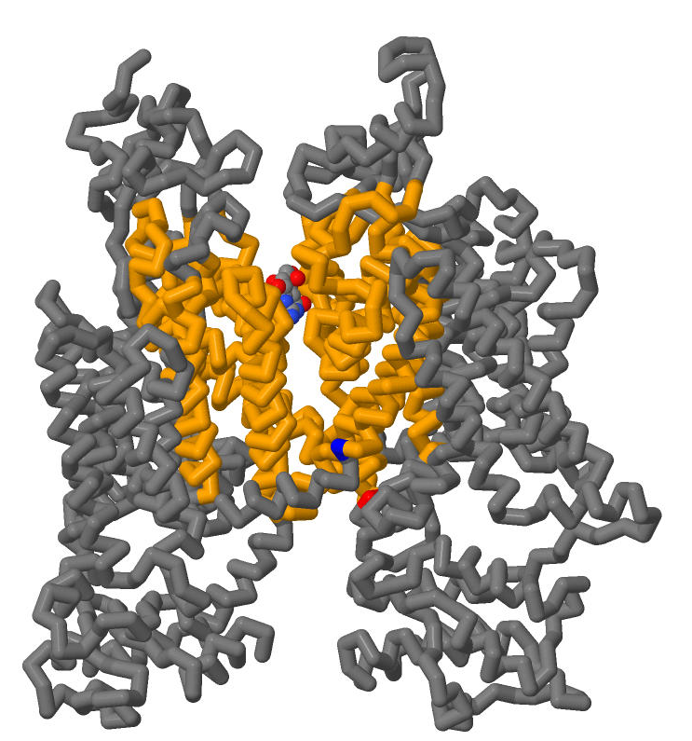
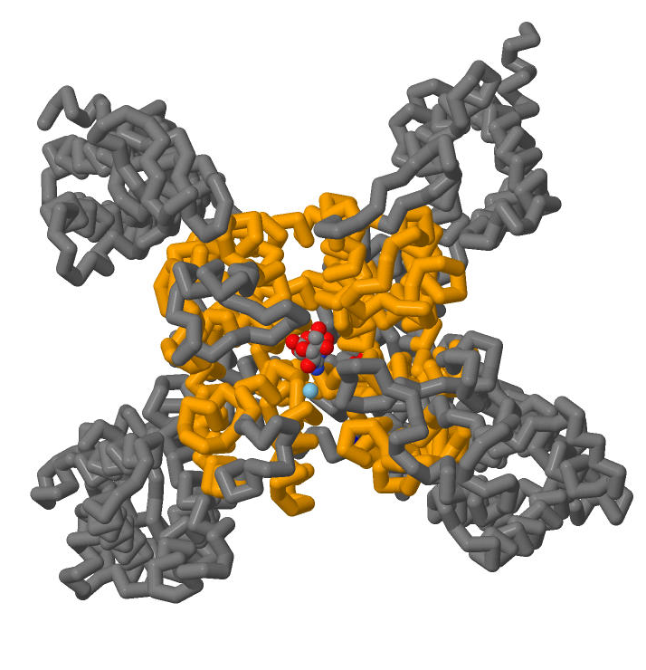
These are Voltage-Gated Na+ Channels - monomers

Slide 31
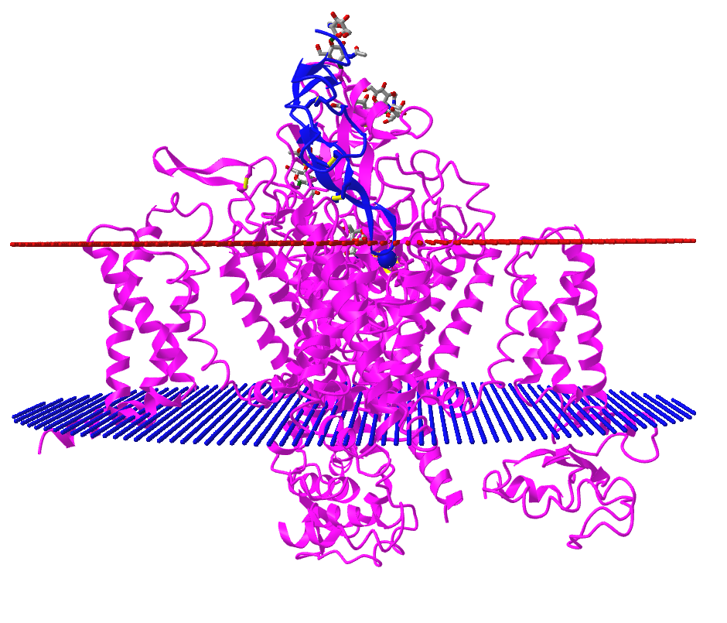
Here it is in a membrane
Outside of the cell
Na+ ion
Voltage sensing domains
Inside of the cell
© 2023 3D Molecular Designs. All Rights Reserved.

Slide 32
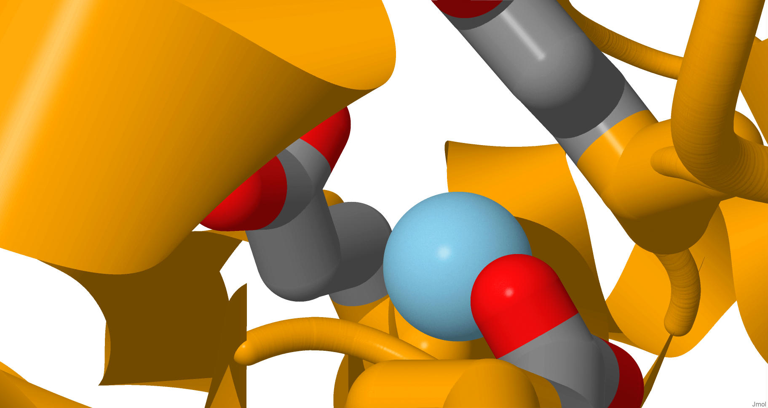
DEE acts as a selectivity filter for Na+ ion
DEE motif – Potential Na+ site in cockroach – Carboxylate groups of ASP- GLU-GLU
D375 - Asp
E701 - Glu
E704 - Glu
E701
E704
Na+
D375
© 2023 3D Molecular Designs. All Rights Reserved.

Slide 33
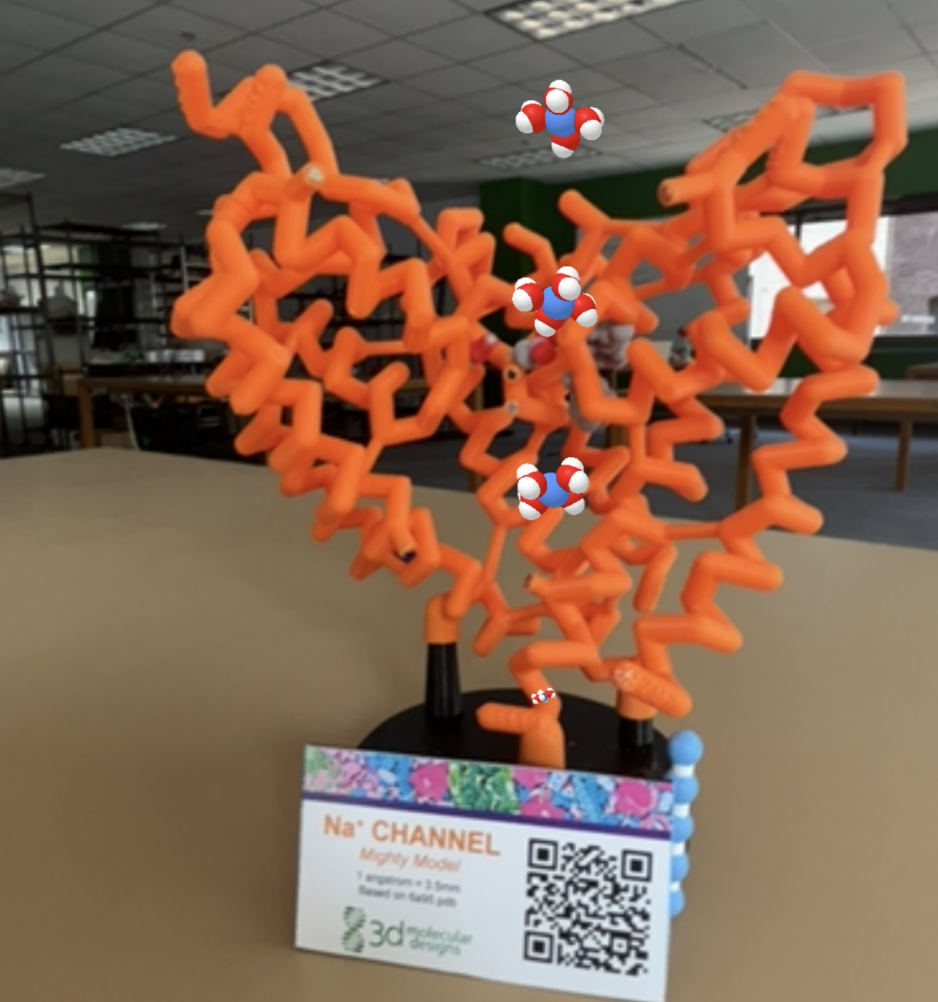
Use the QR code to see it in action-
Note the direction of movement.
What is the molecule around the Na+ ions?

Slide 34
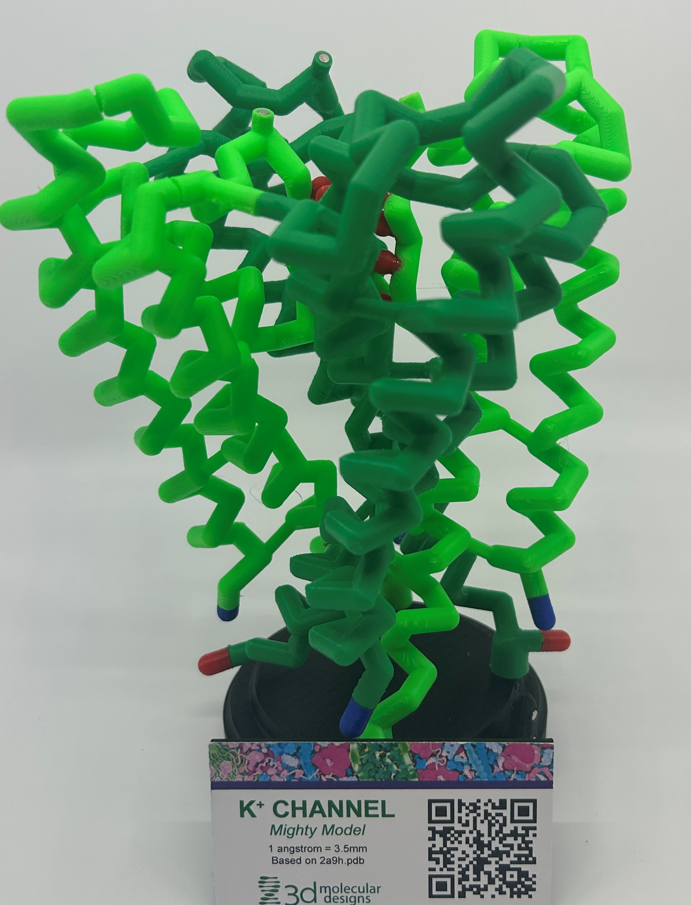
Let’s look at the Potassium (K+) Channel

Slide 35
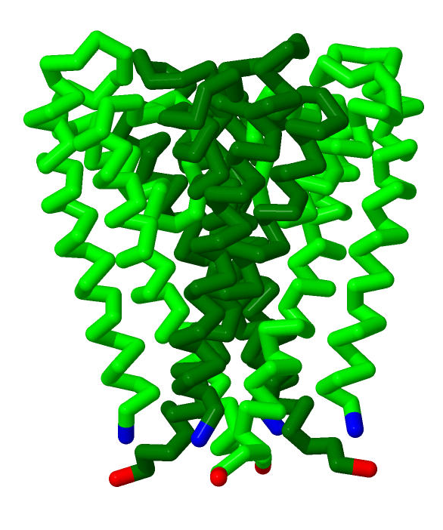
Homotetramer
The K+ channel is made up of 4 identical subunits.
In our pdb file (2A9H), the channel is broken into 4 chains
A:
B:
C:
D:
Notes:
What is the teacher doing: Point out the quaternary structure of this homotetramer. This is a four chain protein that interact with signature sequence which is TTVGYG.
What is the student doing: Students should manipulate the mighty model while their teacher points out the specific structures on the mighty model. Students should realize that these chains are identical.

Slide 36
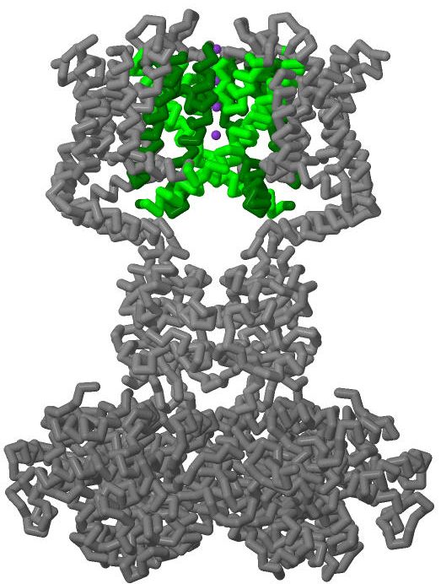
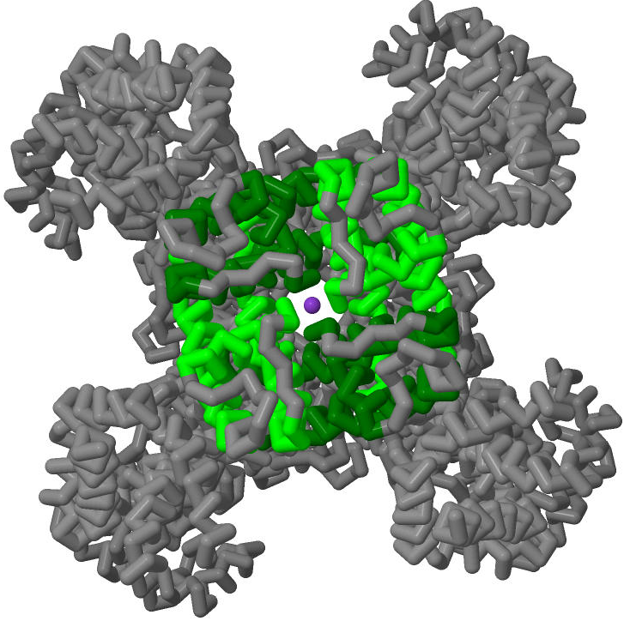
This potassium channel is voltage-gated
Notes:
What the teacher is doing: Show students that this model is “truncated.” The voltage sensing domains have been removed for clarity. Voltage sensing domains detect changes in the potential across the membrane and open and close the channel accordingly.
Note: this is not the same potassium channel because the crystallographer did not build the voltage sensing domains.
What is the student doing: Students should speculate where the pore is on this gated channel. They should appreciate the complexity of life and compare the simplicity of the physical model to the actual biological assembly.

Slide 37
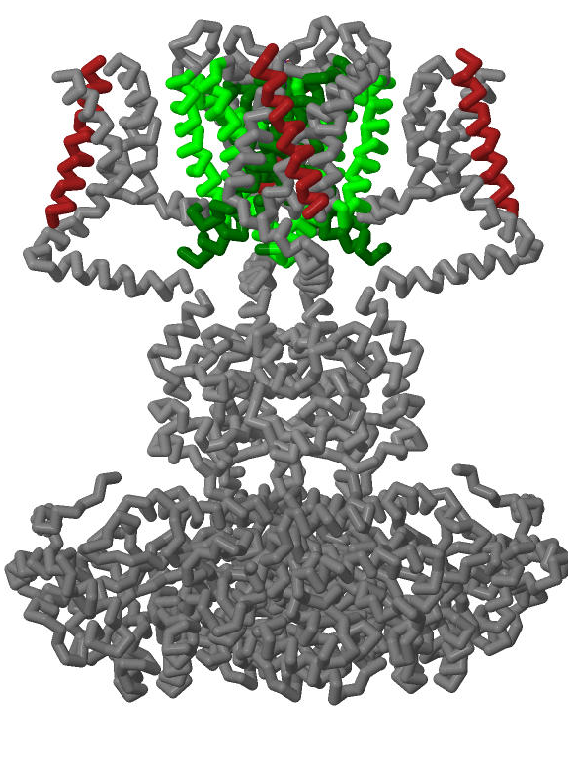
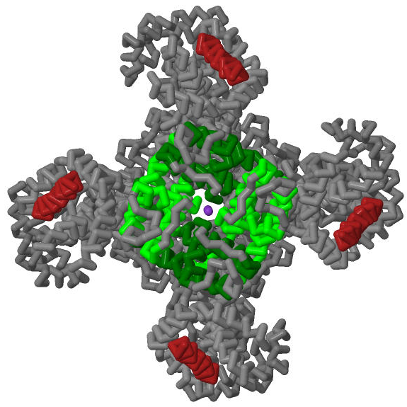
This potassium channel is voltage-gated
Notes:
GOING DEEPER?
What the teacher is doing: Show students that this model is “truncated.” The voltage sensing domains have been removed for clarity. Voltage sensing domains detect changes in the potential across the membrane and open and close the channel accordingly.
Note: this is not the same potassium channel because the crystallographer did not build the voltage sensing domains. – The Voltage sensing domains are highlighted in Firebrick Red, and ARG plays an important role in the regulation of the VSD and activating the channel.
What is the student doing: Students should speculate where the pore is on this gated channel. They should appreciate the complexity of life and compare the simplicity of the physical model to the actual biological assembly.

Slide 38
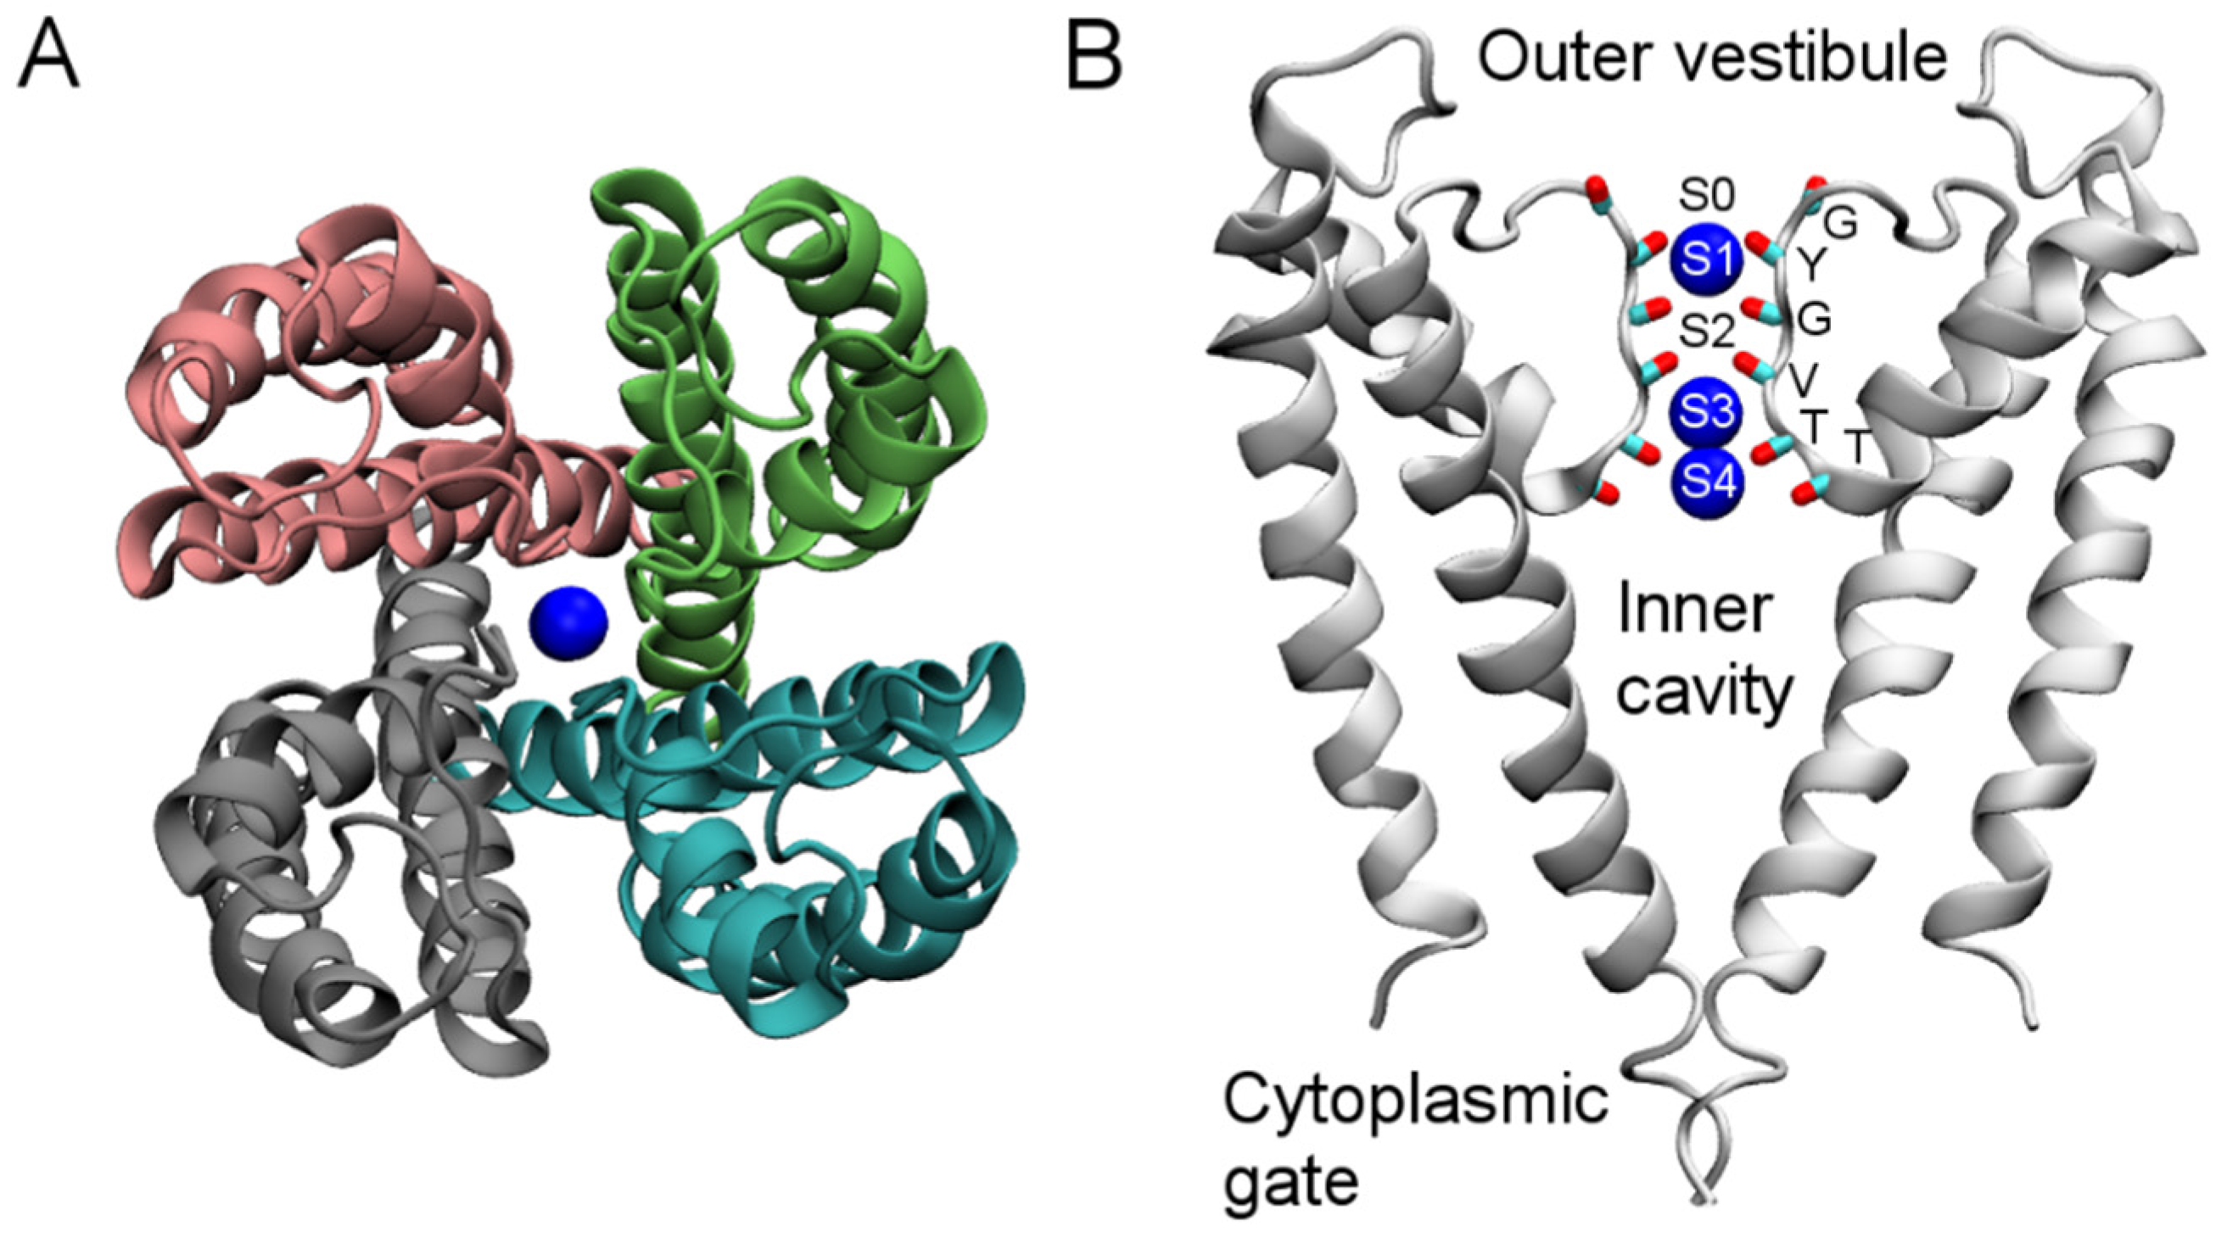
What does a K⁺ channel do?
K⁺ channels play an important role in the nervous system and generating an action potential (message). K⁺ channels are highly selective in the ions it allows to pass through.
Why do you
suppose this is
important?
Protein “Fingerprint”:
TTVGYG
Notes:
What the teacher is doing: Explain that potassium channels move K+ ions across the phospholipid bilayer of the cell membrane.
What the student is doing: Students should notice the helices of this protein that span the membrane. The signature sequence TTVGYG facilitates the movement of K+ ions through the channel and produces the selectivity filter. This sequence is highly conserved across prokaryotic and eukaryotic organisms.

Slide 39
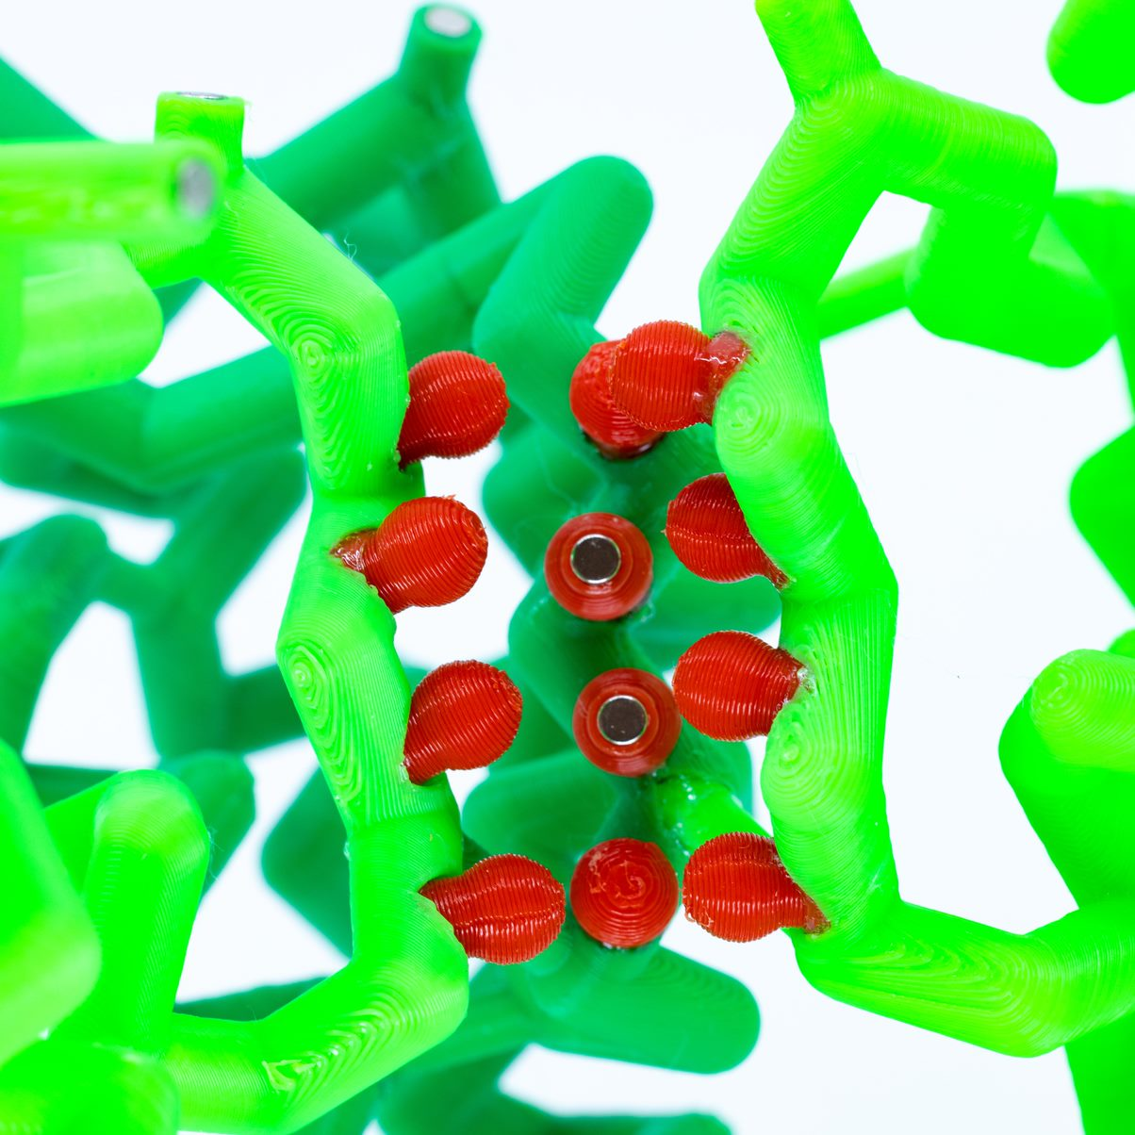
The carbonyl groups
The carbonyl oxygens of the
6 signature sequence amino
acids (TTVGYG) in the
backbone are oriented
towards the pore.
Notes:
What the teacher is doing: Explain the structure and function of K+ channel specifically that the carbonyl oxygens in the backbone line the pore.
What the student is doing: Students should draw and take notes of the structure – function of the channel.

Slide 40
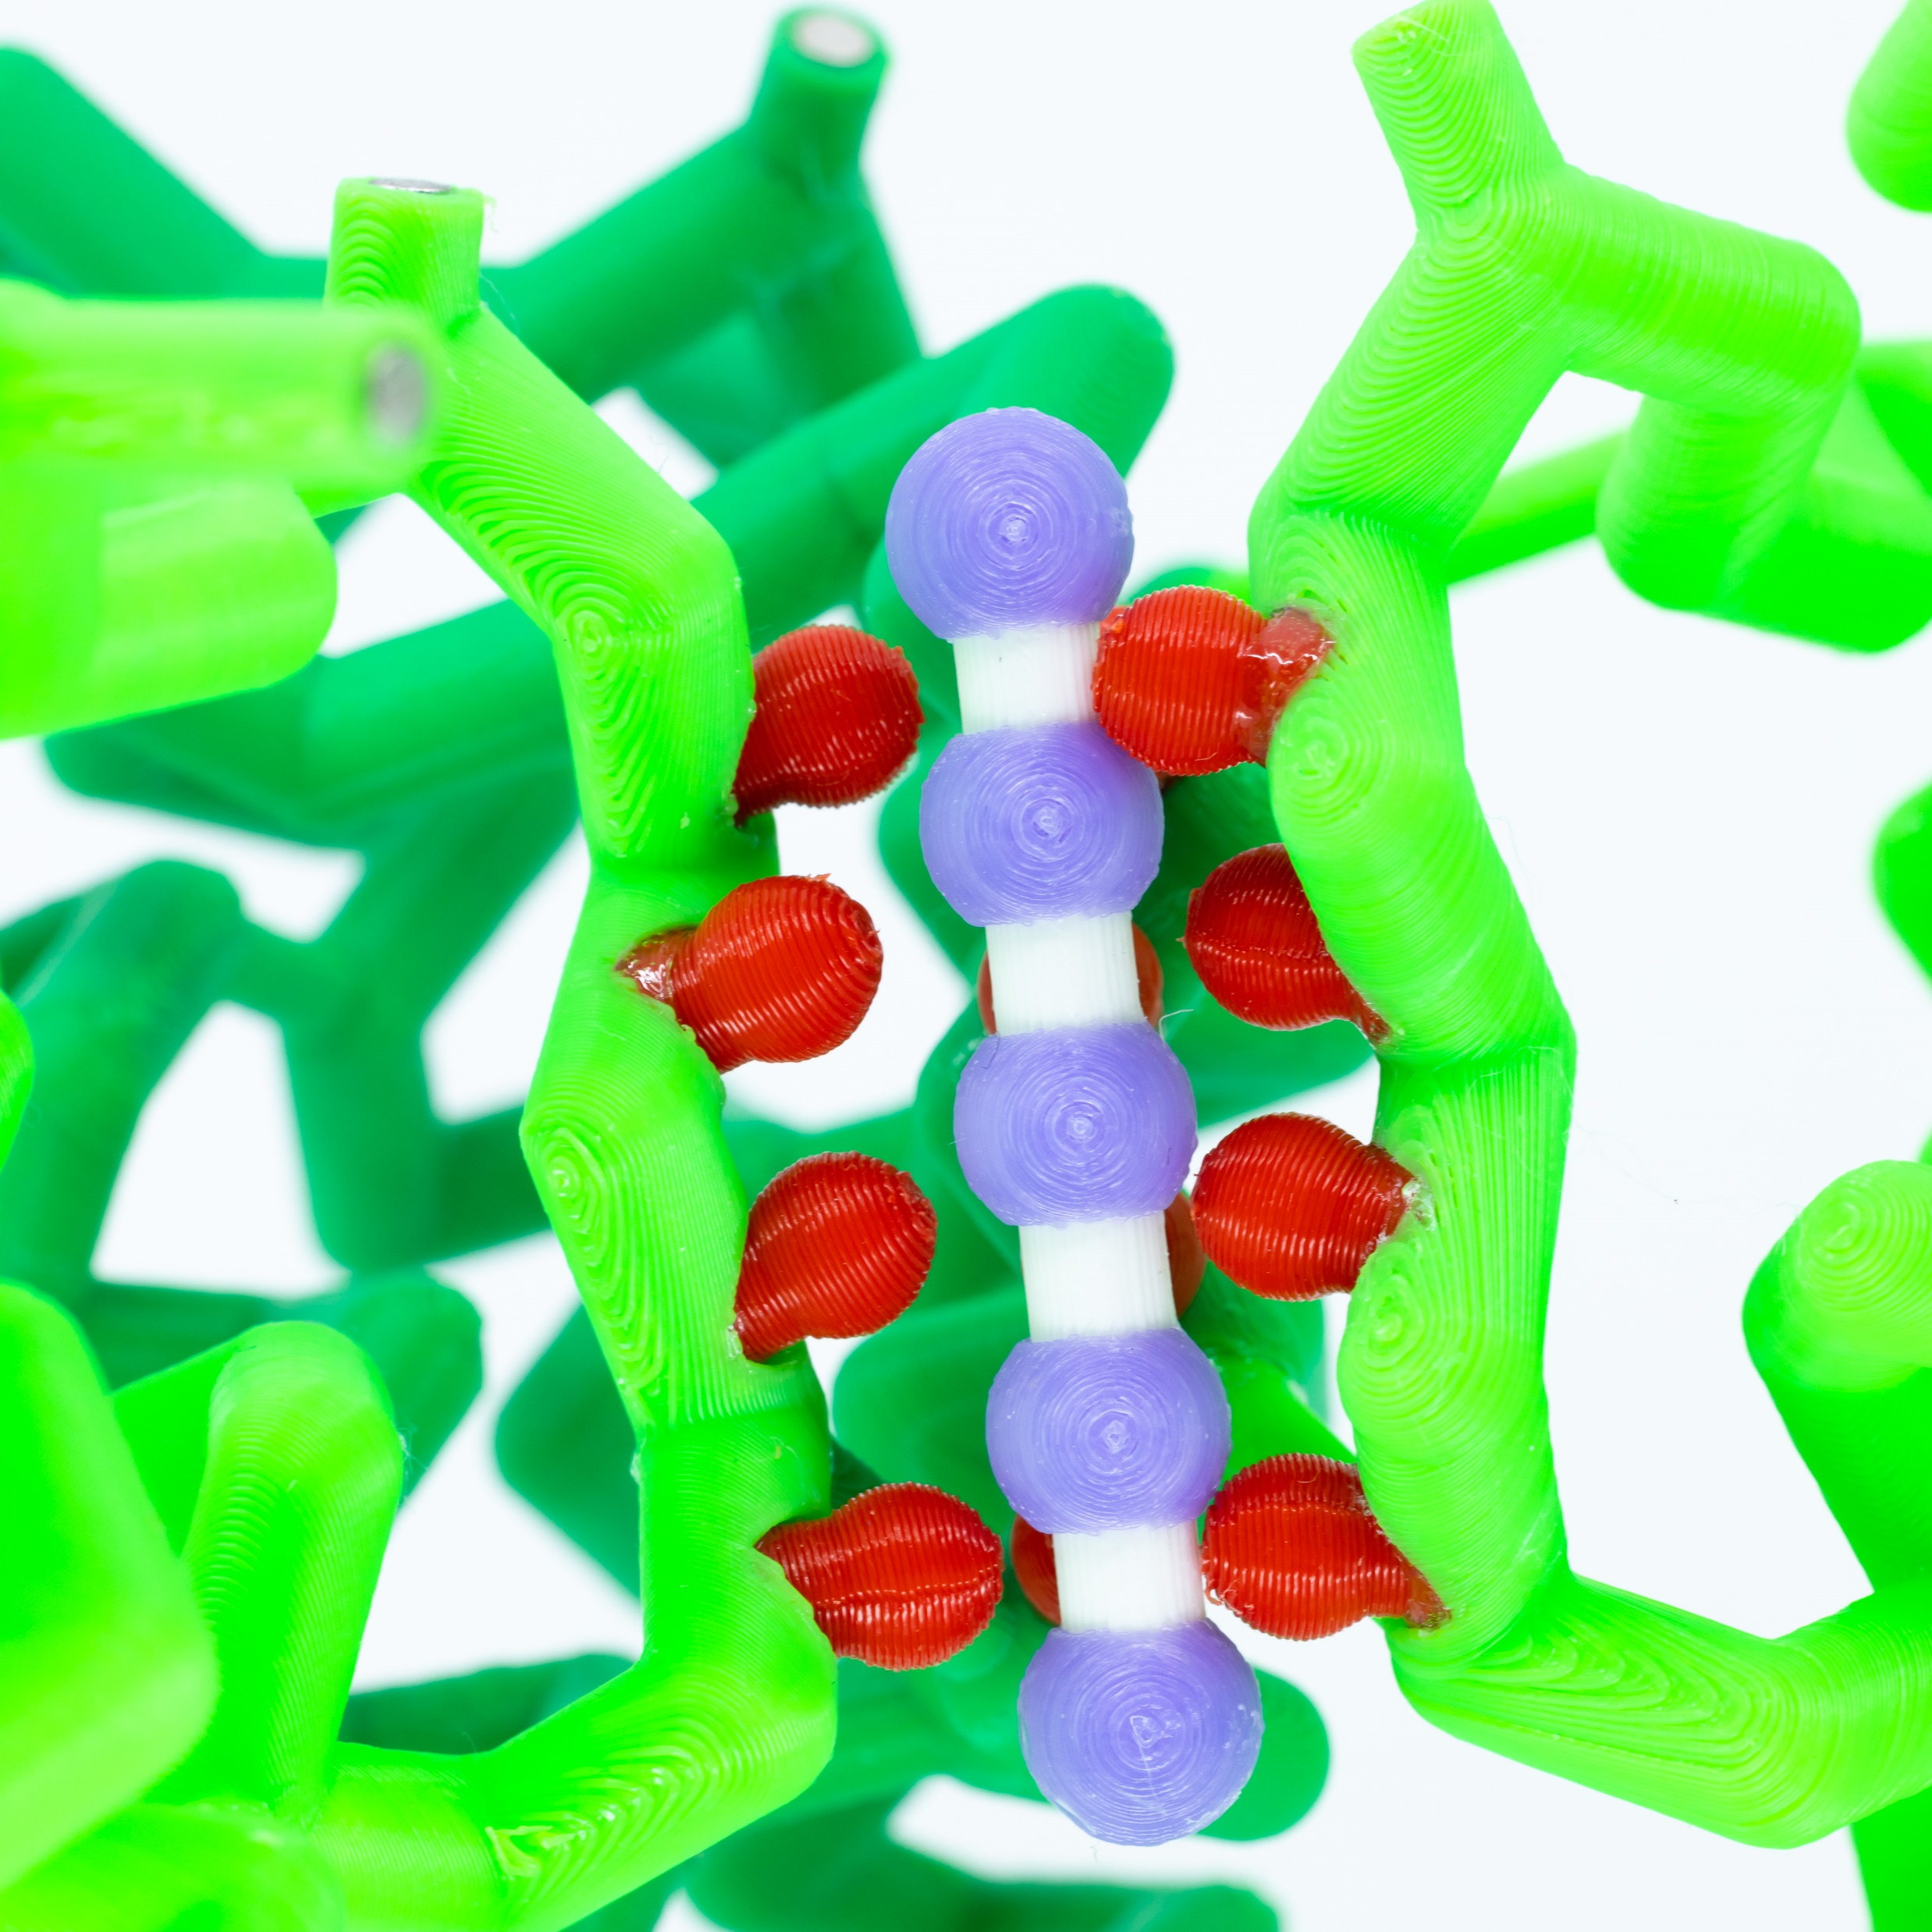
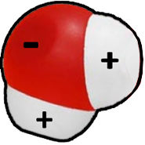
The carbonyl groups
Then polarity of the carbonyl
groups remove water from a
hydrated K+ ion near the
vestibule and facilitate its
movement through the pore
like an elevator.
Notes:
What the teacher is doing: Show students how the polarity of carbonyl groups interacts with the K+ ion. The hydrated K+ ion has water removed and the size of the pore is what prevents other cations from moving through this channel.
What the student is doing: Students should draw and take notes of the structure – function of the channel.

Slide 41
The carbonyl groups
Potassium is immediately
rehydrated once it transitions
through the membrane.
Notes:
What the teacher is doing: Show students how the polarity of carbonyl groups interacts with the K+ ion and moves it up through the pore. Upon exit, it is immediately rehydrated by water molecules outside of the cell.
What the student is doing: Students should draw and take notes of the structure – function of the channel.

Slide 42

Use the QR code to see this in action!
How is this different from the Na+ Channel?
What are the similarities?

Slide 43
Do all the channels work this way?
Yes and no -
There are many different types of Sodium channel, Potassium channel, and Aquaporins

Slide 44
Why is this important?
Drugs, Drug targets, and You… or your patients
It has been suggested that the effects of some antidepressants may be mediated in part via sodium channel blockade.
Research has shown that CBD changes the fluidity of cell membranes and inhibits the activation of Na+ channels
Linopirdine is a cognition-enhancing drug targeting K+ channels that can compensate for the age-related decline in acetylcholine release

Slide 45

Scan this QR code and fill out the survey!
… or head over to https://bit.ly/3YFppC3

Slide 46
NGSS!
Next Generation Science Standards
Science and Engineering Practices | Cross Cutting Concepts | Disciplinary Core Ideas
Scientific Investigations Use a Variety of Methods | Stability and Change | HS-LS1-3
Developing and Using Models | Systems and System Models | HS-LS1-2
Constructing Explanations and Designing

