Slide 1
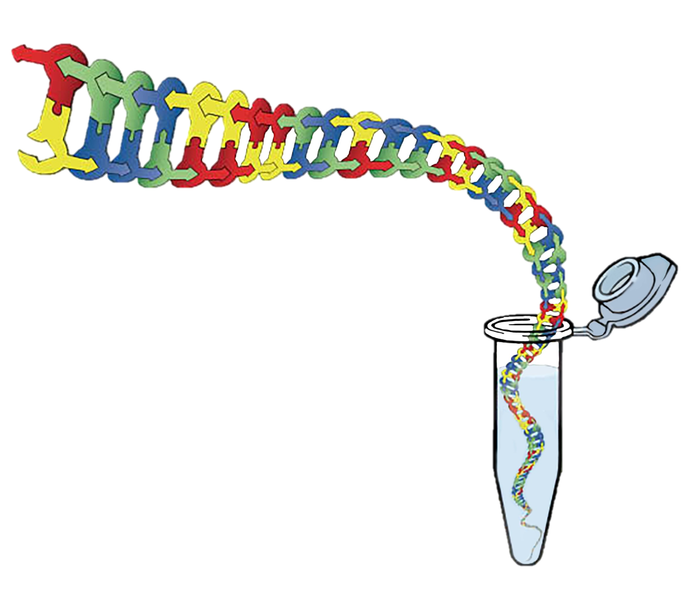
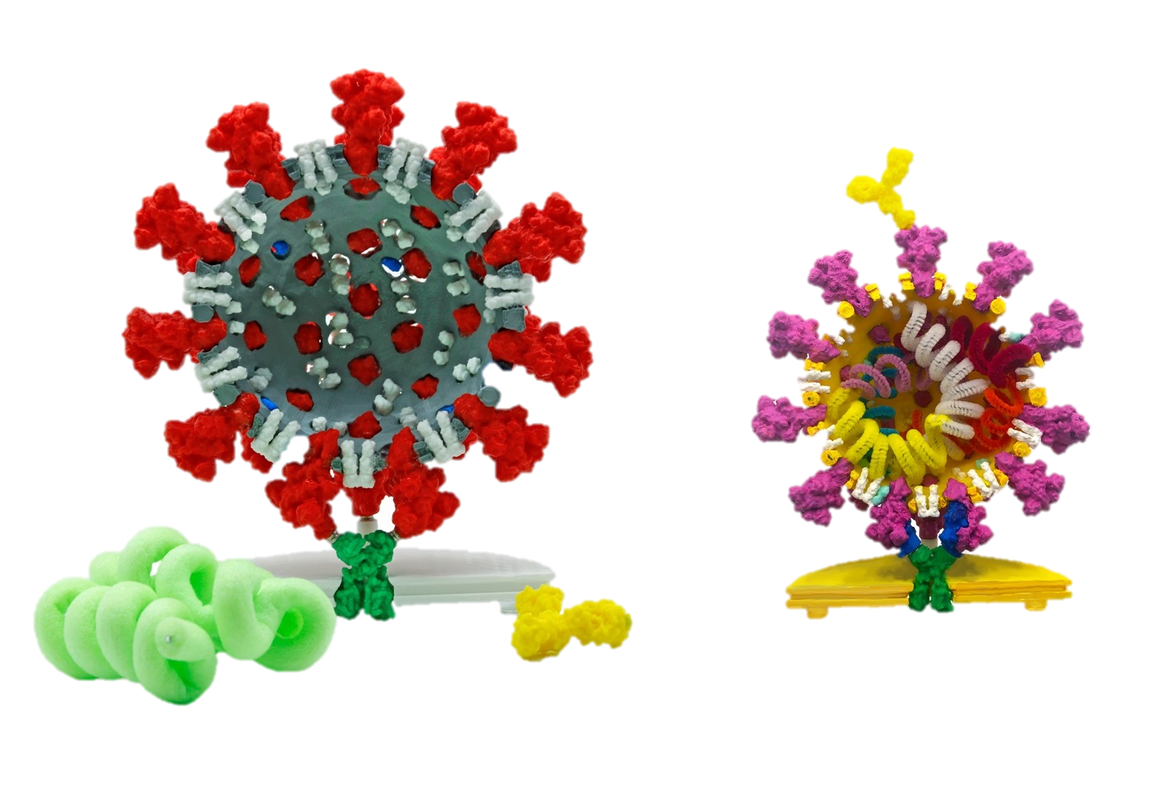
Biotechnology & Coronavirus
The One Kit Wonder: Using Modeling to Teach Biotechnology Concepts
From Biotechnology to a Coronavirus Vaccine

Slide 2


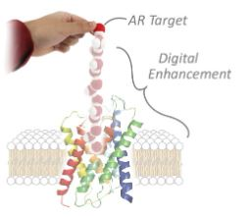
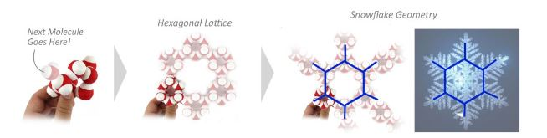
Augmented Reality

Slide 3

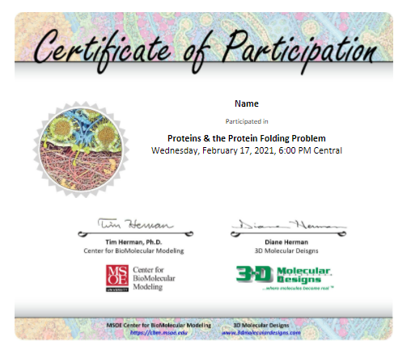


Slide 4
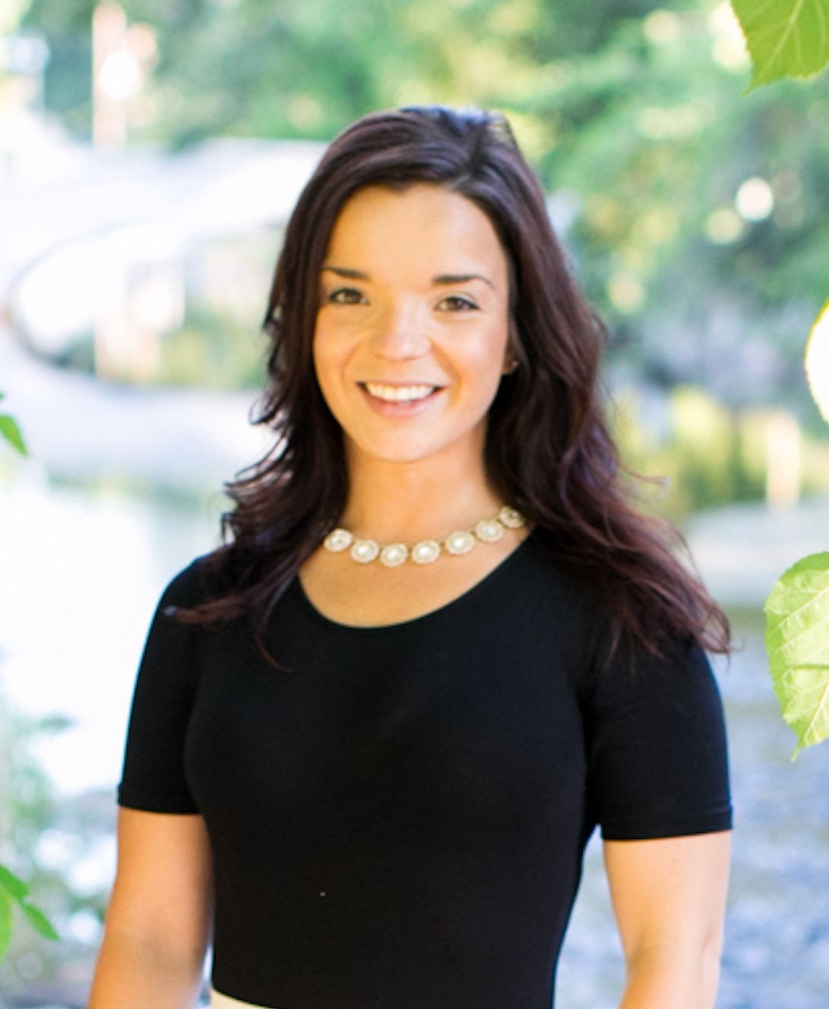
Diane Sigalas
Livingston High School, Biotechnology I & II
Montclair State University in Montclair, New Jersey
Master’s degree in Educational Leadership at The College of New Jersey.

Slide 5
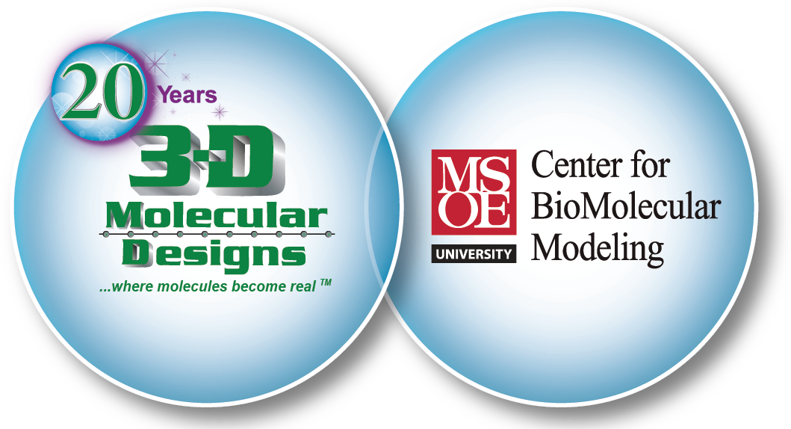

The One Kit Wonder
Using models to teach biotechnology concepts

Slide 6

In order to model later... -
Building dsDNA
Assemble the following section of dsDNA using the colored nucleotides

Slide 7
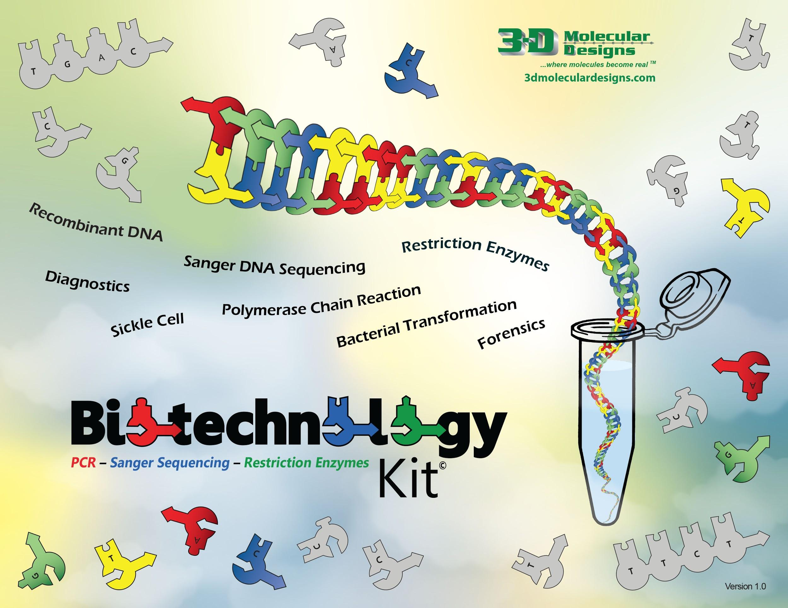
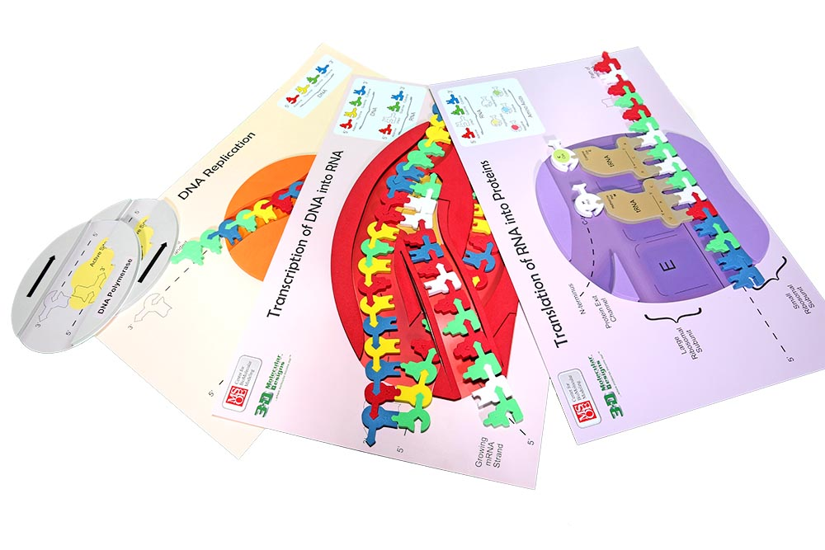
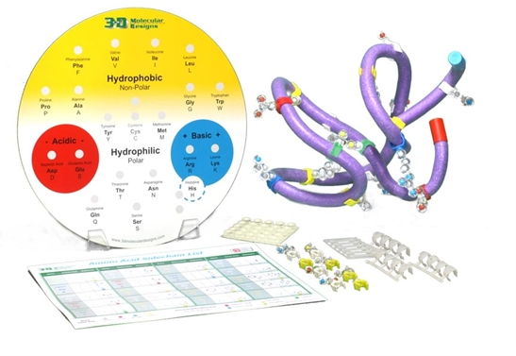
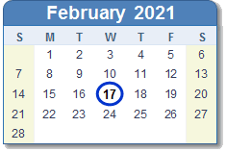
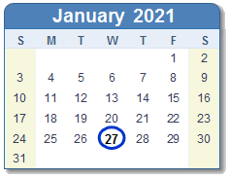
The Big Two
Three
Amino Acid Starter Kit
Flow of Genetic
Information Kit

Slide 8
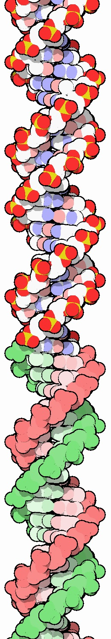
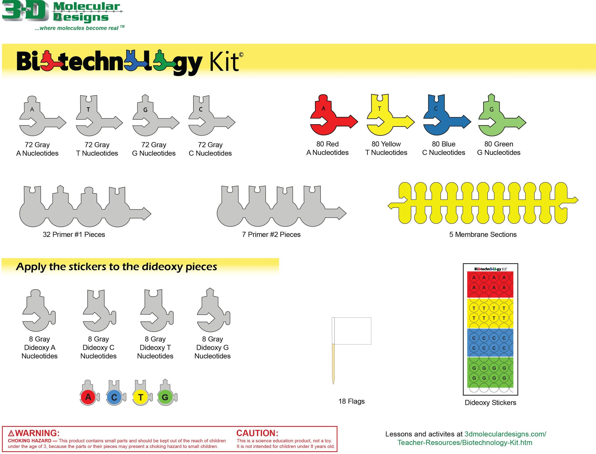
Biotechnology Kit
Contents:
Grey & Colored Nucleotides
Dideoxynucleotides
Primer sequences
Cell Membrane Pieces
Concepts You Can Address:
PCR / Gel Electrophoresis
Sanger Sequencing
Restriction Enzymes
Bacterial Transformation
Semi-Conservative Replication

Slide 9
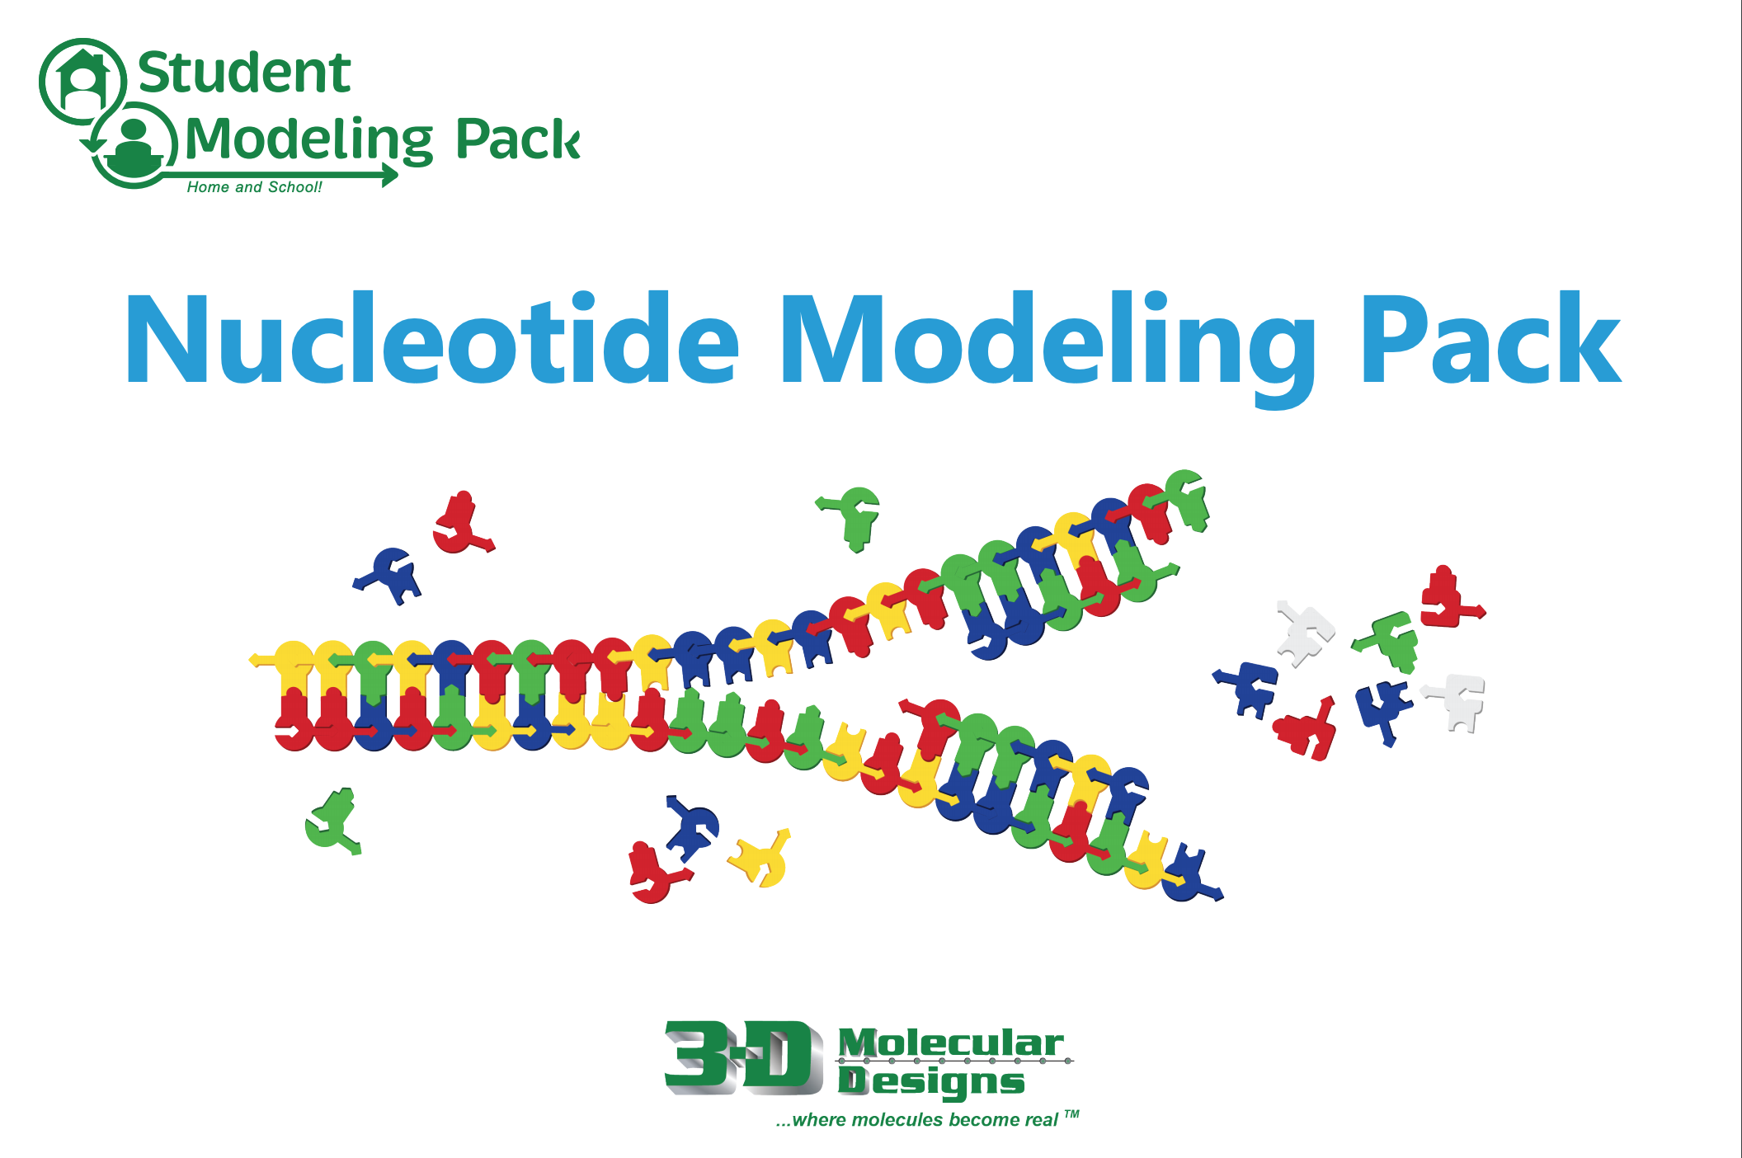
What we are using today
Nucleotide Student Modeling Pack
NSMP
Biotechnology Kit
BTK-01

Slide 10
Workshop Learning Goals
Leave with ideas how this kit will already fit into your curriculum and increase student learning/mastery of topics.
Practice one application of this kit (PCR).
Get excited about the benefits of modeling.

Slide 11

NGSS Connections
SEPs | CCCs | DCIs
Asking Questions and Defining Problems | Patterns | LS3: Heredity: Inheritance and Variation of Traits - LS3.A / LS3.B
Developing and Using Models | Cause and Effect: Mechanism and Explanation | LS1: From Molecules to Organisms: Structures and Processes - LS1.A
 | Structure and Function
 | System and System Models
 | Scale, Proportion, and Quantity
These are also included in the slides next to the content.

Slide 12
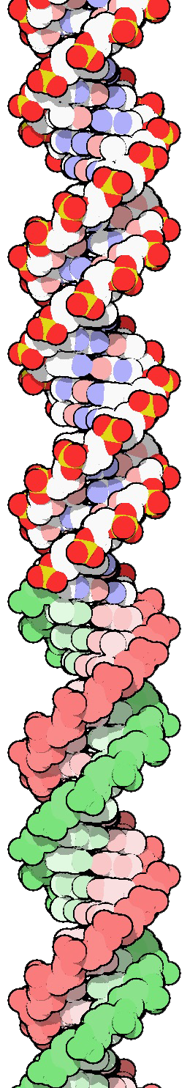
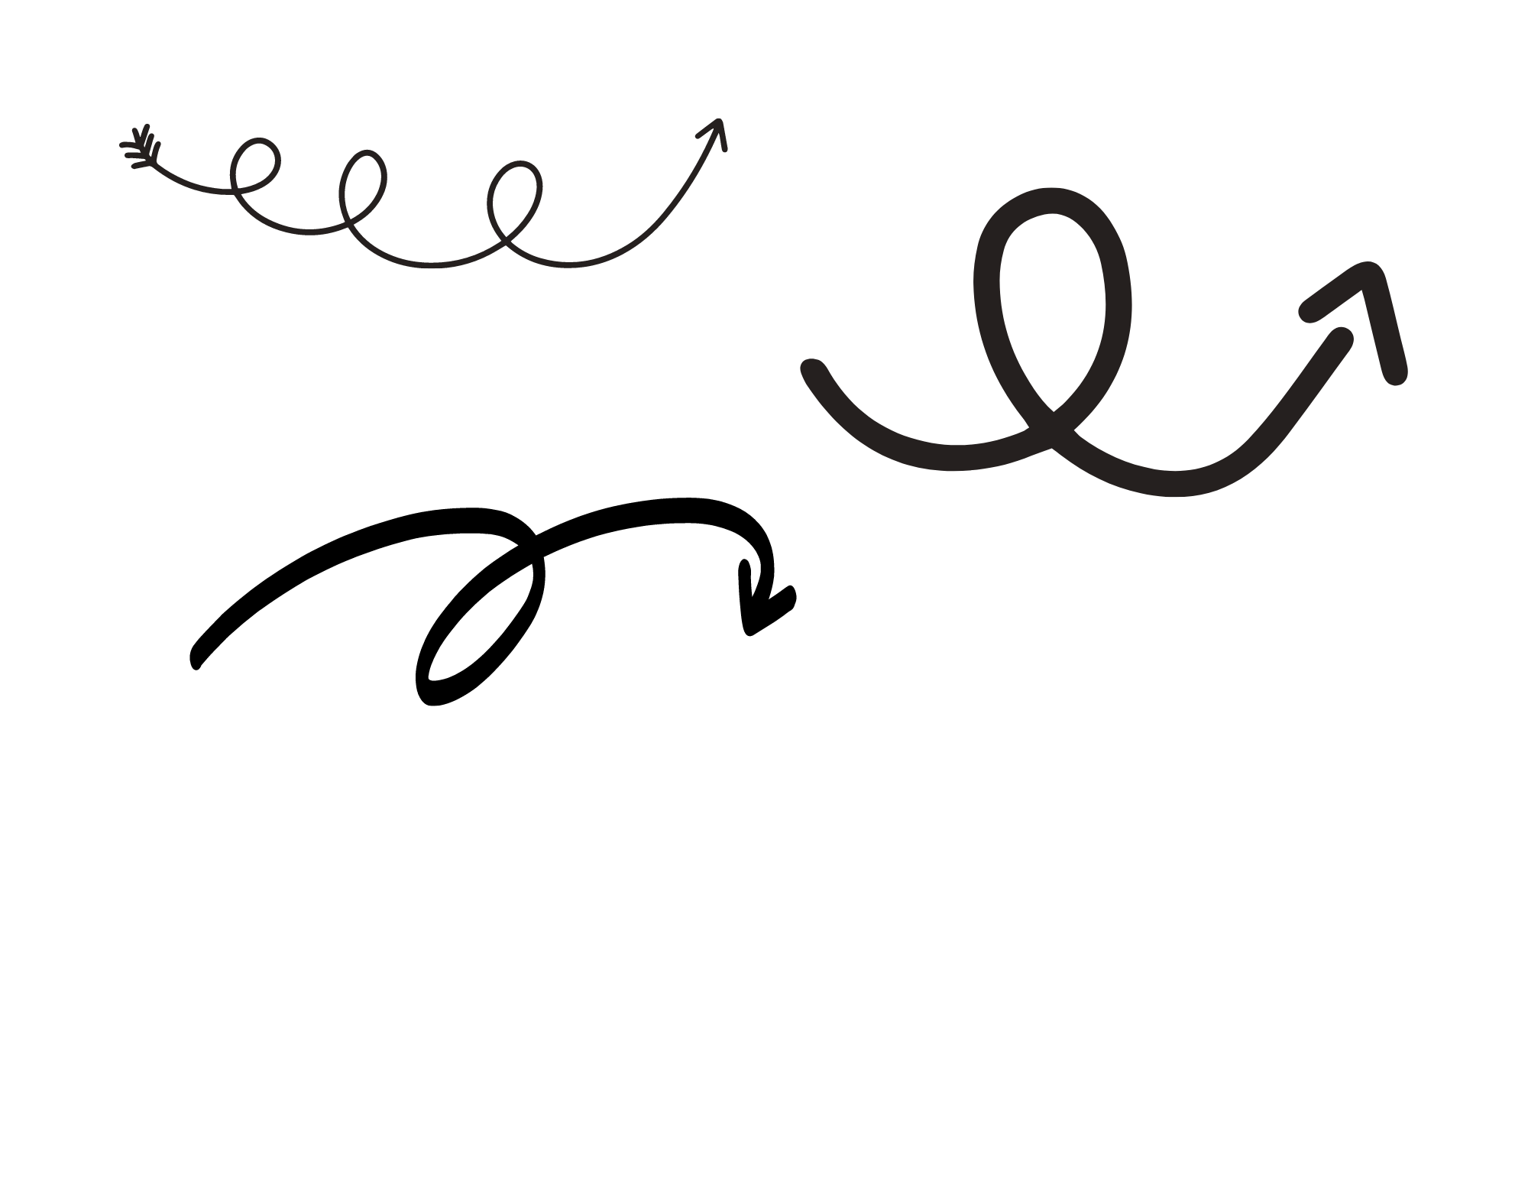
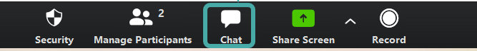
Let’s get that chat going!
How do you currently teach PCR in your classroom?

Slide 13
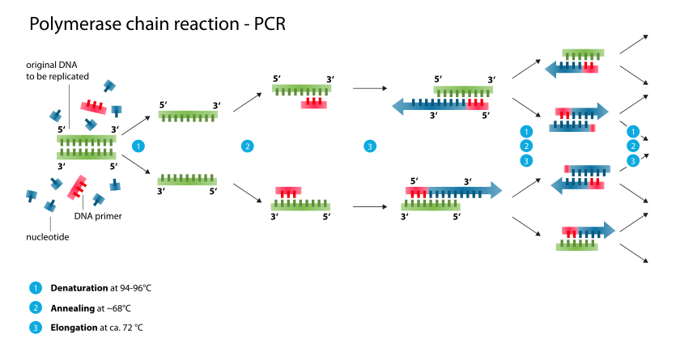

How well do the
kids do with this topic? How do you know they “get it”?

Slide 14
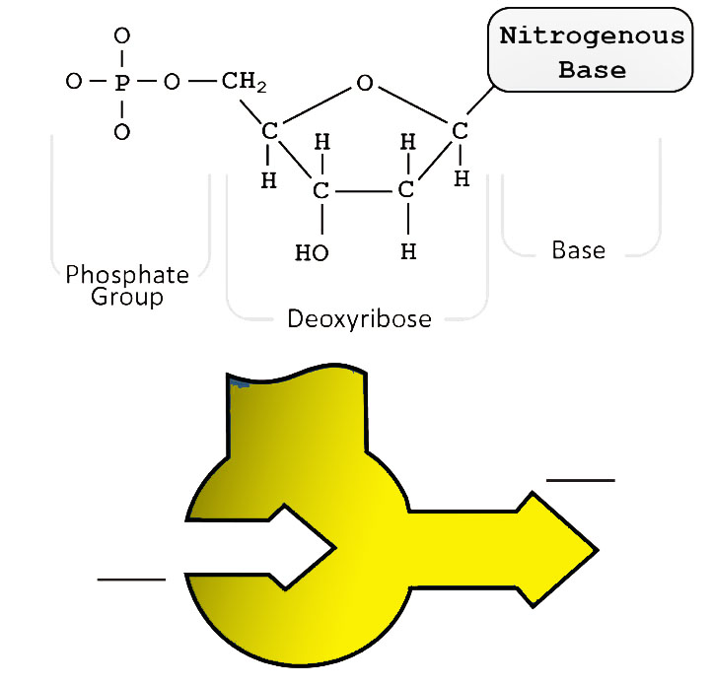



A few things to go over first
5’
4’
1’
3’
2’
At this point - depending on what kits you have, the students should be familiar with this.
3’
5’

Slide 15

Time to model it! - Building dsDNA
Assemble the following section of dsDNA using the colored nucleotides
3’ - TGAGGCTATGAACG - 5’
5’ - ACTCCGATACTTGC - 3’
Option: Save time by pre-assembling

Slide 16
Time to model it! - Building primers
Tonight we are going to model two cycles of PCR
Make two separate piles for Primer 1 and Primer 2. To work with the Student Modeling Pack you received we are going to use RNA nucleotides to represent the primers.
  Primer 1: AAGU
  Primer 2: UCCG
Separate your DNA nucleotides, but keep them off to the side
You will need three of each.
Differentiation possibilities here

Slide 17
Using the dsDNA and “primers” you just made - we are going to explore how the students can model PCR using the Nucleotide Student Modeling Packs from 3DMD!

Slide 18



Model Time - Basic PCR
Denature the double stranded DNA (dsDNA).
Anneal the primers.
Extend the sequence by adding free nucleotides (dNTPs) to the 3’ end of Primer 1 and Primer 2.

Slide 19
Suggestion: Set up groups of four so that each student has a role of a nucleotide. Try to discourage just filling in “their color”

Slide 20
Let’s get that chat going again!
Thinking about how you just modeled PCR, what questions do you think your students would ask after exploring PCR like this?

Slide 21
What else can you do?
What other PCR related concepts can you explore with this kit?

Slide 22
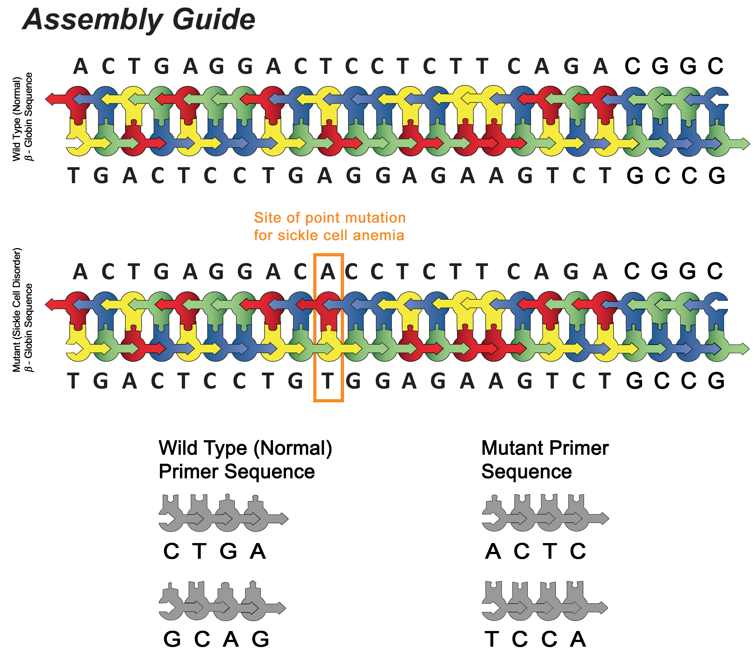
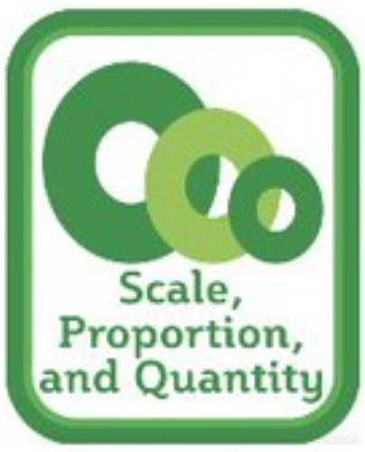

Taking it further :
Modeling PCR as a Medical Tool
Primer Set 1
Primer Set 2
LOTS of set up. But I have options and student suggestions from my own kiddos for you!

Slide 23
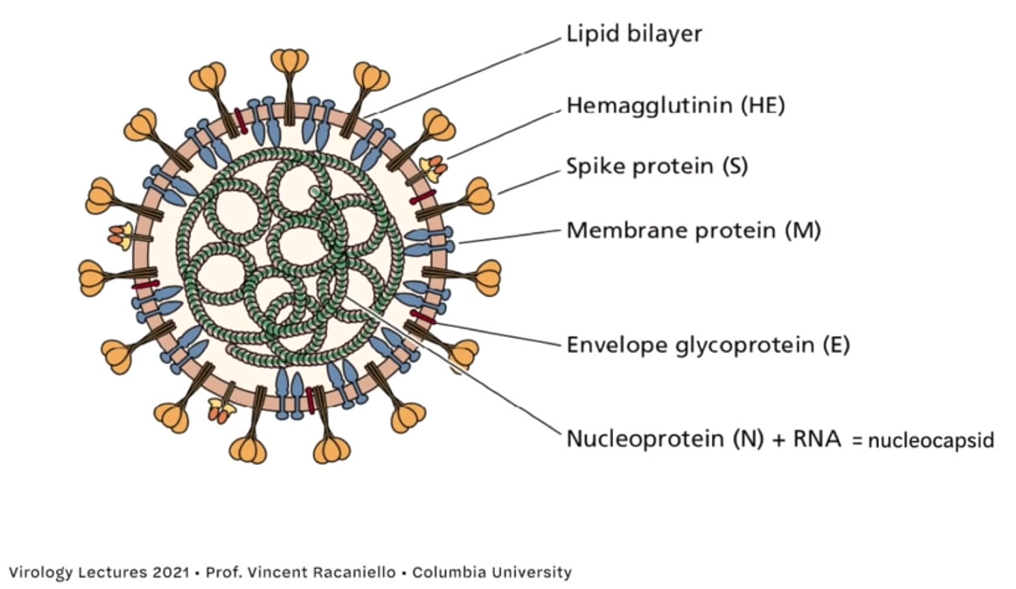
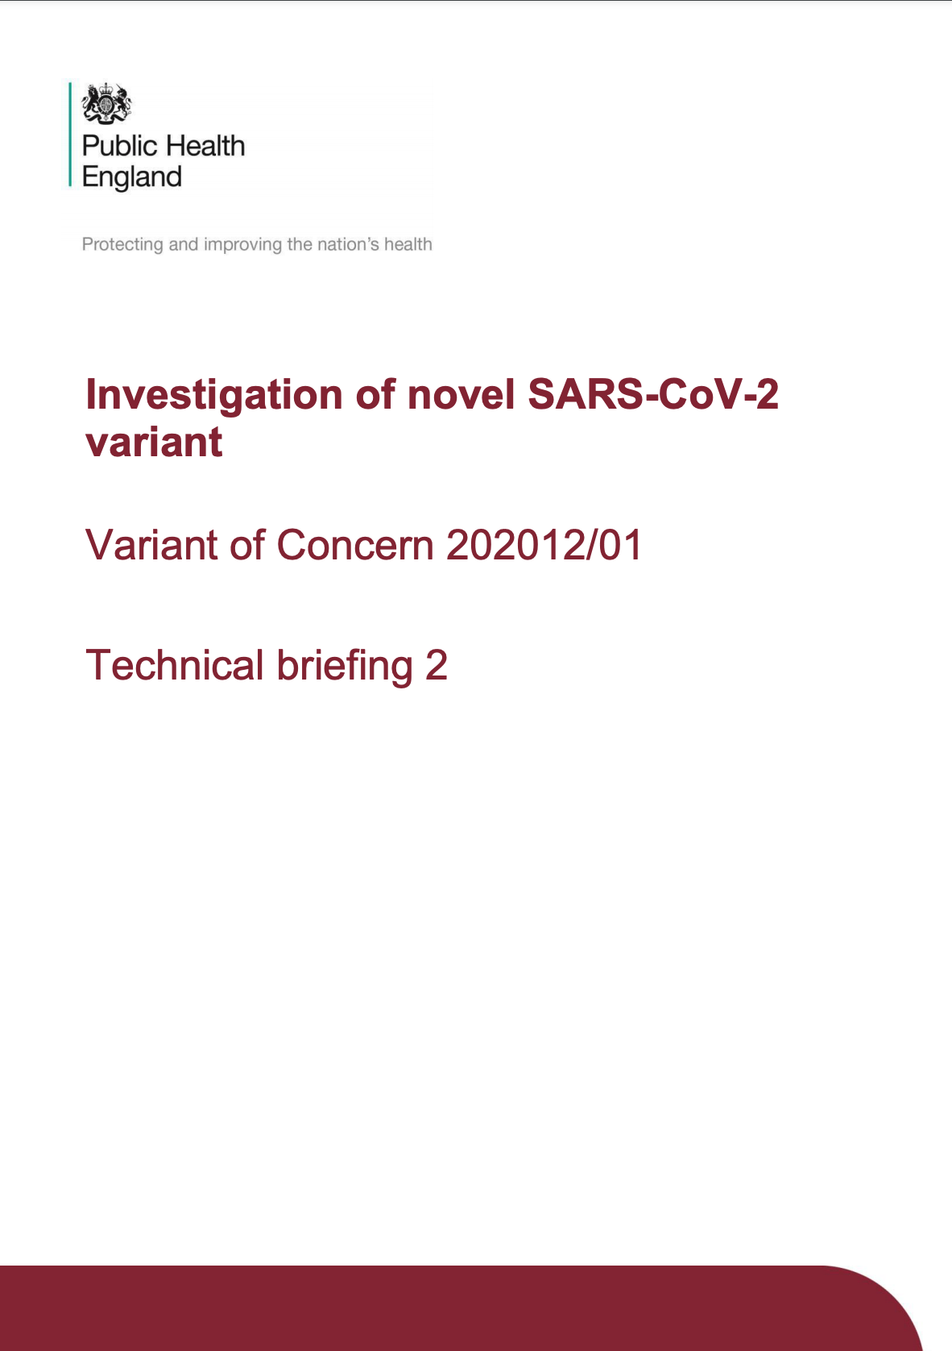
Taking it further :
Connections to SARS-CoV-2
Designing PCR Tests: Challenge your students. Can they figure out how the PCR tests are designed and how they work?
What is an S-Dropout?: Ultimate challenge - Where did this language come from?
Yes, you can do this! Yes they can do this!

Slide 24
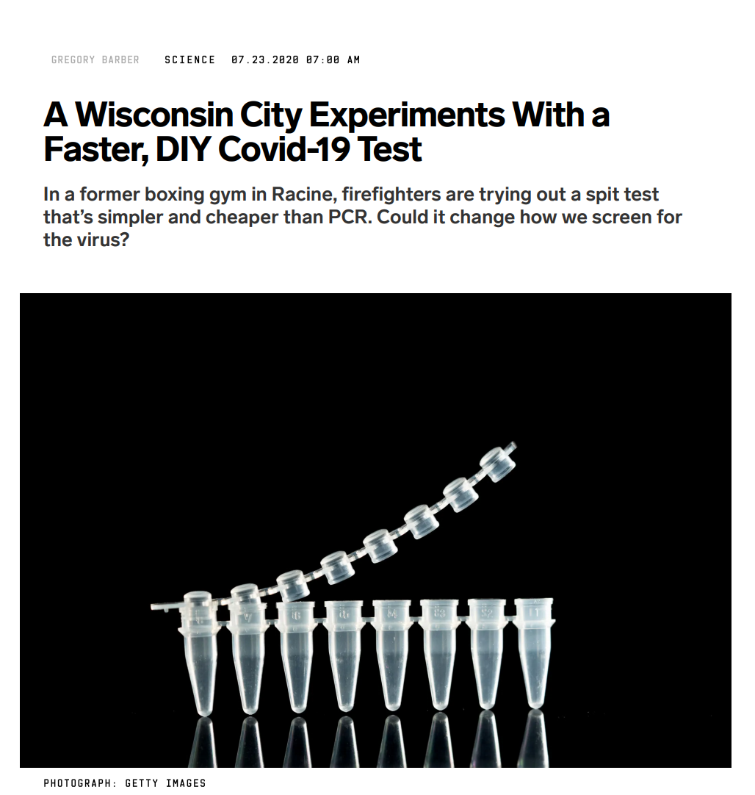

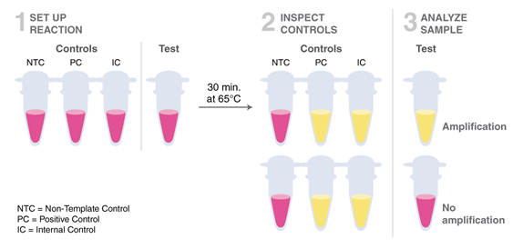
Taking it further :
Extensions to new technology
If thermocyclers are expensive...: What could be changed to make there less of a need to have drastically changing temperatures in a traditional PCR protocol?

Slide 25
The Buffet of Options:
Middle School | High School CP | High School Honors | High School Fo.Sci. | AP Bio | Collegiate Level
Teacher Demo How SARS-CoV-2 tests work | Basic PCR modeling (student ) How SARS-CoV-2 tests work | Basic PCR modeling PCR as a Medical Tool (designing primers) How SARS-CoV-2 tests work | Basic PCR modeling Extension to PCR as a Forensic Science Ecological Tool | Basic PCR modeling PCR as a Medical Tool (designing primers) How SARS-CoV-2 tests work S Dropout Investigation | Basic PCR modeling Designing a SARS-CoV-2 PCR test S Dropout Investigation LAMP PCR

Slide 26
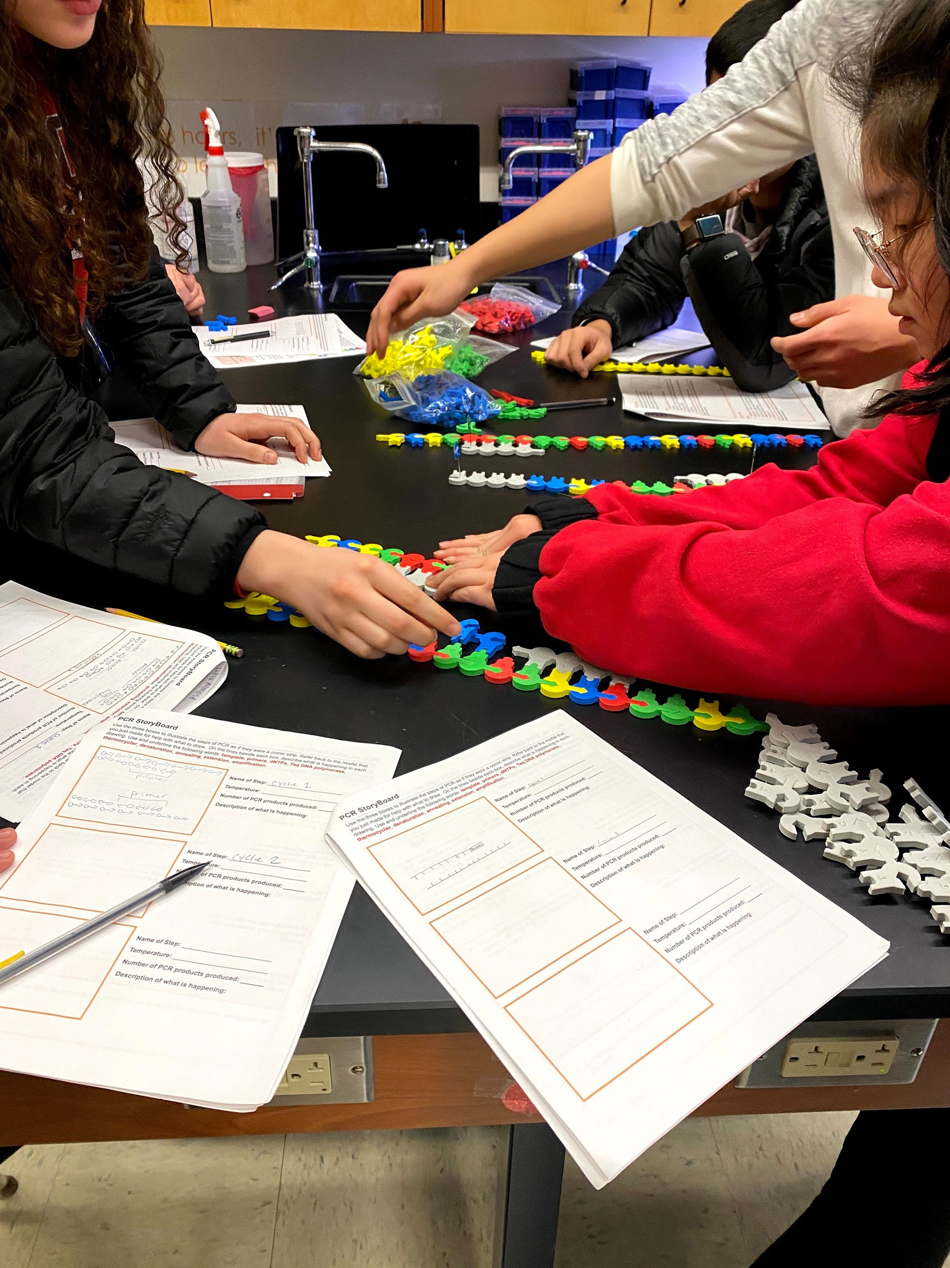

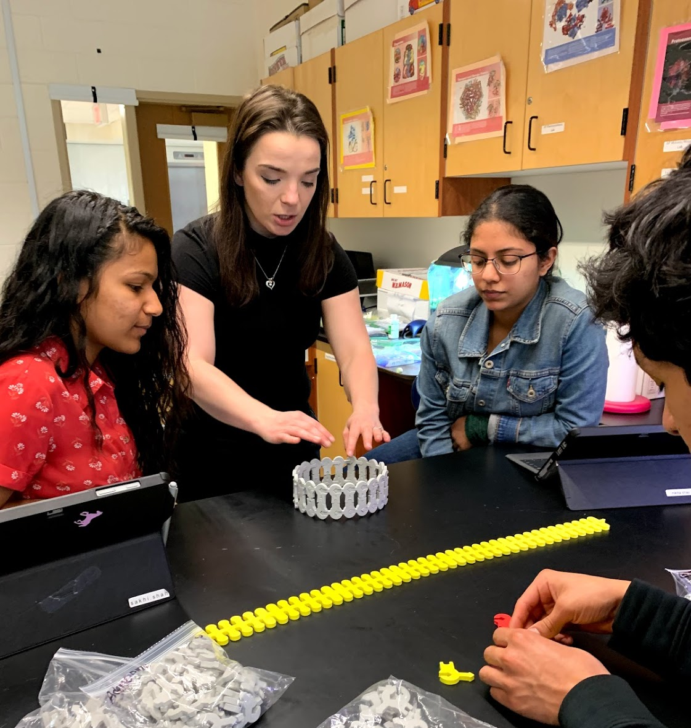
What else is there?
Things you can model
PCR
  Medical and Forensic Science Applications
Sanger Sequencing
Restriction Enzymes
Bacterial Transformation
Semi-Conservative Replication

Slide 27

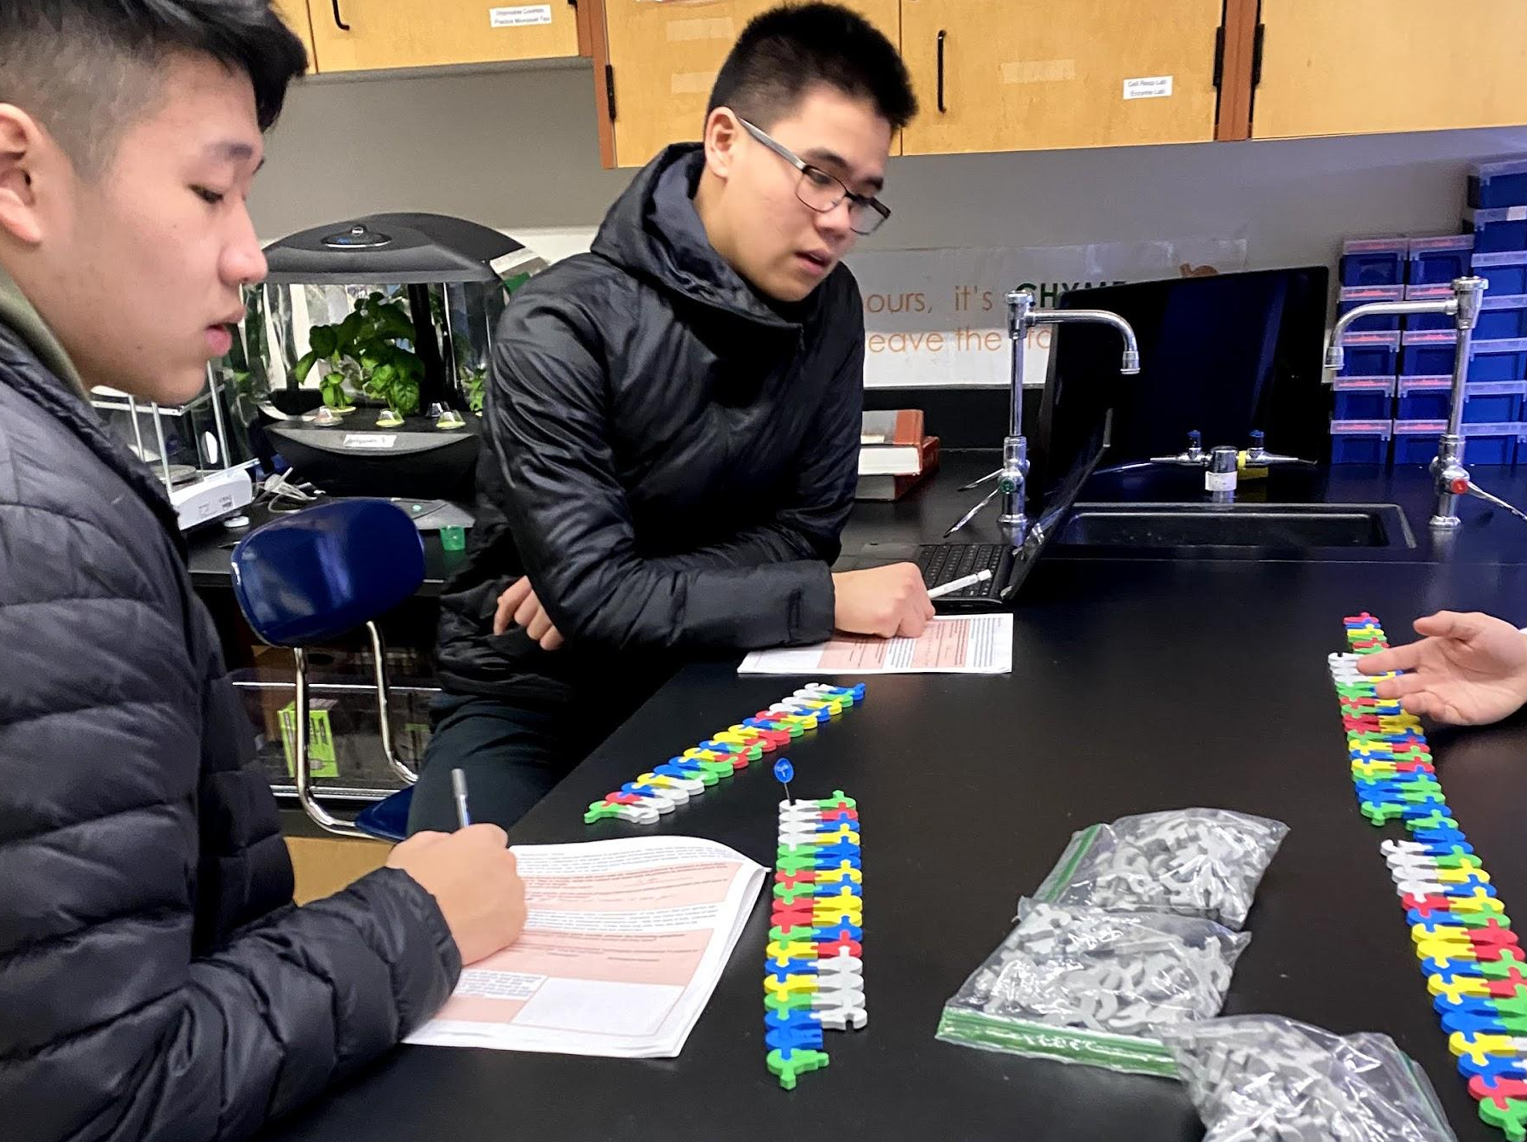
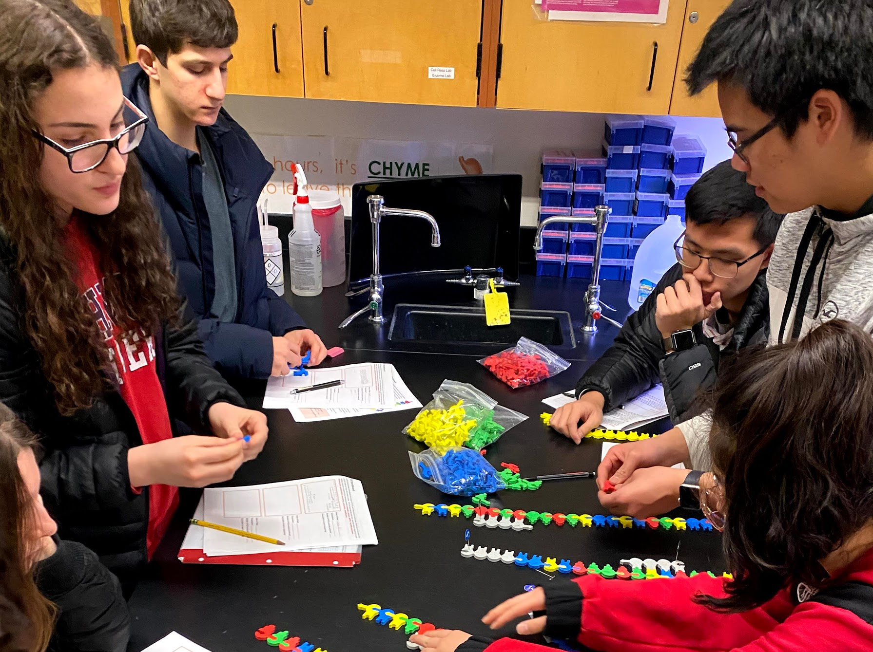
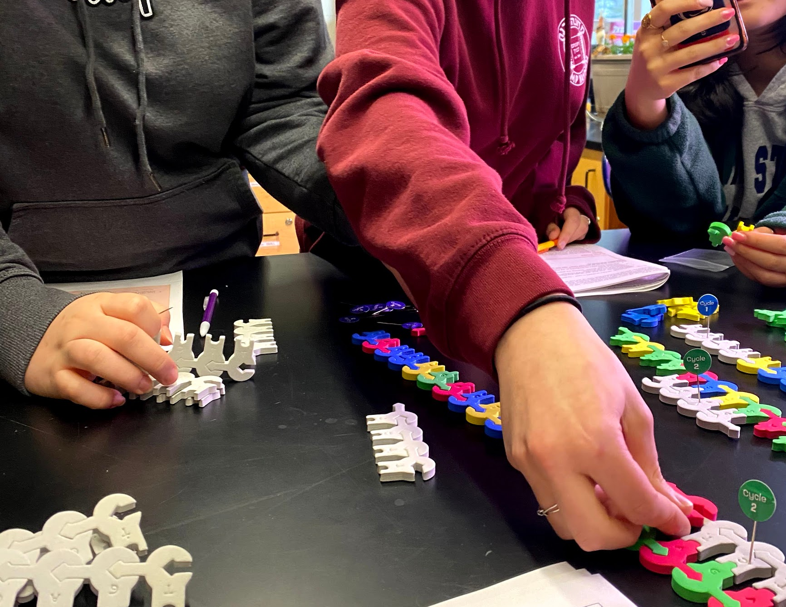
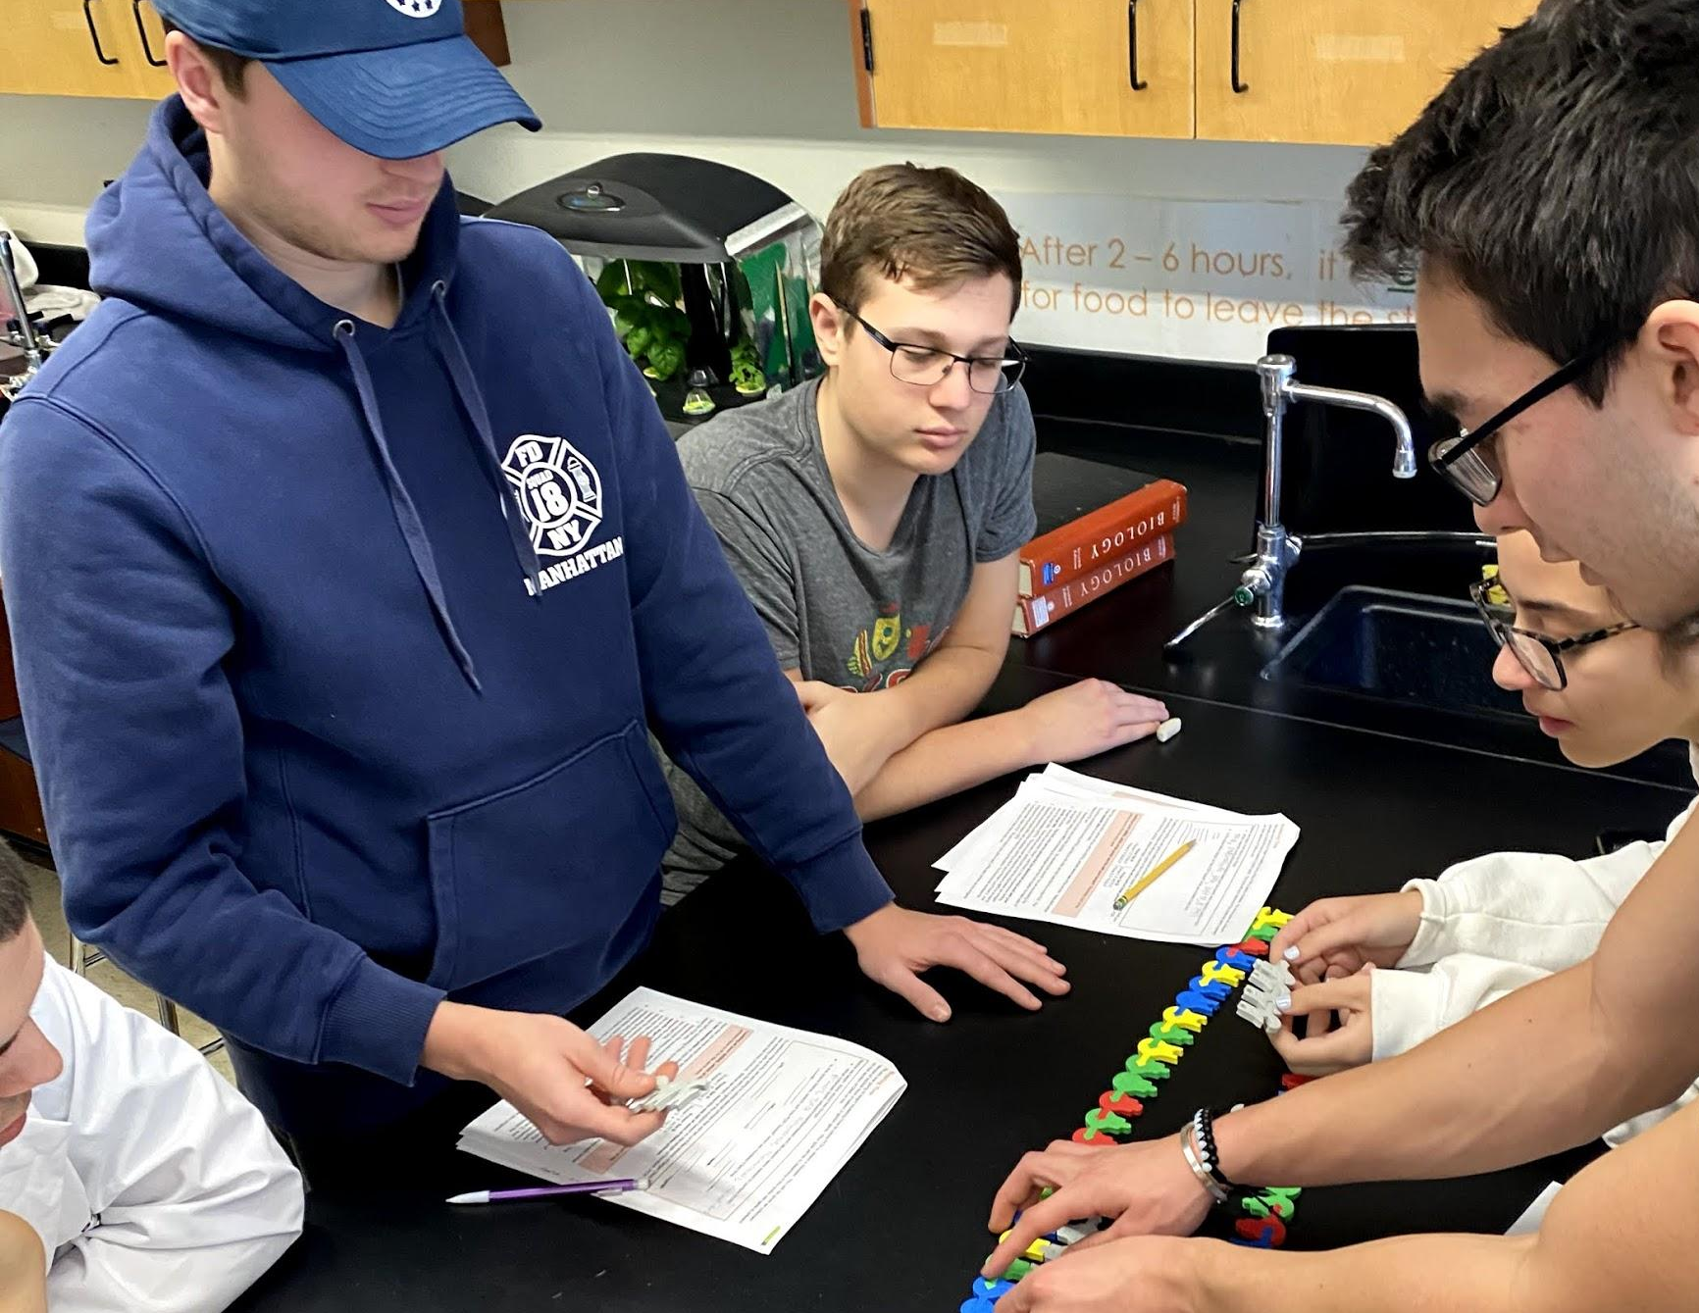
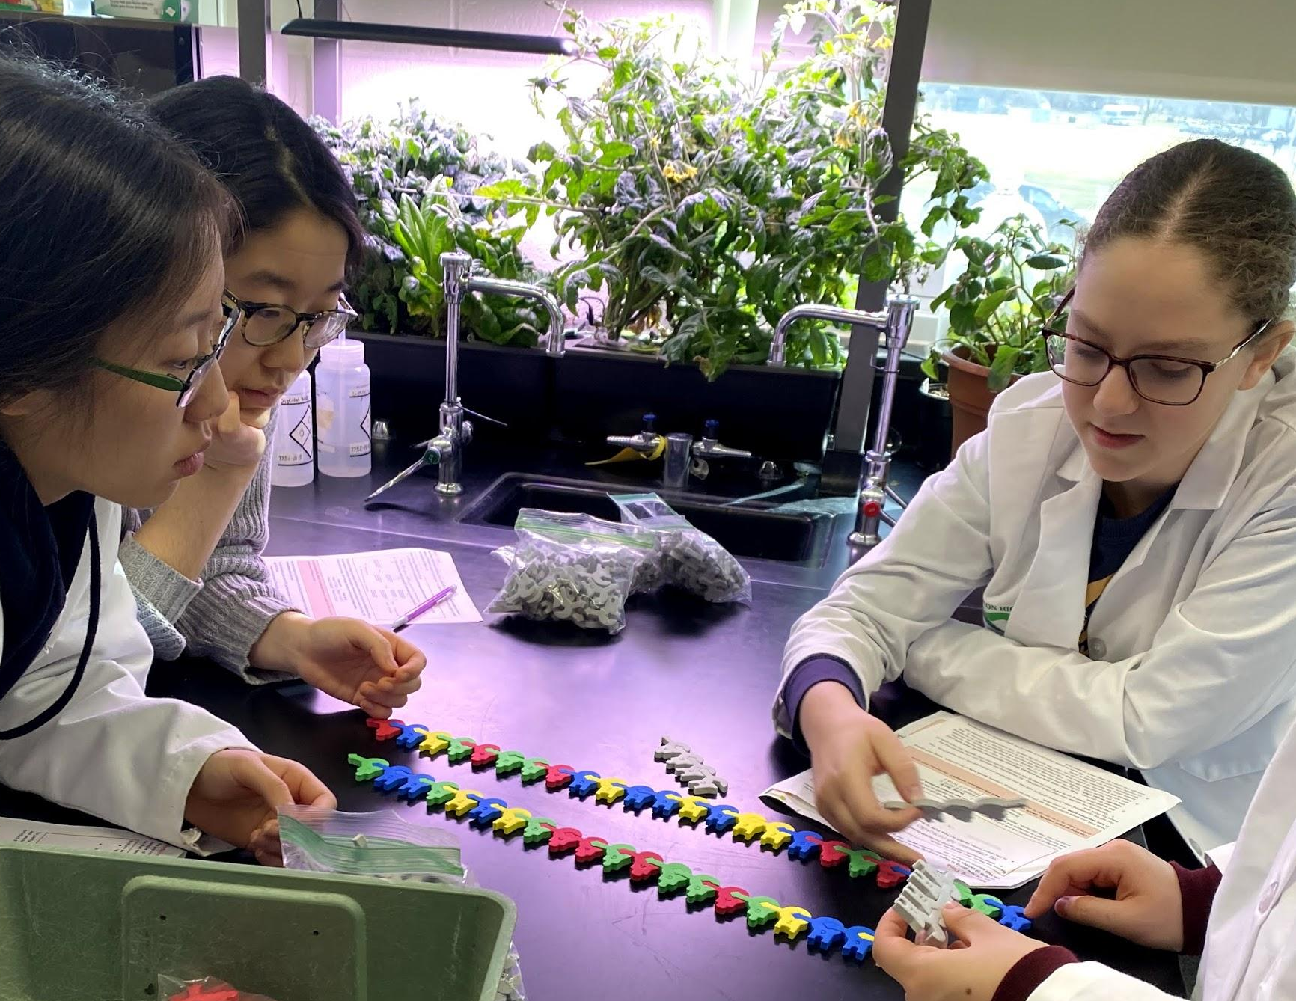
What did my kiddos think?
Increased understanding.
Lasting access to the information.
Connections to current research.
Increasing scientific literacy.
Drumroll please:
My favorite comment was….

Slide 28
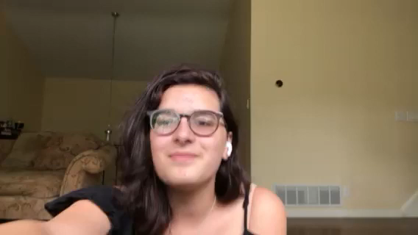
What did my kiddos think?

Slide 29
Kits Used/Referenced Today
Biotechnology Kit
BTK-01
Nucleotide Student Modeling Pack
NSMP
A big one for you! An at-home kit for your kids!

Slide 30
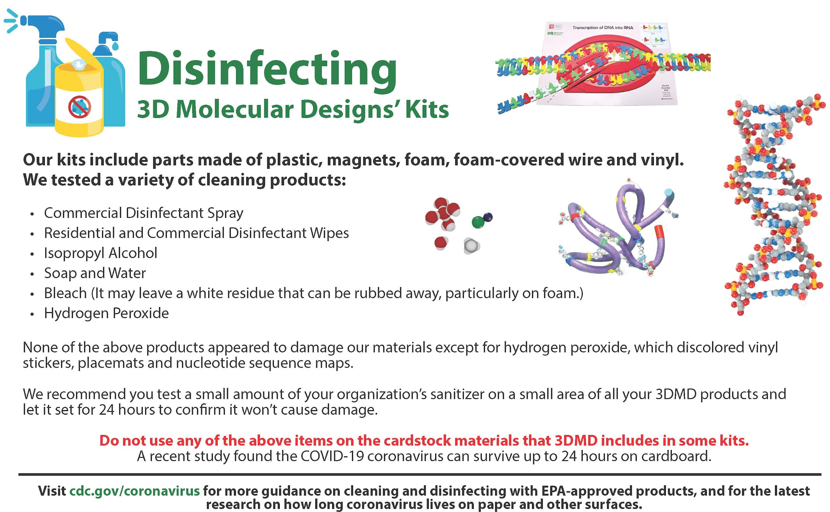

Slide 31
Wrapping Things Up
Thank you for attending!
Question!
Question!

Slide 32

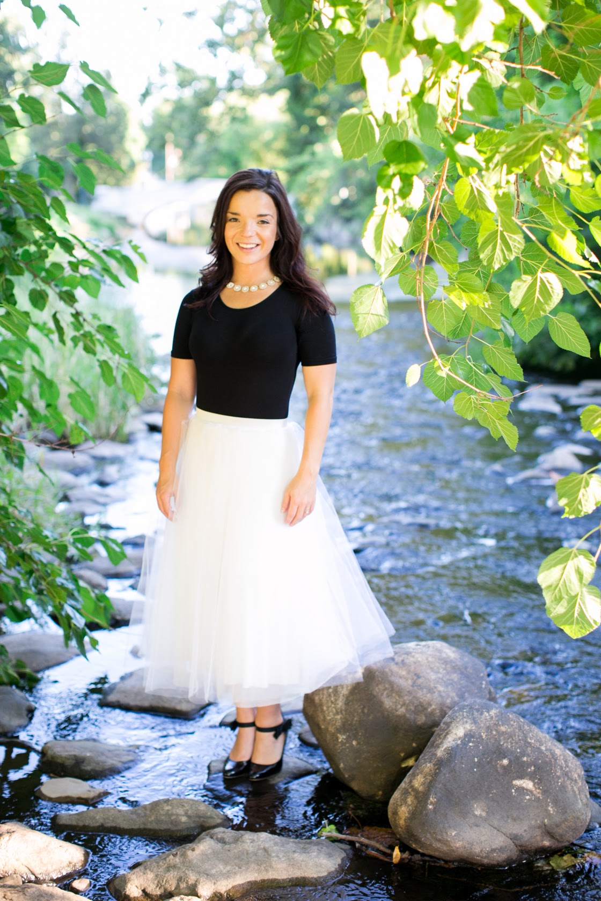






Thank You
Diane Sigalas
dsigalas@livingston.org
https://www.linkedin.com/in/diane-sigalas/
@LancerBiotech

Slide 33
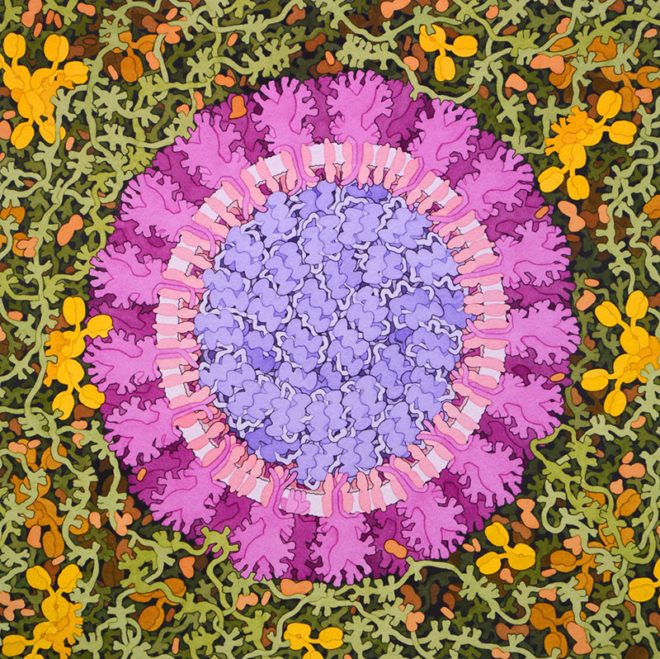
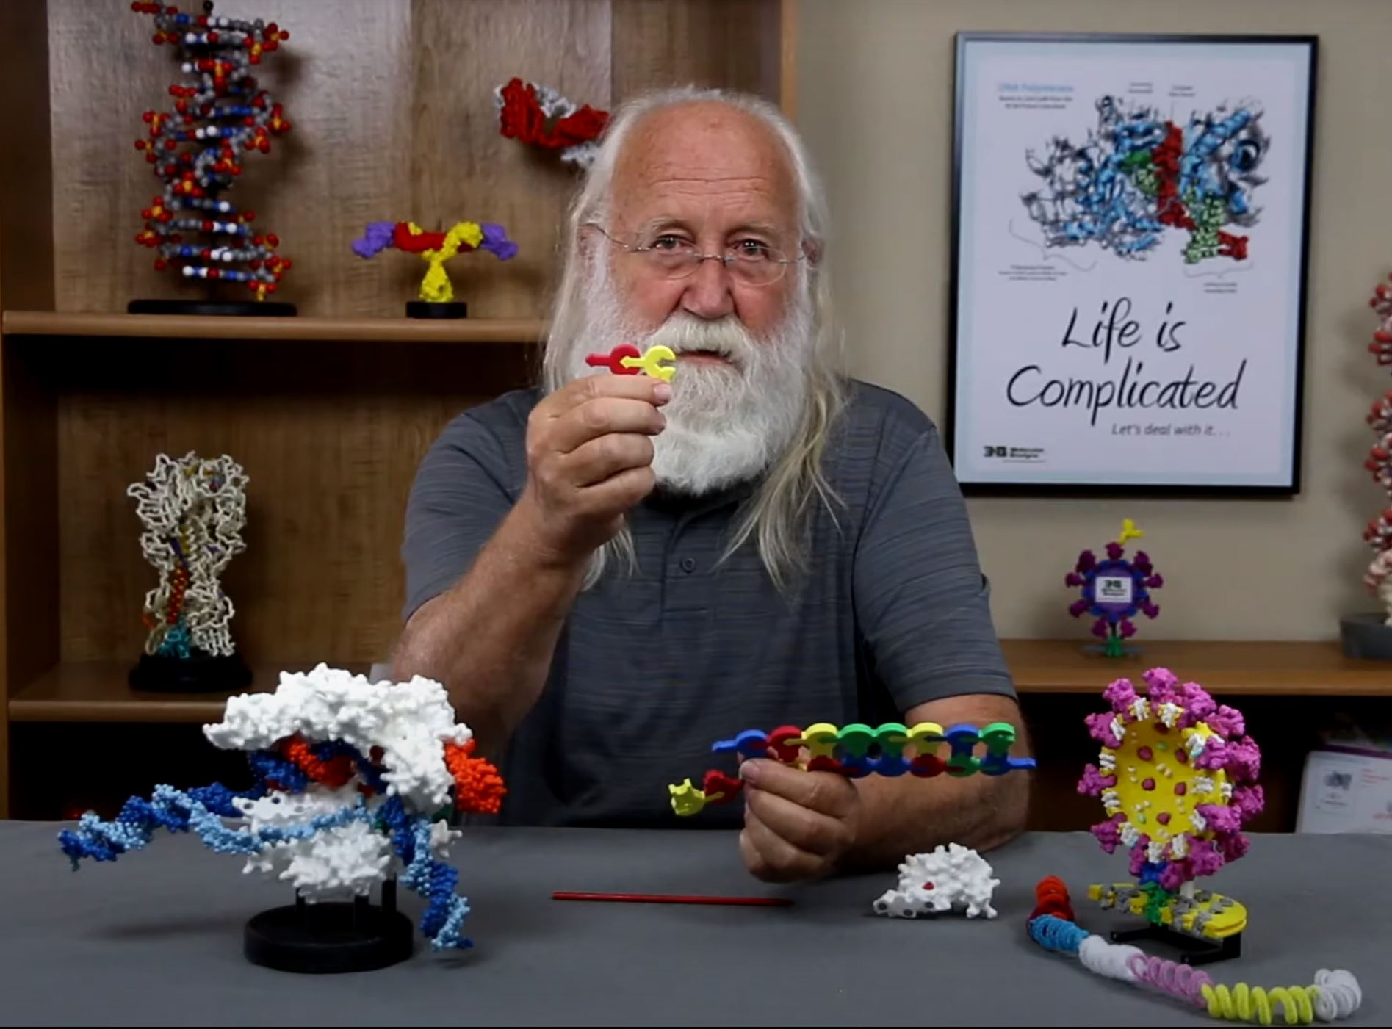
From Biotechnology to a Coronavirus Vaccine

Slide 34
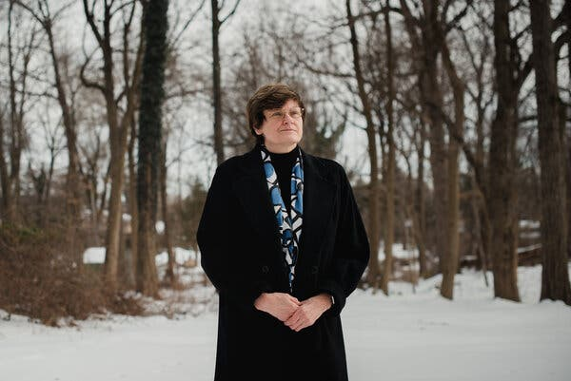
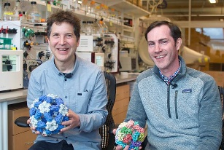
New Approaches to Vaccine Developments:
a preview….
1. Katalin Kariko and mRNA vaccines.
2. David Baker and ultra-potent,
multivalent nanoparticle flu vaccines.

Slide 35
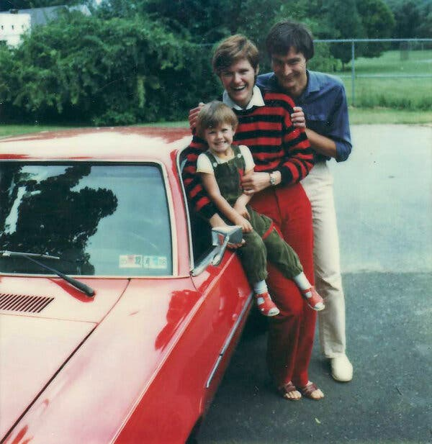
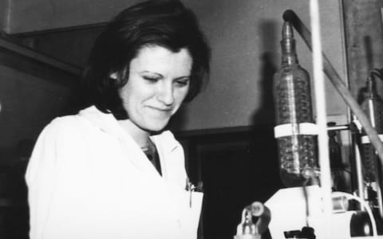
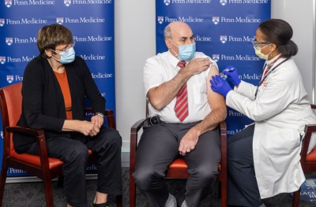
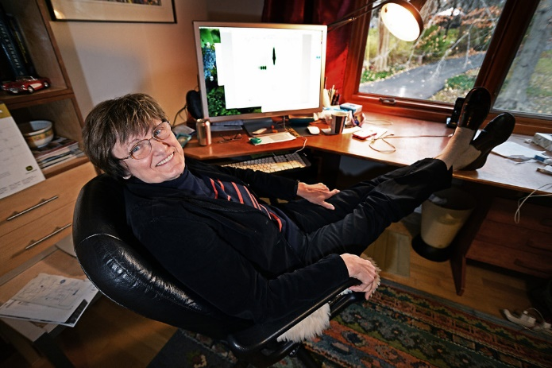
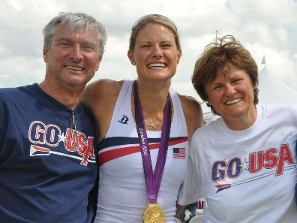
Kati Kariko and the perseverance of women research associates
https://www.nytimes.com/2021/04/08/health/coronavirus-mrna-kariko.html
https://www.cnn.com/2020/12/16/us/katalin-kariko-covid-19-vaccine-scientist-trnd/index.html

Slide 37
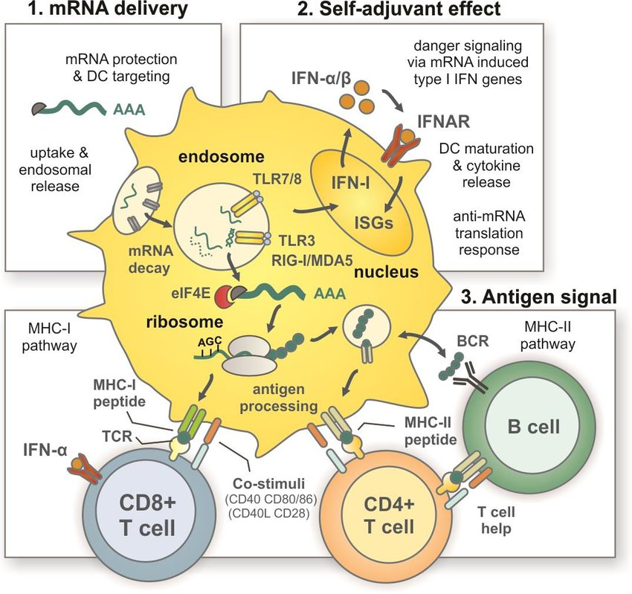

Slide 38
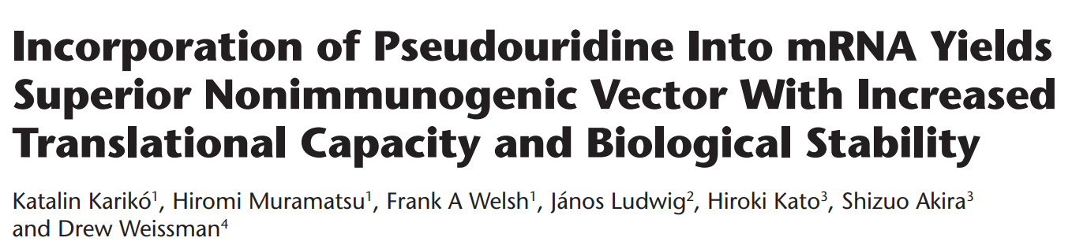
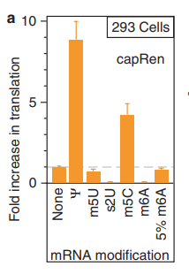
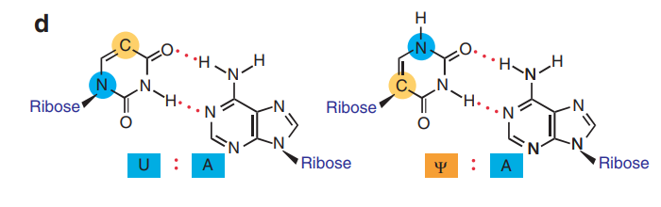
Molecular Therapy vol. 16 no. 11, 1833–1840 nov. 2008
pseudouridine

Slide 40
The modRNA sequence of the vaccine is 4,284 nucleotides long.^{[76]} It encodes the full-length spike protein of Sars CoV-2. It consists of a five-prime cap; a five prime untranslated region derived from the sequence of human alpha globin; a signal peptide (bases 55–102) and two proline substitutions (K986P and V987P, designated "2P") that cause the spike to adopt a prefusion-stabilized conformation ….a codon-optimized gene of the full-length spike protein of SARS-CoV-2 (bases 103–3879); followed by a 3’untranslated region (bases 3880–4174) for increased protein expression and mRNA stability^{[78]} and a poly(A) tail. The sequence contains no uridine residues; they are replaced by 1-methyl-3'-pseudouridylyl.^{[76]}

Slide 41


Slide 42


David Goodsell’s CellPaint
https://ccsb.scripps.edu/cellpaint/2021-cellpaint-contest/

Slide 43

David Baker founder of the Institute for Protein Design
Self-Assembling Nanomaterials and Vaccines
David’s TedTalk https://www.ipd.uw.edu/audacious/

Slide 44
Quadrivalent influenza nanoparticle vaccines induce broad protection
https://www.nature.com/articles/s41586-021-03365-x
Elicitation of Potent Neutralizing Antibody Responses by Designed Protein Nanoparticle Vaccines for SARS-CoV-2
https://www.cell.com/action/showPdf?pii=S0092-8674%2820%2931450-1

Slide 45


Slide 46


Slide 47



Thank You!
Purchase Kits and Models at 3dmoleculardesigns.com
Discount code: WEBINAR20
Stock Up Sale
Buy 4 or more for 25% off, 3 for 20%, 2 for 15%

