Slide 1
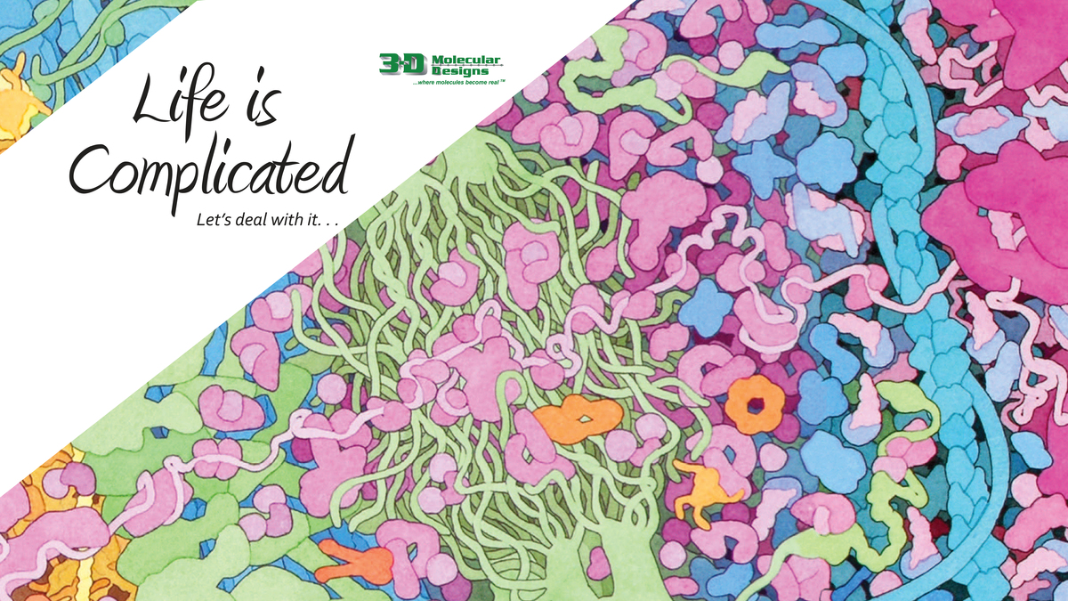
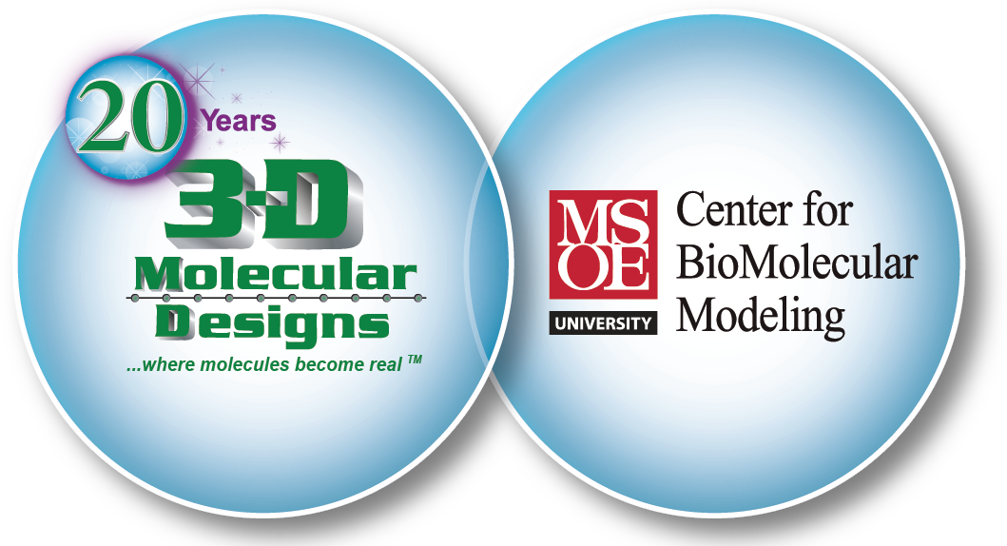
Chromosomes & DNA

Slide 2
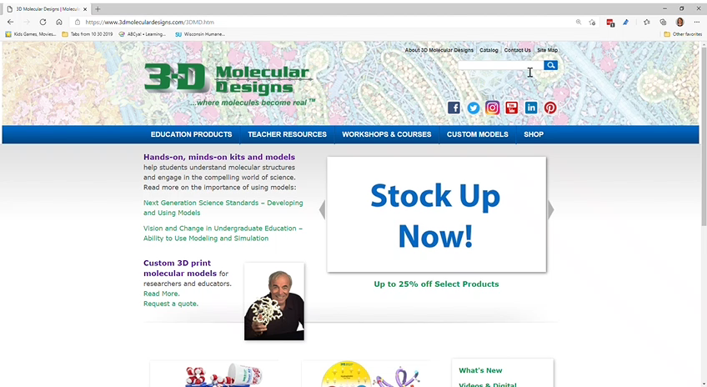
Free Coronavirus Series

Slide 3
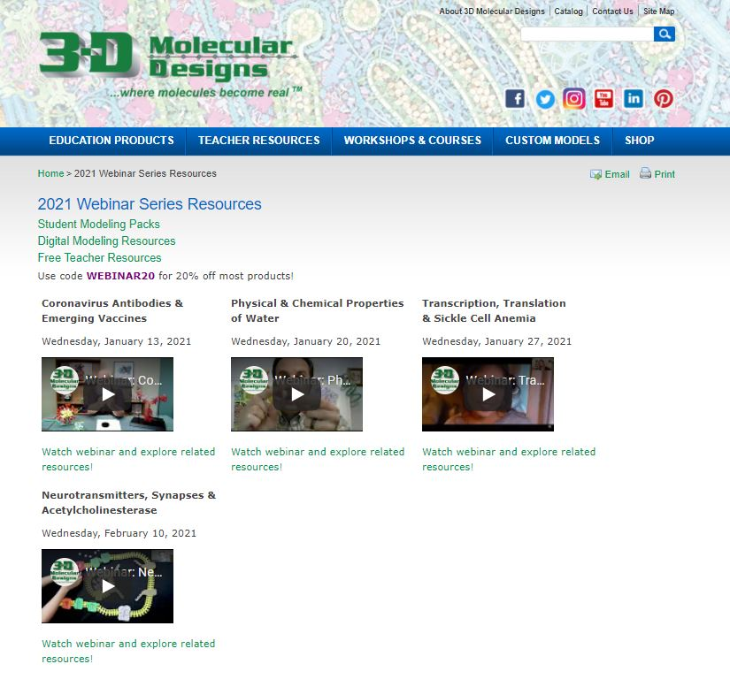
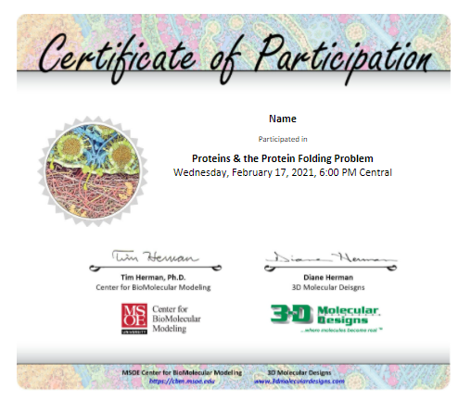


Slide 4
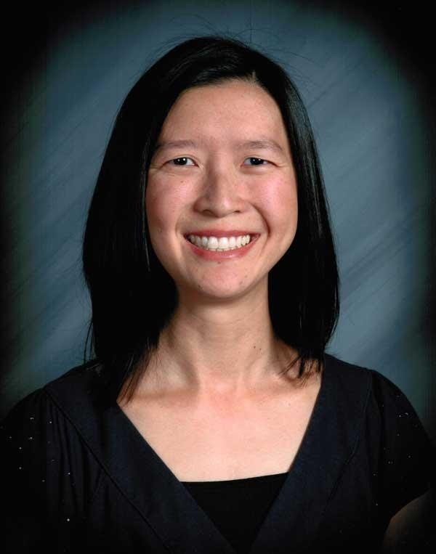
B.S. Bioengineering
Ed.M. Curriculum & Instruction
Longmont High School (Longmont, CO)
Courses: AP Biology, Biotechnology cn_chou@yahoo.com
Chris Chou

Slide 5
Using Models to Make Connections Between DNA and Chromosomes

Slide 6

Chat Time
Where do you live?
What grades/subjects do you teach?

Slide 7
Workshop Learning Goals
Model chromosome structure and anatomy
Compare and contrast mitosis and meiosis
Model mechanisms that contribute to genetic variation
Construct Punnett squares to connect inheritance of traits to chromosomes at the molecular level

Slide 8
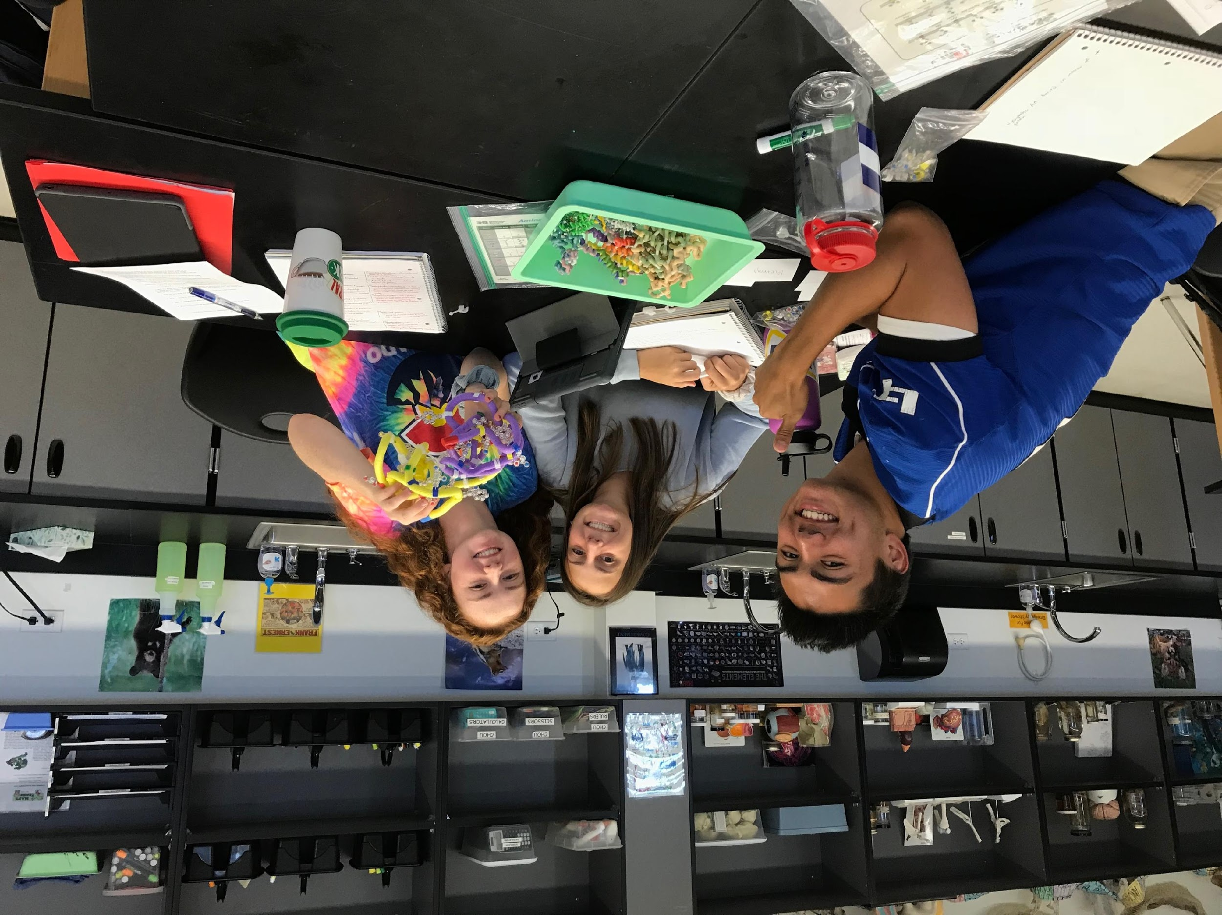
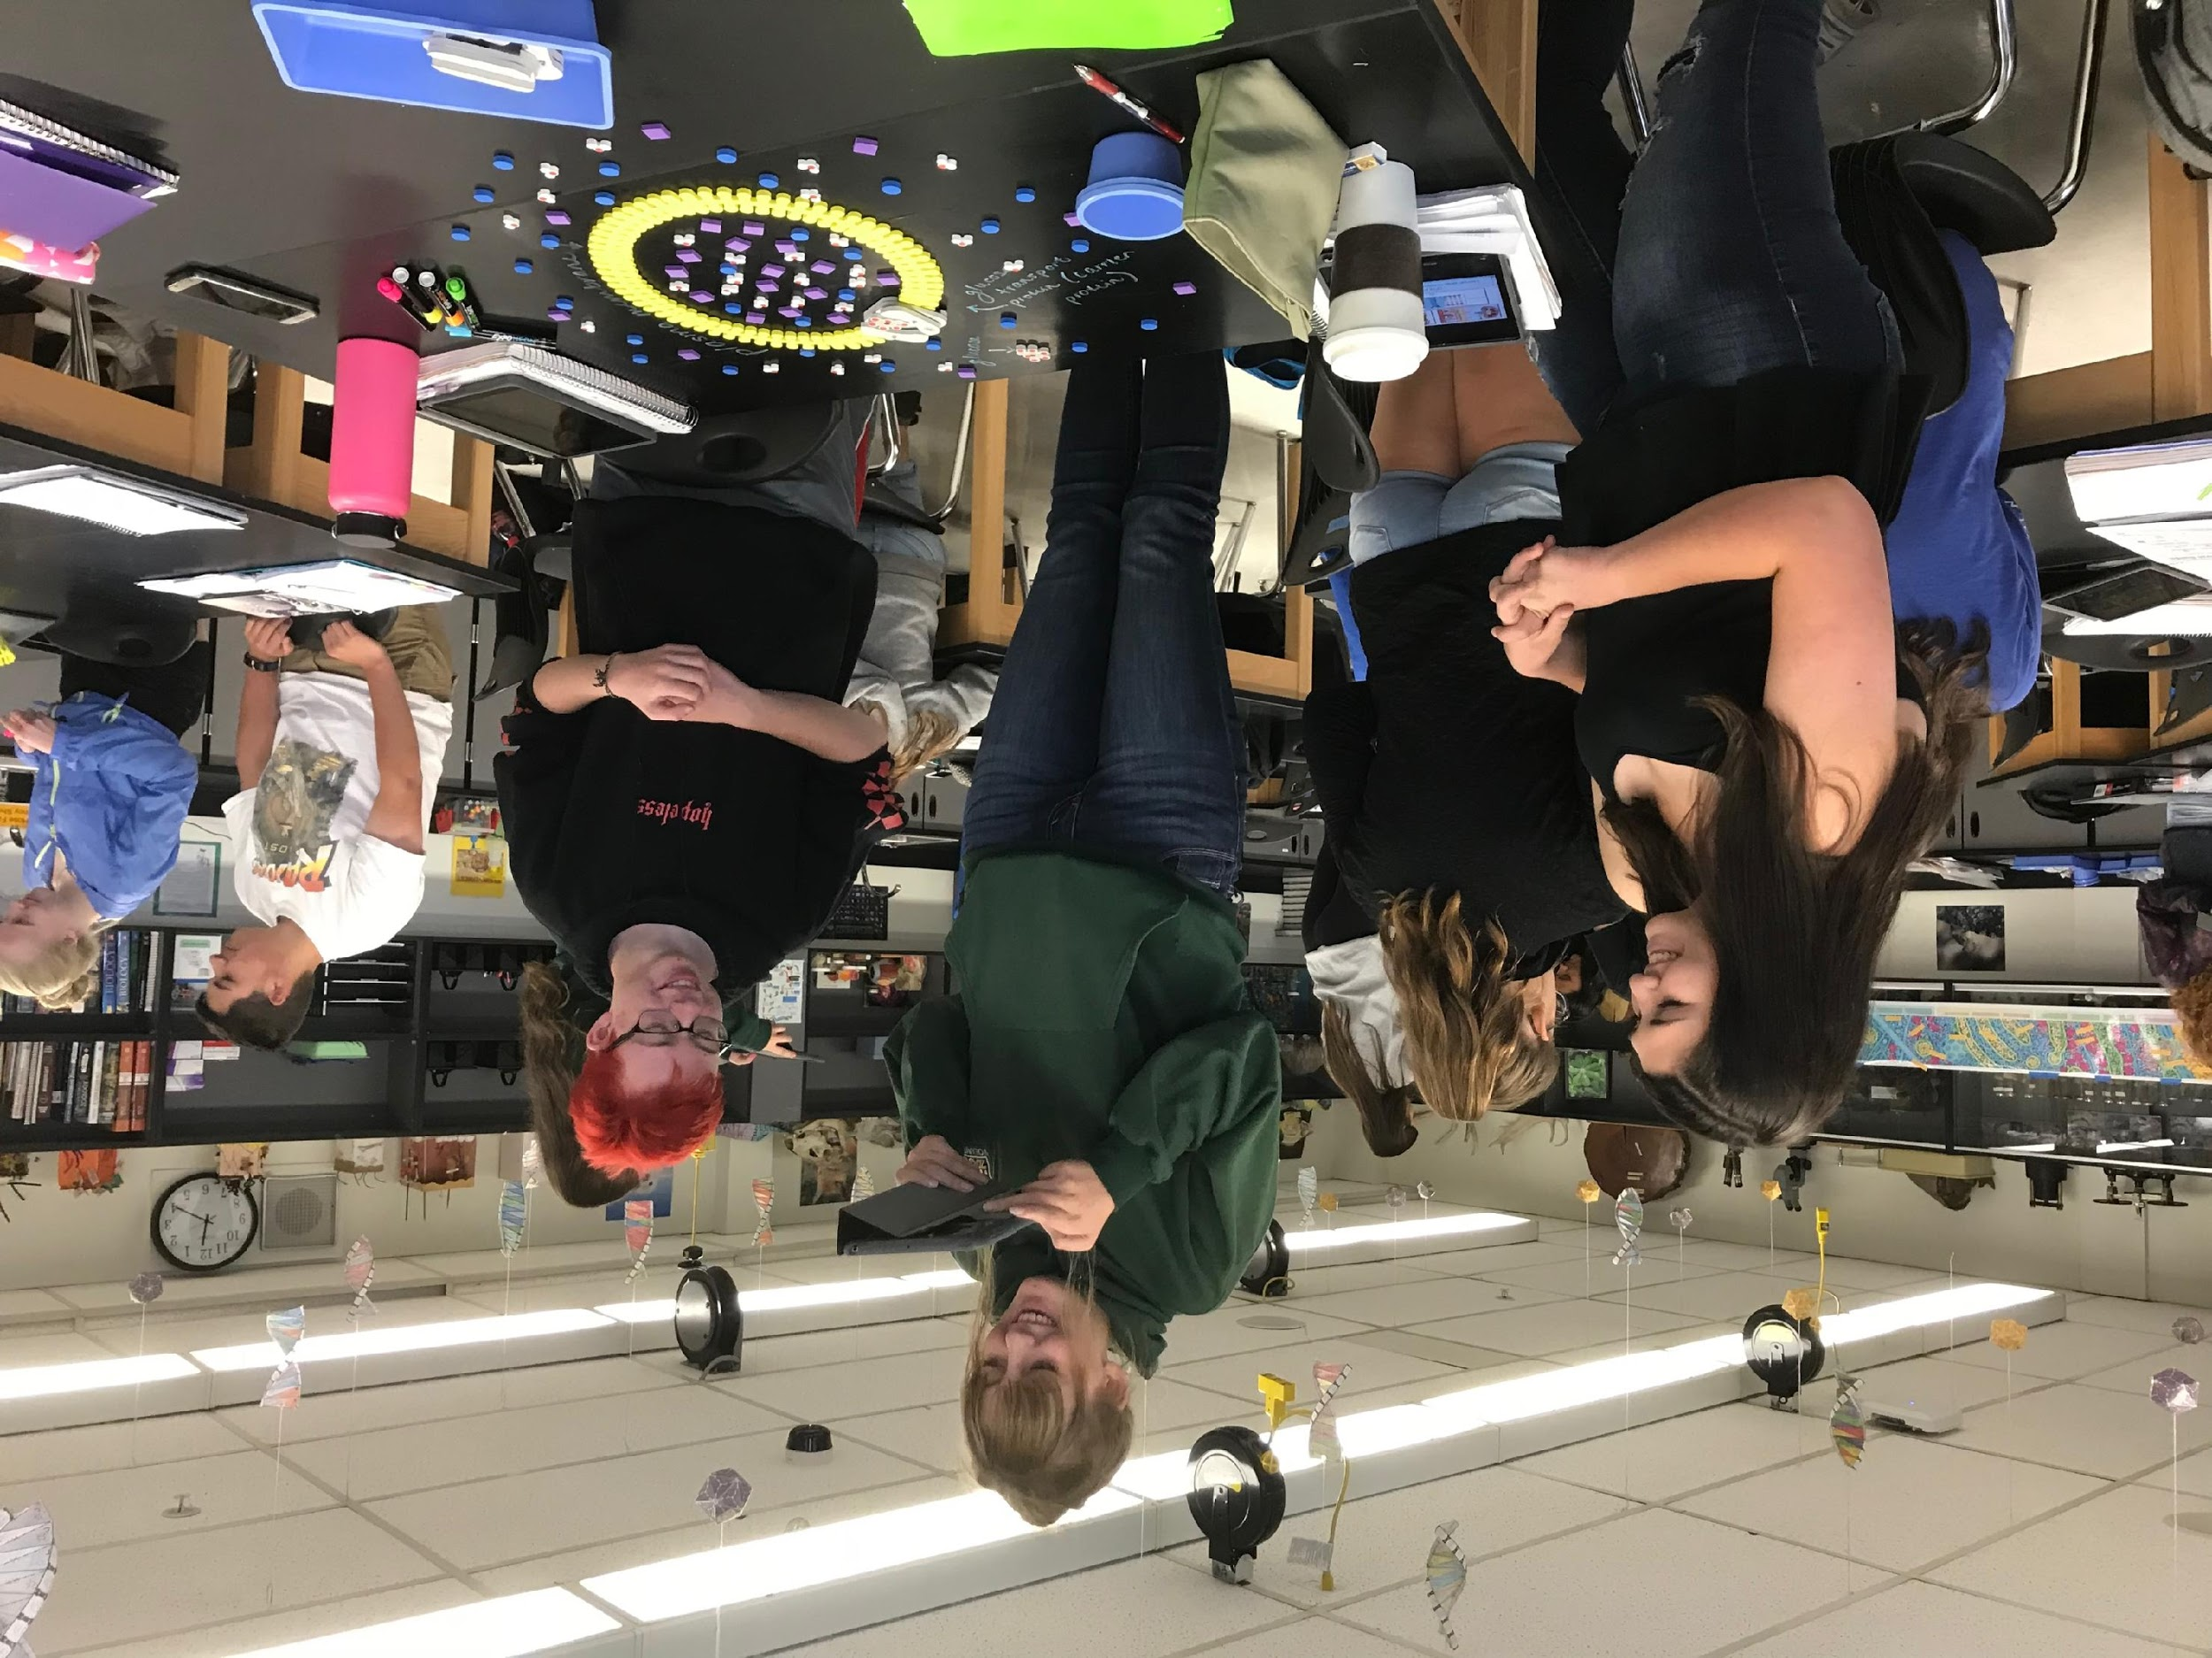
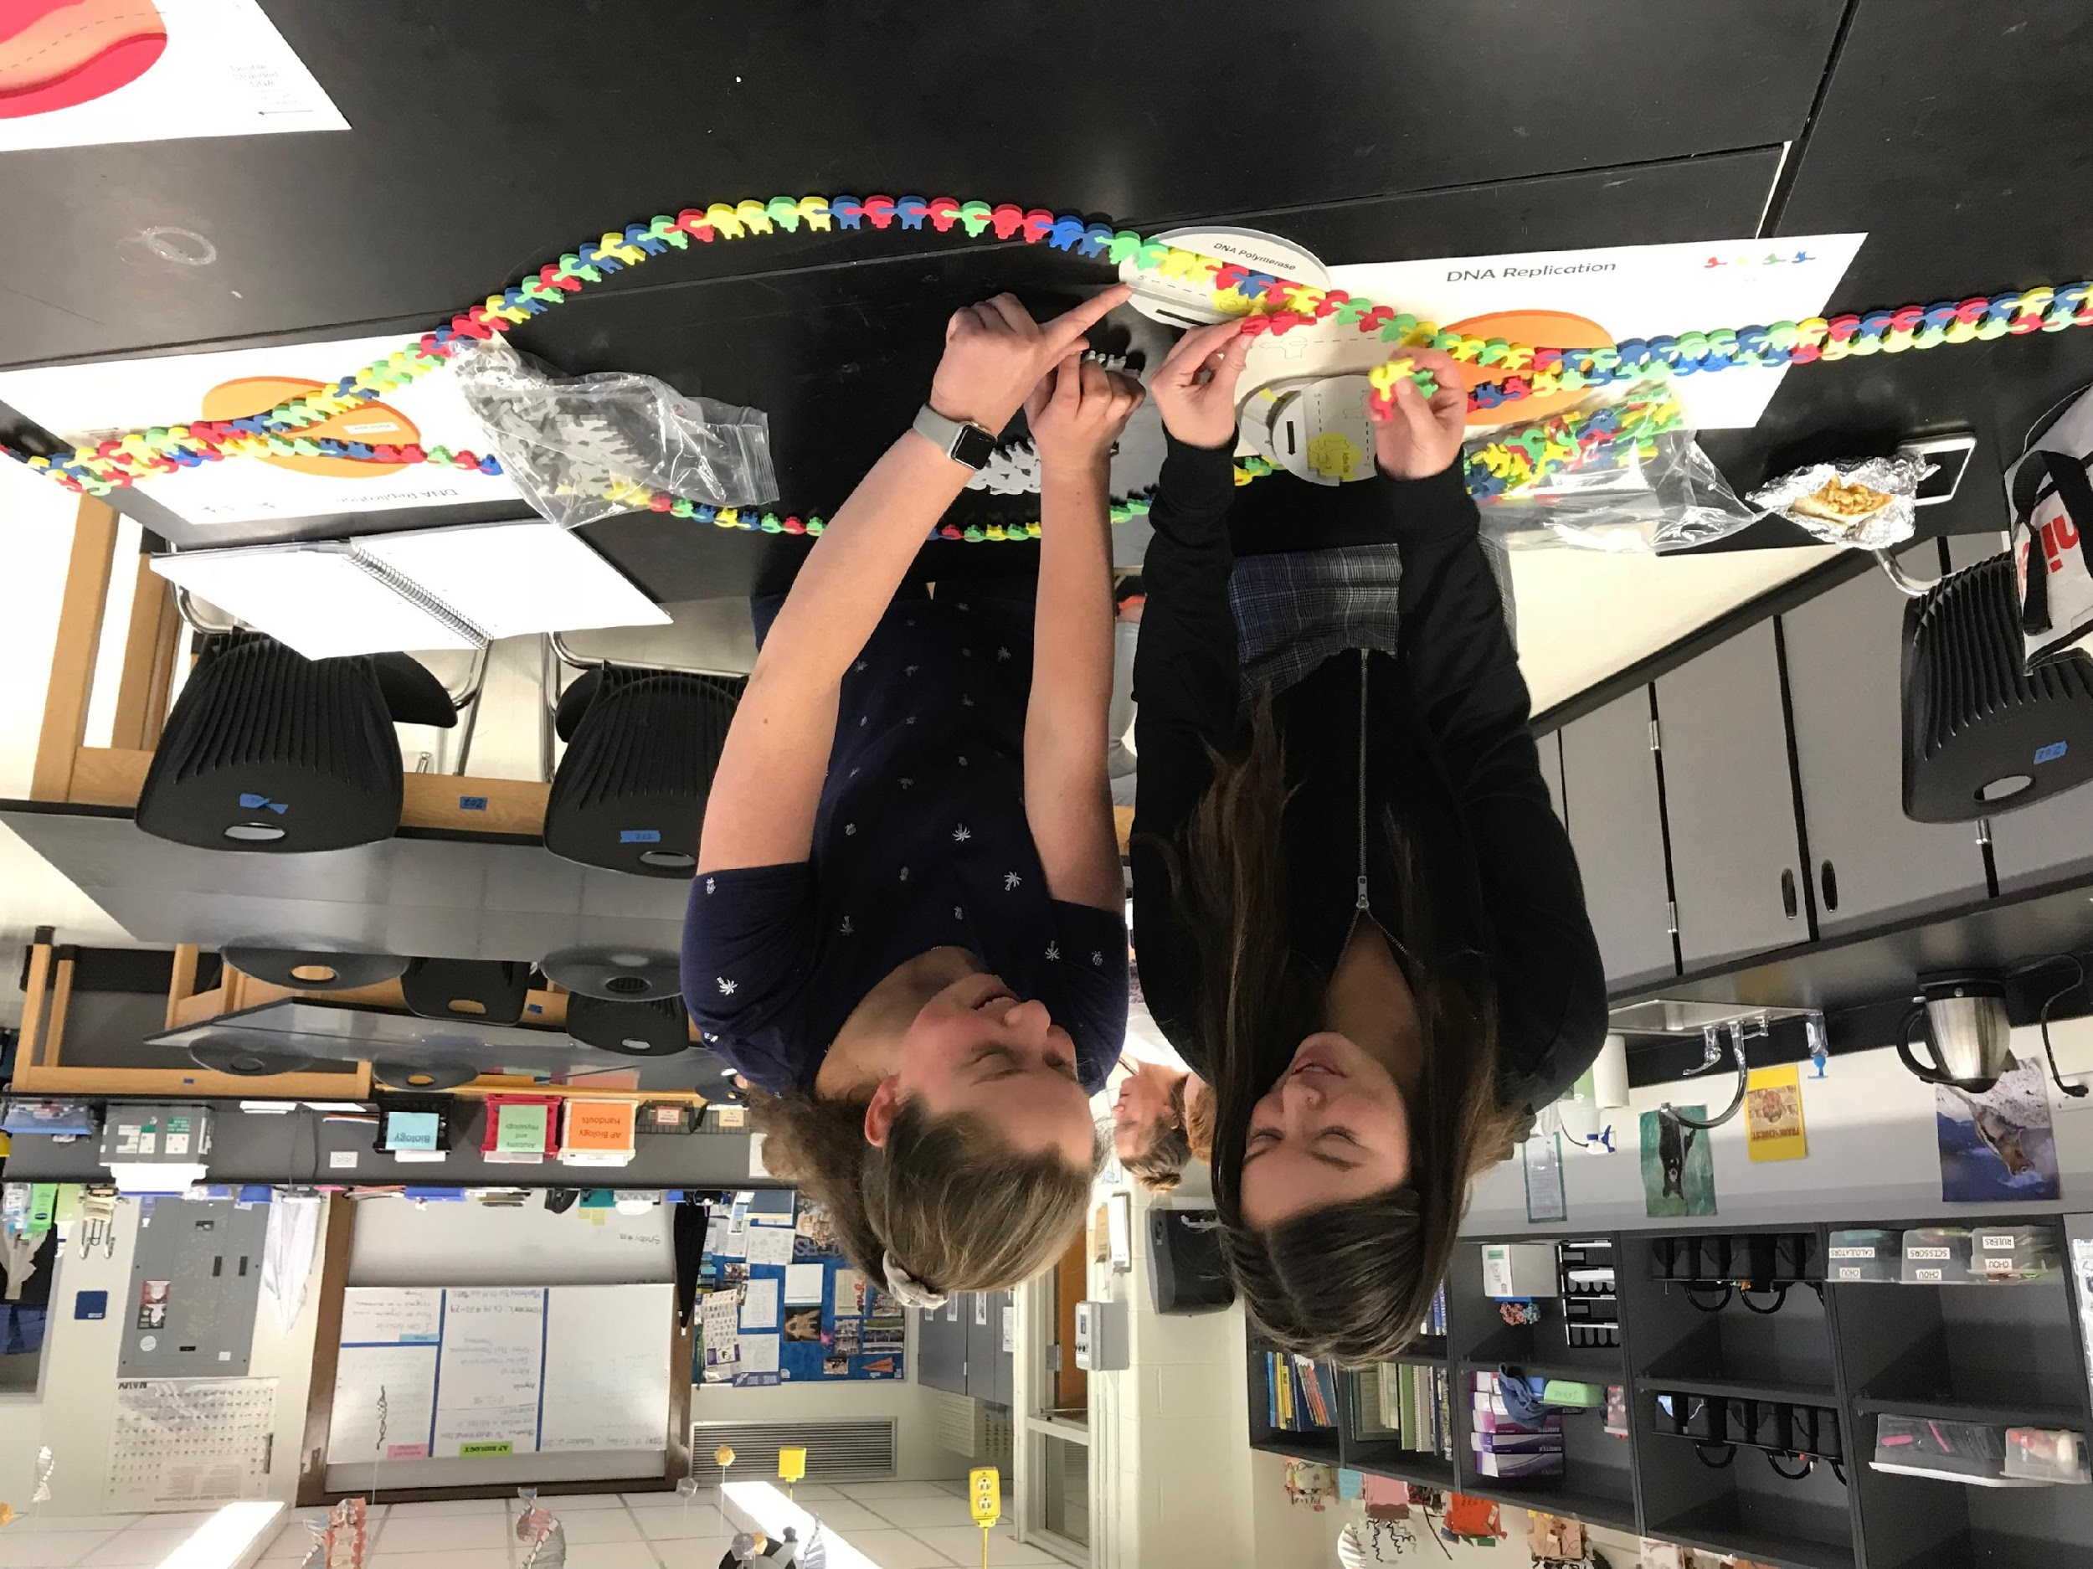
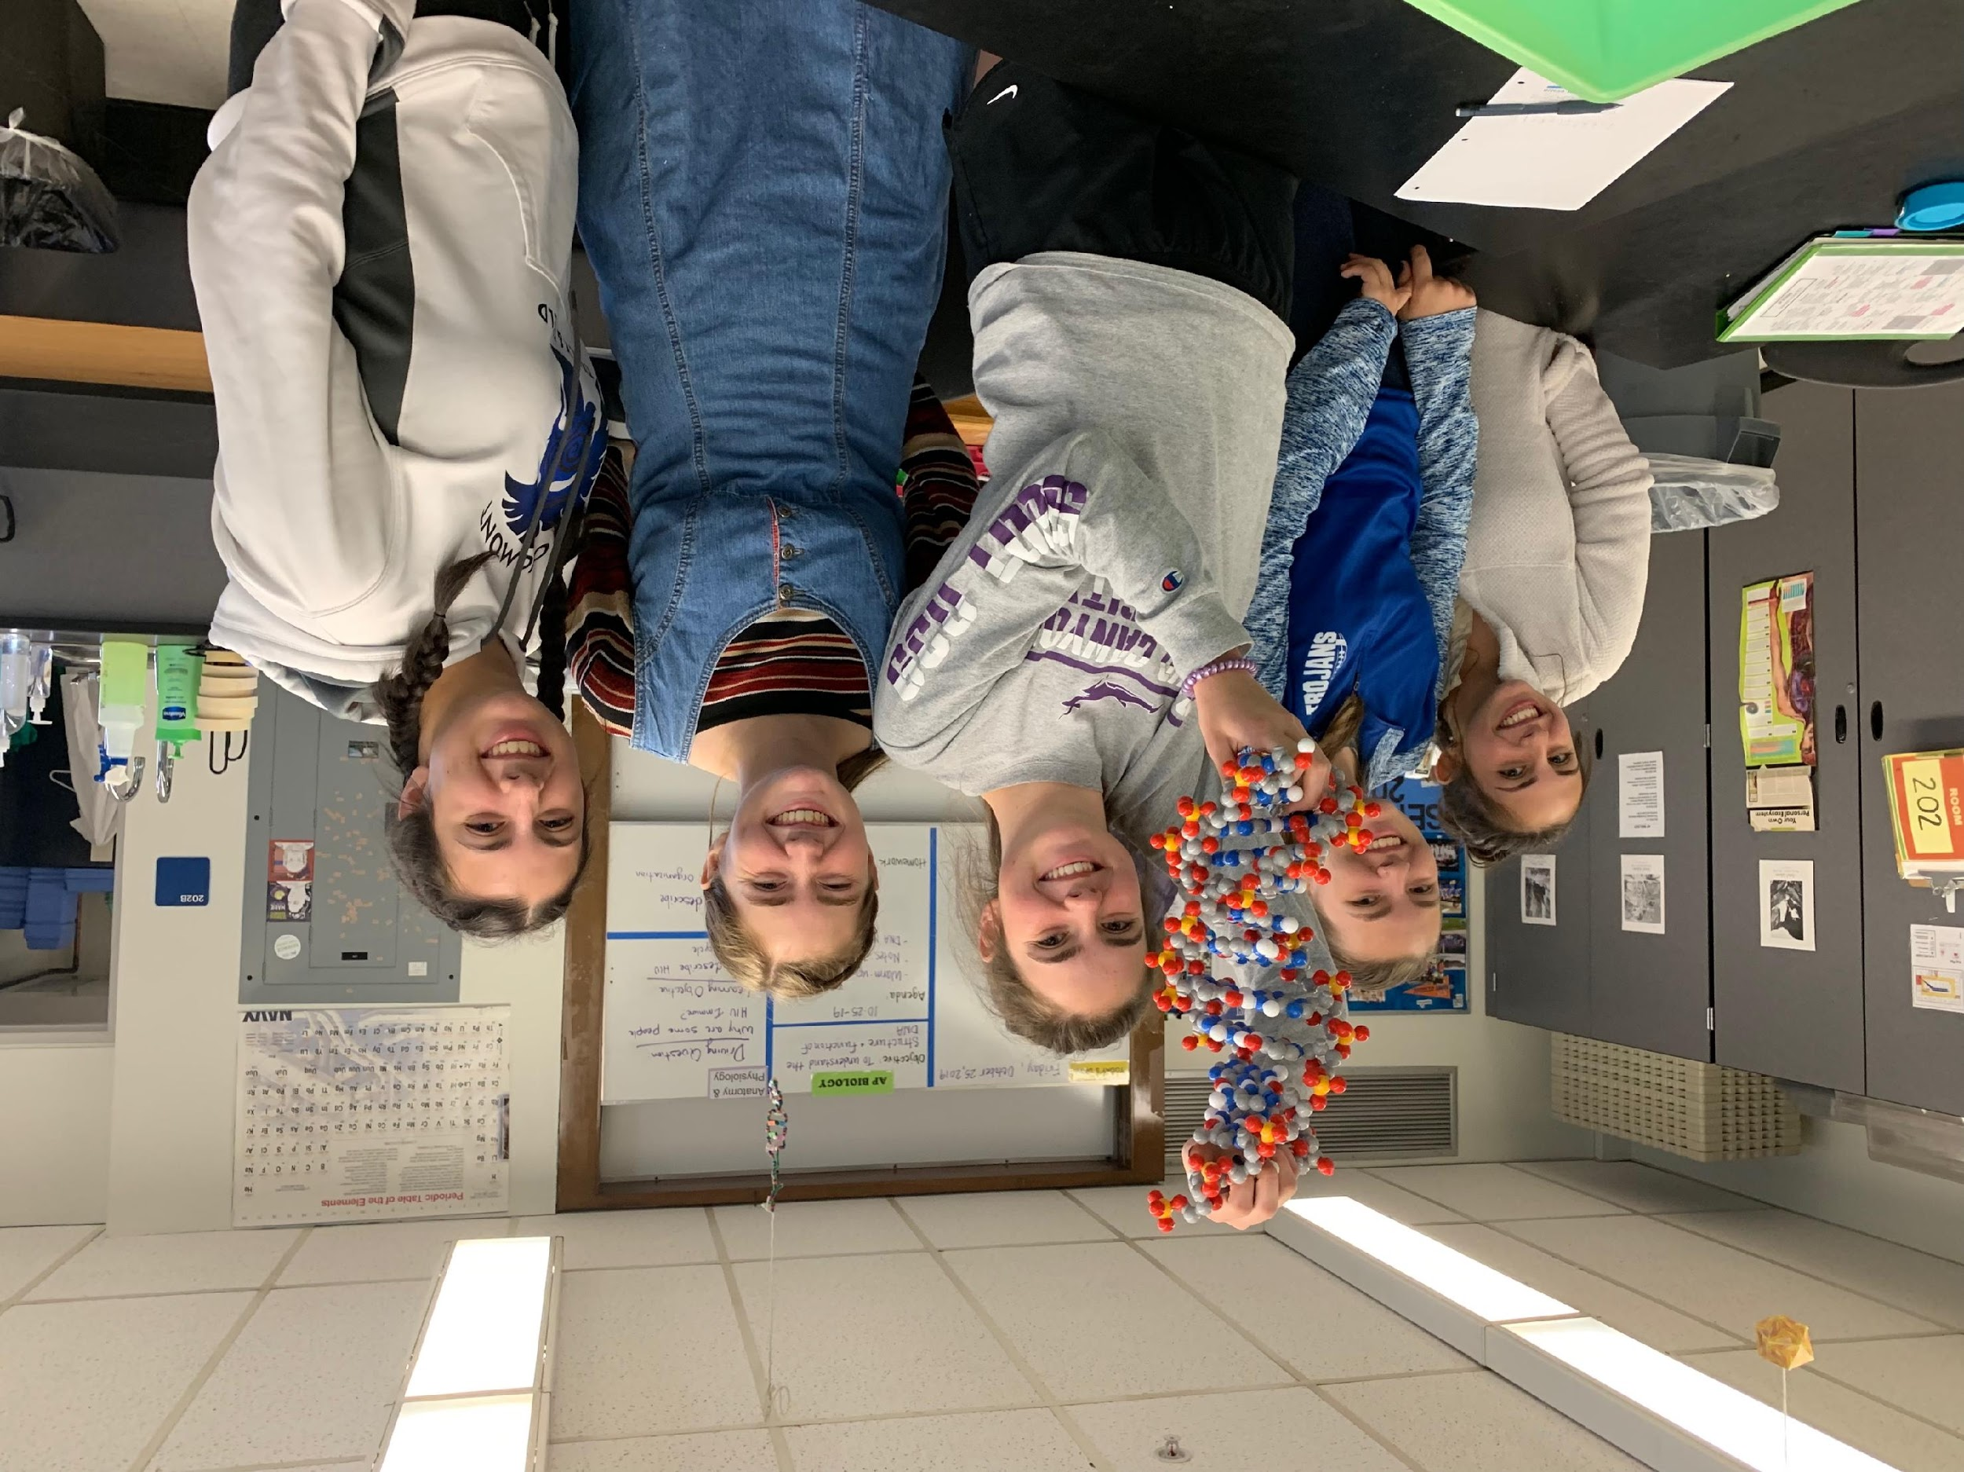
Why Models?
Notes:
Why Models? One important practice of science is to be able to develop and use models. You can help student develop their critical thinking skills when you ask them to evaluate models – What about this model is useful? What things about this model is wrong? Plus, it allows students to engage on hands-on, minds-on learning. They love it! We do a lot of modeling in my classroom. I use many 3D Molecular Design kits, but also playdoh, pipecleaners, and table markers to model biological processes.

Slide 9
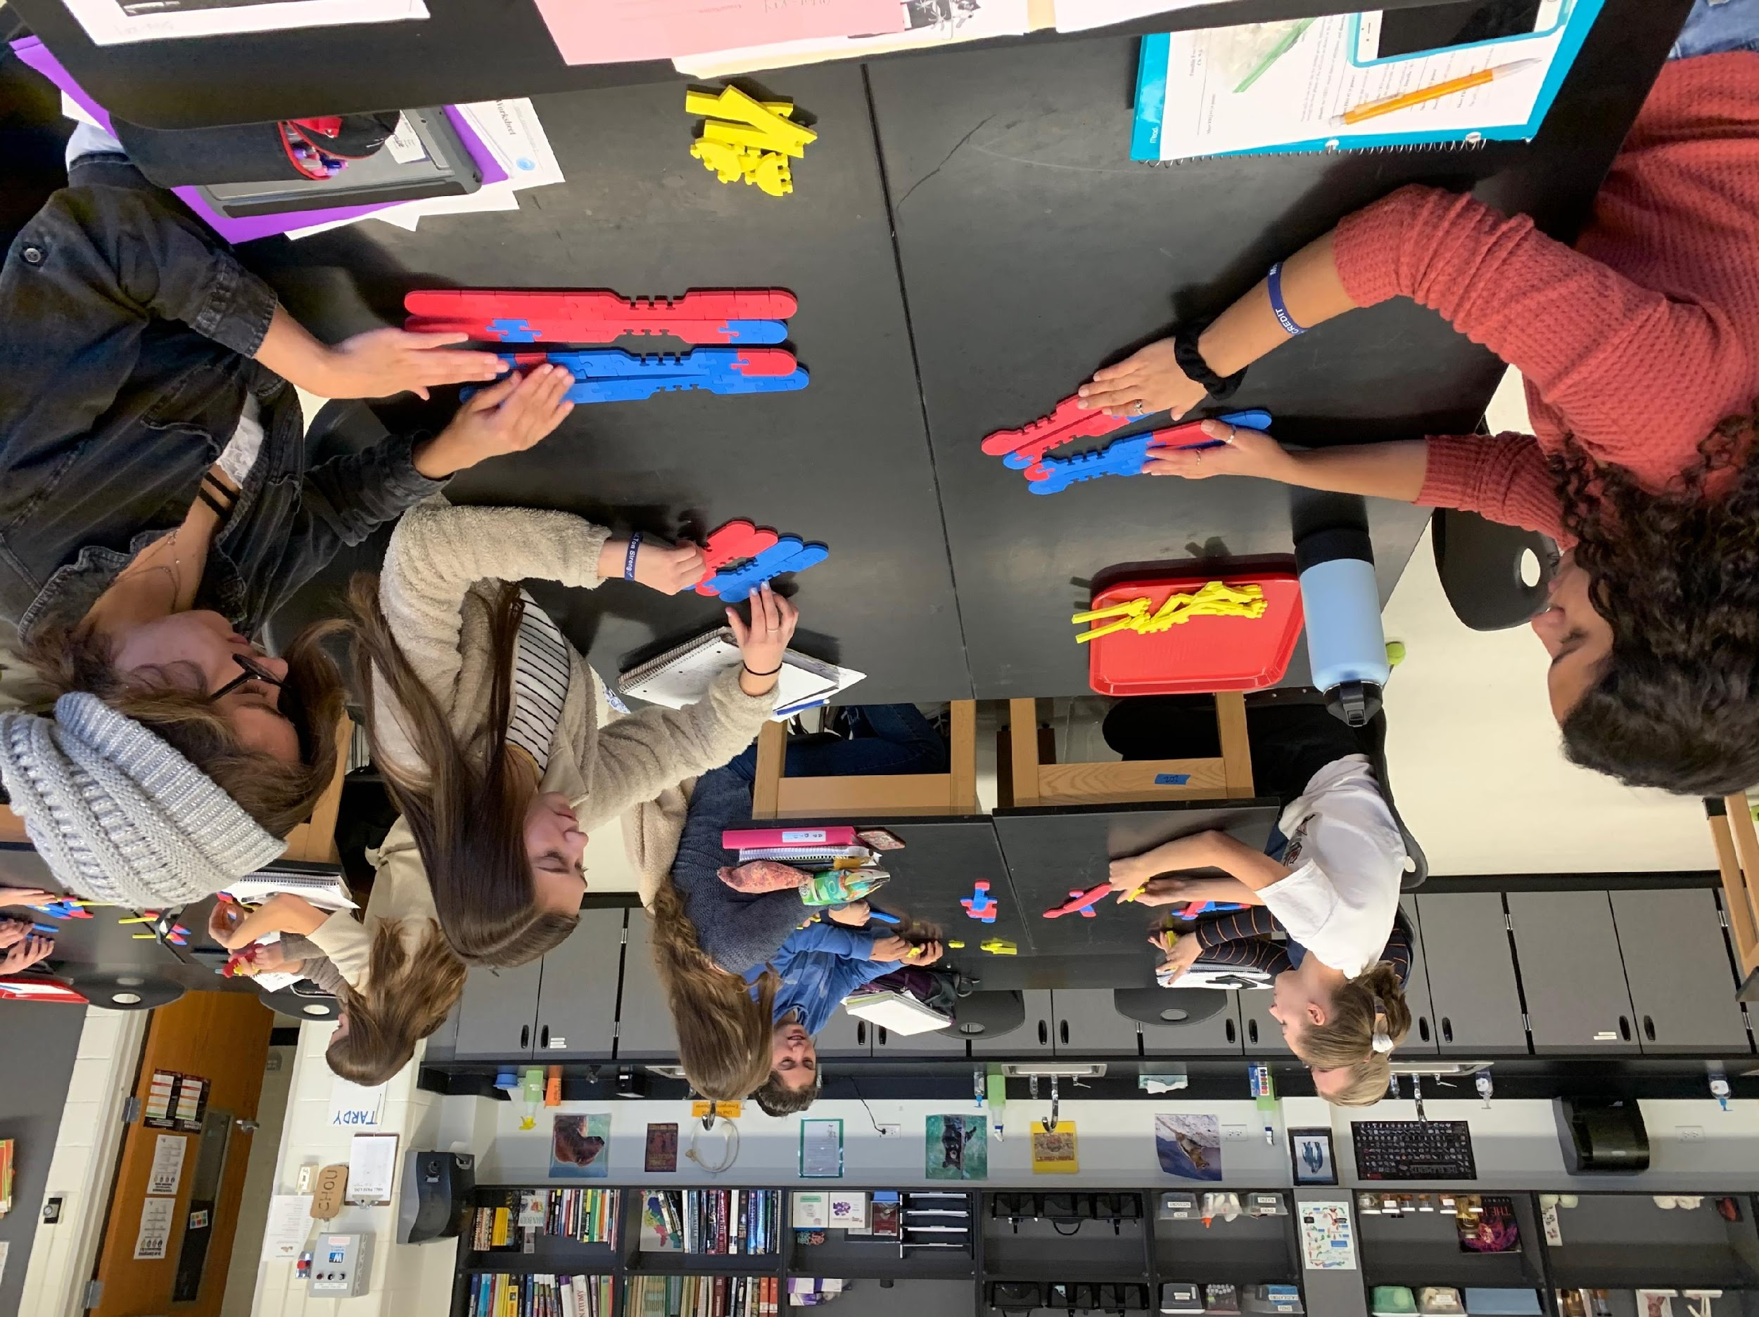
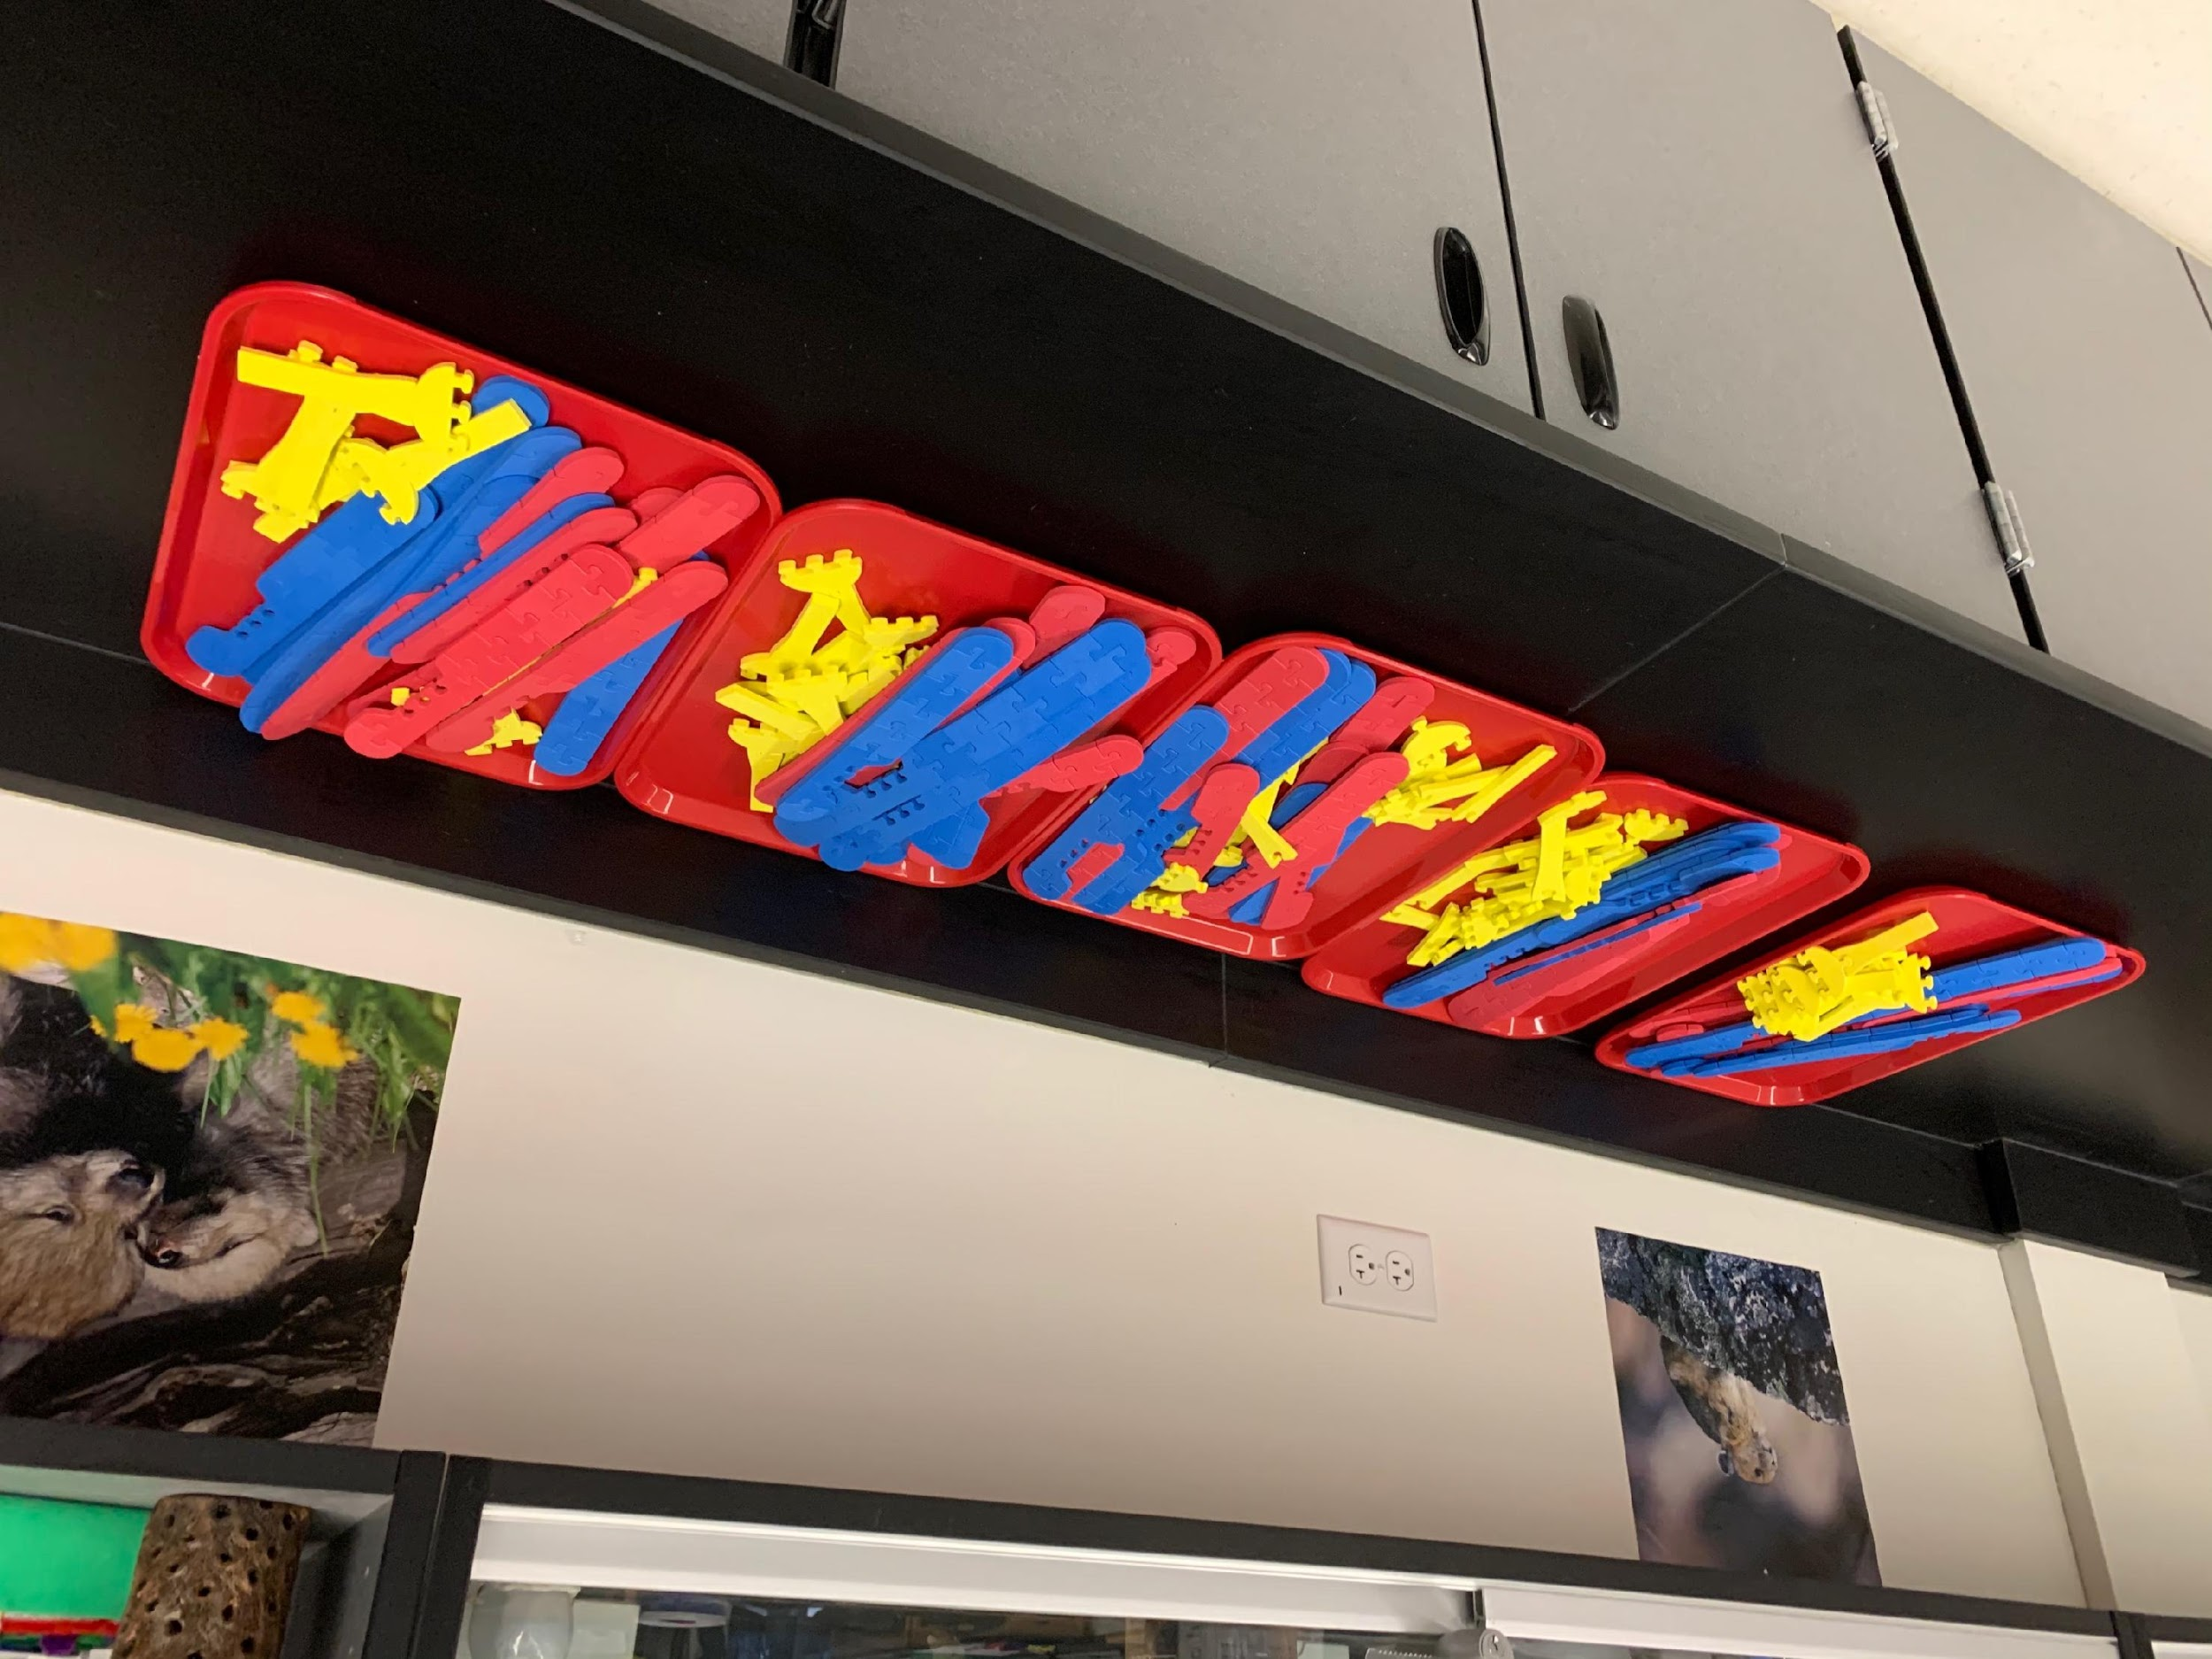
Chromosome Connections Kit

Slide 10
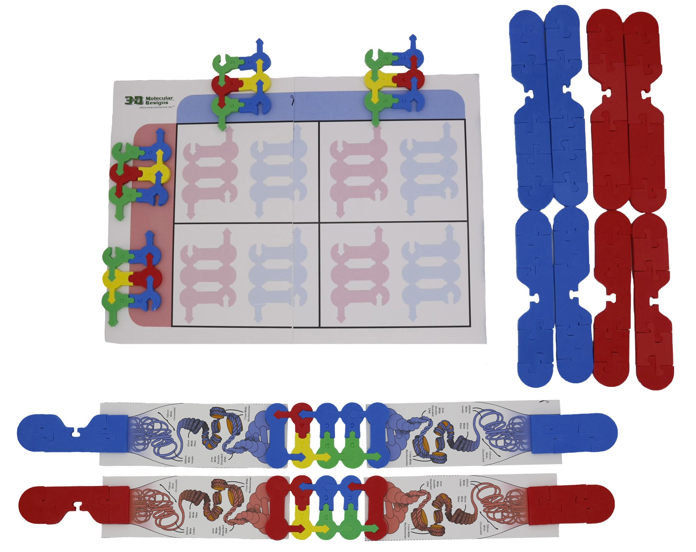
Chromosome Student Modeling Pack
Notes:
Tell participants to have their student pack of supplies ready for the activities; might need to punch out foam pieces and cut apart the diagram drawings. Blank Punnett squares should be included. Additional ones can be printed out on the 3DMD website.

Slide 11
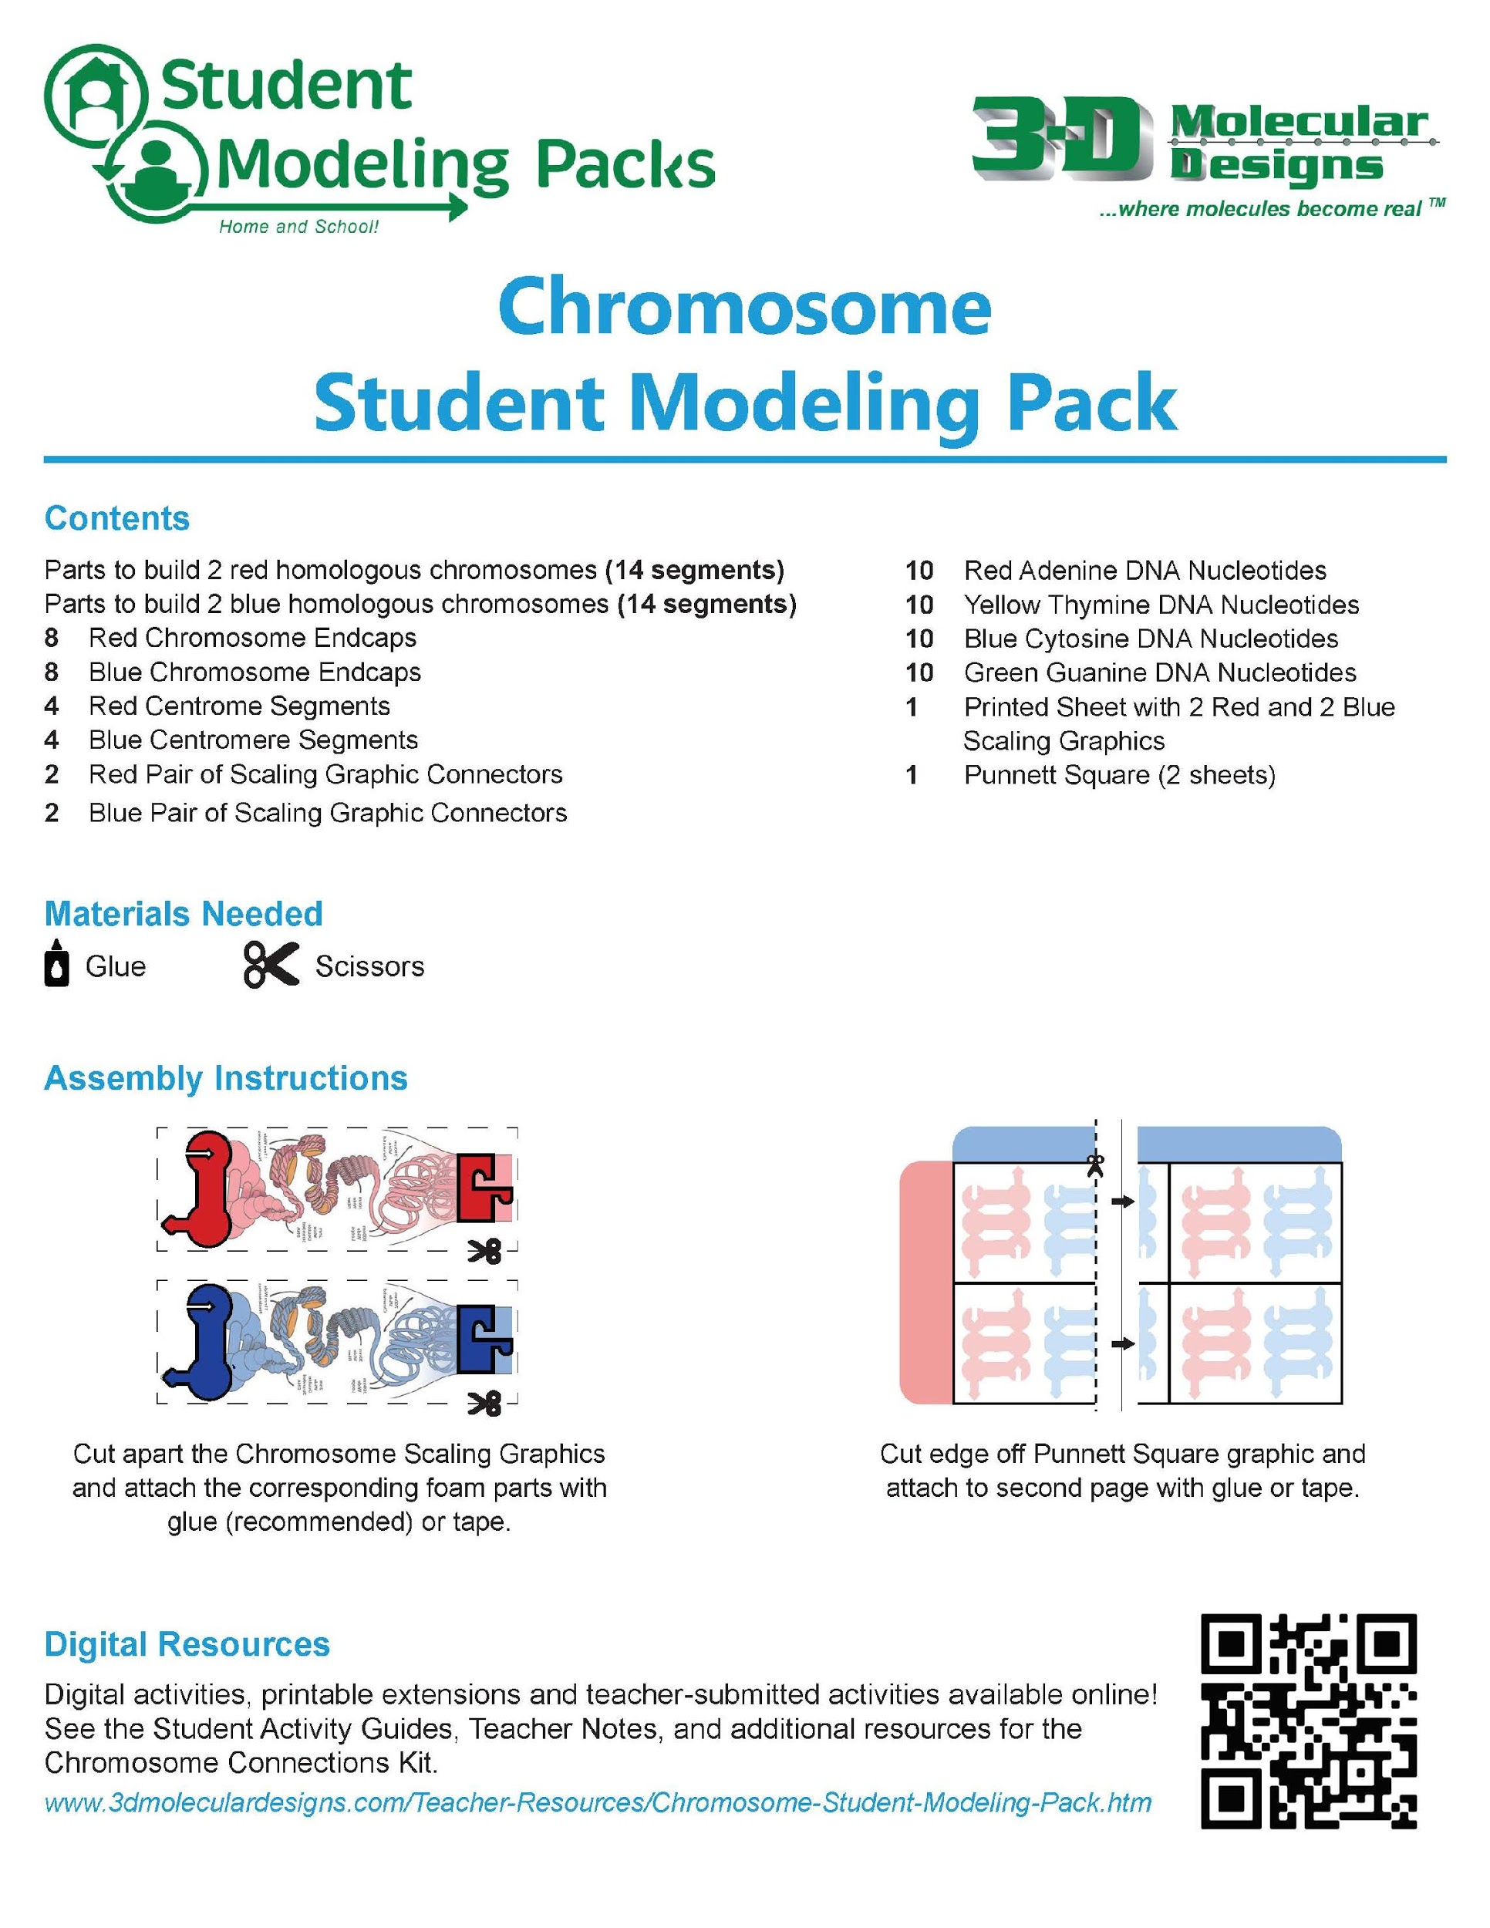
Some Assembly is Required
Notes:
Doesn’t have to be exactly like the photo, but must have a chromosome part, connector, and nucleotides. Let participants know they can glue down a single blue/red midpiece to anchor chromosome onto the diagram, and glue a blue/red connector to anchor the nucleotides to the other end.

Slide 12
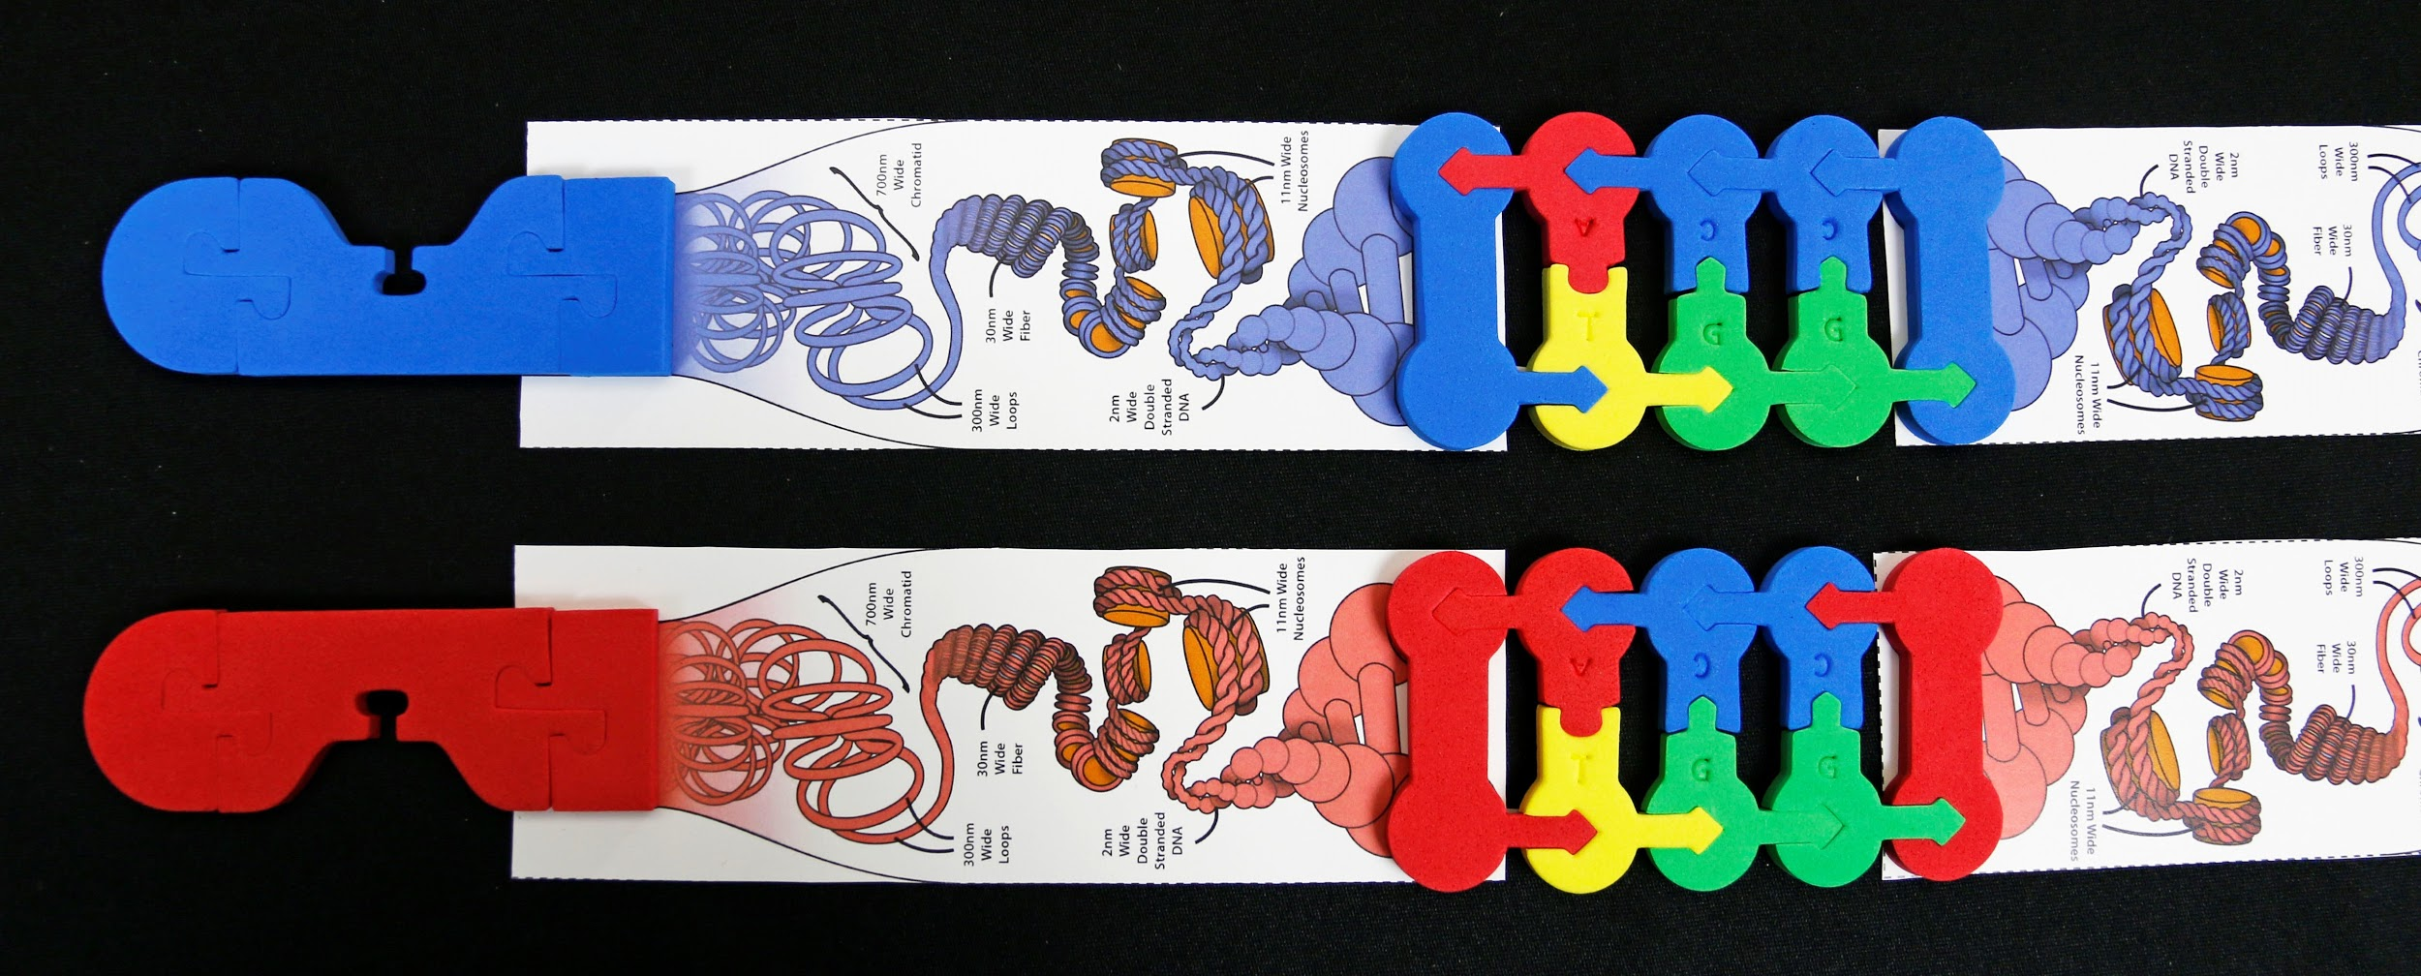

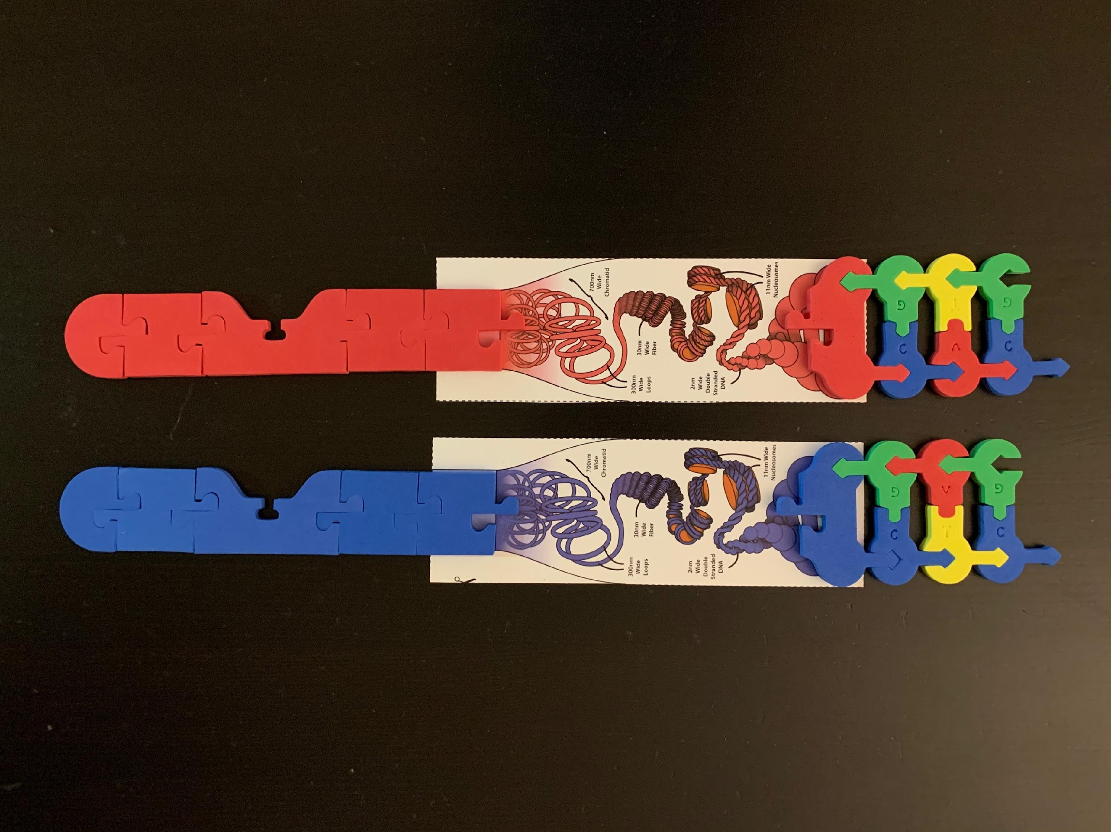
Assemble Chromosomes Shown
Notes:
Ask: Who has a pack in front of them? Note: Doesn’t have to be exactly like the photo, but must have a chromosome part, connector, and nucleotides. Let participants know they can glue down a single blue/red midpiece to anchor chromosome onto the diagram, and glue a blue/red connector to anchor the nucleotides to the other end. (Post in chat when you are finished)

Slide 13
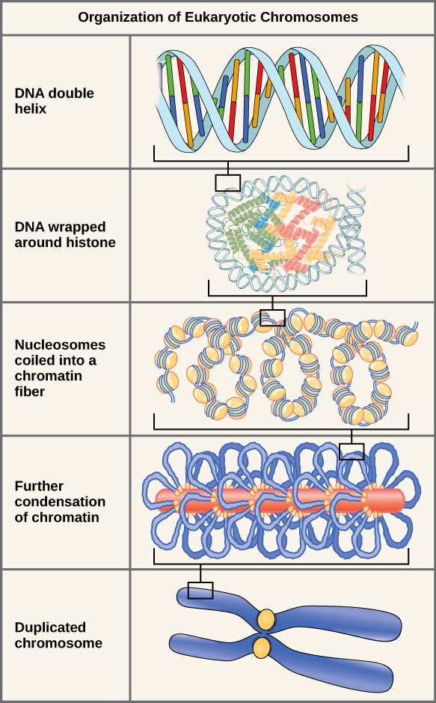
Organization of Eukaryotic Chromosomes
Notes:
Briefly go over how chromosomes are organized from DNA → condensed chromatin level

Slide 14
Notes:
Compare the diagram with your model of a chromosome. Identify each part of the chromosome depicted in your model.

Slide 15
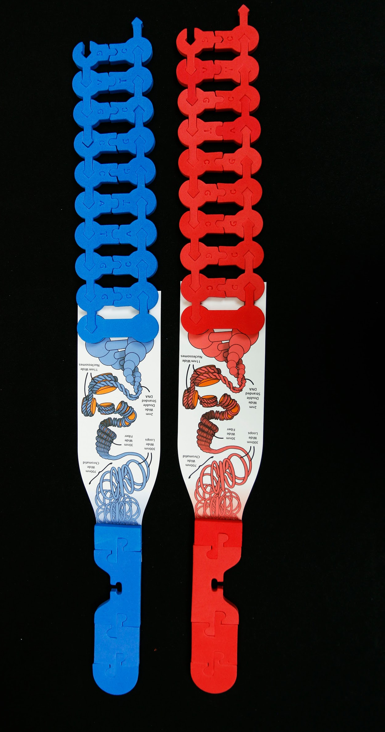
Chromosome Connections Kit
Chromosome Student Modeling Pack

Slide 16
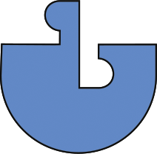


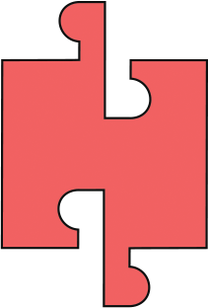


Assemble Chromosomes Shown
Notes:
Helpful to assemble exactly as shown (two tall and two short chromosomes). Note: you are assembling 4 chromosomes.

Slide 17
Homologous chromosomes
Telomere
Centromere
Maternal chromosomes
Telomere
Paternal chromosomes
Notes:
Maternal chromosomes = inherited from the mom (egg); Paternal chromosomes = inherited from dad (sperm cell); Homologous chromosomes = chromosome pairs of approximately the same length, centromere position, and staining pattern, for genes with the same corresponding loci; centromere = constricted region of a chromosome that separates it into a short arm (p) and a long arm (q) AND the region of a chromosome to which the microtubules of the spindle attach, via the kinetochore, during cell division; telomere = the end of a chromosome. Telomeres are made of repetitive sequences of non-coding DNA that protect the chromosome from damage; each time a cell divides, the telomeres become shorter; eventually, the telomeres become so short that the cell can no longer divide.

Slide 18
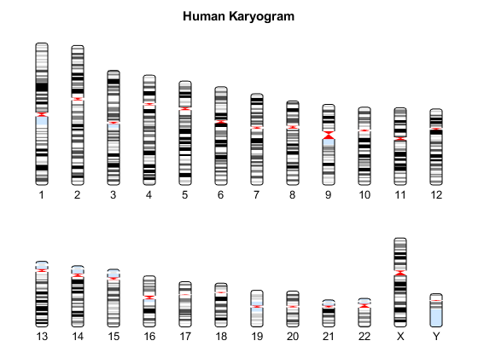
Notes:
A Karyogram is a way used to depict chromosomes, the way chromosomes are organized in the image makes them easy to visualize. They are arranged into homologous pairs each of which is arranged into size order- from largest to smallest.

Slide 19
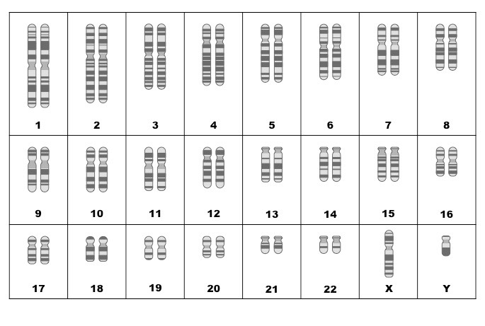
Notes:
This diagram shows 2 of each kind of chromosome. Human have 46 chromosomes in (almost) every cell in our body. One copy of each chromosome comes from your mom (maternal chromosome), and 1 from your dad (paternal chromosome). Each pair of chromosomes is called a “homologous pair”. (For more advanced students, note that our “cell” model has 4 chromosomes, so 2n=4 and n=2.)

Slide 20
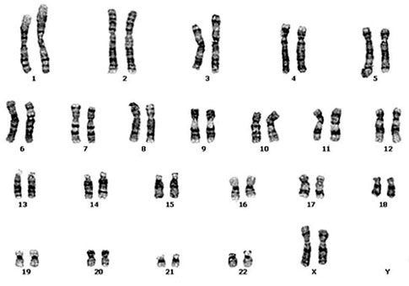
Notes:
(Normal Human Female Karyotype) Karyotype - chromosomal characteristics of an individual cell, shown as the array of metaphase chromosomes from a photomicrograph of a single cell nucleus. The chromosomes are arranged in pairs in descending order of size and according to the position of the centromere. Note: METAPHASE chromosomes means that each chromosome was replicated.

Slide 21
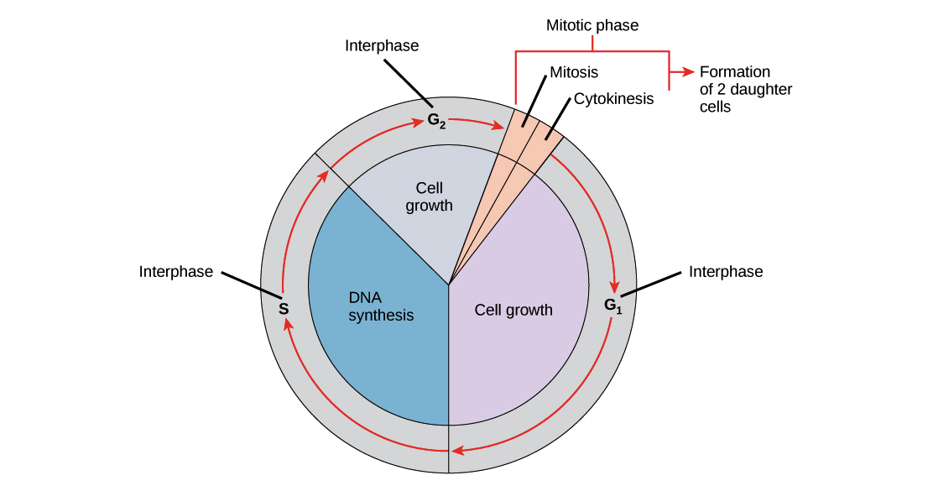
The Cell Cycle
Source: Khan Academy
Notes:
Cell Cycle shows the life cycle of a cell. Briefly explain G1, S, G2 and M phases. Note the “S Phase” where DNA is replicated! Also, “Metaphase” is the part of cell division where is it halted to take a photograph of the “chromosome replicated”. The purposes of cell division are for growth, tissue repair, and reproduction.

Slide 22

The Cell Cycle
DNA Replication
Karyotype
Source: Khan Academy
Notes:
Cell Cycle shows the life cycle of a cell. Briefly explain G1, S, G2 and M phases. Note the “S Phase” where DNA is replicated! Also, “Metaphase” is the part of cell division where is it halted to take a photograph of the “chromosome replicated”. The purposes of cell division are for growth, tissue repair, and reproduction.

Slide 23
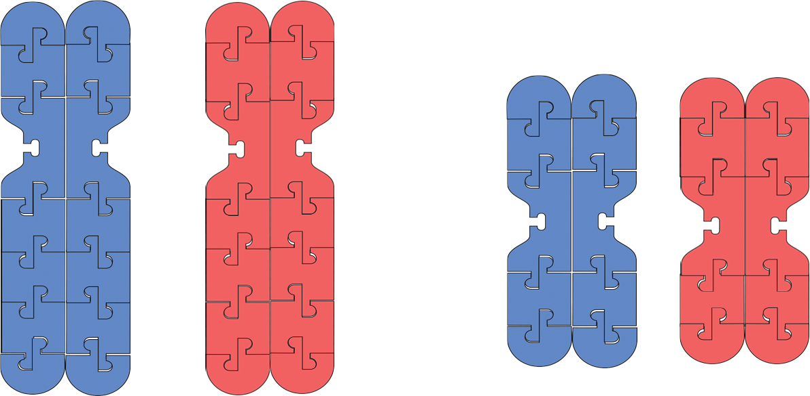
Replicate Your Chromosomes!

Slide 24
Each chromosome = 2 identical sister chromatids
Homologous chromosomes
chromosome
chromosome

Slide 25
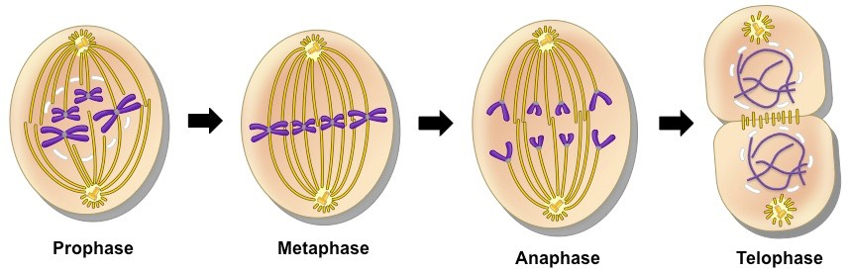
Mitosis
Source: BioNinja
Notes:
The purpose of mitosis is for growth and tissue repair. Now that the chromosomes have been replicated, it’s time to distribute them into 2 identical daughter cells. Each new daughter cell should have a complete set of DNA and should be identical to the parent cell. Note that ”mitosis” refers to the division of the nucleus, and “cytokinesis” refers to the division of the cytoplasm where the 2 daughter cells completely separate from each other. The diagram only shows mitosis, but not cytokinesis.

Slide 26
Move your chromosomes to model the process of Mitosis
Source: BioNinja
Notes:
Ideas for doing this in class: (I do, we do, you do) students pair up and model the process together then take turns modeling and explaining to partner; timelapse video; Stop Motion video (use app);

Slide 27
Move your chromosomes to model the process of Mitosis
Prophase
Metaphase
Anaphase
Telophase
Notes:
Note: Student kit does NOT contain kinetochores and microtubules; can use string to model the spindle fibers in student kit

Slide 28
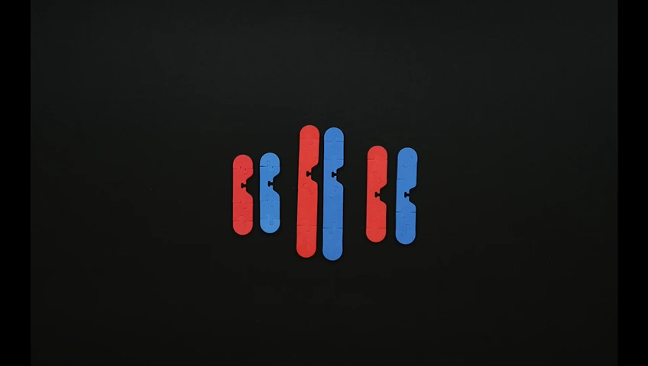

Slide 29
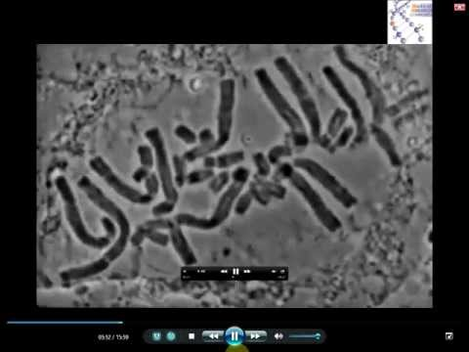
Notes:
Optional: Real cell undergoing mitosis

Slide 30
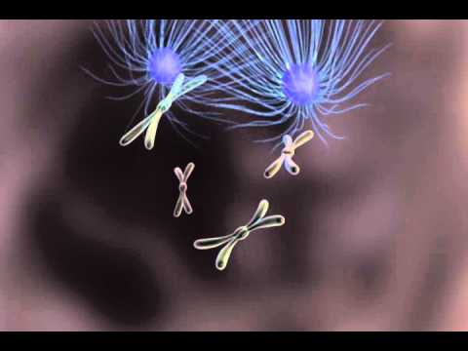

Slide 31
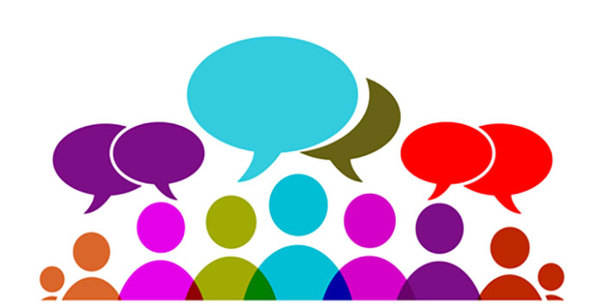
Discuss:
How do the daughter cells compare to the original parent cell?
How many chromosomes were in each parent cell?
How many chromatids were in the cell during prophase?
How many chromosomes are in each daughter cell?
Notes:
Discussion questions for students

Slide 32
Chat Time
How might this activity be used in your classroom?
In what ways could modeling this process be helpful for students?

Slide 33
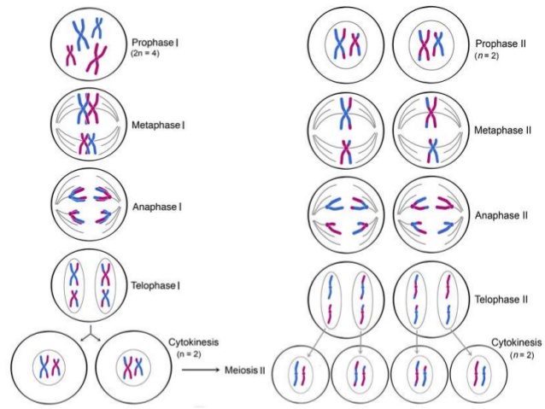
Meiosis
Source: http://cyberbridge.mcb.harvard.edu/
Notes:
The purpose of meiosis is for sexual reproduction. It is used to make gametes or sex cells – eggs and sperm cells. Meiosis is also called a “reduction division” – WHY? The process of meiosis allows sexually reproducing organisms to increased genetic diversity in several ways. We will come back to this after we model meiosis. Notice that there are 2 divisions: Meiosis I and Meiosis II. Look at the diagram. What similarities and differences do you spot between the 2 divisions?

Slide 34
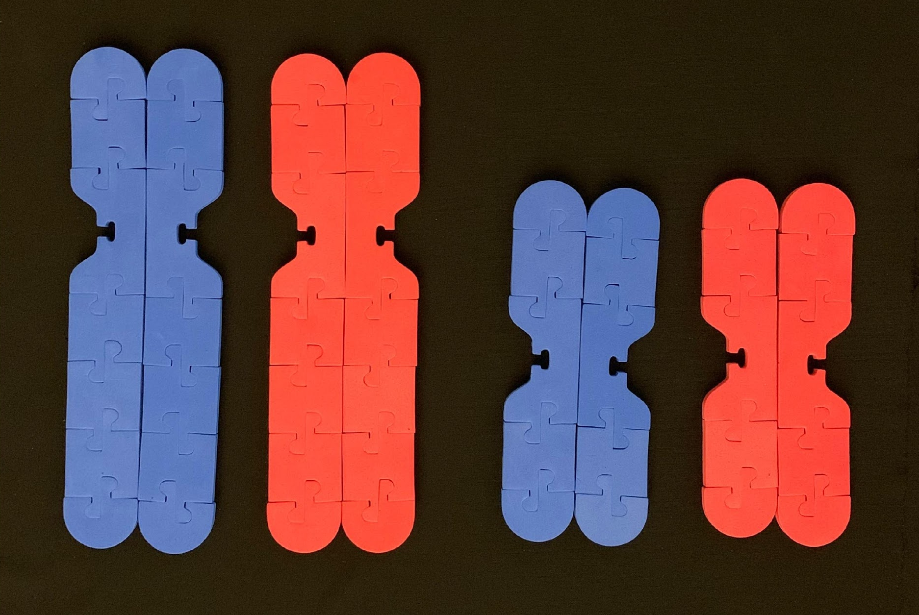
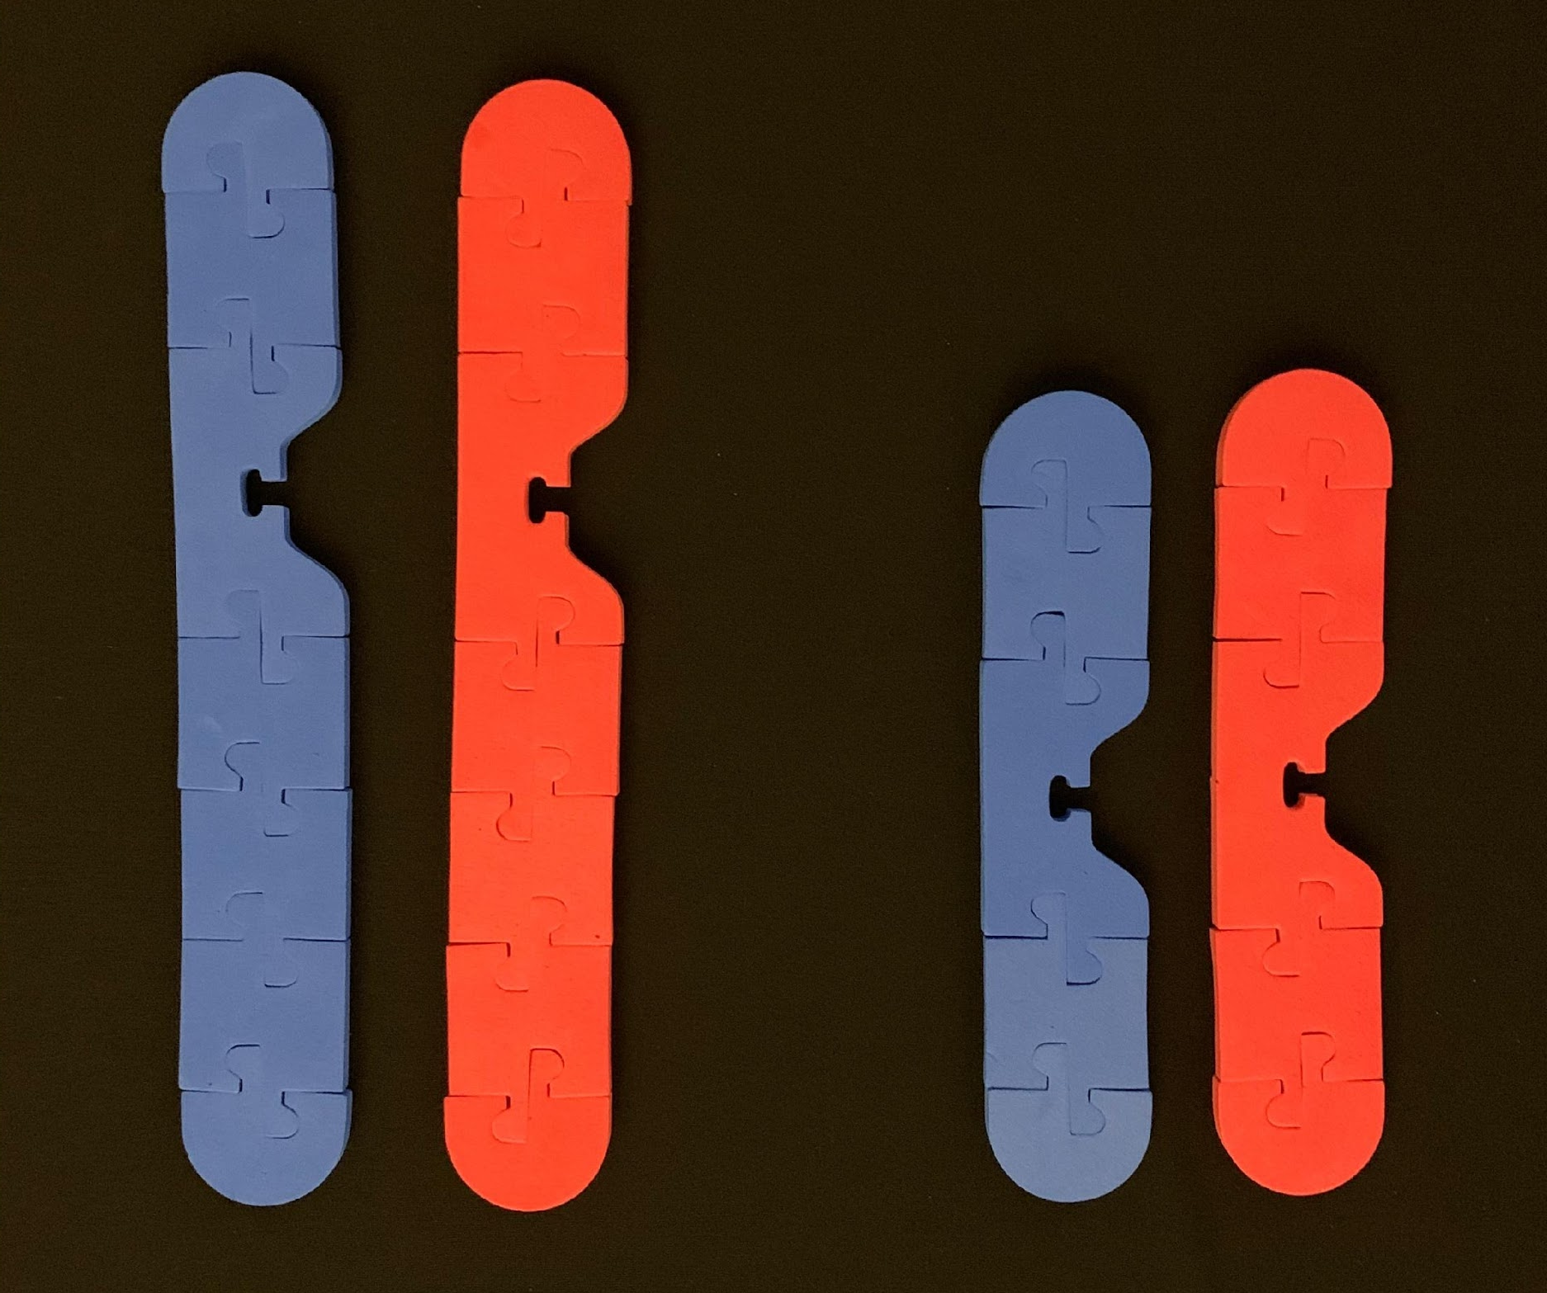
Prophase I – Crossing Over
G₁ Phase
S Phase
(& G₂ Phase)
Notes:
The purpose of meiosis is for sexual reproduction. Start this process by replicating chromosomes (S phase of interphase). Meiosis I begins with Prophase I. Synapsis is when homologous chromosomes come together and form a tetrad (4 sister chromatids together). Then CROSSING OVER occurs. This is actually a complicated process! (See the teacher’s manual in the full-size kit for more info on how to model this!) There are typically 1-3 crossover events between each pair of homologous chromosomes. (Show participants how to do this on camera). What do you notice about the chromosomes that is different than what occurs in prophase in mitosis?

Slide 35
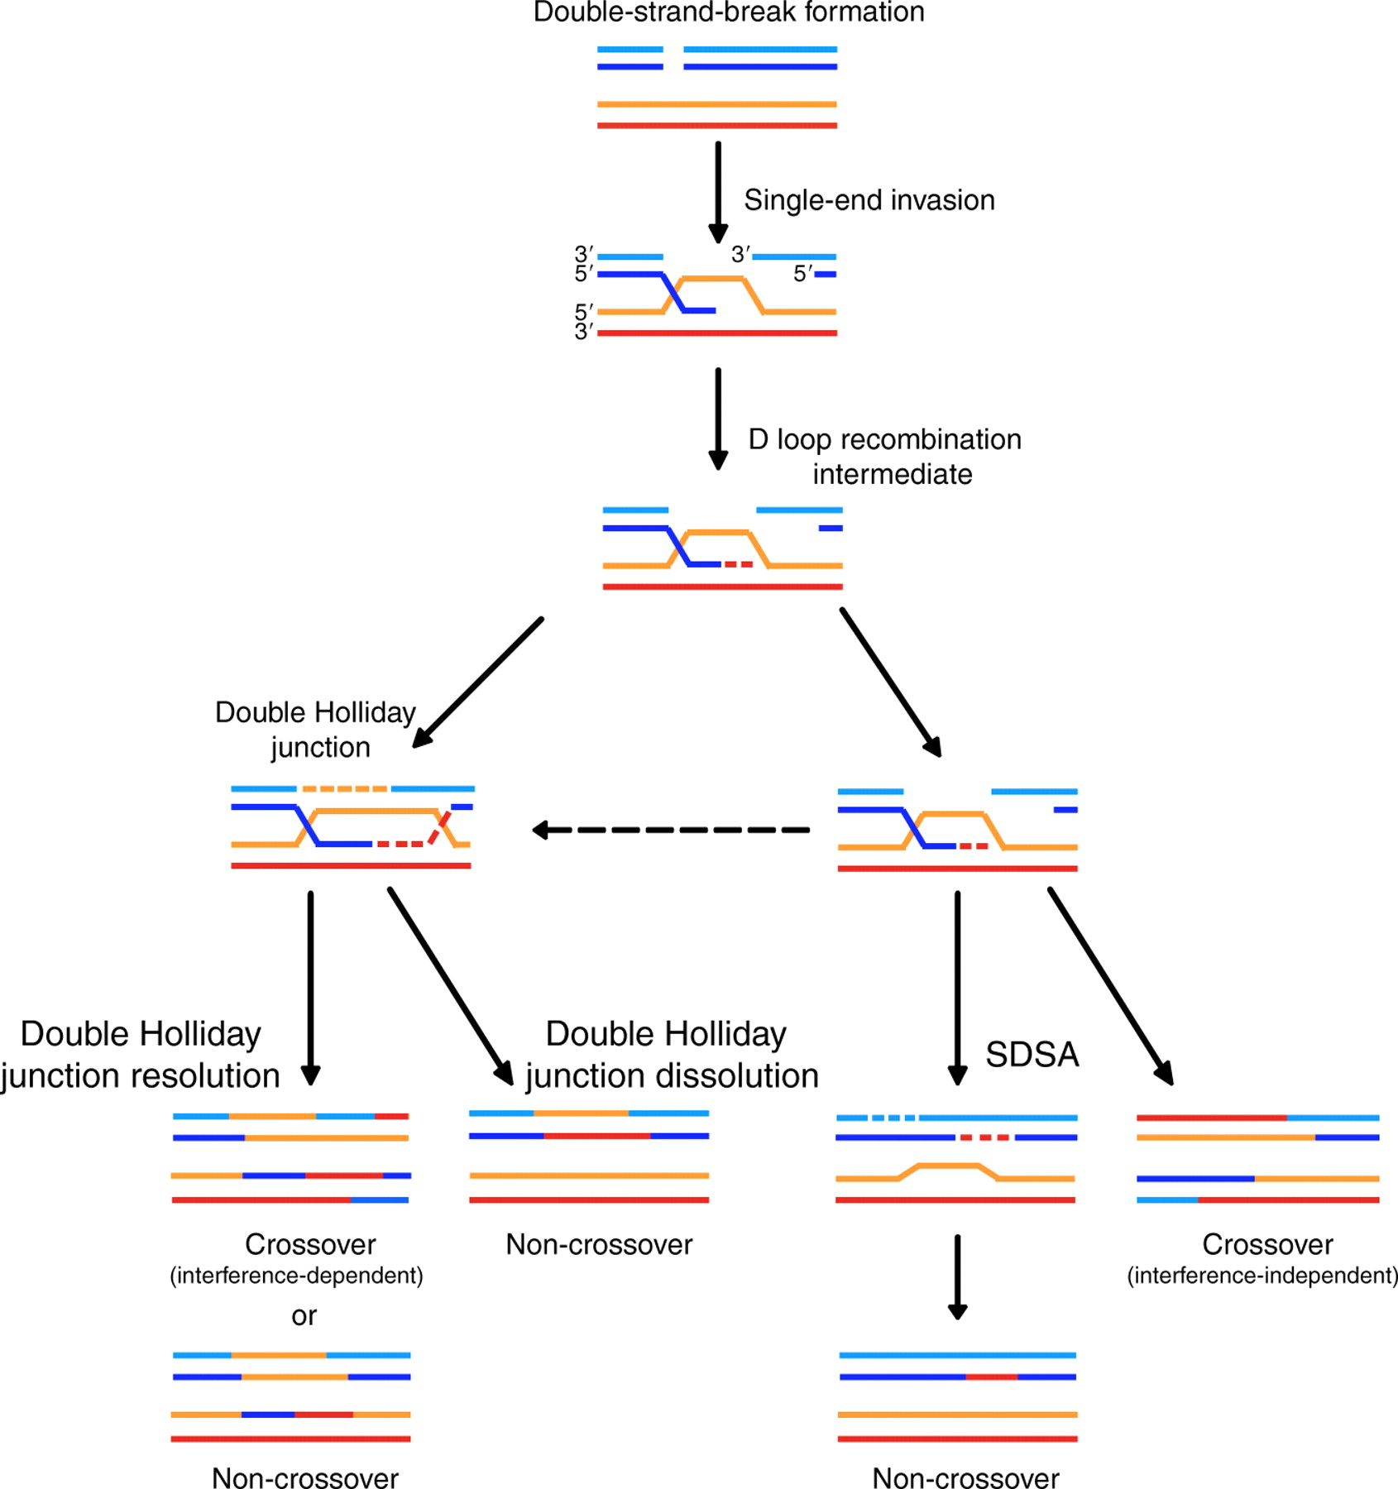
Youds, JL & Boulton, SJ. (2011). The choice in meiosis - defining the factors that influence crossover or non-crossover formation. Journal of Cell Science 2011 124: 501-513; doi: 10.1242/jcs.074427.
Notes:
Meiotic crossing over involves the generation of meiotic double-strand breaks (DSBs), which are subsequently repaired either as crossovers or non-crossovers. Meiotic recombination is not only necessary to create new allele combinations that generate genetic diversity, but is also essential in ensuring accurate chromosome segregation at the first meiotic division because the crossover acts as a tether between homologues, which ensures that each homologue will properly align at the metaphase plate and thereby correctly attach to the spindle.

Slide 36



Slide 37
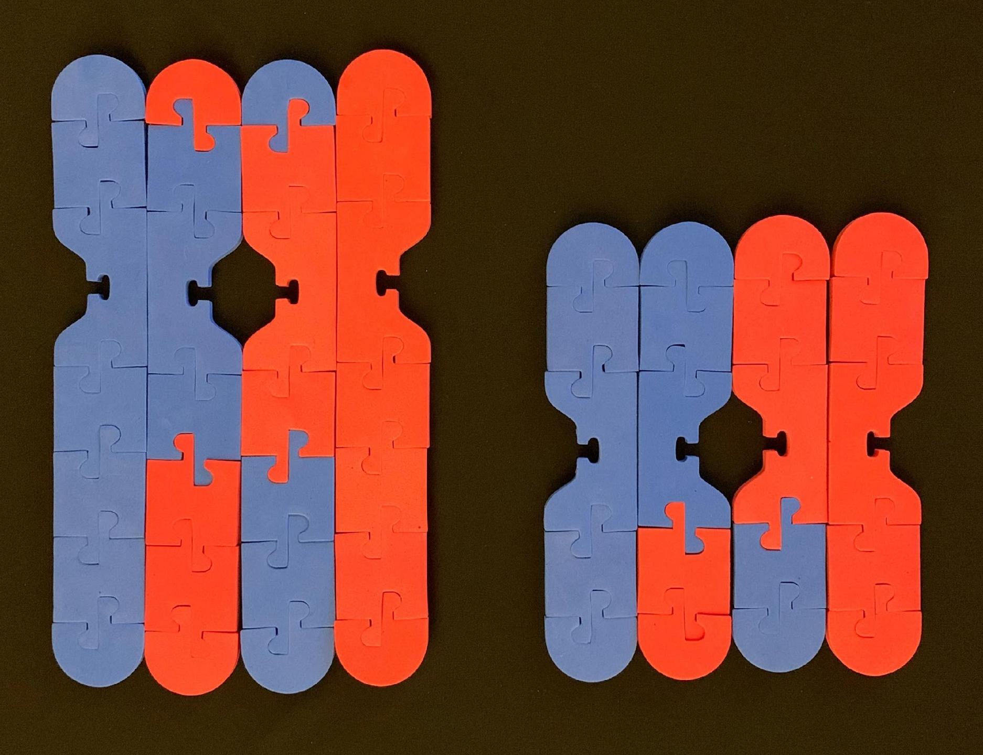
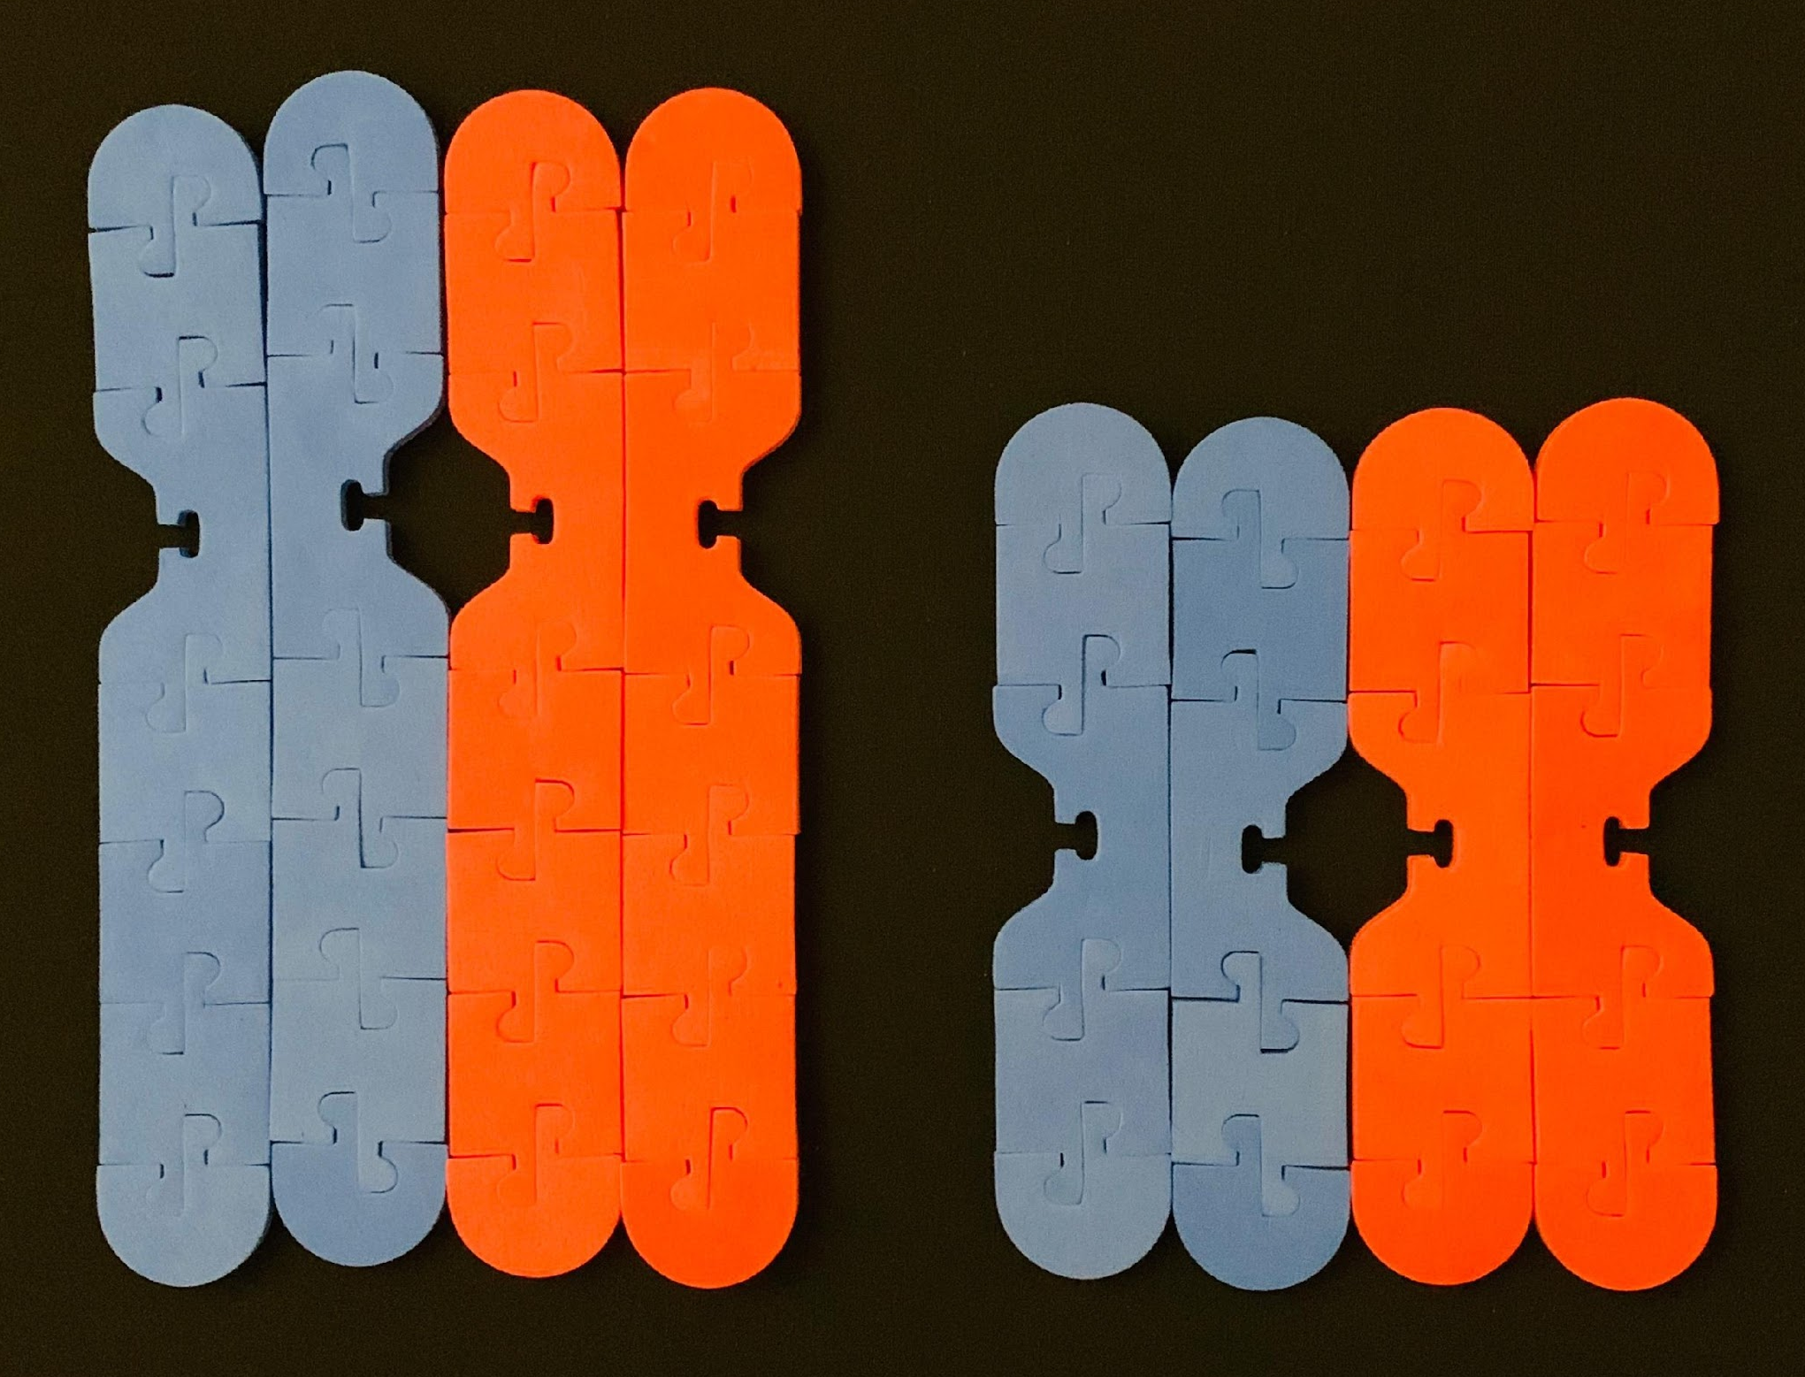
Prophase I – Crossing Over
Meiosis: Prophase I
G₁ Phase
S Phase
(& G₂ Phase)
synapsis
(tetrads form)
crossing over
(1-3 crossover events per chromosome)
Notes:
The purpose of meiosis is for sexual reproduction. Start this process by replicating chromosomes (S phase of interphase). Meiosis I begins with Prophase I. Synapsis is when homologous chromosomes come together and form a tetrad (4 sister chromatids together). Then CROSSING OVER occurs. This is actually a complicated process! (See the teacher’s manual in the full-size kit for more info on how to model this!) There are typically 1-3 crossover events between each pair of homologous chromosomes. (Show participants how to do this on camera). What do you notice about the chromosomes that is different than what occurs in prophase in mitosis?

Slide 38
Move your chromosomes to model 2 divisions: Meiosis I and Meiosis II
Source: http://cyberbridge.mcb.harvard.edu/
Notes:
Note: Student kit does NOT contain kinetochores and microtubules; can use string to model the spindle fibers in student kit; Ideas for doing this in class: (I do, we do, you do) students pair up and model the process together then take turns modeling and explaining to partner; timelapse video; Stop Motion video (use app); This part of modeling reveals a LOT of student misconceptions!!

Slide 39
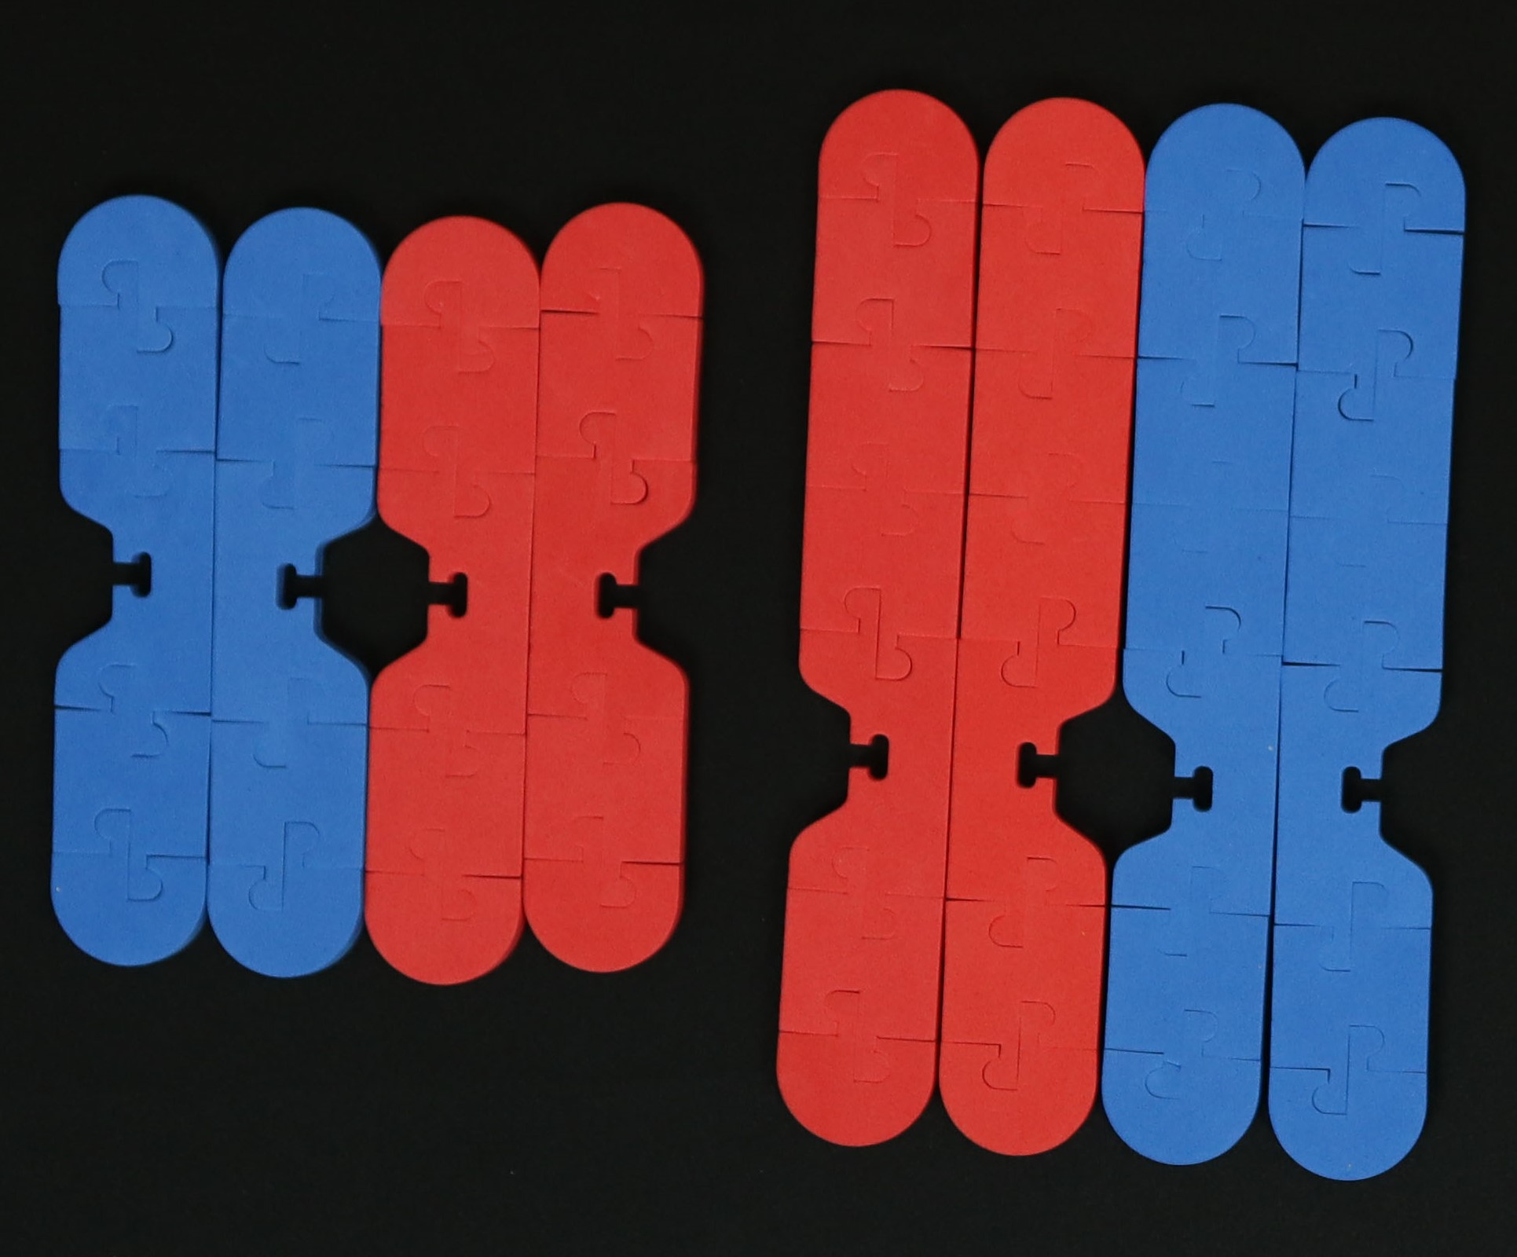
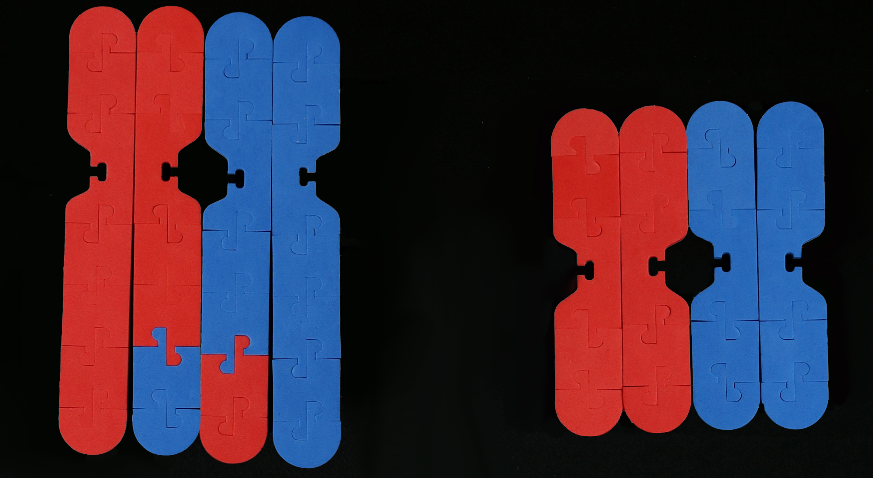
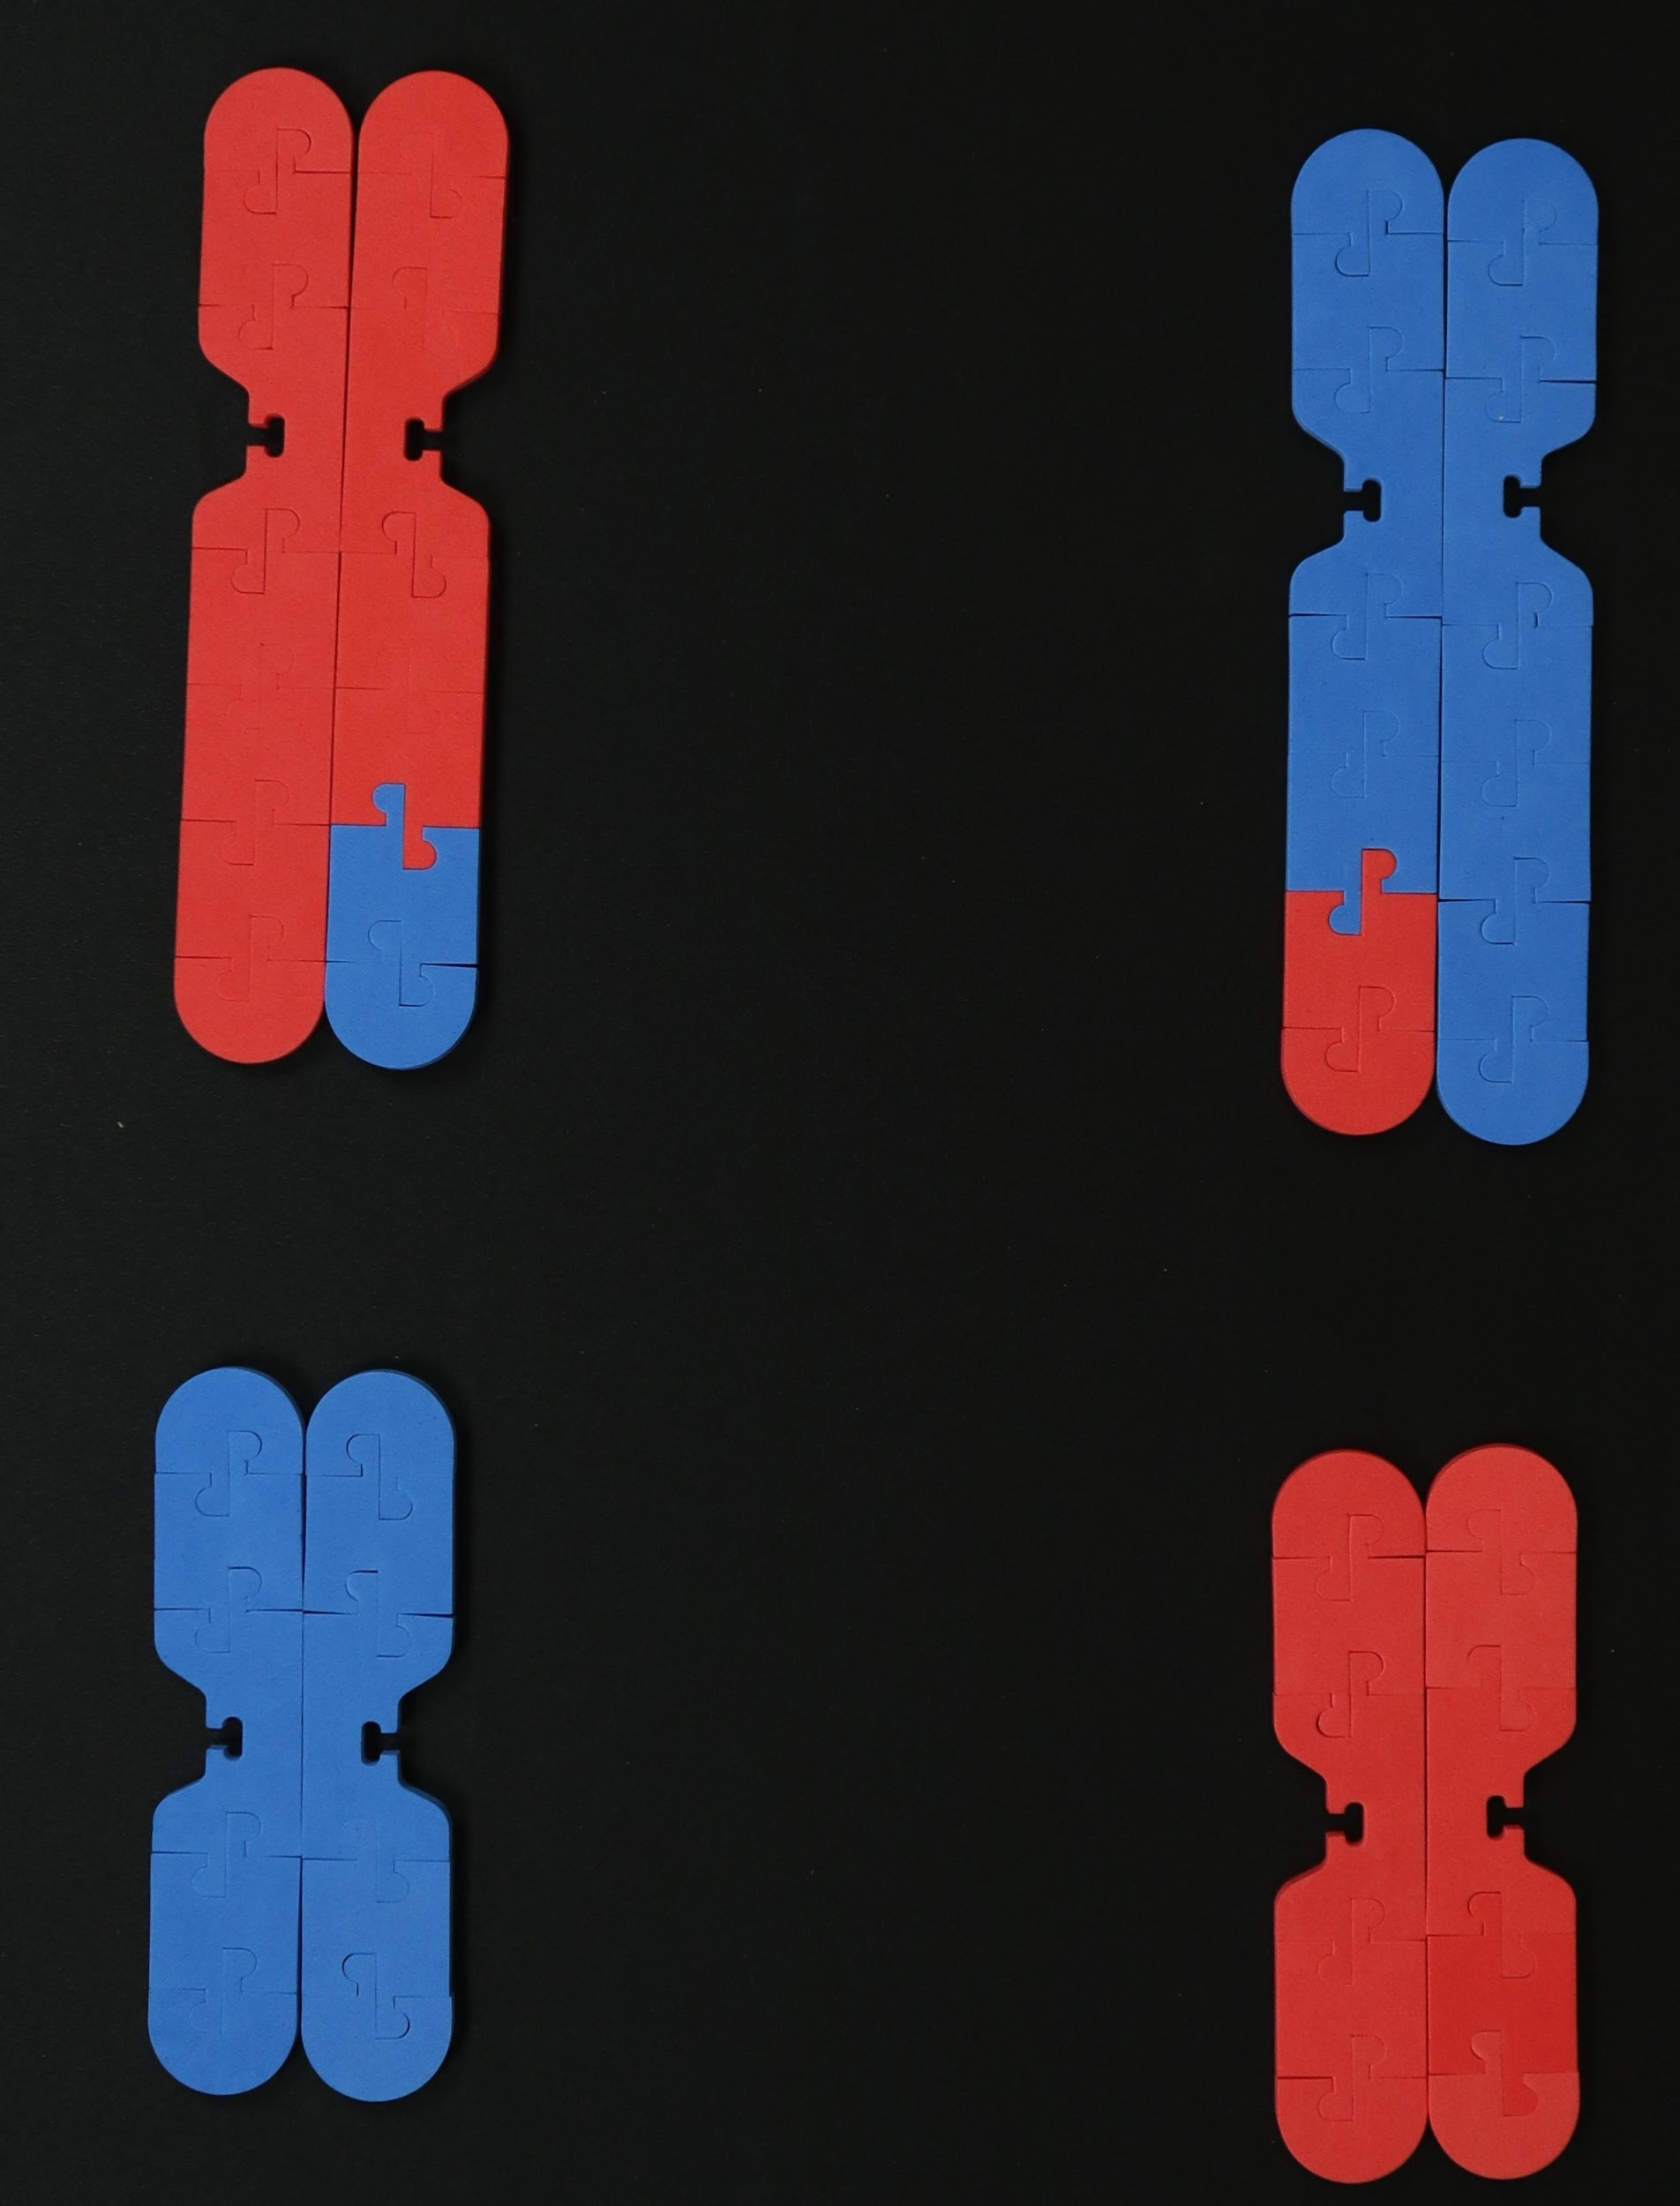
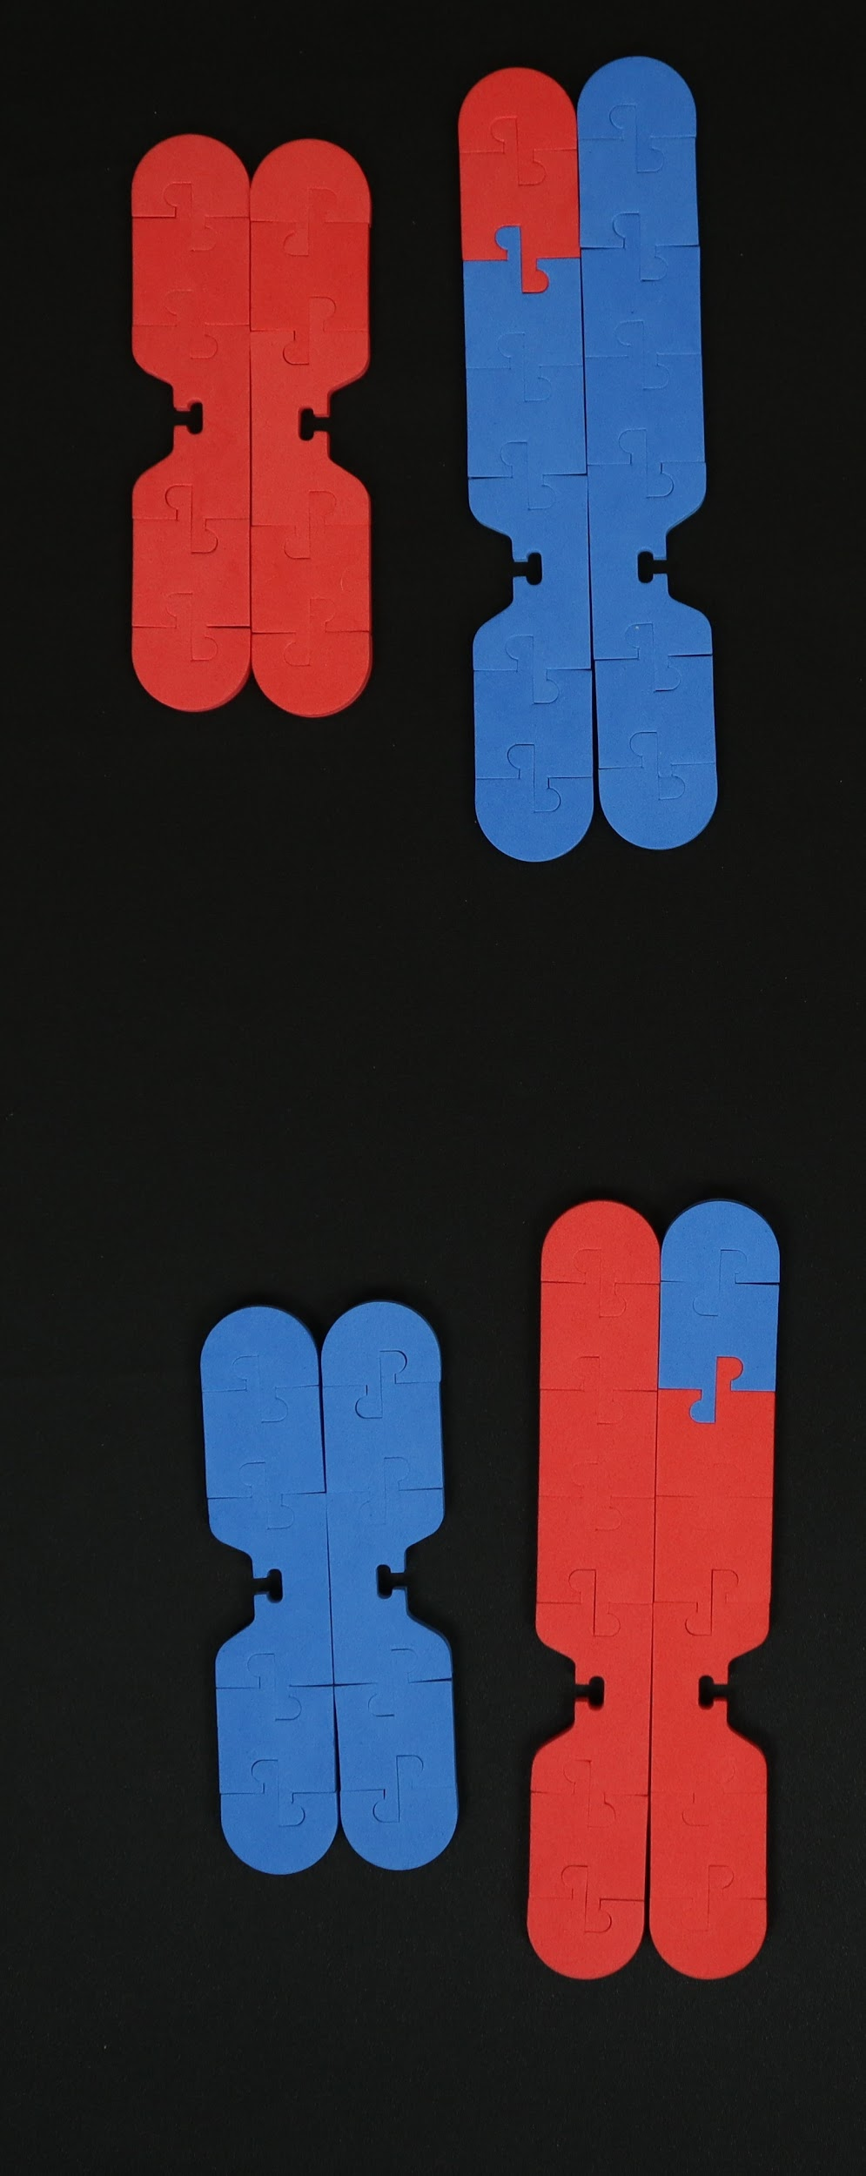
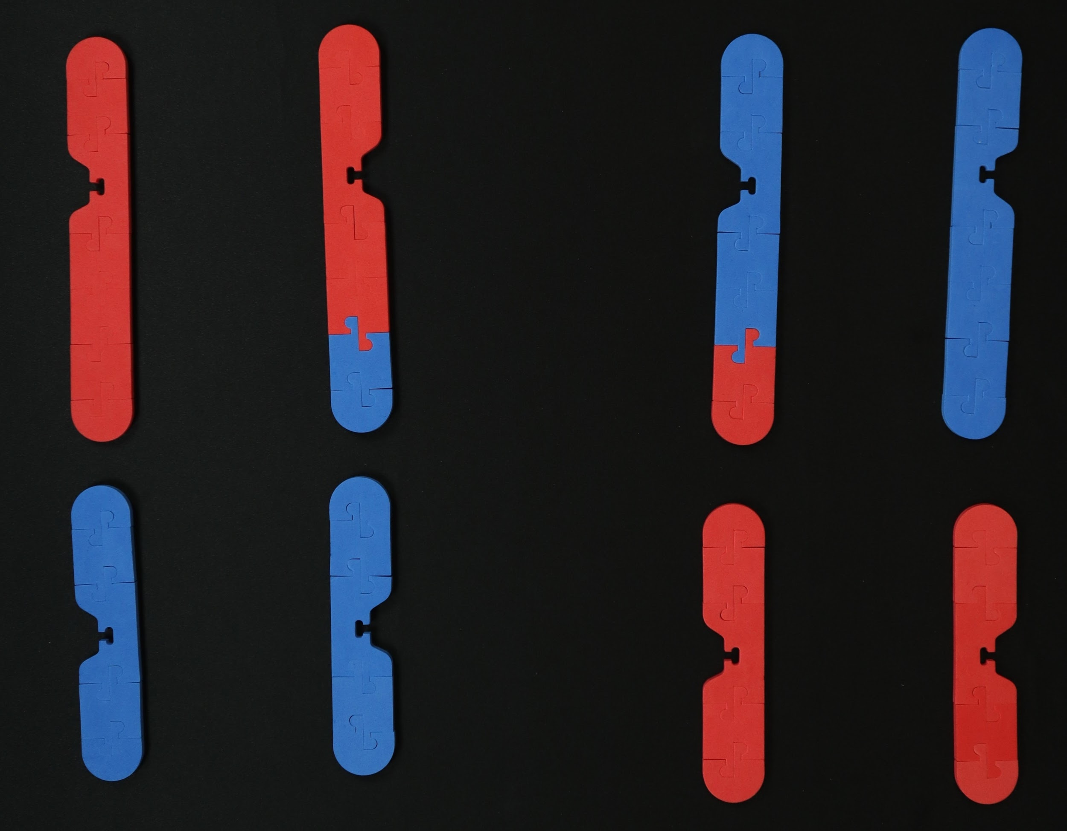
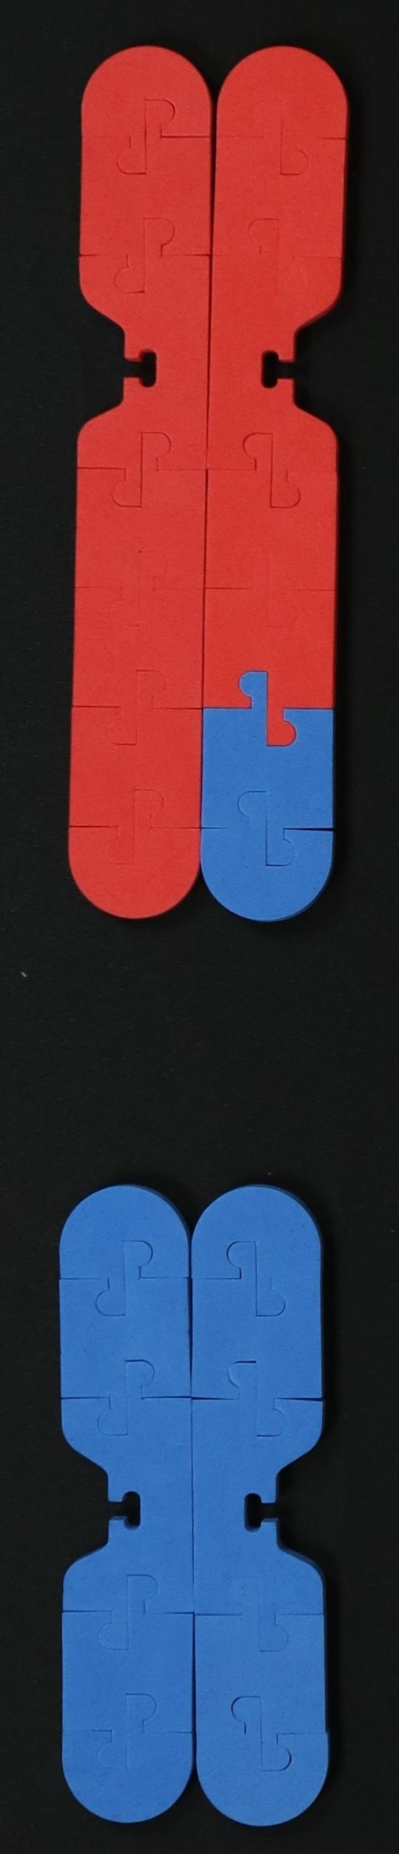
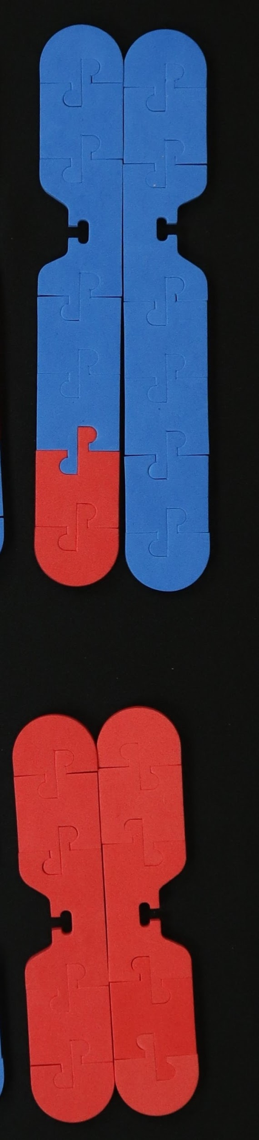
Meiosis I
synapsis
crossing over
Prophase I
Metaphase I
Anaphase I
Telophase I
Meiosis II
Prophase II
Metaphase II
Anaphase II
Telophase II
Notes:
Note: Student kit does NOT contain kinetochores and microtubules; can use string to model the spindle fibers in student kit; Ideas for doing this in class: (I do, we do, you do) students pair up and model the process together then take turns modeling and explaining to partner; time-lapse video; Stop Motion video (use app); This part of modeling reveals a LOT of student misconceptions!!

Slide 41
Discuss:
In meiosis, how do the daughter cells compare to the original parent cell?
How many chromosomes were in the parent cell?
How many chromosomes are in each daughter cell?
List all the ways in which mitosis and meiosis are similar.
List all the ways in which mitosis and meiosis are different.
Notes:
Discussion questions for students

Slide 42
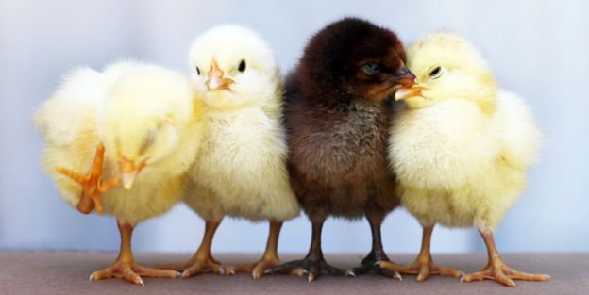
Sources of Genetic Variation
Think back to the ways in which DNA was being shuffled or “mixed up”.
What are the sources of genetic variation?
Notes:
Discussion questions for students; Sources of genetic variation: crossing over, independent assortment (Meiosis I); random fertilization

Slide 43
Chat Time
How might this activity be used in your classroom?
In what ways could modeling this process be helpful for students?

Slide 44


Slide 45
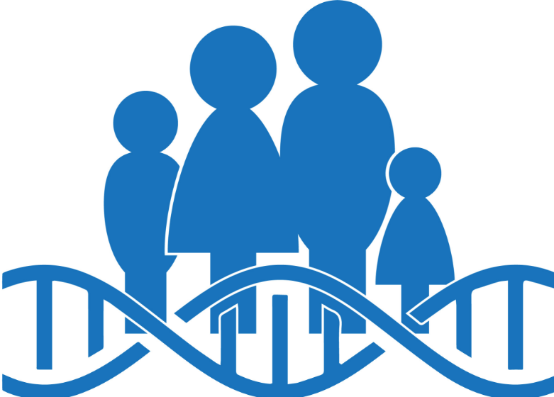
Genetic Counselor Role

Slide 46
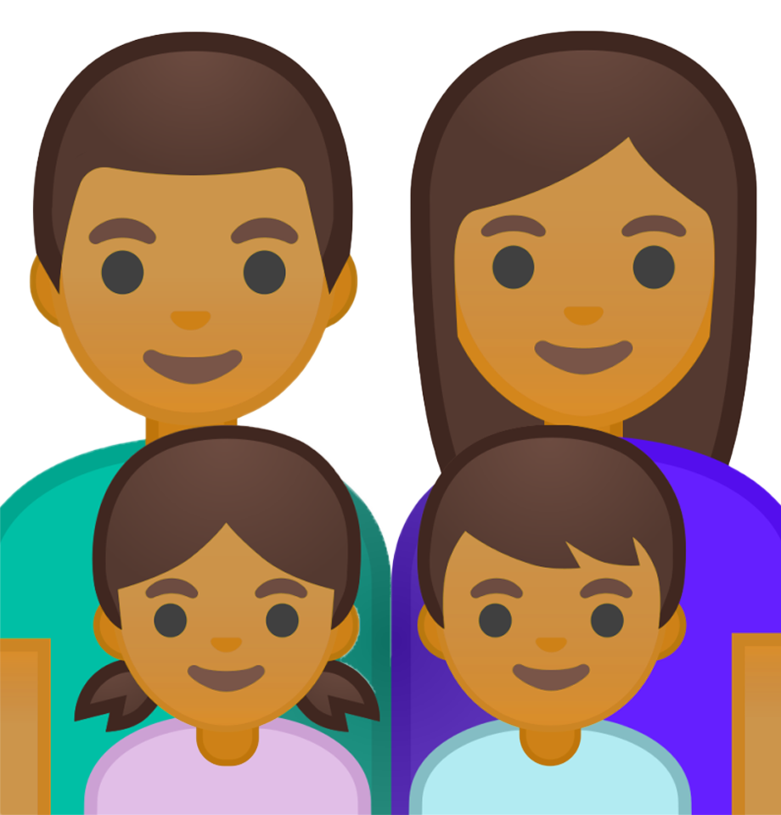
Meet the
Smiths
Notes:
Mr. and Mrs. Smith come to see you, a genetic counselor, because they want to start a family.

Slide 47
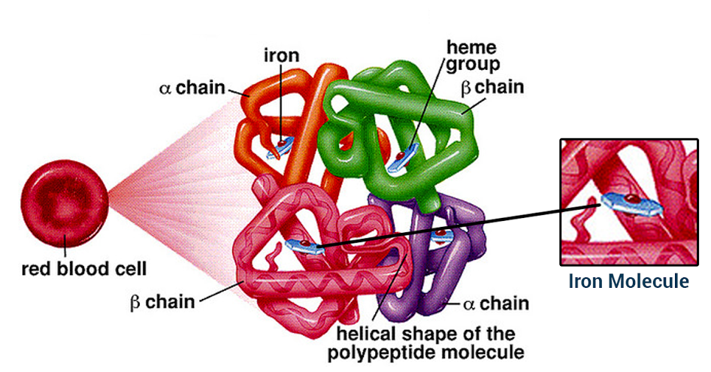
HBB Gene --> Beta-globin protein
Source: https://askhematologist.com/abnormal-hemoglobins/
Notes:
HBB Gene encodes for the beta-globin protein, 2 of the subunits that make up hemoglobin, a protein found in red blood cells. The Hemoglobin protein is made up of 2 alpha and 2 beta-globin subunits. Each globin subunit has a heme-group, which can bind to oxygen. The main job of red blood cells is to carry oxygen throughout the body, so hemoglobin proteins are essential for this task.

Slide 48
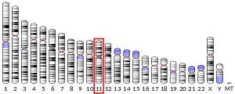
Where is the HBB gene located?
Source: Genome Decoration Page/NCBI
Notes:
The HBB gene is located on human chromosome 11.

Slide 49
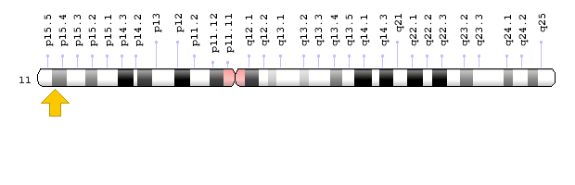
Chromosome 11
HBB Gene
Source: Genome Decoration Page/NCBI
Notes:
HBB protein is produced by the gene HBB which is located in the multigene locus of β-globin locus on chromosome 11, specifically on the short arm position 15.5.

Slide 50
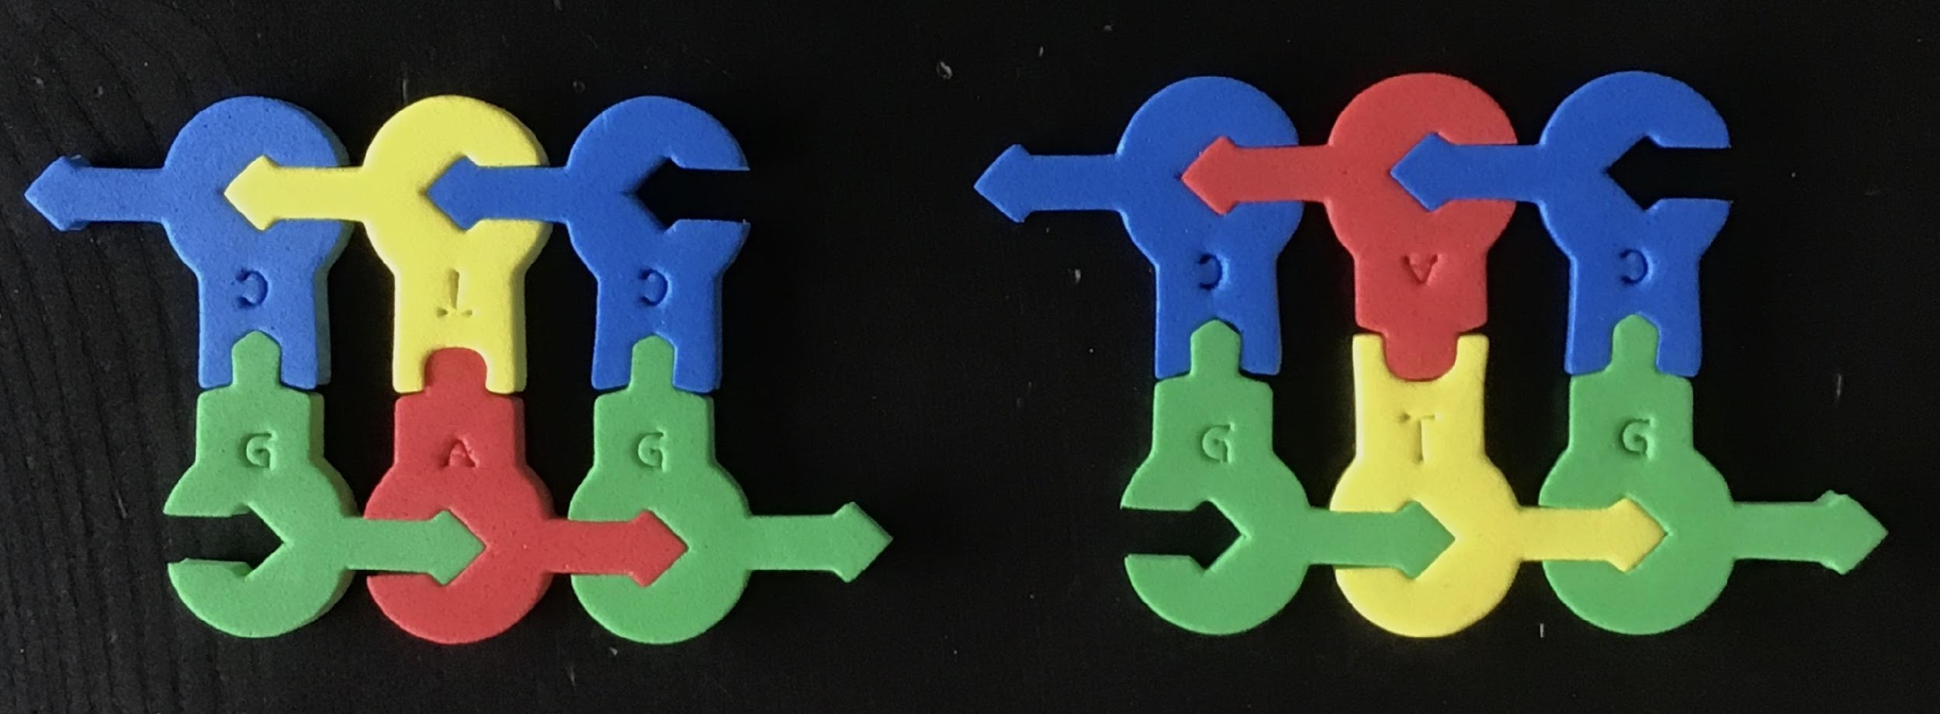
HBB variants (alleles):
What’s the difference?
Notes:
Single base pair substitution of T-->A (in bottom strand) Position 5248232 SNP ID rs334. T/A. Glu7Val. Missense. Most common mutation of HBB gene.

Slide 51

Change in DNA = Mutation
https://beyondthedish.wordpress.com/2015/03/24/stem-cell-researchers-develop-new-method-to-treat-sickle-cell-disease/
Notes:
Single base pair substitution of T🡪A (in bottom strand) Position 5248232 SNP ID rs334. T/A. Glu7Val. Missense. Most common mutation of HBB gene. Glutamic Acid (hydrophilic side chain) to Valine (hydrophobic side chain).

Slide 52


Abnormal Hemoglobin
Normal Hemoglobin
Wu, Tao & Wang, Xiaodong & Cohen, Barry & Ge, Hongya. (2010). Molecular Modeling of Normal and Sickle Hemoglobins.
Notes:
Ask: What differences do you spot between the structure of normal hemoglobin and the abnormal hemoglobin? Answer: The structures are VERY SIMILAR. The only difference is the Glu to Val substitution that creates a hydrophobic pocket (changing the quaternary structure) and the bonding between subunits. This makes the HbS more “sticky” so that subunits clump together in a linear fashion (as shown in the right diagram)

Slide 53
Build these HBB Variants (Alleles)
Normal
Beta-Globin Protein
(Hemoglobin-A)
Abnormal
Beta-Globin Protein
(Hemoglobin-S)
Notes:
Directions: Model these nucleotides. The normal version of the beta-globin protein leads to hemoglobin-A. The abnormal version leads to hemoglobin-S.

Slide 54

HBB Genotypes
What are the possible allele combinations that someone could inherit?
Hemoglobin-A
Hemoglobin-S
Notes:
Note that each person has 2 copies of each chromosome, or 2 copies of each gene. A person could inherit 2 copies of HA, 2 copies of HS or 1 copy of each.

Slide 55
HBB Genotypes
3 possible allele combinations:
H_{A}H_{A} or HH
H_{A}H_{S} or Hh
H_{S}H_{S} or hh
Notes:
Note that each person has 2 copies of each chromosome, or 2 copies of each gene. A person could inherit 2 copies of HA, 2 copies of HS or 1 copy of each. The genotypes can be written in shorthand as shown.

Slide 56
HH = Normal Phenotype
What will be the shape(s) of the hemoglobin molecules?
How do you think the shape of these different molecules will affect the structure and function of red blood cells?
Hh = Sickle Cell Trait
Hh = Sickle Cell Disease
Notes:
Questions to ask your students

Slide 57

Source: About Kids Health

Slide 58

Source: Wikipedia

Slide 59

Mr. & Mrs.
Smith
Notes:
Mr. and Mrs. Smith are a lovely young couple who are ready to start a family. But they are concerned. While neither of them have ever shown any symptoms of sickle cell disease, there IS a history of SCD in both of their families. Just to be cautious, they want to know what are the chances their future children might have sickle cell anemia. They come to you for genetic counseling.

Slide 60
Mr. Smith: Hh
Mrs. Smith: Hh
Notes:
You take blood samples from the couple for analysis. Mr. Smith is a carrier for SCD. His cells contain 1 copy of the normal HBB gene and 1 copy of the mutated HBB gene. Mrs. Smith is also a carrier for SCD. While neither individual has sickle cell disease, they both carry the sickle hemoglobin gene, so they have the sickle cell TRAIT.

Slide 61
Mr. Smith: Hh
Mrs. Smith: Hh
Notes:
Is this what you modeled?

Slide 62





H
h
Mr. Smith: Hh
H
H
H
Mrs. Smith: Hh
h
Notes:
(Need animation of Punnett Square use)

Slide 63
H
h
Mr. Smith: Hh
H
H
H
H
h
Mrs. Smith: Hh
h
H
h
h
h

Slide 64



Place the genotypes onto the Punnett Square handout
Create different combinations of genotypes by moving one “allele” from each parent into the offspring boxes
Take a photo of each offspring box to record each combination of alleles

Slide 65
What are the chances that the Smiths will have a child affected with sickle cell disease?
Notes:
25% chance each child born will inherit SCD; 50% sickle cell trait, 25% normal (not affected)

Slide 66

Sickle Cell Anemia is inherited as an autosomal recessive genetic disorder.
Mr. Smith: Hh
Mrs. Smith: Hh

Slide 67


Slide 68

Notes:
From genome.gov: Genetic counseling as a process. It's a process of understanding the genetic contribution to disease. It's a process of understanding ways to avoid risks or minimize risks to affected individuals. But importantly, it's also a process in which people can talk about their feelings of loss, and disappointment and heartbreak and be given opportunities to make good, informed decisions and to improve their health outcomes.

Slide 69
Workshop NGSS Connections
SEPs | CCCs | DCIs
Asking Questions and Defining Problems | Patterns | LS1.A: Structure and Function
Developing and Using Models | Cause and Effect: Mechanism and Explanation | LS1.B: Growth and Development of Organisms
Constructing Explanation and Designing Solutions | Scale, Proportion, and Quantity | LS3.A: Inheritance of Traits
Engaging in Argument from Evidence | Structure and Function | LS3.B: Variation in Traits
Analyzing and Interpreting Data | Stability and Change

Slide 70


Chromosome Student Modeling Pack
Chromosome Connections Kit

Slide 71

Summer Courses
A few weeks ago, we shared some information about Modeling the Molecular World.
Watch now to learn about two additional Summer Courses the CBM has to offer
To learn about all of the Summer Professional Development Courses the CBM has to offer visit:
https://cbm.msoe.edu/summerCourses

Slide 72

Timothy Herman, PhD
Director of the Center for BioMolecular Modeling at MSOE
Founding Partner of 3D Molecular Designs
B.S. in Chemistry from the University of Nebraska
Ph.D. in Biochemistry from Oregon State University.
Post-doctoral studies in Molecular Biology at Harvard Medical School.
Notes:
Introduce Tim -
Tim Herman is the founder and Director of the MSOE Center for BioMolecular Modeling and the founding partner of 3D Molecular Designs. In addition to grant writing, model development, and digging into recently published research papers, he enjoys spending time with his 4 grandchildren. Tim & Diane had the water molecules out this last weekend with the grandkids and were modeling ice! I’m looking forward to when he starts telling them this Aquaporin story.
And here is Tim -

Slide 73

Ensuring Genome Stability
(while maintaining an escape hatch)

Slide 74
A foundational concept of biology is
GENETICS
MOLECULAR GENETICS
- and the flow of genetic information from -
DNA… to RNA… to Protein
Should you teach EPIGENETICS?

Slide 75


Slide 76
In epigenetics, small chemical markers -- methyl groups and acetyl groups -- are added to both DNA and histones to regulate the accessibility of the DNA to transcription machinery.

Slide 77


David Goodsell
Scripps Research institute
Scientist, Author, and Artist of all things small.

Slide 78


An electron micrograph of an antibody-producing B-cell
Your recent flu shot, in action.

Slide 79


Slide 80
Thinking Deeper….
Consider the human genome – 3.2 billion base pairs of DNA, wrapped up into nucleosomes. Only 1.5% of our genome encodes protein. And only a fraction of all those protein-encoding genes are expressed in any one cell type.
When we transcribe our DNA into mRNA…
how do we find the right genes to express?
… and how do we deal the nucleosomes?

Slide 81


Slide 82


Slide 83
In eukaryotes,. the cytosine of 5’– CpG -3’ is methylated …at the #5 carbon
CH₃
CH₃
CH₃
CH₃
CH₃
CH₃
5’-TCCGTATACCCGGT–3’
3’-AGGCATATGGGCCA–5’
CH₃
CH₃
CH₃
CH₃
(Thymine (T) is already methylated at it #5 carbon.)

Slide 84
And now,
Let’s explore epigenetics with models…

Slide 85
The EMBO Journal Vol.17 No.17 pp.4905–4908, 1998
CpG methylation, chromatin structure and gene silencing—a three-way connection

Slide 86
Ask me in the March 17 webinar...
What does CRISPR ….
have to do with epigenetics?

Slide 87





Thank you for attending!
Dynamic DNA Kit©
Chromosome Student Modeling Pack
Join us on facebook for Science Sunday!
Nucleosome Mini Model
Chromosome Connections Kit©
Use discount code Webinar20 to receive 20% off most items in our catalog.

Slide 88


Invite your colleagues to register!
Genome Editing, I
CRISPR – As an Adaptive Immune System in Bacteria
Wednesday, March 10, 2021 at 6:00 PM Central
Genome Editing II
CRISPR Cas9 - A Powerful New Tool for Editing the Human Genome
Wednesday, March 17, 2021 at 6:00 PM Central
Celebrate World Water Day!
Engage with Water Molecules!
Monday, March 22, 2021 at 6:00 PM Central
https://www.3dmoleculardesigns.com/Webinars4.htm

