Slide 1
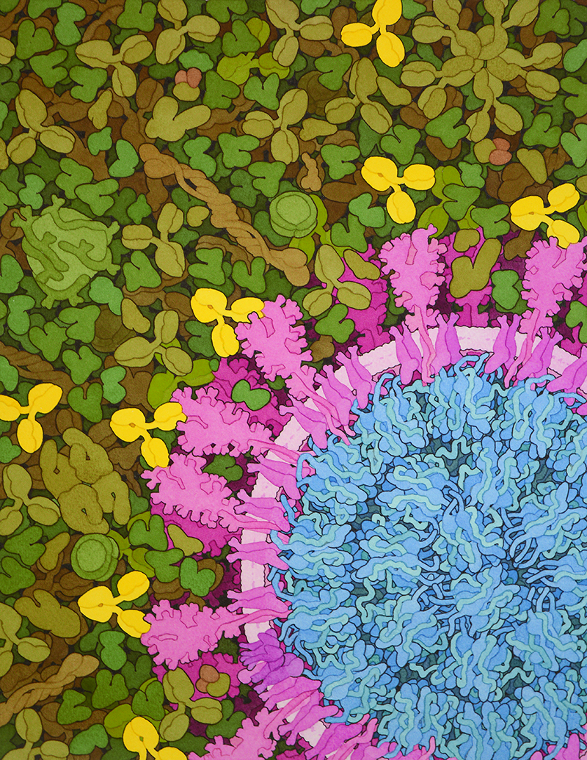
Coronavirus Antibodies & Emerging Vaccines
Notes:
Welcome to Coronavirus Antibodies & Emerging Vaccines! We are very pleased to have you join us for our very first webinar. I really appreciate the support you have shown 3D Molecular Designs and the MSOE Center for BioMolecular Modeling with your registration.
I am Heather Ryan, and I will be your host for the series.

Slide 2
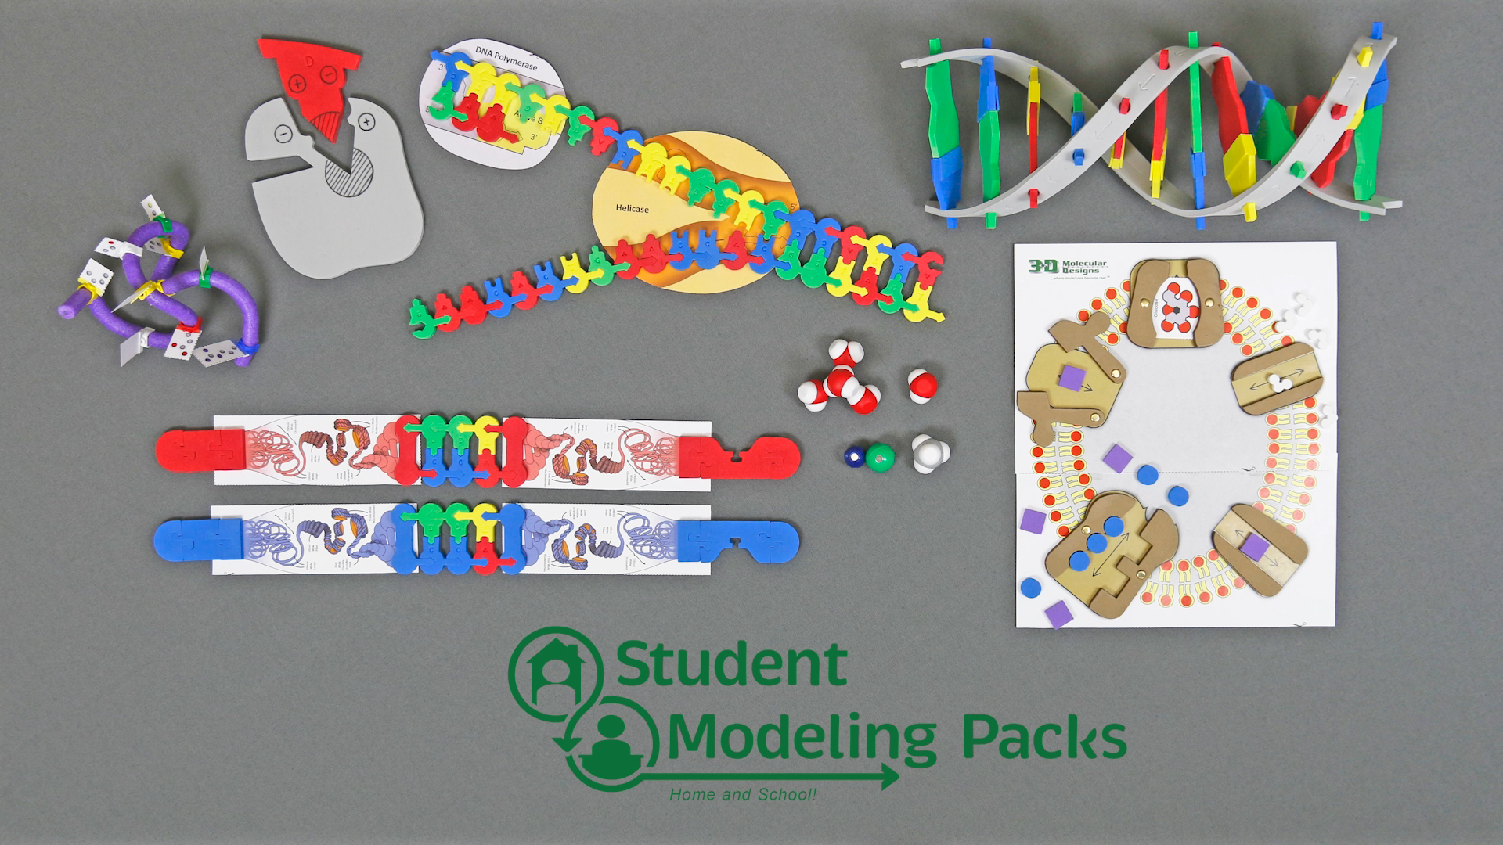
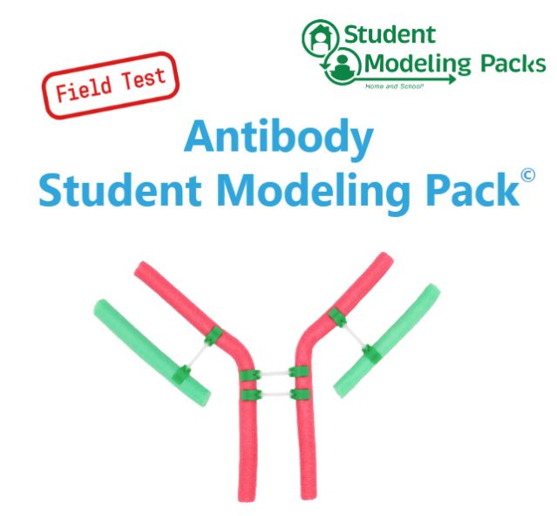
Notes:
I hope you all have received your Student Modeling Packs by now! Kris Click to Short video of other modeling packs
We created these individual packs to support safe, hands-on modeling at school or home during the pandemic. Our classroom kits will always be most effective – both in terms of total cost and student learning, but the Student Modeling Packs give teachers another option at this time. You will see a mix of the regular classroom kits and Student Modeling Packs during this webinar series.
And now I would like to welcome Diane Herman, 3D Molecular Designs’ Managing Partner.

Slide 3
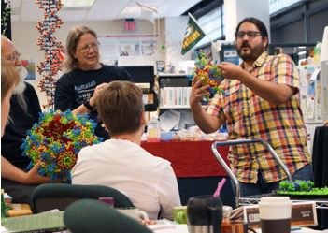
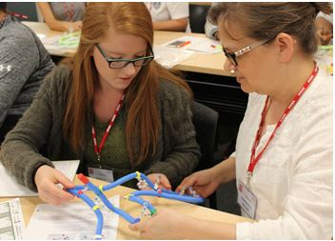
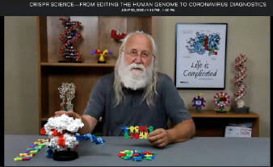
Notes:
We recognize so many of you. Please raise your hand if you have attended one of the CBM’s summer courses or a conference workshop. It is great to interact with you again! We are also excited to have so many new teachers attending. Please introduce yourself in the chat – your name, where and what you teach -- whether returning or new.
I will be monitoring chat and providing information. Don’t be shy about making comments or asking questions. Since this is a large group, if I miss your request or question, please ask again.
And now I’ll welcome Kris Herman our Education Program Manager.

Slide 4



Webinar Norms
Questions for the Speaker should be entered into the Q&A Box
Comments and Questions for 3D Molecular Designs Staff should be entered into the Chat box.
Use the Raise Hand button to participate in discussion when applicable.
Notes:
You will notice we are in a Webinar Zoom due to our participation numbers.
Please raise your hand to ask a verbal question or to turn on your video.
Diane will be monitoring chat to share information – please post and share as much as you want there.
If you have a question for a speaker, please post that in the Q&A. Our speakers will watch that for questions as we go.
We are recording this session and it will be available, along with the session slides to registrants on our website for a year. I will send you an email with a link when it is available.
We are happy to provide Certificates of Participation for attendees. Please complete the form on the link that Diane provides.

Slide 5
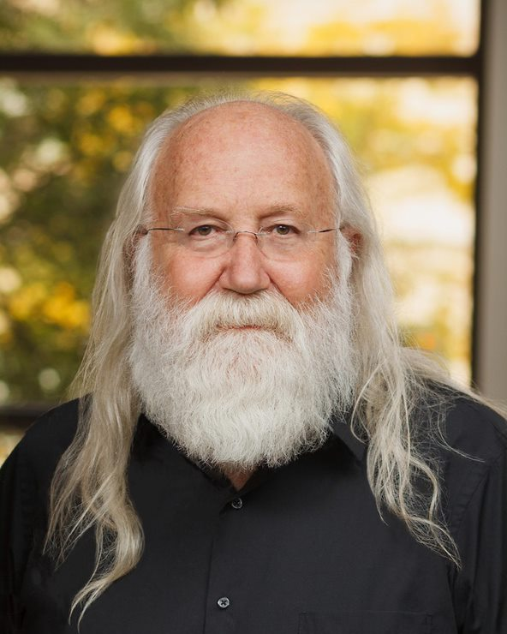
Timothy Herman, PhD
Director of the Center for BioMolecular Modeling at MSOE
Founding Partner of 3D Molecular Designs
B.S. in Chemistry from the University of Nebraska
Ph.D. in Biochemistry from Oregon State University.
Post-doctoral studies in Molecular Biology at Harvard Medical School.
Notes:
I’m pleased to introduce our Speaker Dr. Tim Herman; director of the Center for Biomolecular Modeling at MSOE. Dr. Herman has 25 years of experience producing physical models of proteins and other molecular structures for science researchers and classroom educators. Tim received his B.S. in Chemistry from the University of Nebraska and his Ph.D. in Biochemistry from Oregon State University. He pursued post-doctoral studies in Molecular Biology at Harvard Medical School. Welcome Tim:
10:32 Kris stop screen share
Tim: Coronavirus model

Slide 6
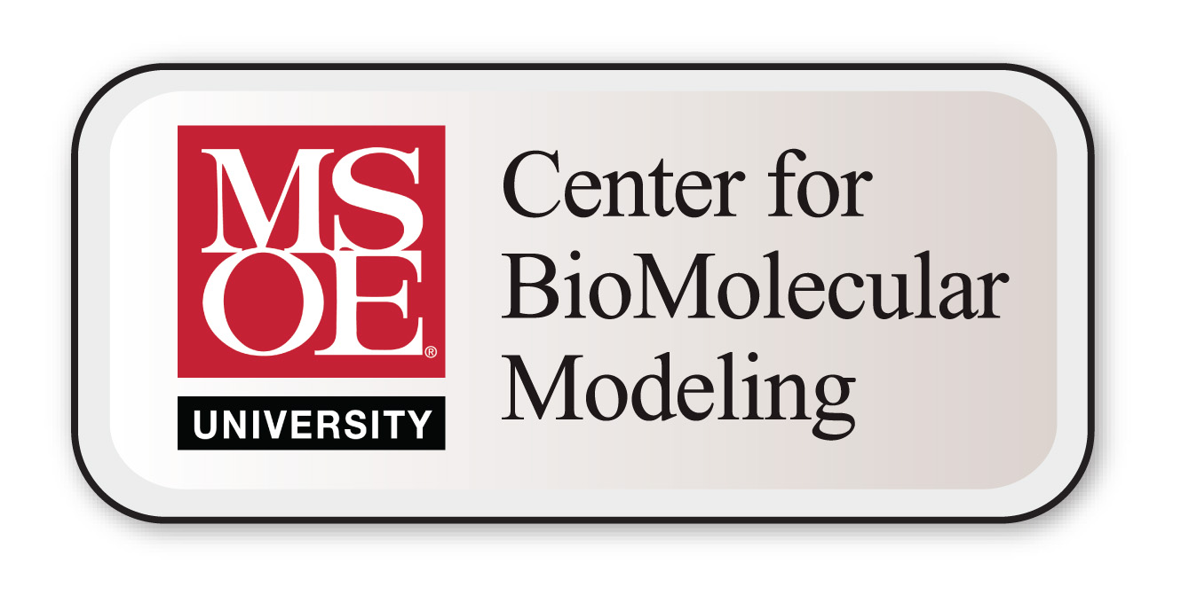

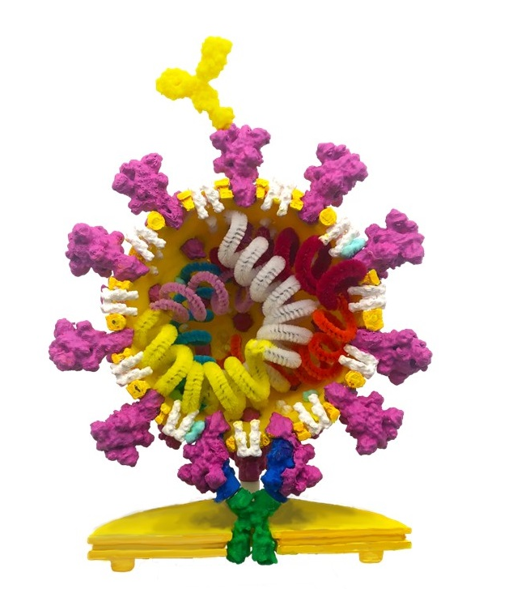
The science of
CORONAVIRUS
…from the perspective of a
reductionist biochemist.

Slide 7
My job?
… to keep up with recent developments in the molecular biosciences,…. and to interpret/communicate these developments for educators and their students.
We do this through modeling!

Slide 8
MAPS Teams
Modeling A Protein Story
CORONAVIRUS
The AeroNab Story

Slide 9
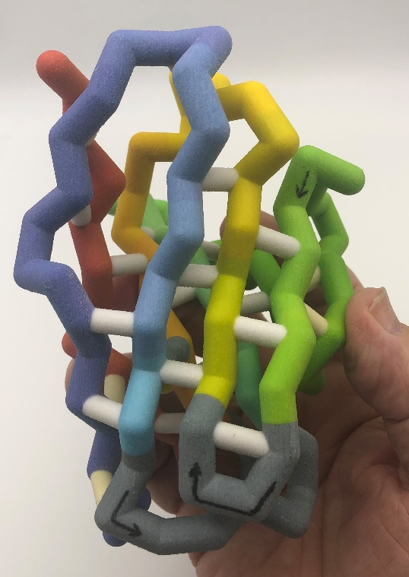
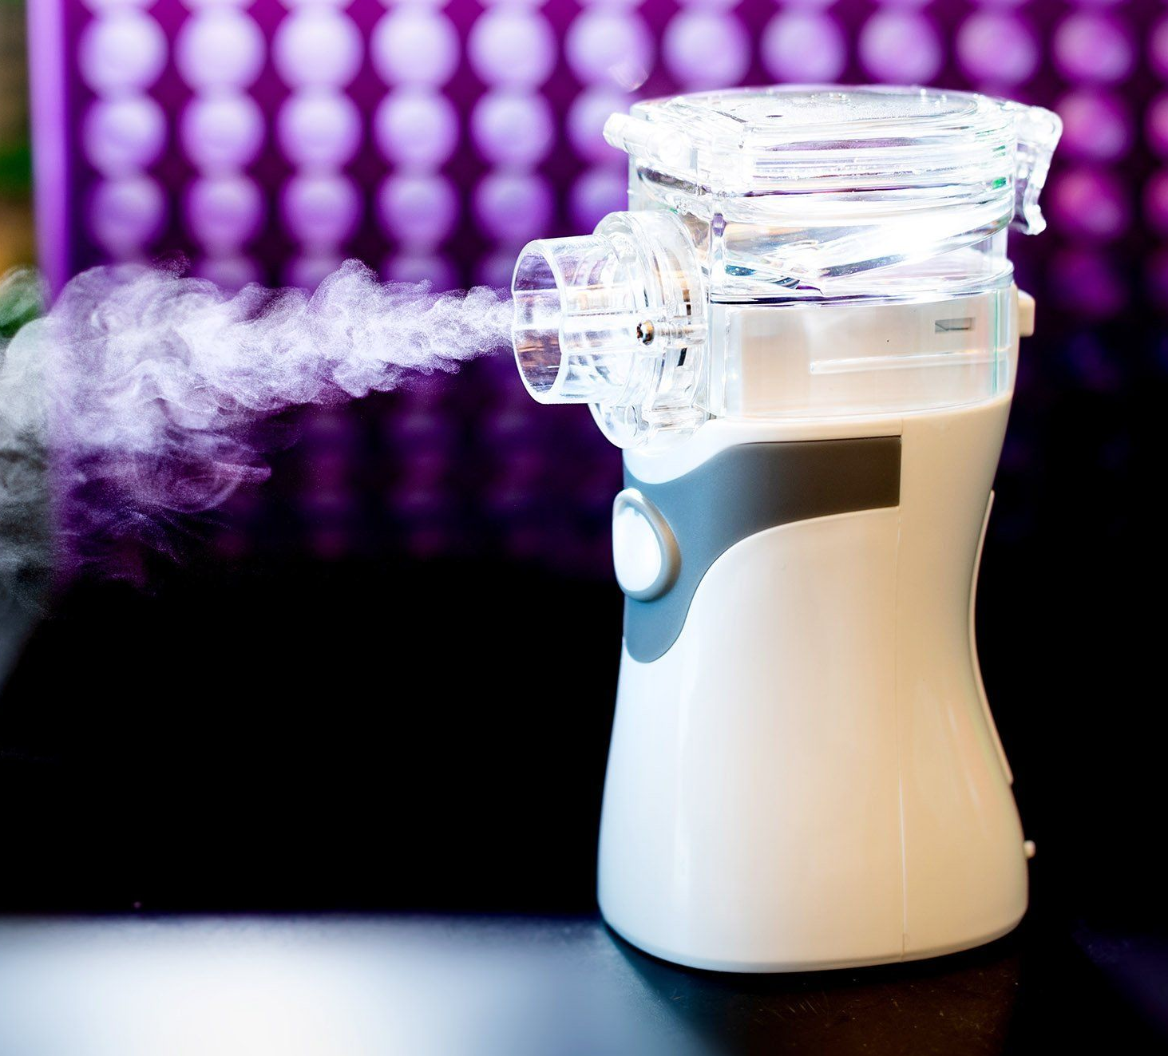
And now,….
Antibodies,…and the AeroNab Story!

Slide 10
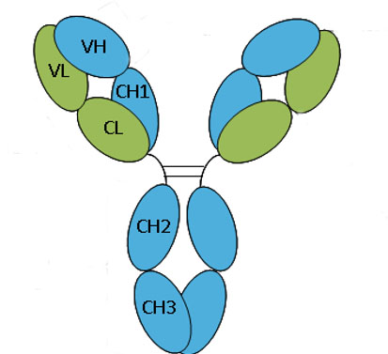
Antigens
Antibodies have a modular design
They are composed of 12 immunoglobulin folds
Each IgG fold is made up of ~120 amino acids
Each IgG fold consists of 2 beta-sheets….connected by a disulfide bond.
An antibody is composed of 2 Light Chains,
and 2 Heavy Chains

Slide 11
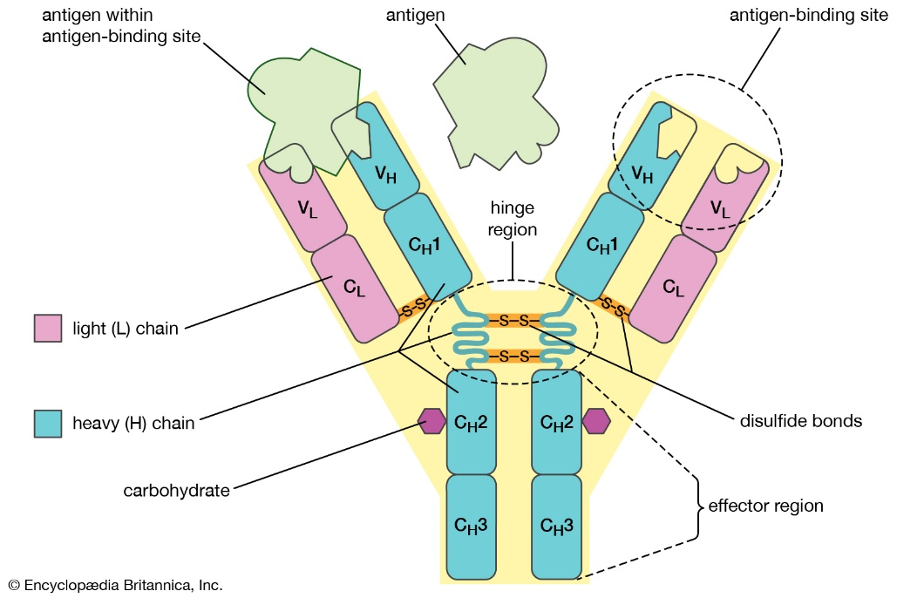

Slide 12
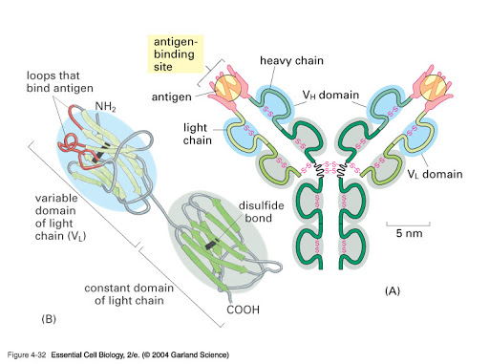

Slide 13
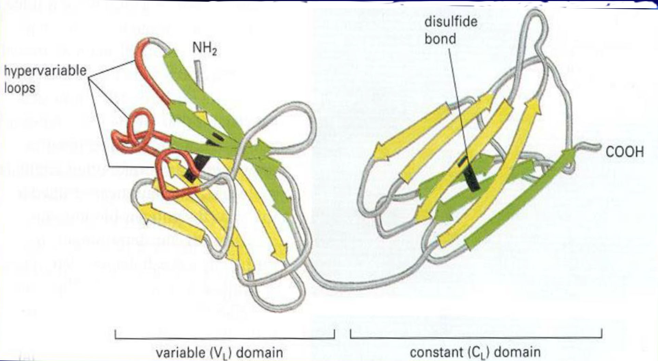

Slide 14
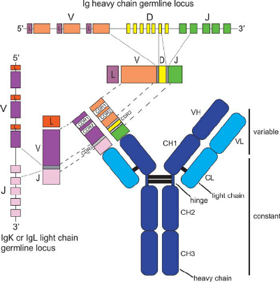

Slide 15
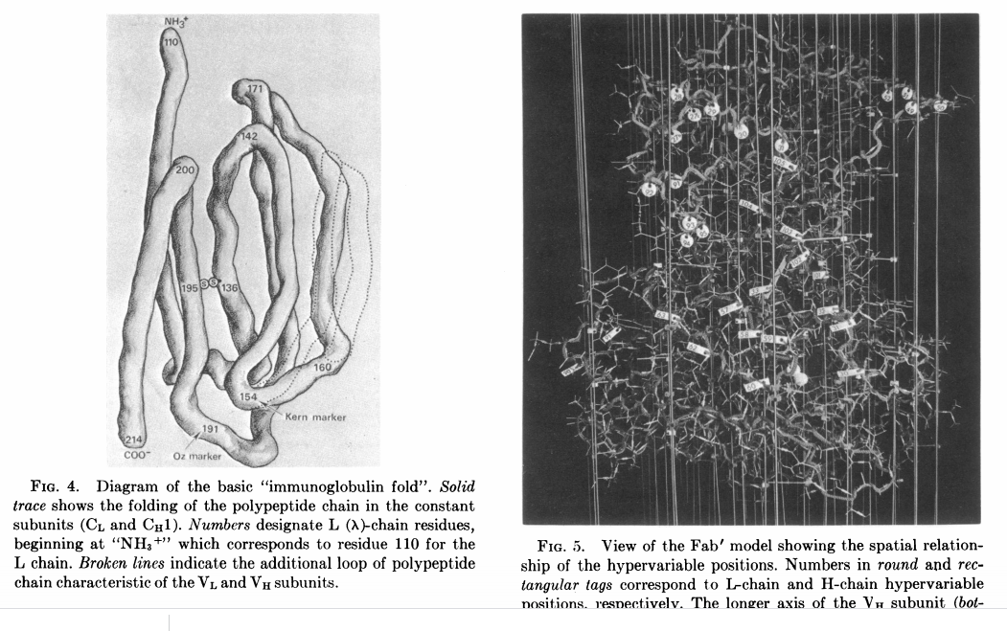
First Antibody Structure…Saul et.al,….1973

Slide 16
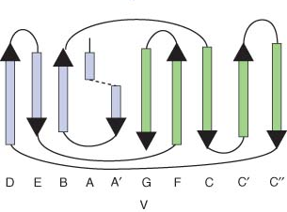
The IgG Fold….
2 beta-sheets, connected by a disulfide bond

Slide 17
An ultra-high affinity synthetic nanobody blocks SARS-CoV-2 infection by locking Spike into an inactive conformation
a bioRxiv preprint: https://doi.org/10.1101/2020.08.08.238469
Michael Schoof^{1,2#}*, Bryan Faust^{1,2,3,4#}, Reuben A. Saunders^{1,5#}, Smriti Sangwan^{1,2#}, Veronica Rezelj^{6#}, Nick Hoppe^{3,4}, Morgane Boone^{1,2}, Christian Bache Billesbølle^{3,4}, Marcell Zimanyi^{1,2,3}, Ishan Deshpande^{3,4}, Jiahao Liang³, Aditya A. Anand^{1,2}, Niv Dobzinski^{1,2}, Beth Shoshana Zha⁷, Benjamin Barsi-Rhyne³, Vladislav Belyy^{1,2}, Andrew W. Barile-Hill⁸, Sayan Gupta⁹, Camille R. Simoneau^{10,11,12}, Kristoffer Leon^{10,11,12}, Kris M. White^{13,14}, Silke Nock^{1,2}, Yuwei Liu^{1,2}, Nevan J. Krogan^{4,5,10,11}, Corie Y. Ralston⁹, Danielle L. Swaney^{4,5,10,11}, Adolfo García-Sastre^{13,14}, Melanie Ott^{10,11,12}, Marco Vignuzzi⁶, QCRG Structural Biology Consortium⁴, Peter Walter^{1,2}*, Aashish Manglik^{3,4,10,15}*
¹Howard Hughes Medical Institute, University of California at San Francisco, San Francisco, CA, USA.
²Department of Biochemistry and Biophysics, University of California at San Francisco, San Francisco, CA, USA.
³Department of Pharmaceutical Chemistry, University of California at San Francisco, San Francisco, CA, USA.
⁴Quantitative Biosciences Institute (QBI) Coronavirus Research Group Structural Biology Consortium, University of California, San Francisco, CA, USA.
⁵Department of Cellular and Molecular Pharmacology, University of California at San Francisco, San Francisco, CA, USA.
⁶Viral Populations and Pathogenesis Unit, CNRS UMR 3569, Institut Pasteur, 75724, Paris, cedex 15, France
⁷Department of Pulmonary, Critical Care, Allergy and Sleep Medicine, University of California San Francisco, San Francisco, CA 94158, USA.
⁸Cytiva Life Sciences, Marlborough, MA, USA.
⁹Molecular Biophysics and Integrated Bioimaging and the Molecular Foundry, Lawrence Berkeley National Laboratory, Berkeley, CA, USA.
¹⁰Quantitative Biosciences Institute (QBI), University of California San Francisco, San Francisco, CA, USA.
¹¹J. David Gladstone Institutes, San Francisco, CA, USA.
¹²Department of Medicine, University of California San Francisco, San Francisco, CA, USA. ¹³Department of Microbiology, Icahn School of Medicine at Mount Sinai, New York, NY, USA. ¹⁴Global Health and Emerging Pathogens Institute, Icahn School of Medicine at Mount Sinai, New York, NY, USA.
¹⁵Department of Anesthesia and Perioperative Care, University of California at San Francisco, San Francisco, CA, USA.

Slide 18
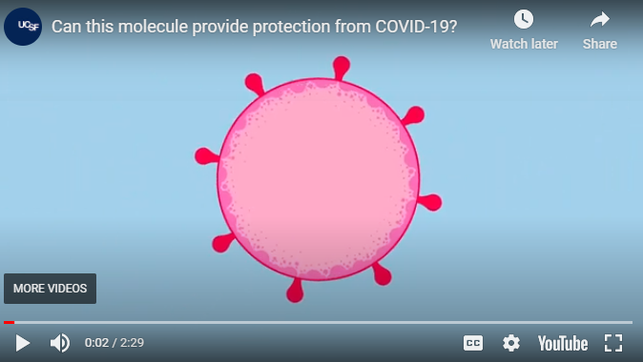
An ultra-high affinity synthetic nanobody blocks SARS-CoV-2 infection by locking Spike 2 into an inactive conformation
a bioRxiv preprint:https://doi.org/10.1101/2020.08.08.238469
https://www.universityofcalifornia.edu/news/aeronabs-promise-powerful-inhalable-protection-against-covid-19
AeroNab – a single domain nanobody that binds the coronavirus Spike protein….and protects us from infection??
https://www.youtube.com/watch?v=WjhbexLtYts&feature=emb_logo

Slide 19
AND NOW,…an update….
On Nov. 23, we learned that the work described in the bioRxiv pre-preprint has been peer-reviewed and accepted for publication in Science.
And more importantly, this means that the pdb files describing the structure of the Nb6 nanobody bound to the coronavirus spike protein is available to everyone,… from the Protein Data Bank. The relevant pdb file is 7KKK.pdb.
A pdf of the Science paper that will soon be published is available here:
Happy Modeling……

Slide 20
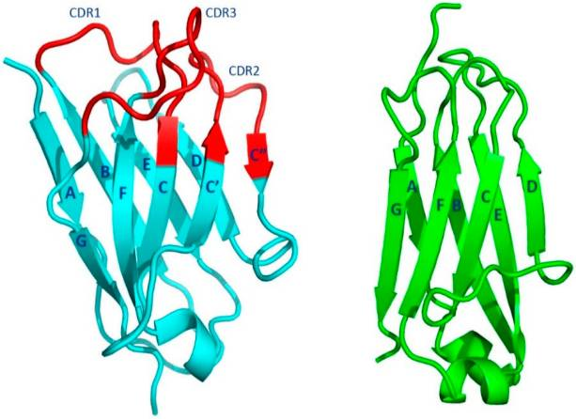
Variable domain
Constant domain

Slide 21
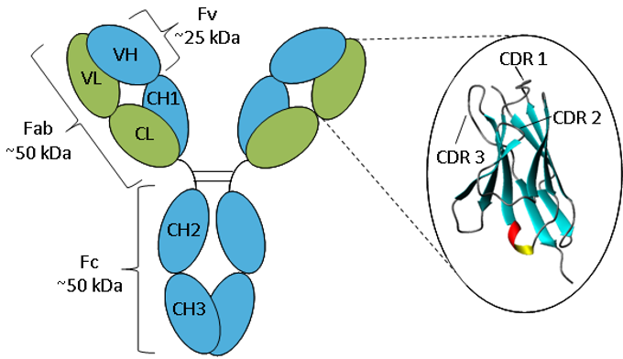

Slide 22
What are we NOT going to talk about …..tonight?
Virology…. But check out TWIV: a podcast about viruses – “the kind that make you sick”.
Immunology….. Innate vs Adaptive Immunity
Humoral vs. Cellular Immunity
Public Health Issues…. Viral diagnostics PCR vs. Rapid tests
Vaccines…. mRNA vaccines

Slide 23
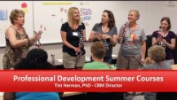
Summer Professional Development Courses
From the MSOE Center for BioMolecular Modeling
The CBM hosts a collection of professional development courses that provide teachers with the experience and community necessary to confidently use models in their classroom
★★ NOTE: Do to Covid-19, we plan to offer this workshop June 22-26, 2020 as a virtual workshop. ★★

Slide 24
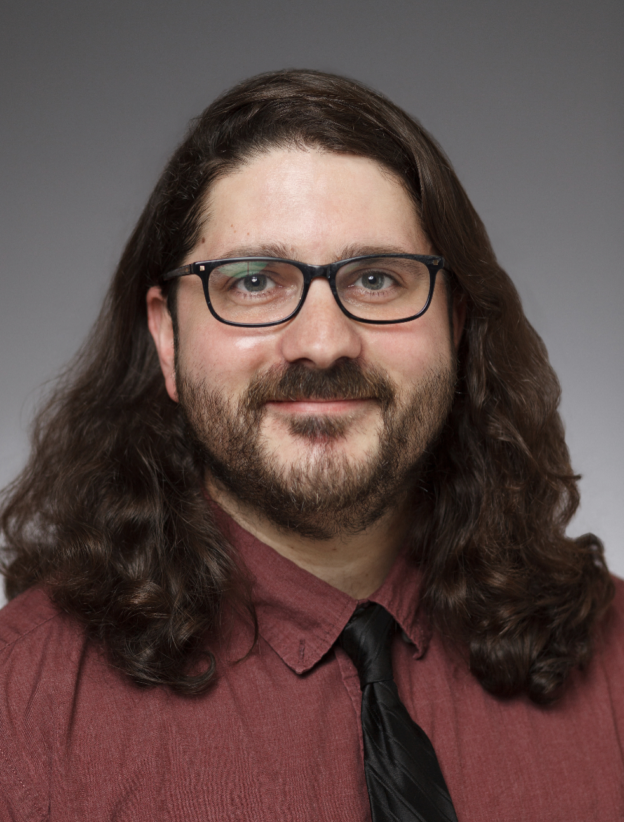
Mark Hoelzer
Director of Digital Media at the Center of BioMolecular Modeling
Partner of 3D Molecular Designs and Lead Model Designer
Masters of Fine Art (2014) in New Media from the Academy of Art University
Notes:
After Tim

Slide 25

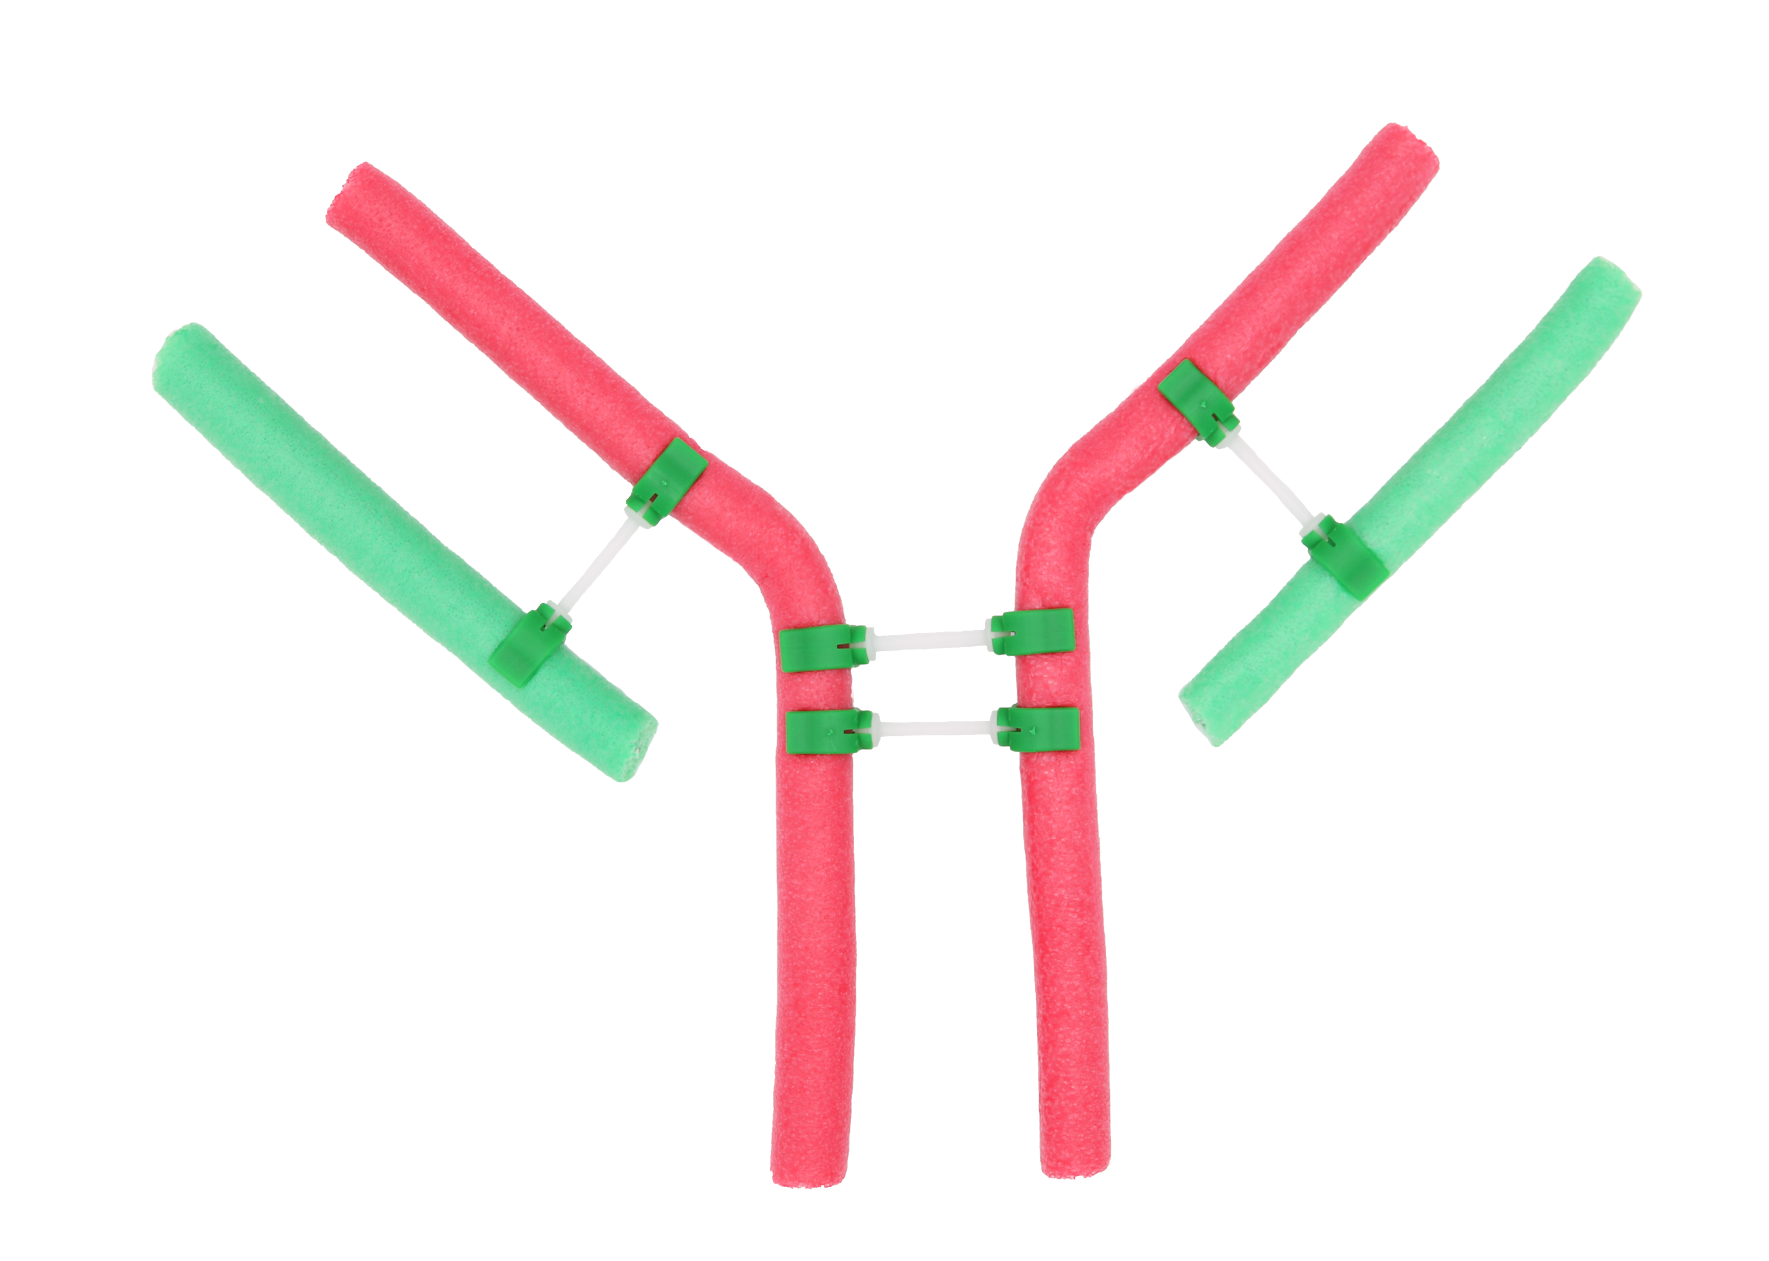
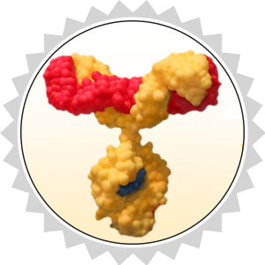

Thank you for attending!
Start your MAPS Team Today
cbm.msoe.edu
Purchase Kits and Models at 3dmoleculardesigns.com.
Discount code: WEBINAR20
Contact us at: Ask3DMD@3dmoleculardesigns.com

Slide 26
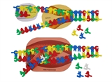
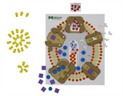
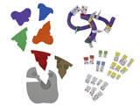
Invite your colleagues to register!
Transcription, Translation, & Sickle Cell Anemia
A Tale of Two Sisters, Modeling Transcription & Protein Synthesis
Wednesday, January 27, 2021 at 6:00 PM Central
Neurotransmitters, Synapses & Acetylcholinesterase
Modeling How Cells Talk – Making Sense of Synapses and Signals
Wednesday, February 10, 2021 at 6:00 PM Central
Proteins & the Protein Folding Problem
Proteins – Now that Everything has Changed
Wednesday, February 17, 2021 at 6:00 PM Central
https://www.3dmoleculardesigns.com/Webinars4.htm

