Slide 1
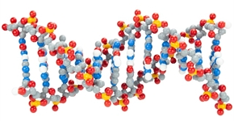
DNA with a Twist
Activating Student Questioning with an interesting TWIST on DNA modeling

Slide 2

Karen Avery
BA, MS Biology,
EdD Student, STEM Education
The Pennsylvania College of Technology Williamsport, Pennsylvania
Instructor: Biology, Microbiology
High School Biology

Slide 3

Dan Williams
BS, MA Biology
High School Teacher
NYS Master Teacher, SAR Biology STANYS
Shelter Island High School
Shelter Island, New York

Slide 4
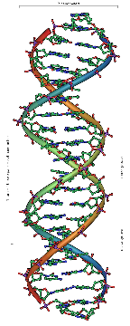
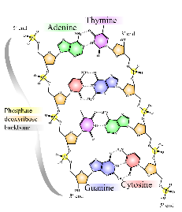
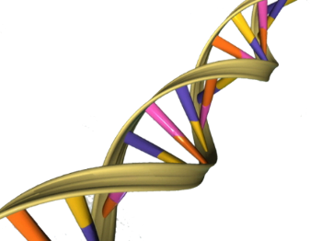
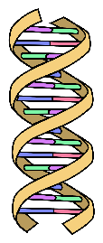
“All models are wrong,
but some are useful”
2
3
1
4

Slide 5
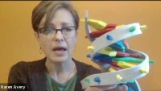
Features of Dynamic DNA Model and the Double Helix Student Modeling Pack

Slide 6
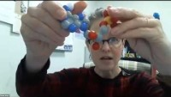
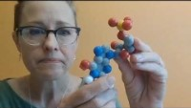
Digging Deeper into Dynamic DNA!
Converting Dynamic DNA nucleotides into Dynamic RNA nucleotides!
Using Dynamic DNA to teach Energetics!

