Slide 1
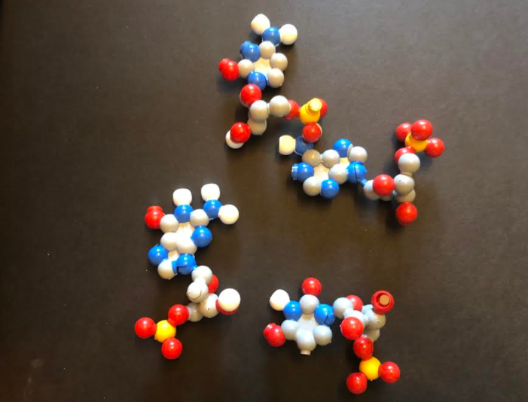
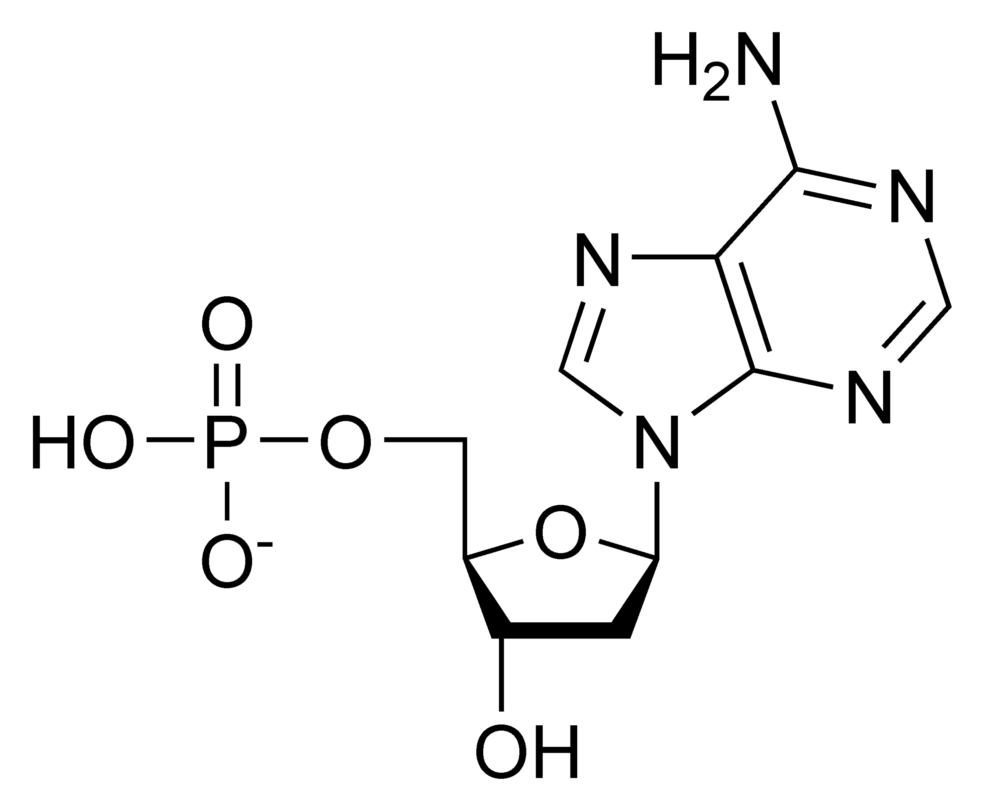
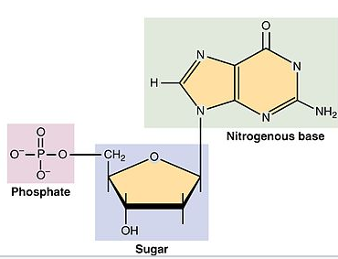
Why is dynamic DNA a good model for students?
Live interaction between both of us
Karen Hand model -Go to full zoom screen?

Slide 2
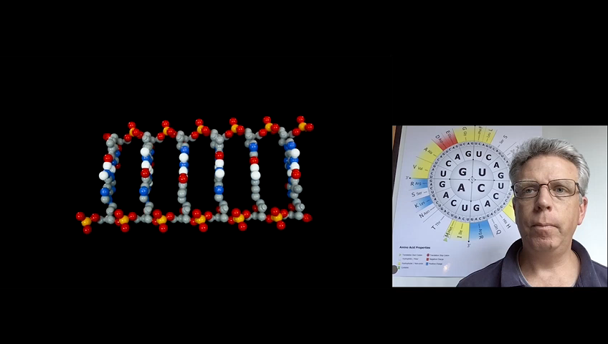
Generates questions!

Slide 3
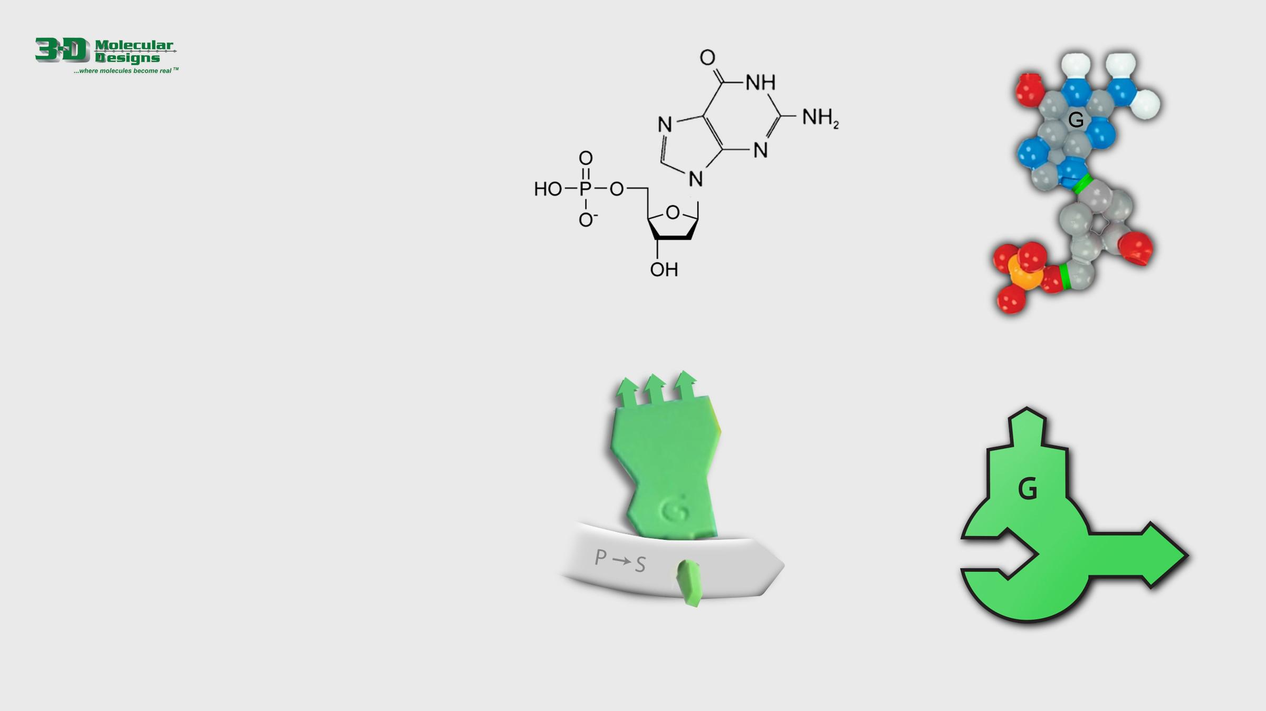
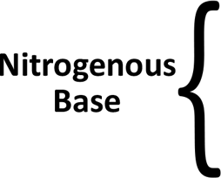



Many Representations of DNA
There are a variety of ways to represent DNA nucleotides. Despite being very different, the four illustrations shown to the right all show the DNA backbone, the nitrogenous base and the 5’ to 3’ directionality ends of the backbone.
1. Grab and position the labels below to name the parts of each nucleotide illustration on the right.
2. Answer the question below and then move to the next slide.
Of the 4 different representations of a nucleotide shown here, which do you think is the most useful? Why?
Notes:
About 30 minutes here.

Slide 4
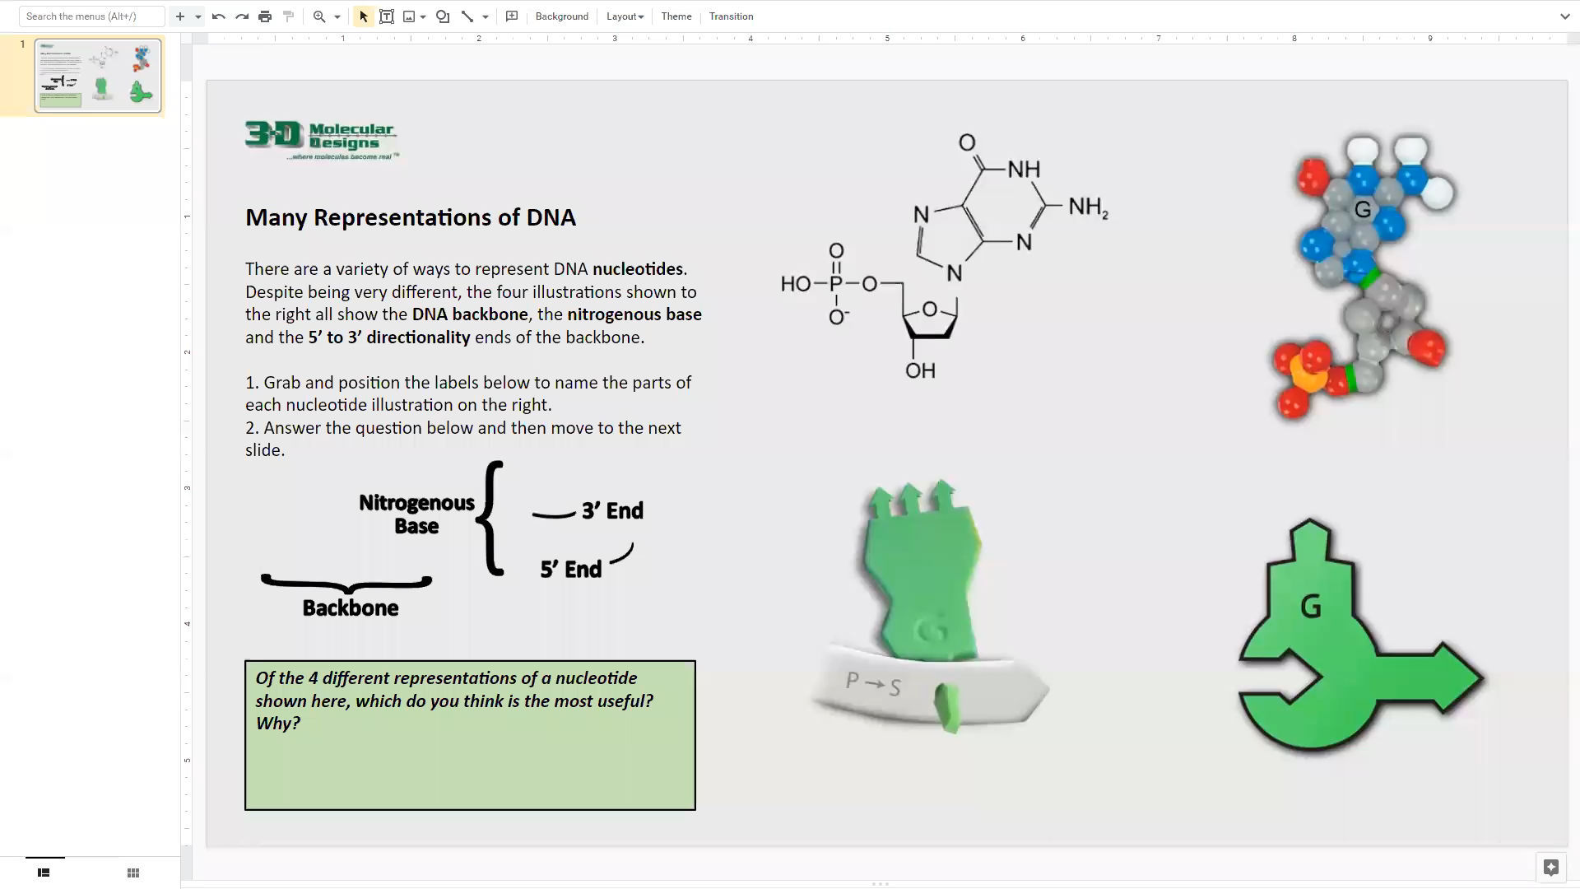

Slide 5
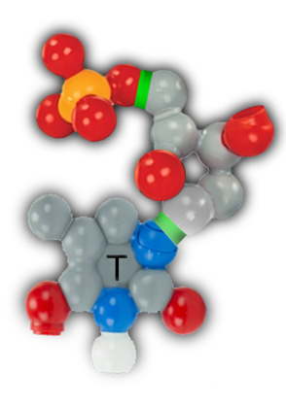
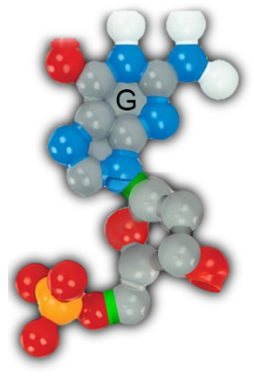


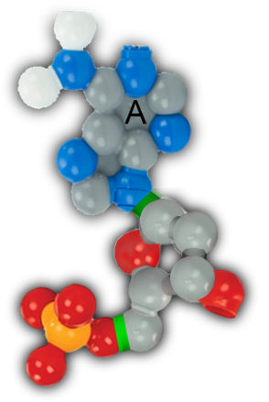
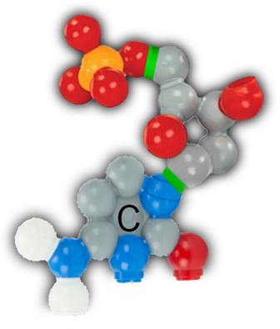
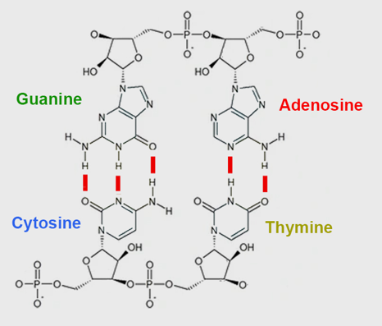


Nucleotides Form Base Pairs
There are four types of nucleotides, each with a different nitrogenous base: guanine (G), cytosine (C), adenosine (A) and thymine (T). They join to form base pairs.
1. Study the chemical structure below.
2. Drag and connect the nucleotides on the right to build base pairs.
3. Answer the question below and move to the next slide.
How does the size of an A-T base pair compare with the size of a G-C base pair?

Slide 6
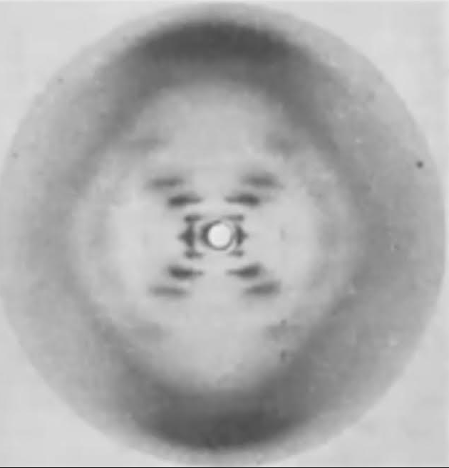
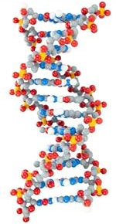
Photo 51 -Using Data to justify models of DNA.

Slide 7
Questions?

