Slide 1
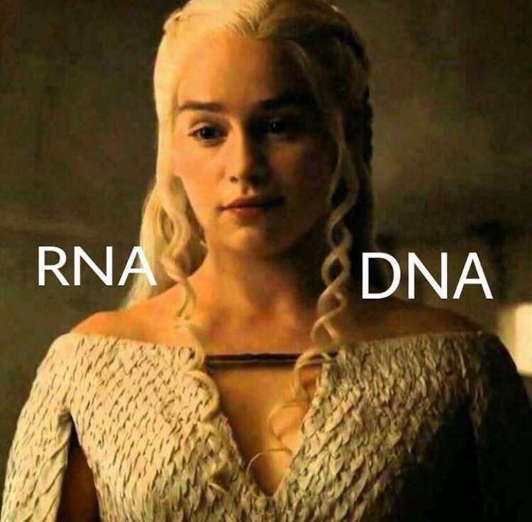
Teaching our kids to think
As we reflect on our teaching, you may notice that we ask our students a lot of “what” questions
What is the difference between DNA and RNA?
Yes, but Why?
RNA has U’s and DNA has T’s
Yes, but so What?
DNA has deoxyribose; RNA has ribose
RNA is single-stranded; DNA is double-stranded
Not really….

Slide 2
STOP Teaching…
the What
START Teaching…
the Why

Slide 3
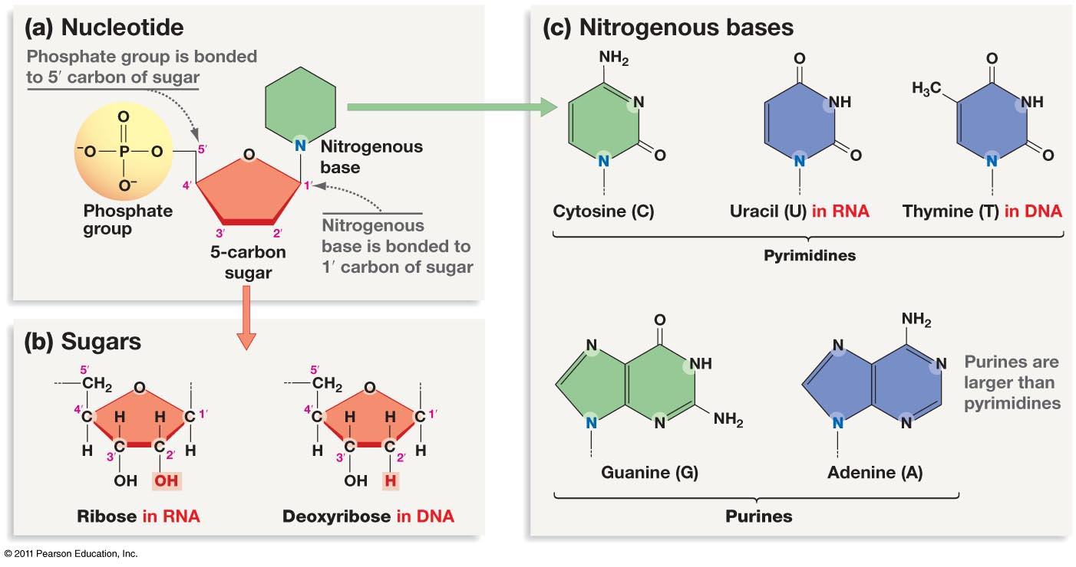

Slide 4
WHY did T replace U in DNA?
spontaneous oxidative deamination of C
…if we had not switched…
AGUCGAAGUCAACCGAGGCUGCGCUAC
UCAGCUUCAGUUGGCUCCGACGCGAUG
U
AGUCGAAGU AACCGAGGCUGCGCUAC
x
UCAGCUUCA UUGGCUCCGACGCGAUG
G
A DNA repair system can remove “U” from DNA.
But, how can we distinguish between a
“deaminated C” and a normal U?
ANSWER: We can’t.

Slide 5
WHY did T replace U in DNA?
spontaneous oxidative deamination of C
but after we switched
AGTCGAAGTCAACCGAGGCTGCGCTAC
TCAGCTTCAGTTGGCTCCGACGCGATG
U
AGTCGAAGT AACCGAGGCTGCGCTAC
x
TCAGCTTCA TTGGCTCCGACGCGATG
G
Uracil glycosidase constantly scans our DNA… looking for U’s.
Any U is a bad U and should be repaired.

Slide 6
Why is RNA single-stranded?
….but wait, RNA is not single-stranded…

Slide 7
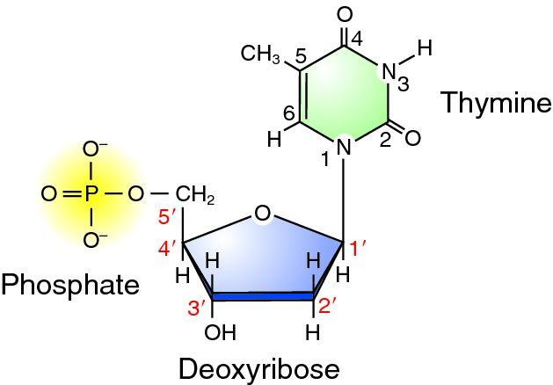
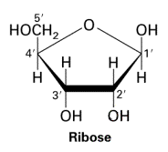
O
O
O
O

Slide 8
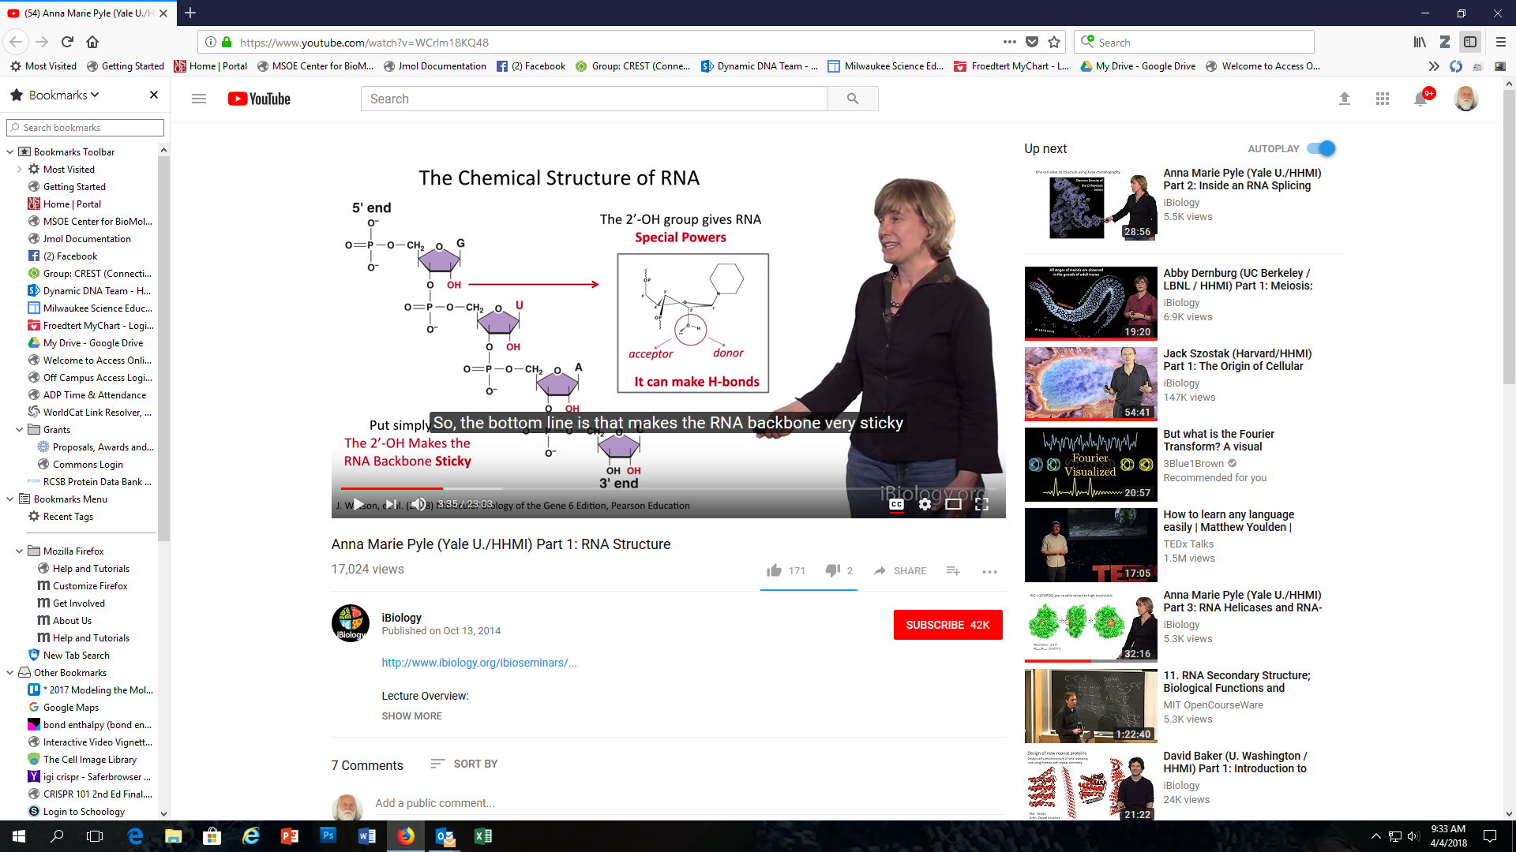
The 2’ OH group gives RNA special powers….
… it can form hydrogen bonds, and fold into complex 3D shapes

