Slide 1
Exploring the Wonderful World of Cell Membranes
Potassium Channels & Scorpion Toxins
Proteins, Lipids, and Ions, Oh My!

Slide 2
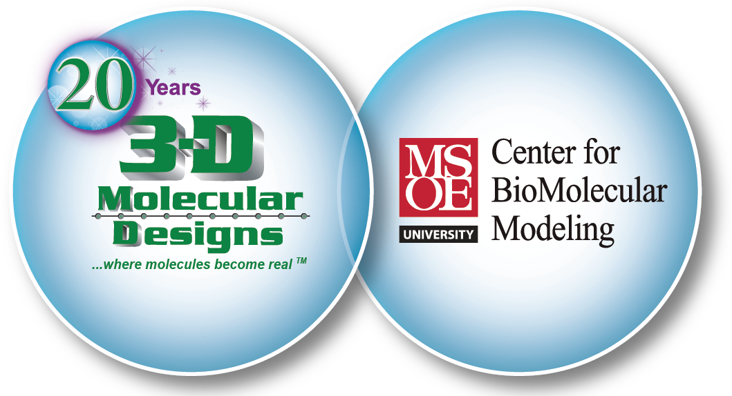
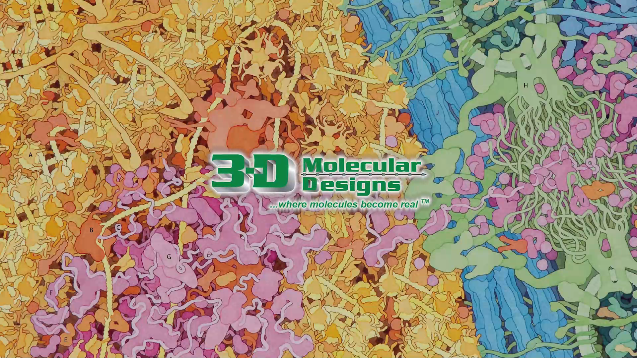
New CRISPR Modeling Kits

Slide 3
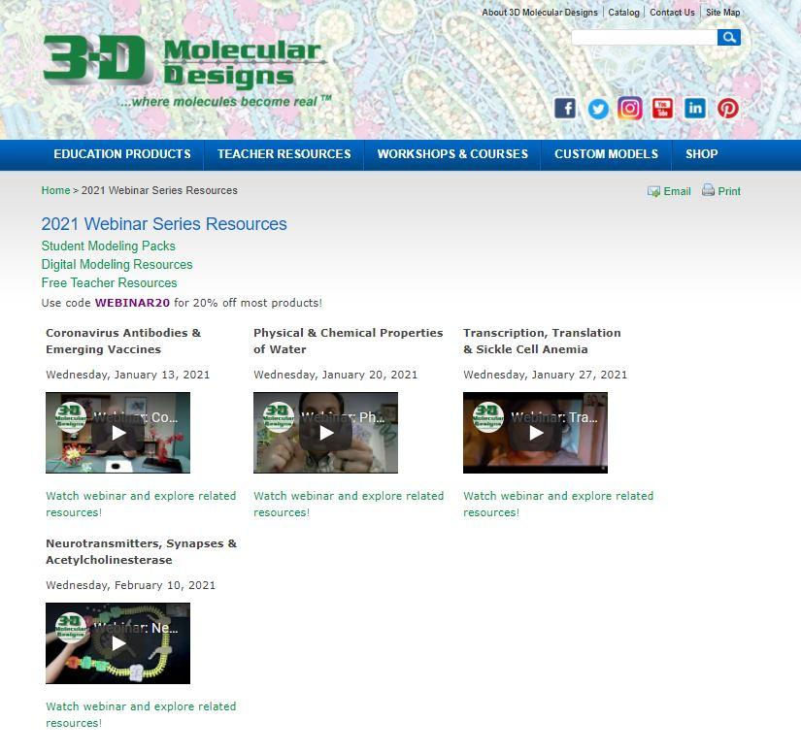
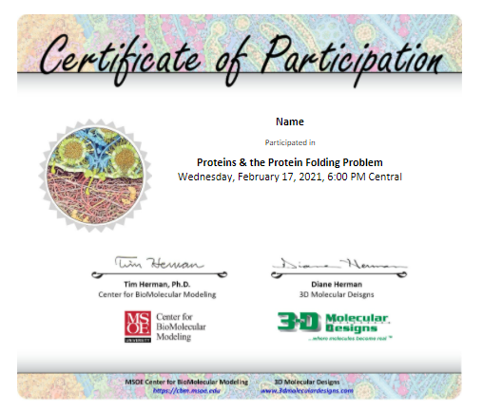


Slide 4
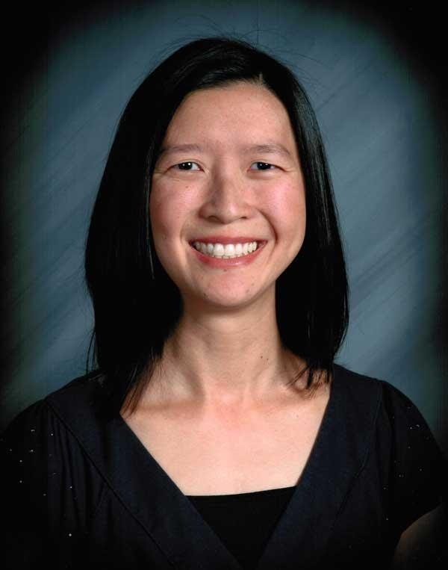
B.S. Bioengineering
Ed.M. Curriculum & Instruction
Longmont High School (Longmont, CO)
Courses: AP Biology, Biotechnology cn_chou@yahoo.com
Chris Chou

Slide 5

Workshop Goals:
Model the structure and functions of the cell membrane
Explore the role of transport proteins in moving ions and small molecules across the cell membrane
Understand how mutations in the CFTR gene cause cystic fibrosis

Slide 6
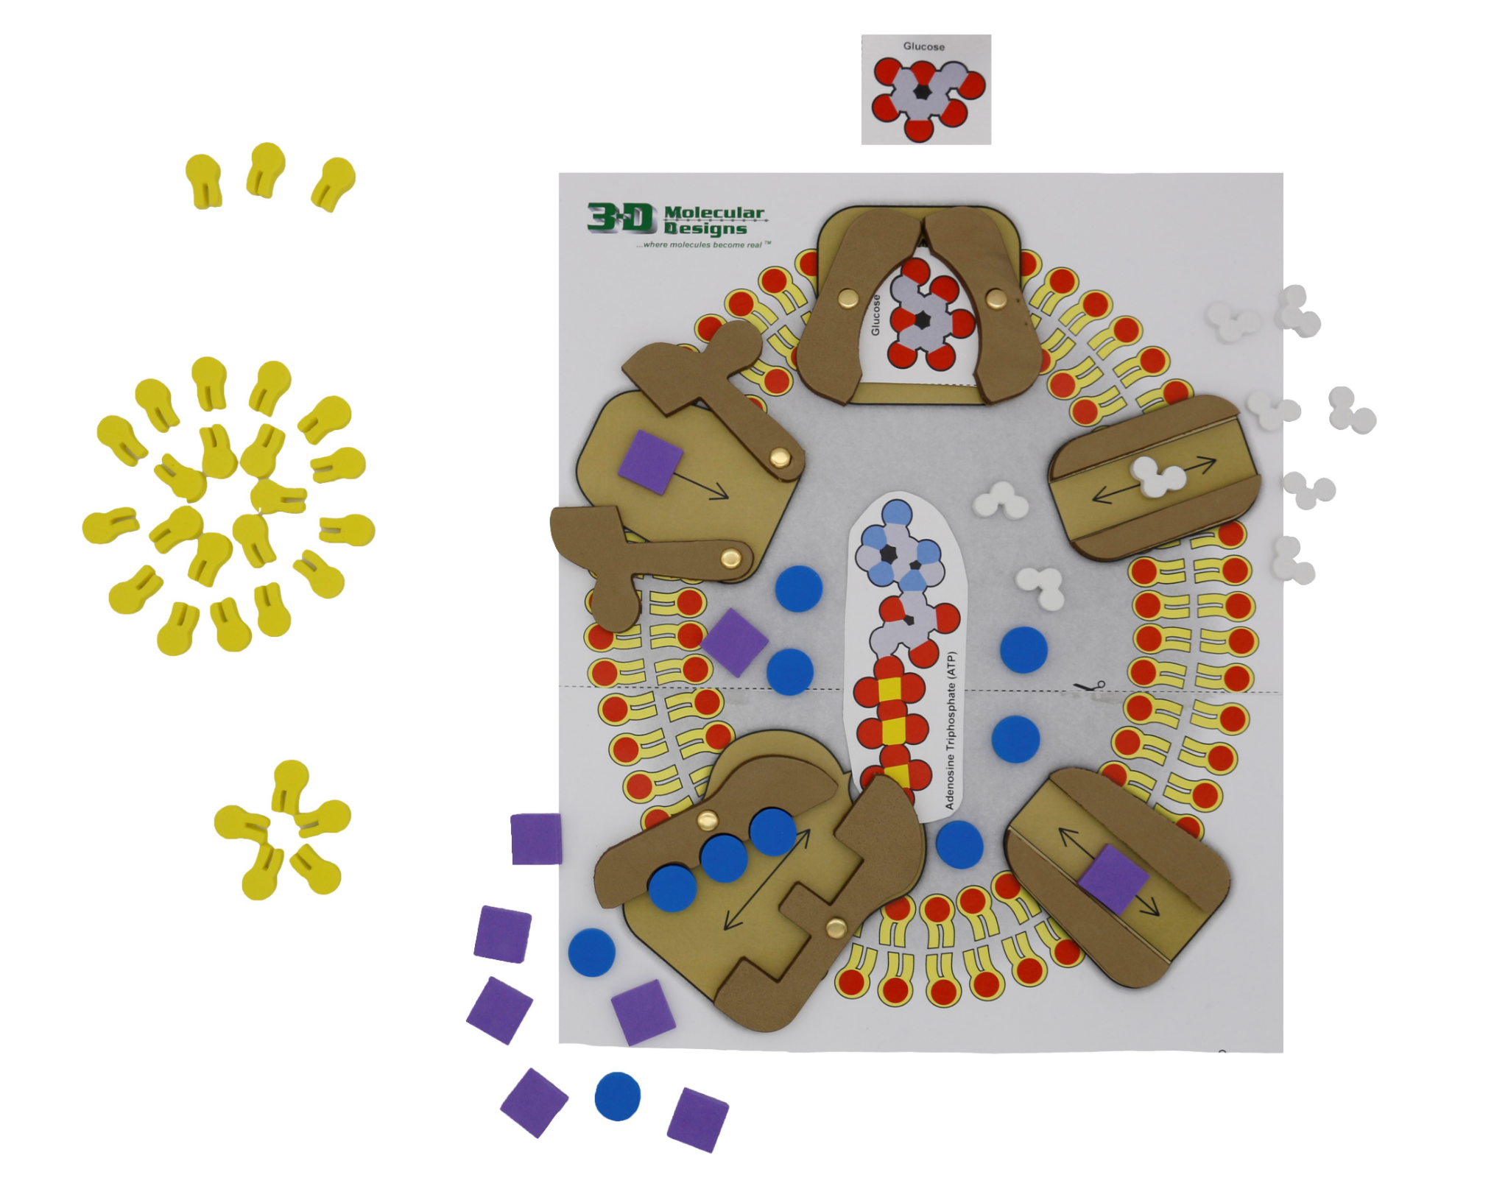
Get Ready to Model!

Slide 7
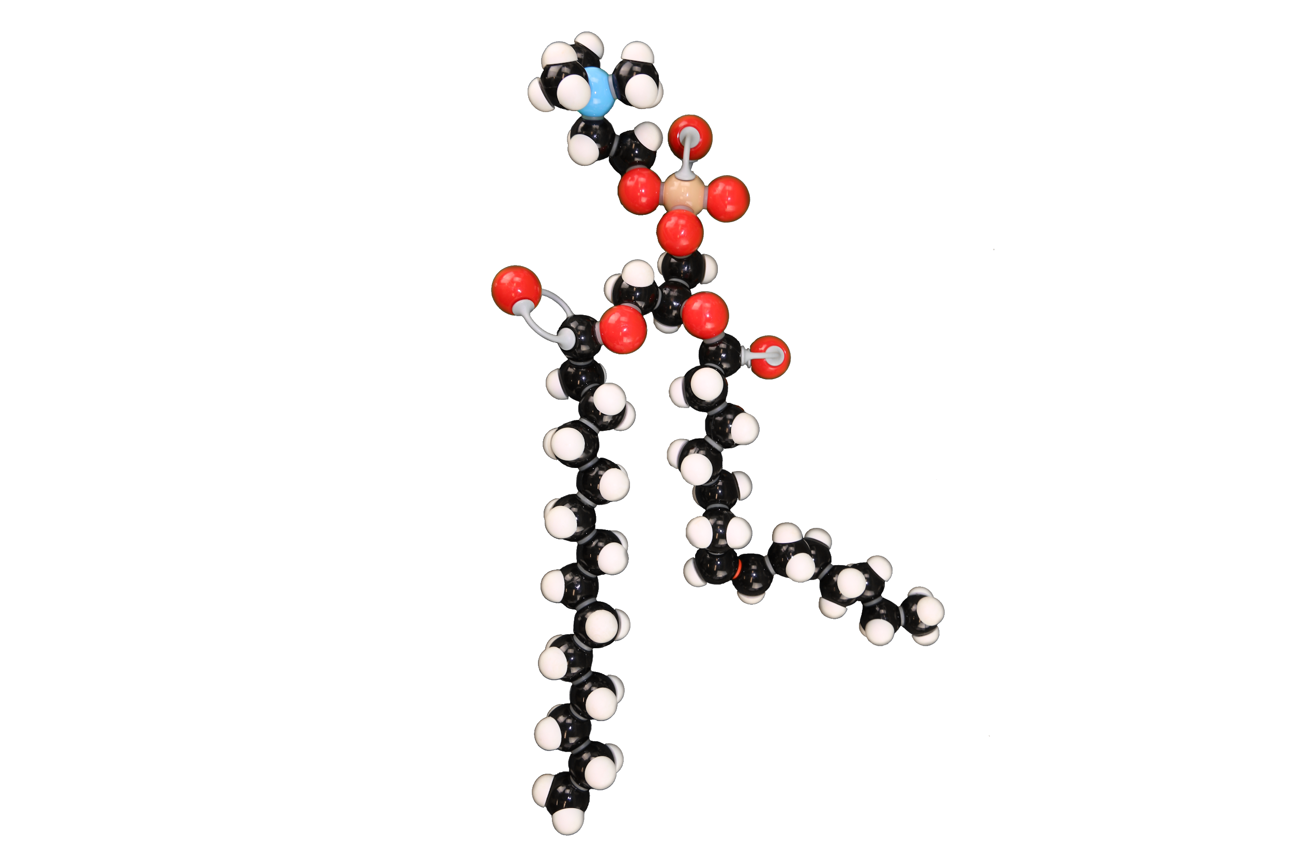
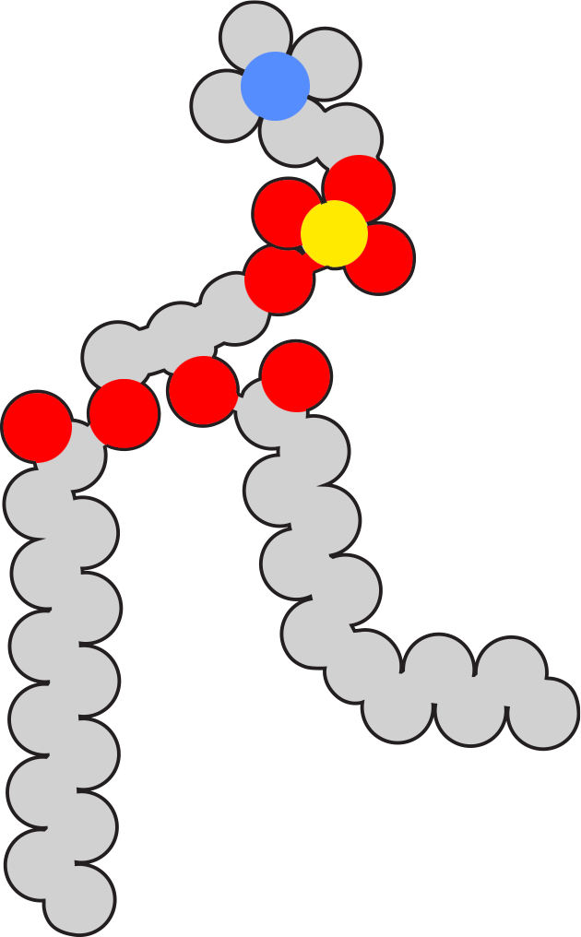

Phospholipids - 3DMD Models
What do you notice? What do you wonder?
Notes:
Let’s take a look at these various examples of models of phospholipids. What do you notice? What do you wonder?

Slide 8
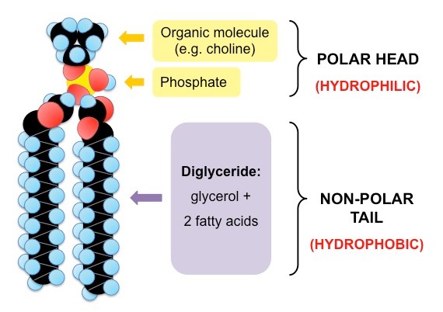
Phospholipid Structure
Notes:
Notes: polar, hydrophilic head (phosphate group, negatively charged); non-polar, hydrophobic tail (long fatty acid residues); amphipathic

Slide 9
Let’s Model!
What are different ways that phospholipids can be arranged within a watery environment?
Notes:
Follow this principle: “Like attracts like” (hydrophobic vs. hydrophilic properties)

Slide 10
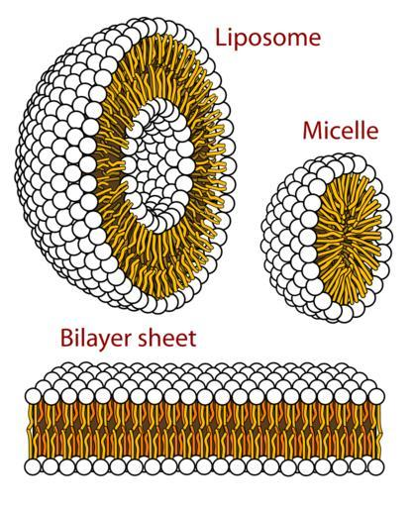
Phospholipid Arrangements
Notes:
Liposome: spherical-shaped vesicle composed of 1+ phospholipid bilayers - can be used as a drug delivery vehicle; micelle: aggregate of surfactant molecules dispersed in a liquid; forms a colloidal suspension; bilayer sheet: flat sheet, forms cell membrane, nucleus, membrane-bound organelles

Slide 11
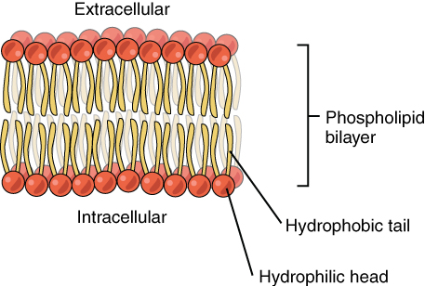
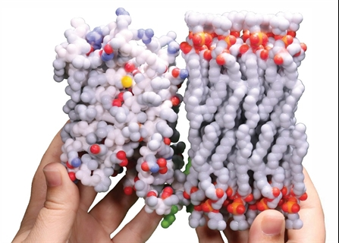
Phospholipid Bilayer

Slide 12
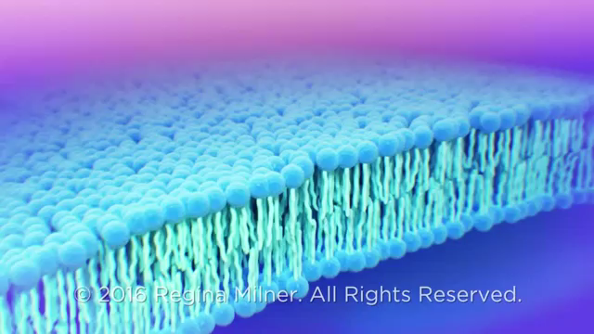
Notes:
Individual phospholipids can move within the bilayer, allowing for membrane fluidity and flexibility

Slide 13
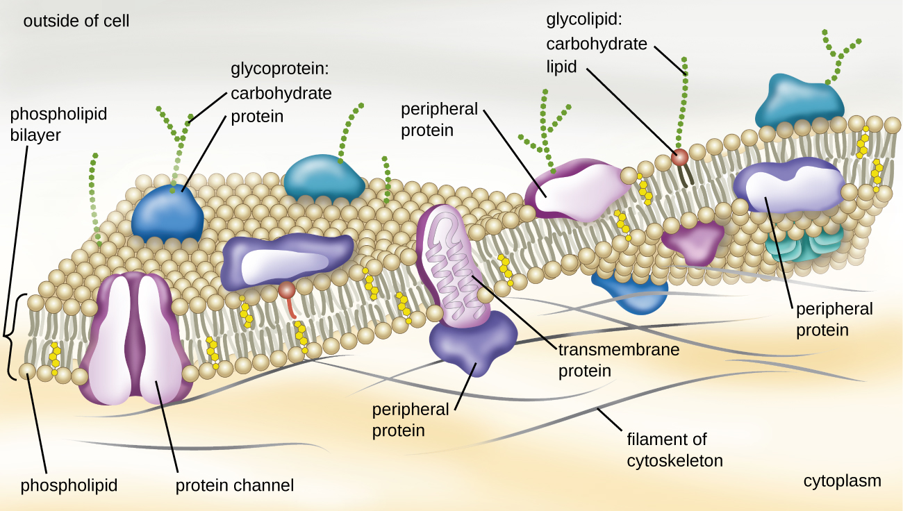
Components of the Cell Membrane
Notes:
Phospholipids, cholesterol, proteins, carbohydrates

Slide 14
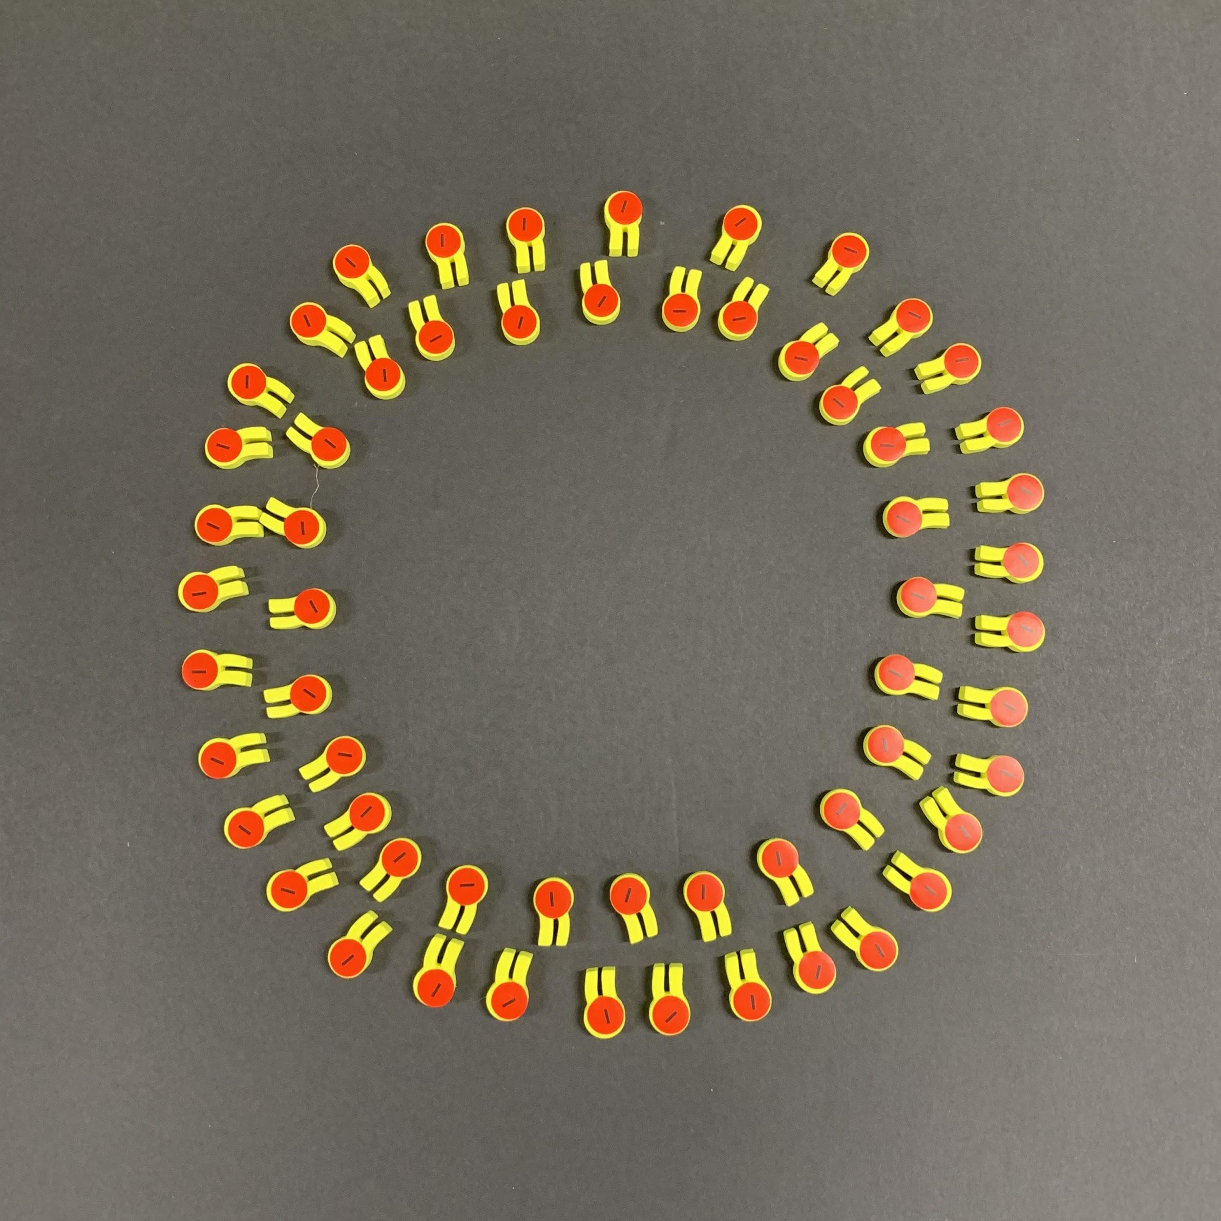
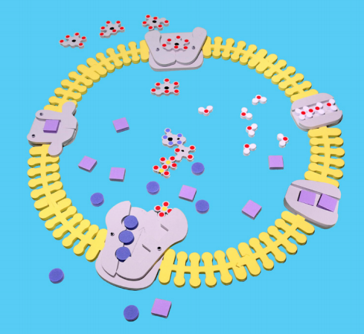
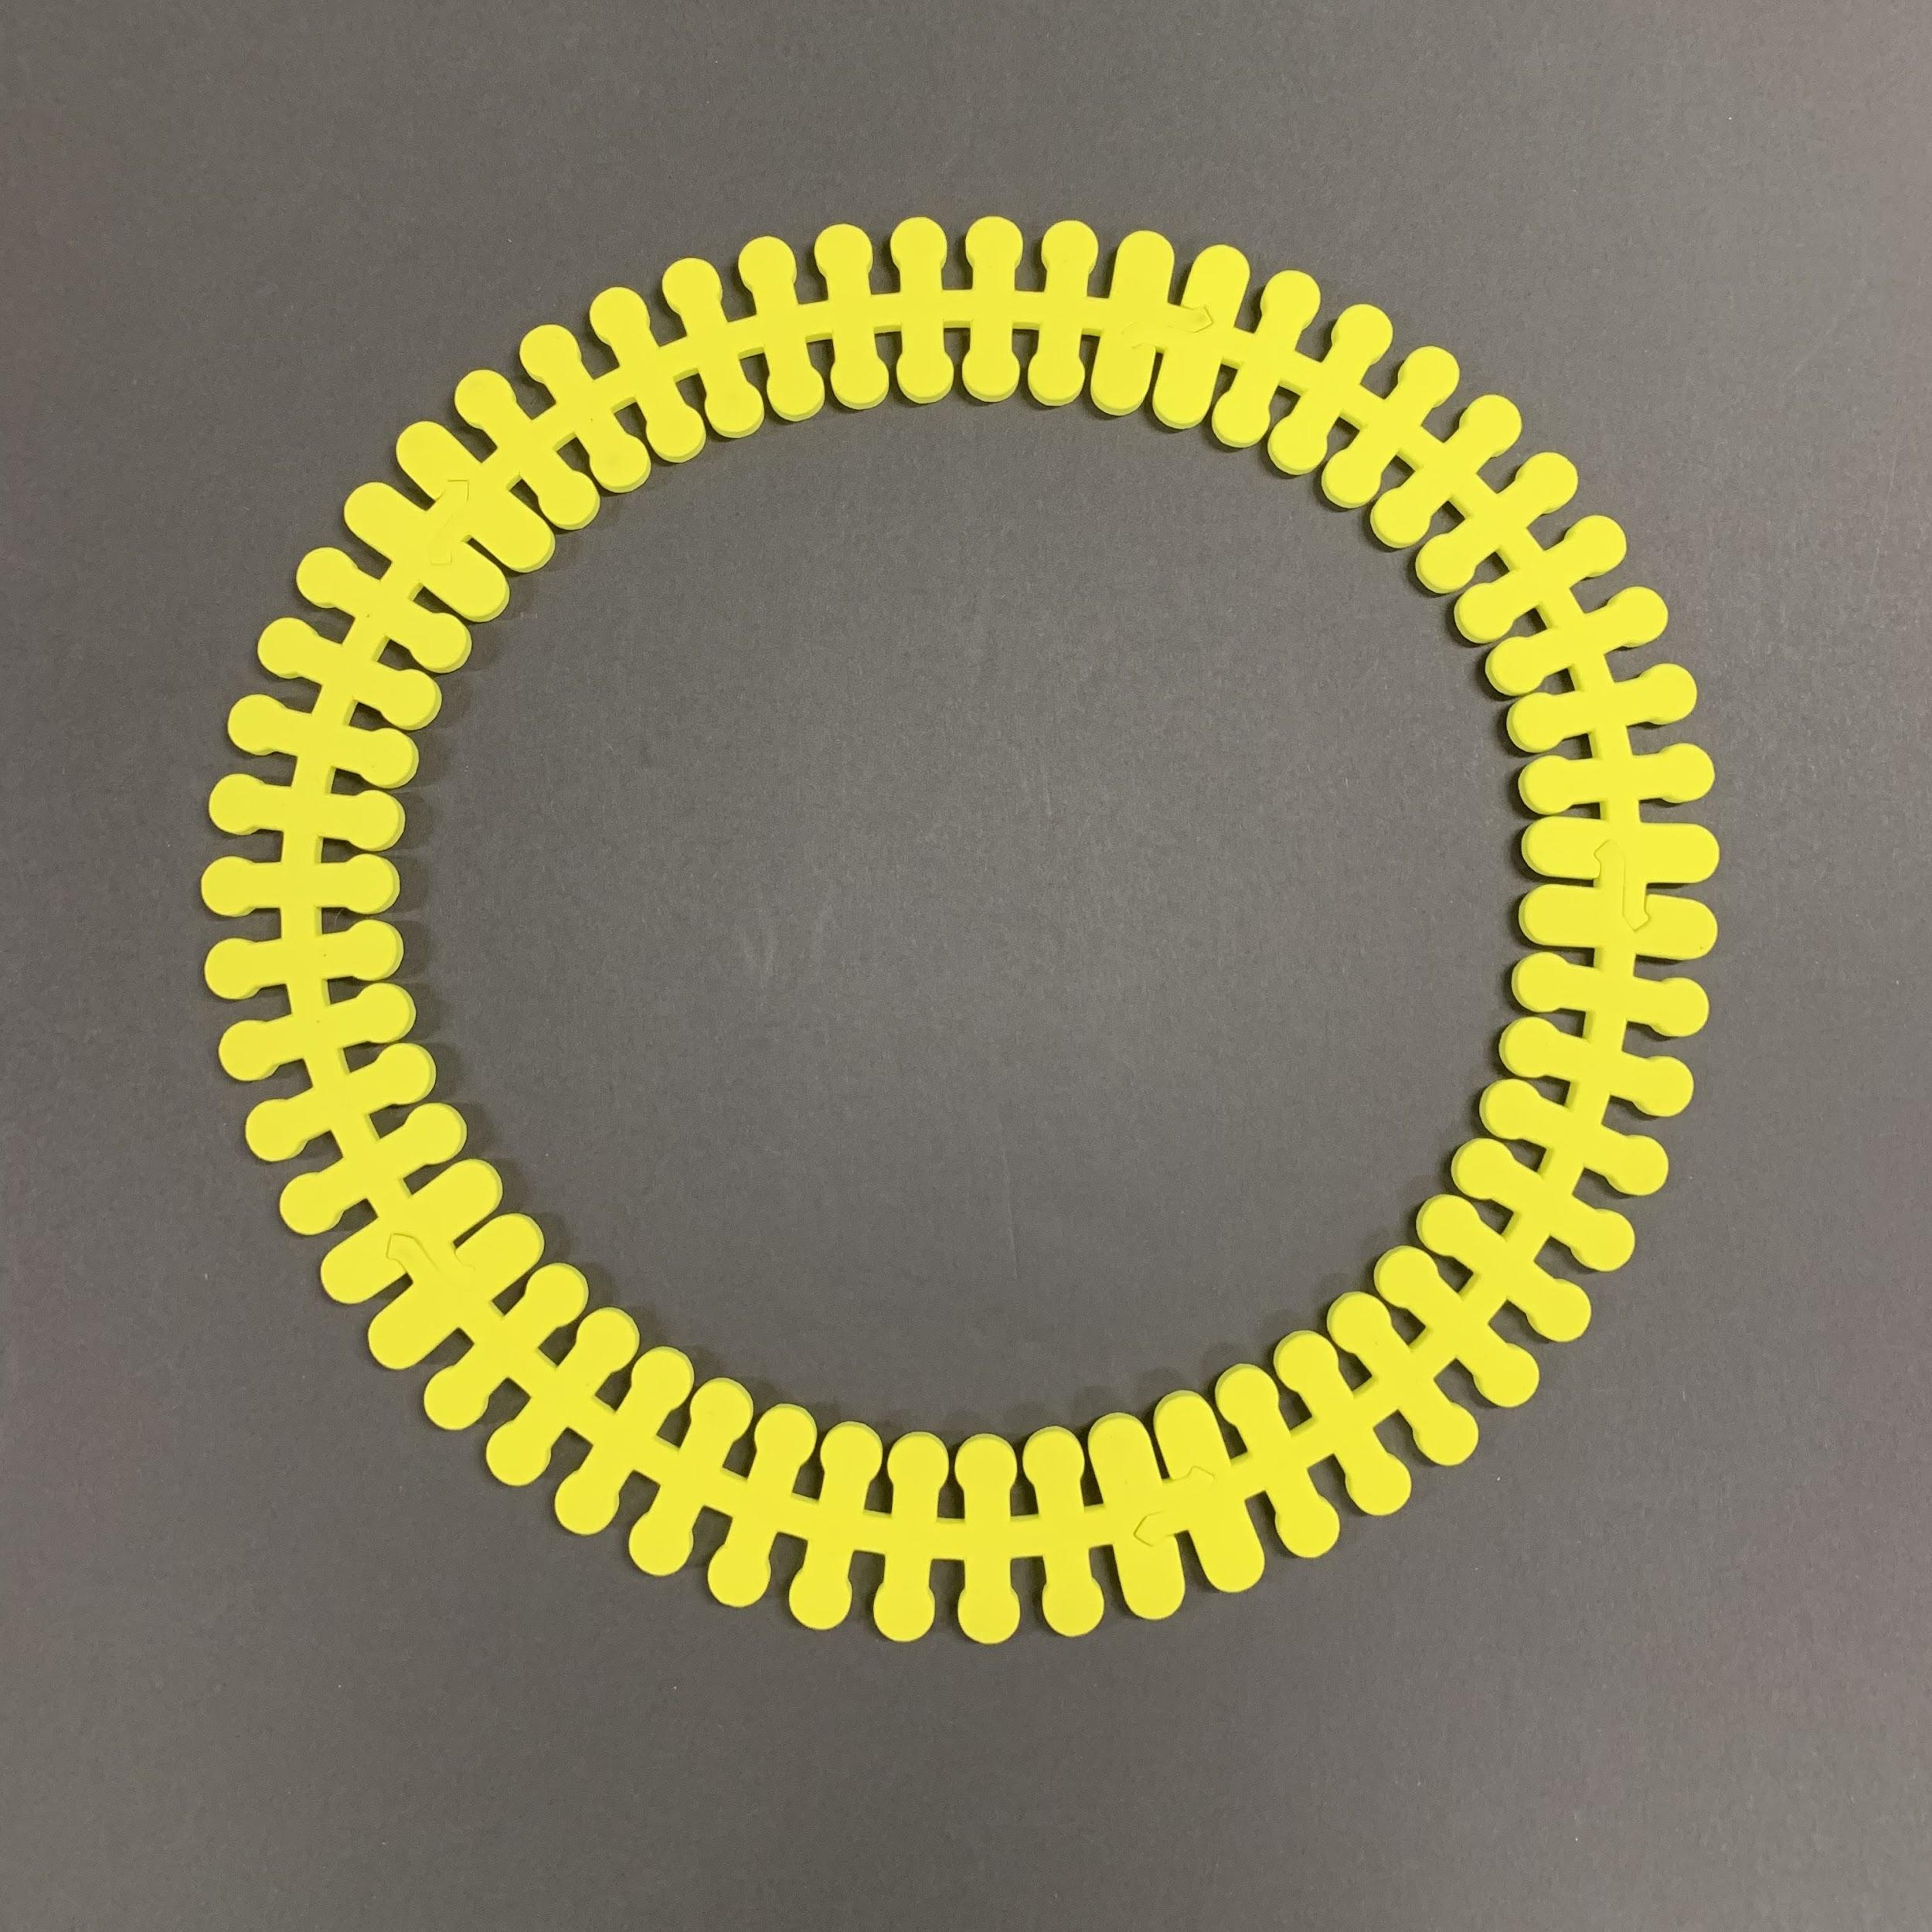
Let’s Model the Cell Membrane!
GLUT Carrier Protein
Gated K⁺ Channel
Aquaporin
Na⁺/K⁺ Pump
Sodium Channel

Slide 15
Membrane Transport Proteins
Channel Proteins
Voltage-gated ion channel
Ligand-gated ion channel
Aquaporins
Cl⁻, Na⁺, K⁺, Ca²⁺
Carrier Proteins
Electrochemical potential-driven
Passive transport (facilitated diffusion) - large polar molecules and charged ions
Active transport
  Na⁺/K⁺ pump
  Proton pump
Notes:
Channel proteins transport substances passively through membrane; do not bind to molecules; carrier proteins transport ions and molecules through facilitated diffusion or active transport - binds to molecules; channel proteins transport materials more quickly

Slide 16
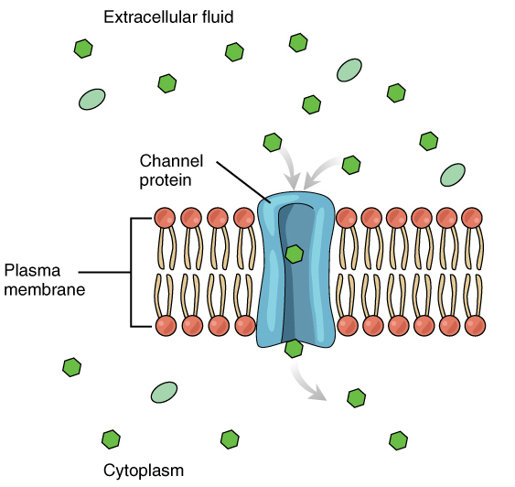
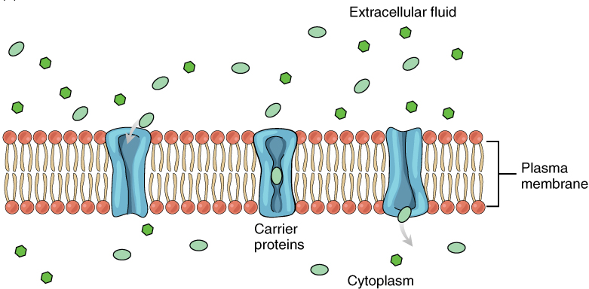
Channel Proteins
Carrier Proteins
Notes:
Channel proteins transport substances passively through membrane; do not bind to molecules; carrier proteins transport ions and molecules through facilitated diffusion or active transport - binds to molecules; channel proteins transport materials more quickly.

Slide 17
Passive Transport

Slide 18
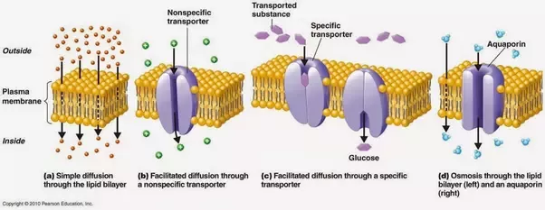
Passive Transport
Notes:
Does not require energy to move substances across cell membranes; moves down the concentration gradient from an area of high concentration to an area of low concentration

Slide 19
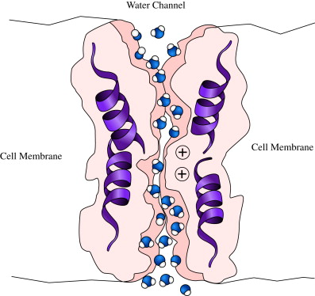
Aquaporins (AQPs)
Transport water and small, uncharged molecules (gases, glycerol, ammonia, urea)
Fluid transport
Homeostatic maintenance
Leak ion channel
  Selective
  Always open
  Bidirectional
Water molecules pass through pore in single-file
https://www.sciencedirect.com/topics/biochemistry-genetics-and-molecular-biology/aquaporin
Notes:
Aquaporins: also called water channels; Water CAN cross the cell membrane via simple diffusion, but because water is polar, the process is relatively slow; majority of water passes through aquaporin; 13 known types of AQPs in mammals; 6 found in the kidney; also in lung, exocrine glands, eye, GI organs, erythrocytes, leukocytes, adipocytes, astrocytes, skeletal muscle; also in plants & microbes (bacteria, yeast)

Slide 20
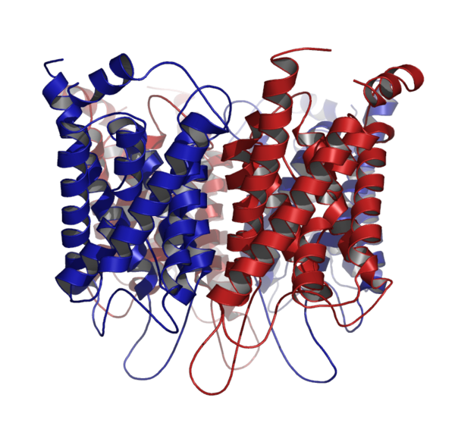
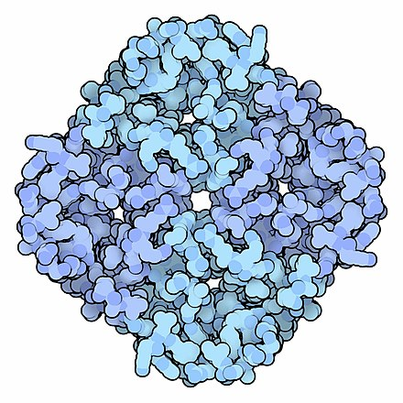
Aquaporin Tetramer
PDB ID: 1J4N
David Goodsell, PDB Molecule of the Month, PDB ID 1FQY
Notes:
AQP: 6 transmembrane a-helices; forms tetramers - each monomer acts as a water channel

Slide 21
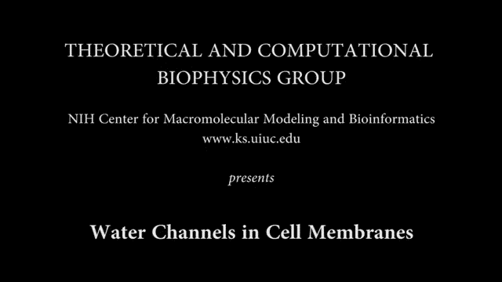

Slide 22
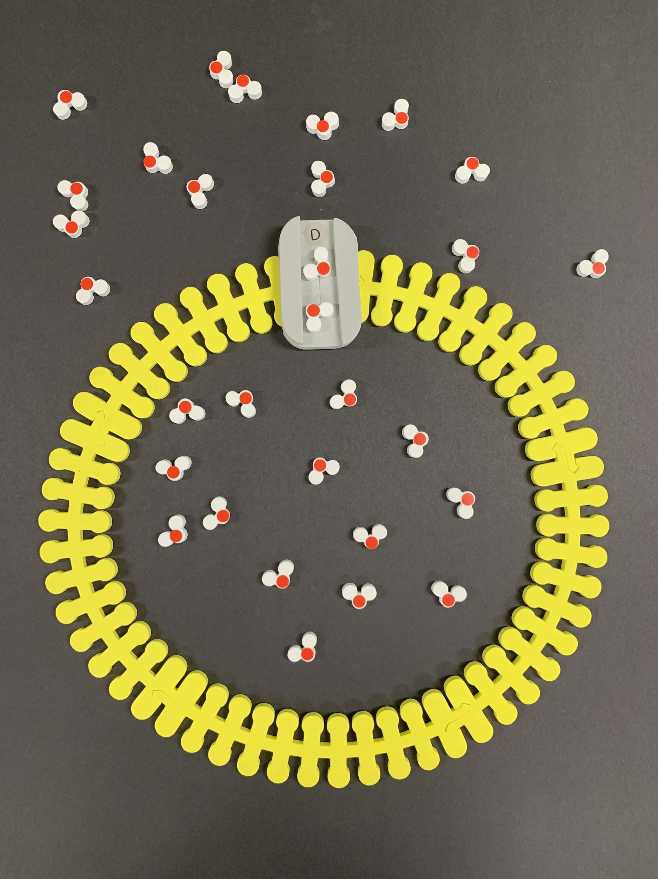
Let’s Model Osmosis!
Aquaporin

Slide 23
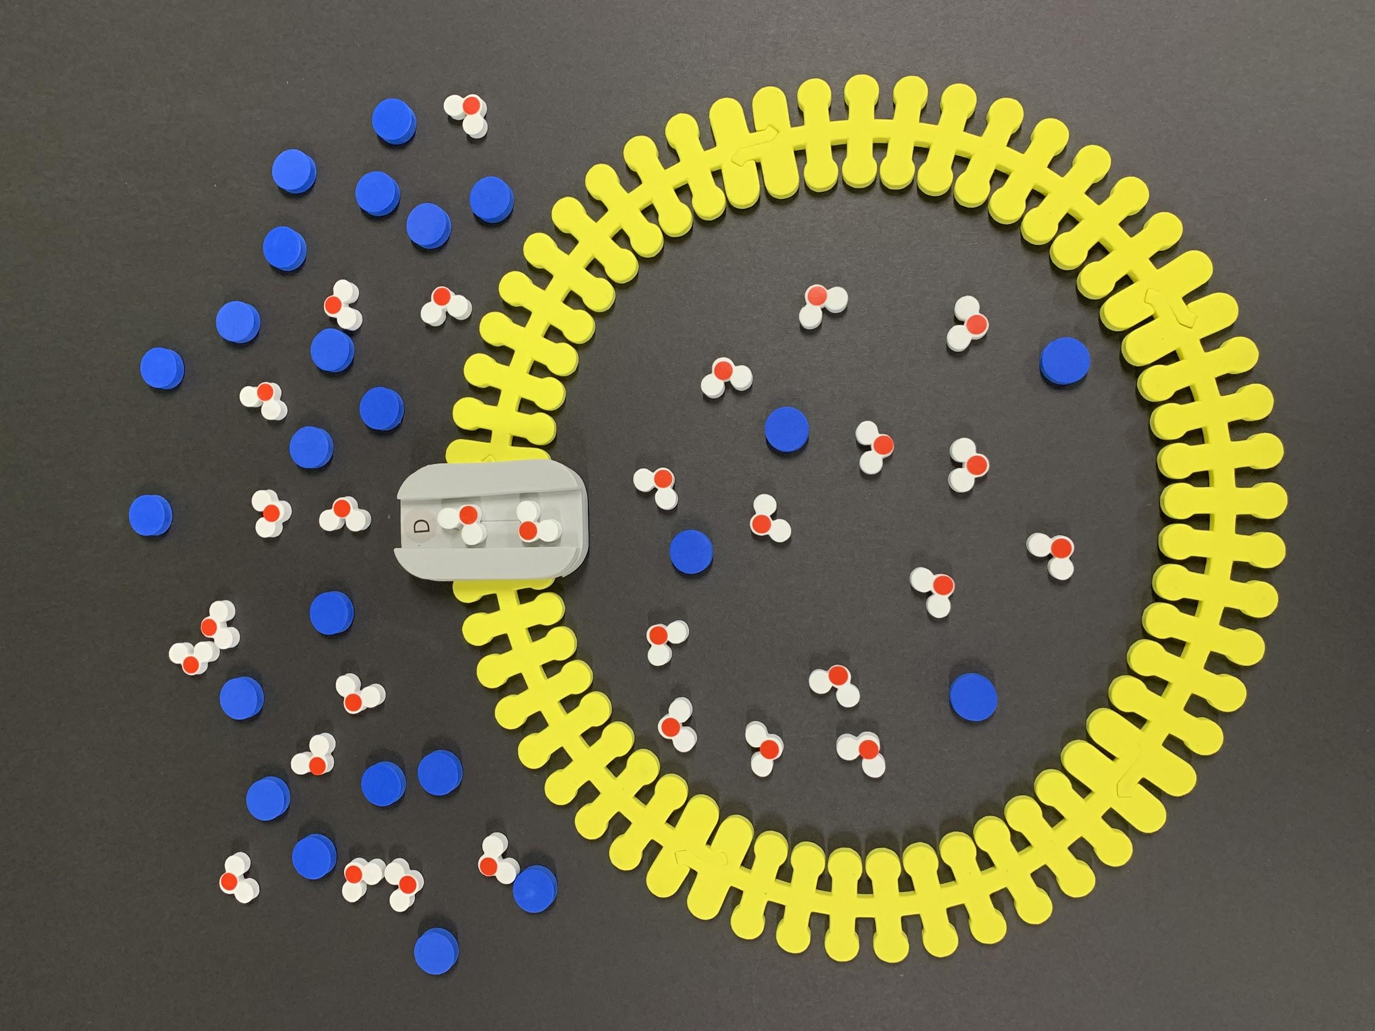
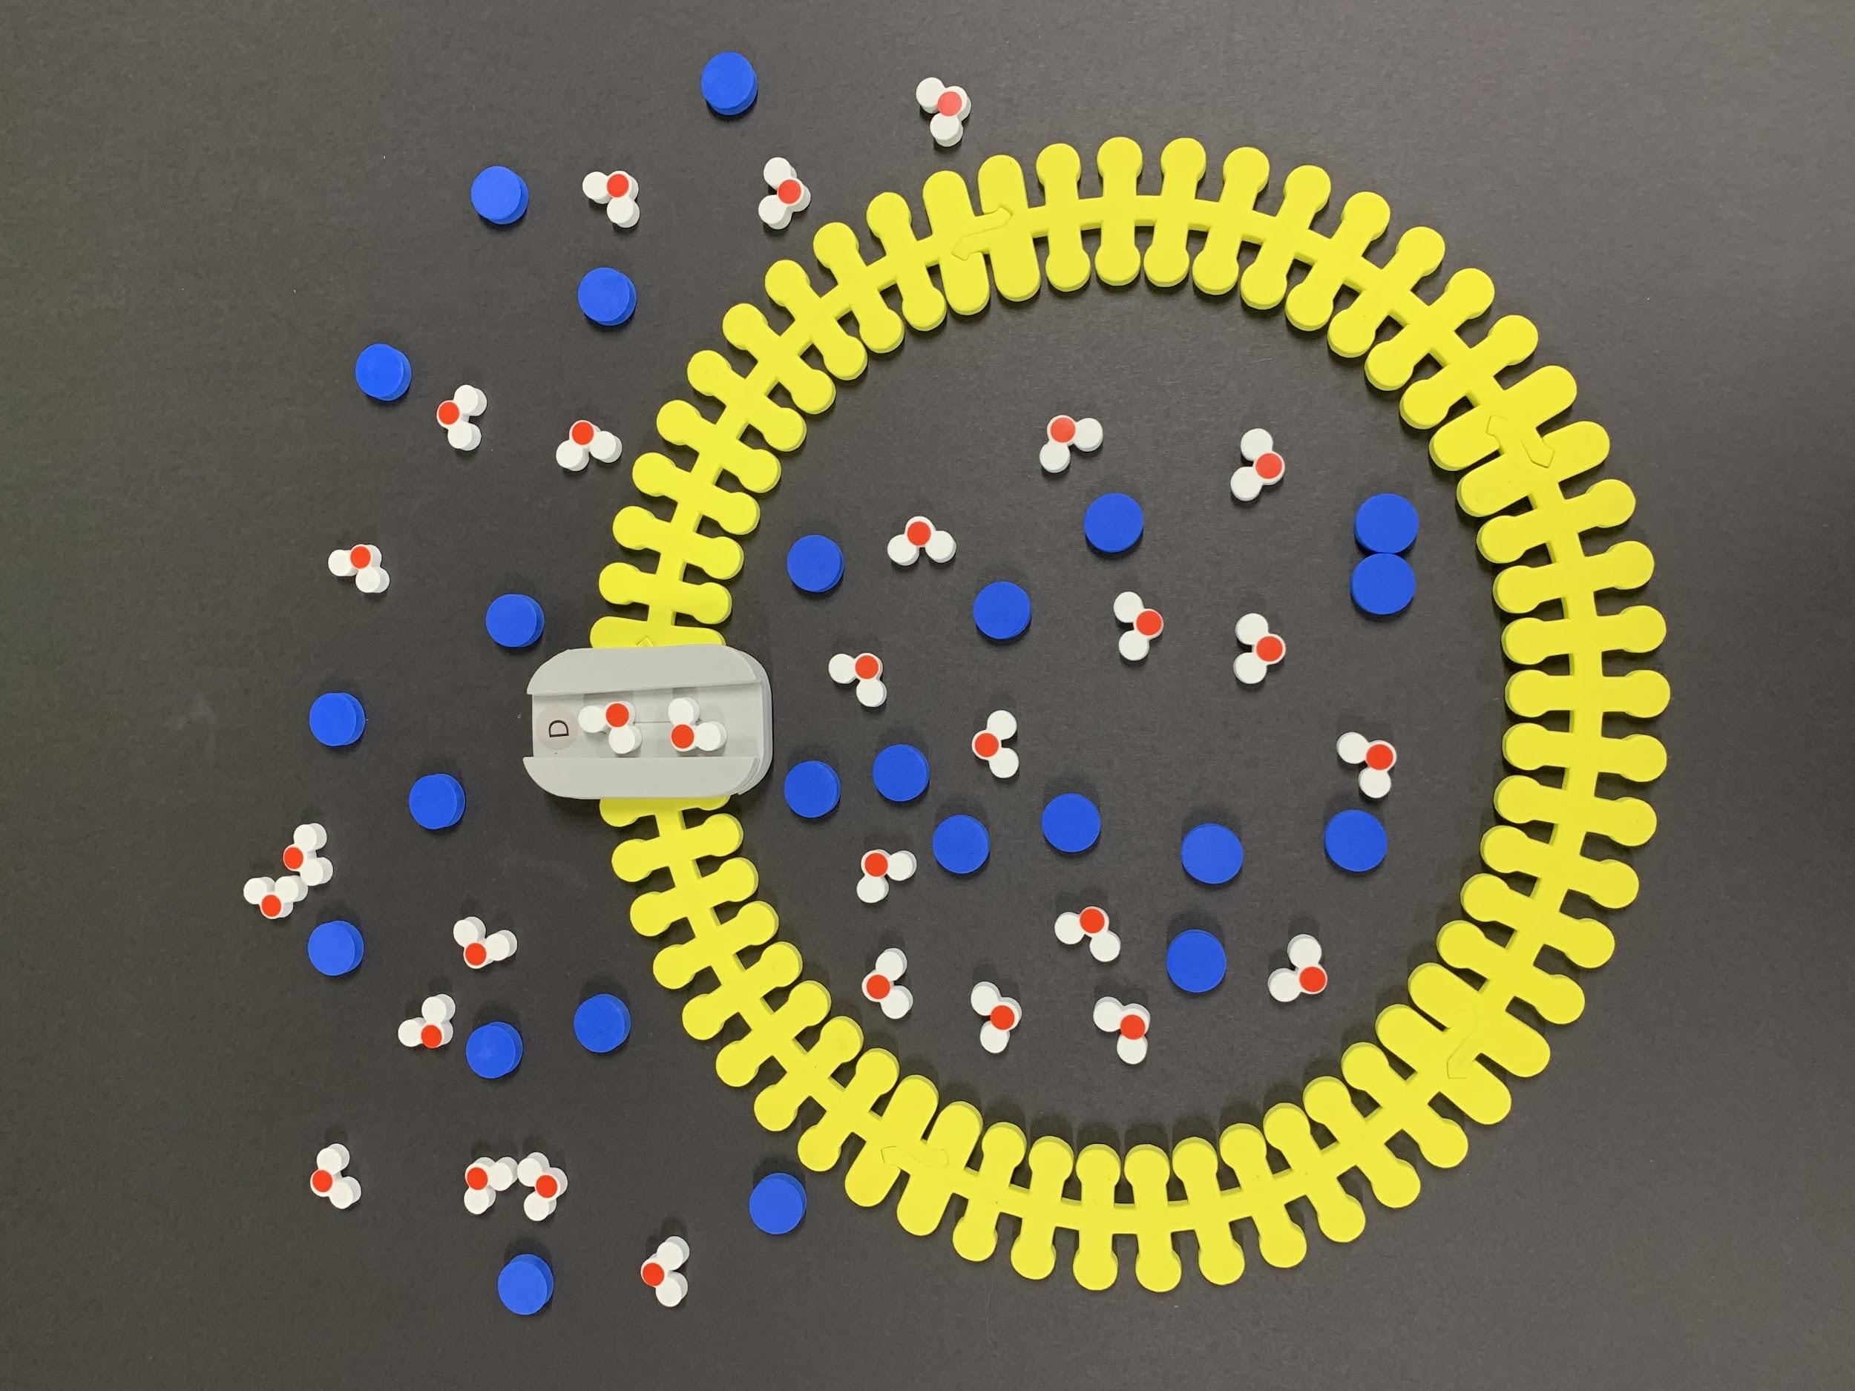
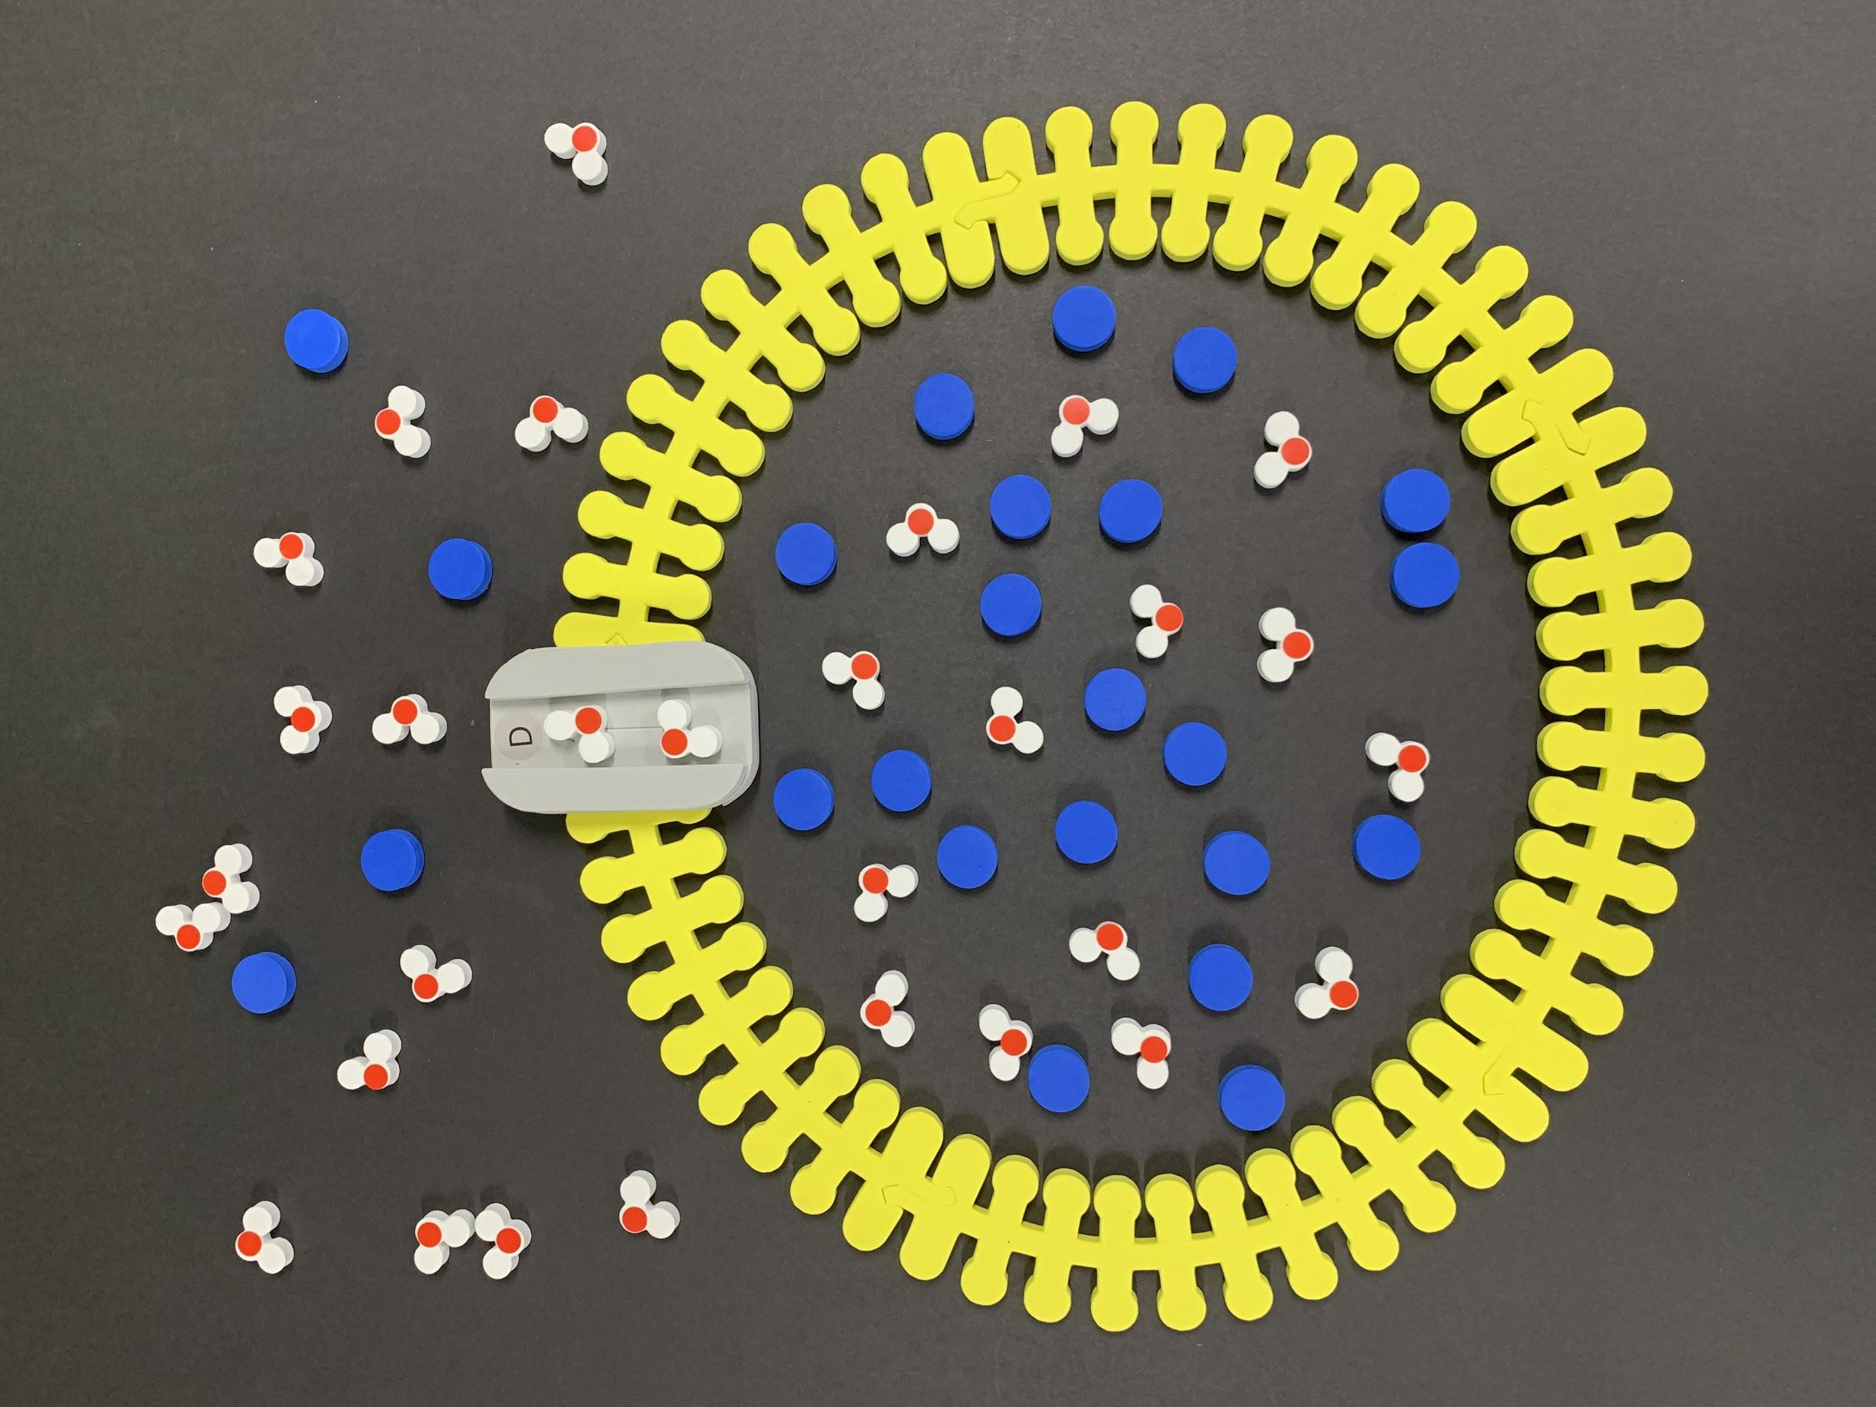
Let’s Model!
Hypertonic Solution
Isotonic Solution
Hypotonic Solution
Which direction will water flow?
Notes:
Put water molecules and Na+ ions inside and outside the cell to represent the following types of solutions (in the environment)

Slide 24
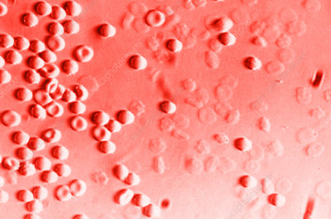
Case Study #1
A patient is admitted to the emergency room with severe vomiting and diarrhea. An intravenous (IV) solution is administered to restore fluid loss. Shortly after, the patient experiences a dramatic loss in blood pressure.
A blood sample is sent to the lab. Under the microscope, the patient’s red blood cells appear very swollen.
Using the membrane model, explain what you think happened at the hospital.

Slide 25


Case Study #1
Hypotonic Solution
(Distilled Water)
Water Flows Into Cell
A patient is admitted to the emergency room with severe vomiting and diarrhea. An intravenous (IV) solution is administered to restore fluid loss. Shortly after, the patient experiences a dramatic loss in blood pressure.
A blood sample is sent to the lab. Under the microscope, the patient’s red blood cells appear very swollen.

Slide 26
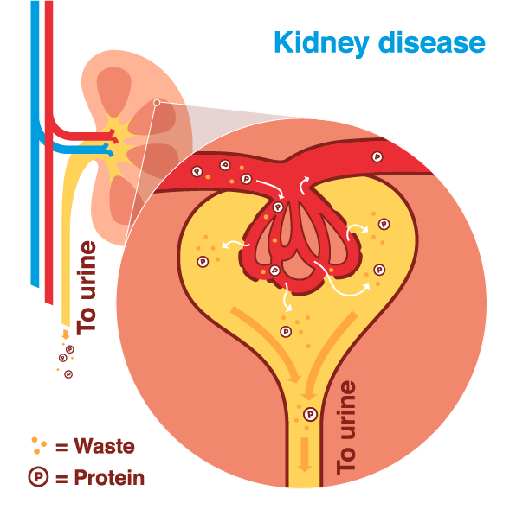
Case Study #2
A couple takes their 7-year-old young son to the doctor. Their child has been complaining of being thirsty all the time and has been getting up several times during the night to urinate.
The doctor orders tests and finds high levels of glucose in the patient’s urine. She suspects her patient may have Type 1 Diabetes.
Using your understanding of osmosis and diffusion, create a model to explain why diabetics can experience frequent urination and increased thirst.

Slide 27
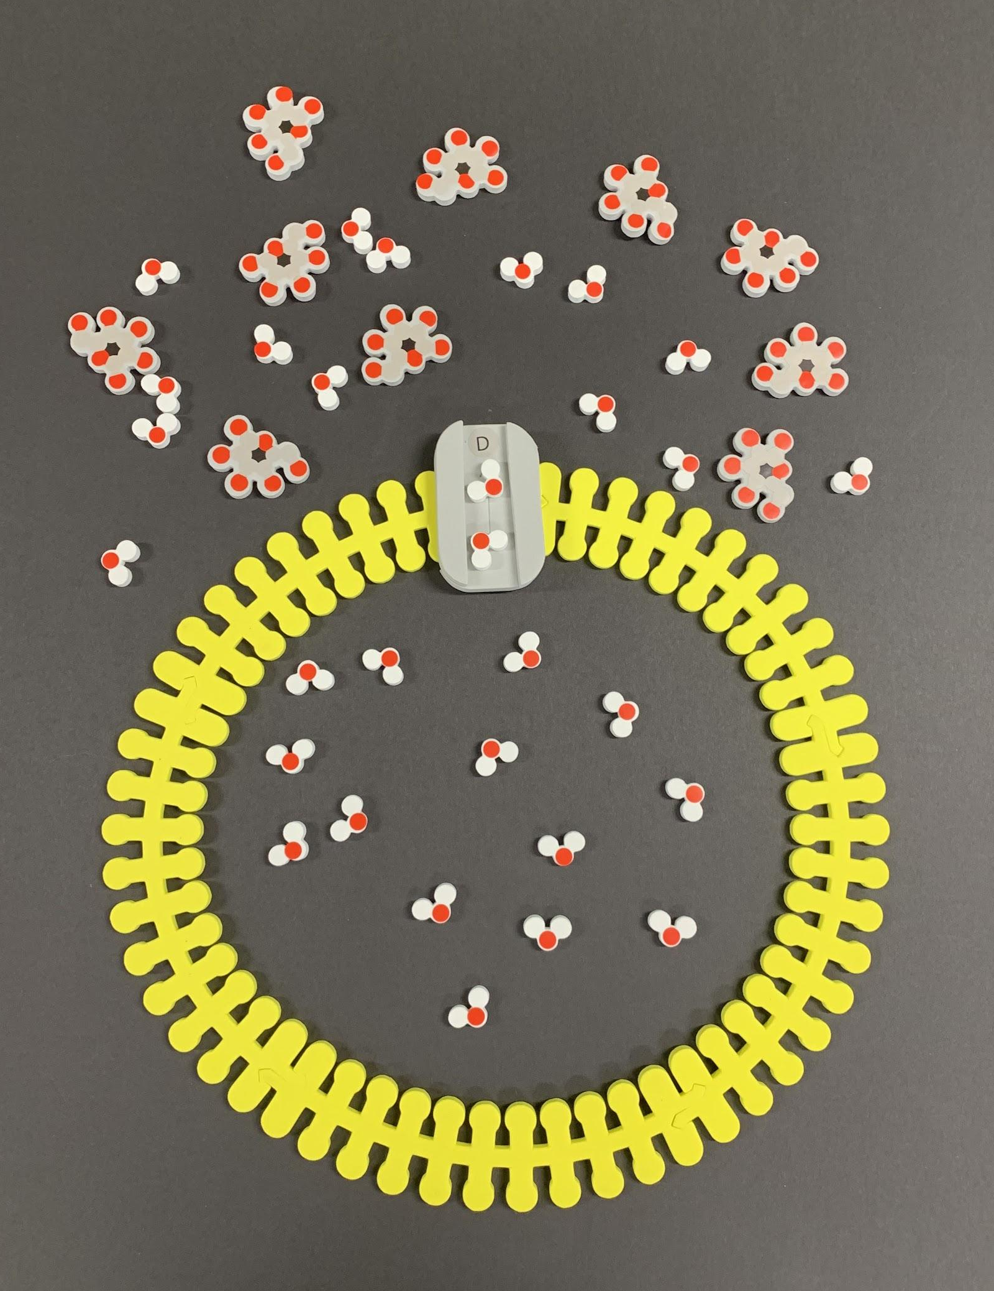
Case Study #2
Hypertonic Solution
Water Flows Out of Cell
(↑urine production)
A couple takes their 7-year-old young son to the doctor. Their child has been complaining of being thirsty all the time and has been getting up several times during the night to urinate.
The doctor orders tests and finds high levels of glucose in the patient’s urine. She suspects her patient may have Type 1 Diabetes.

Slide 28
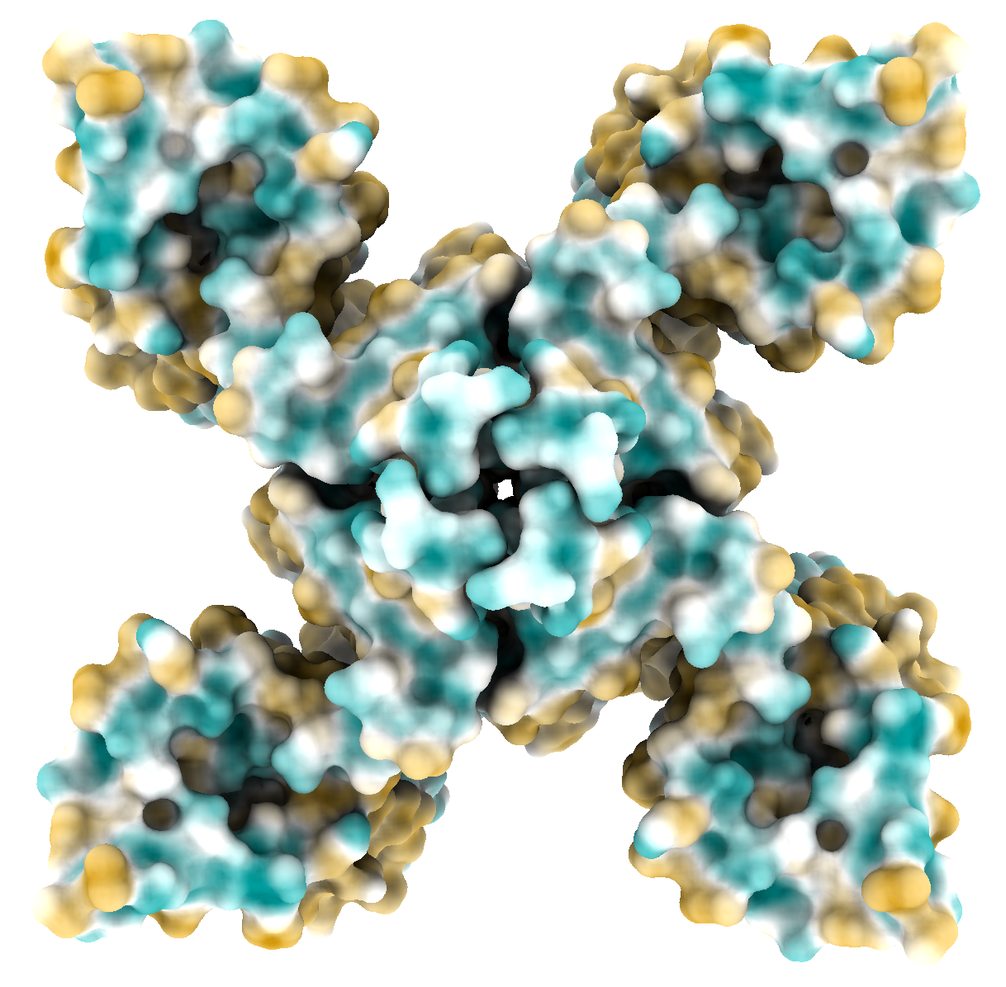
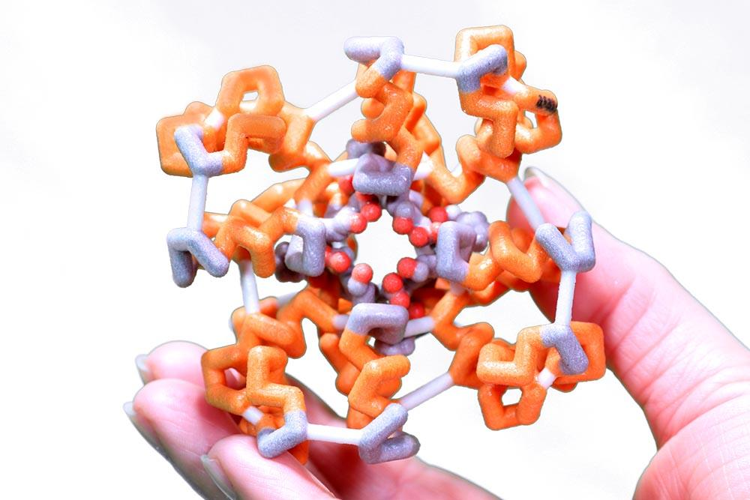
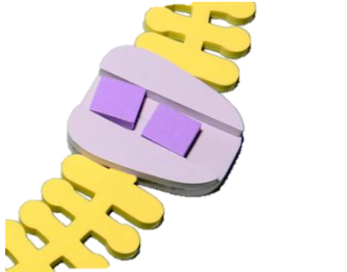
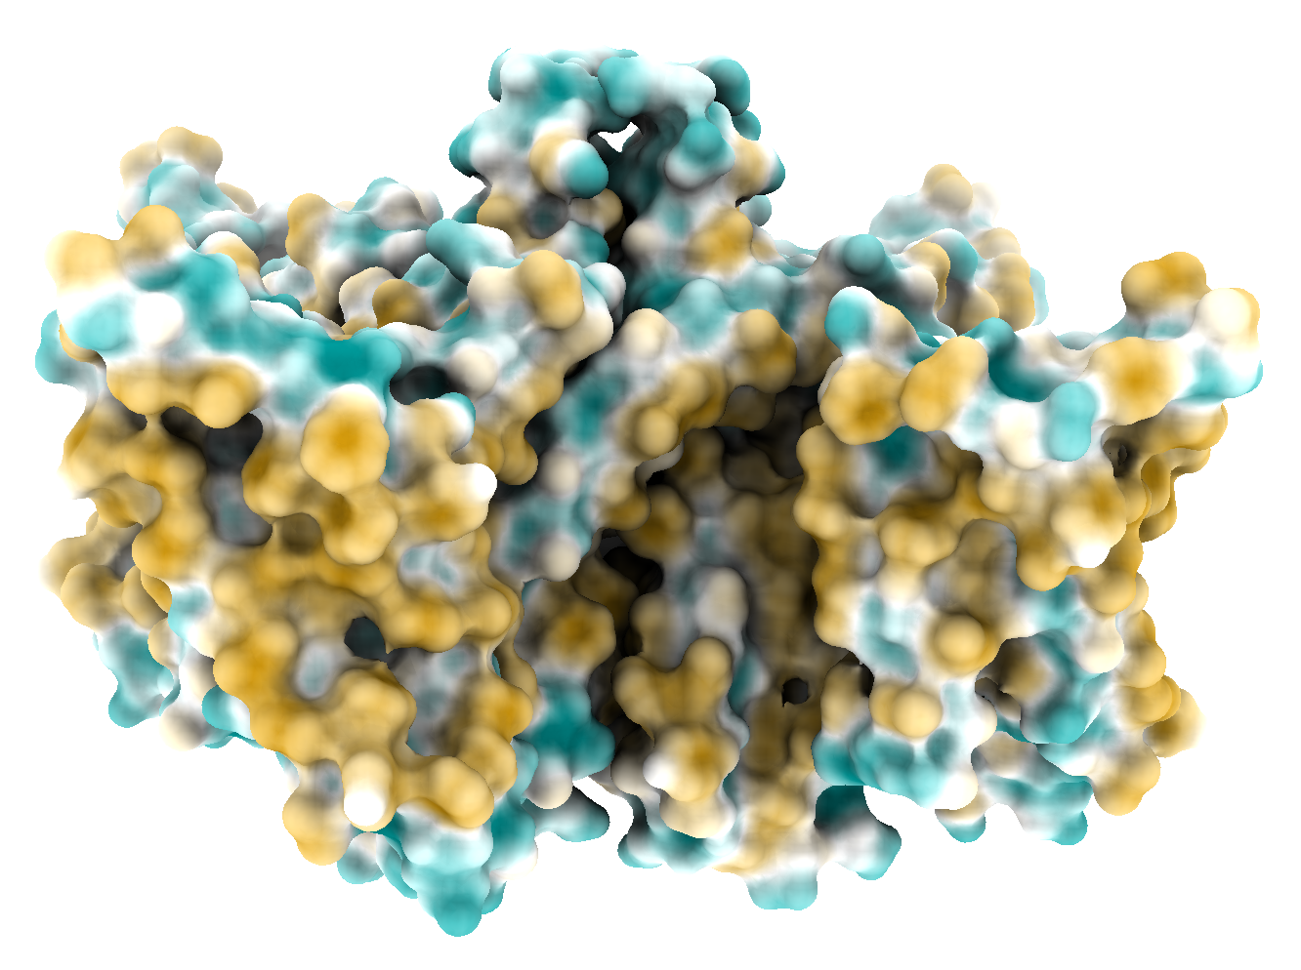
Sodium Channel
PDB ID: 6P6W

Slide 29
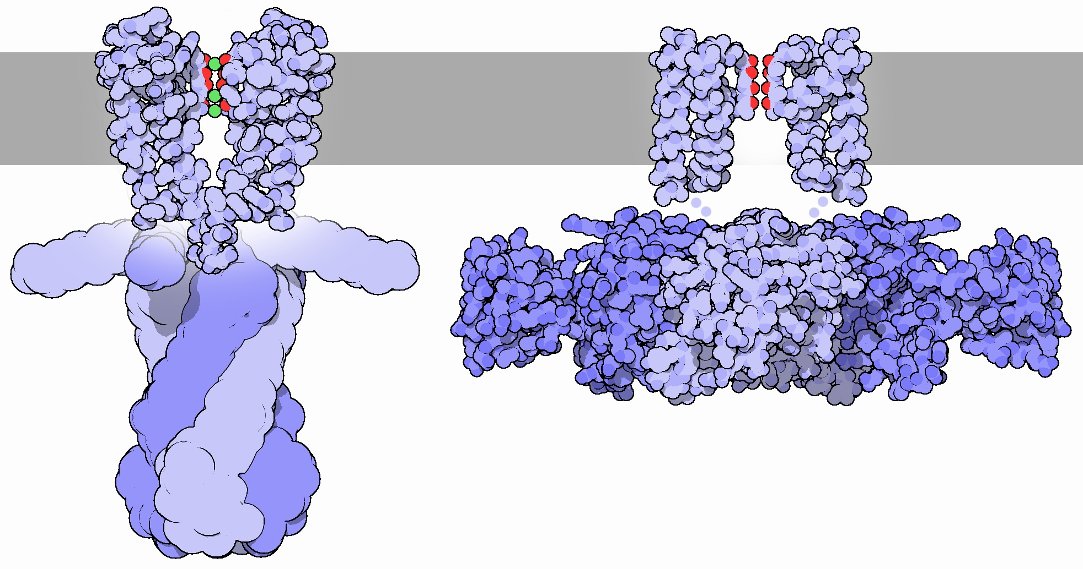
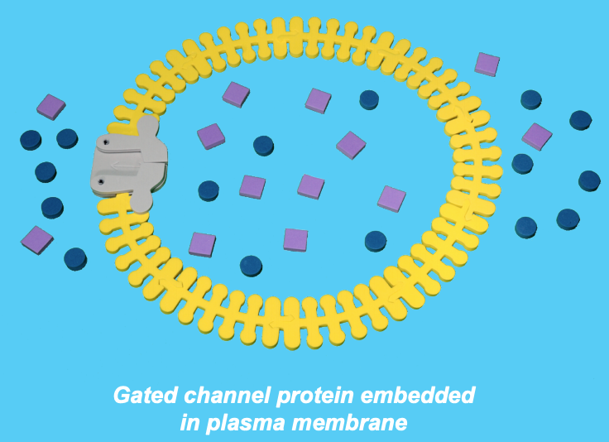
Gated Potassium Channel
“Closed” Channel
“Open” Channel
http://pdb101.rcsb.org/motm/38
Notes:
Potassium channels are designed to allow the flow of potassium ions across the membrane, but to block the flow of other ions--in particular, sodium ions. These channels are typically composed of two parts: the filter, which selects and allows potassium but not sodium to pass, and the gate, which opens and closes the channel based on environmental signals. The potassium channel is comprised of four identical protein molecules that span the width of the membrane, forming a selective pore down the center. Potassium ions, shown in green, flow freely through it, at rates of up to one hundred million ions per second. But it is also remarkably selective--it allows only one sodium ion to pass for every ten thousand potassium ions. Filter shown at the top; Gating domains shown at the bottom.

Slide 30
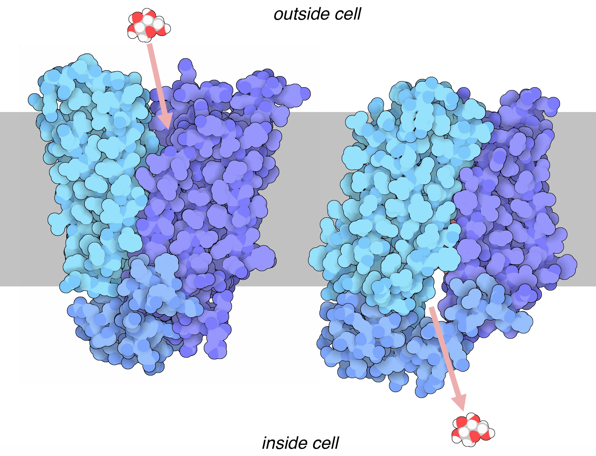
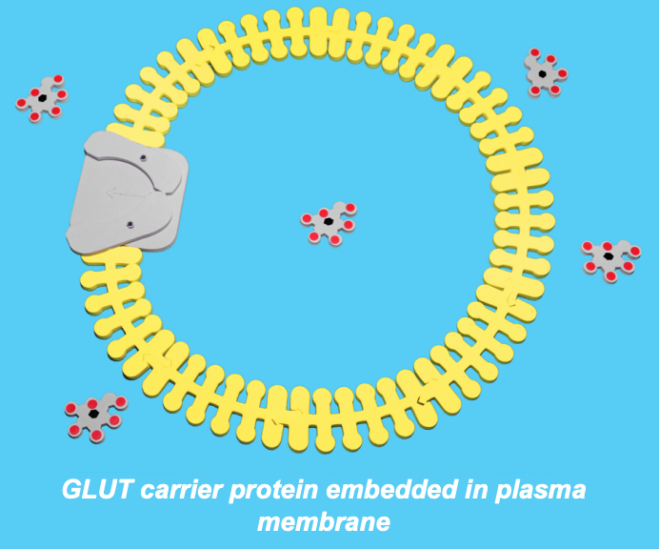
GLUT: Glucose Transporter / Carrier Protein
http://pdb101.rcsb.org/motm/208
Notes:
Glucose transporters manage the traffic of glucose across the cell's outer membrane. They act by alternating between two states. First, the transporter has an opening facing the outside of the cell, and it picks up a molecule of glucose. Then it shifts shape, and opens towards the inside, releasing glucose into the cell. Glucose transporters generally act passively: since glucose is rapidly phosphorylated by hexokinase, the concentration of free glucose in the cytoplasm is generally very low, and the higher concentration of glucose in the blood drives transport of glucose into the cell.

Slide 31
Active Transport
Notes:
Active Transport: movement of molecules or substances from low to high concentration; uses energy (in the form on ATP or GTP)

Slide 32
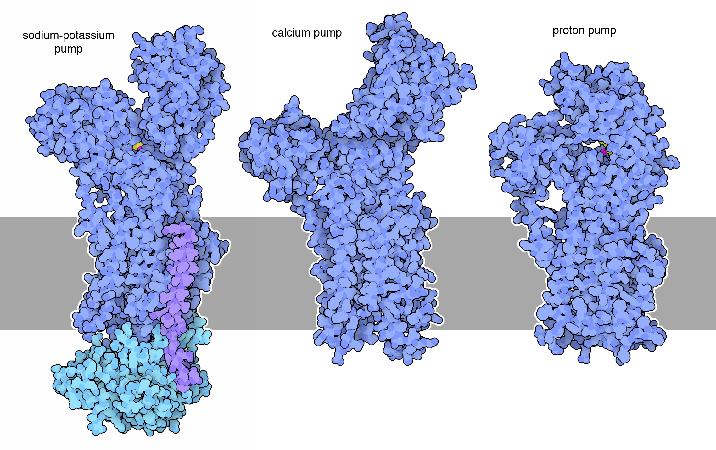
http://pdb101.rcsb.org/motm/118
Notes:
P-type Pumps
The sodium-potassium pump (shown here from PDB entry 2zxe ) is one of a large class of P-type ATPase pumps, so called because they all incorporate a phosphate-linked intermediate in their mechanism. Several other examples are currently available in the PDB. Many structures of the calcium pump are available (PDB entry 1su4 is pictured here), showing how these pumps undergo large conformational changes through the pumping cycle. Other examples include the proton pump found in plant cell membranes (PDB entry 3b8c ), and a proton-potassium pump that acidifies the stomach (PDB entry 3ixz , not shown here). The proton pump and the calcium pump are each composed of a single chain, whereas the pumps that transport potassium typically have a second smaller chain, shown here in turquoise. The structure of the sodium-potassium pump also has a third regulatory chain, shown here in purple.

Slide 33
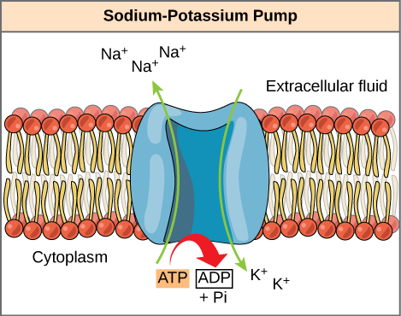
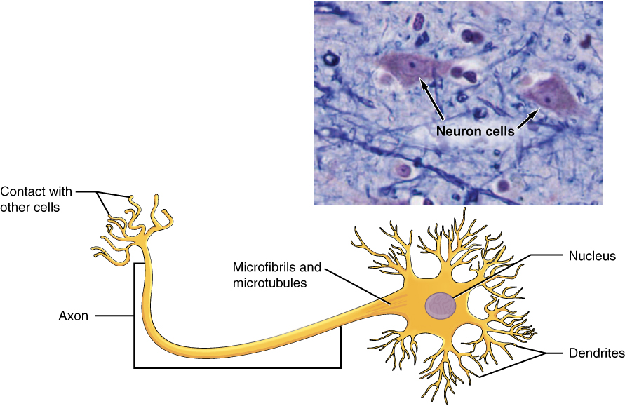
Sodium-Potassium Pump
Notes:
The sodium-potassium pump uses ATP to maintain the concentration and electrical gradient across the cell membrane to facilitate nerve signal transmission.

Slide 34
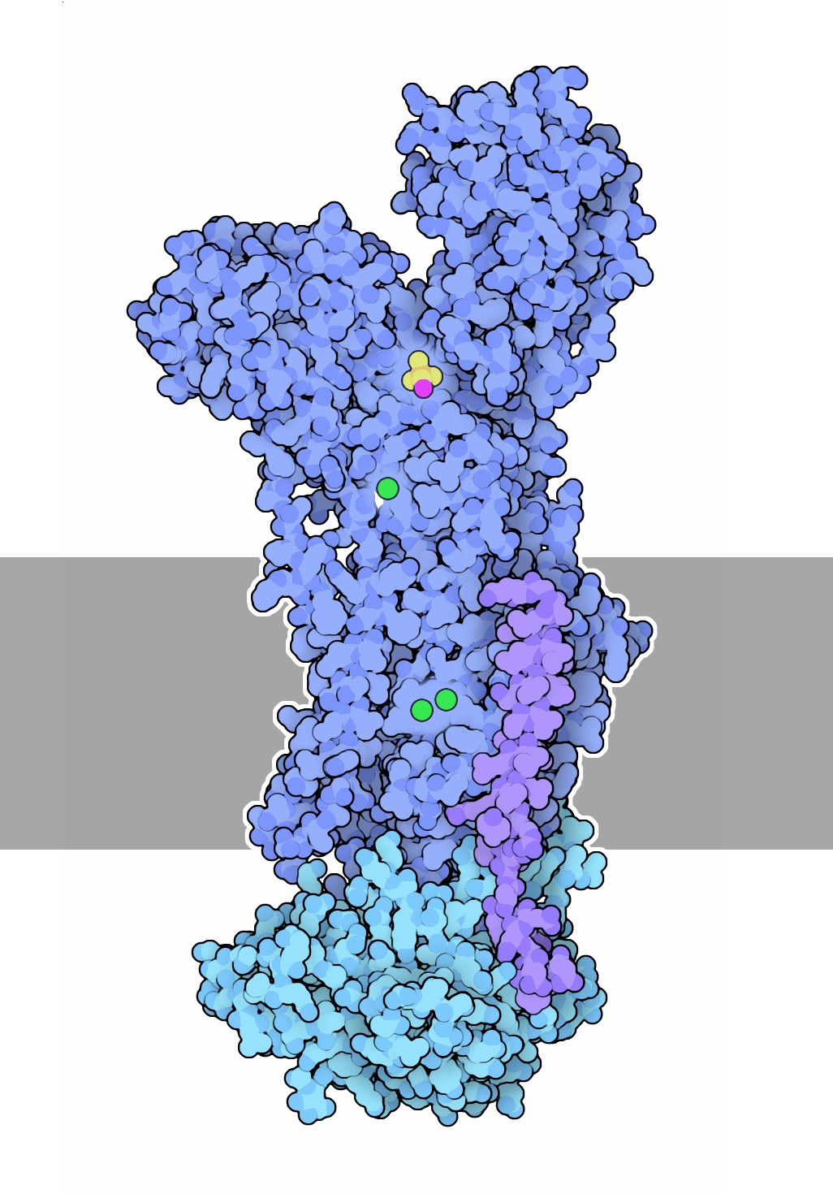
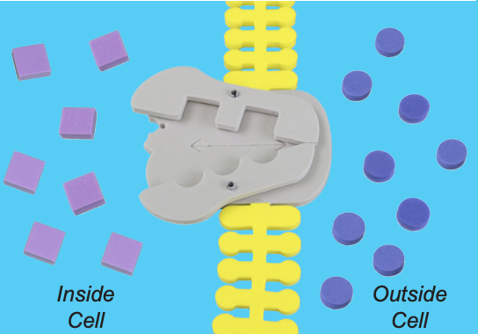
Sodium-Potassium Pump
Inside the Cell
Cell Membrane
Outside the Cell
http://pdb101.rcsb.org/motm/118
Notes:
Sodium-potassium pump with potassium ions (green) in the transport sites and a phosphate analogue (yellow) in the ATP-binding site. The cell membrane is shown schematically in gray.

Slide 35
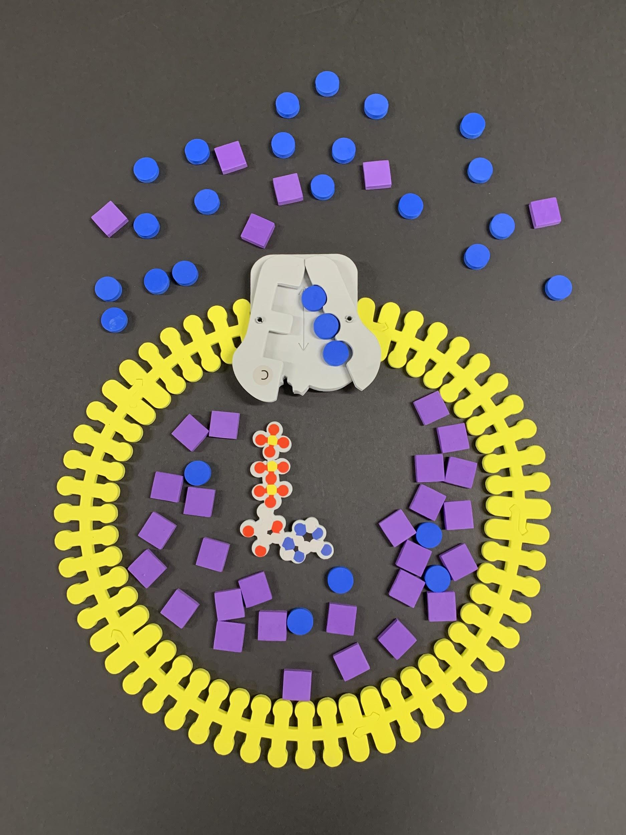
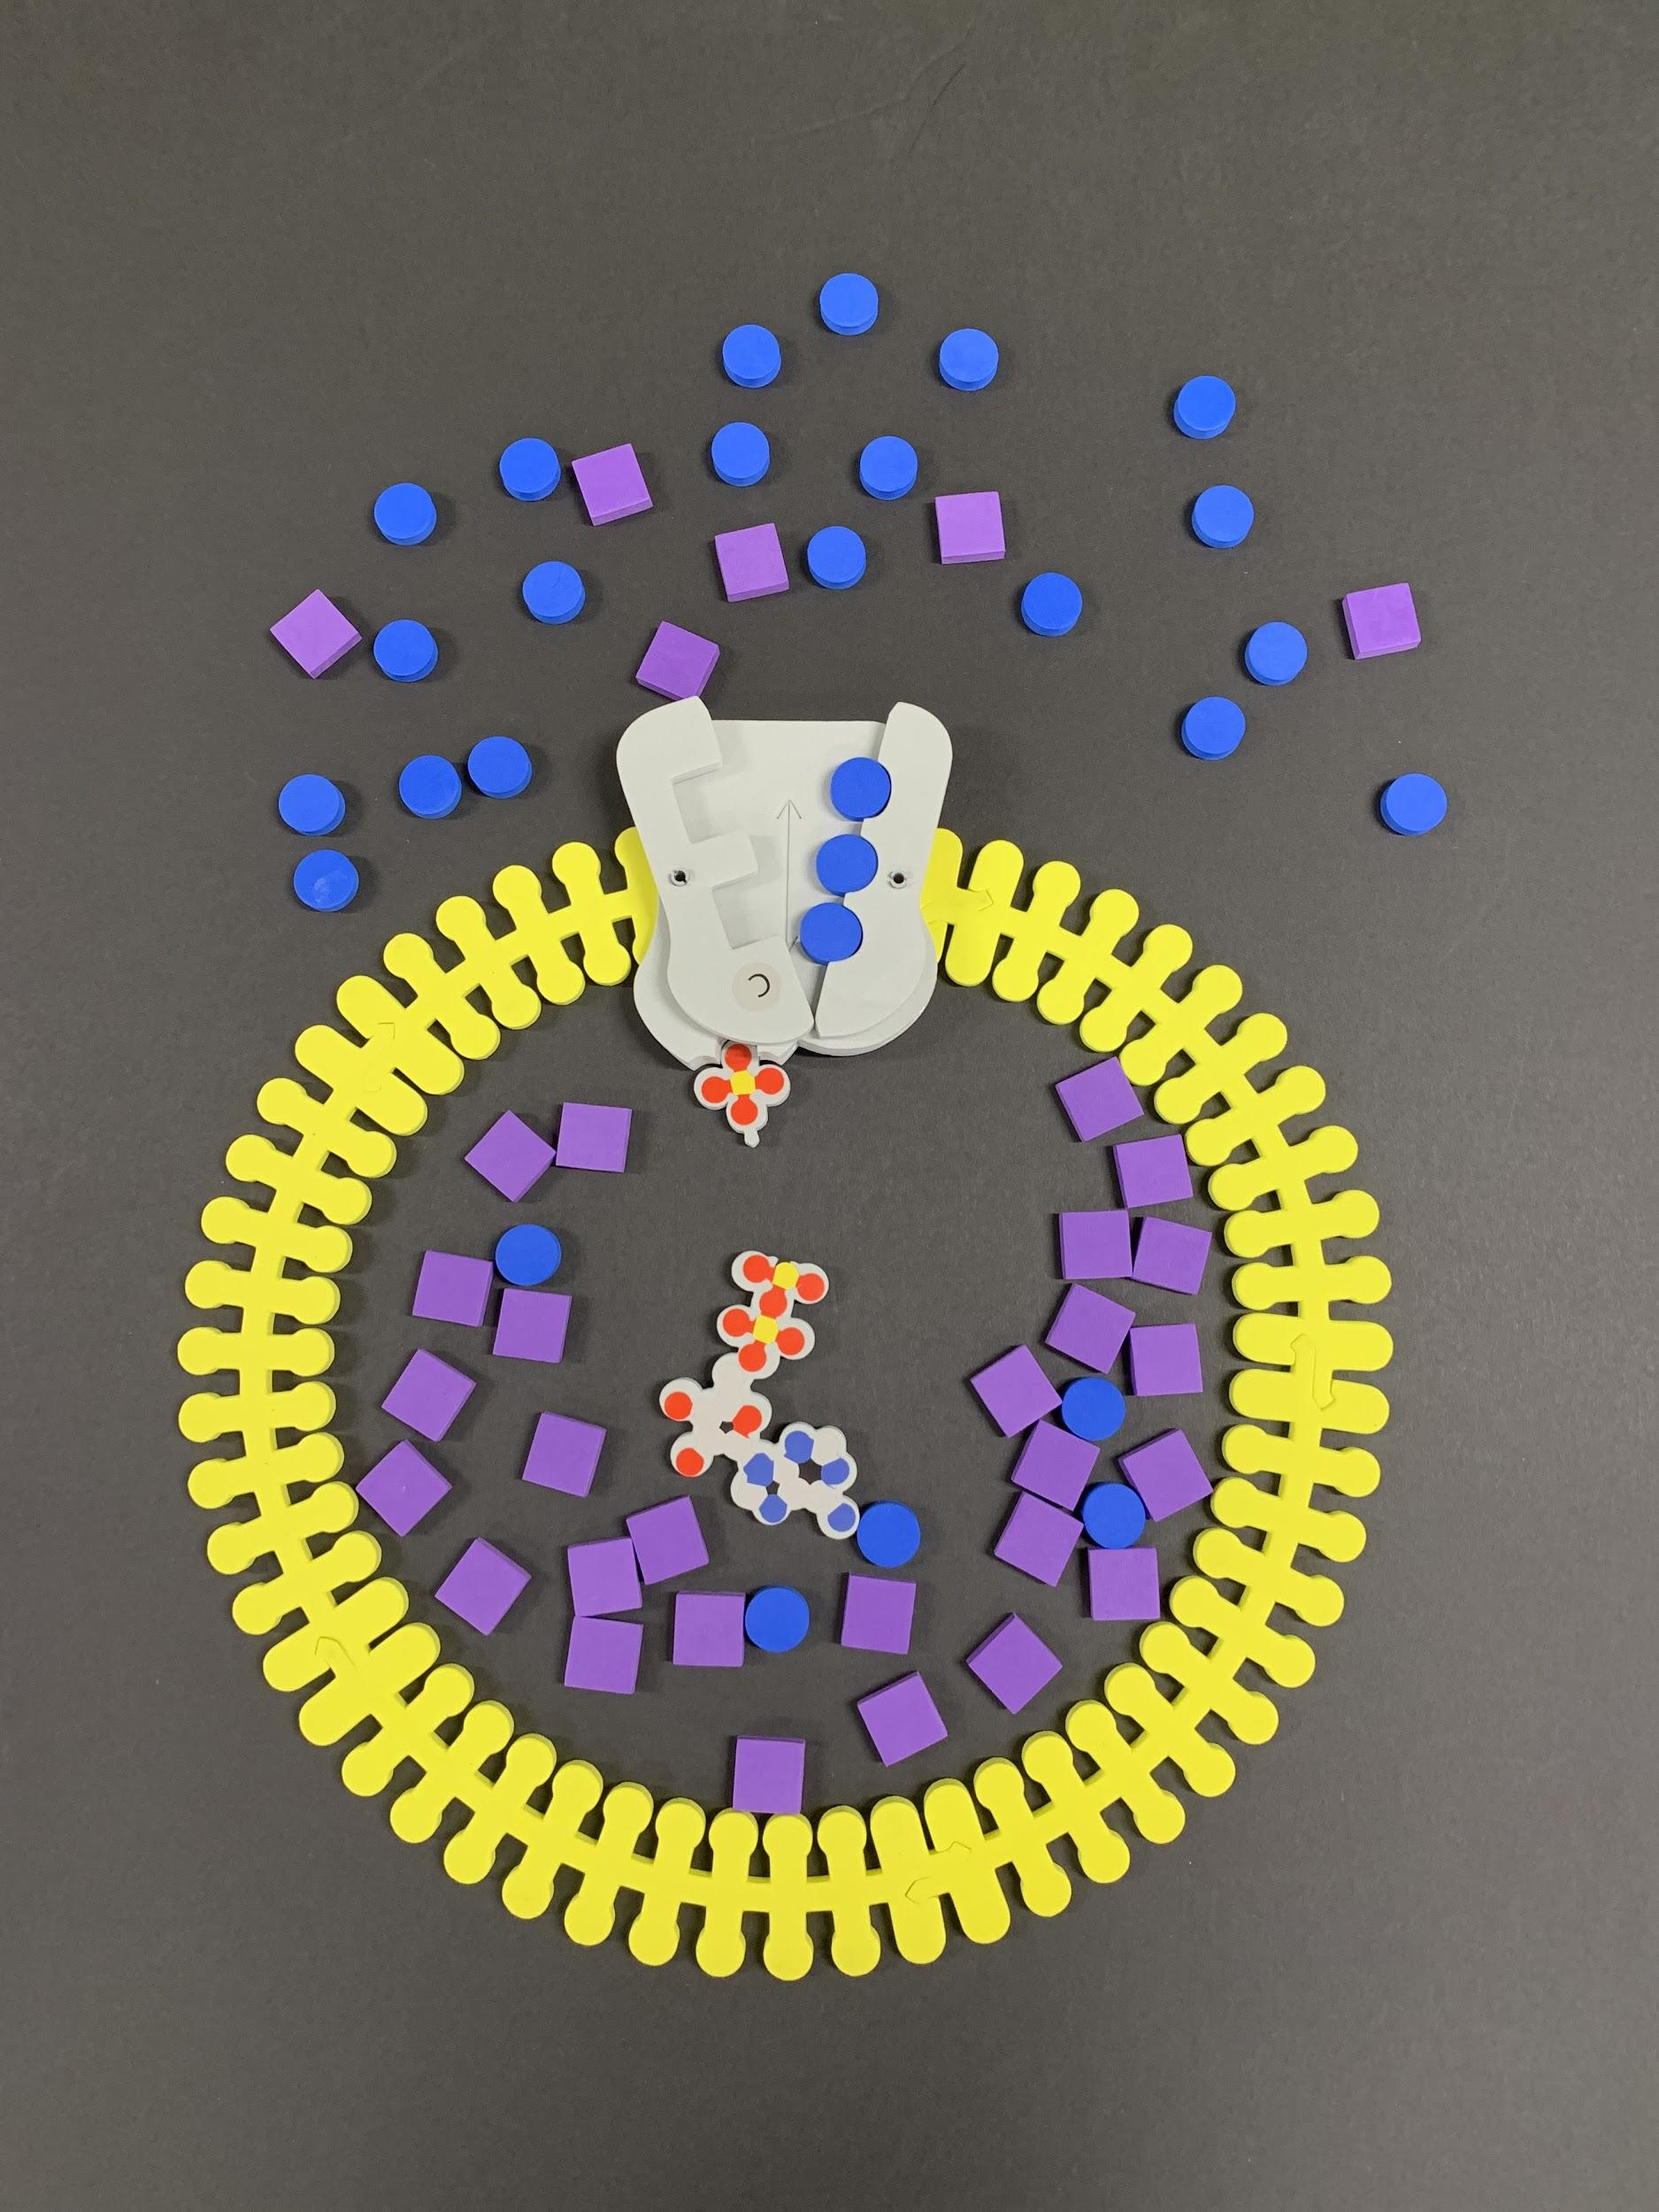
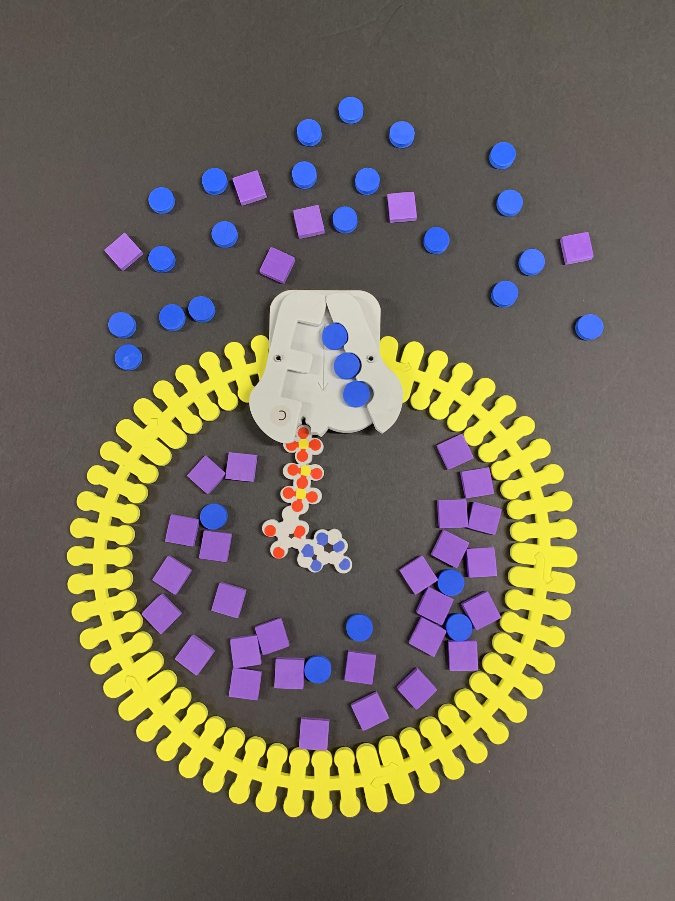
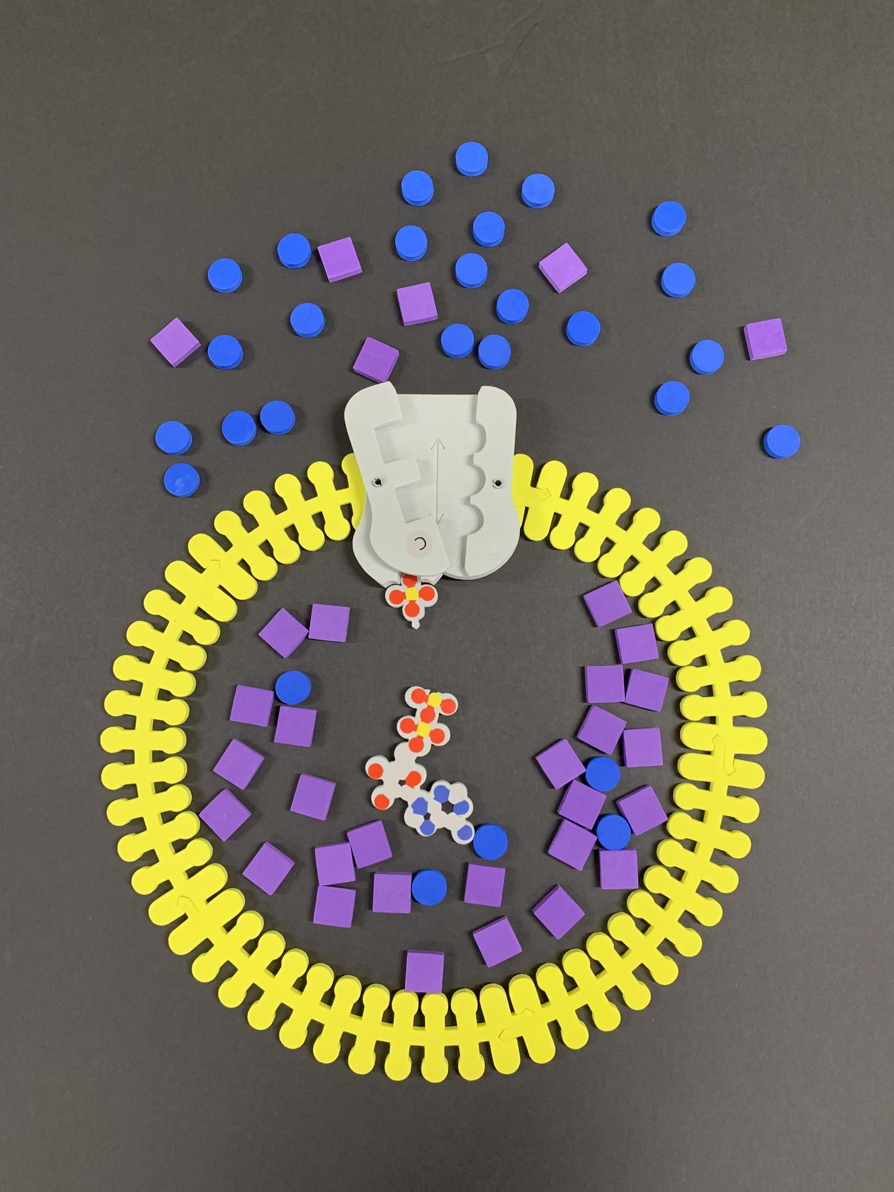
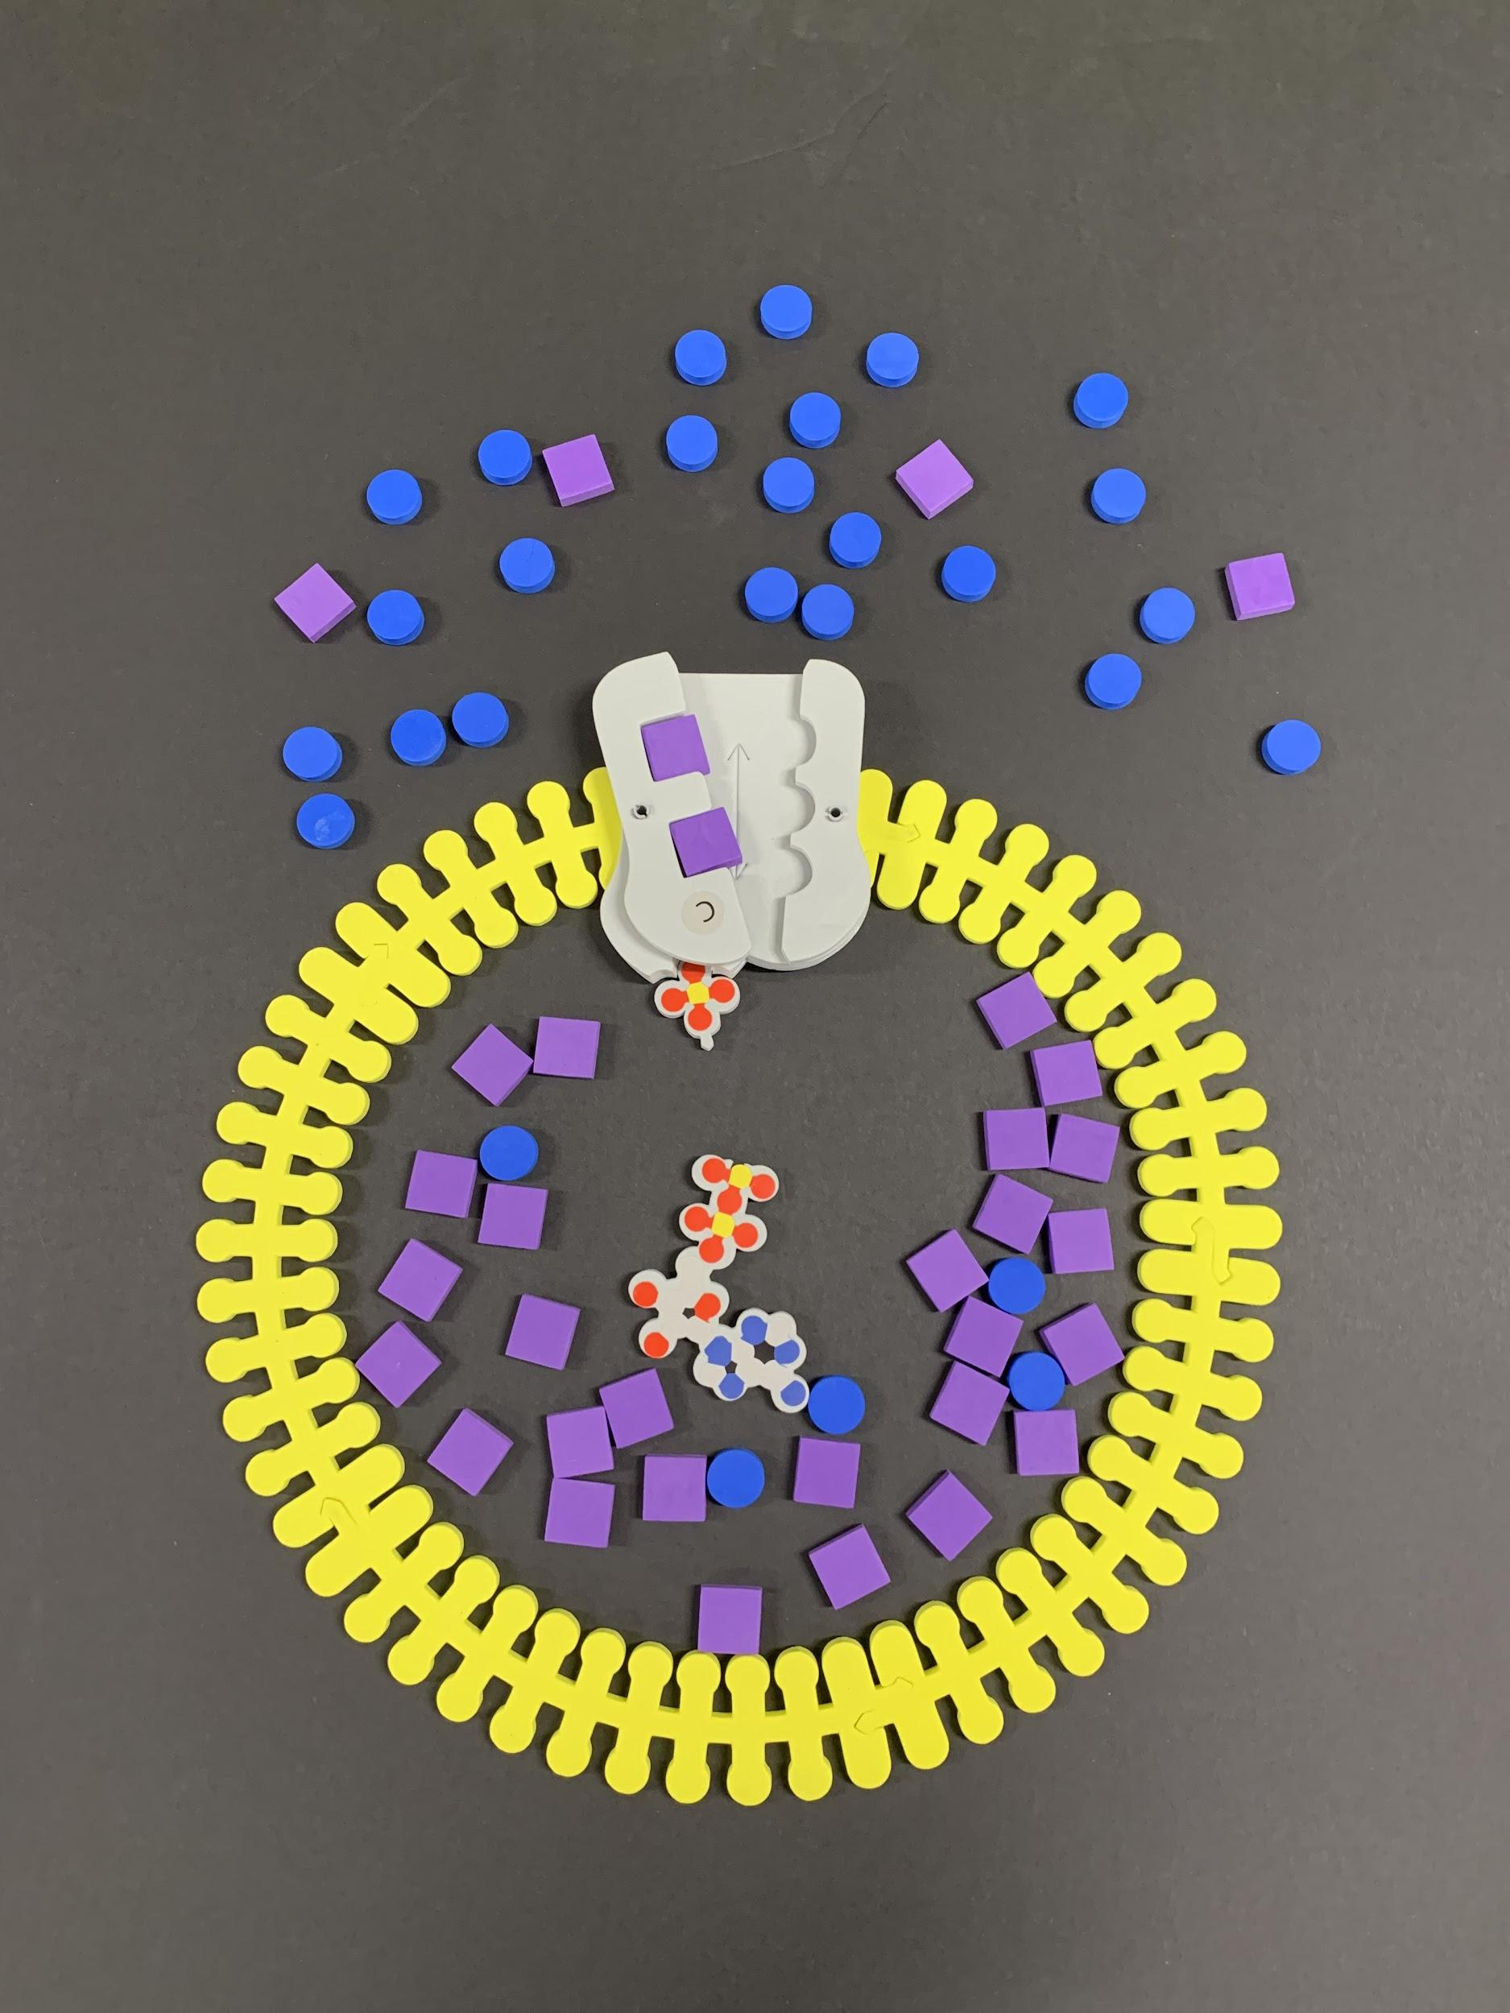
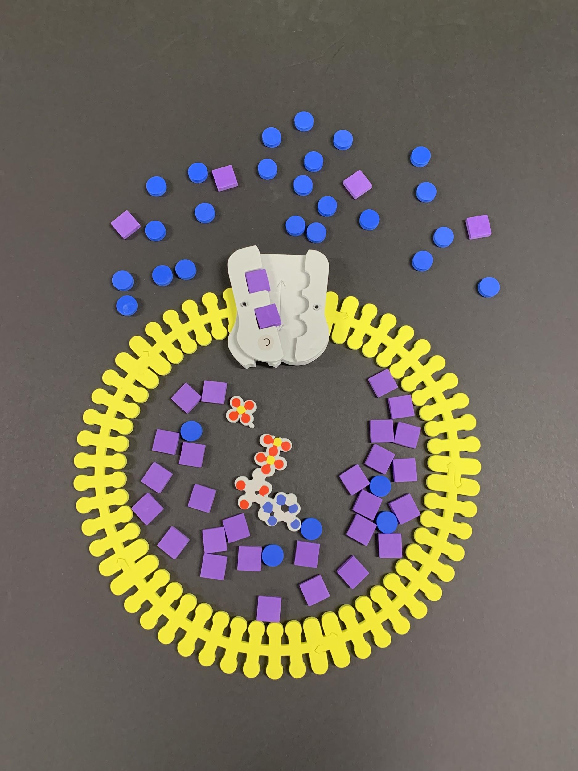


Let’s Model the Sodium/Potassium Pump!
Notes:
Model: 3 sodium ions bind with the protein pump inside the cell. The carrier protein then gets energy from ATP and changes shape. In doing so, it pumps the 3 Na+ ions out of the cell. At that point, 2 K+ ions from outside the cell bind to the protein pump. The potassium ions are then transported into the cell, and the process repeats.

Slide 36
CFTR Protein

Slide 37

Cystic Fibrosis Transmembrane Conductance Regulator (CFTR) Protein
CFTR gene located on chromosome 7
CFTR protein = 1480 amino acids
Gated chloride ion channel: movement of Cl⁻ from inside to outside of cell
2 ATP-binding sites
Involved in production of sweat, digestive fluids and mucus
Jue Chen, Rockefeller University
Notes:
CFTR is a relatively non-selective anion channel - chloride, bromide, iodide, fluoride, bicarbonate; Found on sweat glands, pancreas, GI tract, reproductive system, airways

Slide 38


Liu, Zhang, Csanady, Gadsby, Chen, 2017, Cell.
cff.org
Notes:
2 TMD (Transmembrane Domain) form translocation pathway; 2 NBDs (cytoplasmic nucleotide binding domains) hydrolyze ATP; R (regulatory) domain must be phosphorylated to allow channel to open; R domain is phosphorylated → ATP binding opens the CFTR channel, and ATP hydrolysis closes it; positively-charged arg and lys residues play a role in attracting anions into pore; CFTR is a relatively non-selective anion channel - chloride, bromide, iodide, fluoride, bicarbonate;
From (https://err.ersjournals.com/content/22/127/58): The CFTR protein is a cyclic adenosine monophosphate-regulated chloride ion channel composed of 1,480 amino acids [16]. The channel is an ATP-binding cassette transporter and is composed of five domains: two transmembrane domains (TMD1/TMD2) that form the channel pore, one regulatory domain (R), and two nucleotide binding domains (NBD1/NBD2) [17]. Classical channel opening is thought to be brought about by phosphorylation of the R domain by protein kinase A and recruitment of ATP to the nucleotide binding domains, NBD1 and NBD2. These domains dimerise (NBD1:NBD2) to open the channel pore. Upon subsequent ATP hydrolysis, the NBDs disassociate to close the channel [9, 17]. The entire process of channel opening and closing is aptly termed channel “gating”.

Slide 39

CFTR Cellular Processing
Johns Hopkins Cystic Fibrosis Center
Notes:
Construction and placement of the CFTR protein in the cell membrane occurs in distinct phases. Located on the long (q) arm of chromosome 7 at position 31.2, the CFTR gene is comprised of 27 exons that encode its genetic sequence (1). An exon is a portion of a DNA that contains the code for a protein structure. The CFTR gene is transcribed into a single strand of RNA within the cell nucleus (2); regions that are not needed to make the protein are spliced out, producing the final messenger RNA (mRNA) (3). The mRNA leaves the nucleus (4) and is translated into protein by ribosomes in the endoplasmic reticulum, or ER (5). A number of proteins called chaperones (6), facilitate folding of the new CFTR protein and its to the Golgi apparatus (7) where sugars are added. The CFTR protein then travels (8) to cell surface (9).

Slide 40
Let’s Model!
Model the role of the CFTR protein in the transport of chloride ions and water across the cell membrane.

Slide 41

Let’s Model!
Cl⁻ ions
Cl⁻ transported out of epithelial cell
CFTR protein
aquaporin
water diffuses out of cell
(mucus membrane)

Slide 42


Slide 43
Cystic Fibrosis
Mutation in CFTR gene
  2000+ identified mutations; F508del most common (⅔ cases worldwide; 90% cases in US)
Secretions become thick; affects mostly the lungs, but also the pancreas, liver, kidneys, and intestine
Signs and symptoms: difficulty breathing, coughing up mucus, sinus infections, poor growth, fatty stool, clubbing of fingers and toes, infertility in most males
Diagnosed by sweat test and genetic testing (infant screening at birth)
CF most common among people of Northern European ancestry (1:3000 newborns; 1:25 is carrier); least common in Africans and Asians
Average life expectancy: 42-50 years in developed world
Notes:
Most common mutation: deltaF508 (deletion of 3 nucleotides that results in loss of phenylalanine F at position 508 on protein);

Slide 44

CFTR Mutations
Johns Hopkins Cystic Fibrosis Center
Notes:
CFTR mutations are divided into six classes determined by the specific defect in CFTR protein synthesis, trafficking, function, or stability.
Although mutations of Classes I–III provoke more severe CF disease with absent or very weak residual CFTR activity, mutations representing Classes IV–VI lead to relatively high residual function and are associated with milder forms of CF.
Class 1 mutations: No CFTR protein is produced. Class 1 mutations can be due to early termination of CFTR protein production or large regions of mutated CFTR DNA.
Class 2 mutations: Defective trafficking of CFTR, which does not reach the surface of the cell. F508del is a class 2 mutation.
Class 3 mutations: The CFTR protein reaches the cell surface but it does not function. G551D is a class 3 mutation.
Class 4 mutations: The CFTR protein reaches the cell surface but chloride transport through the channel is defective.
Class 5 mutations: The CFTR channel is normal but the amount of protein at the cell surface is decreased.
Class 6 mutations: The CFTR channel is not stable at the cell surface so the amount of protein at the cell surface is decreased.

Slide 45

Cooney, A.L.; McCray, P.B., Jr.; Sinn, P.L. Cystic Fibrosis Gene Therapy: Looking Back, Looking Forward. Genes 2018, 9, 538.
Notes:
Most common mutation: F508del - cells have little or no CFTR protein; Mutation classes I, II, V = absence or reduced quantity of CFTR protein at cell membrane; III, IV influence function or activity of CFTR at cell membrane;

Slide 46


Let’s Model!
Less water in extracellular space → thicker mucous
Non-functional CFTR protein
Missing CFTR protein
Notes:
Simplified model: Chloride ions are not transported across the membrane, so water is drawn into the cell, leading to thickened mucous on the surface of epithelial lung cells.

Slide 47

Notes:
More complex model: Lack of functional CFTR results in more open Na channels; More Na accumulates within cells; Water is drawn in; Mucus thickens

Slide 48

Cystic Fibrosis Treatment Options
Front. Pharmacol., 27 February 2019 | https://doi.org/10.3389/fphar.2019.00121
Notes:
Potentiator = increase function of CFTR channels expressed at cell surface; Correctors improve intracellular processing and delivery of mutant CFTR protein; Production correctors promote read-through of premature termination codons in mRNA, generating more production of CFTR protein

Slide 49


Ivacaftor: CFTR Modulator Therapy for G551D Mutation
PDB ID: 6O2P
Ivacaftor (red) bound to CFTR protein
Notes:
Ivacaftor - approved by FDA in 2012; helps the G551D mutation (accounts for 2-3% CFTR mutations worldwide); gating mutation. CFTR protein form the right shape so that it can traffic to the cell surface; It is a potentiator that binds to the defective protein at the cell surface and opens the chloride channel so that chloride can flow through;

Slide 50


Classroom Kit vs. Student Modeling Pack

Slide 51

Questions?

Slide 52


Potassium Channels & Scorpion Toxins

Slide 53


3-Minute Break

Slide 54


Slide 55


Slide 56




Thank you for attending!
For a Certificate of Participation
Click the link in the chat
Purchase Kits and Models at 3dmoleculardesigns.com.
Discount code: WEBINAR20
Attend a Summer Course
cbm.msoe.edu
Contact us at: Ask3DMD@3DMoleculardesgins.com

Slide 57



Invite your colleagues to register!
DNA Structure & Function
Inspiring Student Questions with a TWIST in DNA Modeling
Wednesday, April 21, 2021 at 6:00 PM Central
Biotechnology & Coronavirus
The One Kit Wonder: Using Modeling to Teach Biotechnology Concepts
Wednesday, April 28, 2021 at 6:00PM Central
Join us at NSTA Engage!
Virtual Workshops April 29 and April 30
https://www.3dmoleculardesigns.com/Webinars4.htm

