Slide 1
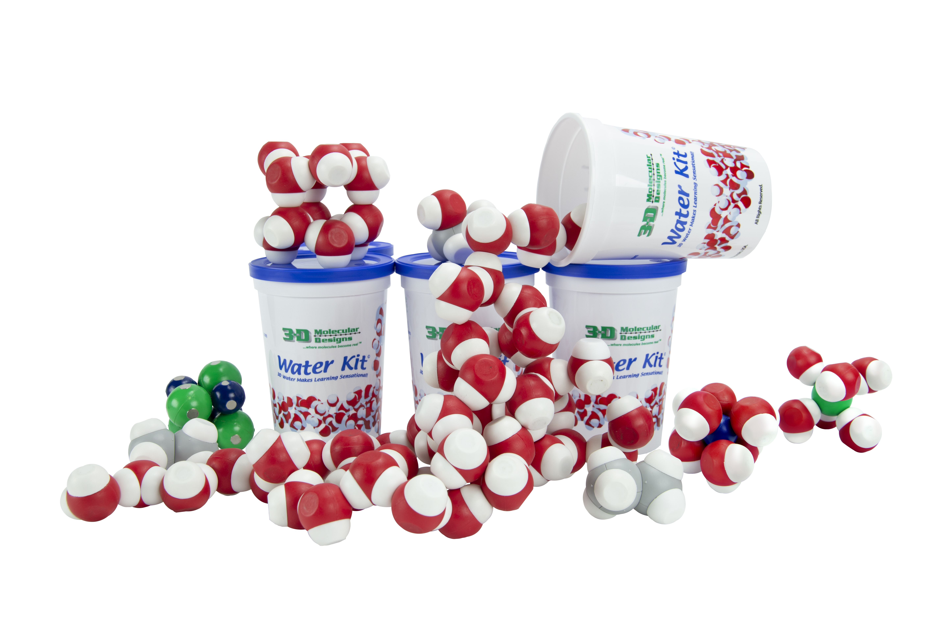
Physical & Chemical Properties of Water
Notes:
Intro - Heather
Welcome to Physical & Chemical Properties of Water! I am happy so many of you returned to join us the for the second session of our webinar series hosted by 3D Molecular Designs and the MSOE Center for BioMolecular Modeling. And – welcome to our new participants!
I am Heather Ryan, Partner and Director of Operations for 3DMD, and I will be your host for the series.

Slide 2
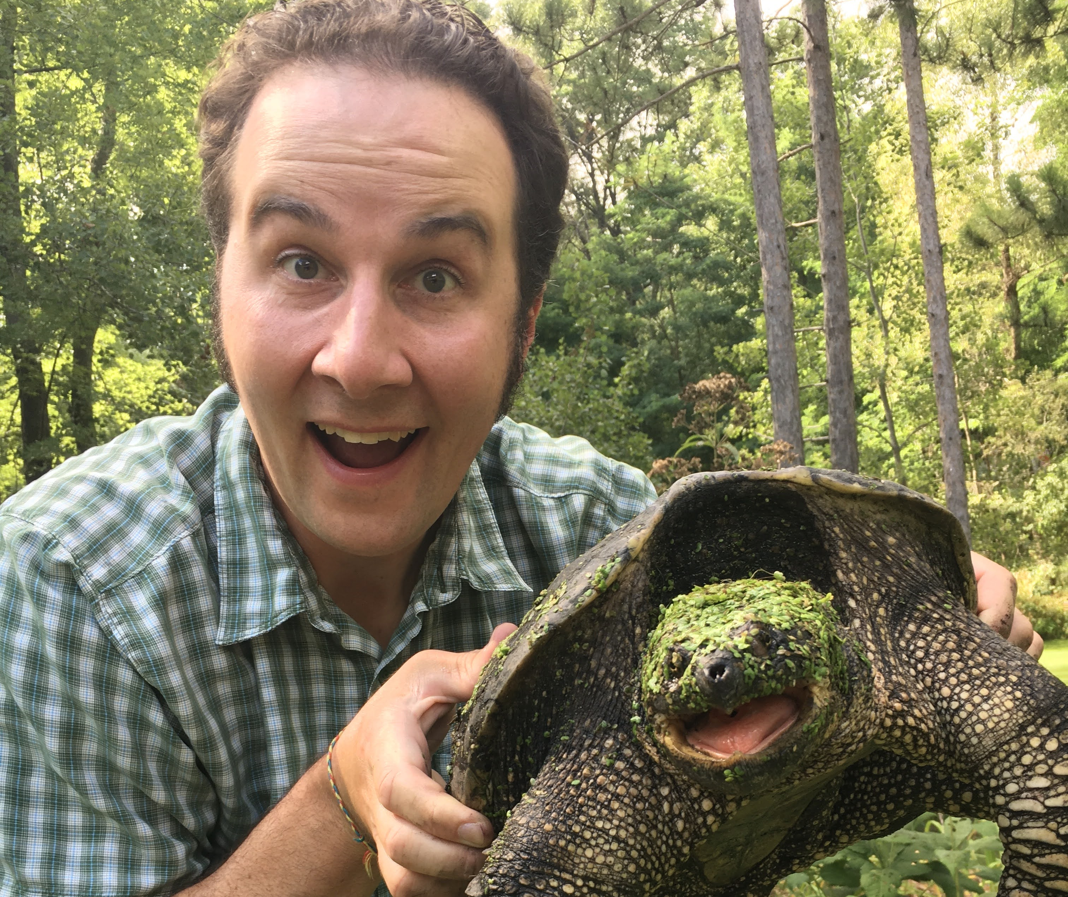
Jim Lane
Mahtomedi High School, Mahtomedi, MN
Augsburg University, Minneapolis, MN
Courses Taught
Introduction to Biology (10th grade)
Field Ecology and Conservation (11th and 12th Grade)
Biomimicry and Molecular Modeling (11th and 12 Grade)
Science Methods for Preservice Teachers (Graduate)
Knowles Teacher Initiative Senior Fellow
HHMI BioInteractive Ambassador Academy Member
Notes:
Jim Lane will start us out tonight with the Water Kit – we will see how many puns he can work into session.
We will answer as many questions as we can for Jim before 7 and will then take a quick break before Tim Herman presents aquaporin – and the story of exploding frog eggs.
After Tim, we will have a Q&A session for both Tim & Jim. And – please stay on to say hello.
I now have the honor of introducing Jim Lane,
Jim Lane earned his bachelor’s degree in biology and his Masters in Science Teaching. He has been teaching high school biology, engineering, and field ecology in Minnesota for over 11 years. Jim also teaches Science Methods for Preservice Teachers in an adjunct position at Augsburg University in Minneapolis, MN.
He is both a Senior Fellow of the Knowles Teacher Initiative and a current member of the HHMI BioInteractive Ambassador Academy.
Jim was awarded the Outstanding New Biology Teacher of the Year Award by NABT in 2011.
He has mentored a MAPS Team for the past four years with support from MSOE.
More recently he has helped developed and facilitate a teaching fellowship for Tibetan Monks who teach science in India and Bhutan through the Science for Monks non-profit.
Jim loves spending time outside with his family going on adventures and exploring the wonder of the natural world.
With that, Jim will begin with
Wet Your Appetite for Learning with the Water Kit
Courses Taught
Introduction to Biology (10th grade)
Field Ecology and Conservation (11th and 12th Grade)
Biomimicry and Molecular Modeling (11th and 12 Grade)
Science Methods for Preservice Teachers (Graduate)
Knowles Teacher Initiative Senior Fellow
HHMI BioInteractive Ambassador Academy Member
I have been a mentor for MAPS Teams for the past 4 years. I am also an advisor for Student Council and EcoClub. I facilitate a fellowship for Tibetan Monks who teach science in India and Bhutan. I love the outdoors, I love my family, and I love to learn.

Slide 3
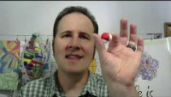
Introduction

Slide 4
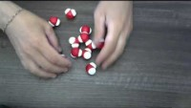
Engaging the Model

Slide 5
Questions and Observations
What did you observe?
What questions did you come up with from these observations?
What are you curious to know more about?
Notes:
STOP screen share

Slide 6
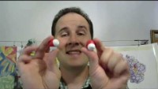
Observations

Slide 7
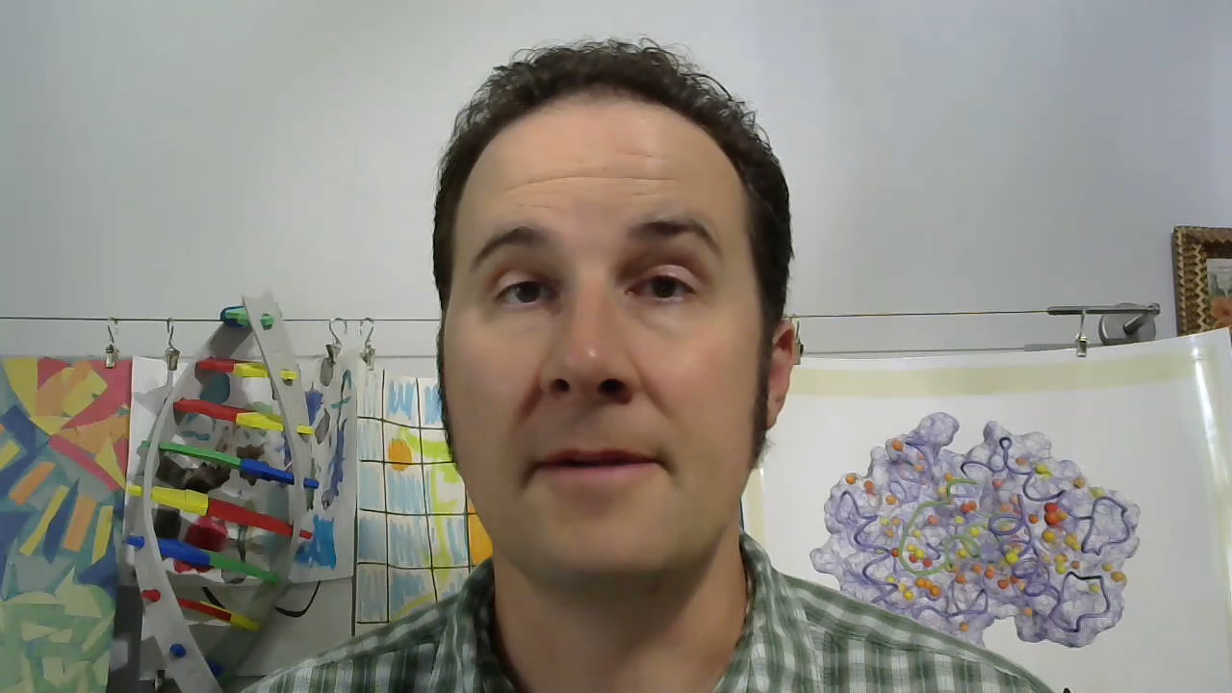
Bond Types
Notes:
SCREEN SHARE
Play video
Stop Screen and Highlight Heather’s overhead camera

Slide 8
Bond Types
What misconceptions could be addressed using this model?
What content areas or topics could this model supplement?
What questions might student have about the model?
Notes:
SCREEN SHARE

Slide 9
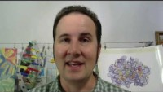
Solutions and States of Matter

Slide 10
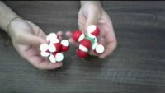
Solutions and States of Matter
Notes:
Will I play this video?

Slide 11
Solutions and States of Matter
How does this model change how you could teach about solutions and states of matter?
How does this support learning more complex ideas?

Slide 12
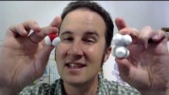
Polarity

Slide 13
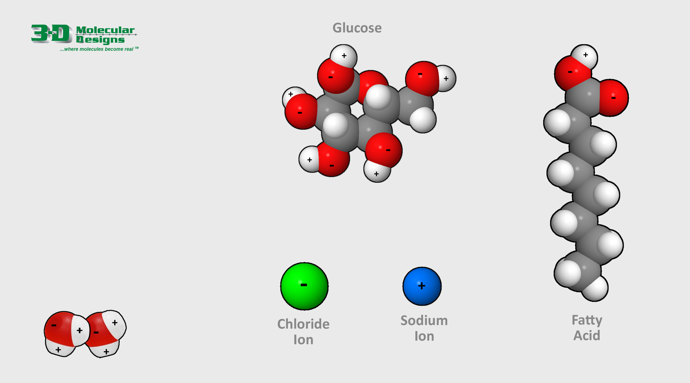
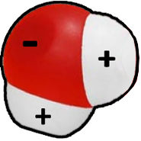
The Polar Nature of Water
The shared electrons in a water molecule spend more time near the oxygen atom and less near the two hydrogen atoms, resulting in slightly positive and slightly negative regions.
This impacts how they interact with other molecules, forming hydrogen bonds when they get close to an opposite charge.
1. Study how two water molecules interact using the image shown below.
2. Drag the water molecule shown to the right to demonstrate how water molecules might interact with the other common molecules.

Slide 14
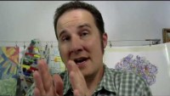
Conclusion and Questions

Slide 15
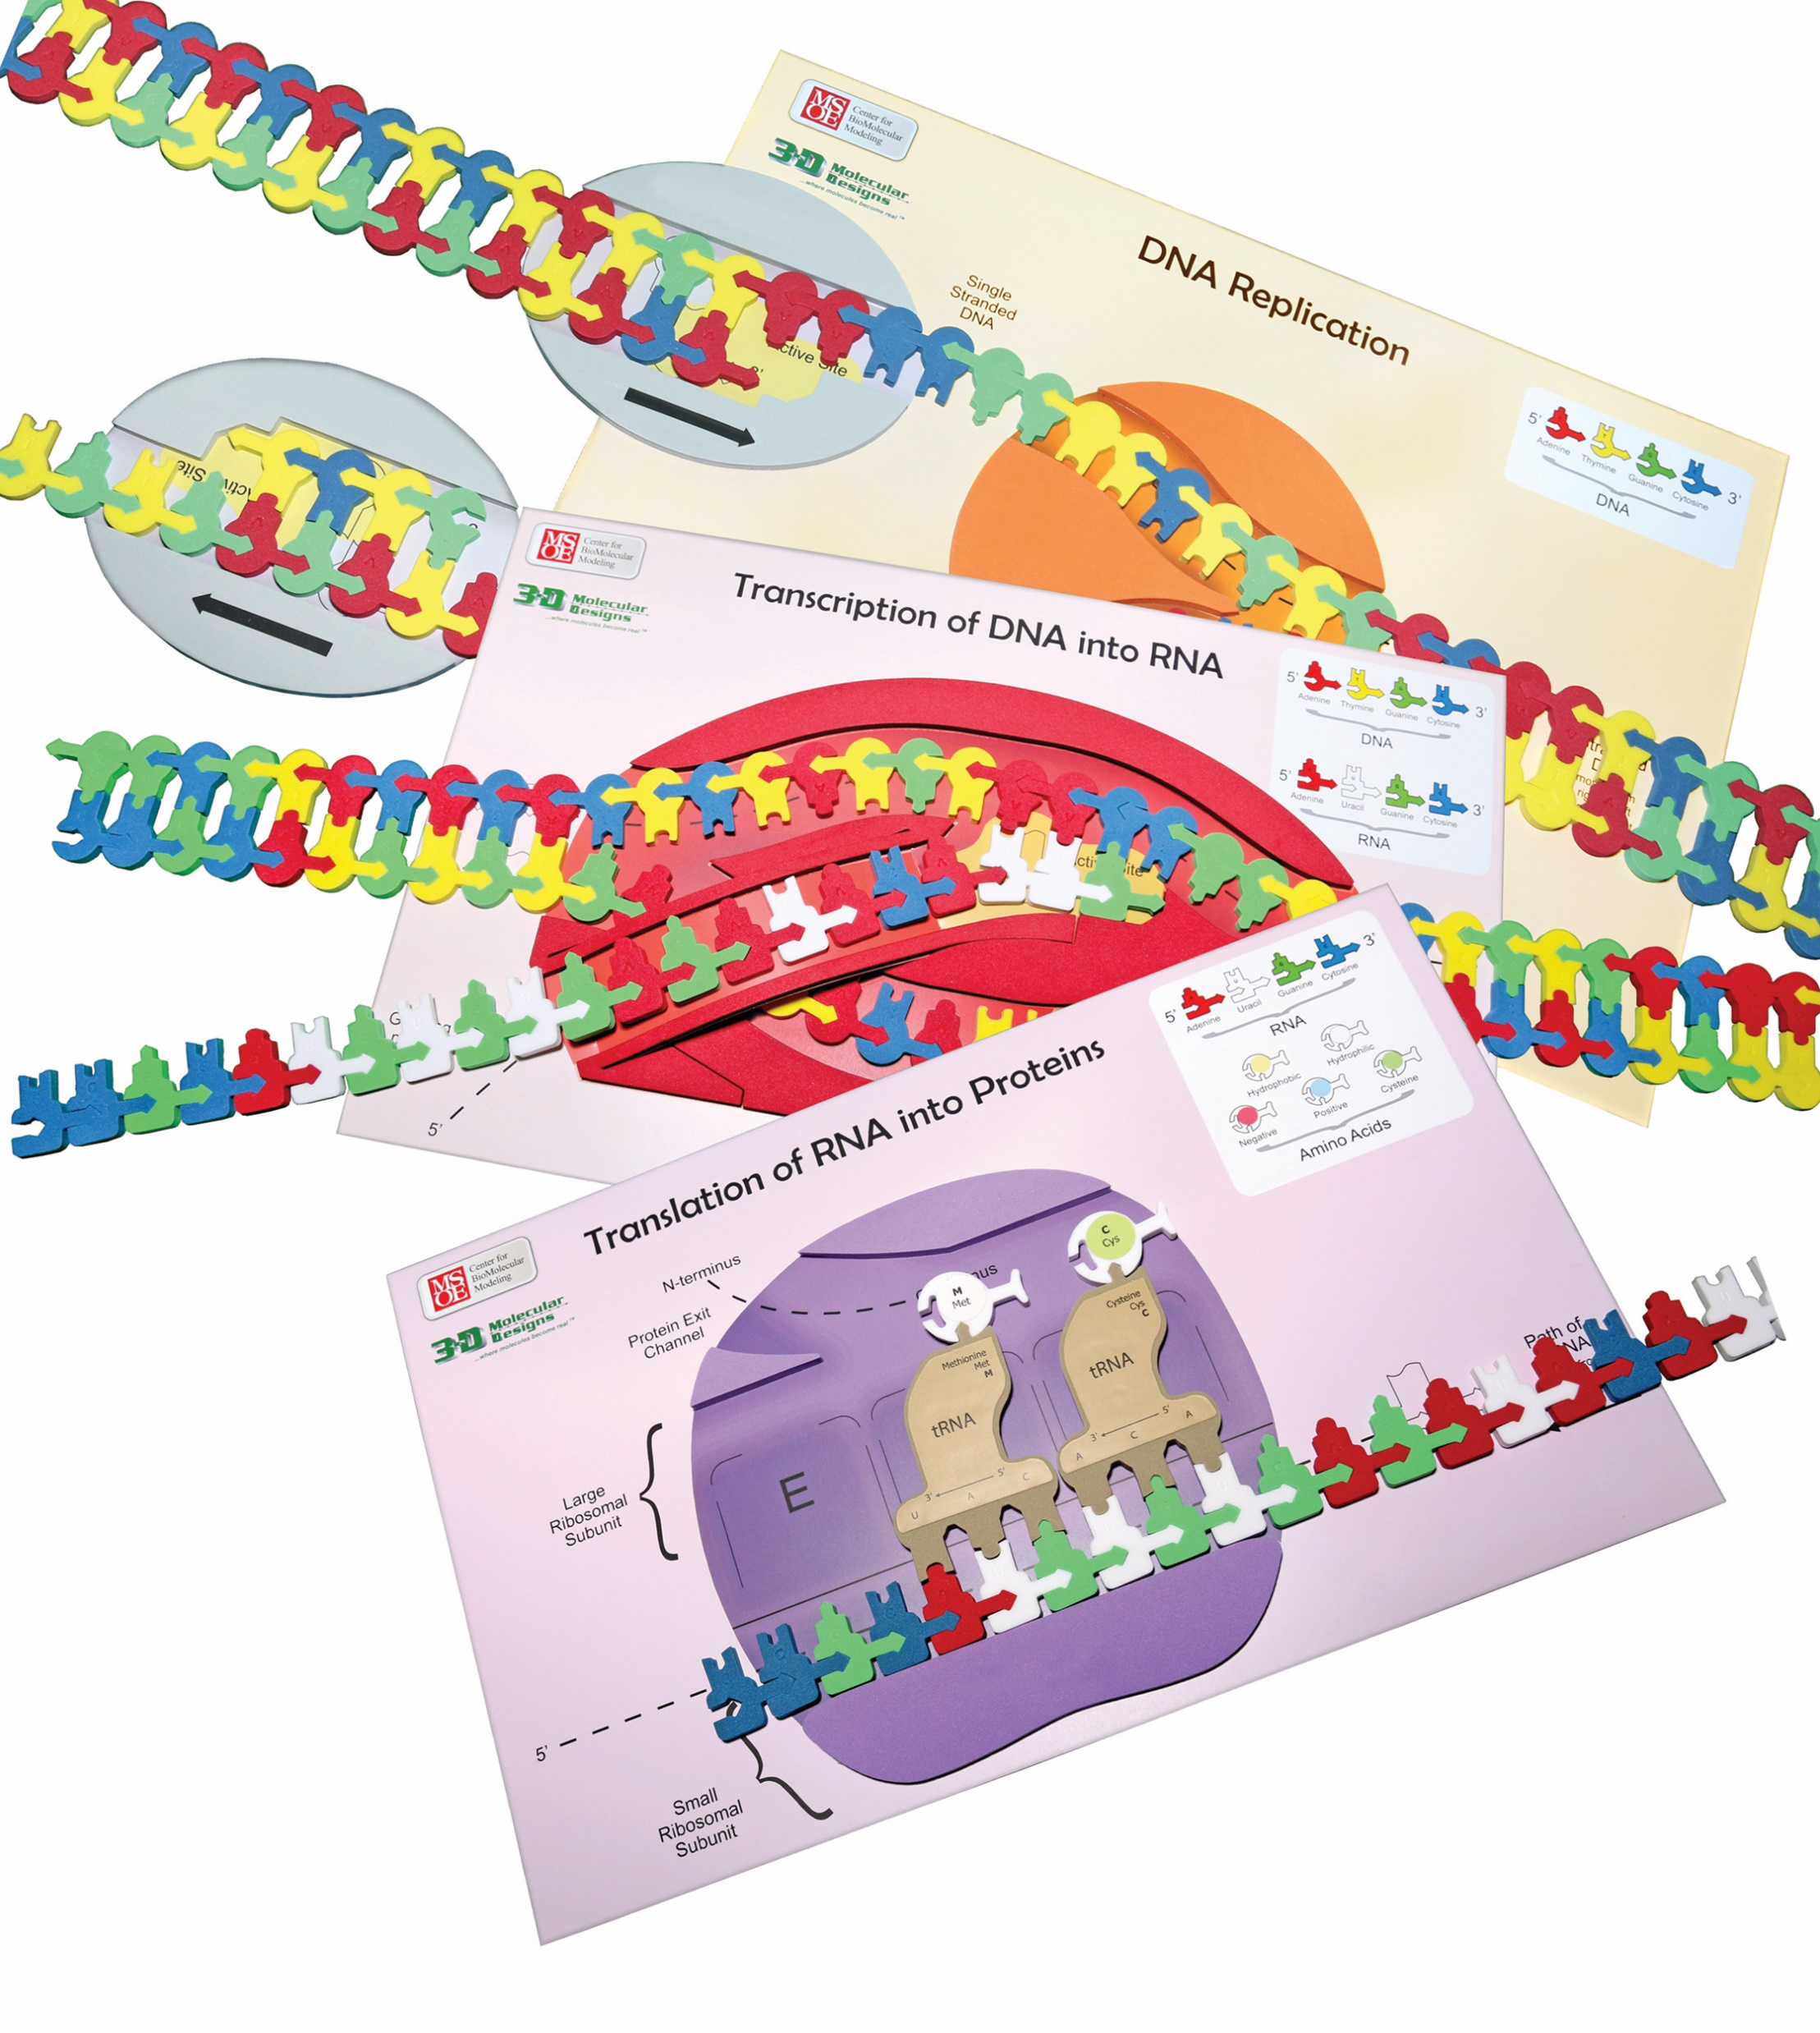
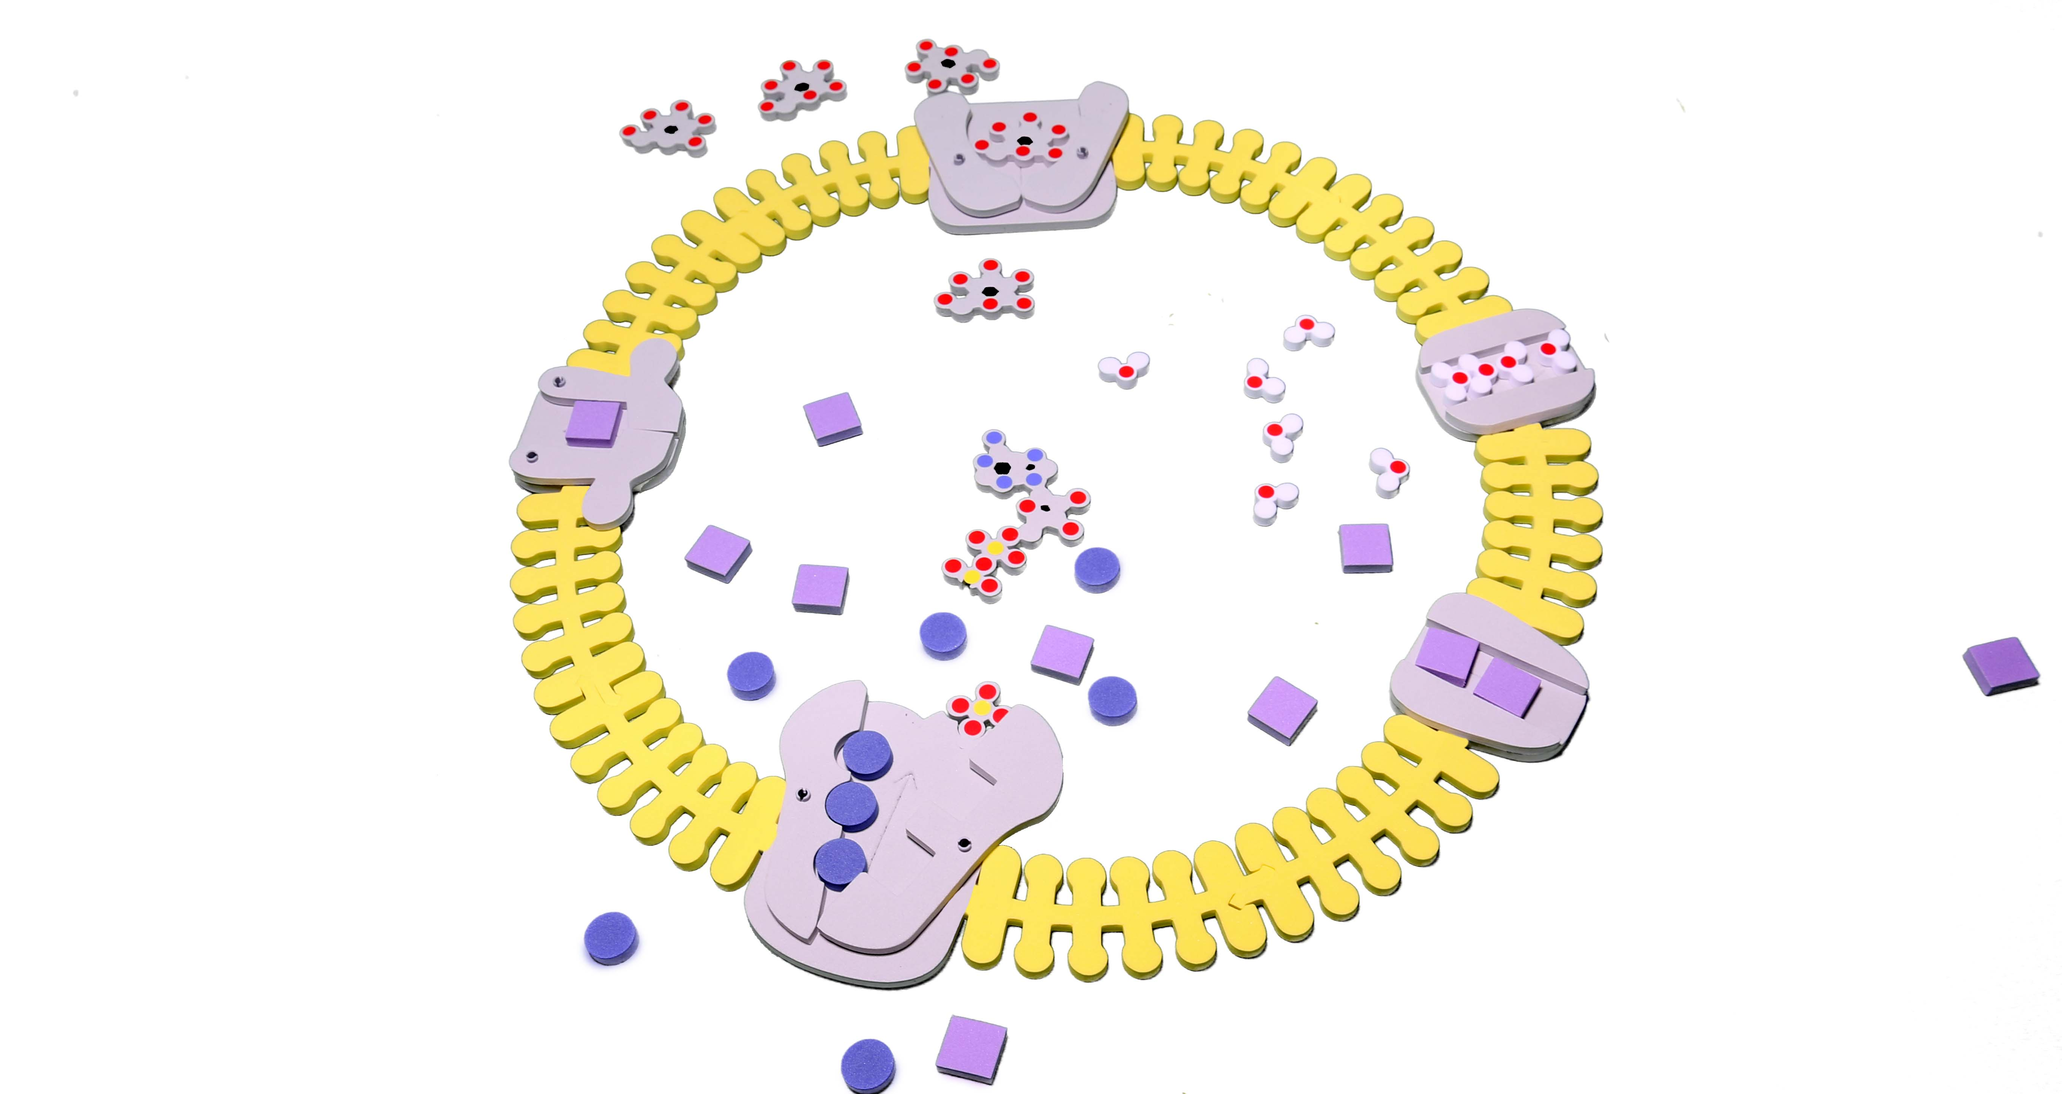
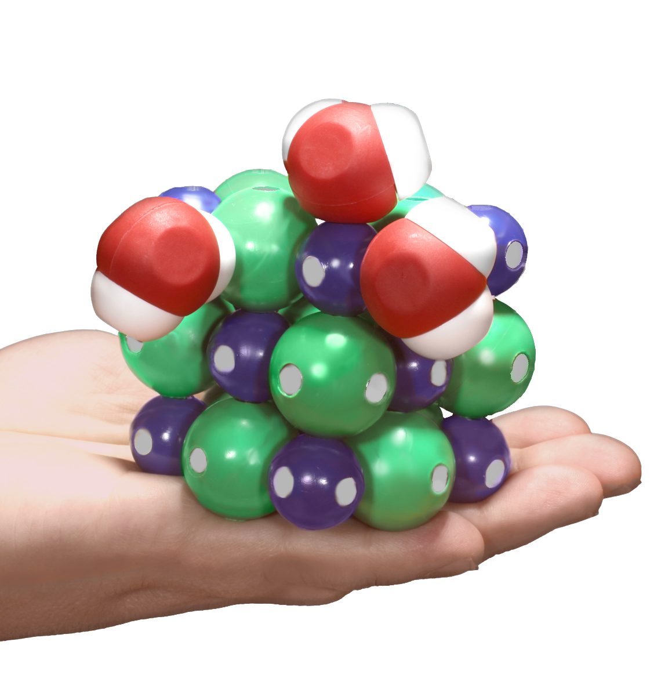
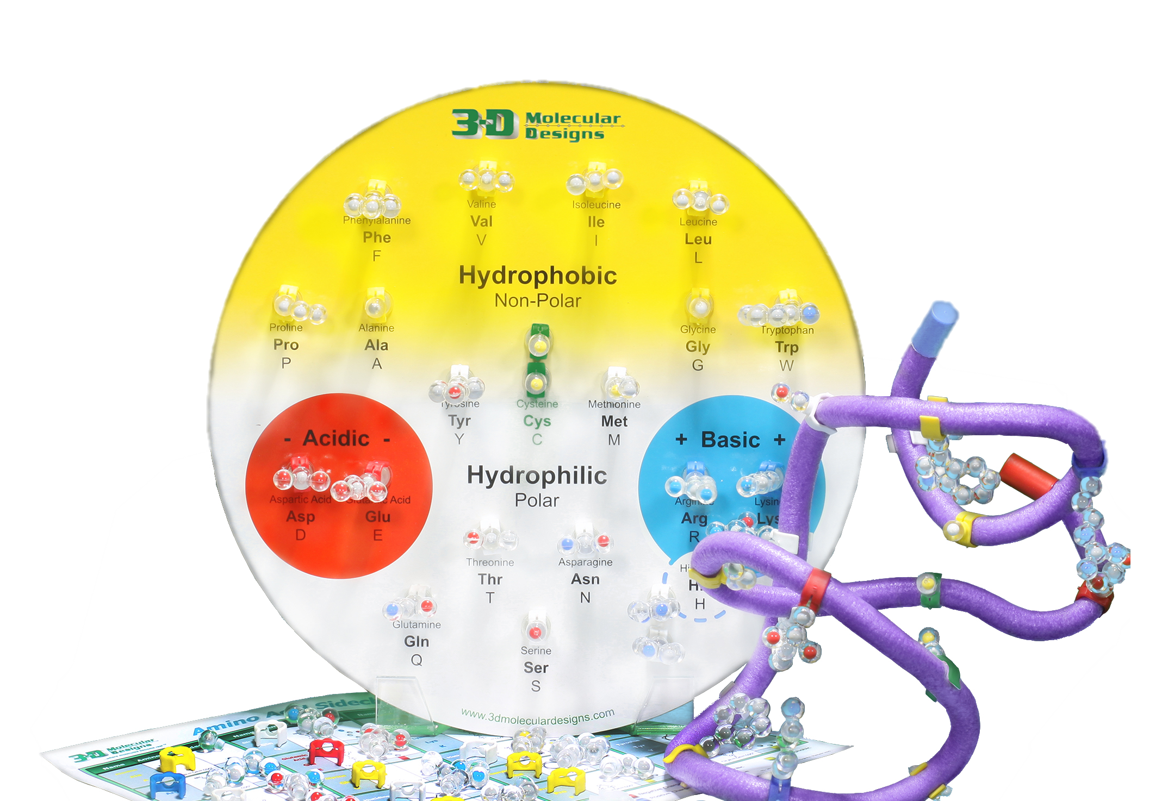
Notes:
Amphipathic Nature

Slide 16
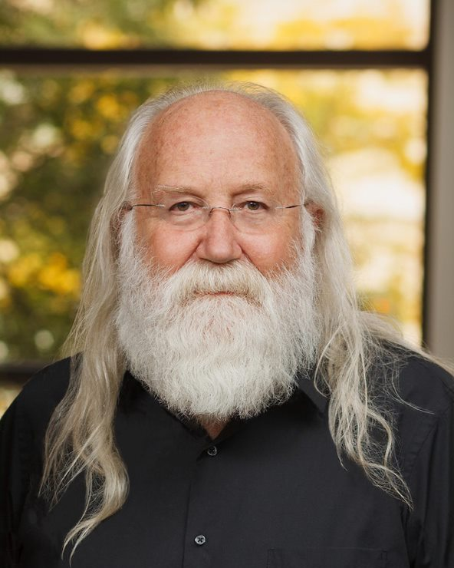
Timothy Herman, PhD
Director of the Center for BioMolecular Modeling at MSOE
Founding Partner of 3D Molecular Designs
B.S. in Chemistry from the University of Nebraska
Ph.D. in Biochemistry from Oregon State University.
Post-doctoral studies in Molecular Biology at Harvard Medical School.
Notes:
Introduce Tim -
Tim Herman is the founder and Director of the MSOE Center for BioMolecular Modeling and the founding partner of 3D Molecular Designs. In addition to grant writing, model development, and digging into recently published research papers, he enjoys spending time with his 4 grandchildren. Tim & Diane had the water molecules out this last weekend with the grandkids and were modeling ice! I’m looking forward to when he starts telling them this Aquaporin story.
And here is Tim -

Slide 17
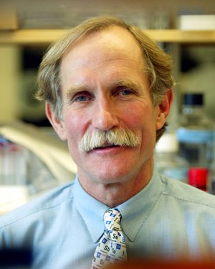
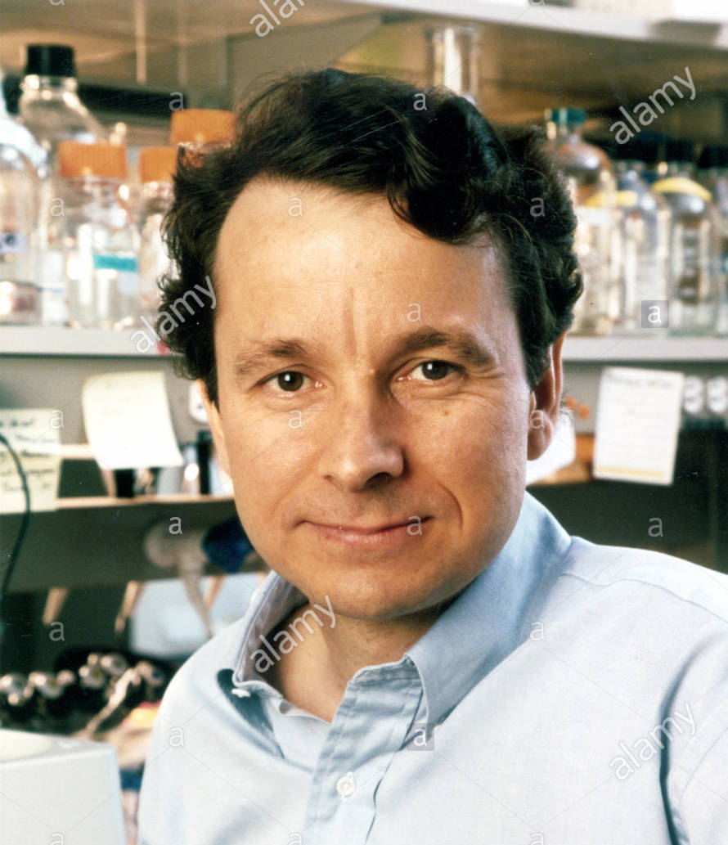
2003 Nobel Prize in Chemistry
The Nobel Prize in Chemistry 2003 was awarded "for discoveries concerning channels in cell membranes" jointly with one half to Peter Agre "for the discovery of water channels" and with one half to Roderick MacKinnon "for structural and mechanistic studies of ion channels."
Peter Agre Roderick MacKinnon

Slide 18
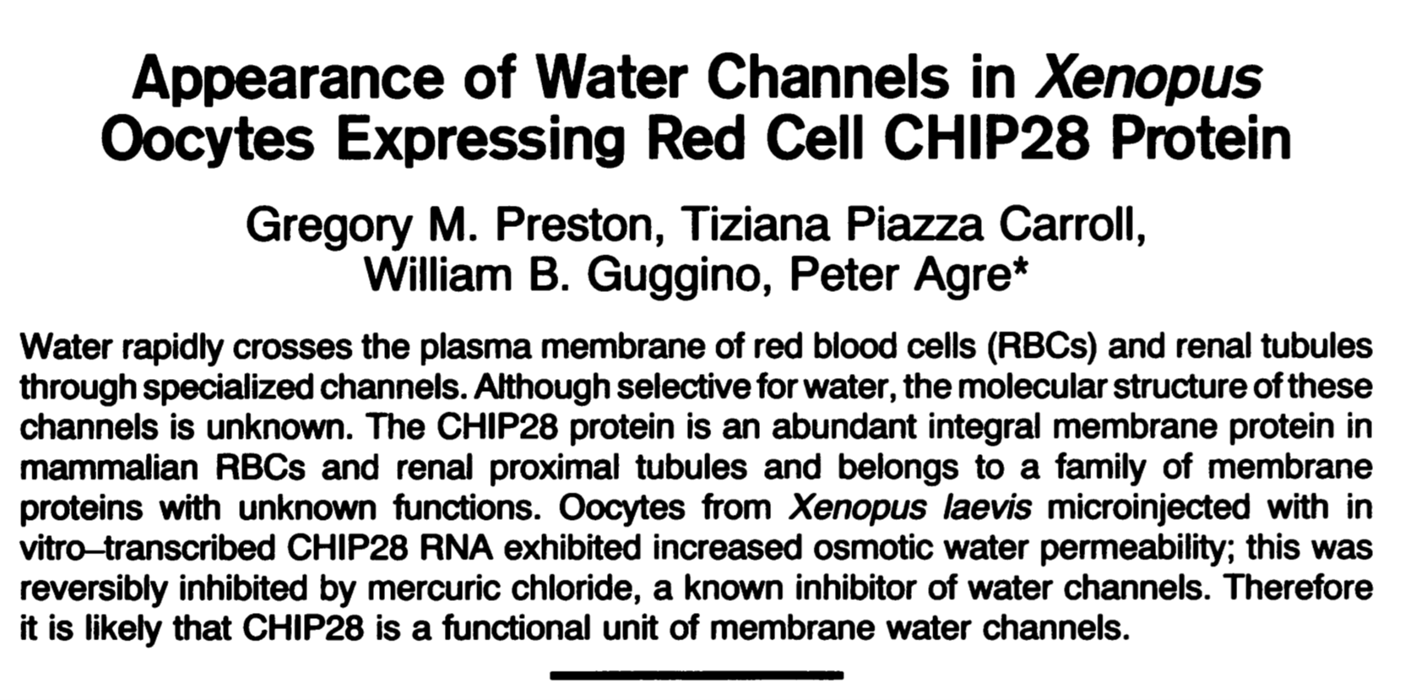
Science 256, 365-387 (1992)

Slide 19
1992 “Model” of Aquaporin
Based on its Amino Acid Sequence
6 Transmembrane Helices
2-Fold Symmetry

Slide 20
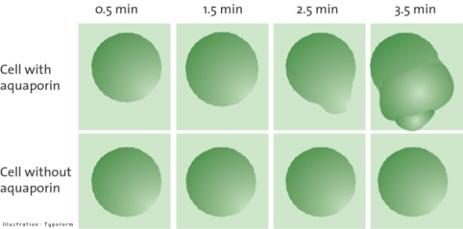
Micro-injection of aquaporin mRNA into frog oocytes

Slide 21
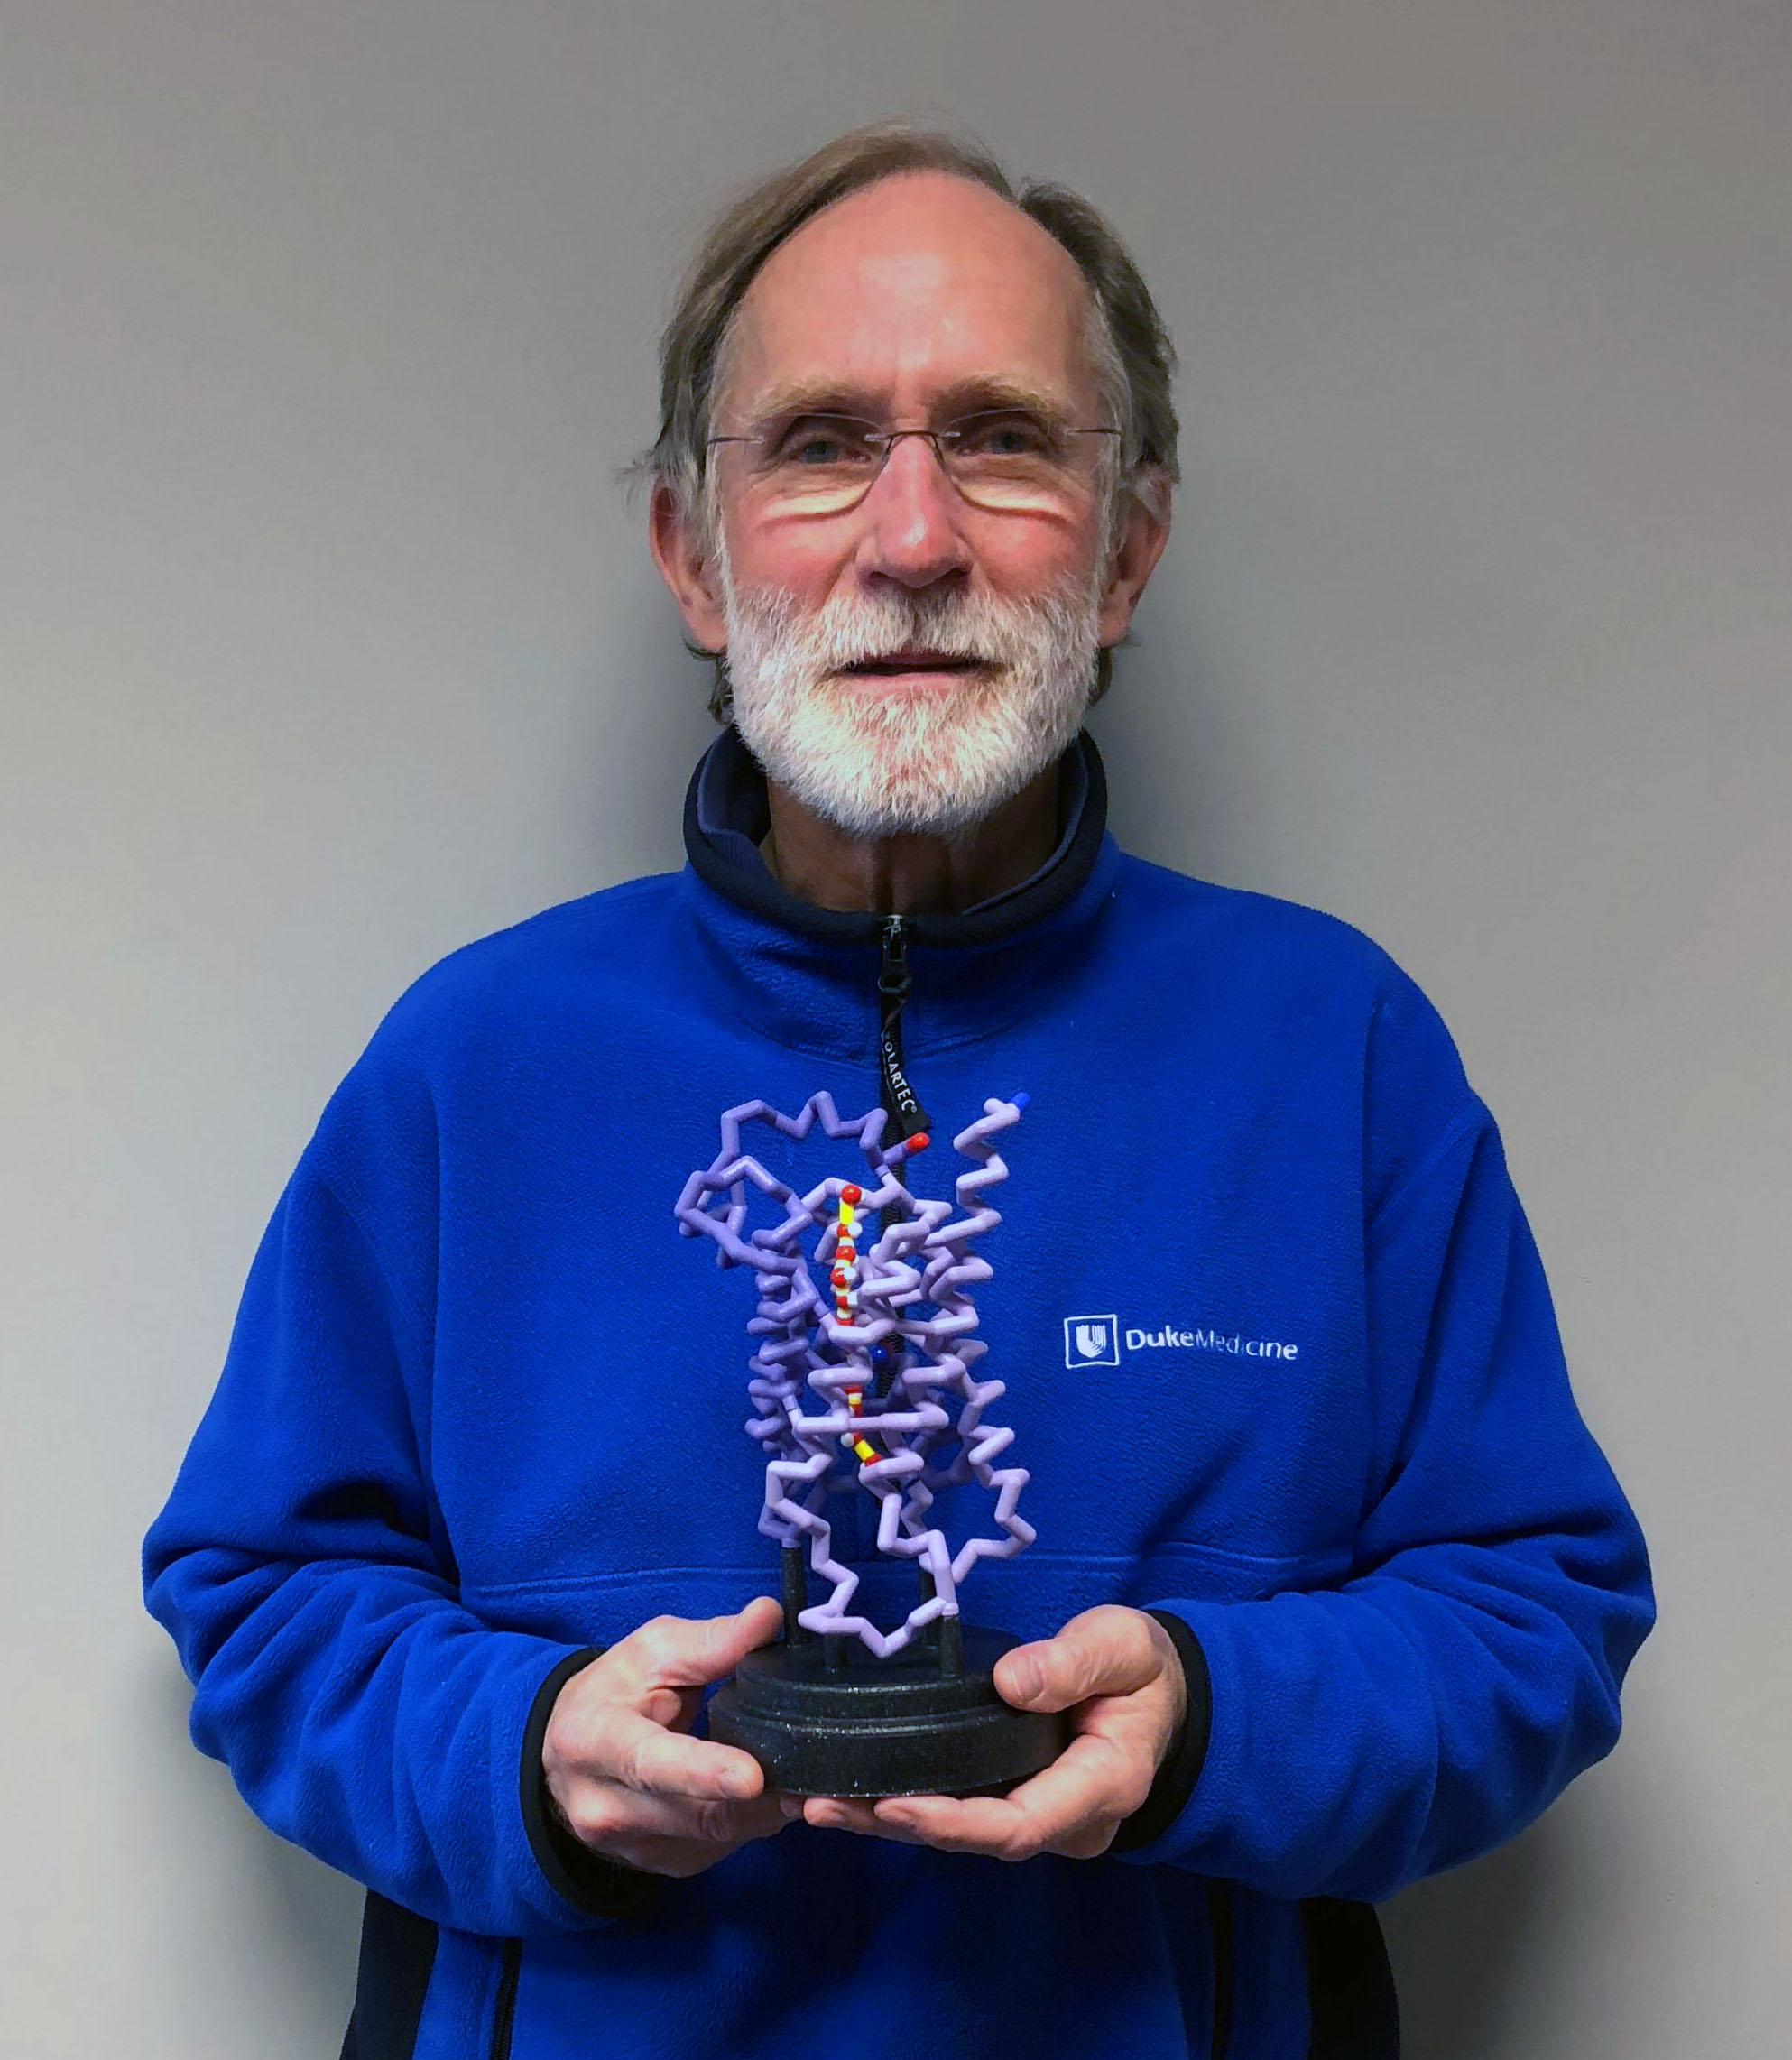
Peter Agre with Aquaporin Model

Slide 22
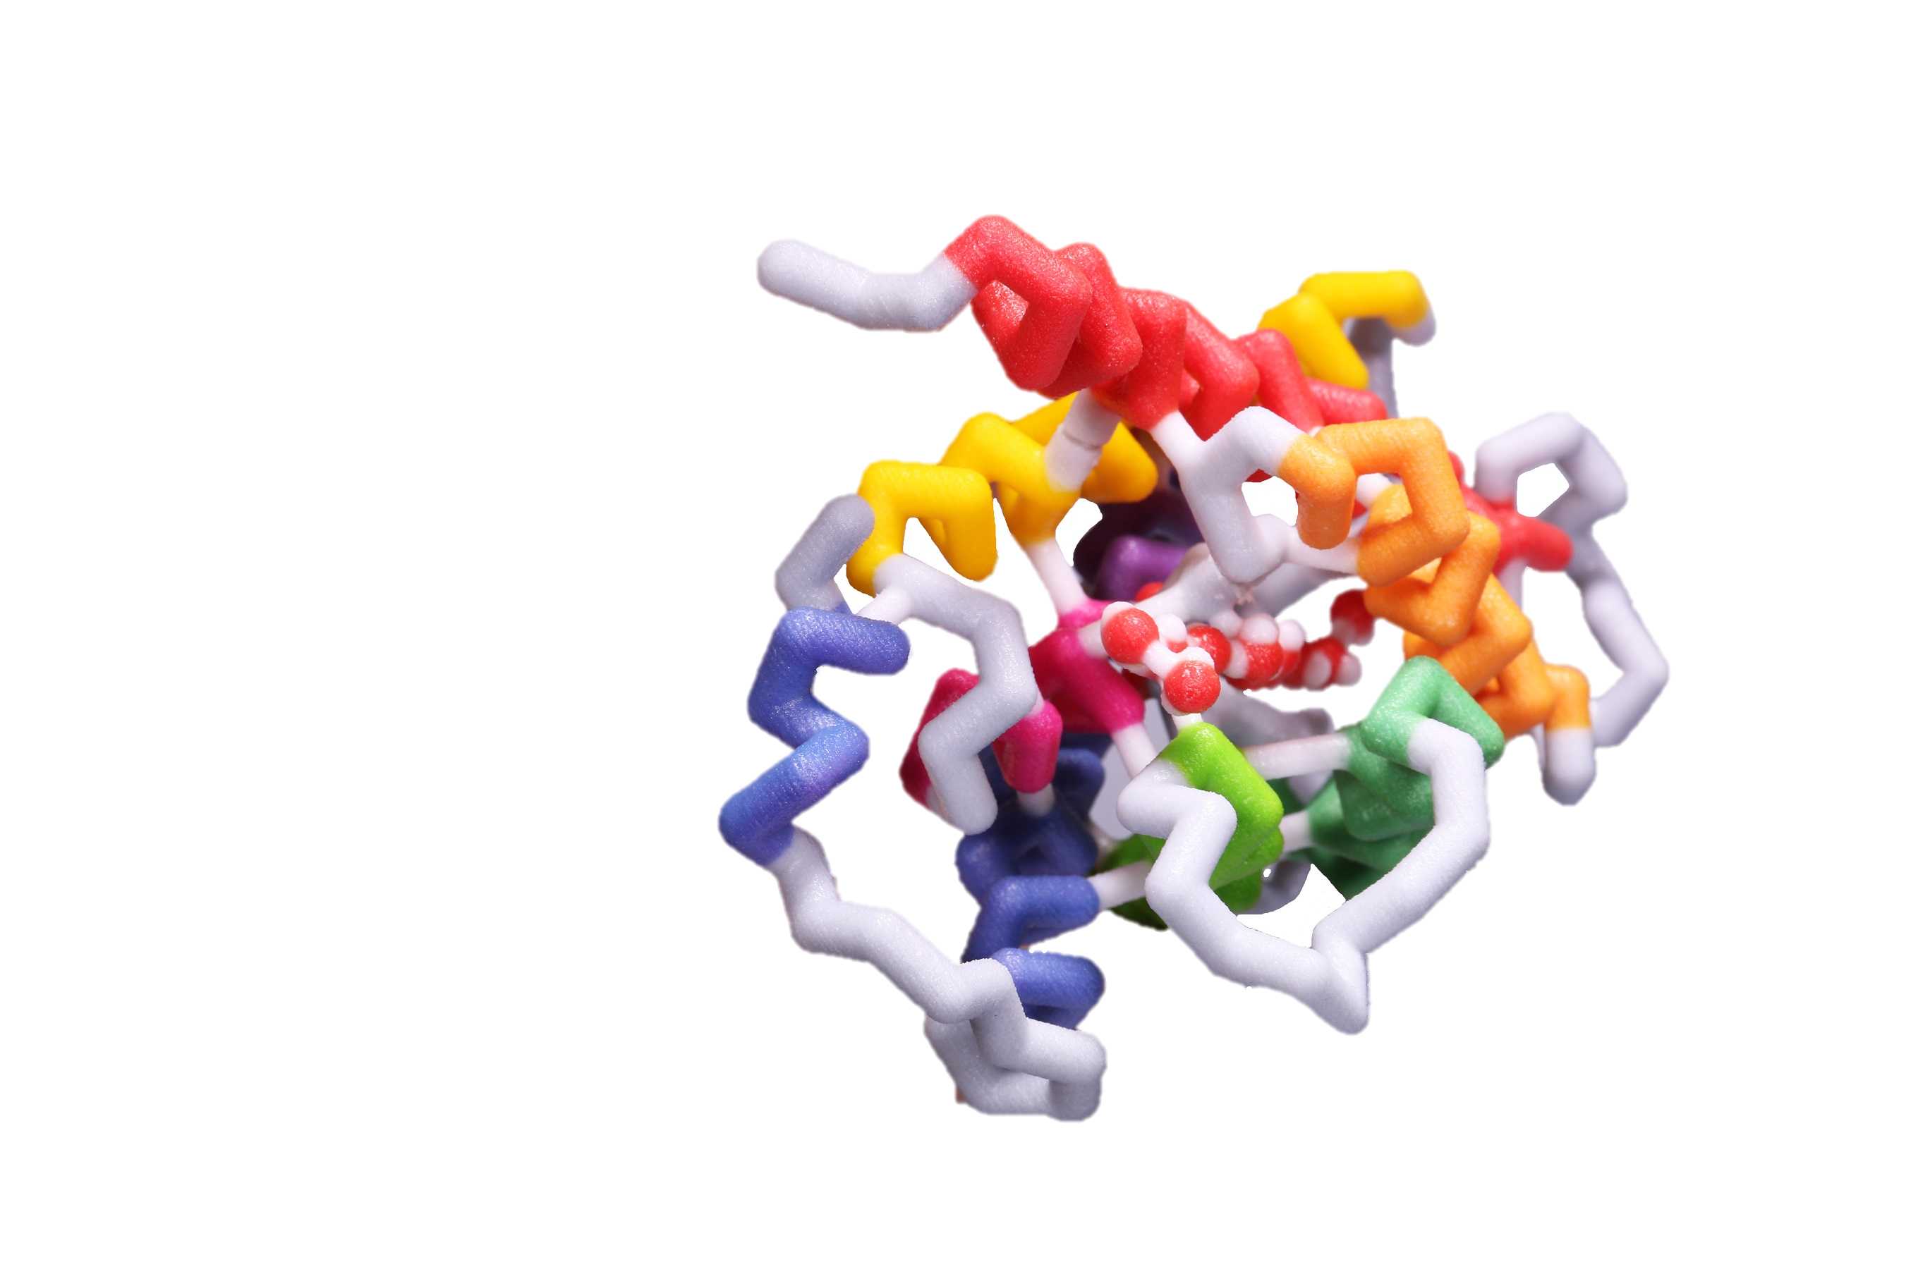

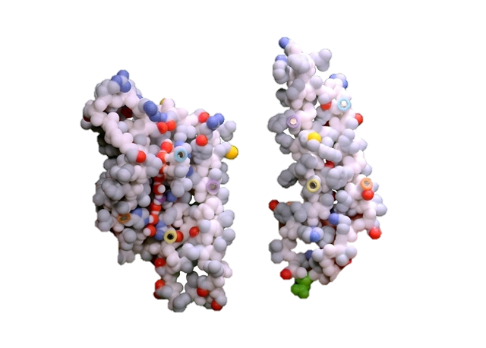
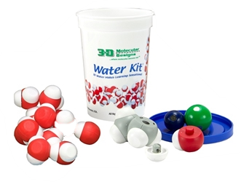
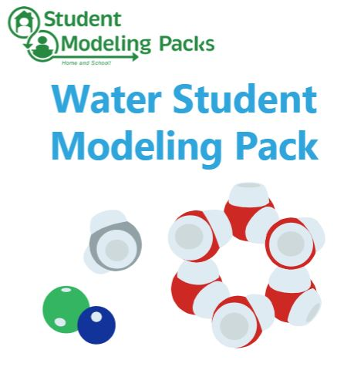
Thank you for attending!
For a Certificate of Participation
Click the link in the chat
Purchase Kits and Models at 3dmoleculardesigns.com.
Discount code: WEBINAR20
Attend a Summer Course
cbm.msoe.edu
Contact us at: Ask3DMD@3DMoleculardesgins.com
Notes:
Thank you, Tim & Jim, for a great session!
Reminder – to receive a Certificate of Participation, click on the link Diane has posted.
Jim used the Water Kit, NaCl Lattice, and the Water Student Modeling Pack today. Tim use the Aquaporin Mini Model and the Aquaporin Protein Model from the Molecules of Life.
Use discount code “WEBINAR20” for 20% off most of 3DMD’s products.

Slide 23
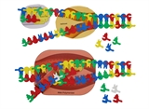
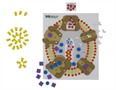
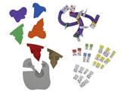
Invite your colleagues to register!
Transcription, Translation, & Sickle Cell Anemia
A Tale of Two Sisters, Modeling Transcription & Protein Synthesis
Wednesday, January 27, 2021 at 6:00 PM Central
Neurotransmitters, Synapses & Acetylcholinesterase
Modeling How Cells Talk – Making Sense of Synapses and Signals
Wednesday, February 10, 2021 at 6:00 PM Central
Proteins & the Protein Folding Problem
Proteins – Now that Everything has Changed
Wednesday, February 17, 2021 at 6:00 PM Central
https://www.3dmoleculardesigns.com/Webinars4.htm
Notes:
Future Sessions - I hope you will join us again next week when Fran Grant and Mark Arnholt from Wisconsin present transcription and translation. Please encourage your colleagues to register and join us!
Survey - You will encounter a short survey as you leave the webinar. We appreciate your feedback!
That concludes our formal presentations tonight – thank you for joining us. We will continue to answer questions and are happy to chat! If you would like to join in, just raise your hand.
Thanks again!

