Slide 1
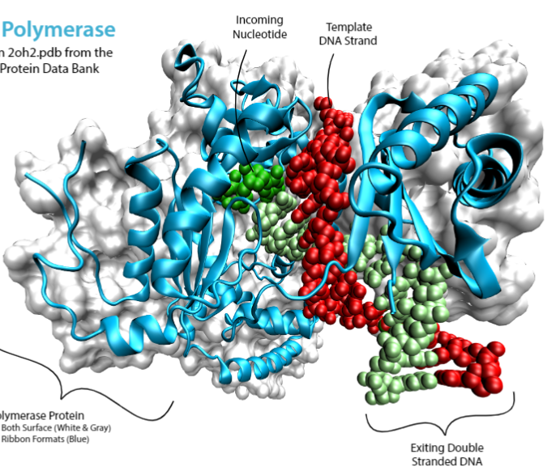
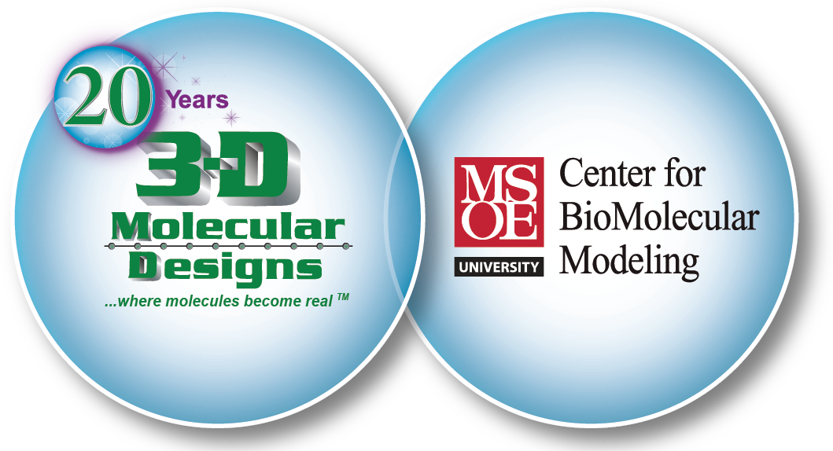
Proteins & the Protein Folding Problem
Proteins – Now that Everything has Changed

Slide 2
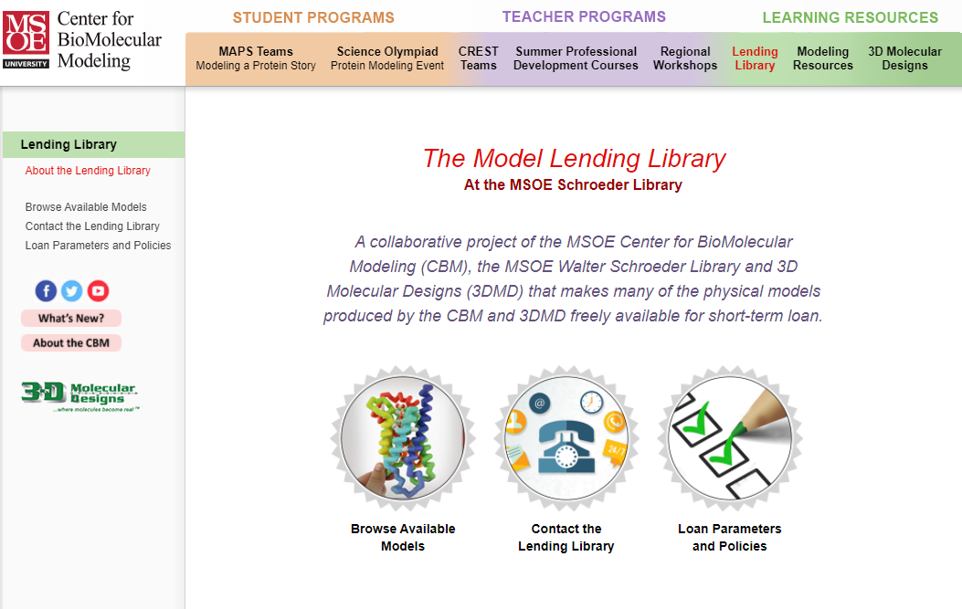
The Model Lending Library
At the MSOE Schroeder Library
A collaborative project of the MSOE Center for BioMolecular Modeling (CBM), the MSOE Walter Schroeder Library and 3D Molecular Designs (3DMD) that makes many of the physical models produced by the CBM and 3DMD freely available for short-term loan.

Slide 3
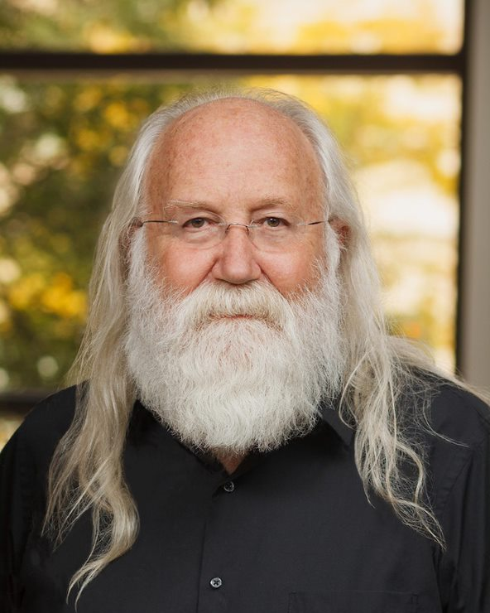
Timothy Herman, PhD
Director of the Center for BioMolecular Modeling at MSOE
Founding Partner of 3D Molecular Designs
B.S. in Chemistry from the University of Nebraska
Ph.D. in Biochemistry from Oregon State University.
Post-doctoral studies in Molecular Biology at Harvard Medical School.
Notes:
Introduce Tim -
Tim Herman is the founder and Director of the MSOE Center for BioMolecular Modeling and the founding partner of 3D Molecular Designs. In addition to grant writing, model development, and digging into recently published research papers, he enjoys spending time with his 4 grandchildren. Tim & Diane had the water molecules out this last weekend with the grandkids and were modeling ice! I’m looking forward to when he starts telling them this Aquaporin story.
And here is Tim -

Slide 4


Slide 5
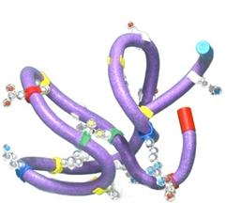
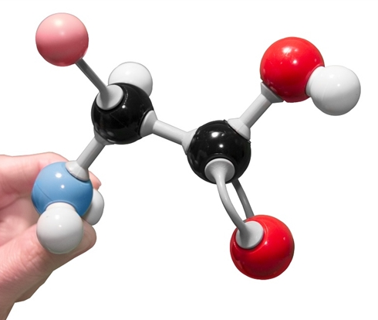
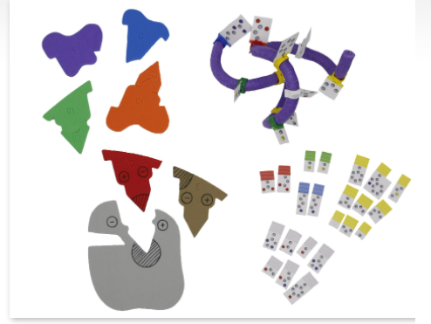
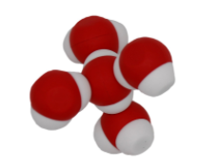
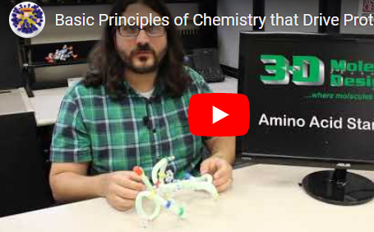
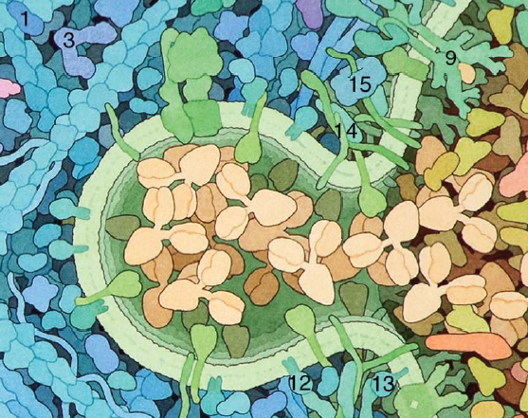
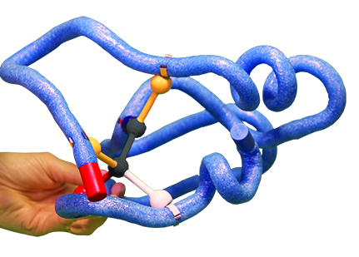
Water Kit
MolyMod Amino Acid Building Blocks
Amino Acid
Starter Kit
Student Modeling Pack
Enzymes in Action &
Molecular Exploration
(an online resource)
Molecular Landscapes
Substrate Specificity Kit

Slide 6
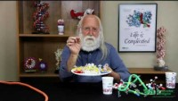
Protein Folding and the Amino Acid Starter Kit

Slide 7
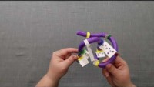
Protein Student Modeling Pack

Slide 8
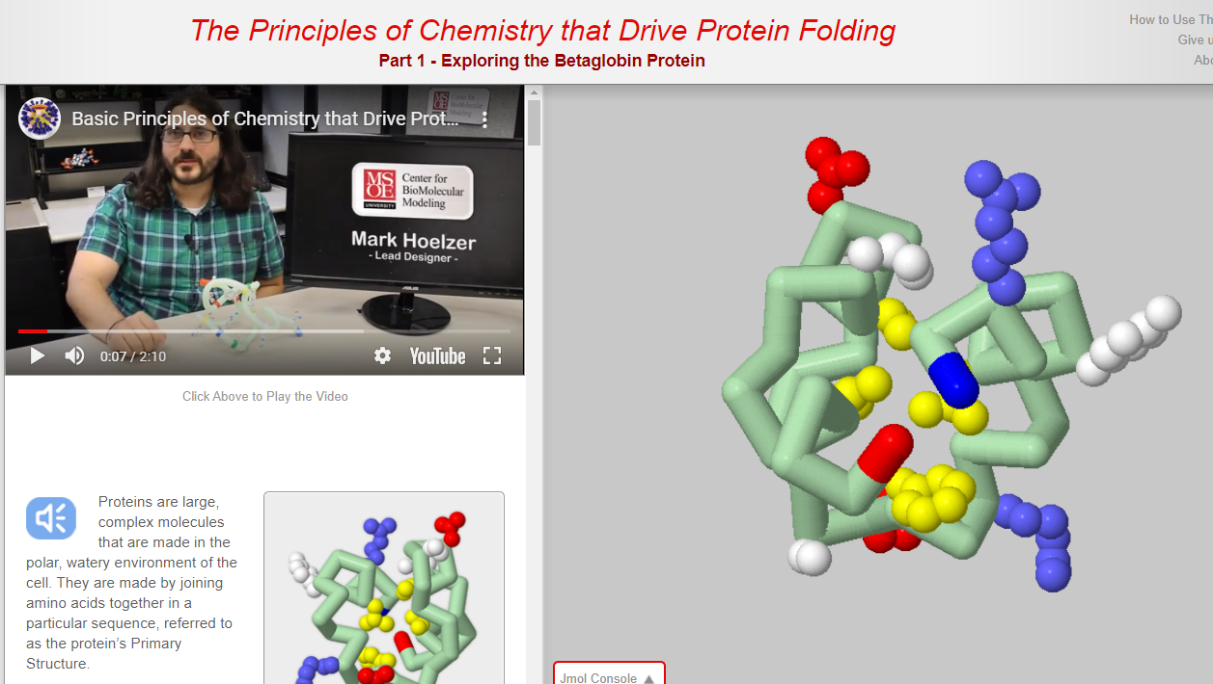
Molecular Explorations

Slide 9
Protein-focused Videos Releasing in May 2021
Acetylcholinesterase - an enzyme active site
Aquaporin - the water channel
Beta-Globin - an oxygen transporter
Antibodies - soldiers of our immune system
Until then, check out the Resource Pages related to each webinar

Slide 10

AlphaFold: The Solution to the Protein Folding Problem?

Slide 11
“I think that we shall be able to get a more thorough understanding of the nature of disease in general by investigating the molecules that make up the human body, including the abnormal molecules, and the understanding will permit…the problem of disease to be attacked in a more straightforward manner such that new methods of therapy will be developed.”
Linus Pauling, 1960

Slide 12
“We have been stuck on this one problem – how do proteins fold up – for nearly 50 years. To see DeepMind produce a solution for this, having worked personally on this problem for so long and after so many stops and starts, wondering if we would ever get there, is a very special moment.”
John Moult, 2020
Co-founder and Chair of CASP, University of Maryland

Slide 13
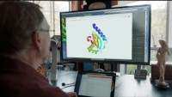
AlphaFold: The making of a scientific breakthrough

Slide 14
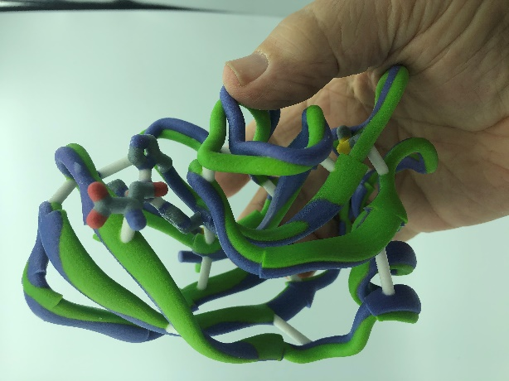
Two physical models of the same protein….one structure solved by x-ray diffraction, and the other predicted by Alphafold.

