Slide 1
Editing the Sickle Cell Gene
Hemoglobin tetramer beta-globin subunit
The first molecular disease, identified in 1949
Macroscopic to Molecular
Sickle Cell Mutation
Gene Editing with CRISPR

Slide 2
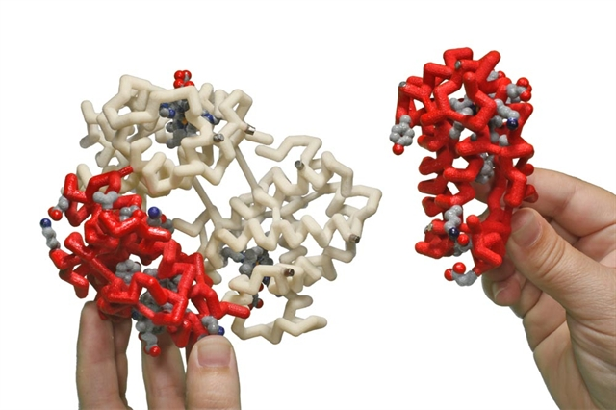
The Hemoglobin Tetramer
Two Alpha-Globins + Two Beta-Globins

Slide 3
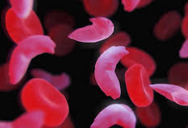
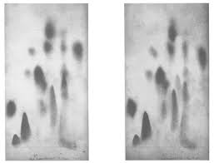

Sickle Cell Anemia
the first molecular disease -1949
Vernon Ingrahm

Slide 4
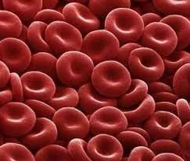
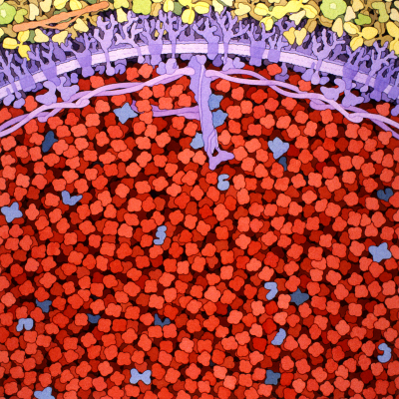
Macroscopic to Microscopic to Molecular
5 million RBCs per drop of blood
270 million hemoglobins per RBC

Slide 5
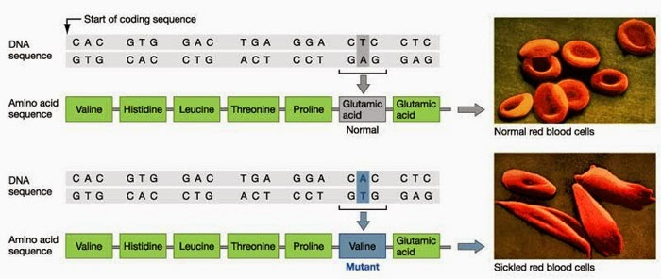
Sickle cell anemia results from
a single base change in the beta-globin gene.

Slide 6
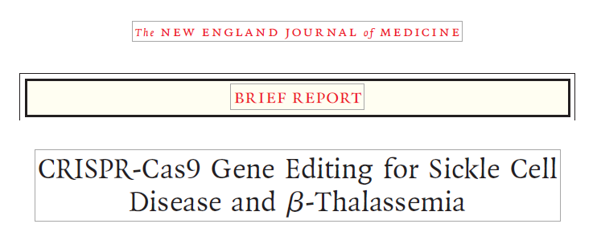
“More than a year later, both patients had high levels of allelic editing in bone marrow and blood, increases in fetal hemoglobin that were distributed pan-cellularly, transfusion independence, and (in the patient with SCD) elimination of vaso-occlusive episodes. “
N Engl J Med 384, 252-260 December, 2020

Slide 7
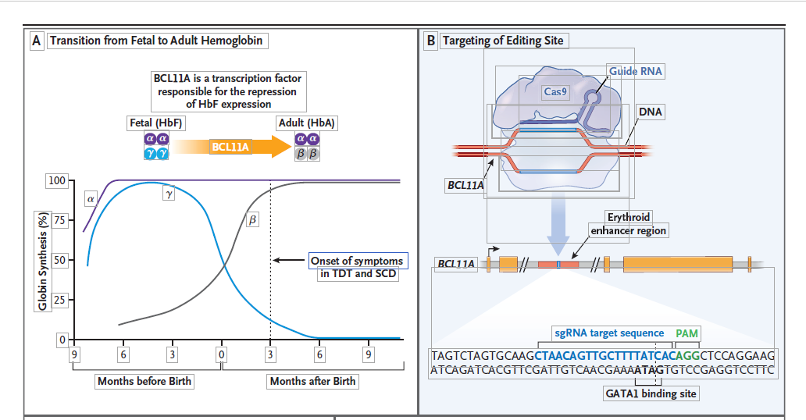
This treatment used CRIPSR to inactivate the BCL11A gene – a repressor of the fetal Hb gene.

Slide 8
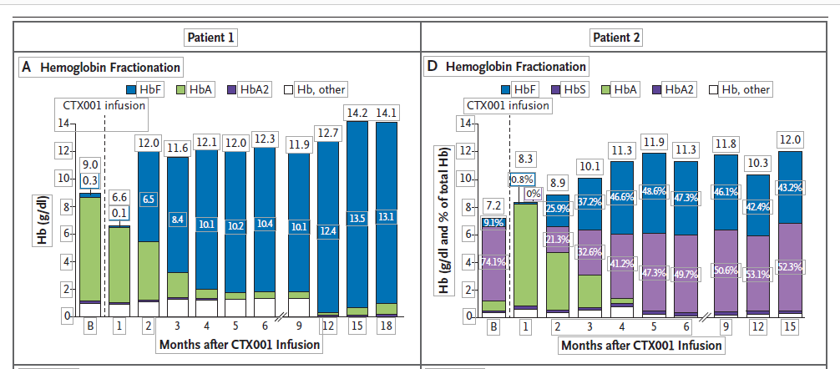
Effect of treatment on levels of fetal hemoglobin

Slide 9
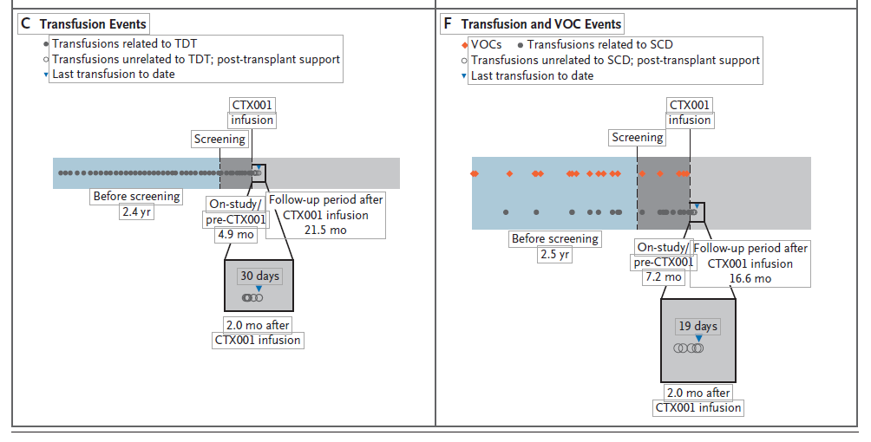
Effect of treatment on frequency of transfusions and pain crises

Slide 10
