Slide 1
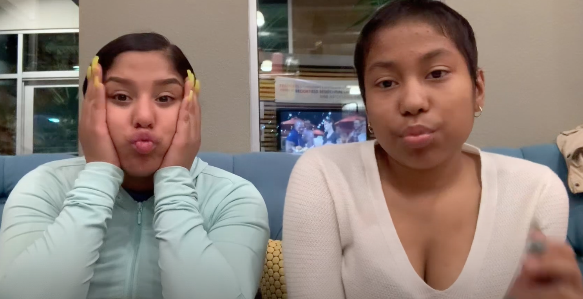
Transcription, Translation, & Sickle Cell Anemia
A Tale of Two Sisters:
Notes:
Heather Welcome

Slide 2
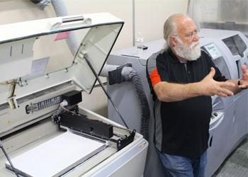
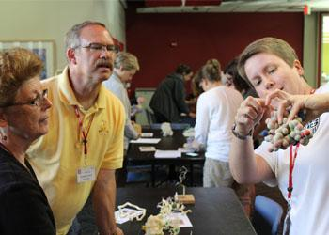
Center for BioMolecular Modeling
Notes:
Heather will do a brief talk about the CBM

Slide 3
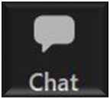
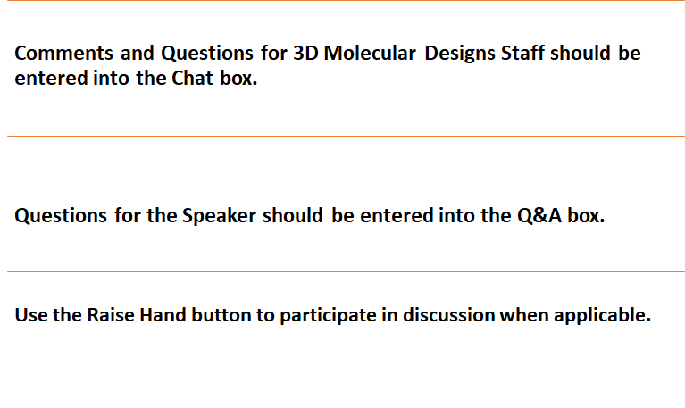

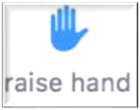
Webinar norms
Notes:
Kris will go over norms.

Slide 4
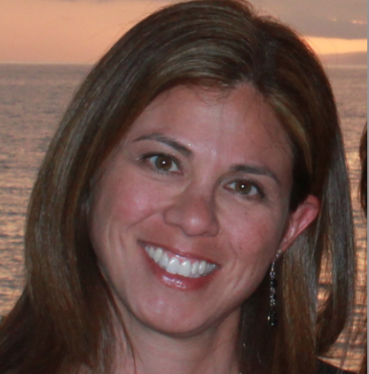
Fran Grant, M.S.
B.S., Biology, Secondary Education
University of WI - Eau Claire
M.S., C and I, Concordia University
Grafton High School, Grafton, WI
PLTW Biomedical Science Teacher (PBS, HBS, MI, BI)
Anatomy and Physiology, Biology
Notes:
Heather will intro Fran

Slide 5
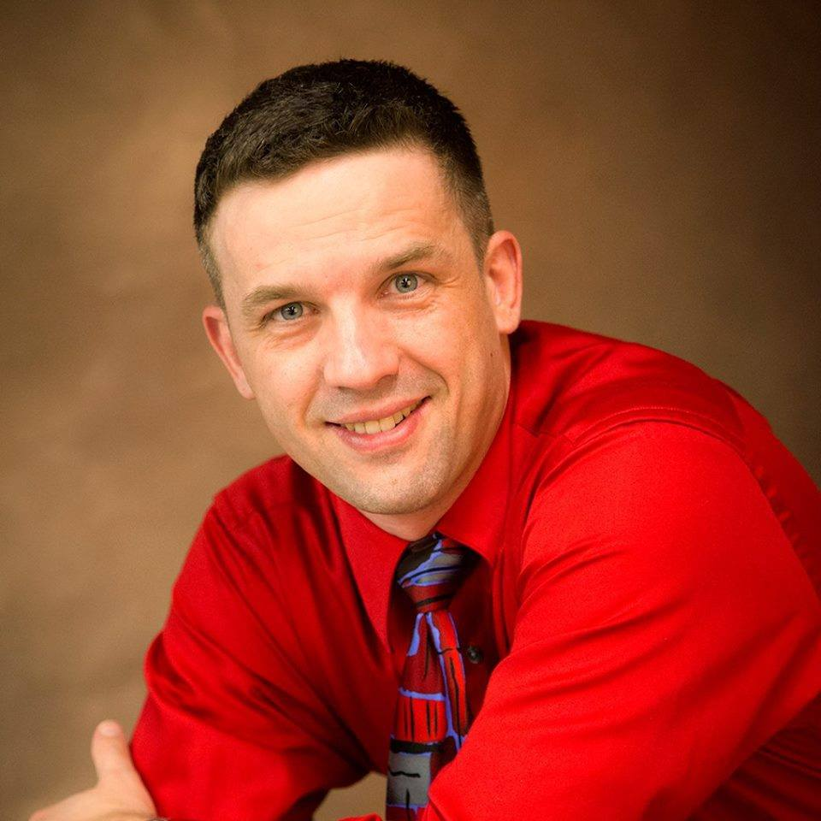
Mark Arnholt
BA Secondary Ed
BS Biology - Concordia University
20 years at Hartford Union High School, Wisconsin
Teaches Fr. Biology, Medical Interventions, Biomedical Innovation
Notes:
Heather will introduce Mark
Now in his 19th year in education, Mark Arnholt teaches cohort biology, Medical Interventions, and Biomedical Innovations in the Biomedical Science curriculum. He has previously taught principles of biomedical science, anatomy & physiology, earth science and aviation. Mark also serves as the Students Modeling a Research Topic (SMART) Team advisor for Hartford Union High School.

Slide 6
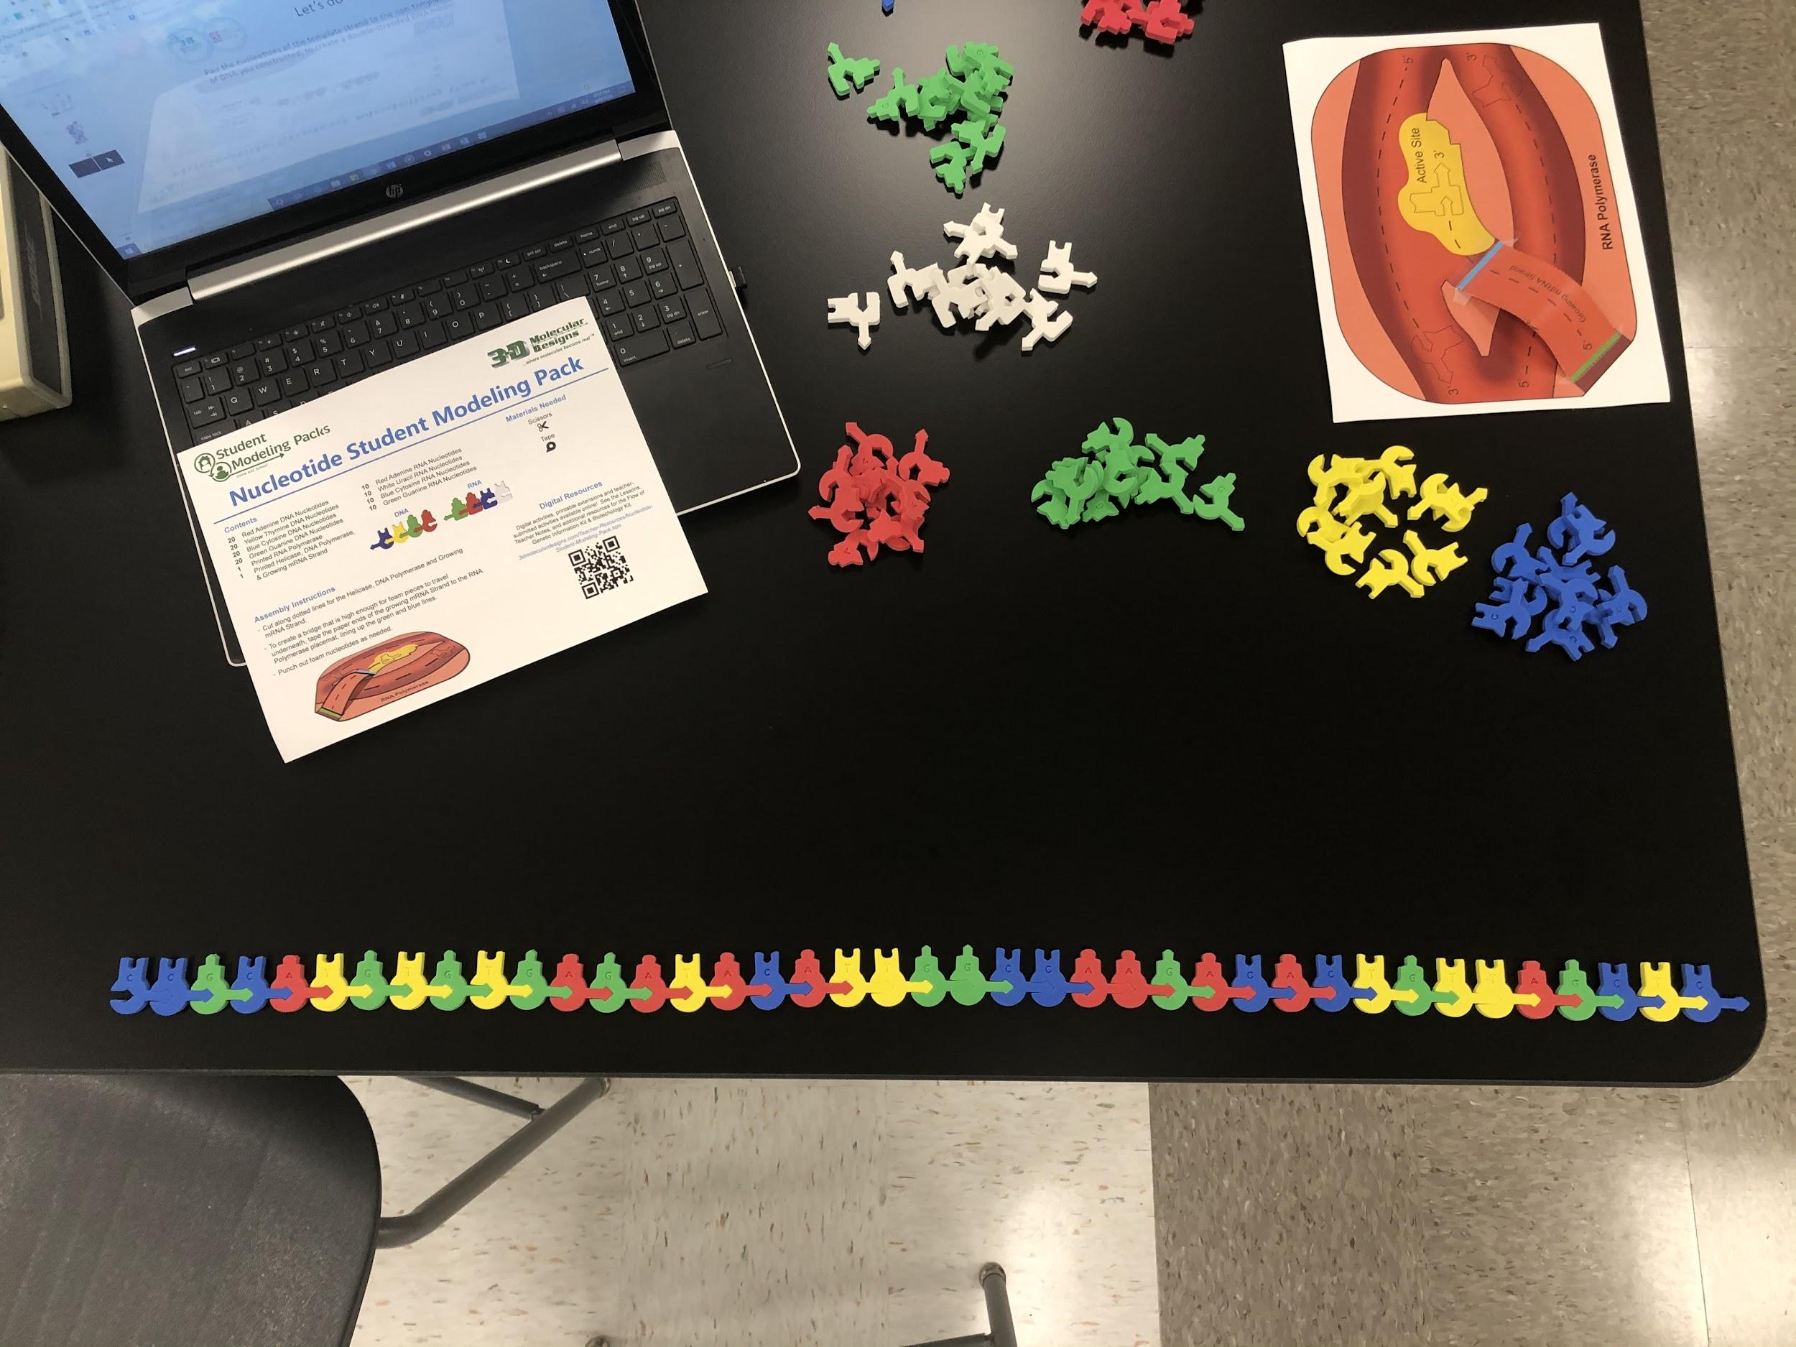
What you’ll need for today
All of the nucleotides from your
student modeling pack
RNA Polymerase sheet with the
bridge taped in place
SPACE! Make sure you have a room
to work in
Notes:
Mark-

Slide 7
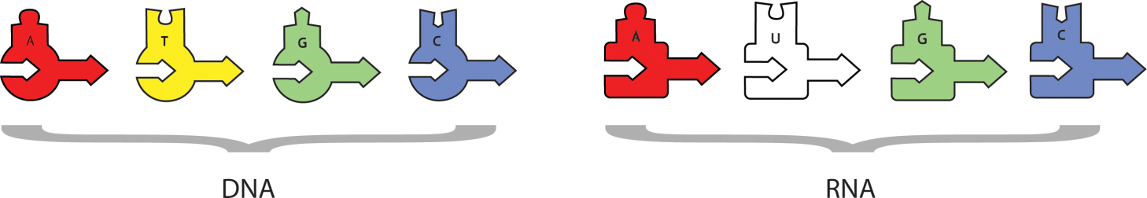
Workshop Norms
Raise your hand to unmute your microphone.
Ask questions in the Q&A
Feel free to use the “chat” option.
Hopefully you have your DNA set up. If not, no worries.
Have RNA nucleotides ready.
Notes:
Mark

Slide 8
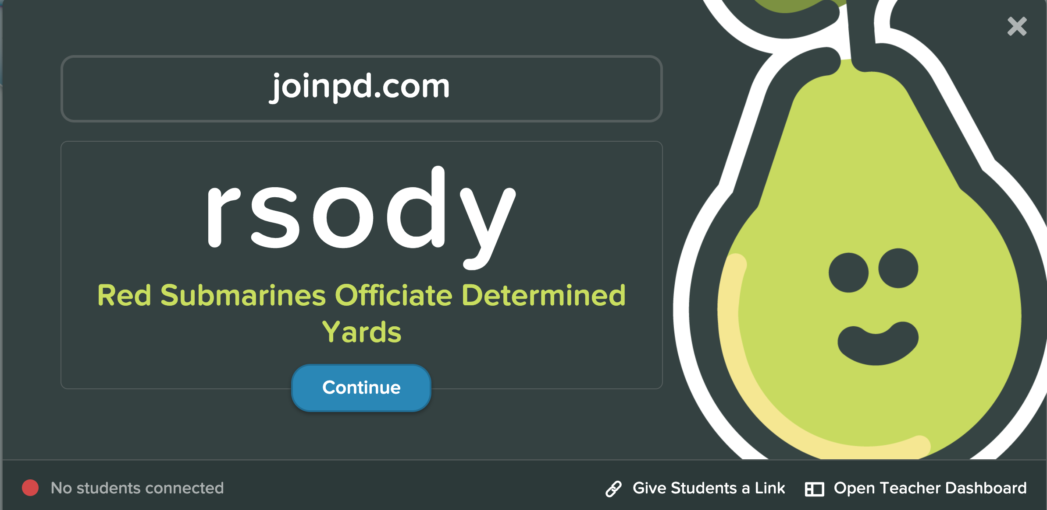
Notes:
Fran

Slide 9
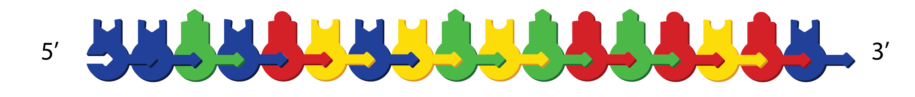
Let’s do it!
5’ CCGCATCTGTGAGATAC 3’

Slide 10
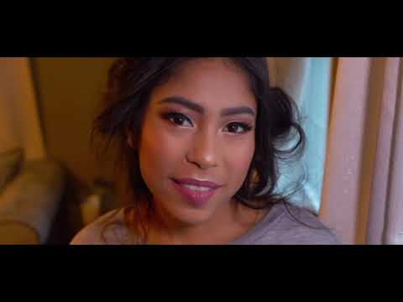
Meet Helen Obando
Kolata, G. (2020, January 10). A Teenager's Breakthrough Gene Therapy for Sickle Cell Disease. Retrieved July 27, 2020, from https://www.nytimes.com/2020/01/10/the-weekly/sickle-cell-dna-reset.html
Notes:
16 years old
She is from Mass.

Slide 11
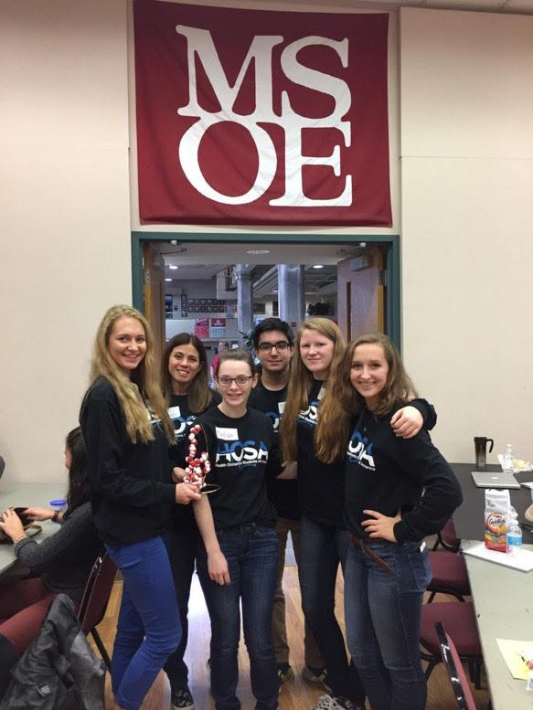
Workshop Learning Goals
Educators attending this workshop will:
Utilize a model for the flow of genetic information that supports both the NGSS student learning outcomes of three dimensional lesson.
Learn how to create hands-on, interactive community virtually to teach biomolecular concepts.
Learn something new and interesting for your own professional development.
Notes:
Mark

Slide 12

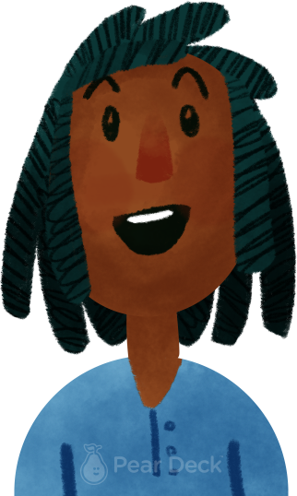
What do you teach?
Notes:
🍐 This is a Pear Deck Multiple Choice Slide. Your current options are: A: High School Biology/AP Biology, B: Middle School, C: High School Chemistry or Physics,
🍐 To edit the type of question or choices, go back to the "Ask Students a Question" in the Pear Deck sidebar.

Slide 13
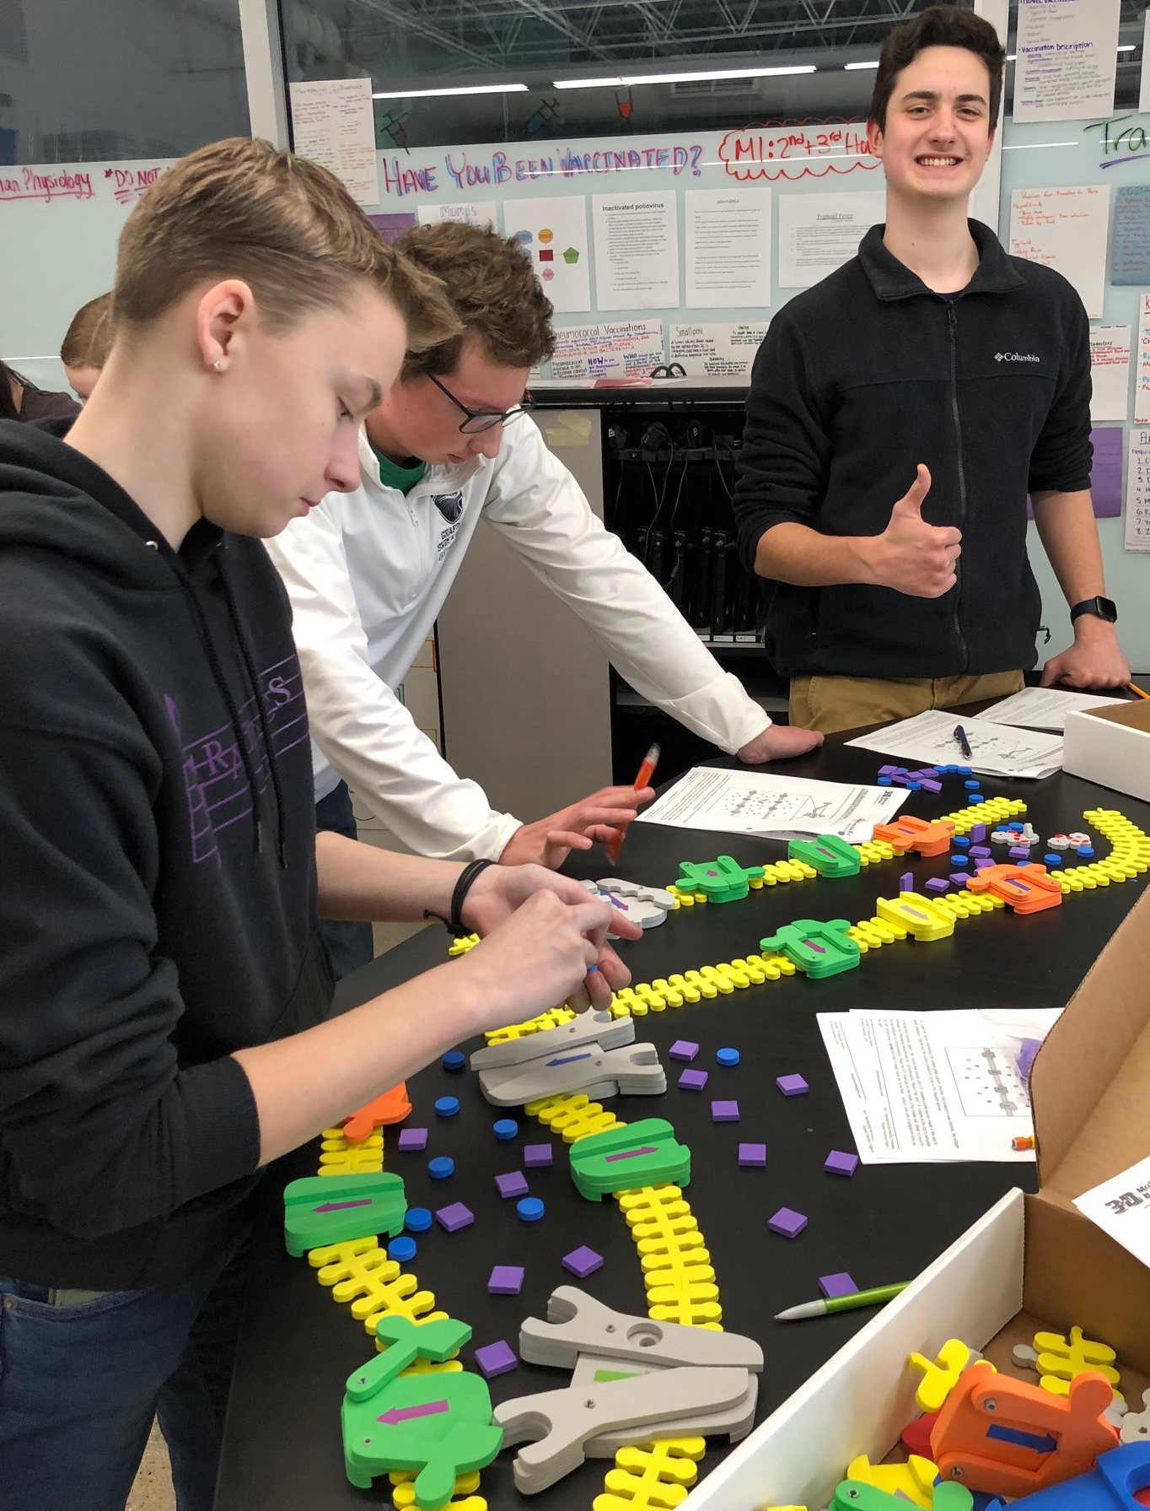
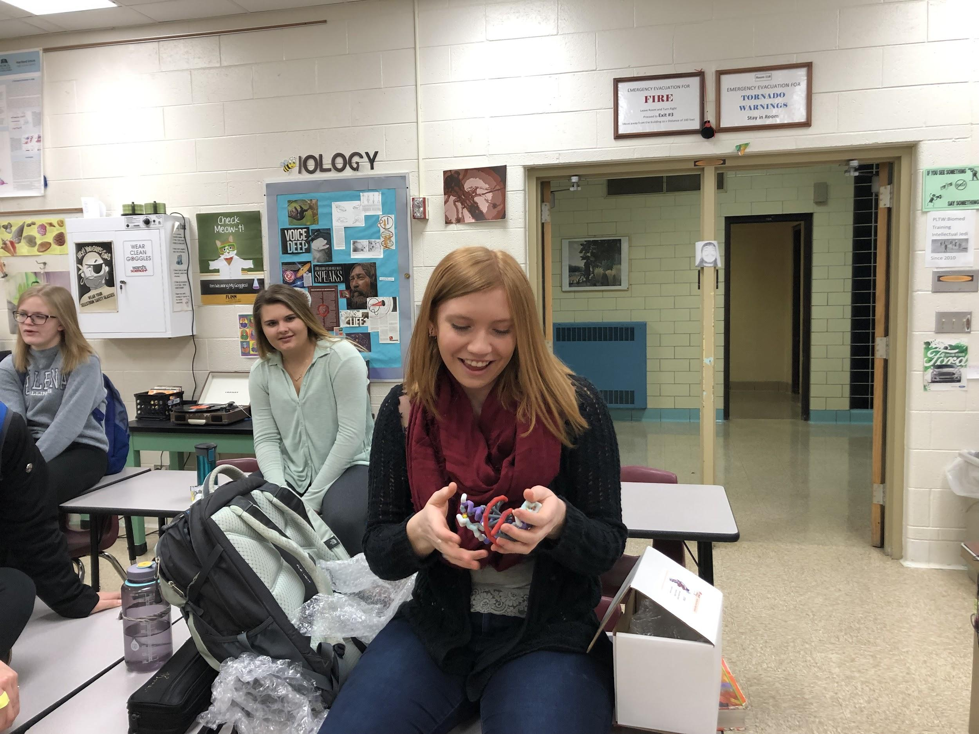
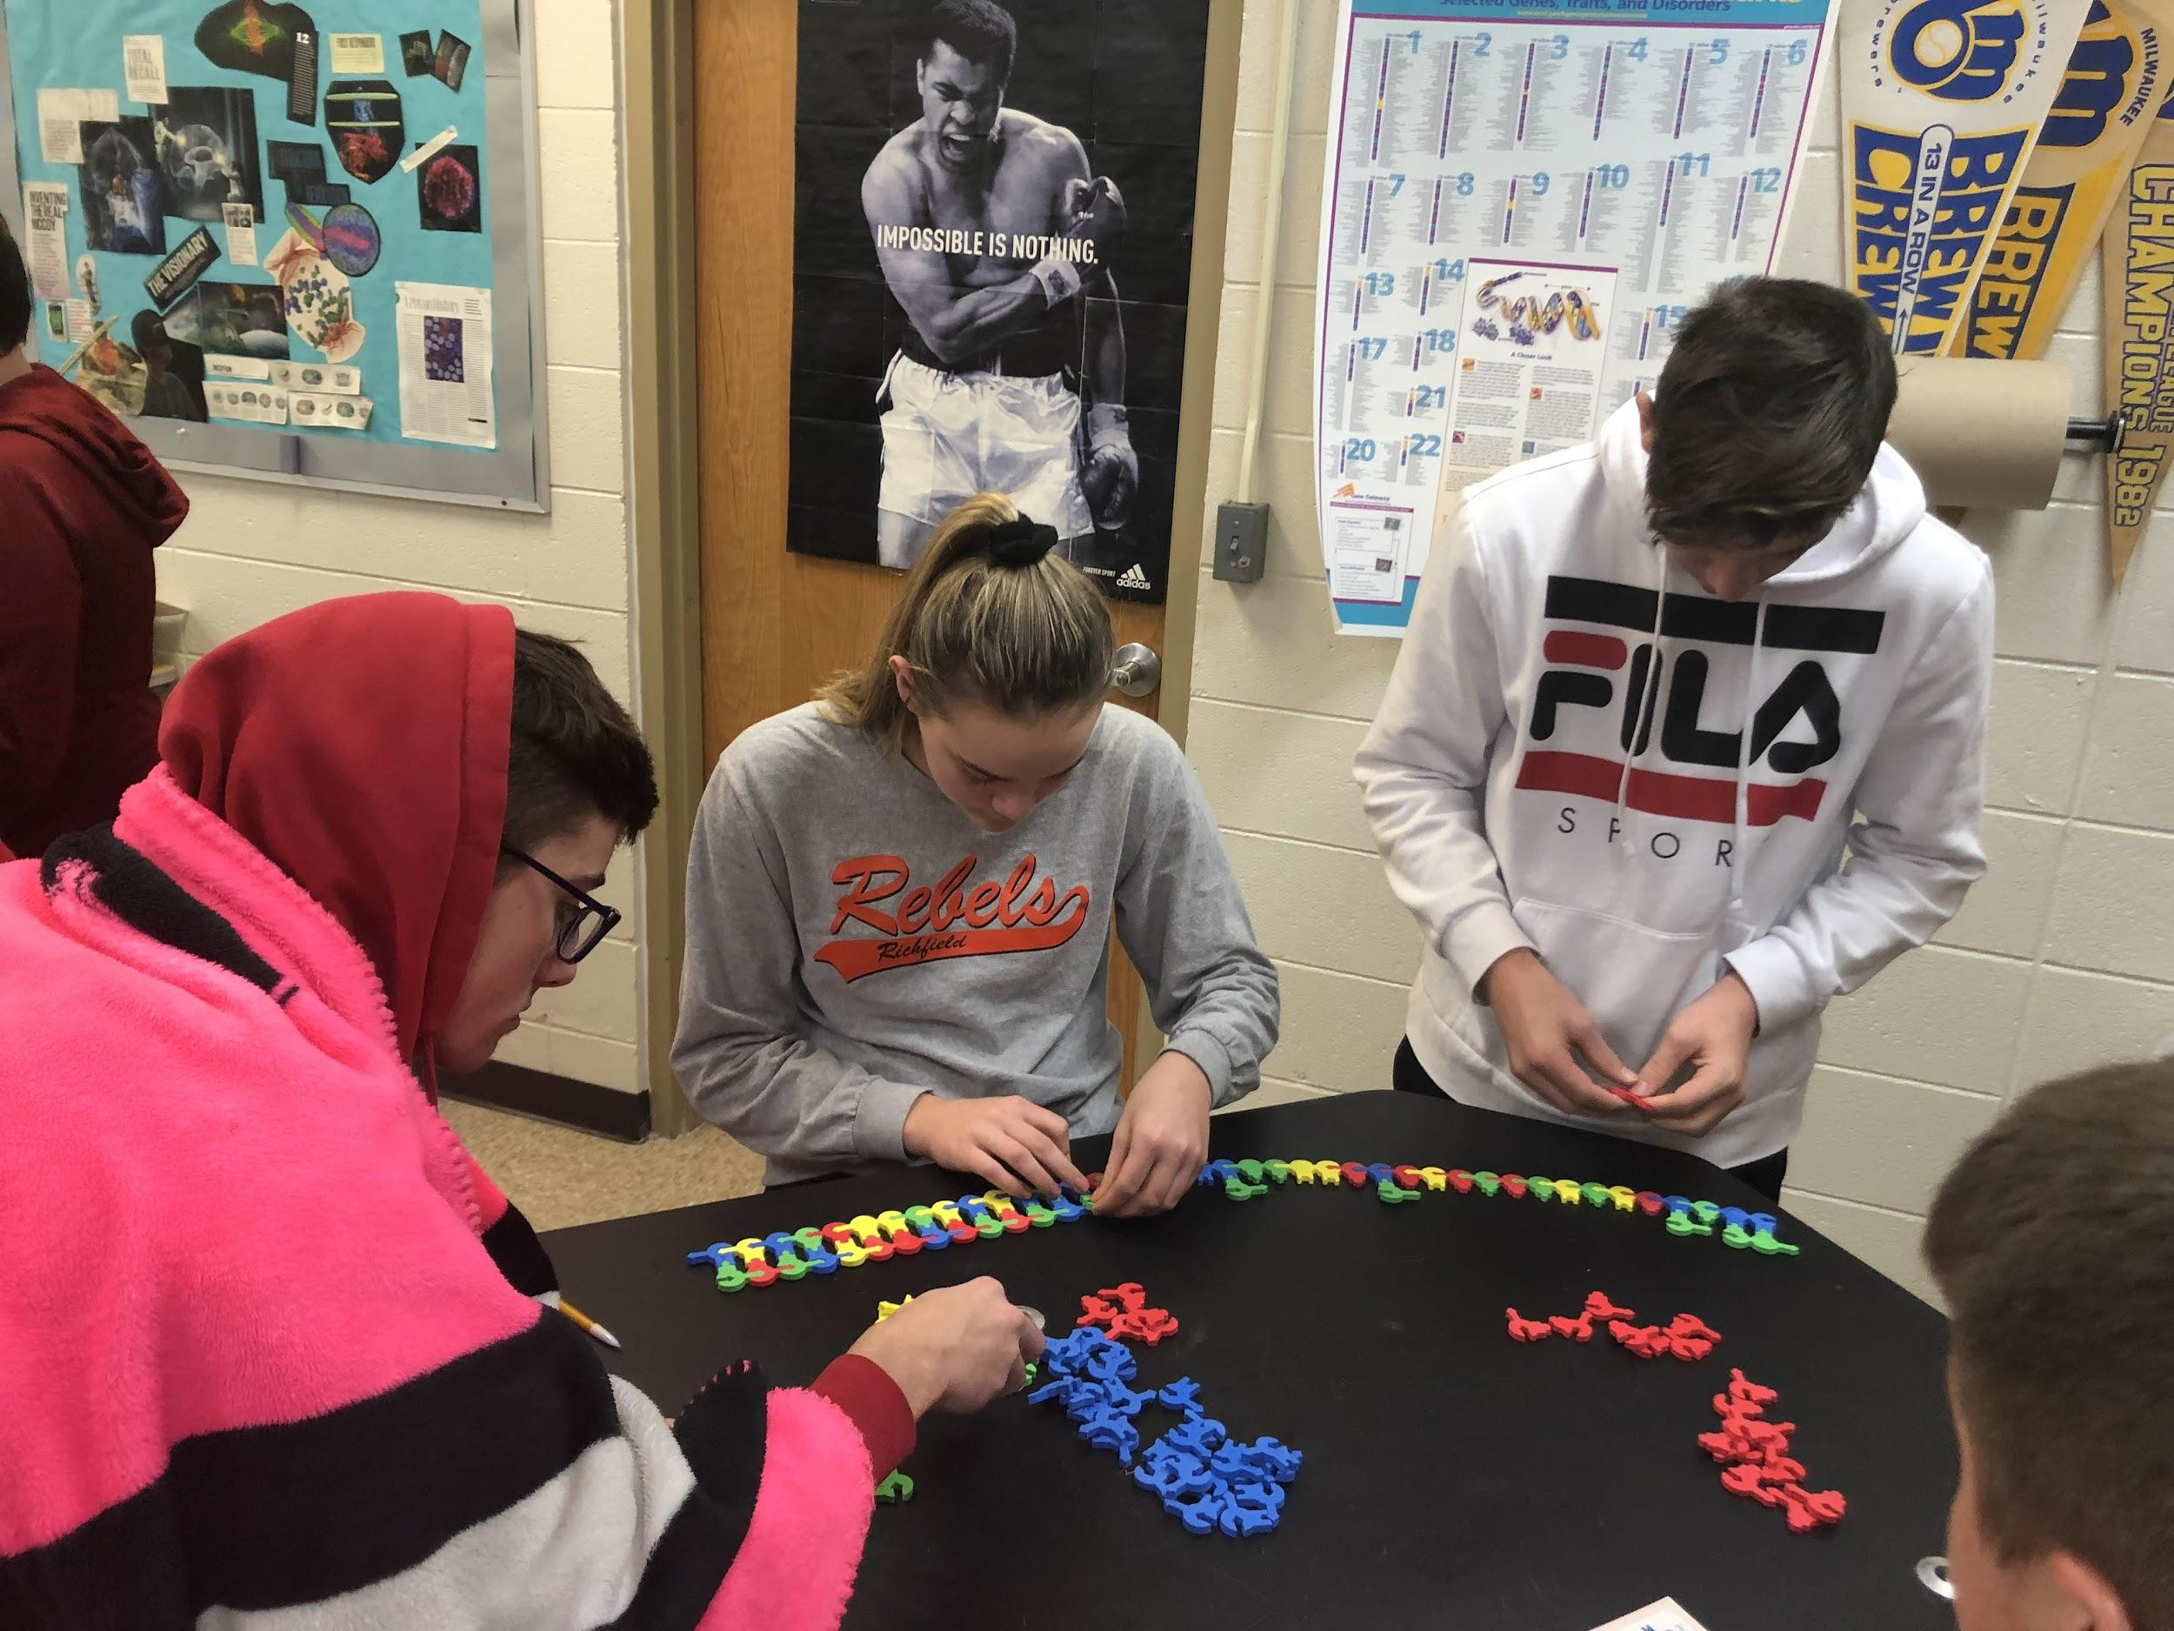
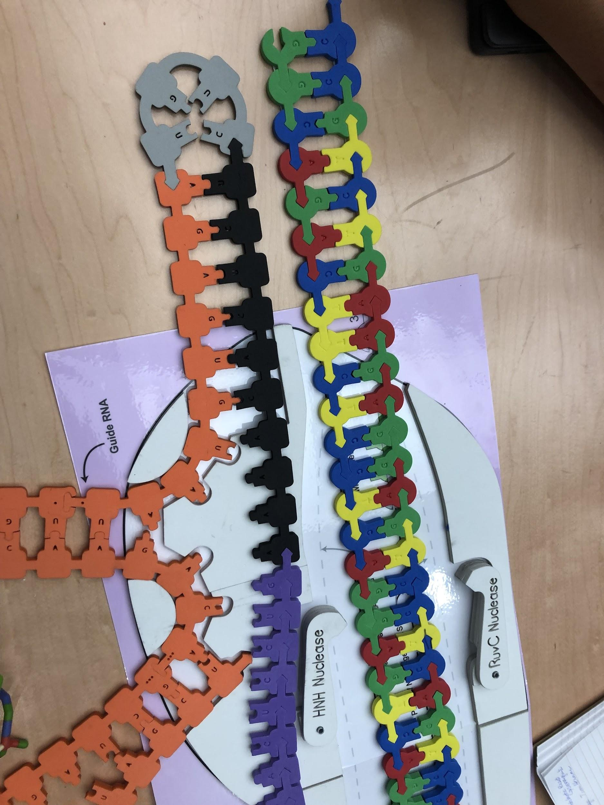
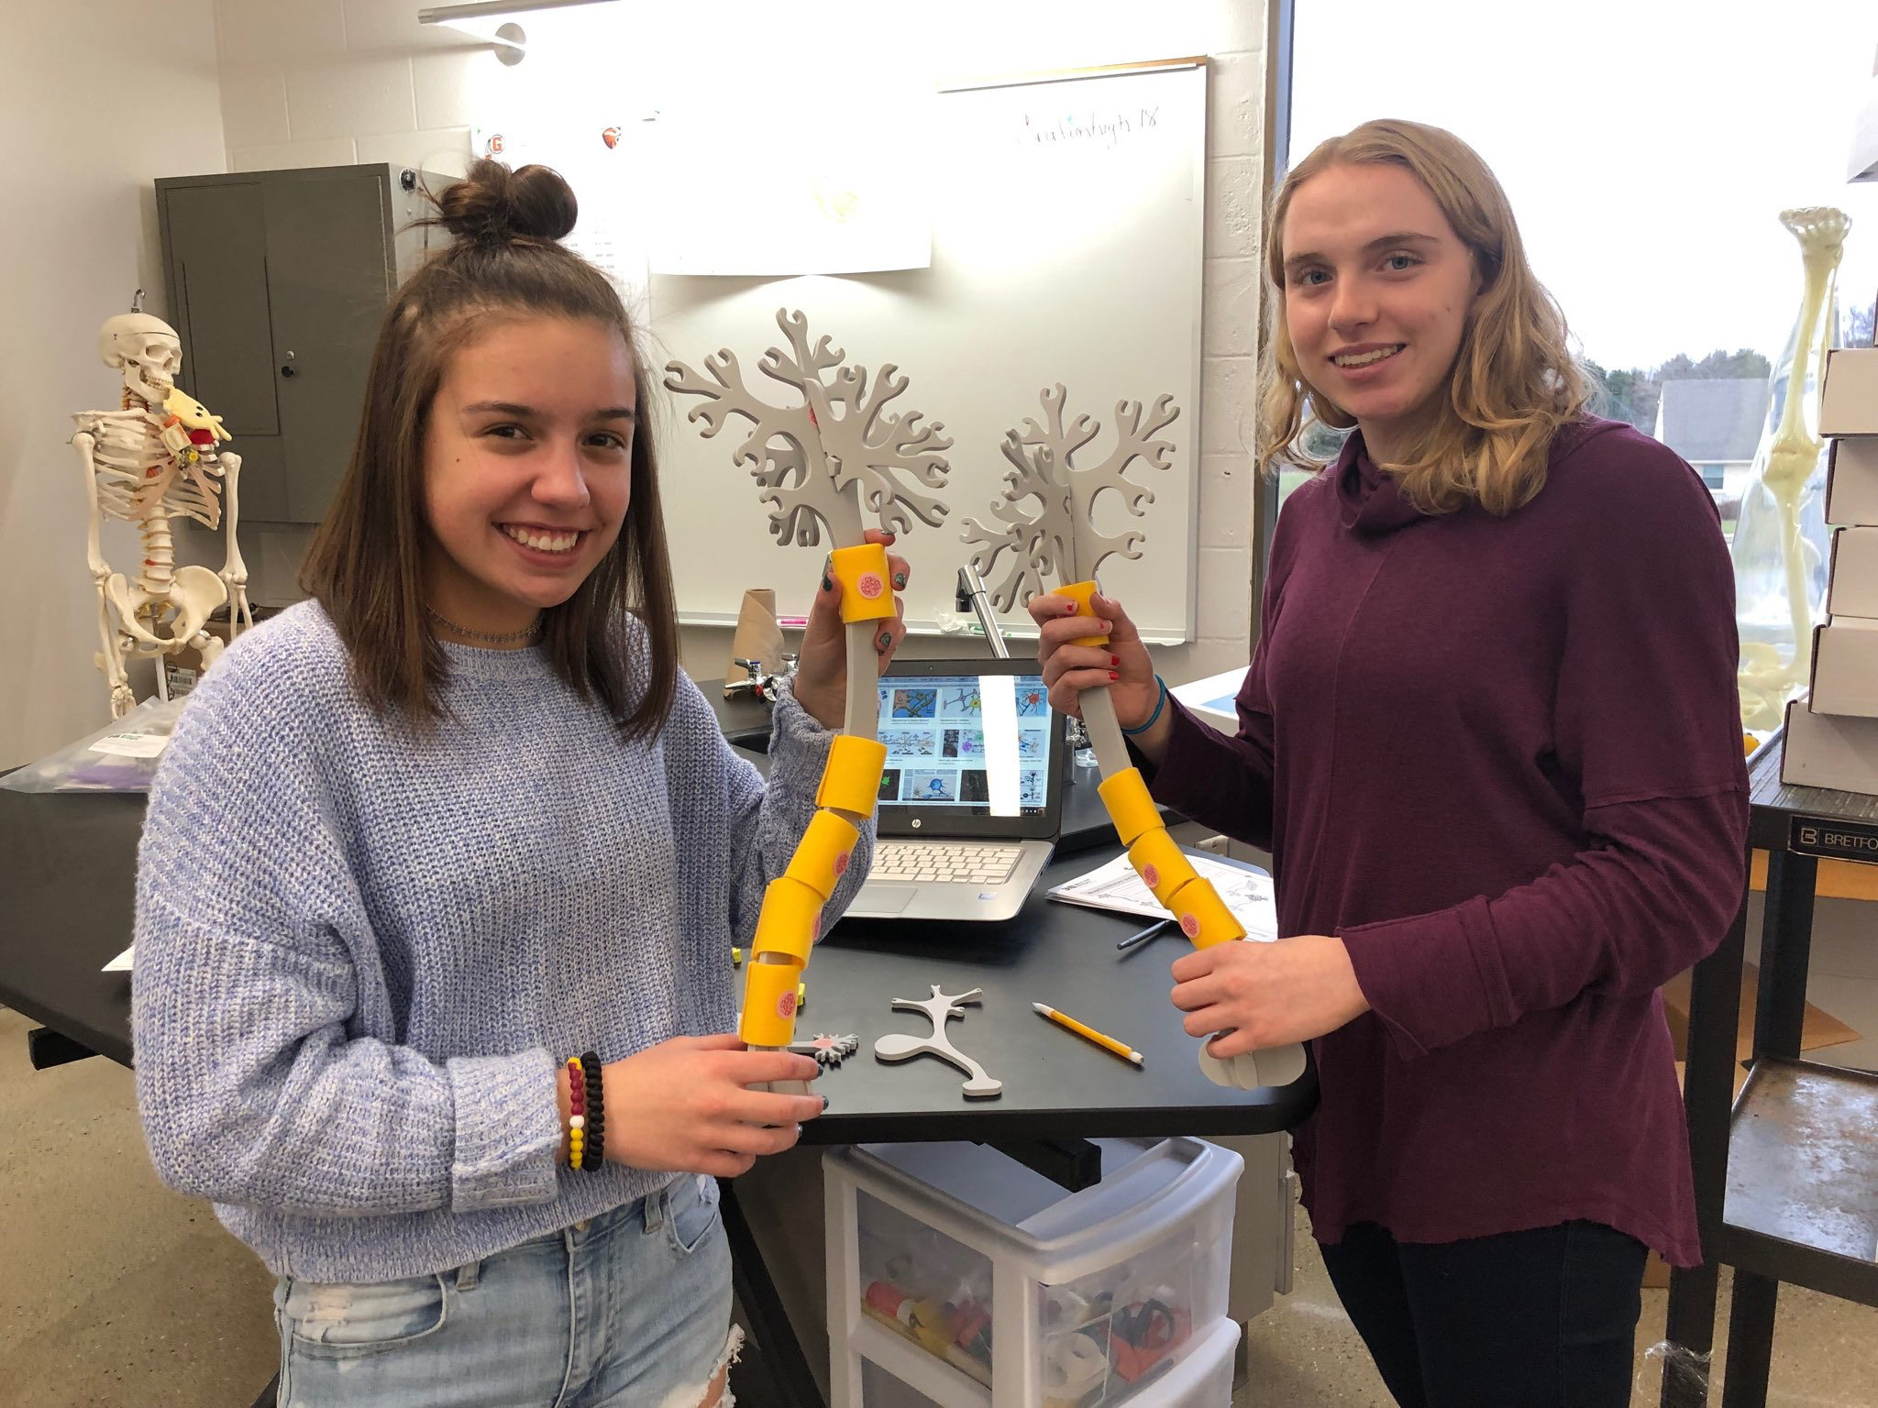
Why Model?
Notes:
Fran -

Slide 14
PBS | HBS | MI
KS 9.1.1 Describe the structure and function of nucleic acids and the relationship among genes, alleles, chromosomes, proteins, and traits. Lessons: PBS 1.1, 2.2 | KS7.1.1 Explain the structure and function of DNA. | KS9.2.1 Explain how molecular tools, such as ligase and restriction enzymes, are used to cut and paste DNA from different sources.
KS 9.1.2 Explain how the order and chemical properties of amino acids influence a protein’s structure and function, PBS 2.2 | KS7.1.2 Explain the action and use of restriction enzymes. | KS9.2.2 Identify which restriction enzyme to use for a given situation.
KS 9.1.3 Describe the processes of DNA replication and protein synthesis. PBS 2.2 | KS7.1.3 Describe how gel electrophoresis can be used to examine DNA differences between individuals. | KS 9.4.1 Identify single base- pair differences in DNA through laboratory techniques, such as DNA extraction, PCR, and restriction analysis.
KS 9.1.4 Explain how mutations in nucleic acids can lead to diseases or disorders or promote evolutionary change., PBS 2.2 | KS7.1.4 Analyze gel electrophoresis data
KS 9.4.1 Explain and demonstrate techniques in molecular biology (DNA extraction, restriction digestion, gel electrophoresis) and interpret results. PBS 1.1 ,1.2, 1.3, 2.2, 2.3
KS 12.2.3 Create, describe, and analyze models of biological processes to explain proper and improper functioning.
Notes:
Mark

Slide 15
TARGETED NGSS DIMENSIONS
SEPs | CCCs | DCIs
Asking questions | Patterns | LS1.A: Structure and function
Developing and using models | Cause and effect | LS3.A: Inheritance of traits
Constructing explanations | Systems and system models | LS3.B: Variation of traits
Analyzing and interpreting data | Structure and function
Notes:
Mark

Slide 16
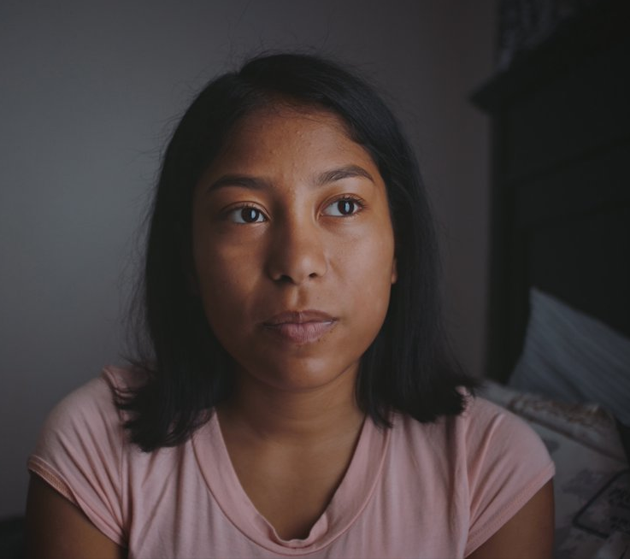
Helen’s Medical History
9 months - blood clot in pelvis
2 yrs. old - spleen removed
hospitized 13 times with acute chest syndrome
bacterial infections in her spine
experiences episodes of severe pain
Hispanic

Slide 17
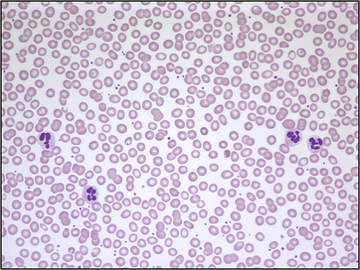
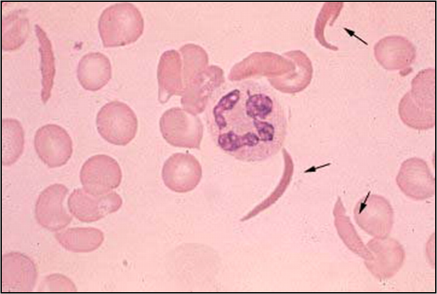
Notes:
🍐 This is a Pear Deck Draggable™ Slide.
🍐 To edit the type of question, go back to the "Ask Students a Question" in the Pear Deck sidebar.

Slide 18
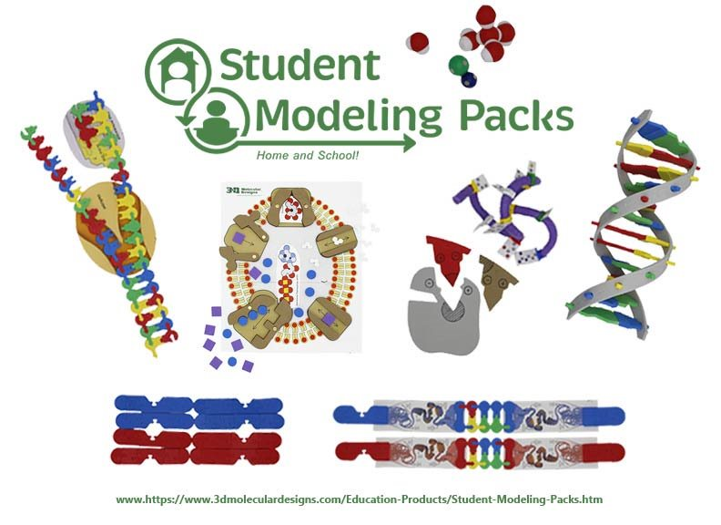

Slide 19
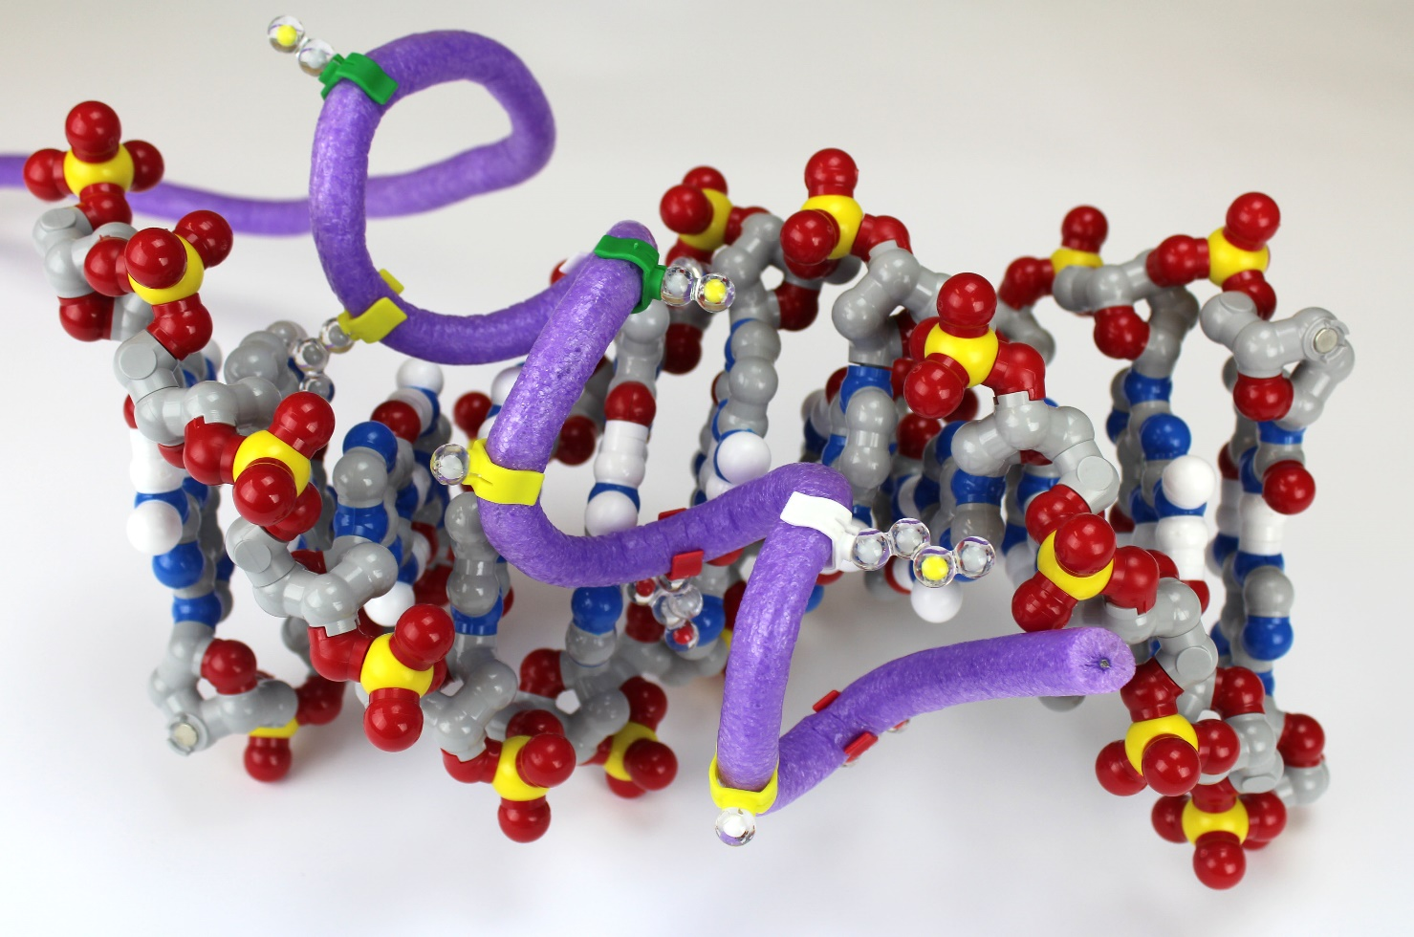
Notes:
Mark

Slide 20
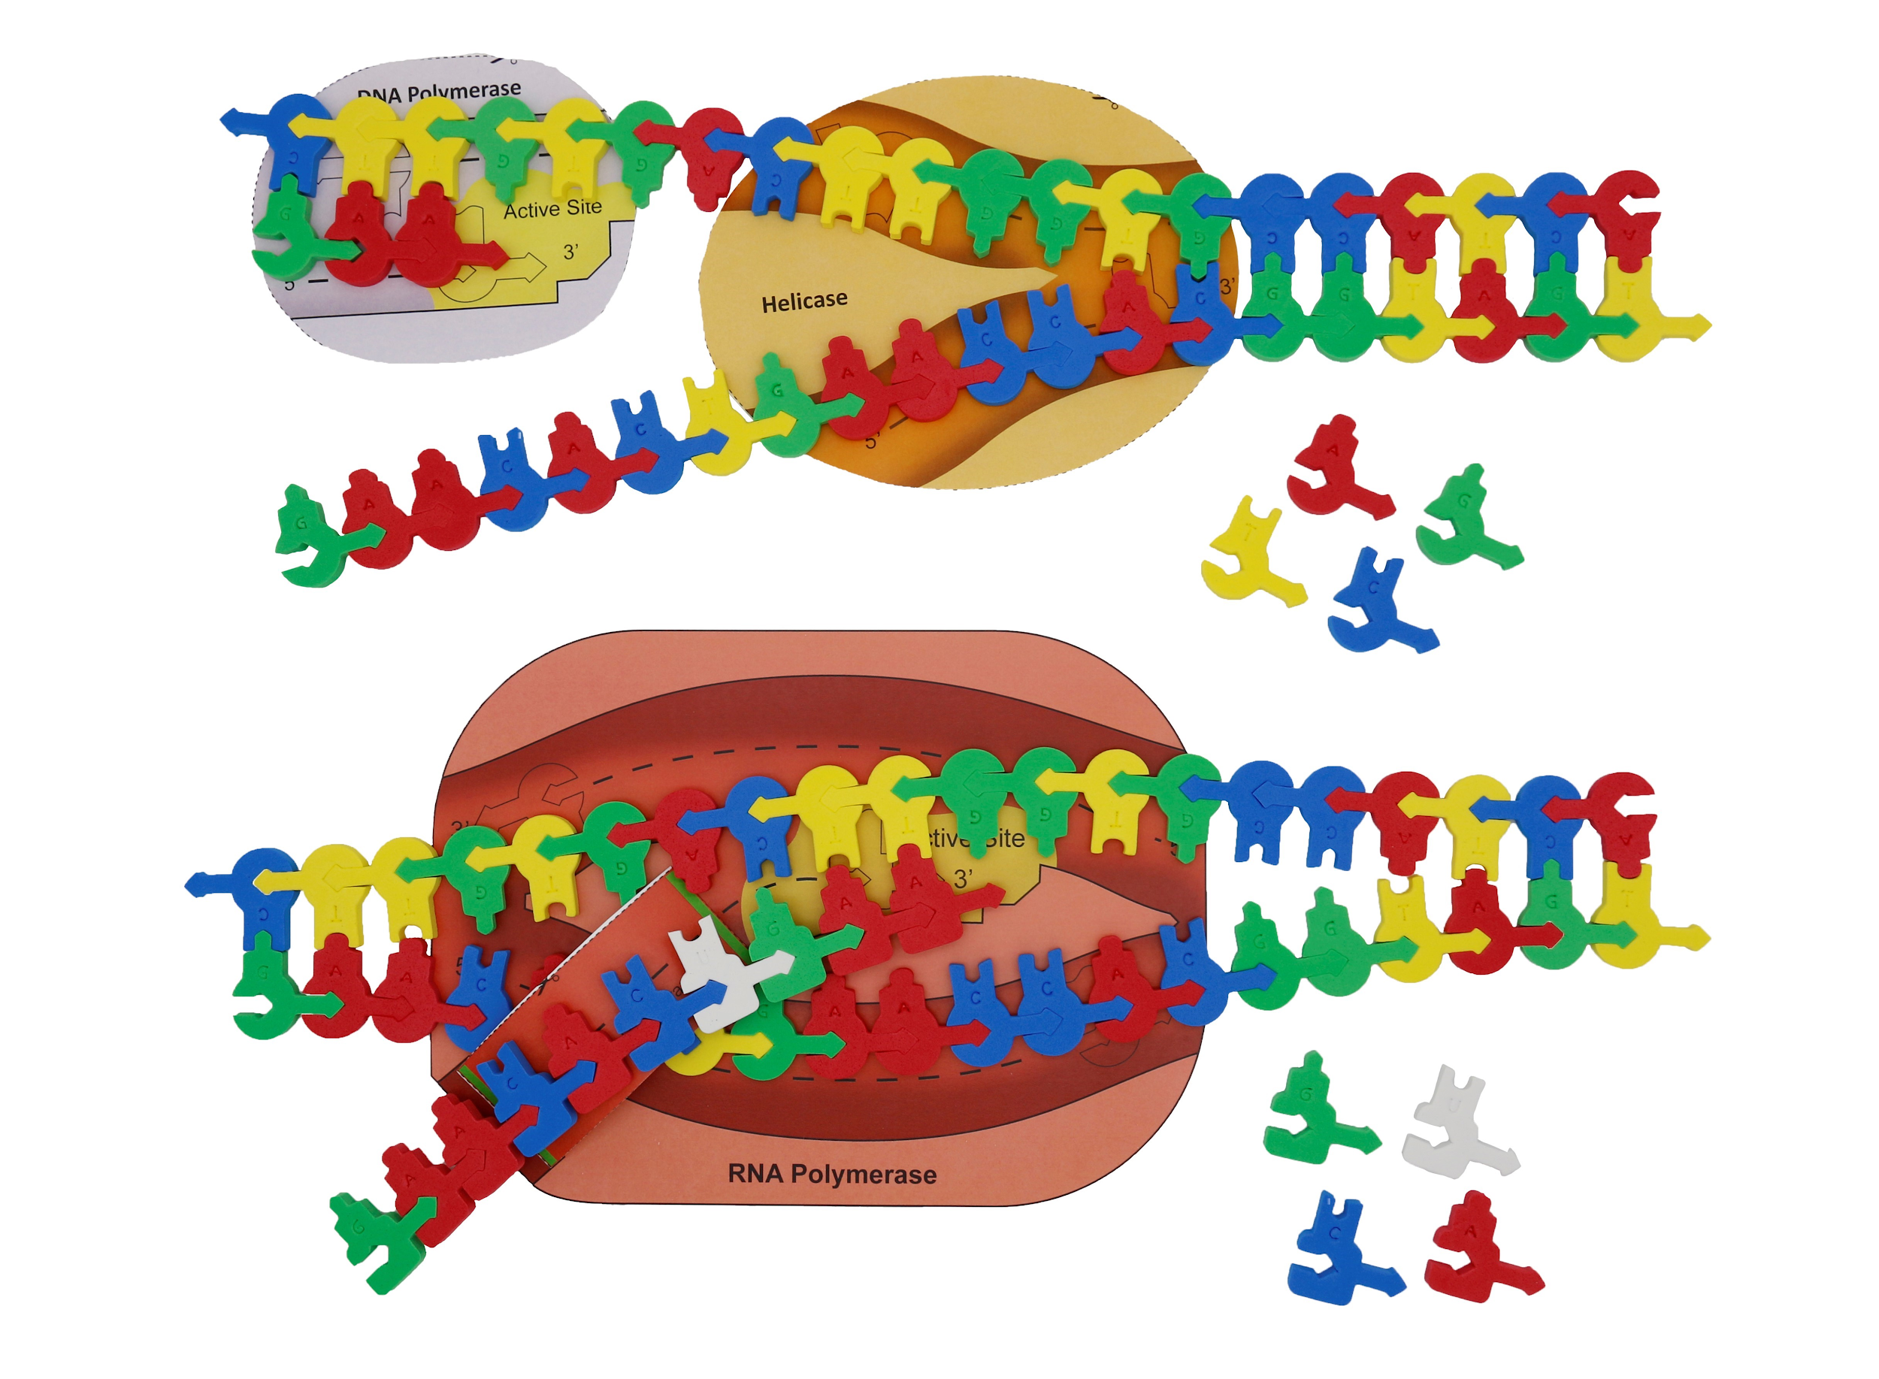
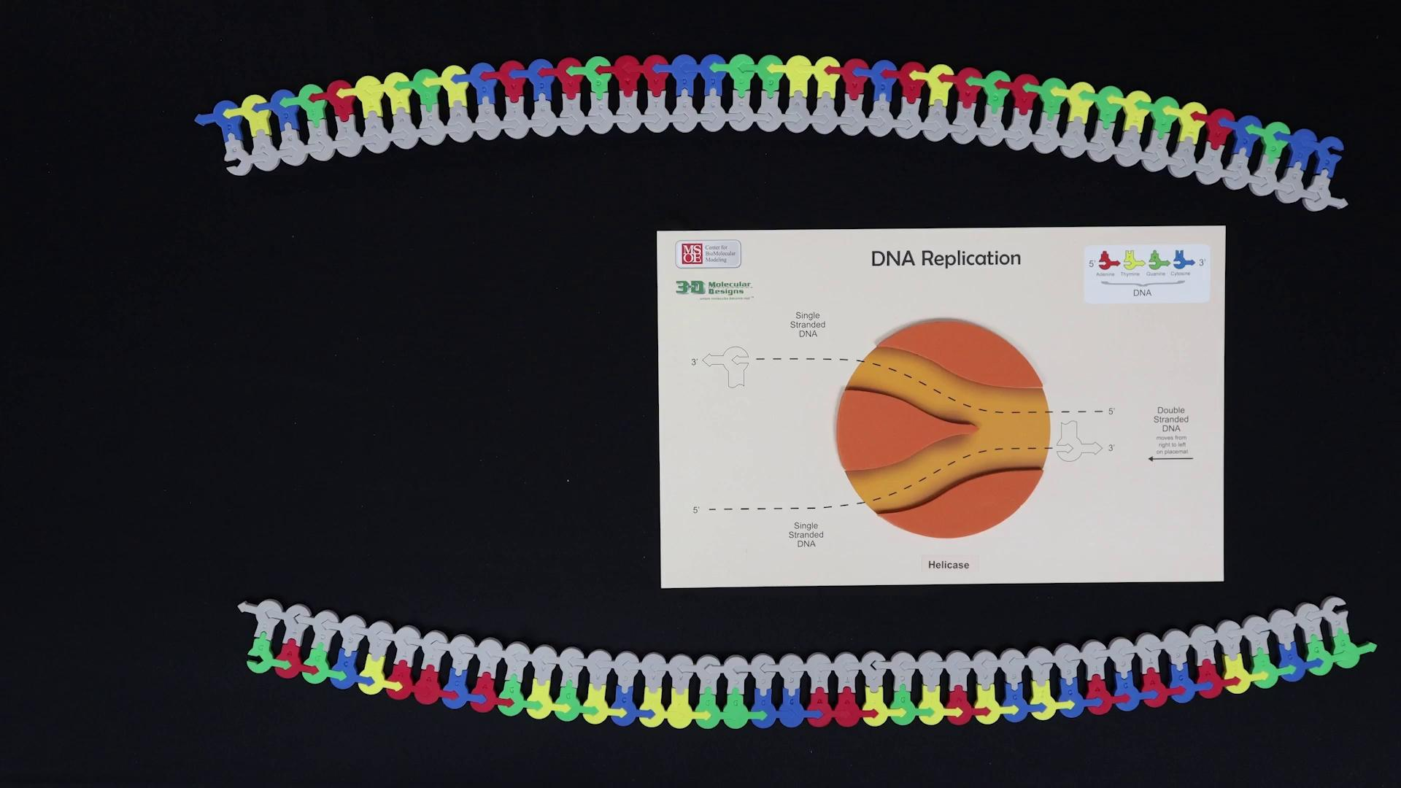
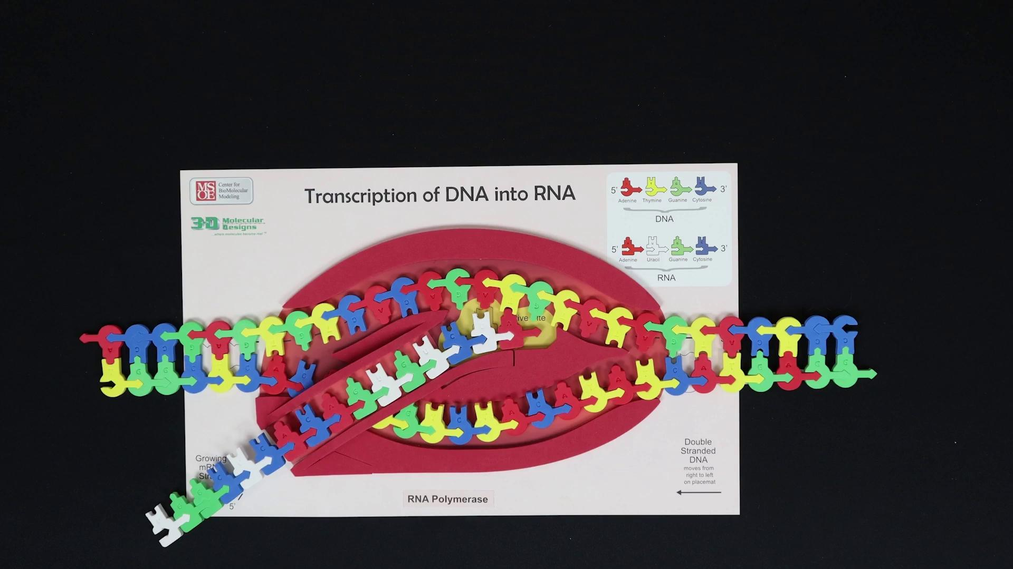
Notes:
Mark

Slide 21
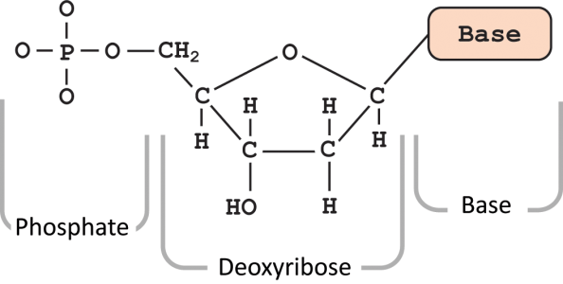

TRANSCRIPTION
THE DEVIL IS IN THE DETAILS!
Take care in loading the DNA in the RNA polymerase.
Remember RNA is synthesized from the 5’ to the 3’ end.
5’
3’
5’
3’

Slide 22

A little bit of direction

Slide 23
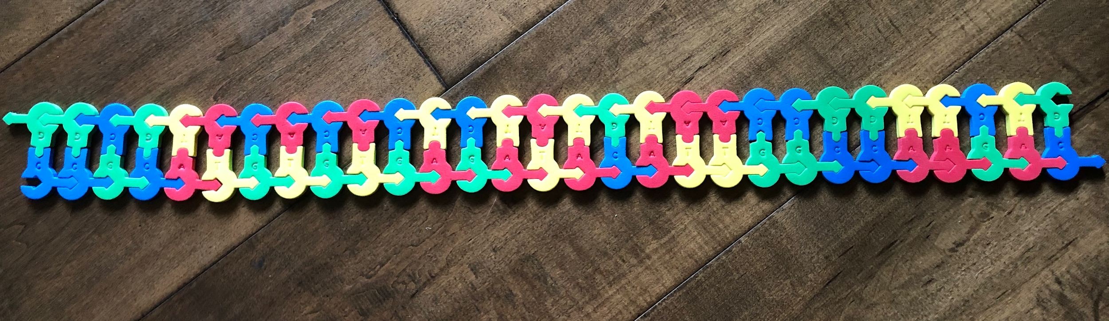
Transcription
DNA: Place red dot on the template strand
Notes:
🍐 This is a Pear Deck Draggable™ Slide.
🍐 To edit the type of question, go back to the "Ask Students a Question" in the Pear Deck sidebar.

Slide 24
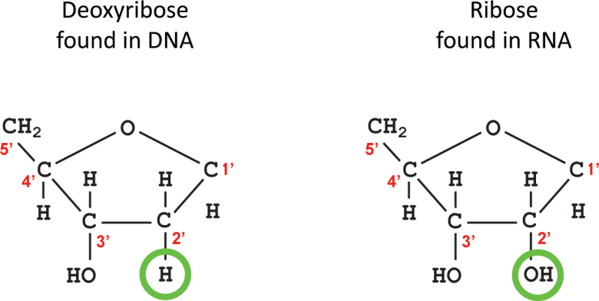
TRANSCRIPTION
TAKE NOTE!
The DNA pieces are different than the RNA pieces!

Slide 25
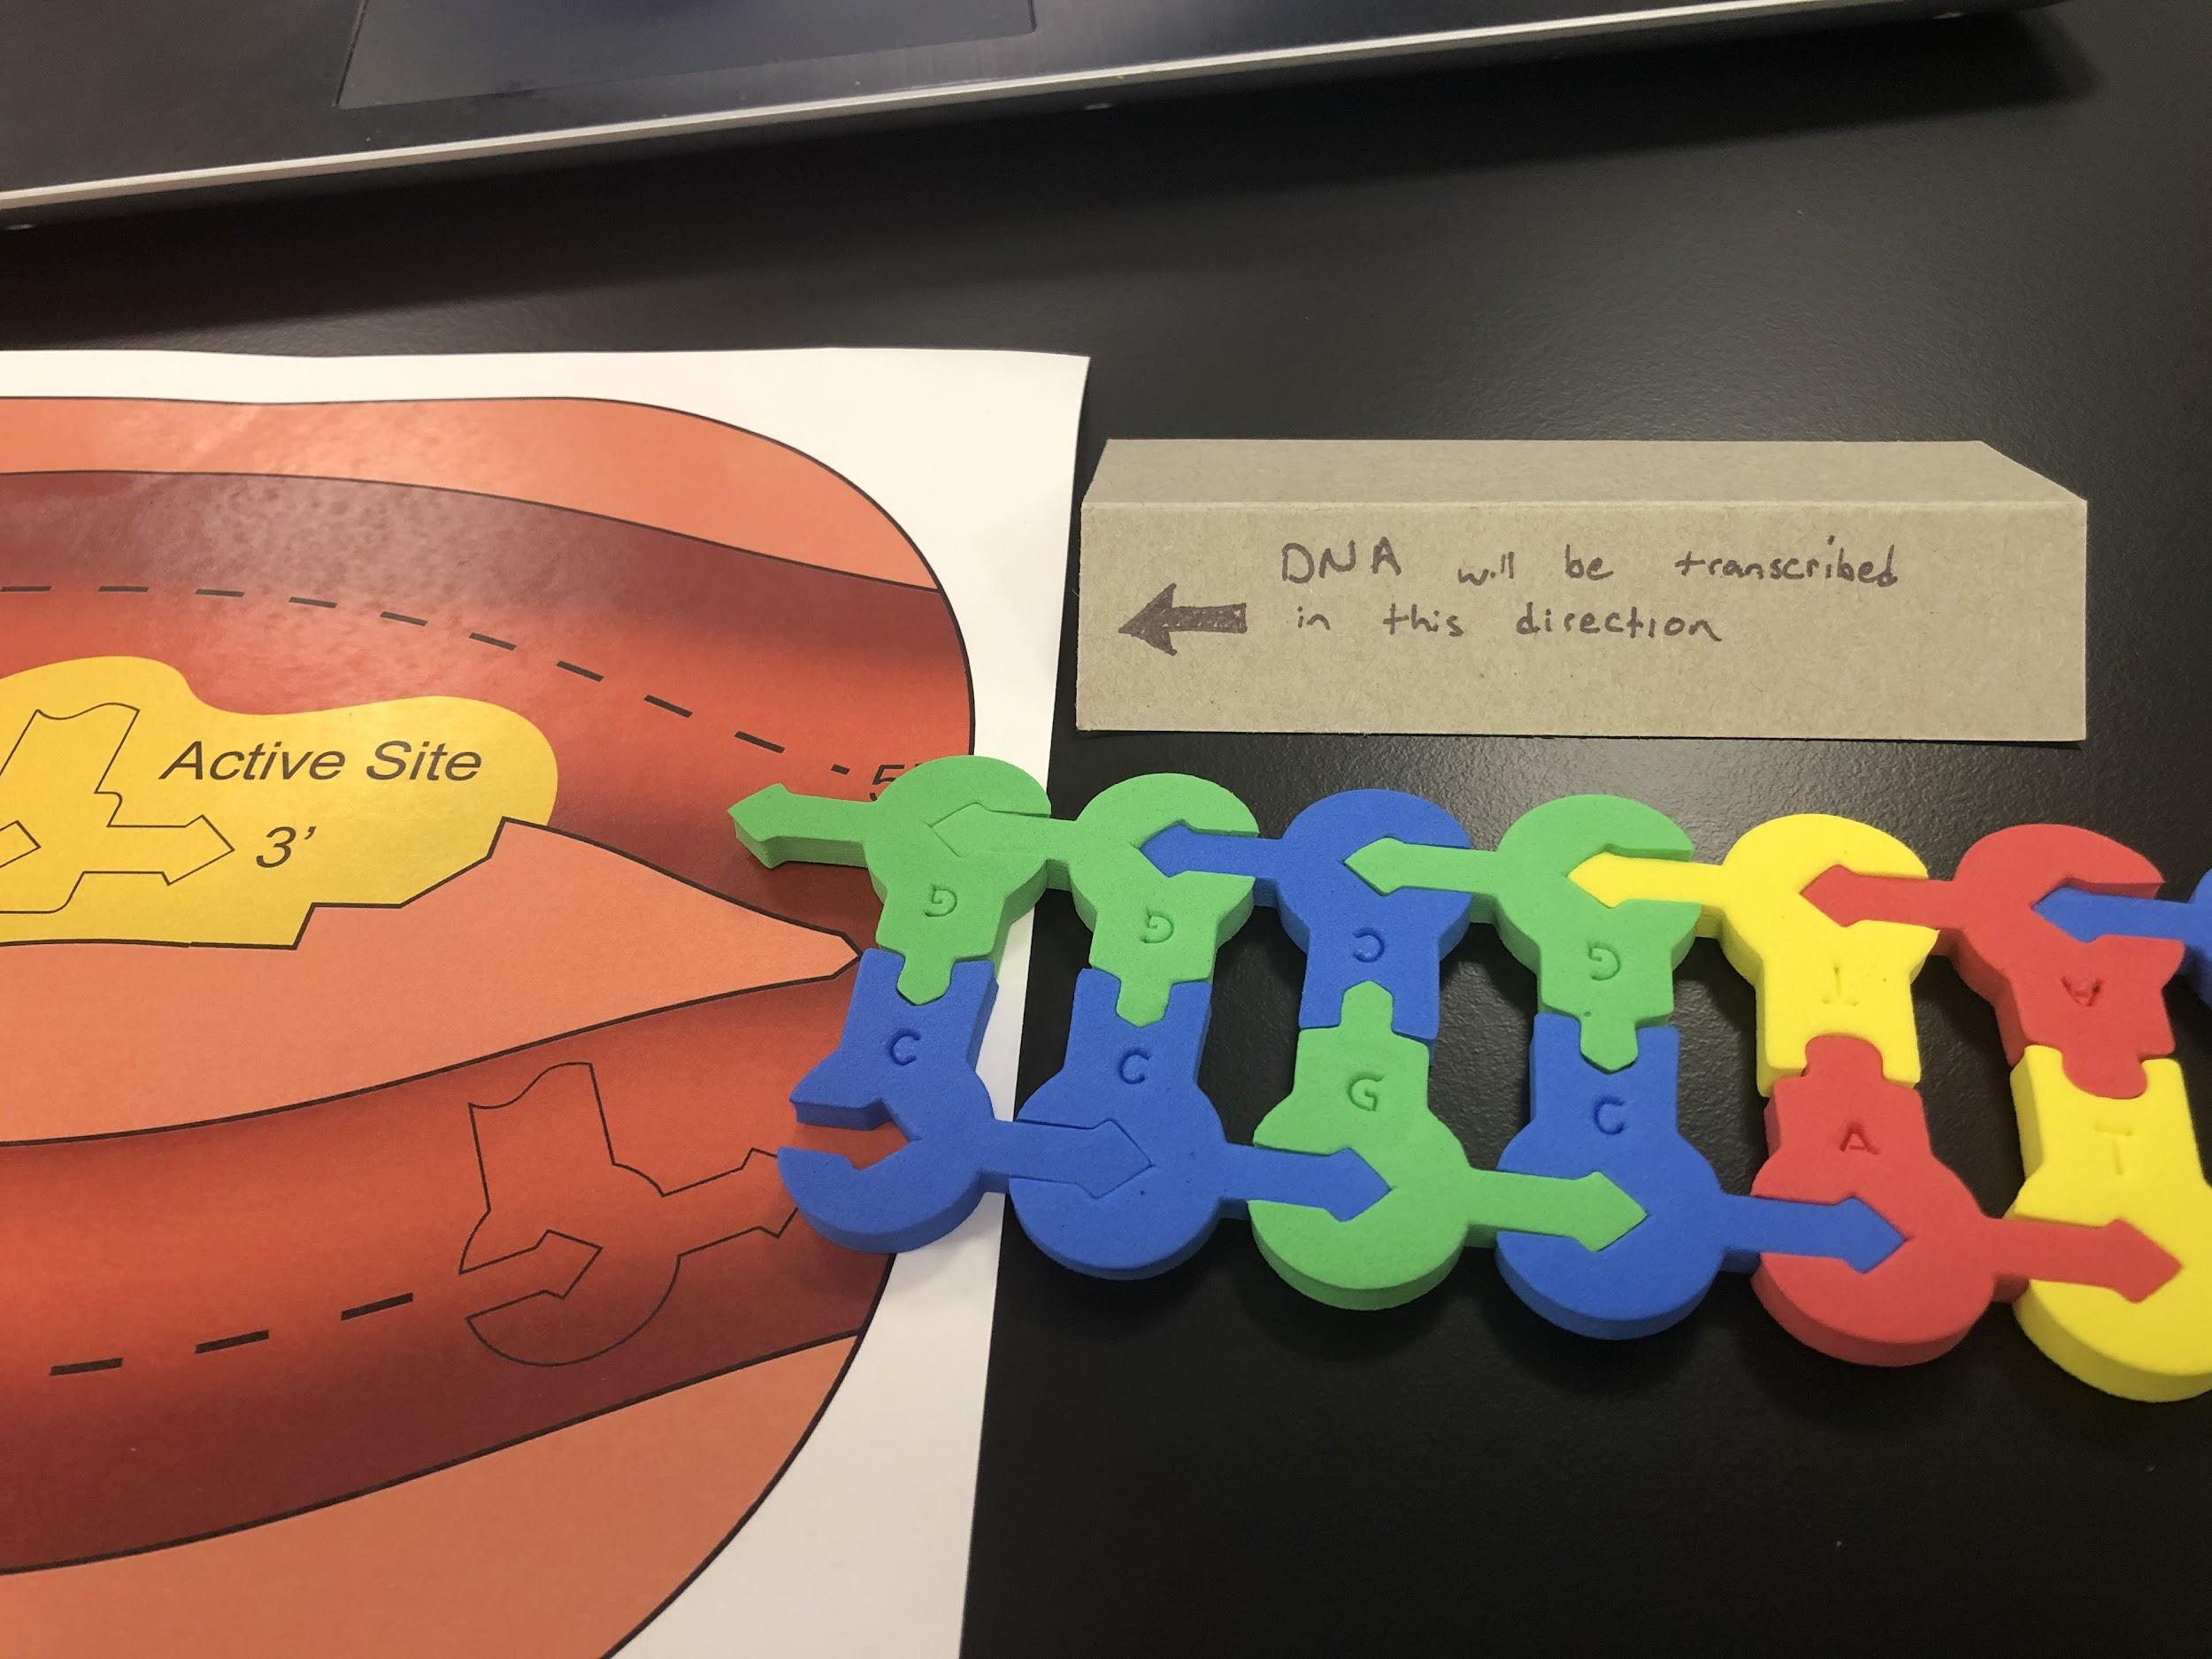

Slide 26
Nucleotide Student Modeling Pack: Transcription

Slide 27
Flow of Genetic Information Kit: Transcription

Slide 28
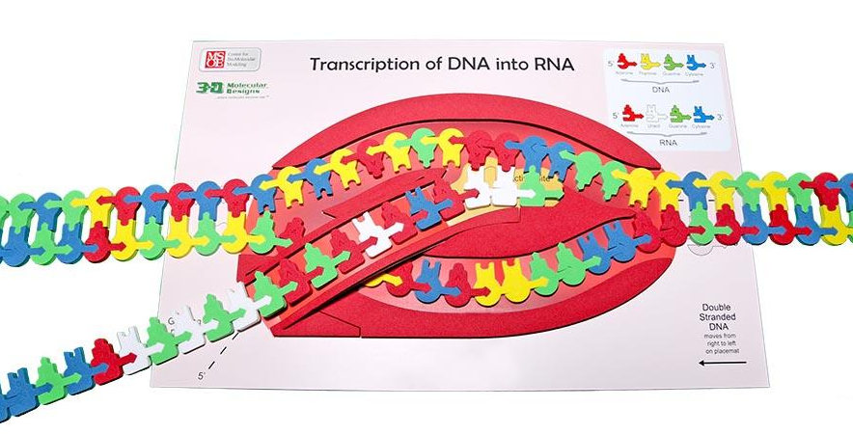
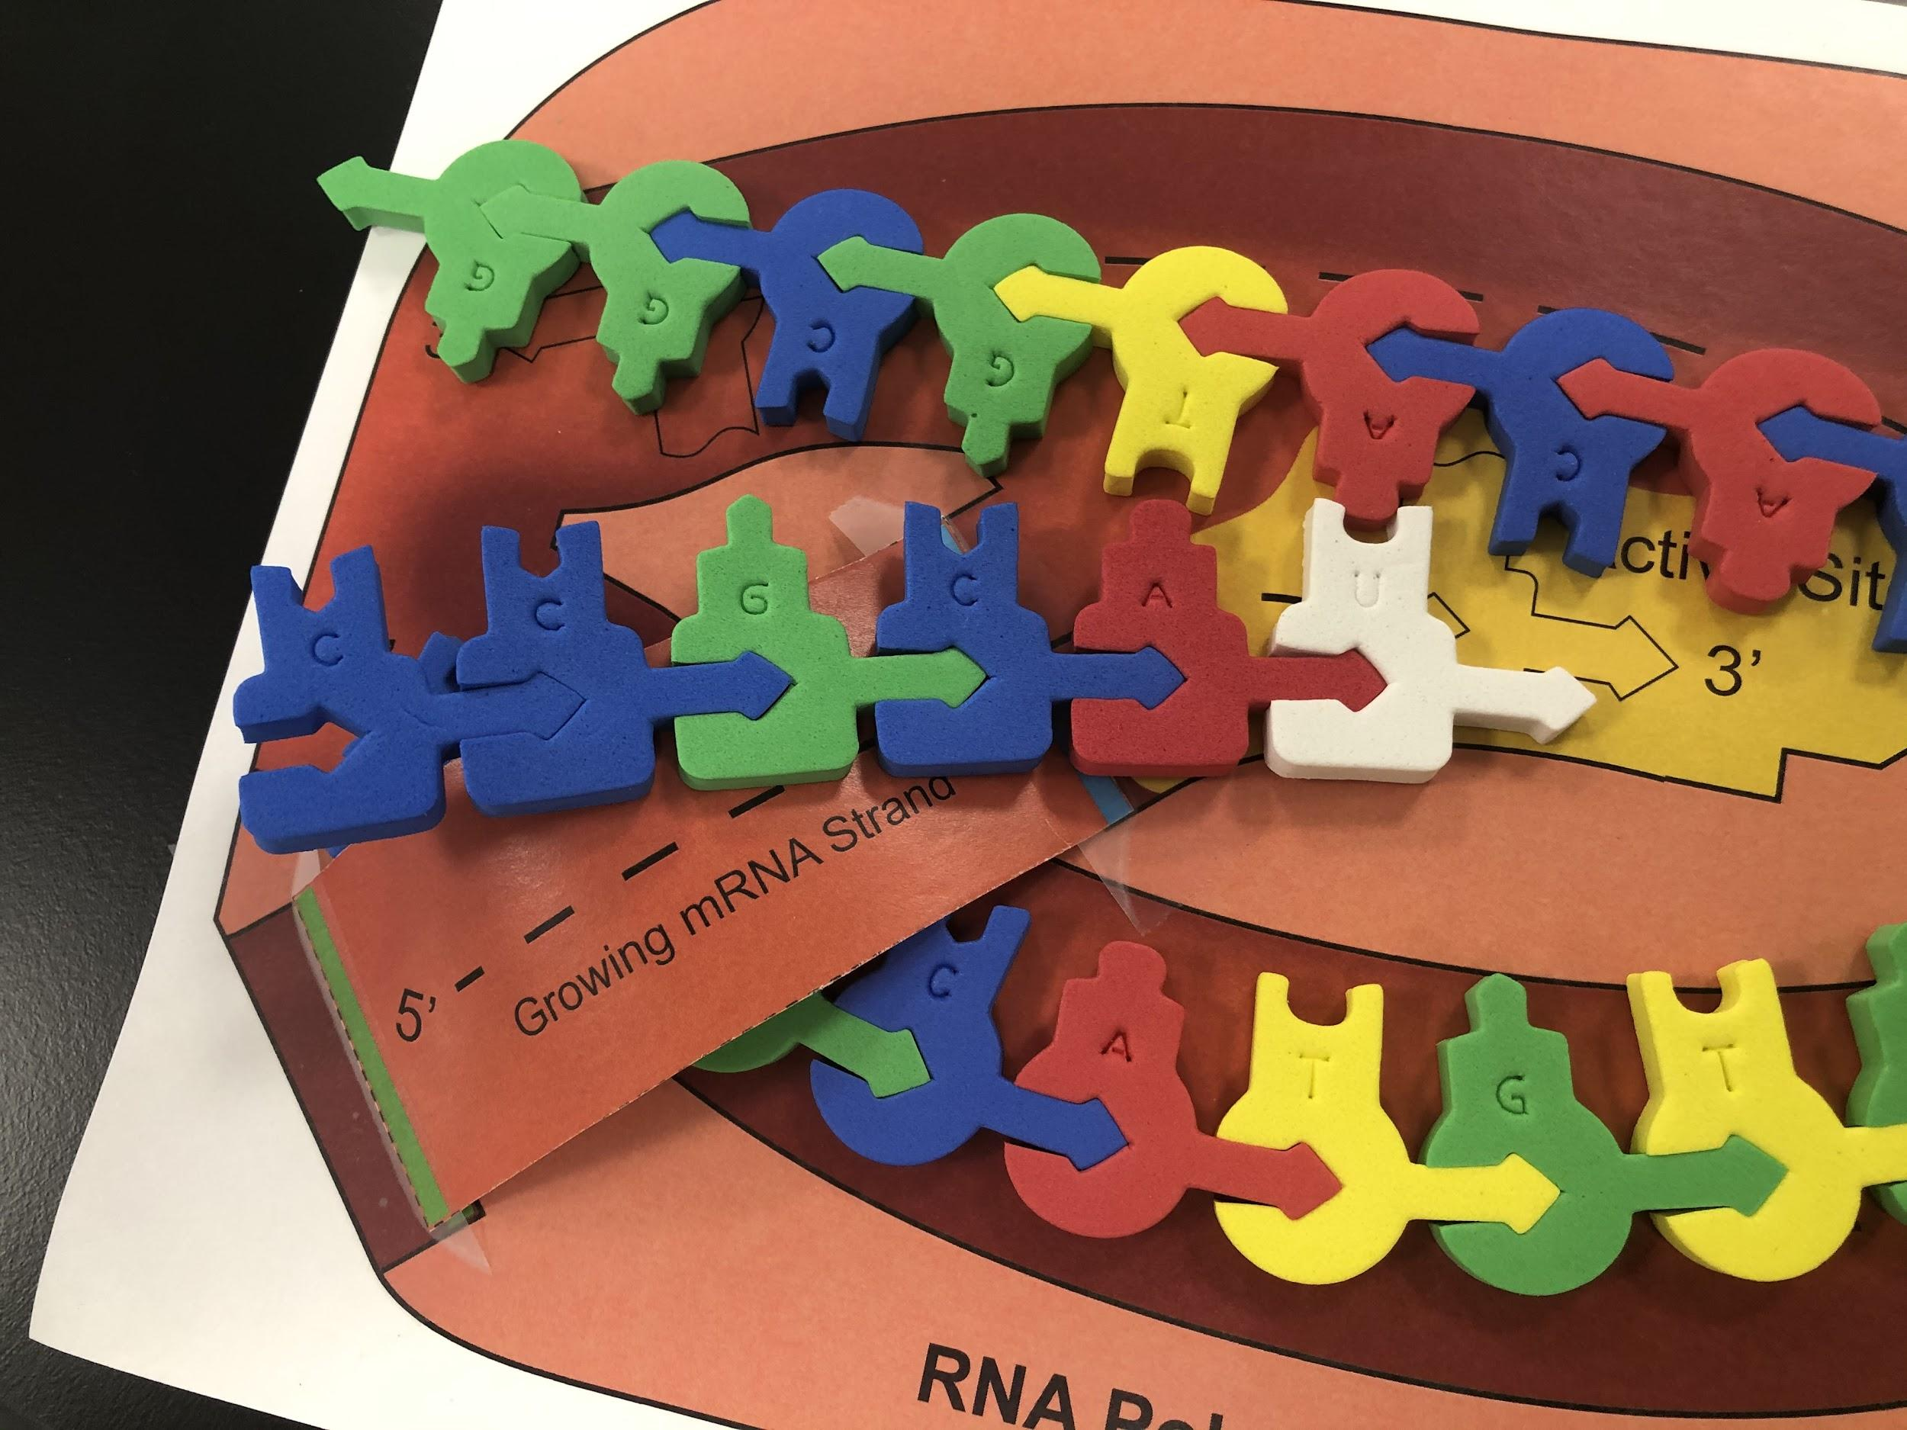
Modeling Transcription
Elongation: Student kit
The mRNA is synthesized.

Slide 29
Student question # 1

Slide 30
Student question #2

Slide 31
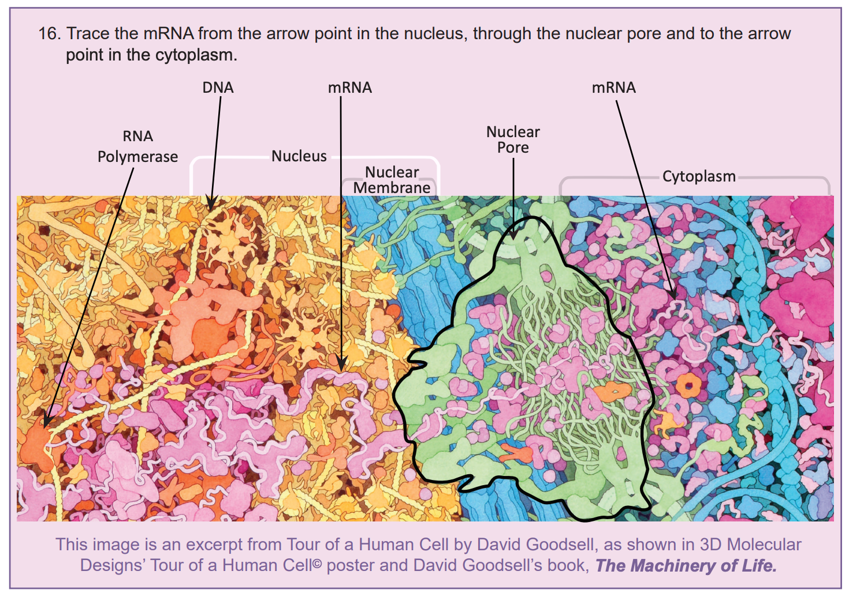
Notes:
🍐 This is a Pear Deck Drawing Slide
🍐 To edit the type of question, go back to the "Ask Students a Question" in the Pear Deck sidebar.

Slide 32
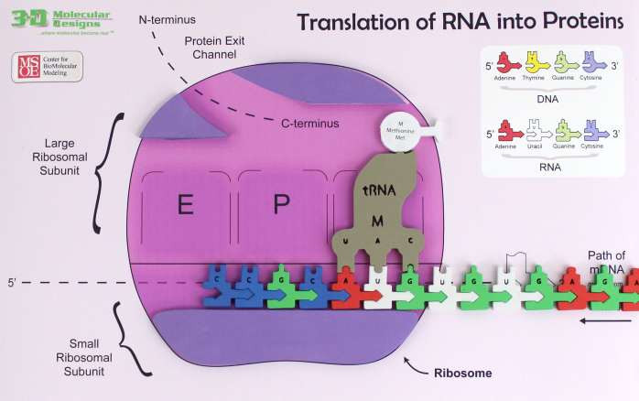
TRANSLATION
Initiation:
Ribosomal subunits bind to the mRNA.

Slide 33
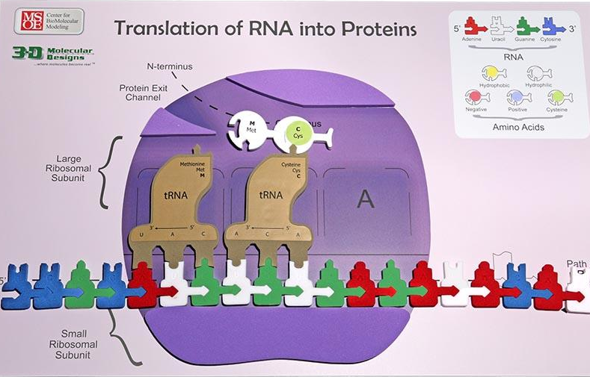
TRANSLATION
Elongation:
Amino acids are added to the growing protein.
Notes:
Mark

Slide 34
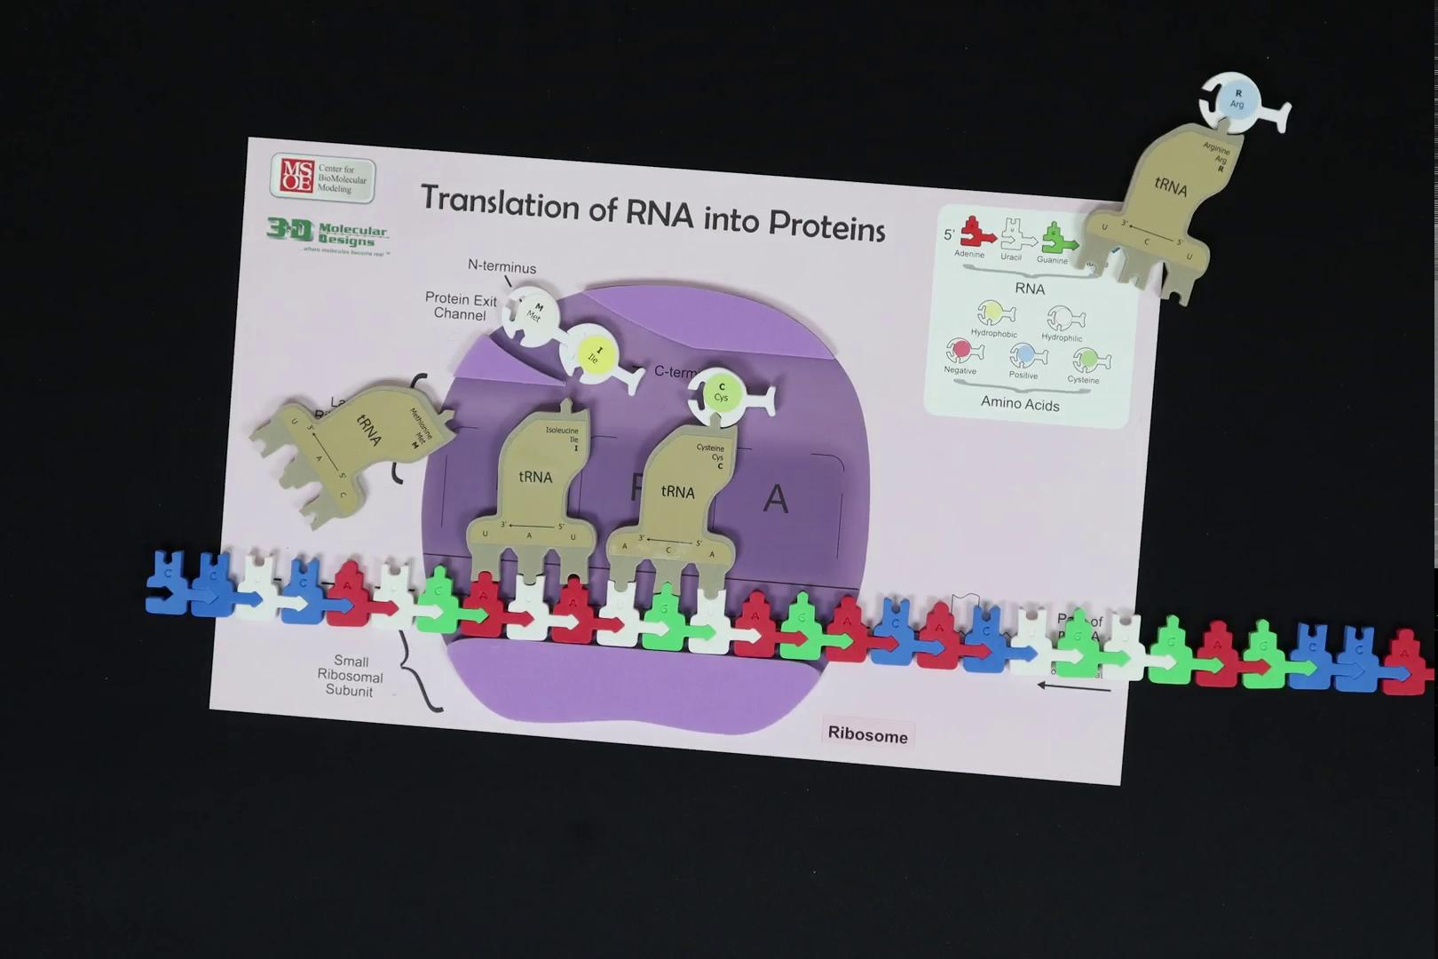

Slide 35
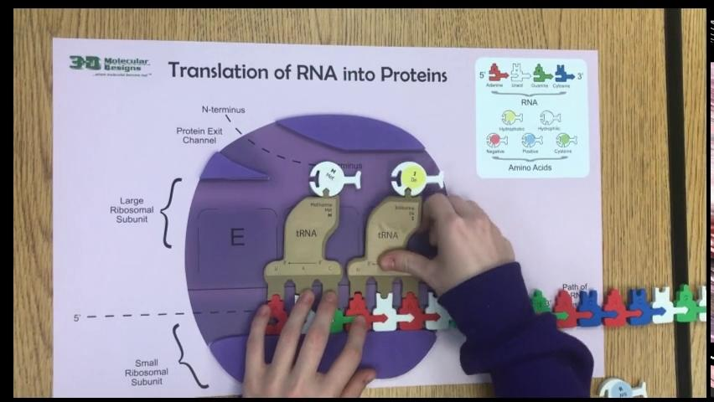
Sample of a student assessment 2019 -
*Used with permission

Slide 36
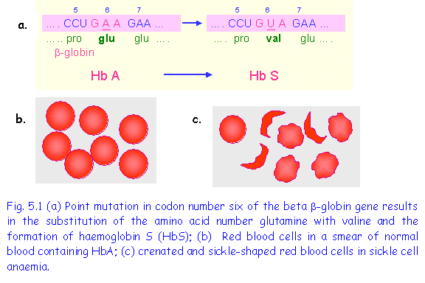
SICKLE CELL ANEMIA CAUSED BY A POINT MUTATION
Sickle Cell Anemia – caused by a point mutation in the beta globin gene changing the amino acid from glutamic acid to valine.
A is replaced with T

Slide 37
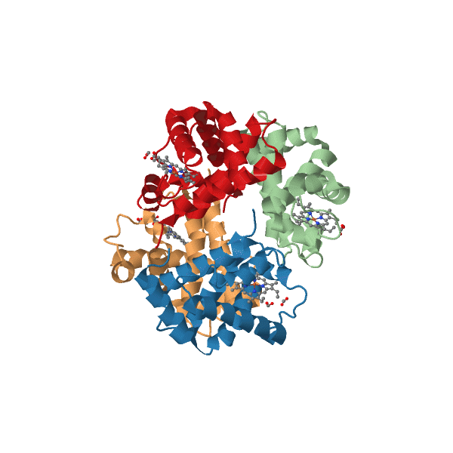
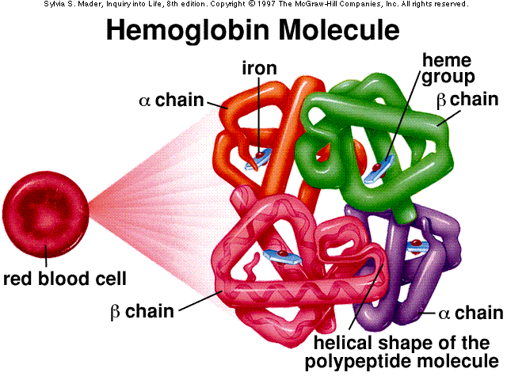
HEMOGLOBIN STRUCTURE
Has 4 subunits:
  2 a-globin proteins
  2 b-globin proteins

Slide 38
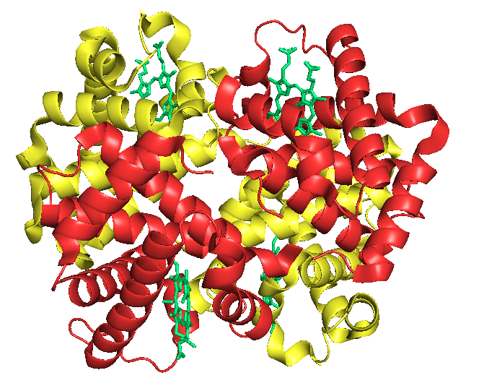
Fetal Hemoglobin
Fetal hemoglobin. (2020, October 19). Retrieved from https://en.wikipedia.org/wiki/Fetal_hemoglobin
Notes:
Difference is the affinity for 2,3-bisphosphoglycerate (2,3-BPG). which allows for the release of oxygens in adult hemoglobin. Gene BCL11A, is blocked , allows patient to create fetal hemoglobin instead of adult hemoglobin

Slide 39
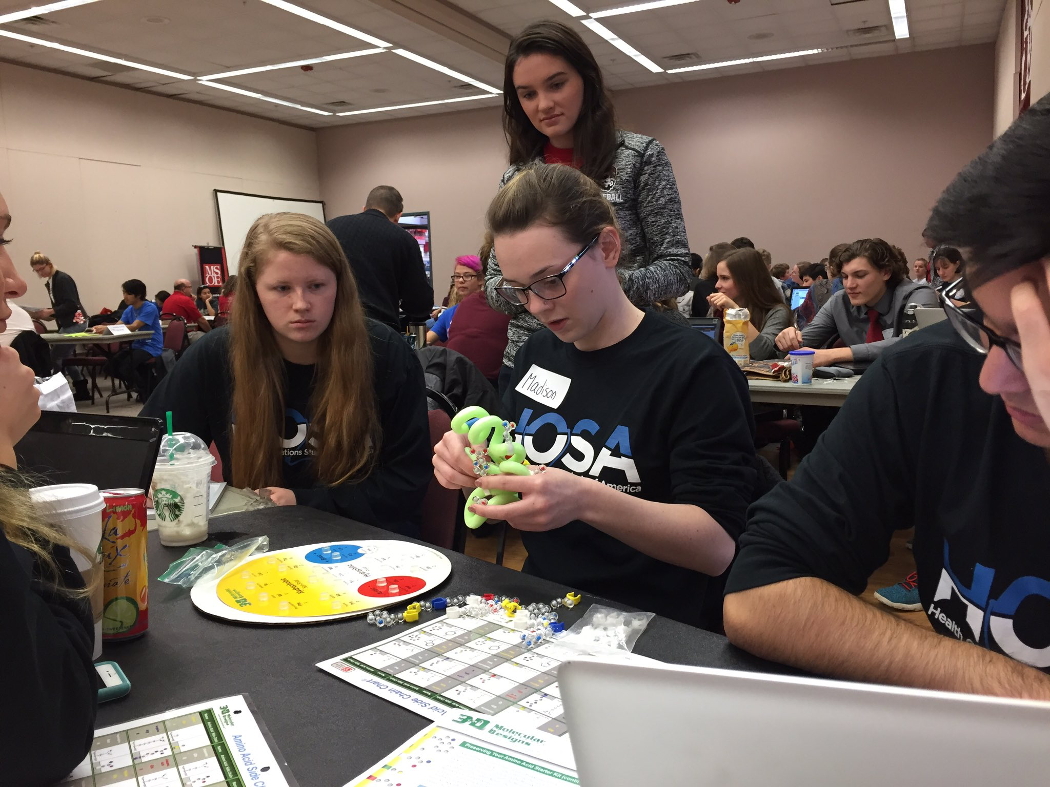
Extension: B-Globin Folding Kit and/or Amino Acid Starter Kit

Slide 40
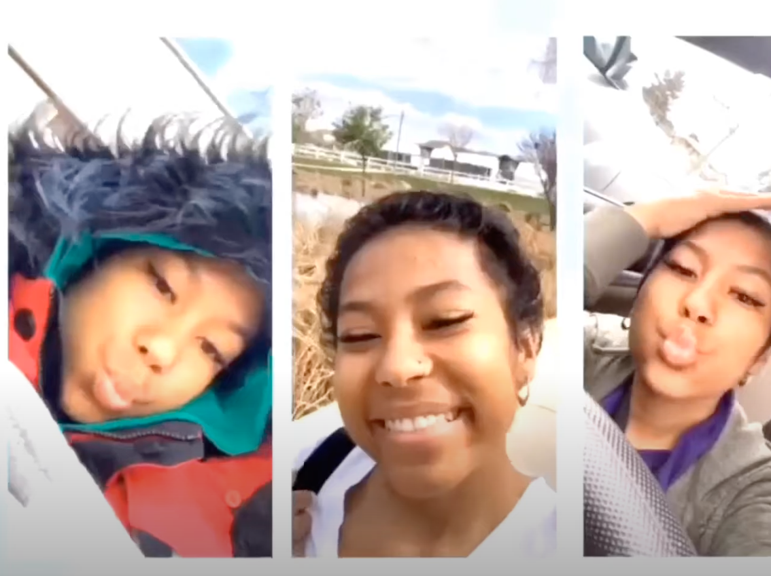
Update: March 2020
Notes:
Extension / Connection to Amino Acid Starter kit?

Slide 41
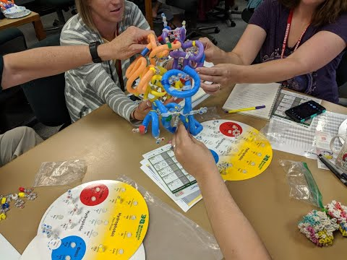

Slide 42
